Slide 1
Reflections of a Chief Engineer International Space Station
Frank Buzzard
ISS Chief Engineer 1996-2002
NASA Retired

Slide 2
We dreamed of a reusable Space Plane to build a Space Station…A transportation node to go to Mars
“I have decided today that the United States should proceed at once with the development of an entirely new type of space transportation system designed to help transform the space frontier of the 1970's into familiar territory, easily accessible for human endeavor in the 1980's and '90's.
This system will center on a space vehicle that can shuttle repeatedly from Earth to orbit and back. It will revolutionize transportation into near space, by routinizing it. It will take the astronomical costs out of astronautics. In short, it will go a long way toward delivering the rich benefits of practical space utilization and the valuable spinoffs from space efforts into the daily lives of Americans and all people. “ Richard M Nixon
President Richard M. Nixon and NASA Administrator James C. Fletcher announced the Space Shuttle program had received final approval in San Clemente, California, on 5 January 1972.

Slide 3
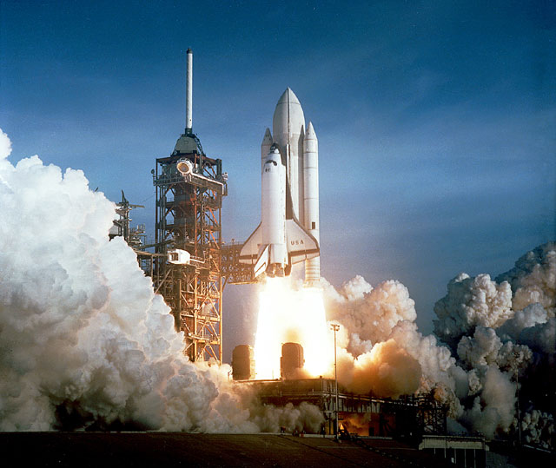
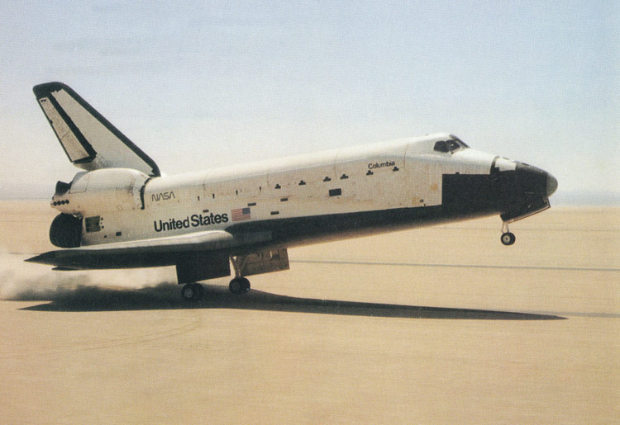
“It worked…the damn thing worked!” Frank Buzzard, MCC Guidance Support to Jim I’anson, Entry Guido and WW2 B-17 pilot
Full up crewed mission April 12-14, 1981 STS 1

Slide 4
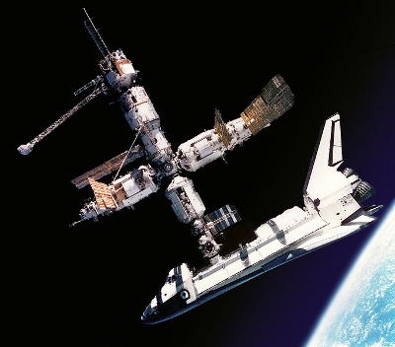
We redesigned Space Station Freedom and added Russia in 1994. Shuttle visited MIR space station 10 times between 1994 and 1998. Seven American Astronauts flew to MIR. 16 nations collaborated and cooperated to learn to work with our Russian colleagues to redesign and build the International Space Station.

Slide 5
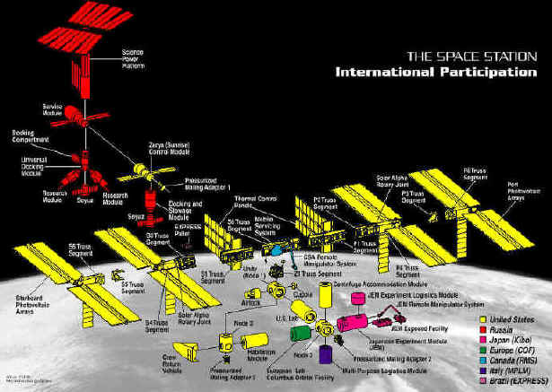
Sixteen Nations together build ISS and learn to work in space

Slide 6
Keys to Success
A clear objective and a common goal built on past success, hardware, facilities, and hard won expertise.
Division of labor aligned with NASA center core competencies and International Partner agencies
Engineering excellence and outstanding people building on past successes and processes
Facilities, tools, and budget to do the job
Building NASA multi-center and International Partner relationships based on humility, trust, sincerity, respect, and commitment to the mission. Arrogance is the enemy.
Acceptance of a better idea is a strength, not weakness
Lead from the front and by example
Communicate, Communicate, Communicate.

Slide 7
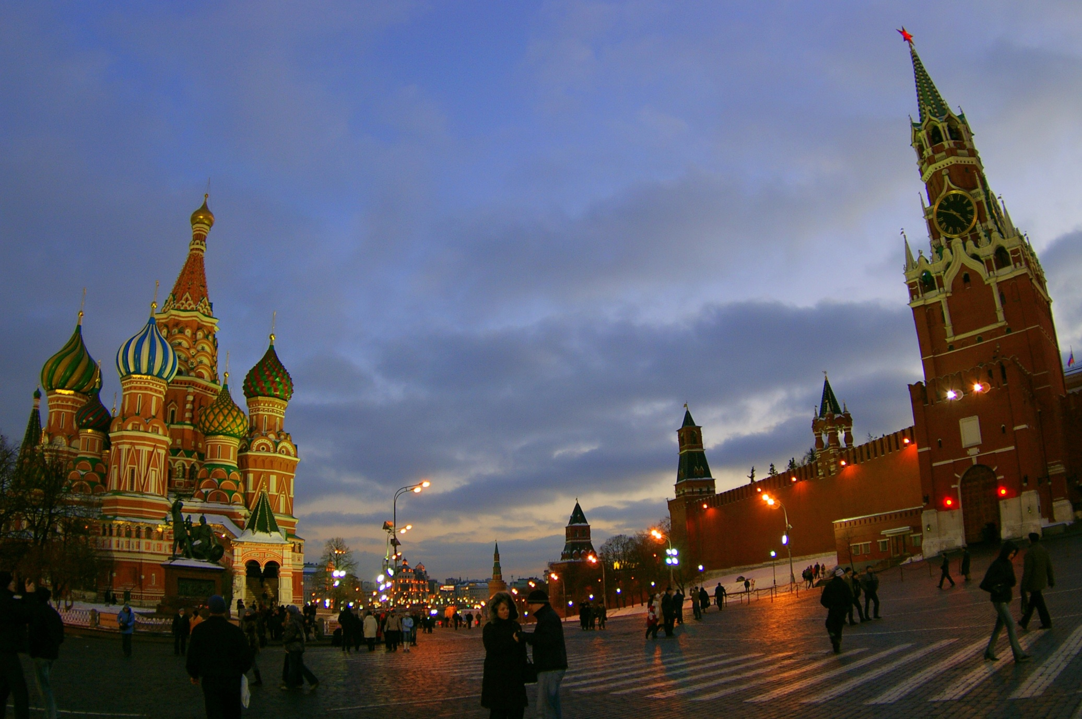
Child of the Cold War in Red Square

Slide 8
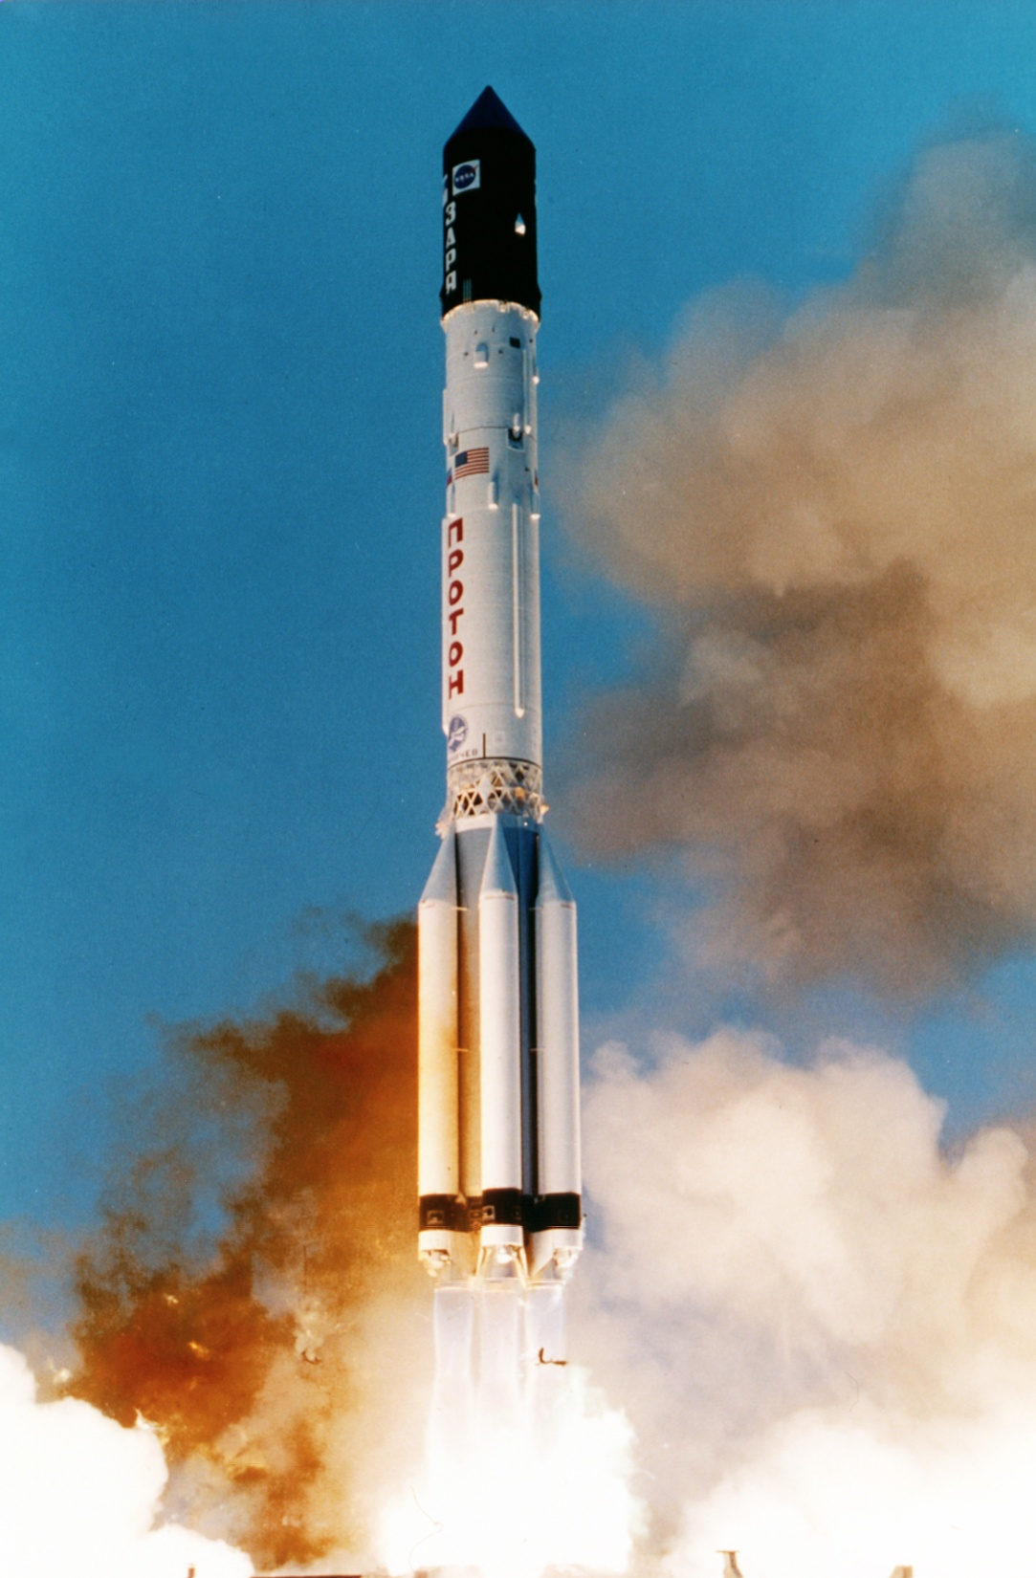
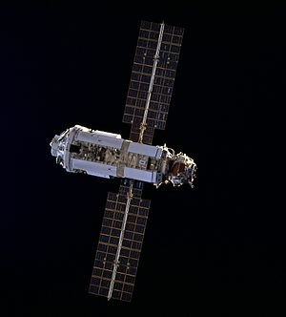
Functional Cargo Block or FGB
Launch on a Proton Rocket November 20, 1998 from Baikonur.
Zarya--the first module of the International Space Station--provided electrical power, propulsion, and control of ISS during the initial stage of assembly.

Slide 9
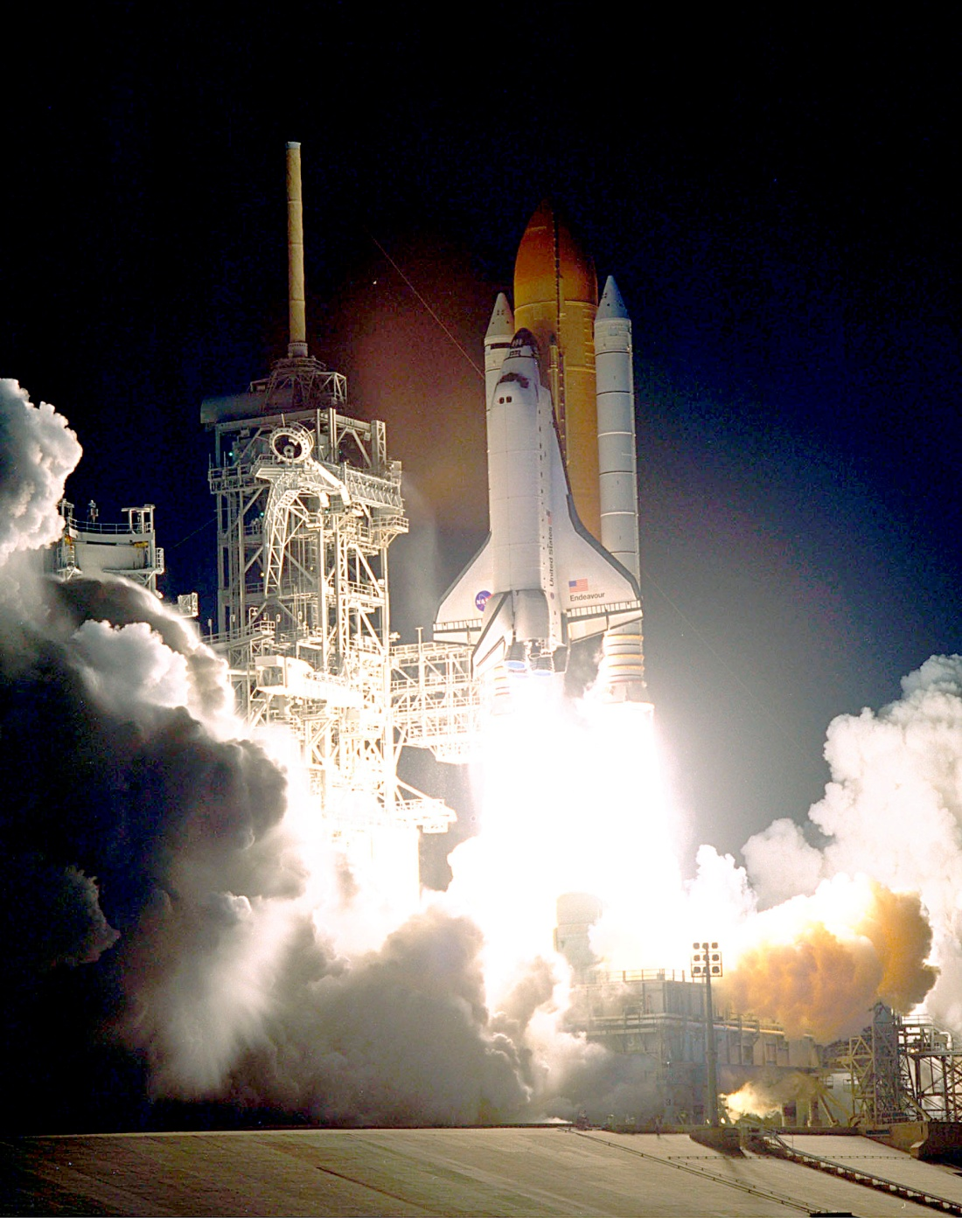
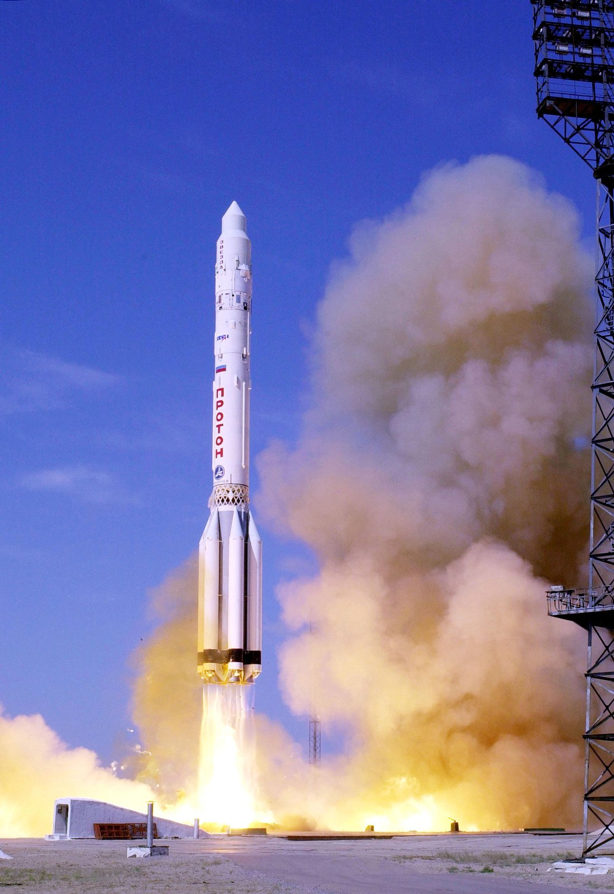
Launch of US Node 1 Unity and Zvezda Crew Living Quarters
December 4, 1998 July 11, 2000

Slide 10
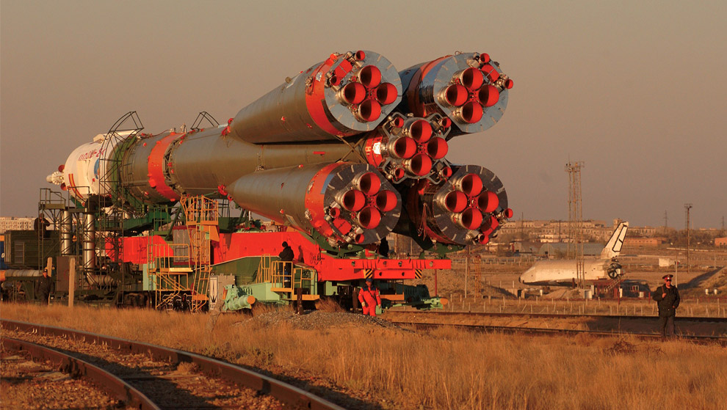
Soyuz rollout at Baikonur Cosmodrome. Buran in background

Slide 11
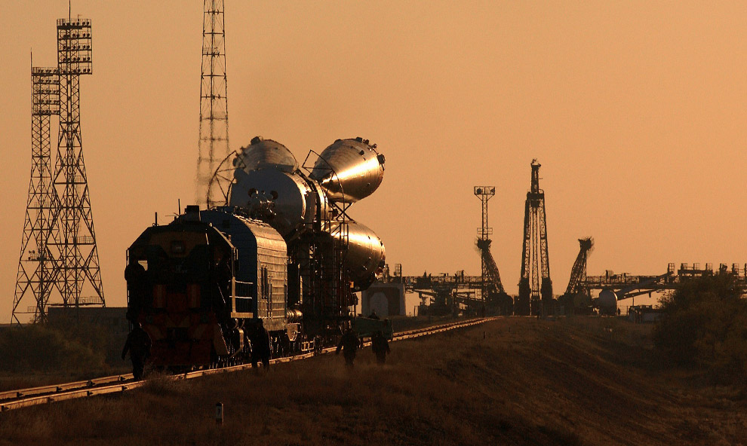
Soyuz headed for the pad

Slide 12
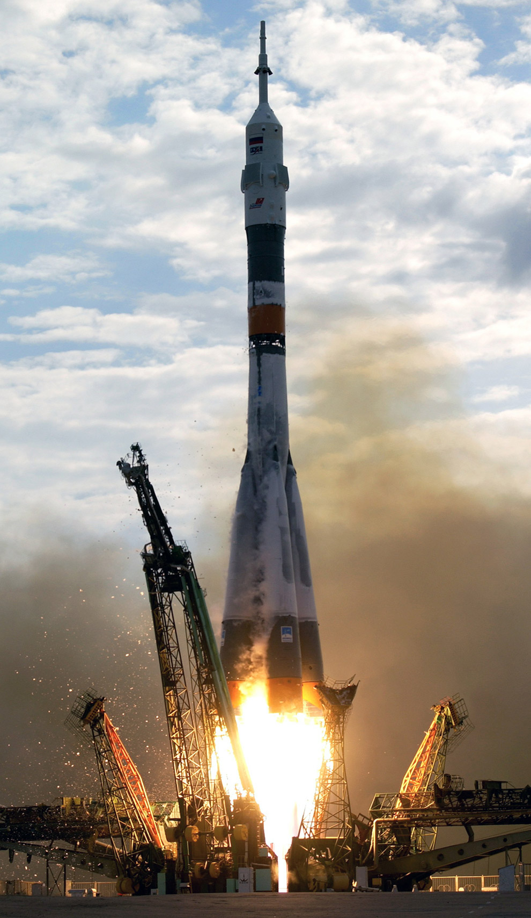
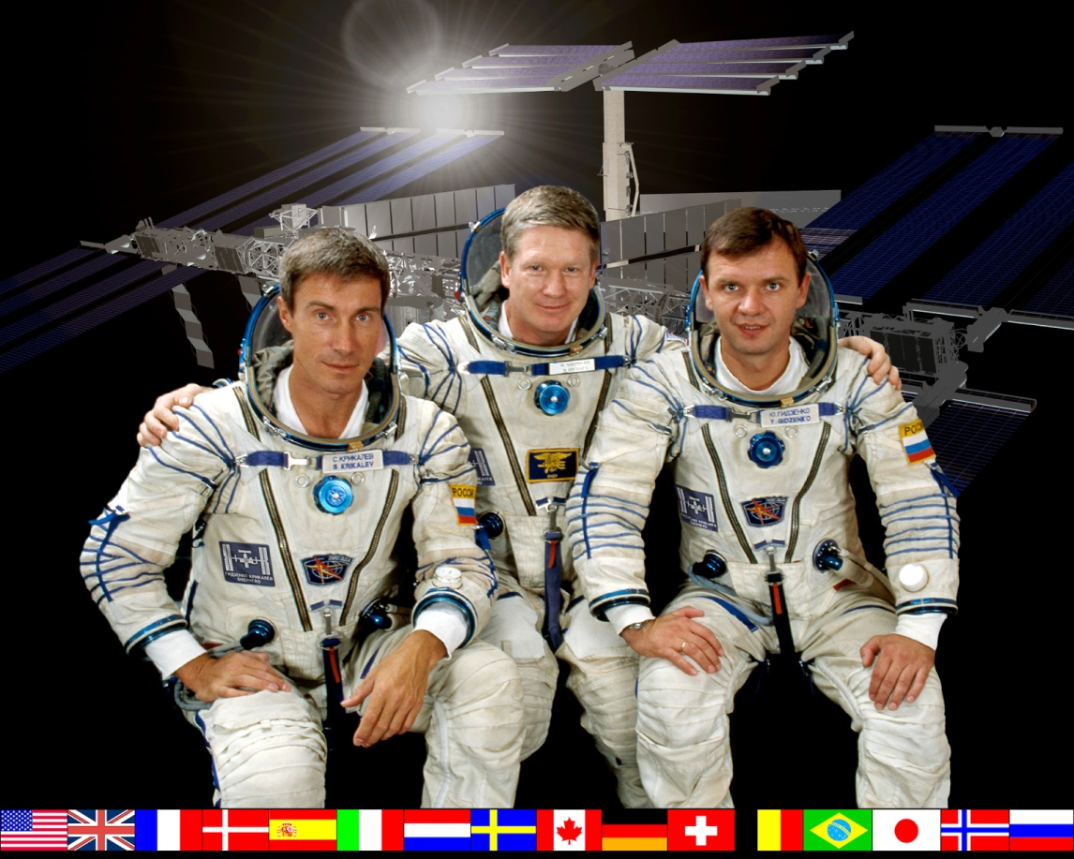
Expedition 1 ISS crew
William M. (Bill) Shepherd (center) is flanked by Soyuz Commander Yuri P. Gidzenko (right) and Flight Engineer Sergei K. Krikalev (left) launch on November 2, 2000 on their Soyuz Rocket from Baikonur Cosmodrome

Slide 13
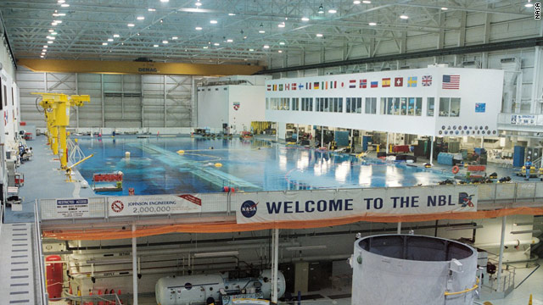
We learned on Gemini 9 in June 1966 with Astronaut Gene Cernan that zero G assembly in space required special restraints, training, and tools.
Underwater training was the key to success. So we built the Sonny Carter Neutral Buoyancy Lab NBL in Houston for the unprecedented number of space walks (EVA) required for ISS assembly
The NBL is 202 ft in length, 102 ft in width, and 40 ft in depth and holds 6.2 million gallons of water.

Slide 14
NBL is crucial to EVA successes

Slide 15
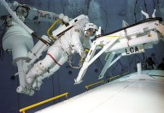
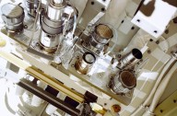
We practiced ISS Assembly Space Walks over and over in the NBL
Special Quick Disconnects for fluid and electrical lines required unique design for EVA and the space environment

Slide 16
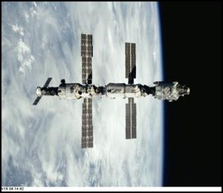
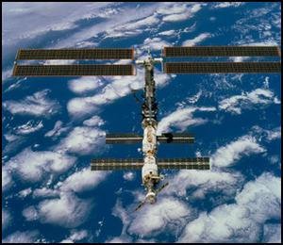
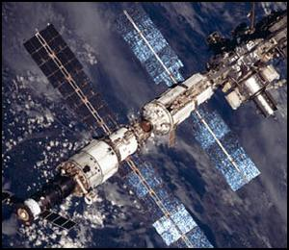
Building the International Space Station 1998-2001

Slide 17
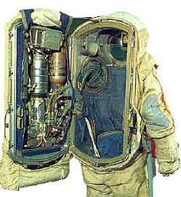
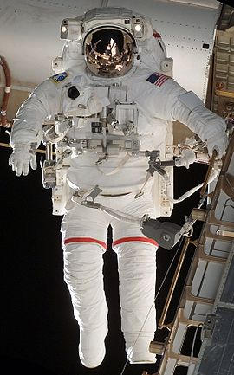
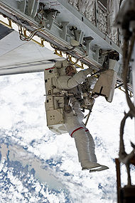
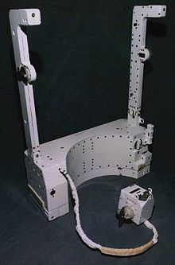
Extra-vehicular Activity EVA space suits
US Mike Foale in Russian Orlan Spacesuit

Slide 18
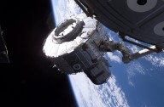
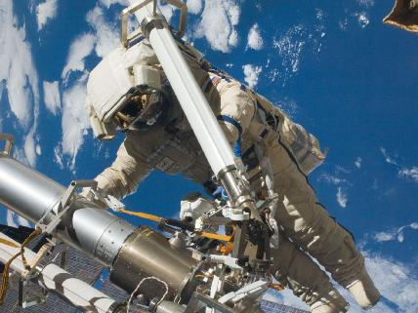
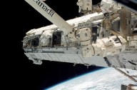
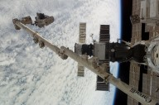
Every Shuttle mission to ISS delivered new modules that required robot arm and EVA assembly

Slide 19
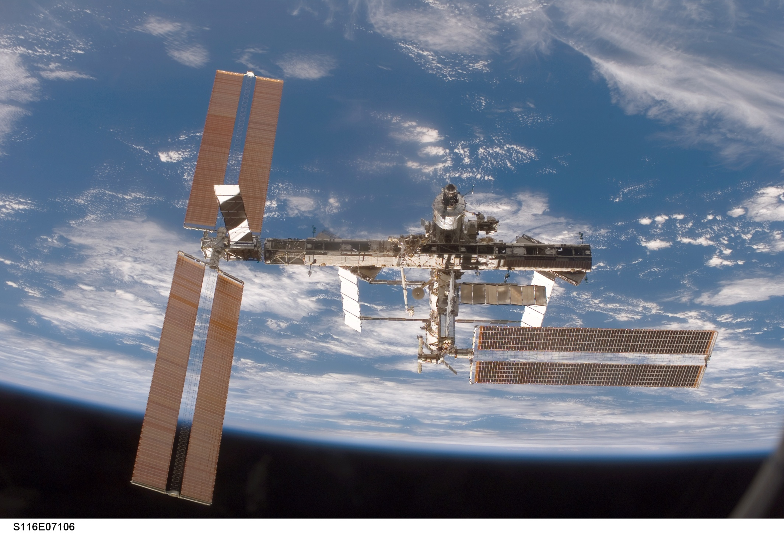
Newly installed P5 power truss with P6 array partially retracted Four spacewalks completely rewired the ISS power grid in Dec 2006

Slide 20
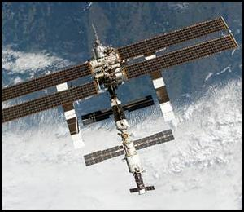
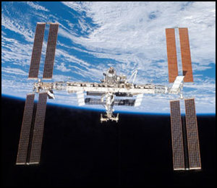
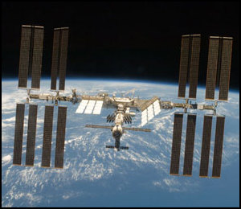
Building the International Space Station 2002-2010

Slide 21
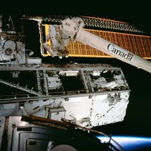
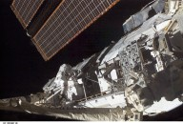
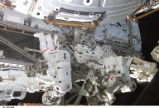
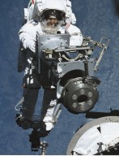
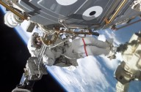
Continuing ISS Assembly

Slide 22
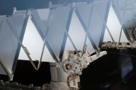
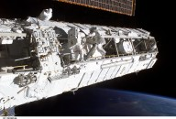
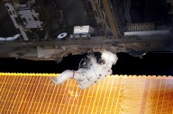
Continuing ISS Assembly

Slide 23
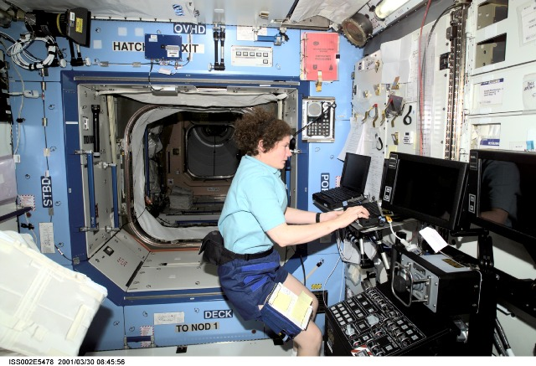
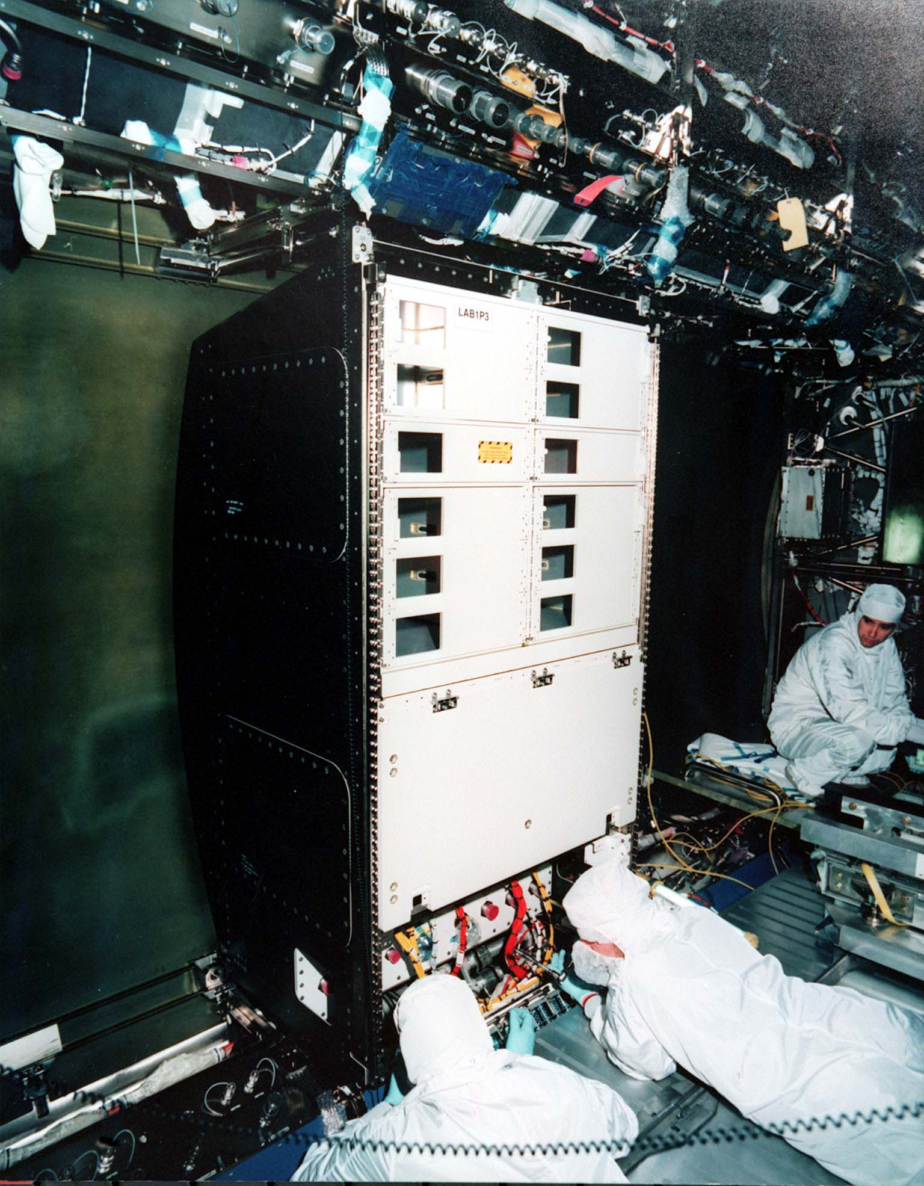
Research in Space on the ISS
Susan Helms configures the Canada Arm Control Station in the US Lab Destiny
US Lab can hold 24 Standard experiment and system Racks.

Slide 24
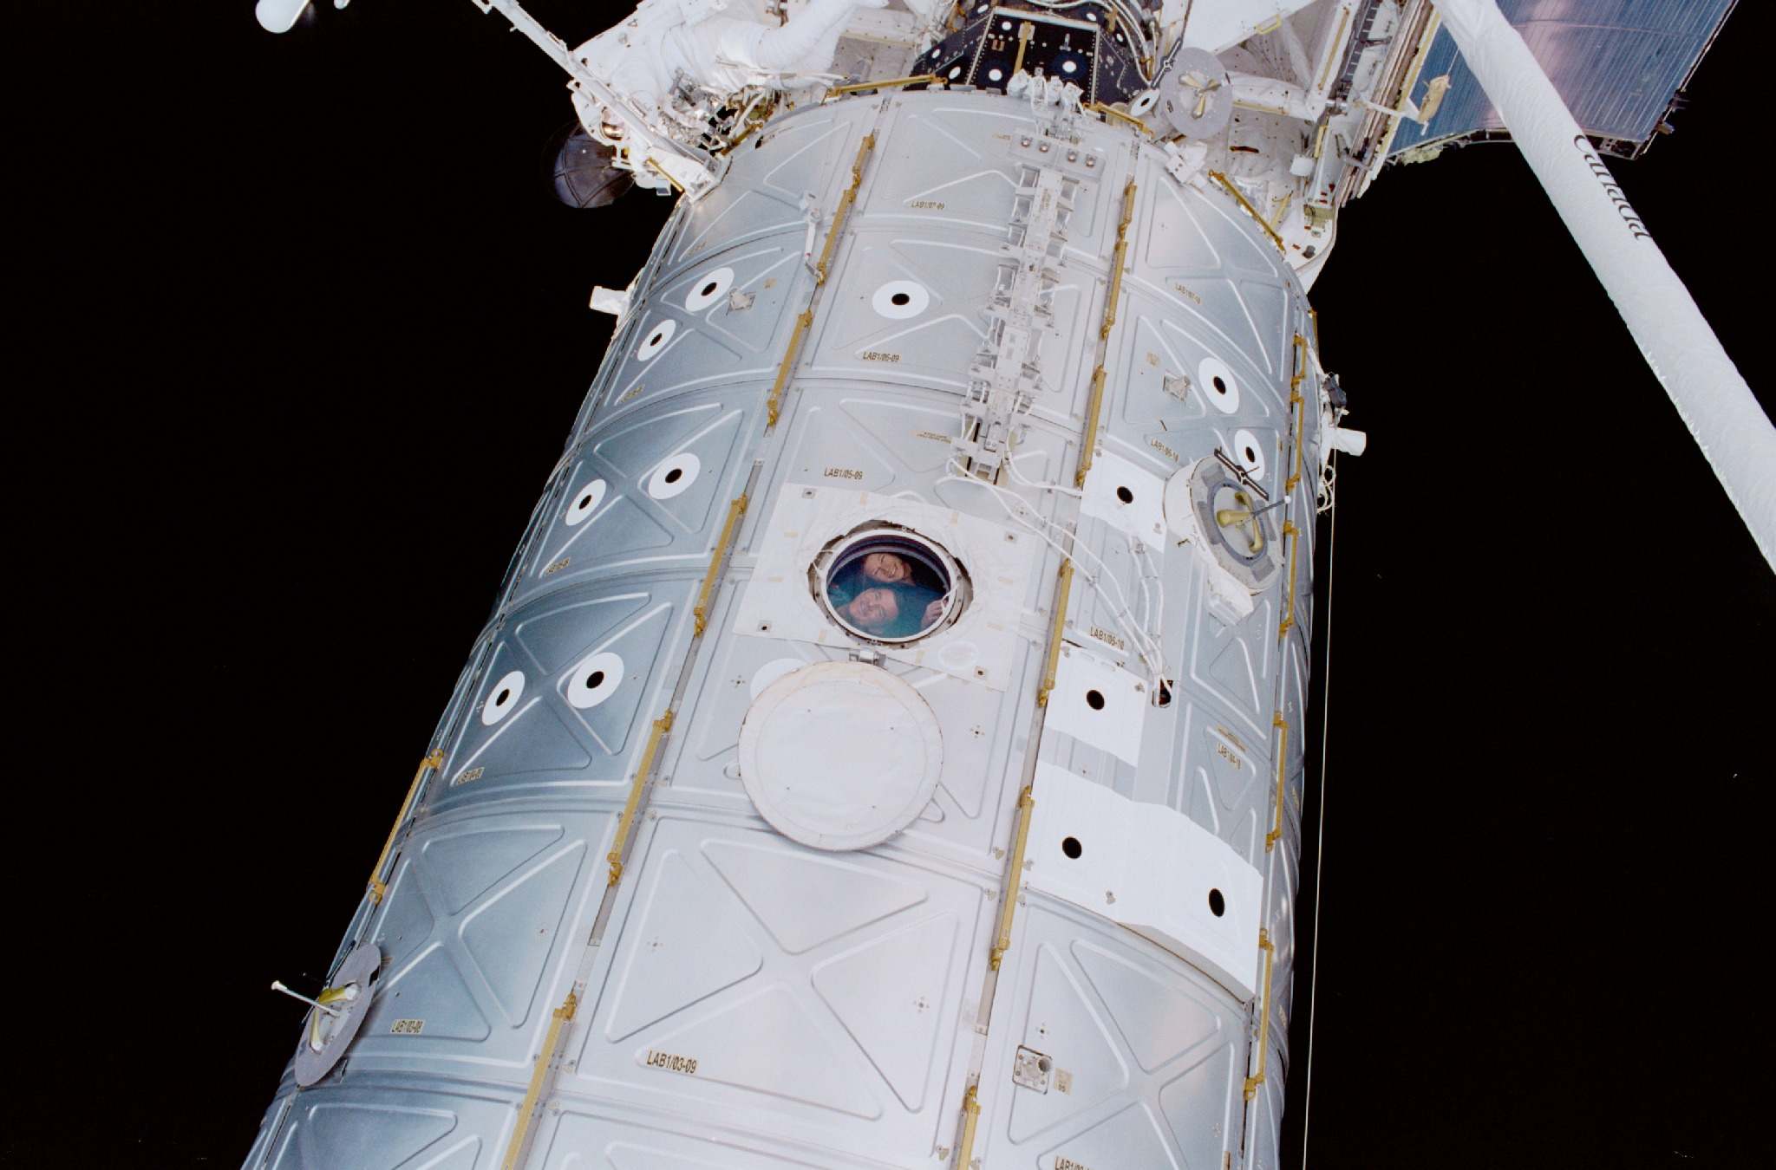
Research in Space
Jim Voss and Susan Helms in Optical window

Slide 25
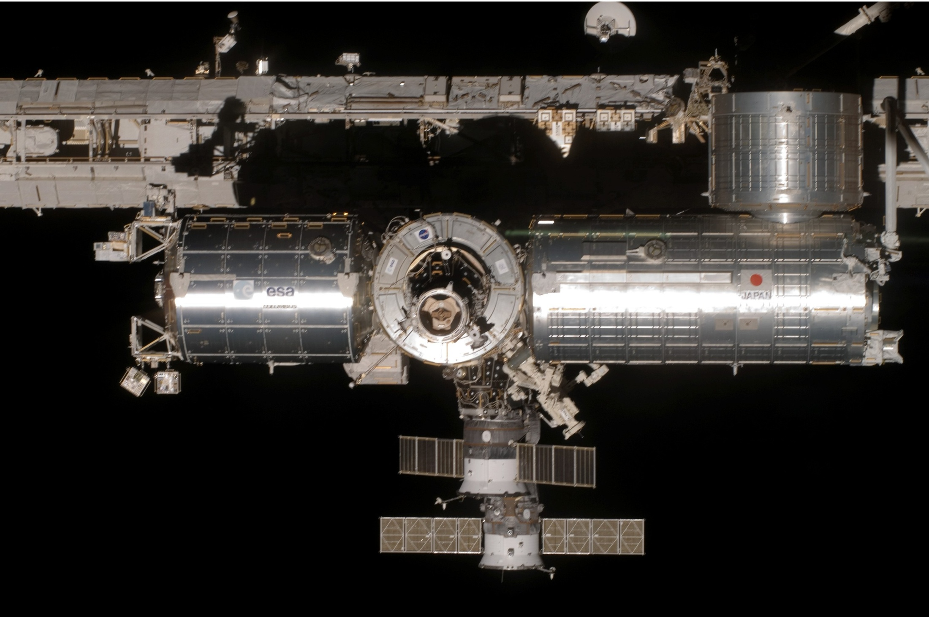
Research in Space
ISS unique International laboratories—ESA Columbus, JAXA Kibo

Slide 26
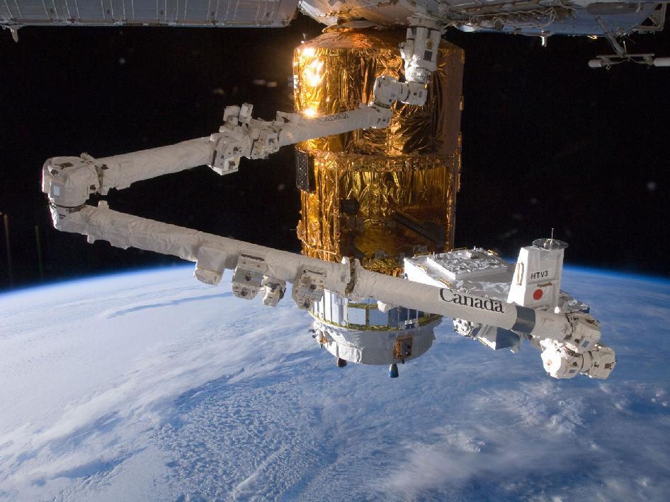
International Space Exploration at its finest
Sept 2014, Canada’s ISS Robotic Arm installs Earth facing research cameras on the USA Node 3 Tranquility delivered by the European Space Agency (ESA) HTV cargo vehicle from launch site at Kourou in French Guiana on the north coast of South America

Slide 27
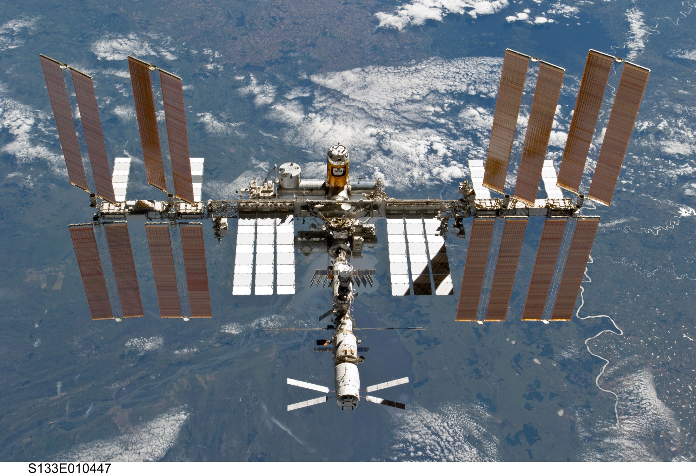
ISS Assembly Complete with ATV and HTV 2011

Slide 28
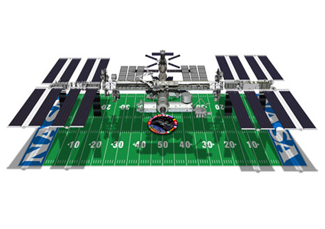
ISS Facts and Figures
Weight-925,000 lbs/419,455 kg. 747 aircraft weight and pressurized volume
Power generation-85 kilowatts. 45 average US homes. 8 miles of power cables
52 computers running 1.8 million lines of code control ISS.
Four times larger than Mir Space Station and five times larger than Skylab
Solar Arrays cover more than one acre
ISS manages 20 times more signals than Space Shuttle
115 rocket launches and 174 Spacewalks to construct ISS.

Slide 29
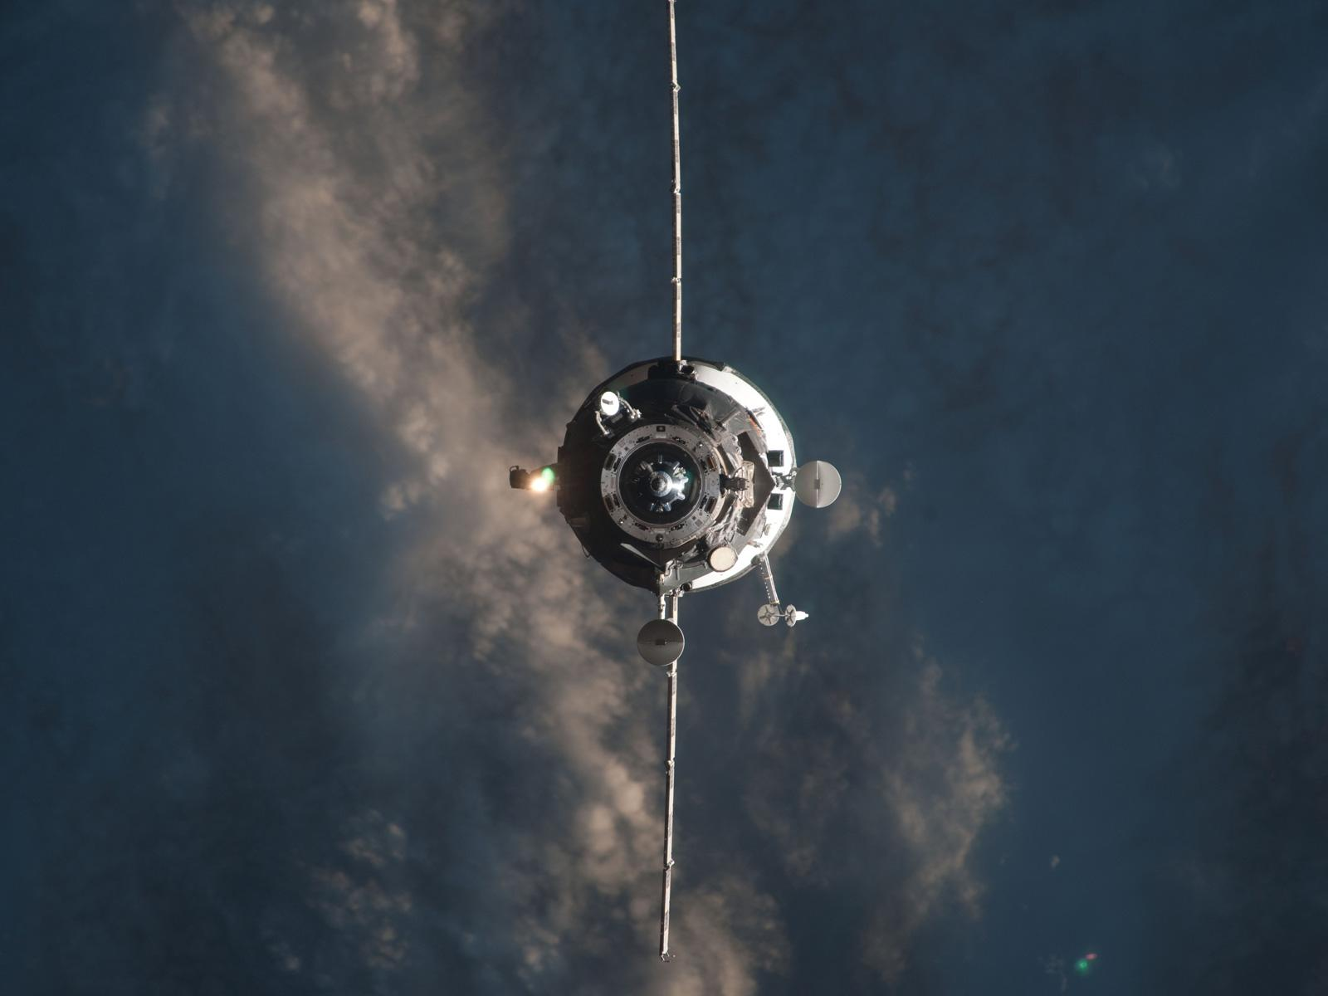
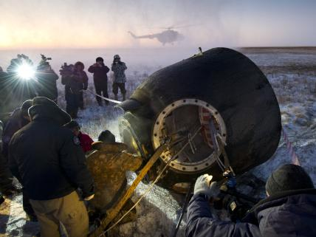
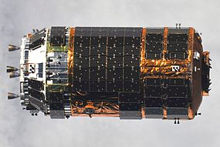
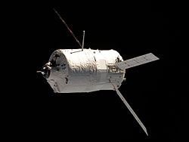
ISS Resupply and Crew Rotation

Slide 30
ISS Resupply Launch Sites
ESA photo
JAXA photo
Ariane V-ATV launch, Kourou
H-IIB-HTV launch, Tanegashima

Slide 31
Soyuz crew capsules and Progress Resupply ships launch from Baikonur, Kazakhstan

Slide 32
What a View!

Slide 33
What a view!

Slide 34
What a view!

Slide 35
What a view!

Slide 36
What a view!

Slide 37
Northern Lights viewed from the ISS

Slide 38
August Perseid Meteor seen from ISS

Slide 39
ISS transits the sun
taken from Germany by Thio Kranz. STS 132 May 2010

Slide 40
Make sure you have fun along the way
Some things are better left in the ocean rather than eaten raw!
Our Japanese ISS partners at Japanese Launch site

Slide 41
Parting Thoughts
Future Space Exploration will and should be an International effort. We should build on the ISS relationships and proven worldwide space industry expertise
Commercial transportation initiative to LEO is vital. Building the Transcontinental Railroad (not government subsidized Amtrak) and 1930s Airline industry expansion/government cooperation models worked for major transportation infrastructure change
NASA should transition from designing and operating new LEO rockets to designing new Lunar/Mars habitats and beyond
Will America lead space exploration or go the way of Portugal? Henry the Navigator 1394-1460. Leadership in ship design, sails and navigation. Portugal explores Africa in 15 century. Explores Asia, Indonesia, China, and Japan in early 16th century. Gives up exploration leadership to Spain, England, and Dutch

Slide 42
And now, If America has the will and leadership, on to Mars and exploring our Solar System

Slide 43
Common Buzzard at Loch Awe Scotland
Common Buzzard
(Buteo Buteo)
In flight

Slide 44
You can view video and slides for this lecture at my website
frankbuzzard.com

