Slide 1
Managing Stress
Exploring stress in myself and my staff

Slide 2
To Help Reduce Stress, Anxiety and Panic
Abdominal Breathing
Relax tummy
Breathe in through nose
Allow tummy to expand – move outwards
Breath from tummy up into chest – air moves in wave from tummy up into chest
Open mouth
Breathe out
Contract tummy muscles lightly to push air out
When all air is gone release contracted tummy muscles and start again at 1.
Lateral Breathing
Place hands on ribs
Breathe fully and deeply through nose
Feel breath pushing outwards (laterally) into ribs
Feel your ribs expand, lift and separate
Open mouth, breathe out
Feel ribs dropping and contracting
When all air gone re-start from 2.

Slide 3
Full Practice: 2-3 minutes. Practice everyday for 2 weeks. If you get light-headed go back to more shallow breathing and then try a deeper breath. Over 2 weeks light-headedness will resolve.
Breathe with one of above methods
On first breath say: “Just slow down”
Breathe a few additional breaths just focussing on the breath
On the next breath say: “Here and now I’m safe”
Alternate these two statements every few breaths through the breathing practice
Usage
Notice your stress/anxiety graph as you go about your day. Whenever you feel stressed/anxious say:
Breathe
“Just slow down
“Here and Now I’m safe”

Slide 4
Physical Signs STRESS Mental Signs
Headaches
Tension
Indigestion
Breathlessness
Rashes
Frequent Colds
Recurrence of illness
Sleep Disturbance
Dizziness
Dry Mouth
Inability to Concentrate
Worrying/ Indecisive
Making Mistakes
Muddled Thinking
Persistent Negative Thinking/ Crying
Nervousness
Memory Losses
Work Errors
Irritability/ Critical/ Bad temper
Bullying

Slide 5
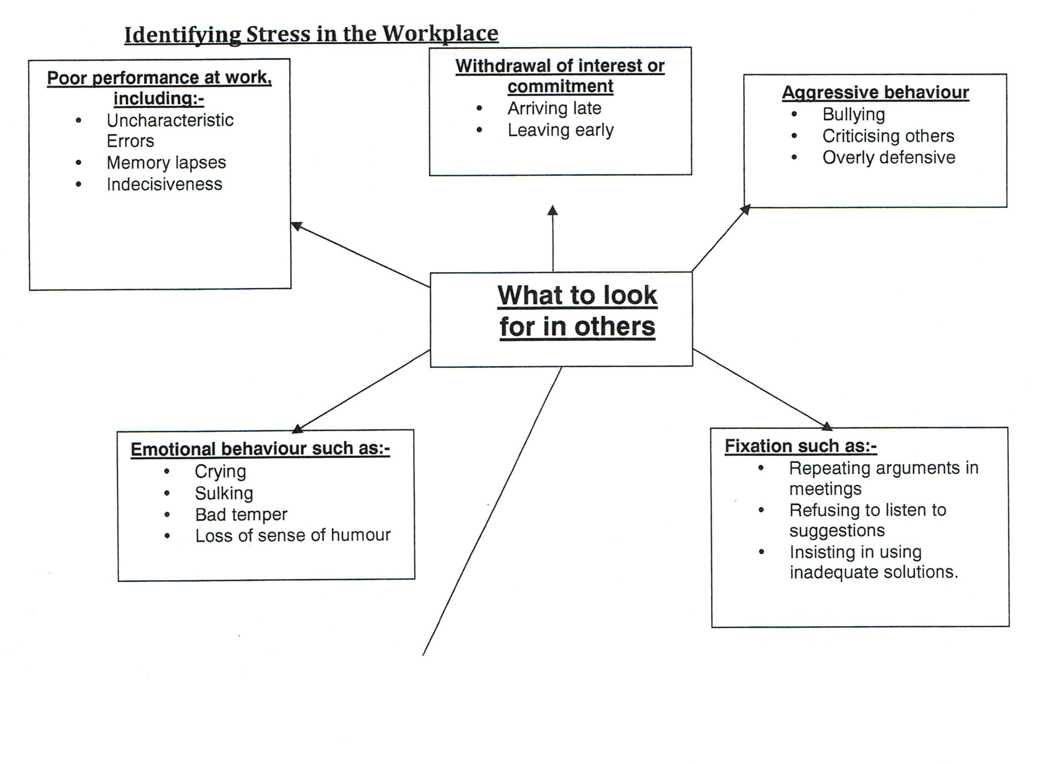

Slide 6
Avoiding the Present
BUSY MIND
RUMINATING
CATASTROPHISING
PRESENT
PAST
FUTURE

Slide 7
LIVING IN THE HERE & NOW
Quieter Mind - Living in the Present
Reduced Ruminating
Reduced Catastrophising
PAST
PRESENT
FUTURE

Slide 8
Benefits of Mindfulness: Living in The Here & NOW
Lowers Cortisol – stress hormone
Greater Blood Flow to Frontal Cortex
Improvement in Communication between Left & Right Hemispheres of the Brain
Improved Executive Function i.e capacity to think rationally
Improves mood
Increases empathy
Improves resilience & equanimity
Enhances creativity
Improves decision making
Improves lucidity
www.lifehack.org

Slide 9
The Dialogue Consultancy
www.dialogueconsultancy.com
jonathan@dialogueconsultancy.com
Tel: 020 8892 3644

