Slide 1
GENERATING GRASSROOTS FINANCIAL SUPPORT
JOE CERUTTI
Certified Music Judge
BHS Staff, Director of Outreach
Artistic Director, Alexandria Harmonizers

Slide 2
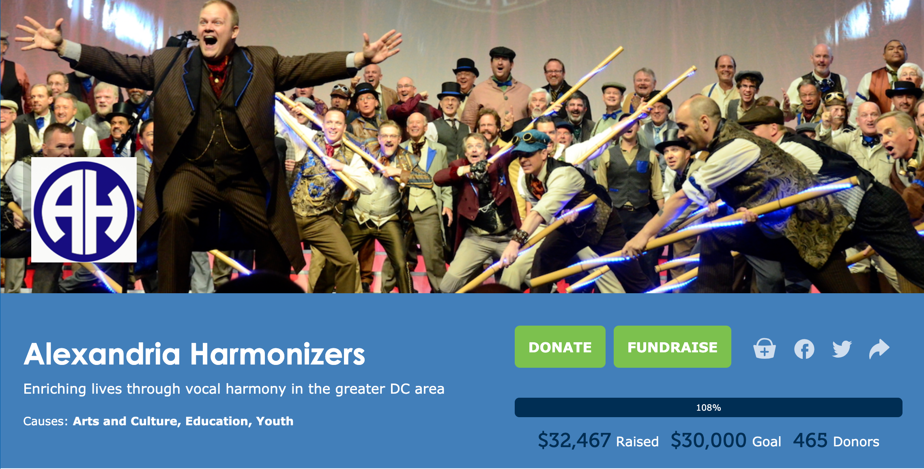

Slide 3
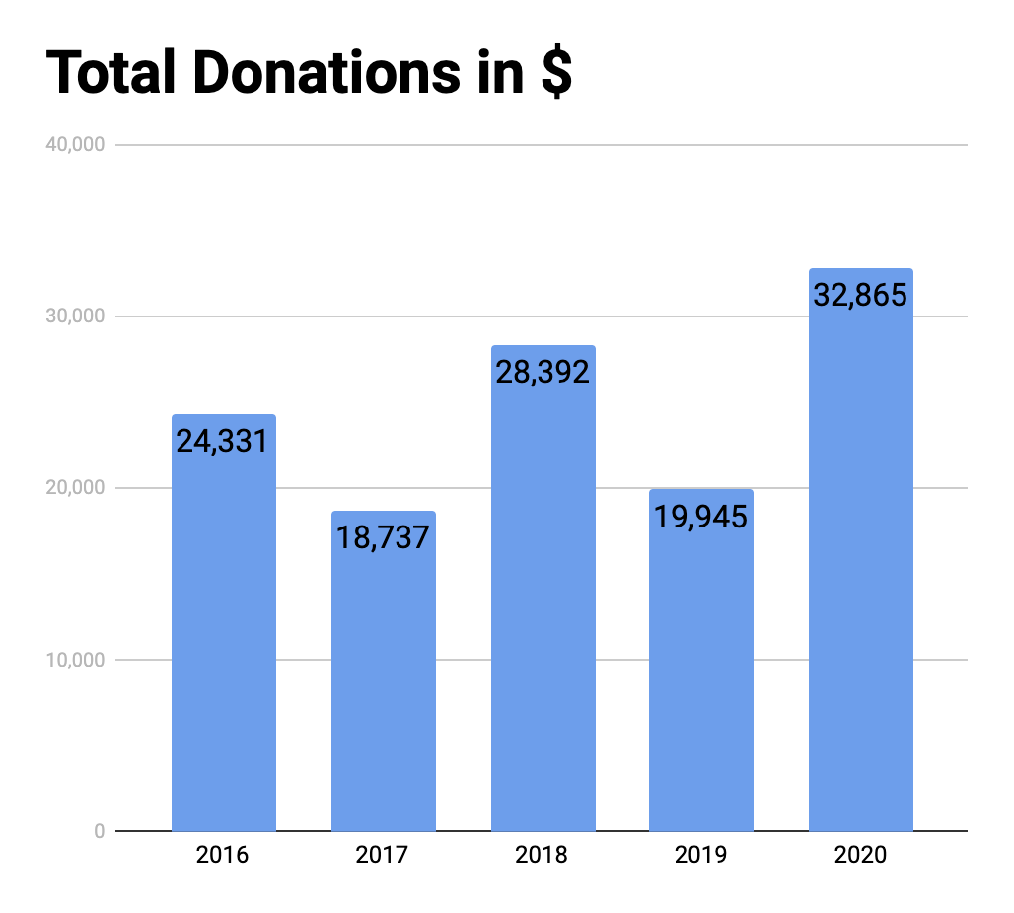
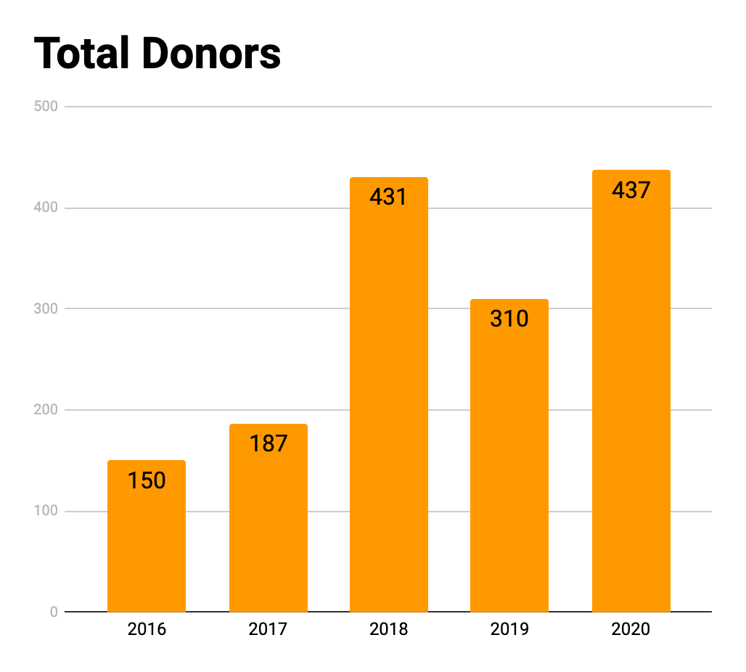
5 YEAR COMPARISON: DONOR VS DOLLAR

Slide 4
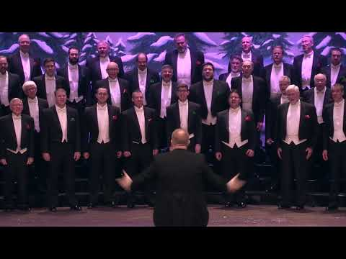
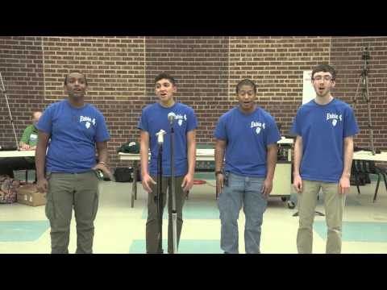
WHO/WHAT/WHY VIDEOS
WHO ARE WE?
WHAT DO WE DO?
WHY DONATE?

Slide 5
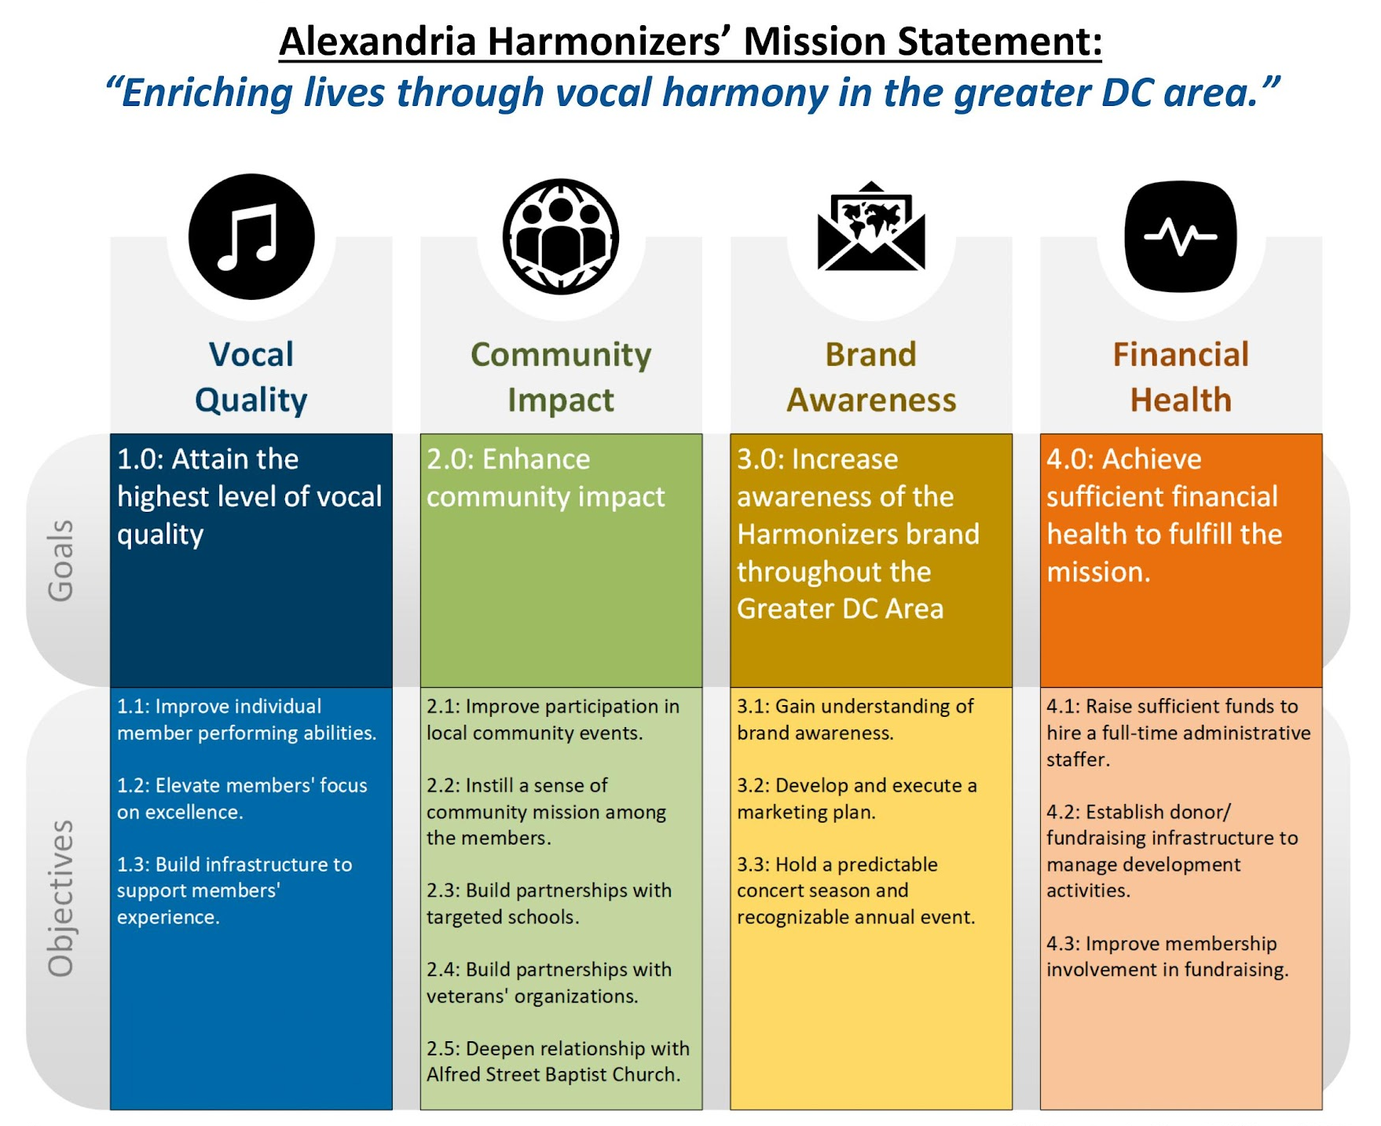
3-5 YEAR STRATEGIC PLAN
step back from day-to-day ops
create new goals/objectives
target plan to achieve them
develop new priorities
establish future direction
sharpen focus/min. distraction
align membership mindset
communicate your message
engage community for help

Slide 6
SUCCESS MEASUREMENT & EVALUATION
How Do You Measure Success?
What Are Your Measures of Success?
How Do You Define Them?

Slide 7
SUCCESS MEASUREMENT & EVALUATION
What do you do that aligns to your Measures of Success?

Slide 8
SUCCESS MEASUREMENT & EVALUATION
Clarify how you will specifically measure the outcomes?
Answer question(s) for each activity depending on # of measures
Evaluate their impact based on alignment to success measures
Decide to intentionally continue, stop, modify each activity

Slide 9
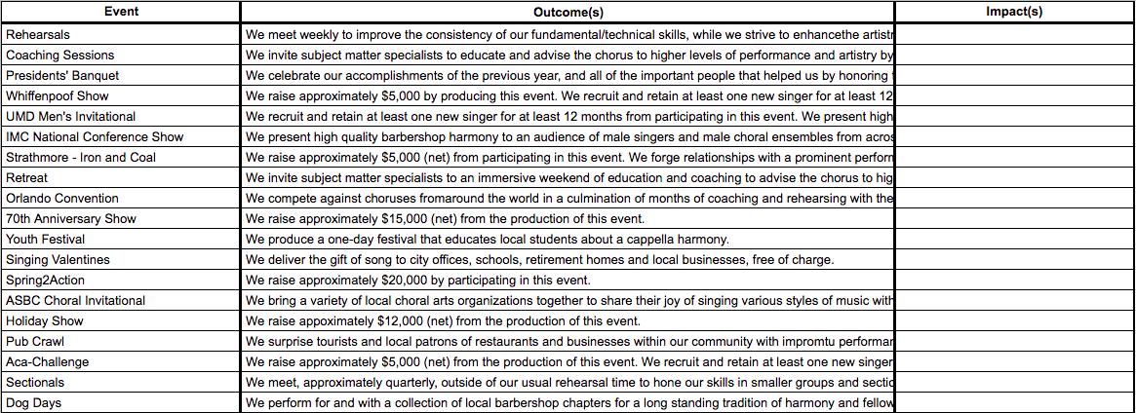
SUCCESS MEASUREMENT & EVALUATION
What are the impacts based on those outcomes?
?

Slide 10
ANNUAL REPORT - TELL YOUR STORY
comprehensive look at preceding year
summarize achievements
increase confidence in membership
establish interest from community
garner support from donor base
support/legitimize grant applications
compare Y2Y - build your story/legacy
start small, ask for help

Slide 11
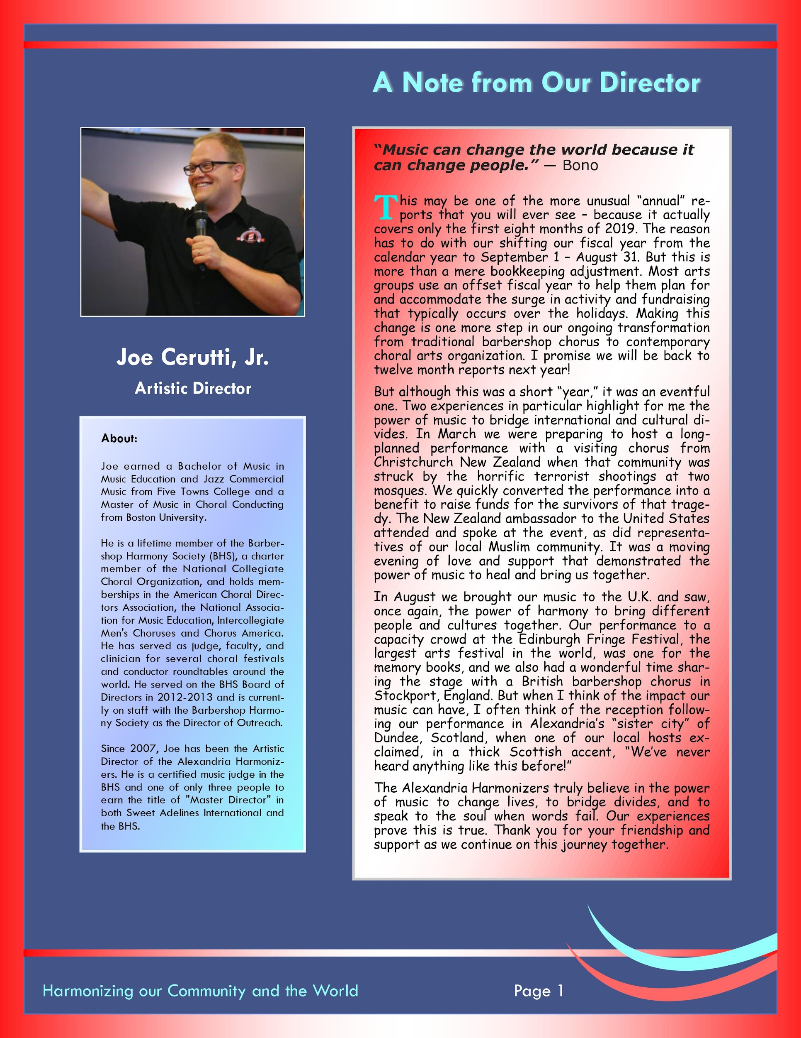
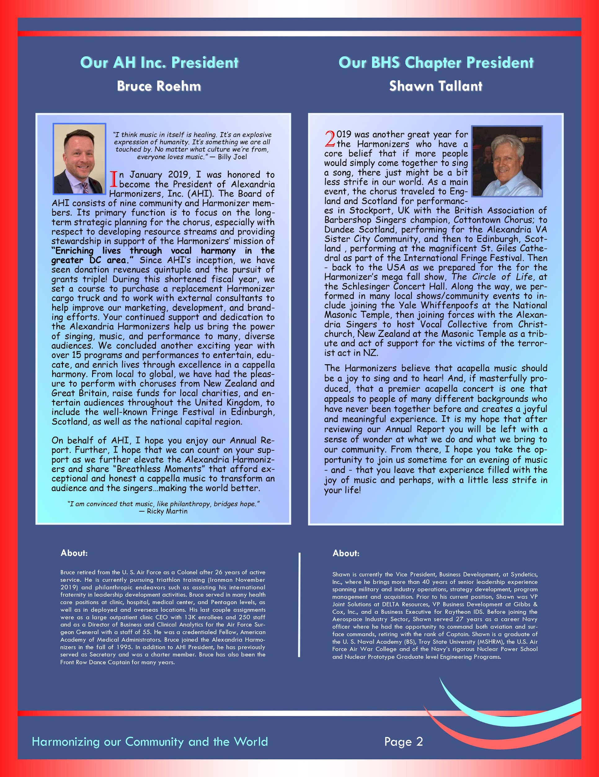
ANNUAL REPORT
MESSAGE FROM DIRECTOR
MESSAGE FROM PRESIDENT(S)
ABOUT US

Slide 12
ANNUAL REPORT
PERFORMANCE
COMMUNITY
YOUTH

Slide 13
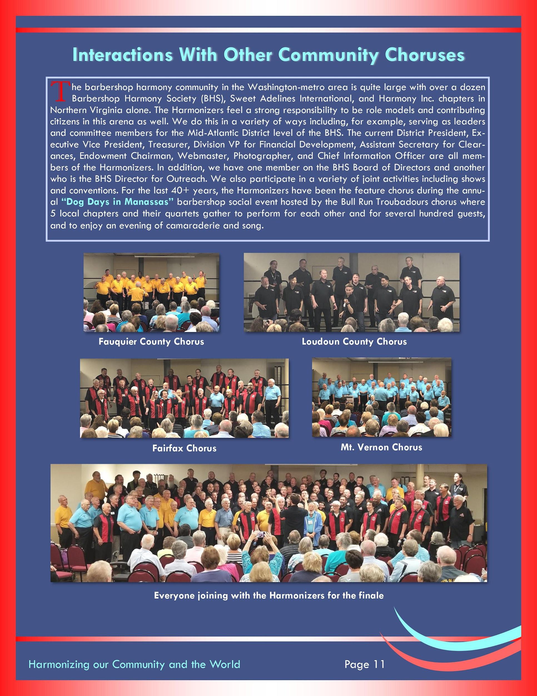
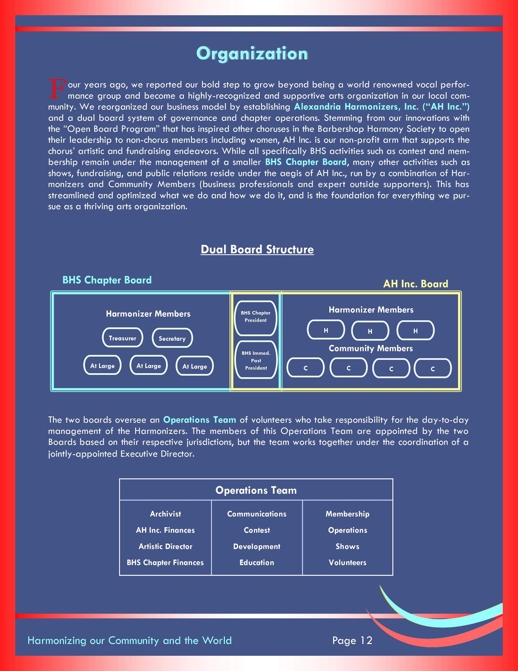
ANNUAL REPORT
COLLABORATIONS
QUARTETS
ORG STRUCTURE

Slide 14
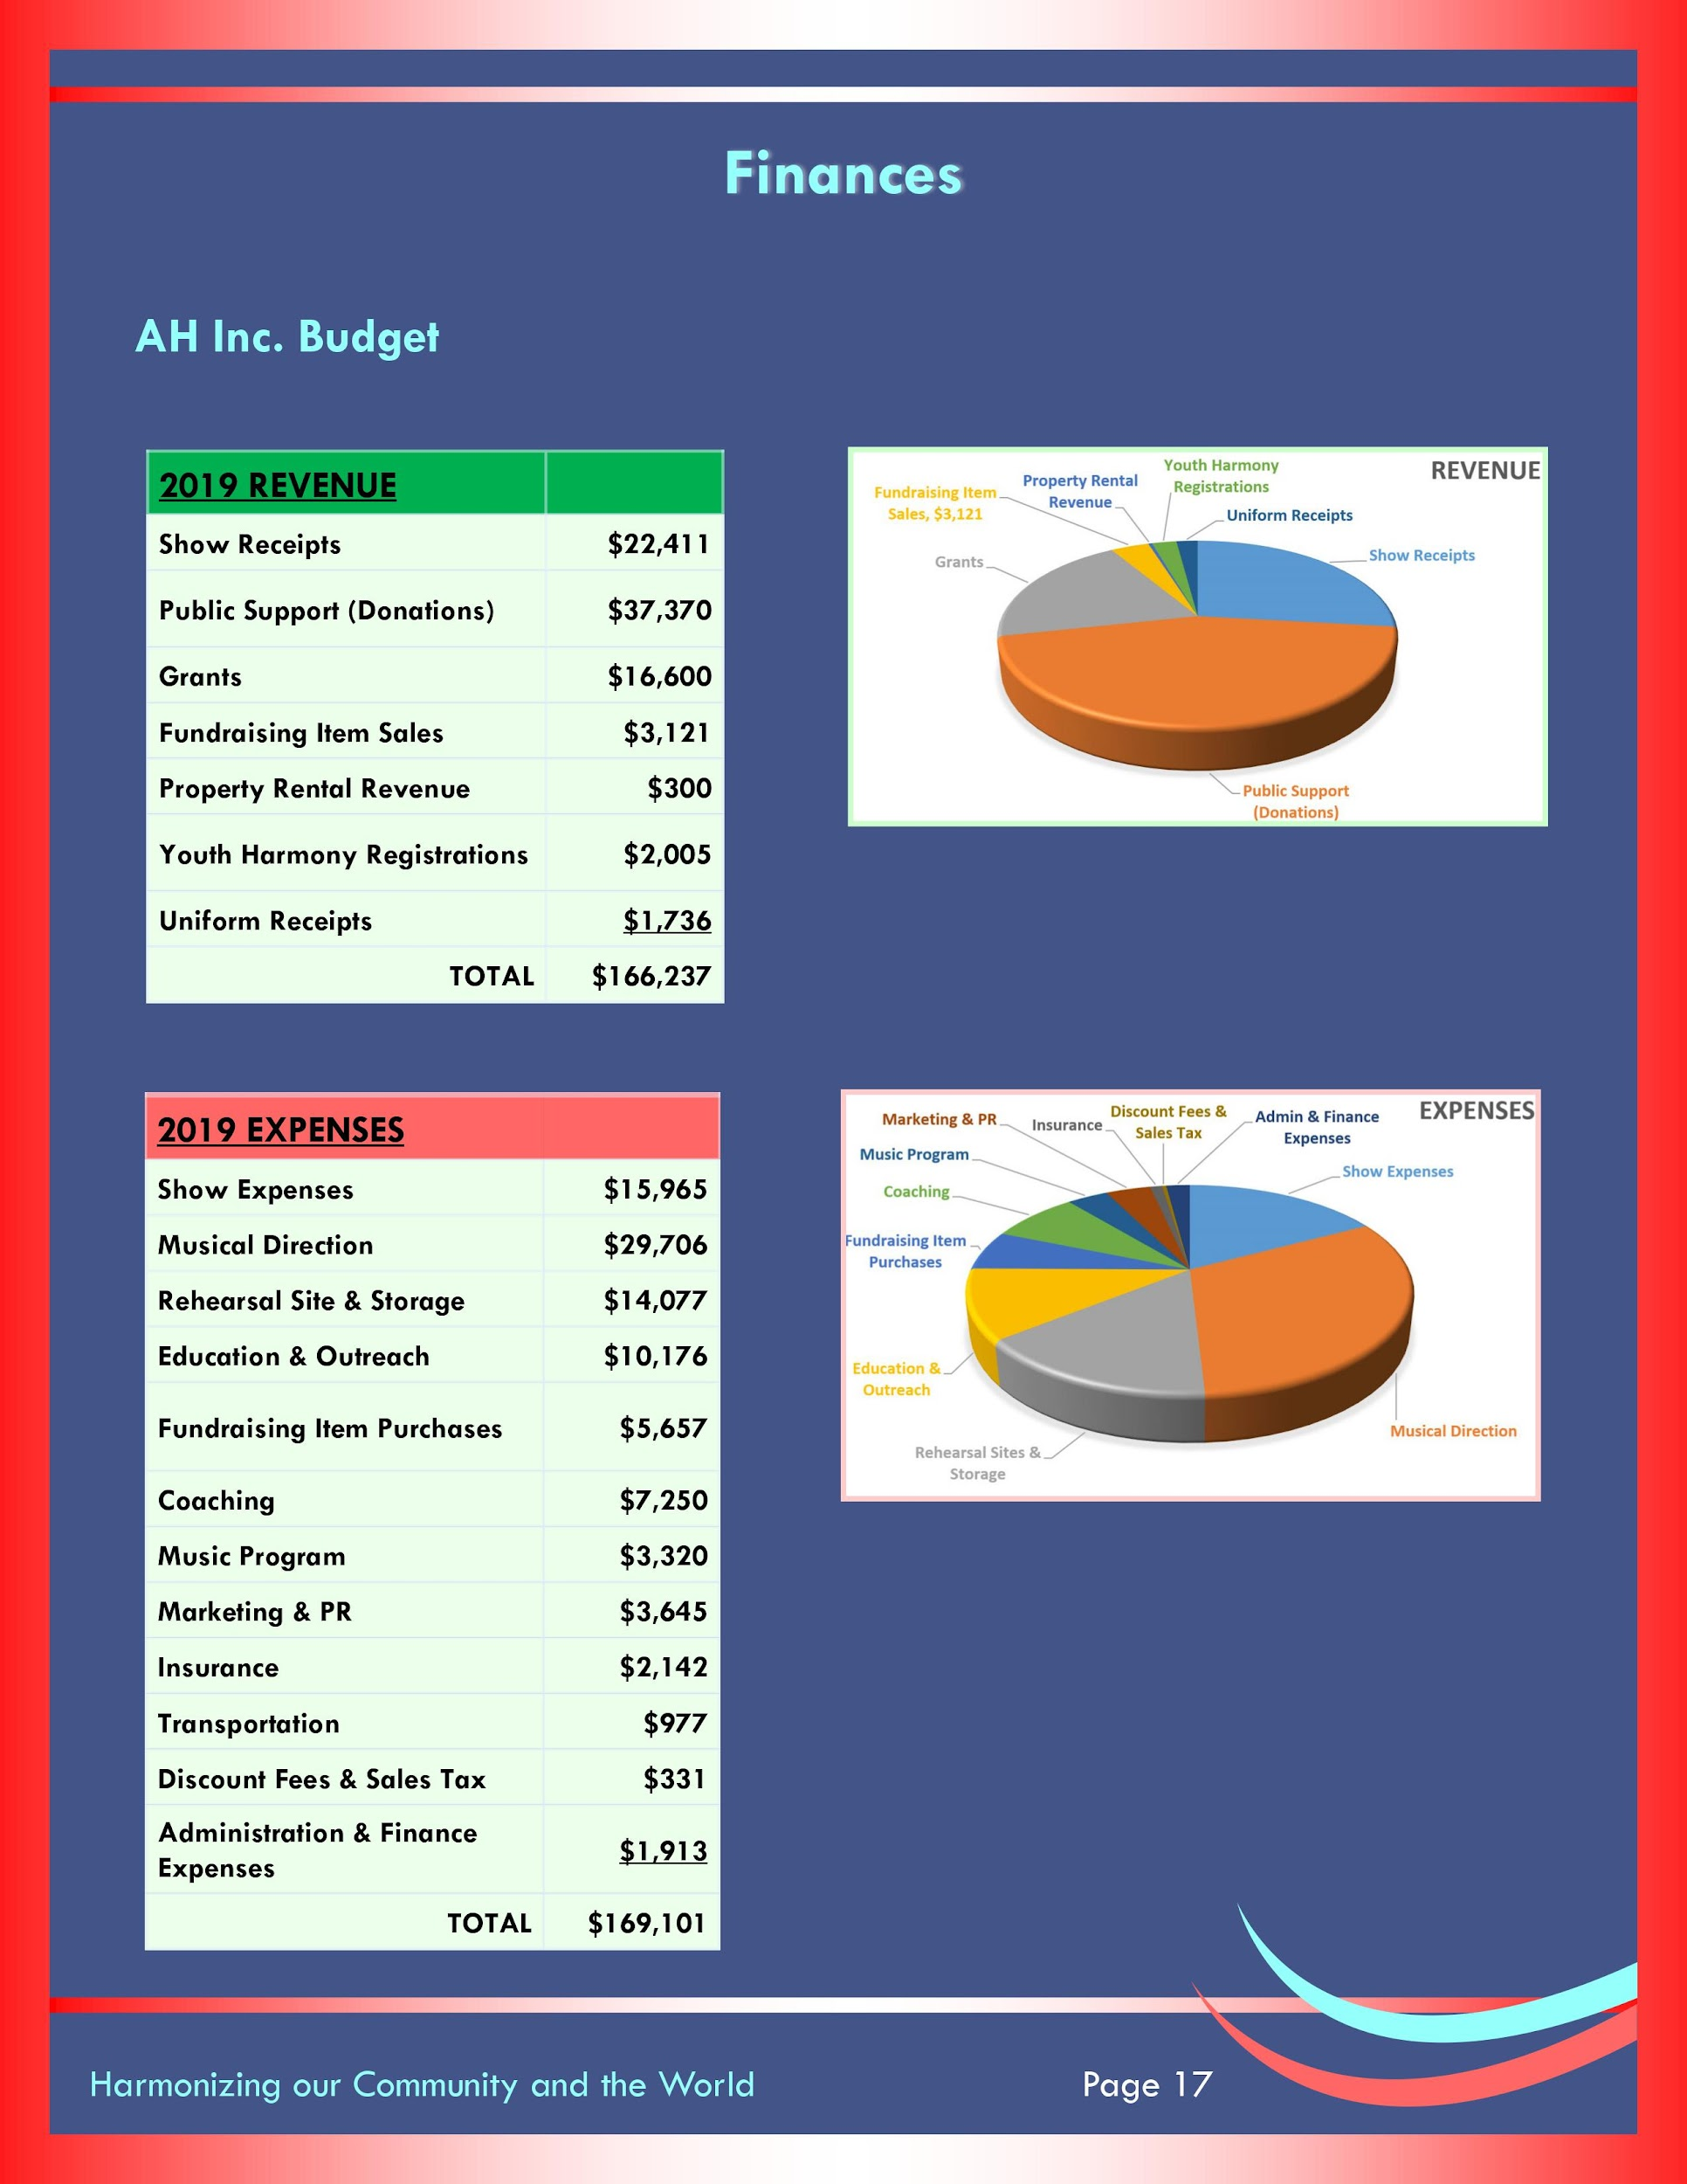
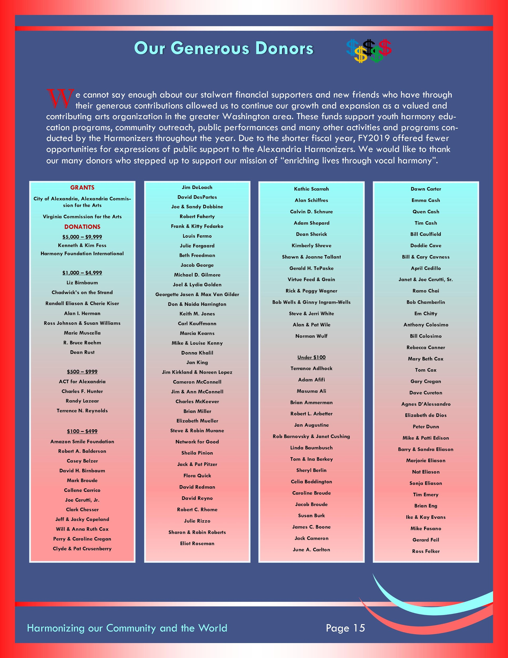
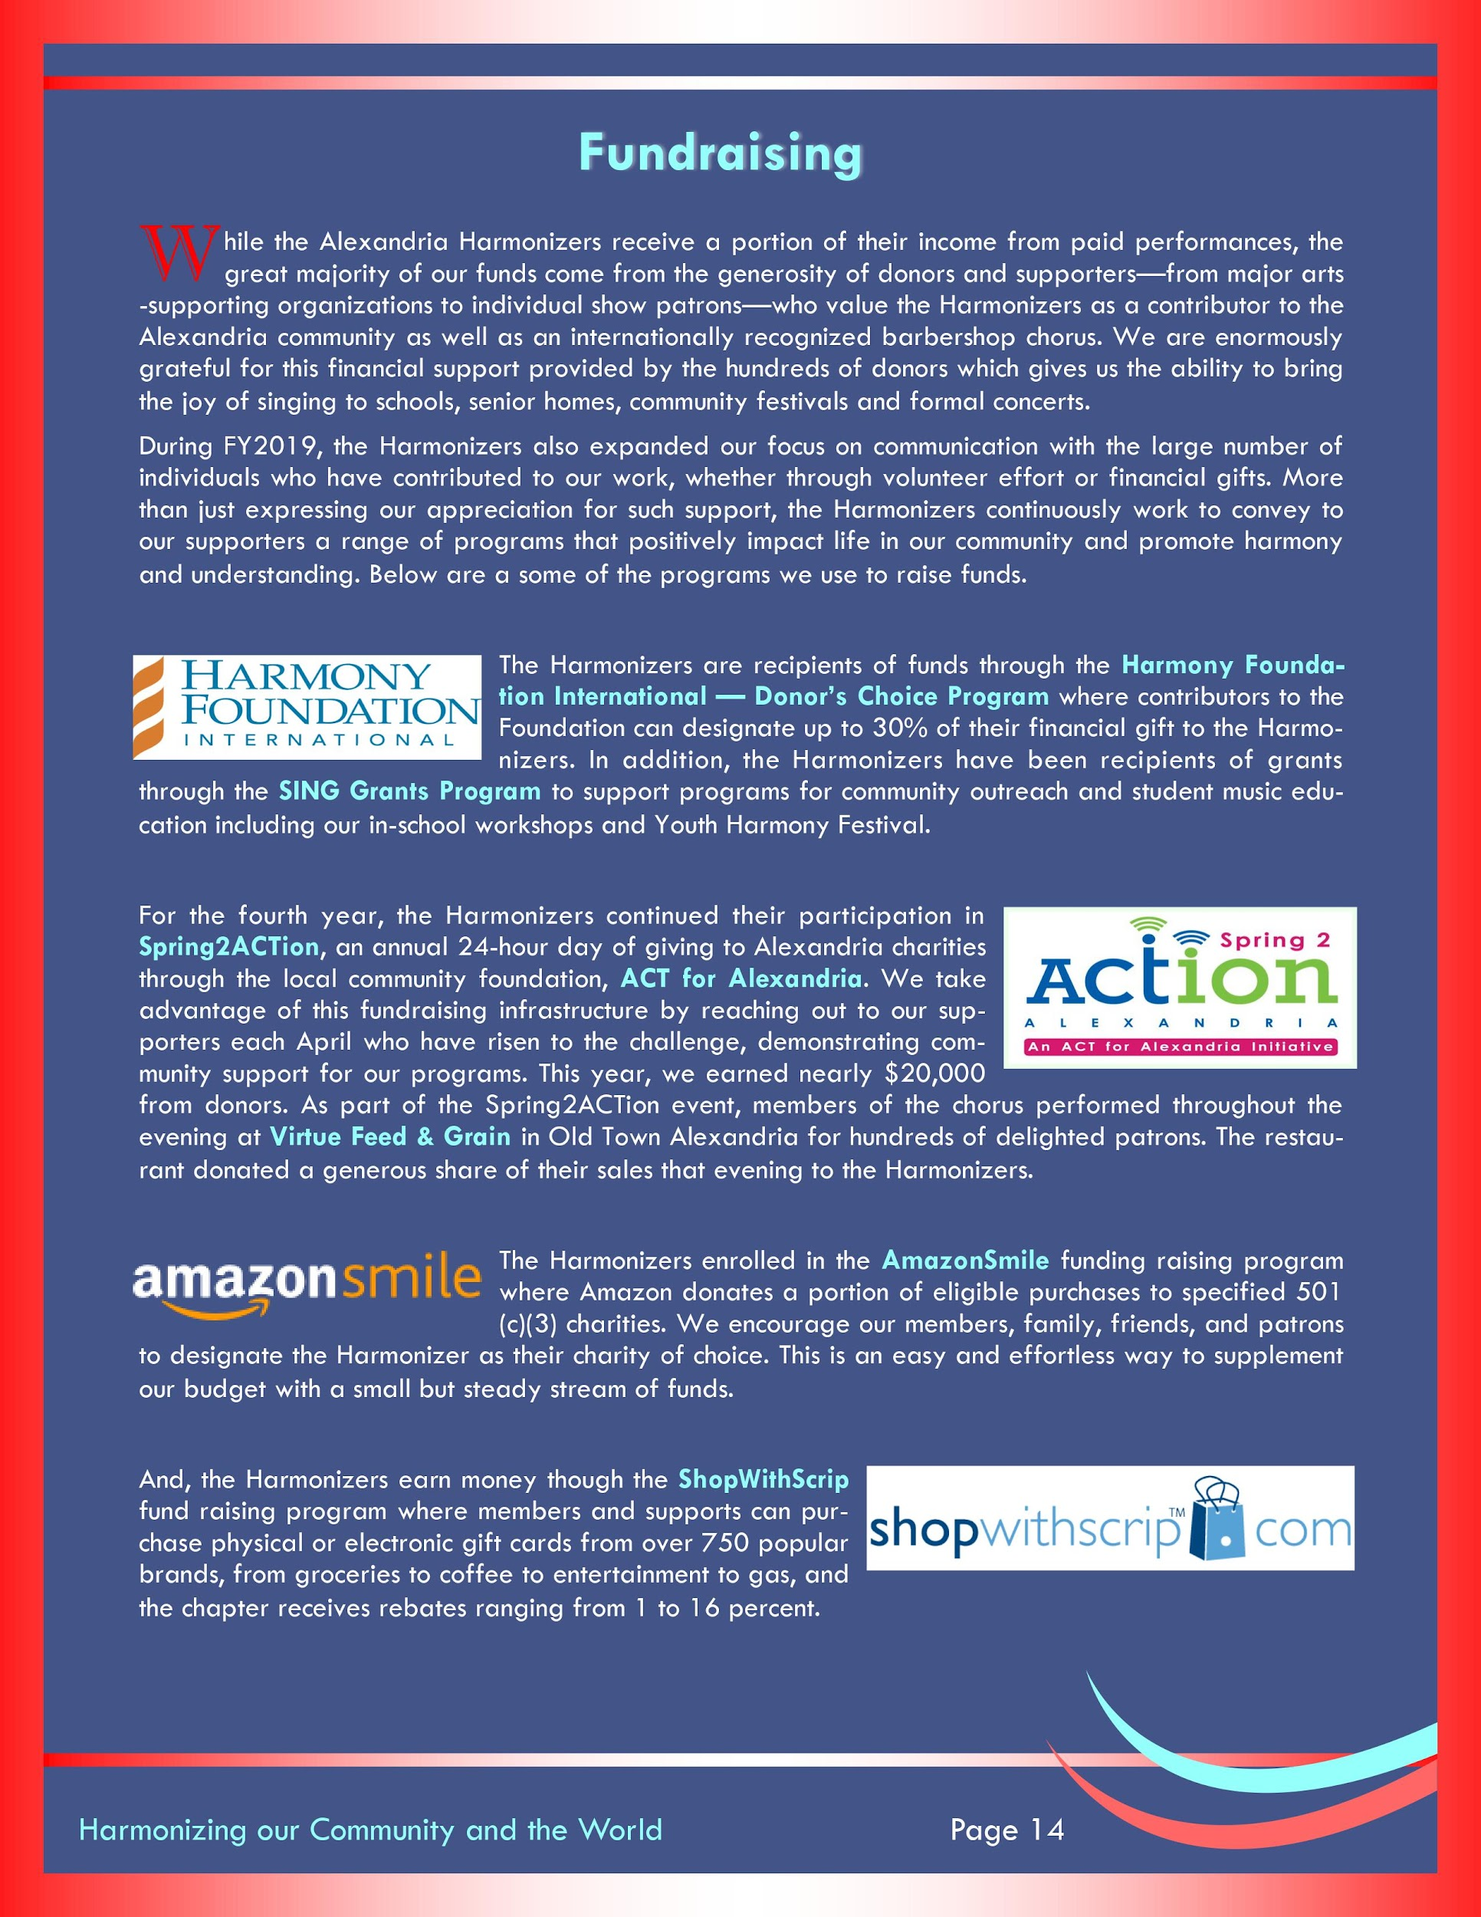
ANNUAL REPORT
FINANCES
DONOR BASE
PHILANTHROPY

Slide 15
COMMUNITY BOARD MEMBERS
a best practice of non-profit community choral arts organizations
start small, eventually a “pay-to-play” commitment
focus on key needs: fundraising, community influence, strategy
create awareness, broaden network, garner support
motivate membership and relieve membership of commitment
consider surveying membership for possible candidates

Slide 16
ANNUAL DAY OF GIVING
start small/slow
focus on members
broaden network
social media
matching challenge
consider incentives

Slide 17
QUESTIONS?
jcerutti@barbershop.org

