Slide 1
,,
Presentation on animal health and diseases
Dr Mburu M.G
UON,BVM
masalampuru@gmail.com, 0659390154

Slide 2
Primary Animal Health Care (PAHC)
Appetite
Mucous membranes
Vital parameters (TRP)
Skin coat
Lameness?
feces & urine
Body condition

Slide 3
Monitor animal health
Rectal thermometer
Stethoscope

Slide 4
Animal diseases
Controlled
Notifiable
Non controlled
Zoonotic

Slide 5
Common animal diseases in production animals
Foot and Mouth Disease
Brucellosis ( Contagious abortion, B. melitensis, abortus, ovis)
Tick borne ( Heartwater by R. ruminantium, red water by Babesia spp , verminous etc)
Pneumonia ( pasteurella, mycoplasma etc)
Footrot ( footbaths, copper sulphate)
Mastitis ( Clinical vs subclinical, coliform mastitis )
eye infections ( Pink eye)
Mange ( Demodex, Sacorptes, Psoroptes)

Slide 6
Clostridial ( Black leg, Pulpy kidney, tetanus etc)
African Swine fever
Lumpy skin Disease (LSD)
Helminths
Blue tongue
Coccidiosis

Slide 7
Presentation of animal diseases FMD

Slide 8
Frothy nasal discharge due to Heartwater

Slide 9
Lateral flexion

Slide 10
Mange in pigs

Slide 11
Mastitis

Slide 12
Pneumonia

Slide 13
Footrot

Slide 14
Lumpy Skin Disease

Slide 15
Pink eye( Moraxella Bovis)

Slide 16
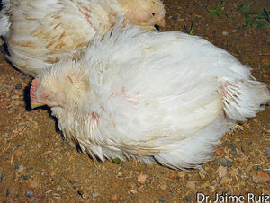
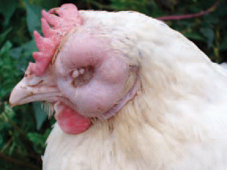
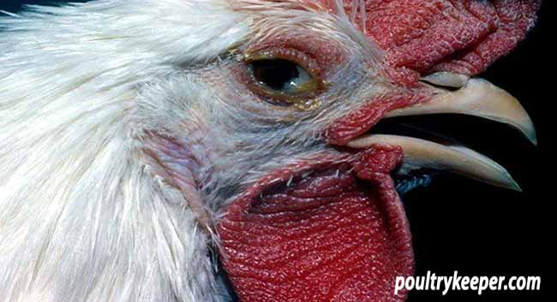
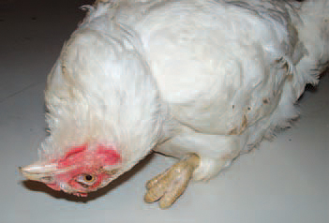
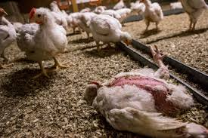
How to spot a sick chicken

Slide 17
Diseases prevention & Management
Short acting
Long acting

Slide 18
Footrot solution
Clinical signs
Footbath

Slide 19
THANK YOU

Slide 20
QUESTIONS??

