Slide 1
INNOVATION AND AGRICULTURE
The power of Experemential learning !!

Slide 2
WHAT AM I TALKING ABOUT?
What is innovation ?
it is the process of introducing new ideas,practices or products that create value.It involves creativity,risk-taking and willngness to experiment.When we talk about innovation in agriculture we are talking about new ways of farming that improve effeciency,sustainability and productivity.This could include things like using new technologies,implementing new practices,or developing new products.

Slide 3
STRATEGY OF INNOVATION IN AGRICULTURE
Hands-on learning also known as experimential learning is the key to innovation,it is a form of education that involves learning through direct experience.Instead of learning through books or lectures,learners learn by doing,In agriculture, this could mean geting your hands dirty by planting high-demand crops,tending to livestocks,or operating machinery.Hands-on learning allow students to learn by making mistakes,think critically,solving problems,geting feedback from their instrutors and make impact to the world.
“Christensen (1997) argues that Innovation is not just about coming up with new ideas, but about having the courage to challenge the status quo and take risks.”

Slide 4
CONT....
Researches have shown that students who participate in hands-on learning are more likely to remember what they've learned and apply it to real-world situations. They are also more likely to enjoy the learning process and be engaged . In short, hands-on learning leads to better learning outcomes.
Moreover,both the National Science Foundation and the Havard school of Graduate Association have suported the statement that I have made here above.

Slide 5
CONT....
It is essential for the learners to have exposure to farms which are operational , and which are doing well in the market for practicals.
As agricultural science educators we need to make the learners aware that agriculture is not about being dirty or being a farm slave, there are lot of opportunities in the agricultural sector such as engineering etc. we must make them fall inlove with the subject.
We need learners who are going to be problem solvers within the sector, learners who will take agriculture to the next level in the near future.

Slide 6
As an Agricultural science educator, i have put my best foot foward to prove that the method or strategy (Experimental Learning) works. I started farming Oyster mushrooms last year August after identifying a gap in the market for mushroom production in our country (South Africa). i started with what i have.

Slide 7
WHAT ARE OYSTER MUSHROOMS
Oyster mushrooms known as Pleurotus Ostreatus is a widely distributed edible fungus with a greyish-brown oyster-shaped cap and a very short or absent stem.
The oyster mushroom is named for its shell-like appearance and resemblance to oyster. It is very versatile(able to adapt to many different functions) and has quickly become an intergral part of many Asian dishes,from soup to sauces and beyond

Slide 8
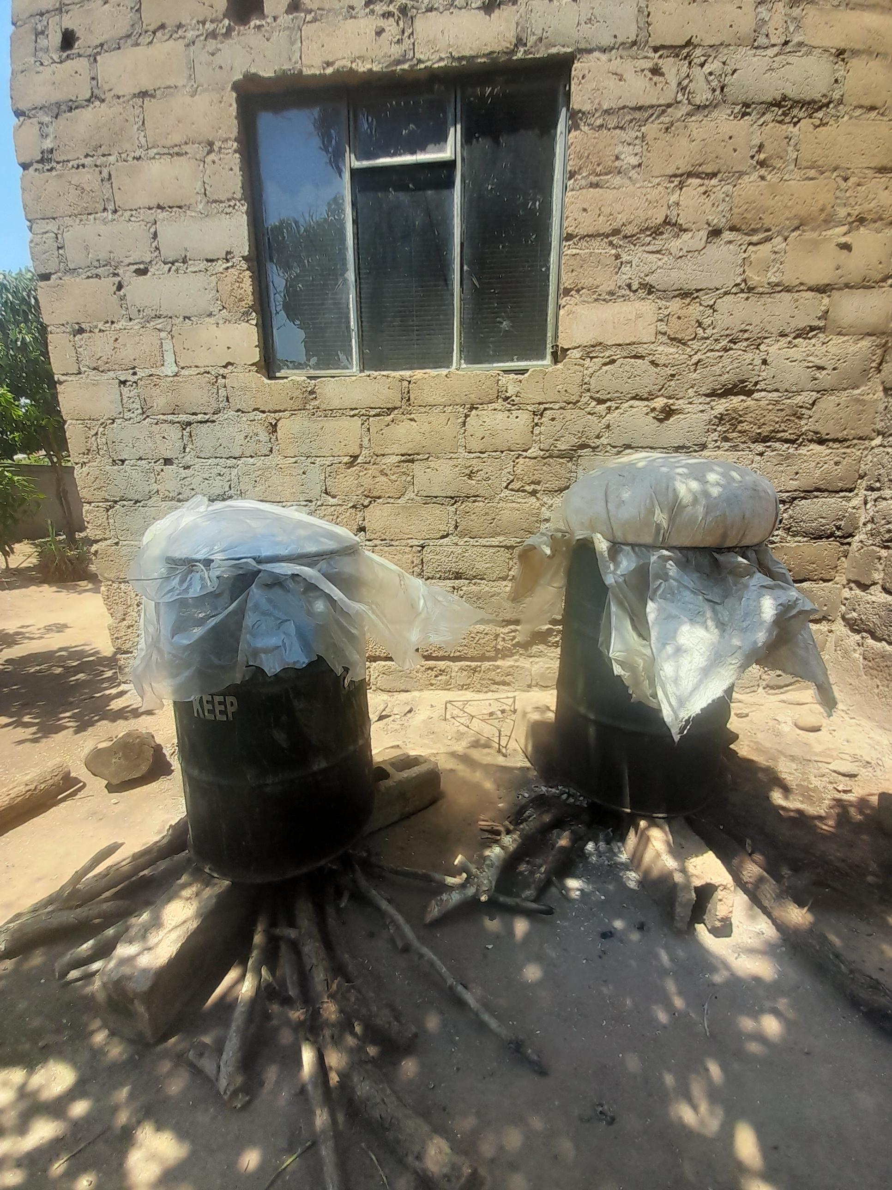
PASTEURIZATION AND STERILIZATION

Slide 9
INOCULATION PHASE

Slide 10
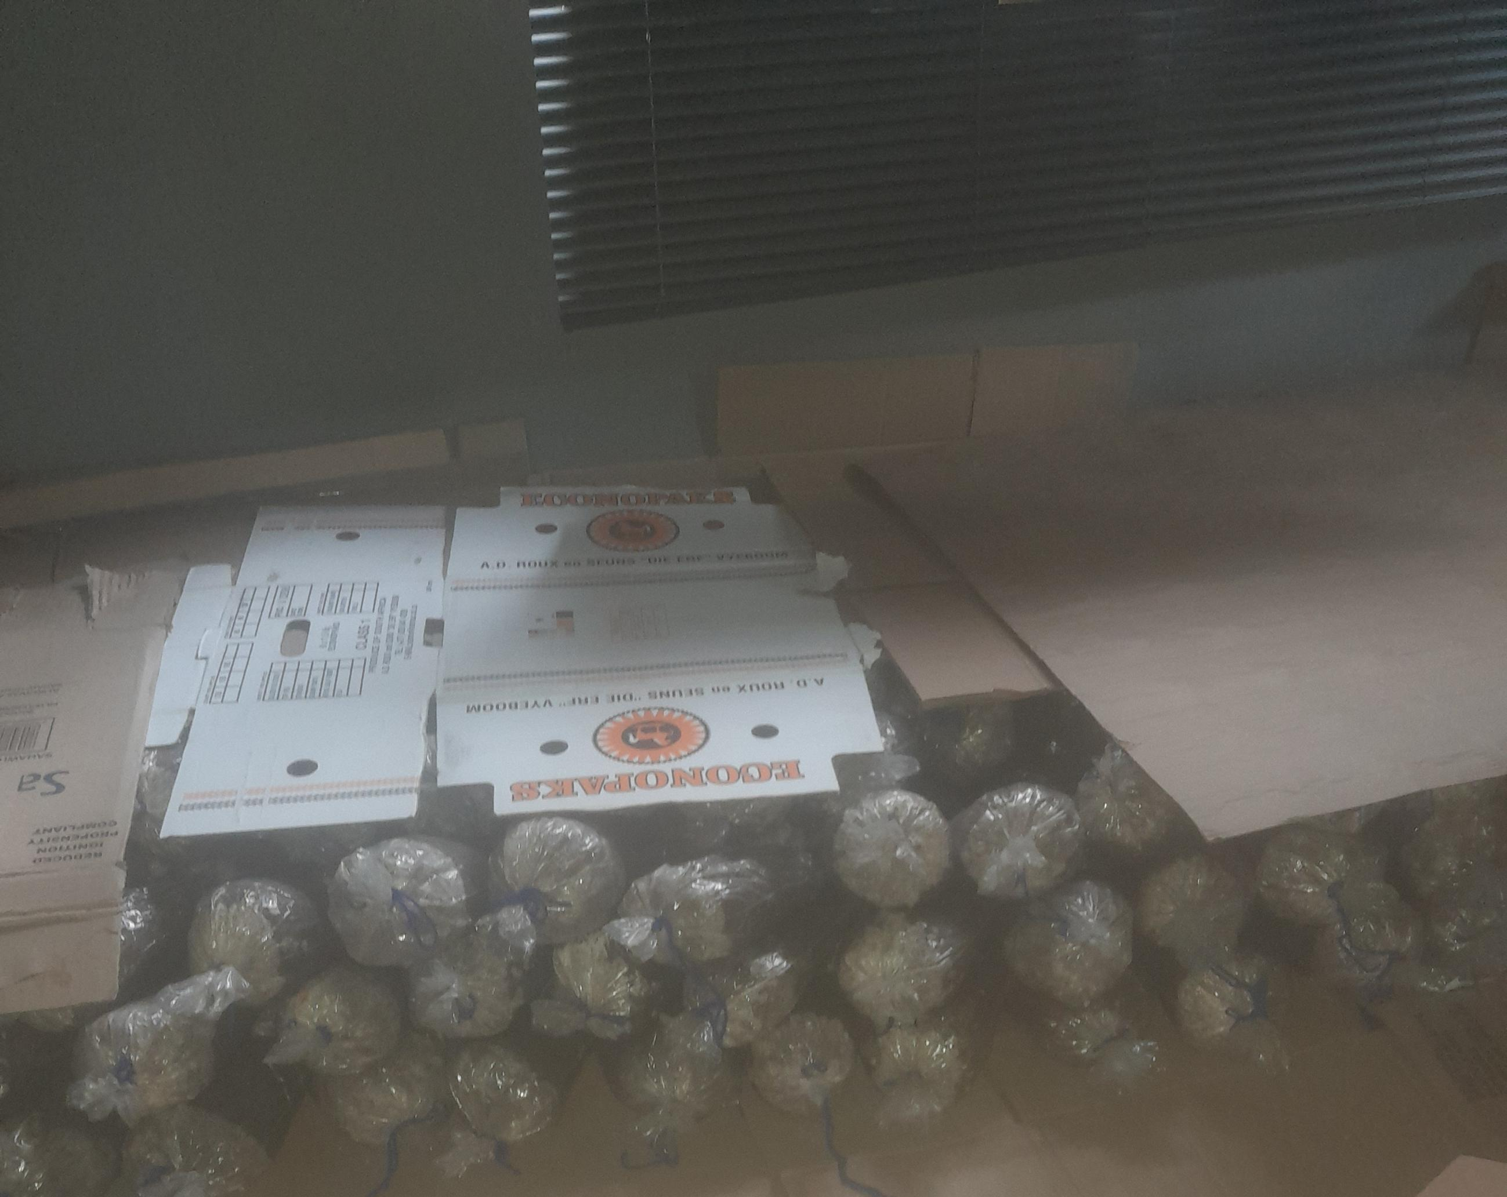
INCUBATION PHASE

Slide 11
CROPPING HOUSE

Slide 12
COMPLIENCE
I involved inspectors who are experts in this field
I attended Hazard Analysis Critical & Control Point (HACCP) which ensures that there are good safety management system, which is in line with the regulation 638- Foodstuff Cosmetics and Disinfectant Act (FCD Act)

Slide 13
CONT...

Slide 14
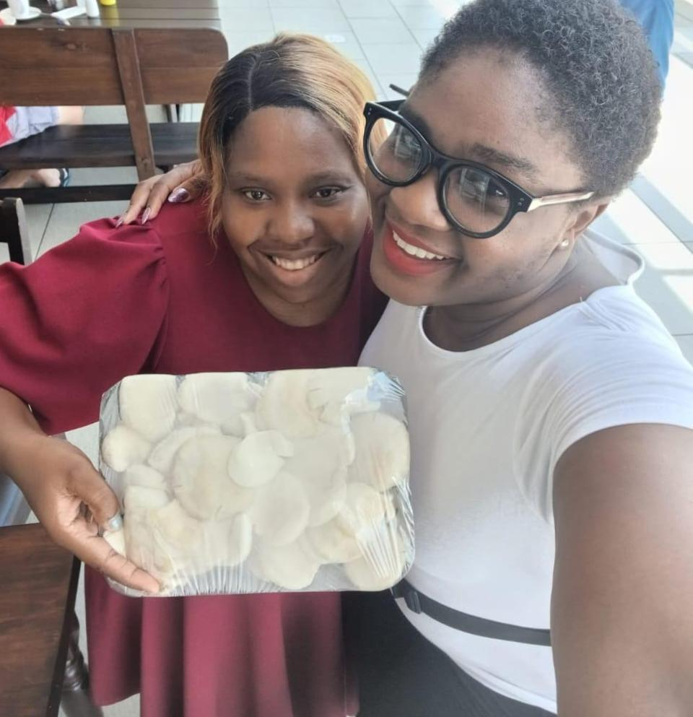
MCHE OYSTER MUSHROOMS TO THE MARKET!!

Slide 15
BENEFITS OF OYSTER MUSHROOMS
Prevents osteoporosis and arthritis.
Boost vitamin D levels.
Help maintain blood pressure
Lower bad cholesterol levels
May prevent anemia
Rich in antioxidants
Provide protection against cancer
Boost bone mineral density

Slide 16
CONT...
Considering the health benefits and nutrients of mushrooms, i wish mushrooms can be added in the school nutrition and also in hospitals.

Slide 17
BY WORKING TOGETHER WE CAN CREATE A BRIGHT FUTURE!!!!
The process of innovation and agriculture may be time-consuming and difficult, but the rewards are worth it.
By investing in innovation, we can reap the benefits of higher yields, better quality products, and a more sustainable future. The time and effort required to innovate are nothing compared to the benefits that we can reap as a society.

Slide 18
CONCLUTION
I greatly appreciate the opportunity that ASAAE has provided me with to share my experience in agricultural innovation

Slide 19
THANKS TO YOU ALL!!

