Slide 1
POTATO PRODUCTION ASAAE 2024 (Louis Trichardt High School)

Slide 2
SOIL REQUIREMENTS
Slightly acidic soil (pH 5.5 - 6)
Well prepared/tilled soil
Well drained/aerated soil
Soil sampling for analysis is important

Slide 3
WATER REQUIREMENTS
Potatoes require a minimum of 25mm of water every week
This can be achieved by splitting application into two eg:
12mm on Tuesday and
13mm on Friday

Slide 4
CHOOSING THE CORRECT/RIGHT CULTIVAR
Correct cultivar depends, among other things, on:
Requirement by the market
Purpose of production
Season length (early, mid, or late season varieties)
Climatic conditions
Degree of succeptibility to fungal infections
Buy certified seed from reputable dealer
Dealer must be a registered dealer/distributor
Seed bags must have a label indicating:
Name/code of the producer and production site ( for traceability)
Variety/cultivar
Burn off date
Seed count/size

Slide 5
PLANT POPULATION
Each hectare of potato is normally occupied by 37 000 seed tubers:
90cm between the lines
30cm between tubers
Seed size will therefore tell as to how many seed bags you need for each ha:
Chats (<28g – about 700 in a bag) means 53 bags per ha
28g – 90g (about 400 in a bag) means 93 bags per ha
90g -160g (about 240 in a bag) means 155 bags per ha
160g – 200g (about 150 in a bag) means 247 bags per ha

Slide 6
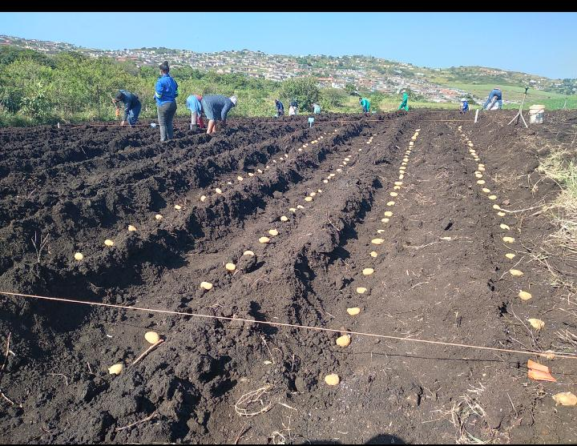
OUTLINE

Slide 7
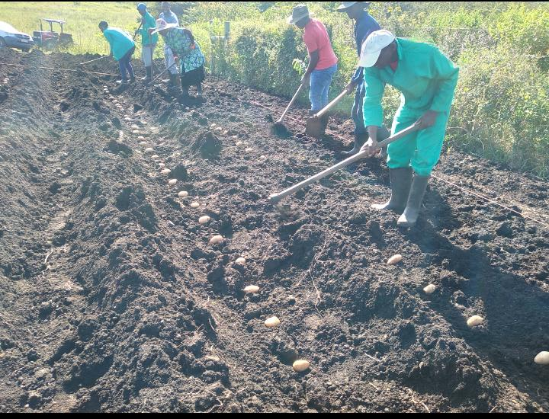
COVERING THE SEED

Slide 8
DISEASE AND PEST CONTROL
Potato is mostly affected by fungal infections (Blight being the most common disease)
Diseases and pests are controlled by adhering to the prescribed spraying programme
Spraying mixture should include pesticides and fungicides:
Pesticide should alternate
Fungicides should also alternate and rotation to include both contact and systemic chemicals
Spraying is mostly done every week after irrigation or after rain, but should there be an infection observed it should be done immediately

Slide 9
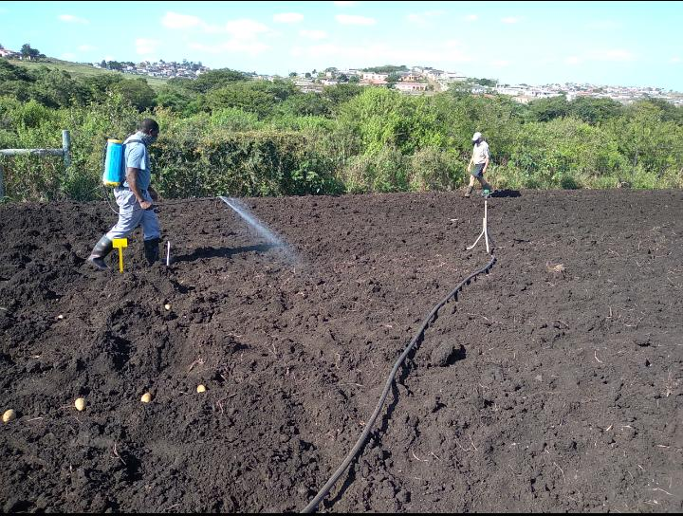
PRE EMERGENCE HERBICIDE SPRAYING

Slide 10
HARVESTING
Potatoes are harvested when physiological growth has ceased, and foliage dried off
Potatoes are dug either by garden forks or tractor-drawn potato lifter
Harvesting is mostly done when product is to be delivered immediately, unless one has cool storage

Slide 11
SORTING/GRADING AND PACKAGING
Potatoes are sold either washed or unwashed
For better market price they need to be sorted and packed into sizes of Large, Large medium, Medium, Small, and Baby.
Grading should be in terms of visual appearance, physical blemishes, truth to shape
Packaging is done according to the need of the customer and ease of handling and transportation

Slide 12
PRICING
Pricing of potatoes (just like other agricultural goods) is determined by:
Cost of production plus percentage
Being in line with the National Market price
Taking into consideration the retail price in the area

Slide 13
MARKET
This include:
The Provincial Fresh produce markets
Local retailers
Informal hawkers
Local households
Catering companies
Feeding schemes
Governmental departments

Slide 14
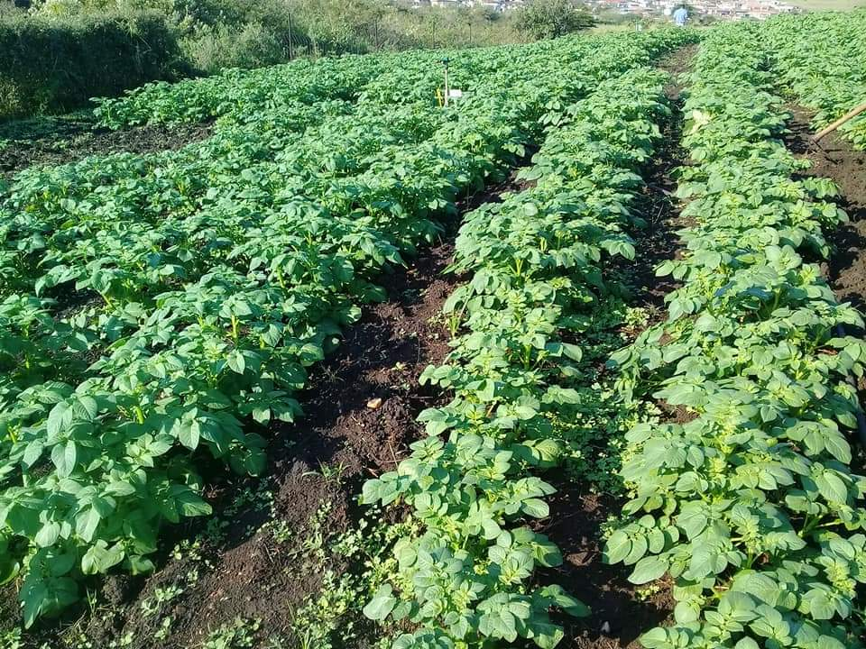
GROWTH

Slide 15
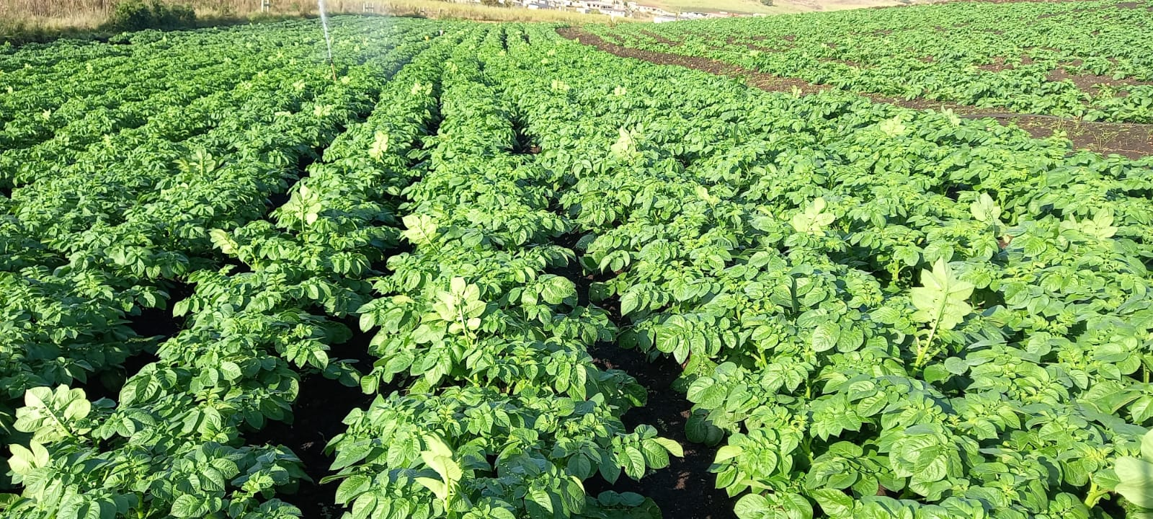
GROWTH Cont…

Slide 16
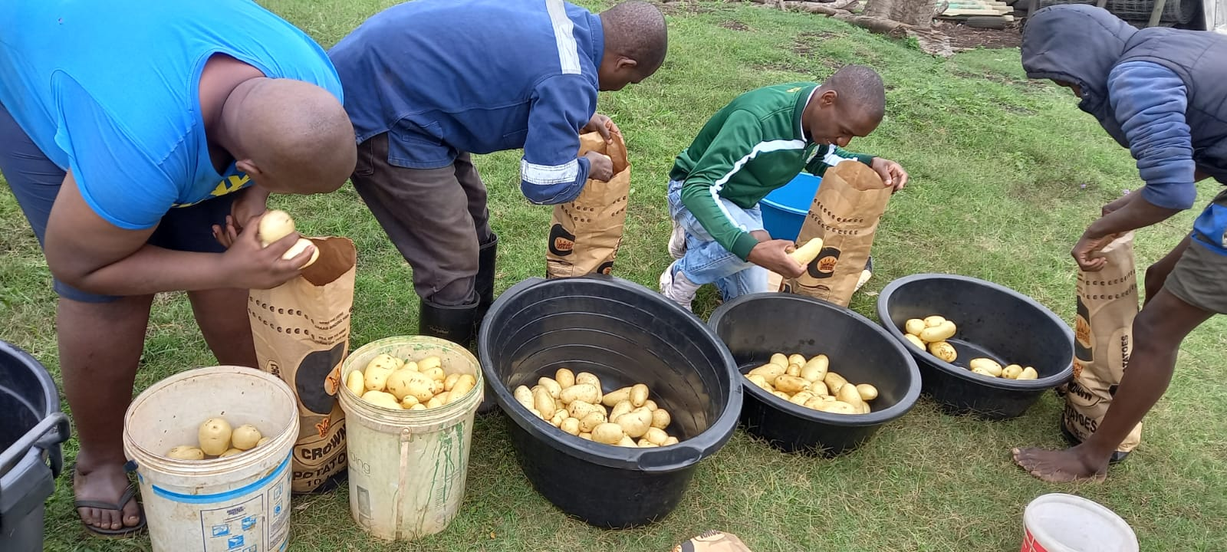
SAMPLE PACKING

Slide 17
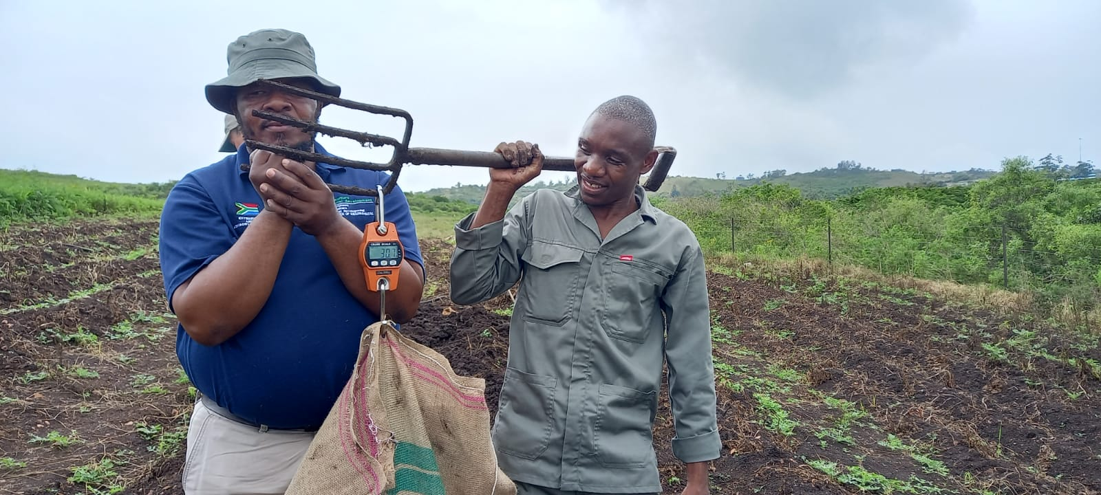
YIELD DETERMINATION

Slide 18
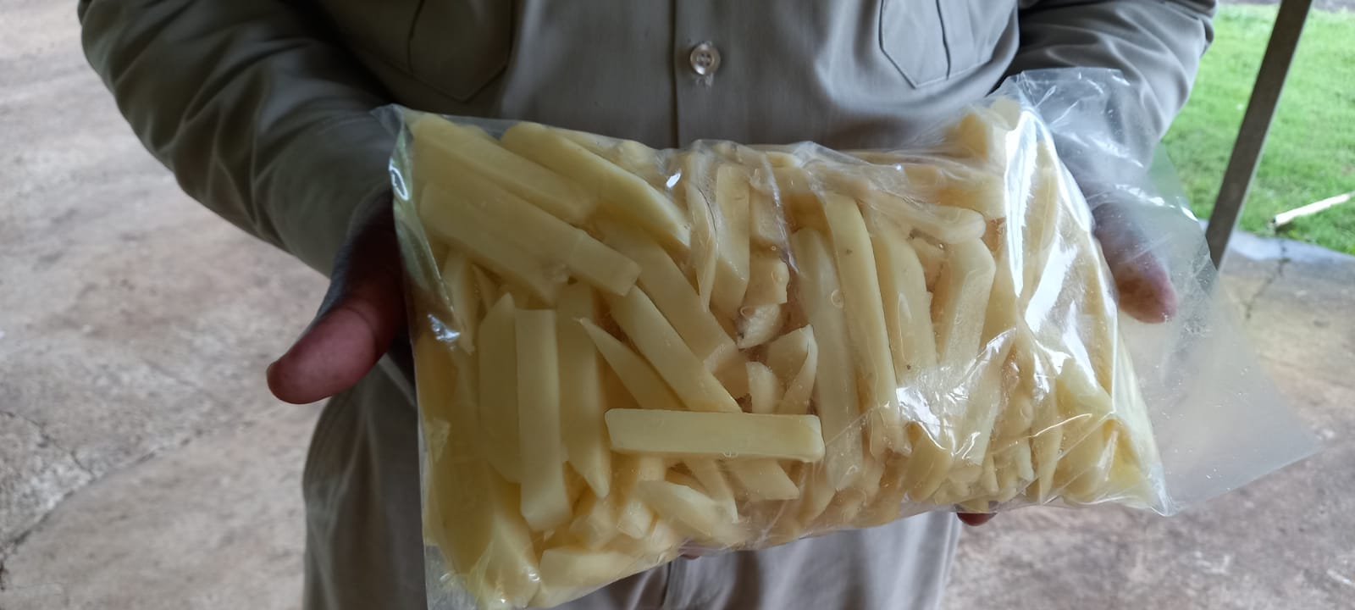
ADD VALUE TO VALUELESS

Slide 19
THANK YOU

Slide 21
Qinisani Mzimela 072 271 5458

