Slide 1
Building Human Capital: The Educational Path to Alabama’s Economic Success … and why reading matters.
Jim Purcell, Ed.D, Executive Director
Alabama Commission on Higher Education

Slide 2
Building Human Capital: The Educational Path to Alabama’s Economic Success … and why reading matters.
New economic realities
Our old economies and their legacy
Quantifying our literacy needs

Slide 3
Building Human Capital: The Educational Path to Alabama’s Economic Success … and why reading matters.
New economic realities
Our old economies and their legacy
Quantifying our literacy needs

Slide 4
New Economic Realities

Slide 5
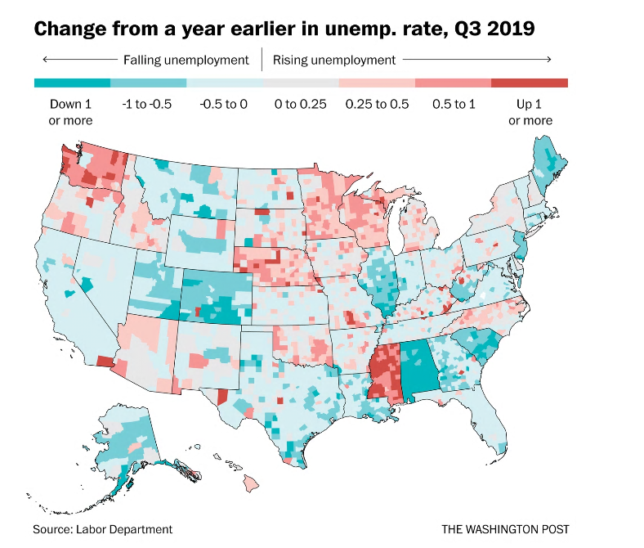
New Economic Realities

Slide 6
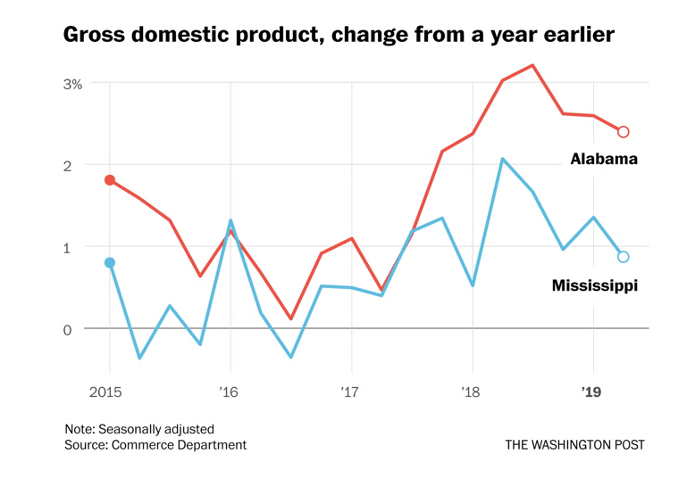
New Economic Realities
Alabama, on the other hand, diversified beyond low-skilled manufacturing… It now ranks near the top in its reliance on higher-paid, but still trade-sensitive, manufacturing jobs.
Mississippi relies more on low-wage versions of these production jobs than does any other state…

Slide 7
New Economic Realities
Alabama has cultivated different industries, notably aerospace and automobiles, and ended up with an economy that differs from its neighbor’s in significant ways.
In addition, Alabama’s … more urbanized. The Birmingham, Ala., metropolitan area has twice as many people as Mississippi’s Jackson, and that’s before we’ve even counted Huntsville.

Slide 8
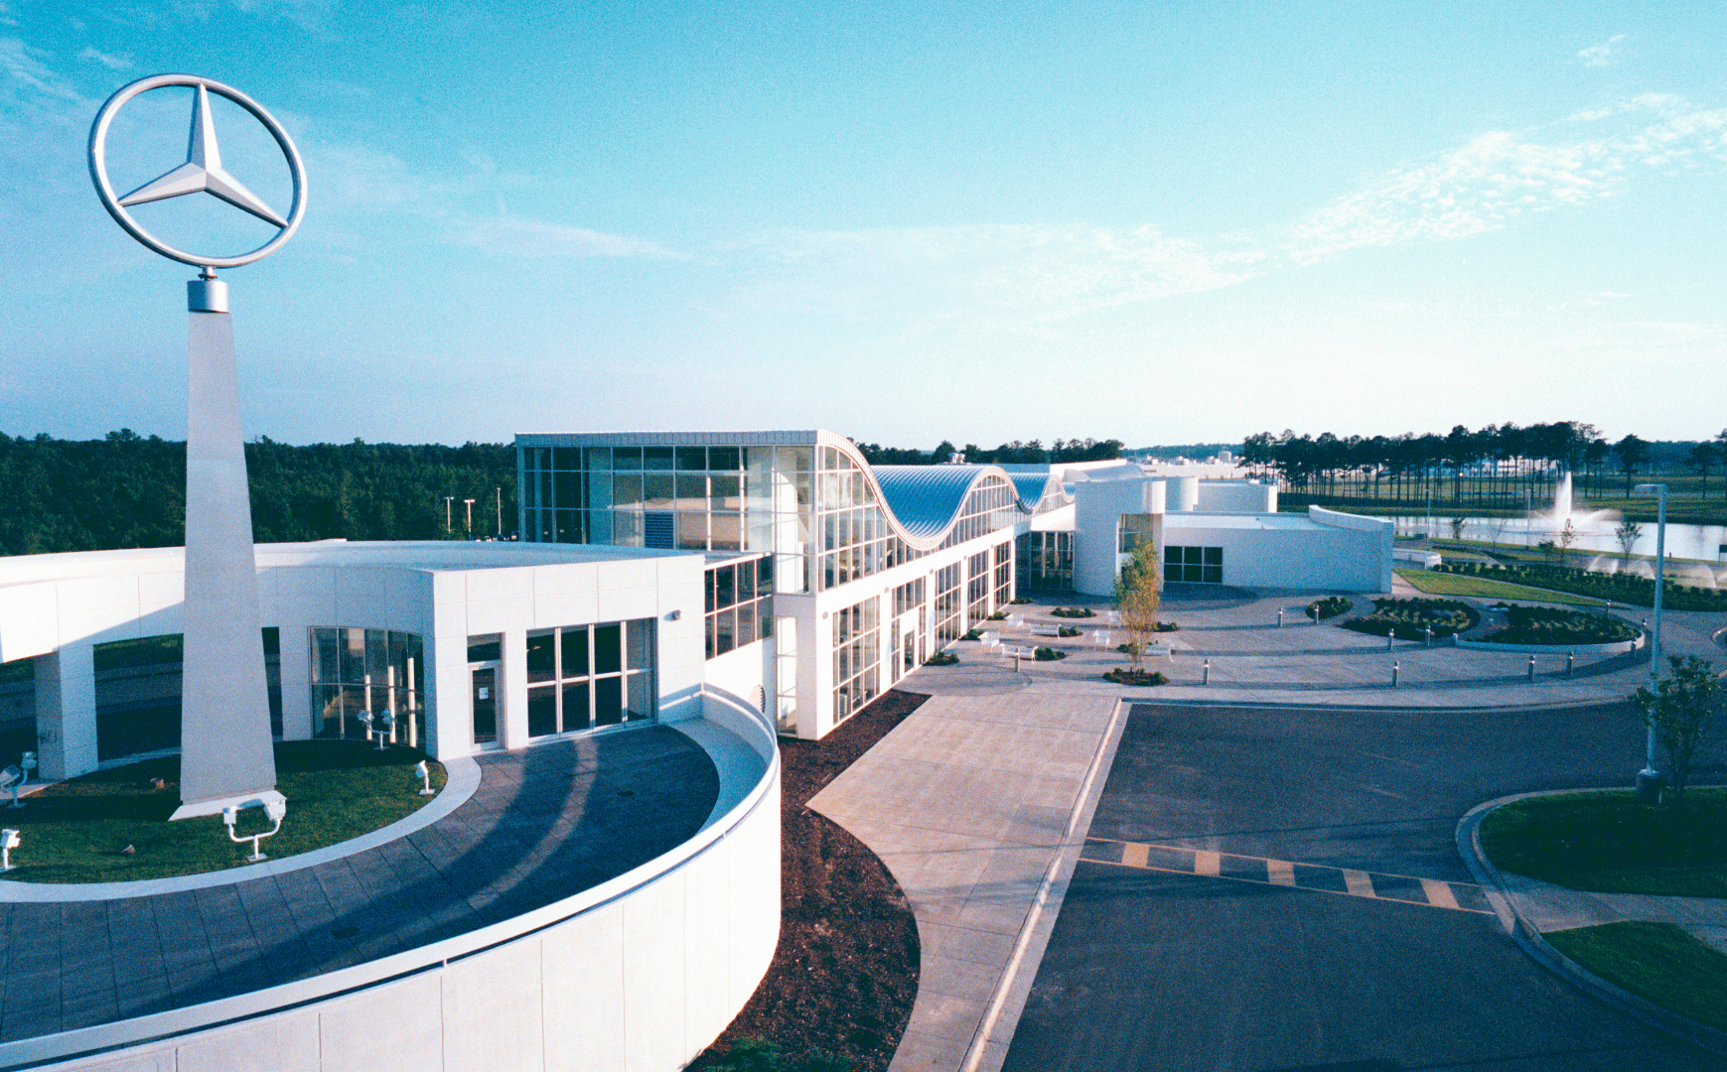

Slide 9
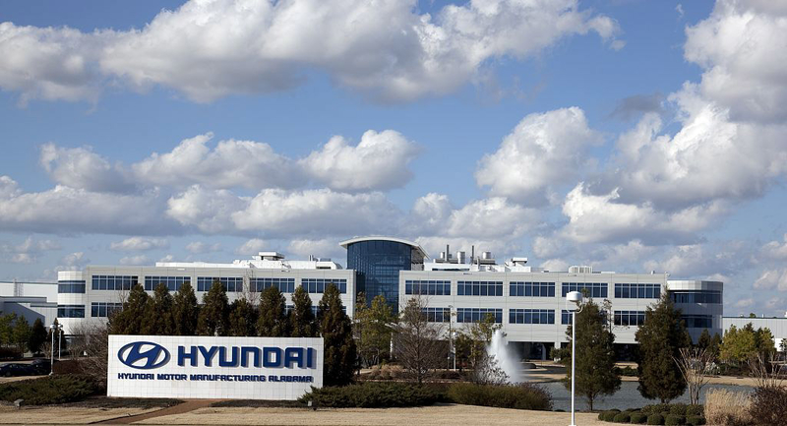

Slide 10
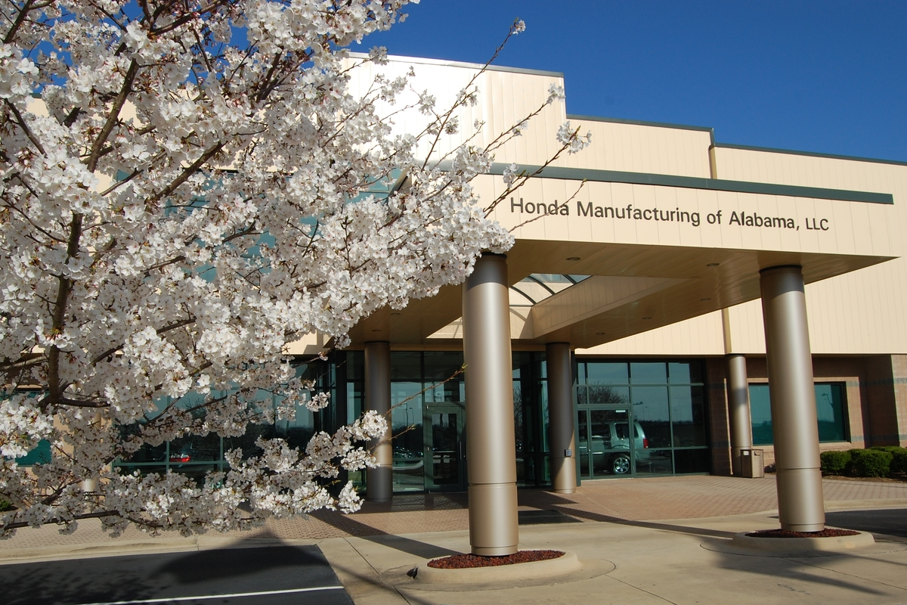

Slide 12
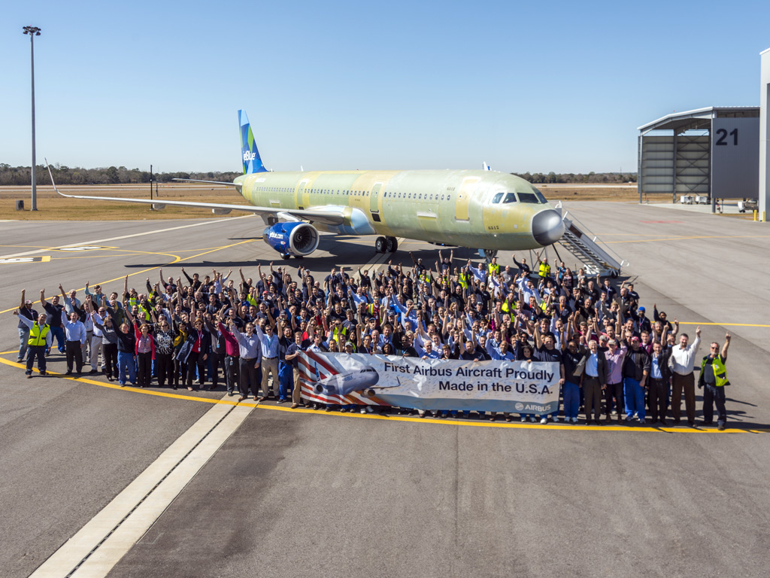

Slide 14
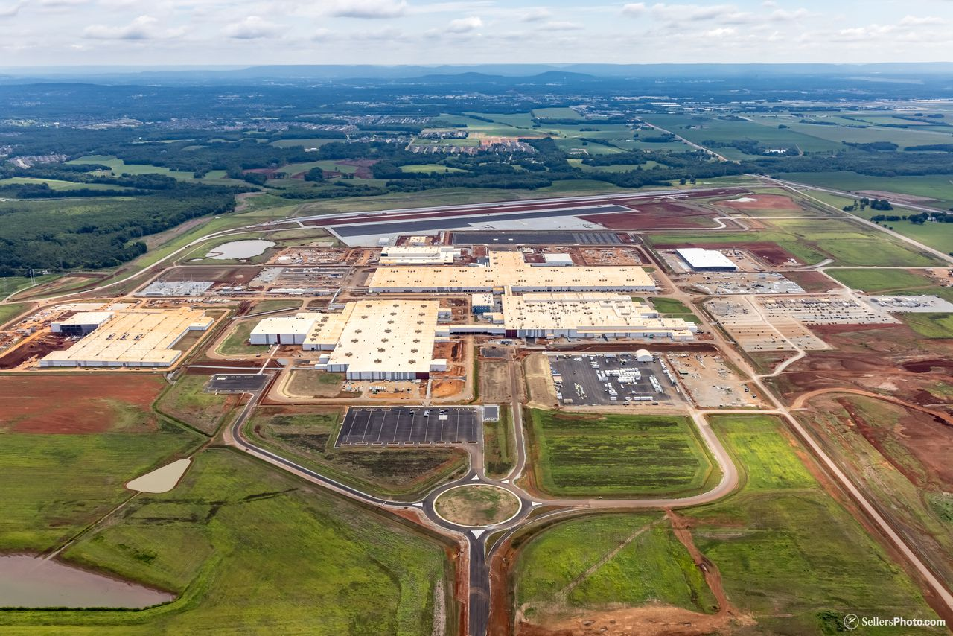

Slide 15
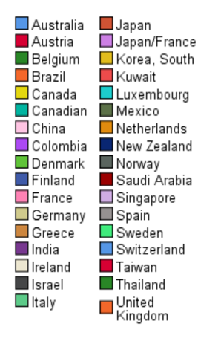
Impact of International Investment in Alabama (481 Locations)
New Economic Realities
Percent

Slide 16
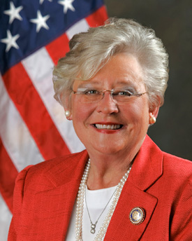
Building Human Capital
Governor Ivey on Human Capital
“The best investment in economic development is an investment in education. If we don’t have a qualified, effective, up-to-date workforce, then the top companies will not come to Alabama no matter what we do. A well-trained workforce is essential.”

Slide 17
Strong Start, Strong Finish: An Education-to-Workforce Vision for Alabama
Governor Ivey established a strategic vision for aligning Alabama’s education and workforce programs from pre-k to the workforce to provide for a seamless education-to-workforce continuum for all Alabamians.
Governor Ivey has set a postsecondary education attainment goal of adding 500,000 credential holders to Alabama’s workforce by 2025 and a goal to increase Alabama’s labor force participation rate of 57.6 percent to the national average by 2025.

Slide 18
2/3 of new jobs in Alabama will require a University degree
1/3 of needed credentials can be earned at Alabama’s Community Colleges

Slide 19
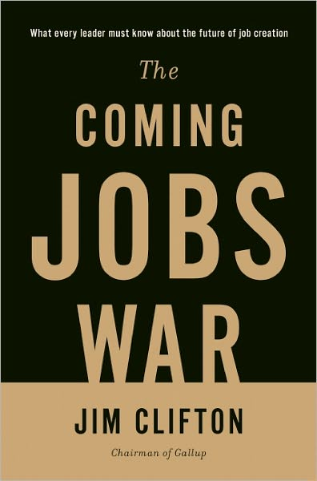
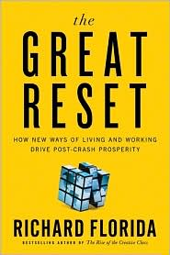
Time and Place
Those individuals, families, cities, states and –increasingly—countries with the most education are prospering, while those with the least higher education are experiencing relative and often absolute economic decline.
--Postsecondary Education OPPORTUNITY, June 2005.
For people and communities to thrive in the new economy they will need to have access to a good college and good health care.

Slide 20
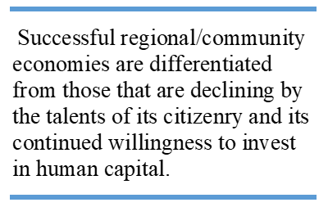

Slide 21
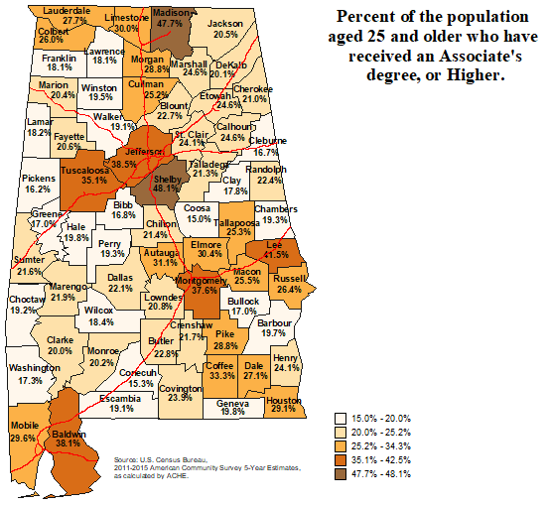
Education
Futurists say that communities with higher levels of educated and skilled citizens have the potential of becoming the ‘engines’ that drive a state’s economy.

Slide 22
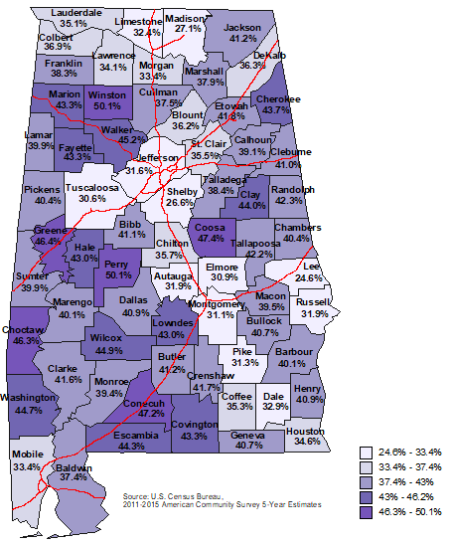
Income
Percentage of households receiving Social Security Income
Some economist argue that economies which have more than 50% of their households supported by local/ state/ federal government resources are not sustainable in the long run. (This includes county, city and school district workers, and transfer payments like Social security.)
This chart is only of SS income. If we added the households dependent on local government salaries, more than half of the counties would be considered as not having sustainable economies.

Slide 23
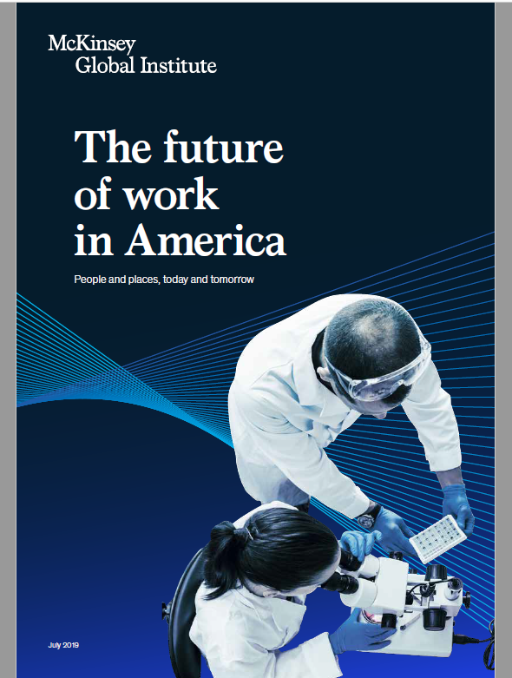
Automation technologies promise to deliver major productivity benefits…
beginning to reshape the American workplace, and this evolution will become more pronounced in the next decade.
Some occupations will shrink, others will grow, and the tasks and time allocation associated with every job will be subject to change.
The challenge will be equipping people with the skills that will serve them well, helping them move into new roles, and addressing local mismatches.

Slide 24
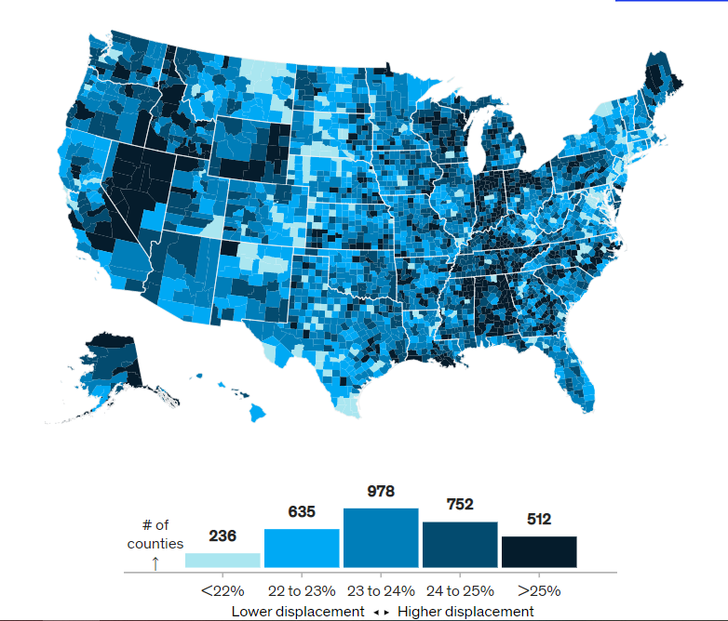
Changing Economy

Slide 25
Changing Economy

Slide 26
Building Human Capital: The Educational Path to Alabama’s Economic Success … and why reading matters.
New economic realities
Our old economies and their legacy
Quantifying our literacy needs

Slide 27
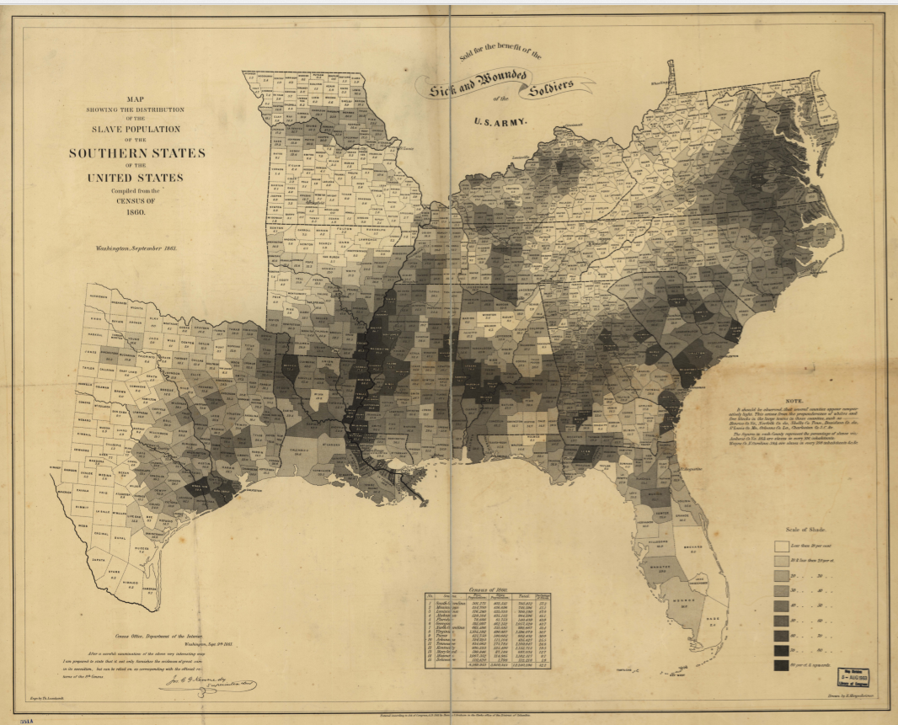
Our old economies and their legacy
This is a map of slaveholding counties in the US in 1860.

Slide 28
Our old economies and their legacy
Counties with persistent poverty rates of 20% and above (2010 Census)

Slide 29
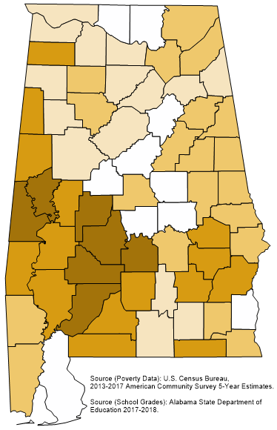
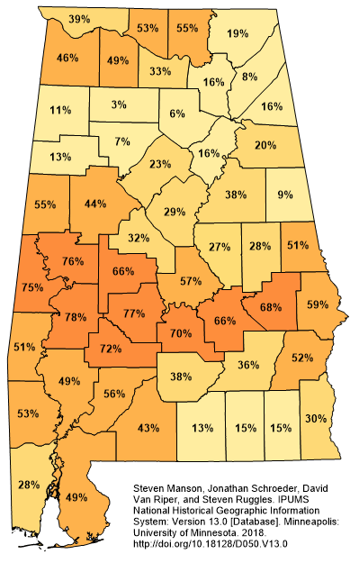
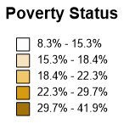
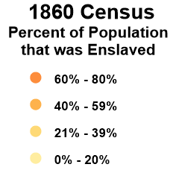
Side-by-side maps.
S
M
S
M
2017

Slide 30
Our old economies and their legacy
Throughout the history of mankind, the agrarian economy has always been built on a model of cheap labor.

Slide 31
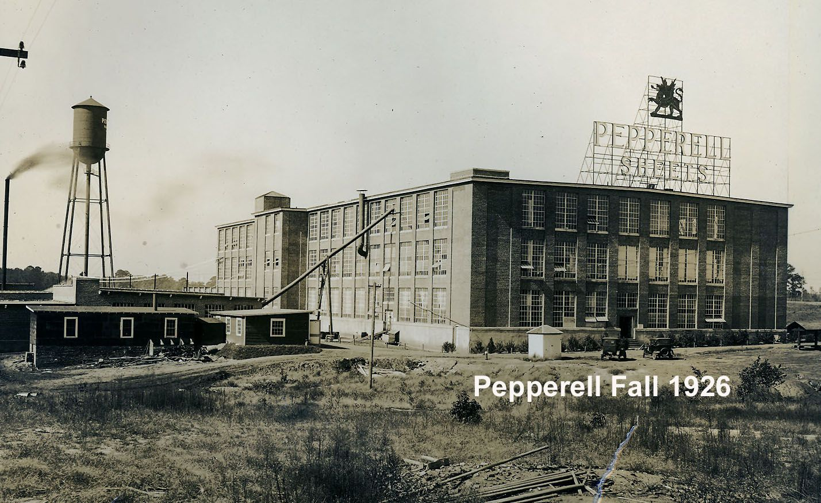
Our old economies and their legacy
The industrialization of Alabama post Civil War was also built on this cheap labor model and to some extent in the extreme. Alabama, in essence, became a conveniently located third world workforce where literacy and quality education was not that necessary to find work.

Slide 32
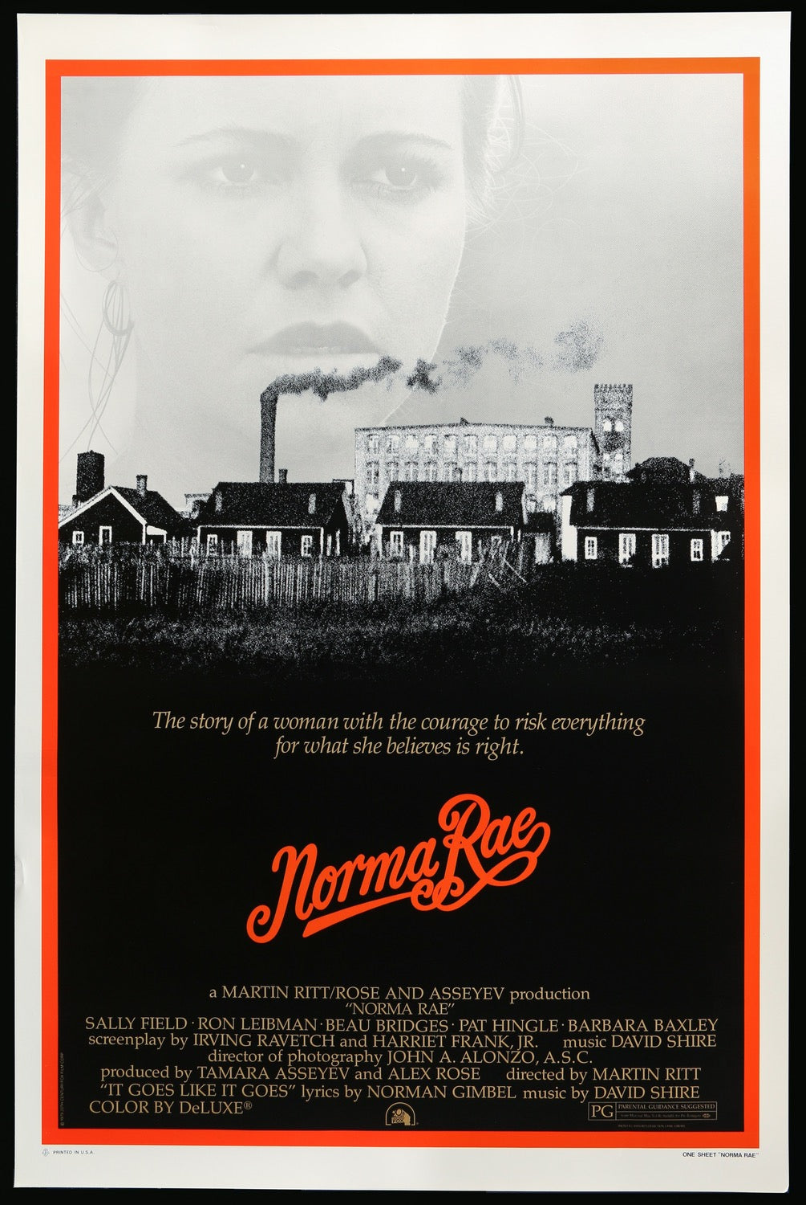

Slide 33
Our old economies and their legacy
Counties with persistent poverty rates of 20% and above (2010 Census)

Slide 34
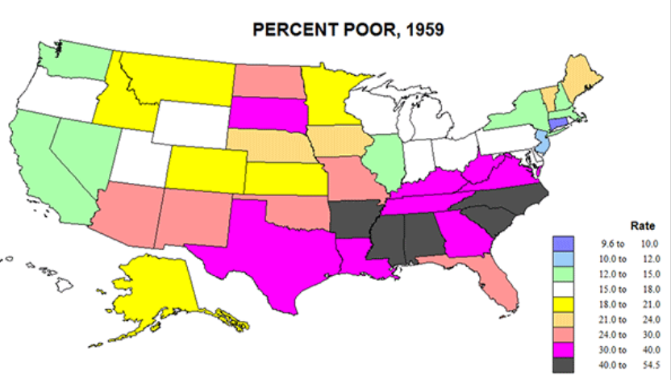
Alabama, very poor.

Slide 35
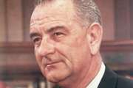
LBJ addresses the issues from the previous map with the war on poverty.
President Lyndon Johnson announced the ”Unconditional War on Poverty” in 1964.
He considered the depth and extent of poverty in the country (nearly 20 percent of Americans at the time were poor) to be a national disgrace that merited a national response.
“The cause may lie deeper in our failure to give our fellow citizens a fair chance to develop their own capacities, in a lack of education and training, in a lack of medical care and housing, in a lack of decent communities in which to live and bring up their children.”

Slide 36
Alabama, very poor.

Slide 37
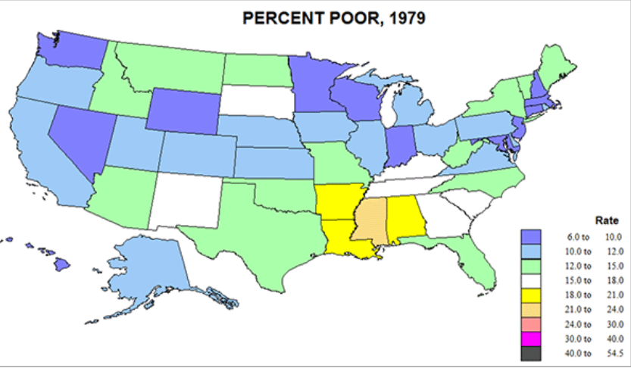
20 years later:
Alabama, half as poor as they were.

Slide 38
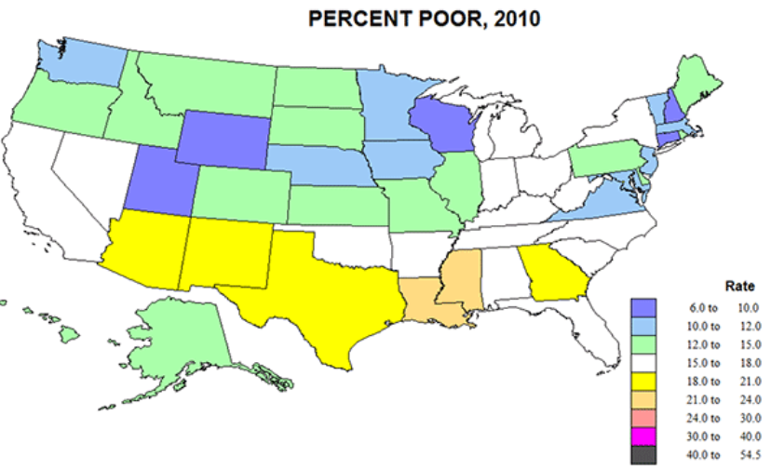
50 years later:
Alabama, much improved

Slide 39
Our old economies and their legacy
Counties with persistent poverty rates of 20% and above (2010 Census)

Slide 40
Our new economic realities
Our old economies and their legacy
Quantifying our literacy needs

Slide 41
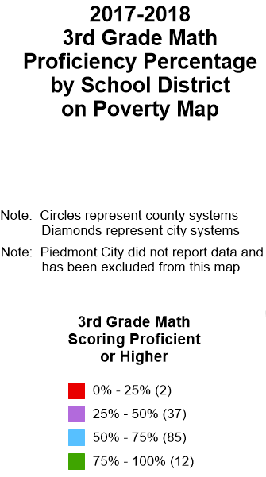
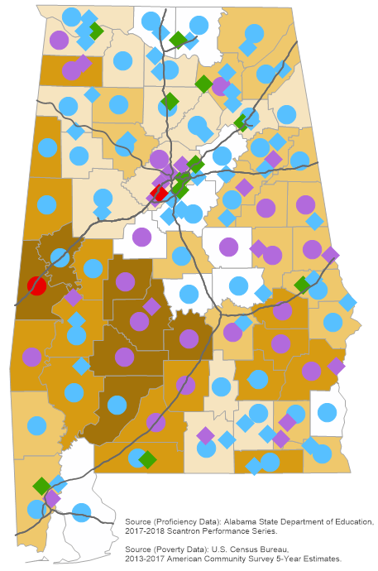
The proficiency in math of 3rd graders over the poverty map.

Slide 42
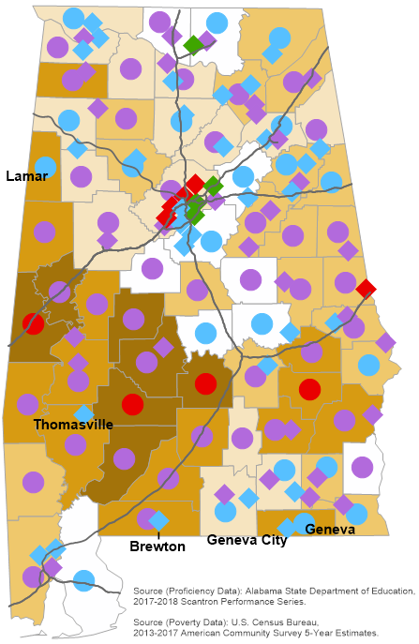
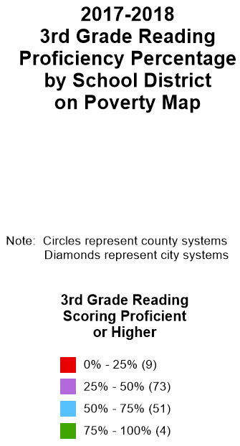
The proficiency in reading of 3rd graders over the poverty map.

Slide 43
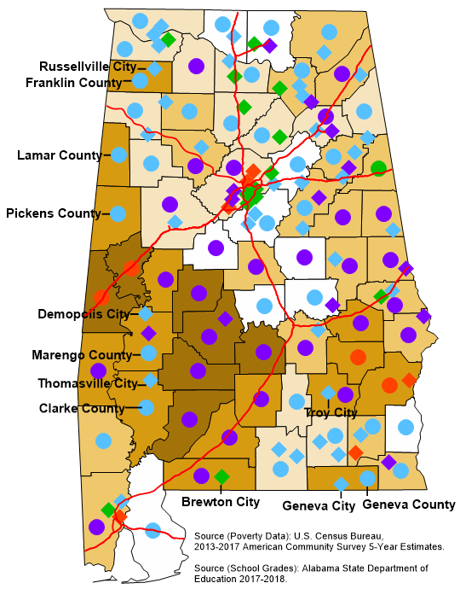
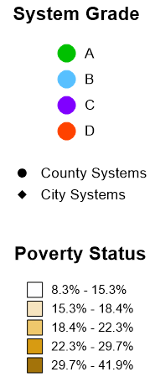
The Report card of School Districts over the poverty map.

Slide 44
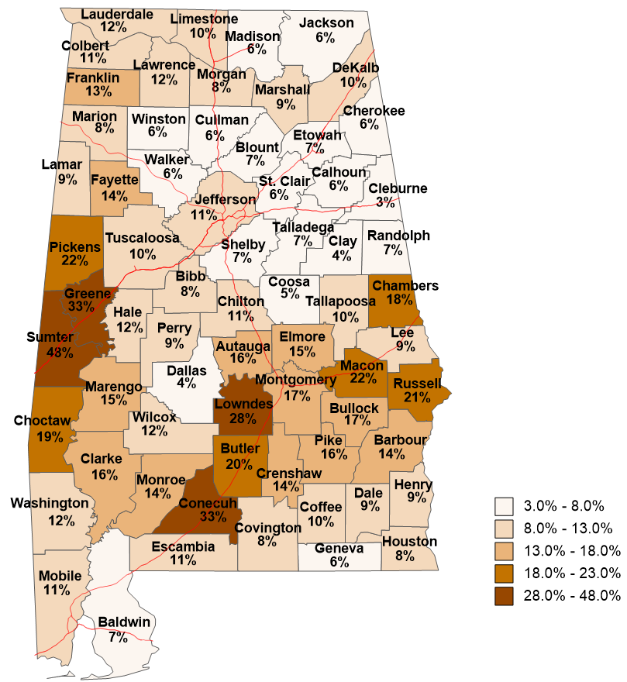
2020-2021
High School Graduates
Who Enrolled in
Alabama Public Institutions
Fall 2021
and were Enrolled in
Remedial English
2/72
2/49
12/25
Remedial English
All Races/Ethnicities
Percent of High School Graduates from the county who Enrolled in Remedial English.
State Total Remediation
English 10%

Slide 45
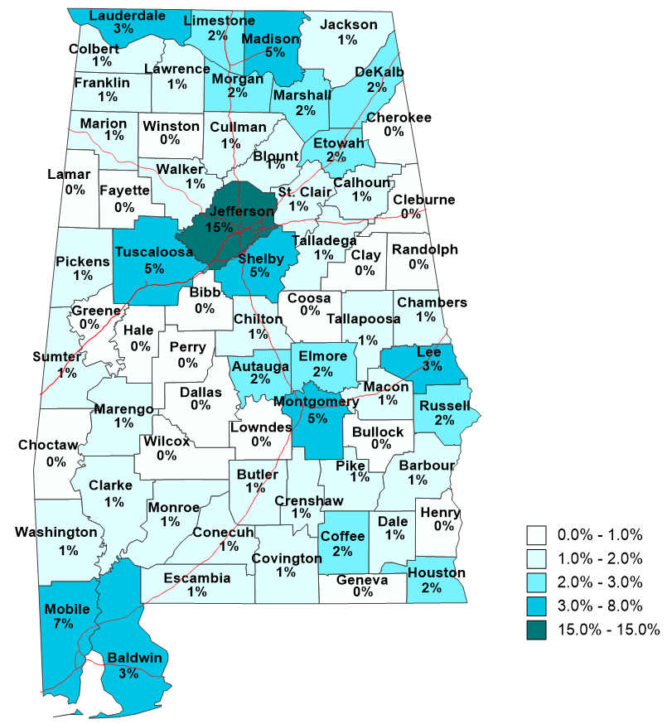
2020-2021
High School Graduates
Who Enrolled in
Alabama Public Institutions
Fall 2021
and were Enrolled in
Remedial English
301/1991
Remedial English
All Races/Ethnicities
Remedial English of County divided by State total Remedial English

Slide 46
Our Charge (those of us in this room)
Continue Governor Ivey’s emphasis in improving Education and the Workforce.
Expand the state’s investment in Pre-K
Increase the number and percentage of students proficient in reading in the third grade
Increase student preparation for post-secondary education.
Reduce remediation rates in Math and English
Provide many options for citizens to prepare themselves for a quickly changing workforce
Integrate reading proficiency throughout elementary and secondary education.
Increase state and local support for students as they move through the education system.
Commit to reducing rural poverty in our lifetime.
Build sustainable economies by improving workforce participation rates.
Improve student critical thinking skills and discernment of information.

Slide 47
… gazing on the printed word, [we] call it God.
We think by compulsory education to free the average man from the darkness of literacy and ignorance.
We think to free him from his cunning exploiters, so he would be able to think for himself. But we have discovered the fallacy, He cannot think …
The exploiters once could only reach the illiterate directly, a slow and tedious task. Now thanks to education and the printed word, they are able to seduce the millions, where once they were only able to seduce hundreds.

Slide 48
civic involvement
volunteer activity by education levels
50%
45.6% (60 hours)
B.A. or Higher
40%
34.1% (52 hours)
Some College
30%
21.7% (48 hours)
Percentage Volunteering
20%
High School Diploma
9.9% (48 hours)
10%
Less Than High School Diploma
0%
Notes:
Bureau of Labor Statistics. (2003). Volunteering in the United States, 2003. USDL03-888. U.S. Department of Labor.

Slide 49
civic involvement
blood donation by education level
percentage who donate regularly
20%
17%
13%
B.A. or Higher
15%
Percentage Donating Blood
11%
Some College
10%
High School Diploma
6%
5%
Less Than High School Diploma
0%
Notes:
Source: DBD Worldwide. (2000). DBD Lifestyle Survey. Chicago. Available at www.bowlingalone.com.

Slide 50
government
participation assistance programs
education level
24.3%
Less Than High School Diploma
10.2%
High School Diploma
4.6%
Some College & Bachelor’s Degree or More
Ever Participated in Assistance Programs
Notes:
Source: Postsecondary Education Opportunity, May 28, 1997, pg 47.

Slide 51
government
incarceration rates by education levels
2.5%
1.9%
2.0%
Less Than High School Diploma
1.5%
Percentage Incarcerated
1.2%
1.0%
High School Diploma
0.5%
0.3%
Some College
0.1%
0.0%
B.A. or Higher
Notes:
Source: Harlow, C.W. (2003). Education and Correctional Populations. Bureau of Justice Statistics, Department of Justice. NCJ195670.

Slide 52
economic
Percent Below Poverty Threshold
40%
32%
30%
Less Than High School Diploma
Percentage Home Ownership
20%
15%
High School Diploma
10%
10%
Some College
4%
0%
B.A. or Higher
Notes:
Census Bureau

Slide 53
economic
unemployment rates and education level
9.7%
10
Less Than High School Diploma
7.5%
8
High School Diploma
6
5.1%
4.6%
Some College
B.A. or Higher
4
2
0
Notes:
Source: Employment Policy Institute

Slide 54
Quality of Life
Home Ownership
80%
75%
B.A. or Higher
69%
70%
66%
Percentage Home Ownership
High School Diploma
Some College
60%
58%
Less Than High School Diploma
50%
Notes:
Census Bureau, American Housing Survey for the United States:2005

Slide 55
Safety
Seatbelt Use while intoxicated
percentage who use seatbelt
80%
78%
66%
60%
B.A. or
Higher
52%
41%
Some College
39%
40%
High School Diploma
Less Than High School Diploma
31%
20%
20%
15%
0%
Notes:
Source: American Journal of Public Health, 1990

Slide 56
Average family income by educational attainment
economic
175
150
125
100
Income ($000)
75
50
25
0
LT-9
9-12
HSG
Some
AA
BA
MA
PhD
Prof
College
Notes:
Source: Postsecondary Education Opportunity, 2005

Slide 57
economic
The Impact of Education on Individuals: Lifetime Earnings
Education Level
Estimated
Lifetime
Earnings
Difference
Compared to
High School Graduate
Less than 9th grade
$976,350
-$478,903
High school dropout
1,150,698
-304,555
High school graduate
1,455,253
0
Some college, no degree
1,725,822
270,569
Associate degree
1,801,373
346,120
Bachelor's degree
$2,567,174
$1,111,921
Master's degree
2,963,076
1,507,823
Doctorate
3,982,577
2,527,324
Source: Federal Reserve Bank of Dallas, 2005
Professional degree
5,254,193
3,798,940
Notes:
Source: Federal Reserve Bank of Dallas, 2005

Slide 58
At the end of WWII, the U.S made a bold decision to invest in the future of its economy by providing $1.9 billion annually to the education of returning veterans of the war. This commitment to human capital helped enable the WWII generation to become the “greatest generation.”
Possibly, Alabama’s greatest generation is at the schoolhouse door waiting for the opportunity to propel Alabama into the global economy.

Slide 60
Building Human Capital: The Educational Path to Alabama’s Economic Success … and why reading matters.
Jim Purcell, Ed.D.
Executive Director
Alabama Commission on Higher Education
100 N Union Street
Montgomery AL 36104
Jim.purcell@ache.edu
Cell 334-328-7177

Slide 61
extras

Slide 62
New Realities
More than 40 % of college graduates take positions out of school that don't require a degree.
more than 1 in 5 college grads still aren't working a degree-demanding job a decade after leaving school.
Employers are surprisingly specific of the work-ready skills you’re supposed to bring in . . . that makes it challenging for students who haven’t designed their path through college to include picking up those kind of skills.”
“Once you’re underemployed, it’s increasingly difficult to escape."

Slide 63
The top bar is the unemployed number divided by the civilian non-institutional population (January data for each year)

Slide 64
Retain Alabama is a initiative established in response to the 2020 Employment Outcomes Report

