Slide 1
Mental Toughness for the Modern HR Professional
Dr. Melissa Briggs-Phillips
Behaveforward.com
With the City of Columbus HR Leadership

Slide 2
Significant learning happens within a significant relationship
How are we going to pull this off today?

Slide 3
Statement of the pandemic problem for people
“Micro” conversations are a place that knowledge is shared that can have HUGE impact on a project, and it cannot always be planned! Now we need to schedule a Zoom…
Emotional and relational labor frequently happens in small, spontaneous moments as well and this stopped happening in March of 2020.
Boundaries were OBLITERATED; When does work start/stop? No break from the part of the Life Pie Chart that wasn’t the best part. Politics came to work and we were not ready. Roles and responsibilities shmooshed together. (There is NO SUCH THING as multi tasking folks, we “task switch”, and this costs cognitive capital to on/off ramp).

Slide 4
UNCERTAINTY + INTERDEPENDENCE=our worst selves?
high
ψ
safety
low
Comfort
Zone
Learning Zone
Apathy Zone
Anxiety
Zone
low MOTIVATION AND ACCOUNTABILITY high

Slide 5
G+r+I=T

Slide 6
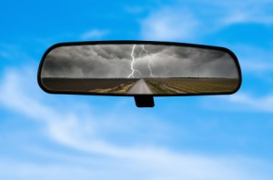
Mental Toughness is: Willingness and Capacity to BEHAVEFORWARD

Slide 7
10 Point Mental Toughness Bootcamp
Pity Party vs Self Compassion
Blame vs Ownership
Control vs Radical Acceptance
The Jury vs Internal Tuning Fork
Blind Spot vs Common Denominator
Envy vs Celebration
Lonely vs Alone
Entitlement vs Commission
Now vs Later
Ability vs Effort

Slide 8
Pity Party vs. SELF-COMPASSION
If you say things like: No one else had to deal with what I had to deal with, I got screwed over, There was nothing I could do about it, I was stuck there because it was not fair, why does this always happen to ME.
PITY PARTY=NOT mentally tough
Answer this question:
What do I know about myself now, I did not know then?
Do you believe that life is fair? Do you REALLY live that way?
Just World Hypothesis, “karma”, and cultural mythologies around “The American Dream” etc…have you done the work to deconstruct these things? What do you accept? What do you REJECT? Do your actions reflect this?

Slide 9
OWNERSHIP vs. BLAME
If you say things like: He makes me feel bad about myself, My kids make me feel unimportant, My in-laws make me furious, this co worker does not respect me and it drives me crazy.
GIVE AWAY YOUR MOOD= NOT mentally tough
Answer this question:
What am I avoiding having to decide or do for myself by blaming this person for my feelings?
How am I culpable for this series of events?
What did I ignore until it was too late?
What is my ASK? (try to NOT tell someone you are offended/hurt/annoyed until you can articulate “the ask”)

Slide 10
RADICAL ACCEPTANCE vs. CONTROL
If you say things like: What if he stops loving me, What if she gets sicker, What if the storm is huge, What if the buyout leads to a layoff, What if his family hates me?
OR
I am not a control freak! I just have the right ideas!
I am not a control freak, I am JUST TRYING TO HELP.
RUMINATE ABOUT WHAT YOU CANNOT CONTROL=NOT mentally tough
Answer these question:
What is the one thing I CAN DO right now to alleviate my anxiety?
Have you been invited?
HELP is the sunny side of control.

Slide 11
INTERNAL TUNING FORK vs. Your Jury
If you say thing like: I really hope they don’t make fun of me, I bet they will judge me for this, I better ask 67 people what they think I should do, how many likes did I get, will they laugh at my number of followers.
OBSESSION WITH APPROVAL=NOT mentally tough
Answer this question:
When I imagine bleacher seats populated with people who are evaluating and judging my choices, who is sitting there?
STRIVING FOR APPROVAL is not a flaw (it usually means you are not a sociopath) but OBSESSION with approval? There are consequences.

Slide 12
ENVY vs. CELEBRATION
If you say things like: Why should she get that promotion and not me? How does good stuff always seem to happen for them and not me? I cannot talk to you right now because I am too angry I lost. Her life is so perfect on Facebook, why is my life not THAT?
RESENTMENT OF OTHERS SUCCESS=NOT mentally tough
Answer this question:
What is your first memory of coveting something a friend had in childhood that you desperately wanted? (Atari, Jordache Jeans, Flintstone Vitamins are on my list)
What did you do with that then? Have you matured in how you handle this experience as an adult?
Shiny lives on FB and Insta…view as aspirational for THEM, not FACT.
Comparison is the thief of joy, social media is destroying our mirror neurons AND driving the Dunning Kruger effect and might destroy us. Not kidding.

Slide 13
ENTITLEMENT vs. COMMISSION
If you say things like: Well, I work hard, I deserve this (fill in the blank); It’s not fair! People hurt me, I should be taken care of, How dare you!
DETERMINING THE WORLD OWES YOU=NOT mentally tough
AND
DETERMINING YOU OWE YOURSELF TO THE WORLD=not mentally tough
Answer this question:
Do you routinely tell stories about loss and getting an “unfair” deal in the past to justify bad behavior in the present?
When you use the word “deserve” or “earn”, how are you using them? Do you sometimes accept LESS THAN, because you do not feel “entitled” to MORE?
Martyr complex, codependency the flip side of this.

Slide 14
ALONE vs. LONELY
If you say things like: I am sooooooo bored, I cannot sit still, I need to find something to do, I always have Instagram/Twitter/FB open
AVOIDANCE OF SOLITUDE=NOT mentally tough
Answer this question:
What are the first three things that happen to your body and what are the first three thoughts that pop into your head when you are in silence?
Sleep with your phone in another room.
(the inability to LOOK OUTSIDE and avoid solitude, is one of the reasons we have seen epic spikes in depression and anxiety)

Slide 15
NOW vs. LATER
If you say things like: I will never be able to wear a size 8 again, I will never be able to graduate, I want these shoes/chips/beach vacation NOW
INABILITY TO DELAY GRATIFICATION= NOT mentally tough
Answer this question:
The last time I remember sacrificing and waiting to purchase/eat/say something I wanted was…

Slide 16
EFFORT vs. ABILITY
If you say things like: I just wasn’t born with a silver spoon, I am unlucky, I am not smart enough, I do not have the right background for that
LACK OF PERSISTENCE=NOT mentally tough
Answer this question:
When is the last time I solved a complicated problem or puzzle in my life? What did it take? When do I tend to give up when facing challenges?
Procrastination is not just ONE THING, it can be lots of things: lack of self trust to handle the unexpected one of the most common.

Slide 17
COMMON DENOMINATOR vs. BLIND SPOT
If you say things like: I keep dating the same person in another body over and over again! I keep getting fired from stupid companies for no reason, I am always bored at my jobs, people are all such morons, this system is full of idiots…
AVOIDING THE MIRROR AND SHORT TERM MEMORY=NOT mentally tough
Answer these questions:
Why do I keep ignoring signs that something is “off” until it is too late?
What am I accusing other people of on a routine basis?
What mistakes have I made in my life, do I spend a lot of time hiding from others?
What do I demonstrate, when I feel I have not been heard?
What DATA am I using to draw these conclusions? (Dunning Kruger Effect)

Slide 18
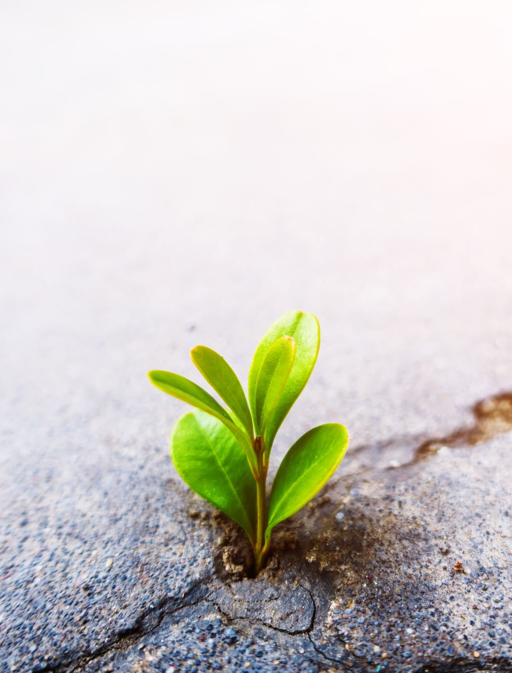
What is gratitude?
An affirmation that there is goodness
An affirmation that this goodness comes from OUTSIDE of yourself
Claiming this goodness, in spite of evidence it does not belong to you
Gratitude is ground zero for getting over yourself
Gratitude is NOT the solution, it is the pause button to interrupt and ask yourself “Is my experience the center of the story right now?”

Slide 19
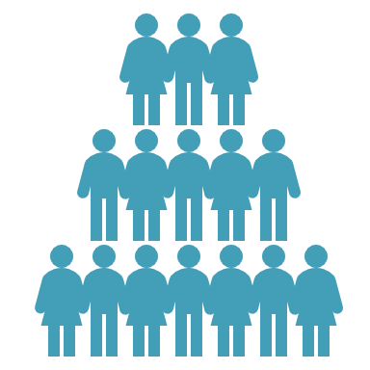
The grateful workplace
Focus on ALL team members, as consistently as possible.
BE SPECIFIC, don’t be lazy thankers!
There are many ways to show appreciation, don’t make assumption that if someone is quiet they do not feel gratitude or enjoy receiving it
“psychological immune system for turbulence of the future”

Slide 20
TOXIC POSITIVITY
DENIAL that something is painful or scary
AVOIDANCE of the uncomfortable that you cannot “make better”
AMERICAN-things always having to be THE BEST! EPIC! ELITE!
REDUCING a person’s lived experience
DRIVEN by (sometimes) the well meaning
IMPATIENT approach to process and pace
A REACTION to honoring a past that is perceived as threatening
VS. RUTHLESS OPTIMISM

Slide 21
What are you RESPONSIBLE FOR?

Slide 22
How SELF AWARE are you? Rate yourself 1-10 1=I HAVE serious blind spots to 10=call me buddha

Slide 23
Self Awareness is hard.
(and unpleasant)
(and not everyone can do it)

Slide 24
therapy
This Photo by Unknown Author is licensed under CC BY-ND

Slide 25
Self Awareness sits at the nexus of how we see ourselves, how others see us, and the comparisons we make with others. CHAnge tolerance is impossible without it.
Self Awareness
Self
Others
Comparisons

Slide 26
High self awareness
Stronger relationships
Profitable companies
BETTER
Communicator
Decision making
BUILD
MORE
Confident
Creative
Effective
Satisfied

Slide 27
15%

Slide 28
Favorite self awareness action item FIVE LOVING CRITICS
Tell me a story of when you saw me at my best?
What do I demonstrate, when I feel I have not been heard?
What do I do, that makes you notice I am “off”?
The SKS method

Slide 29
COGNITIVE DISTORTIONS
Filtering
Polarization
Overgeneralization
Jumping to Conclusions (Mind reading and Future Telling)
Catastrophizing and Minimizing
Personalization
Control Fallacies
Fallacies of Fairness
Blaming
Tyranny of the Shoulds
Fallacy of Change
Heavens Reward Fallacy

Slide 30
COGNITIVE DISTANCING and COGNITIVE FLEXIBILITY are the BUSINESS SUPER POWERS of the 21st Century
Ban Movie Making
On a Scale of 1-10
Feeling Wheel Practitioner
Process vs. Content
Practices over Beliefs
My Future Self
Response vs Reaction
Primary Pain Points
Oak vs. Bamboo
Scaffolding vs. Pillar
Nondualistic Framing
Paradox vs. Polarization
Tolerating Ambivalence
Radical Acceptance
HELP is the SUNNYSIDE of control

Slide 31
What is INTENTION?
A clear, specific and positive statement of an outcome you want to experience.
A goal, or vision, that guides your activities, thoughts, attitudes, and choices.
They influence your actual experiences.
They can be of wildly varying scale (small/large), content (tangible/experiential) and focus (internal/external).

Slide 32
What does INTENTION do?
It provides a framework for you to-
set priorities
use your time wisely
align yourself with the resources you need to manifest your goals.
It announced to others you are serious
Provides clarity of purpose, direction and commitment
INTENTIONS ARE MORE POWERFUL THAN GOALS

Slide 33
Why do YOU work?
8
8
8

Slide 34
Rate 1-10 the following: 1=sucks 10=awesome
How do you feel about your work?

Slide 35
Rate 1-10 the following: 1=sucks 10=awesome
My commute
The space I occupy (the lighting, the colors, the furniture)
The proximity of my work space to things I care about
The view from where I sit
The coworkers located PROXIMAL to me
The coworkers I get to collaborate with
My clients/customers
Daily tasks
The mission or cause of the company I work for
The flexibility or autonomy I experience with my schedule
The clarity I have about what is next for me here
My salary/wage/benefits
The pride or prestige of my title

Slide 36
It is not about HAPPY. It is about THE BIG WHY (outcome is almost an afterthought)
I BELONG HERE
I AM ADDING VALUE
I AM CONNECTED TO OUR PURPOSE

Slide 37
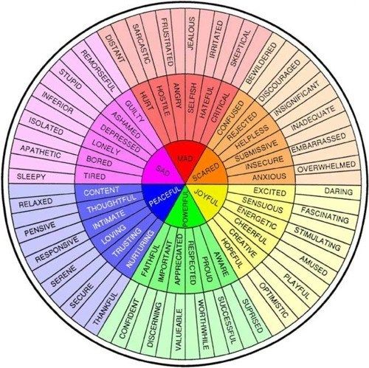

Slide 38
BEHAVIOR is HUMAN CURRENCY
BELIEFS (thoughts)
BEHAVIORS
FEELINGS

Slide 39
Thank you!!
drmelissa@behaveforward.com
behaveforward.com
800 570 1509

