Slide 1
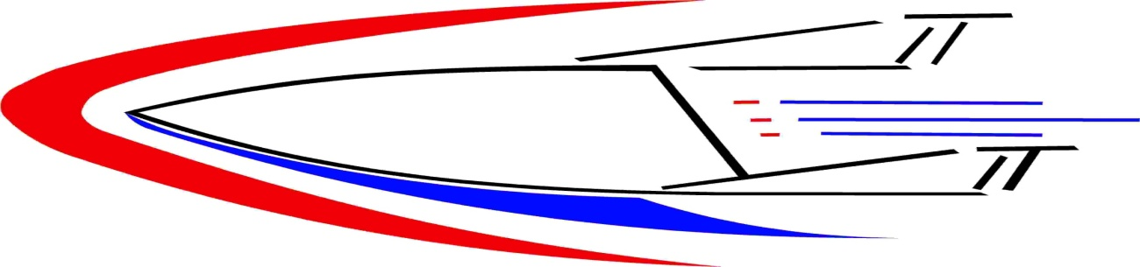
US-Space Plane Systems LLC.
US-Space Plane Systems LLC is a Research & Development Company involved in creating advanced vehicle designs and manufacturing methods that will allow the construction of manned orbital and suborbital space vehicles for commercial and military customers.
US-Space Plane Systems utilizes patented technology, superior vehicle design, streamlined manufacturing, component integration and vehicle processing.
Combined with an experienced aerospace contracting group accompanied by a veteran aerospace management team make for a good start.

Slide 2
US-Space Plane LLC. & SF
US-SpacePlane Systems LLC’s goal is to manufacture a reusable 420 passenger suborbital transport aircraft capable of reaching a 5000 mi downrange landing site in approximately one hour, in addition to manufacturing a 12 passenger orbital vehicle capable of daily access to orbit.
“Super Flight” Suborbital Flight Services will use this technology to create an international “point to point” suborbital air passenger and cargo service operating in cooperation with a select group of international airline partners.

Slide 3
Super Flight Suborbital flight services
Ultrafast travel around the world

Slide 4

The Future is Coming

Slide 5


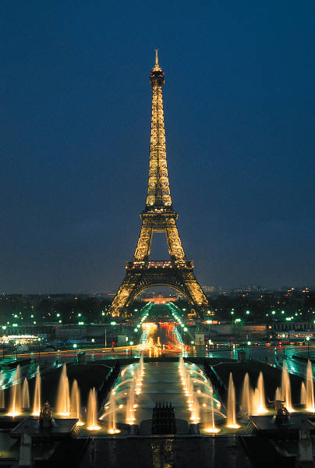
Flight Scenarios
Imagine leaving New York and arriving
in Paris in 45 minutes.

Slide 6
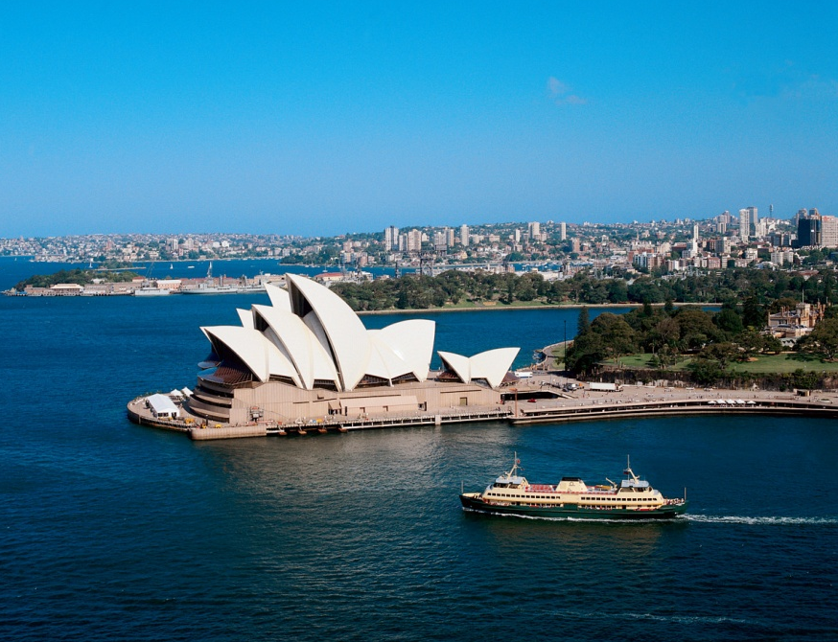
Flight Scenarios
Imagine leaving the Los Angeles and arriving in Sydney in 55 minutes.

Slide 7
Worlds Top 10 Airports
Incheon Int. Seoul South- Korea 2 million passengers per year 25 airlines fly to 30 destinations.
Hong Kong Int. (IATA) 51M passengers 2010, 900M in expansion.
Changi Int. Singapore.
Zurich Int. Germany- Handled 22.1 million passengers in 2008.
Munich Int. Germany-34.7 million passengers in 2008 second to Frankfurt.
Kansai Int. Japan-50km south of Osaka, cost.3.5 billion.
Kuala Lumpur Int. Malaysia. Handled 27.5 million passengers in 2008 with an annual increase of 4% per year. 50 airlines fly to 90 destinations. Moved 728 tones of cargo.
Amsterdam Int.- 3 largest in International travelers. Showcases largest shopping mall in the airport.
Sentrair Nagoya Airport Japan.
Auckland Airport, New Zealand- 13 million passengers yearly. Supports 30 airlines with annual passenger flow increases.

Slide 8
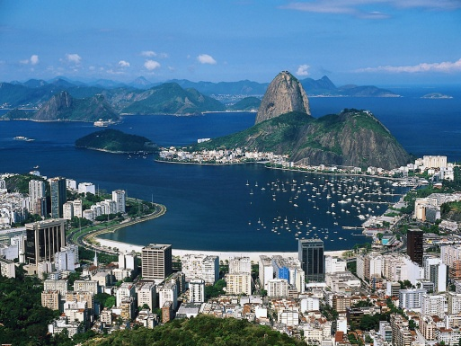

Flight Scenarios
Imagine leaving the Rio De Janeiro and arriving in London in 40 minutes.

Slide 9
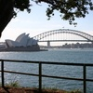
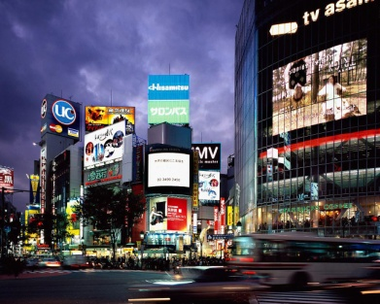
Flight Scenarios
Imagine leaving the Sydney and arriving in Tokyo in 50 minutes.

Slide 10
Business Idea
An alliance of ten nations and thirteen international corporations will make up our core partner group.
Each member will participate in the collective network of landing sites and servicing facilities necessary for the daily operation of international service.
It is proposed that international air carriers in each country shall provide connecting domestic flights for SUPER FLIGHT suborbital service.
As the service matures, the aerospace administrations of each partnering country can anticipate the second phase of development. The Orbital Vehicle.
With low cost and simplicity as the driving factor, our 12 passenger SUV space craft will be available as a purchase or leased item.
With our design, the carrier transport aircraft can double as an aerial launch platform for our orbital vehicle utilizing a two stage to orbit system.
Super Flight shall provide the mother ships for air launching of the orbital crafts under a lease or contract agreement. Each country’s aerospace agency operate their own orbital vehicle.
This arrangement will lead to daily flight to orbital stations.

Slide 11
Atlantic Destination Cities
London UK
Amsterdam
Zurich
Munich
Rio De Janeiro
Madrid Spain
Lisbon Portugal
Kenya & Johannesburg Africa
New York New York
KSC Florida
Paris France

Slide 12
Pacific Destination Cities
Auckland New Zealand
Kuala Lumpur
Hong Kong
Kansai Japan
Sentrair Nagoya
Sydney Australia
Tokyo Japan
New Delhi India
Honolulu Hawaii

Slide 13
Vehicle Test Program
The first generation transport aircraft will begin flight service departing the Mojave Space Port, California and fly the 2500nm suborbital trip to the Hawaiian Space Port on the Island of Hawaii in just under 45 minutes. This will demonstrate the aircrafts capability and certify FAA manned rated requirements. This test aircraft will hold 100 passengers and a limited cargo area.

Slide 14
Flight Operations
Two flights per day departing each designated space port.
A morning and evening flight will enable passengers unprecedented flexibility.
At the beginning of “Super Flight” operations, a total of 60 aircrafts servicing 13 international cities providing 120 flights per day make up our global coverage.
Notes:
Two and one half years aircraft development and two years operational development

Slide 15
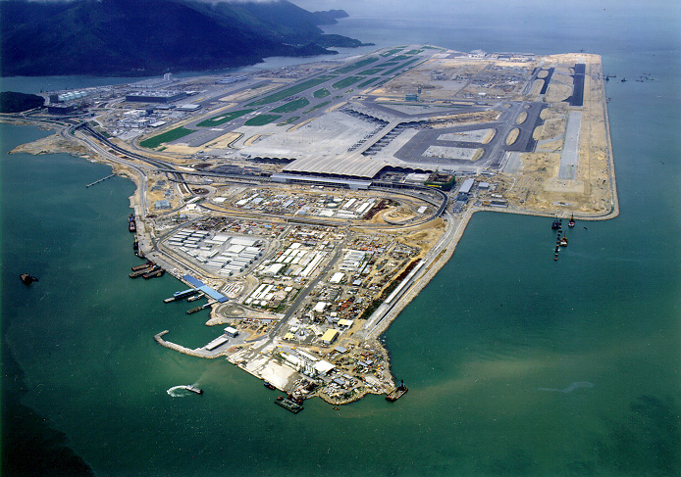
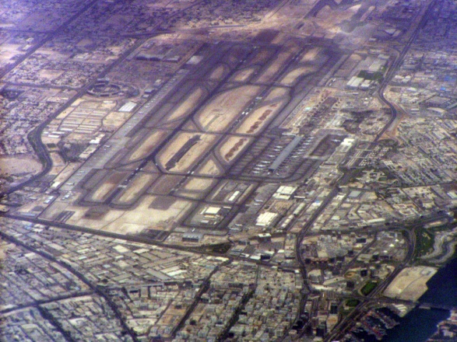
Global Reach
Our point to point daily service to these airports and others will allow passengers and cargo to connect to hundreds of destinations through the region.
Dubai
Hong Kong

Slide 16
Potential Global Partners
Japan-, Air Japan, Mitsubishi, Honda, Kawasaki, JAS.
Australia- Quantis, BAE, Australian Aerospace.
India- Air India, (HAL), (ISRO)
France- Air France, ESA, GIFAS Aerospace Group.
UK- Virgin Group, British Aerospace , ESA.
United Arab Emirates- UAE Airline, Mubadala Development Company, MEAC, Al Maktoum Air Port.
Africa- Air Africa, SA Aerospace Maritime & Defense Industry Association.
Spain- Spanish Air Line Spanish Aerospace Consortium.

Slide 17
Good Profit Potential
With a ticket price of 2K us dollars and an average passenger volume of 400, a revenue of $800,000 per flight can be generated.
The large volume cargo area will enable oversize items to be transported.
Contracts with major cargo companies will generate an additional revenue of up to 50%
Revenue per flight could yield 1.2 million.
It is estimated 41% of the flight revenue is operating , maintenance, International fees, tariffs and insurance.
With all “startup spaceports” fully operational providing two flights per destination per day, a total of 20 air routs creating 80 flights per 24 hour period. Generating an est. 96 million in revenue daily.

Slide 18
Aircraft Technology
The Super Flight fleet of aircraft shall use a technology referred to as lifting bodies.
This design will allow a massive internal cabin and cargo space that will enable passengers the freedom of being in a large auditorium.
Advances in composite materials, air breathing and rocket engine, propellant formulas and light weight construction techniques will make our aircraft the safest and most operationally efficient in the world.

Slide 19
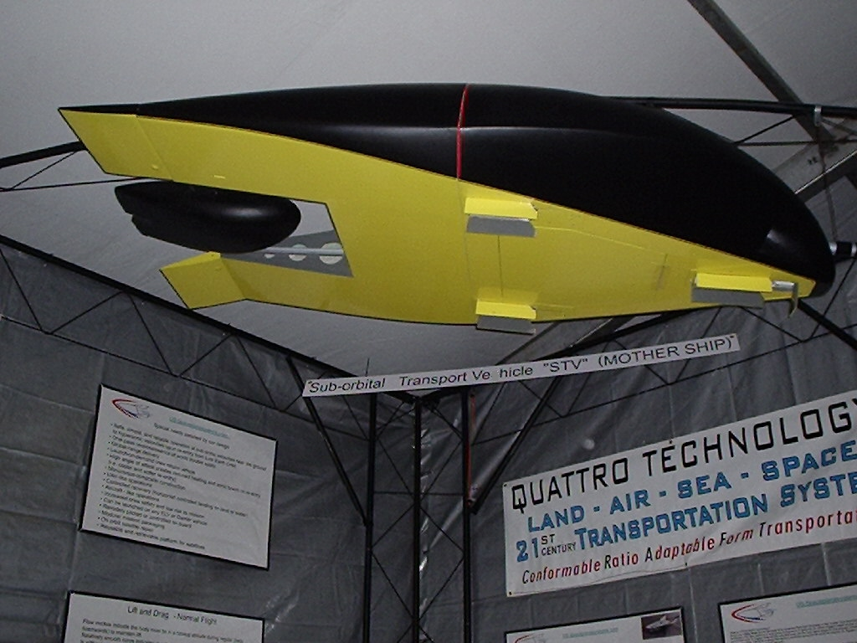
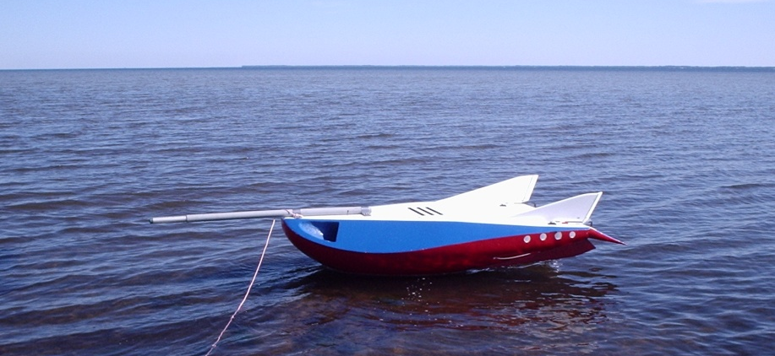
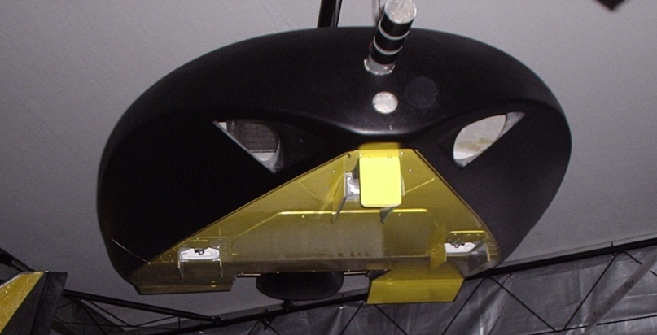
The Basic Aircraft Design
120 % scale “Global Flyer” Transport vehicle
Even at 160ft, this “phase one” aircraft can abort to a safe water landing!
Flight test aircraft 80002B

Slide 20
How it works
A “lifting body” aircraft is a vehicle that produces sustained lift from the unique shape of its body alone, eliminating the need for conventional wings.
As current aircraft generate lift from the use of wings, air flowing over a wings top and bottom surfaces cause a difference in pressure on the wings surface thus allowing the aircraft to fly.
The lifting body aircraft is “different” in the way air flow affects the craft. The effect has now become very three dimensional, like a submerged submarine hull moving through the water.
By carefully designing portions of the lifting bodies surface contours, we can now force the airflow to go where we want it to go. This result produces a very dynamic shift in the way the craft is able to sustain useful lift. As speed and angel of attack change, air moving around the craft can proceed in a positive manner, enhancing the planes flying abilities. They are by far the best flying machines in the world today.

Slide 21
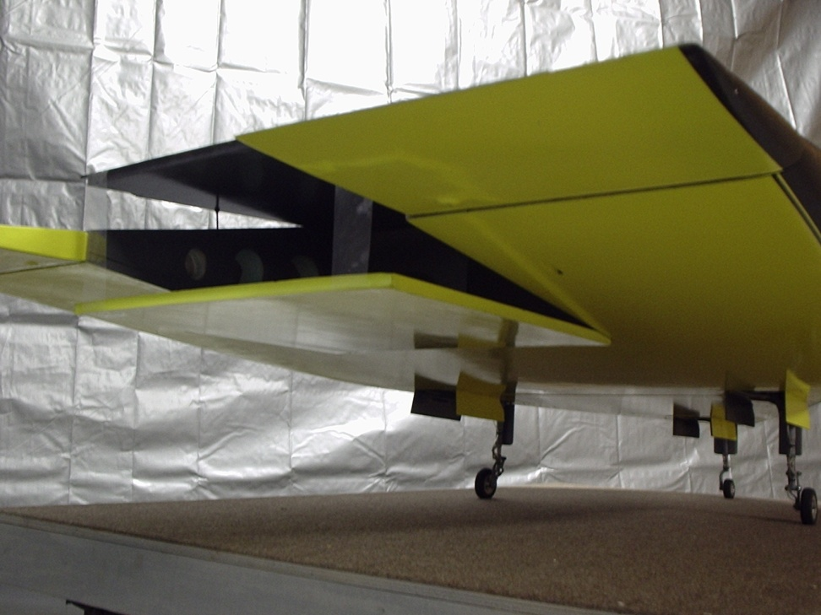
Passengers will love our aircraft
The aircraft’s unique design will allow a large volume passenger interior, a radical departure from the small tubular airframes of the past.
This design will also allow an upper and lower deck with arena style seating for passengers.
Large view port windows are provided to enable passengers a spectacular view while high above the earth.
A conventional horizontal takeoff and landing mode will be easer on passengers.
Best of all, most flights last only one hour.

Slide 22
Aircraft Construction
Global Flyer “phase one” will be 160ft in length with a 110ft span. The main structure will consist of micro filament bulkheads and outer skin, filled with pressurized gas. Advancements in composite strands and windings will allow an airframe that is lighter and stronger in tensile strength, while providing the necessary elasticity in flight.
A modular construction will permit the airframe to be mostly built using automated processes. This will ensure consistent components and a huge cost reduction. As sections of the airframe time out, replacement pieces are easily replaced.
Maintenance and annual inspections are far less costly and time consuming.
Notes:
Lindstrand technologies/ Vertigo- HDT

Slide 23
Advanced Propulsion
MICRO CELLULAR FUEL TECHNOLOGY.
Fuel and oxidizer used in our engine is encapsulated into singular micro sized pellets measuring 10 microns.
This process will enable custom blends of fuel and oxidizer to meet specific performance requirements.
Solid rocket booster motors can be produced with throttling capabilities.
This technology will allow an air breathing turbofan aircraft engine and a rocket engine to combine into a single unit.
The advantage is a fuel and oxidizer combination stored in a low pressure non cryogenic mono container.
Notes:
SPS web site

Slide 24
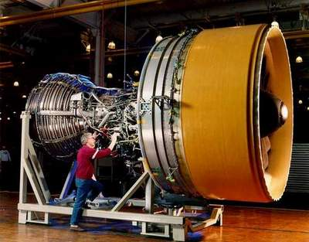
Advanced Hybrid Engine
A bid proposal for the development of a combination high bypass turbofan aircraft engine with a rocket engine be presented to qualified engine manufactures.
Engine propellant will utilize the Micro Cellular fuel/oxidizer technology.
A custom rocket engine.

Slide 25
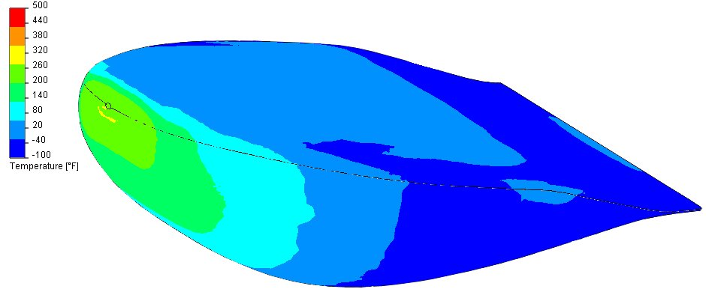
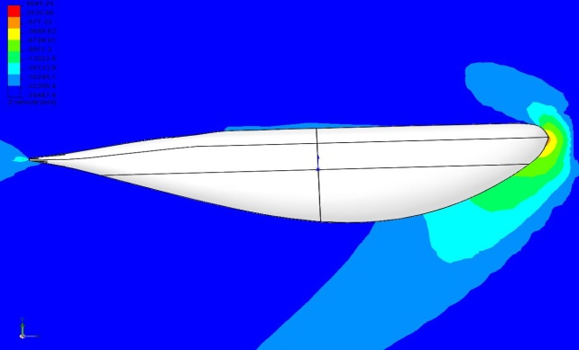
Thermal System
Advanced fuselage shape allows efficient cooling system design.
The process of shedding thermal energy from this type of vehicle shape is much easer than with winged vehicles. The nose of the craft takes the brunt of the heat and distributes the remainder in a more even manner.
High temperature reusable blanketing material similar to that used on space shuttle will be employed in an overlapping manner beginning at the nose of the craft.
Re-enforced carbon carbon will form the nose cone.
Our craft also forms a well defined bow wave in front of the craft which also helps deflect heat away from the vehicle.
2012

Slide 26
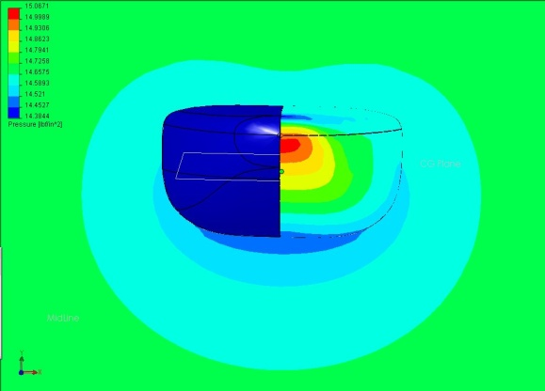
Active Thermal Protection
The blanket material will be aided by an active cryogenic cooling system embedded beneath the blanket. Tubes of super cold liquid will circulate in high frictional heating areas.

Slide 27
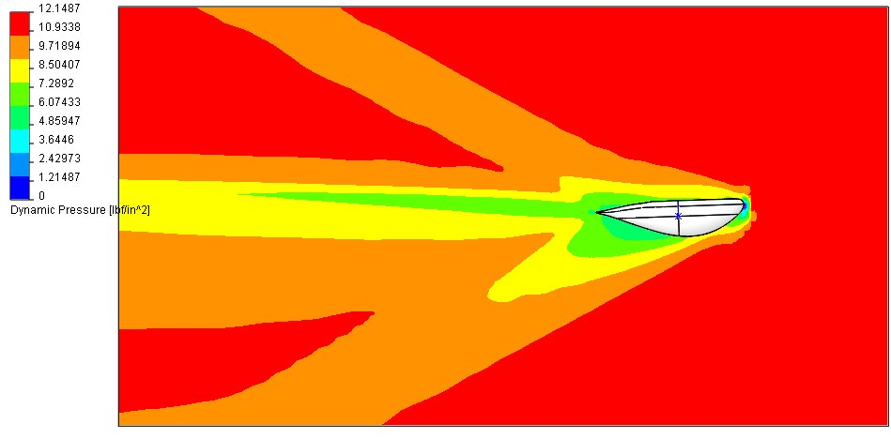
Development at tier 6 stage
Six years of R&D show a vehicle with excellent flight dynamics and stability.
Flow model at right shows a well defined shock wave consistent with established studies.

Slide 28
FAA Regulations
The regulations necessary for suborbital intercontinental flight are being discussed with in the international community of air carrying nations right now. Guide lines for vehicle safety and manned flight certification are being published. International rules regarding over flight altitudes and emergency decent are all being discussed. Most all of the worlds air carriers are anticipating point to point service with in their own flight routs. International government agencies are ready to begin this exciting new phase in air travel.
Notes:
Hawaiian Space Port / YOUTUBE

Slide 29
What we will accomplish first year
Establish the International partner group.
Acquire commitments from international countries and their corporate partners.
Finalize joint venture agreements with int. partners to establish the point to point network.
Establish working relation ships with Int. governmental aerospace agencies.
Finalize financial commitments with each country with in the core partnership.
Completed business plan for Super Flight.
Create an International marketing network for Super Flight.
Finalize aircraft design.
Begin sub-contractor selection
Produce scaled mockups.
Begin construction of first prototype “test” aircraft.
Fly first 30 ft “test” aircraft in 12 months

Slide 30
Phase 2 (ORBITAL ACCESS)
Upon the successful start of Super Flight intercontinental point to point flight service, and as production of transport aircrafts become routine. US-Space Plane Systems LLC shall commence with the second phase of production, the orbital craft.
After year 5, US-Space Plane Systems will tool up to build the orbiter. Once again our streamlined manufacturing process already in place for the carrier, will be utilized for producing the orbiter.

Slide 31
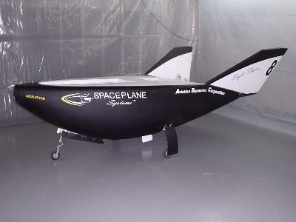
12 passenger SUV scale model

Slide 32
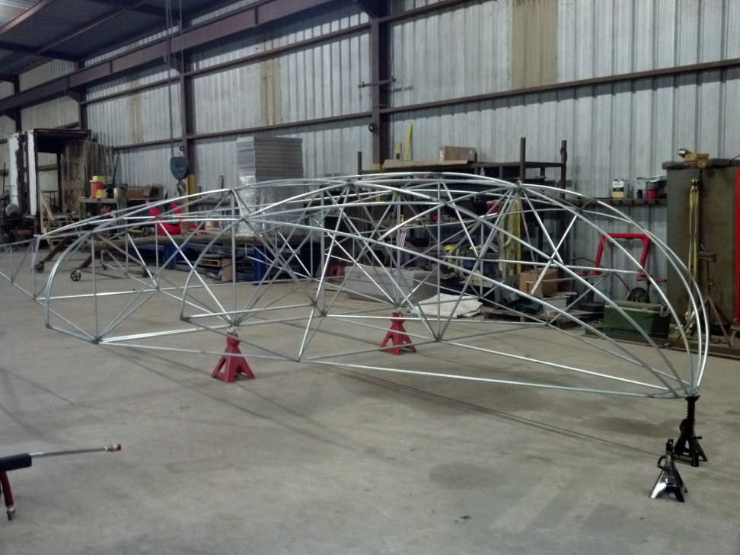
Lets Go

