Slide 1
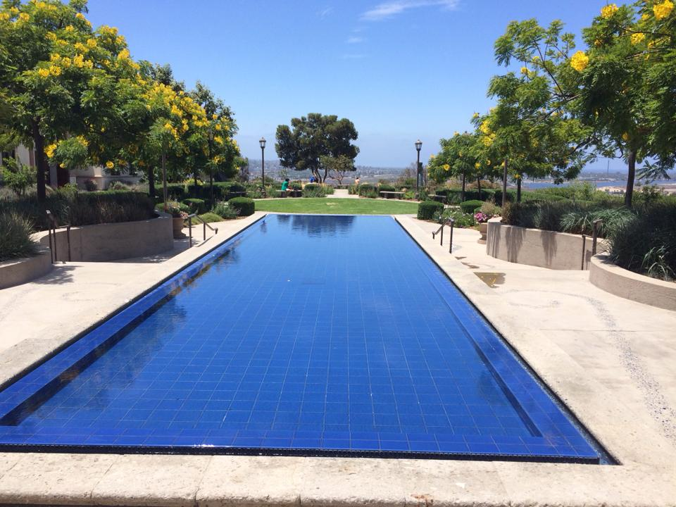
AP conference 2014
AP by the Sea Conference with Sandra Coker
Westlake high school, austin, tx

Slide 2
For the teacher
Give 1 MC passage every 2 weeks
(50% on MC and 3 5’s each a 3)
Do a rhetorical triangle on Reagan: Challenger speech
Top 10 Essays
Lincoln
Kennedy
Churchill
Orwell
Ghandi
MLK
M. Wolfstonecraft’s letter
Virginia Wolf (Death of a Moth)
Dillard
Didion (Bethlehem)
Sontag
Baldwin (on Education)
Twain (Advice to Youth)
H. Lee (eulogy of GW)

Slide 3
For the teacher
Syntax for the superior student
  From page 14 of the binder
Go through and underline the first 3 words of each of your sentences:
  If they are article, verb, subject each time, then you need to VARY your sentence
Go through your essay and circle all verb forms of be: being, am, were, are
  Use effective verbs
Do “Imitation” handout page 15 & do “Copying Passages” assignment p. 17
Add “In Praise of Bats” to Rhetoric Packet (p 61, Diane Ackerman)
Add Annie Dillard’s “The Fixed” to the syntax or rhetoric packet p. 65

Slide 4
For the teacher
Other suggested books:
Devil’s Highway
  about a Mexican crossing illegally into Arizona with a “coyote”
Read Mary Gordon’s “More Than Just a Shrine: Paying Homage to the Ghosts of Ellis Island”
Rad Mary Wollstonecraft’s letter from 1795 (p. 75)
Give the Montagu essay/argument from 1996 Exam Q1 (p 81)
Add the Richard Rodriguez essay on Christmas & fam
  http://sharepoint.mvla.net/teachers/HectorP/Language%20and%20Comp%20AP/Documents/Resource%20AP%20Prompts/Richard%20Rodriguez%20attitude%20towards%20family%20%28sample%29.pdf

Slide 5
For the teacher: Satire
Read The Onion…Aug 18, 2006 “Girl Moved to Tears By Of Mice and Men Cliffs Notes.” (p 91-92)
Add The Onion: “All Seven Deadly Sings Committed at Church Bake Sale” p. 200 The Norton Sampler

Slide 6
Rhetorical triangle
MESSAGE
SPEAKER AUDIENCE

Slide 7
For the students
Avoid “Nowadays…”
  Use “Currently….”
Learn to spell “argument”
  NOT argument
Use “I” or “we” in your argument with AUTHORITY, but don’t use YOU
Very is very overused

Slide 8
More satire terms
Inference: info derived by reasoning
Invective: the harsh denunciation of some person or thing in abusive speech or writing
Parody: imitation of serious work or style in a ridiculous manner (SNL)
Lampoon: imitation in writing (humorous) harsh satire directed toward an individual or thing
Sarcasm: technique that ridicules through caustic language

Slide 9
Suggested non fiction books
Rumor of War by Caputo
Artic Dreams
Desert Solitude
Devil in White City
In Cold Blood by Capote

Slide 10
Multiple choice tips
Look at AP English Lang/Comp Question Stems page 27 in binder
Reflections on the Multiple Choice
  Do test corrections assignment on page 31
Underline the stems from the questions
“Reflect” on incorrect answers
If you don’t know the Roman numeral questions immediately, just skip them and come back to them at the end (time trap)
Recommended book: 5 Steps to a 5

Slide 11
Ways to improve your multiple choice
Review the question stems
Answer choices
Reflections
Rationales
Pre-20th/contemporary
Up your SAT/ACT score

Slide 12
For the students
When you think of an image or you look for an image, look for:
  Visual
  Auditory
  TOUCH
  Gustatory
  Olfactory
Then discuss its EFFECT

Slide 13
“there are many rooms in the house of 8.”
- Sandra coker
Look at the elements in the rubric

Slide 14
For the students: “…in order to…”
Remember:
  Purpose & effect
  Talk about the technique & then add “IN ORDER TO” between the technique and the purpose
  The Scoring Guideline for AP Readers says:
    “For the purpose of scoring, analysis means explaining the rhetorical choices an author makes in an attempt to achieve a particular effect or purpose”

Slide 15
For the students
Check out this site:
  http://rhetoric.byu.edu/
Great source for detailed rhetoric terms

Slide 16
Toulmin template (for stating your position)
Argument: to support claims with premises (reasons & assertions)
  Identify a topic
  Make a statement about the topic
  Supply a reason (a “because” clause to support your claim)
  State your claim (your statement of position)
  Add a warrant (assumption of S/B’s or shared values)
  Put these together in this order: since-statement-because
  Example: Because such actions can be proactive, school administrators should consider random backpack searches, since student safety is of utmost importance.
  (You could also start with “Although” and a concession, before your stated claim)
    I prefer this method

Slide 17
For the students: How many paragraphs for the argument?
In the argument…
  Take out “I believe…” before your position
  Just go right into stating your position
    Use the Toulmin Model
  Two strong BODY paragraphs is better than three weak BODY paragraphs

Slide 18
synthesis
This is a great essay with a great skill you may need for:
  Analysis papers to examine related theories
  Research papers to incorporate multiple sources
  Argument papers to compare differing views
  Business reports to examine differing ideas & blend into a coherent plan

Slide 19
Questions?

