Slide 1
Persuasion/Argumentation Terminology
English
Mr. Mooney

Slide 2
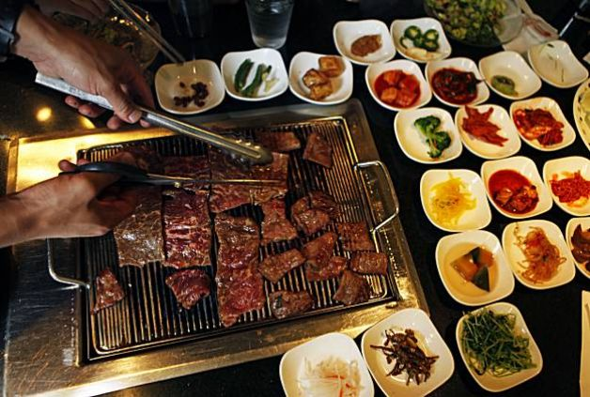
Persuasion
An appeal in order to compel some action
  Example: Like trying to persuade someone that Korean BBQ is the best type of food & he/she should try it

Slide 3






Argumentation
Forming reasons, drawing conclusions, and applying them to a case in debate
  Ex. Let’s debate: What is the greatest American novel of all time?

Slide 4
Claim/Assertion/Proposition/Position/Thesis
Something asserted or maintained, the main point or position of your argument
  Ex. Korean BBQ is the best.

Slide 5
Sub claims
A subordinate point to a larger claim or position in your argument
  1 Subclaim: You get to cook the meat yourself to your own liking
  2 Subclaim: It’s all-you-can-eat
  3 Subclaim: it’s a fun group outing

Slide 6
Support/Evidence
Support or evidence used to help strengthen (or support) your argument
Examples: facts, anecdotes, descriptions, statistics, or details

Slide 7
Refutation/Counter Argument/Counter Claim
To discredit an argument, particularly a counterargument(aka counter claim)
Ex. American rib eye or filet minon at restaurants sometimes is not prepared the way you like it. Then I say, “Take it back!”

Slide 8
Concession
Conceding, acknowledging or admitting an opponent’s point
(Some also consider a concession a form of counter-claim)
  Ex. Even though I love my mom’s home-cooked lasagna, I still prefer Korean BBQ.
  Ex. Even though it’s a meat lovers meal, they also provide a wide array of veggie side dishes for the vegetarian in the group.

Slide 9
Evidence Types

Slide 10
Fact!!!!
(A thing done); an actual occurrence
  Bears eat beets.
  When I go to a Korean BBQ restaurant, I see a diverse array of cultures eating – not just Koreans.

Slide 11
Statistic
A collection of quantitative data
  9 out of 10 of these are made up
  9 out of 10 Korean BBQ restaurants have an “A” rating, but a “B” is good enough for me, if I’m in LA.

Slide 12
Example/Anecdote
An individual instance taken to be representative of a general pattern, and usually a short narrative of a relevant episode
Ex. For my daughter’s 12th birthday, I asked her where she wanted to eat, and she said Korean BBQ.

Slide 13
Opinion
A judgment, view, or appraisal formed in the mind
  In my opinion, you should never start a sentence with “in my opinion.”
  Ex. I love red meat.

Slide 14
Analogy/Comparison
A comparison to a directly parallel case (when a writer uses an analogy, he or she argues that a claim reasonable for one case is reasonable for the analogous case.)
  Ex. Korean BBQ is like Japanese Teppanyaki but you’re the chef!
  Ex. Korean BBQ is today what Mongolian BBQ was in the 1980’s.

Slide 15
Authority/Expertise
Support from an authority on the subject; expert advice or opinion.
  (Readers are expected to accept claims if they are in agreement with an authority’s view.)
  Ex. Anthony Bourdain and Mrs. Brewer like it...

Slide 16
Shared Beliefs/Values
When a writer argues that if something is widely believed or valued, then readers should accept it.
  Ex. Who doesn’t like all-you-can-eat?

Slide 17
Causal Relationship (C/R)
A writer asserts that one thing results from another.
(To show how one thing produces or brings about another is often relevant in establishing a logical argument)
  Ex. When you’re done eating, your clothes will smell like Korean BBQ. (C/R and a concession)

Slide 18
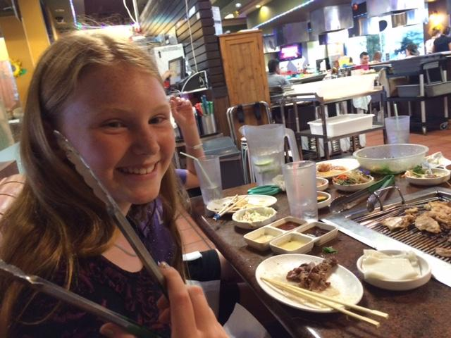
Emotional (Pathos)
Appeal based on emotion.
  Example: humor
    Advertisements tend to be pathos-driven
  Cute kids provide nice pathos

Slide 19
Logical (Logos)
Appeal based on logic or reason.
  Example: corporate documents tend to be logos driven.
  Causal relationships are employing logos: Ex. If you are going to run a mile or go on a date after, you may not want to go to Korean BBQ, because you will not want to move after, and you will stink.

Slide 20
Ethical (Ethos)
Appeal based on character of the speaker.
  An ethos-driven document relies on the reputation of the author. Ex. Bill of Rights
  Ex. My Korean friends tell where the best places to go in Irvine, Garden Grove, and Koreatown are...

Slide 21
Sentimental
Evoking sorrow or pity. (Over-emotionalism can be the result of an excess of pathos. )
  Example: advertisements for starving babies in Africa.
  Some all-you-can eat places will charge you for meat you didn’t eat, and you will need to employ sentimental appeals to avoid this extra charge.

Slide 22
Logical Fallacies:
  mistakes in logic…avoid these at all costs! Especially the Slippery Slope!!!!

Slide 23
Ad hominem
Attacks the personality of the individual (instead of dealing with arguments & issues).
  Example: What do you know about Korean BBQ; you’re white trash, Mooney!

Slide 24
Nonsequitur
Latin for “it does not follow”
When 1 statement isn’t logically connected to another
Examples:
  I bet she’s expecting, she vomited twice this morning. (She vomited twice this morning; therefore, she must be pregnant.)
  I ate Korean BBQ and then got a listing the next day. As long as I keep eating Korean BBQ, I will keep getting real estate listings.

Slide 25
False Analogy
When 2 cases are not sufficiently parallel (to lead readers to accept a claim of connection between them.)
Example: Students are like nails. Just as nails must be hit in the head in order to make them work, so must students.
Ex. Korean BBQ is better than a BMW X-5.

Slide 26
Hasty/Sweeping/Over Generalization
Uses too few examples needed to reach a valid conclusion.
  Example: She drives a red convertible. She must be rich!
  Ex. I went to one Korean restaurant and it was dirty. All Korean restaurants are dirty.
  Counterargument: I like my restaurants with a little bit of dust. It helps build up my immune system. I do not want a weak immune system.

Slide 27
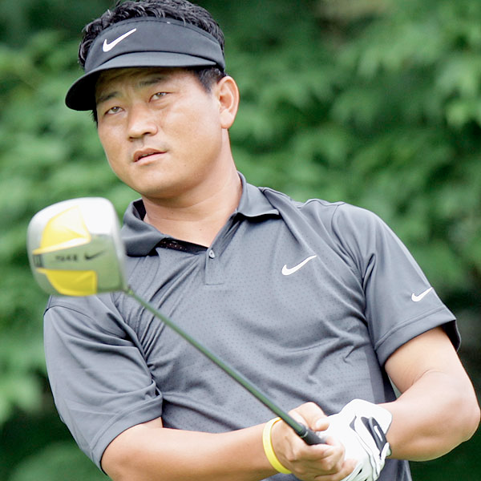
Stereotyping
An oversimplified conception that one is regarded as embodying a set type.
  Example. All Irish people are angry drunks.
  Ex. All Koreans are good at golf.

Slide 28
Begging the Question
Assumes something to be true that needs proof: (the arguer uses as proof the very argument that needs proving.)
  Example: I like her because she is likeable.
  Ex. I like Korean BBQ because it’s the best.

Slide 29
False Authority
(This fallacy is committed…) when the person in question is not a legitimate authority on the subject.
  Ex. What do you know about Korean food: you’re white!

Slide 30
Slippery Slope
(One asserts that) some event must inevitably follow from another without any argument for the inevitability of the event in question
"We have to stop the tuition increase! The next thing you know, they'll be charging $40,000 a semester!"

Slide 31
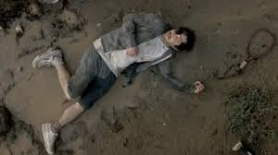
SS Ad
1. When your cable company puts you on hold, you get angry.
2. When you get angry, you go blow-off steam.
3. When you go blow-off steam, accidents happen.
4. When accidents happen, you get an eye-patch.
5. When you get an eye-patch, people think you’re tough.
6. When people think you’re tough, people want to see how tough.
7. And when people want to see how tough, you wake-up in a roadside ditch.
8. Don’t wake-up in a roadside ditch. Get rid of cable.

Slide 32
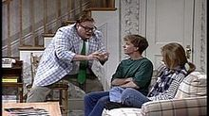
Slippery Slope
Ex. I ate Korean BBQ before a job interview.
I smelled so badly, the Human Resources guy threw me out of the interview.
I went on unemployment, but couldn’t pay all my bills.
I got kicked out of the house, because I couldn’t help pay the mortgage and taxes.
I had to move into my van and park it down by the river.
Don’t eat Korean BBQ before a job interview, or you’ll end up in a van down by the river.

Slide 33
Either/Or Reasoning
Does not allow for any shades of meaning, compromise or intermediate cases.
  Example: We either abolish cars or the environment is doomed.
  Ex. I must eat Korean BBQ after this presentation, or I will starve to death.

Slide 34
Smoke Screen
(Similar to “straw man”)
Method of argument in which an opponent creates a weakened, incomplete, and often distorted version of an argument, then destroys it.
Example: Bill and Jill are arguing about cleaning out their closets.
  Jill: “We should clean out the closets. They are getting a bit messy.”
  Bill: “Why, we just went through those clothes last year. Do we have to clean them out every day?”
  Jill: “I never said anything about cleaning them every day. You just want to keep all your junk forever, which is just ridiculous.”

Slide 35
Smoke Screen
Chad: We should eat Korean barbecue. They have a new dish and we have some discount coupons.
Me: Are you saying that we should eat wherever is cheapest?
Chad: No, I was just saying we could try a new dish while paying less. You’re always trying to make me look like a Scrooge and it’s getting old!

Slide 36
Smoke Screen
Ex. John: You should try Korean BBQ; it’s the best.
Me: I don’t really like all-you-can eat. It makes me fat.
John: I never said you have to get All-You-Can-Eat. You can order a la carte.
Me: You are always calling making jokes about my waist, which is really hurtful.

Slide 37
Conclusion:
Look for opportunities to introduce these argument concepts and terms in our literature:
There are arguments in: The Great Gatsby, Lord of the Flies, The Scarlet Letter, The Catcher in the Rye, Romeo & Juliet, Macbeth, Frankenstein, East of Eden, and the list goes on...

Slide 38
Questions?
Ask Mrs. Pagani, authority/expertise!

