Slide 1

The Synthesis Essay
Mr. Beukema/Mr. Mooney
AP English Language & Composition
Taking Eggs and Making an Omelette

Slide 2

Introduction
Synthesis FRQ – the combination, or synthesis, of ideas to form an argument.
Consider this a research paper for which you are given the research. Thank you, Collegeboard.
YOUR claim is paramount.

Slide 3
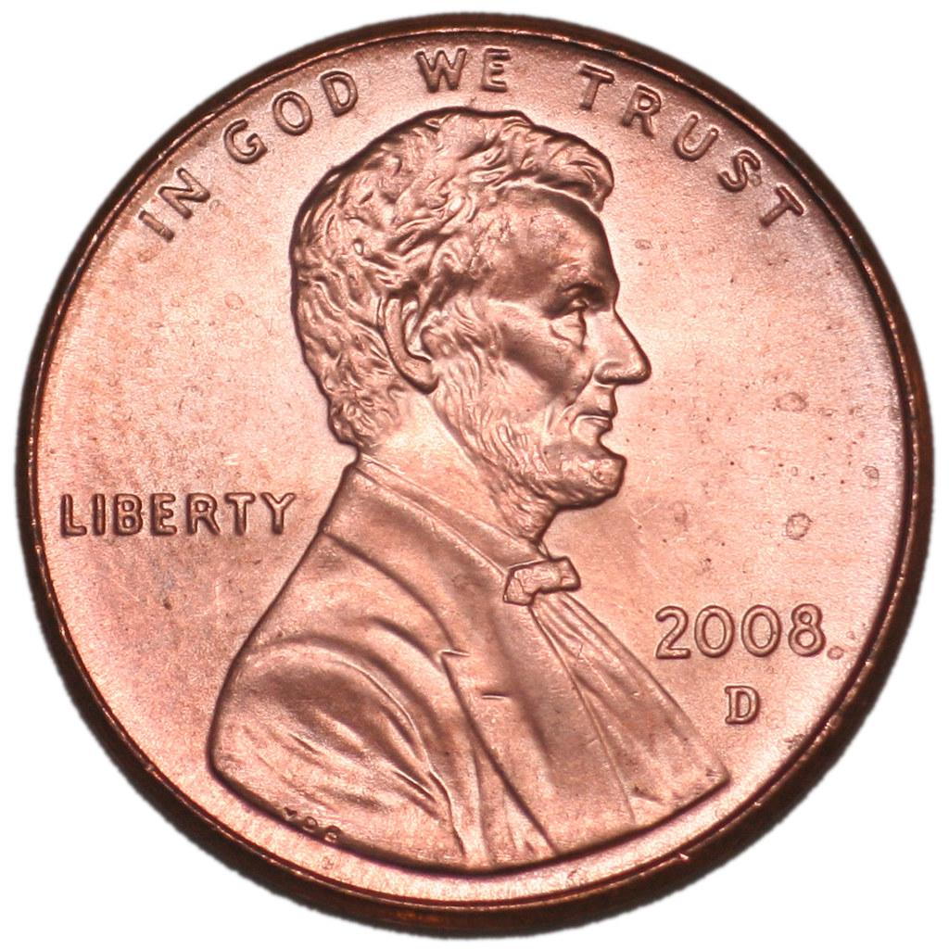
Controversial Topics
Controversial with differing sides
  ex: eminent domain
  proposed abolishment of the penny
  the locavore movement
  government censoring of the internet
  most important factors that an agency should consider when deciding whether to establish a wind farm
Think: topics which offer clear and distinct opposing views

Slide 4
Synthesis Questions
Type 1 – Persuasive₁
  Asked to defend, challenge, qualify a position on an argument
  “Carefully read the following sources, including the introductory information for each source. Then synthesize information from at least three of the sources and incorporate it into a coherent, well-developed essay that defends, challenges, or qualifies the claim that……”
1. Footnote: Based on the new rubric released by College Board, I’m guessing we will have this type

Slide 5
Synthesis Questions
Type 2 – analyze and/or evaluate
  Asked to look at issues surrounding a controversy
  “Carefully read the following sources, including the introductory information for each source. Then synthesize information from at least three of the sources and incorporate it into a coherent, well-reasoned essay that develops a position about what issues are most important in …….”

Slide 6
In 2nd type
  Not asked to take a position but asked to discuss what considerations are most important in making a decision on the controversy
ex. The abolishing of the penny

Slide 7

Overall Advice

Slide 8

Sources
It’s a potential trap!
  Don’t just summarize! (A common error!)
  Use the sources to develop and support your position/claim
  Your readers do not need or want a summary of the articles: they will be quite familiar with them--more than you will be!
  Your readers want to hear YOUR ARGUMENT
  “Be sure to put quotation marks around each section of material quoted from one of the sources, even if it is only a few words. Part of your score will reflect your careful use of sources” (Campbell 192)
  “……”(NYT Article).

Slide 9
Organization
Introduction
  STATE YOUR POSITION/CLAIM! Make the thesis statement strong and emphatic. Put it @ end of 1st par.
  FRONT-LOAD your concessions, just like FRQ 3
    C & C
  Personal anecdote, local issue, historical knowledge is great intro info (but only time you would use “I”)

Slide 10
Organization
Body paragraphs
  Strong topic sentences (AKA subclaims)!
  Spend significantly more time on your main point than on the concession/refutation.
    C&C: Concede: then CRUSH!
    You can still use, the “Although + C + Counter” formula from the arg.
  Use of sources that flow…..NO dumped quotes!
    Again, don’t fall into the trap
  Discuss reasons why…….big picture
  Discuss broader implications

Slide 11

Organization
3
You MUST use at least 3 of the sources
  Use as many as you can to strengthen your argument, but don’t fall into the trap!
Conclusion – yes, it’s best to have one
  Use pathos
Discuss the big picture (periodic parallel is a nice form in which to complete this)
Cheesy extended metaphor: 3-egg omelettes are the best

Slide 12
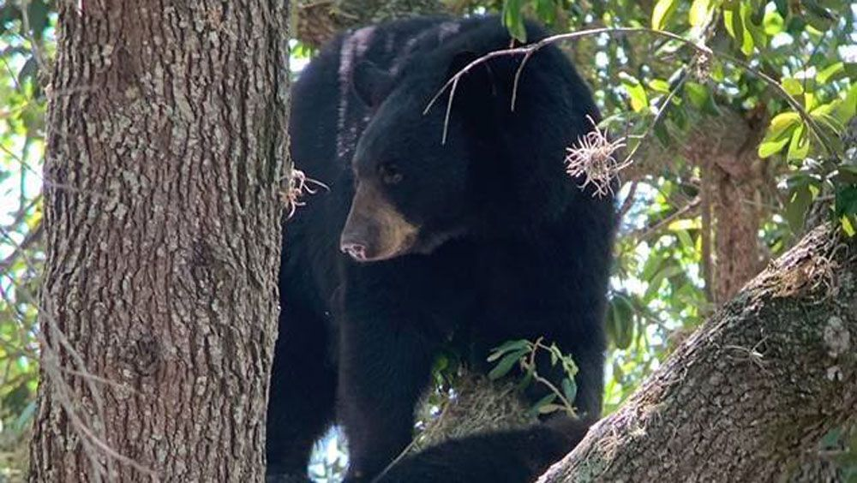
More Suggestions
Limit first person
Use academic language
  Incorporate quotes and evidence seamlessly
Use strong EFFECTIVE verbs per the poster:
  The source INDICATES, ASSERTS, SUGGESTS, ILLUSTRATES, DEMONSTRATES……
  btw….. a source never “talks about”
  Do not say, “In conclusion”

Slide 13

AA
AA
AA = Answer the Assignment
  Answer the Assignment in the first paragraph, probably the last sentence -- 2 if need be
Bend the sources to YOUR argument and YOUR position
Your argument should be the focus of your essay
For the top score the lingo is: “Crafting a nuanced argument by consistently identifying and exploring complexities or tensions across the sources.”

Slide 14

Handling Sources
­Make sure you cite by saying:
–…in Campbell’s essay (use last name)
–…in the article “Has Television Reshaped Politics?”
–Do NOT say “in source A” & do not use footnotes
Look for the nuggets that will make your omelette….I mean your argument... AWESOME

Slide 15

Handling Sources
­Look for the nuggets that will make your argument AWESOME
  What I mean is you don’t need to quote whole paragraphs, or even entire sentences
  Take the phrase, the idea, or a part of the quote, and use that “nugget” to strengthen your argument with solid support
    This will also help you avoid the trap

Slide 16




Be an Informed Citizen --
at least in May
­Yes, you can bring in outside information!
The topics often prove topical and current
The more you know about the world, the better chances you can tie in outside knowledge to whatever topic comes up
  For the top score, the new rubric states: “Articulating the implications or limitations of an argument (either the student’s argument or arguments conveyed in the sources) by situating it within a broader context.”

Slide 17
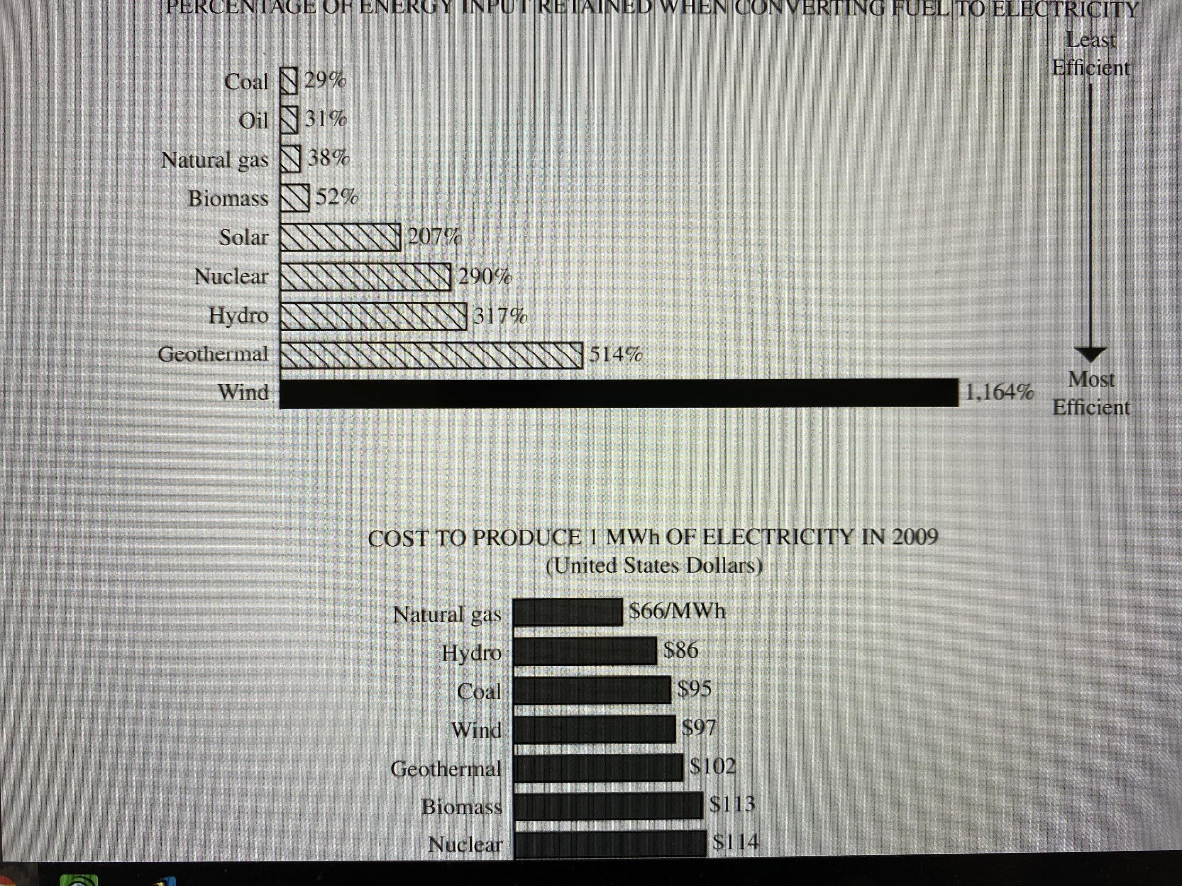
Chart or Graphic
Each synthesis includes at least 1 chart or graphic
  Practice reading political cartoons and discussing w/educated adults in your life
  Sometimes it is a chart: practicing reading and analyzing charts & drawing inferences & applying them to your argument
    In 2019, the FRQ included a chart breaking down the most efficient uses of electricity

Slide 18
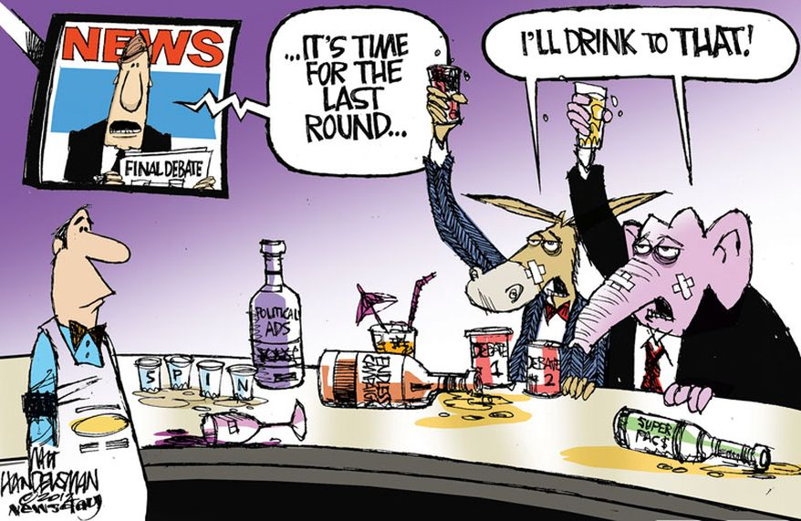
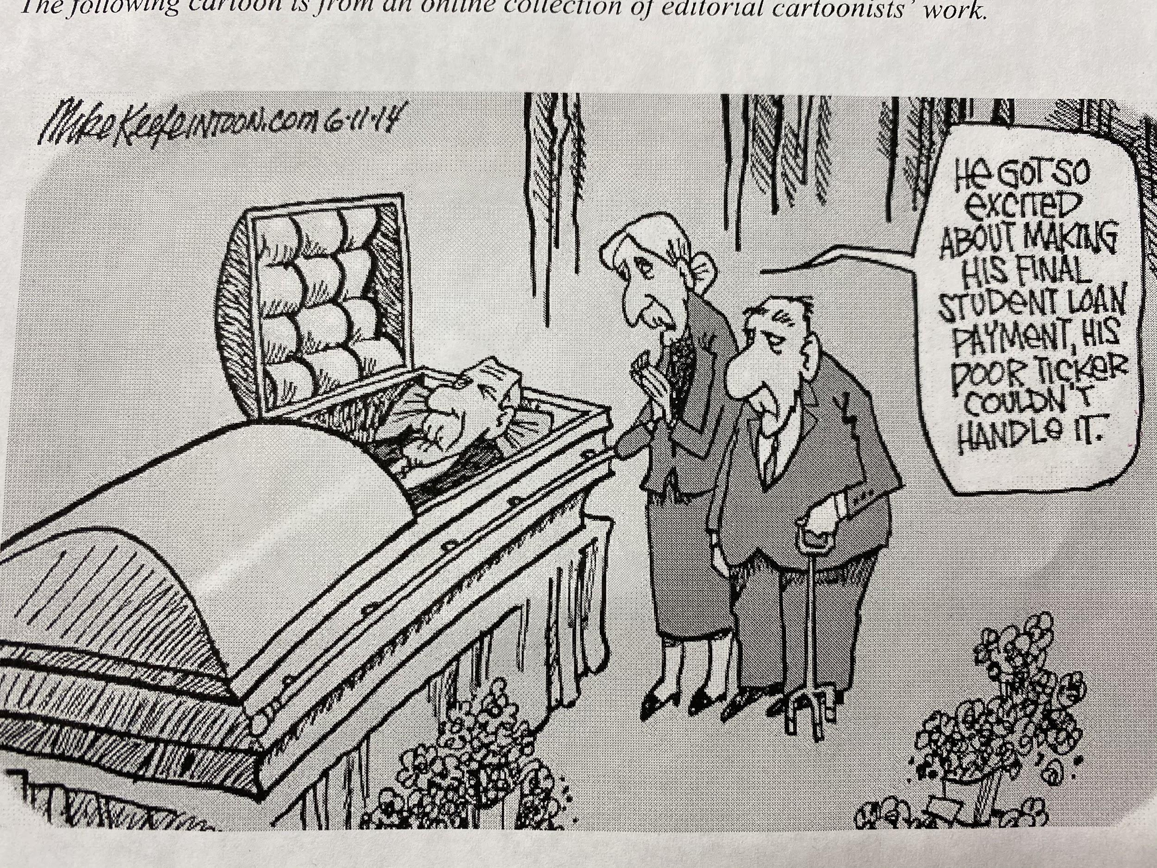
Chart or Graphic
Washington Times

Slide 19

Syllogism
Bears eat beets.
Bears sometimes step into bear traps.
You are not a bear.
Do not step into the synthesis trap.

Slide 20


Slide 21

How many sources?

Slide 22
Did I mention?
Your argument should be the focus of your essay

Slide 23
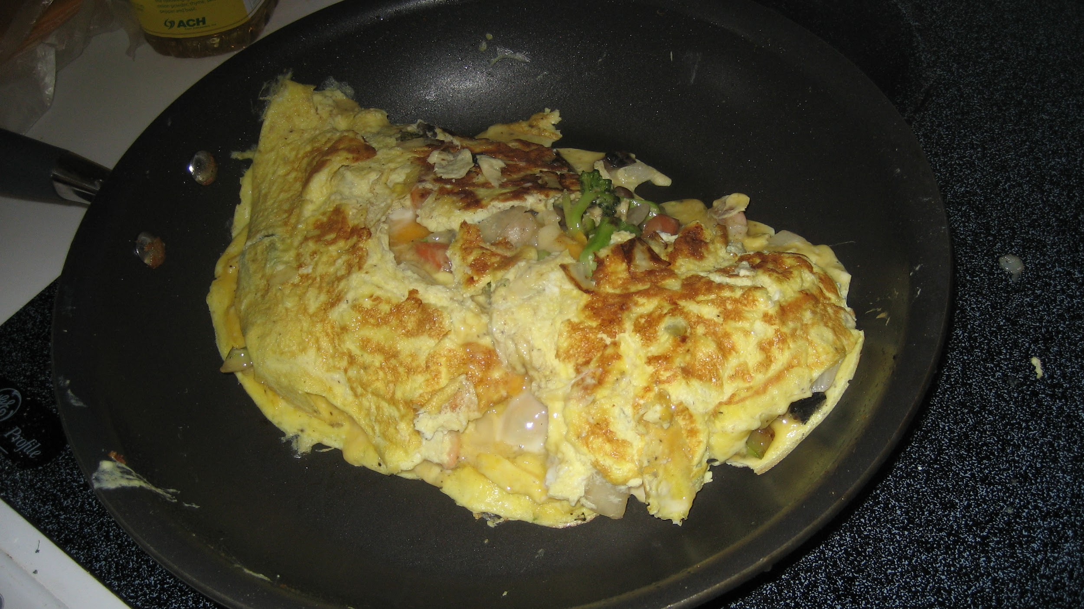

Questions on how to make an omelette?

