Slide 1
Social Justice
Craig Vincent Mitchell, PhD
Ethics and Political Economy Center

Slide 2
Biblical Justice
Justice and Righteousness
Justice- tsideq
This word pair is commonly used throughout the Old Testament
Justice is a synonym for righteousness
The difference is that justice is the state or characteristic of being just or fair while righteousness is (uncountable) the quality or state of being righteous; holiness; purity; uprightness; rectitude righteousness, as used in scripture and theology, in which it chiefly occurs, is nearly equivalent to holiness, comprehending holy principles and affections of heart, and conformity of life to the divine law.
“to make right.” Justice is, first and foremost, a relational term — people living in right relationship with God, one another, and the natural creation. ... As God is just and loving, so we are called to do justice and live in love.

Slide 3
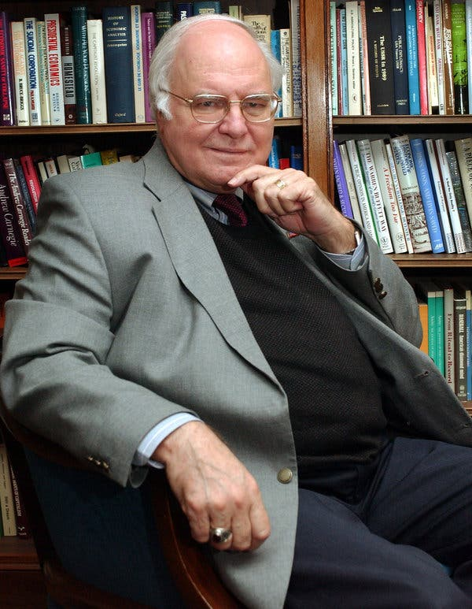
What is social justice? Michael Novak
For its proponents, "social justice" is usually undefined. Originally a Catholic term, first used about 1840 for a new kind of virtue (or habit) necessary for post-agrarian societies, the term has been bent by secular "progressive" thinkers to mean uniform state distribution of society's advantages and disadvantages. Social justice is really the capacity to organize with others to accomplish ends that benefit the whole community. If people are to live free of state control, they must possess this new virtue of cooperation and association. This is one of the great skills of Americans and, ultimately, the best defense against statism.

Slide 4
What is Social Justice?
Social Justice- (noun) justice in terms of the distribution of wealth, opportunities, and privileges within a society. OED
"individuality gives way to the struggle for social justice
Social justice is a concept of fair and just relations between the individual and society, as measured by the distribution of wealth, opportunities for personal activity, and social privileges.
In Western as well as in older Asian cultures, the concept of social justice has often referred to the process of ensuring that individuals fulfill their societal roles and receive what was their due from society. In the current global grassroots movements for social justice, the emphasis has been on the breaking of barriers for social mobility, the creation of safety nets and economic justice.

Slide 5
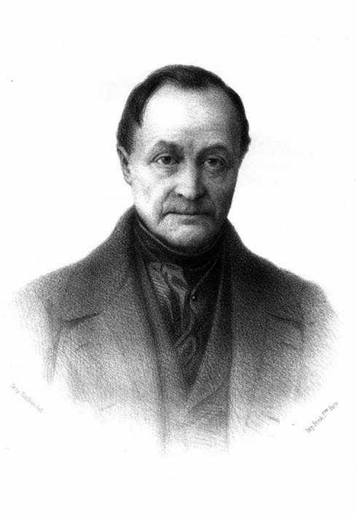
Positivism and Social Justice
Auguste Comte, 19 January 1798 – 5 September 1857)
He was a French philosopher and writer who formulated the doctrine of positivism.
He is often regarded as the first philosopher of science in the modern sense of the term. Comte is also seen as the founder of the academic discipline of sociology.
He viewed sociology as the queen of the sciences.

Slide 6
Positivism and Social Justice
Comte first described the epistemological perspective of positivism in The Course in Positive Philosophy, a series of texts published between 1830 and 1842.
These texts were followed by the 1848 work, A General View of Positivism (published in English in 1865).
The first three volumes of the Course dealt chiefly with the physical sciences already in existence (mathematics, astronomy, physics, chemistry, biology), whereas the latter two emphasized the inevitable coming of social science.
Theological Stage:
Before the enlightenment
Metaphysical Stage:
Metaphysical Realism
Positive Stage:
Pure Science

Slide 7
Social Justice and The Social Sciences
Social Sciences
Political Science
Sociology
Economics
Law

Slide 8
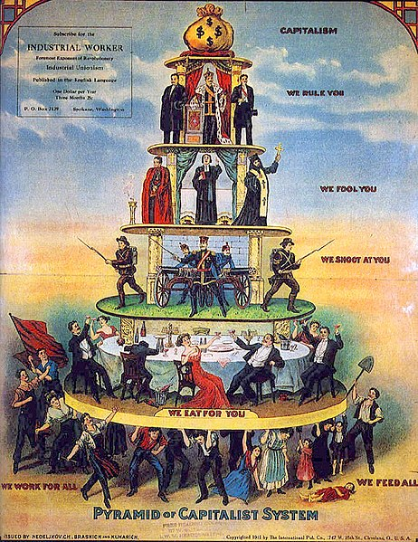
Social justice and Social Stratification
Social stratification is a term used in the social sciences to describe the relative social position of persons in a given social group, category, geographical region or other social unit.
It derives from the Latin strātum (plural '; parallel, horizontal layers) referring to a given society's categorization of its people into rankings of socioeconomic tiers based on factors like wealth, income, social status, occupation and power.
In modern Western societies, stratification is often broadly classified into three major divisions of social class: upper class, middle class, and lower class
Social may also be delineated on the basis of kinship ties or caste relations.

Slide 9
Explanations of Social Stratification: Sociology
Structural Functionalism
Conflict Theory
Structural functionalism, or simply functionalism, is "a framework for building theory that sees society as a complex system whose parts work together to promote solidarity and stability".
This approach is a broad focus on the social structures that shape society as a whole, and believes that society has evolved like organisms. This approach looks at both social structure and social functions.
Functionalism addresses society as a whole in terms of the function of its constituent elements such as: customs, norms, traditions, and institutions.
It suggests that society is a meritocracy.
Conflict theories, such as Marxism, point to the inaccessibility of resources and lack of social mobility found in stratified societies. Many sociological theorists have criticized the fact that the working classes are often unlikely to advance socioeconomically while the wealthy tend to hold political power which they use to exploit the proletariat (laboring class).

Slide 10
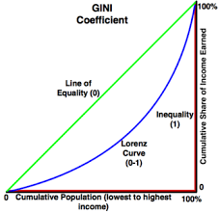
Explanation of Social Stratification: Economics
The Gini index or Gini coefficient is a statistical measure of distribution developed by the Italian statistician Corrado Gini in 1912. It is often used as a gauge of economic inequality, measuring income distribution or, less commonly, wealth distribution among a population.

Slide 11
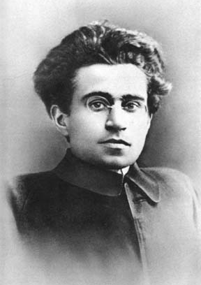
Explanation of Social Stratification: Politics
Gramsci is best known for his theory of cultural hegemony, which describes how the state and ruling capitalist class – the bourgeoisie – use cultural institutions to maintain power in capitalist societies. The bourgeoisie, in Gramsci's view, develops a hegemonic culture using ideology rather than violence, economic force, or coercion. Hegemonic culture propagates its own values and norms so that they become the "common sense" values of all and thus maintain the status quo.

Slide 12
Explanation of Social Stratification: Politics
Judges
Politicians
Clergy
Professors
Hegemonic power is therefore used to maintain consent to the capitalist order, rather than coercive power using force to maintain order. This cultural hegemony is produced and reproduced by the dominant class through the institutions that form the superstructure.
Hegemonic power is maintained by the “robes” of the superstructure. Gramsci believed that by filling these positions, that a counter hegemony could be attained and that the status quo could be changed.
Believing in the need for a working class culture, Gramsci developed what is now commonly called “Cultural Marxism.”
He was the first to develop critical theory

Slide 13
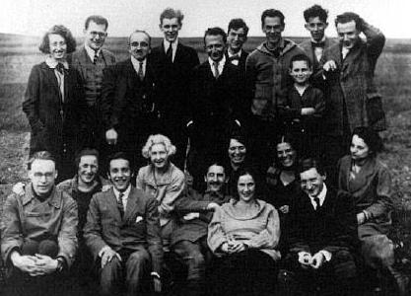
Explanation of Social Stratification: Politics
The Frankfurt School is a school of social theory and critical philosophy associated with the Institute for Social Research, at Goethe University Frankfurt.
The Frankfurt School comprised intellectuals, academics, and political dissidents who were critical of capitalism and of Marxism–Leninism as philosophically inflexible systems of social organization.
The School's critical theory research indicated alternative paths to realizing the social development of a society and a nation.

Slide 14
Explanation of Social Stratification: Politics
The Combahee River Collective
Results
A Black feminist, lesbian organization active in Boston from 1974 to 1980. The Collective was instrumental in highlighting that both the white feminist movement and the Civil Rights movement were not addressing their particular needs as Black lesbians.
The mainstream feminist movement was at large silent on issues that affected specifically Black and/or queer women, while much of the Civil Rights movement had a homophobic reputation.
Combahee River Collective Statement, a key document in the history of contemporary Black feminism and the development of the concepts of identity as used among political organizers and social theorists.
Combahee River Collective
Identity Politics
Intersectionality

Slide 15
Explanation of Social Stratification: Politics
Intersectionality is a theoretical framework for understanding how aspects of one's social and political identities (e.g. gender, race, class, sexuality, ability, etc.) might combine to create unique modes of discrimination. It aims to broaden the agenda of the first waves of feminism, which largely focused on the experiences of white, middle class women.
For example, a black woman might face discrimination from a company that is not distinctly due to her race (because the company does not discriminate against black men) nor her gender (because the company does not discriminate against white women), but by a unique combination of the two.
The term was coined by black feminist scholar Kimberlé Williams Crenshaw in 1989.
There are various forms of social stratification such as class, race, sexual orientation, age, religion, creed, ability, and gender, which are included in the consideration of intersectional feminism and its social and cultural effects.
The purpose of intersectionality as a theory is to identify how overlapping categories of identity impact individuals and institutions, and take these relationships into account when working to promote social and political equity.

Slide 16
Explanation of Social Stratification: Law
Legal Realism
Critical Legal Studies (CLS)
Legal Realism is a rejection of Natural Law by Progressivist legal scholars.
Legal realism is a naturalistic approach to law. It is the view that jurisprudence should emulate the methods of natural science, i.e., rely on empirical evidence. Hypotheses must be tested against observations of the world.
Legal realists believe that legal science should only investigate law with the value-free methods of natural sciences.
The focus of all legal realists is on legal science proper.
is a school of critical theory that first emerged as a movement in the United States during the 1970s.
Critical Legal Studies adherents claim that laws are used to maintain the status quo of society's power structures; it is also held that the law is a codified form of society's biases against marginalized groups.

Slide 17
Explanation of Social Stratification: Law
Critical Race Theory began as a theoretical movement within American law schools in the mid- to late 1980s as a reworking of critical legal studies on race issues, and is loosely unified by two common themes:
First, CRT proposes that white supremacy and racial power are maintained over time, and in particular, that the law may play a role in this process.
Second, CRT work has investigated the possibility of transforming the relationship between law and racial power, and more broadly, pursues a project of achieving racial emancipation and anti-subordination.
By 2002, over 20 American law schools and at least three law schools in other countries offered critical race theory courses or classes which covered the issue centrally.
Critical race theory is taught and innovated in the fields of education, law, political science, women's studies, ethnic studies, communication, and American studies.
Legal Realism
Critical Legal Theory
Critical Race Theory
Natural Law

Slide 18
Social Justice and Social Stratification
 | Left | Right
Sociology | Conflict theories: Critical theory, feminism, etc. | Structural functionalism
Politics | Progressivism, socialism, fascism, communism | Classical liberalism/ conservativism
Economics | Marxism- | Free Markets/ Capitalism
Law | Legal Realism Critical Race Theory | Natural Law

Slide 19
Social Justice and Theology
Postmodern Theology
Liberation Theologies
Critical
Race Theory
Intersectionality
Liberation theologies are fellow travelers with critical race theory and intersectionality.
Both Critical Race Theory and Intersectionality have made their way into the theological discussion.
Both Catholic and Protestant groups have adopted aspects of CRT and Intersectionality.
This is even true of many Evangelical institutions.

Slide 20
Social Justice and Theology
Liberation Theologies
South American
Black
Feminist
Liberation theology is a synthesis of Christian theology and socio-economic analyses, based on Marxism.
In the 1950s and the 1960s, liberation theology was the political praxis of Latin American theologians, such as Gustavo Gutiérrez of Peru, Leonardo Boff of Brazil, Juan Luis Segundo of Uruguay, and Jon Sobrino of Spain.
The Latin American context also produced evangelical advocates of liberation theology, such as C. René Padilla of Ecuador, Samuel Escobar of Peru, and Orlando E. Costas of Puerto Rico, who, in the 1970s, called for integral mission, emphasizing evangelism and social responsibility.
Theologies of liberation have developed in other parts of the world such as black theology in the United States and South Africa, Palestinian liberation theology, Dalit theology in India, and Minjung theology in South Korea.

