Slide 2
Craig Vincent mitchell, PhD
Associate Professor of Christian Ethics
Southwestern Baptist theological Seminary
Religious Pluralism:
The Economics of Religion

Slide 3
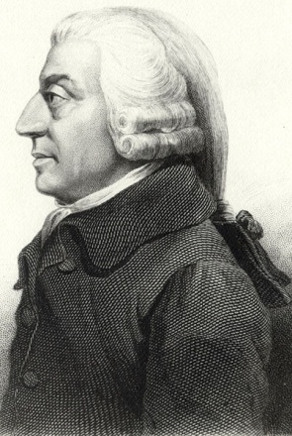
Adam Smith on Religion
Wealth of Nations
Adam Smith
bk. 5, CH. 1, PT. 3, ART. 3
Of the Expence of the Institutions for the Instruction of People of all Ages

Slide 4
Adam Smith on Religion
The institutions for the instruction of people of all ages are chiefly those for religious instruction. This is a species of instruction of which the object is not so much to render the people good citizens in this world, as to prepare them for another and a better world in a life to come. The teachers of the doctrine which contains this instruction, in the same manner as other teachers, may either depend altogether for their subsistence upon the voluntary contributions of their hearers; or they may derive it from some other fund to which the law of their country may entitle them; such as a landed estate, a tythe or land tax, an established salary or stipend. Their exertion, their zeal and industry, are likely to be much greater in the former situation than in the latter.

Slide 5
Adam Smith on Religion
The clergy of an established and well-endowed religion frequently become men of learning and elegance, who possess all the virtues of gentlemen, or which can recommend them to the esteem of gentlemen; but they are apt gradually to lose the qualities, both good and bad, which gave them authority and influence with the inferior ranks of people, and which had perhaps been the original causes of the success and establishment of their religion.

Slide 6
Adam Smith on Religion
Such a clergy, upon such an emergency, have commonly no other resource than to call upon the civil magistrate to persecute, destroy, or drive out their adversaries, as disturbers of the public peace. It was thus that the Roman catholic clergy called upon the civil magistrate to persecute the protestants; and the church of England, to persecute the dissenters; and that in general every religious sect, when it has once enjoyed for a century or two the security of a legal establishment, has found itself incapable of making any

Slide 7
Adam Smith On Religion
Clergymen work harder when they are paid by their congregation
Clergymen will act rationally and will attempt to maximize their utility
Churches can be viewed as firms and they participate in a religious market structure
Clergymen desire monopoly and will seek the aid of politicians to get it.
With religious monopoly clergymen become lazy and immoral

Slide 8
Factors of Production
Religious Capital
Religious Labor
Tithes
Gifts
Offerings
Buildings
Equipment
Church staff
Church members/ workers

Slide 9
Religious Products
Churches should produce:
  new converts
  New churches
Spillover effects:
  Positive externalities
  Moral effect on the community
  Helping the poor
  Help in emergencies
  Negative externalities
    Religious conflict or low economic growth

Slide 10
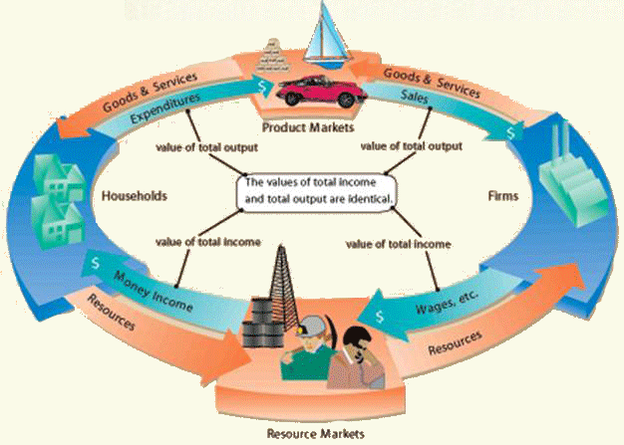
The Microeconomic Circular Flow

Slide 11
Market Structure
Market Structure
Perfect Competition
Oligopoly
Monopoly
Monopolistic Competition

Slide 12
Religious Market Structure
Official State Religion
Monopoly
Only one religion sanctioned
Very difficult to establish other religions
Religious adherence has high cost
Clergy is unresponsive
Examples: most Islamic countries,
Can produce negative externalities like lower economic growth
Only one firm
Firms have barriers to entry
The government gives a single firm the exclusive right to produce some good or service
Firm is a price maker
A single firm can produce output at a lower cost than can a larger number of firms

Slide 13
Religious Market Structure
Semi- pluralistic
Oligopoly
Examples include: Post Reformation Europe with Roman Catholic, Protestant and Jewish religions
Positive externalities
Negative externalities include religious war/conflict
Only a few firms
Everyone is a price taker
Danger of collusion or cartels

Slide 14
Religious Market Structure
Semi- Pluralistic
Monopolistic Competition
Examples include: America before 1963 with Roman Catholic, Protestant and Jewish religions
Spillover effects are positive externalities
many firms
Firms produce differentiated goods
Everyone is a price taker
Firms have ease of entry and exit
No spillover effects
Perfect information

Slide 15
Religious Market Structure
Pluralism: Religious Liberty
Perfect Competition
Many religions: pluralism
All offer salvation
Easy to start a religion
Examples include: USA after 1963
Spillover effects are positive externalities
Many buyers and sellers
Homogenous goods
Firms have ease of entry and exit
Everyone is a price taker
No spillover effects
Perfect information

Slide 16

Economics of Religion
Rodney Stark, PhD
Professor at Baylor University.
Religious liberty means religious preference
Religious marketplace suggests the application of consumer choice theory
Religious marketplace also implies that rational choice theory can be used to analyze religion
Comity agreements act as cartels

Slide 17
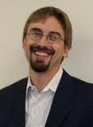
Economics of Religion
Laurence Iannaccone, PhD
Professor at George Mason University.
Adam Smith argued that self-interest motivates clergy just as it does secular producers; that market forces constrain churches just as they do secular firms; and that the benefits of competition, the burdens of monopoly, and the hazards of government regulation are as real in religion as in any other sector of the economy.

Slide 18
Economics of Religion vs. Religious Economics
Economics of Religion
Religious Economics
It applies economic perspectives to the domain of conventional religious beliefs
Related to sociology of religion
Why do some congregations/ denominations grow, while others shrink?
The commercial side of religion
Religious contributions
Congregational assets and expenses
Islamic economics
Christian economics
What is the Christian view of wealth and poverty?

Slide 19
International Economics of Religion
Harvard University economics professor Robert Barro has an interest in the relationship between, economics, politics and religion. There are three studies in particular that he did with Rachel McCleary that are of some significance. In each of these papers, they employed econometric methods to analyze religious and economic data.

Slide 20
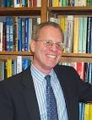

International Economics of Religion
Robert Barro
Rachel McCleary

Slide 21
Barro and McCleary: Religion and Political Economy in an International Panel, 2002.
They investigated the way that economic and political developments affect religiosity and vice versa. In this study, they used data gathered over a twenty year period for fifty-nine different countries.

Slide 22
Barro and McCleary:
Religion and Political Economy in an International Panel, 2002.
State religion promotes monopoly and therefore, poor service and low rates of church attendance.”
State religion results in a low degree of religious pluralism.
An increase in religious beliefs (at least belief in heaven) or a decrease in church attendance tends to stimulate economic growth.”
The measures of religiosity are positively related to education and negatively to urbanization.
Enhanced life expectancy and reduced fertility are inversely related to church attendance but have weak associations with religious beliefs.”

Slide 23
Barro and McCleary:
Religion and Economic Growth, 2003
Focused on the relationship between religion and economic growth. They used data from 87 countries. They sought to “determine how church attendance and beliefs co-vary with per capita GDP, education, and urbanization, while holding fixed other measures of economic development and the other independent variables.”

Slide 24
Barro and McCleary:
Religion and Economic Growth, 2003.
Economic growth responds positively with religious beliefs, notably those in heaven and hell, but negatively to church attendance.
There is a weak correlation with economic growth when church attendance and religious beliefs “move together.”
Roman Catholicism and Muslim religious services was higher than for other religions. The same is true for belief in heaven and hell.
Higher religious beliefs stimulate growth because they help to sustain aspects of individual behavior that enhance productivity.
Higher church attendance is accompanied by lower economic growth because of a larger use of resources by the religion sector. In other words, the social capital associated with higher church attendance is expensive.

Slide 25
Barro and McCleary:
International Determinants of Relgiosity, 2003.
Increases in GDP result in decreased religiosity.
There is a causal relationship between GDP and religiosity. The more the economic growth a country experiences, the less religious the people become.
The existence of a state religion increases religiosity. This is the result of government subsidies to the state religion.
Government regulation of the religious marketplace reduces religiosity.
Religiosity is positively related to education and the presence of children and negatively related to urbanization

Slide 26

The Church and Society
Association of Christian Economists
Journal
Faith and Economics, Number 55, Spring 2010
Love thy Neighbor as thyself: Community Formation and the Church
Thomas Deliere
Thomas Jeitschko
Seamus O’Connell
Rowena A. Pecchenino

Slide 27
The Church and Society
A secular equilibrium is always in existence that is based upon the state and culture. If this is unbalanced by Religious Equilibrium then society may unravel. Men are inherently moral creatures and the church provides moral norms that ensure a civil society.
A Religious Equilibrium exists when a minimum level of religious devotion exists and a minimum level of financial resources

Slide 28
The Church and Society
An equilibrium in which agents sustain religious participation does not exist if the Church lacks sufficient moral authority
In the religious equilibrium, an increase in Church membership yields higher religious participation by individual members and results in higher levels of spirituality and over-all wellbeing

Slide 29
The Church and Society
In religious equilibrium, a strengthening of Church doctrine and an improvement of the quality of Church leadership yields higher religious participation by members and results in higher levels of spirituality and over-all wellbeing.
In the religious equilibrium, an increase in the financial resources available to the Church yields higher religious participation by members and results in higher levels of spirituality and over-all wellbeing

Slide 30
The Church and Society
In the religious equilibrium, an increase in the socially minimal requirements on time spent at leisurely activities yields diminished religious participation by members and results in lower levels of spirituality and overall wellbeing.

Slide 31


The Religious Individual
Arthur Brooks
Economics of Happiness

Slide 32
The Religious Individual
“Religious people of all faiths are much happier than secularists on average. In 2004, 43 percent of religious folks said they were very happy with their lives, versus 23 percent of secularists.” He also notes that money, age, education, family status, race, or sex do not affect the happiness of religious or secular people. Religious people tend to have more children than secular people. In fact, Brooks finds a 41 percent fertility gap.

Slide 33
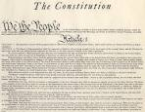
Religious Market Structure in America
Congress shall make no law respecting an establishment of religion, or prohibiting the free exercise thereof; or abridging the freedom of speech, or of the press; or the right of the people peaceably to assemble, and to petition the Government for a redress of grievances.

Slide 34
Religious Market Structure in America
In the beginning, The USA had a religious market structure that was largely a monopoly of protestant denominations
Beginning in the 1800s, there was a large immigration from Europe with many Roman Catholics. The religious market structure, became more of a monopolistic competition.
Until 1963, the religious market structure in the USA was monopolistic competition. This was because there were mai

Slide 35

Religious Market Structure in America
Creative Destruction
Joseph Schumpeter
In a free market system, the entrepreneur must be wise with his capital and labor. If he is not, then his firm will fail. His capital and labor will then go to another who will use these resources efficiently

Slide 36
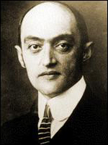
Religious Market Structure in America
The Entrepreneur
Joseph Schumpeter
Schumpeter argued that the innovation and technological change of a nation come from the entrepreneurs, or wild spirits. He coined the word Unternehmergeist, German for entrepreneur-spirit.

Slide 37
Religious Market Structure in America
The Entrepreneur- Pastors and especially church planters are social entrepreneurs.
Creative Destruction- Pastors must be wise and efficient with their capital (finances, facilities, equipment) and labor (church staff, and church members) or they will lose them to other Churches who will be.
Pastors must continually seek to grow their congregations and or plant new churches

Slide 38
Conclusions: The Church
The Church can be viewed as a firm
In the USA, we have freedom of religion, consequently we have a perfect competition religious market structure
Creative destruction applies to churches, denominations, and religions

Slide 39
Conclusions: Pastors
Pastors and church planters are entrepreneurs
  Pastors must constantly review their situation to make sure that they are using their capital and labor wisely
  Pastors must work hard to reach new people with the Gospel
Pastors and religious leaders must model and maintain moral purity
Pastors and religious leaders must teach sound doctrine
Especially true for youth pastors

Slide 40
Conclusions: Laity
Truly committed believers are happier
Truly committed believers live holy lives
Truly committed believers adhere to sound doctrine
Truly committed believers give
Truly committed believers share their faith
Truly committed believers will have stronger marriages and larger families

