Slide 1
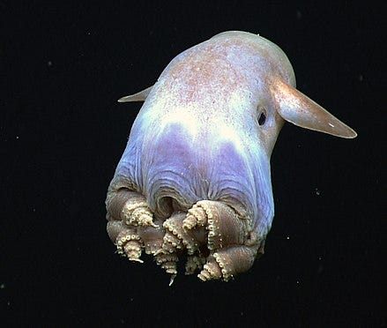
Learning Intention:
Describe bathymetric features of the ocean floor, including the continental margin, ocean-basin floor, deep-sea trenches, mid-ocean ridges, abyssal plain
Success Criteria:
Complete Marine Education worksheet ‘1. Explore the Floor’
Notes:
Image: https://medium.com/@amykwilson/weird-and-wonderful-creatures-of-the-deep-sea-66826a3ae5e4

Slide 2
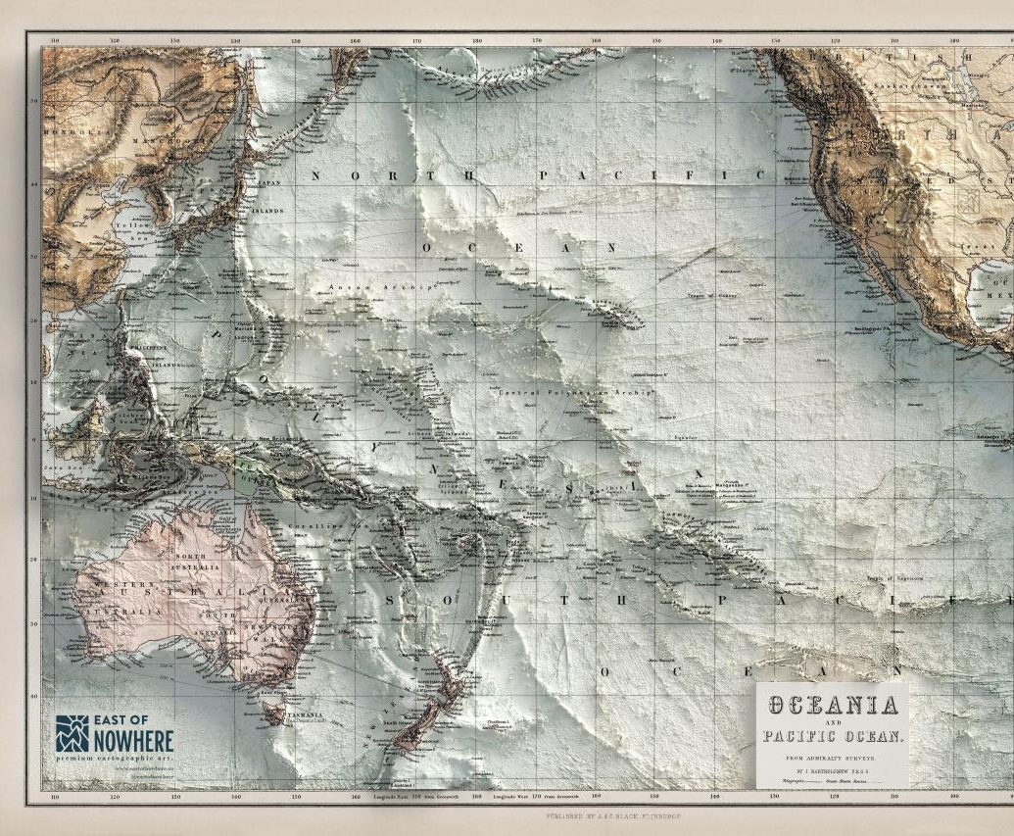
ocean
Bathymetry:
“the depths and shapes of underwater features”
Notes:
Image: https://mapsontheweb.zoom-maps.com/post/664689059746217984/the-bathymetry-of-the-pacific-ocean

Slide 3
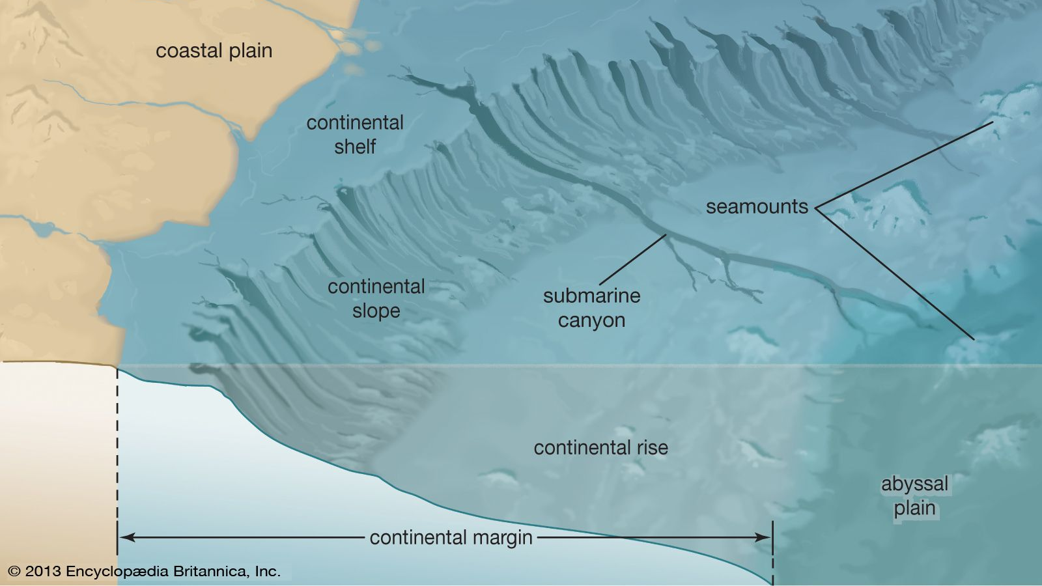
(Shelf + Slope + Rise)

Slide 4
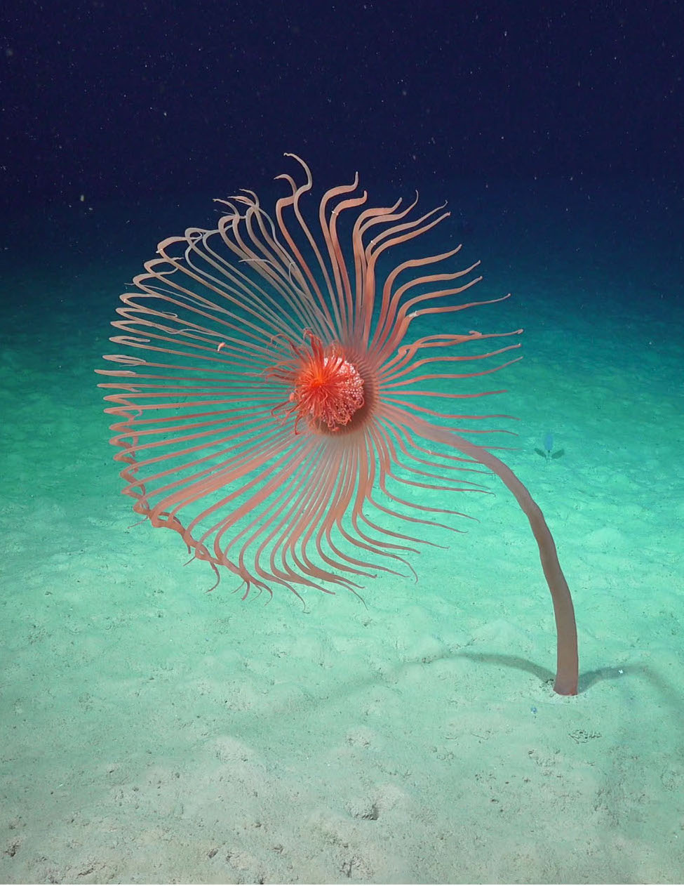
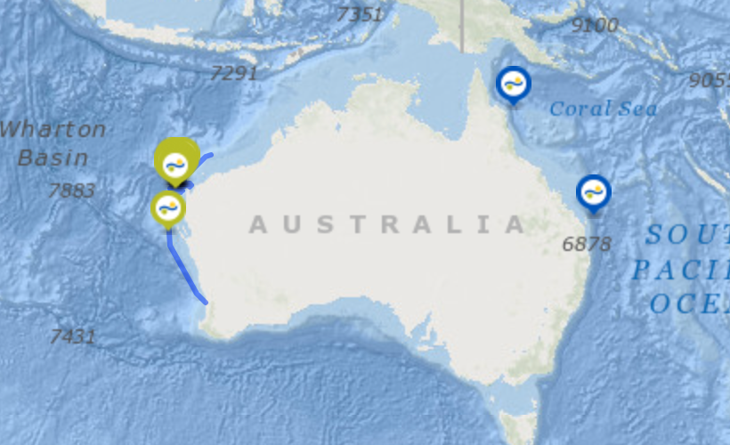
A rare hydroid discovered thousands of metres down on the sea floor of
Cape Range Canyon (Ningaloo, Western Australia).
It is the first time this amazing animal has been filmed and collected in Australian waters.
It stood 1m tall.
Image: Schmidtocean.org/
Notes:
Image: https://schmidtocean.org/collection/illuminating-biodiversity-of-the-ningaloo-canyons/

Slide 5
https://www.youtube.com/watch?v=6C3xulQuGWI&t=145s
Notes:
https://www.youtube.com/watch?v=6C3xulQuGWI&t=145s

Slide 6
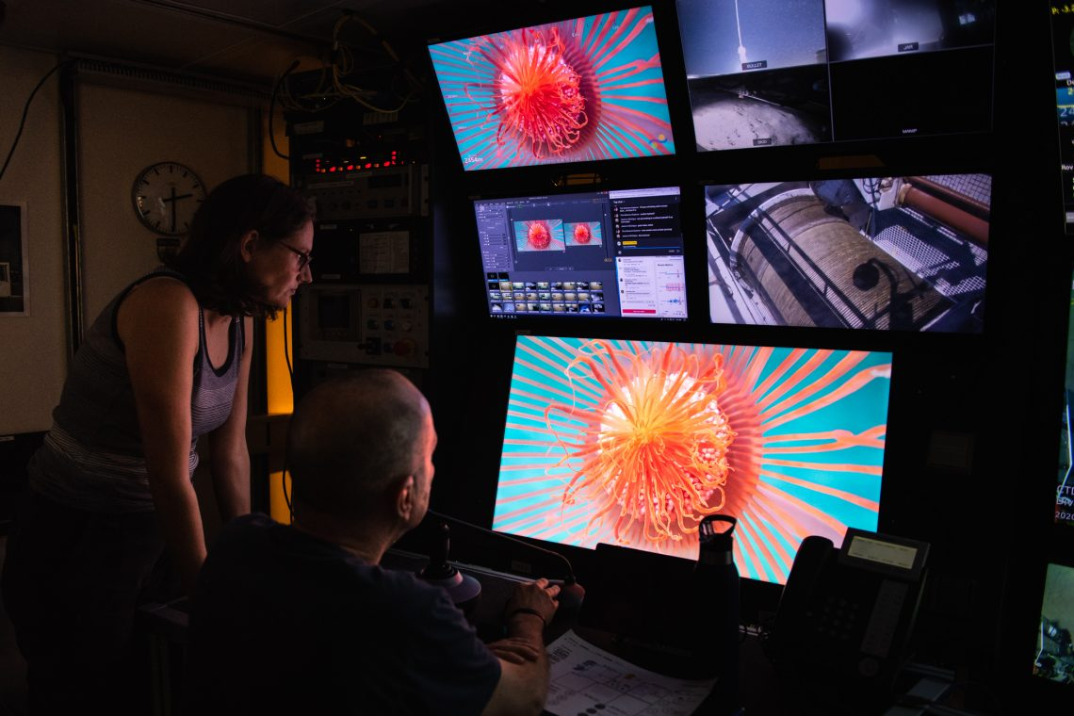
Notes:
https://schmidtocean.org/collection/illuminating-biodiversity-of-the-ningaloo-canyons/

Slide 7
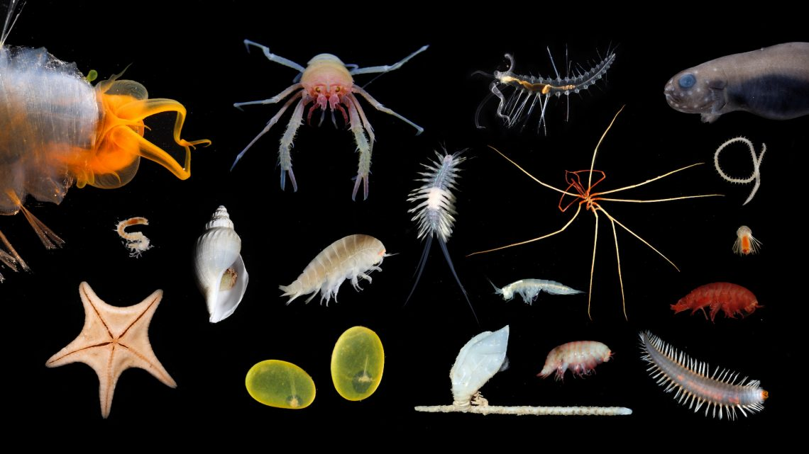
Notes:
https://schmidtocean.org/collection/illuminating-biodiversity-of-the-ningaloo-canyons/

Slide 8
Notes:
Image: Schmidt Institute

Slide 9
Notes:
Image: Schmidt Institute

Slide 11
Notes:
Image: Schmidt Institute

Slide 12
Notes:
Image: Schmidt Institute

Slide 13
Notes:
Image: Schmidt Institute

Slide 14
Notes:
Image: Schmidt Institute

Slide 15
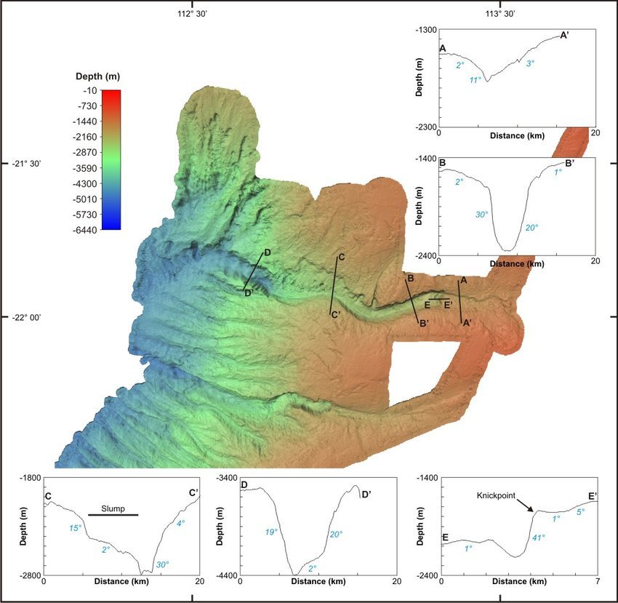
Submarine canyons
Steep-walled cliffs, shaped like a ‘V’,
that cut into the continental margin.
This is a cross section of one found off the Western Australian coast, called the ’Cape Range Canyon’ (near Ningaloo Reef).
It’s walls are 1000m high (BB).
Notes:
Image: https://schmidtocean.org/wp-content/uploads/False-colour-bathymetry-image-of-Cape-Range-Canyon-and-Cloates-Canyon-see-Fig-53.jpg
Zhi Huang, Scott L. Nichol, Peter T. Harris, M. Julian Caley, Classification of submarine canyons of the Australian continental margin, Marine Geology, Volume 357, 2014, Pages 362-383, ISSN 0025-3227, https://doi.org/10.1016/j.margeo.2014.07.007.

Slide 16
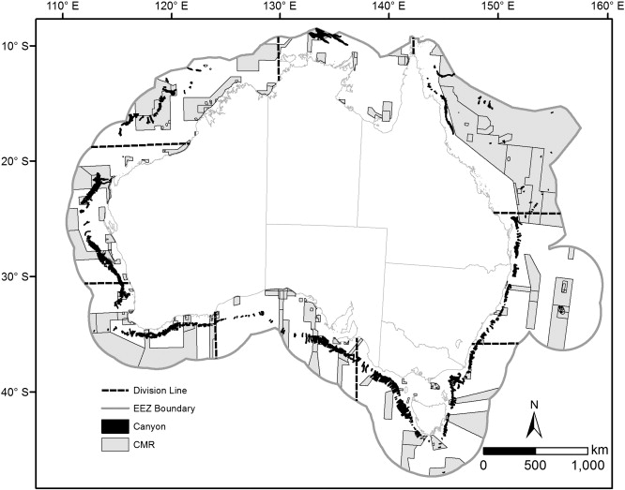
There are 713 submarine canyons on
Australia’s continental margin.
Note: grey areas are Commonwealth Marine Reserves (CMR)
Notes:
Zhi Huang, Scott L. Nichol, Peter T. Harris, M. Julian Caley, Classification of submarine canyons of the Australian continental margin, Marine Geology, Volume 357, 2014, Pages 362-383, ISSN 0025-3227, https://doi.org/10.1016/j.margeo.2014.07.007.

Slide 17
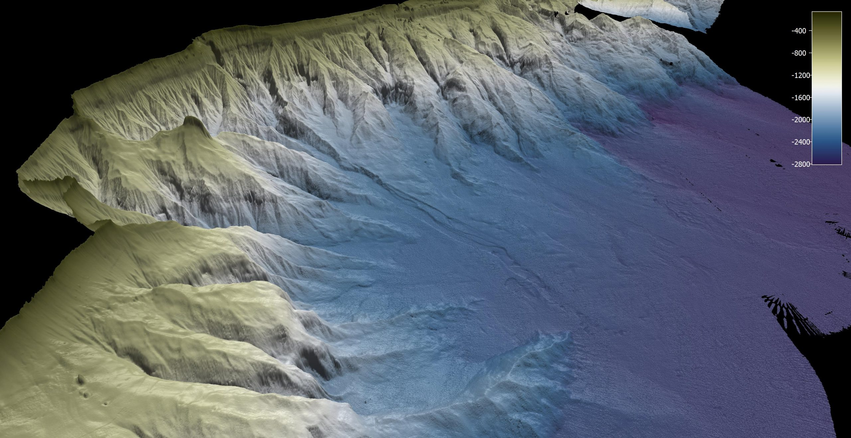
Sediment flowing down submarine canyons resemble waterfalls on land
2500m
3D view of 14 separate canyons offshore of Princess Charlotte Bay, Cape York.

Slide 18
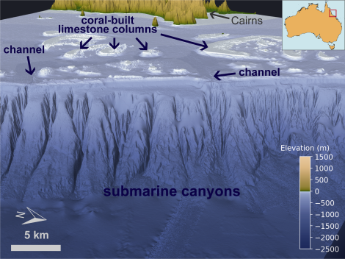
Submarine canyons off the Great Barrier Reef (Cairns)
Then , after the continental margin…
is the deep ocean basin floor.
Notes:
Image: https://grgusyd.org/2020/07/20/how-the-great-barrier-reef-sculpts-underwater-landscapes/

Slide 19
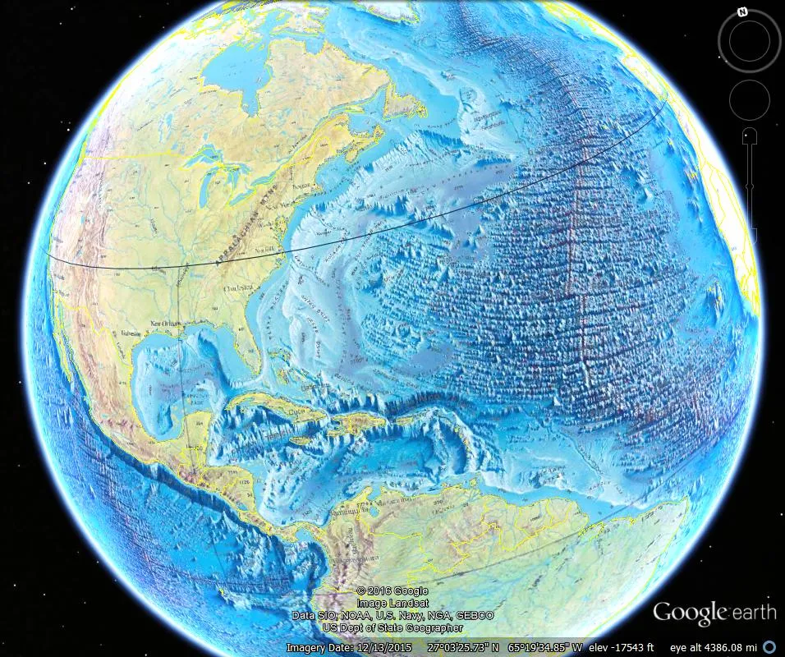
In the deep ocean, features include abyssal plains, deep sea trenches, seamounts and mid-ocean ridges.

Slide 20
https://www.youtube.com/watch?v=vkfTSlTnaBQ
Notes:
https://www.youtube.com/watch?v=vkfTSlTnaBQ

Slide 21
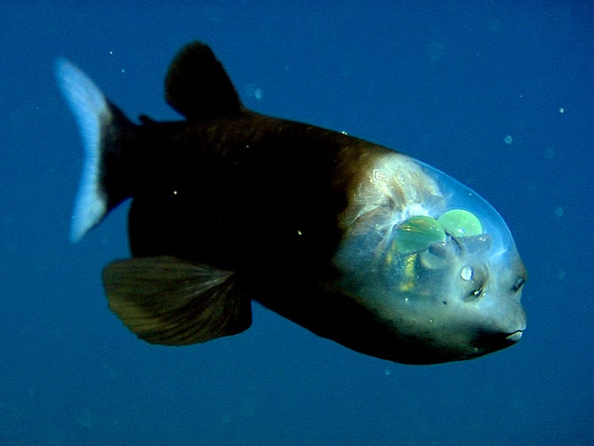
The barreleye, also known as a spook fish, has extremely light-sensitive eyes on the top of its fluid-filled head.
Notes:
Image: https://www.insider.com/strange-deep-sea-creatures-trivia-facts-2018-4

Slide 22
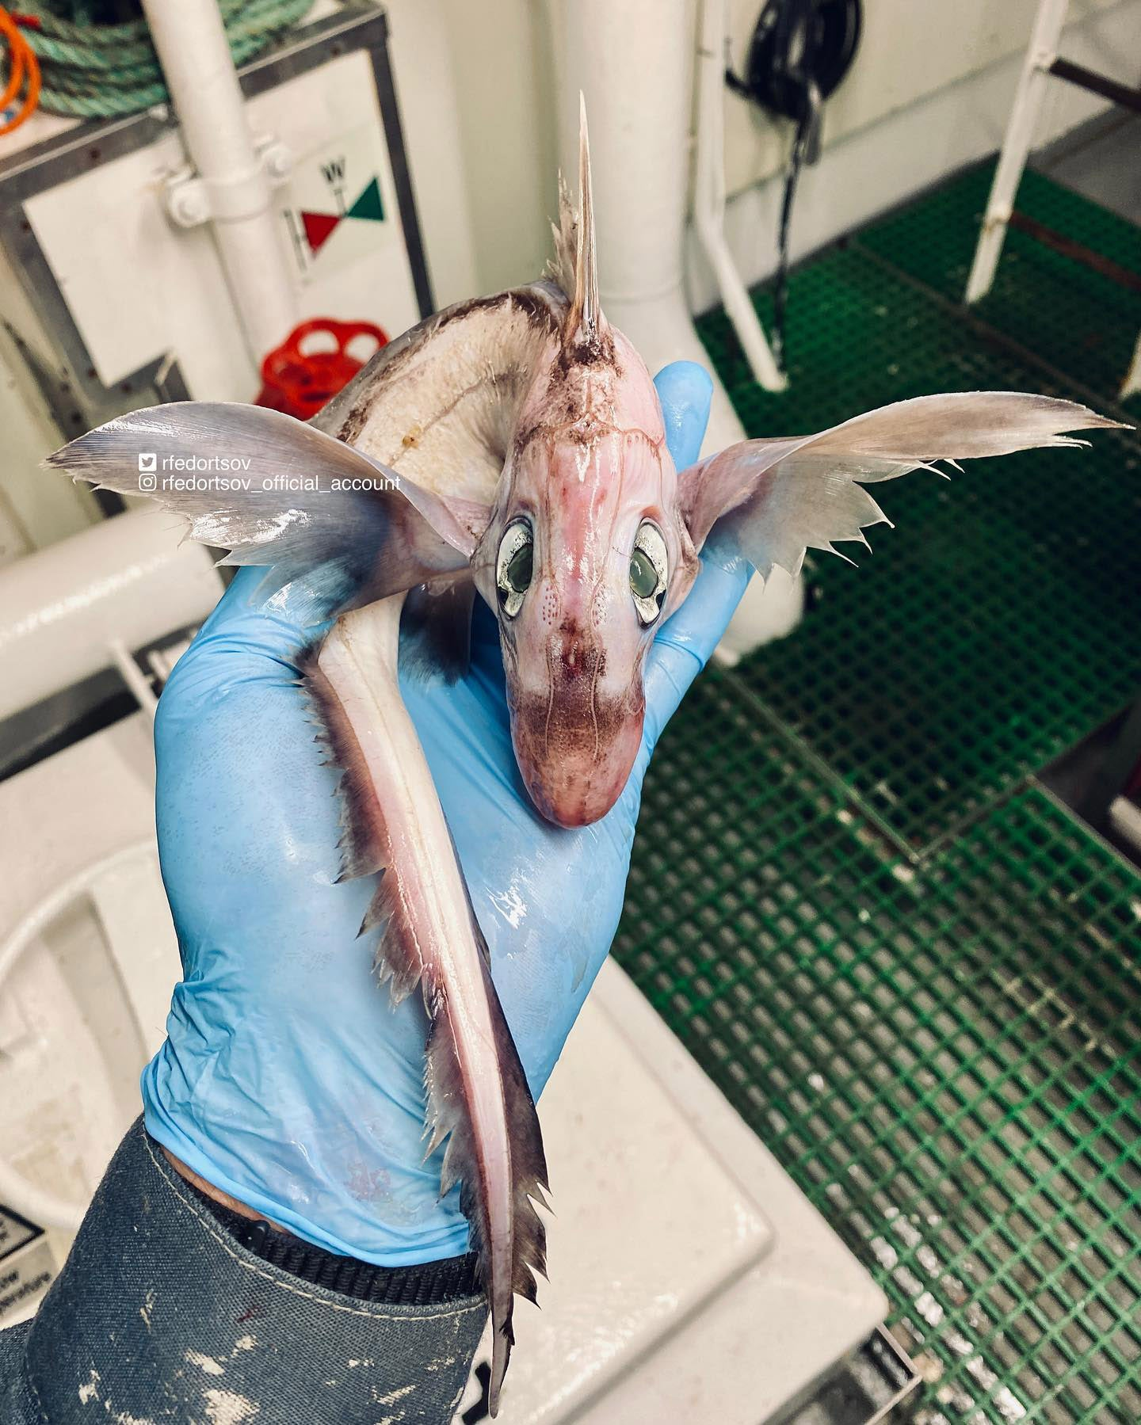
Roman Fedortsov was fishing in the Norwegian Sea when he came across the unusual-looking creature.
“It looks a little like a newly hatched dragon to me,” one person said in the comments, while another added: “Looks like a baby dragon!”
The fish has since been identified as a chimaera – a cartilaginous fish.
Notes:
Image: https://www.independent.co.uk/news/world/bizarre-sea-creatures-baby-dragon-b2087090.html

Slide 23
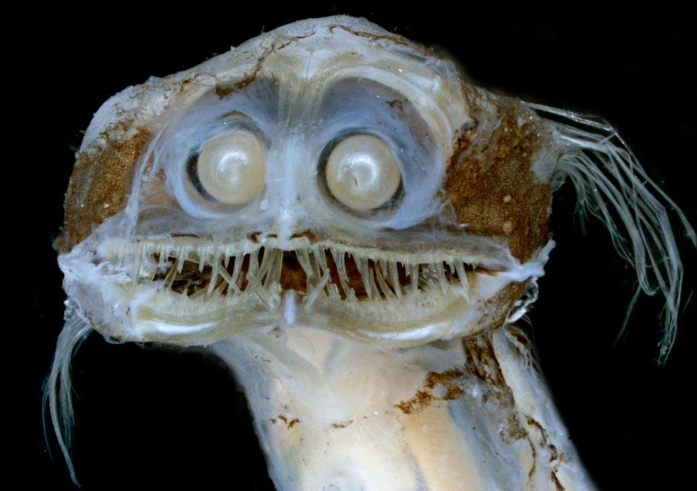
Notes:
Image: https://owlmanandy.com/2020/09/29/spooky-sea-creatures/

Slide 24
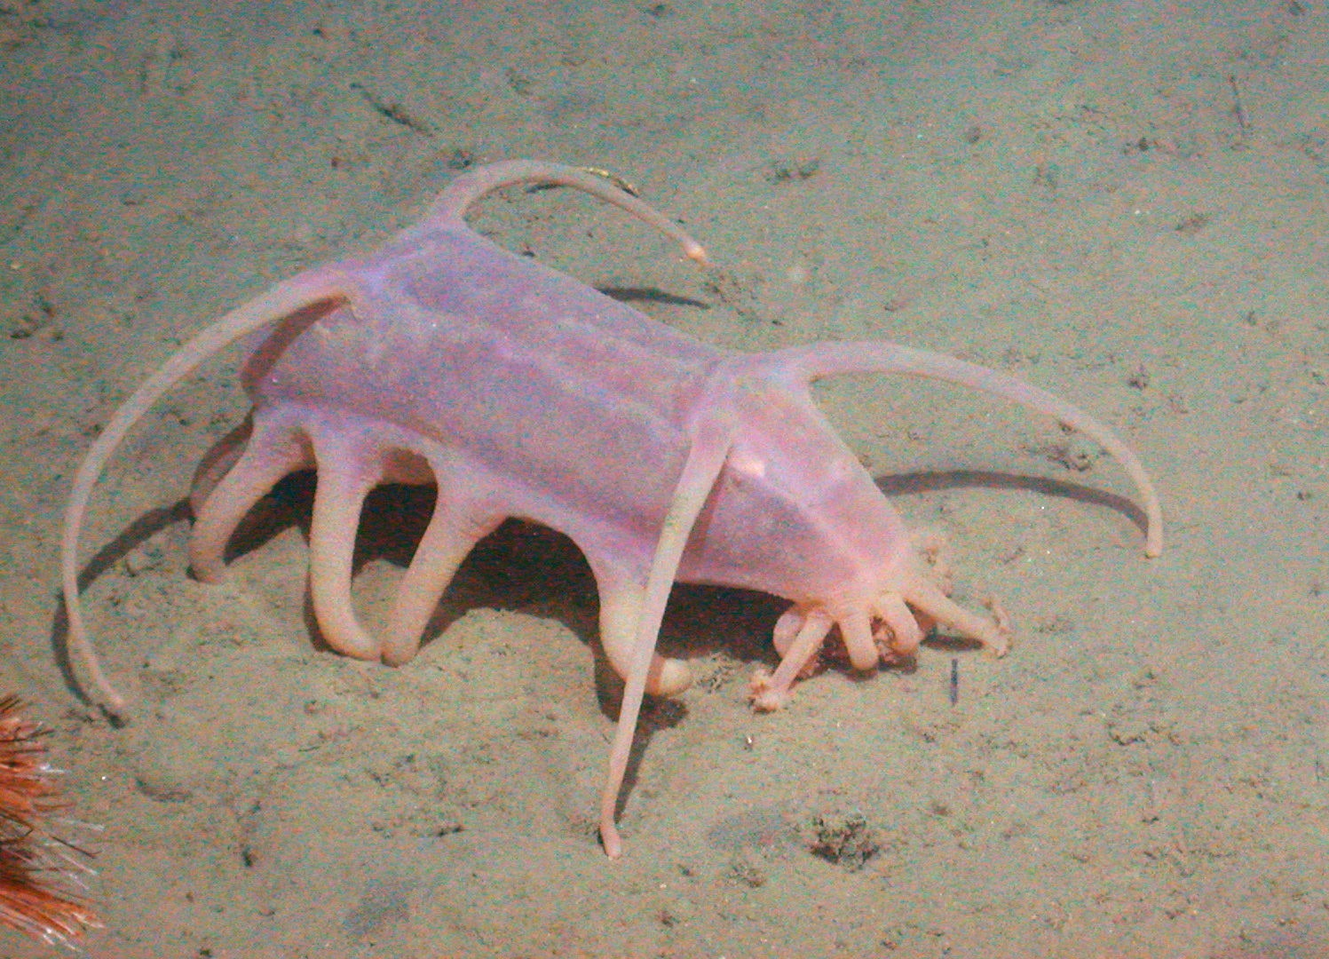
Scotoplanes globosa
or “Sea pig”
is a sea cucumber that lives on the abyssal plain.
It’s a deposit feeder, eating detritus which has sunk to the ocean floor.
Notes:
Image: https://www.wired.com/2014/06/the-creature-feature-10-fun-facts-about-sea-pigs/

Slide 25
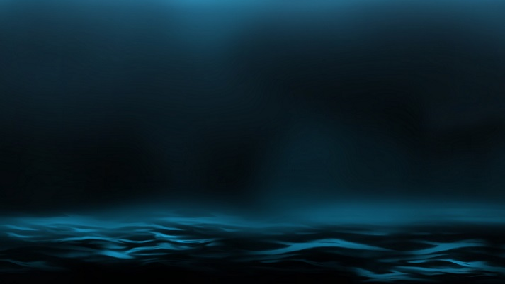
The abyssal plain is FLAT

Slide 26
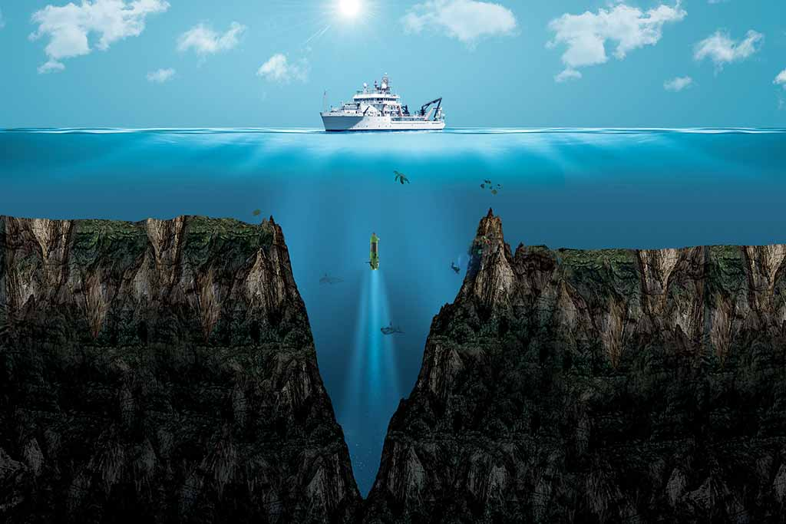
unlike a TRENCH (big HOLE)
The Mariana Trench is the deepest point on Earth. Image: Shutterstock/DOERS
Notes:
Image: https://geographical.co.uk/science-environment/geo-explainer-exploring-the-mariana-trench

Slide 27
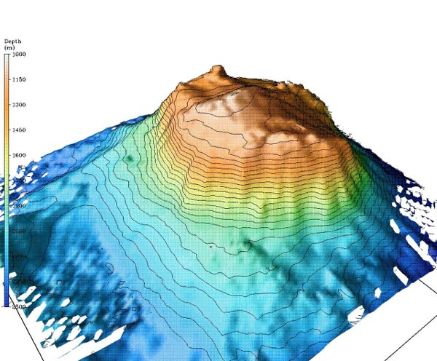
a SEAMOUNT (undersea mountain)
Seamounts are undersea mountains that never reach the surface.
They must be taller than 1km to be called a seamount.
Notes:
Image: wikapedia

Slide 28
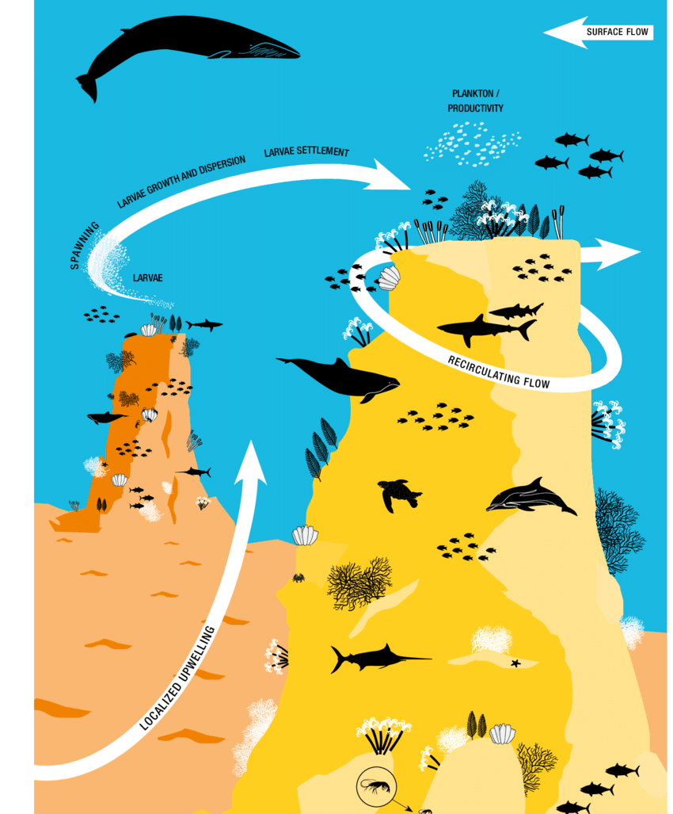
Seamounts are biodiversity hotspots.
They intercept the flow of nutrient–rich deep ocean currents.
Notes:
Image: https://www.researchgate.net/figure/A-representation-of-a-seamount-community-showing-potential-currents-and-how-dispersal_fig9_340584052

Slide 29
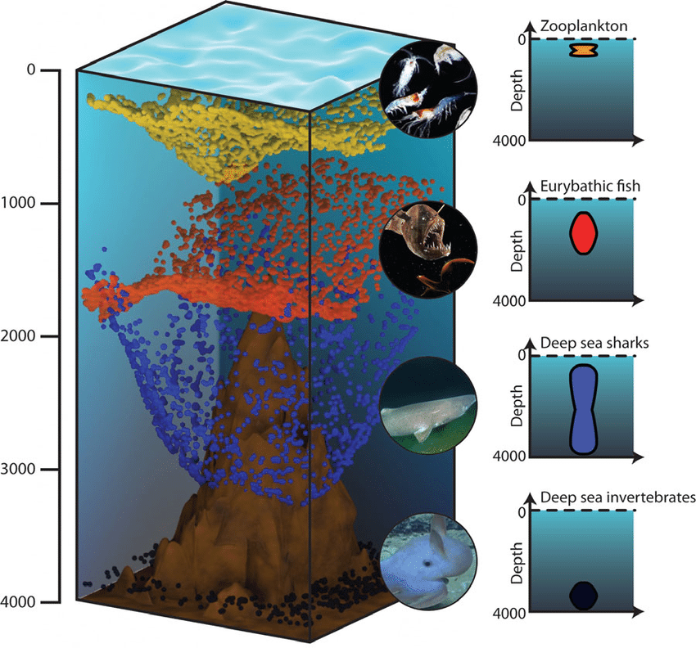
Illustration of the three-dimensional structure of a seamount and some of it’s occupants at varying depths.
Notes:
Illustration of the three-dimensional structure of deep-sea ecosystems. The figure includes both the benthic component (seafloor) and the pelagic component (water column), with an example of the diversity of various planktonic components across depths and some life cycles and behavioral aspects. The mesopelagic deep ocean (also called the twilight zone) is generally defined as the part of the water column between 200 m and ca. 1,000 m depth. The upper limit coincides with the maximum depth of seasonal variability in temperature, the seasonal thermocline, and the penetration of sunlight sufficient to support photosynthesis. Between 200 to 1,000 m depth, light can penetrate and influence the nictemeral cycle of many planktonic and benthic species. Below 1,000 m begins the entirely dark portion of the oceans. The zones beneath the mesopelagic (see Glossary of terms), which are the bathypelagic and abyssopelagic zones, comprise nearly 75% of the volume of the oceans and are generally less influenced by the seafloor and its ecological communities. Light, chemical, and physical clines are barriers to marine species across depths; the photic cline, thermocline and the halocline can limit the photosynthetic production and export of primary production, and hamper the biological exchange among specific classes of organisms.
https://www.researchgate.net/figure/llustration-of-the-three-dimensional-structure-of-deep-sea-ecosystems-The-figure_fig3_319414901

Slide 30
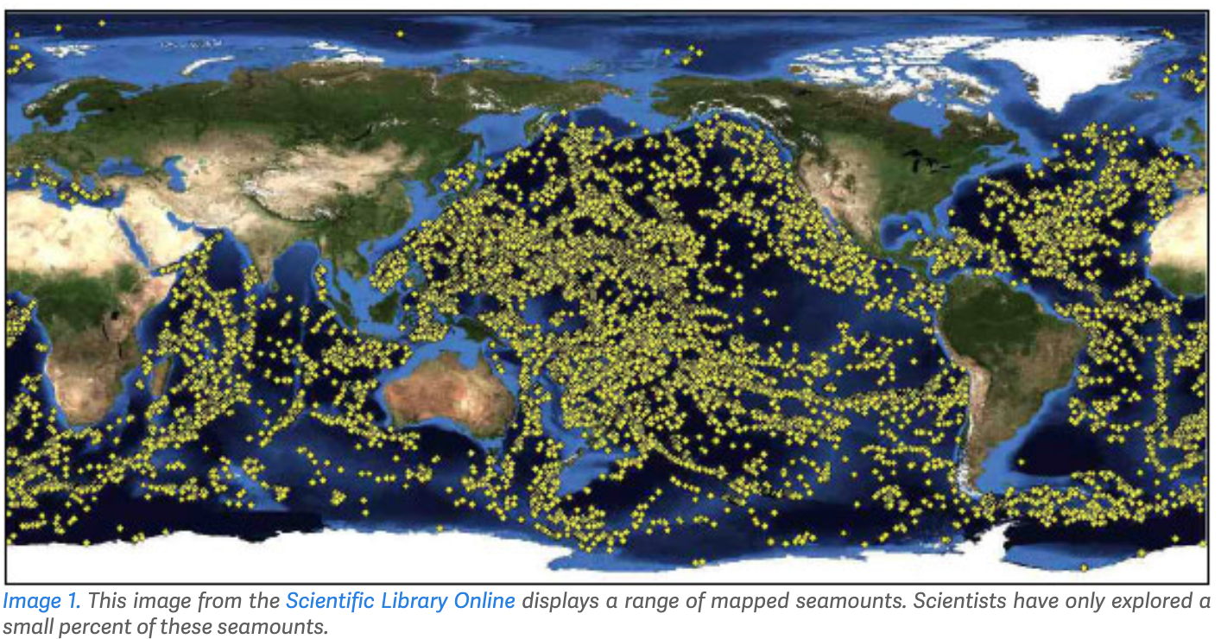
Notes:
Image: http://jupiterfoundation.org/current/2018/3/7/mountains-in-the-deep-sea

Slide 31
https://www.youtube.com/watch?v=rpqc6tlKSgk&t=191s
Notes:
https://www.youtube.com/watch?v=rpqc6tlKSgk&t=191s

Slide 32
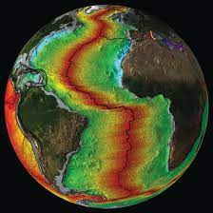
a MID-OCEAN RIDGE (seafloor spreading centres)

Slide 33
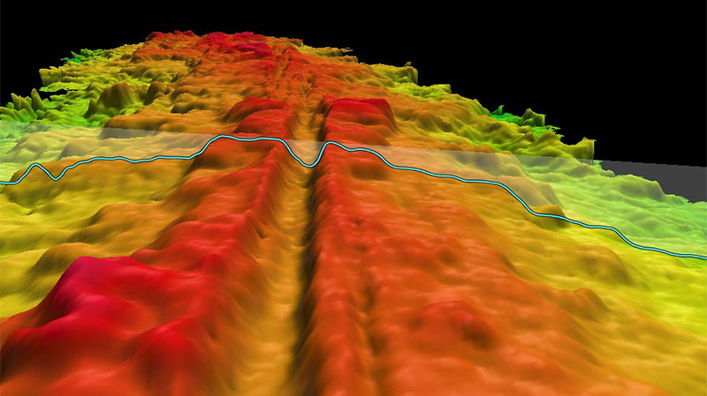
Mid-ocean ridges are where new oceanic crust is formed. They create the longest mountain ranges in the world
Notes:
Image: https://oceanexplorer.noaa.gov/welcome.html

Slide 34
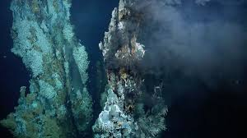
Hydrothermal vents
‘black smoker chimneys’
Looking through the portholes of the submersible ALVIN near the bottom of the Pacific Ocean in 1979, American scientists saw for the first time chimneys, several meters tall, from which black water at about 300 degrees and saturated with minerals shot out.

Slide 35
Notes:
Image: Schmidt Institute

Slide 36
https://www.youtube.com/watch?v=yYt_psQXvEM
Notes:
https://www.youtube.com/watch?v=yYt_psQXvEM

Slide 37
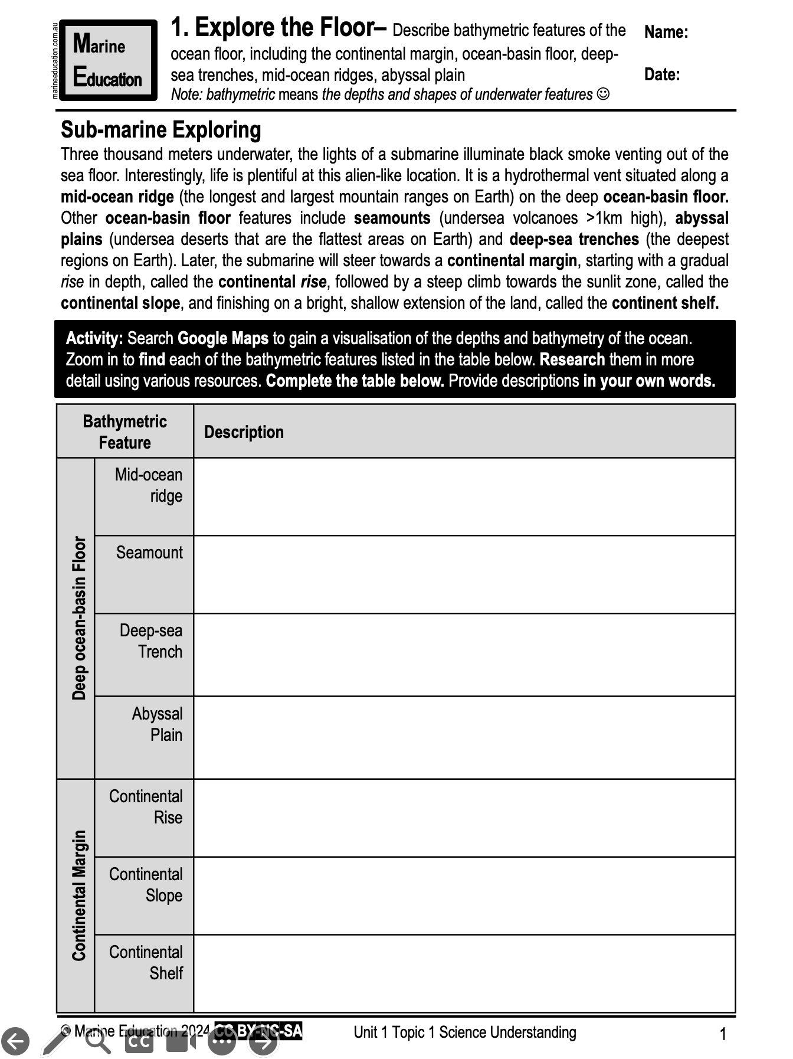
Learning Intention:
Describe bathymetric features of the ocean floor, including the continental margin, ocean-basin floor, deep-sea trenches, mid-ocean ridges, abyssal plain
Success Criteria:
Complete Marine Education worksheet ‘1. Explore the Floor’
Notes:
Image: https://medium.com/@amykwilson/weird-and-wonderful-creatures-of-the-deep-sea-66826a3ae5e4

