Slide 1
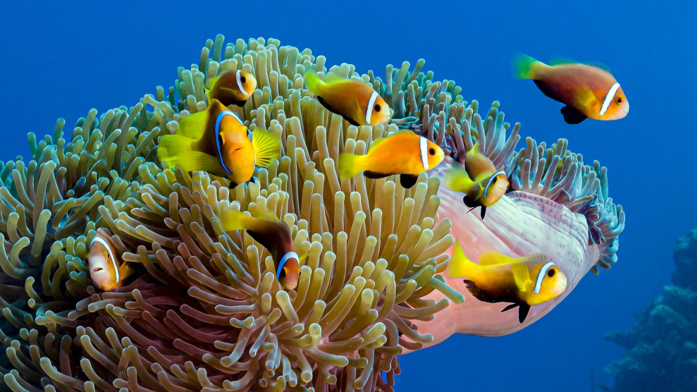
Learning Intention:
Describe the three main types of diversity, i.e. genetic, species and ecosystem.
Success Criteria:
Complete Marine Education worksheet ‘1. Life’s Diversity’

Slide 2
Genetic diversity

Slide 3
Genetic diversity is the diversity of genes in one species.
The greater the diversity, the greater chance of adapting to change and avoiding extinction.

Slide 4
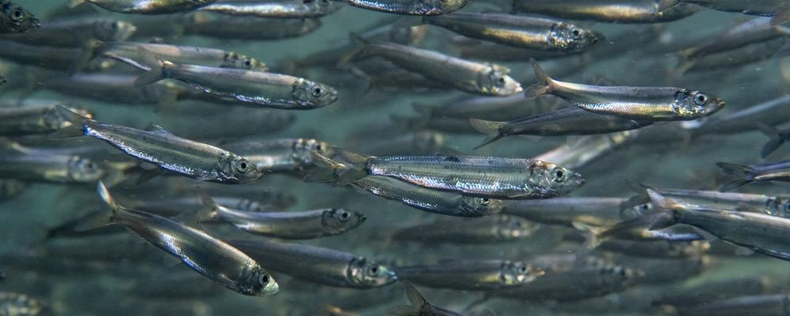
For example….
Low genetic diversity (all the same)

Slide 5
High genetic diversity (all different)

Slide 6
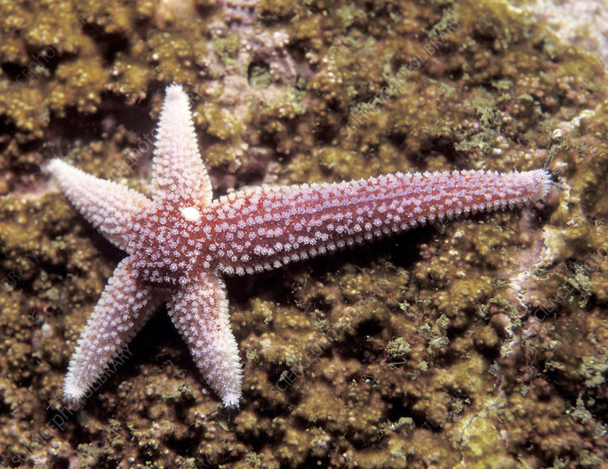
Asexual reproduction = identical offspring
(all the same)

Slide 7
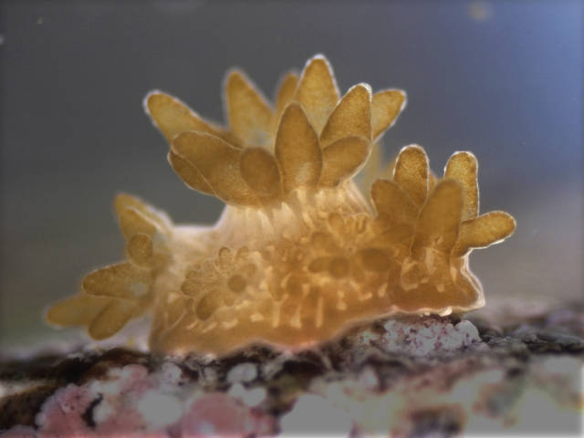
e.g. budding

Slide 8
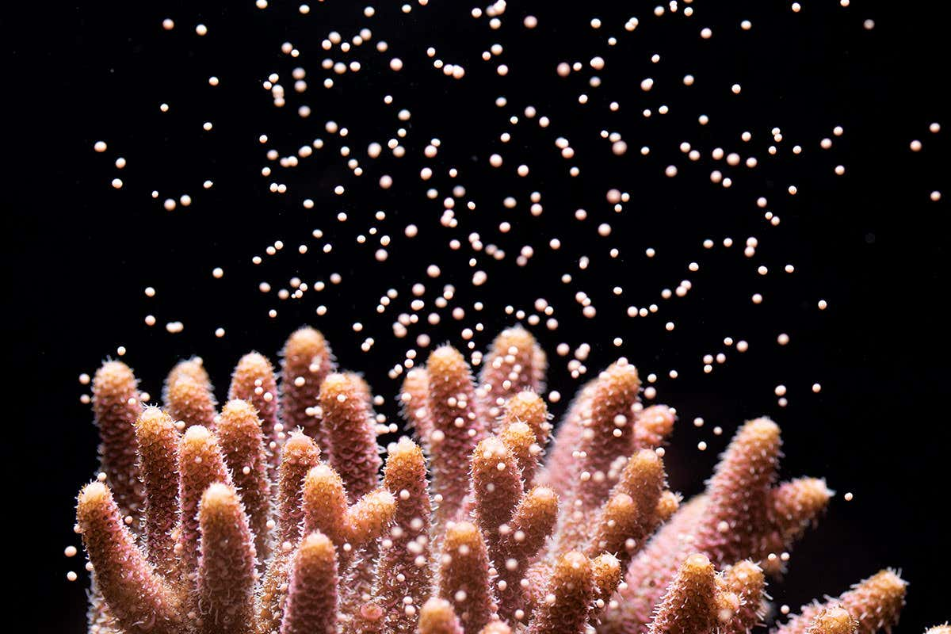
vs. sexual reproduction
(all different)
Notes:
Image; https://www.newscientist.com/article/2077033-playing-cupid-to-get-reluctant-corals-in-the-mood-for-love/

Slide 9
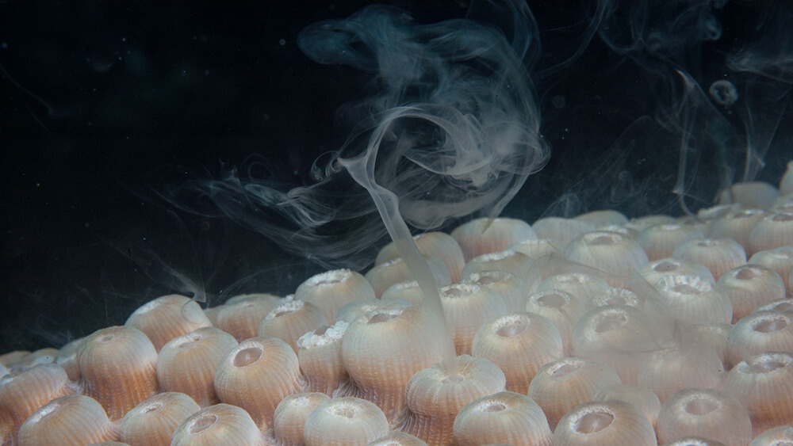
e.g. coral spawning
Notes:
Image: https://sanctuaries.noaa.gov/news/may22/explore-spectacular/coral-spawning.html

Slide 10
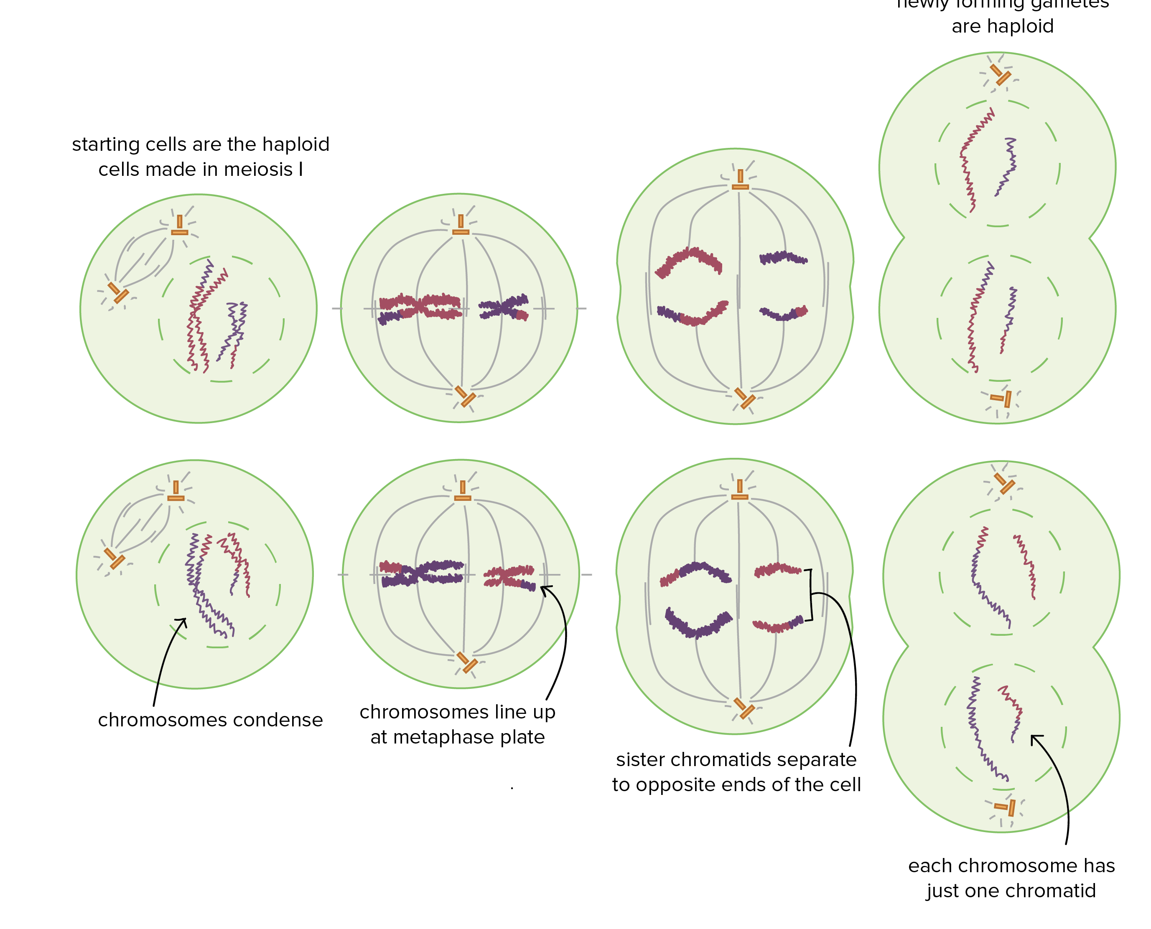
Meiosis

Slide 11
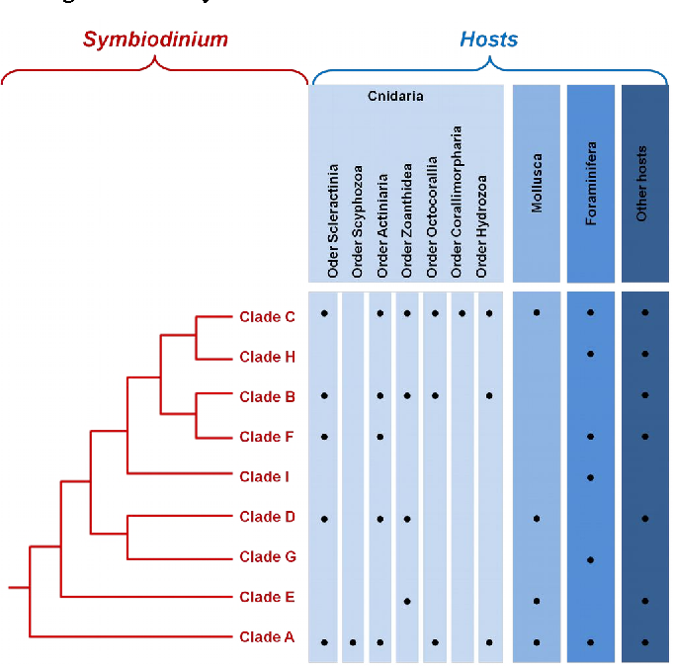
zooxanthellae
e.g. zooxanthellae exist as many different genetic clades
Notes:
Image: https://www.semanticscholar.org/paper/The-story-of-symbiosis-with-zooxanthellae-%2C-or-how-Fournier/75f7f63a1dc6b0f1e42a0d149d6eb237ed8b564a

Slide 12
https://www.youtube.com/watch?v=uFCojXVAKyw
Notes:
Youtube video title: The genes of heat tolerant corals on the Great Barrier Reef (AIMS)

Slide 13
Species diversity

Slide 14
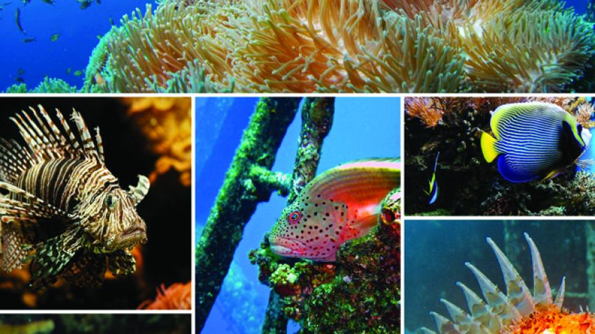
Species diversity is the diversity of species in an ecosystem.
The greater the diversity, the healthier and more resilient the ecosystem.

Slide 15
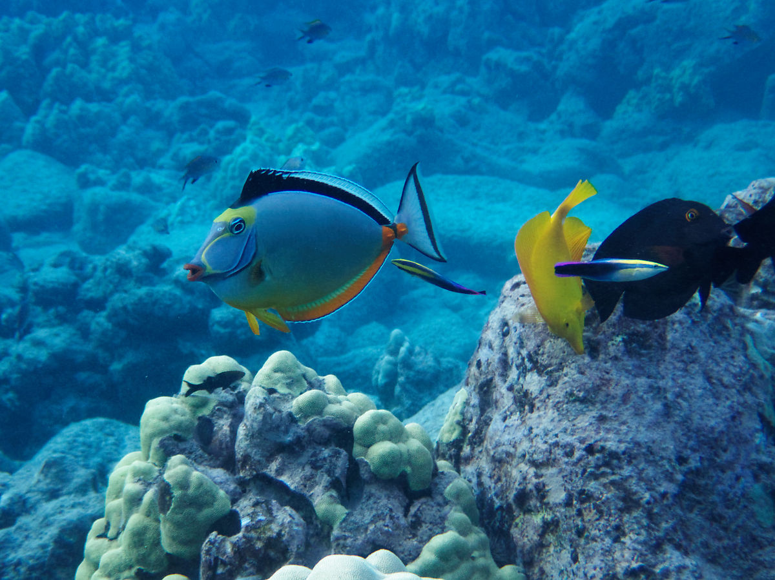
How many different species can you count?

Slide 16
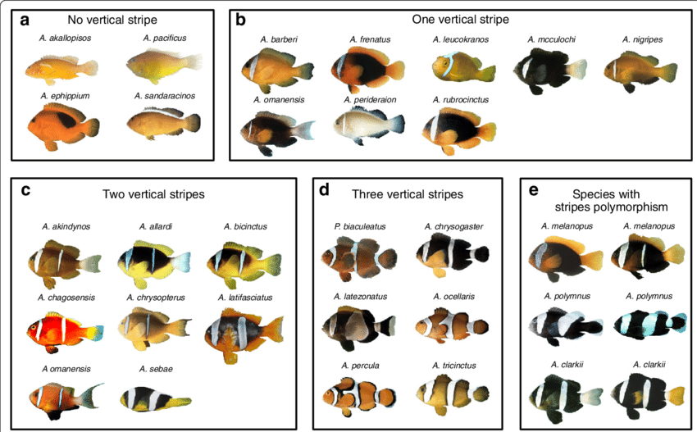

Slide 17
https://www.youtube.com/watch?v=MXsKEs19Jzs
Notes:
Image: https://www.youtube.com/watch?v=MXsKEs19Jzs Living Coral Biobank

Slide 18
Ecosystem diversity

Slide 19
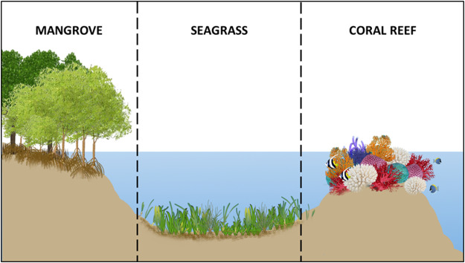
Ecosystem diversity is the diversity of ecosystems.
The greater the diversity, the more habitat diversity for more species to occupy.

Slide 20
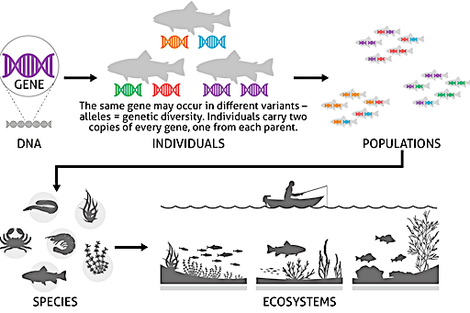
To summarise:

Slide 21
Measuring Species biodiversity

Slide 22
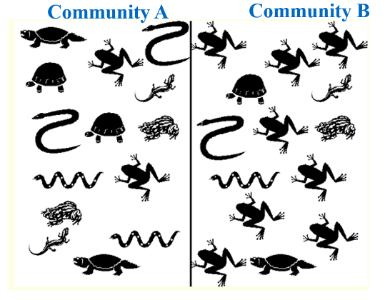
Species Richness (# of different species) and species evenness (even?)
# | Name | tally in A | tally in B
1
2
3
4
5
6
7

Slide 23
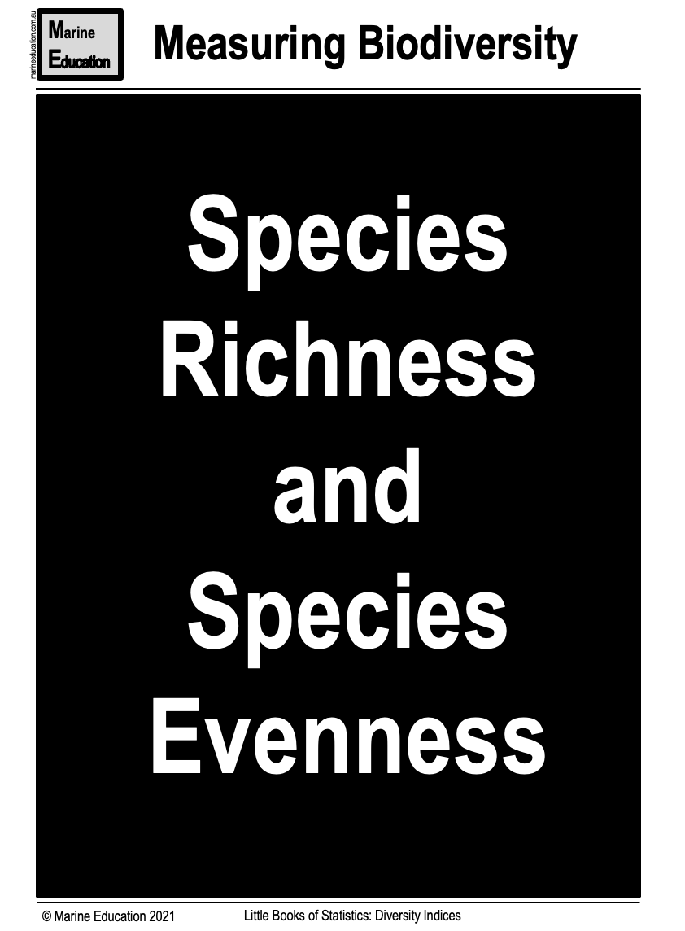
Download from marineeducation.com.au

Slide 24
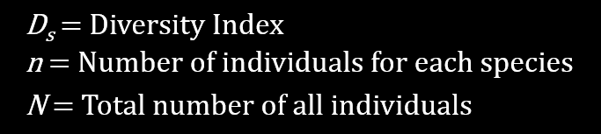
Simpson’s Diversity Index

Slide 26
Simpsons Diversity Index
Close to 1.0 means high species diversity
Close to zero means low species diversity

Slide 27
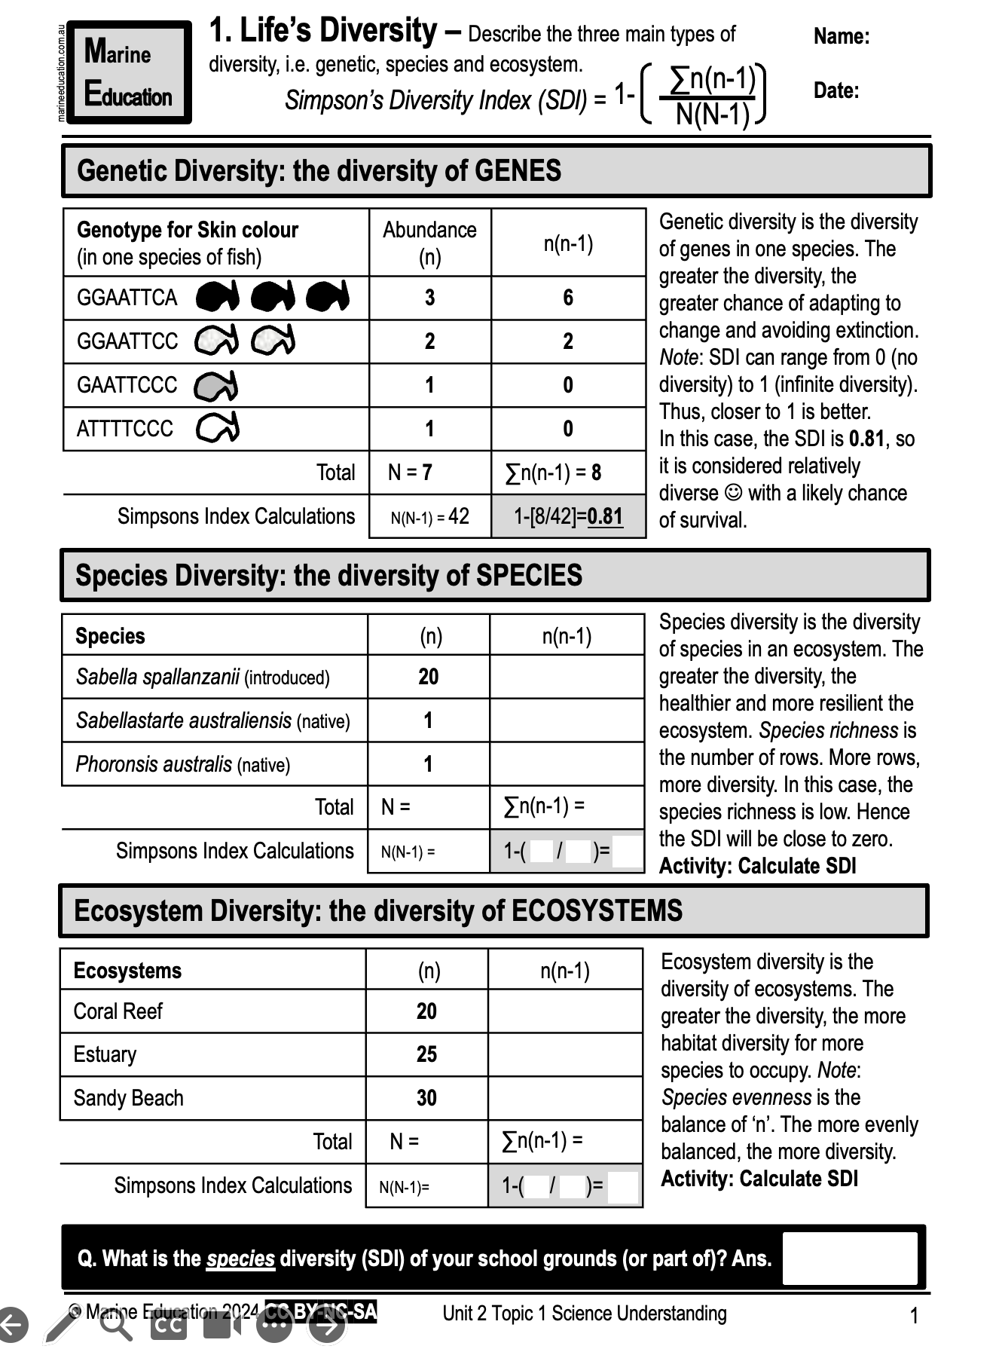
Learning Intention:
Describe the three main types of diversity, i.e. genetic, species and ecosystem.
Success Criteria:
Complete Marine Education worksheet ‘1. Life’s Diversity’

