Slide 1
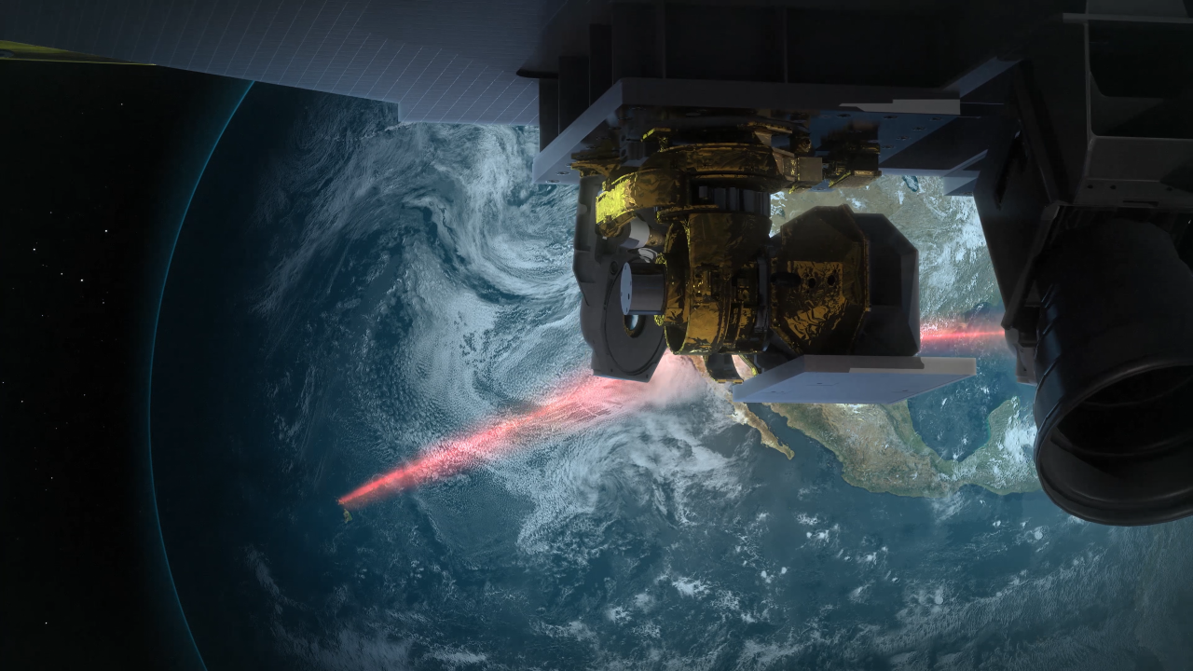
Learning Intention (2019 & 2023 syllabus):
Appreciate that development of satellite measurement techniques allows scientists to predict the direction and rate of plate movement. Consider how this has developed improved understandings of processes such as sea floor spreading and mantle convection.
Success Criteria:
Complete Marine Education worksheet ‘Eyes Looking Down’
Learning Intention:
Appreciate that development of satellite measurement techniques allows scientists to predict the direction and rate of plate movement. Consider how this has developed improved understandings of processes such as sea floor spreading and mantle convection.
Success Criteria:
Complete Marine Education worksheet ’10. Eyes Looking Down’
Notes:
https://www.nasa.gov/missions/tech-demonstration/new-ground-station-brings-laser-communications-closer-to-reality/

Slide 2
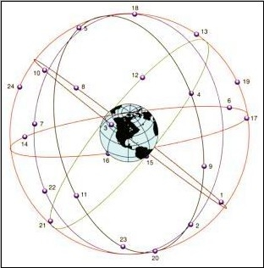
The measurement of plate motion is measured directly using GPS, the Global Positioning System.
This network of 24 satellites is more stable than the Earth's surface,
so when a whole continent moves somewhere at a few centimetres per year, GPS can tell.
Notes:
https://sciencing.com/how-fast-do-gps-satellites-travel-12213923.html

Slide 3
Activity:
Find the latitude and longitude coordinates for where you are now
https://www.latlong.net/

Slide 4
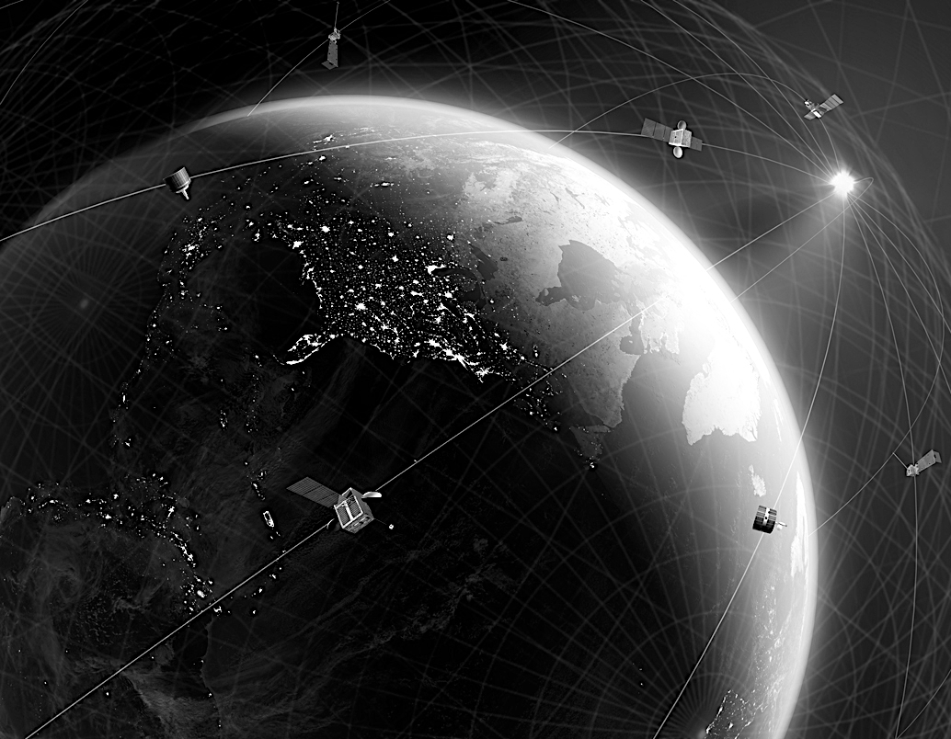
Developed by the military for tracking subs and launching nuclear weapons, GPS is a network of satellites, equipped with an atomic clock, a computer, and a radio, orbiting Earth approximately every 12 hours.
Notes:
https://www.science.org/content/article/scientists-create-their-own-gps-spying-internet-satellites

Slide 5
Geodesy is the science of accurately measuring and understanding the Earth's geometric shape, orientation in space, and gravity field.

Slide 6
https://www.youtube.com/watch?v=_Cj1vgmXr5M&t=3s
Notes:
https://www.youtube.com/watch?v=_Cj1vgmXr5M&t=3s

Slide 7
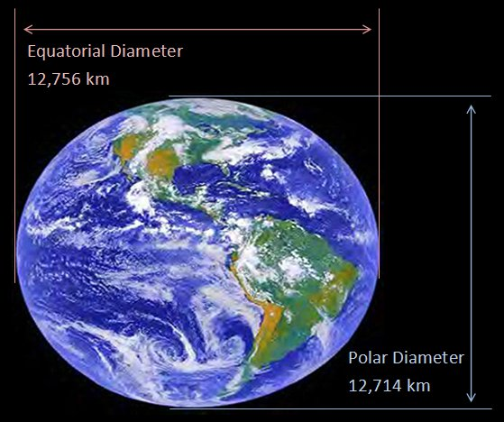
We often think of the Earth as a sphere.
But our planet is actually a little squashed at the equator.
It is “ellipsoid”
Notes:
https://en.wikipedia.org/wiki/Figure_of_the_Earth#/media/File:Earth2014shape_SouthAmerica_small.jpg

Slide 8
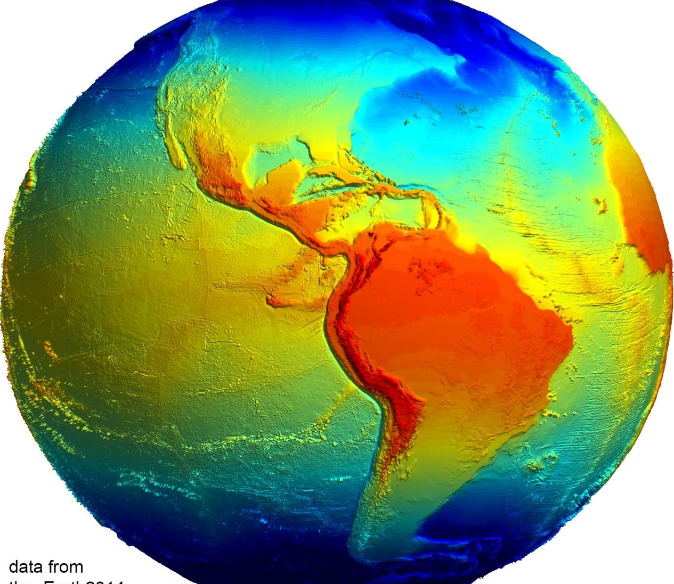
Our planet is also very bumpy and irregular
Notes:
https://en.wikipedia.org/wiki/Figure_of_the_Earth#/media/File:Earth2014shape_SouthAmerica_small.jpg

Slide 9
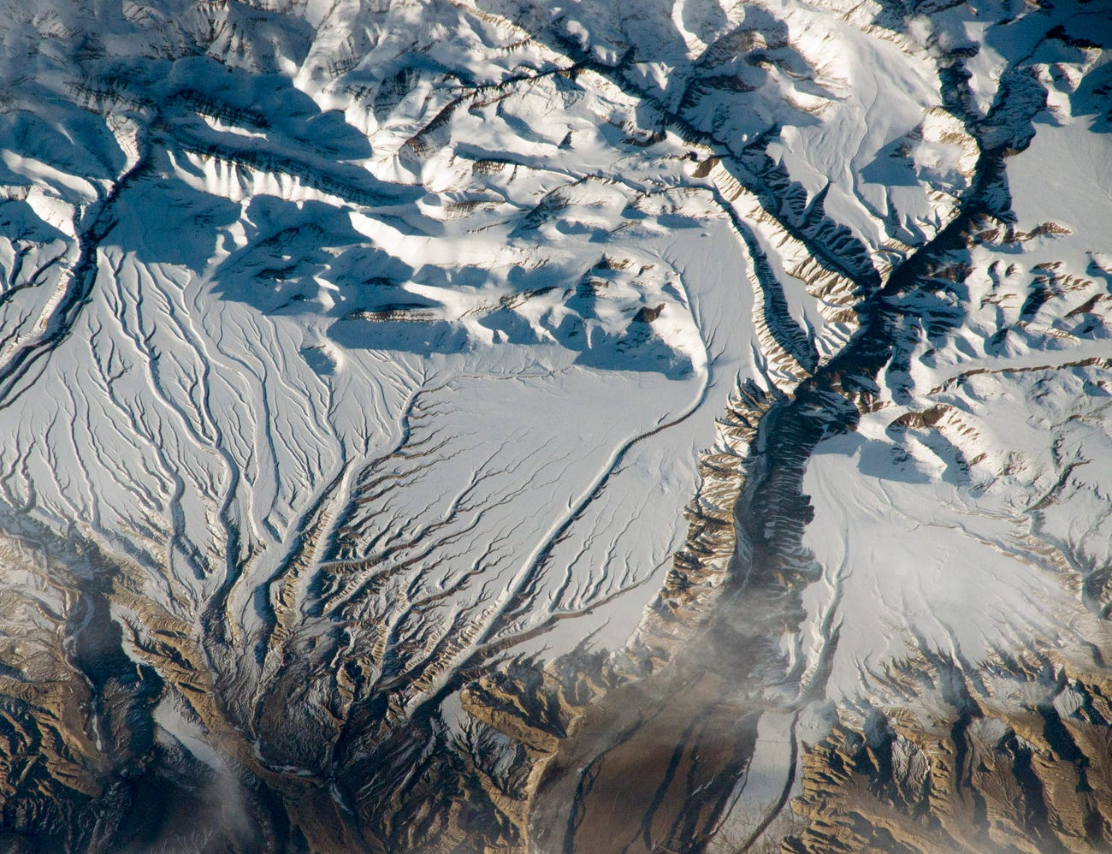
Because the Earth is bumpy and irregular,
Earth’s gravity is also bumpy and irregular.

Slide 10
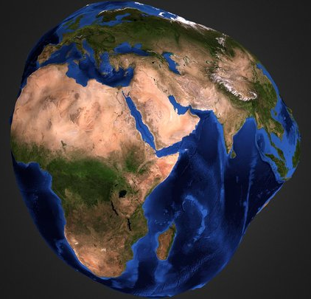
The geoid model of Earth is a model of what the Earth would look like if the entire Earth was:
covered in water,
there were no waves or tides or currents, and
the water would seek its own mean sea level relative to gravity.

Slide 11
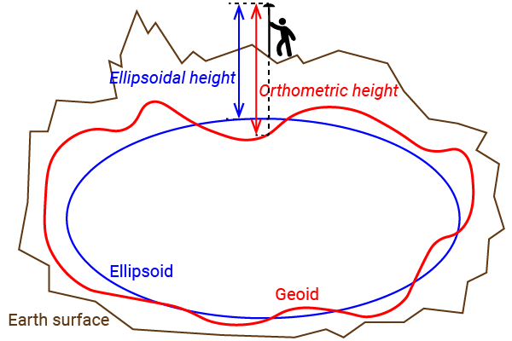
Notes:
https://www.ardusimple.com/ellipsoidal-orthometric-and-geoid-height/

Slide 12
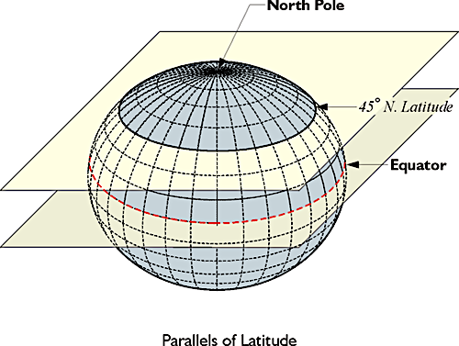
We use the ellipsoid model of earth to measure the horizontal coordinate system that gives us our coordinates for
latitude and longitude

Slide 13
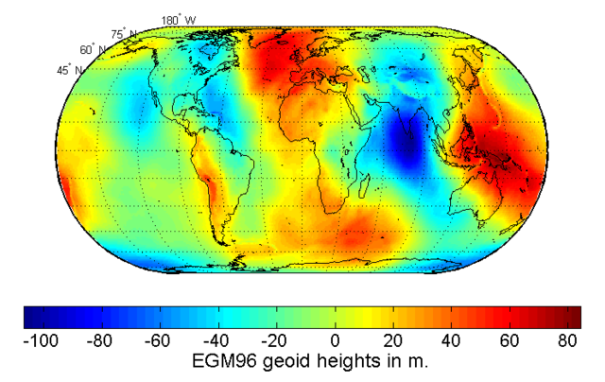
We use the geoid model to measure the vertical surface elevations (the ups and downs)
with a high degree of accuracy
(using mean sea level as the baseline - but without the tides, currents or waves).
Notes:
https://en.wikipedia.org/wiki/Earth_Gravitational_Model

Slide 14
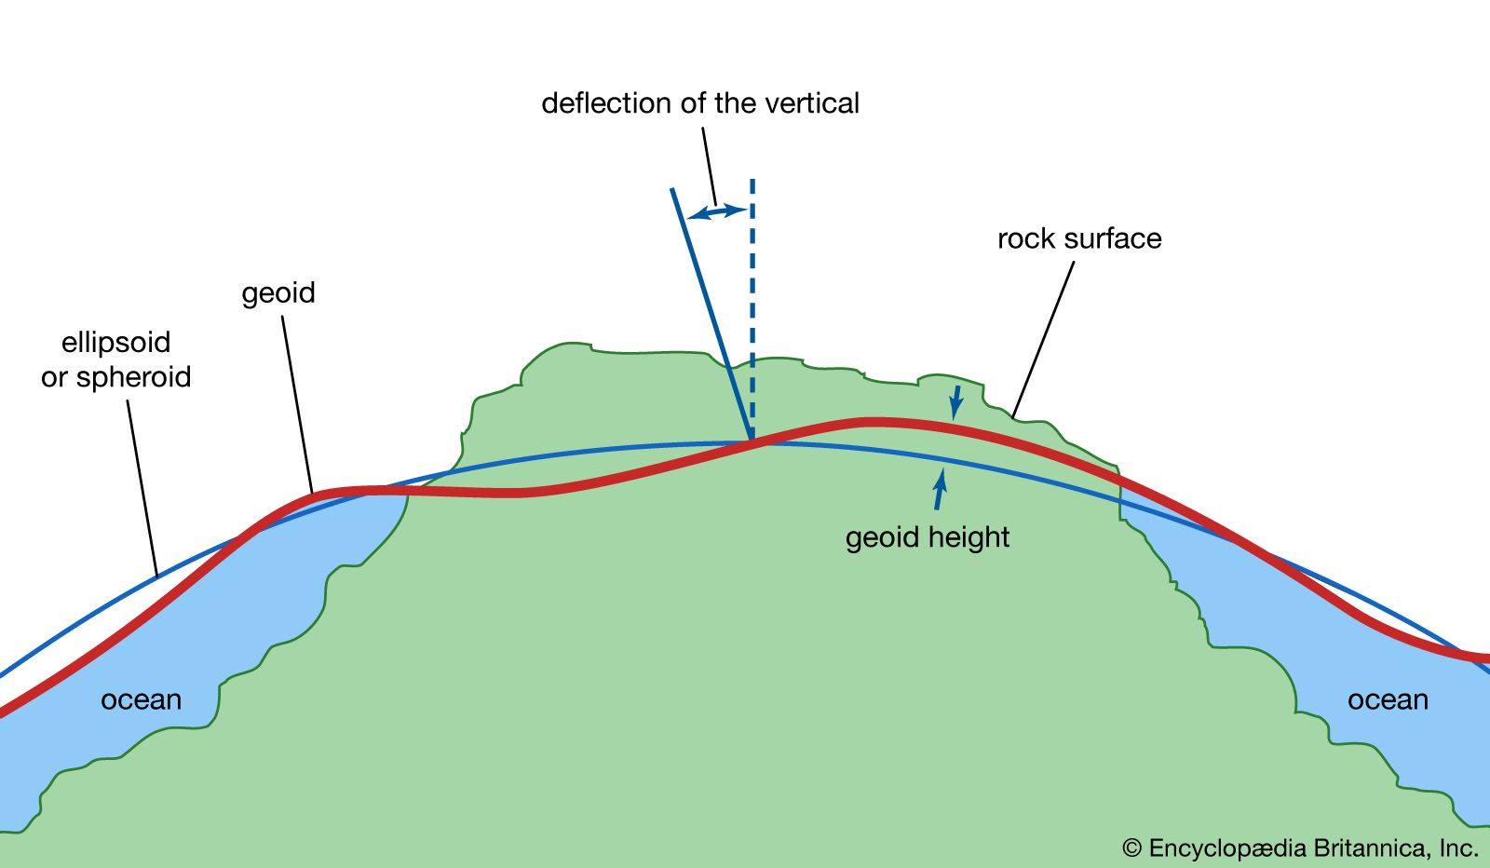
The geoid model of Earth is a model of what the Earth would look like if the entire Earth was:
covered in water,
there were no waves or tides or currents, and
the water would seek its own mean sea level relative to gravity.
The geoid model of earth serves as a reference surface that can be used to measure precise elevations of Earth’s surface features.
Notes:
https://www.britannica.com/science/geoid

Slide 15
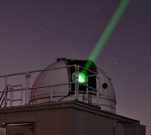
Satellite laser ranging stations and radar altimeters are used to measure the height of the geoid, accurate to less than 10cm at long wavelengths less than 1,500 km.

Slide 16
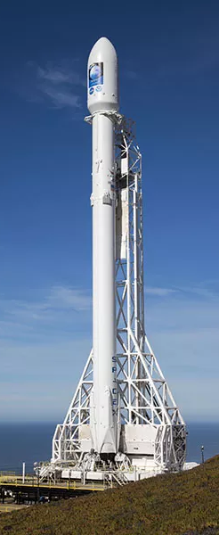
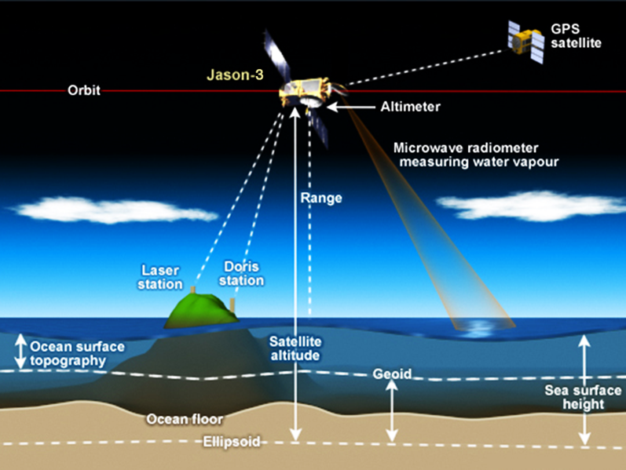
Launching Jason 3 in 2016
Notes:
https://commons.wikimedia.org/wiki/File:NASA_Jason_3_satellite_altimetry.png

Slide 17
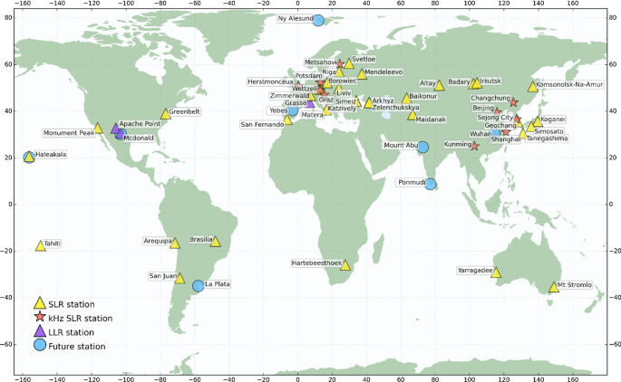
There are 42 Satellite laser ranging (SRL) stations (yellow triangles)
Notes:
https://link.springer.com/article/10.1007/s00190-018-1196-1

Slide 18
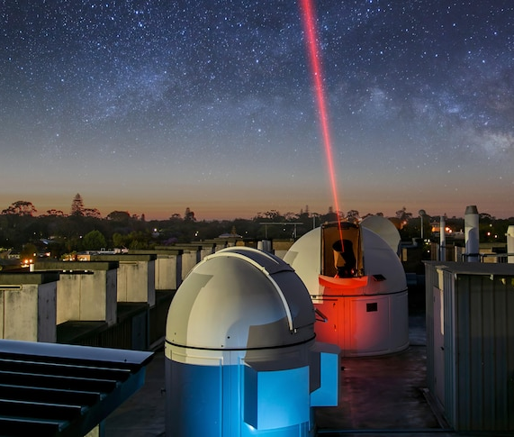
The position of the SLR stations in reference to one another reveal how tectonic plates are moving with respect to each other
(accurate to mm/year).

Slide 19
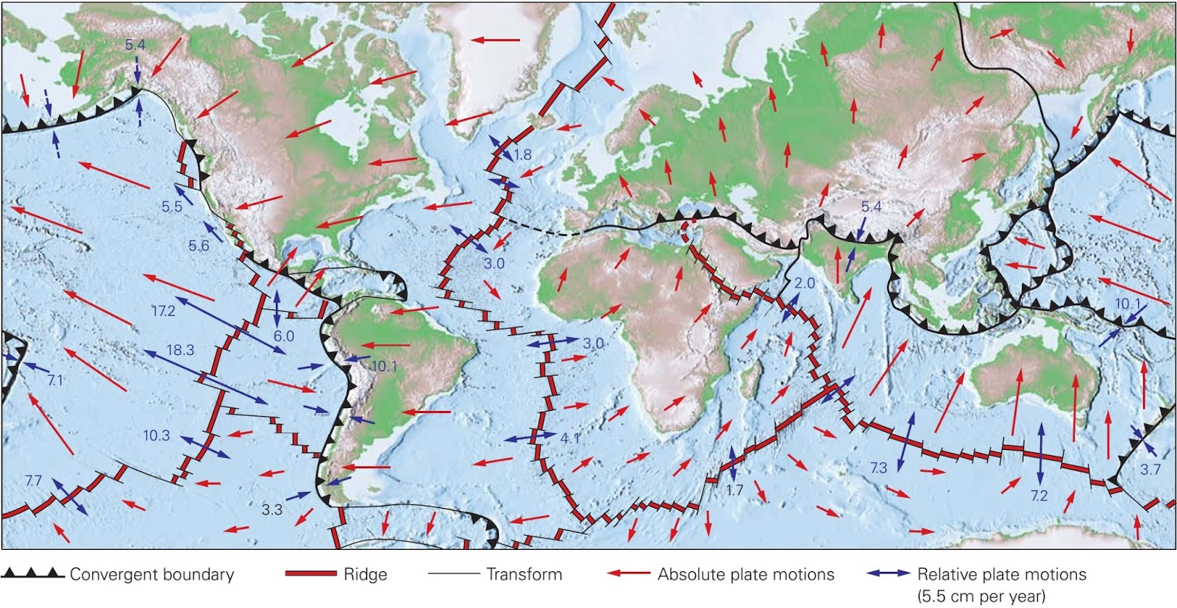
With the invention of satellite laser ranging stations, now dotted all over the world, their position in reference to one another reveal how tectonic plates are moving with respect to each other.
Relative plate velocities: The blue arrows show the rate and direction at which the plate on one side of the boundary is moving with respect to the plate on the other side. The length of an arrow represents the velocity. Absolute plate velocities: The red arrows show the velocity of the plates with respect to a fixed point in the mantle.
Notes:
http://geologylearn.blogspot.com/2016/02/what-drives-plate-motion-and-how-fast.html

Slide 20
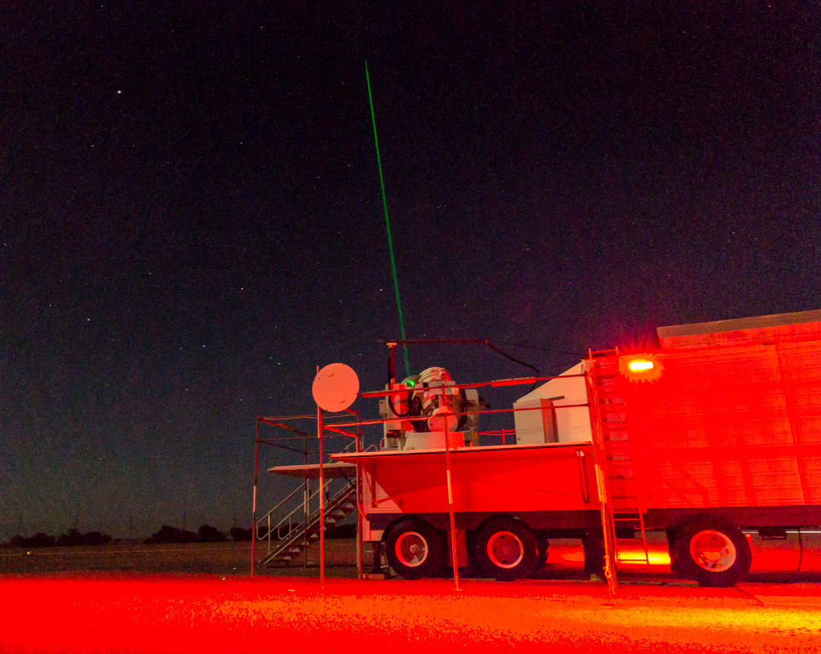
SLR stations like this one at Yarragadee W.A. shoots high-powered lasers at satellites flying thousands
of kilometres overhead to measure how far away they are.
Notes:
https://www.ga.gov.au/news/yarragadee-the-geodetic-supersite-in-the-west-australian-desert

Slide 21
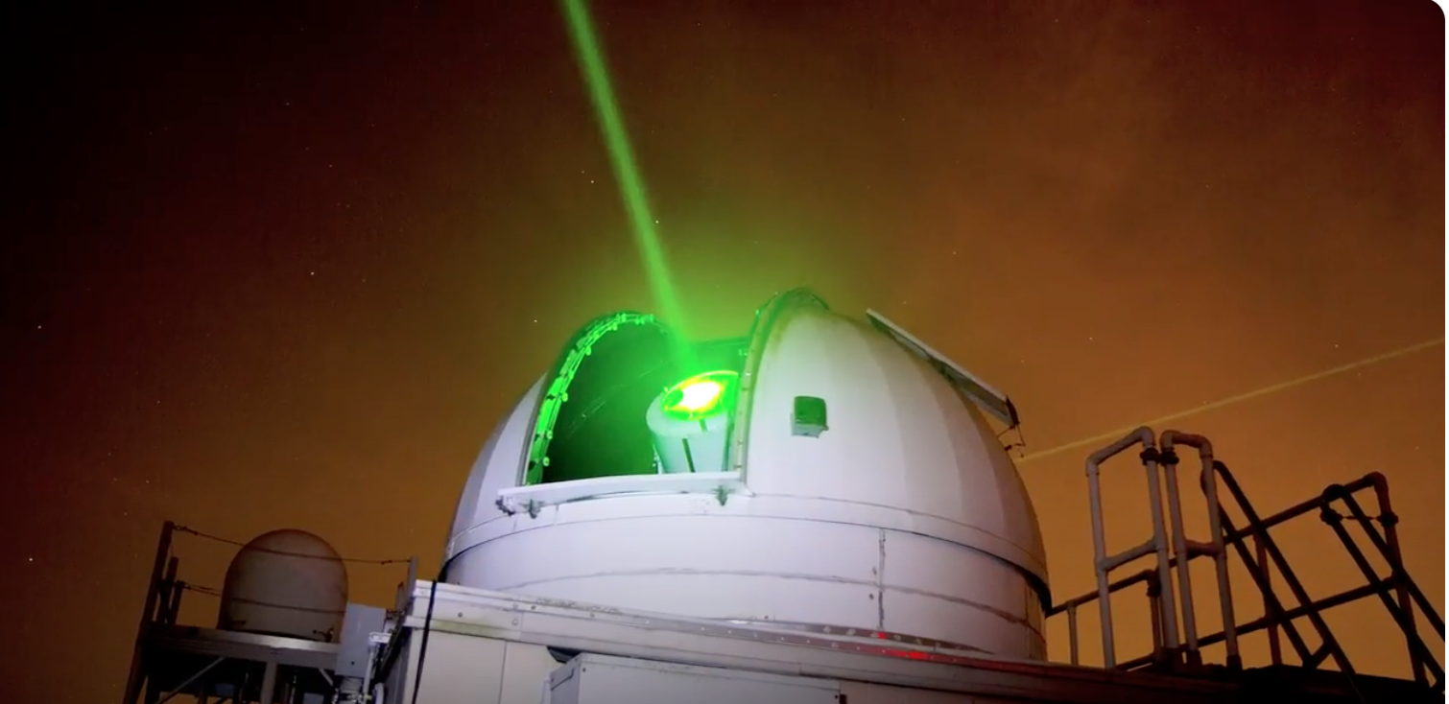
There is another station like this one in Australia and 42 stations around the world
(only 7 in the southern hemisphere).
Notes:
https://www.ga.gov.au/news/yarragadee-the-geodetic-supersite-in-the-west-australian-desert

Slide 22
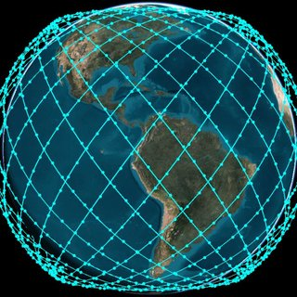
Once you know the distance to a satellite you can calculate its orbit.
Combining all the orbits of all the satellites reveals our planet’s changing shape and gravity.
Satellite constellation for Phase I of Starlink.
Notes:
https://www.researchgate.net/figure/Satellite-constellation-for-Phase-I-of-Starlink_fig1_349641367

Slide 23
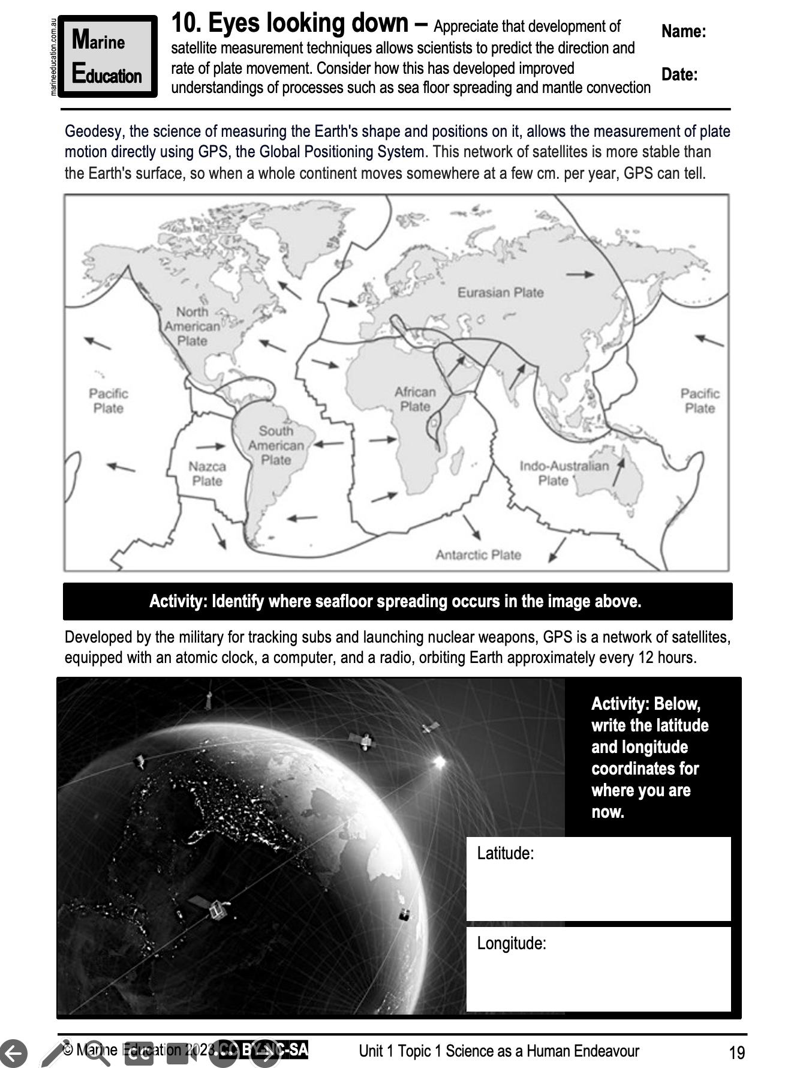
Learning Intention (2019 & 2023 syllabus):
Appreciate that development of satellite measurement techniques allows scientists to predict the direction and rate of plate movement. Consider how this has developed improved understandings of processes such as sea floor spreading and mantle convection.
Success Criteria:
Complete Marine Education worksheet ‘Eyes Looking Down’
Learning Intention:
Appreciate that development of satellite measurement techniques allows scientists to predict the direction and rate of plate movement. Consider how this has developed improved understandings of processes such as sea floor spreading and mantle convection.
Success Criteria:
Complete Marine Education worksheet ’10. Eyes Looking Down’
Notes:
https://www.nasa.gov/missions/tech-demonstration/new-ground-station-brings-laser-communications-closer-to-reality/

