Slide 1
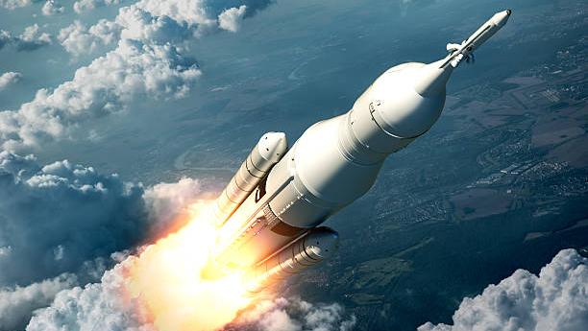
Learning Intention:
Consider how advances in remote sensing have enabled scientists to map ocean currents and develop models of the complex pathways involved in regulating global climate, such as the ‘global ocean conveyor belt’.
Success Criteria:
Complete Marine Education worksheet ’11. Keeping Track’
Notes:
https://www.istockphoto.com/photos/satellite-launch

Slide 2
With drifters, floats, satellites and CTDs, researchers are examining ocean-wide processes.
Nice video of remote sensing images courtesy of NASA www.youtube.com/watch?v=CCmTY0PKGDs
Notes:
Nice video of remote sensing images courtesy of NASA

Slide 3
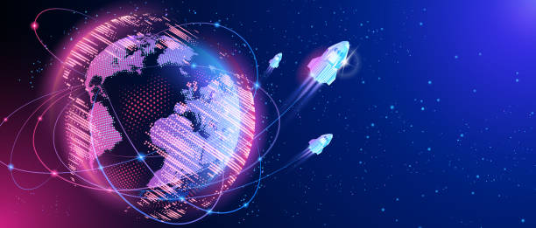
Remote sensing: the scanning of earth by satellite or high-flying aircraft in order to obtain information about it.
What about before then?

Slide 4
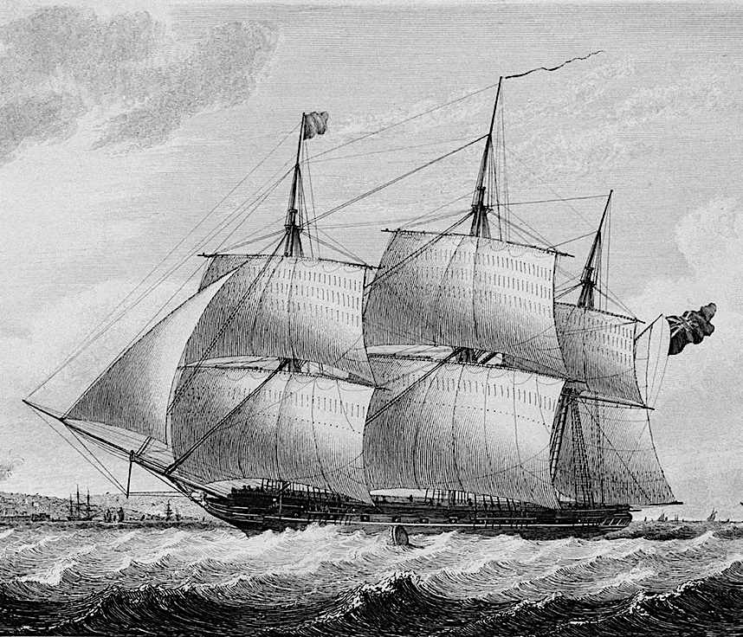
In the 1800s,
the HMS Challenger kept records of course alterations in
ship-drift reports.
The reports recorded current strength and direction.

Slide 5
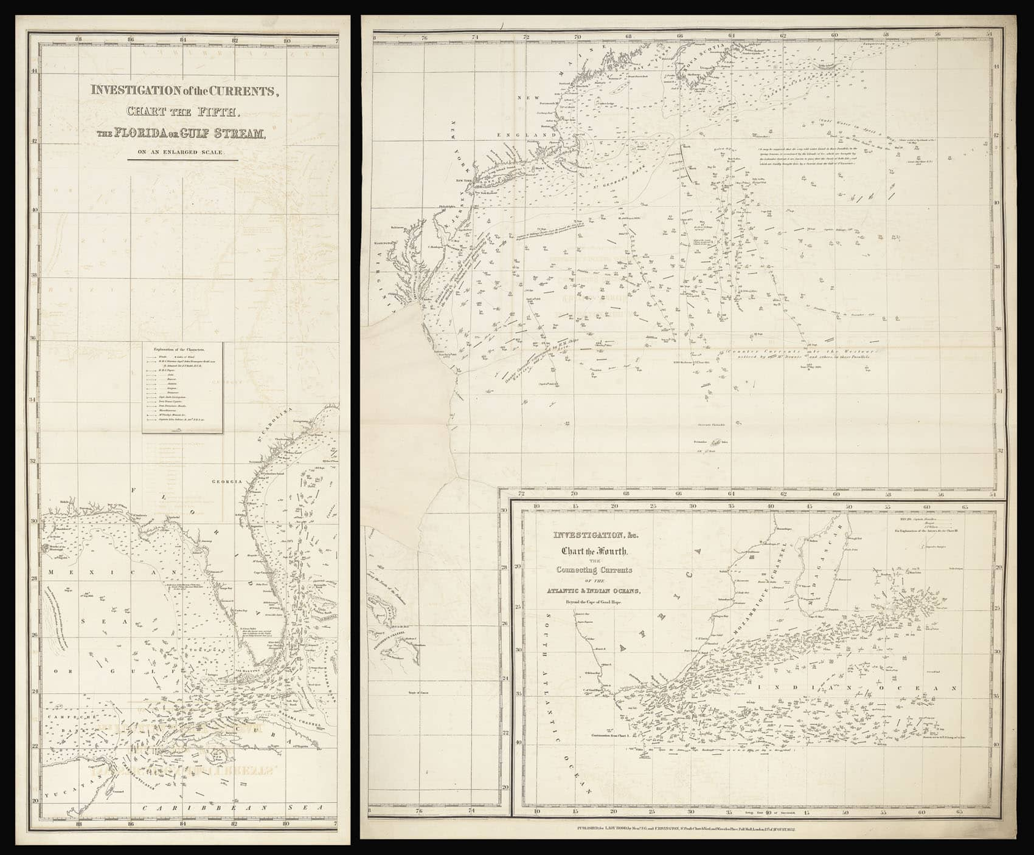
Ship-drift reports
documented course alterations made by Captains to allow for sea surface currents that would otherwise cause ships to drift off course.

Slide 6
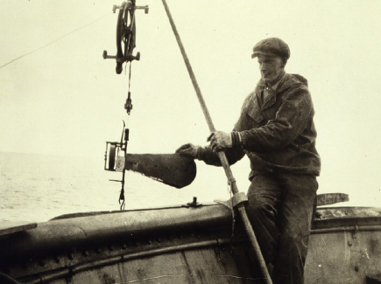
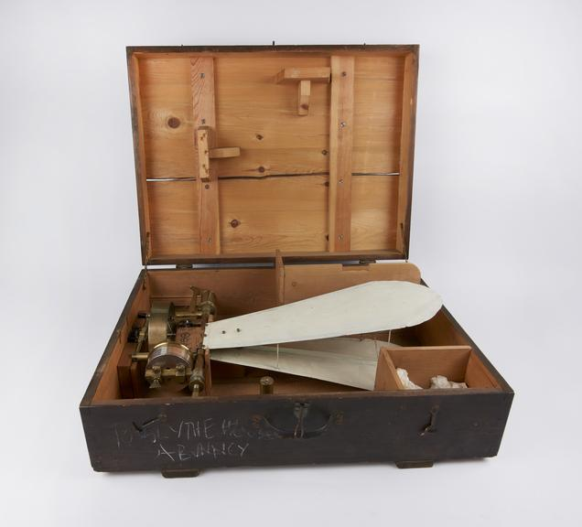
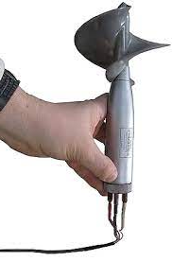
??
1920’s
An Ekman Current meter. Used in 1922 to measure current speed and direction.
It had a propeller.

Slide 7
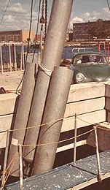
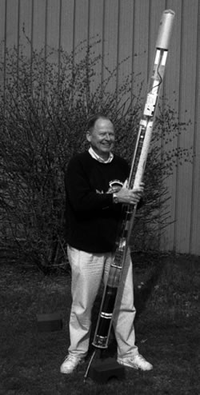
1960’s
SOFAR floats and RAFOS floats.
Whilst they didn’t actually ‘float’, they did record the speed of sound within the walls of a permanent thermocline at 1000m that behaved like a ‘sound tunnel’ across the ocean.
RAFOS float
SOFAR float
Notes:
Good read: - https://flypaper.soundfly.com/discover/what-is-the-sofar-channel-probably-not-what-you-think/

Slide 8
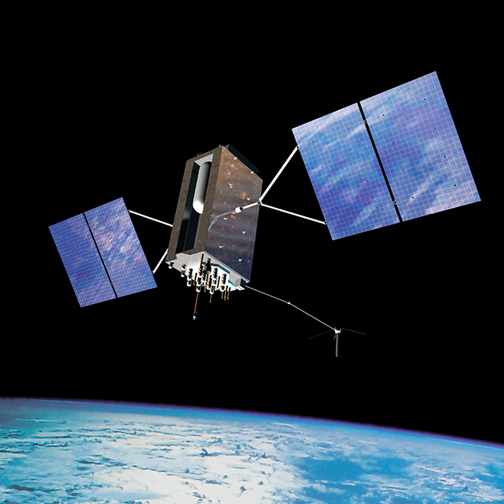
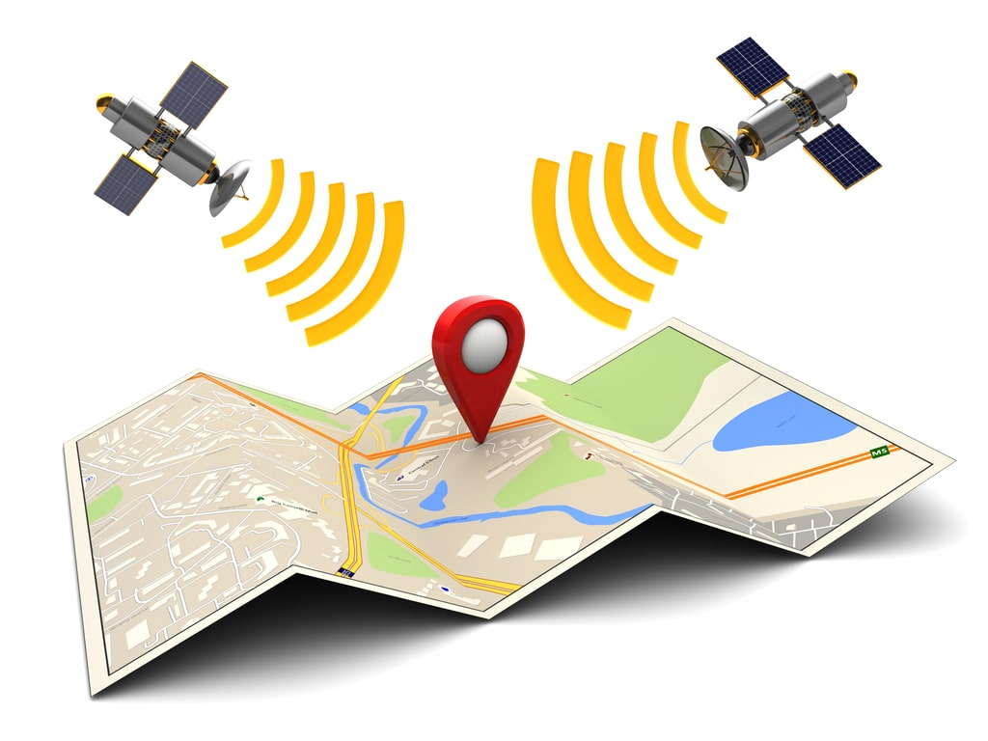
1970’s
GPS
Global Positioning System

Slide 9
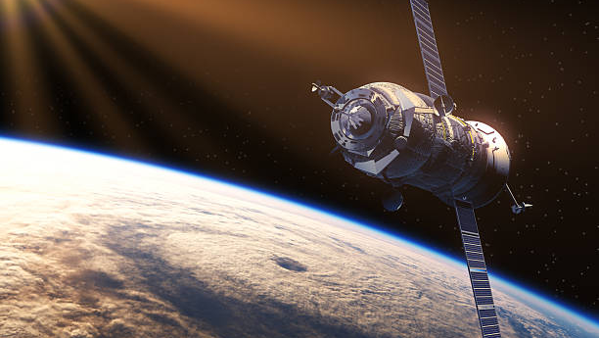
Notes:
https://www.istockphoto.com/photos/satellite-launch

Slide 10
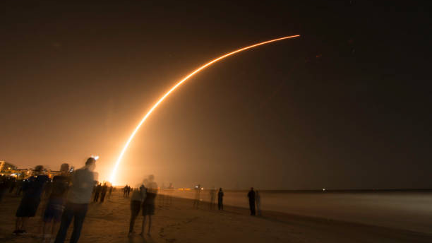
Night launch

Slide 11
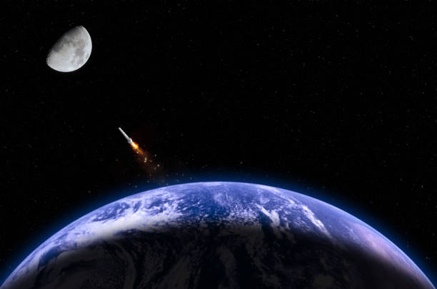

Slide 12
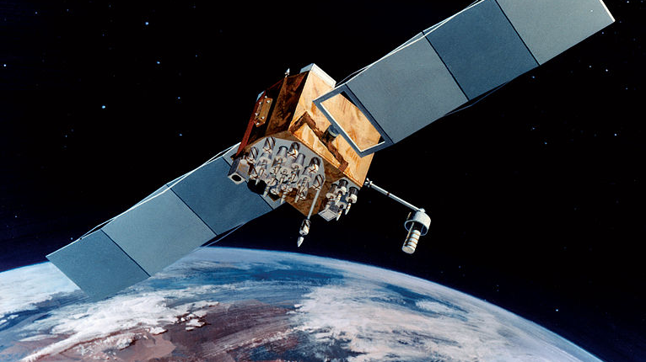
Navstar-2F satellite
Notes:
https://phys.org/news/2011-04-gps-satellites.html

Slide 13
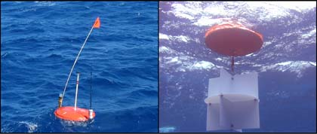
Drifters (1970s invention)
GPS-equipped ocean current Drifters float on the surface. GPS track their changing positions.
Notes:
Image: https://www.usgs.gov/media/images/gps-equipped-ocean-current-drifters
Good read: - https://flypaper.soundfly.com/discover/what-is-the-sofar-channel-probably-not-what-you-think/

Slide 14
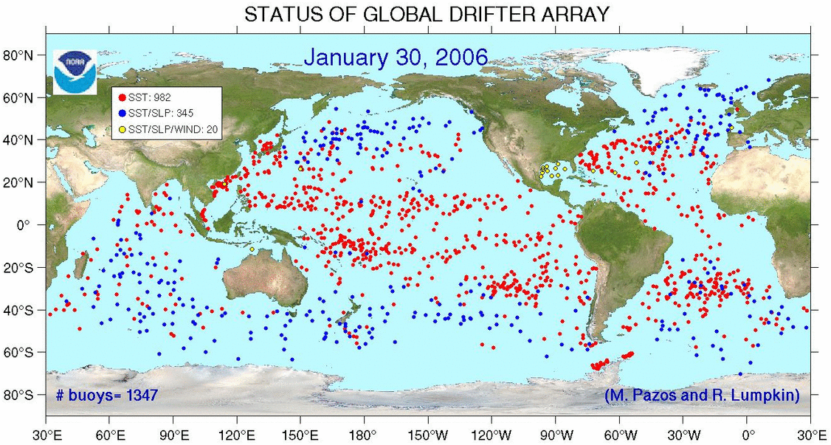

Slide 15
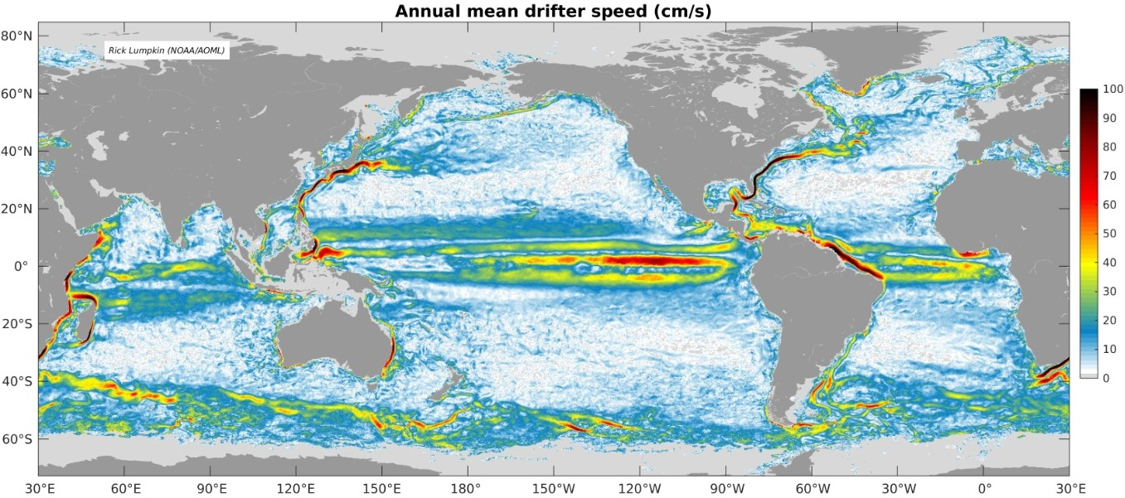
The drifters paint a picture of current speed and direction. Drifters also measure other parameters like sea surface temperature, salinity, barometric pressure, and wave height.
Notes:
Image: https://www.aoml.noaa.gov/global-drifter-program/

Slide 16
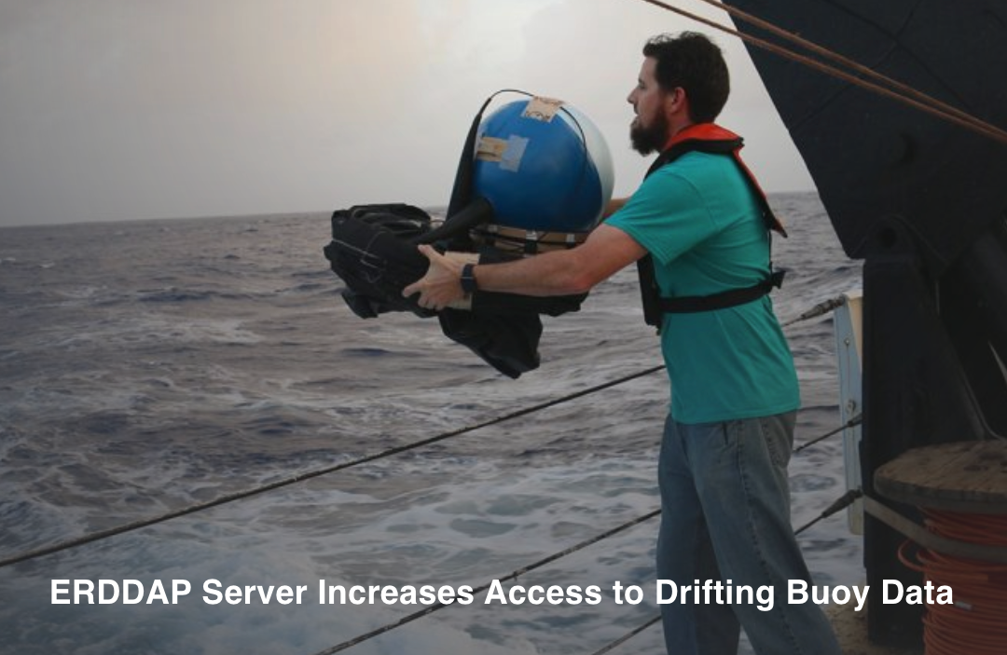
Notes:
https://www.aoml.noaa.gov/global-drifter-program/

Slide 17
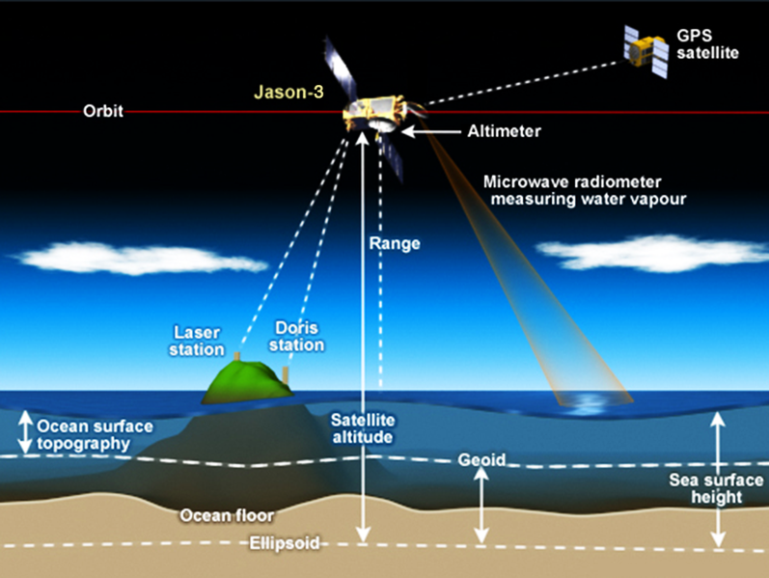
Radar altimeters (1990’s invention)
Radar altimeters (altimetry) measure sea level height via satellite.
Notes:
https://commons.wikimedia.org/wiki/File:NASA_Jason_3_satellite_altimetry.png

Slide 18
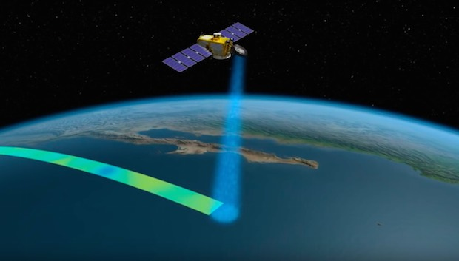
Radar altimeters work like a sounder/fish-finder but instead, the transducer and receiver are on a satellite.
Warm water sits at a higher elevation than cold water (more dense).
Notes:
https://spaceflightnow.com/2016/03/19/jason-3-satellite-begins-surveying-worlds-oceans/

Slide 19
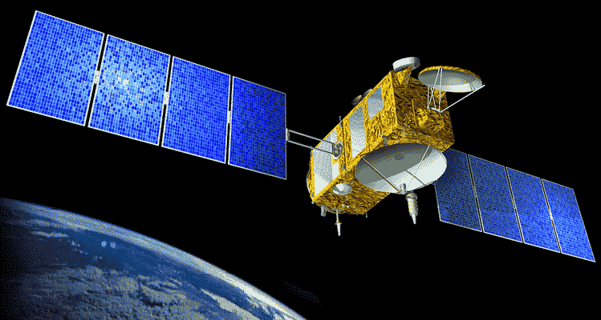
Jason -1 satellite altimeter launched 2001
(JASO=Journées Altimétriques Satellitaires pour l'Océanographie)
Notes:
https://en.wikipedia.org/wiki/Jason-1

Slide 20
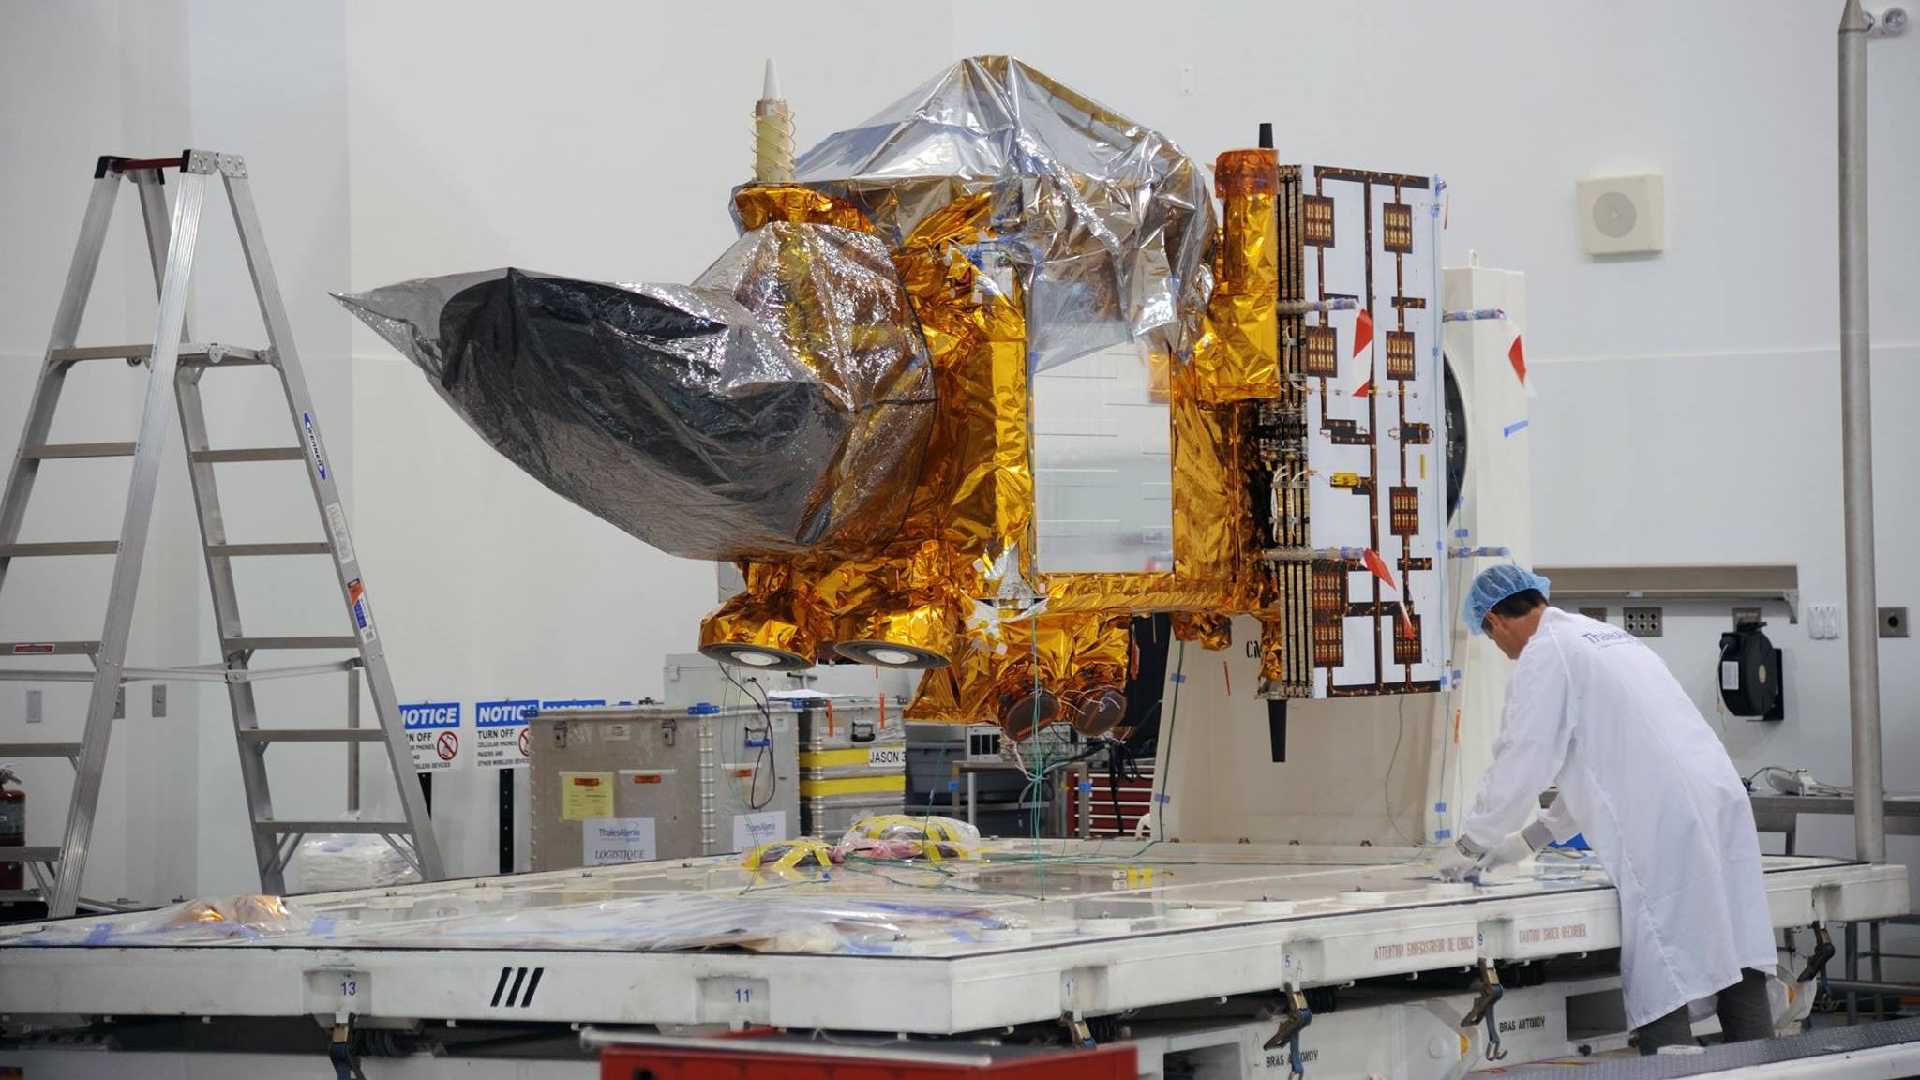
The Jason-3 satellite undergoing final preparations for launch atop a SpaceX Falcon-9 rocket.
Notes:
https://www.americaspace.com/2016/01/15/jason-3-critical-to-understanding-rising-sea-levels-interview-with-project-scientist-josh-willis-part-1/The Jason-3 satellite undergoing final preparations for placement within a payload fairing for launch atop a SpaceX Falcon-9 rocket, currently scheduled for Sunday, Jan. 17 from Vandenberg AFB in southern CA. Photo Credit: NASA

Slide 21
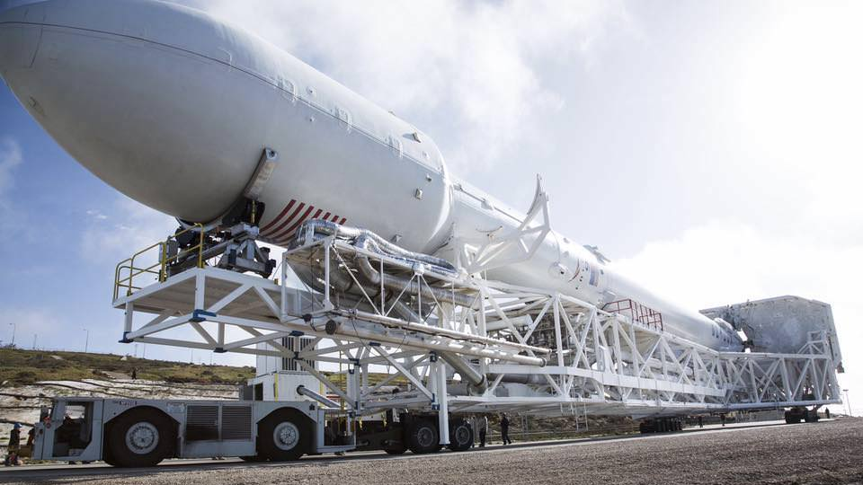
SpaceX Falcon 9 rolls out to California launch pad in advance of Jason-3 launch for NASA on Jan. 17, 2016. Credit: SpaceX
The 3rd flight unit of the JASON series was also called the “Ocean Surface Topography Mission (OSTM)”.
Notes:
https://www.universetoday.com/126834/spacex-launching-nasa-jason-3-ocean-surveillance-satellite-jan-17-barge-rocket-landing-watch-live/

Slide 22
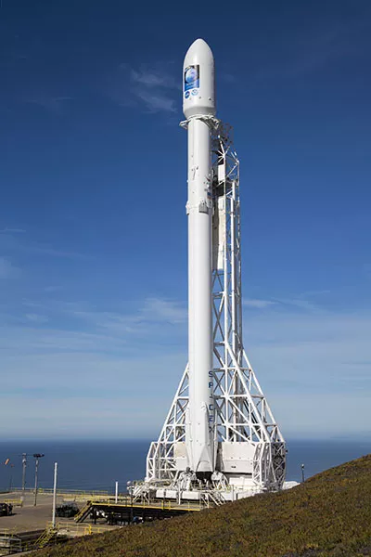
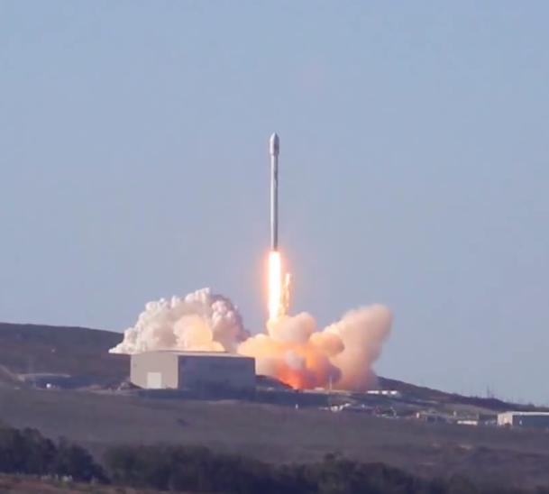
Jason-3 launch

Slide 23
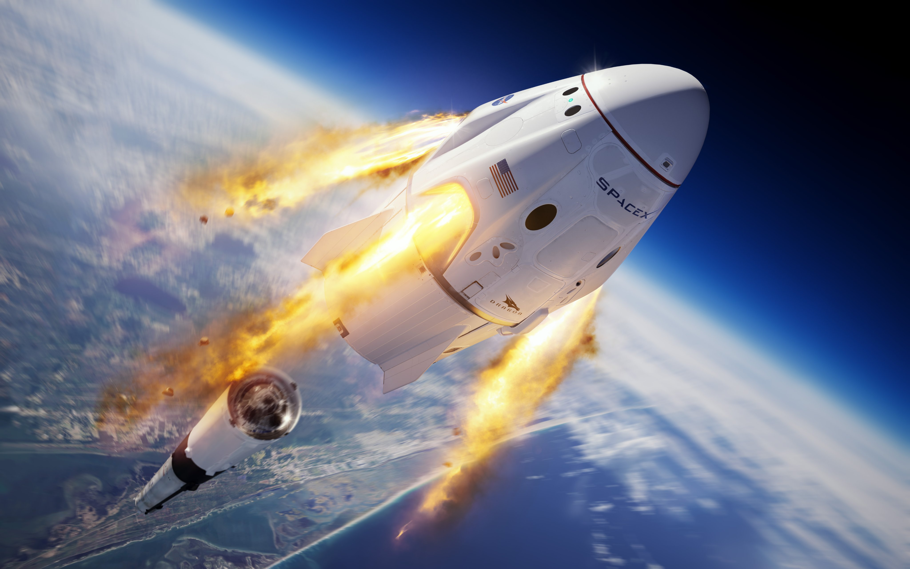
Notes:
https://www.space.com/spacex-crew-dragon-in-flight-abort-test-launch-webcast.html

Slide 24
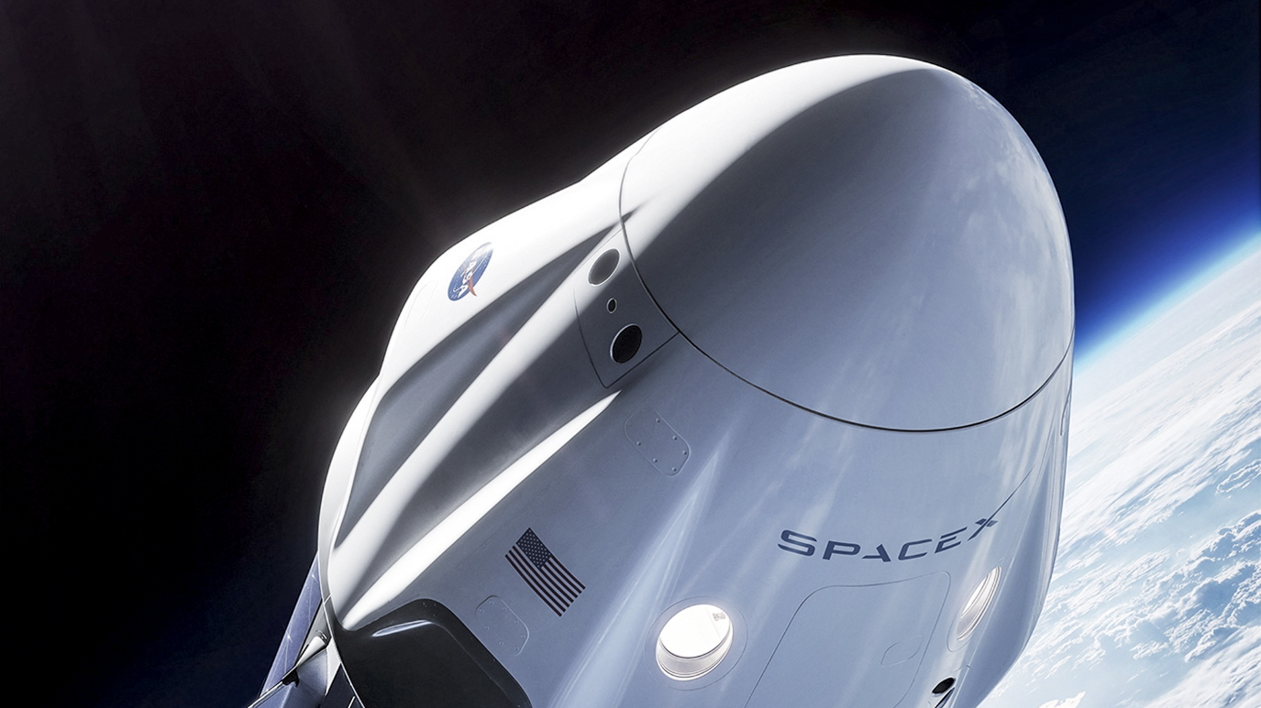

Slide 25
https://www.youtube.com/watch?v=ErRLf6d2anI

Slide 26
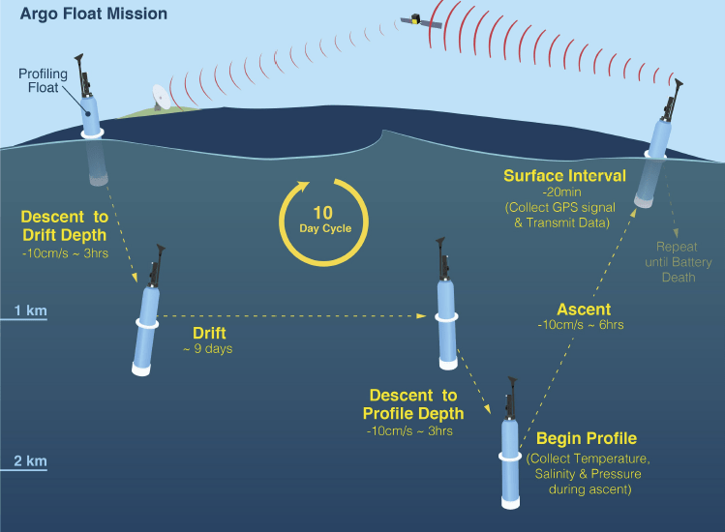
Argo Floats
(2000’s invention)
Argo is a global array of 3,000 free-drifting profiling floats (underwater robots) that measure the temperature and salinity of the upper 2000m of
the ocean.

Slide 27
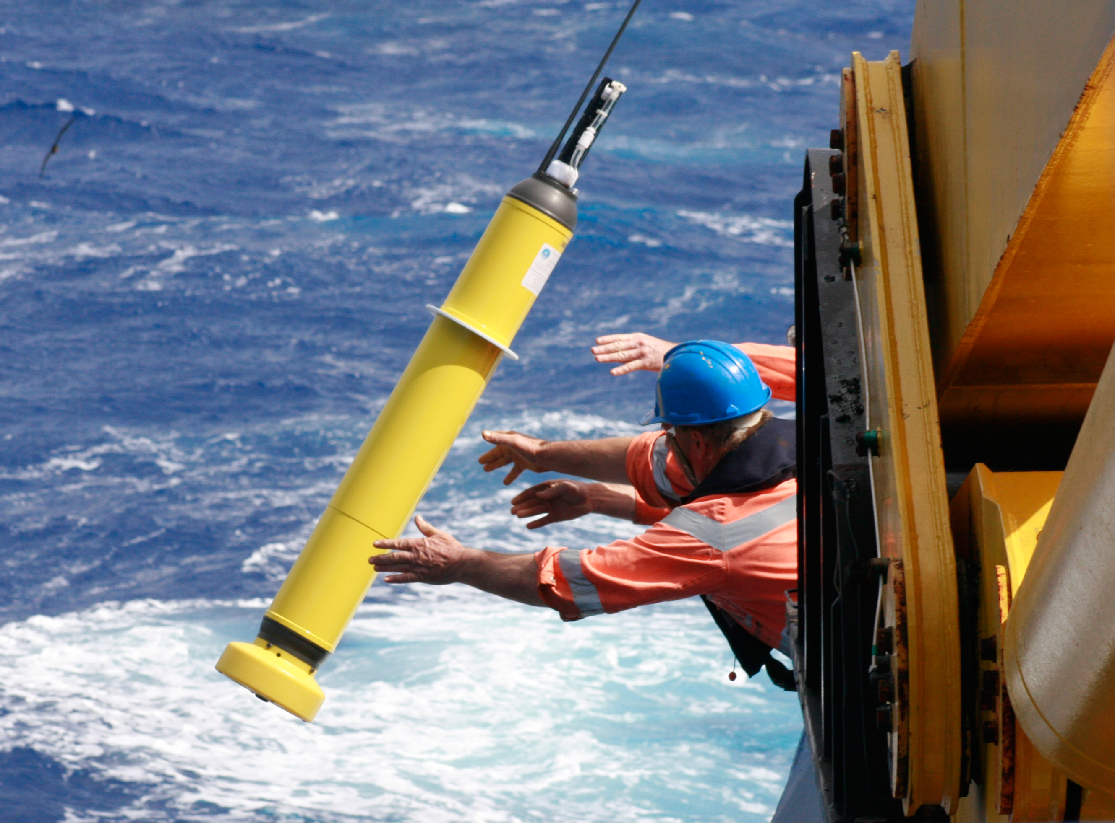
.
The name Argo was chosen to emphasize the strong complementary relationship of the global float array with the Jason satellite altimeter mission.
Notes:
https://www.csiro.au/en/news/all/news/2014/january/bio-robots-make-a-splash-in-the-indian-ocean

Slide 28
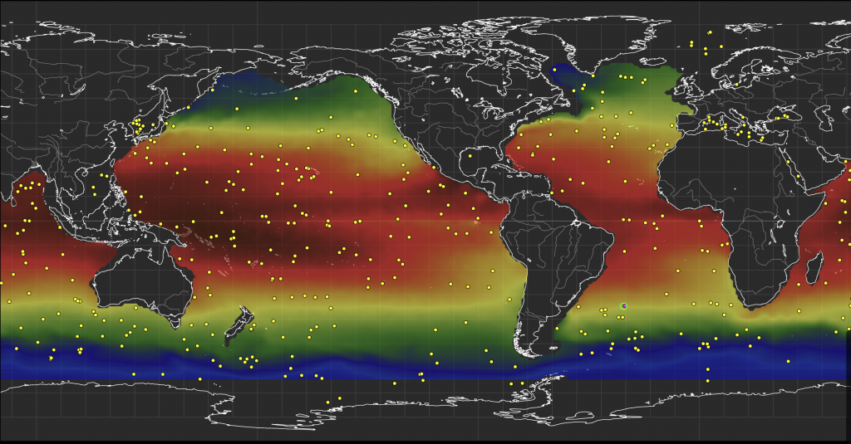
Argo floats worldwide
ARGO FLOAT LOCATIONS IN THREE DAYS SHOWN AS YELLOW DOTS. TEMPERATURE FROM ARGO FLOATS SHOWN AS COLOR UNDERNEATH WITH RED INDICATING WARMER TEMPERATURES AND BLUE INDICATING COLDER TEMPERATURES.

Slide 29
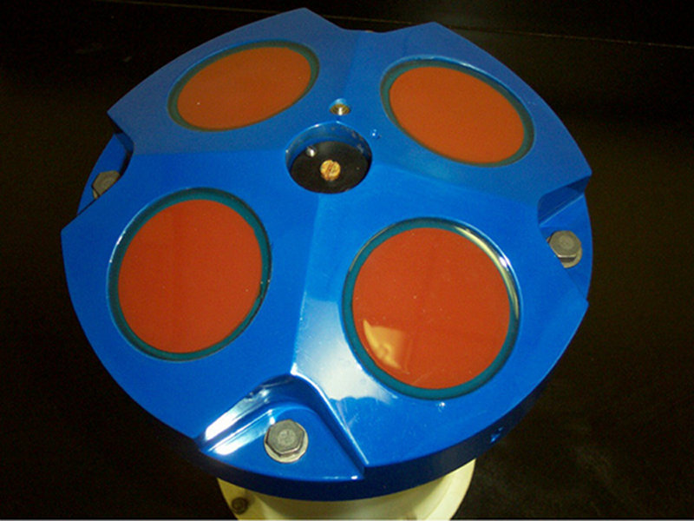
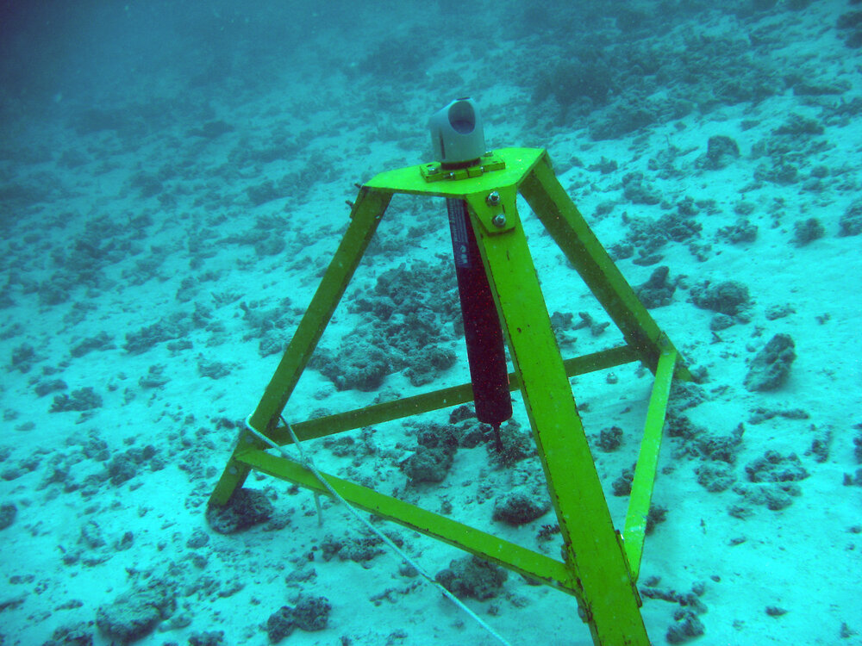
Acoustic doppler current profilers (ADCP) (21st Century invention)
ADCPs are like underwater speed cameras that transmit and receive sound signals using the doppler effect to measure the speed of suspended particles, drifting in currents, moving towards or away from the ADCP, depending on their pitch. ADCPs can be mounted on anything.
Typical 4 beam ADCP sensor head. The red circles are 4 transducers.

Slide 30
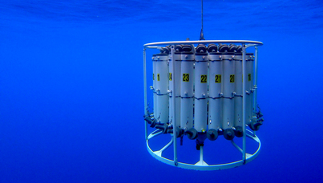
Conductivity, Temperature, Depth (CTD) sensors
CTDs are like giant multimeters protected by a cage that is lowered on a cable down to the seafloor. Scientists observe the water properties in real time via a conducting cable connecting the CTD to a computer on the ship.
Notes:
https://news.climate.columbia.edu/2015/10/20/exploring-rugged-hills-turbulent-waters-4500-meters-down/

Slide 31
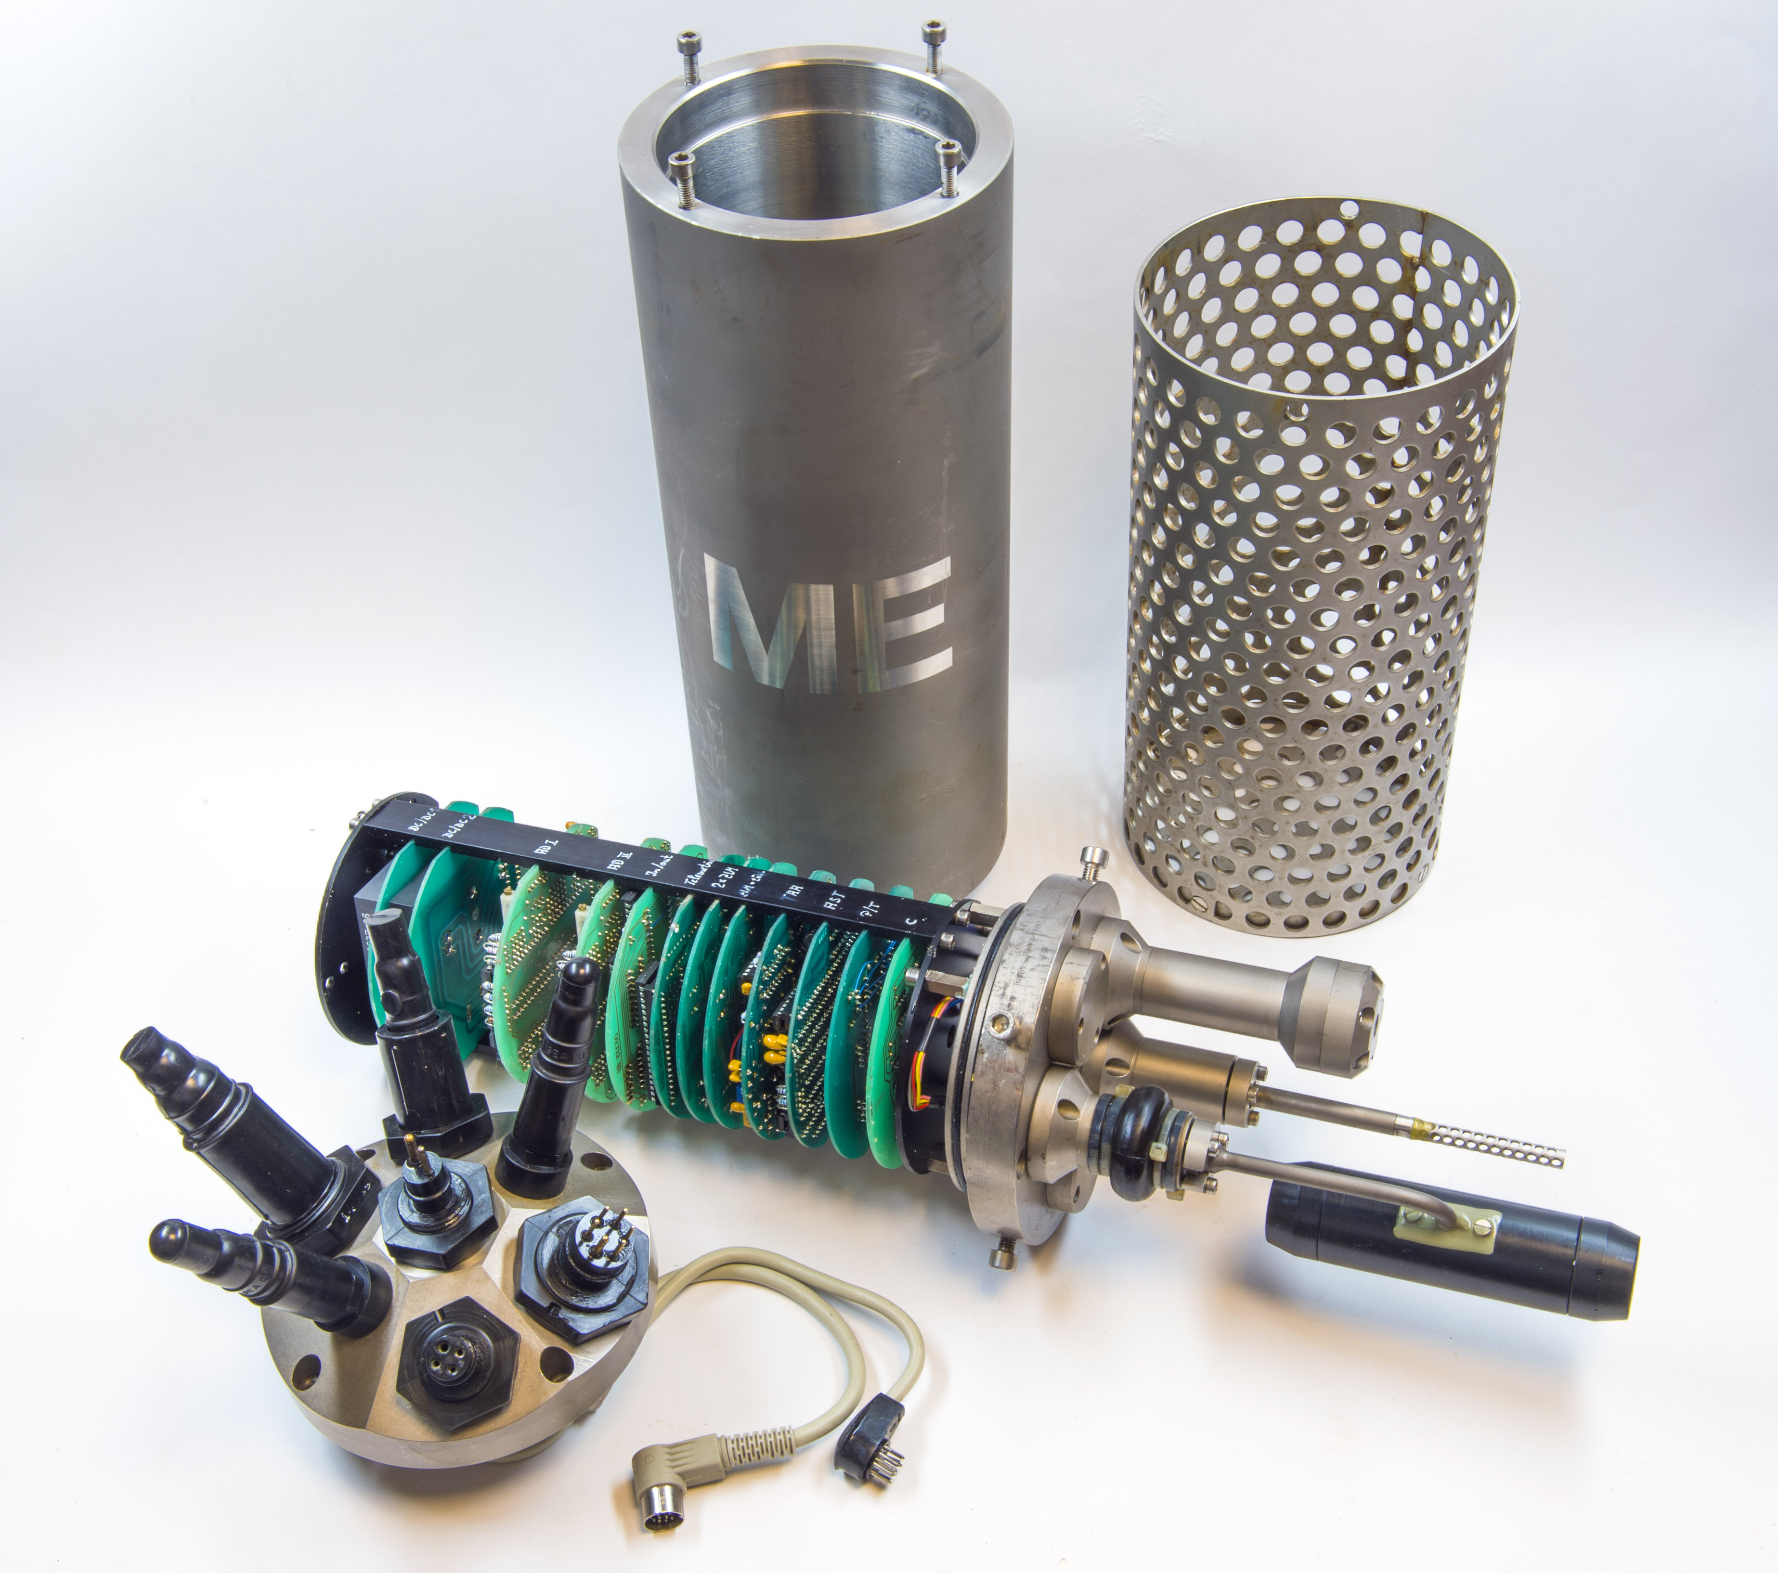
You can attach a host of accessories and instruments to the CTD package such as ADCPs, oxygen sensors and water bottles that can be closed as the instrument ascends to sample the physical properties of the water column at a specific depth.
Notes:
Image: wikapedia

Slide 32
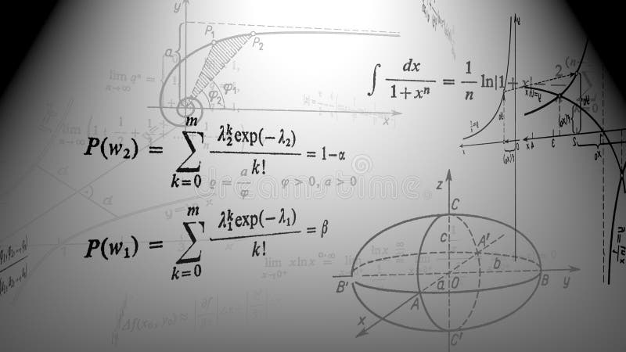
Ocean Circulation Models
Computer models use complex mathematical equations to make sense of all the data, to predict what the future will be like.

Slide 33
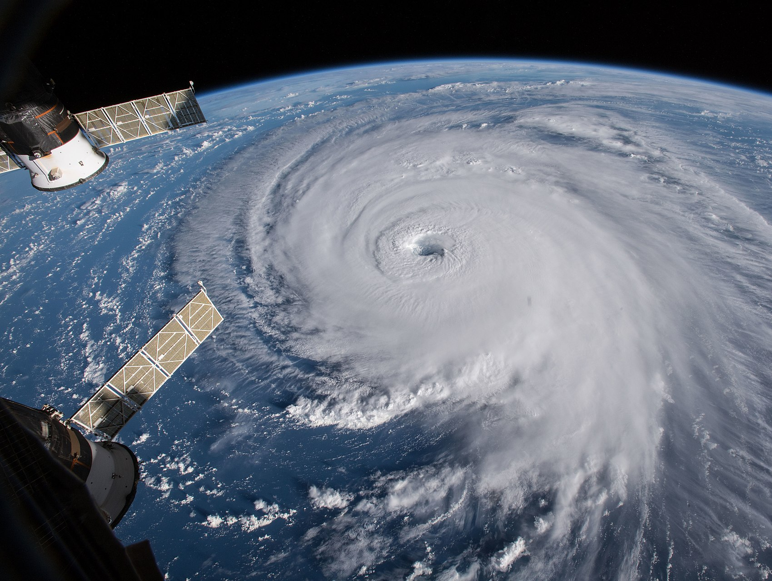
Ocean circulation models are key to predicting natural disasters such as flood events, cyclones, heat waves, cold snaps and mass bleaching events.
Notes:
https://en.wikipedia.org/wiki/Tropical_cyclone

Slide 34
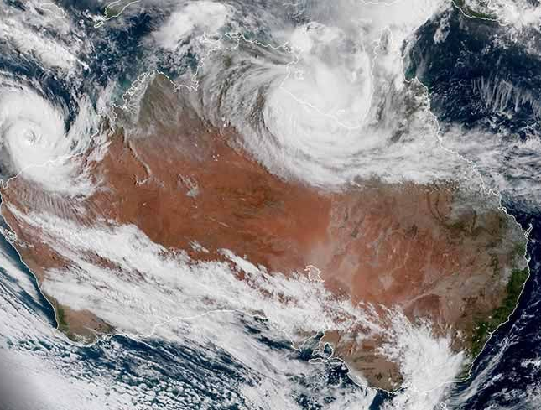
Currents have a strong influence on weather and climate.
For example, a cyclone will not form unless the sea surface temperature is more than 26 °C.

Slide 35
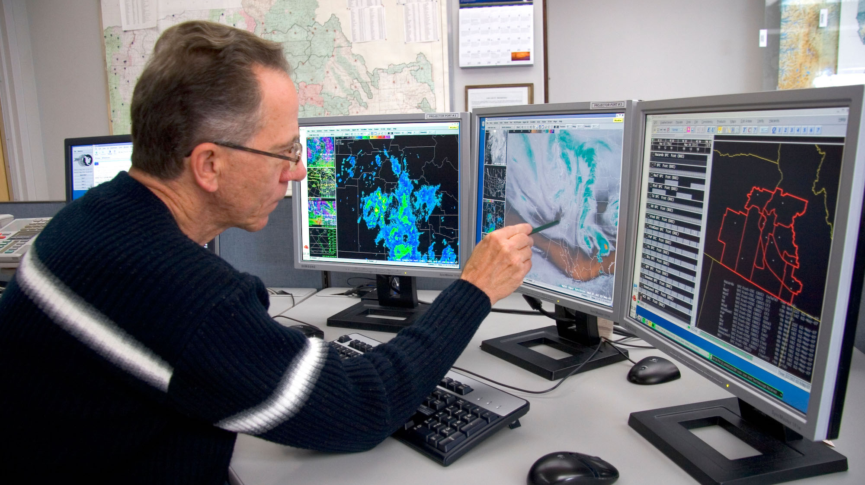
Notes:
https://education.nationalgeographic.org/resource/simulating-global-ocean/

Slide 36
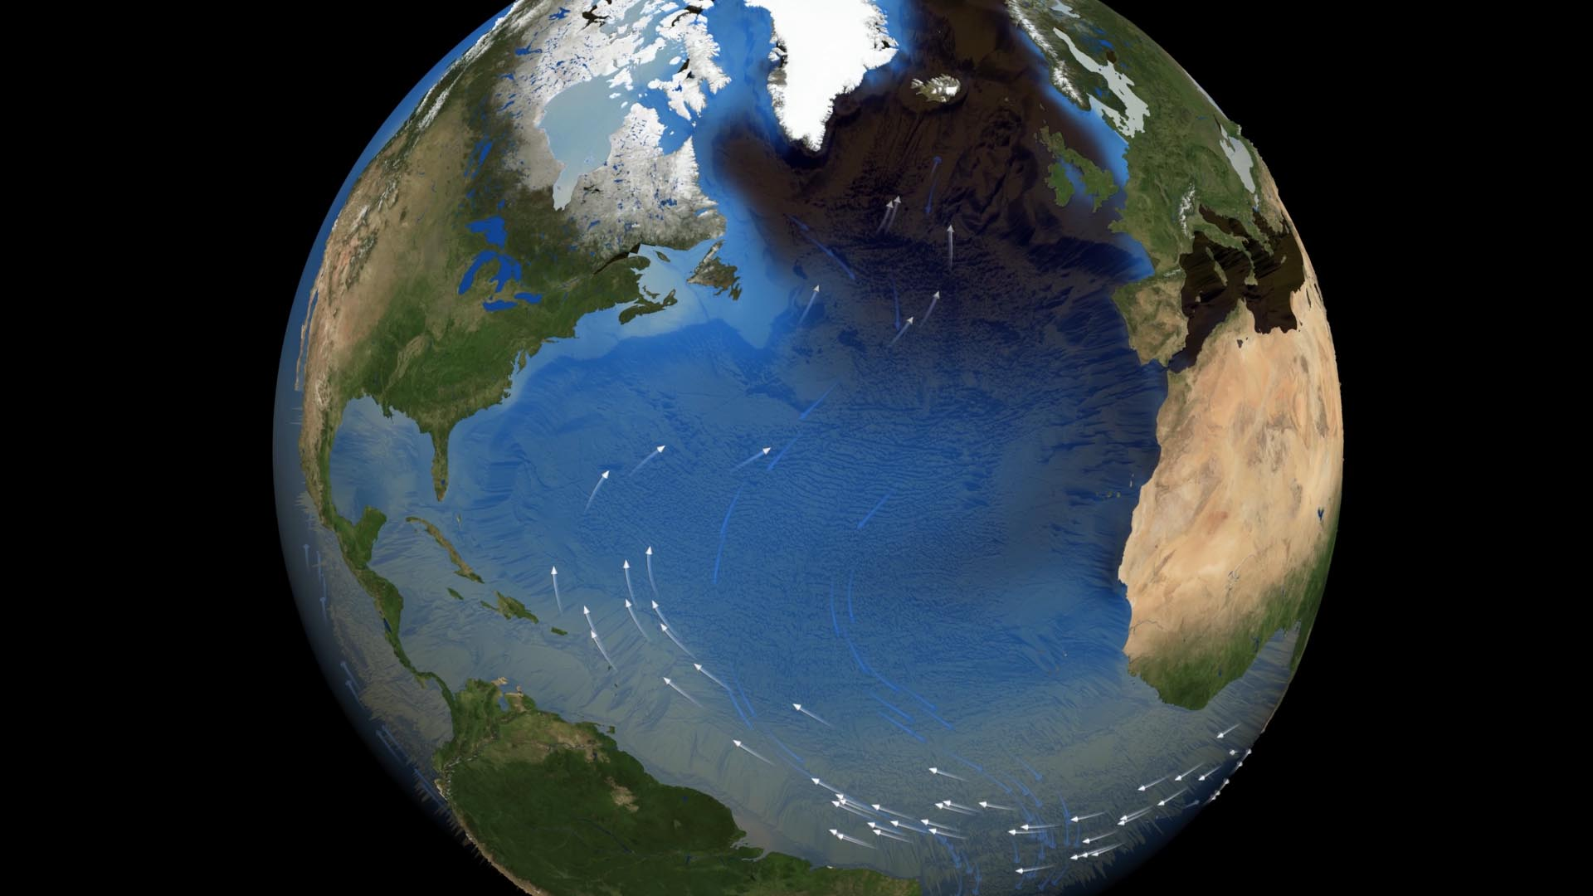
What if the Gulf Stream stopped?

Slide 37
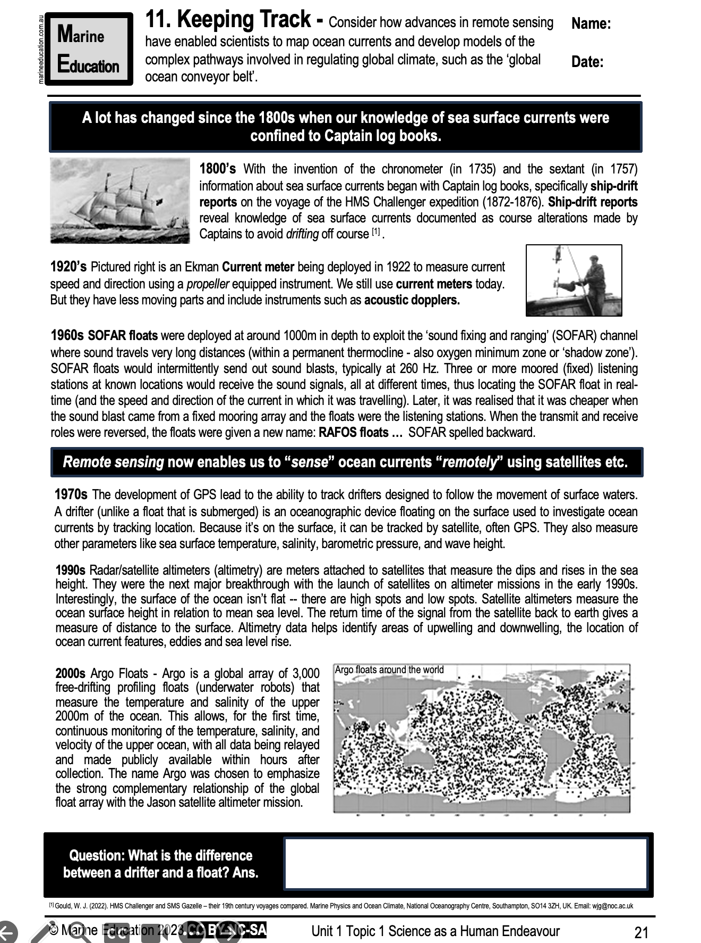
Learning Intention (2023 syllabus):
Consider how advances in remote sensing have enabled scientists to map ocean currents and develop models of the complex pathways involved in regulating global climate, such as the ‘global ocean conveyor belt’.
Success Criteria:
Complete Marine Education worksheet ’11. Keeping Track’
Notes:
https://www.istockphoto.com/photos/satellite-launch

