Slide 1
Learning Intention:
Consider that contemporary weather predictions are based on computer models but still rely on human input to determine the most accurate and reliable forecast. Consider how this scientific knowledge enables scientists to inform decision-making for coastline management and marine industries.
Success Criteria:
Complete Marine Education worksheet ‘’12. Cloudy and a chance of meatballs’
Notes:
https://www.eumetsat.int/what-we-do/monitoring-weather

Slide 2
A Computer Weather Model
is the main tool used to forecast weather.

Slide 3
Weather Models create a virtual planet Earth, simulating the atmosphere, ocean, land surface and sea ice, and use mathematical equations to predict future weather.
Notes:
https://www.meteosource.com/blog/category/meteorology

Slide 4
Corridor of computer servers
Notes:
https://www.noaa.gov/media-release/noaa-upgrades-global-ensemble-forecast-system

Slide 5
Notes:
https://www.innovationnewsnetwork.com/aspire-project-optimises-accuracy-and-efficiency-of-weather-forecasts/27771/

Slide 6
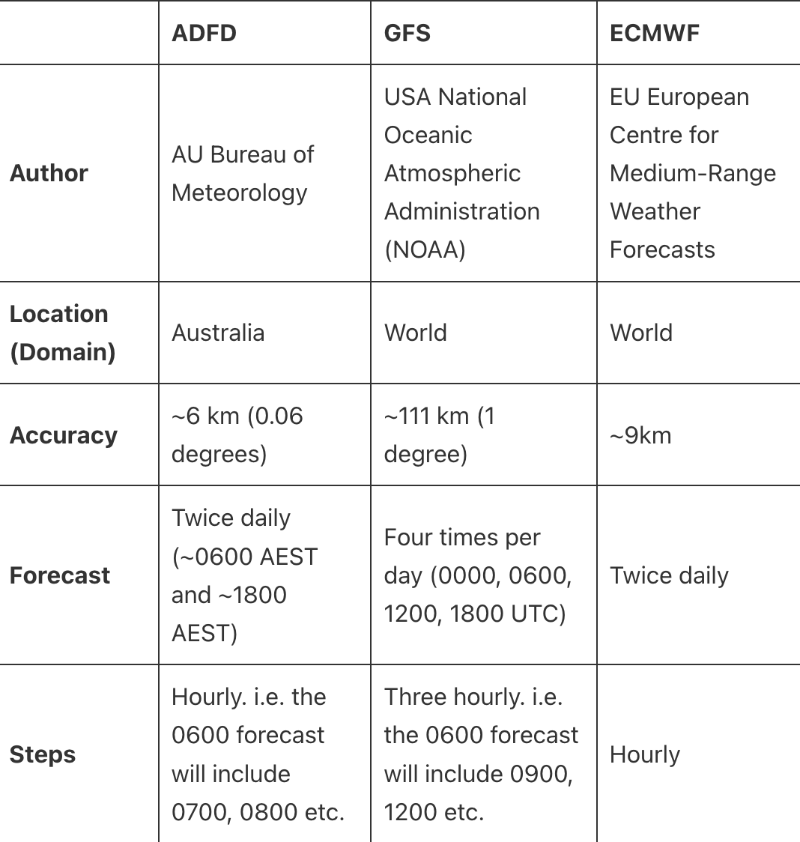
Popular weather models include:
Australia’s ADFD (Australian Digital Forecast Database)
America’s GFS (Global Forecast System)
Europe’s ECMWF (European Centre for Medium-Range Weather Forecasts)
Notes:
https://disasterscience.co/ufaq/what-is-the-adfd/

Slide 7
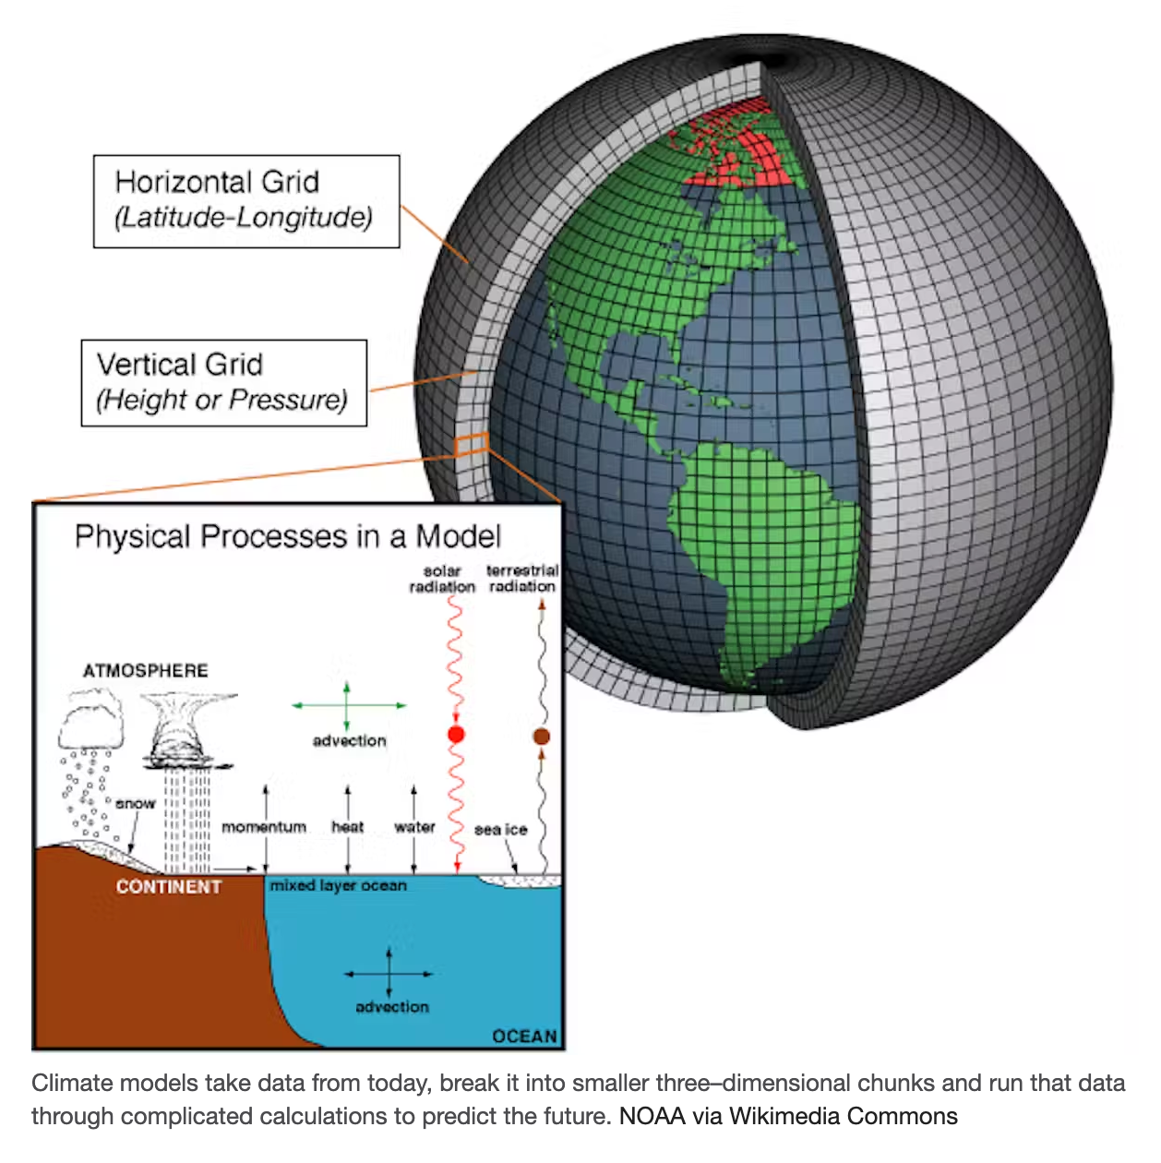
Weather models carve up the Earth into a large number of grid boxes, horizontally and vertically.
Observations are fed into the model and the model is “run” to work its magic.
Notes:
https://theconversation.com/winners-of-2021-nobel-prize-in-physics-built-mathematics-of-climate-modeling-making-predictions-of-global-warming-and-modern-weather-forecasting-possible-169329

Slide 8
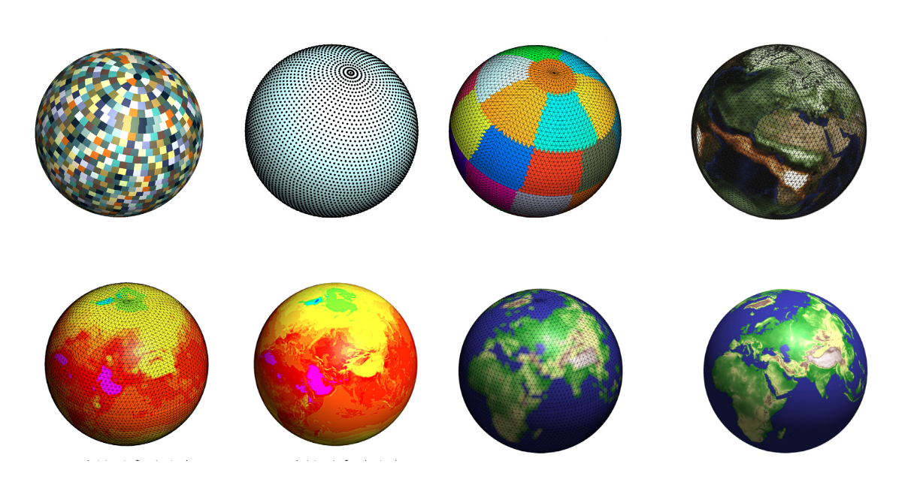
Notes:
https://www.sciencedirect.com/science/article/pii/S0010465517302138

Slide 9
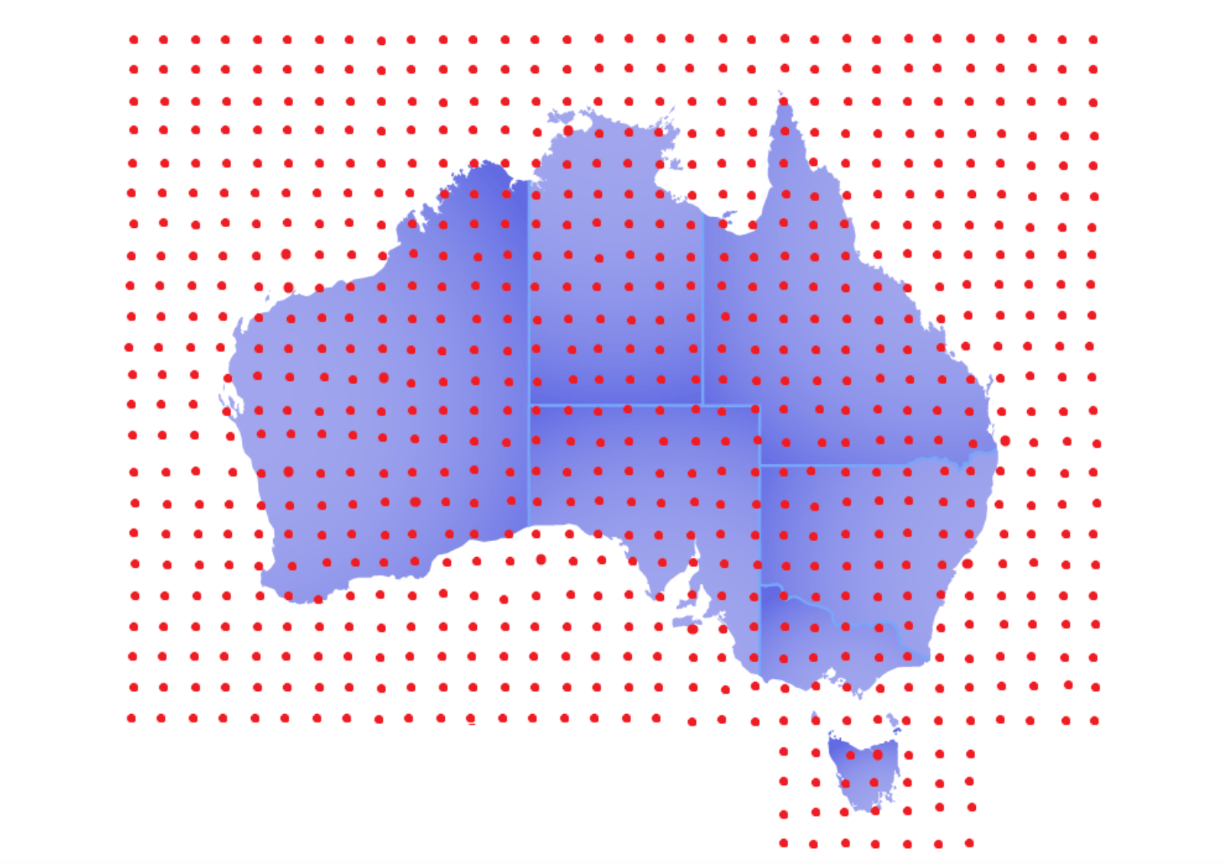
A series of points are laid out in each grid. The Weather Models use math calculations from the laws of thermodynamics and other laws to identify how weather at one point will interact with weather at the next point. By repeating this process over and over, it predicts what the weather will be at each point in the grid.
Notes:
https://www.fishranger.com.au/the_truth_about_weather_sites

Slide 10
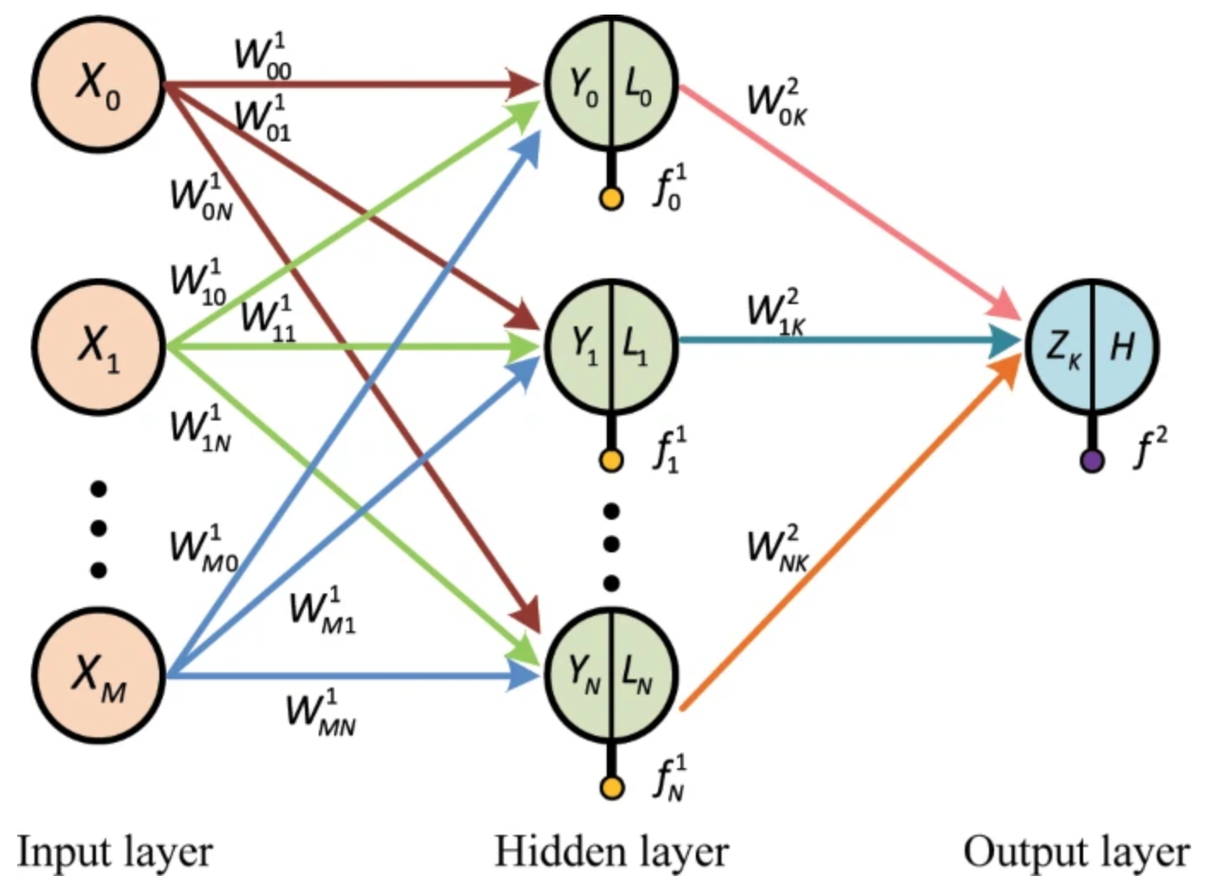
Algorithm for a short-term rainfall forecast model
Each model uses different combinations of these equations.
Solving them all is a huge job and (depending on the power of the computer)
can take hours to solve.
Notes:
https://www.nature.com/articles/s41598-019-56452-5

Slide 11
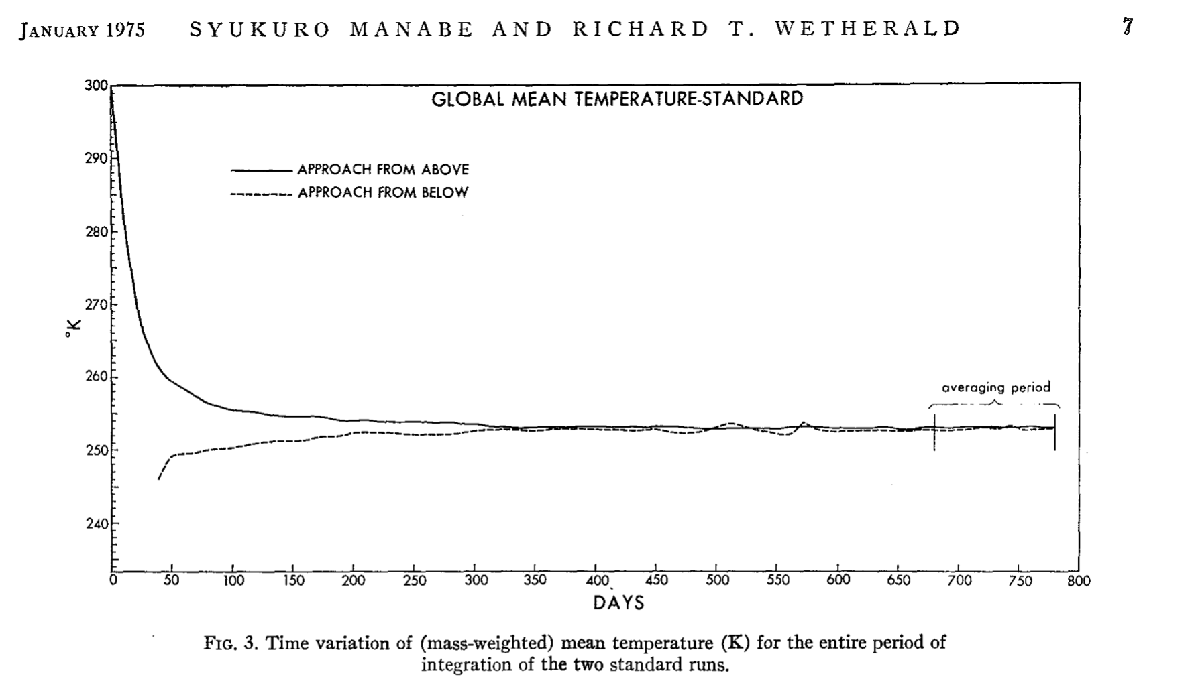
When finished, the equations are run again. Multiple times over.
Each time with slightly different starting conditions to find out if small changes in the atmosphere or ocean are likely to cause a change in the forecast.
different starting conditions (for ℃)

Slide 12
Long term forecasts from the Bureau of Meteorology are run 99 times.

Slide 14
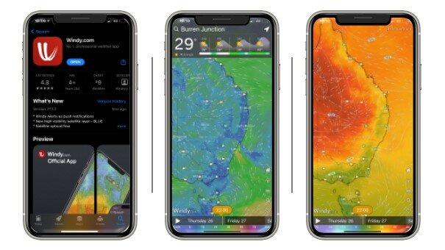
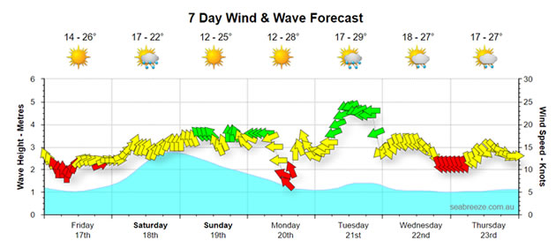
When finished, the results are available to download
(for apps like windy.com and seabreeze who can decifer all the coding)
Some downloads are free
Others cost money
windy
seabreeze

Slide 15
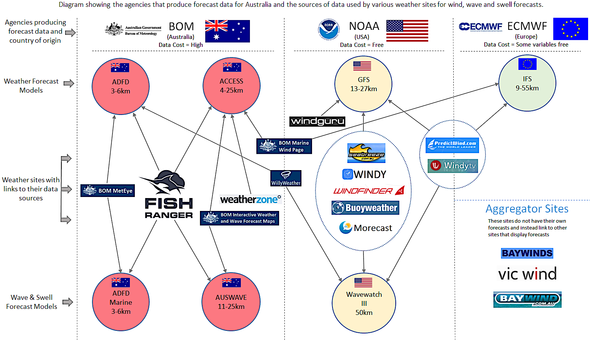
Each
weather app on the market chooses which model/s results
to download

Slide 16
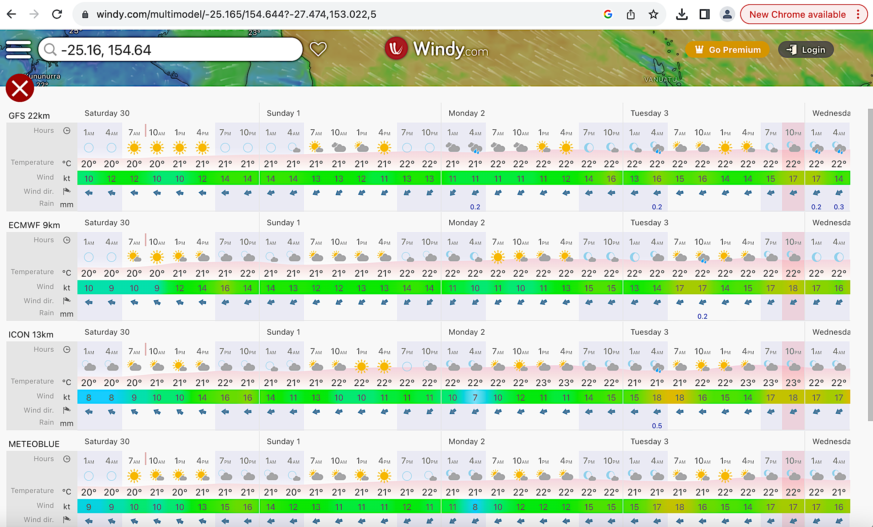
www.windy.com download quite a few (Click your location, down arrow, ‘’Compare”)
GFS
ECMWF
ICON
METEOBLUE
and more….

Slide 17
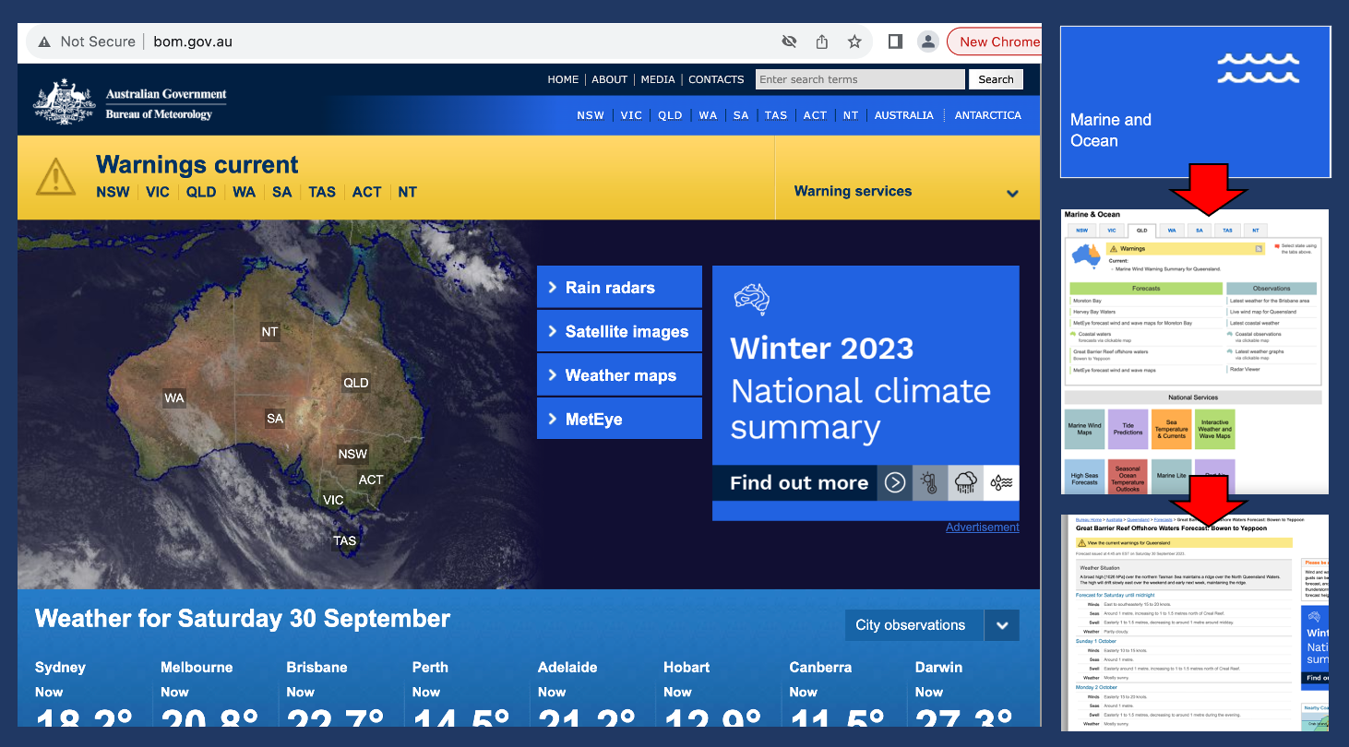
The ADFD model calculations are run by the BOM who charge $ for commercial apps to download. The BOM publish their own graphs free to the public.
BOM.gov.au collects weather station data ‘observations tab’
ADFD Model does calculations to make predictions
Output sold to commercial weather apps
BOM publishes their own weather apps and forecasts
via www.bom.gov.au

Slide 18
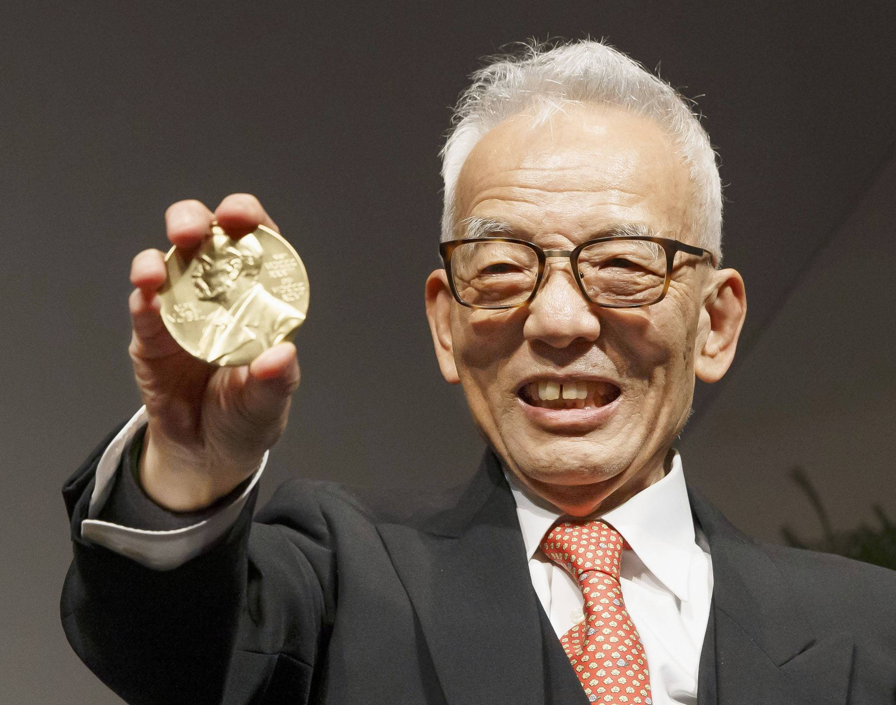
So who designs the models?
This guy “Suki” started it in his 20s. He’s now 93
Japan born Syukuro “Suki” Manabe is a pioneer in the development of physical models of the Earth’s climate. In the 1960s he was the first to study how the balance of energy absorbed and emitted by the Earth interacts with the vertical transport of air masses.
In 2021, the 90 year old
won the Nobel Prize
“for ground breaking contributions to our understanding of complex physical systems”
"Studying climate is fun," he said. "I want more young Japanese people to join."
Notes:
https://www.japantimes.co.jp/news/2021/12/07/national/manabe-nobel/

Slide 19
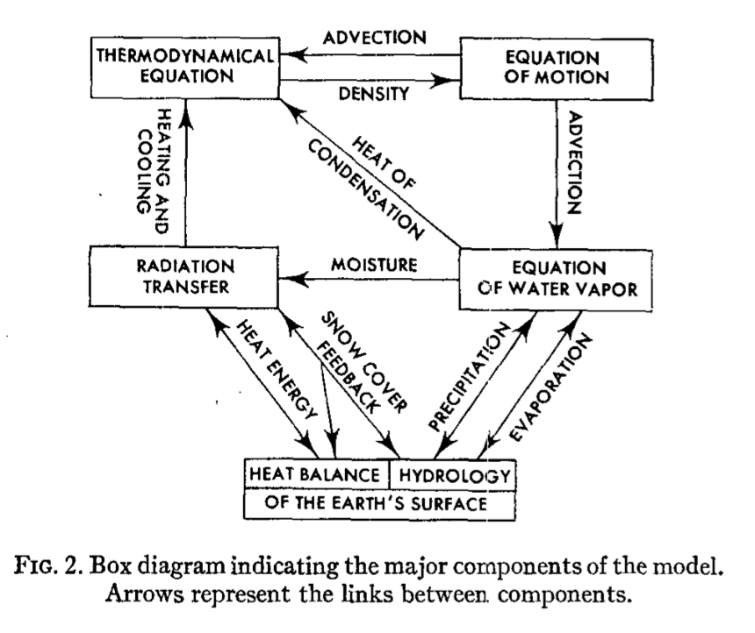
Pictured right is a box diagram of the major components of a model Suki famously used in 1975 to predict the effects of doubling atmospheric carbon dioxide (CO₂) from 300ppm to 600ppm.
Notes:
https://media.bom.gov.au/social/blog/2102/explainer-weather-models/

Slide 20
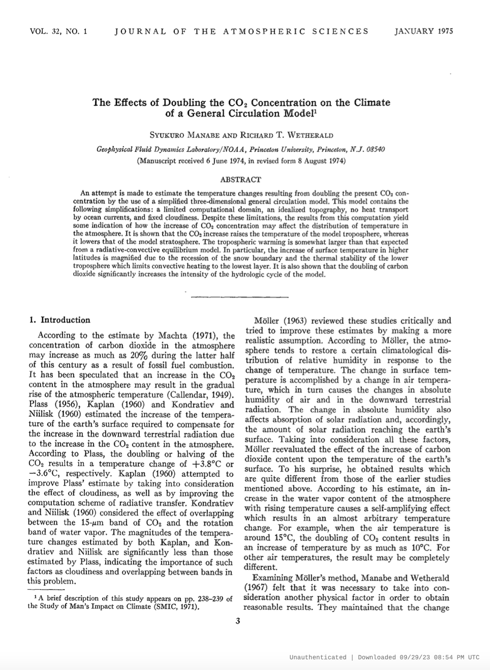
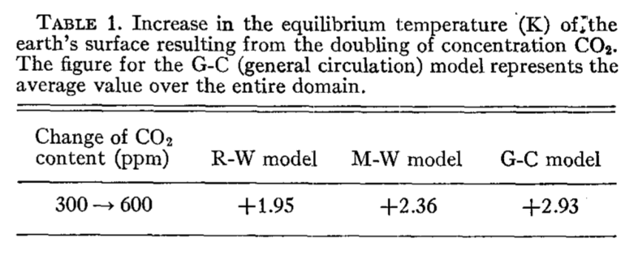
All the predictions thus far have come true
(although we haven’t reached a doubling of CO₂ yet).

Slide 21
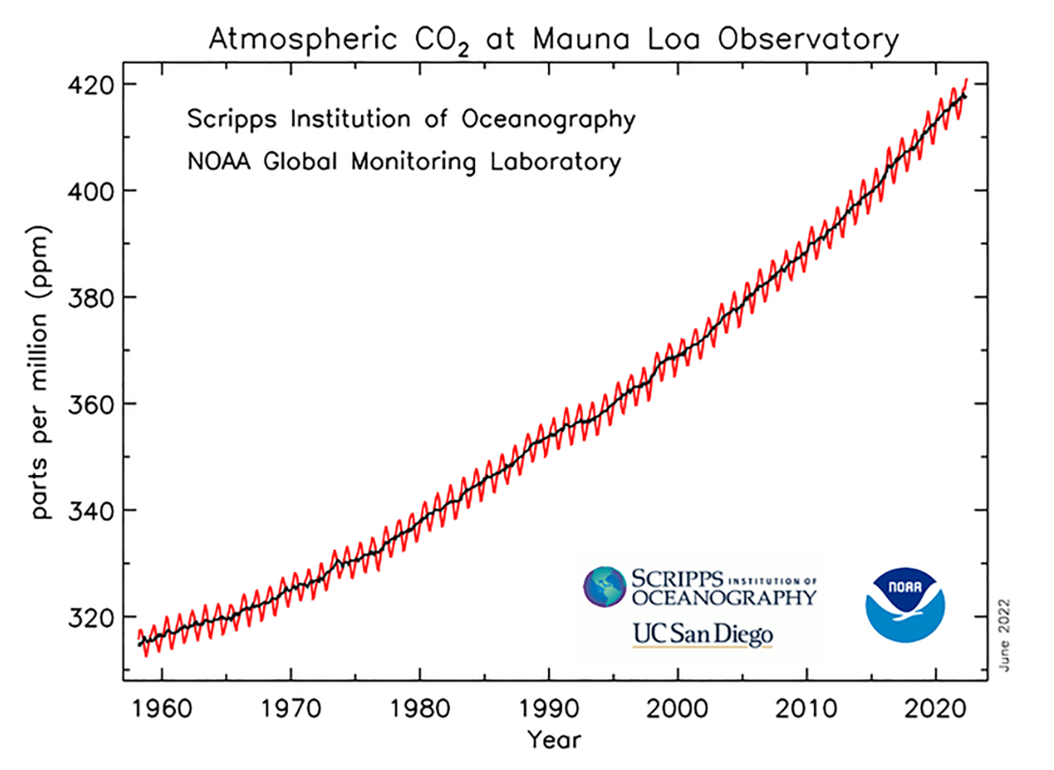
Mean CO₂ concentrations on 28th Sept 2022 were 415.38ppm
Mean CO₂ concentrations on 28th Sept 2023 were 418.20ppm
Notes:
https://climate.copernicus.eu/summer-2023-hottest-record

Slide 22
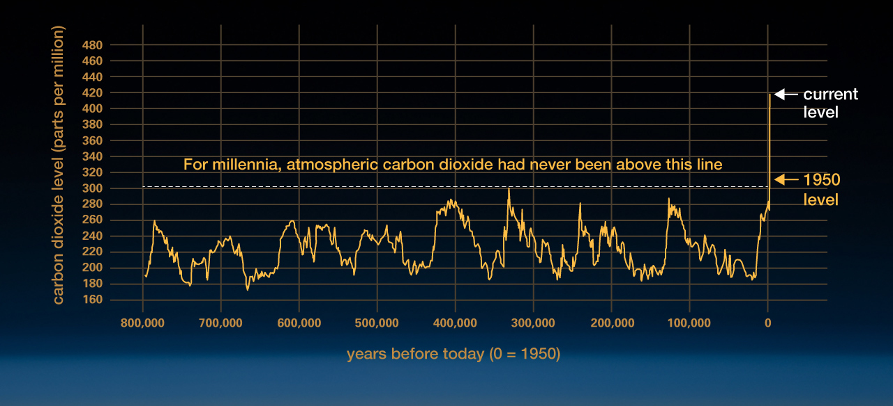
CO₂
© NASA
Notes:
https://climate.nasa.gov/climate_resources/24/graphic-the-relentless-rise-of-carbon-dioxide/

Slide 23
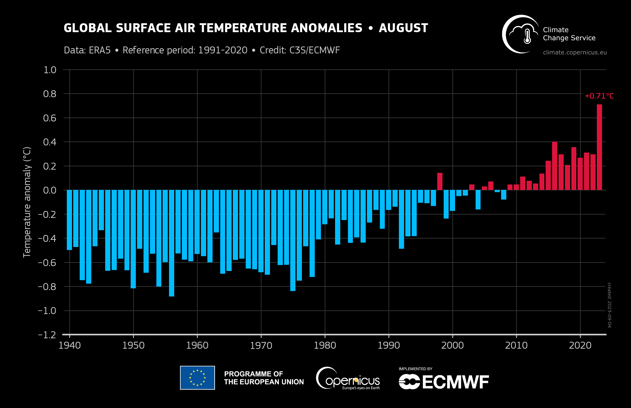
℃
Notes:
https://climate.copernicus.eu/summer-2023-hottest-record

Slide 24
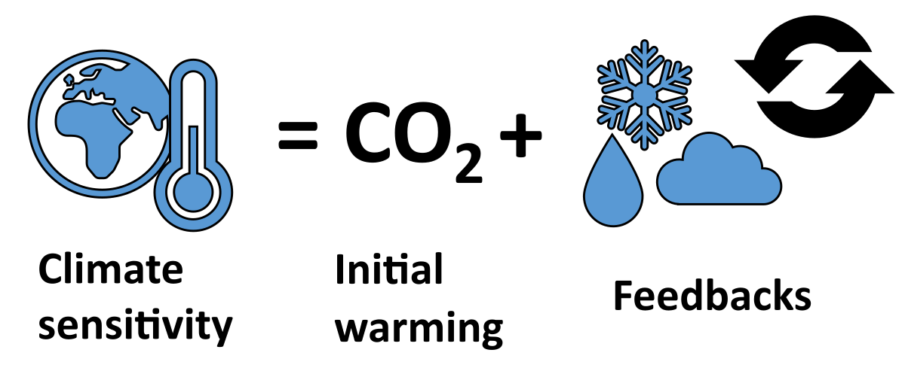
Climate sensitivity asks the question – how much warming can we expect from a rise in CO₂?
Essentially we are asking how sensitive our climate is to increases in CO₂, hence the term – ‘climate sensitivity’.
Notes:
https://en.wikipedia.org/wiki/Climate_sensitivity

Slide 25
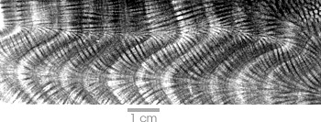
Climate sensitivity is measured using:
Palaeoclimate records (ice cores, coral cores, etc.)
Historical climate records (we have been documenting this since the 19th century)
Climate Models
Coral core with dark bands indicating El Nino years when growth was stunted.
Notes:
https://earthobservatory.nasa.gov/features/Paleoclimatology_CloseUp/paleoclimatology_closeup_2.php

Slide 26
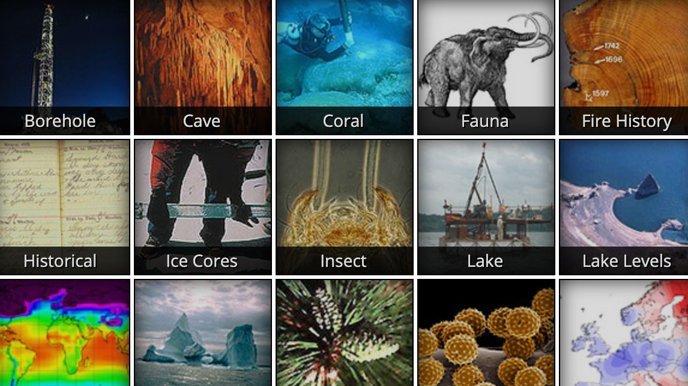
Climate sensitivity is now measured using:
Palaeoclimate records (ice cores, coral cores, etc.)
Historical climate records (we have been documenting this since the 19th century)
Climate Models
Notes:
https://www.climate.gov/maps-data/dataset/natural-records-past-climate-maps-visualizations-and-descriptive-information
https://www.ncei.noaa.gov/products/paleoclimatology/ice-core

Slide 27
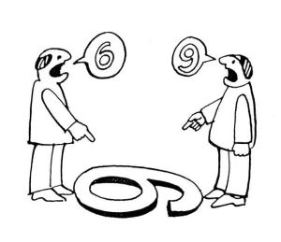
All involve making a number of assumptions
(to fill in the gaps where data is missing).
Notes:
https://justcasualread.wordpress.com/2018/05/24/assumptions-the-messmaker/

Slide 28
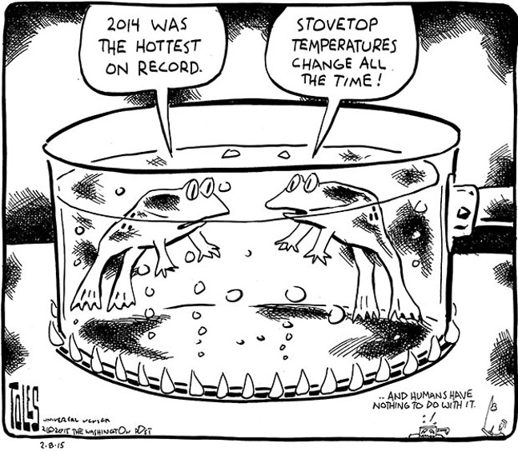
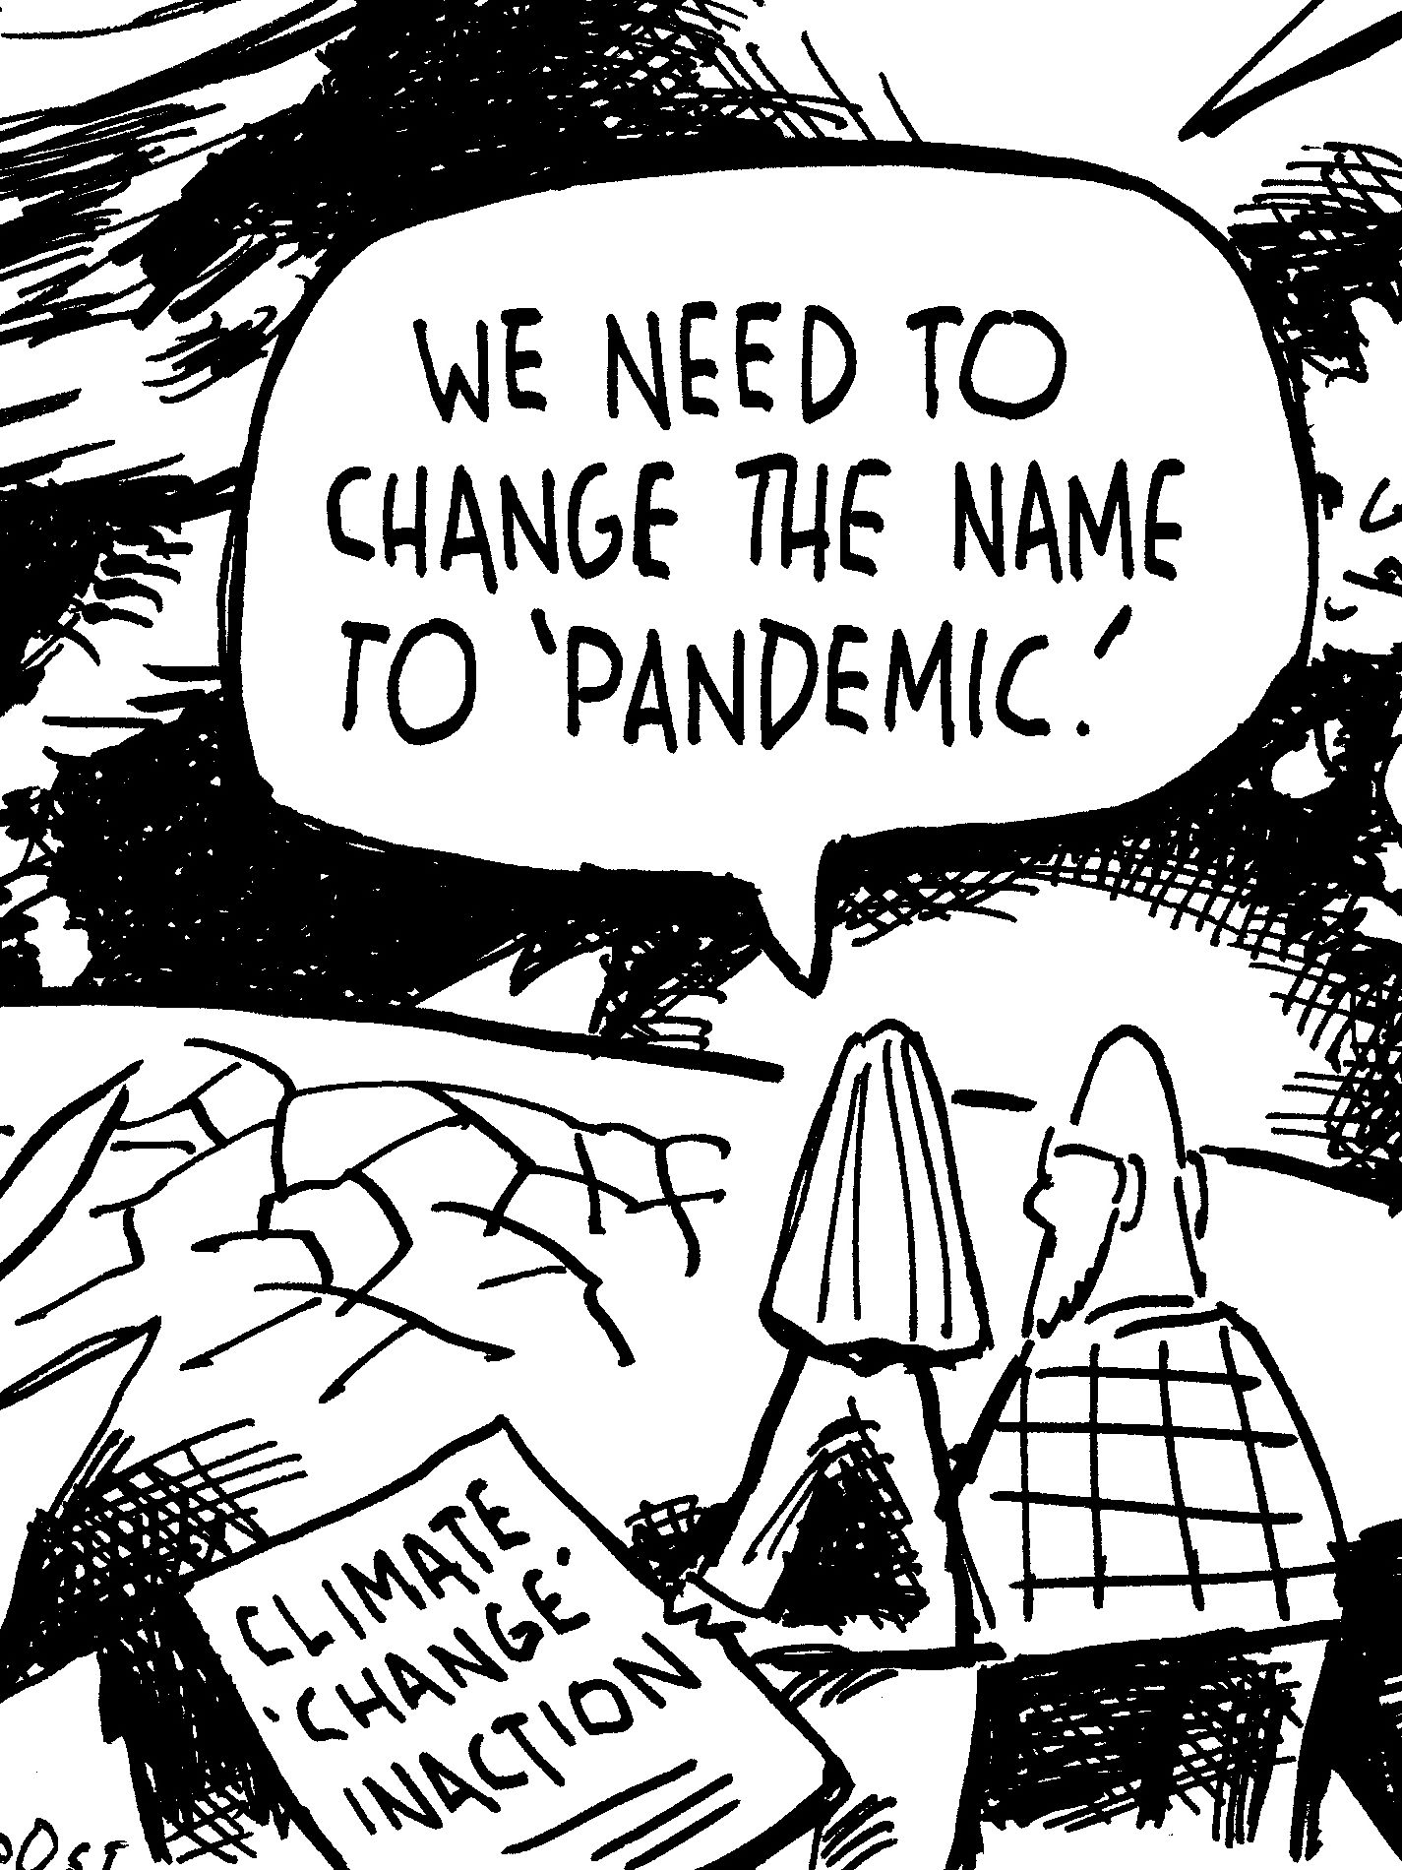
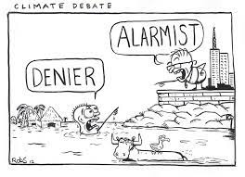
Leaving room for much interpretation

Slide 29
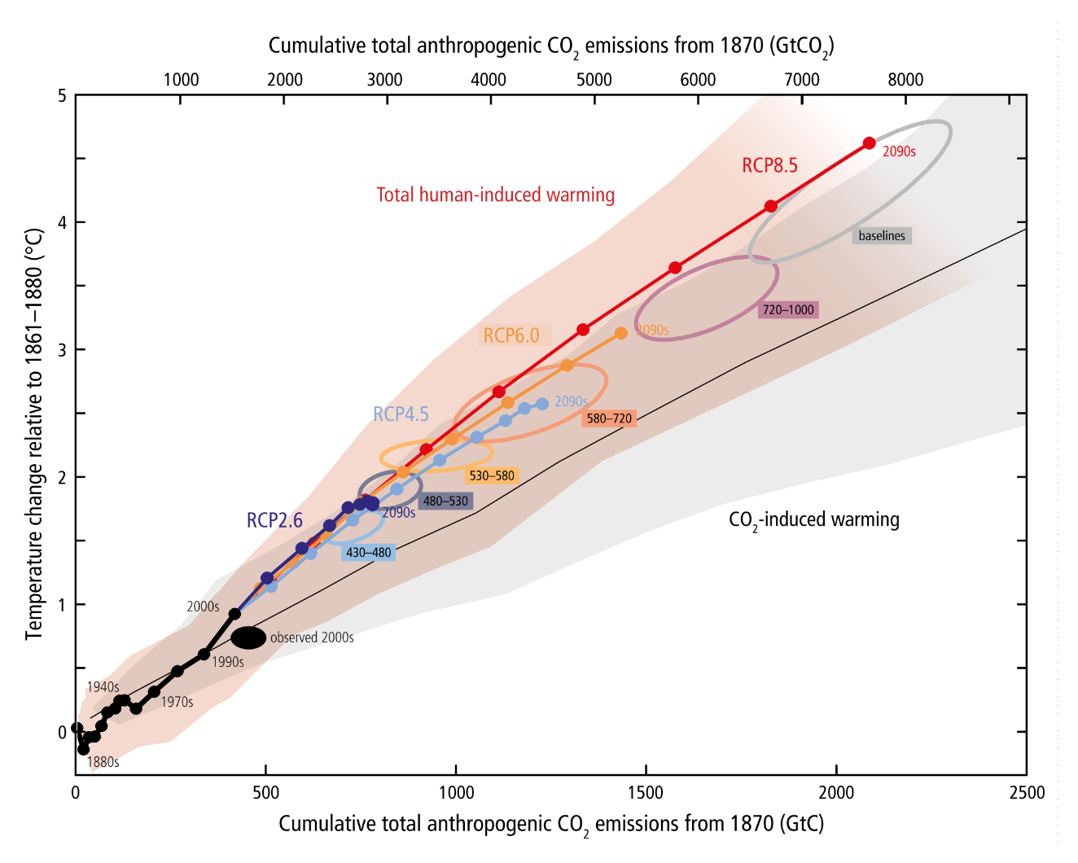
The 2013 IPCC report estimated the likely
temperature rise
(with a doubling of CO₂ )
is between 1.0 – 2.5°C
Rising more than 3°C is extremely unlikely.
Notes:
https://ar5-syr.ipcc.ch/topic_futurechanges.php

Slide 30
Who is the IPCC?
In 1988, governments from around the world created the International Panel on Climate Change (IPCC).
They recruit climate change experts – 100s of them – to author reports every 5-6 years
to help inform government policy decisions.
Who is the ICPP?
In 1988, governments from around the world created the International Panel on Climate Change (IPCC).
They recruit climate change experts – 100s of them – to author reports every 5-6 years to help inform government policy decisions.
Notes:
https://ar5-syr.ipcc.ch/topic_futurechanges.php

Slide 31
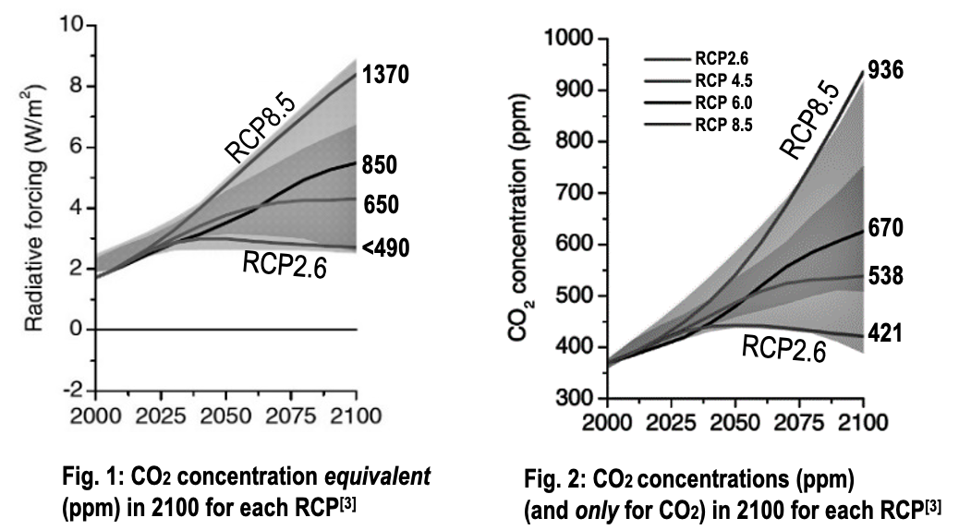
In their reports, what are the RCPs?
Representative Concentration Pathways
Future CO₂ emissions (W/m²).
RCP2.6 is a world with
low CO₂ emissions
(best case scenario)
RCP8.5 is a world with
high CO₂ emissions
(worst case scenario)
Notes:
https://ar5-syr.ipcc.ch/topic_futurechanges.php

Slide 32
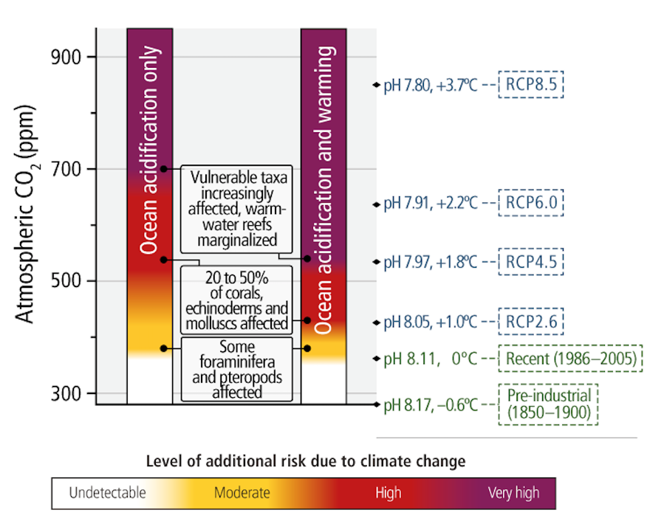
Rapid increases in atmospheric CO₂ not only raise global temperatures
(due to the green house effect)
but it also drops ocean
pH levels.
pH is a scale of acidity.
Hence the name,
Ocean acidification
Notes:
https://ar5-syr.ipcc.ch/topic_futurechanges.php

Slide 33
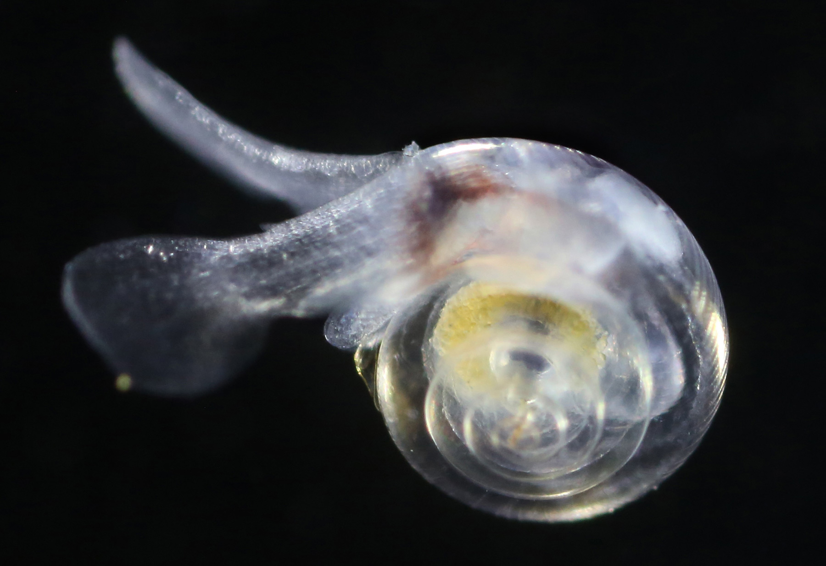
Pteropods are at risk to ocean acidification because their thin shells are sensitive to changes in ocean chemistry.
Notes:
https://www.britannica.com/animal/pteropod
https://aoan.aoos.org/impacts/species-response/pteropods/

Slide 34
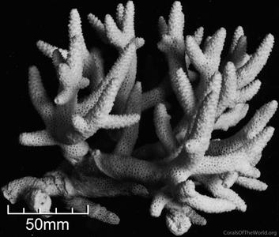
Corals are susceptible to ocean acidification as their skeletons are made of calcium carbonate
Notes:
http://www.coralsoftheworld.org/species_factsheets/species_factsheet_summary/acropora-aspera/

Slide 35
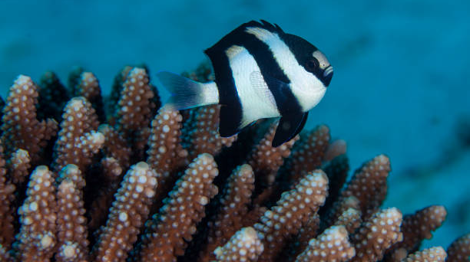
Fish and other animals rely on coral reefs for habitat and shelter
Notes:
http://www.coralsoftheworld.org/species_factsheets/species_factsheet_summary/acropora-aspera/

Slide 36
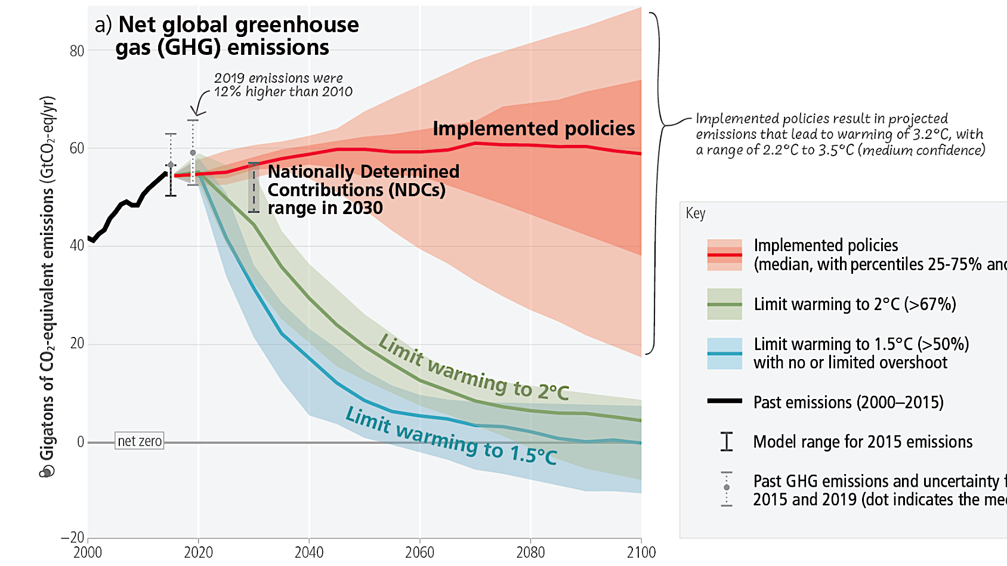
Why we need to achieve net zero CO₂
If we keep doing what we’re doing now
Results from the 2023
IPCC report
Net zero
Notes:
https://www.istockphoto.com/search/2/image?phrase=black+and+white+damselfish

Slide 37
How we achieve net ZERO CO₂ and limit warming to 1.5℃
Energy supply (including electricity) includes bioenergy with carbon dioxide capture and storage and direct air carbon dioxide capture and storage.
Net zero
Notes:
https://www.ipcc.ch/report/ar6/syr/figures

Slide 38
Apologies, I digressed…
…we will visit this again in year 12 ☺
Now where were we? Oh that’s right….weather models
I should perhaps mention at this point that weather is day-to-day whereas
climate is over longer time frames.
Both are however making predictions for something that hasn’t yet occurred so unless you have a crystal ball, all models will have limitations on what they can do.

Slide 39
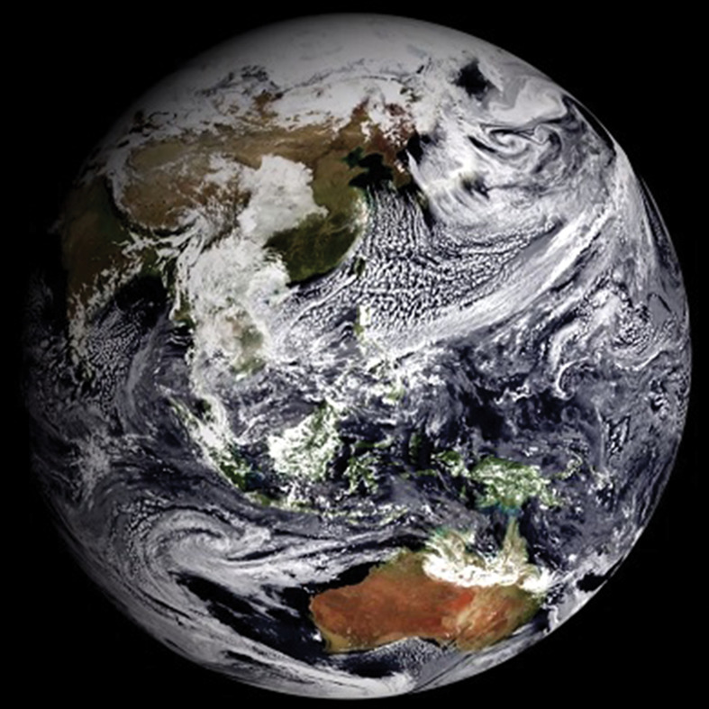
Increasing the accuracy of a weather model basically boils down to three things…..
Notes:
https://wires.onlinelibrary.wiley.com/doi/10.1002/wcc.454

Slide 40
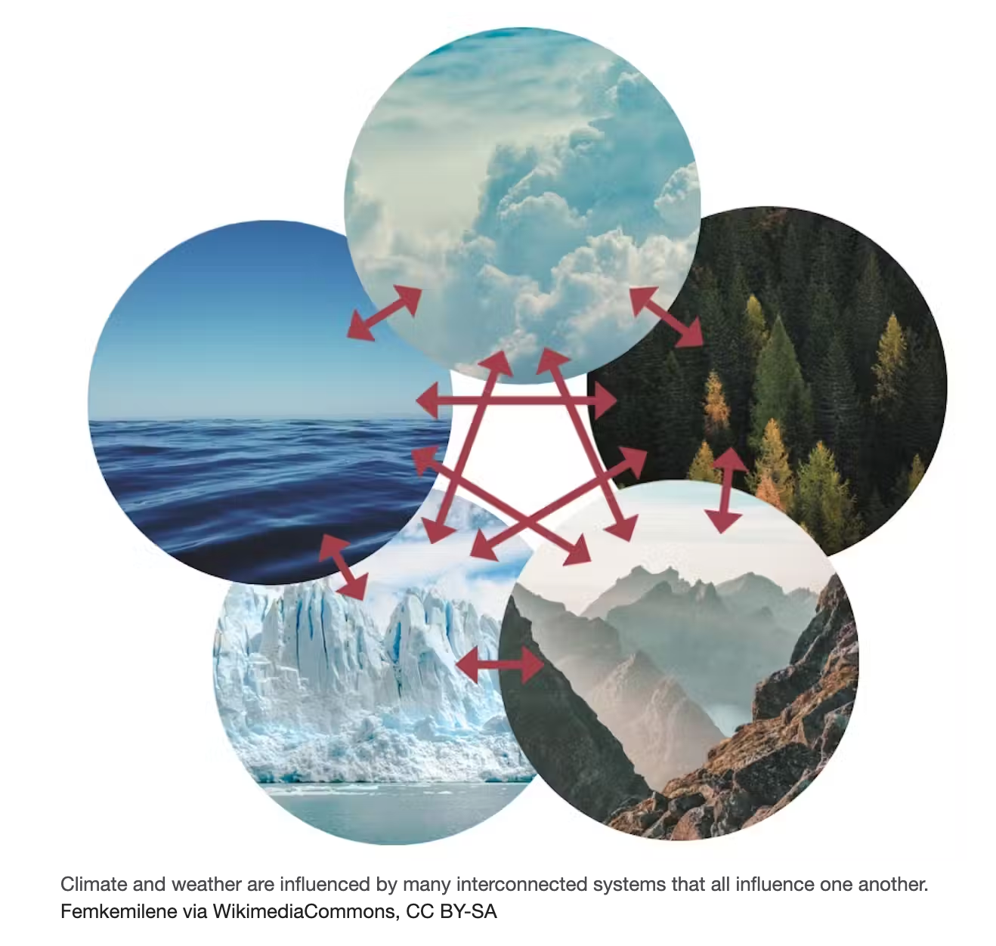
1. adding more interactions between the different systems, such as modelling the atmosphere and ocean together.
Notes:
https://theconversation.com/winners-of-2021-nobel-prize-in-physics-built-mathematics-of-climate-modeling-making-predictions-of-global-warming-and-modern-weather-forecasting-possible-169329

Slide 41
2. increasing the model resolution to give more detailed information
i.e. smaller grids and more dots

Slide 42
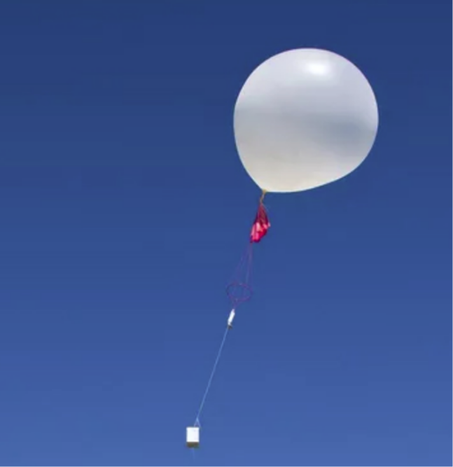
Meteorological Weather Balloon
3. being able to input better data about current conditions such as temperature, humidity and air pressure at the start of the process.
More “observations”

Slide 43
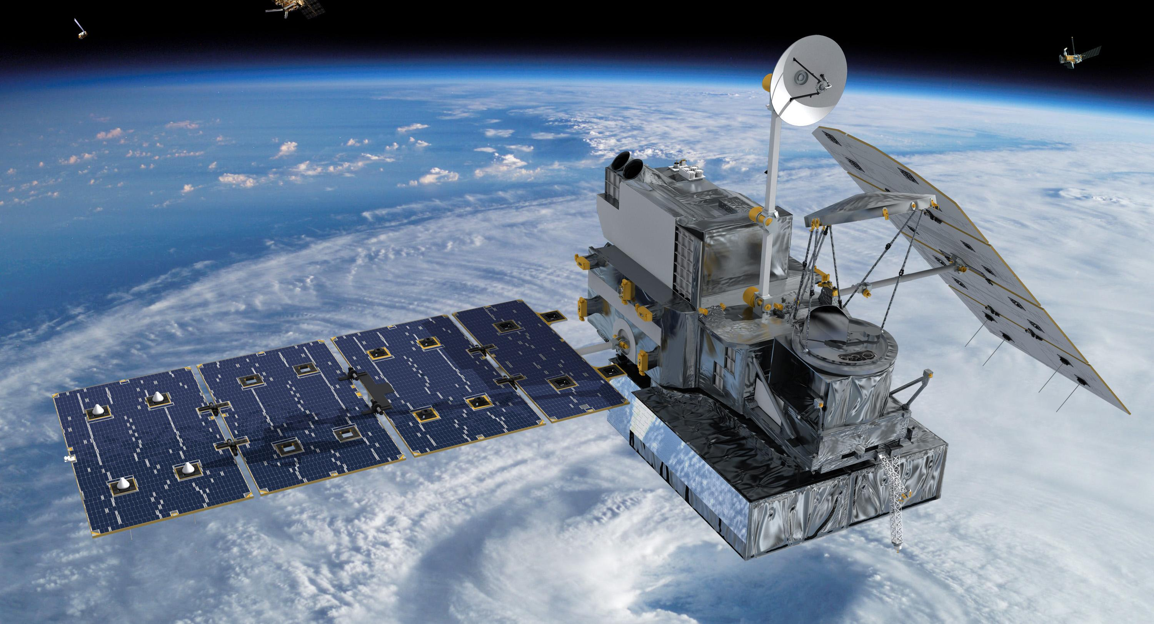
Satellites

Slide 44
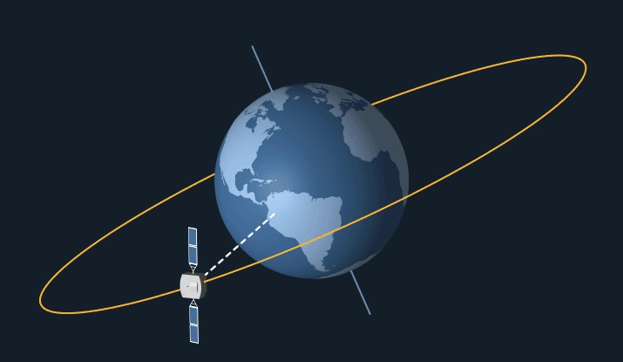
Geostationary satellites
orbit approximately 36,000km above Earth moving at the same rate
that Earth rotates.
“Geostationary” means they focus on one spot. Taking pictures of the weather ‘right now’.
Great for tracking cyclones.
Notes:
https://www.ucsusa.org/resources/what-are-satellites-used

Slide 45
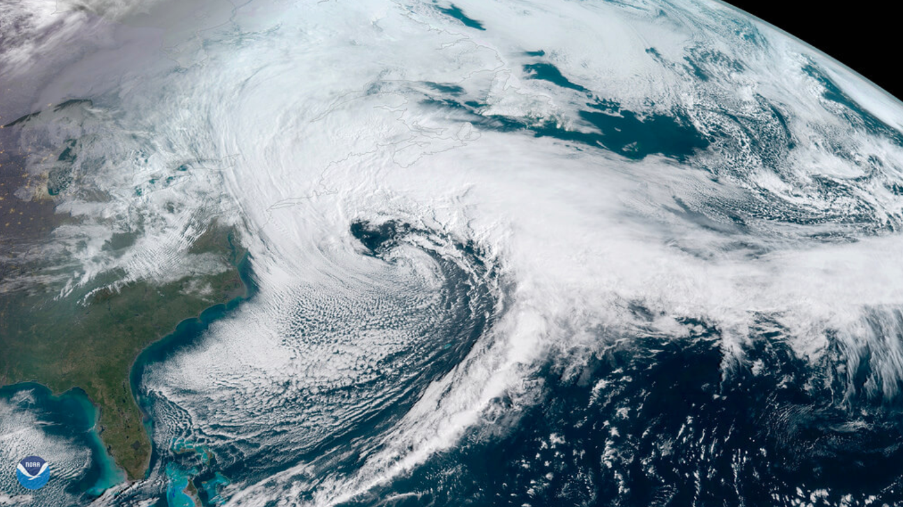
An image of a Nor'easter off the coast of New England captured by a NOAA geostationary satellite called GOES-East. It is one of three types of satellites NOAA uses to monitor Earth’s weather. Credit: NOAA

Slide 46
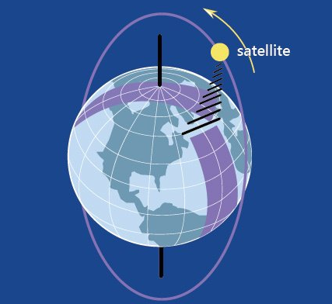
Polar-orbiting satellites
are closer to earth, orbiting approximately 800km above Earth, zipping around the planet from pole to pole 14 times a day. Being so close, they monitor the entire Earth’s atmosphere, clouds and oceans at high resolution. These satellites help meteorologists to predict long-term forecasts—up to 7 days in the future.

Slide 47
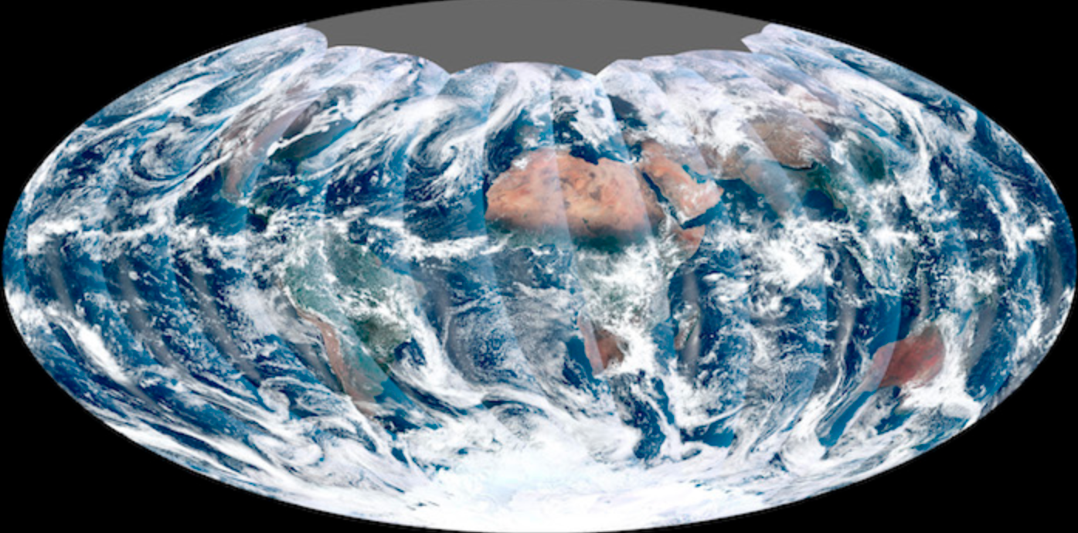
Polar-orbiting satellites captured pictures of the planet as a series of wedges that were pieced back together.
Notes:
https://scijinks.gov/forecast-reliability/

Slide 48
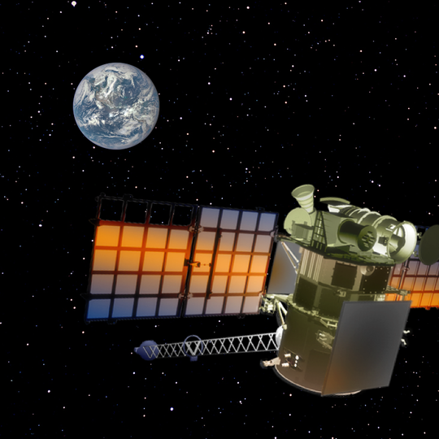
Deep Space satellite DSCOVR
as the name suggests, orbits in deep space, approximately 1 million miles above the Earth.
As a point of reference, the moon is 240 miles away (so it’s past the moon) and the sun is 92 million miles away from Earth. DSCOVR is the primary source of real time solar wind and magnetic field data to alert us of anything headed our way.
An artist's rendering of DSCOVR at the first L1 point, where is sits between the sun and earth, alerting us of the incoming solar wind
Notes:
https://www.theatlantic.com/technology/archive/2015/07/our-new-and-daily-view-of-the-blue-marble/399011/

Slide 49
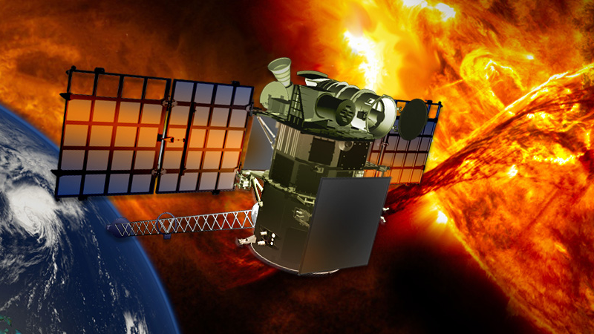

Slide 50
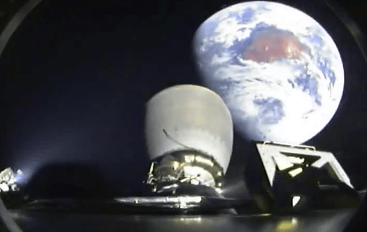
A view from the second stage of a SpaceX Falcon 9 rocket (SpaceX) in 2015 (not yet at its destination).
DSCOVR now orbits at the same rate around the sun as the Earth and always sees the side of the earth facing the sun.
It will serve in some ways like a Tsunami buoy does in the ocean – providing enough warning so that managers on the ground can prepare satellites and other critical infrastructure for a solar storm.
Notes:
https://www.spaceweatherlive.com/en/news/view/405/20200302-welcome-back-dscovr.html

Slide 51
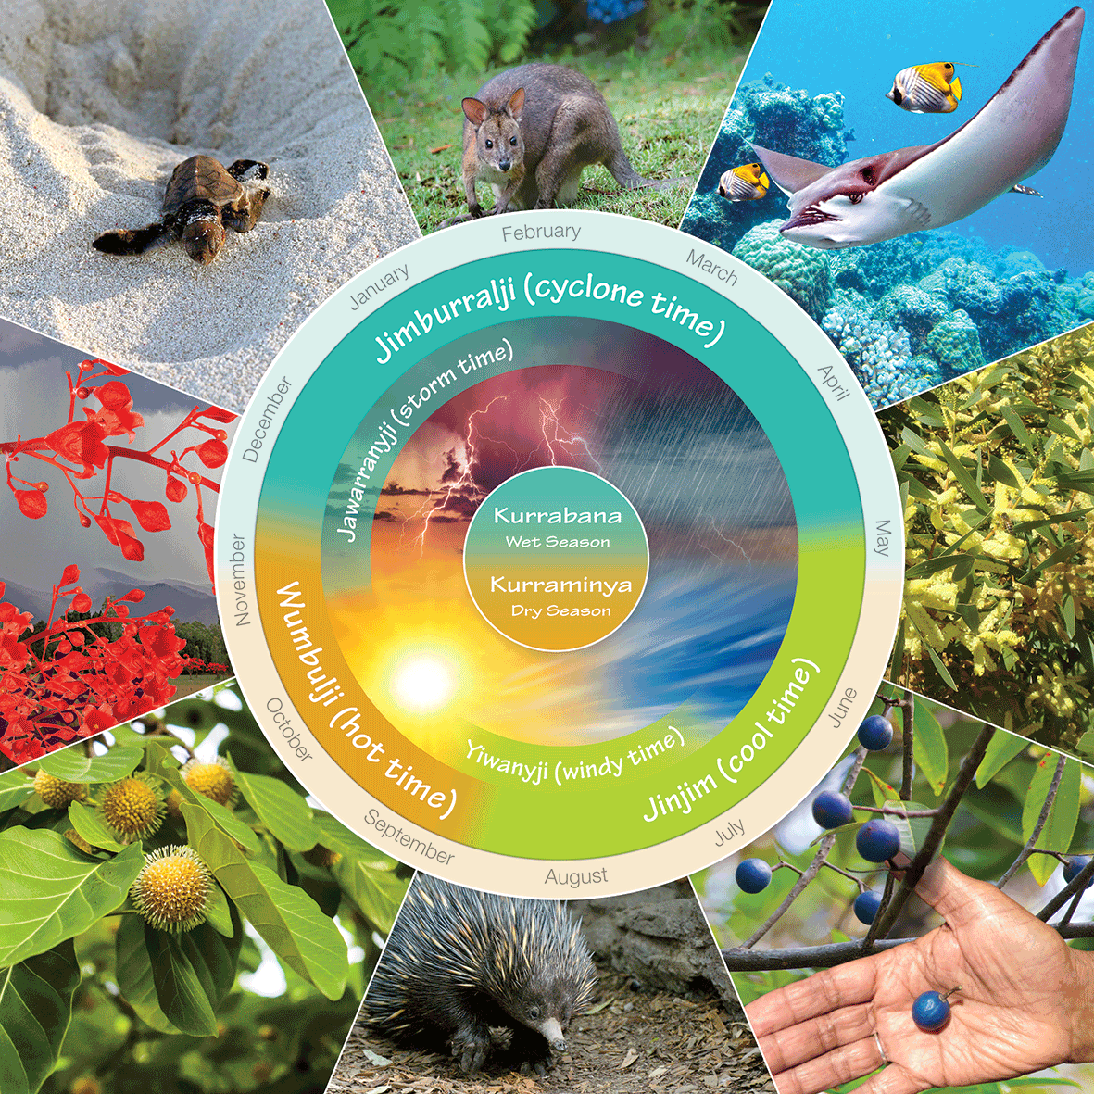
Indigenous weather knowledge
provides a far more intricate and subtle overview of Australia's climate than the four-season European climate description of summer, autumn, winter and spring.
Notes:
http://www.bom.gov.au/iwk/calendars/yirrganydji.shtml

Slide 52
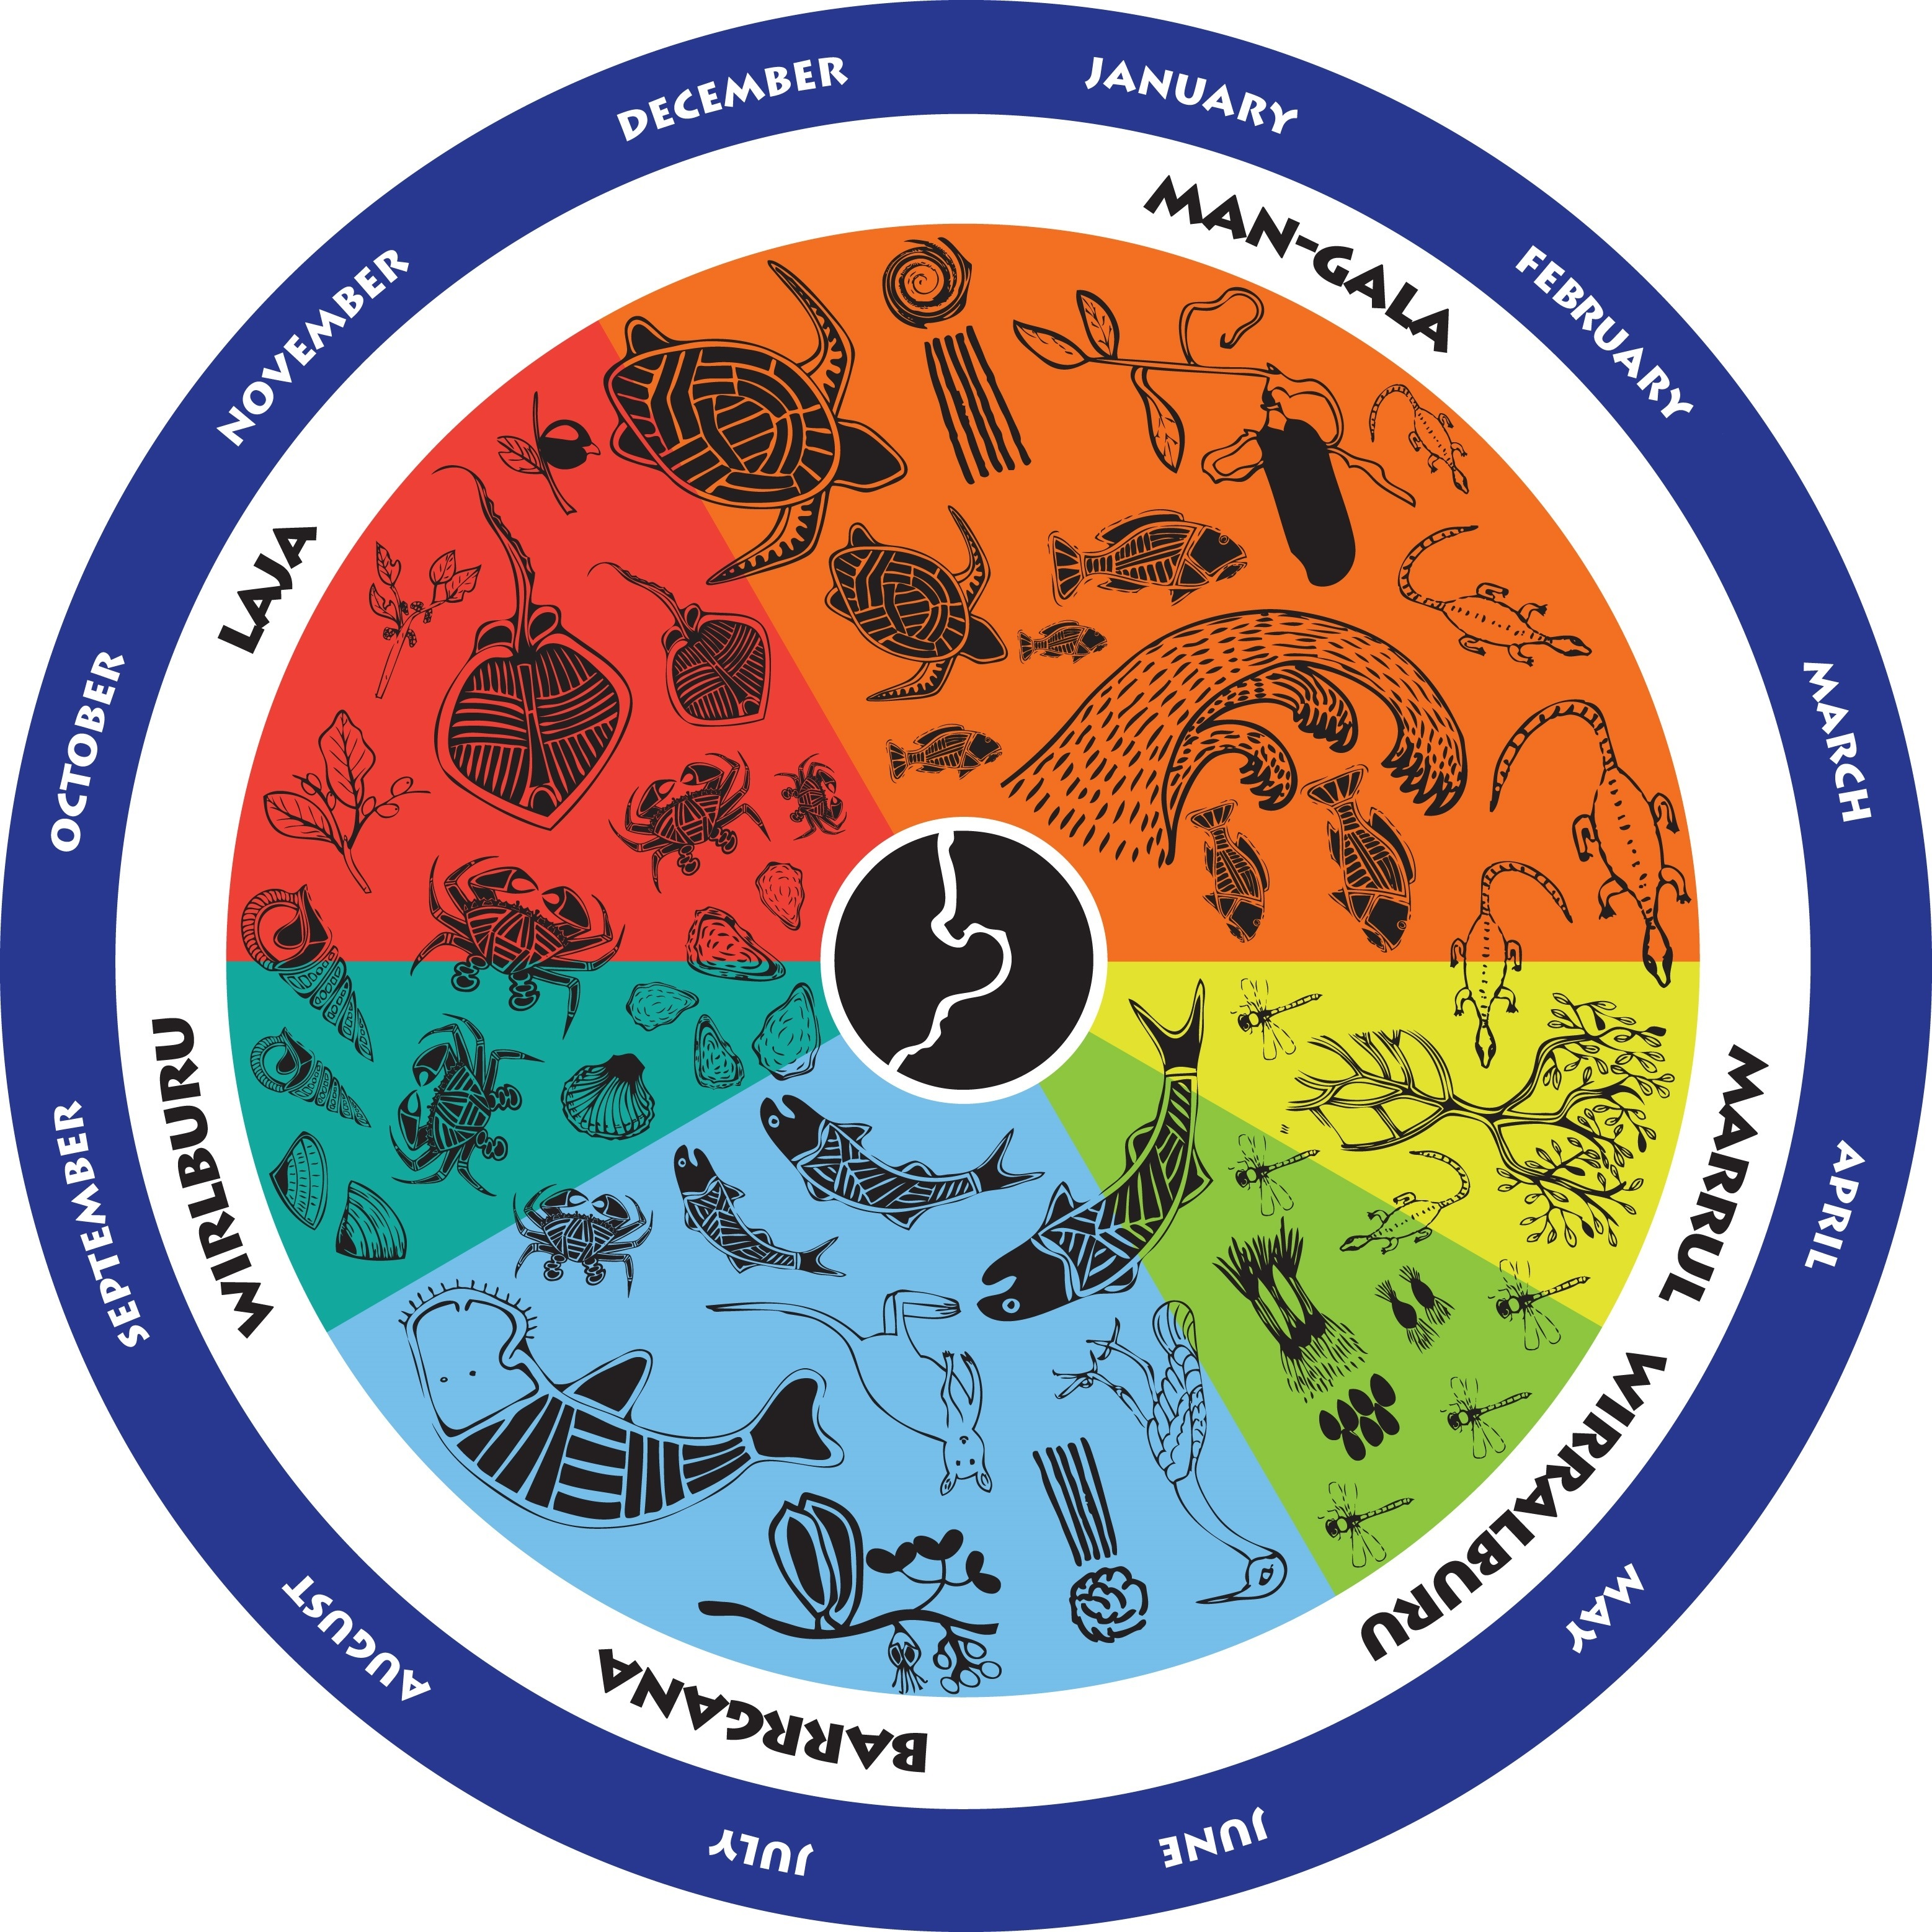
The Indigenous Weather Knowledge website
was launched in 2002 as a joint partnership between the Bureau of Meteorology, the Aboriginal and Torres Strait Islander Commission (ATSIC) and Monash University's Centre for Indigenous Studies
Notes:
http://www.bom.gov.au/iwk/index.shtml
http://www.bom.gov.au/iwk/images/yawuru/yawuru-season-wheel-big.jpg

Slide 53
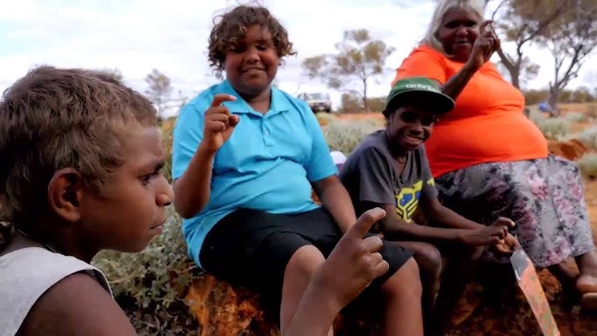
Notes:
https://www.youtube.com/watch?app=desktop&v=zIkC-ddFVFE

Slide 54
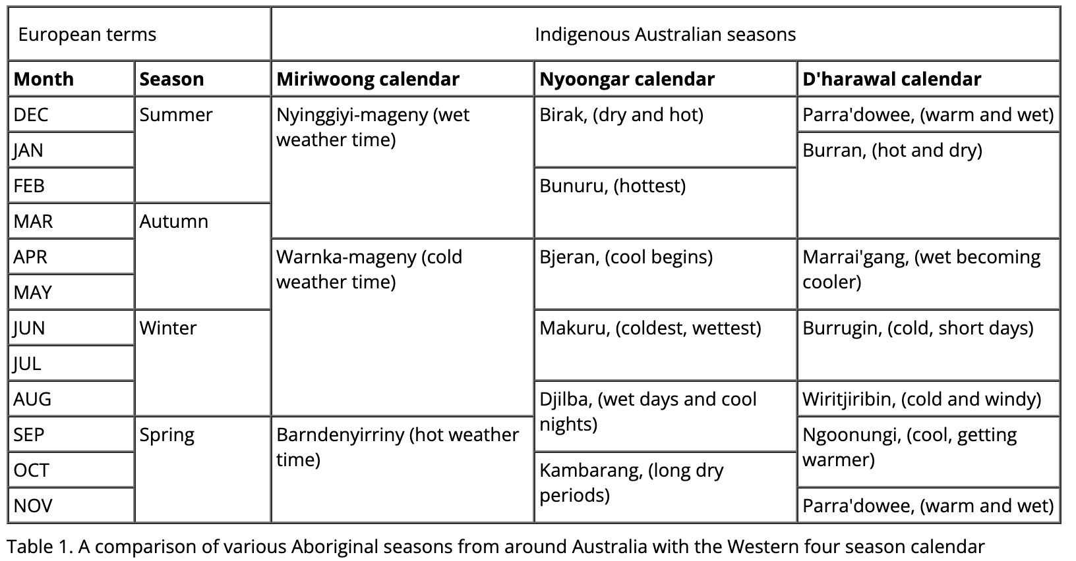

Slide 55
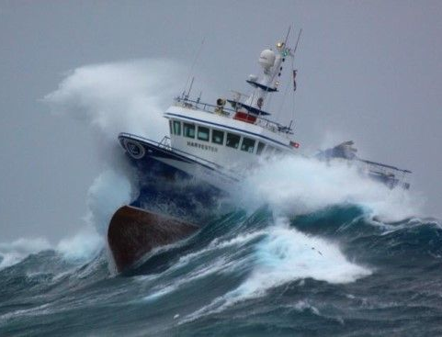
Consider how our knowledge of weather and climate helps to inform decision-making for coastline management and marine industries.

Slide 56
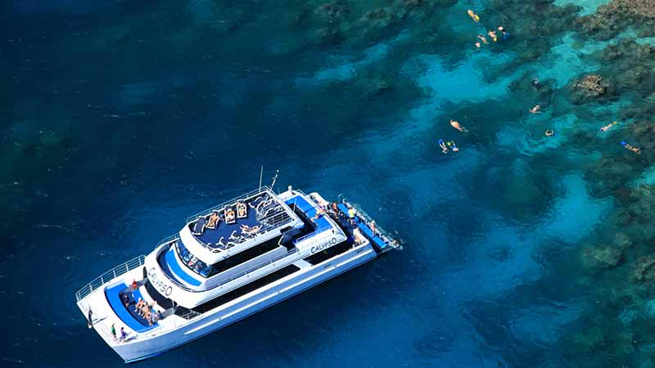
It helps to have an accurate forecast
Notes:
https://www.bookme.com.au/things-to-do/cairns-port-douglas/reef-trip-calypso-snorkel-and-dive-port-douglas/72689/showReview

Slide 57
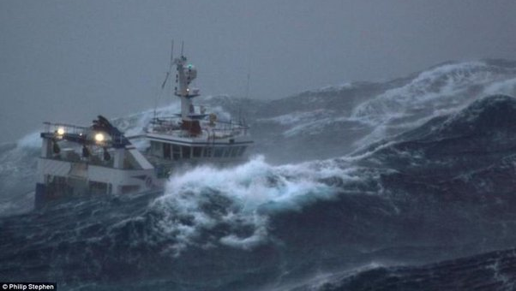

Slide 58
Notes:
https://www.ryanmoodyfishing.com/safety-tips-storms-at-sea/

Slide 59
Satellite images fed into the CoastSat model revealed beaches on the SE coast of Australia narrow during prolonged La Niña, while they widen – or accrete – during El Niño periods.
Notes:
https://newsroom.unsw.edu.au/news/science-tech/beach-erosion-satellites-reveal-how-climate-cycles-impact-coastlines

Slide 60
Judge finds in favour of 6,800 Brisbane residents who sued over management of Wivenhoe and Somerset dams
(2011 floods)
Notes:
https://www.theguardian.com/australia-news/2019/nov/29/thousands-queenslanders-win-class-action-dams-2011-floods

Slide 61
Photographer creates incredible composite image of Brisbane being struck by 107,000 bolts of lightning December 2015.
Notes:
https://www.dailymail.co.uk/news/article-3340170/Brisbane-gets-rocked-incredible-thunderstorms-just-weeks-freakish-weather-smashed-Sydney-Melbourne.html

Slide 62
Noosa District State High School Year 11 students asked Seven News weatherman Livio Regano to interpret and explain a variety of weather phenomenon featured in a range of photographs.
Notes:
https://www.couriermail.com.au/news/queensland/sunshine-coast/ndshs-students-email-livio-weather-photos/news-story/937affede143a533f1f8e888ff0722f2

Slide 63
Learning Intention:
Consider that contemporary weather predictions are based on computer models but still rely on human input to determine the most accurate and reliable forecast. Consider how this scientific knowledge enables scientists to inform decision-making for coastline management and marine industries.
Success Criteria:
Complete Marine Education worksheet ‘’12. Cloudy and a chance of meatballs’
Notes:
https://www.eumetsat.int/what-we-do/monitoring-weather

