Slide 1
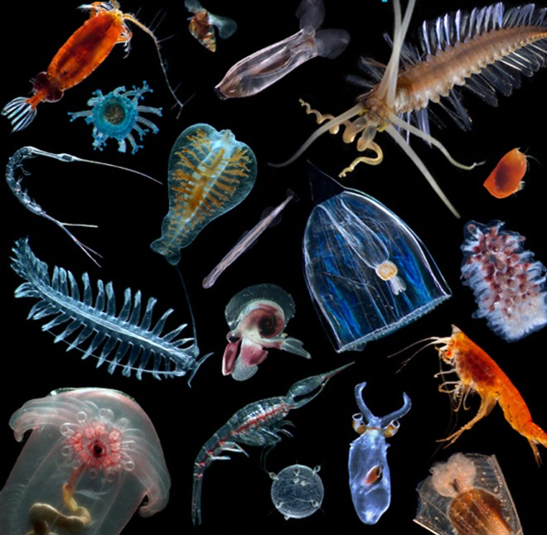
Learning Intention:
Appreciate that knowledge of the oceans is limited and requires further investigation
Success Criteria:
Complete Marine Education worksheet ’14. Are you up for the challenge?’
Notes:
by Woods Hole Oceanographic Institution on 8 Oct 2010
https://www.sail-world.com/Australia/The-Census-of-Marine-Life-reveals-thousands-of-new-species/-75562?source=google
WHOI researchers Peter Wiebe, Nancy Copley, and Larry Madin joined the effort to find, identify, and analyze indicator genes of the world’s animal plankton, known as the Census of Marine Zooplankton (CMarZ). CMarZ is one of more than 17 research projects within the Census of Marine Life, a ten-year project to catalog all life in the sea. - Census of Marine Life Woods Hole Oceanographic Institution (WHOI) http://www.whoi.edu/

Slide 2
Lack of sampling and expertise
Knowledge is limited because of a lack of sampling and taxonomic expertise.
Headline of an Australian Museum blog
Notes:
https://australian.museum/blog-archive/amri-news/amri-marine-taxonomists-are-becoming-endangered/

Slide 3
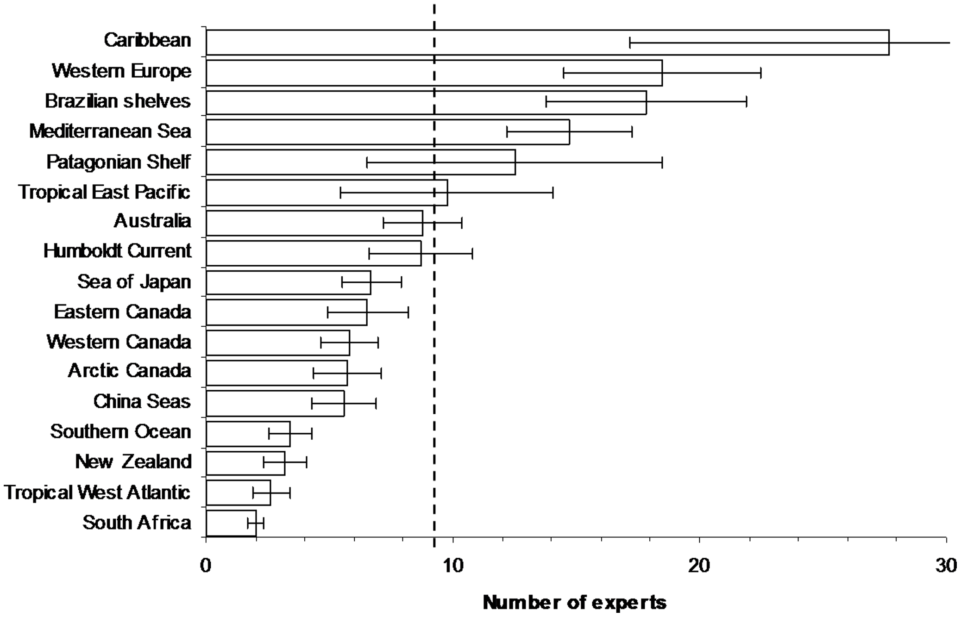
Notes:
https://journals.plos.org/plosone/article?id=10.1371/journal.pone.0012110

Slide 4
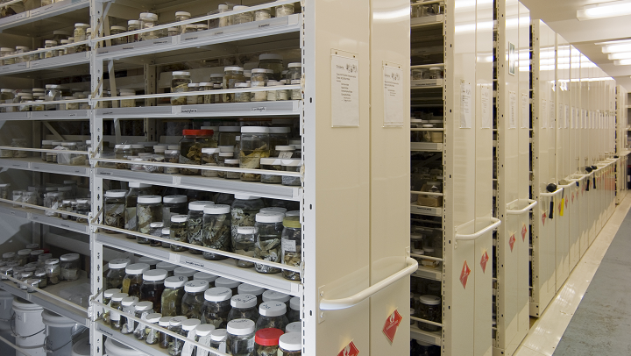

Slide 5
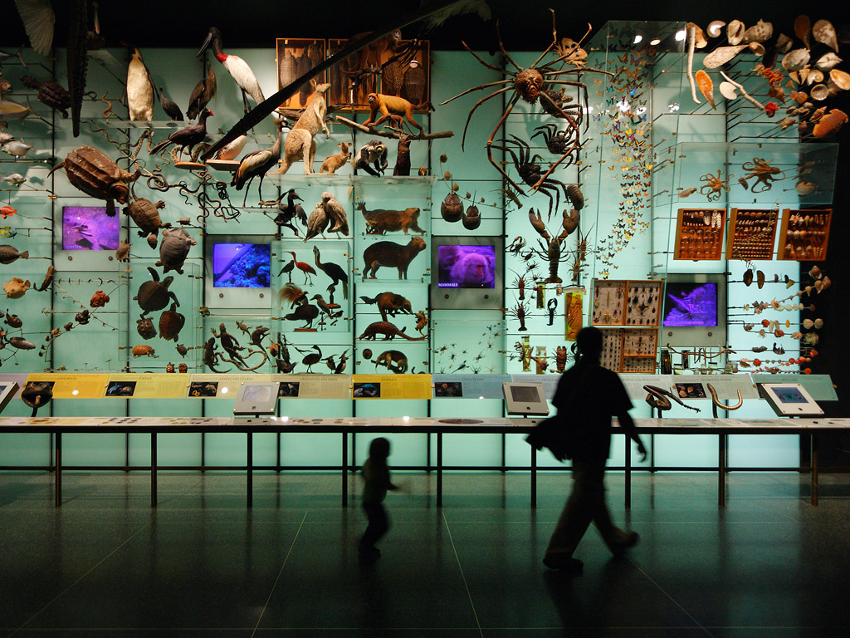
Notes:
https://methodsblog.com/2022/03/02/best-practices-for-taxonomic-harmonization-an-overlooked-yet-crucial-step-in-biodiversity-analyses/

Slide 6
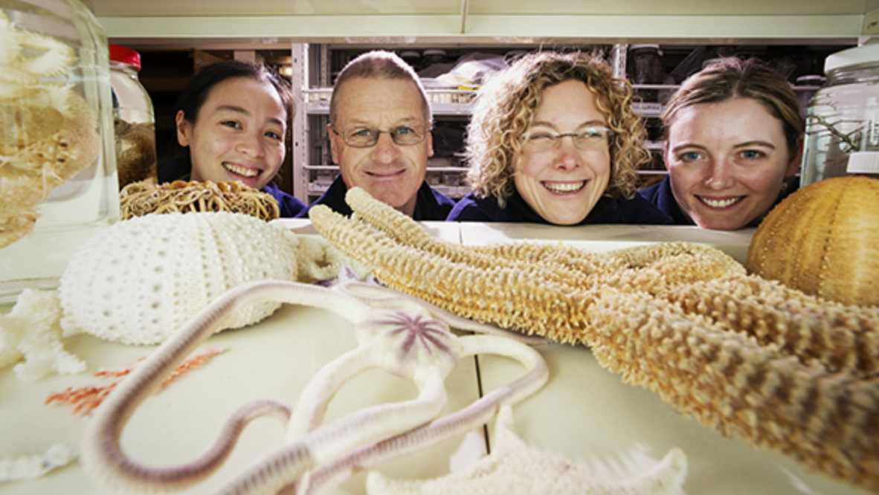

Slide 7
March 19 is Taxonomist appreciation day!

Slide 8
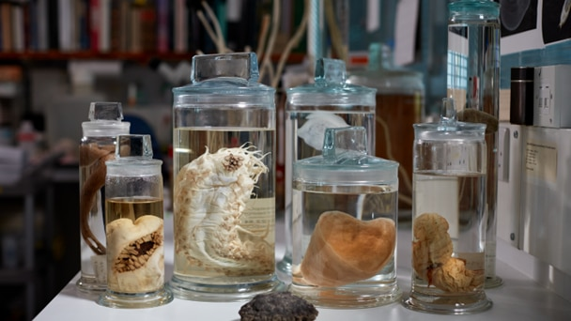

Slide 9
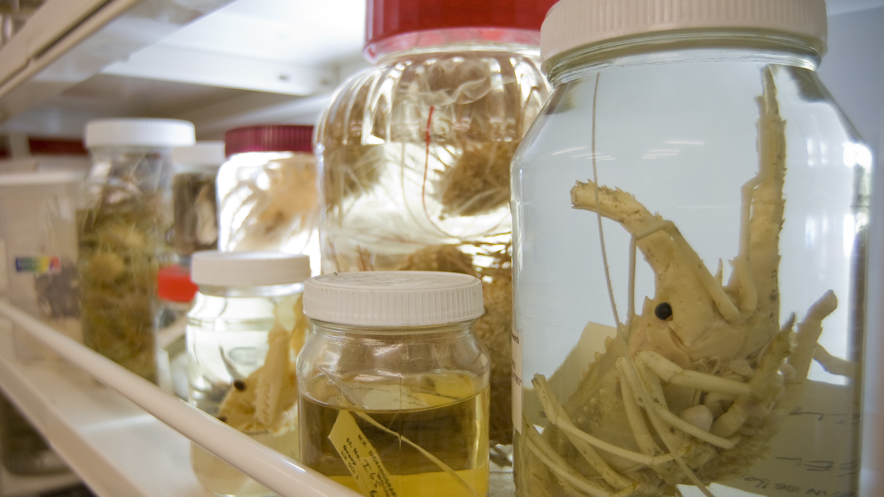
Notes:
https://niwa.co.nz/our-services/online-services/nic

Slide 10
Charlie Veron
https://www.youtube.com/watch?v=emGhm9rAoT0
“Young people today have a critical role to play in this because The Reef’s future will soon be in their hands”
Notes:
https://www.youtube.com/watch?v=emGhm9rAoT0

Slide 11
It is estimated that only 20-30% of all marine species have been discovered.
The World Register of Marine Species (WoRMS) is an open-access online database created by 270 taxonomists from 146 institutions in 32 countries. The first goal of WoRMS was to make a list of all marine species. They ended up listing 222,000–230,000 species in 2012, but estimated there was between 704,000 and 972,000 species in total.
Notes:
Appeltans, W., Ahyong, S. T., Anderson, G., Angel, M.V., Artois, T., et al., (2012). The Magnitude of Global Marine Species Diversity. Current Biology. Volume 22, Issue 23, Pages R996-R997. DOI: 10.1016/j.cub.2012.09.036

Slide 12
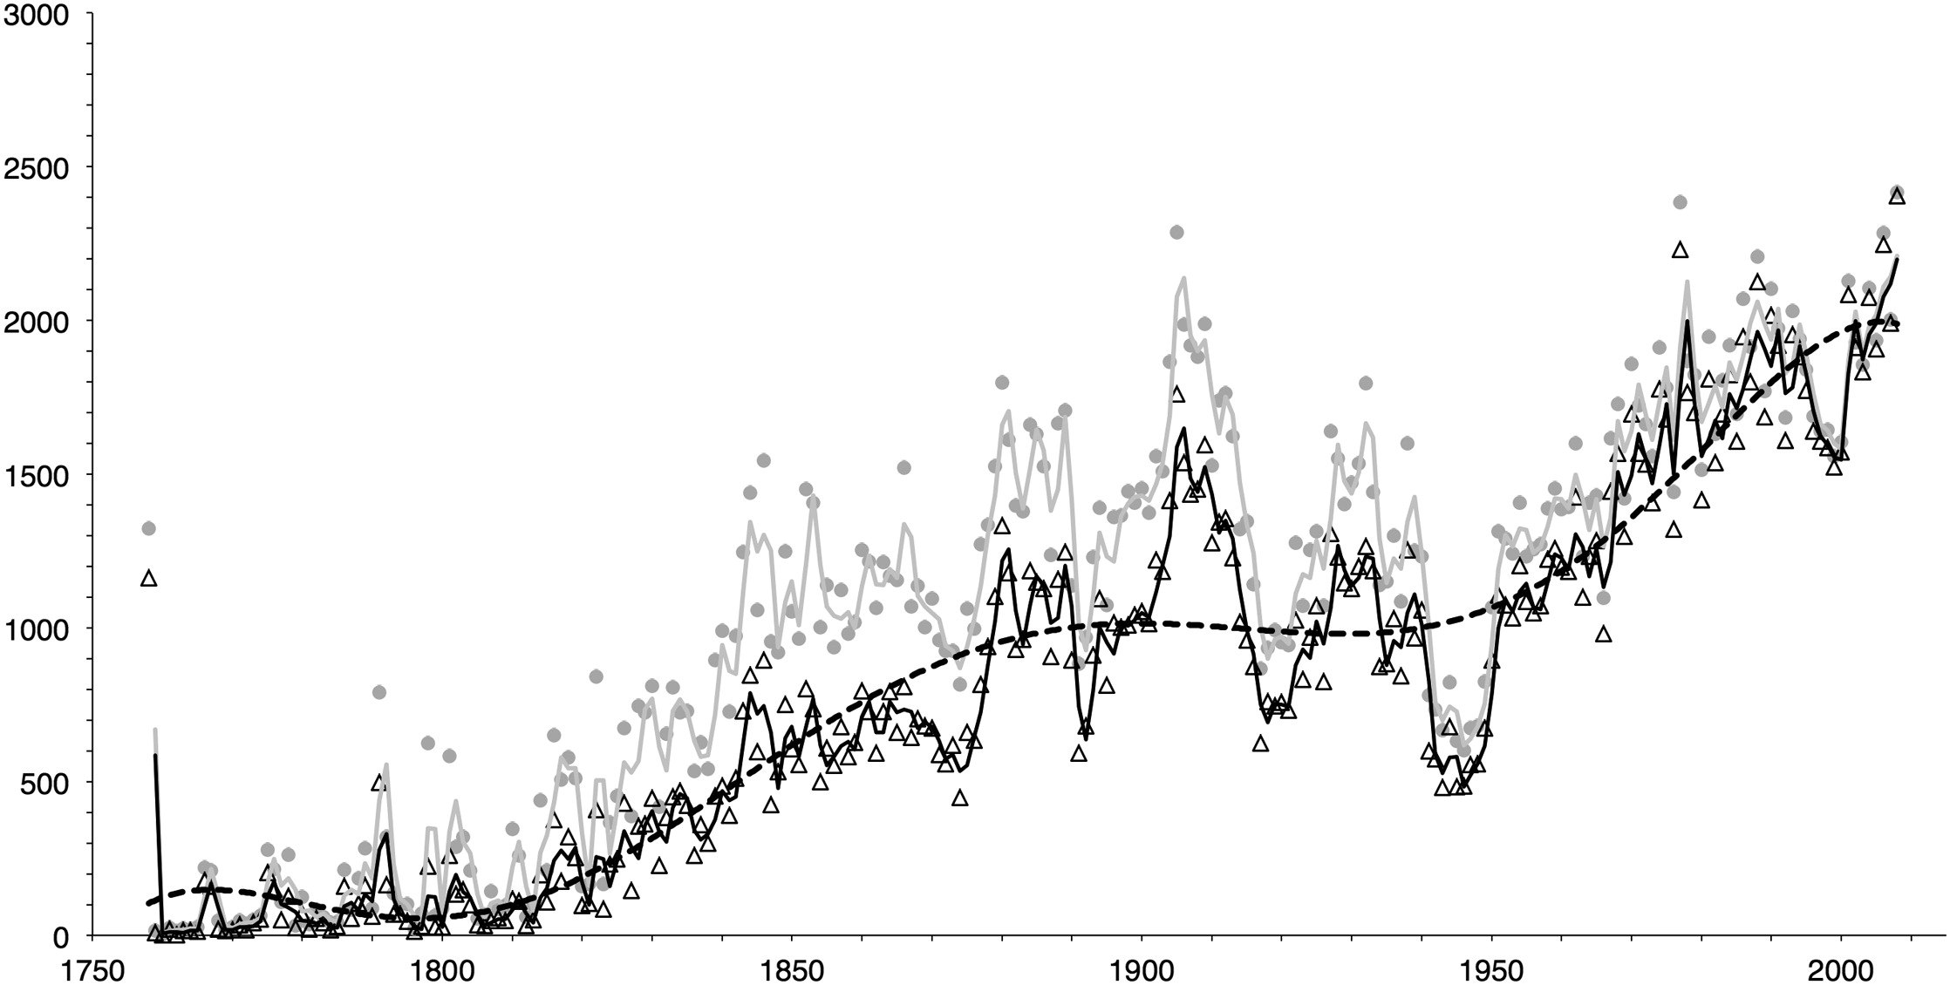
We are still discovering more and more marine species every year.
Pictured below is when new species have been discovered (grey) and recognized as being valid (black).
Grey circles/line: number of species described per year
Black triangles/line: number of species recognized as valid
r² = 0.869
Number of new species found
WW1
WW2
(Appeltans et al., 2012)
Notes:
Appeltans, W., Ahyong, S. T., Anderson, G., Angel, M.V., Artois, T., et al., (2012). The Magnitude of Global Marine Species Diversity. Current Biology. Volume 22, Issue 23, Pages R996-R997. DOI: 10.1016/j.cub.2012.09.036

Slide 13
The Census of Marine Life (2000–2010)
was the largest global research programme on marine biodiversity.
The census was an international project spanning 10 years that recorded the diversity, distribution, and abundance of life in the ocean. More than 2,700 scientists from 80 nations contributed to the Census. The results of their research, which included 540 marine expeditions, were reported at The Royal Society, London, in October 2010.

Slide 14
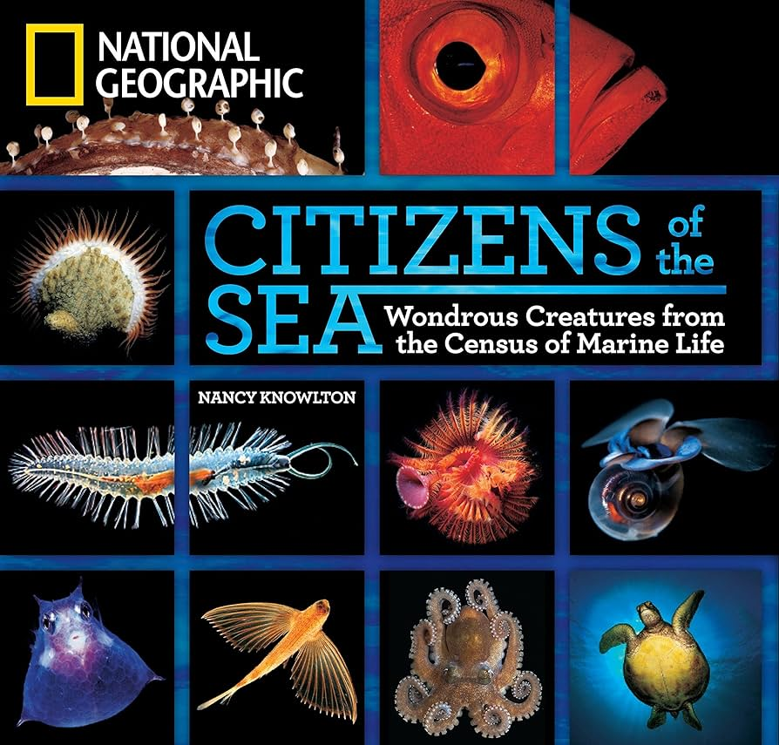
September 2010 issue
During the 10 year Census, scientists found and formally described more than 1,200 new marine species,
with thousands more awaiting formal descriptions.

Slide 15
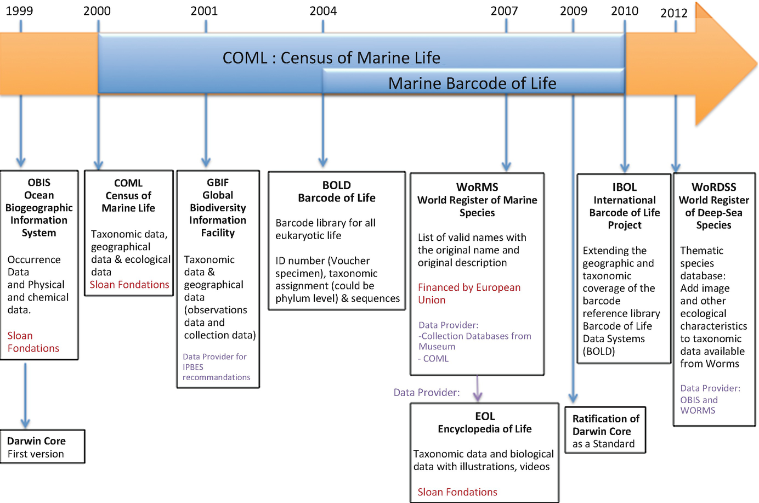
Notes:
https://link.springer.com/chapter/10.1007/978-3-030-10991-2_3
Marine Biodiversity Databanks
Anouk Barberousse &
Sophie Bary
Chapter
Open Access
First Online: 18 June 2019

Slide 16
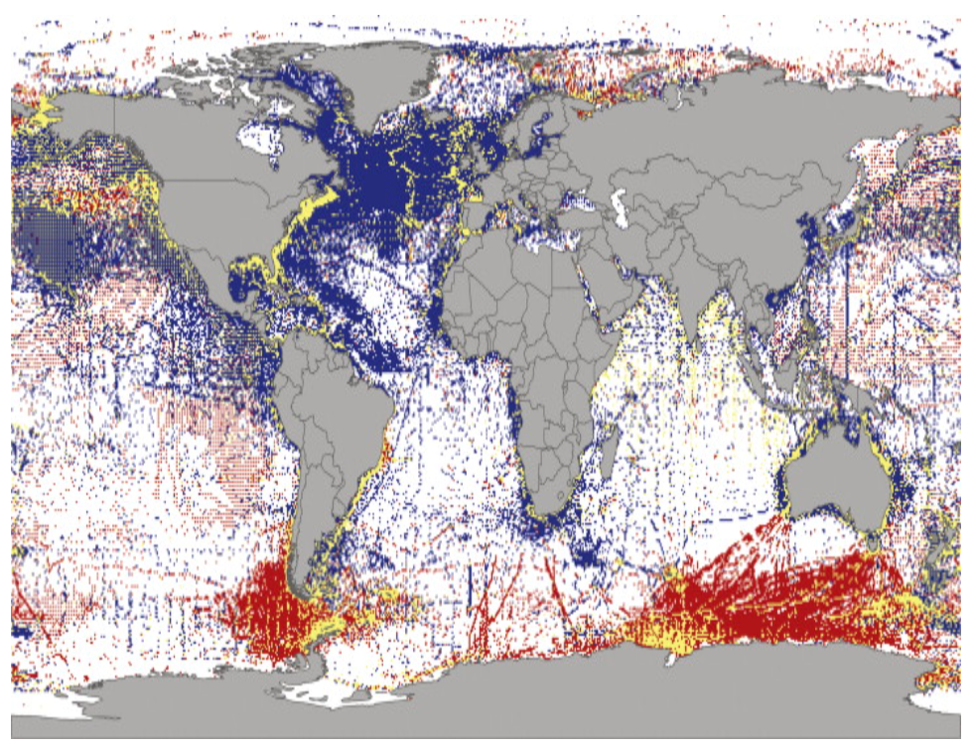
Our known and unknown ocean
Blue: data from before the Census.
Yellow: Census data.
Red: new data from the Census.
Notably, the Eastern Pacific remains largely unexplored.
Notes:
https://www.sciencedirect.com/topics/agricultural-and-biological-sciences/census-of-marine-life

Slide 17
Some of the least known taxonomic groups….
Notes:
The Least-Known Taxonomic Groups. Groups for which fewer than an estimated 20% of the species have been described included some taxa with few known species (i.e., Cycliophora, Loricifera, Placozoa, Tantulocarida, Leptostraca, Caudofoveata). However, most have hundreds (Myxozoa, Acoela, Kinorhyncha, Oligochaeta, Gastrotricha, Dicyemida, Orthonectida, and Entoprocta) to thousands (Bacillariophyceae, Ciliophora, Rhabditophora, Cumacea, Tanaidacea, Isopoda) of species. The largest numbers of undiscovered species may be in Isopoda (+63,150–123,600 spp.), Gastropoda (+85,000–105,000 spp.), Bacillariophyceae (+50,000 spp.), Nematoda (+50,000 spp.), Copepoda (+30,125–50,125 spp.), Ostracoda (+2,625–34,000 spp.), Rhabditophora (excluding Neodermata; +5,500–29,000 spp.), Tanaidacea (+21,900–24,900 spp.), Amphipoda (+20,000 spp.), Monogenea (+10,700–20,300 spp.), Porifera (+17,300–18,000 spp.), Ciliophora (+4,231–19,368 spp.), Oligochaeta (+5,900–16,900 spp.), and marine Fungi (+15,000 spp.) (Appeltans et al., 2012).
Appeltans, W., Ahyong, S. T., Anderson, G., Angel, M.V., Artois, T., et al., (2012). The Magnitude of Global Marine Species Diversity. Current Biology. Volume 22, Issue 23, Pages R996-R997. DOI: 10.1016/j.cub.2012.09.036

Slide 18
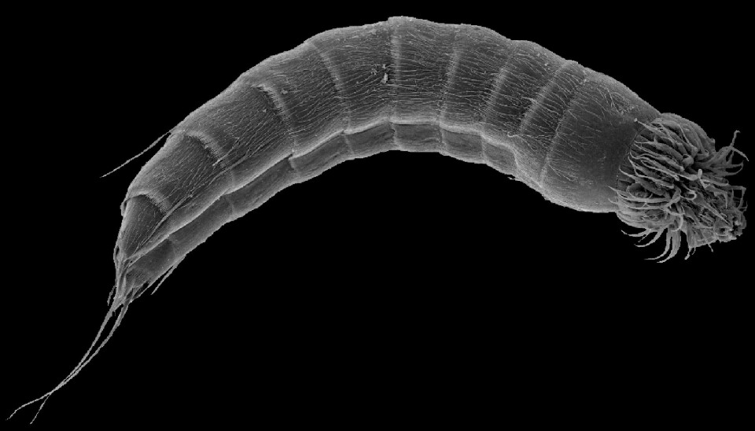
Loricifera phylum
The Kinorhyncha (mud dragons) – benthic marine invertebrates
Notes:
The Least-Known Taxonomic Groups. Groups for which fewer than an estimated 20% of the species have been described included some taxa with few known species (i.e., Cycliophora, Loricifera, Placozoa, Tantulocarida, Leptostraca, Caudofoveata). However, most have hundreds (Myxozoa, Acoela, Kinorhyncha, Oligochaeta, Gastrotricha, Dicyemida, Orthonectida, and Entoprocta) to thousands (Bacillariophyceae, Ciliophora, Rhabditophora, Cumacea, Tanaidacea, Isopoda) of species. The largest numbers of undiscovered species may be in Isopoda (+63,150–123,600 spp.), Gastropoda (+85,000–105,000 spp.), Bacillariophyceae (+50,000 spp.), Nematoda (+50,000 spp.), Copepoda (+30,125–50,125 spp.), Ostracoda (+2,625–34,000 spp.), Rhabditophora (excluding Neodermata; +5,500–29,000 spp.), Tanaidacea (+21,900–24,900 spp.), Amphipoda (+20,000 spp.), Monogenea (+10,700–20,300 spp.), Porifera (+17,300–18,000 spp.), Ciliophora (+4,231–19,368 spp.), Oligochaeta (+5,900–16,900 spp.), and marine Fungi (+15,000 spp.) (Appeltans et al., 2012).
Appeltans, W., Ahyong, S. T., Anderson, G., Angel, M.V., Artois, T., et al., (2012). The Magnitude of Global Marine Species Diversity. Current Biology. Volume 22, Issue 23, Pages R996-R997. DOI: 10.1016/j.cub.2012.09.036

Slide 19
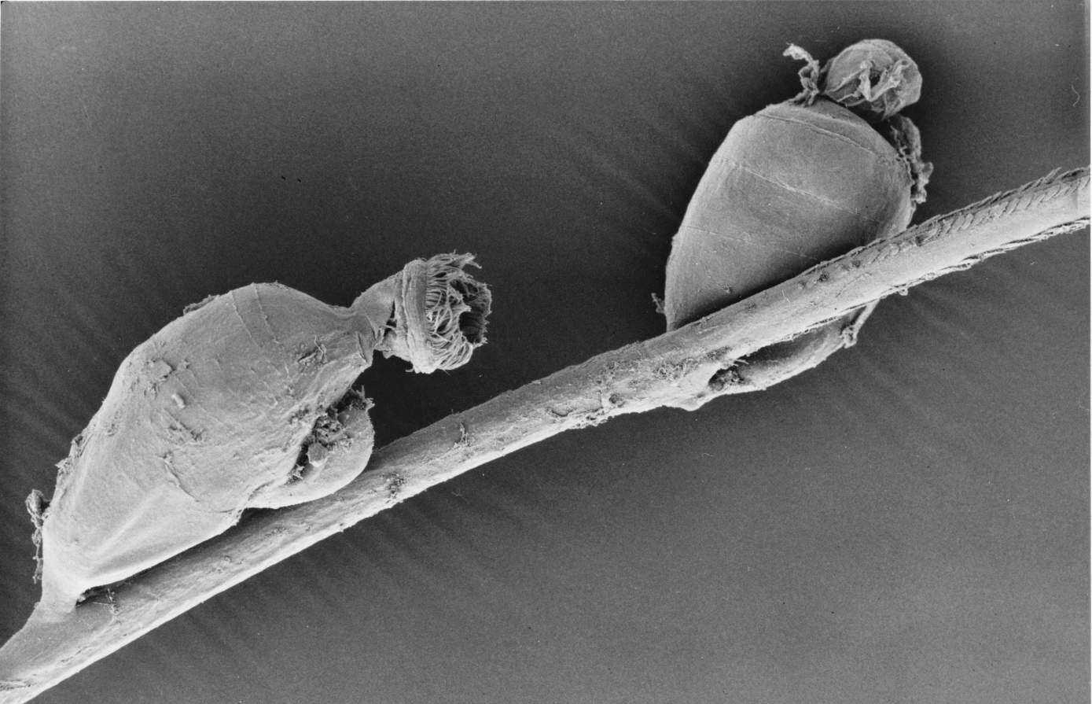
Cycliophora phylum
Live attached to the mouthparts of cold-water lobsters
Notes:
The Least-Known Taxonomic Groups. Groups for which fewer than an estimated 20% of the species have been described included some taxa with few known species (i.e., Cycliophora, Loricifera, Placozoa, Tantulocarida, Leptostraca, Caudofoveata). However, most have hundreds (Myxozoa, Acoela, Kinorhyncha, Oligochaeta, Gastrotricha, Dicyemida, Orthonectida, and Entoprocta) to thousands (Bacillariophyceae, Ciliophora, Rhabditophora, Cumacea, Tanaidacea, Isopoda) of species. The largest numbers of undiscovered species may be in Isopoda (+63,150–123,600 spp.), Gastropoda (+85,000–105,000 spp.), Bacillariophyceae (+50,000 spp.), Nematoda (+50,000 spp.), Copepoda (+30,125–50,125 spp.), Ostracoda (+2,625–34,000 spp.), Rhabditophora (excluding Neodermata; +5,500–29,000 spp.), Tanaidacea (+21,900–24,900 spp.), Amphipoda (+20,000 spp.), Monogenea (+10,700–20,300 spp.), Porifera (+17,300–18,000 spp.), Ciliophora (+4,231–19,368 spp.), Oligochaeta (+5,900–16,900 spp.), and marine Fungi (+15,000 spp.) (Appeltans et al., 2012).
Appeltans, W., Ahyong, S. T., Anderson, G., Angel, M.V., Artois, T., et al., (2012). The Magnitude of Global Marine Species Diversity. Current Biology. Volume 22, Issue 23, Pages R996-R997. DOI: 10.1016/j.cub.2012.09.036

Slide 20
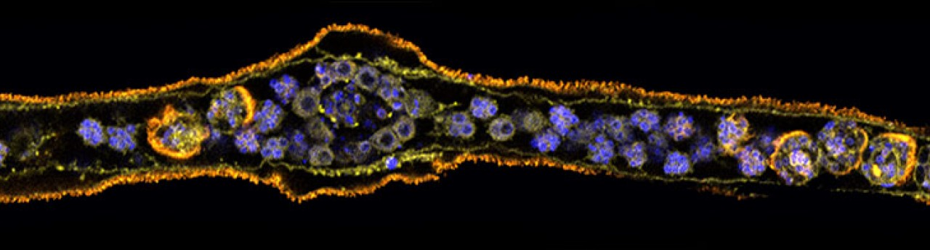
Dicyemida phylum
Microscopic parasites that live inside cephalopods such as octopuses and cuttlefish.

Slide 21
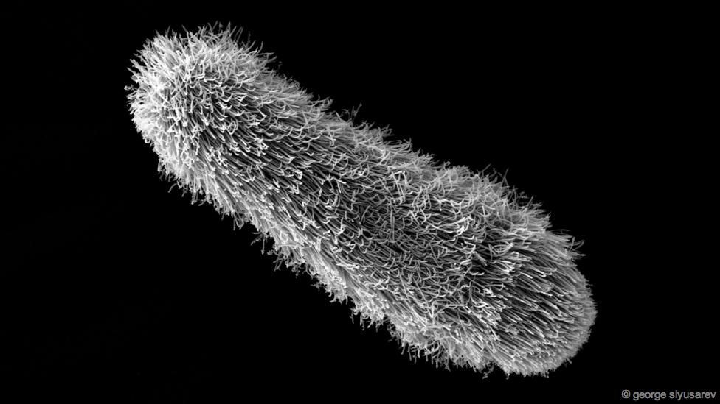
Orthonectida phylum
Another poorly known parasite of marine invertebrates

Slide 22
The Least-Known Taxonomic Groups. Groups for which fewer than an estimated 20% of the species have been described included some taxa with few known species (i.e., Cycliophora, Loricifera, Placozoa, Tantulocarida, Leptostraca, Caudofoveata). However, most have hundreds (Myxozoa, Acoela, Kinorhyncha, Oligochaeta, Gastrotricha, Dicyemida, Orthonectida, and Entoprocta) to thousands (Bacillariophyceae, Ciliophora, Rhabditophora, Cumacea, Tanaidacea, Isopoda) of species. The largest numbers of undiscovered species may be in Isopoda (+63,150–123,600 spp.), Gastropoda (+85,000–105,000 spp.), Bacillariophyceae (+50,000 spp.), Nematoda (+50,000 spp.), Copepoda (+30,125–50,125 spp.), Ostracoda (+2,625–34,000 spp.), Rhabditophora (excluding Neodermata; +5,500–29,000 spp.), Tanaidacea (+21,900–24,900 spp.), Amphipoda (+20,000 spp.), Monogenea (+10,700–20,300 spp.), Porifera (+17,300–18,000 spp.), Ciliophora (+4,231–19,368 spp.), Oligochaeta (+5,900–16,900 spp.), and marine Fungi (+15,000 spp.).
Notes:
Appeltans, W., Ahyong, S. T., Anderson, G., Angel, M.V., Artois, T., et al., (2012). The Magnitude of Global Marine Species Diversity. Current Biology. Volume 22, Issue 23, Pages R996-R997. DOI: 10.1016/j.cub.2012.09.036

Slide 23
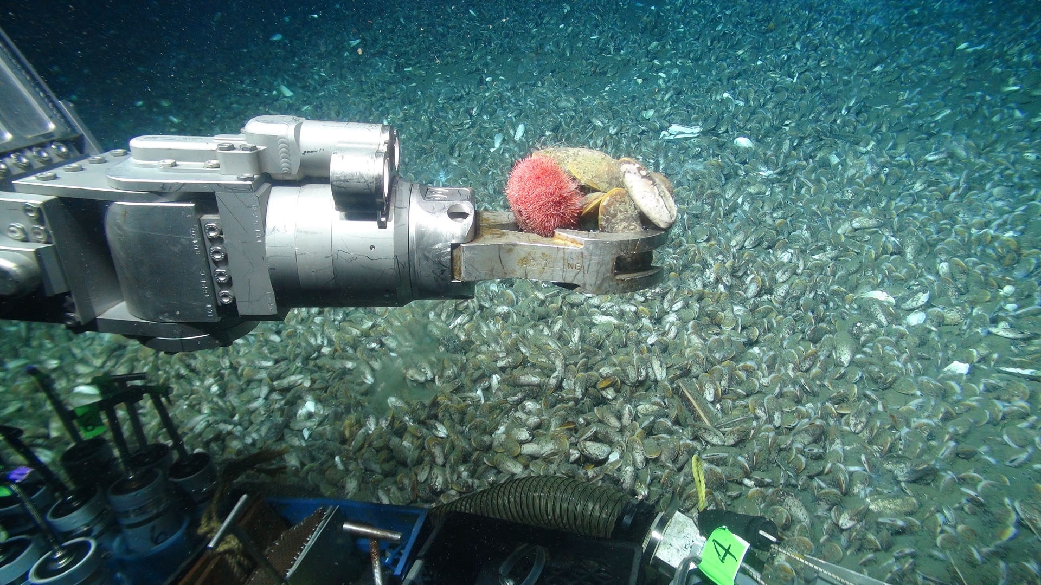
Challenging conditions
Knowledge is limited because of the challenges working underwater.
Working underwater requires special equipment that is expensive and limited in scope.
Images of the
remotely operated vehicle Jason2 sampling a sea urchin in a deep sea mussel community found near a gas seep on the U.S. outer continental shelf. Images courtesy Deepwater Canyons 2013 - Pathways to the Abyss expedition, NOAA-OER/BOEM/USGS.
Notes:
https://www.usgs.gov/media/images/roc-sampling-deep-sea-urchin-0

Slide 24
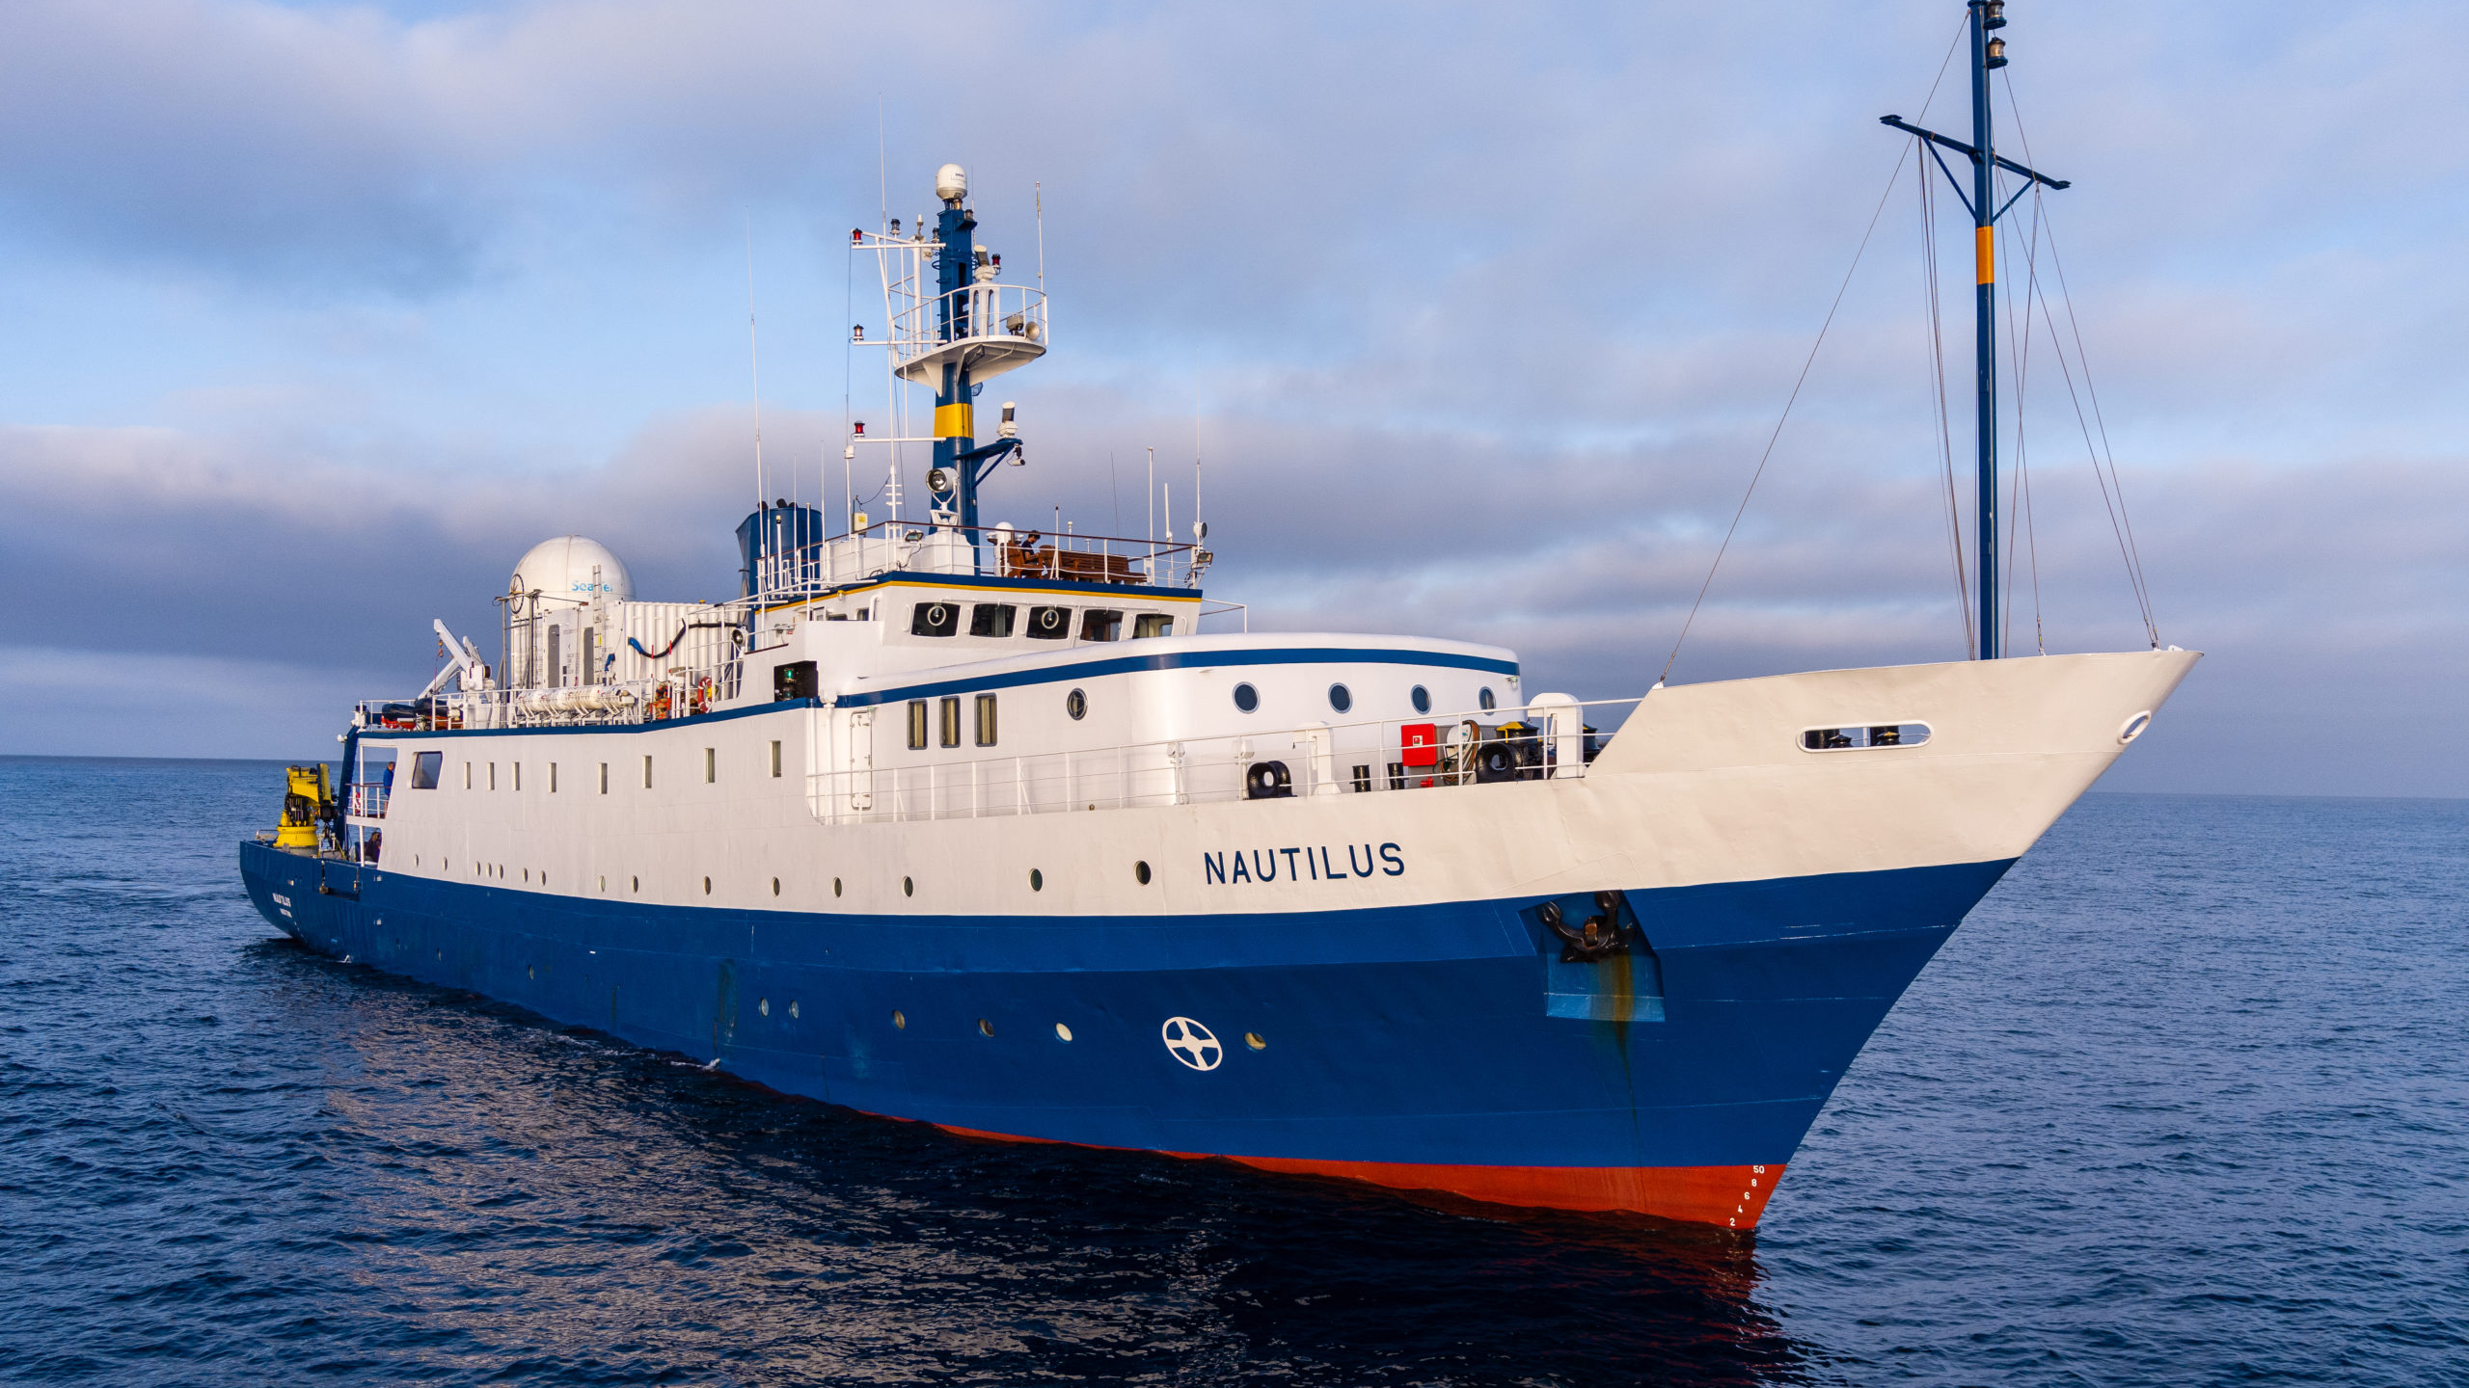
The USA’s National Oceanic and Atmospheric Administration (NOAA) Exploration Vessel Nautilus
Notes:
https://deepoceaneducation.org/vessels/

Slide 25
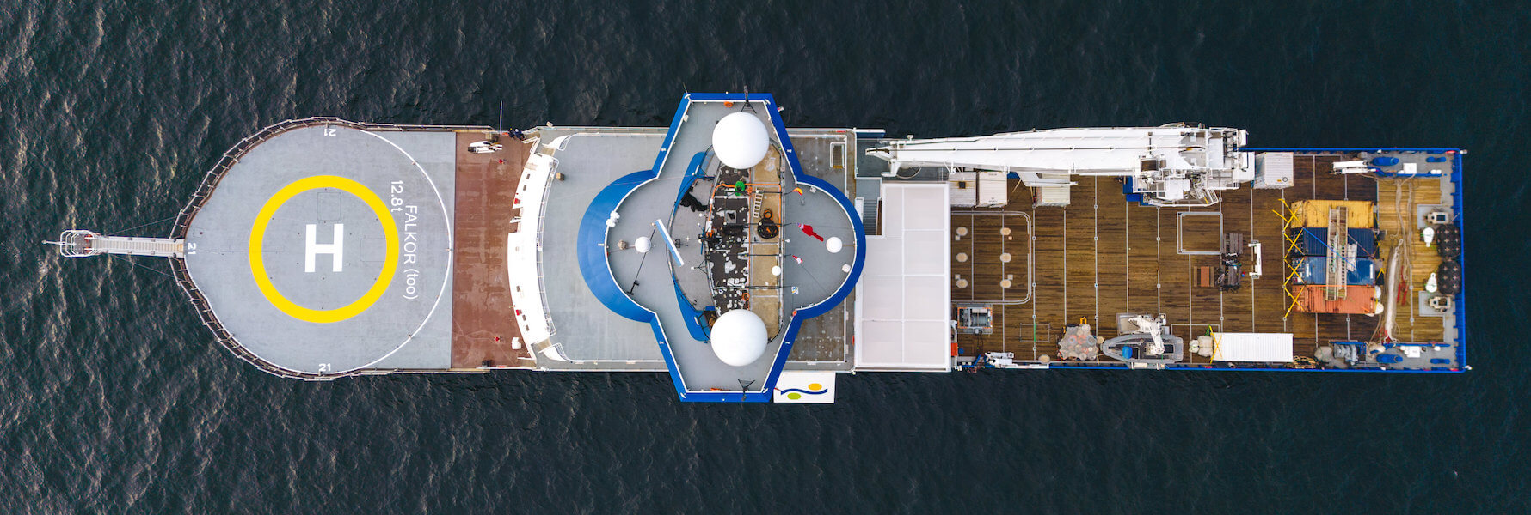
Schmidt Ocean Institute’s Research Vessel Falkor (too).
Notes:
https://deepoceaneducation.org/vessels/

Slide 26
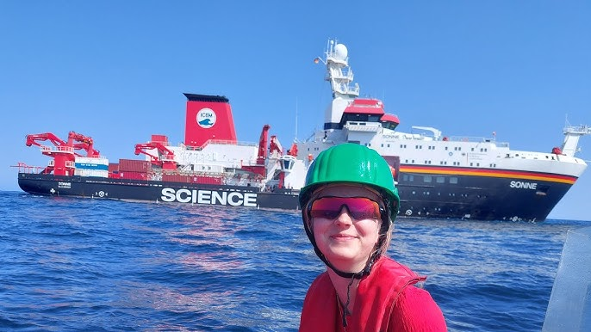
Notes:
https://www.youtube.com/watch?v=5Sg_XKCbvhg

Slide 27
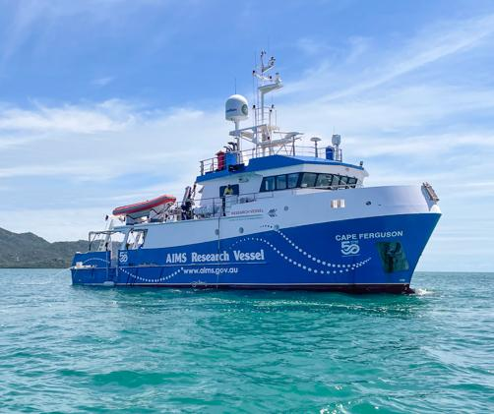
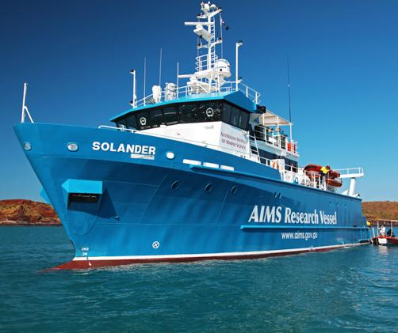
The Australian Institute of Marine Science (AIMS) has two research vessels:
RV Cape Ferguson and
RV Solander

Slide 28
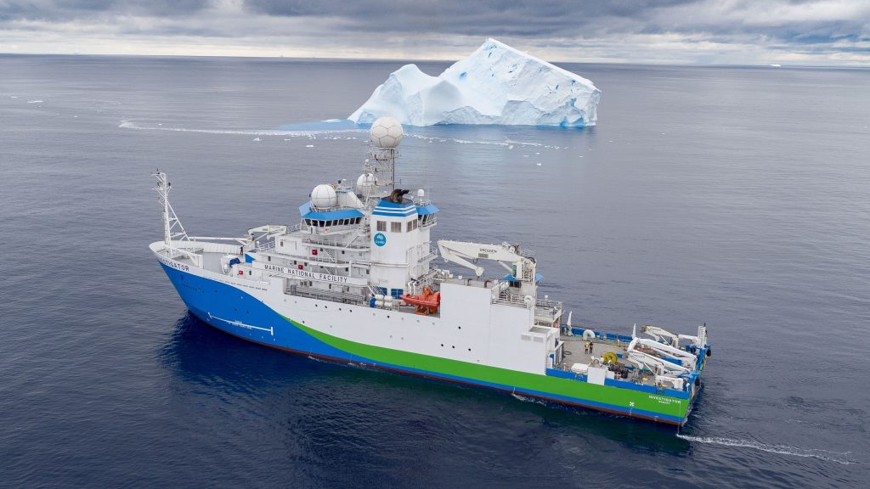
Australia’s RV Investigator owned and managed by CSIRO

Slide 29
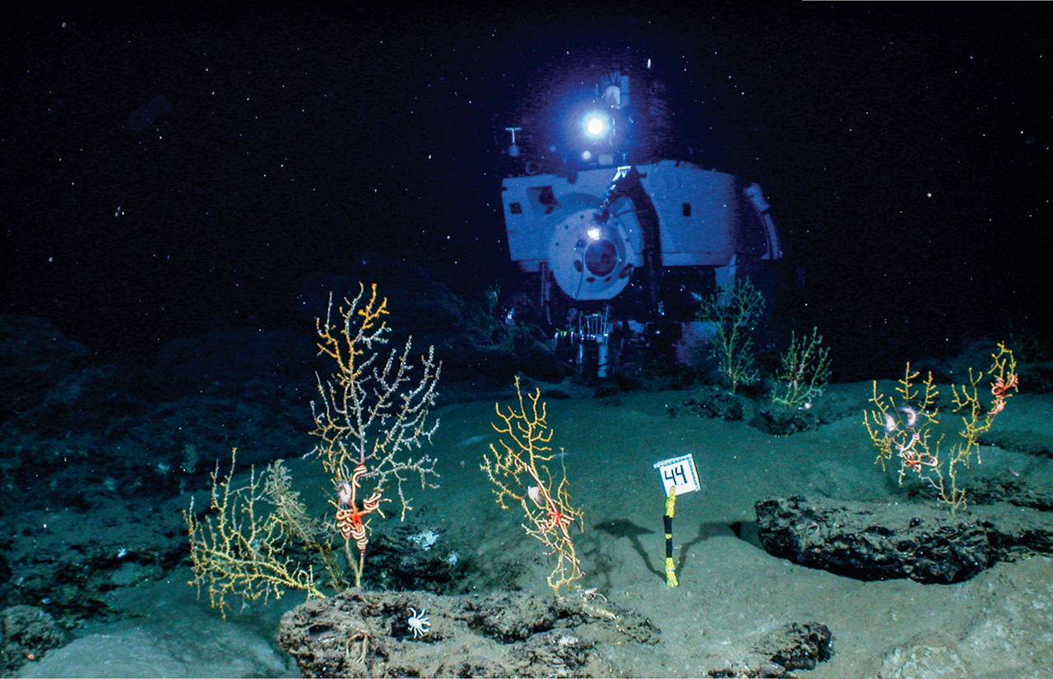
Deeper seas are poorly sampled
Notes:
https://www.science.org/doi/10.1126/science.aah7178

Slide 30
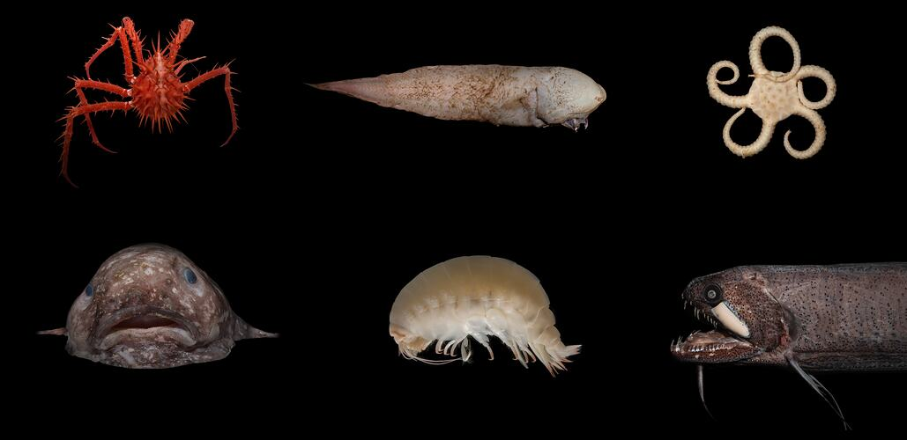

Slide 31
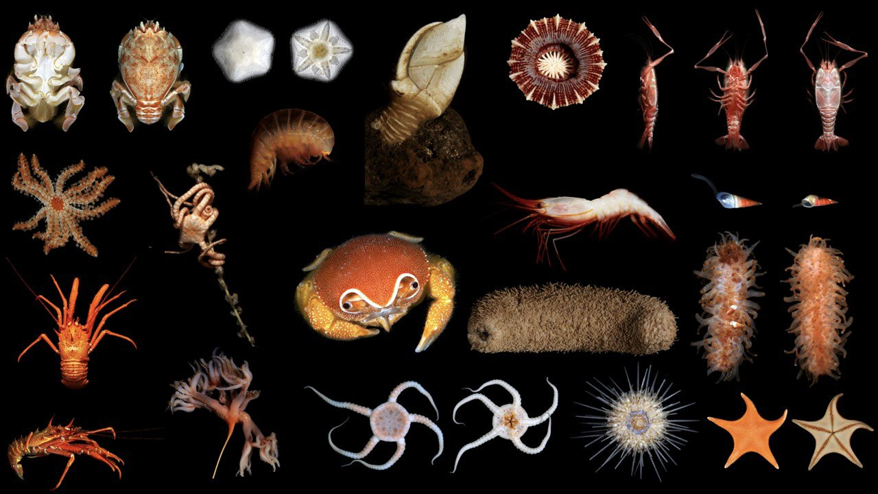

Slide 32
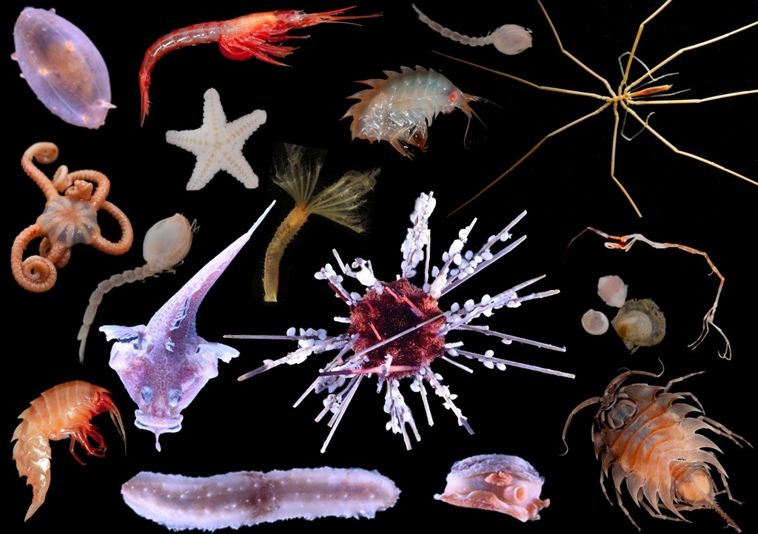

Slide 33
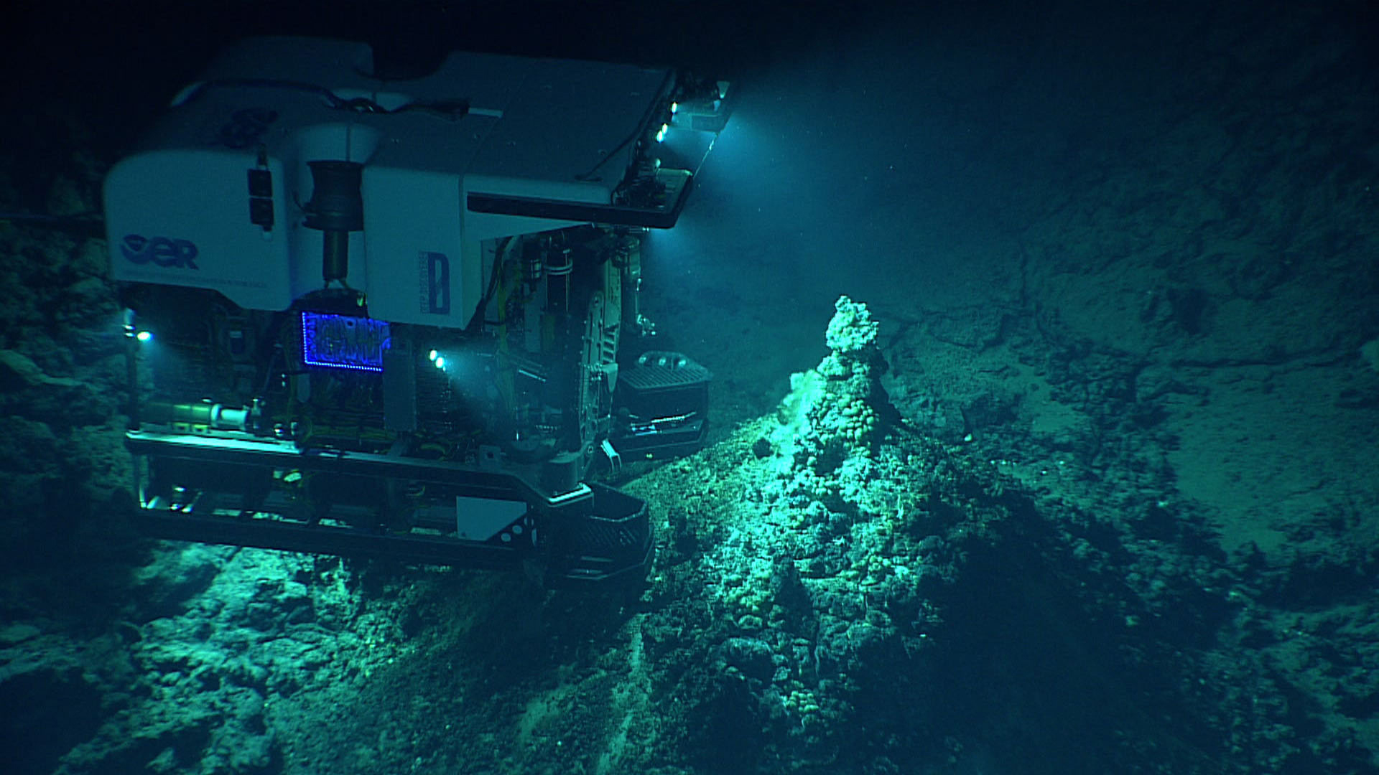
Notes:
https://pina.com.fj/2021/12/06/a-rush-to-mine-the-deep-ocean-has-environmentalists-worried/

Slide 34
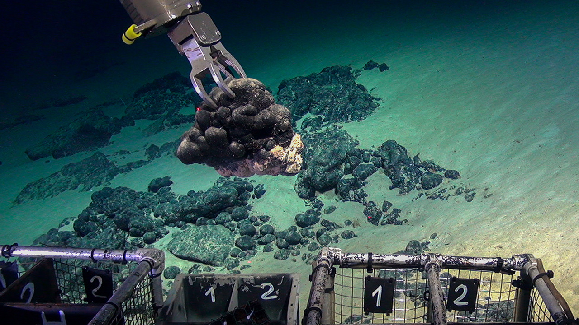
Ferromanganese deposits were one target of a recent research expedition to the Tropic Seamount off of Africa's coast © NERC
Notes:
https://www.science.org/content/article/mountains-hidden-deep-sea-are-biological-hot-spots-will-mining-ruin-them

Slide 35
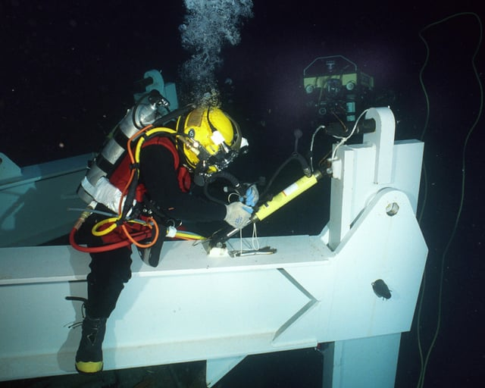
The oil and gas industry has the funding for deep sea exploration
Notes:
https://www.reddit.com/r/submechanophobia/comments/qejaui/navy_saturation_diver_performs_a_deep_sea_salvage/

Slide 36
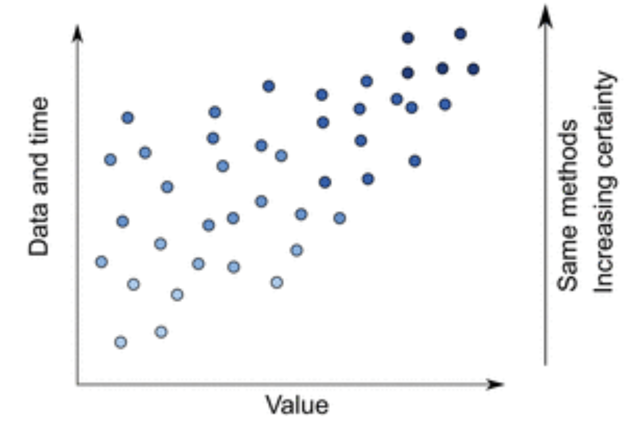
Data-poor fisheries
Knowledge is limited because of the correlation between the value of a fishery and the amount of data collected on it. Fisheries considered of little value are allocated smaller amounts of time and money.
Notes:
https://academic.oup.com/icesjms/article/72/1/186/822177

Slide 37
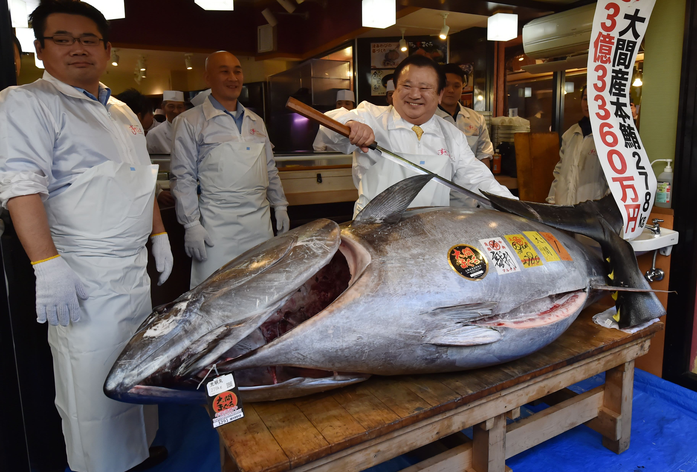
Massive tuna nets $3.1 million at Japan auction

Slide 38
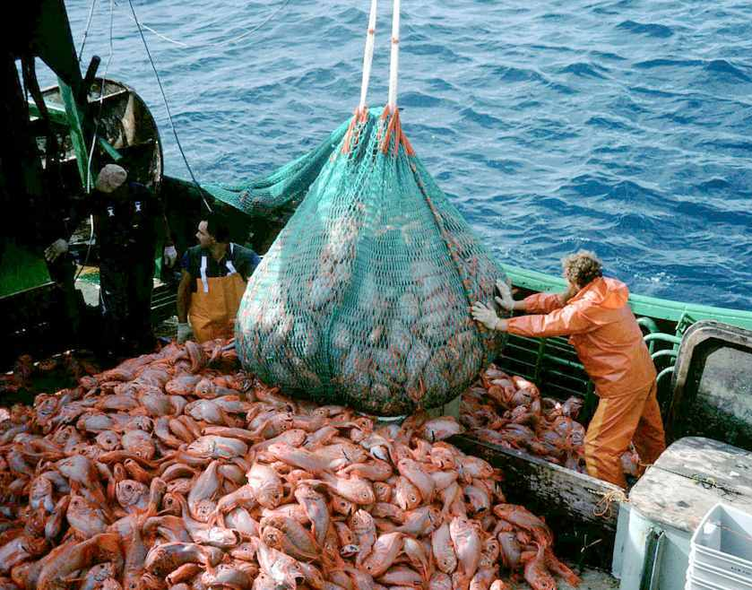
Orange roughy
Sustainable or not?
Some say yes, others strongly argue no.

Slide 39
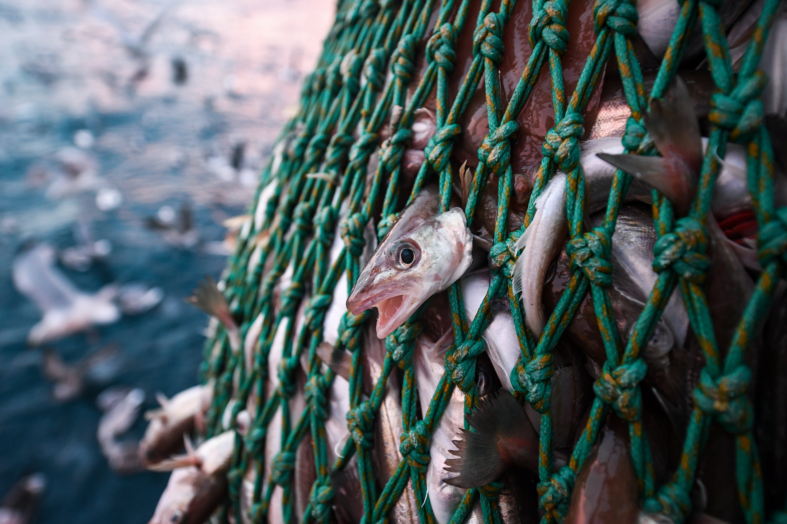
Data -poor fisheries are at greater risk of overfishing.
Notes:
https://blog.nature.org/2016/05/11/hyperstability-the-achilles-heel-of-data-poor-fisheries/
Hyperstability masks declines in bumphead parrotfish (Bolbometopon muricatum) populations
Richard J. Hamilton,
Glenn R. Almany,
Don Stevens,
Michael Bode,
John Pita,
Nate A. Peterson &
J. Howard Choat
Coral Reefs volume 35, pages751–763 (2016)

Slide 40
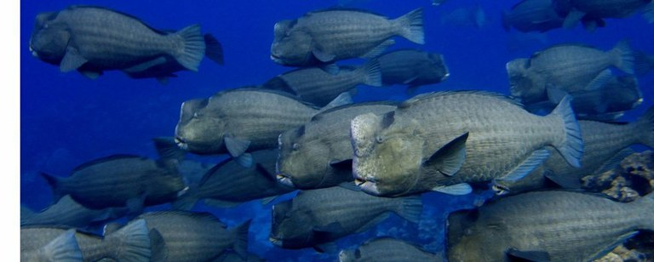
Even if a fish species is not considered valuable commercially, it may be very important functionally!
Notes:
https://blog.nature.org/2016/05/11/hyperstability-the-achilles-heel-of-data-poor-fisheries/
Hyperstability masks declines in bumphead parrotfish (Bolbometopon muricatum) populations
Richard J. Hamilton,
Glenn R. Almany,
Don Stevens,
Michael Bode,
John Pita,
Nate A. Peterson &
J. Howard Choat
Coral Reefs volume 35, pages751–763 (2016)

Slide 41
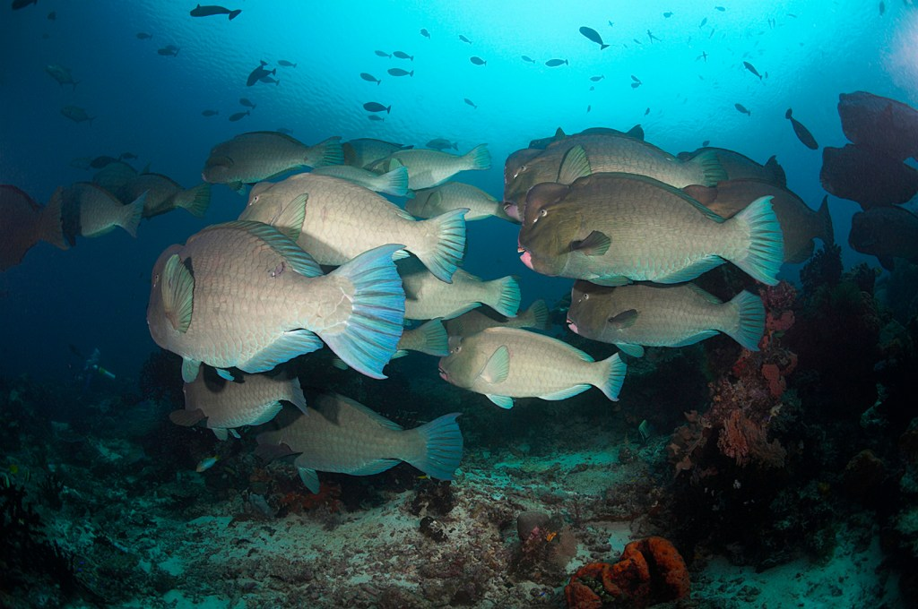
Did you know…
when a fish stock is rapidly depleting, the catch rates can still remain high.
This is known as ‘hyperstability’.
Hyperstability is a major challenge when assessing data-poor fisheries.
Notes:
https://blog.nature.org/2016/05/11/hyperstability-the-achilles-heel-of-data-poor-fisheries/
Hyperstability masks declines in bumphead parrotfish (Bolbometopon muricatum) populations
Richard J. Hamilton,
Glenn R. Almany,
Don Stevens,
Michael Bode,
John Pita,
Nate A. Peterson &
J. Howard Choat
Coral Reefs volume 35, pages751–763 (2016)

Slide 42
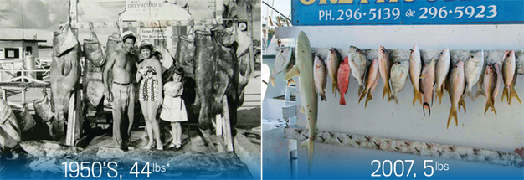
Shifting baselines

Slide 43
Shifting Baselines: the baseline of what is considered healthy shifts over time, leading to failure to identify the actual “baseline” population size (i.e. how many fish existed long before records began).
Fishery Health
Notes:
https://waterbucket.ca/rm/2014/09/01/creating-future-british-columbia-reverse-shifting-baseline/

Slide 44
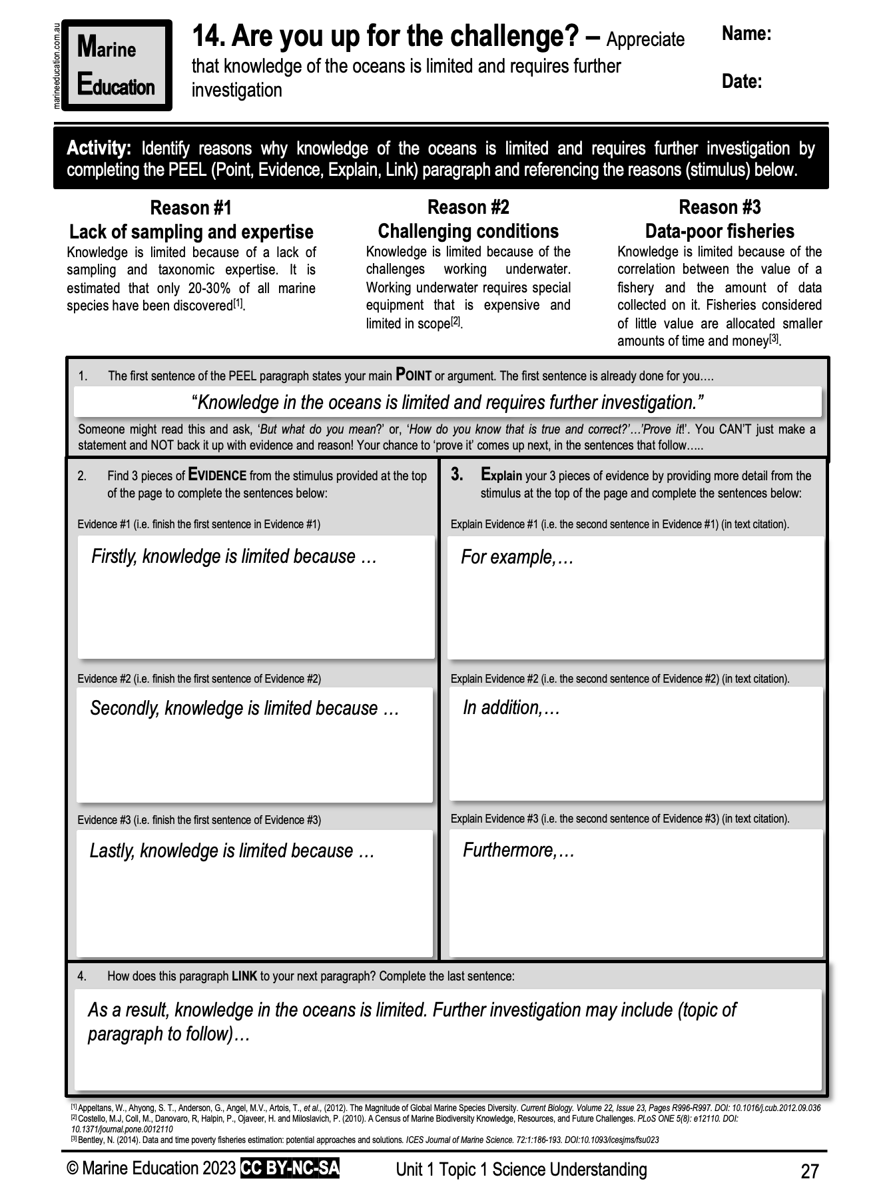
Learning Intention:
Appreciate that knowledge of the oceans is limited and requires further investigation
Success Criteria:
Complete Marine Education worksheet ’14. Are you up for the challenge?’
Notes:
by Woods Hole Oceanographic Institution on 8 Oct 2010
https://www.sail-world.com/Australia/The-Census-of-Marine-Life-reveals-thousands-of-new-species/-75562?source=google
WHOI researchers Peter Wiebe, Nancy Copley, and Larry Madin joined the effort to find, identify, and analyze indicator genes of the world’s animal plankton, known as the Census of Marine Zooplankton (CMarZ). CMarZ is one of more than 17 research projects within the Census of Marine Life, a ten-year project to catalog all life in the sea. - Census of Marine Life Woods Hole Oceanographic Institution (WHOI) http://www.whoi.edu/

