Slide 1
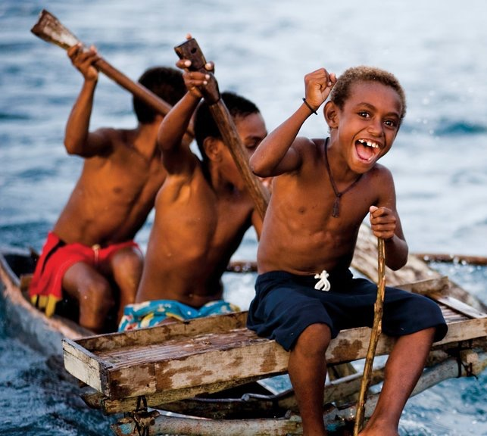
Learning Intention:
Recognise that decisions relating to resource management are affected by the economic development of a nation and the value placed on marine environment
Success Criteria:
Complete Marine Education worksheet ’15. EEeezy Money’
Notes:
https://www.expedia.com/pictures/australia-and-south-pacific/papua-new-guinea.d132

Slide 2
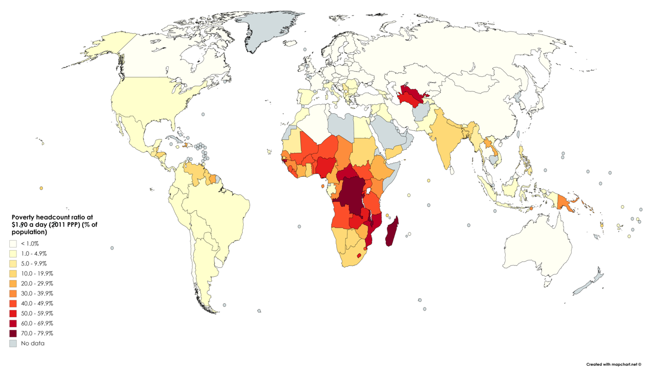
People living on $1.90 per day
Notes:
World map of poverty headcount ratio at $1.90 a day (2011 PPP) (% of population). Based on World Bank data ranging from 1998 to 2018
https://en.wikipedia.org/wiki/List_of_sovereign_states_by_percentage_of_population_living_in_poverty#/media/File:Poverty_headcount_ratio_at_1.90_a_day.png

Slide 3
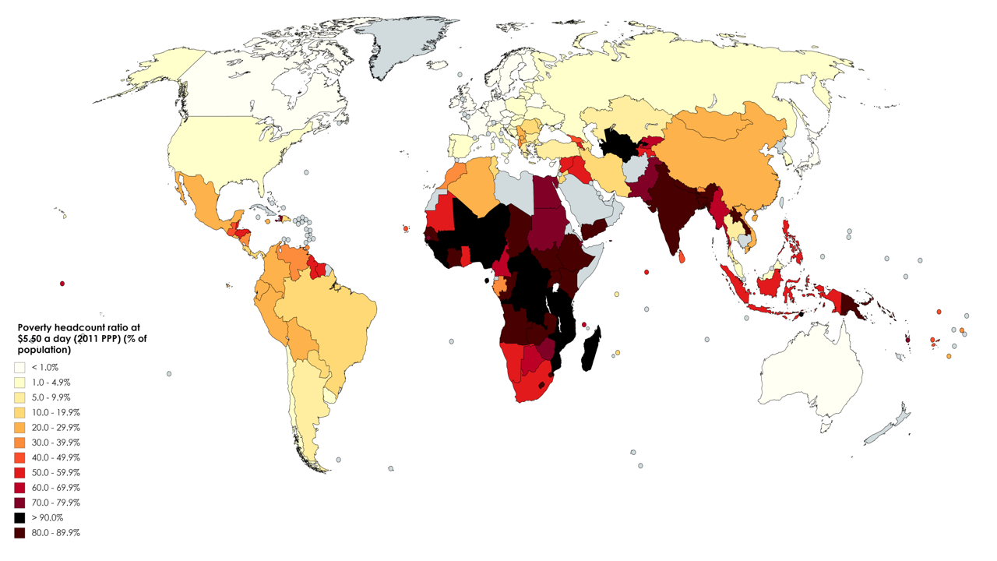
People living on $5.50 per day
Notes:
World map of poverty headcount ratio at $1.90 a day (2011 PPP) (% of population). Based on World Bank data ranging from 1998 to 2018
https://en.wikipedia.org/wiki/List_of_sovereign_states_by_percentage_of_population_living_in_poverty#/media/File:Poverty_headcount_ratio_at_1.90_a_day.png

Slide 4
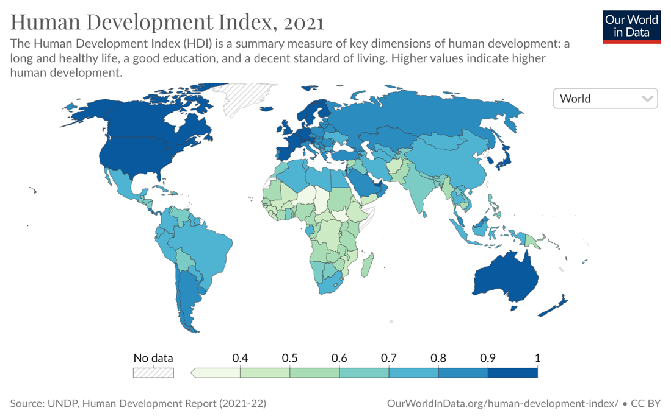
(a.k.a. living standards)
Notes:
https://ourworldindata.org/grapher/human-development-index

Slide 5
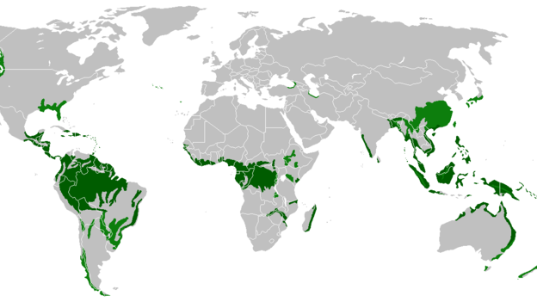
Rainforests around the world

Slide 6
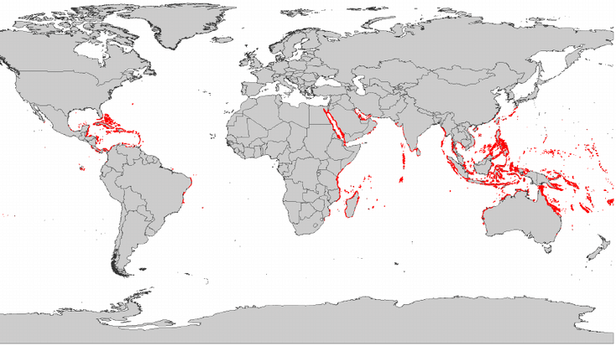
The Coral Triangle
Coral reefs around the world

Slide 7
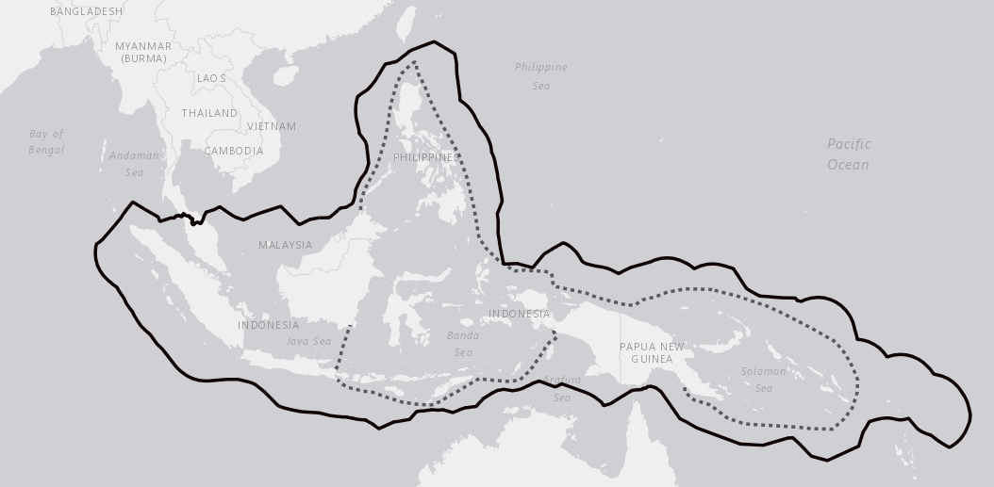
The Coral Triangle
Notes:
Dotted line: Coral Triangle Scientific Boundary - highest coral diversity in the world (more than 500 species) Thick line: CTI-CFF Implementation area - The CTI-CFF Plan of Action may be implemented within waters under national jurisdiction of each of the Coral Triangle governments
https://www.coraltriangle.org/

Slide 8
The Coral Triangle has the highest coral diversity in the world (more than 500 species).
By comparison, Australia’s Great Barrier Reef hosts fewer than 500 coral species. On the other side of the globe the Caribbean Sea can boast only 61 species.
The Coral Triangle is home to >350 million people across Indonesia, Malaysia, Papua New Guinea, the Philippines, the Solomon Islands and Timor Leste (called the CT6).
Notes:
https://files.worldwildlife.org/wwfcmsprod/files/Publication/file/7s2ggtlibx_CTSP_LessonsLearned_final__MK_edits__PD_review_2014_Jan_15.pdf?_ga=2.25416699.775569735.1697312787-486517325.1697312771

Slide 9
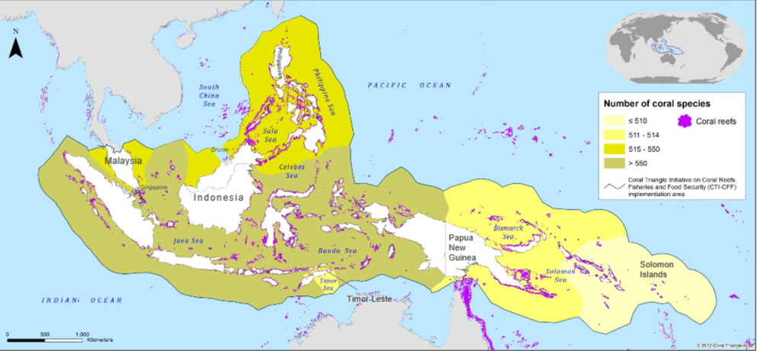
Number of coral species
<500
500-515
515-550
<550
Notes:
http://ctatlas.coraltriangleinitiative.org/MapGallery

Slide 10
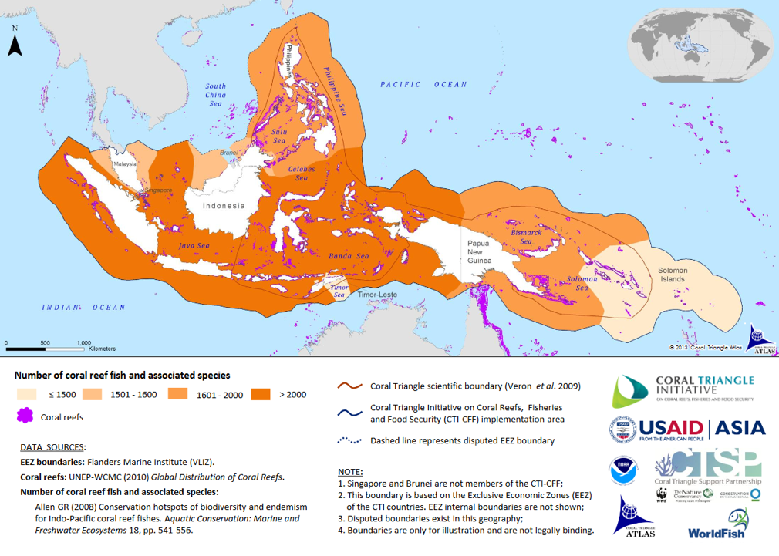
Number of coral reef fish and associated species
<500
500-1600
1600-2000
>2000
Notes:
http://ctatlas.coraltriangleinitiative.org/MapGallery

Slide 11
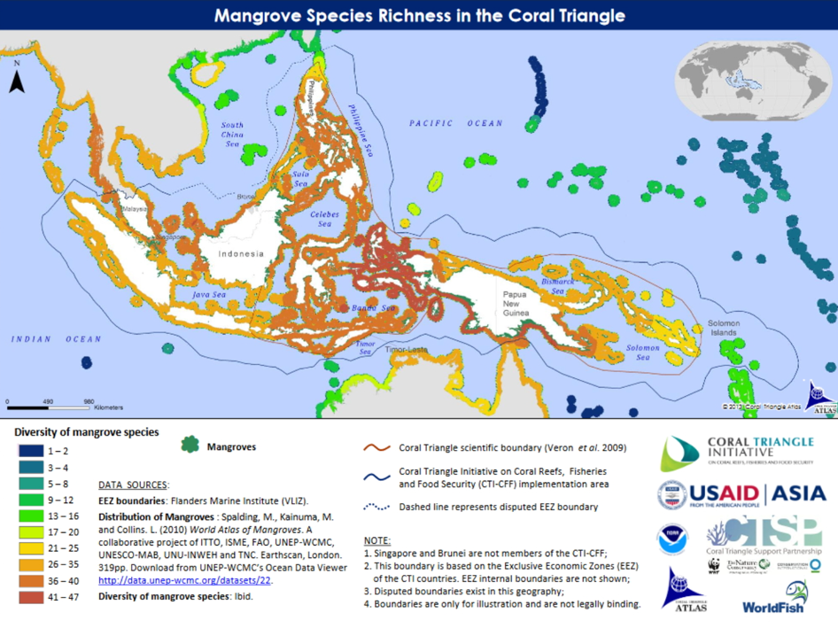
Number of mangrove species
1-2
5-8
13-16
21-25
36-40
41-47
Notes:
http://ctatlas.coraltriangleinitiative.org/MapGallery

Slide 12
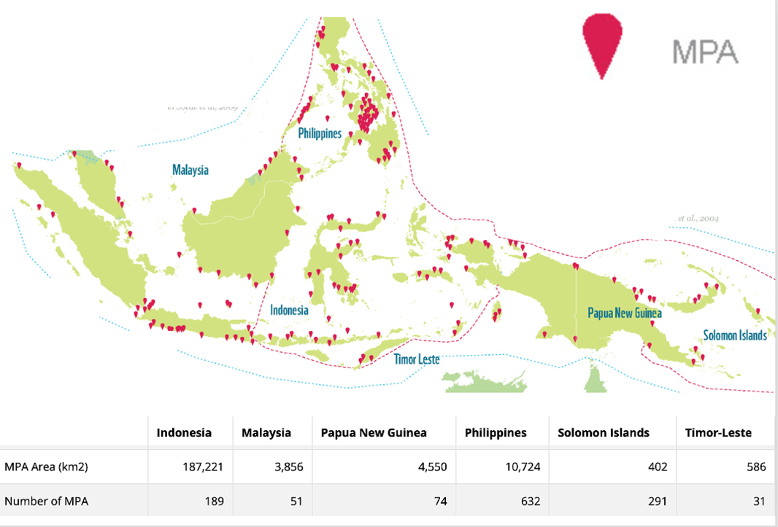
Number of MPAs
(Marine Protected Areas)
Notes:
https://wwf.panda.org/wwf_news/?201819/Infographic-Marine-Protected-Areas-in-the-Coral-Triangle

Slide 13
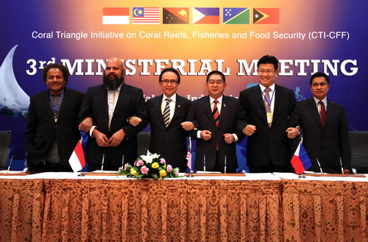
In 2009, Indonesian President Yudhoyono inspired other leaders in the region to launch the Coral Triangle Initiative (CTI) on Coral Reefs, Fisheries and Food Security (CTI-CFF) through the signing of the Leaders Declaration.
Notes:
https://coraltriangleinitiative.org/about

Slide 15
In signing the declaration, they all agreed to protect the coral triangle by implementing a CTI-CFF Action Plan, to then go back to their countries to develop their own national plans of action
(to adopt the CTI-CFF goals to their local conditions).

Slide 16
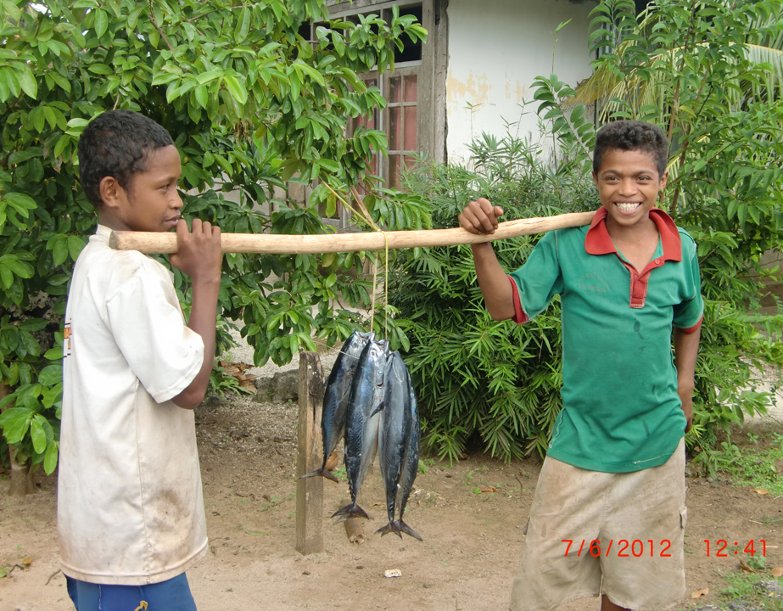
Indonesia
16% of the world’s coral reefs are found in Indonesia
Approx. 17000 islands
Nearly 60 million people live within 20 miles of a coral reef.
Highest total seafood consumption of any nation in SE Asia.
Notes:
https://coraltriangleinitiative.org/country-gallery/Indonesia

Slide 17
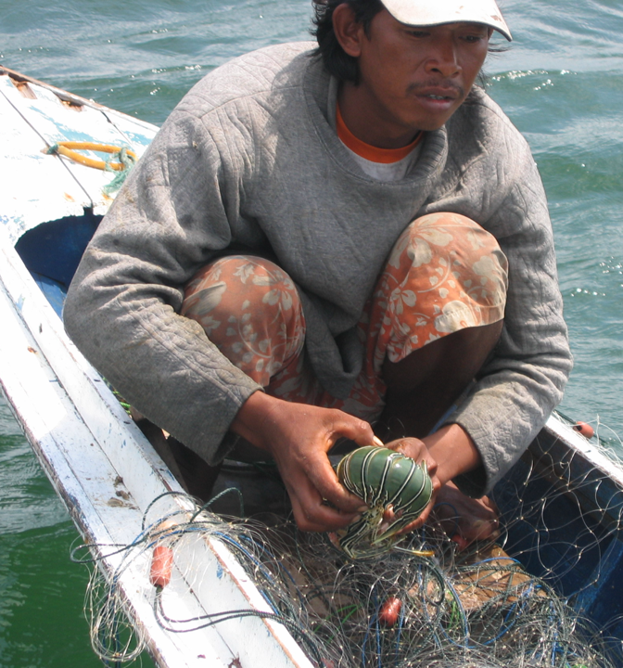
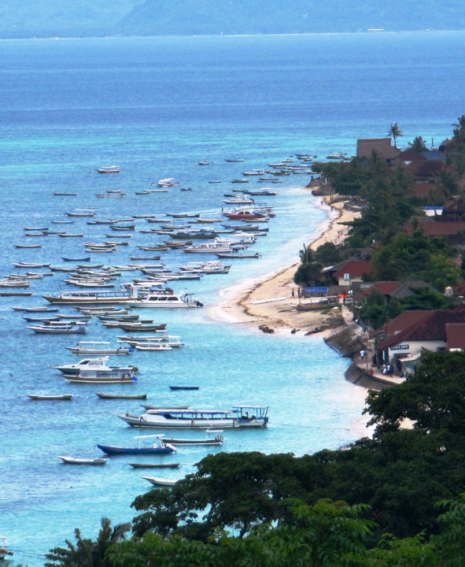
Notes:
https://coraltriangleinitiative.org/country-gallery/Indonesia

Slide 18
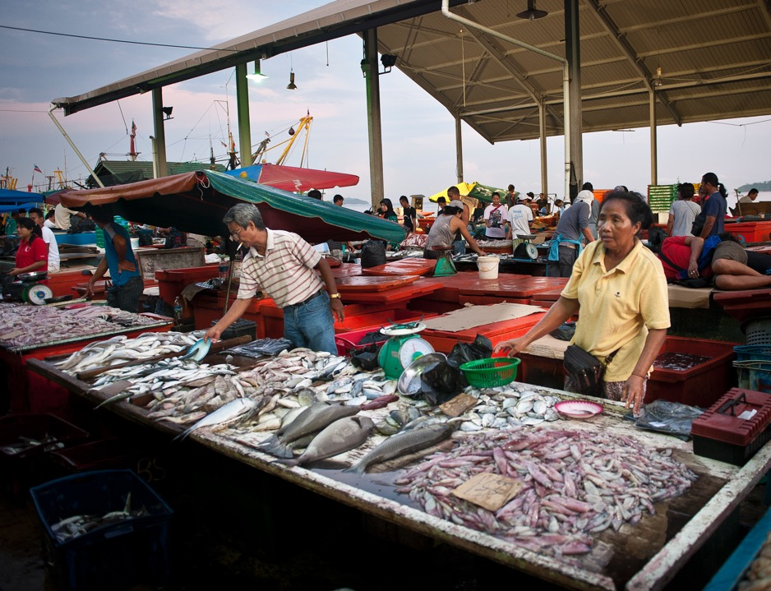
Malaysia
5 million people live within 20 miles of a coral reef
Fisheries provide 60 percent of the nation’s protein
Rapid coastal development and a fast-growing economy taking a toll on its marine resources
Notes:
https://coraltriangleinitiative.org/country-gallery/Malaysia
https://files.worldwildlife.org/wwfcmsprod/files/Publication/file/7s2ggtlibx_CTSP_LessonsLearned_final__MK_edits__PD_review_2014_Jan_15.pdf?_ga=2.25416699.775569735.1697312787-486517325.1697312771

Slide 19
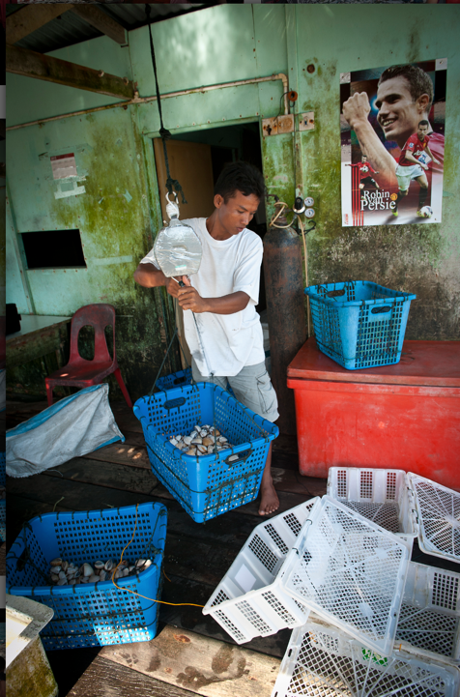
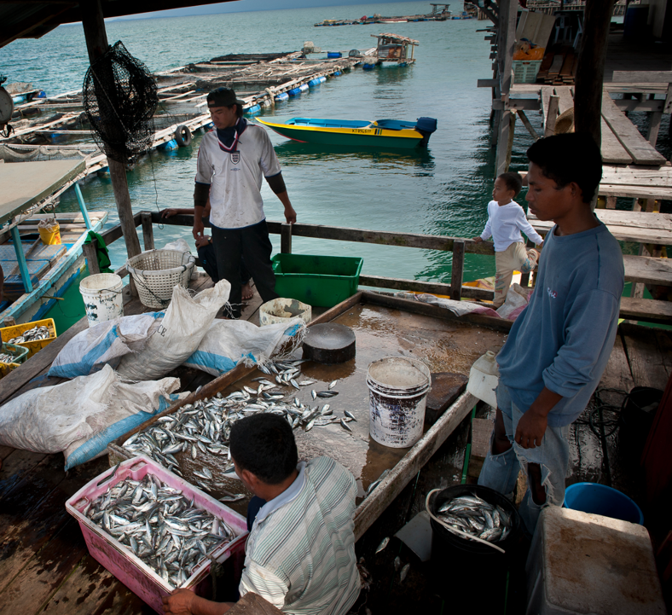
Notes:
https://coraltriangleinitiative.org/country-gallery/Malaysia

Slide 20
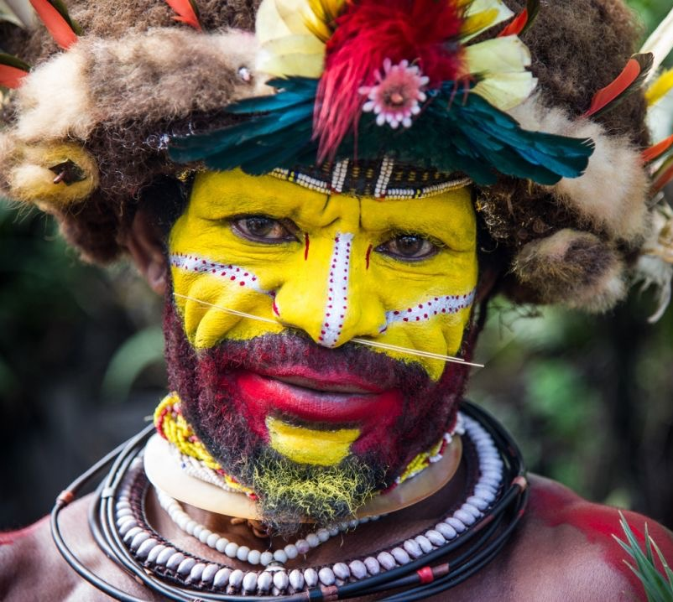
Papua New Guinea
85% live in rural villages and depend on subsistence livelihoods
Majority of land under local “customary” ownership and traditional laws (hence national strategies can be difficult to incorporate at the local level).
Notes:
https://files.worldwildlife.org/wwfcmsprod/files/Publication/file/7s2ggtlibx_CTSP_LessonsLearned_final__MK_edits__PD_review_2014_Jan_15.pdf?_ga=2.25416699.775569735.1697312787-486517325.1697312771

Slide 21
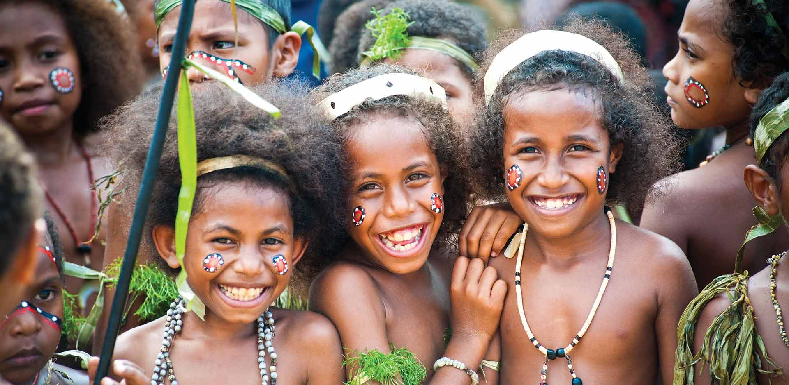

Slide 22
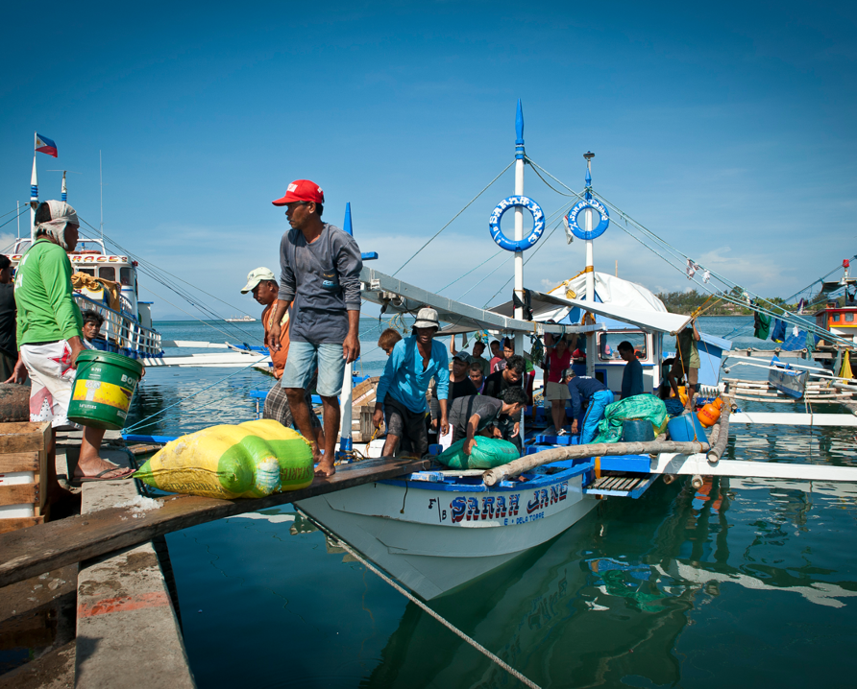
Philippines
>7000 islands
9% of world’s coral reefs are found in the Philippines
> 40 million people live within 20 miles of coral reef
26% live in poverty (and increasing)
Notes:
https://coraltriangleinitiative.org/country-gallery/Philippines

Slide 23
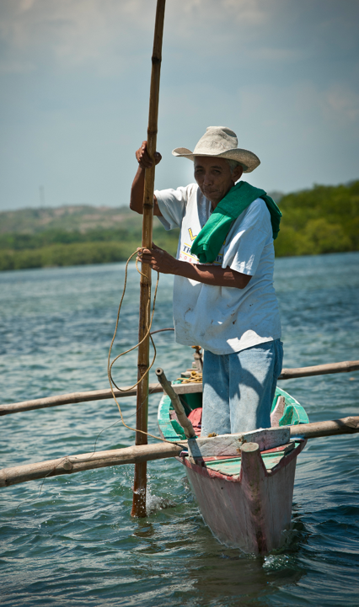
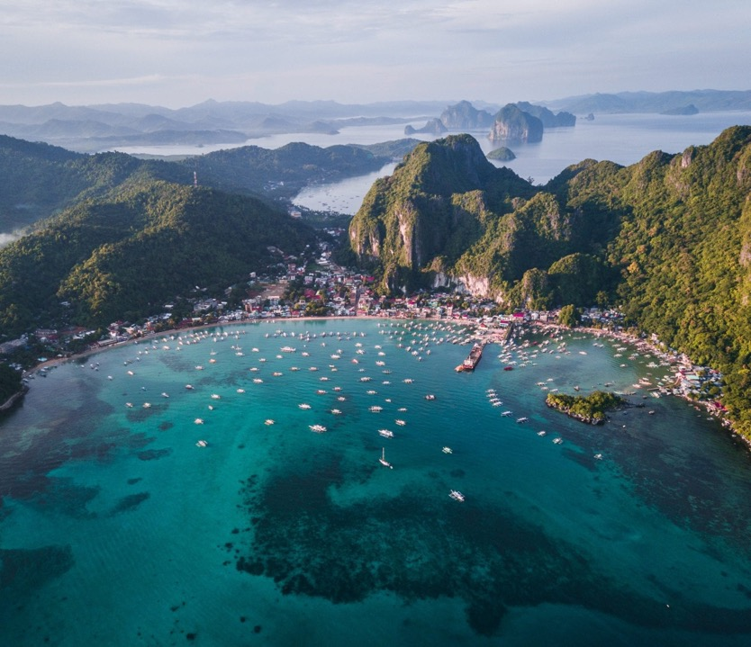
Notes:
https://coraltriangleinitiative.org/country-gallery/Philippines

Slide 24
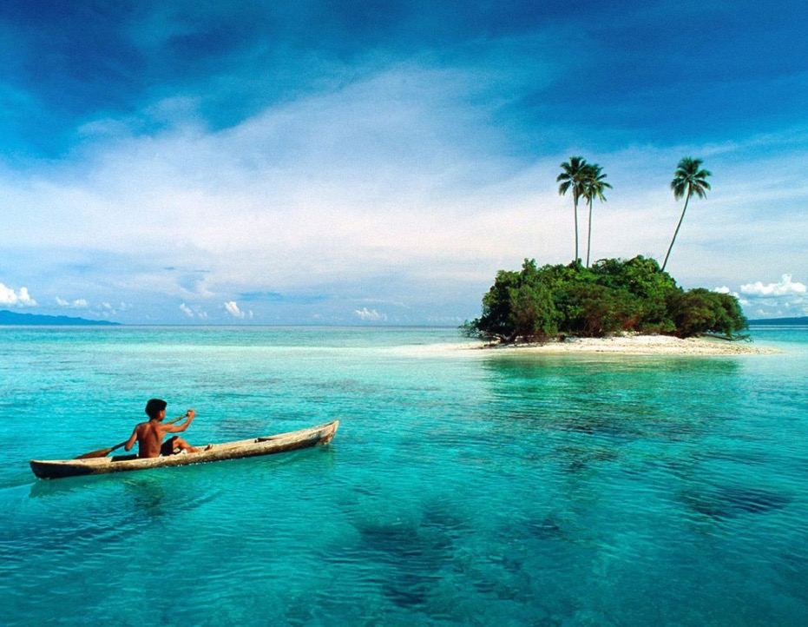
Solomons
6 main islands and more than 986 smaller ones
½ million people (97%) live within 20 miles of coral reef
<21 miles of paved roads in entire country

Slide 25
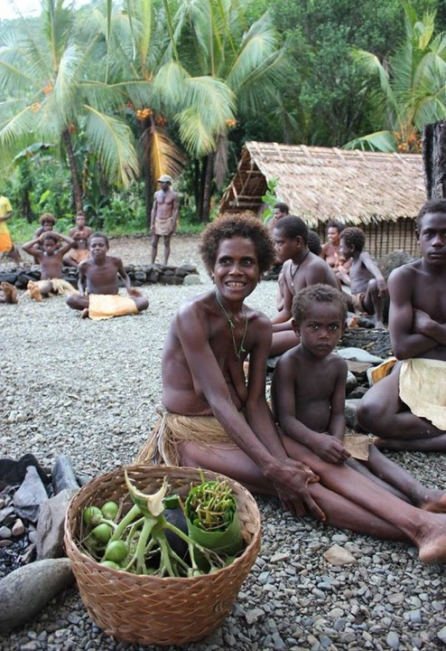
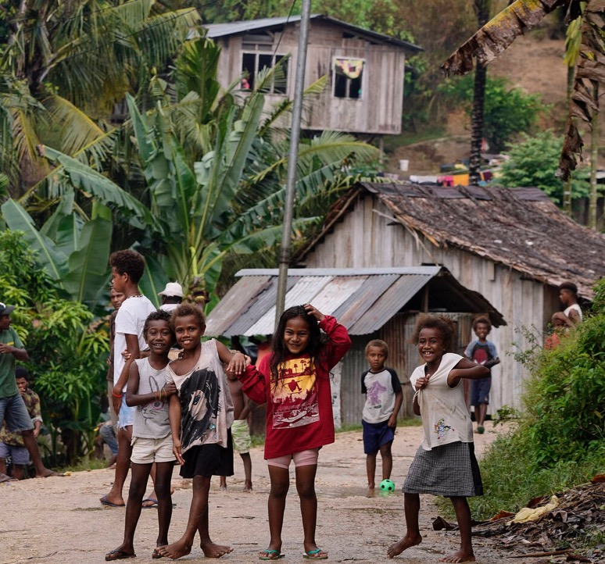
Notes:
https://www.coraltriangleinitiative.org/country-gallery/Timor-Leste

Slide 26
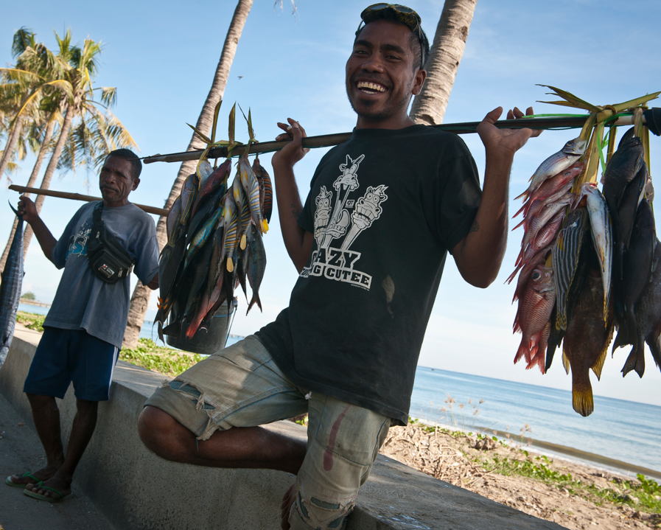
Timor Leste
(East Timor)
Young country - achieved independence from Indonesia in 2002.
One of the world’s poorest countries.
Depend on subsistence livelihoods.

Slide 27
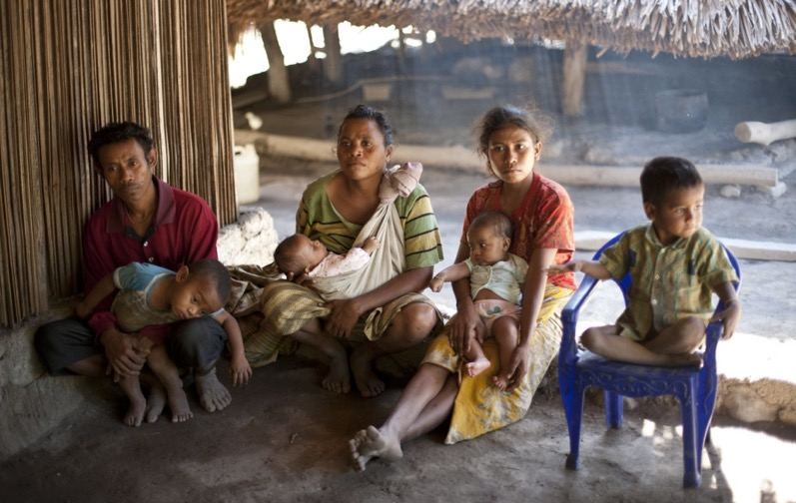
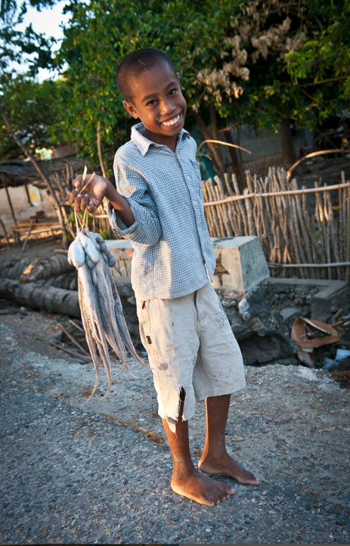
Notes:
https://www.coraltriangleinitiative.org/country-gallery/Timor-Leste
https://borgenproject.org/top-10-facts-about-living-conditions-in-timor-leste/

Slide 28
Caribbean

Slide 29
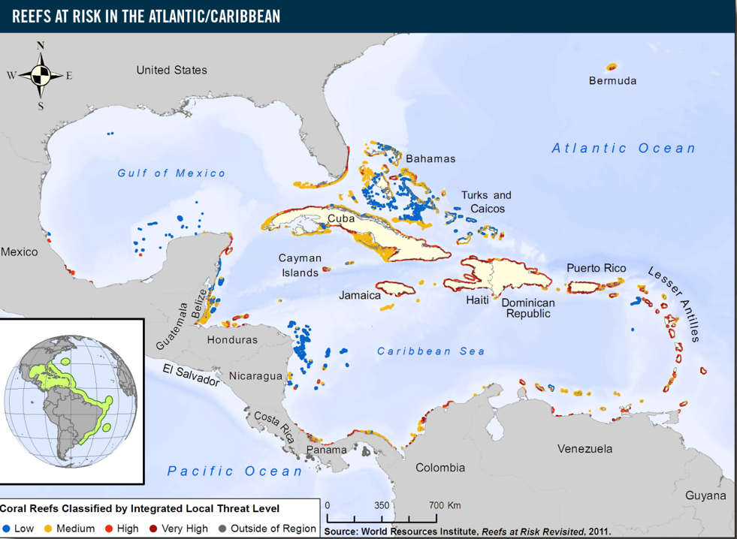
Caribbean
reefs at risk
USA
Low
Medium
Caribbean Sea
High
Very High
South America

Slide 30
Maldives

Slide 31
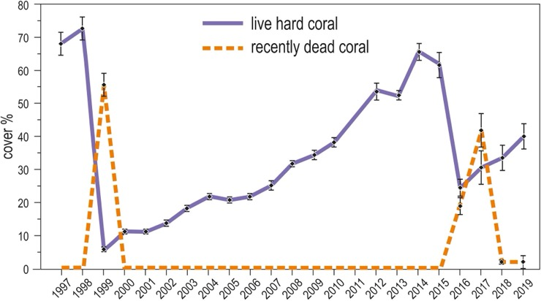
Maldives
1,192 islands within 26 coral atolls atop a 960km submarine ridge.
Most islands only 1m above sea level.
2 severe bleaching events (1998 & 2016).
It took 16 years for reefs to fully recover from the 1998 bleaching event.
Notes:
https://www.frontiersin.org/articles/10.3389/fmars.2020.00587/full
Influence of Local Pressures on Maldivian Coral Reef Resilience Following Repeated Bleaching Events, and Recovery Perspectives
Front. Mar. Sci., 24 July 2020 Sec. Marine Ecosystem Ecology Volume 7 - 2020 | https://doi.org/10.3389/fmars.2020.00587

Slide 32
The Red Sea

Slide 33
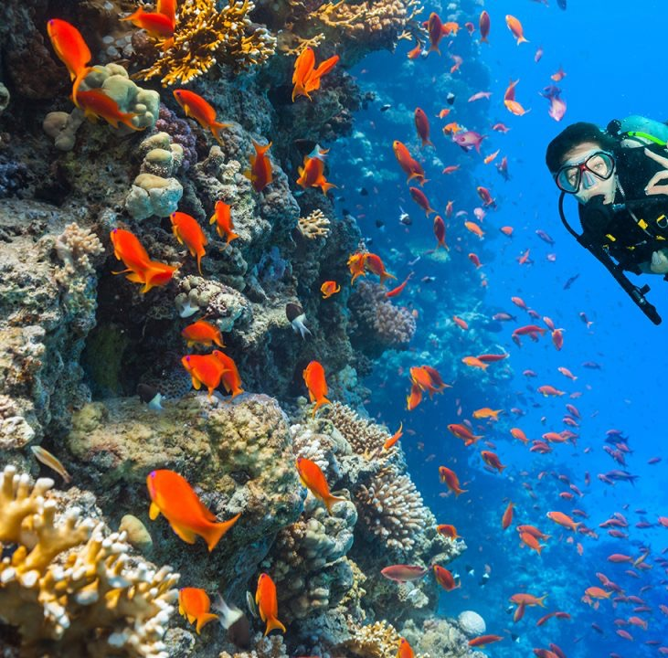
The Red Sea
‘super corals’
Corals in the Northern Red Sea are exceptionally resistant to thermal stress.
The Gulf of Aqaba could potentially be one of the planet’s largest marine refuges from climate change.
Notes:
https://www.bbc.com/future/article/20200408-the-middle-eastern-corals-that-could-survive-climate-change
https://www.frontiersin.org/articles/10.3389/fmars.2020.00090/full

Slide 34
Madagascar

Slide 35
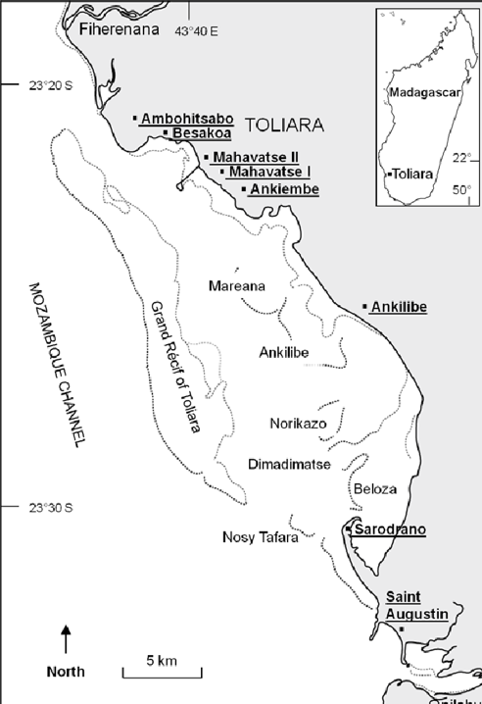
Madagascar
Reefs run continuously for >450km along the SW coastline (3rd largest reef in the world)
The Grand Récif is a 19km stretch of reef nestled up against Toliara, the 2nd largest city in the south of the country (also very poor).
The Grand Récif reef has suffered great loss in the last 40 years due to population growth (and the destruction of mangroves), no resource management, destructive fishing and no pollution control (incl. sewage).
Notes:
https://blueventures.org/wp-content/uploads/2021/03/Harris_2010_ARB.pdf

Slide 36
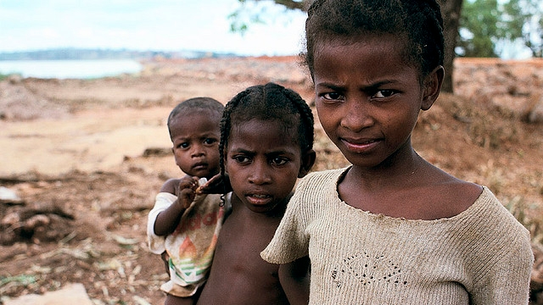
Extreme poverty in Madagascar
Notes:
https://mslilyteacher.wordpress.com/2018/01/28/extreme-poverty-in-madagascar/

Slide 37
Australia

Slide 38
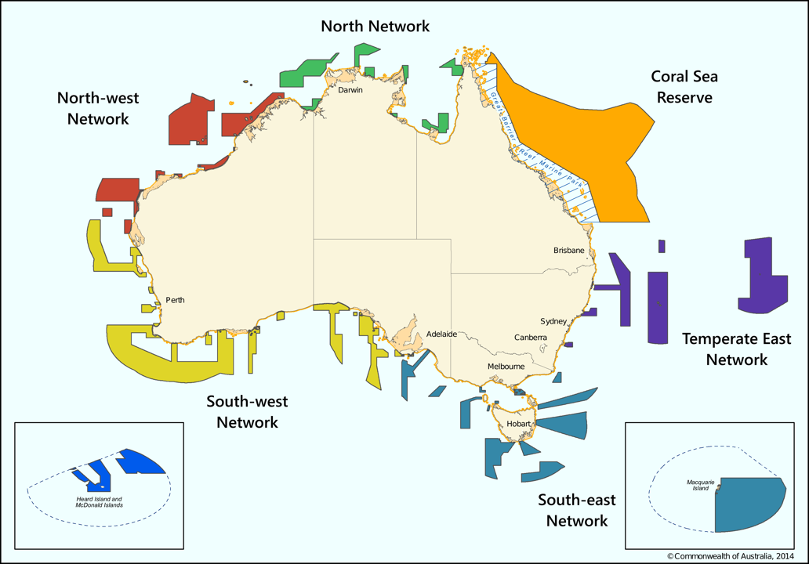
Australia’s National Marine Parks

Slide 39
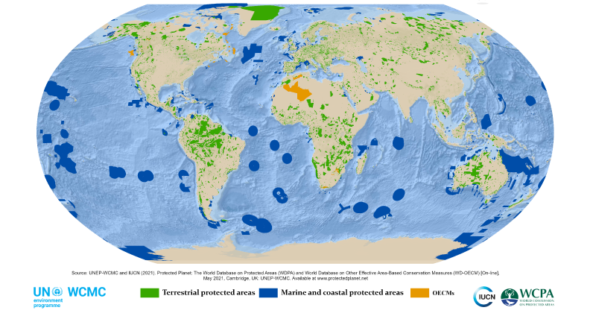
National Parks Globally
Notes:
http://nationalparksofparaguay.blogspot.com/2021/05/protected-planet-report-2020.html

Slide 40
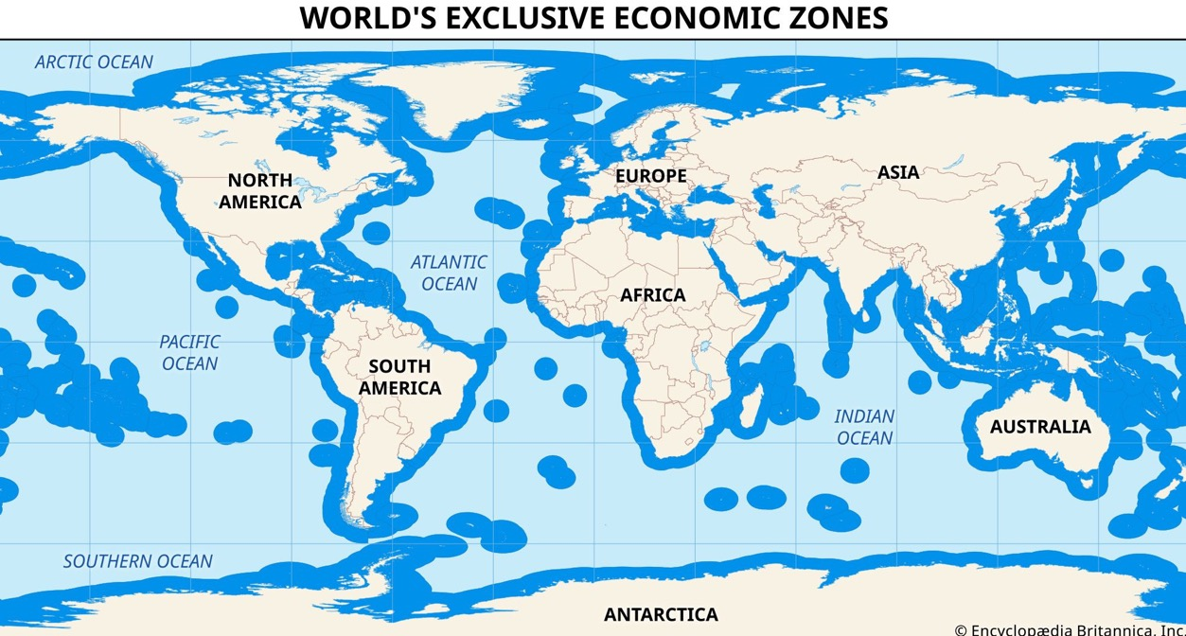
Notes:
https://www.britannica.com/topic/exclusive-economic-zone

Slide 41
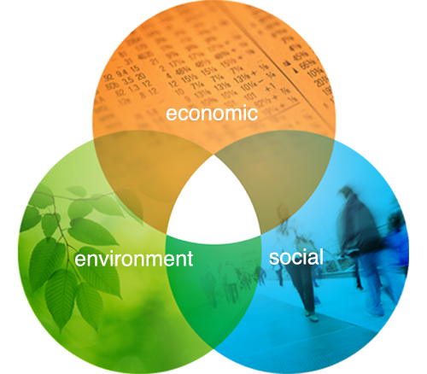
Ecological Sustainable Development
“Development that meets the needs of the present without compromising the ability of future generations to meet their own needs”
The Brundtland report

Slide 42
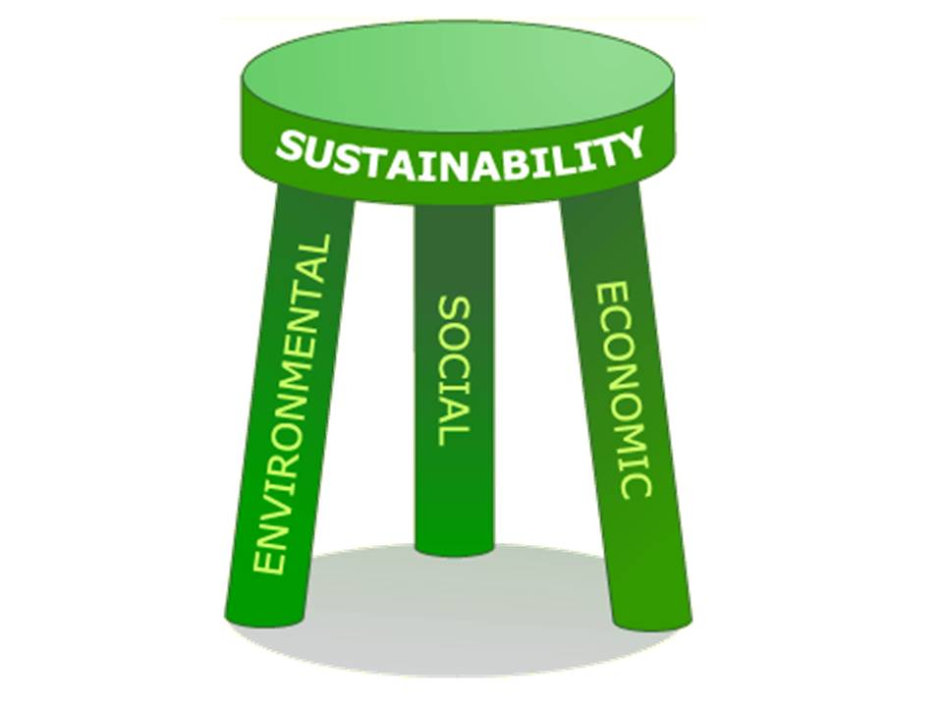
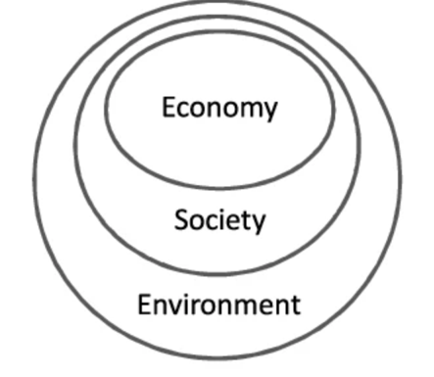
Ecological Sustainable Development
Notes:
https://en.wikipedia.org/wiki/Sustainability

Slide 43
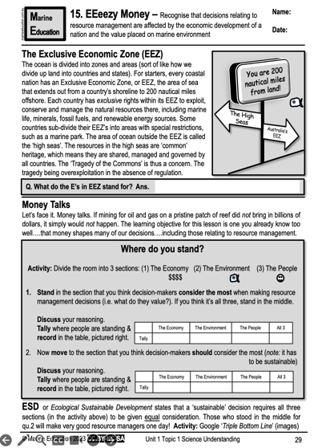
Learning Intention:
Recognise that decisions relating to resource management are affected by the economic development of a nation and the value placed on marine environment
Success Criteria:
Complete Marine Education worksheet ’15. EEeezy Money’
Notes:
https://www.expedia.com/pictures/australia-and-south-pacific/papua-new-guinea.d132

