Slide 1
Learning Intention:
Investigate convection
Success Criteria:
Complete Marine Education worksheet ‘Convection Prac’
Notes:
https://news.climate.columbia.edu/2015/10/20/exploring-rugged-hills-turbulent-waters-4500-meters-down/

Slide 2
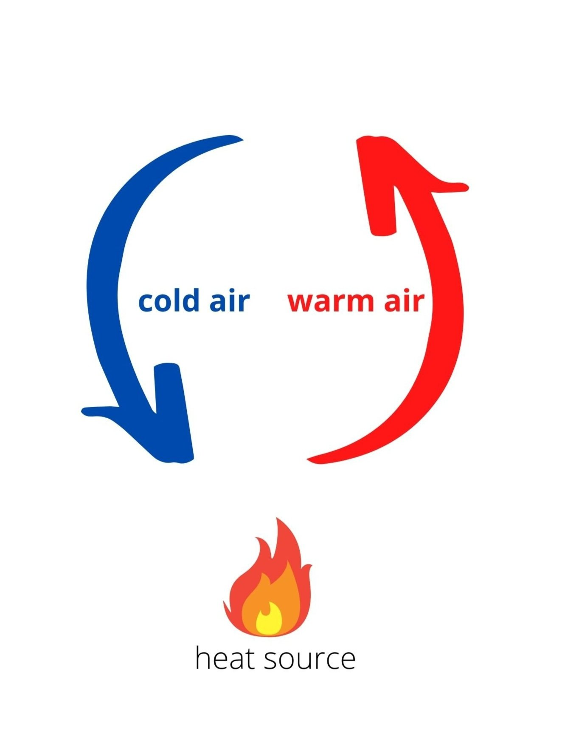
Convection currents are
caused by a difference in temperature

Slide 3
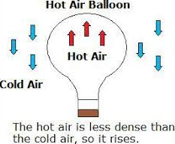
The difference in temperature relates directly to the density of the material, causing this effect

Slide 4
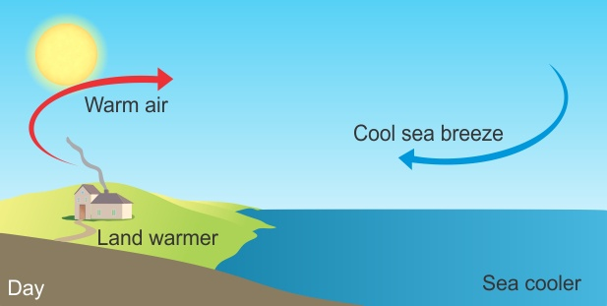
Convection currents occur in
air
Notes:
Image: https://quizizz.com/admin/presentation/5f88799ea8e5c4001e9fc633

Slide 5
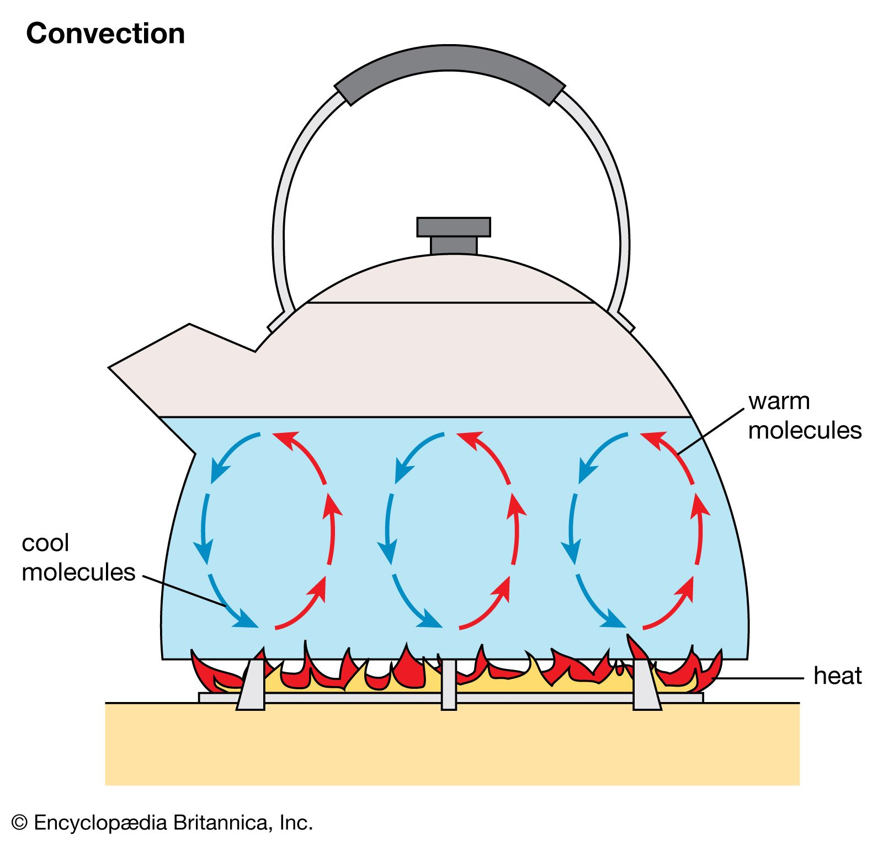
Convection currents occur in water

Slide 6
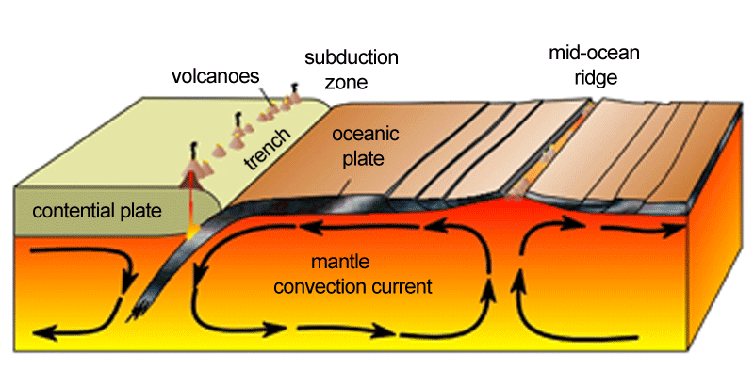
Convection currents occur in melted rock
Notes:
Image: https://socratic.org/questions/how-are-convection-currents-related-to-plate-tectonics

Slide 7
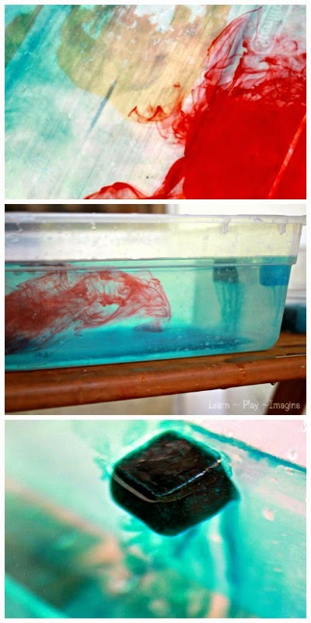
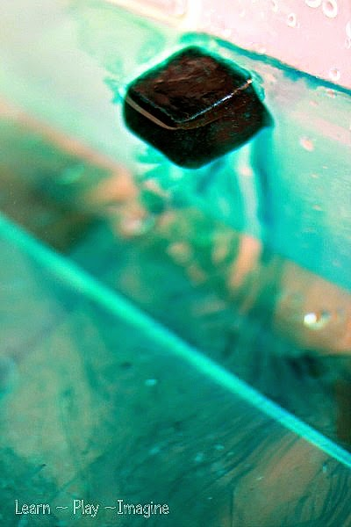
Convection current experiments

Slide 8
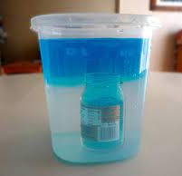
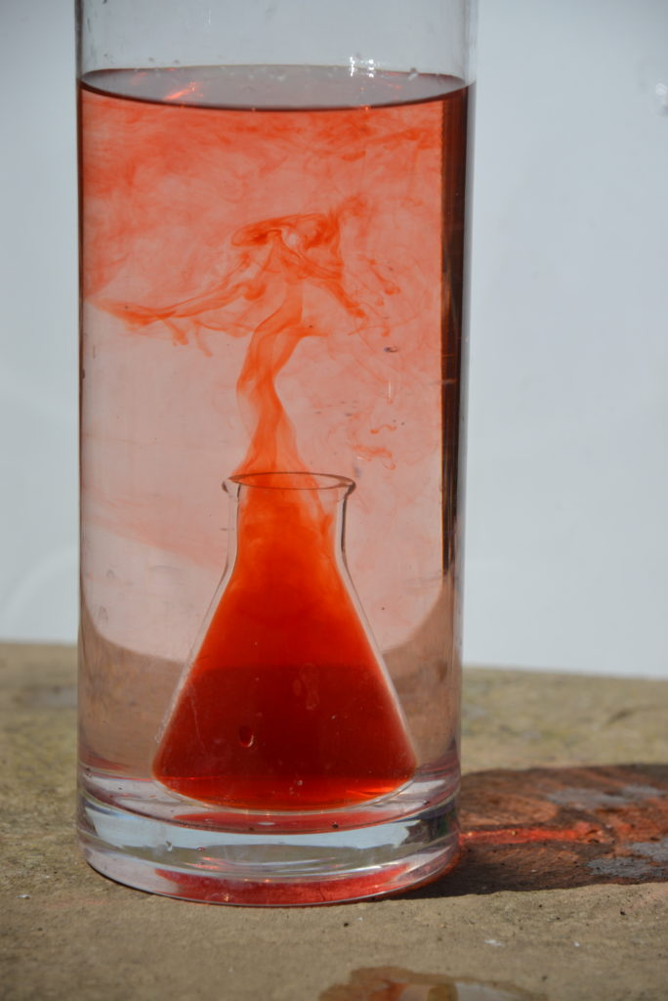

Slide 9
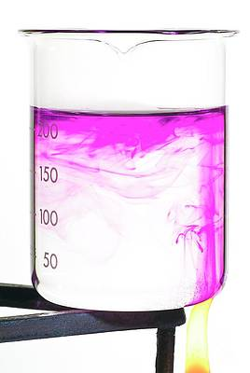
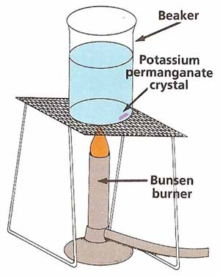

Slide 10
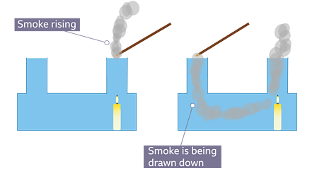

Slide 11
https://www.youtube.com/watch?v=hX9GVMyA6Us
Notes:
https://www.youtube.com/watch?v=hX9GVMyA6Us

Slide 12
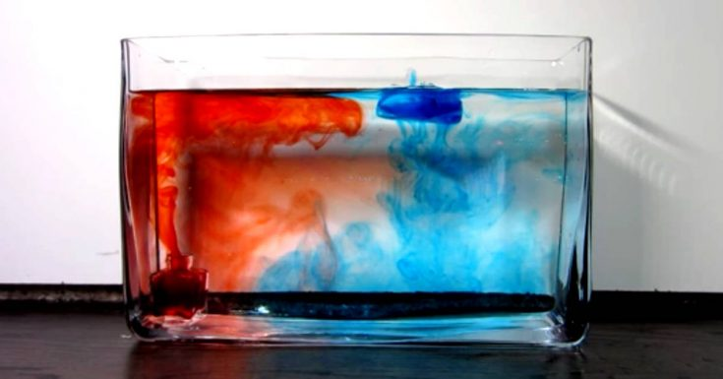

Slide 13
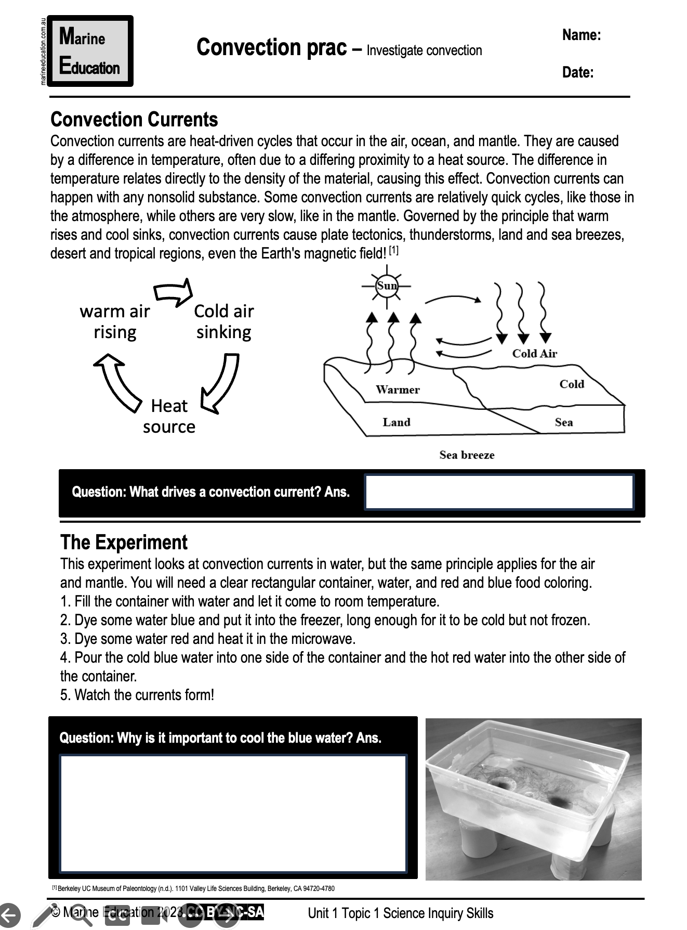
Learning Intention:
Investigate convection
Success Criteria:
Complete Marine Education worksheet ‘Convection Prac’
Notes:
https://news.climate.columbia.edu/2015/10/20/exploring-rugged-hills-turbulent-waters-4500-meters-down/

