Slide 1
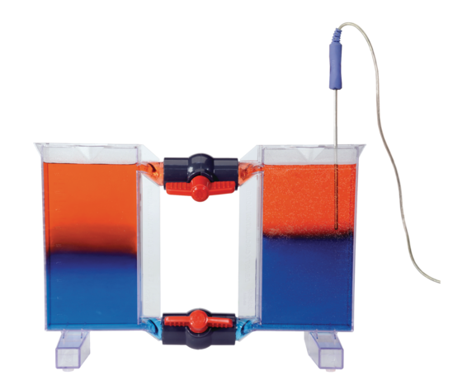
Learning Intention:
Investigate thermoclines (using ice and water, and hot and cold coloured water); salinity (using student-made straw hydrometers); stratification (using salt and fresh water).
Success Criteria:
Complete Marine Education worksheet ‘”Density Divides”
Notes:
https://www.pasco.com/products/lab-apparatus/earth-and-environmental/me-6816

Slide 2
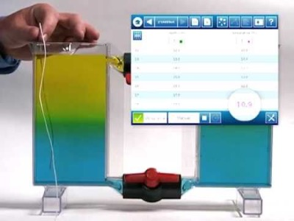
https://www.youtube.com/watch?app=desktop&v=wqtFeAvDOwk
Notes:
https://www.youtube.com/watch?app=desktop&v=wqtFeAvDOwk

Slide 3
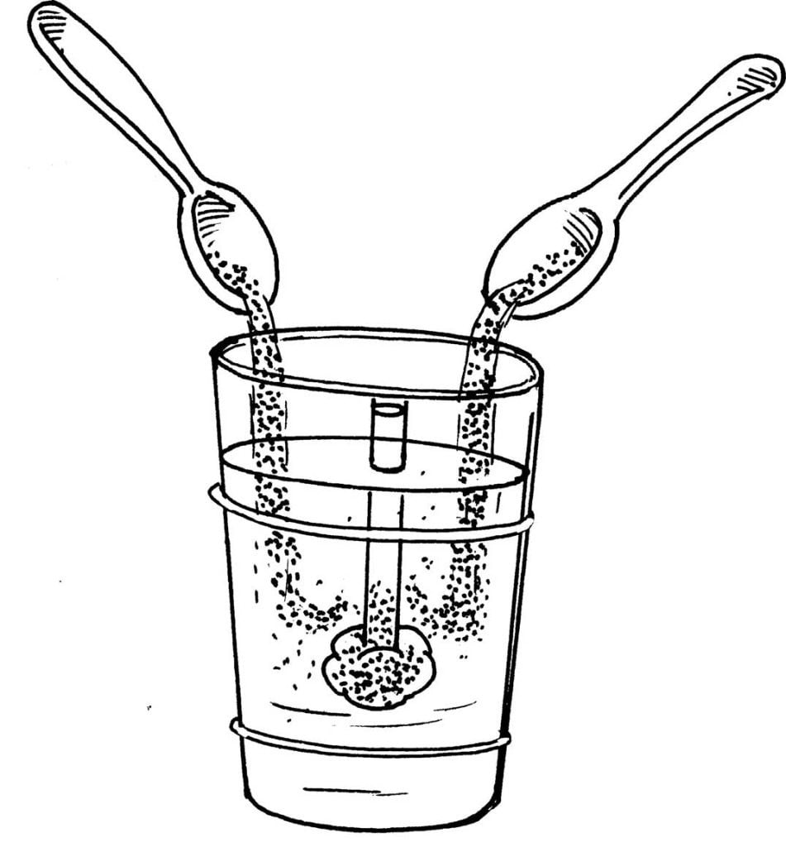
How to make a straw hydrometer
Fill a measuring cylinder with water
Press a small ball of playdough the size of a marble into one end of a straw to form a plug.
Put the straw hydrometer plug-end down into the water.
Remove or add playdough until the hydrometer floats, without touching the bottom of the cylinder.
Measure the length of the straw that is OUT of the water. Record your result.
Add salt to the measuring cylinder.
Measure the length of the straw that is OUT of the water. Record your result.
Notes:
https://www.youtube.com/watch?v=qIz1BEQyHWI

Slide 4
Learning Intention:
Investigate thermoclines (using ice and water, and hot and cold coloured water); salinity (using student-made straw hydrometers); stratification (using salt and fresh water).
Success Criteria:
Complete Marine Education worksheet ‘”Density Divides”
Notes:
https://news.climate.columbia.edu/2015/10/20/exploring-rugged-hills-turbulent-waters-4500-meters-down/

