Slide 1
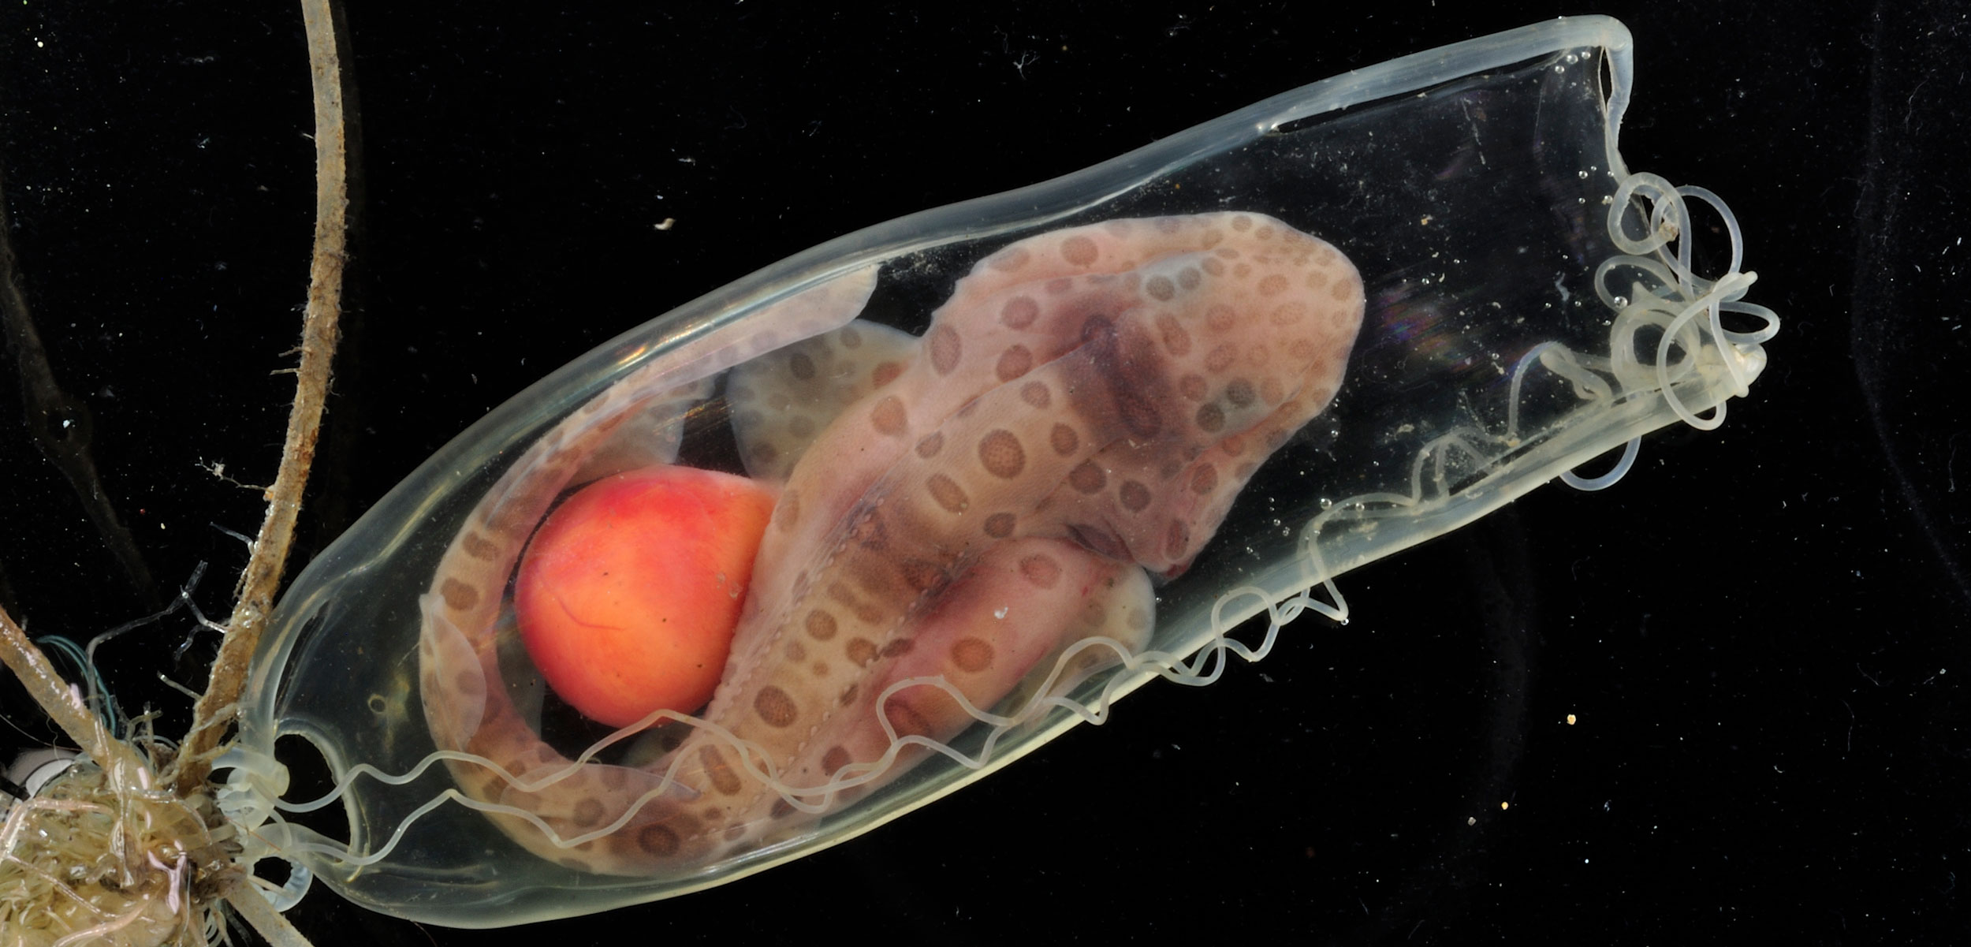
Learning Intention:
Explain the three unique characteristics of marine biodiversity , i.e. wide dispersal at sea, the need for structural complexity, critical nursery habitats.
Success Criteria:
Complete Marine Education worksheet ‘2. Marine Must-haves’
Notes:
Image: https://hakaimagazine.com/news/this-mommy-shark-has-a-unique-way-of-making-babies/

Slide 2
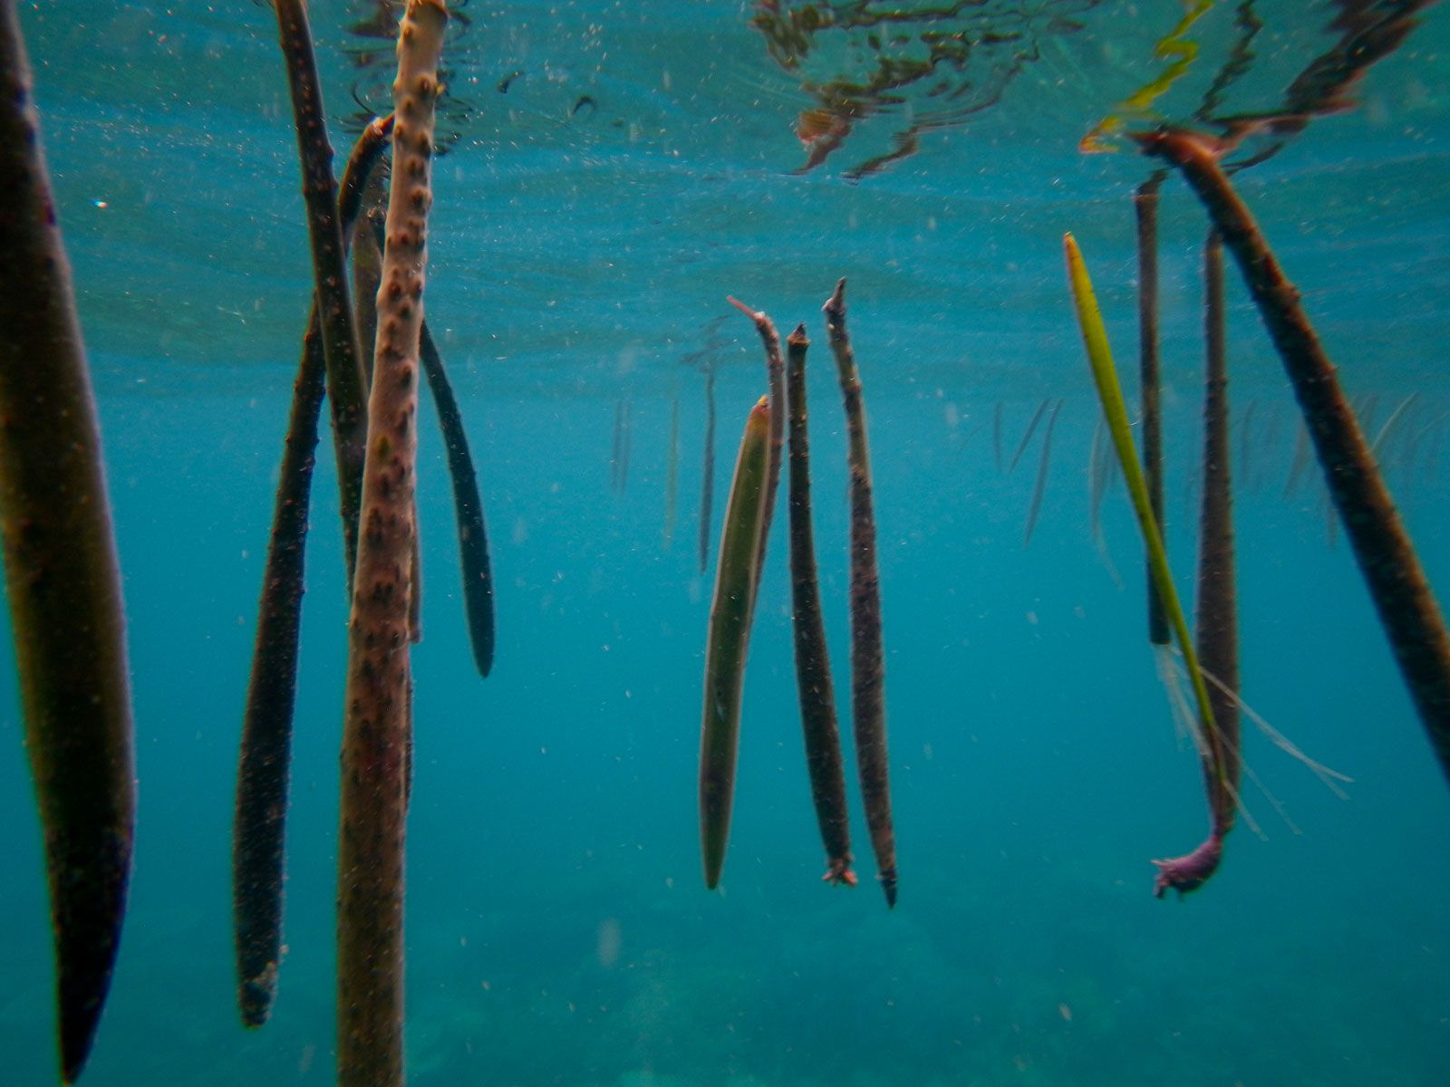
Wide dispersal at sea
Notes:
Image: https://www.britannica.com/science/seed-plant-reproductive-part/Dispersal-by-water

Slide 3
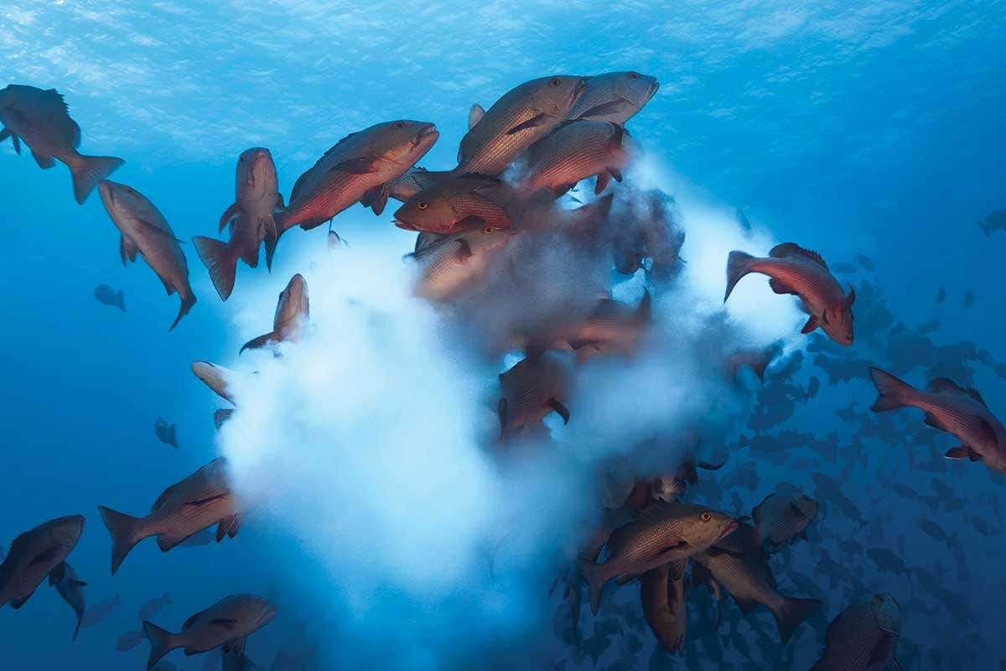
Wide dispersal at sea
Notes:
Image: https://www.newscientist.com/article/2078973-mass-of-spawning-fish-make-a-milky-way-on-a-coral-reef/

Slide 4
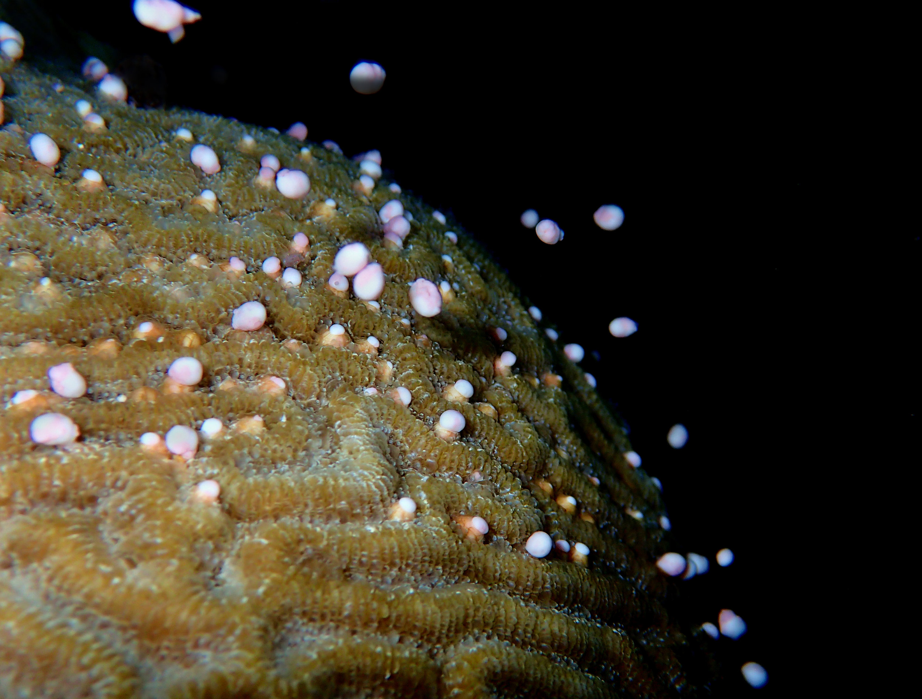
Wide dispersal at sea
Notes:
Image: https://www.livwilliamson.com/coral-spawning

Slide 5
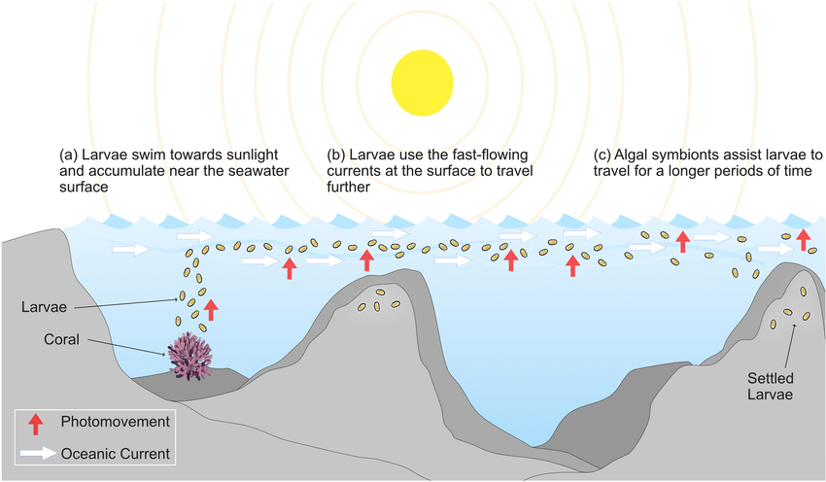
Wide dispersal at sea
Notes:
Image: https://www.researchgate.net/figure/Schematic-illustrating-the-photo-response-dispersal-model-proposed-for-Pocillopora_fig5_352545731

Slide 6
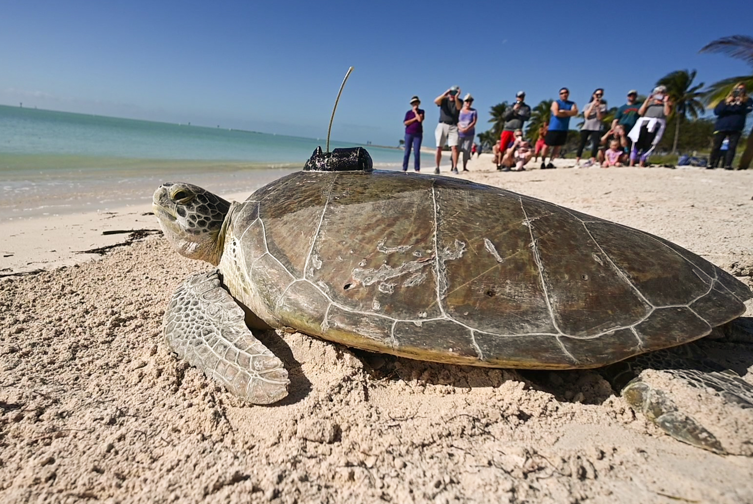
How do we know where they go?
Notes:
Image: https://news.wgcu.org/show/gulf-coast-life/2022-08-29/tour-de-turtles-marathon-tracks-sea-turtle-migration-across-continents

Slide 7
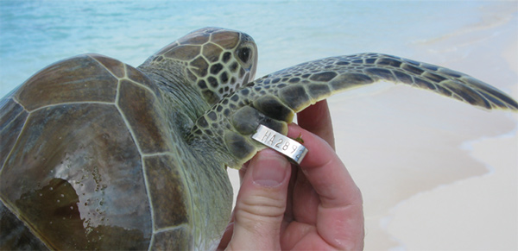
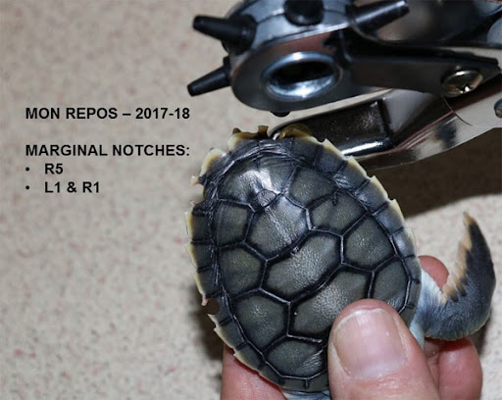
Tagging
Notes:
Image: https://accstr.ufl.edu/resources/report-a-tag/

Slide 8
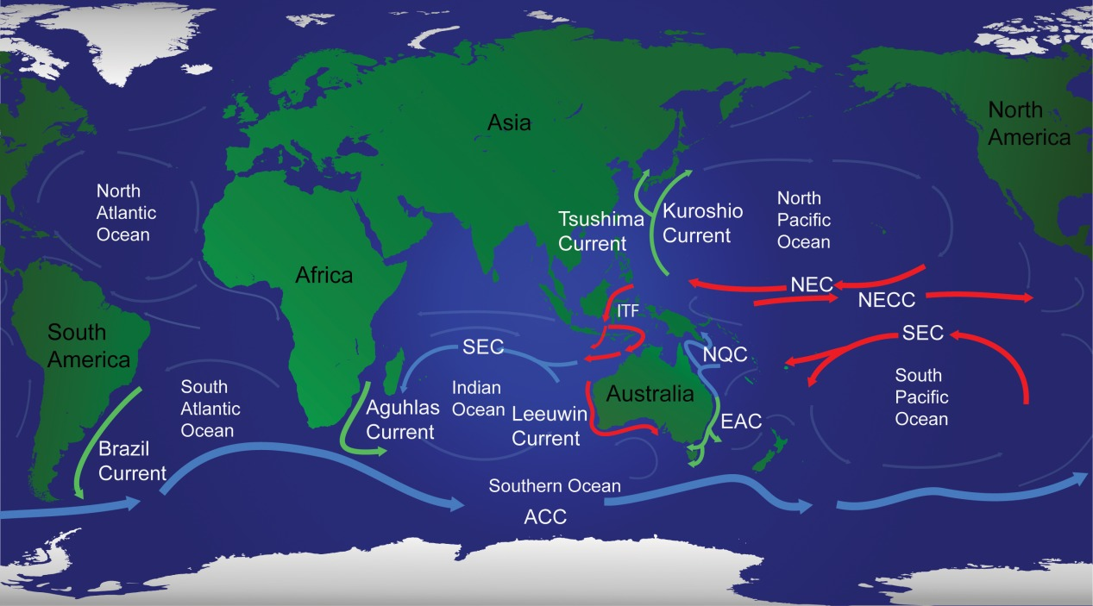
Notes:
Image: https://onlinelibrary.wiley.com/doi/full/10.1111/geb.12456

Slide 9
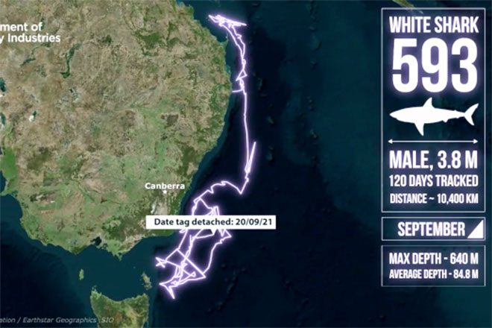
Notes:
Imagel https://bnbfishing.com.au/shark-593-tracker/

Slide 10
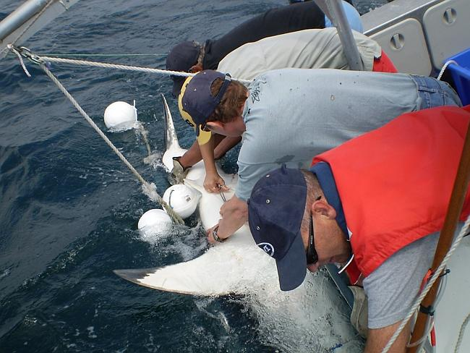
Tagging
Notes:
Image: https://www.csiro.au/en/news/All/Articles/2013/December/7000km-and-counting-on-the-tail-of-a-great-white-shark

Slide 11
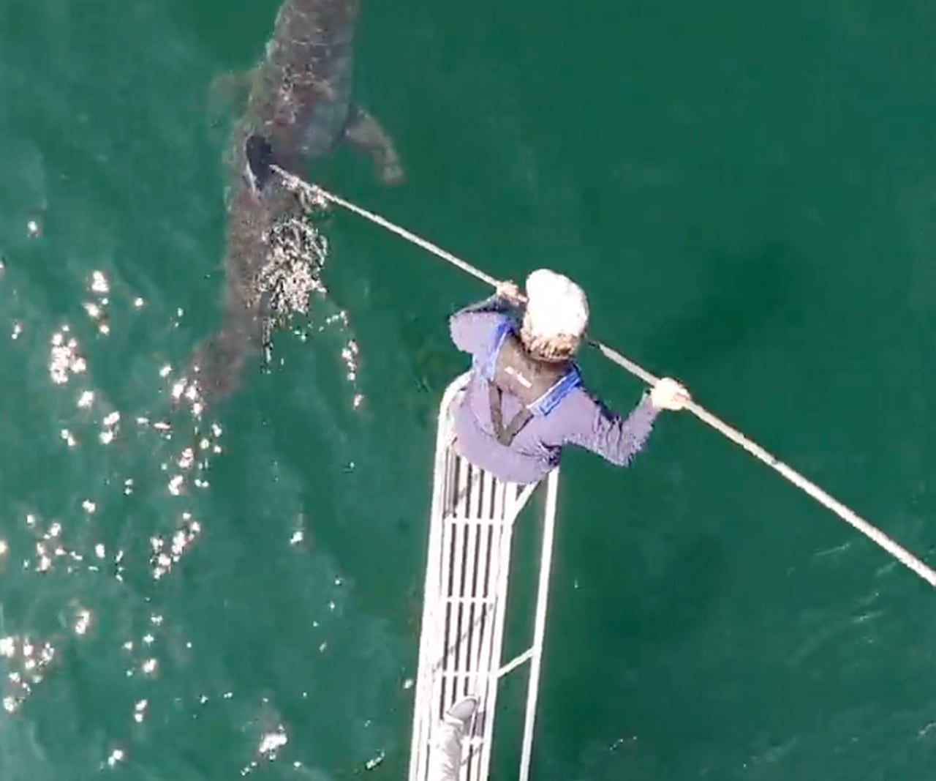
Tagging

Slide 12
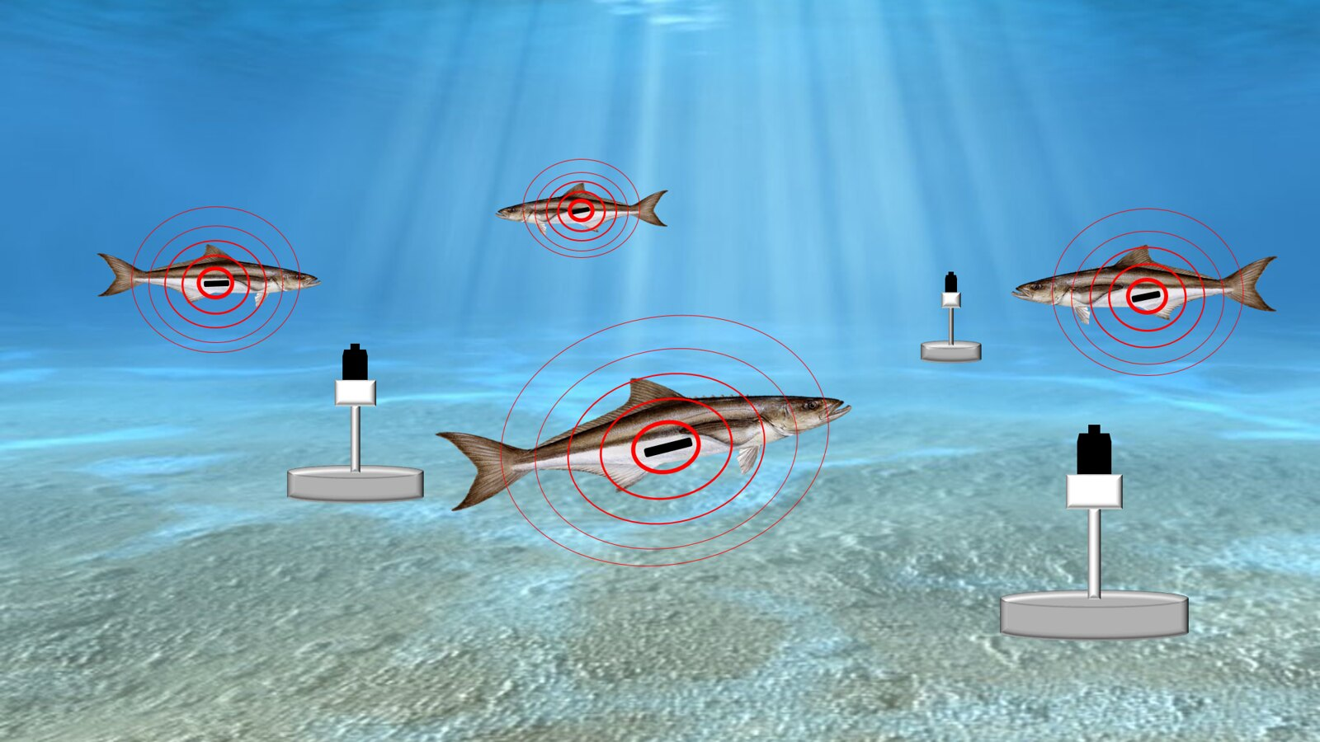
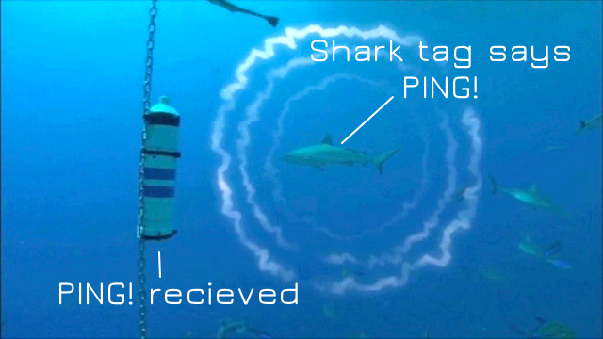

Slide 13
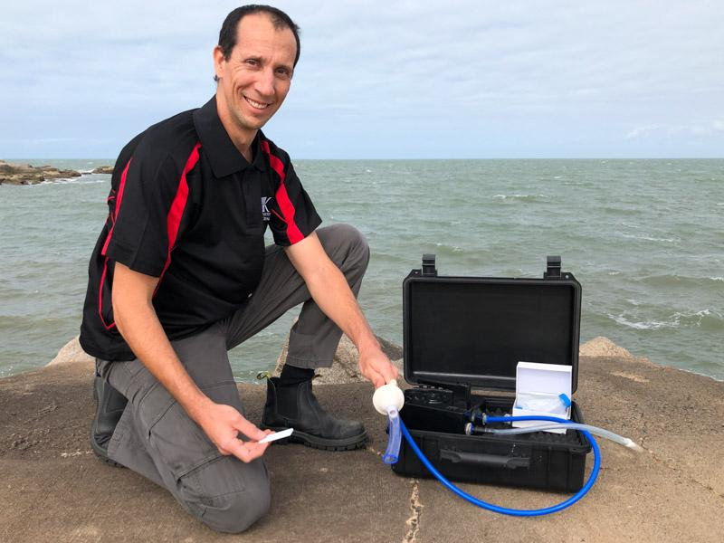
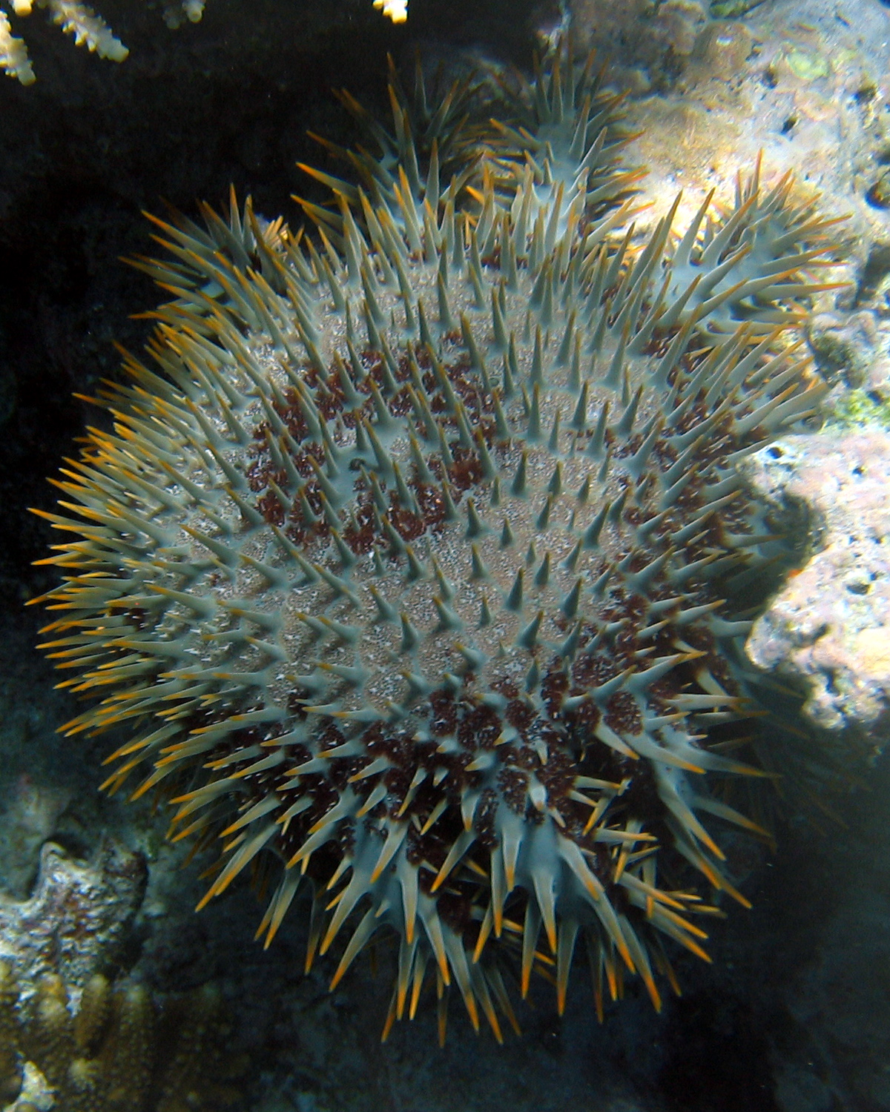
Testing for DNA in the water
(e.g. COTS DNA)
Notes:
Image: https://www.aims.gov.au/information-centre/news-and-stories/stick-em-new-test-can-detect-crown-thorns-starfish-quickly-home-pregnancy-kit

Slide 14
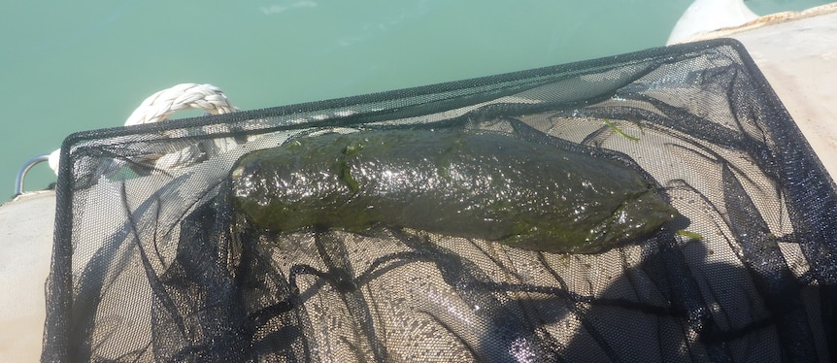
Detection of seeds and DNA in faeces (e.g. dugong faeces)
Notes:
Image: https://www.abc.net.au/news/2021-08-31/seagrass-grows-better-after-been-eaten-by-dugongs-turtles/100419004

Slide 15
The need for structural complexity

Slide 16
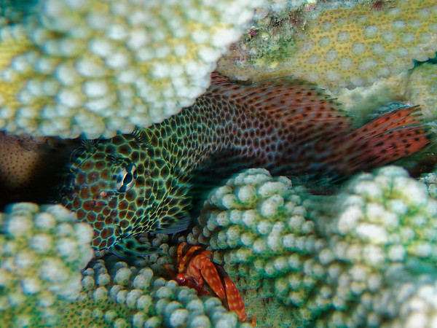
More places to hide

Slide 17
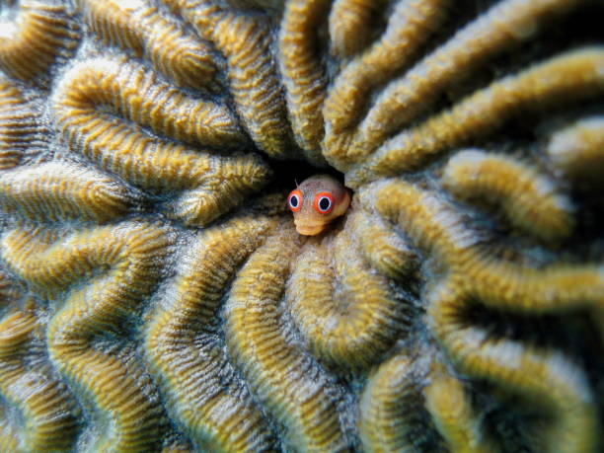
More places to live

Slide 18
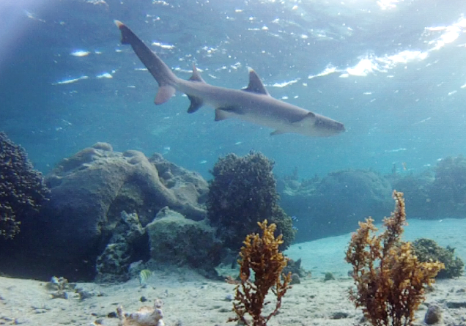
More places to dine

Slide 19
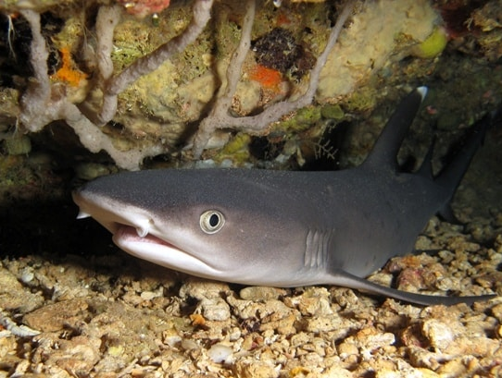
More places to rest

Slide 20
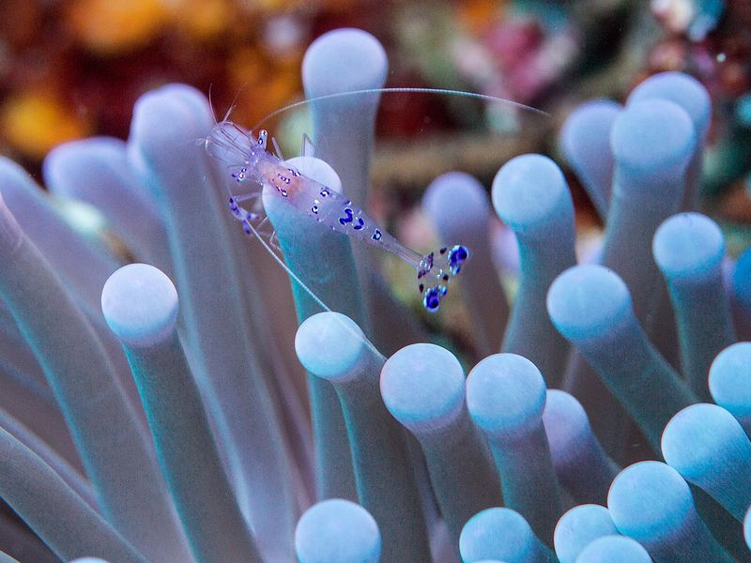
More places to hang out with friends

Slide 21
Rugosity is a measurement of structural complexity
Notes:
Image: https://www.researchgate.net/figure/Chain-tape-rugosity-illustration-Image-adapted-from-26_fig2_233950009

Slide 22
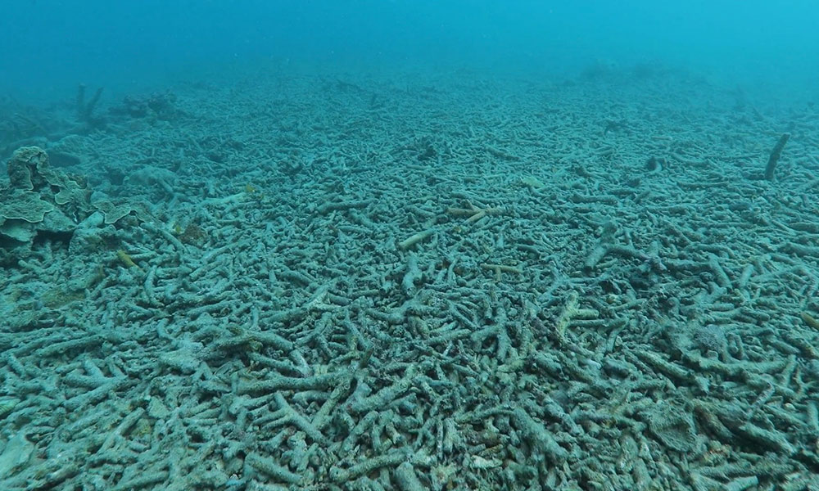
Notes:
Image: https://wwf.org.au/news/2018/statement-on-adani-by-dermot-o-gorman-ceo-of-wwf-australia/

Slide 23
The need for critical nursery habitats

Slide 24
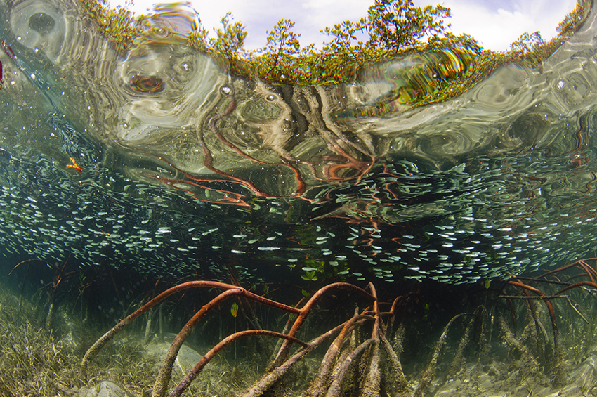
A place to hide
Notes:
Image: https://www.iucn.org/news/forests/201708/mangroves-nurseries-world%E2%80%99s-seafood-supply

Slide 25
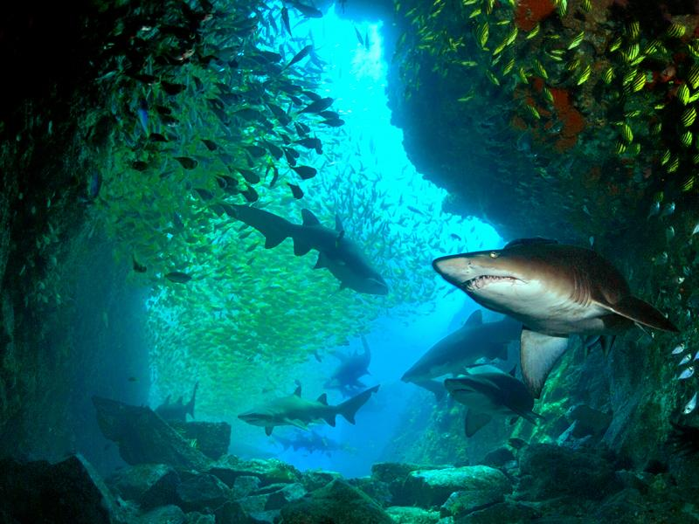
A place to hide

Slide 26
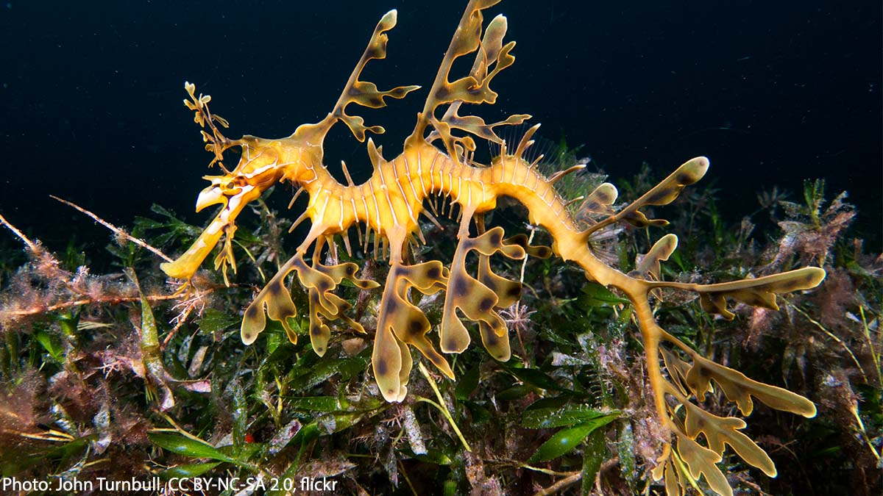
A place to hide
Notes:
Image: https://twitter.com/AMNH/status/1501726782030028806

Slide 27
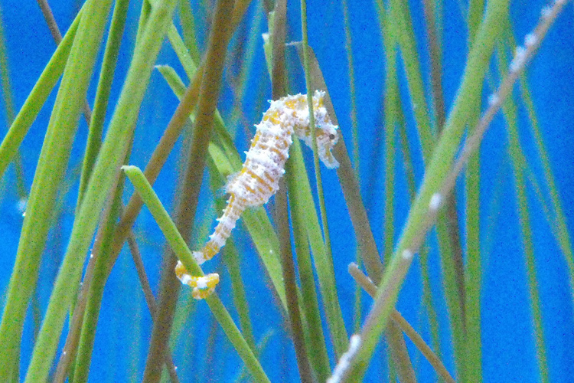
A place to hide

Slide 28
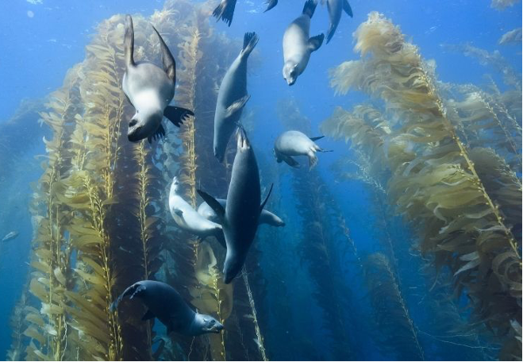
A place to hide

Slide 29
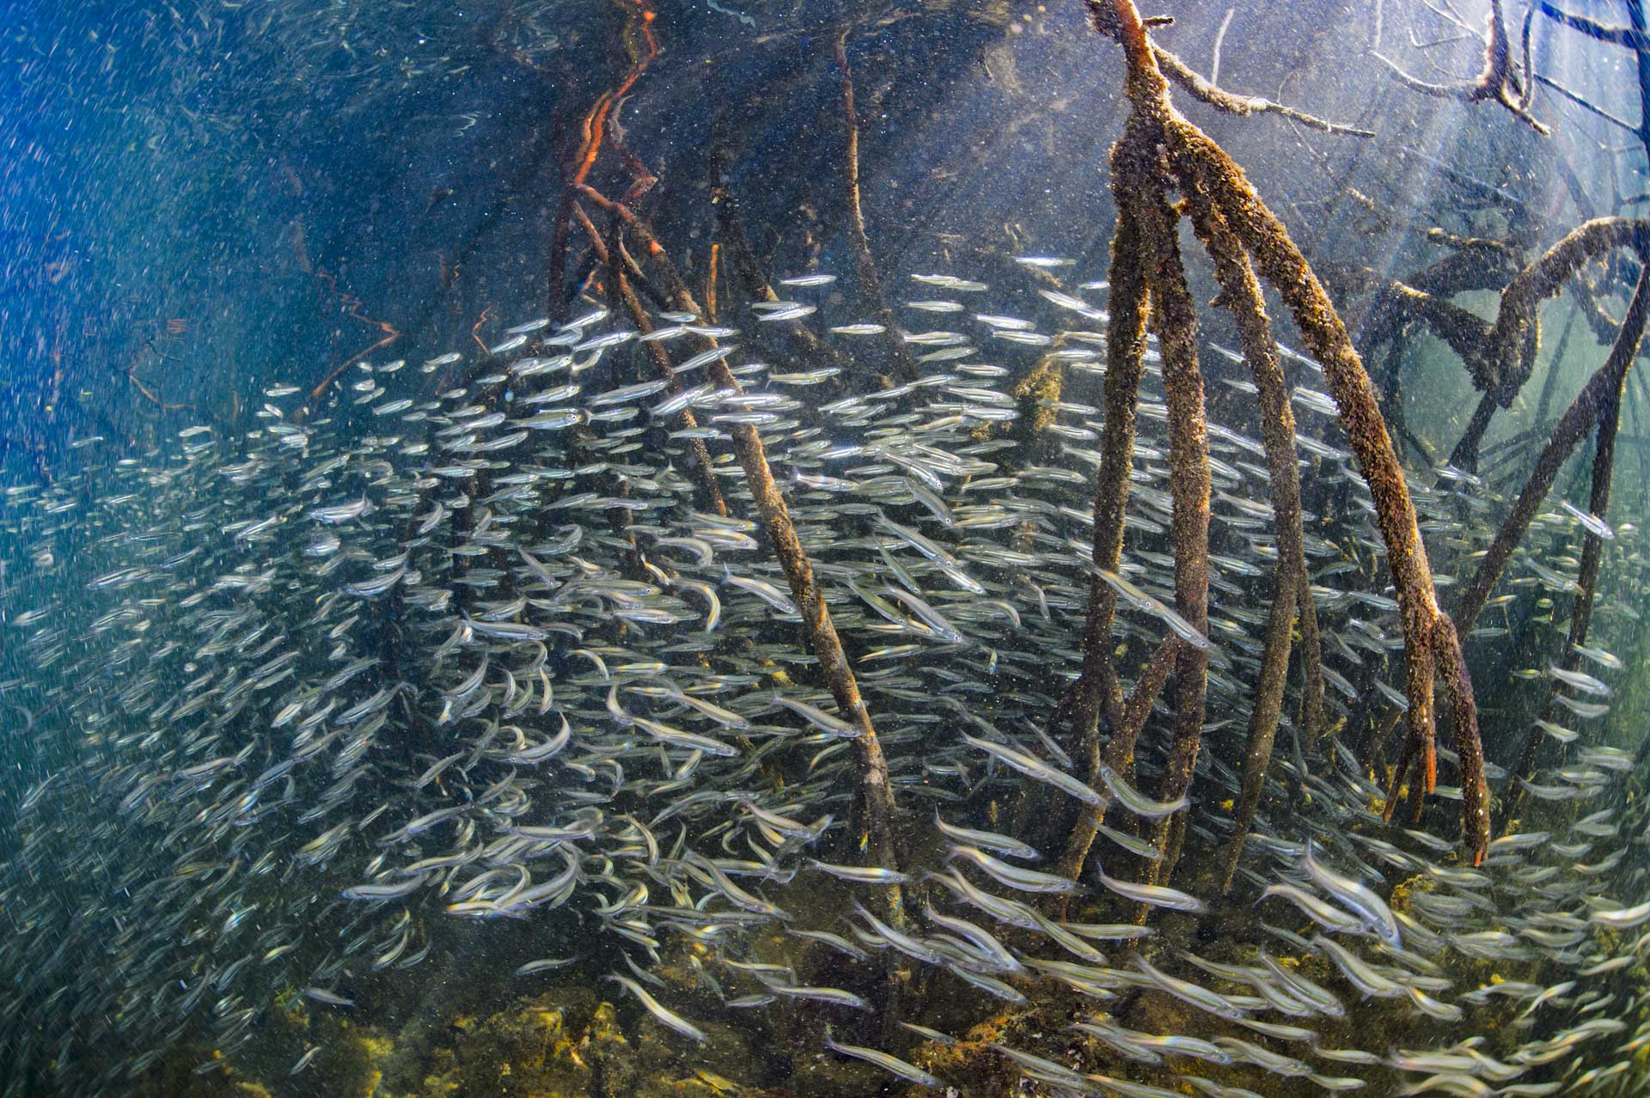
A place that has lots of food
Notes:
ImAge: https://liceohuepil.com/?c=charles-darwin-foundation-new-study-reveals-mangroves-in-the-cc-DbN9ZNUd

Slide 30
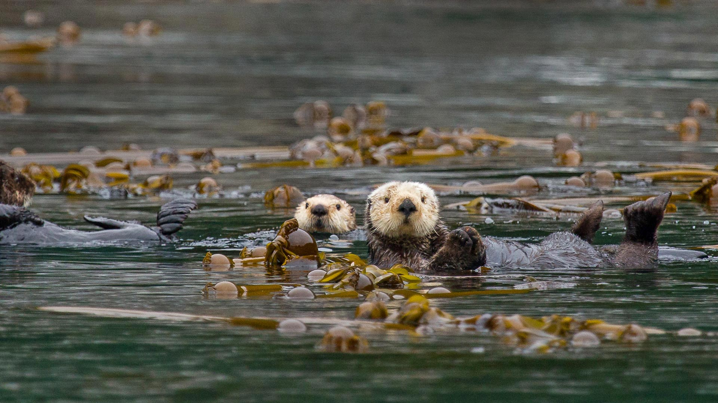

Slide 31
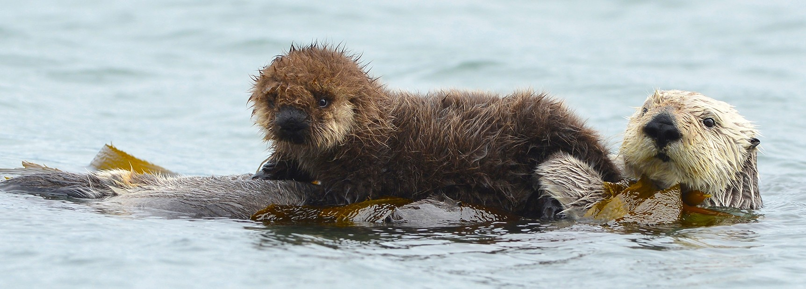
Notes:
Image: https://www.bbcearth.com/news/genius-sea-otter-parents

Slide 32
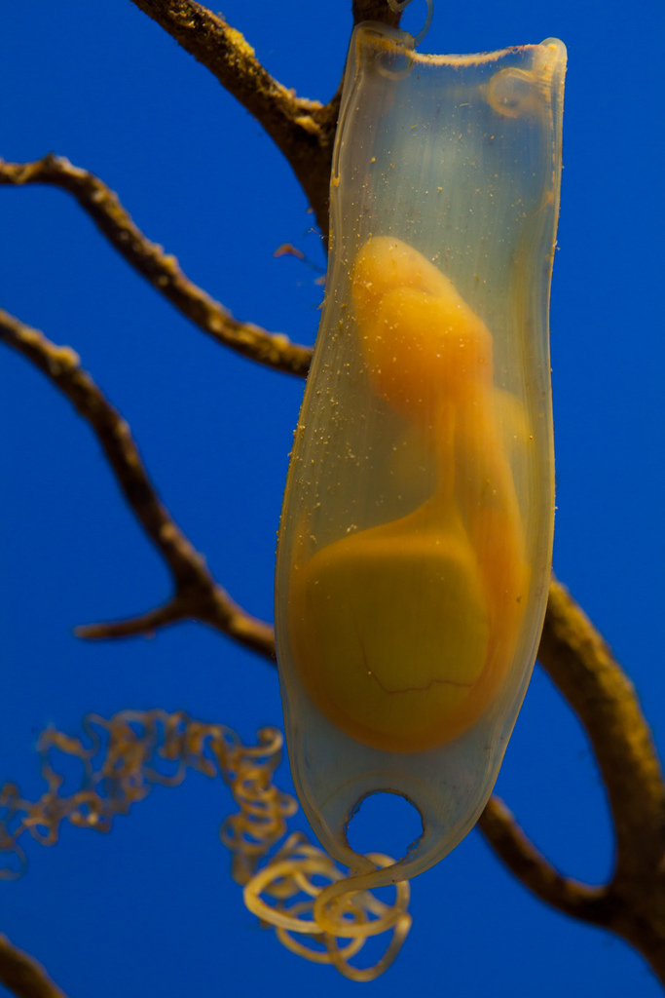
A place to be born

Slide 33
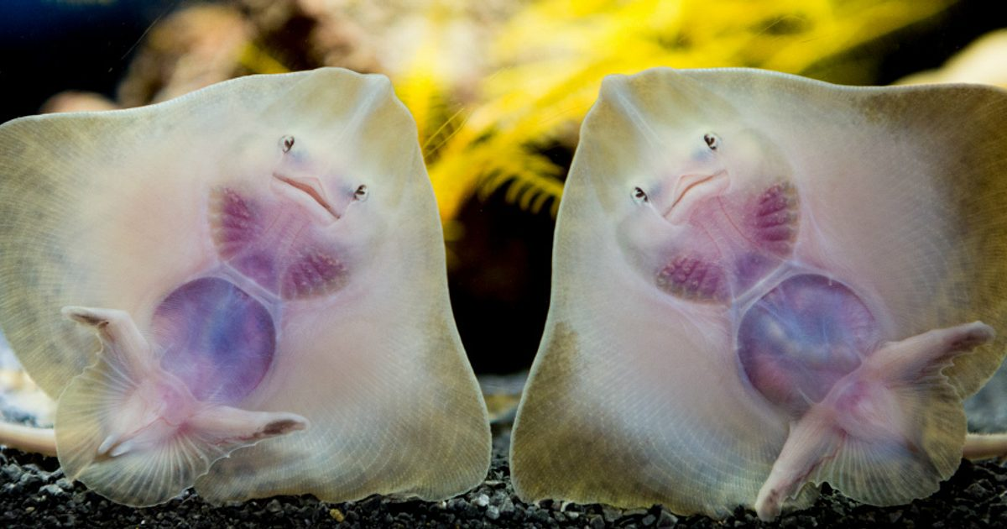

Slide 34
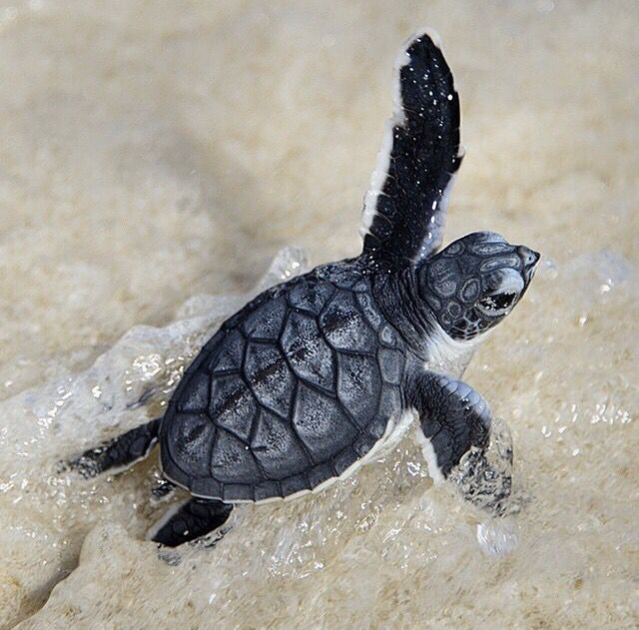
Notes:
Image: https://www.pinterest.com.au/pin/33495590963912911/

Slide 35
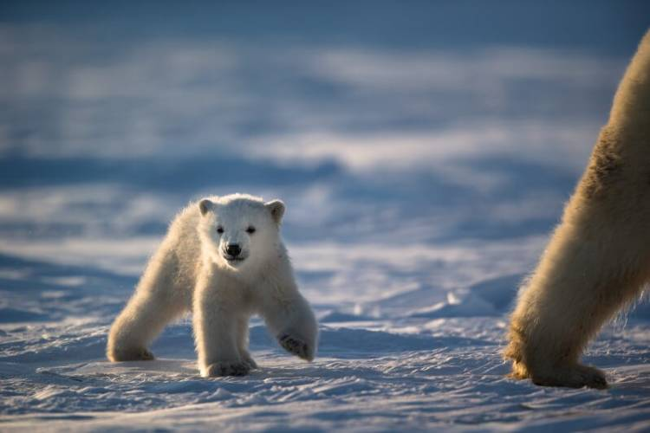
Notes:
Image: https://polarbearsinternational.org/news-media/articles/polar-bear-mom-cub-facts/

Slide 36
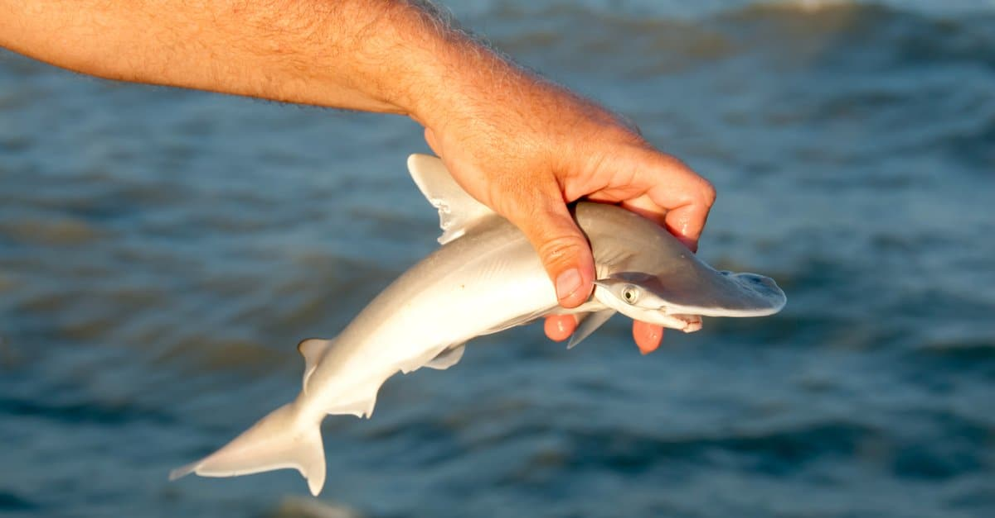

Slide 37
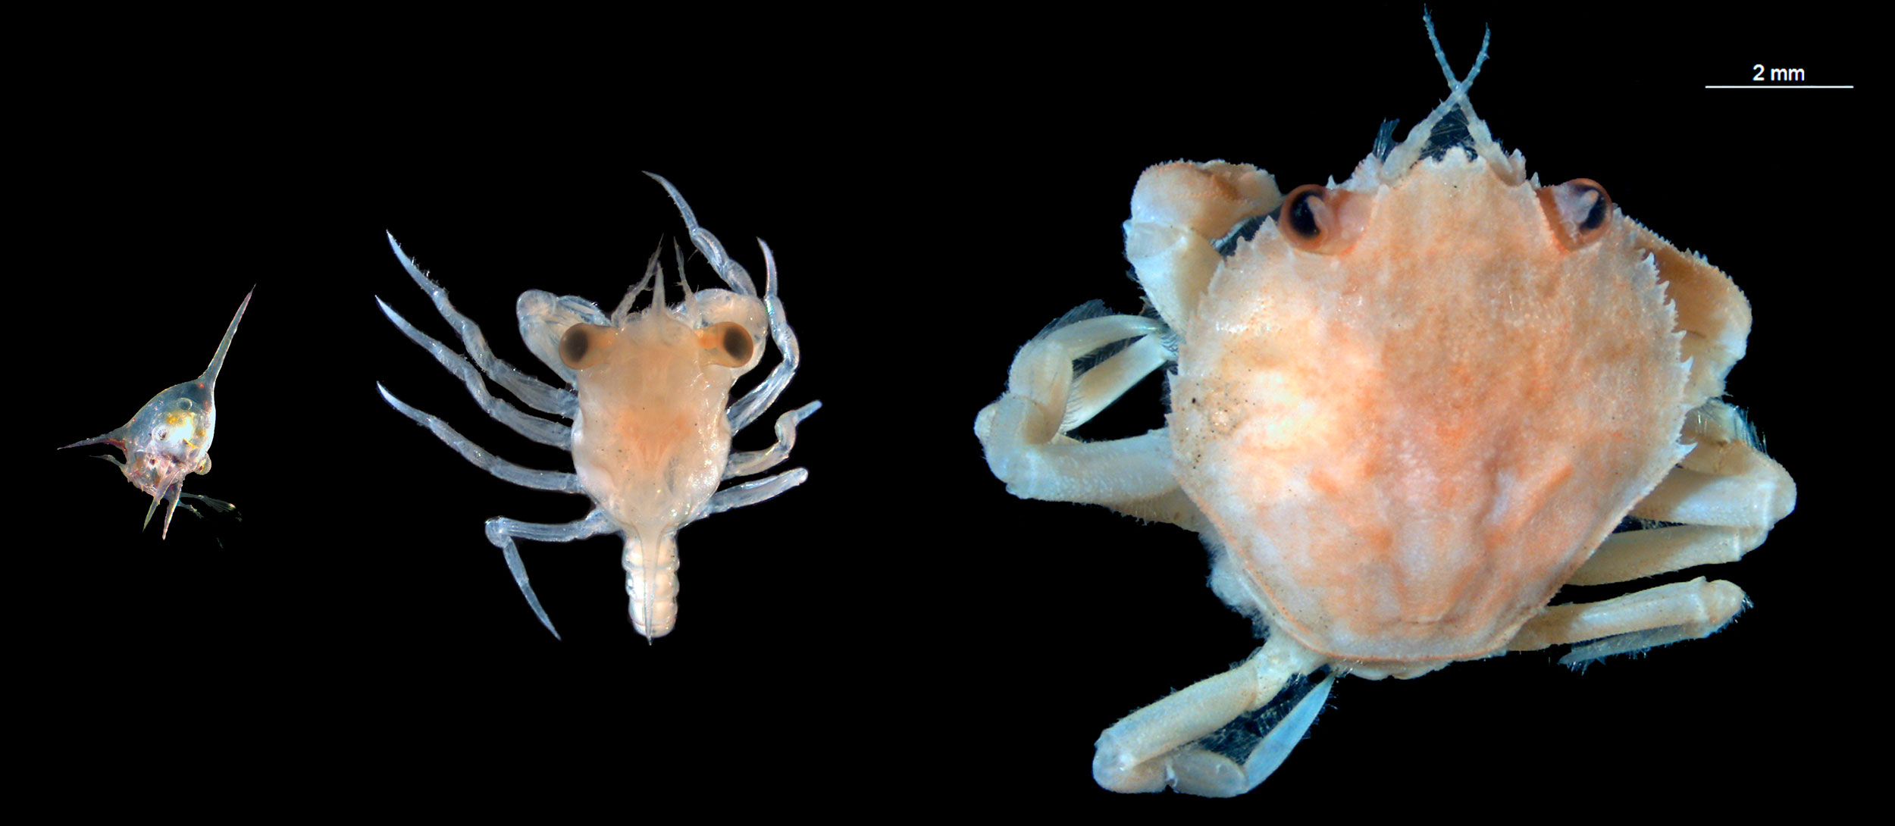
Notes:
Image: https://hakaimagazine.com/features/shining-the-light-on-baby-crabs/

Slide 38
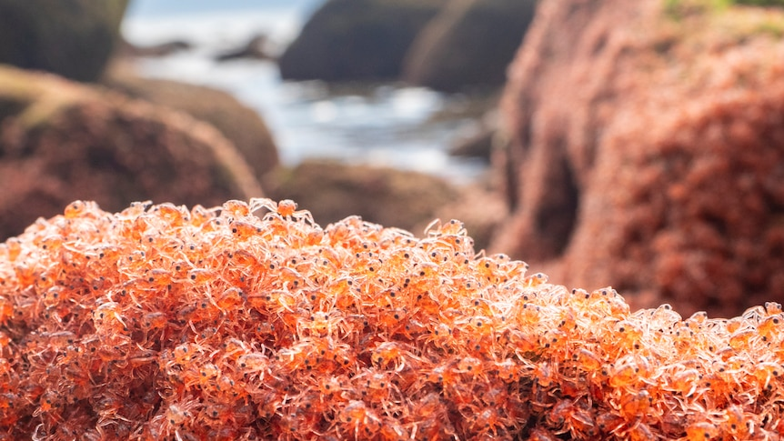
Notes:
Image: https://www.abc.net.au/news/2022-01-12/resurgence-of-christmas-island-red-crab-population/100750748

Slide 39
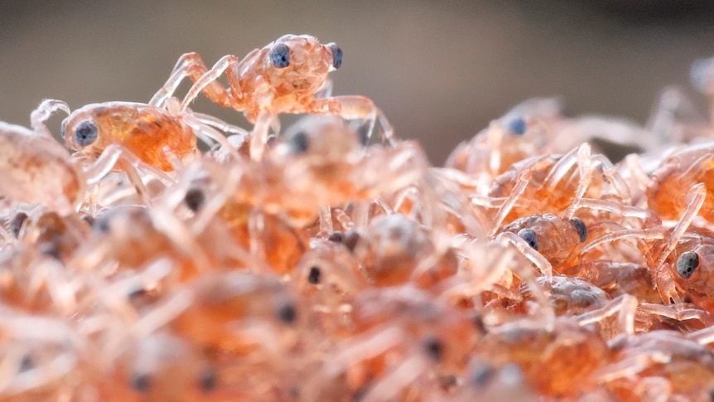
Notes:
Image: https://www.abc.net.au/news/2022-01-12/resurgence-of-christmas-island-red-crab-population/100750748

Slide 40
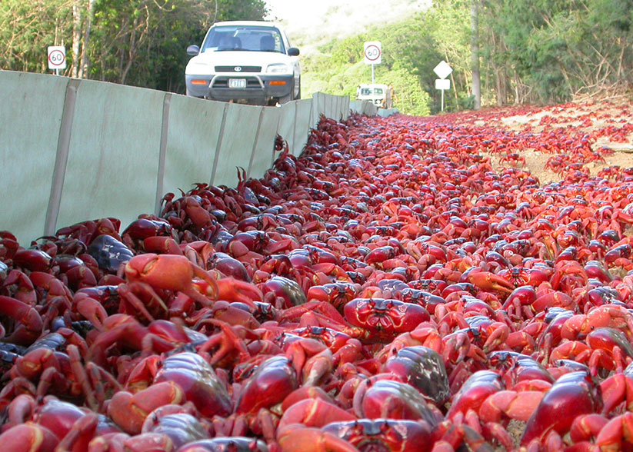
Christmas Island

Slide 41
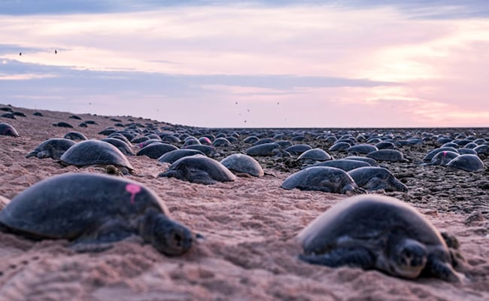
Raine Island
Notes:
Image: https://www.ndtv.com/world-news/worlds-largest-green-turtle-colony-in-raine-island-nearly-twice-as-big-as-thought-2243939

Slide 42
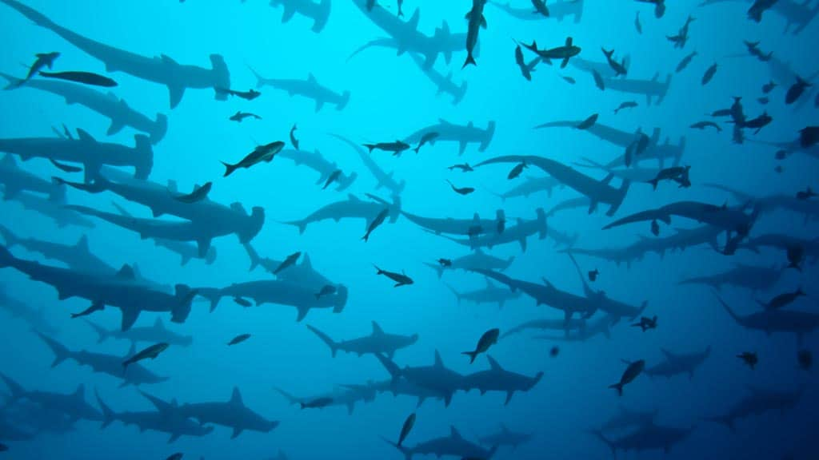
Galapogos Islands
Notes:
Image: https://happygringo.com/blog/hammerhead-shark-galapagos/

Slide 43
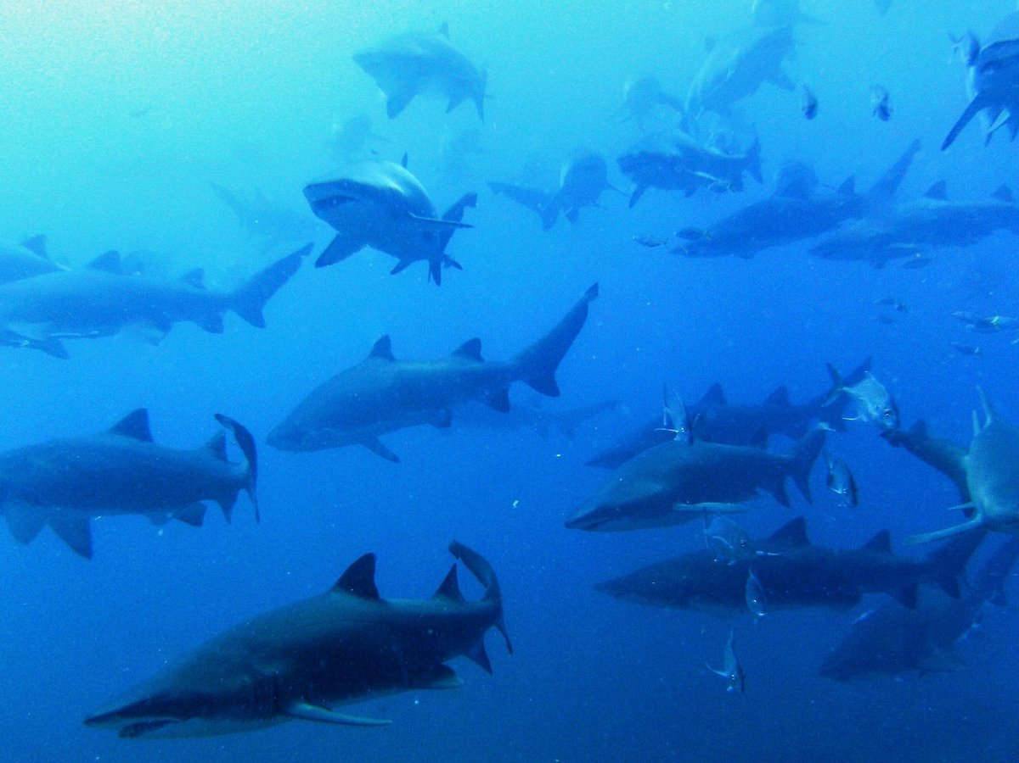
Wolf Rock (Rainbow Beach)

Slide 44
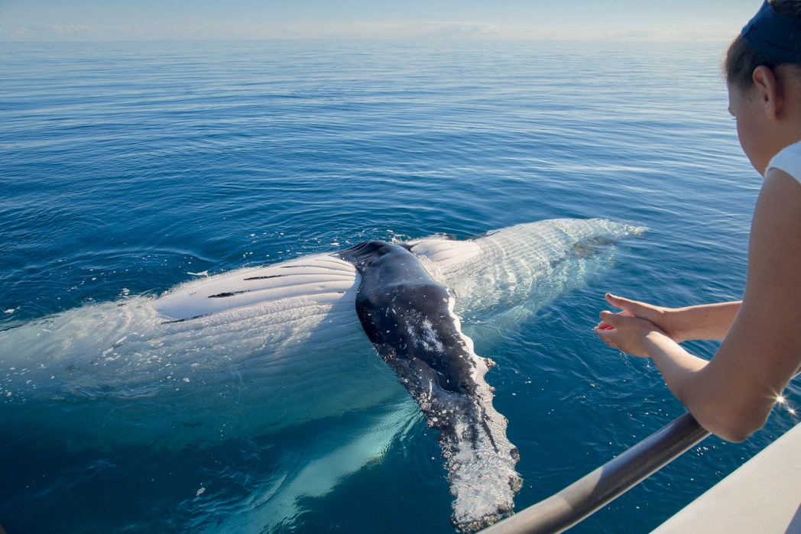
Hervey Bay
Notes:
Image: https://www.queensland.com/in/en/places-to-see/experiences/nature-and-wildlife/whales/whale-watching-hervey-bay

Slide 45
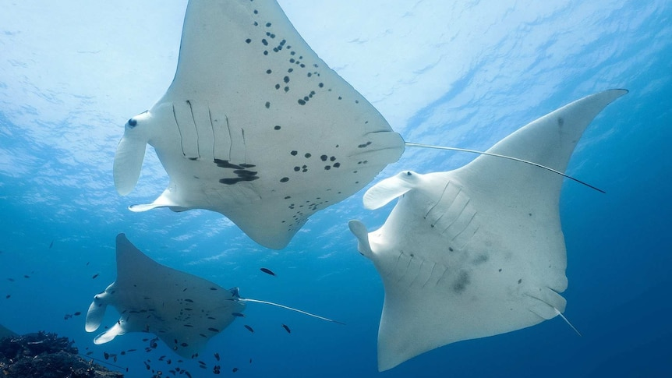
Lady Elliot Island
Notes:
Image: https://www.abc.net.au/news/2022-10-03/worlds-oldest-manta-ray-taurus-40-great-barrier-reef/101485304

Slide 46
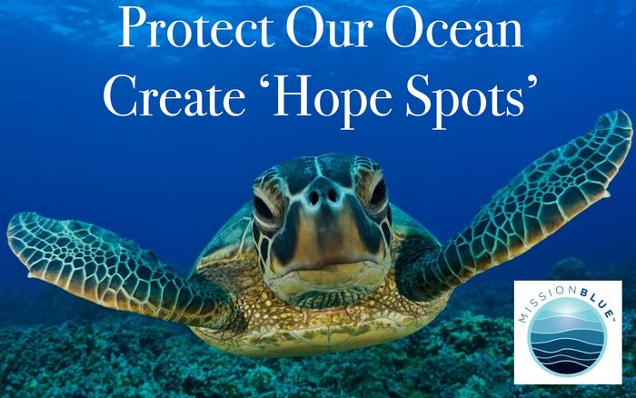
Notes:
Image: https://twitter.com/MissionBlue/status/1066089116318740480

Slide 47
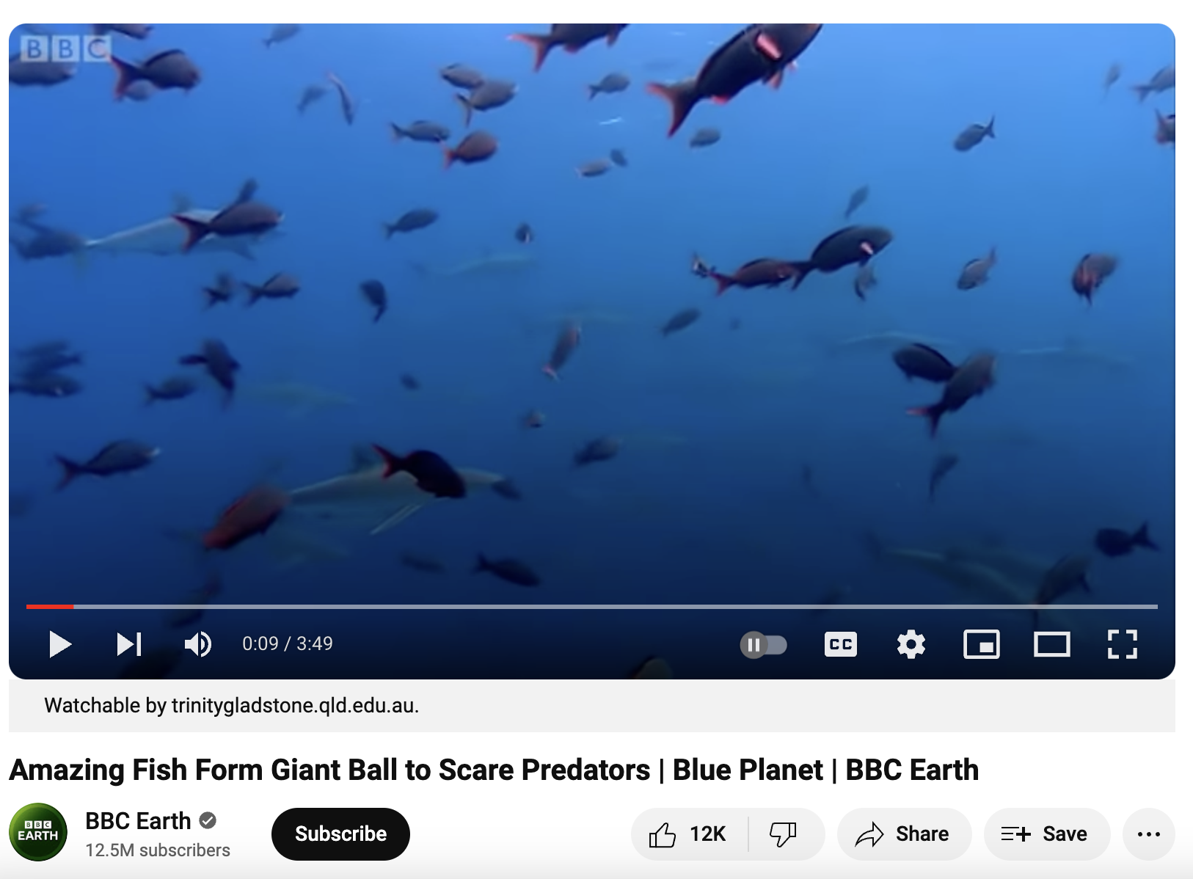
https://www.youtube.com/watch?v=15B8qN9dre4
Notes:
Video: https://www.youtube.com/watch?v=15B8qN9dre4

Slide 48
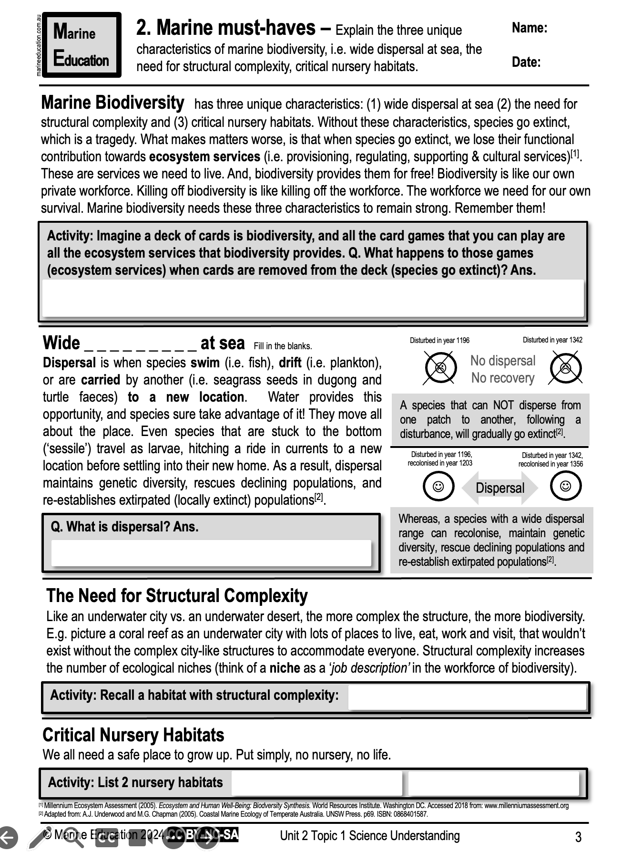
Learning Intention:
Explain the three unique characteristics of marine biodiversity , i.e. wide dispersal at sea, the need for structural complexity, critical nursery habitats.
Success Criteria:
Complete Marine Education worksheet ‘Marine Must-haves’
Notes:
Image: https://hakaimagazine.com/news/this-mommy-shark-has-a-unique-way-of-making-babies/

