Slide 1
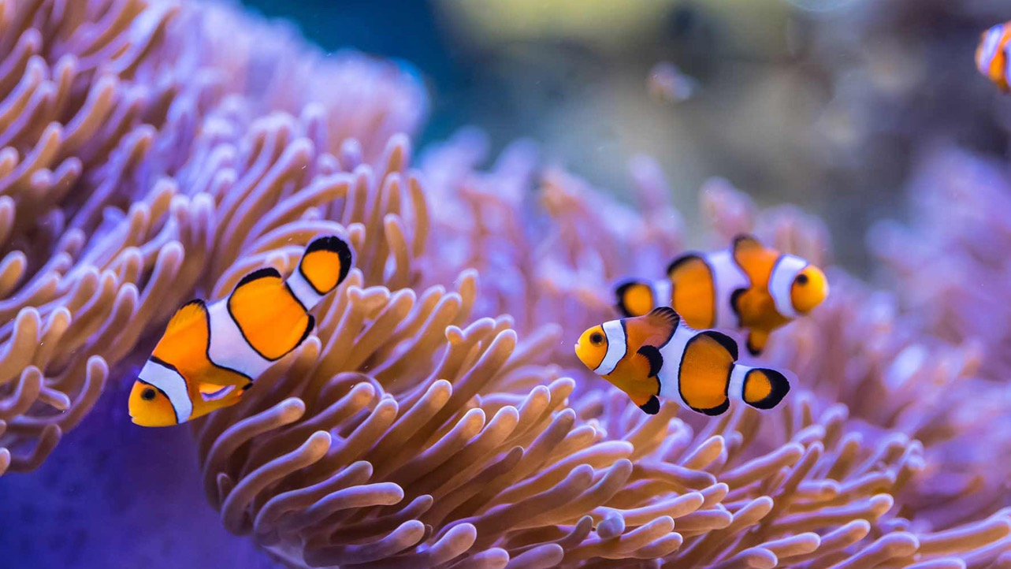
Learning Intention:
Classify different groups of animals using structural characteristics.
Success Criteria:
Complete Marine Education worksheet ‘23. Marine Matchup’
Notes:
Image: https://www.scuba.com/blog/sea-anemones-flowers-of-the-ocean/

Slide 2
Echinoderms
(Greek root word echino- meaning spiny; Latin root word -derm meaning skin)

Slide 3
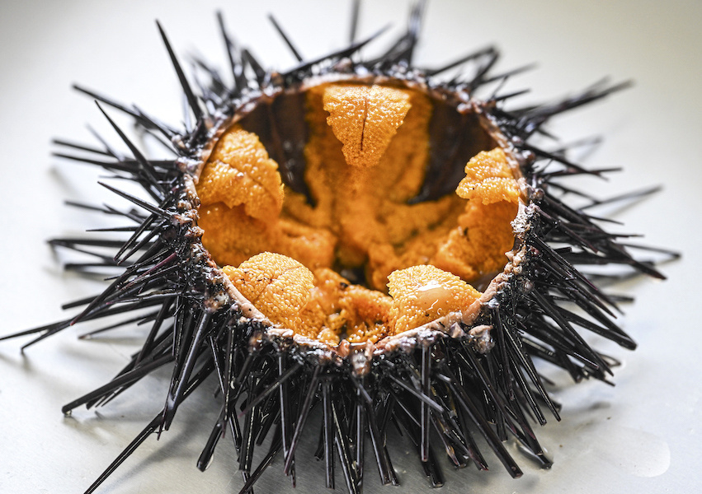
Sea urchin
(in half, plump with roe/eggs)
Echinoderm
Spiny skin
Notes:
Image: https://www.japan.go.jp/kizuna/2023/10/delicious_sea_urchins.html

Slide 4
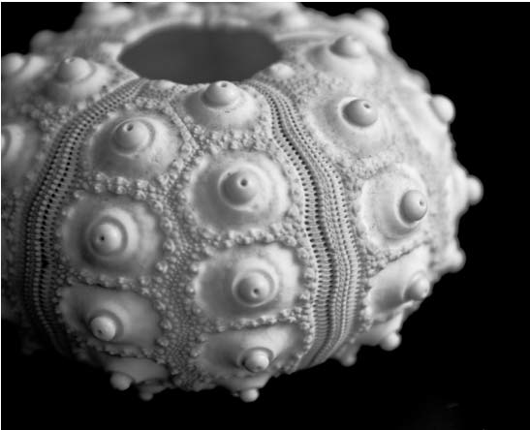
Echinoderm
Calcareous skeleton
Sea urchin

Slide 5
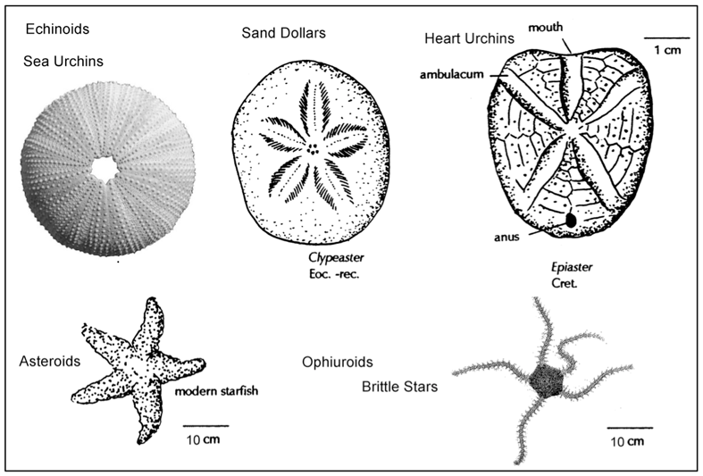
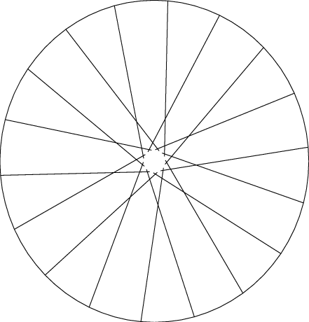
Echinoderm
Radial Symmetry (like the spokes of a wheel)
Notes:
Image: https://pressbooks.bccampus.ca/earthhistorylab/chapter/phylum-echinodermata/

Slide 6
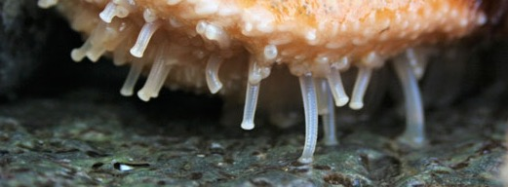
Echinoderm
No heart, but do have a water vascular system (including tube feet)
Notes:
Image: https://www.sciencenews.org/article/sea-stars-ancient-echinoderms-nibbled-tiny-tube-feet

Slide 7
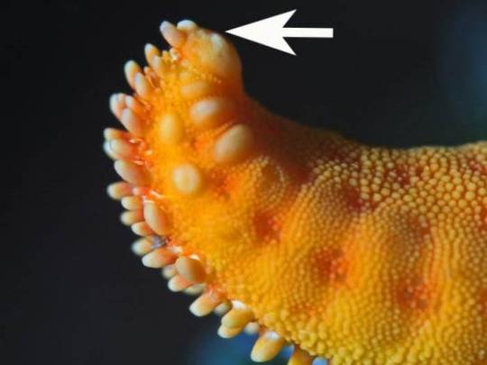
Eye spot (ocellus), to detect light and dark
No brain, but do have a complex central nervous system
Notes:
Image: https://alphynix.tumblr.com/post/175648749770/hi-bog-i-appreciate-your-commitment-to-pointing
Interesting article: https://www.ncbi.nlm.nih.gov/pmc/articles/PMC3896028/

Slide 8
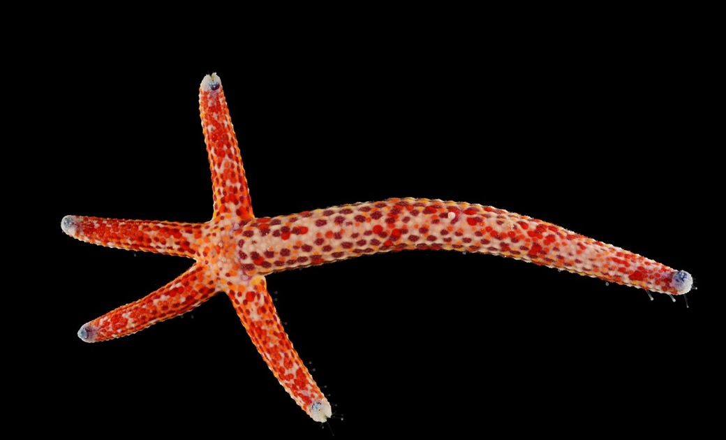
Echinoderm
Powers of regeneration
Notes:
Image: https://francoismichonneau.net/2012/11/from-the-field-in-the-sea-comets-become-stars/

Slide 9
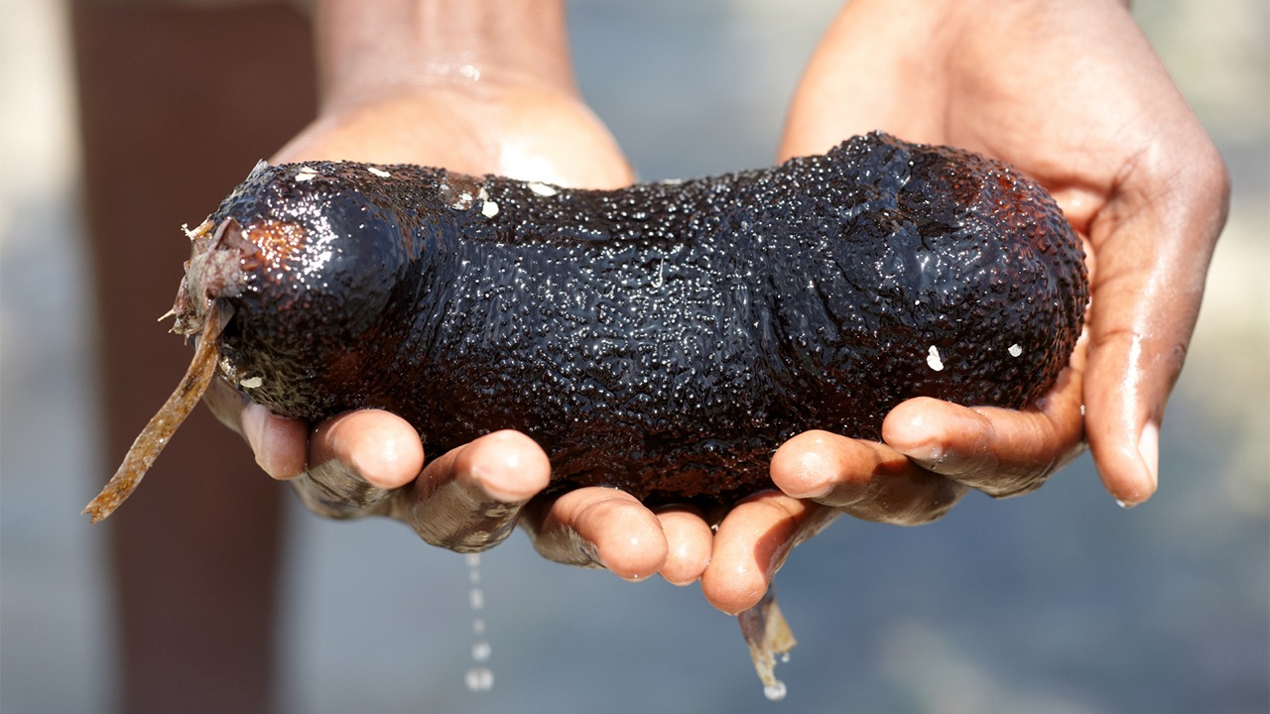
Sea cucumber
Echinoderm

Slide 10
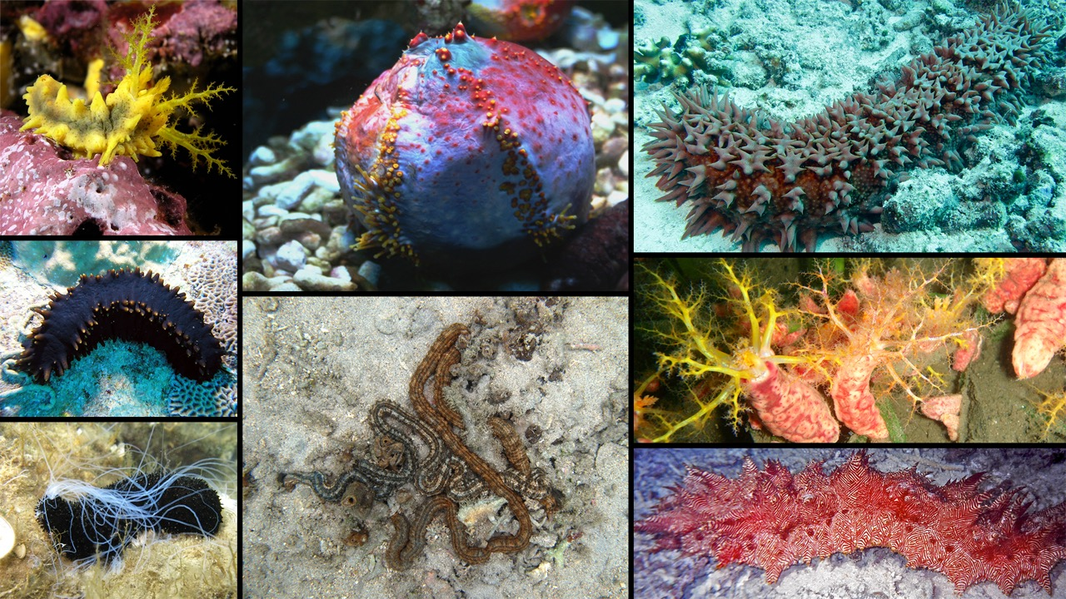
Sea cucumbers
Echinoderm
Notes:
Image: https://www.digitalatlasofancientlife.org/learn/echinodermata/holothuroidea/

Slide 11
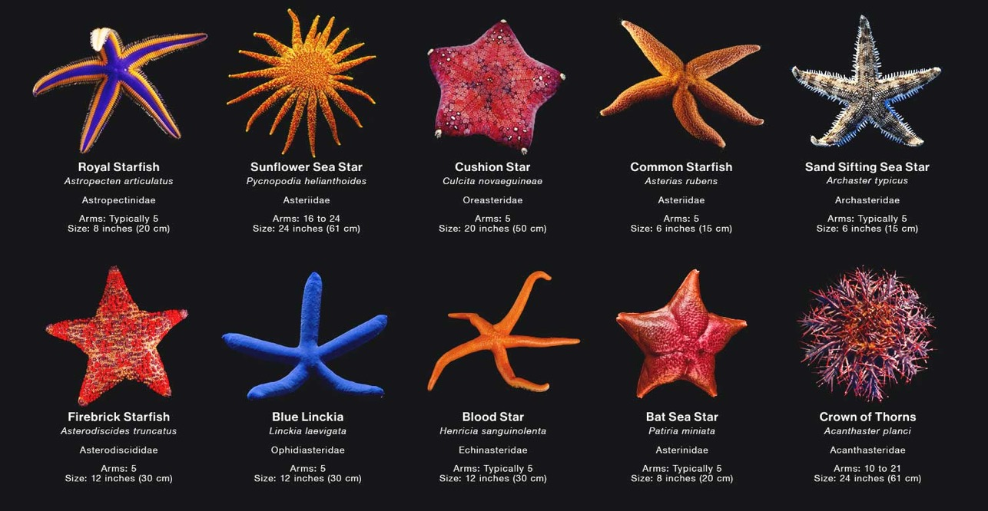
Sea stars
Echinoderm
Notes:
Image: https://www.citrusreef.com/blogs/news/different-types-of-starfish

Slide 12
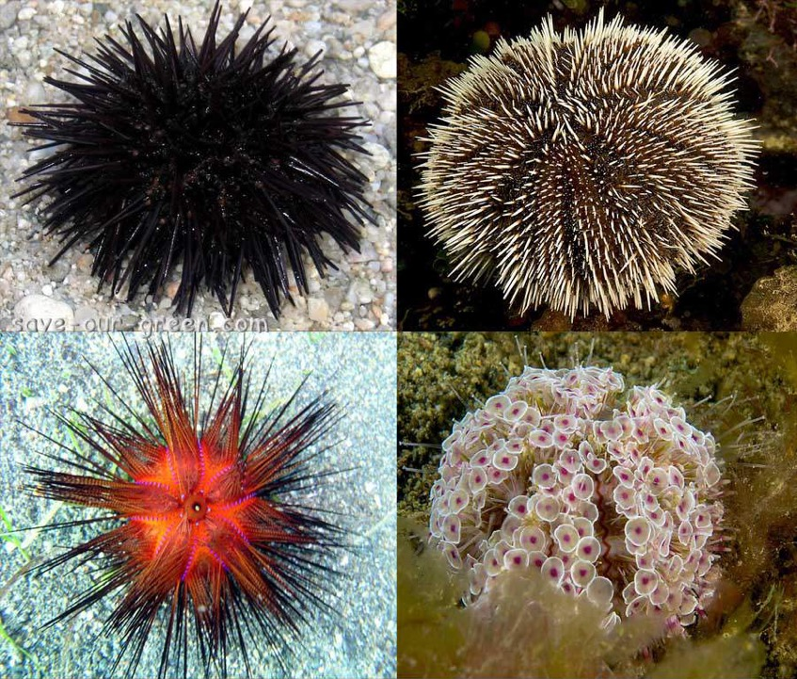
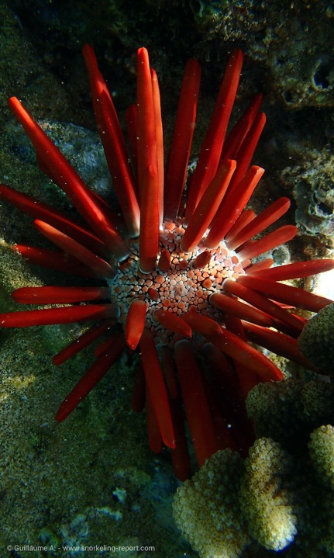
Echinoderm
Sea urchins
Notes:
Image (left): https://mosaic-lille.fr/?o=sea-urchin-save-our-green-rr-gl49V3hj
Image (right): https://www.snorkeling-report.com/sea-urchins-species-identification/

Slide 13
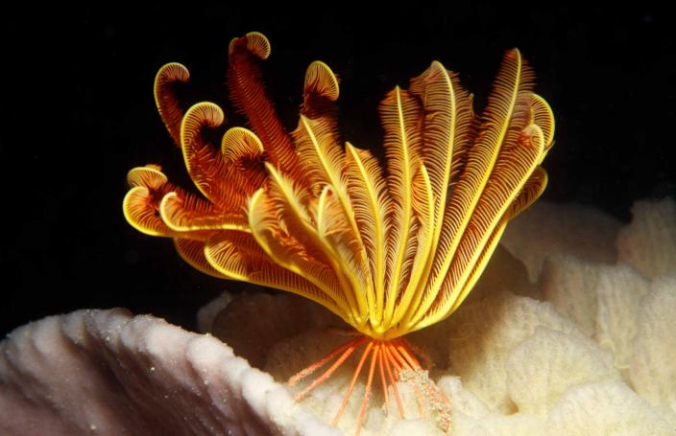
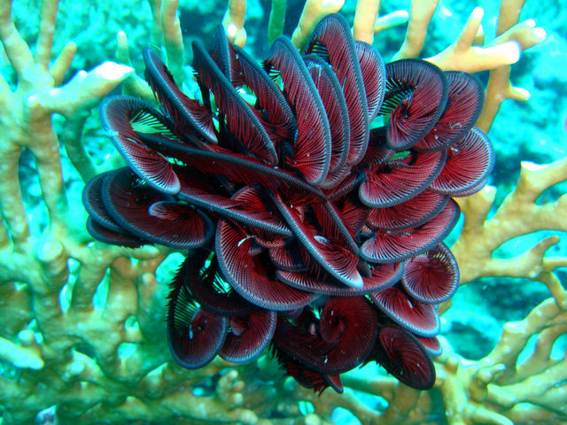
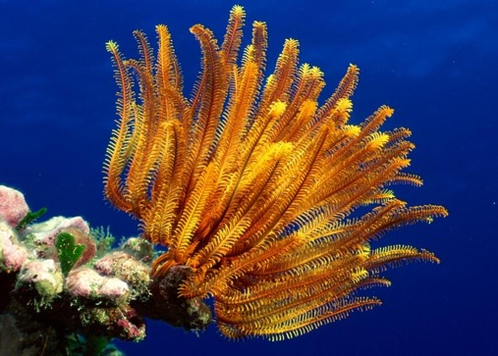
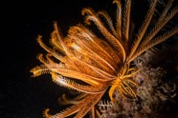
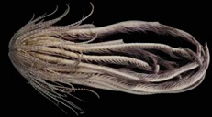
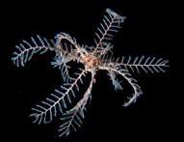
Feather stars
Echinoderm
Notes:
Image (top left): https://museum.wa.gov.au/research/collections/aquatic-zoology/marine-invertebrates-section/echinodermata-echinoderms-class-cr
Image (far bottom left): https://www.greenmatters.com/community/jimbacrinus-crinoid-swimming-feather-star
Image (top right): https://www.gaiaguide.info/Group.html?groupId=QPfB4GLN
Image (bottom left): https://www.earth.com/news/sea-monster-with-20-arms-found-in-the-dark-antarctic-waters/
Image (bottom middle): https://www.wildwondersofchina.com/image/I0000kYfmYzG50s8
Image (bottom right): https://www.istockphoto.com/photos/feather-star-in-sipadan-malaysia

Slide 14
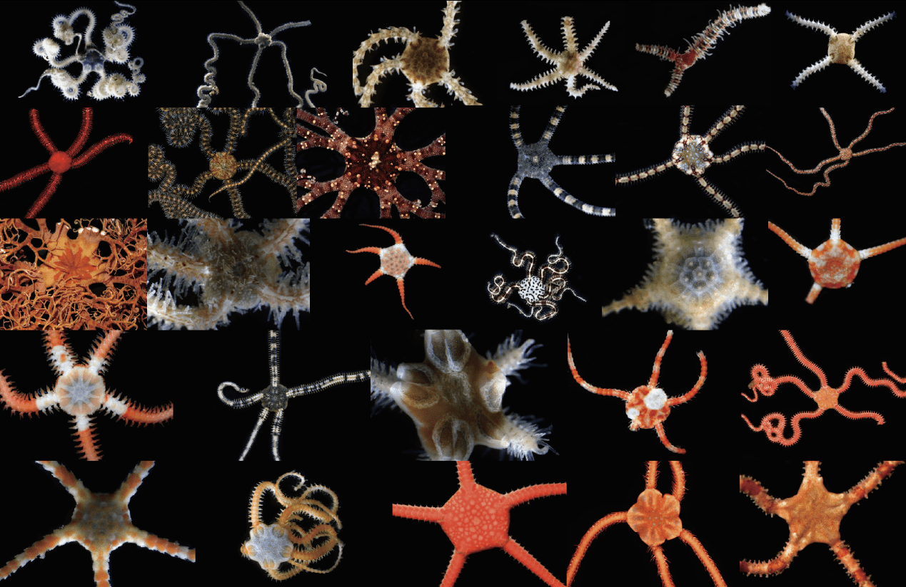
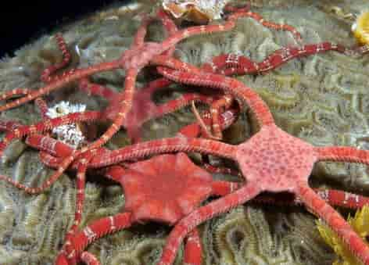
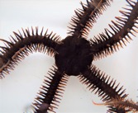
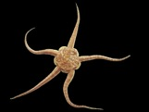
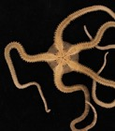
Echinoderm
brittle stars
Notes:
Image: https://statisticsofantarctica.com/api/users?token=L2hpNTJzdDJjcnI_a2V5PTBmMjJjMWZkNjA5ZjEzY2I3OTQ3YzhjYWJmZTFhOTBkJnN1Ym1ldHJpYz0xNDk2MTYxNA

Slide 15
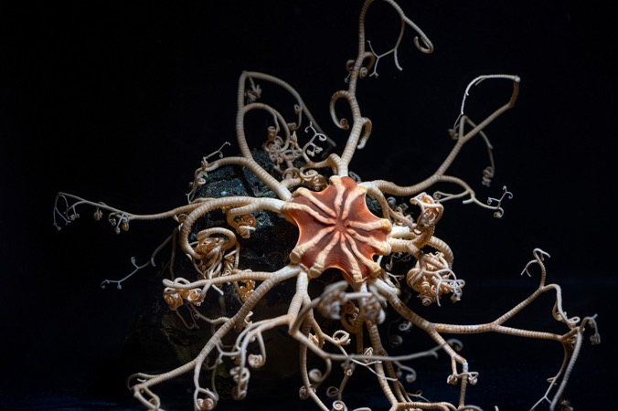
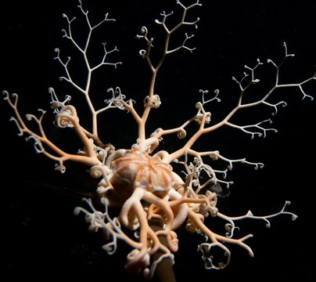
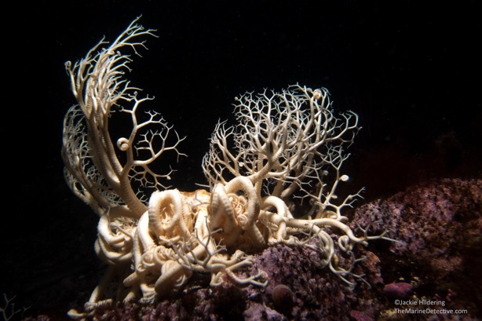
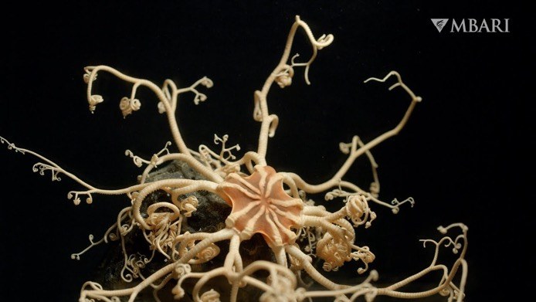
Echinoderm
basket stars

Slide 16
Crustaceans
(Crusta = ‘shell’)

Slide 17
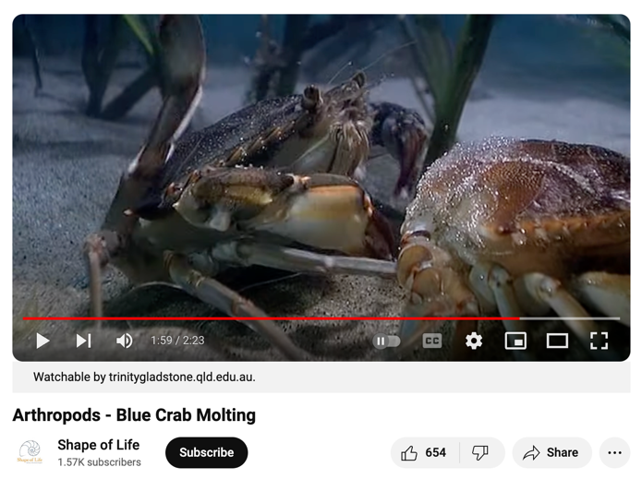
Crustacean
Hard exoskeleton
https://www.youtube.com/watch?v=8pEsPi1VKe4

Slide 18
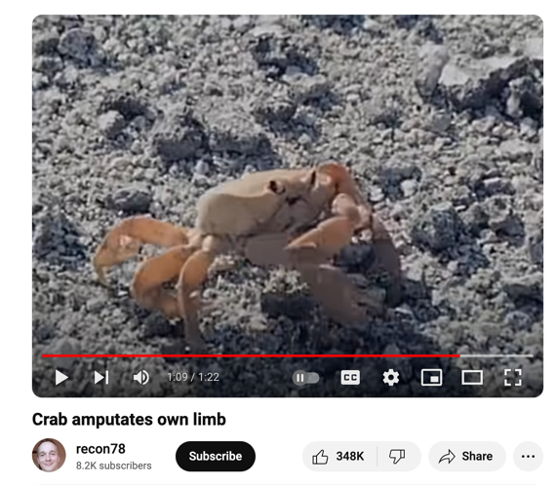
Crustacean
Limbs can be amputated and grow back
https://www.youtube.com/watch?v=v241TF-cSzU

Slide 19
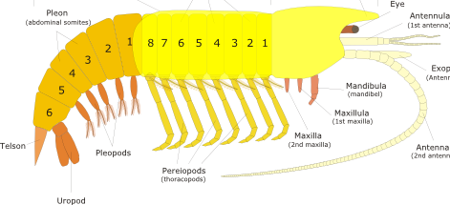
Crustacean
Head, thorax, abdomen and tail region
thorax
head
abdomen
Tail
Notes:
Image adapted from: https://www.quantum-immortal.net/other/crustacea.php

Slide 20
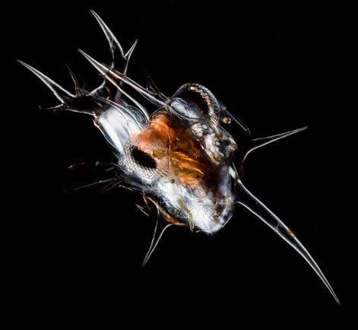
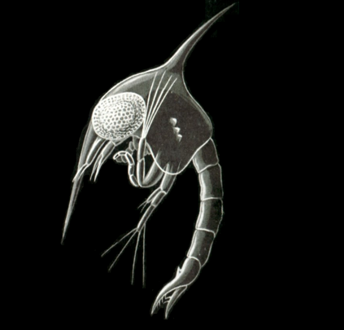
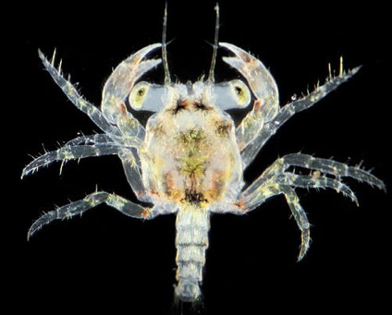
Crustacean
Nauplius
larvae stage
2. Zoea
larvae stage
3. Megalopa
larvae stage
crab
Notes:
Image (crab nauplius): https://www.photomacrography.net/forum/viewtopic.php?t=31667

Slide 21
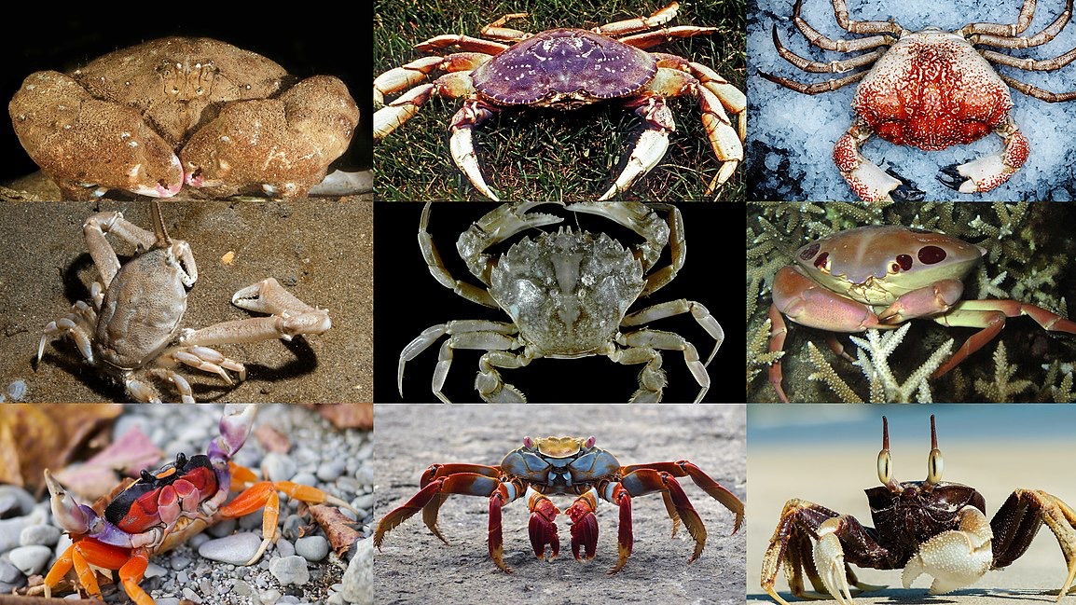
crabs
Crustacean

Slide 22
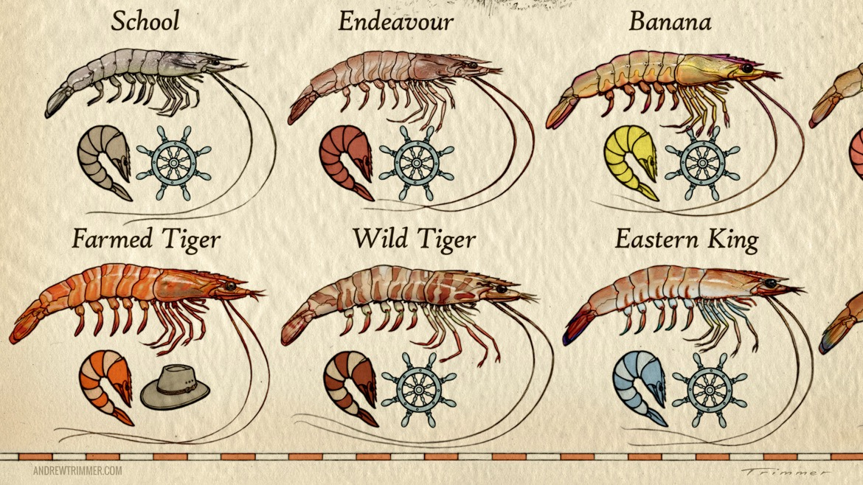
prawns
Crustacean

Slide 23
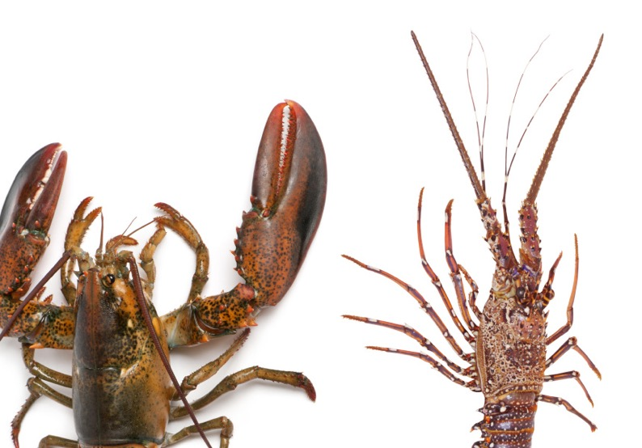
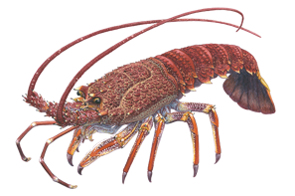
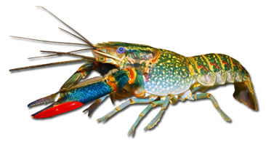
Crustacean
Lobsters /crayfish
Lobsters typically have two large front claws. However, the common names lobster and crayfish can swap interchangeably depending on cultural interpretations.
Southern rock lobster
Red claw crayfish
Notes:
Images (right): https://link.springer.com/chapter/10.1007/978-981-32-9094-5_2
Image (left): https://www.broadsheet.com.au/national/food-and-drink/article/lobster-versus-crayfish

Slide 24
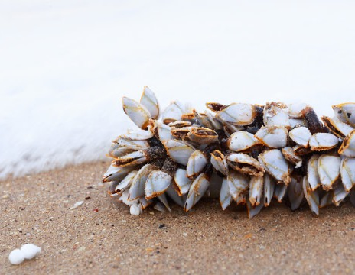
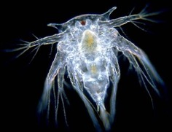
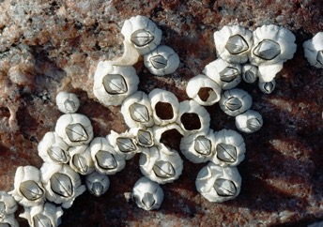
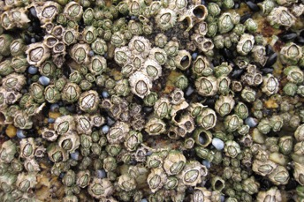
Barnacles (classified as crustacean due to having a nauplius larvae stage)
Crustacean
Barnacle nuaplius
Acorn barnacle – look like volcanoes (Chthamalus antennatus)
Six plated barnacle (Chthamalus antennatus)
Gooseneck barnacles (Lepas anserifera)
Notes:
Image (barnacle nauplius): https://courses.washington.edu/mareco07/students/nina/barnacleshome.html

Slide 25
Molluscs

Slide 26
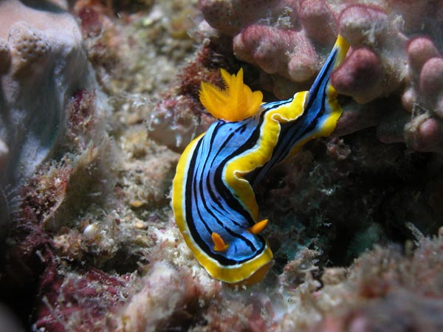
Mollusc
Soft Body
Nudibranch (Chromodoris elisabethina). Photo: Gary Cobb (nudibranch.com.au)
Notes:
Image: https://nudibranch.com.au/

Slide 27
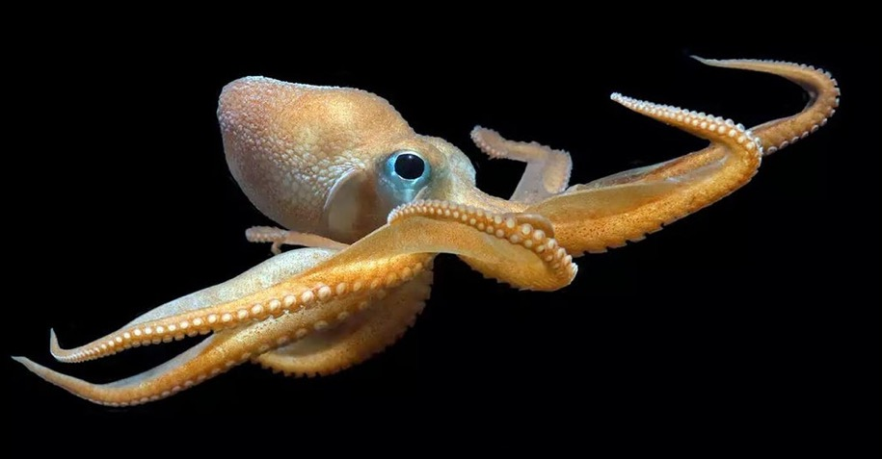
Mollusc
Soft Body
A North Pacific bigeye octopus. Monterey Bay Aquarium
Notes:
Image: https://slate.com/technology/2022/12/octopus-californicus-rescue-babies-eggs-raised.html

Slide 28
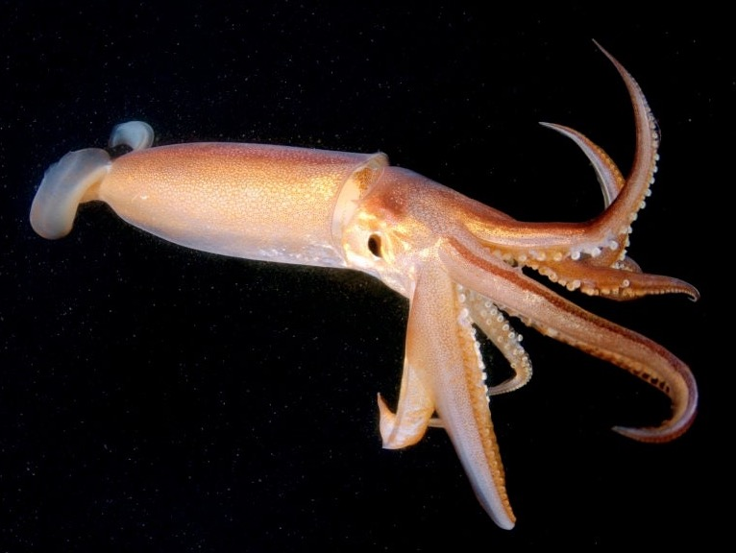
Mollusc
Soft Body
Squid
Notes:
Image: https://www.medicalnewstoday.com/articles/are-squids-as-smart-as-dogs

Slide 29
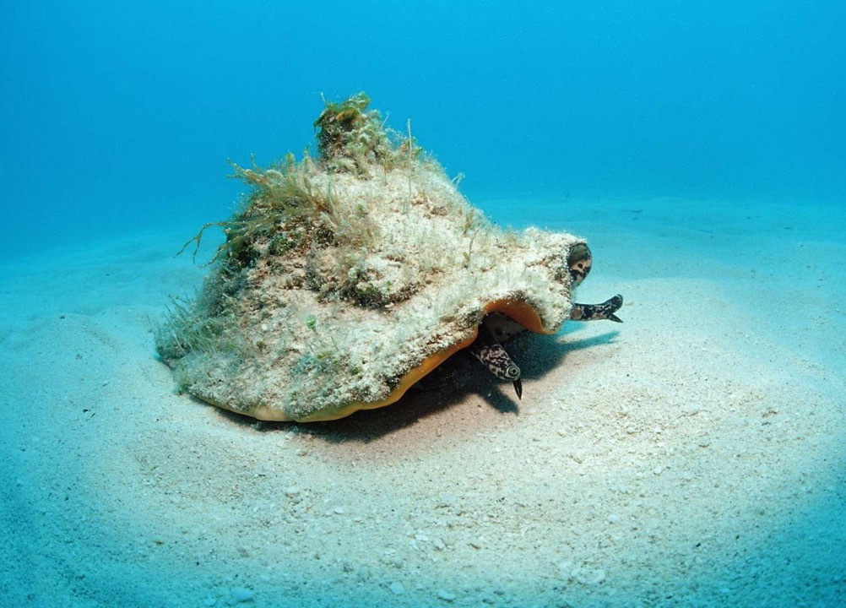
Mollusc
some with an external shell
Queen conch Photo: Reinhard Dirscherl / WaterFrame/ Getty Images
Notes:
Image: https://www.thoughtco.com/types-of-gastropods-2291933 AND/OR https://www.wired.com/story/the-queen-conchs-gambit/

Slide 30
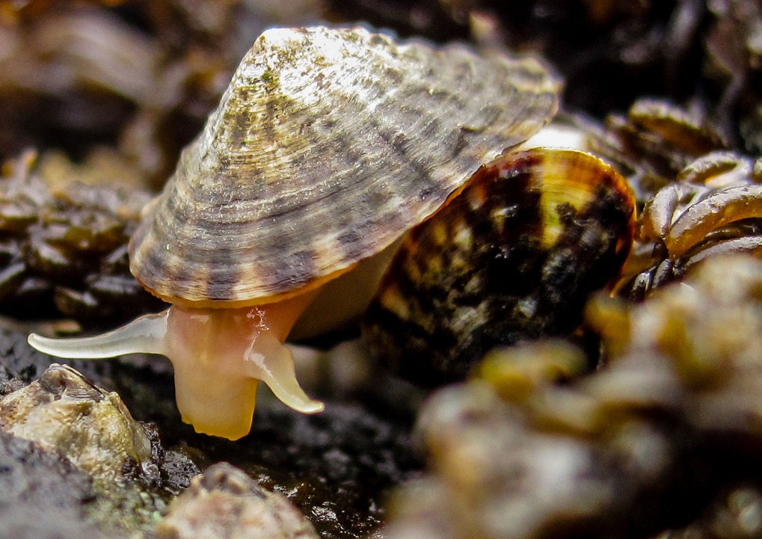
Mollusc
some with an external shell
Limpet. Photo: Rebecca Kordas/UBC
Notes:
Image: https://hakaimagazine.com/news/how-tiny-limpets-do-the-heavy-lifting-of-climate-resilience/

Slide 31
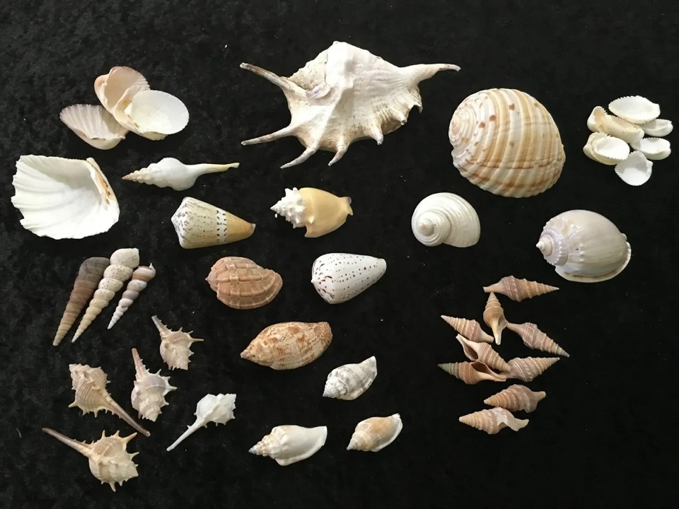
Mollusc
some with an external shell

Slide 32
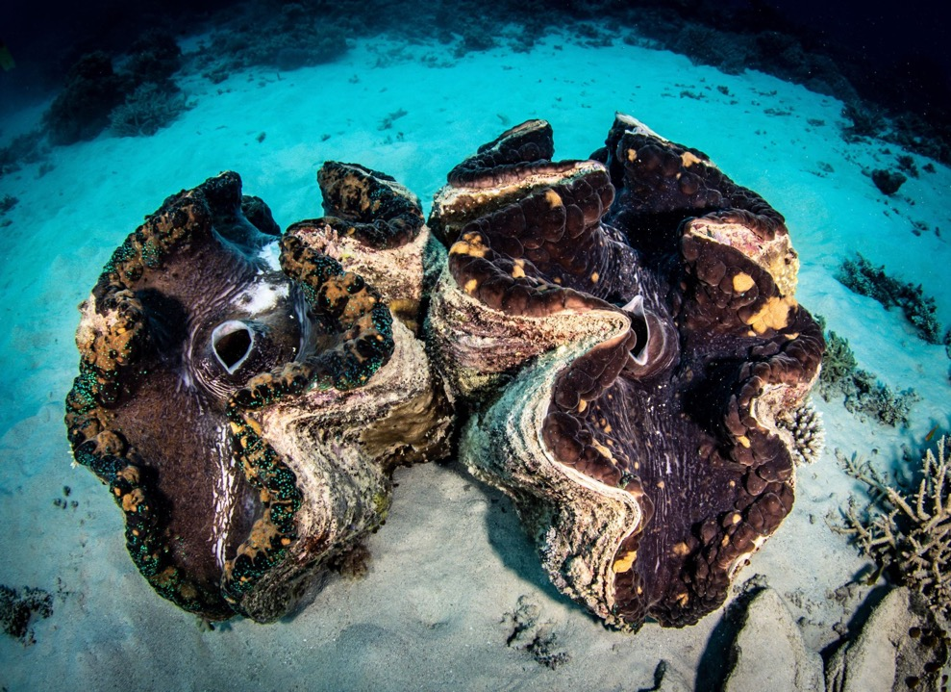
Mollusc
some with an external shell
Giant clam
Notes:
Image; https://greatbarrierreeftours.com/great-barrier-reef/great-barrier-reef-animals/giant-clam/

Slide 33



Cuttlefish
Mollusc
some with an INTERNAL shell
Notes:
Image;

Slide 34


Mollusc
Spirula spirula (deep sea squid)
some with an INTERNAL shell
Notes:
Image: https://www.google.com/search?q=spirula+spirula&source=lmns&bih=669&biw=1185&prmd=isvmnbtz&hl=en&sa=X&ved=2ahUKEwjmn67OmKCFAxVRzDgGHZ6iAjAQ0pQJKAB6BAgBEAI#vhid=-NbEYrgjJdqgTM&vssid=l

Slide 35

Mollusc
Mantle
Egg cowrie (there’s always TWO)
Notes:
Image;

Slide 36

Mollusc
Giant clam
The mantle is the organ that makes the shell
Notes:
Image: https://spie.org/news/photonics-focus/septoct-2021/photonics-research-inspired-by-animal-plant-symbiosis-#_=_

Slide 37

Mollusc
Notes:
Image: https://klumcollection.com/produkt/giant-clam-iv/

Slide 38

Mollusc
Mantle of a scallop (blue parts are eyes)
Notes:
Image; https://www.popularmechanics.com/science/animals/a13987338/the-humble-scallop-has-eyes-like-an-advanced-telescope/
Matthew Krummins via Wikimedia Commons

Slide 39

Mollusc
Sometimes the mantle covers the shell entirely
Polka dot egg cowrie
Notes:
Image; https://www.reddit.com/r/DiscoverEarth/comments/tdrjph/a_polka_dot_egg_cowrie_a_type_of_sea_snail_found/

Slide 40

Mollusc
Visceral Mass (internal organs)
Notes:
Image: https://www.reddit.com/r/Awwducational/comments/4hus0r/snails_anuses_are_above_their_heads_this_is_due/

Slide 41

Mollusc
The visceral mass includes the digestive, nervous, excretory, reproductive, and respiratory systems
Notes:
Image: https://flexbooks.ck12.org/cbook/ck-12-advanced-biology/section/15.22/primary/lesson/mollusk-body-plans-advanced-bio-adv/

Slide 42

Mollusc
Notes:
Image: https://molluscsf.blogspot.com/2007/03/what-is-mollusk.html

Slide 43




Mollusc
Cephalopods

Slide 44



Mollusc
Gastropods
Textile cone shell (very dangerous)
Notes:
Image (textile coneshells): https://www.sawanonlinebookstore.com/textile-cone-snail/ and wikapedia
Image: https://ucmp.berkeley.edu/taxa/inverts/mollusca/gastropoda.php
Variation in shell morphology in some marine gastropods: Clockwise from top left, Calliostoma antonii from off the Pacific coast of Panama; the dovesnail Columbella strombiformis from offshore near San Carlos, Mexico; the moonsnail Natica elenae from the Gulf of Panama; Oliva peruviana from shallow water near Iquique, Chile; the turbinid Guildfordia triumphans from Wakayama, Japan; the muricid Vokesimurex elenensis from the Pacific coast of Mexico; a wentletrap, Epitonium scalare, from the Phillippines; and another muricid, Pteropurpura trialata, from offshore near Los Angeles, California.

Slide 45

Mollusc
Bivalves
(‘2 valves’)
e.g. clams, pipi, mussel, oyster, scallop, etc.
Notes:
Image; https://en.wikipedia.org/wiki/Bivalvia

Slide 46

Mollusc
Chitons (pronounced ‘kye-tonne’)
Notes:
Image: https://seashellsofnsw.org.au/Chitonidae/Pages/Chiton_jugosus.htm

Slide 47


Mollusc
Nudibranchs
(nudi=naked; branch = gill)
Blue dragon or Blue glaucus (Glaucus atlanticus)
Notes:
Image (left): https://www.australiangeographic.com.au/fact-file/blue-dragon/
Image (right): https://www.pinterest.com.au/pin/550635491912151699/

Slide 48
Vertebrates
(vertebrae – backbone)

Slide 49

Spinal chord (notochord)
Vertebrate
Reptiles
Notes:
Image: https://www.australiangeographic.com.au/topics/wildlife/2022/07/yes-crocodiles-can-be-cute/

Slide 50

Vertebrate
Reptiles
Notes:
Image: https://www.britannica.com/animal/turtle-reptile

Slide 51

Vertebrate
Reptiles
Notes:
Image: https://www.forbes.com/sites/priyashukla/2018/10/07/why-fatal-sea-snake-bites-are-unusual/?sh=451907fb3415

Slide 52

Vertebrate
ALL fish
Notes:
Image: https://www.discoverwildlife.com/animal-facts/fish/can-fish-drown

Slide 53

Vertebrate
Cetaceans (dolphins & whales)
Notes:
Image: https://www.usatoday.com/videos/news/have-you-seen/2022/07/08/dolphins-take-playful-joy-ride-off-bow-whale/10017335002/

Slide 54

Vertebrate
All sharks
Great White Shark
Notes:
Image: https://kids.nationalgeographic.com/animals/fish/article/surprising-sharks

Slide 55

All birds
Vertebrate
Booby Bird
Notes:
Image: https://www.nytimes.com/2017/03/06/science/galapagos-blue-footed-boobies.html

Slide 56

Amphibians
Vertebrate
Axolotl
Notes:
Image: https://www.worldwildlife.org/magazine/issues/summer-2021/articles/meet-the-peter-pan-of-salamanders-the-axolotl

Slide 57

Amphibians
Vertebrate
Green tree frog
Notes:
Image: https://www.mentoneaquarium.com.au/post/how-to-best-care-for-your-green-tree-frog

Slide 58
Annelids (segmented worms)

Slide 59

Annelid worm
Annelid
Notes:
Image: https://www.earth.com/earthpedia-articles/annelids/

Slide 60

Annelid worms (often used for bait)
Annelid
Notes:
Image; https://www.earth.com/earthpedia-articles/annelids/

Slide 61

Annelid Polychaete worm
Annelid
Christmas tree worm

Slide 62


Annelid Polychaete worm
Annelid
Bristle worm
Notes:
Image (left): https://www.telegraph.co.uk/news/earth/earthpicturegalleries/9093312/Creatures-of-the-deep-terrifying-macro-pictures-of-polychaetes-or-bristle-worms.html
Image (right): https://www.chesapeakebay.net/discover/field-guide/entry/bristle-worms

Slide 63

Annelid Polychaete worm
Annelid
Bristle worm
Notes:
Image: https://www.chesapeakebay.net/discover/field-guide/entry/bristle-worms

Slide 64

Annelid Polychaete worm
Annelid
Beach worm
Notes:
Image: https://www.youtube.com/watch?v=zewFg1vXeFk

Slide 65
Nematodes (round worms)

Slide 66

Nematode
Parasitic nematode worm

Slide 67
Cnidarians
(cnid = nettle or stinging cell)

Slide 68

Cnidarian
Stinging cells (nematocysts)
on the tentacles only
Notes:
Image: https://cnidologytonight.wordpress.com/2021/03/01/how-do-jellyfish-sting/
Cnidocyte of the blubber jelly, Catostylus mosaicus as seen under an electronic microscope. Credit, Meredith Peach. this image is from Jellypedia

Slide 69

Cnidarian
https://www.youtube.com/watch?v=7WJCnC5ebf4

Slide 70

Deadly jellyfish
Cnidarian
Medusa body plan
Shaped like an umbrella with tentacles
Free swimming
Notes:
Image: https://www.britannica.com/animal/cnidarian

Slide 71

Sunflower coral
Cnidarian
and/or Polyp
body plan
Upside-down medusa, attached to something
Not free-swimming
Notes:
Image: https://www.kidcyber.com.au/coral-polyps

Slide 72

Cnidarian
One opening for mouth and anus
Coral polyps in a colony
Notes:
Image: https://www.livingoceansfoundation.org/education/portal/course/coral-anatomy/

Slide 73

Cnidarians
Notes:
Image adapted from: https://en.wikipedia.org/wiki/Cnidaria#/media/File:Radiata_diversity.jpg

Slide 74









Cnidarian
Scyphozoa Jellyfish
Moon jelly
Jellyfish lake Palau

Slide 75

Cnidarian
Cubozoa (box) jellyfish
Lethal if lots of tentacles touch the skin

Slide 76






Cnidarian
Irukandji
Lethal if heart can’t cope.
Pain is gone within 24hrs.
First symptom is lower back pain.
Can fit through stinger net.
Irukandji
Notes:
Image: https://beachsafe.org.au/surf-safety/irukandji

Slide 77





Cnidarian
Blue bottle
Hydrozoans
Feels like a sting. First aid: apply ice
Fire coral
Stinging hydroids
By the wind sailor (Velella velella)

Slide 78


Cnidarian
Anthozoa
Sea anemone
Notes:
Image: https://www.grida.no/resources/3524

Slide 79
Porifera (sponges)

Slide 80

Porifera
Porous - small pores (ostia) and large openings (oscules)
Notes:
Image; https://pngtree.com/freebackground/marine-vase-sponge-sea-life-aquarium-marine-sponge-photo_3813316.html

Slide 81

Porifera
Filter feeders (with beating flagellum that work like a pump)
Notes:
Image: https://experiment.com/u/tiDWCA

Slide 82

Porifera
Lots of different shapes and colours

Slide 83
Test your memory!
Can you remember which one it is?
Photos to follow….
Echinoderm
Crustacean
Mollusc
Vertebrate
Annelids & Nematodes (worms)
Cnidarians
Porifera (sponges)
← Choose from this list…

Slide 84

Brittle star
Hint: radial symmetry, calcareous skeleton….
Echinoderm
Crustacean
Mollusc
Vertebrate
Annelids & Nematodes (worms)
Cnidarians
Porifera (sponges)
Notes:
Image: https://www.swifft.net.au/cb_pages/sp_brittle_star_amphiura_triscacantha_and_ophiocomina_australis.php

Slide 85

Feather star
Hint: radial symmetry, calcareous skeleton….
Echinoderm
Crustacean
Mollusc
Vertebrate
Annelids & Nematodes (worms)
Cnidarians
Porifera (sponges)
Notes:
Image: https://www.australiangeographic.com.au/blogs/creatura-blog/2017/08/feather-stars/

Slide 86

Basket star
Hint: radial symmetry, calcareous skeleton….
Echinoderm
Crustacean
Mollusc
Vertebrate
Annelids & Nematodes (worms)
Cnidarians
Porifera (sponges)
Notes:
Image: https://www.mediastorehouse.com.au/nature-picture-library/2013-highlights/close-deepsea-basket-star-gorgonocephalus-sp-15264127.html

Slide 87

Sea urchin
Hint: radial symmetry, calcareous skeleton….
Echinoderm
Crustacean
Mollusc
Vertebrate
Annelids & Nematodes (worms)
Cnidarians
Porifera (sponges)
Notes:
Image: https://www.aquariumdomain.com/SpeciesProfiles/MarineInverts/RedSlatePencilUrchin.shtml

Slide 88

Sea cucumber
Echinoderm
Crustacean
Mollusc
Vertebrate
Annelids & Nematodes (worms)
Cnidarians
Porifera (sponges)
Hint: radial symmetry, calcareous skeleton, tube feet….
Notes:
Image: https://ladymusgraveexperience.com.au/bundaberg-tourism/sea-cucumber/

Slide 89

Crinoid (feather star) shrimp
Echinoderm
Crustacean
Mollusc
Vertebrate
Annelids & Nematodes (worms)
Cnidarians
Porifera (sponges)
Notes:
Image: https://pixels.com/featured/crinoid-shrimp-cebu-philippines-bruce-shafer.html

Slide 90

Japanese spider crab
Echinoderm
Crustacean
Mollusc
Vertebrate
Annelids & Nematodes (worms)
Cnidarians
Porifera (sponges)
Notes:
Image: https://en.wikipedia.org/wiki/Japanese_spider_crab

Slide 91


Mantis shrimp
Echinoderm
Crustacean
Mollusc
Vertebrate
Annelids & Nematodes (worms)
Cnidarians
Porifera (sponges)

Slide 92

Leaf sheep nudibranch (Costasiella kuroshimae)
Hint: soft body
Echinoderm
Crustacean
Mollusc
Vertebrate
Annelids & Nematodes (worms)
Cnidarians
Porifera (sponges)
Notes:
Image: https://www.citrusreef.com/blogs/news/strangest-types-of-nudibranch

Slide 93

Spanish dancer nudibranch (Hexabranchus sanguineus)
Hint: soft body
Echinoderm
Crustacean
Mollusc
Vertebrate
Annelids & Nematodes (worms)
Cnidarians
Porifera (sponges)

Slide 94

Cuttlefish
Hint: soft body
Echinoderm
Crustacean
Mollusc
Vertebrate
Annelids & Nematodes (worms)
Cnidarians
Porifera (sponges)
Notes:
Image: https://www.sciencefocus.com/nature/everything-you-wanted-to-know-about-cuttlefish

Slide 95

Pearl shell
Hint: has a shell
Echinoderm
Crustacean
Mollusc
Vertebrate
Annelids & Nematodes (worms)
Cnidarians
Porifera (sponges)

Slide 96

Nautilus
Hint: has a shell
Echinoderm
Crustacean
Mollusc
Vertebrate
Annelids & Nematodes (worms)
Cnidarians
Porifera (sponges)

Slide 97

Triton shell
(eating a sea star)
Hint: has a shell
Echinoderm
Crustacean
Mollusc
Vertebrate
Annelids & Nematodes (worms)
Cnidarians
Porifera (sponges)
Notes:
Image: https://www.wildlifeadventurer.com.au/triton-shell/

Slide 98

Chiton
Hint: has a shell
Echinoderm
Crustacean
Mollusc
Vertebrate
Annelids & Nematodes (worms)
Cnidarians
Porifera (sponges)

Slide 99

Humpback Whale
Hint: has a backbone
Echinoderm
Crustacean
Mollusc
Vertebrate
Annelids & Nematodes (worms)
Cnidarians
Porifera (sponges)
Notes:
Image: https://www.northernbeaches.nsw.gov.au/environment/species/humpback-whales

Slide 100

Green paddle worm (segmented)
Echinoderm
Crustacean
Mollusc
Vertebrate
Annelids & Nematodes (worms)
Cnidarians
Porifera (sponges)
Notes:
Image: https://www.reddit.com/r/AIDKE/comments/iho1q7/the_green_paddle_worm_phyllodoce_novaehollandia/

Slide 101

Hint: polyp body plan
Mushroom coral (Lithophyllon undulatum)
Echinoderm
Crustacean
Mollusc
Vertebrate
Annelids & Nematodes (worms)
Cnidarians
Porifera (sponges)
Notes:
Image: https://tidalgardens.com/stock-blue-eye-lithophyllon-plate-chalice.html

Slide 102

Box jellyfish
Hint: medusa body plan
Echinoderm
Crustacean
Mollusc
Vertebrate
Annelids & Nematodes (worms)
Cnidarians
Porifera (sponges)
Notes:
Image: https://animalecologyinfocus.com/2021/12/08/how-and-what-do-jellyfish-see/
Image shows Tripedalia cystophora from: Jan Bielecki; Alexander K. Zaharoff, Nicole Y. Leung, Anders Garm, Todd H. Oakley (June 2014). “Ocular and Extraocular Expression of Opsins in the Rhopalium of Tripedalia cystophora (Cnidaria: Cubozoa)”. PLOS ONE 9 (6). DOI:10.1371/journal.pone.0098870

Slide 103

Hint: polyp body plan
Anemone, Epiactis sp.,
Photo: David Staples
Echinoderm
Crustacean
Mollusc
Vertebrate
Annelids & Nematodes (worms)
Cnidarians
Porifera (sponges)
Notes:
Image: https://collections.museumsvictoria.com.au/species/8616

Slide 104

Hint: polyp body plan
gorgonian sea fan
(with brittle star)
Echinoderm
Crustacean
Mollusc
Vertebrate
Annelids & Nematodes (worms)
Cnidarians
Porifera (sponges)

Slide 105

Hint: porous filter feeder
Sponge
Echinoderm
Crustacean
Mollusc
Vertebrate
Annelids & Nematodes (worms)
Cnidarians
Porifera (sponges)

Slide 106

Learning Intention:
Classify different groups of animals using structural characteristics.
Success Criteria:
Complete Marine Education worksheet
‘23. Marine Matchup’
Notes:
Image: https://www.scuba.com/blog/sea-anemones-flowers-of-the-ocean/

