Slide 1
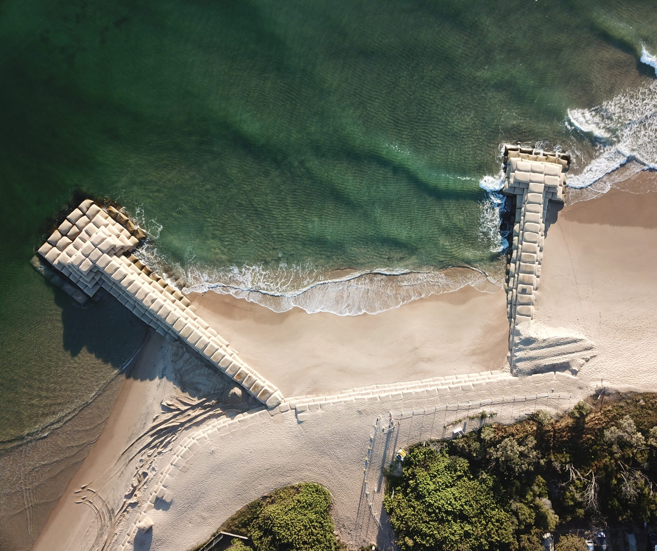
Learning Intention:
Consider how historical local planning decisions on dynamic shorelines have influenced the selection of coastal management strategies.
Success Criteria:
Complete Marine Education Worksheet ‘24. Constructing Coastlines’
Notes:
Image: https://www.sunshinecoastnews.com.au/2022/05/03/cotton-tree-maroochy-groyne-renewal/
New sandbags will be placed on two groynes to prevent coastal erosion.
SUNSHINE COAST NEWS
3 MAY 2022

Slide 2
Dynamic = changing constantly
Notes:
Image: https://www.studiobinder.com/blog/what-is-dynamic-range-photography/

Slide 3
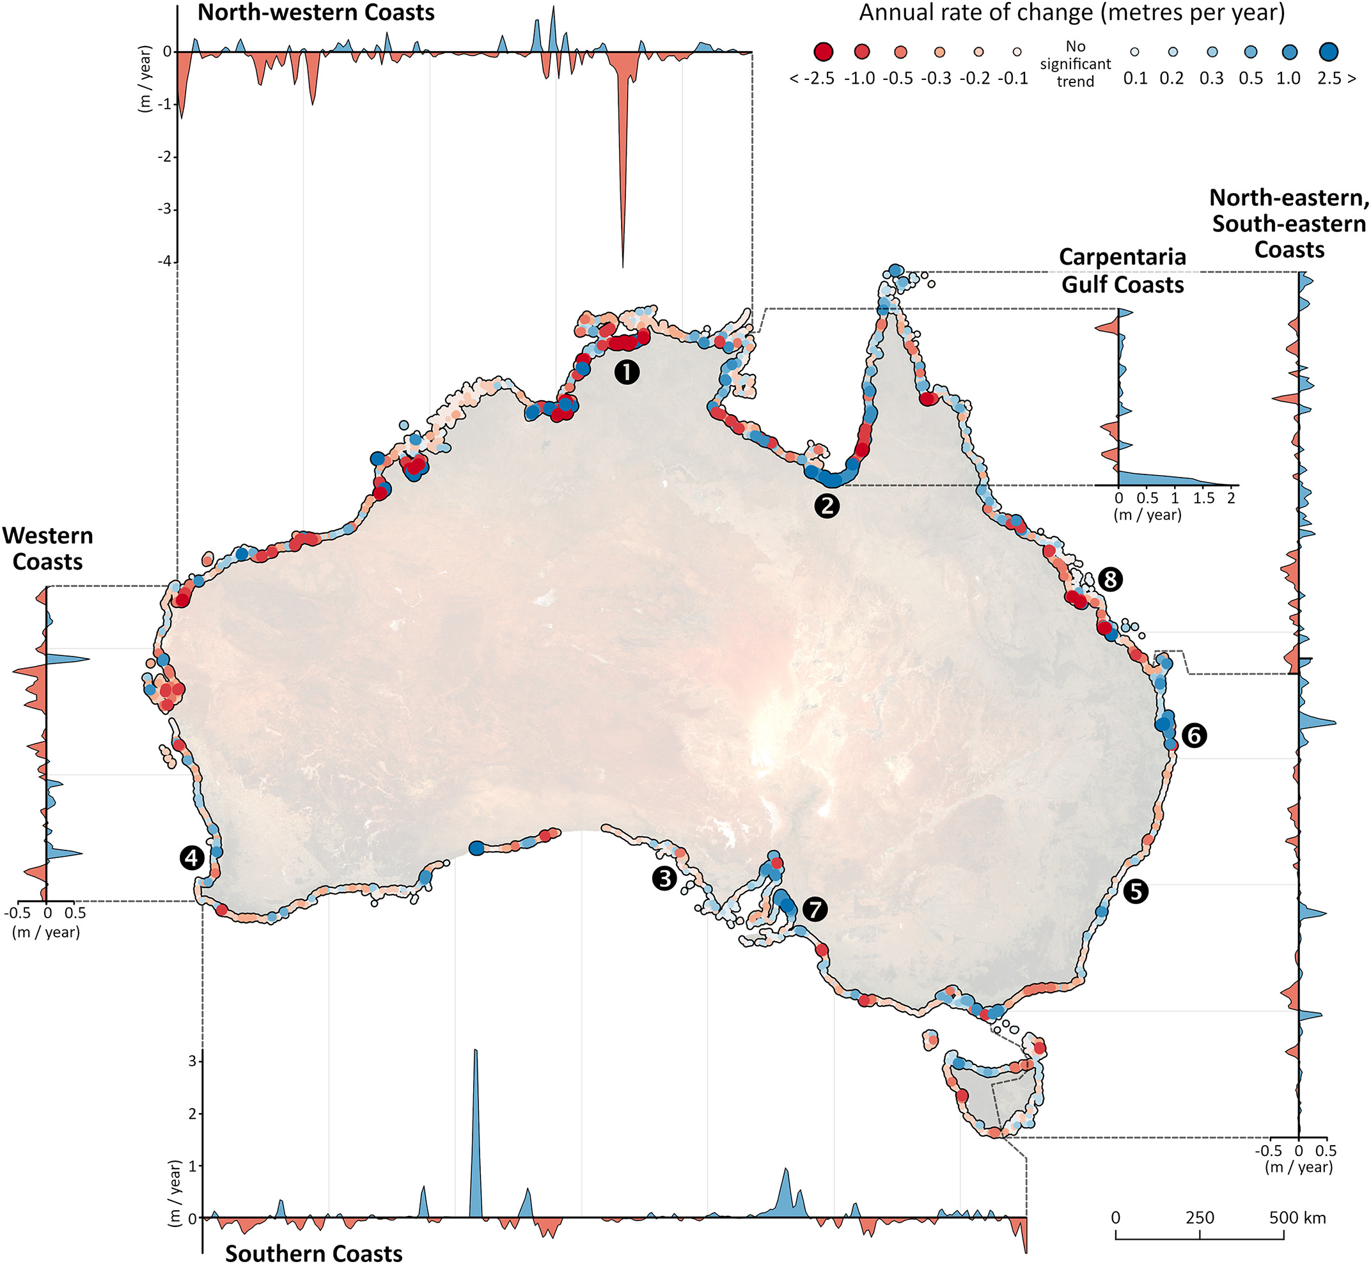
Australia’s shoreline is dynamic, constantly changing
“22% of Australia’s non-rocky coastlines have changed significantly since 1988”.
Some are retreating (red).
Others are growing (blue).
Source: Robbi Bishop-Taylor, Rachel Nanson, Stephen Sagar, Leo Lymburner (2021). Mapping Australia's dynamic coastline at mean sea level using three decades of Landsat imagery, Remote Sensing of Environment, Volume 267, 112734, ISSN 0034-4257.
Notes:
Paper: Robbi Bishop-Taylor, Rachel Nanson, Stephen Sagar, Leo Lymburner (2021). Mapping Australia's dynamic coastline at mean sea level using three decades of Landsat imagery, Remote Sensing of Environment, Volume 267, 112734, ISSN 0034-4257,
Image: https://doi.org/10.1016/j.rse.2021.112734.Image: https://www.sciencedirect.com/science/article/pii/S0034425721004545
Fig. 7. Continental coastal change across Australia based on DEA Coastlines. Transects visualise patterns and hotspots of coastal retreat and growth across Australia's six major coastal regions using a 0.1 degree moving average (McPherson et al., 2015). Numbered points indicate the location of key sites discussed in the text: 1) Point Stuart, Northern Territory; 2) southern Gulf of Carpentaria, Queensland; 3) Streaky Bay, South Australia; 4) Port Geographe and Cape Peron, Western Australia; 5) Narrabeen Beach, New South Wales; 6) Tugun Beach, Queensland; 7) West Beach, South Australia, and 8) Broad Sound and Shoalwater Bay, Queensland.

Slide 4
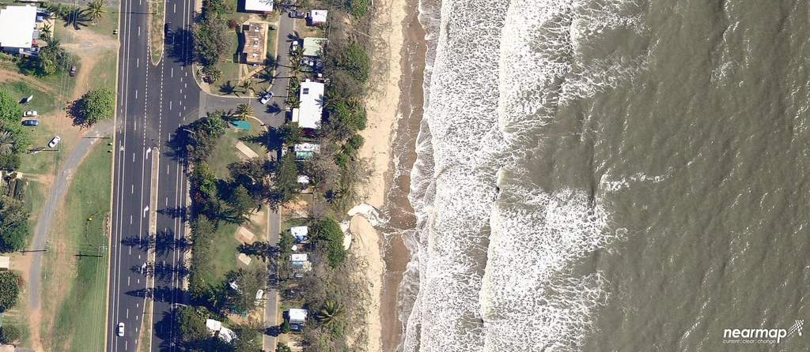
Erosion is a common problem for councils in Qld
Notes:
Image: https://www.couriermail.com.au/news/queensland/sunshine-coast/aerial-photos-reveal-queensland-beach-erosion/image-gallery/8cc3dce66bab841040291d505b4884b6

Slide 5
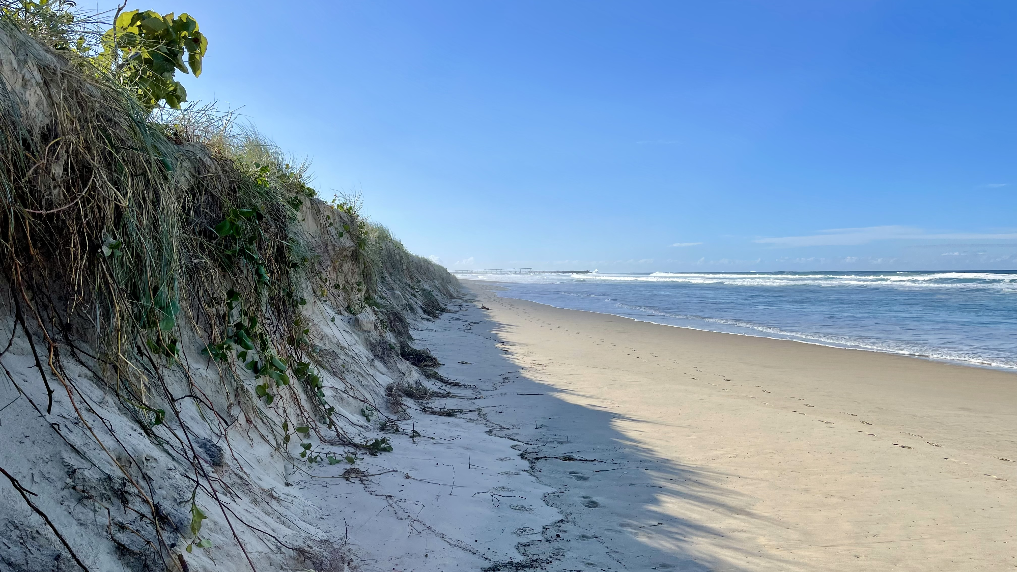
Notes:
Image: https://commons.wikimedia.org/wiki/File:Beach_erosion_at_The_Spit,_Queensland,_June_2021.jpg

Slide 6
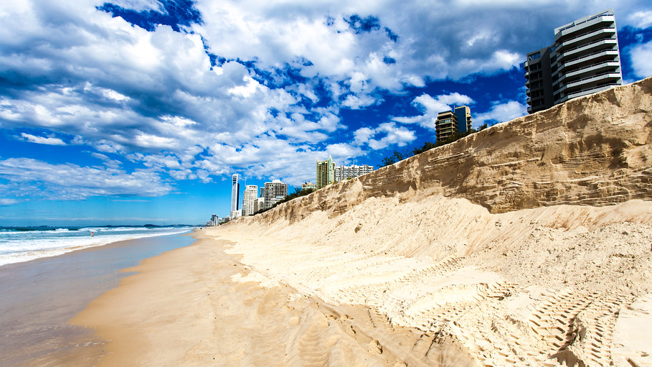
Notes:
Image: https://www.flickr.com/photos/obliterated/7664809096

Slide 7
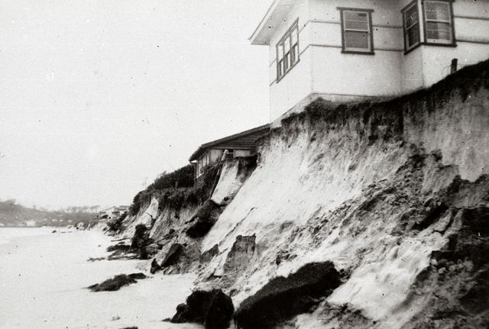
The cyclone of 1954
(Gold Coast)
Notes:
Image: https://www.goldcoaststories.com.au/the-cyclone-of-1954/

Slide 8
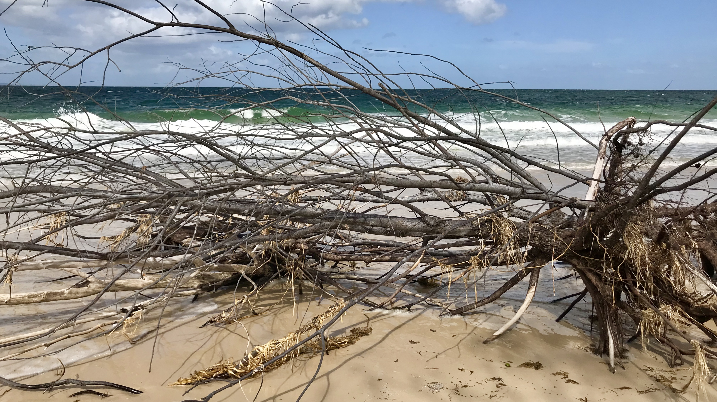
Notes:
Image; https://commons.wikimedia.org/wiki/File:Beach_erosion_at_Woorim_beach,_Bribie_Island,_Queensland_04.jpg

Slide 9
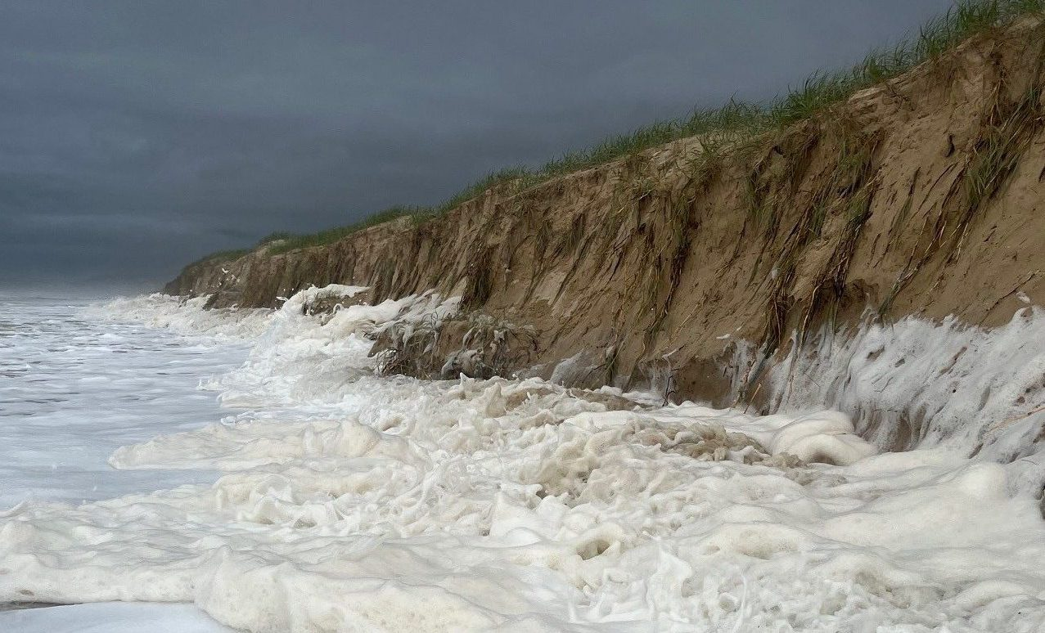
Notes:
Image; https://www.sunshinecoastnews.com.au/2022/03/07/sunshine-coast-beach-erosion/
Towering beach cliffs at Peregian. Picture: Darryl Olson

Slide 10
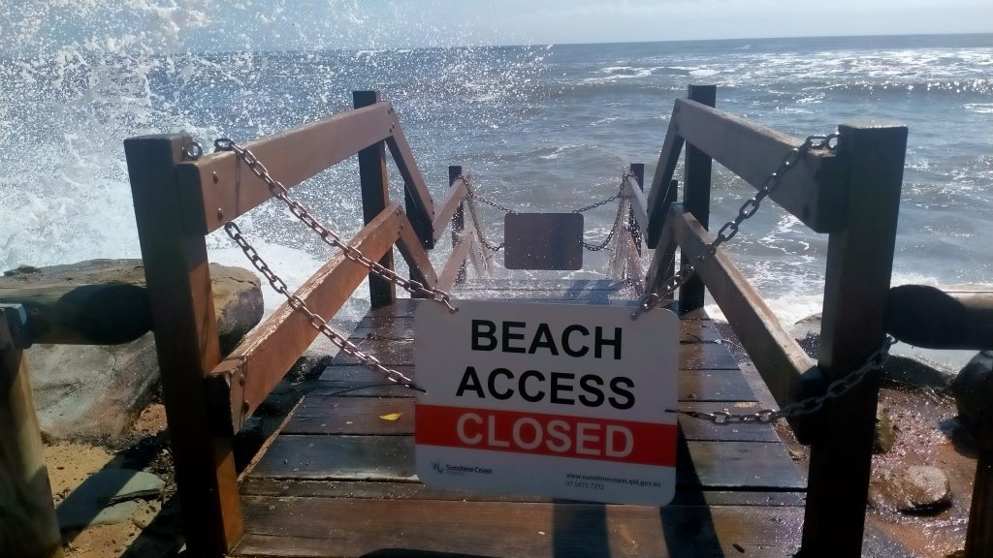
Notes:
Image: https://www.sunshinecoastnews.com.au/2022/03/07/sunshine-coast-beach-erosion/
The beach access at Moffat Beach is off limits. Picture: Kat Donaghey

Slide 11
Councils make local planning decisions in response to the dynamic nature of our coastlines
(and responding to the needs and wants of the voters who live there)
Notes:
Image: https://makingvoicescount.ca/kit/city-decision-making

Slide 12
Coastal management strategies (to choose from) include…

Slide 13
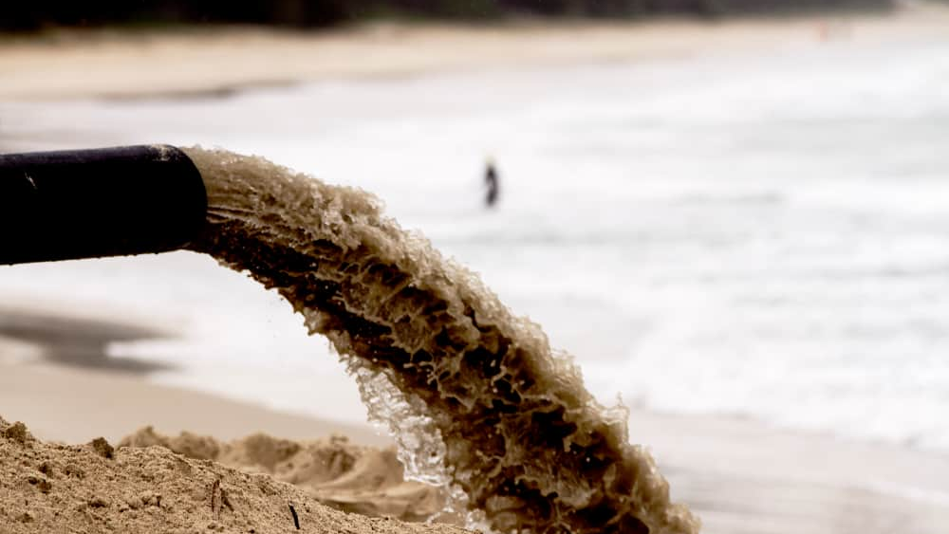
Coastal management strategies (to choose from) include…
Moving sand from here to there…
Notes:
Image; https://www.pumpindustry.com.au/gold-coast-beaches-boosted-with-sand-pumping-operation/

Slide 14
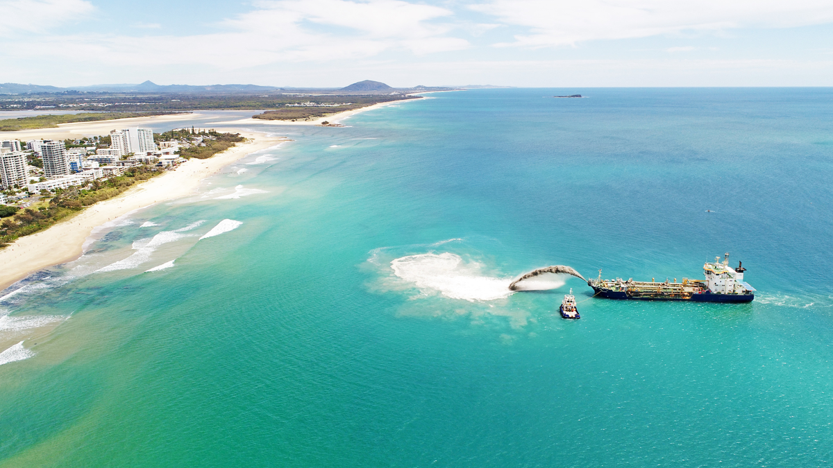
Moving sand from here to there…
Notes:
Image: https://www.sunshinecoast.qld.gov.au/council/planning-and-projects/completed-projects/maroochydore-nearshore-beach-nourishment-trial

Slide 15
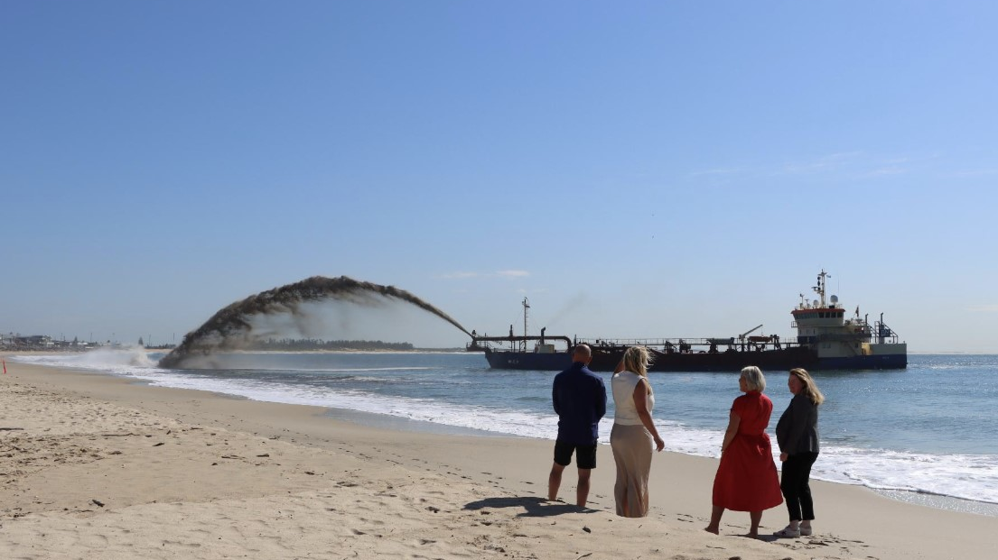
Moving sand from here to there…
Notes:
Image: https://www.dredgingtoday.com/2023/10/16/dredger-trud-r-begins-beach-nourishment-at-stockton-beach/

Slide 16
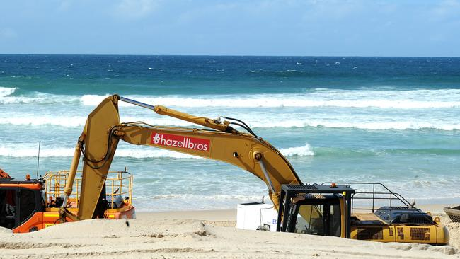
Moving sand from here to there…
Notes:
Image: https://www.goldcoastbulletin.com.au/subscribe/news/1/?sourceCode=GCWEB_WRE170_a_GGL&dest=https%3A%2F%2Fwww.goldcoastbulletin.com.au%2Flifestyle%2Fbeaches-and-fishing%2Fgold-coast-at-threat-of-severe-erosion-and-property-damage-research-shows%2Fnews-story%2F46326698783e430830f4e668b0086191&memtype=anonymous&mode=premium

Slide 17
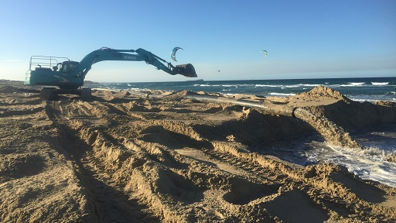
Moving sand from here to there…
Notes:
Image: https://www.sunshinecoast.qld.gov.au/council/planning-and-projects/infrastructure-projects/maroochydore-sand-renourishment

Slide 18
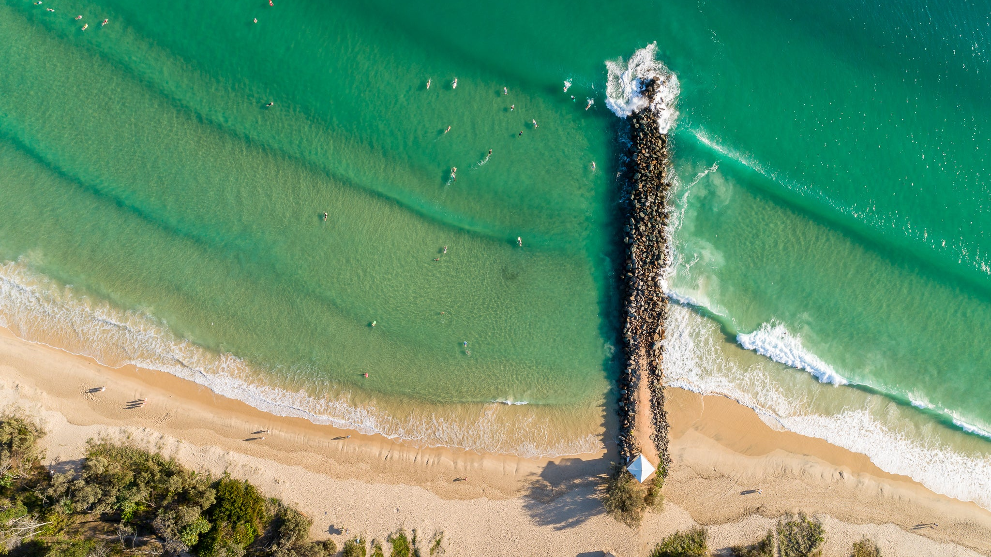
Rock structures
Notes:
Image; https://thesaltypixel.com/products/breakwall-noosa-main-beach?variant=39246977761345

Slide 19
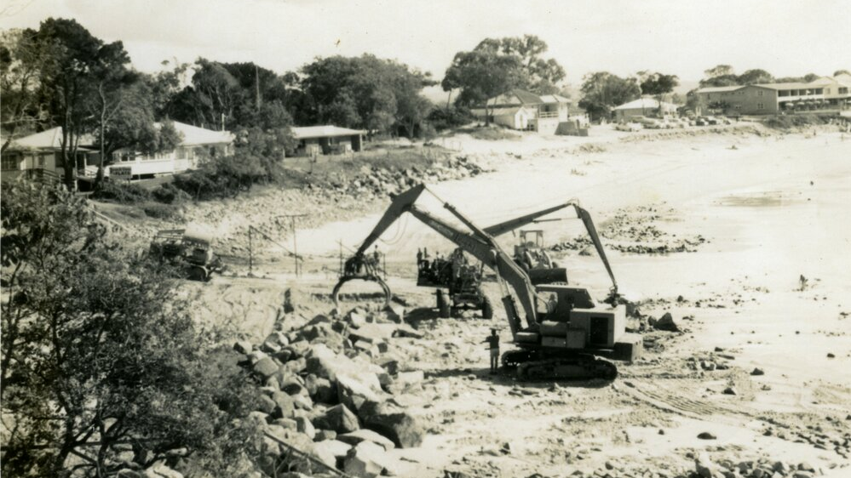
Rock structures
Notes:
Image: https://heritage.noosa.qld.gov.au/nodes/view/7972

Slide 20
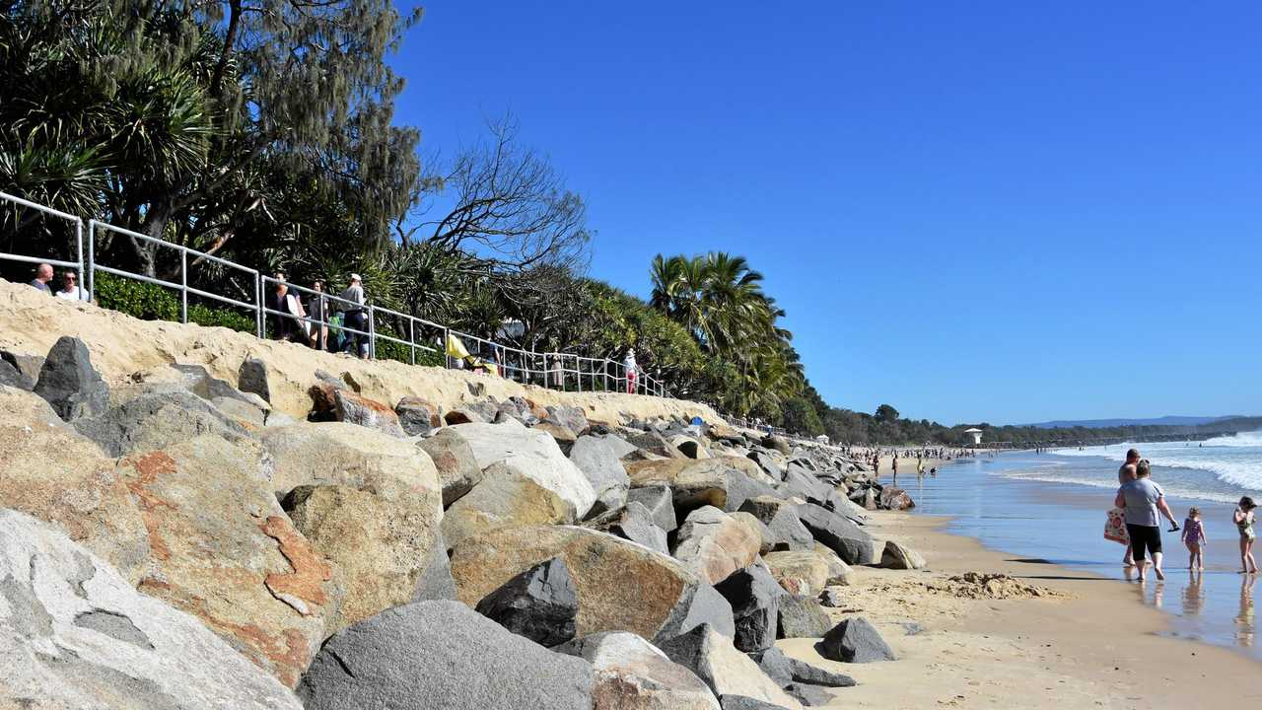
Rock structures
Notes:
Image: https://www.couriermail.com.au/news/queensland/noosa/community/big-blow-for-beach-after-swell/news-story/3c5b1d386f8994f20763b1c2ee72d13d

Slide 21
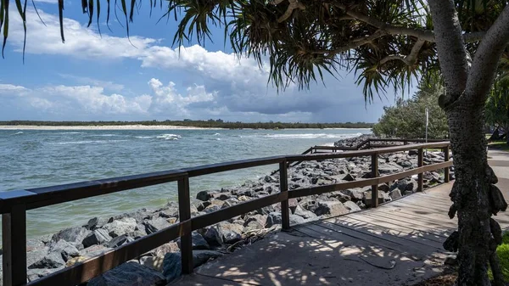
Rock structures
Notes:
Image; https://depositphotos.com/photos/sunshine-coast-australia.html

Slide 22
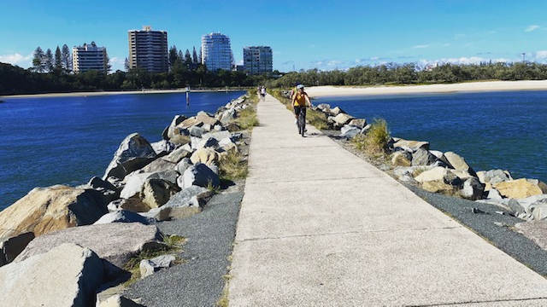
Rock structures
Notes:
Image: https://sunshinecoastwalks.com/tag/wet-weather-trails/

Slide 23
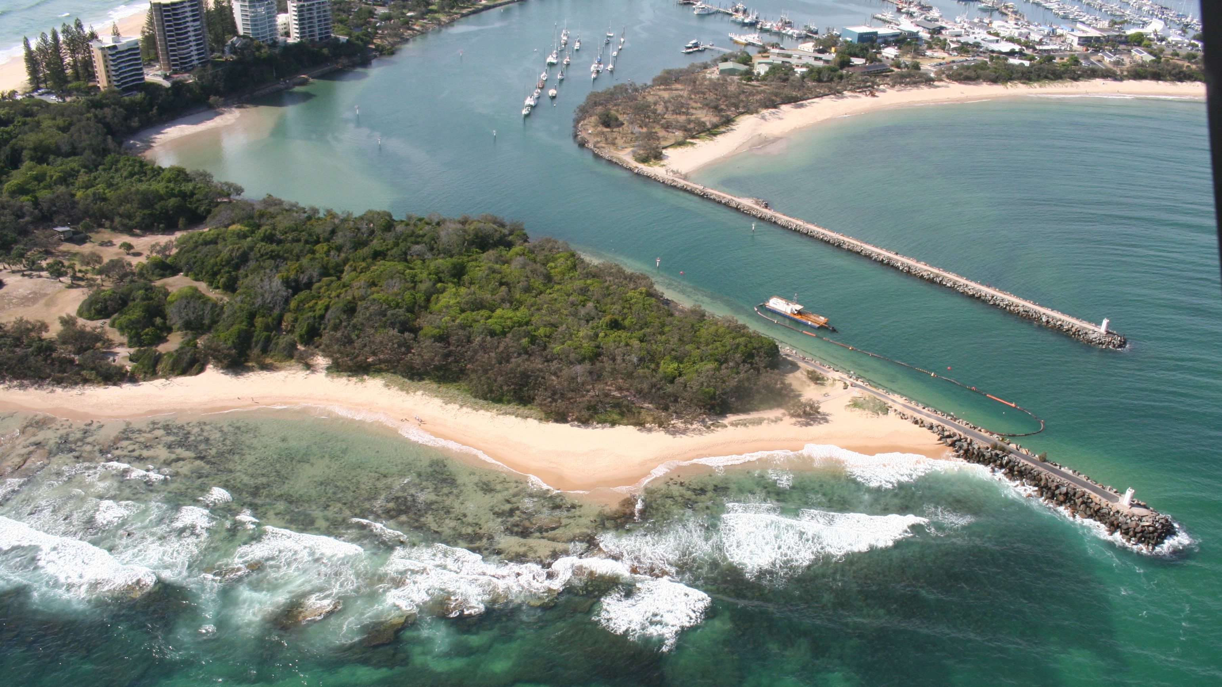
Rock structures
Notes:
Image; https://www.msq.qld.gov.au/boating-facilities/mooloolaba-boat-harbour-dredging

Slide 24
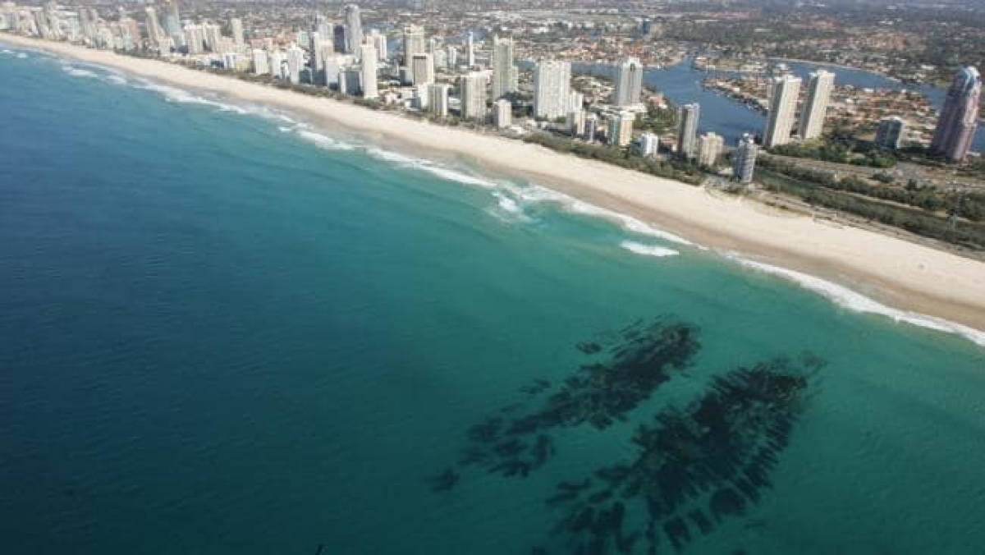
Artificial reefs
Narrowneck Reef, Gold Coast

Slide 25
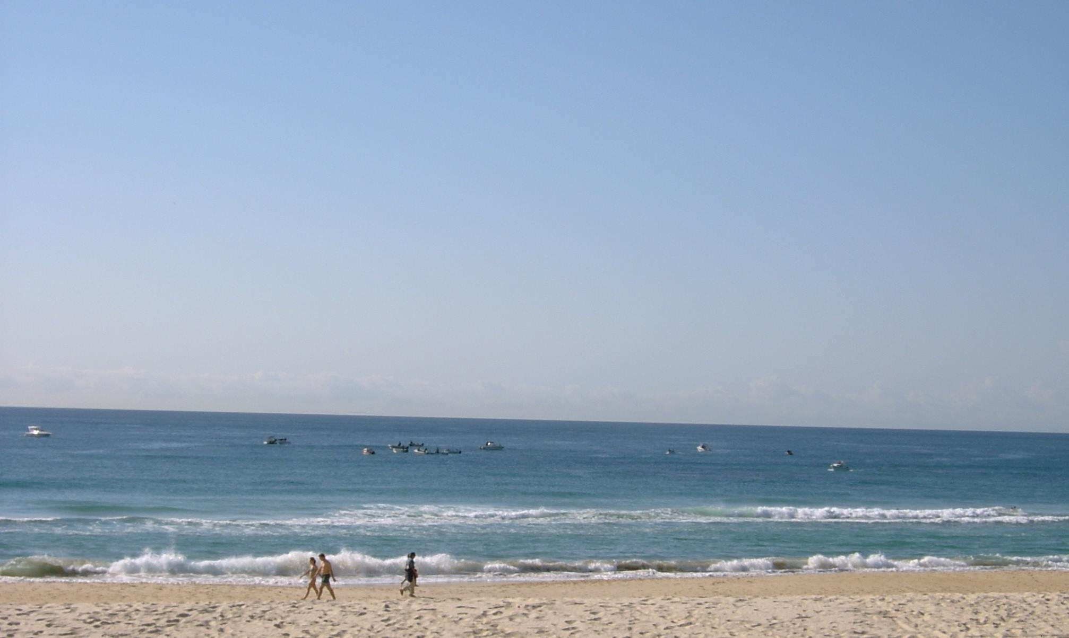
Artificial reefs
Narrowneck Reef, Gold Coast
Notes:
Image: Narrowneck Reef Facebook page

Slide 26
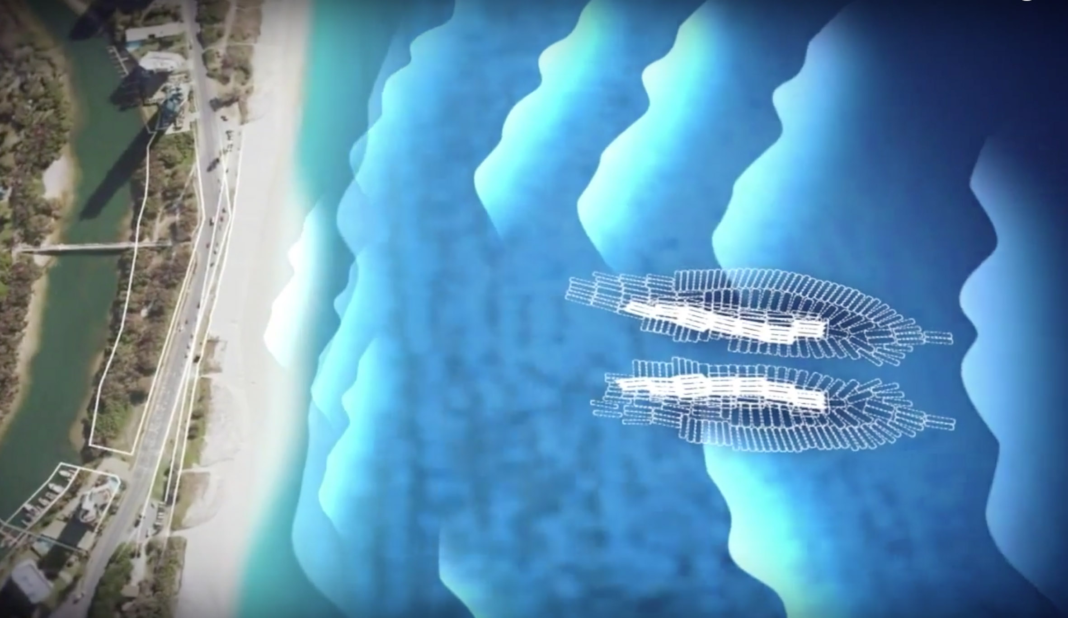
Artificial reefs
Notes:
Image: https://www.theinertia.com/surf/opinion-uncle-sam-should-buy-l-a-an-artificial-reef/

Slide 27
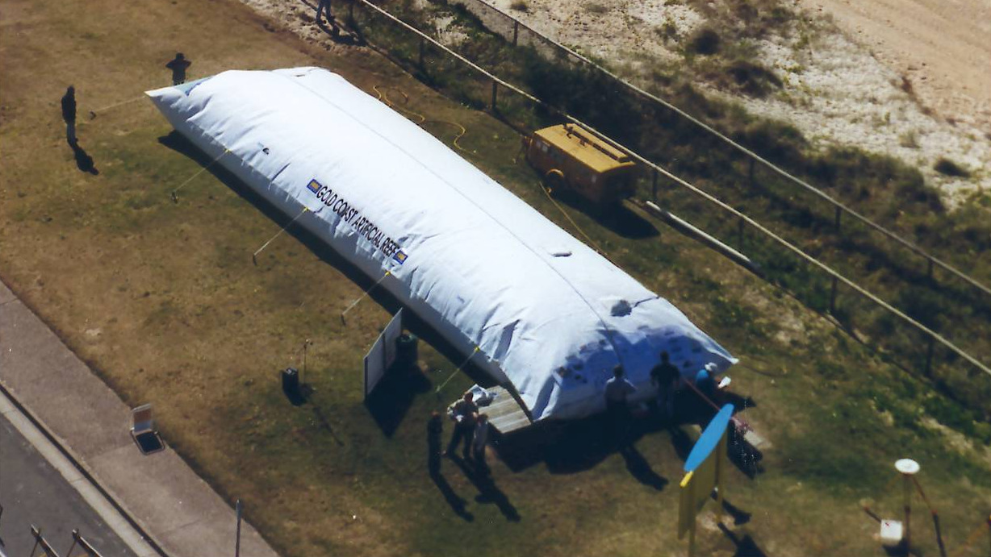
Artificial reefs
Narrowneck Reef’s sand-filled geotextile bags, Gold Coast
Notes:
Image: https://www.swellnet.com/news/swellnet-analysis/2019/08/19/narrowneck-renewal-deemed-success

Slide 28
Not all artificial reefs have been a success….

Slide 29
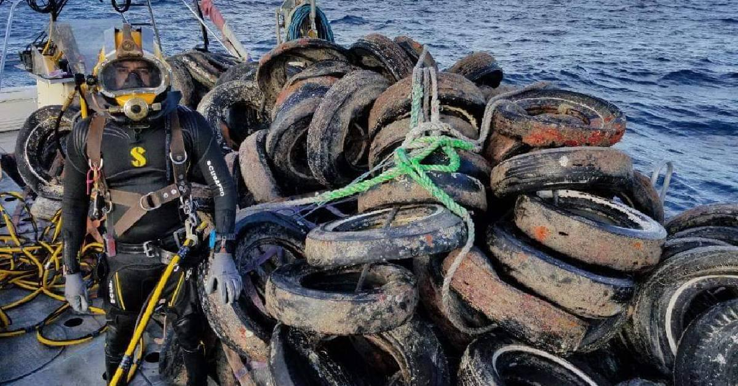
Notes:
Image: https://interestingengineering.com/innovation/osborne-reef-a-failed-artificial-reef-of-discarded-tires
In the hopes of building a reef, roughly 2 million old tyres were sunk off of Florida in the 1970s. But, nature had some other plans, and this ecological operation failed miserably. The saline waters corroded these materials leading the tires to separate from each other. They began getting carried away by the ocean waves and currents.

Slide 30
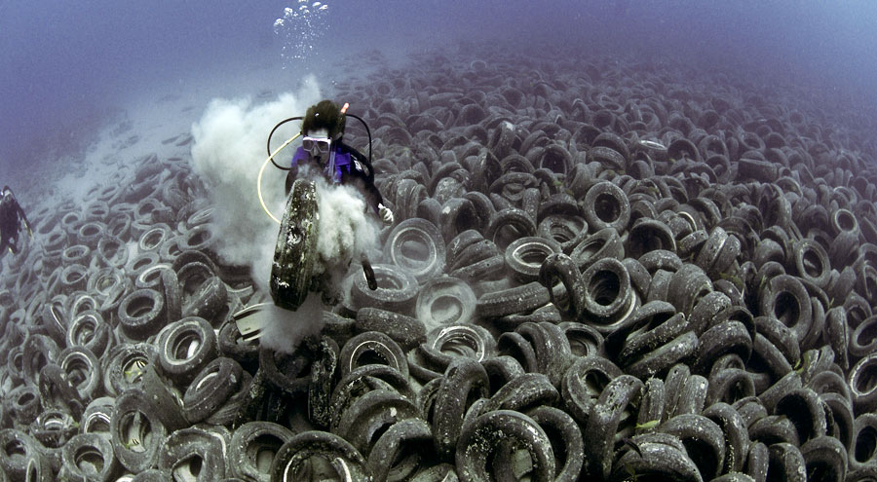
Florida USA
Notes:
Image: https://californiadiver.com/treaded-mess-millions-of-tires-being-removed-from-artificial-reef-projects-worldwide/
Tyres in Ft. Lauderdale, Florida, dumped in the 1970s in an attempt to establish an artificial reef. Photo: Steve Spring/Marine Photobank.

Slide 31
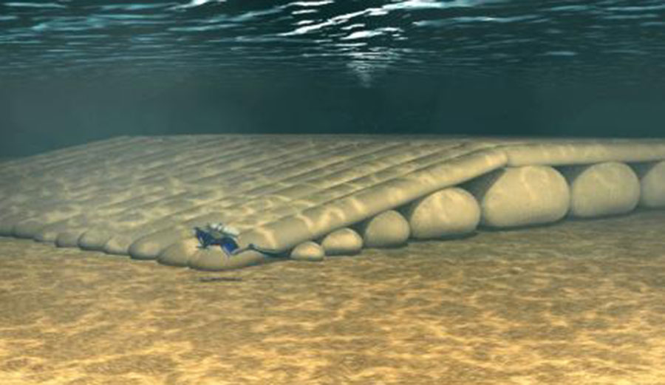
Boscombe Surf Reef, Dorset England.
Notes:
Image: https://www.theinertia.com/surf/english-town-spent-3-2-million-on-an-artificial-reef-that-was-declared-a-potential-deathtrap/
The idea that didn’t work. Image: Gary Elsoon/BNPS
Boscombe Surf Reef was an artificial reef built to enhance surfing conditions at Boscombe in Dorset, England. That it failed to do.

Slide 32
Similarly, not everyone agrees that rock structures are a
good idea…
Once a rock structure has been made,
erosion will be a problem downstream of the rock structure
(e.g. at the end of a rock wall or lee side of a groyne)
E.g. once you start building a rock wall,
who decides where it will end?

Slide 33
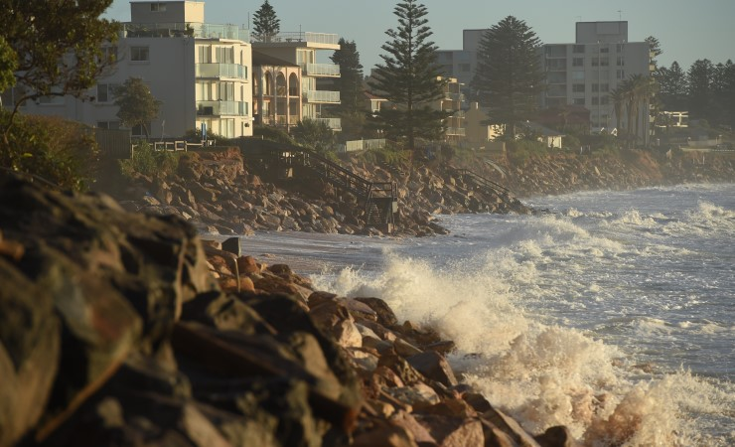
Notes:
Image: https://www.crikey.com.au/2020/01/28/australias-collapsing-coast-part-three/
(IMAGE: AAP/DEAN LEWINS)

Slide 34
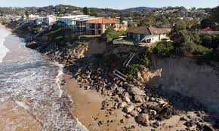
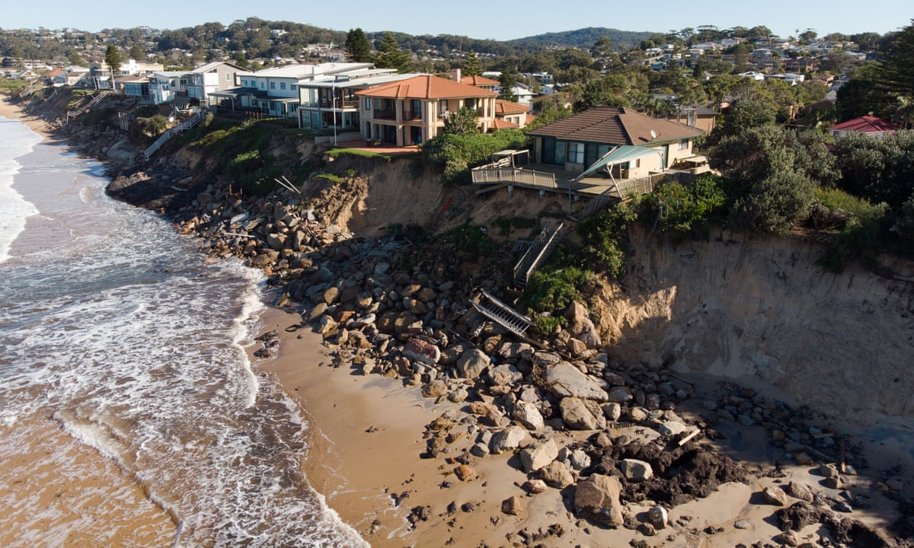
Wamberal, NSW coast
Notes:
Image: https://www.theguardian.com/environment/2020/jul/27/nsw-coastal-councils-face-dilemma-over-land-erosion-and-who-should-pay-for-building-seawalls
Coastal beach erosion and home damage at Wamberal on the NSW Central Coast. A report says a trade-off of protecting about 60 beachfront properties with a seawall would be a potential drop in visitors due to loss of the beach. Photograph: Carly Earl/The Guardian

Slide 35
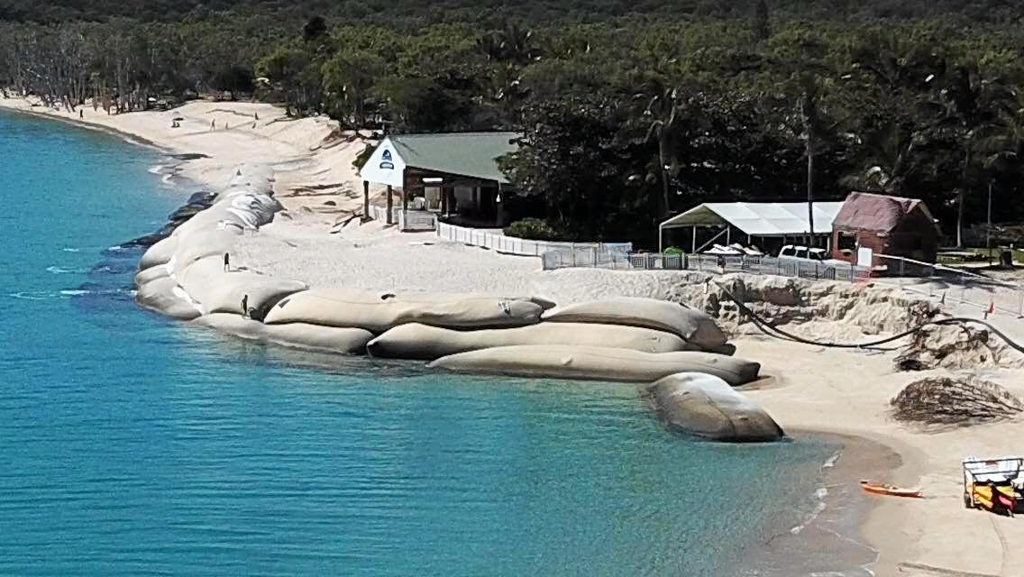
Great Keppel Island
Notes:
Image: https://www.couriermail.com.au/subscribe/news/1/?sourceCode=CMWEB_WRE170_a_GGL&dest=https%3A%2F%2Fwww.couriermail.com.au%2Fnews%2Fconcerns-raised-about-the-gki-beach-sand-bag-strategy%2Fnews-story%2Fa842351fb020f8016937f1a3f3d76ccd&memtype=anonymous&mode=premium&v21=HIGH-Segment-1-SCORE

Slide 36
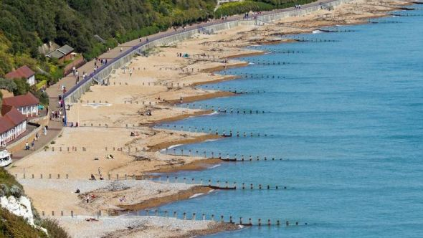
Notes:
Image: https://theconstructor.org/water-resources/hydraulic-structures/groynes-classification/30554/

Slide 37
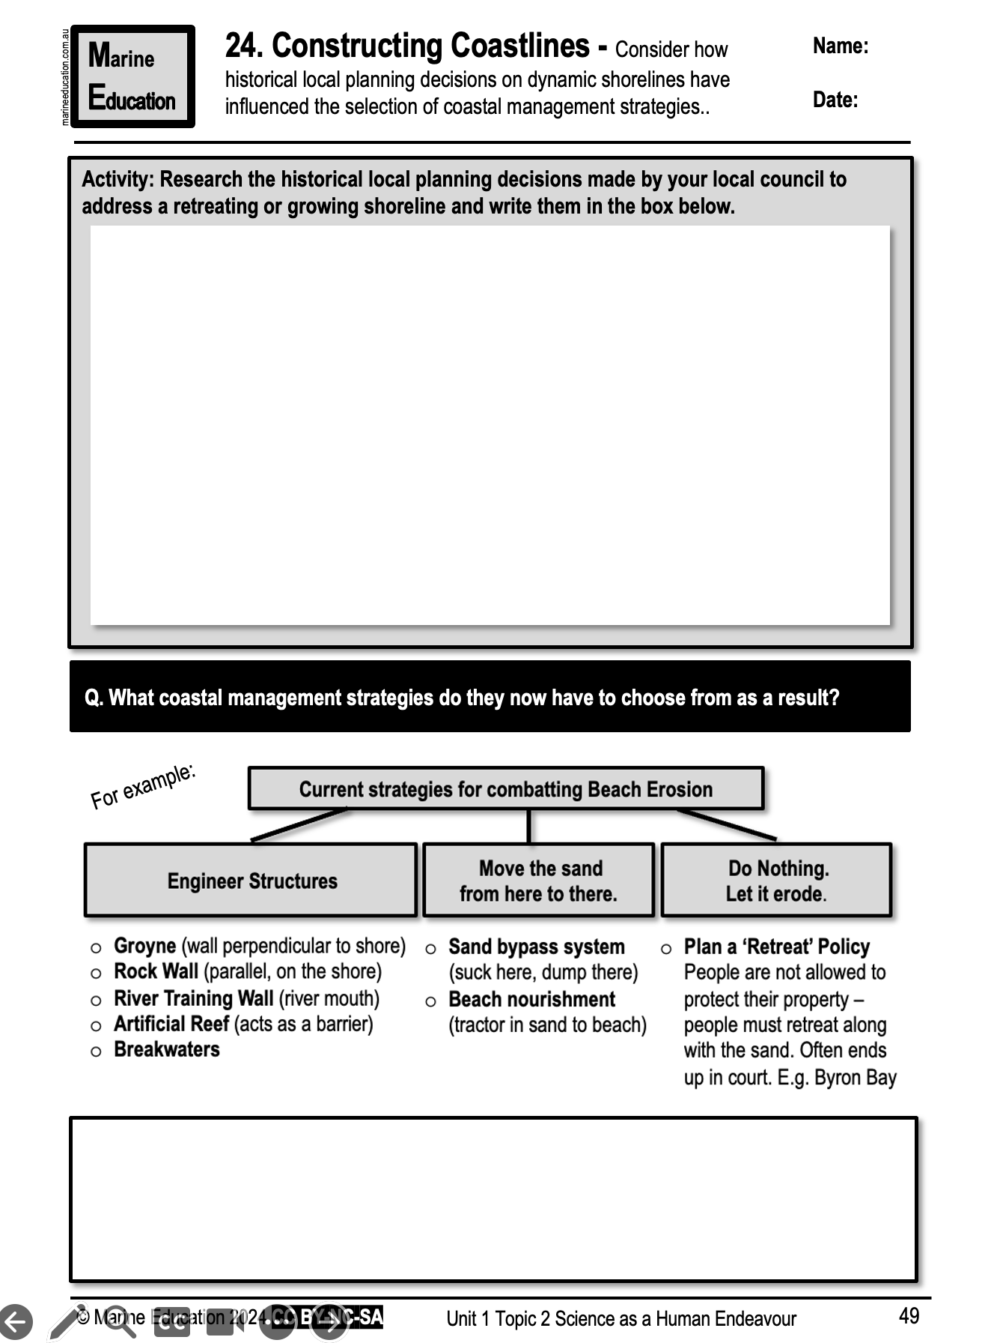
Learning Intention:
Consider how historical local planning decisions on dynamic shorelines have influenced the selection of coastal management strategies.
Success Criteria:
Complete Marine Education Worksheet ‘24. Constructing Coastlines’
Notes:
Image: https://www.sunshinecoastnews.com.au/2022/05/03/cotton-tree-maroochy-groyne-renewal/
New sandbags will be placed on two groynes to prevent coastal erosion.
SUNSHINE COAST NEWS
3 MAY 2022

