Slide 1
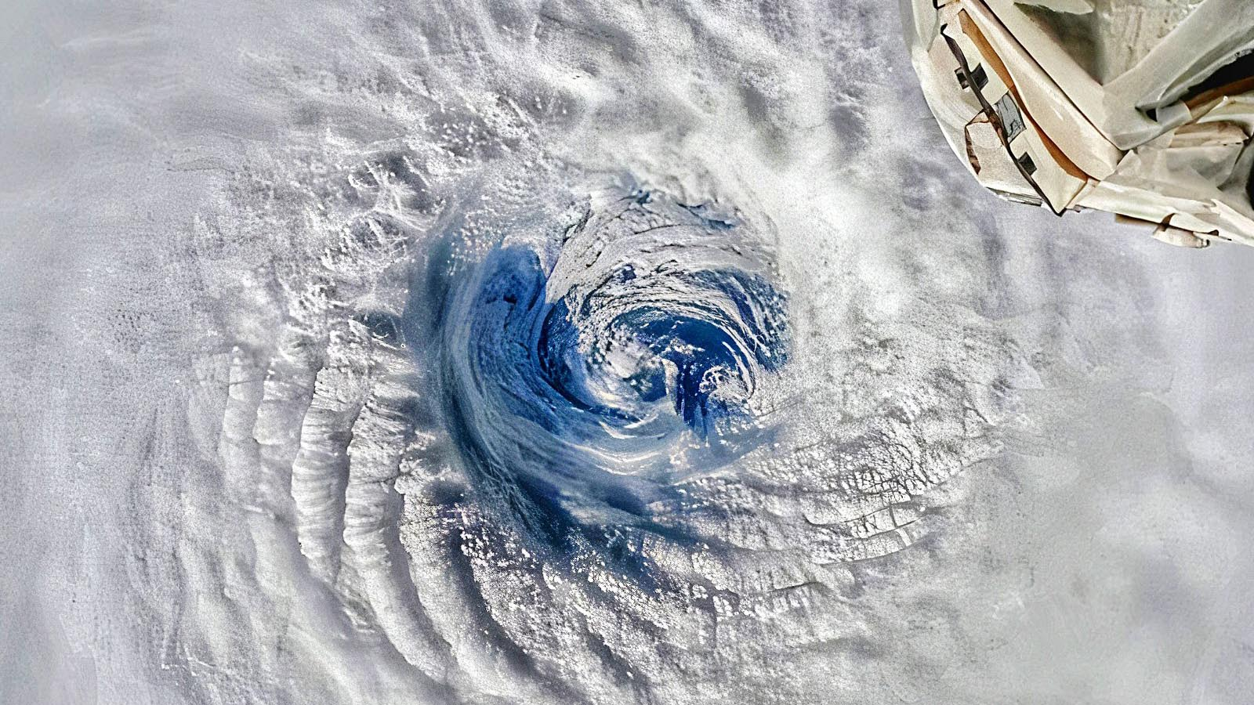
Learning Intention:
Recognise that impact levels from pulse events alter as populations increase and landscape dynamics change.
This leads to increased pressure on infrastructure designed to mitigate risk.
Success Criteria:
Complete Marine Education worksheet ’25. Disturbance Dynamics’
Category 3 Cyclone Freddy hits Madagascar, Feb 13th 2023
Notes:
Image: https://yaleclimateconnections.org/2023/02/category-3-cyclone-freddy-hits-madagascar/

Slide 2
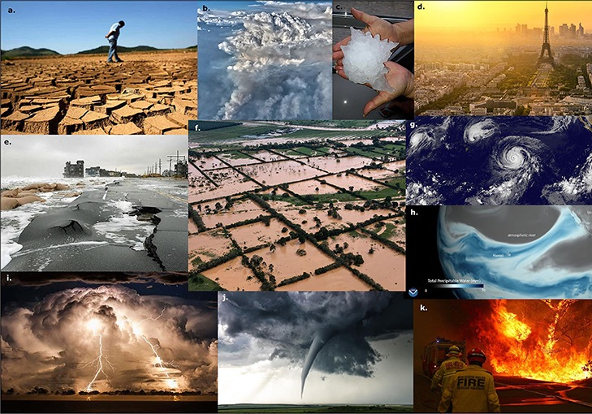
A pulse event is a (short-term) extreme weather event.
Notes:
Image; https://kids.frontiersin.org/articles/10.3389/frym.2022.682759
Figure 1 - Different types of climate and weather extremes and their impacts: (a) Drought conditions near Jaguari dam, Brazil (January 2014).
(b) Smoke from the Williams Flat Fire (WA, USA, 8 August 2019). (c) The “Victoria’s hailstone” in Villa Carlos Paz in Argentina (8 February 2018). (d) Paris during a heatwave (France). (e) New Jersey shoreline after a storm surge (USA). (f) Flooding following hurricane Eta (Central America, November 2020). (g) Four tropical cyclones across the Pacific Ocean (1 September 2015): Typhoon Kilo, Hurricane Ignacio, Hurricane Jimena, and Tropical Depression 14E. (h) Atmospheric river bringing moisture from the tropics to the Western U.S. (2018). (i) Thunderstorm off the coast of Byron Bay, Australia. (j) Tornado. (k) Wildfire and firefighters near Bilpin, Australia (19 December 2019). See the Author’s Note section for photo credits.

Slide 3
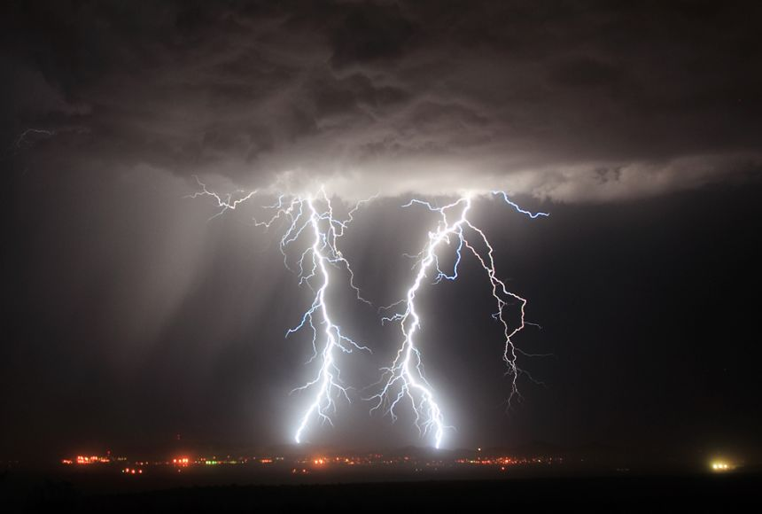
Air, water, and heat are the three main ingredients that make the weather.
Depending on the combinations of these ingredients, different types of weather form.
Notes:
Image: https://education.nationalgeographic.org/resource/weather/

Slide 4
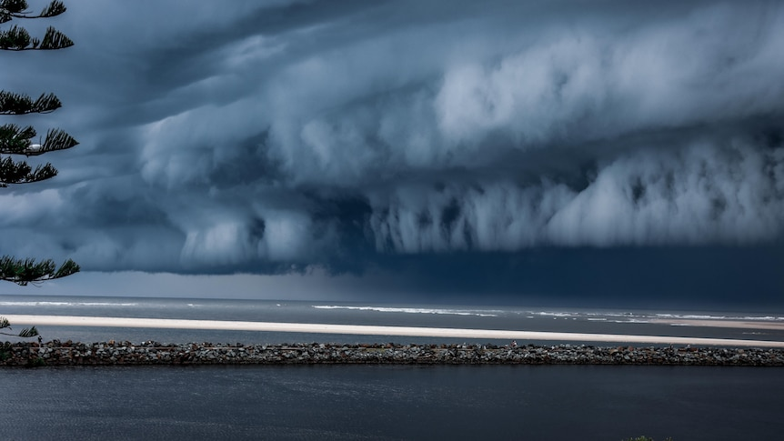
When the ocean is warm, air directly above the ocean is warm.
When the air is warm,
it rises up into the atmosphere
as an updraft.
updraft
Notes:
Image: https://www.abc.net.au/news/rural/2022-09-27/qld-braces-for-wet-september-end-weather/101476372

Slide 5
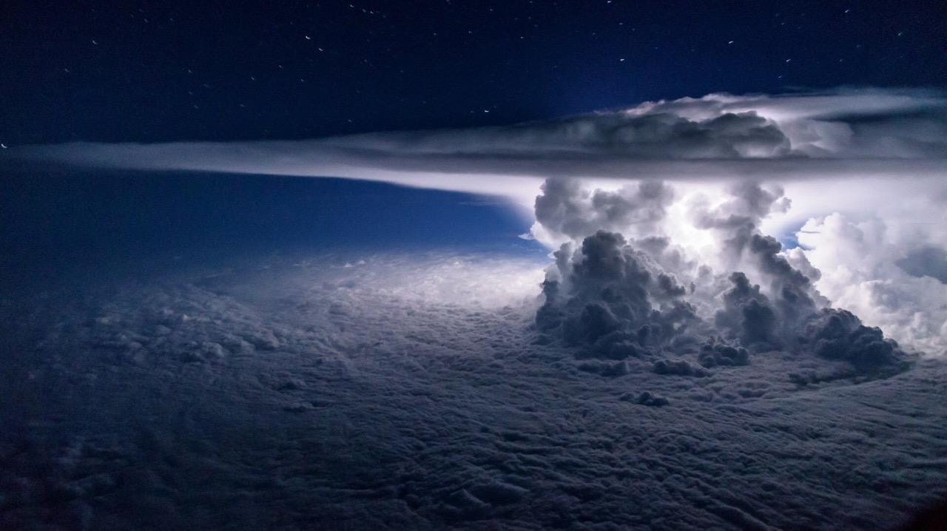
Pacific Storm from 11km above the ocean
Notes:
Image: https://www.reddit.com/r/NatureIsFuckingLit/comments/6gl2w5/pacific_storm_from_37000_feet_above_the_ocean/

Slide 6
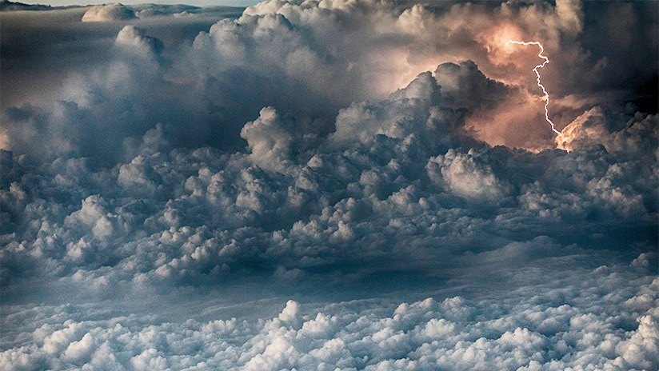
An updraft transfers heat energy (and water molecules) from the ocean to the atmosphere.
The extra heat in the atmosphere means more energy for storms.
Notes:
Image: https://flightsafety.org/asw-article/tossed-by-a-thunderstorm/

Slide 7
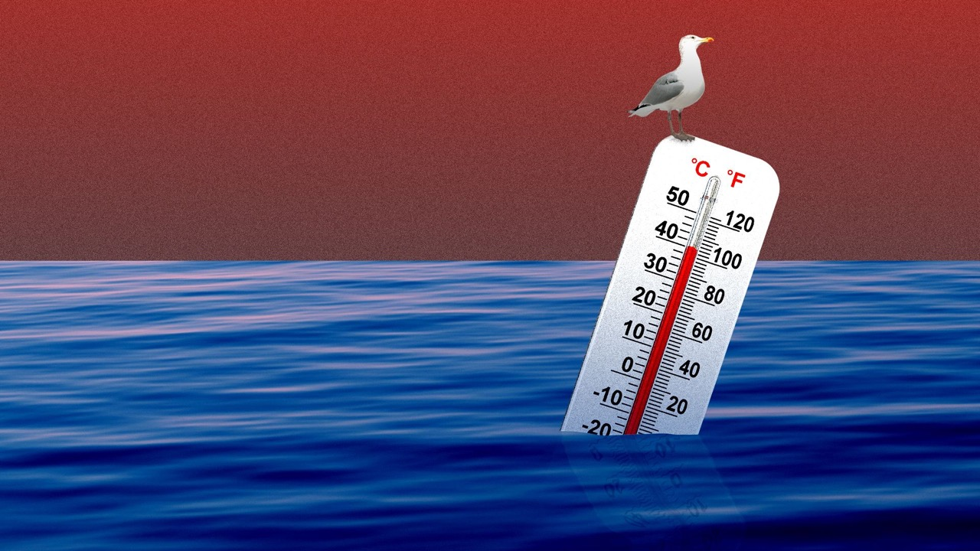
The ocean is warming.
Notes:
Image: https://www.axios.com/2018/11/01/worlds-oceans-warming-60-percent-faster-than-thought

Slide 8
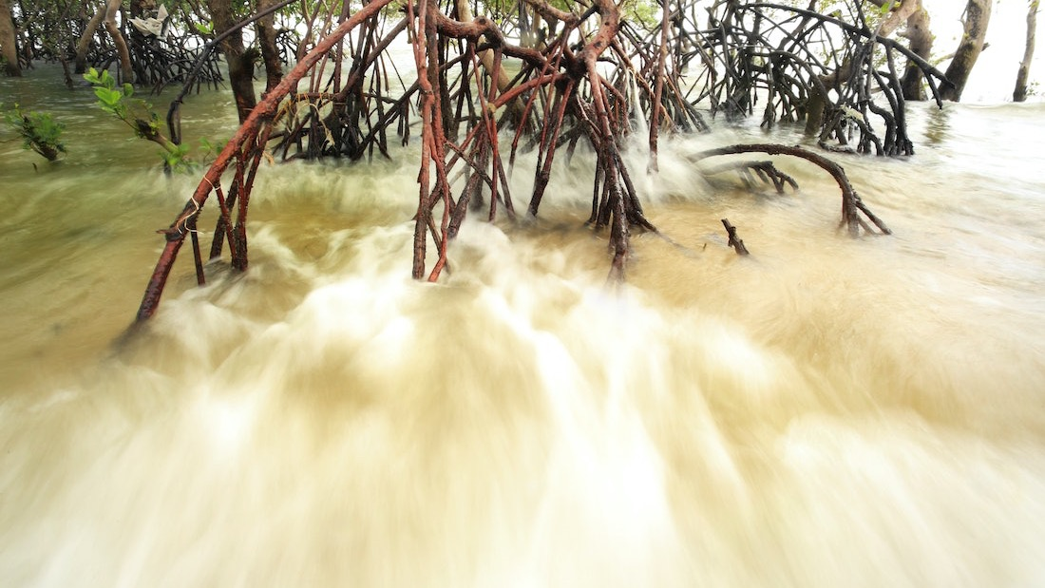
Storms generate destructive winds, intense rainfall and storm surge
Notes:
Image: https://social.shorthand.com/IUCN_forests/nCec1jyqvn/mangroves-against-the-storm

Slide 9
Mangroves provide a protective buffer from strong winds and large waves
reducing wave height
Notes:
Image: https://www.mdpi.com/2071-1050/13/15/8212
Paper: Mapping Mangrove Opportunities with Open Access Data: A Case Study for Bangladesh

Slide 10
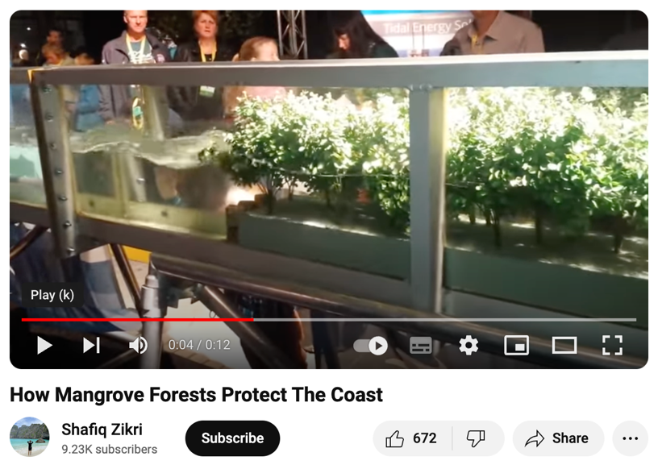
Play video: https://www.youtube.com/watch?v=aoMrLYJOdA4

Slide 11
More mangroves means more protection during pulse events
Notes:
Image: https://www.sciencedirect.com/science/article/pii/S1674237022000874
Paper: Mangrove forests as a nature-based solution for coastal flood protection: Biophysical and ecological considerations. Water Science and Engineering Volume 16, Issue 1, March 2023, Pages 1-13

Slide 12
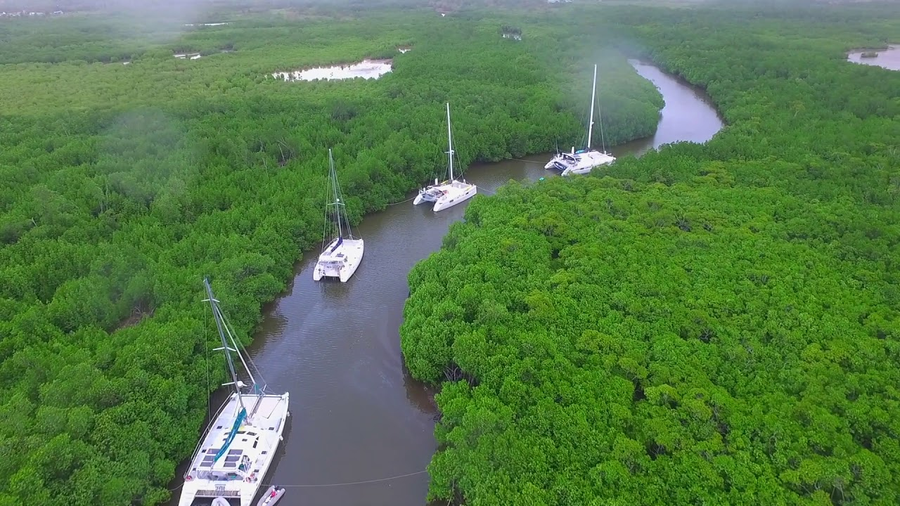
Notes:
Image: https://www.youtube.com/watch?v=o32nvI3bIC8

Slide 13
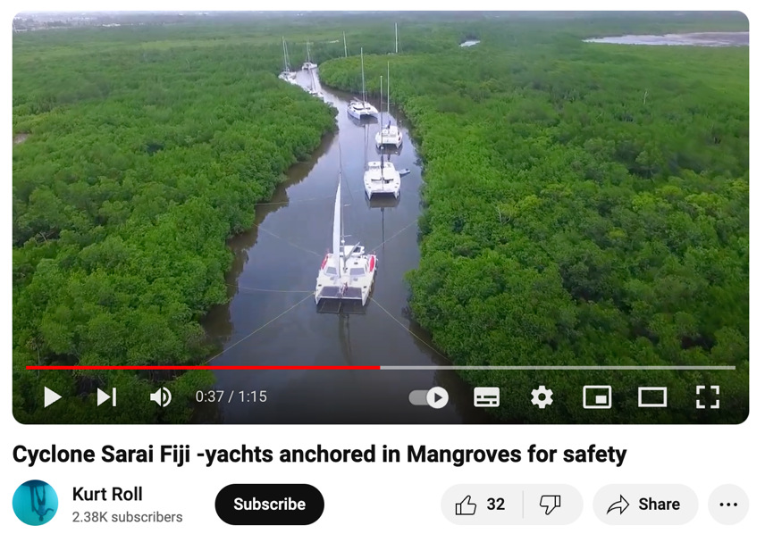
https://www.youtube.com/watch?v=o32nvI3bIC8

Slide 14
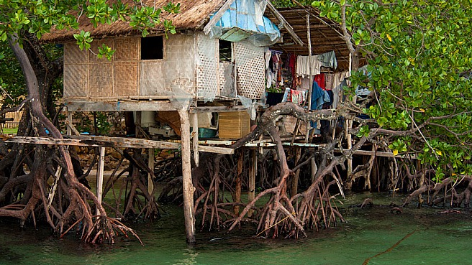
Notes:
Image: https://www.naturepl.com/stock-photo-a-thatched-house-built-in-amongst-the-mangrove-roots-on-stilts-nature-image01348523.html

Slide 15
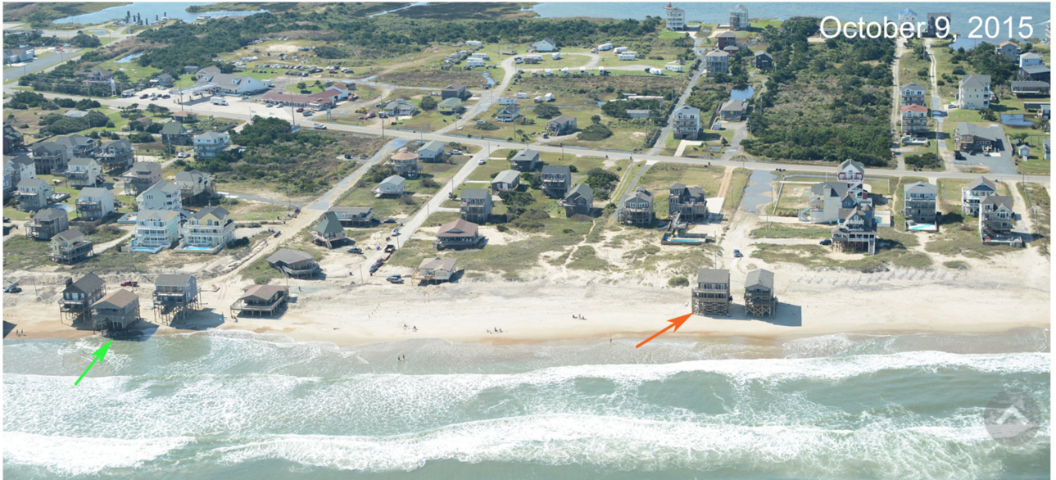
Houses in Rodanthe, North Carolina USA on the verge of collapsing into the ocean
Notes:
Image: https://www.usgs.gov/media/images/aerial-photographs-rodanthe-north-carolina
More: https://www.wfae.org/energy-environment/2022-05-09/beach-nourishment-along-outer-banks-will-be-sustainable-for-foreseeable-futureA house in Rodanthe is on the verge of collapsing into the ocean on March 25, 2022

Slide 16
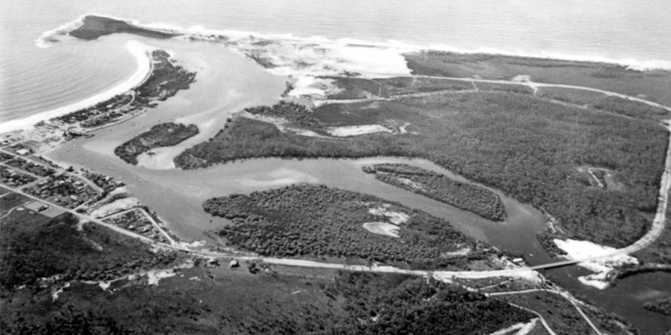
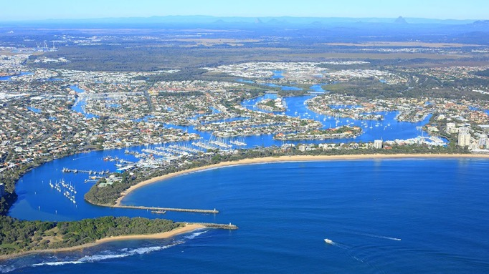
Mooloolaba 1960s
When people move to coastal locations in large numbers, the landscape changes.
Mangroves are replaced by housing and development.
Mooloolaba 2000s
Notes:
Image: https://www.yourtimemagazine.com.au/neighbourhoods-rise-from-the-dunes/

Slide 17
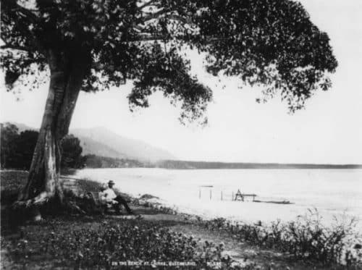
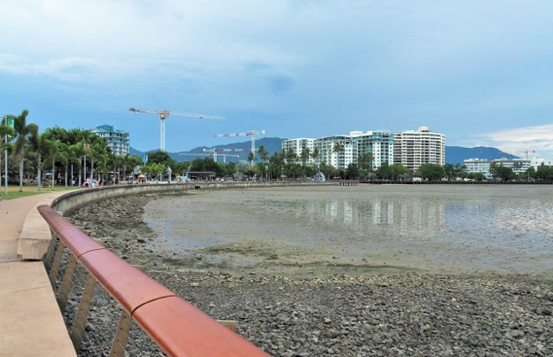
1883
Cairns Esplanade
100⁺ years later
Notes:
Images: https://www.robpyne.com.au/old-pictures-of-cairns/#h-cairns-esplanade

Slide 18
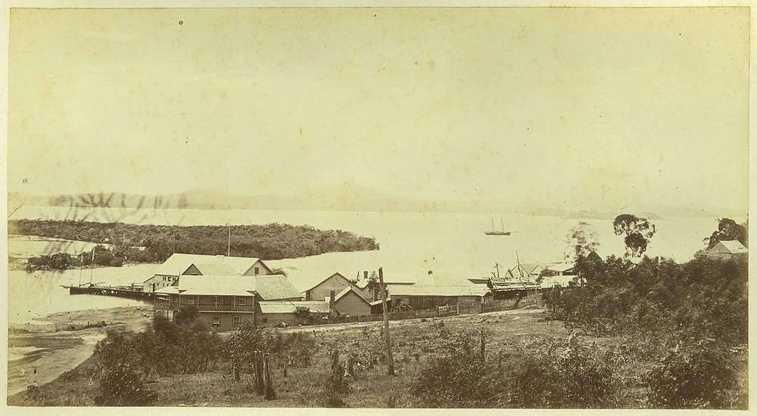
Harbour at Gladstone, Queensland, ca. 1873
Notes:
Image: http://www.bonzle.com/pictures-over-time/pictures-taken-in-1873/page-2/picture-ywxz3pe9/size-4/gladstone/harbour-at-gladstone-queensland-ca-1873

Slide 19
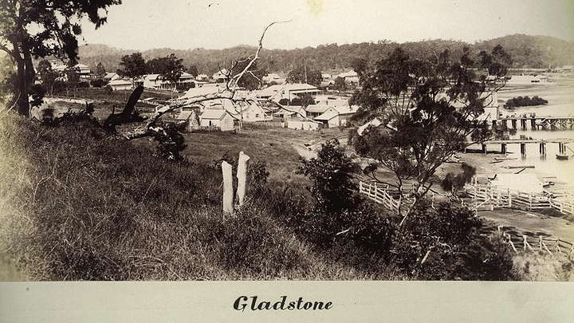
1890

Slide 20
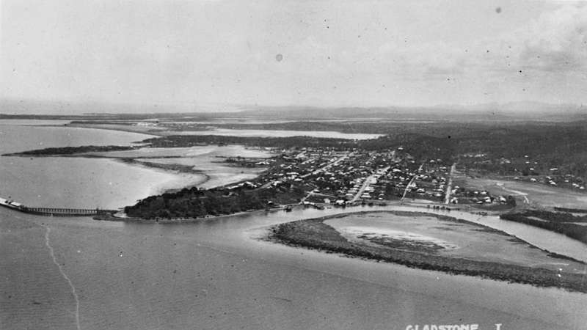
Aerial view of Gladstone, ca. 1924
Notes:
Image: http://www.bonzle.com/c/a?a=p&p=953&d=pics&yr=1924&c=1&x=151%2E25635&y=%2D23%2E84761&w=40000&mpsec=0

Slide 21
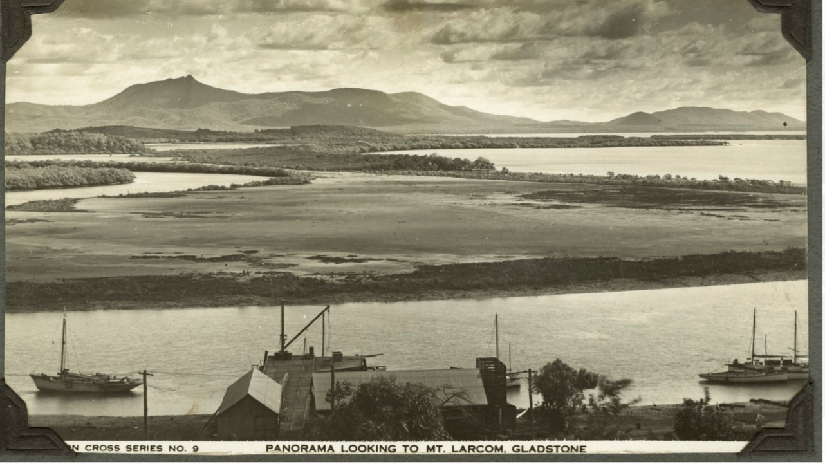
Harbour at Gladstone, Queensland, 1937
Notes:
Image: https://www.historicprints.com.au/unrestored/gladstone-queensland-unrestored?itemId=hobp7dyvjgcigogkyhjb7p23hdtzpe

Slide 22
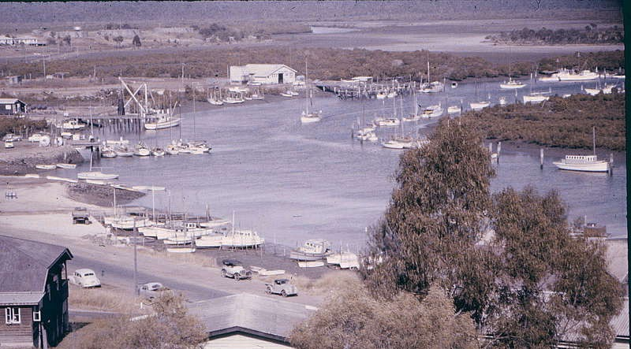
Gladstone Harbour 1960
2020

Slide 23
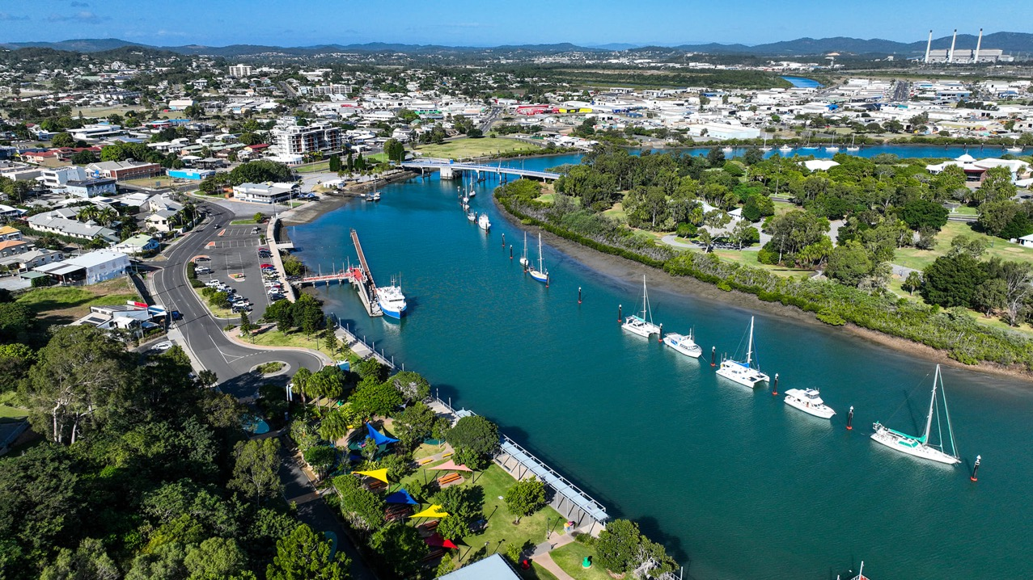
Gladstone Harbour 2023. Image: Blueys Photography

Slide 24
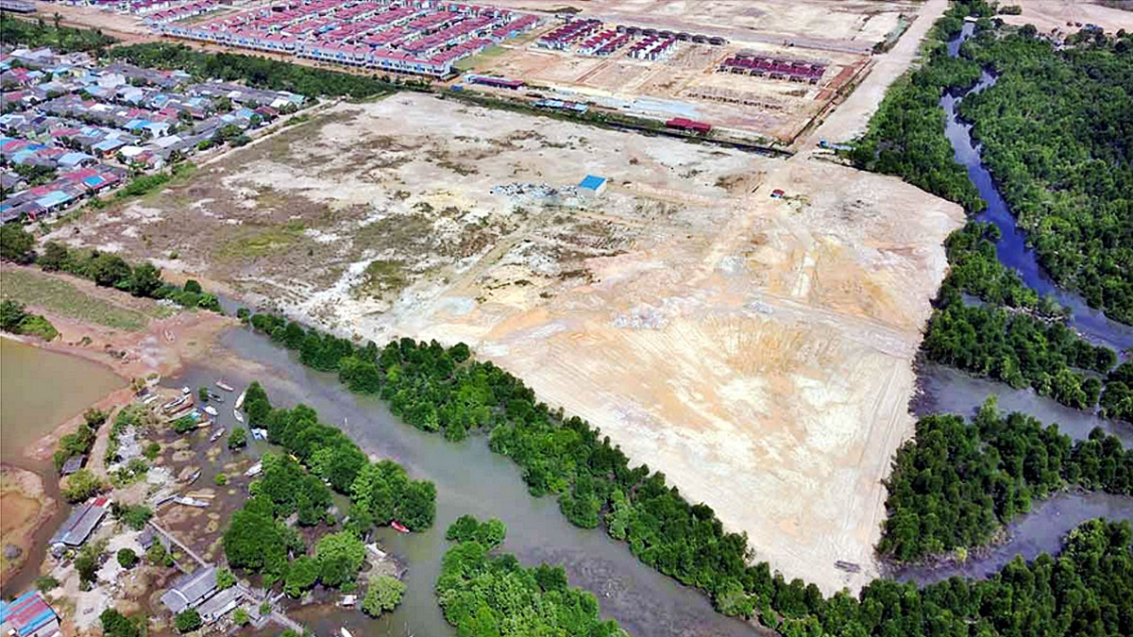
Batam, Indonesia
Notes:
Image: https://magz.tempo.co/read/environment/40023/batam-mangrove-forest-damaged-due-to-the-development-of-housing-complex

Slide 25
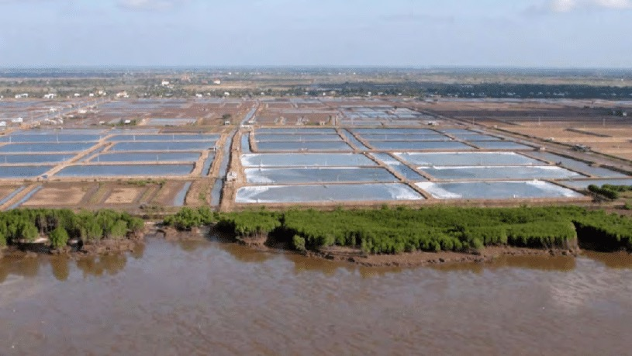
Mangroves in Viet Nam are threatened by expanding aquaculture and salt farming on the land side, and coastal erosion induced through wave's forces especially during storms (on average 7 cyclones per year), as well as climate change induced sea level rise on the coast side. Planned dikes for coastal protection restrict mangrove ecosystem functioning as the tidal trees require constant water exchange. Photo courtesy of GIZ (via IUCN)
Notes:
Image: https://www.researchgate.net/figure/3-Mangroves-in-Viet-Nam-are-threatened-by-expanding-aquaculture-and-salt-farming-on-the_fig2_258342762

Slide 26
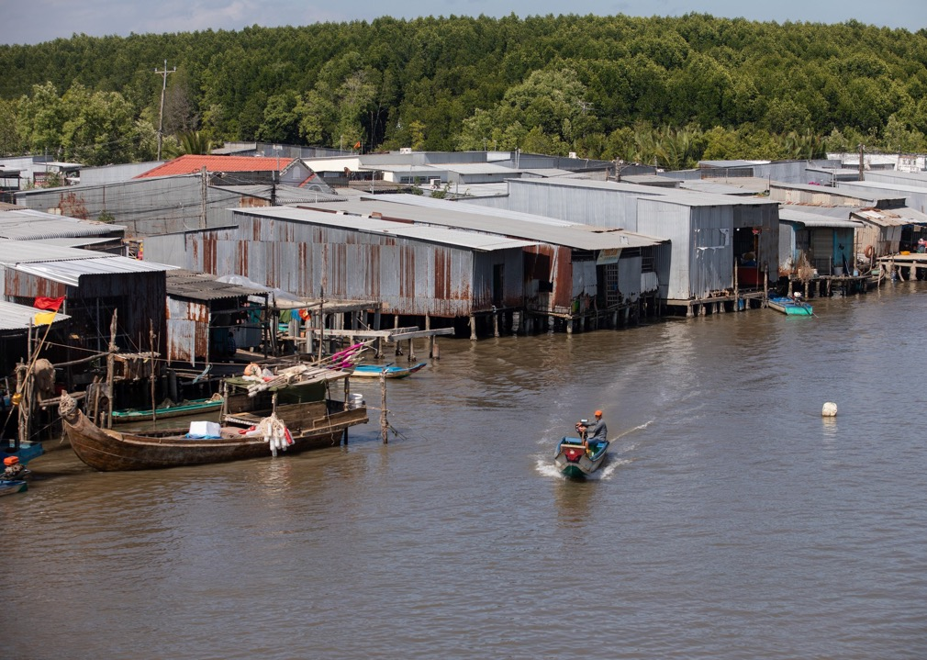
When mangroves are gone,
their protective function is also gone.
Notes:
Image: Houses flanking a canal on the fringes of Ca Mau Cape National Park, a protected area where afforestation projects are ongoing (Image: Thanh Nguyen / The Third Pole)
Source: https://www.thethirdpole.net/en/livelihoods/shrimp-farmers-working-with-mangroves-mekong-delta-vietnam/

Slide 27
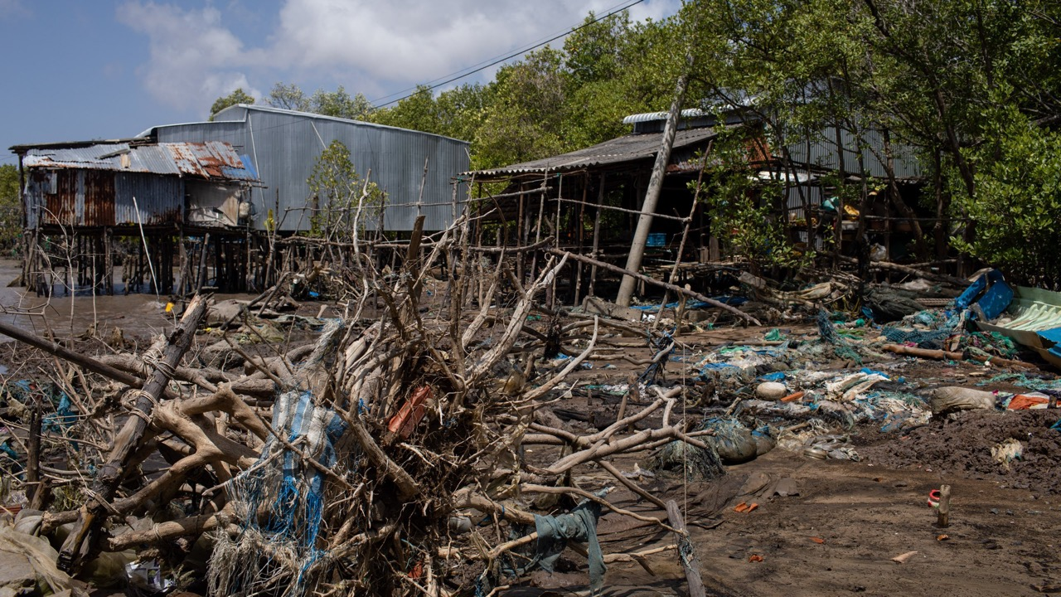
Abandoned houses in a hamlet in Ngoc Hien district, Ca Mau.
Notes:
Image: https://www.thethirdpole.net/en/livelihoods/shrimp-farmers-working-with-mangroves-mekong-delta-vietnam/

Slide 28
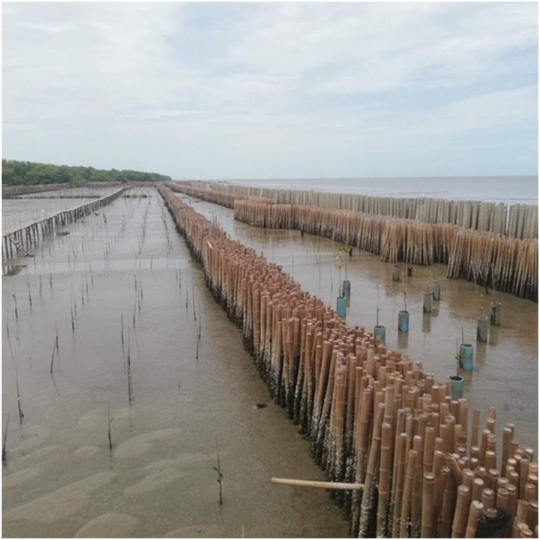
Mangrove loss leads to increased pressure on infrastructure designed to mitigate risk.
Do they work?
Pictured right: Bamboo dykes in Thailand built to protect against erosion.
The total area of mangrove forests in Thailand decreased by more than 50% between 1961 and 1996.
Notes:
Image: https://onlinelibrary.wiley.com/doi/full/10.1111/1745-5871.12580

Slide 29
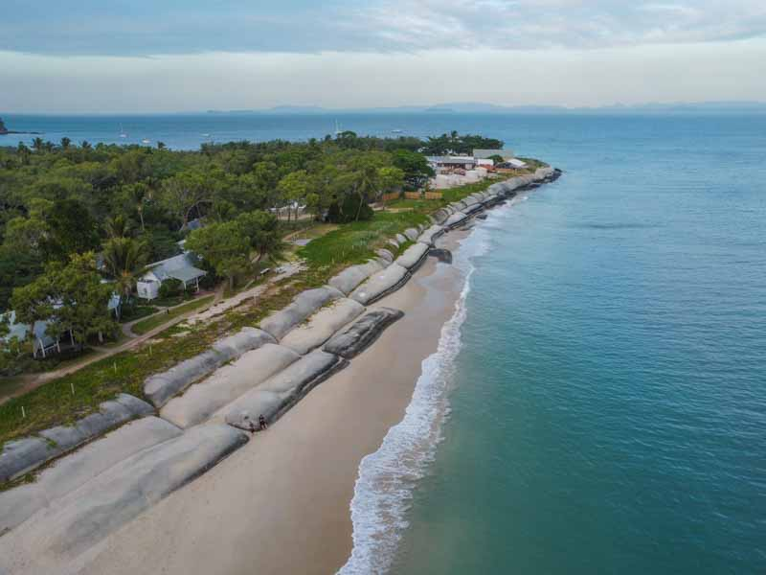
Pictured left:
Great Keppel Island erosion mitigation.
Could it withstand a cyclone?

Slide 30
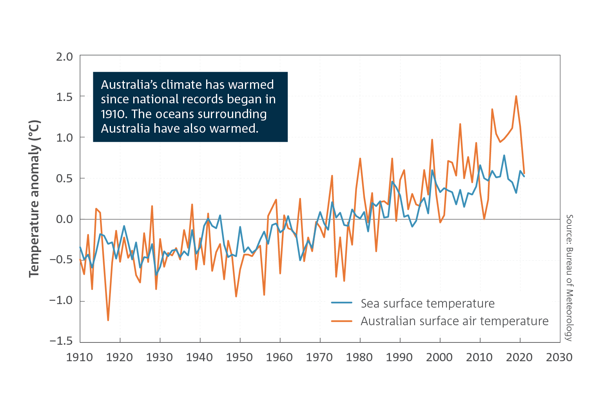
The severity of a pulse event, such as a high intensity storm event, increases on a background of presses, such as the effects of climate change.
Notes:
Image: http://www.bom.gov.au/state-of-the-climate/

Slide 31
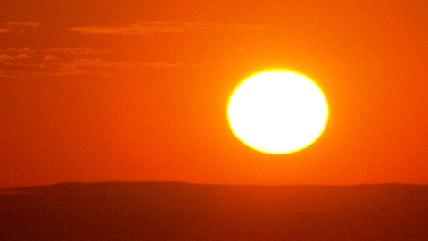
Presses are long term pressures on an environment (as opposed to pulse events that are short term stressors).
e.g. rising sea surface temperatures associated with climate change.

Slide 32
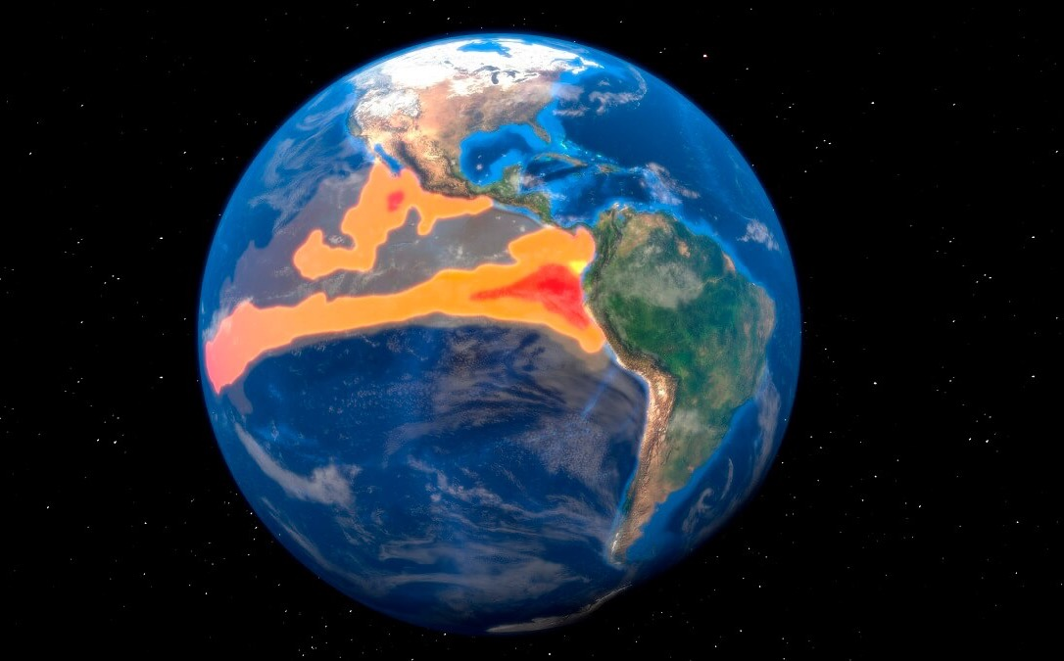
In a press-pulse framework, the impacts of an extreme weather event depends not only on the
magnitude, duration, frequency and timing of the pulse, but also
the state of the press.

Slide 33
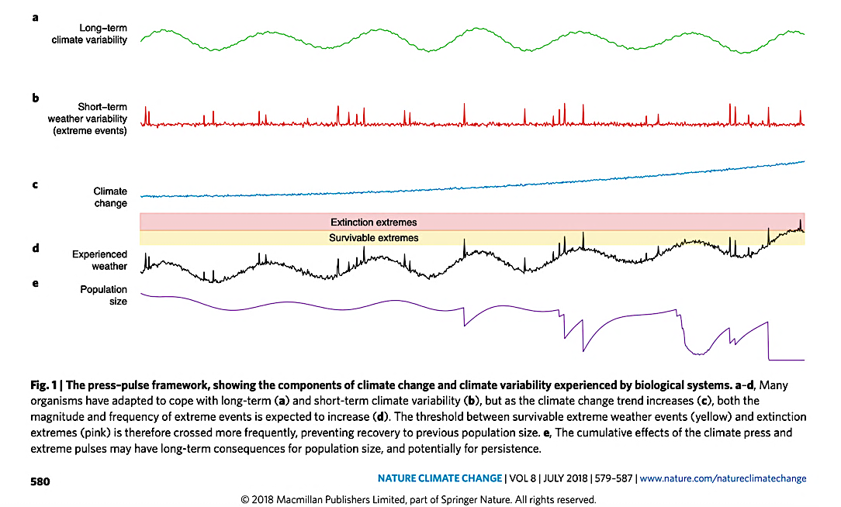
Notes:
Image: https://www.researchgate.net/profile/Mike-Letnic/publication/326067239_Biological_responses_to_the_press_and_pulse_of_climate_trends_and_extreme_events/links/5b4e9dd445851507a7a9a3c2/Biological-responses-to-the-press-and-pulse-of-climate-trends-and-extreme-events.pdf (accessed via google scholar)

Slide 34
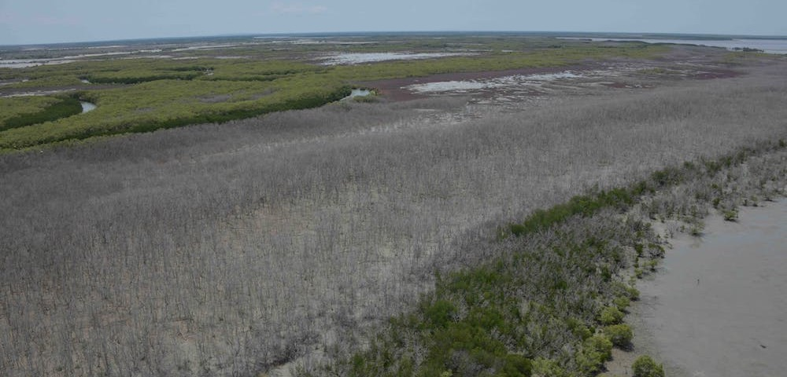
E.g. Mangrove dieback (Gulf of Carpentaria, 2015–2016)
Approximately 39.4 million trees died
releasing an estimated 820,895 tonnes of carbon
Notes:
Image: https://nesplandscapes.edu.au/projects/nesp/gulf-mangrove-dieback/
Info: https://nesplandscapes.edu.au/projects/nesp/gulf-mangrove-dieback/

Slide 35
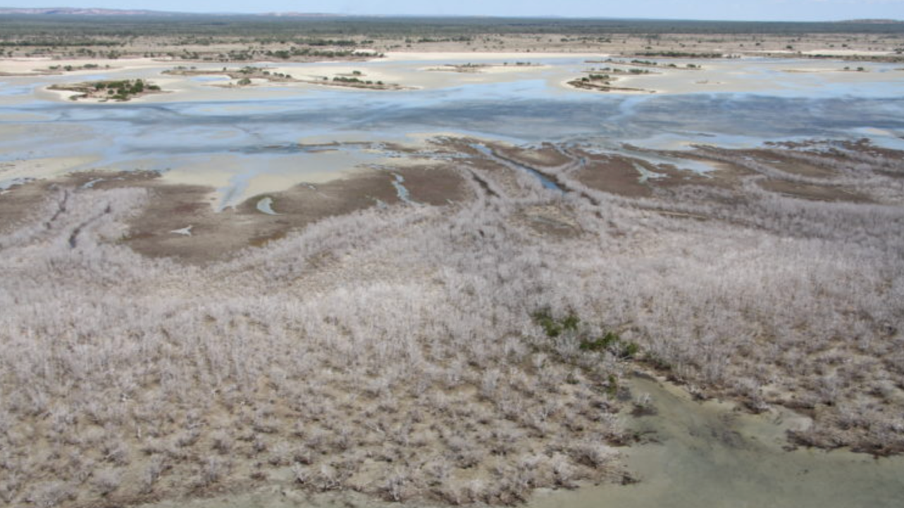

Slide 36
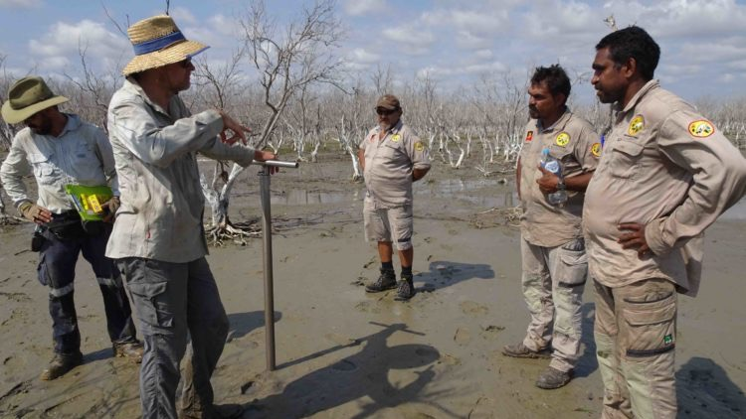

Slide 37
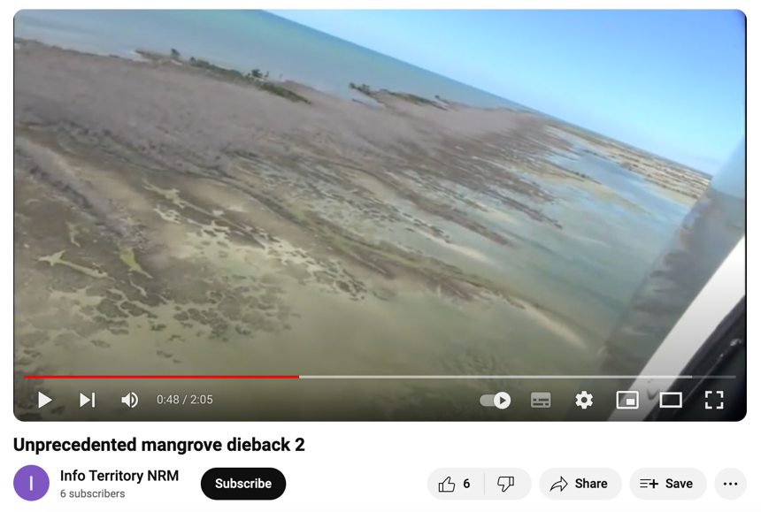
Views of mangrove shorelines impacted by dieback event in late 2015, east of Limmen Bight River, Northern Territory (imagery: NC Duke, June 2016).
Play video: https://www.youtube.com/watch?v=rLCUF-Kc5hY
Notes:
Another video: https://www.youtube.com/watch?v=p__8Pod_gzg

Slide 38
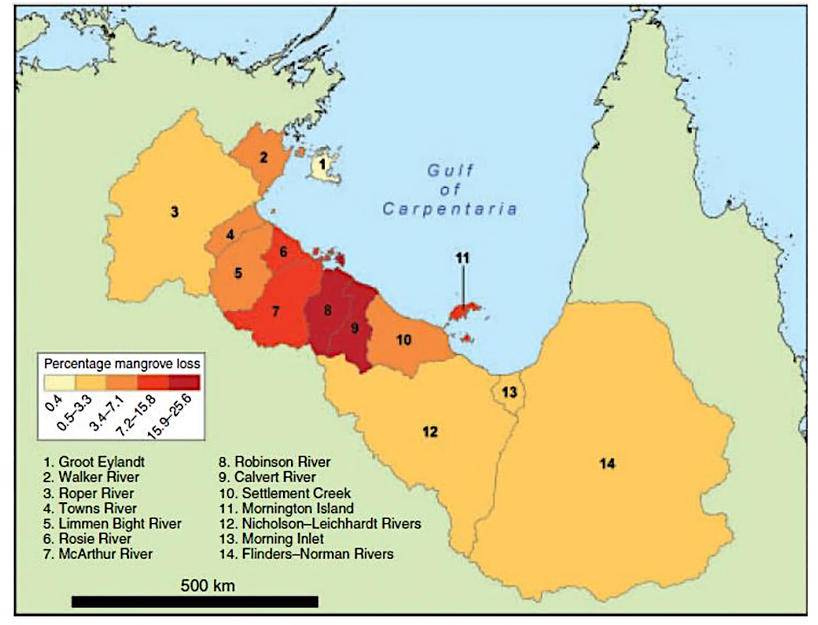
They died of thirst.
A drought, heat wave conditions and sea level drop of approx. 20cm (it was an El Nino year) is thought to have caused the die-back.
Notes:
Figure 1: Proportional losses of mangroves for 14 catchment areas bordering the southern shorelines of the Gulf of Carpentaria. From Duke et al. 2017, their Figure 10
Source: https://researchonline.jcu.edu.au/50134/1/2017_HarrisHope%20plus%20BOM.pdf
Paper: Climate drivers of the 2015 Gulf of Carpentaria mangrove dieback Todd Harris, Pandora Hope, Eric Oliver, Robert Smalley, Julie Arblaster, Neil Holbrook, Norman Duke, Karen Pearce, Karl Braganza and Nathaniel Bindoff March 2017

Slide 39
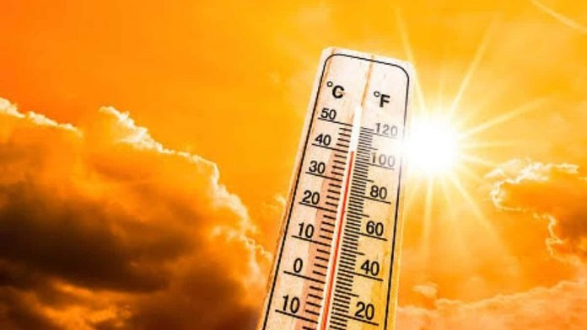
In a press-pulse framework, pulse events interact with press events - they do not occur in isolation.
E.g. thanks to climate change, heat waves are expected to become hotter and last longer.

Slide 40
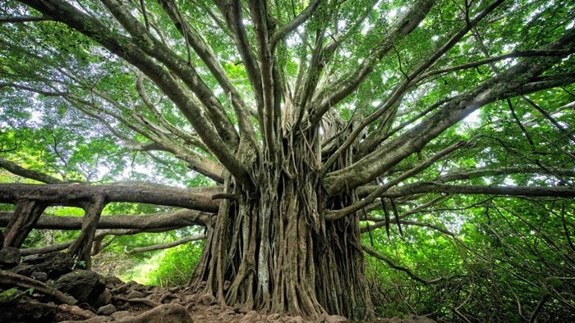
We need our mangroves to be alive now, more than ever before!
Notes:
Image: https://davesgarden.com/guides/articles/roots-the-twisted-tale-of-the-mangrove

Slide 41
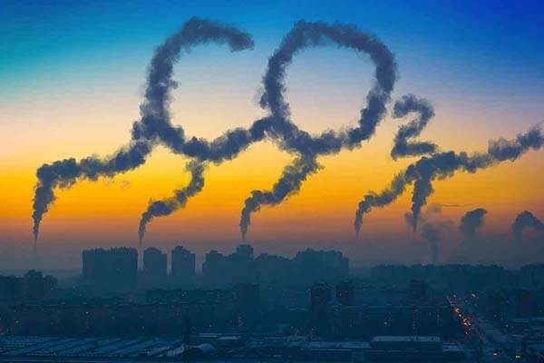
Mangroves not only protect people from the effects of climate change…
…they also combat it at the source – CO₂ emissions

Slide 42
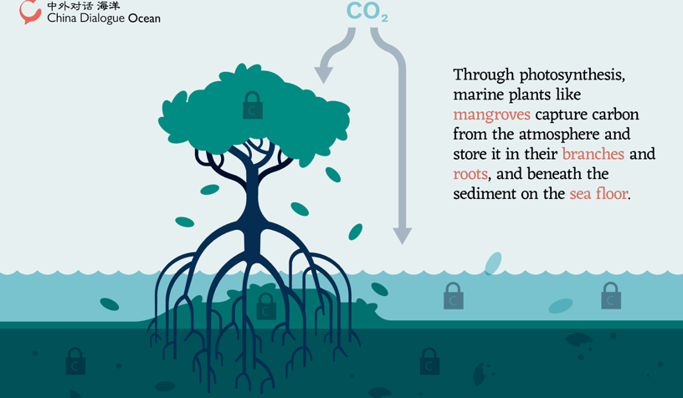
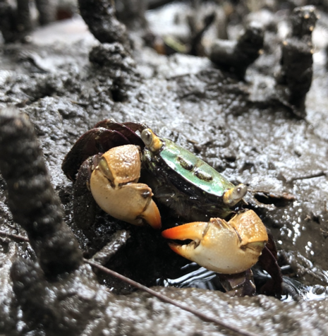
Mangroves trap carbon 50 times faster than any other forest! How?
Rapid leaf production and high leaf turnover rates (from ditching salty leaves all the time).
Crabs then grab the leaves and bury them under the mud.
Thus, locking up the carbon and throwing away the key.
Notice how the leaves are never on the ground for very long? That’s why!
Notes:
Illustration: Ed Harrison/China Dialogue Ocean
Image: https://chinadialogueocean.net/en/conservation/blue-carbon-how-coastal-ecosystems-help-capture-emissions/
Crab: https://fieldofmar-e.schools.nsw.gov.au/fact-sheets/mangrove-forest.html

Slide 43
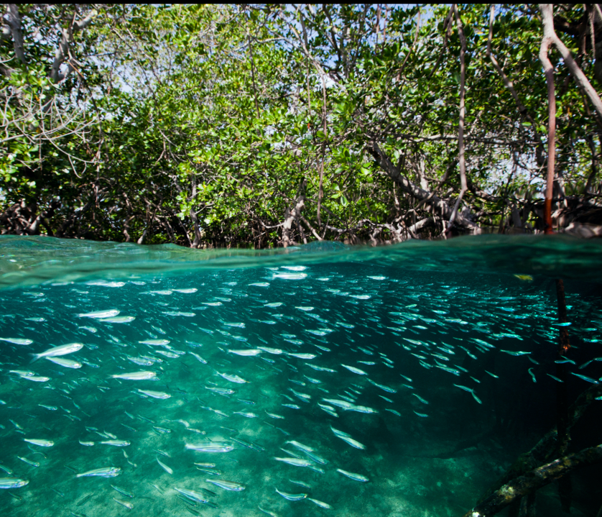
Mangroves are nurseries for juvenile marine life
Notes:
https://chinadialogueocean.net/en/conservation/blue-carbon-how-coastal-ecosystems-help-capture-emissions/
Mangroves in Komodo National Park, Indonesia. In addition to capturing blue carbon, mangroves provide a habitat for a wide variety of species and act as a natural barrier against flooding. (Image: Paul Hilton/Greenpeace)

Slide 44
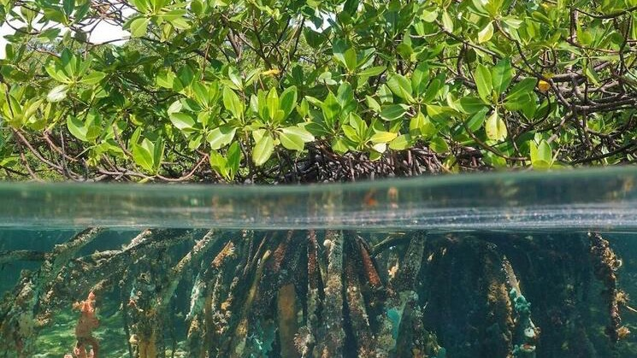
Mangroves filter the water and keep it clean!
Notes:
Image: https://www.worldwildlife.org/blogs/sustainability-works/posts/investing-in-mangroves-to-protect-people

Slide 45
What man-made infrastructure, designed to mitigate risk, can do all that?!
and mangroves do it all, for free!!

Slide 46
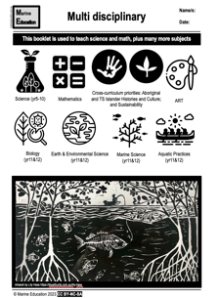
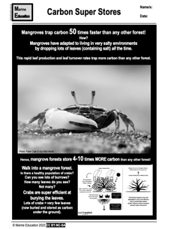
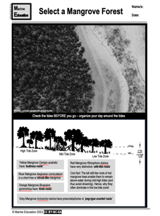
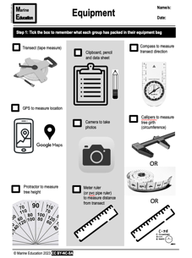
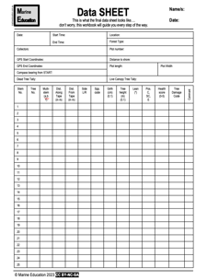
Help Jock save the mangroves!

Slide 47
Learning Intention:
Recognise that impact levels from pulse events alter as populations increase and landscape dynamics change.
This leads to increased pressure on infrastructure designed to mitigate risk.
Success Criteria:
Complete Marine Education worksheet ’25. Disturbance Dynamics’
Category 3 Cyclone Freddy hits Madagascar, Feb 13th 2023
Notes:
Image: https://yaleclimateconnections.org/2023/02/category-3-cyclone-freddy-hits-madagascar/

