Slide 1
Learning Intention:
Appreciate that diver-propelled vehicles with customised high-definition cameras and automated image-annotation methods have dramatically increased the size, accuracy, and geographic and temporal scope of the datasets that marine scientists work with.
Success Criteria:
Complete Marine Education worksheet ’26. Eyes under the water’

Slide 2
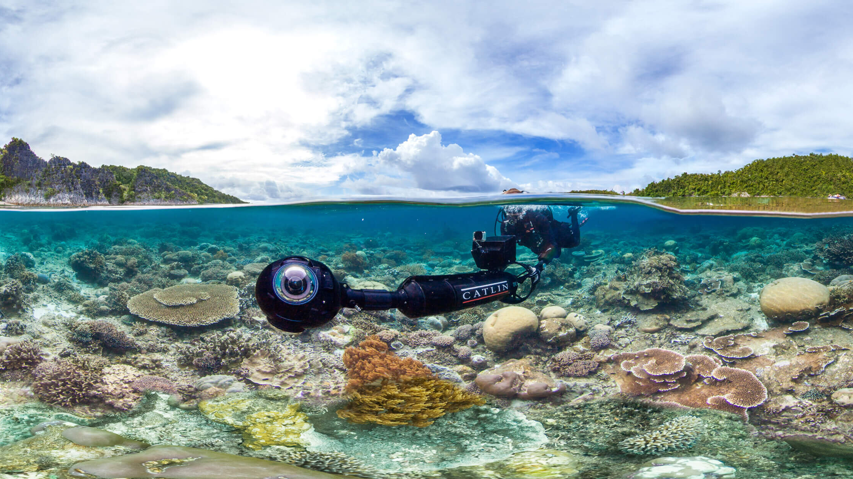

Slide 3
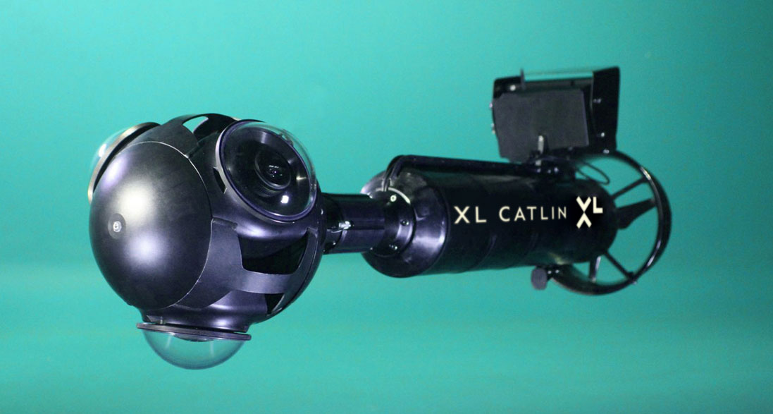
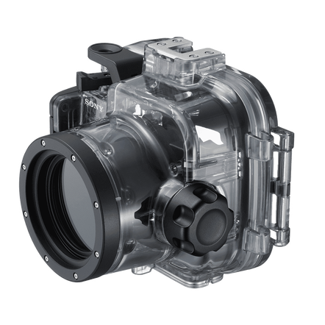
before…
…to now
Notes:
Image: http://www.globalreefrecord.org/methodology

Slide 4
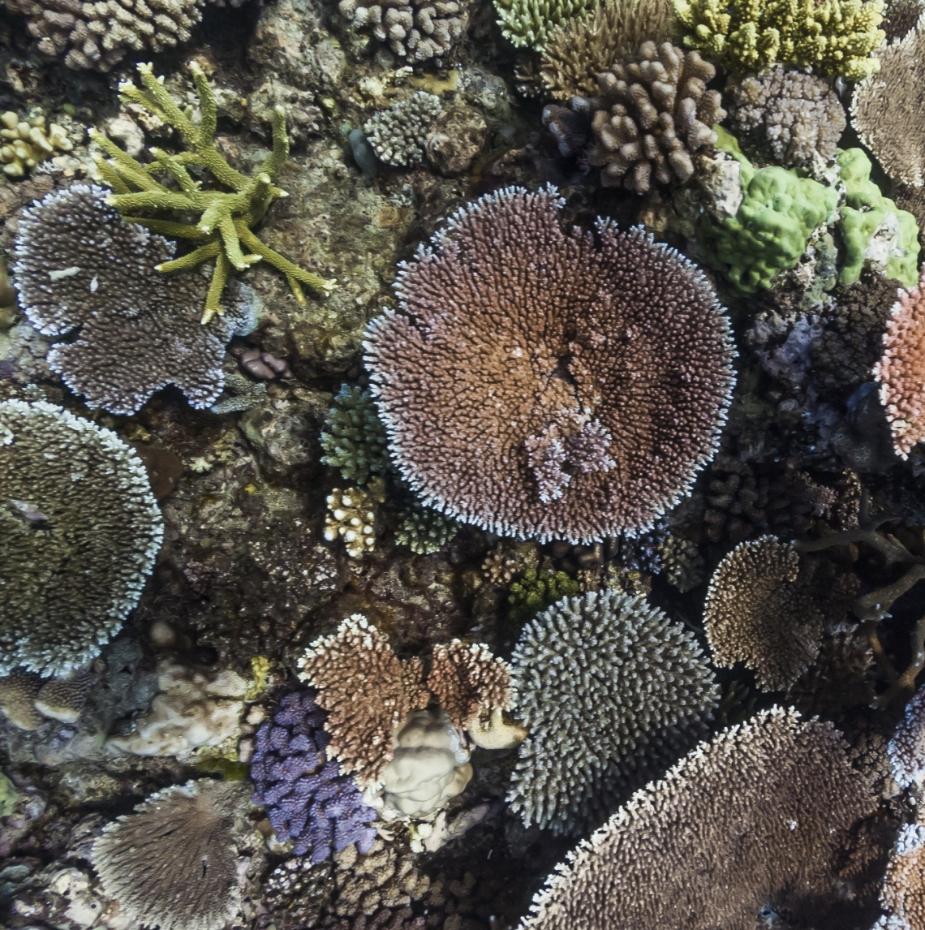
Activity:
Estimate percentage hard coral cover in the photo pictured left
E.g. what percentage of the photograph is hard coral?
Note: % hard coral cover is used to measure reef health
© Underwater Earth / XL Catlin Seaview Survey / The University of Queensland
Notes:
Image: https://espace.library.uq.edu.au/data/UQ_
González-Rivero, M., Rodriguez-Ramirez, A., Beijbom, O., Ganase, A., Dalton, P., Kennedy, E.V., Neal, B.P., Vercelloni, J., Bongaerts, P., Bryant, D.E.P., Brown, K., Kim, C., Radice, V.Z., LopezMarcano, S., Dove, S., Bailhache, C., Beyer, H.L. & Hoegh-Guldberg, O. 2019. Seaview Survey Photo-quadrat and Image Classification Dataset. The University of Queensland. DOI: 10.14264/uql.2019.930

Slide 5
How did you go?
Now multiply that by 1.1 million.

Slide 6
The XL Catlin Seaview Survey Project collected 1.1 million photo-quadrats between 2012 and 2018 at 860 transect locations from 23 coral reef countries around the world, including: the Caribbean and Bermuda, the Indian Ocean, the Coral Triangle, the Great Barrier Reef, Taiwan and Hawaii.
All of them needed to be analysed.
Notes:
Image: https://espace.library.uq.edu.au/view/UQ:734799
González-Rivero, M., Rodriguez-Ramirez, A., Beijbom, O., Ganase, A., Dalton, P., Kennedy, E.V., Neal, B.P., Vercelloni, J., Bongaerts, P., Bryant, D.E.P., Brown, K., Kim, C., Radice, V.Z., LopezMarcano, S., Dove, S., Bailhache, C., Beyer, H.L. & Hoegh-Guldberg, O. 2019. Seaview Survey Photo-quadrat and Image Classification Dataset. The University of Queensland. DOI: 10.14264/uql.2019.930

Slide 7
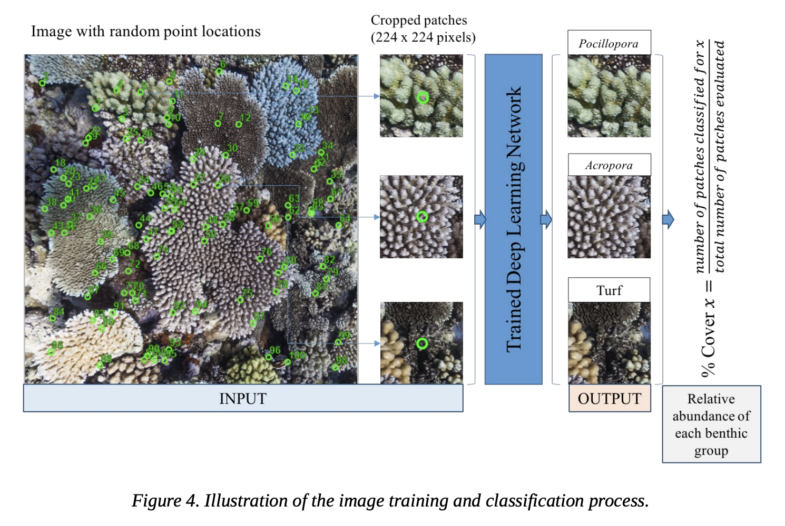
Enter…..
Artificial intelligence (AI)
Notes:
Image: https://espace.library.uq.edu.au/view/UQ:734799_
González-Rivero, M., Rodriguez-Ramirez, A., Beijbom, O., Ganase, A., Dalton, P., Kennedy, E.V., Neal, B.P., Vercelloni, J., Bongaerts, P., Bryant, D.E.P., Brown, K., Kim, C., Radice, V.Z., LopezMarcano, S., Dove, S., Bailhache, C., Beyer, H.L. & Hoegh-Guldberg, O. 2019. Seaview Survey Photo-quadrat and Image Classification Dataset. The University of Queensland. DOI: 10.14264/uql.2019.930

Slide 8
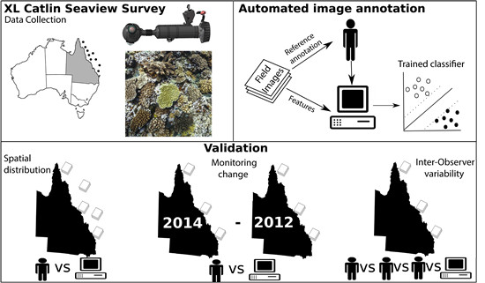
CoralNet was the AI tool used to analyse those 1.1million photoquadrat images
Notes:
Source: https://openaccess.thecvf.com/content/ICCV2021W/OceanVision/papers/Chen_A_New_Deep_Learning_Engine_for_CoralNet_ICCVW_2021_paper.pdf

Slide 9
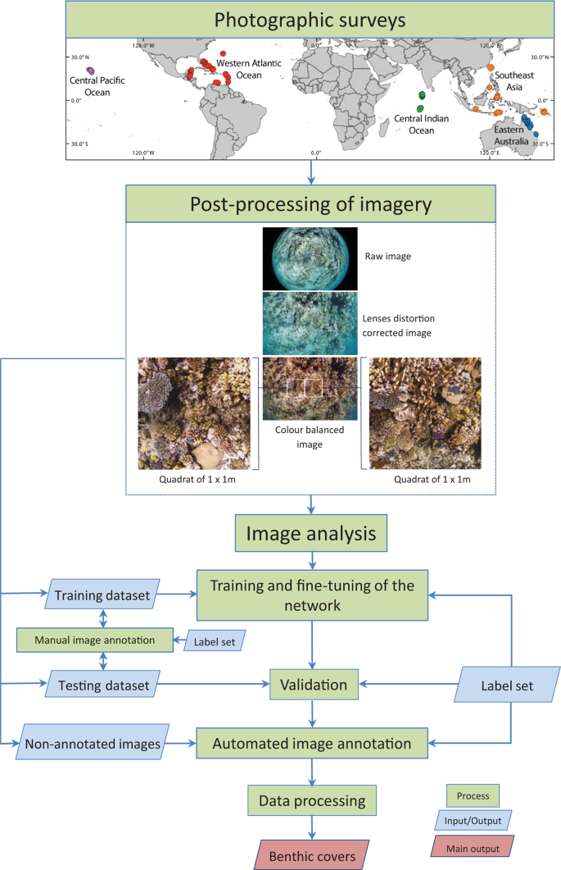
How CoralNet works (in very basic terms) -
Log in and upload your images.
Click on random points within each image and identify what lies under each point (like in Coral Point Count). This trains an AI classifier.
Test your AI classifier’s training for accuracy (validation).
Let your AI classifier identify the rest!
Continue to train and validate the AI classifier for accuracy.
Notes:
Fig.1 Theworkflowforgeneratingtheglobaldatasetofcoralreefimageryandassociateddata.The860 photographic surveys from the Western Atlantic Ocean, Southeast Asia, Central Pacific Ocean, Central Indian Ocean, and Eastern Australia, were conducted between 2012 and 2018. Reef locations are represented by points colour-coded according to the survey region. Surveys images were post-processed in order to transform raw fish- eye images into 1 × 1 m quadrats for manual and automated annotation (inset originally published in González- Rivero et al.23 as Figure S1). For the image analysis, nine networks were trained. For each network, images were divided in two groups: Training and Testing images. Both sets were manually annotated to create a training dataset and verification dataset. The training dataset was used to train and fine-tune the network. The fully trained network was then used to classify the test images, and contrast the outcomes (Machine) against the human annotations (Observer) in the test dataset during the validation process. Finally, the non-annotated images (photo- quadrats) were automatically annotated using the validated network. The automated classifications were processed to originate the benthic covers that constitute this dataset. QGIS software was used to generate the map using the layer “Countries WGS84” downloaded from ArcGIS Hub (http://hub.arcgis.com/datasets/UIA::countries-wgs84).

Slide 10
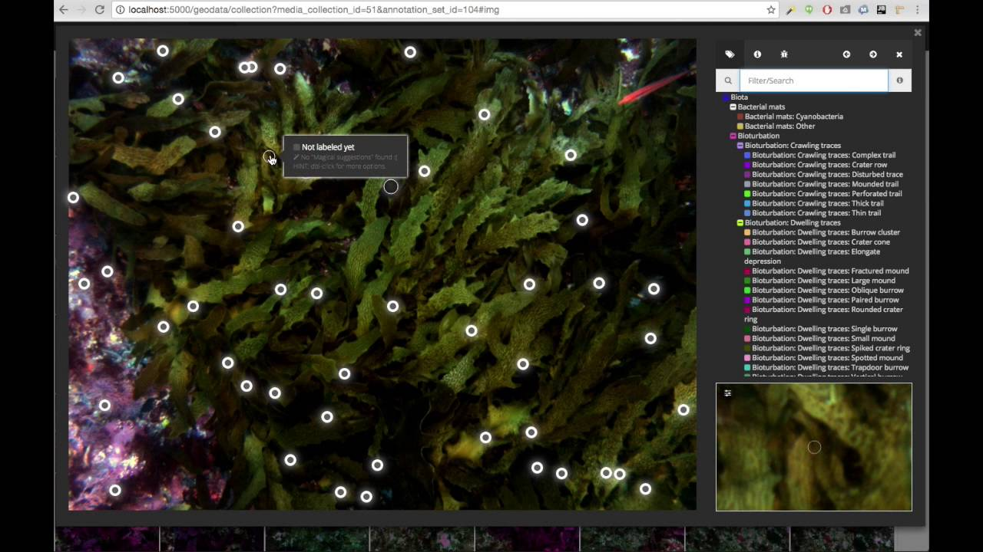
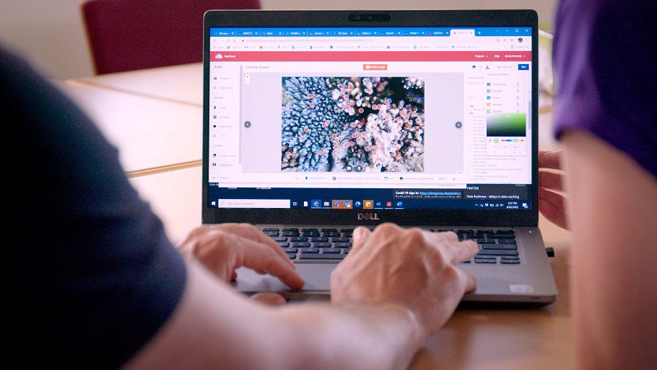
Other programs that are used to quickly analyse coral data using AI include Squidle, and Reef Cloud
squidle
Reef Cloud (AIMS)
Notes:
Squidle image: https://soi.squidle.org/about/
ReefCloud image: https://www.aims.gov.au/research/technology/reefcloud

Slide 11
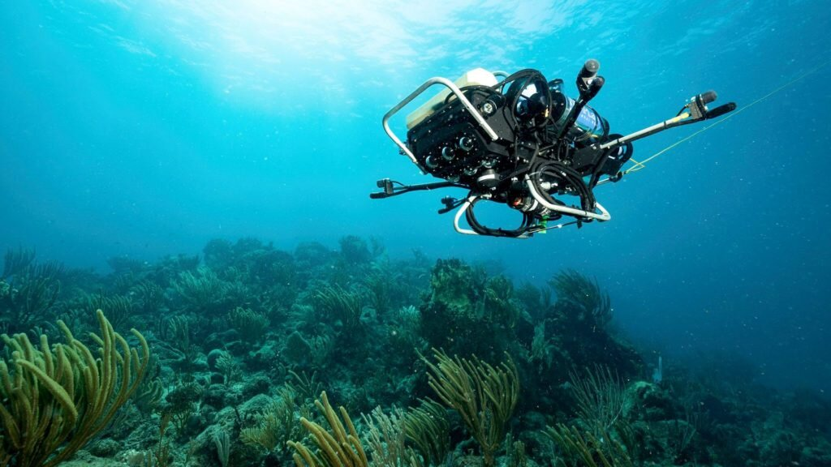
CUREE the autonomous underwater vehicle (AUV)
Together, the high-tech cameras that take high quality photos and the AI that analyses them at lightening speeds has dramatically increased the size, accuracy and scope of our coral reef datasets, both in location (geographic scope) and time (temporal scope).
We now know so much more than just 10 years ago.
Notes:
Image: https://phys.org/news/2023-04-technology-centered-focus-coral-reefs.html

Slide 12
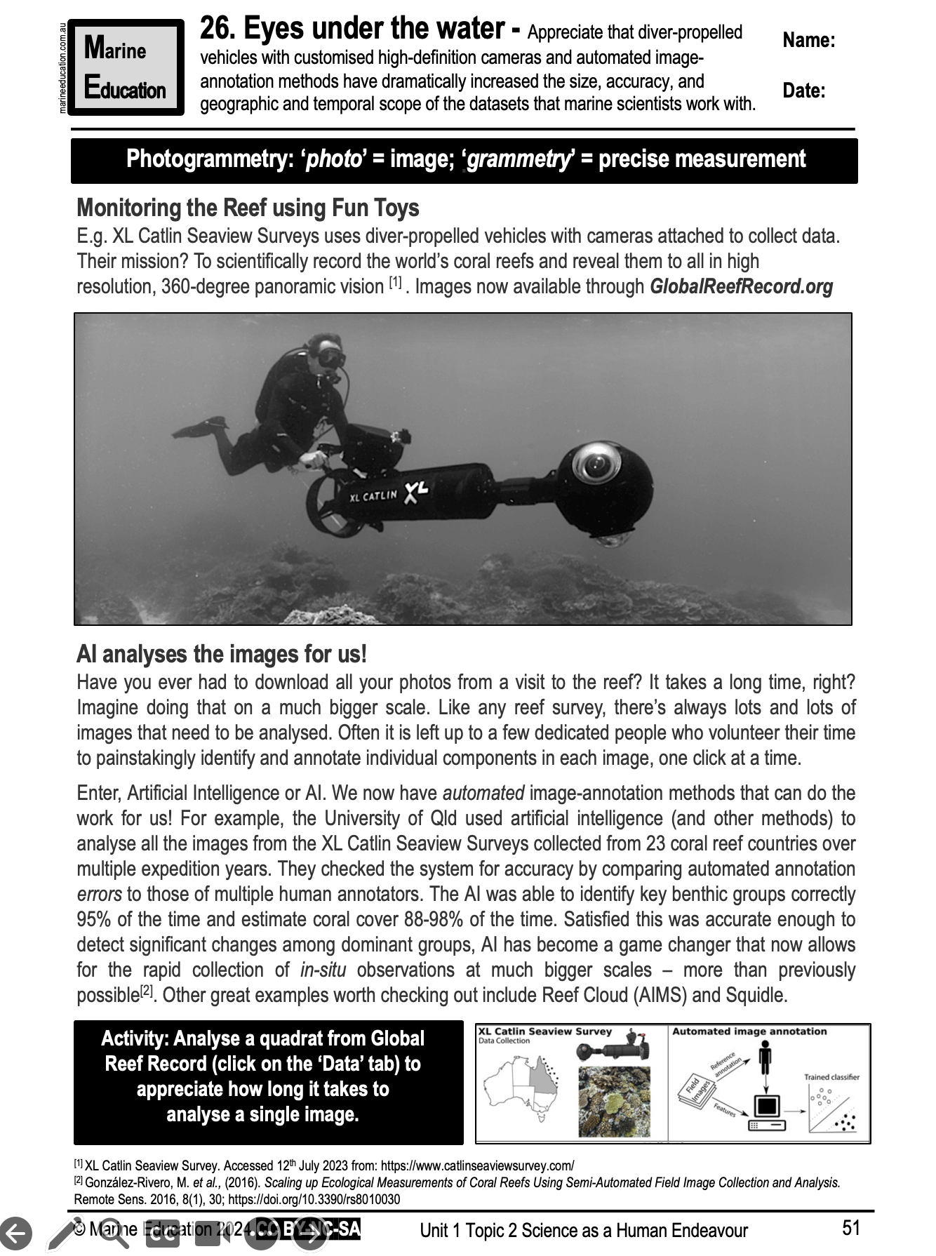
Learning Intention:
Appreciate that diver-propelled vehicles with customised high-definition cameras and automated image-annotation methods have dramatically increased the size, accuracy, and geographic and temporal scope of the datasets that marine scientists work with.
Success Criteria:
Complete Marine Education worksheet ’26. Eyes under the water’

