Slide 1
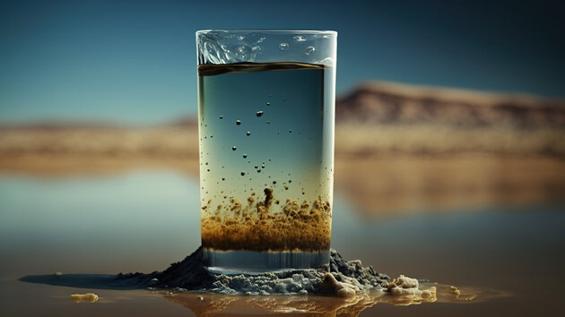
Learning Intention:
Recognise that the effectiveness of land-based management practices has a direct impact on the health of marine ecosystems. Scientific monitoring of these practices can be used to develop and evaluate projected impacts on marine conservation strategies
Success Criteria:
Complete Marine Education worksheet ’27. Roads to Reefs’
Notes:
Image: https://roundglasssustain.com/species/mudskipper

Slide 2
What happens on the land affects what happens on the reef
“Since the commencement of European settlement in the 1860s we document a tripling of flood-plume suspended sediment loads delivered by the Burdekin River to the GBR lagoon relative to ‘natural’ pre-European baseline levels”.
(D'Olivo & McCulloch, 2022)
Notes:
Image: Juan Pablo D'Olivo ª, Malcolm McCulloch ^{b}
Impact of European settlement and land use changes on Great Barrier Reef river catchments reconstructed from long-term coral Ba/Ca records. Science of The Total Environment Volume 830, 15 July 2022, 154461
Info: Land use change in the river basins of the Great Barrier Reef, 1860 to 2019: A foundation for understanding environmental history across the catchment to reef continuum. Marine Pollution Bulletin Volume 166, May 2021, 112193. https://www.sciencedirect.com/science/article/pii/S0025326X21002277
The arrival of Europeans in the GBR catchment area (GBRCA) (from c. 1840 in southern areas to c. 1865 for the northern areas) resulted in changes to land use including agriculture, mining, forestry and urban townships. Consequential changes to the landscape have included tree/shrub clearing and the resulting reduction of the extent of vegetation bioregions (e.g. Kemp et al., 2007; Seabrook et al., 2006, Seabrook et al., 2007), the application of fertilisers and pesticides across the agricultural and urban land uses, resulting in increases in the loads of suspended sediment, nutrients (nitrogen and phosphorus) and pesticides delivered to the GBR (Kroon et al., 2012; Waterhouse et al., 2012; McCloskey et al., 2017, McCloskey et al., 2021a, McCloskey et al., 2021b).

Slide 3
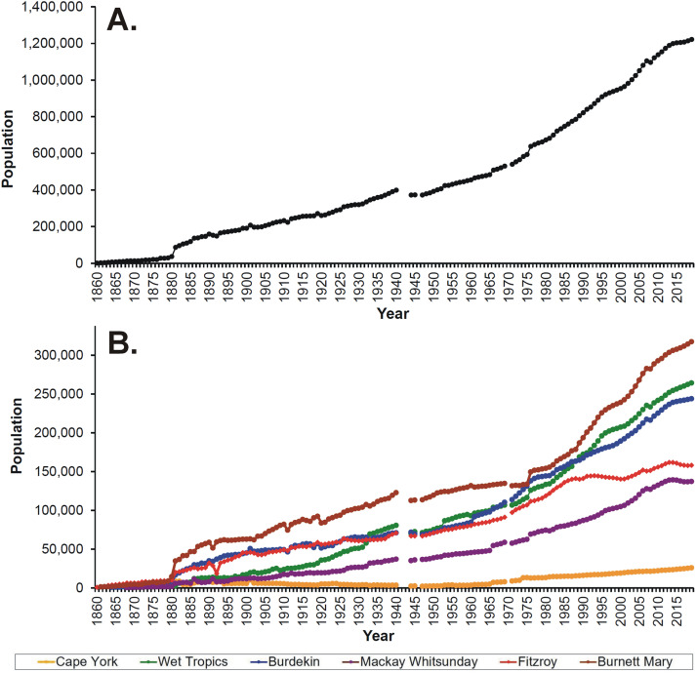
a growing human population
needs to eat!
Fig. 1: Human population time series data for (A) the Great Barrier Reef catchment area and (B) the 6 Natural Resource Management Regions from 1860 to 2019 (Lewis et al., 2021)
Notes:
https://www.sciencedirect.com/science/article/pii/S0025326X21002277

Slide 4
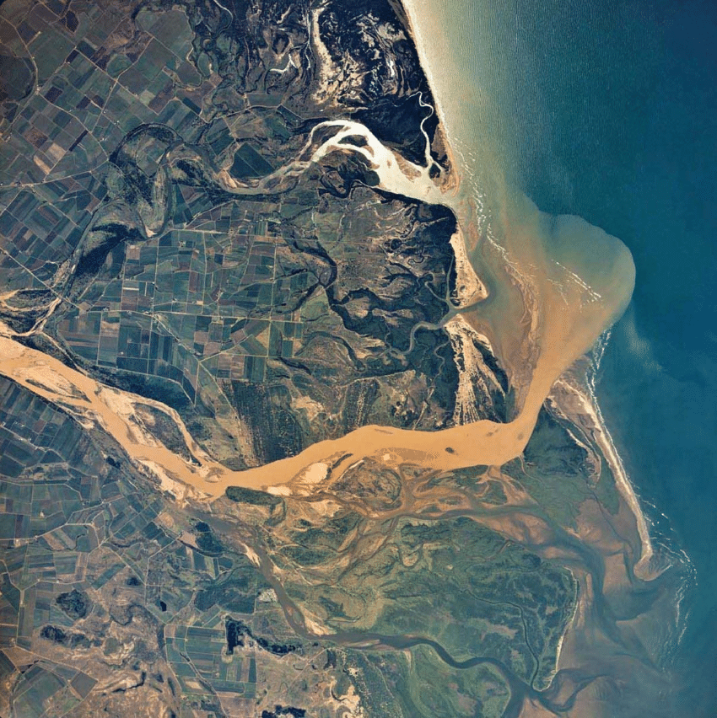
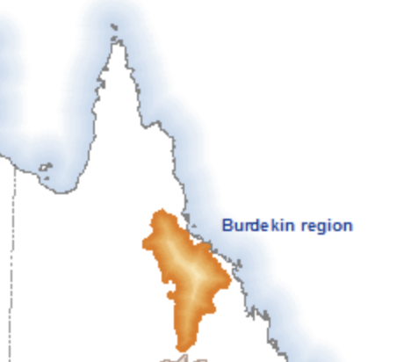
Burdekin River
90% of the region is used for grazing and agriculture
Notes:
Image: https://www.researchgate.net/figure/The-lower-Burdekin-River-forms-an-extensive-floodplain-and-delta-system-Source_fig1_330913939
The lower Burdekin River forms an extensive floodplain and delta system. Source: Geoscape, Department of Natural Resources and Mines, 2005.
Source: http://www.bom.gov.au/water/nwa/2016/burdekin/regiondescription/geographicinformation.shtml

Slide 5
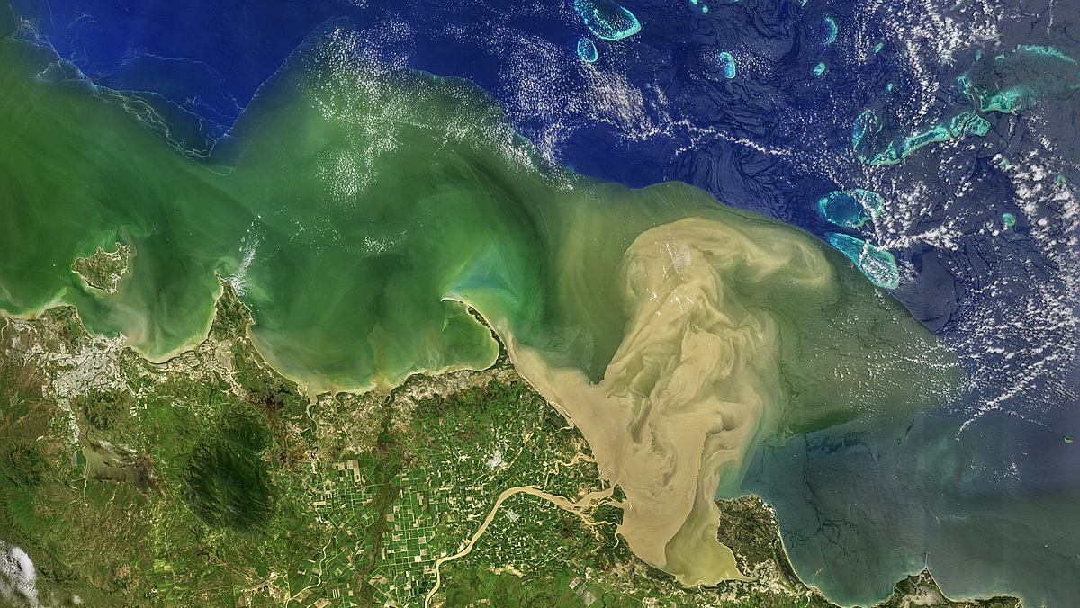
Burdekin River in flood
Ayr
Notes:
Image: https://oceancolor.gsfc.nasa.gov/gallery/620/
Flooding of Queensland, Australia's Burdekin River has sent a large plume of turbid water into Upstart Bay and beyond. When this Landsat 8 image was collected on February 11, 2019, the plume had reached all the way to Old Reef at the inside edge of the Great Barrier Reef — some sixty kilometers from the river's mouth.

Slide 6
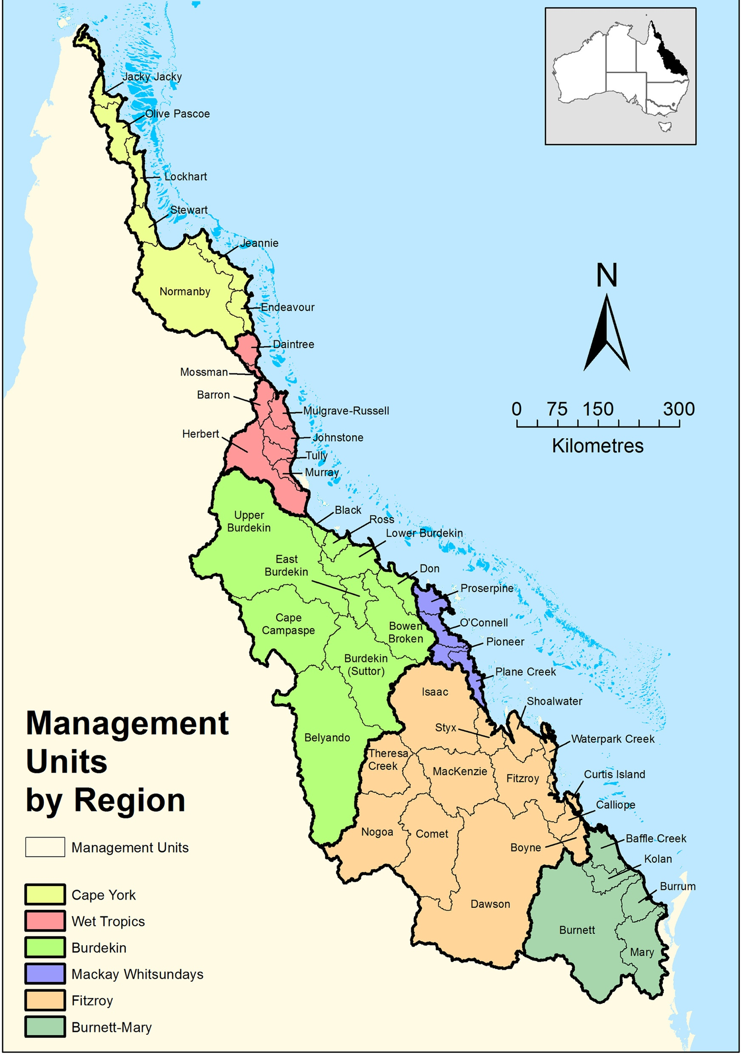
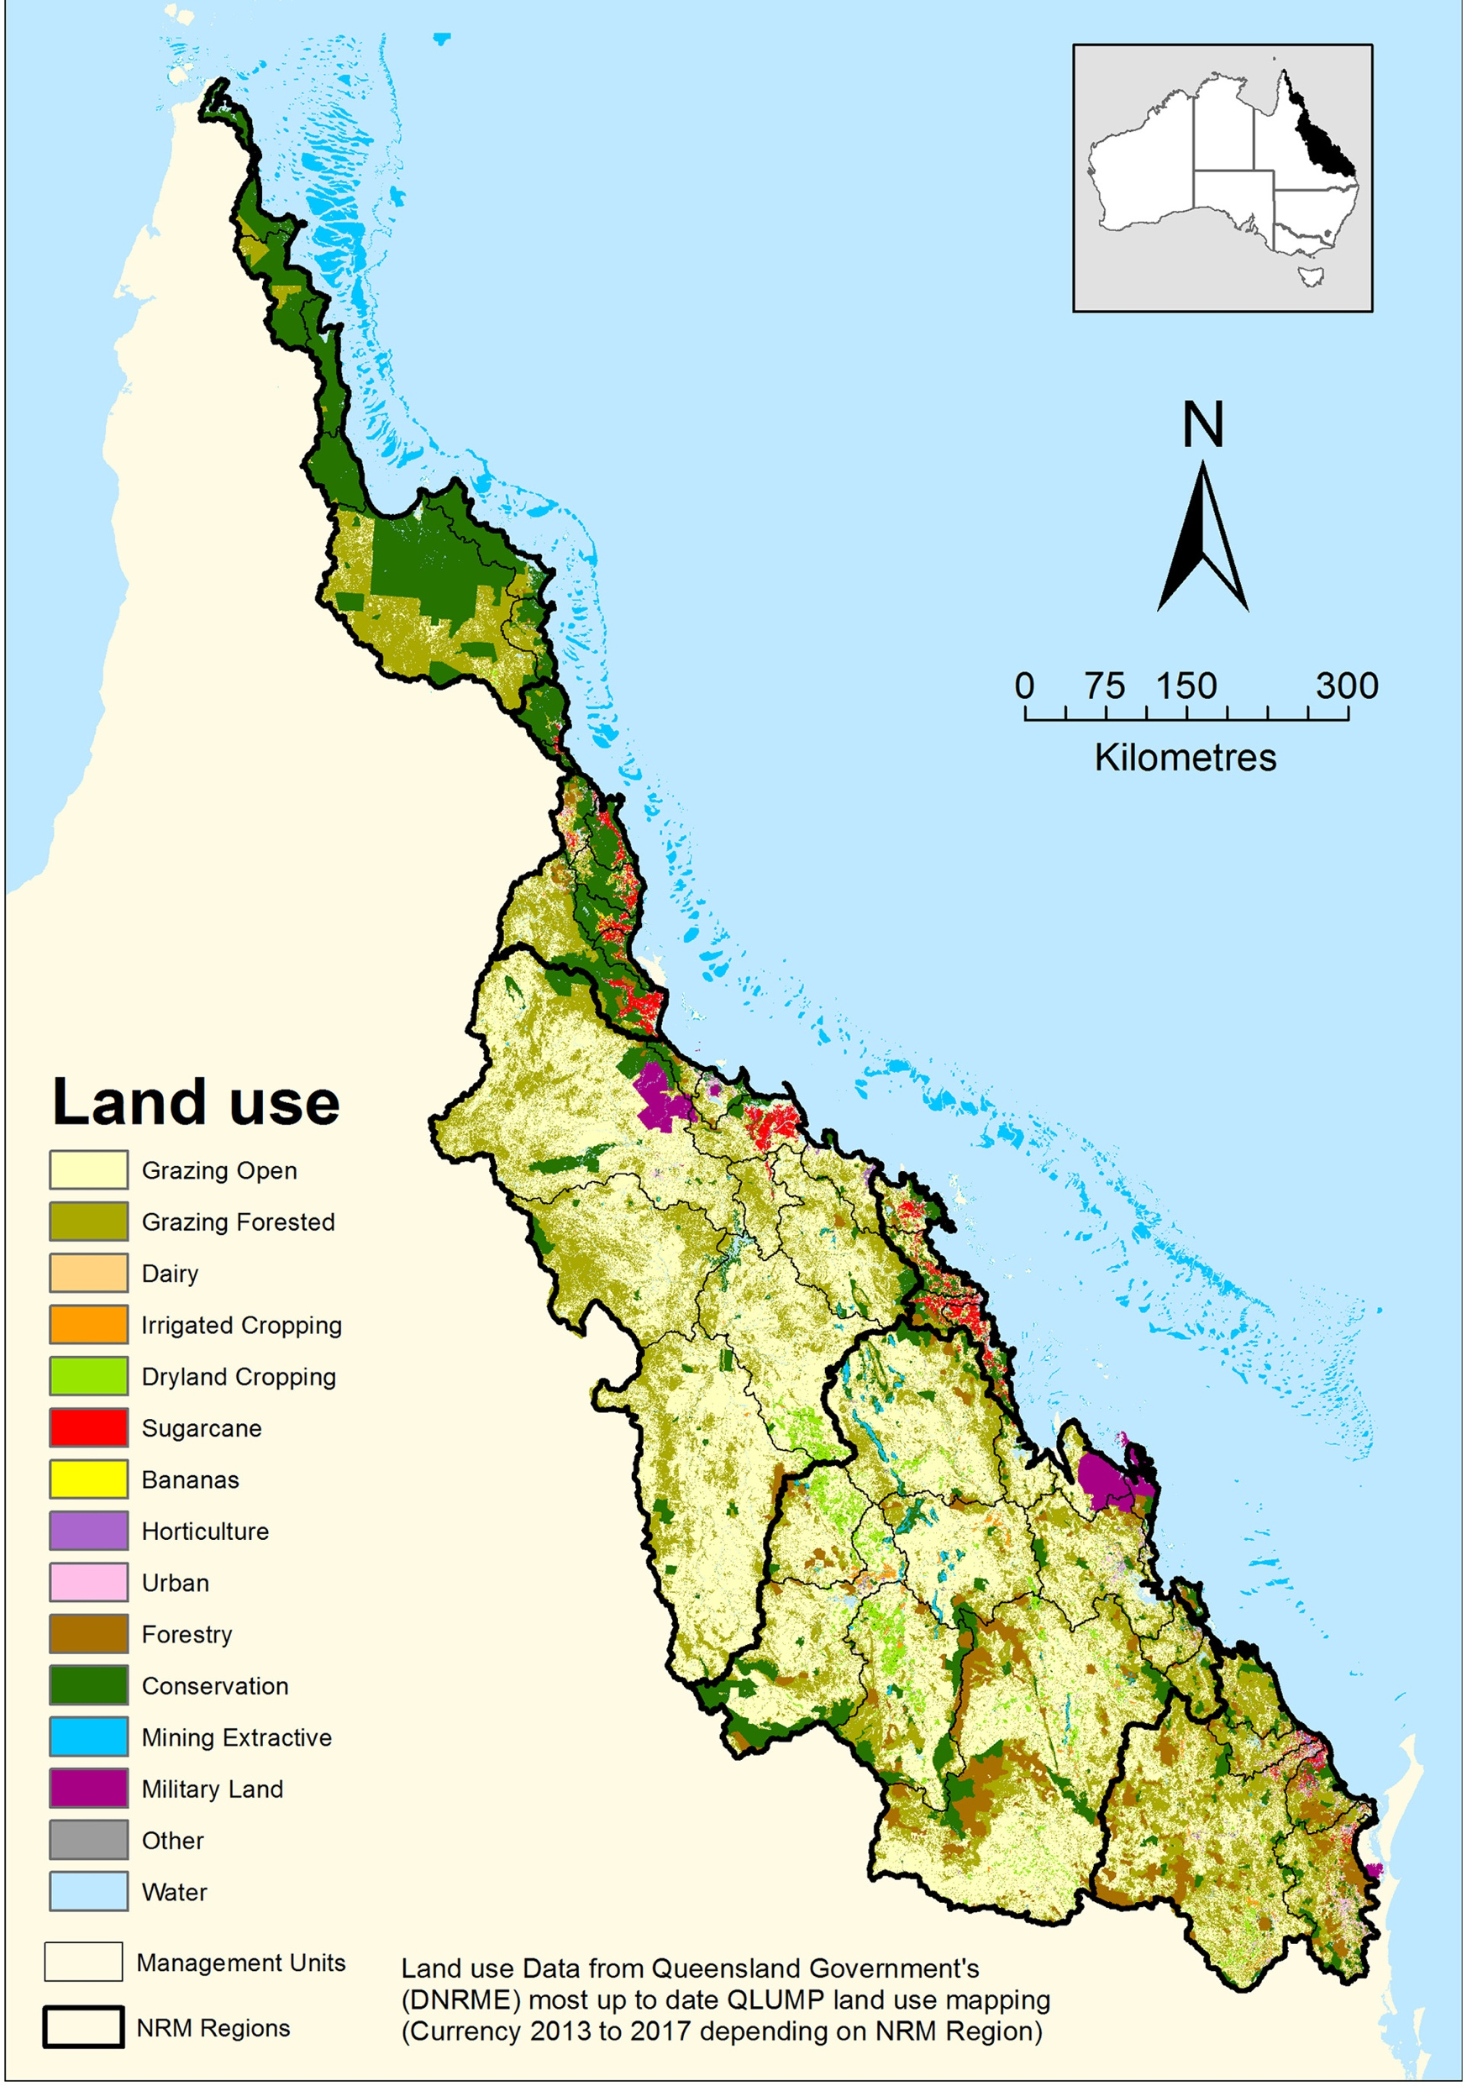
The Great Barrier Reef receives water from 35 basins that drain approximately 440,000 km²
of agricultural land.
Notes:
Image source: Land use change in the river basins of the Great Barrier Reef, 1860 to 2019: A foundation for understanding environmental history across the catchment to reef continuum. https://www.sciencedirect.com/science/article/pii/S0025326X21002277

Slide 7
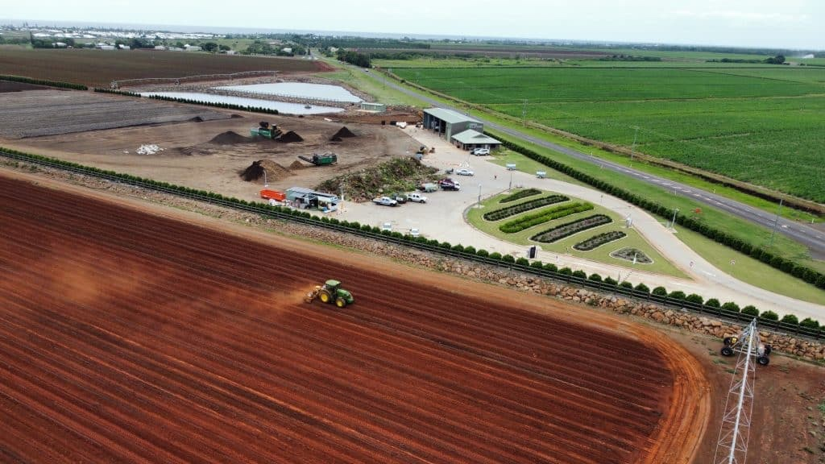
Bundaberg
Notes:
Image: https://www.bundabergnow.com/2023/02/19/green-solutions-celebrates-massive-month/

Slide 8
Notes:
Image: https://pasture.io/grazing-systems/pasture-raise-cows

Slide 9
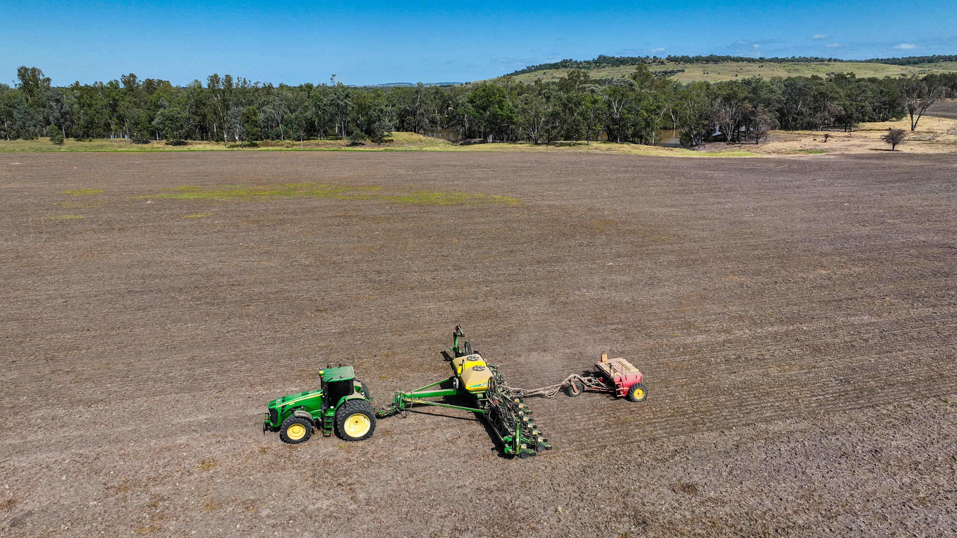
Image: Blueys Photography

Slide 10
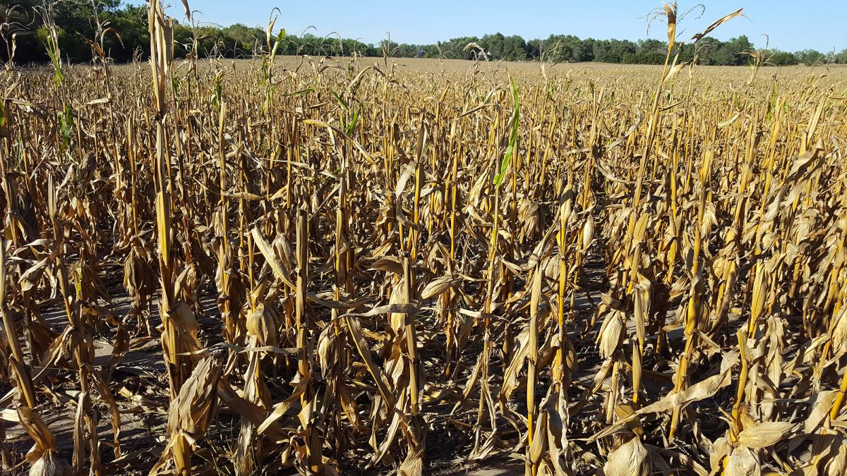
Diseased crops
Notes:
Image: https://www.hakahakionline.com/en/4088/farmers-worried-over-diseased-crop/

Slide 11
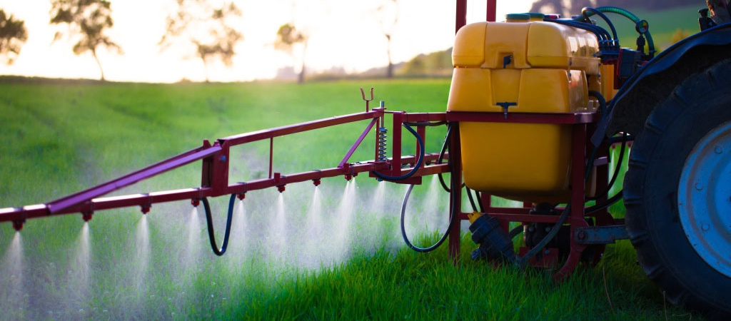
Pesticides are chemicals used to control pests
e.g. fungicides, herbicides and insecticides
Notes:
Image: https://www.niehs.nih.gov/health/topics/agents/pesticides/index.cfm

Slide 12
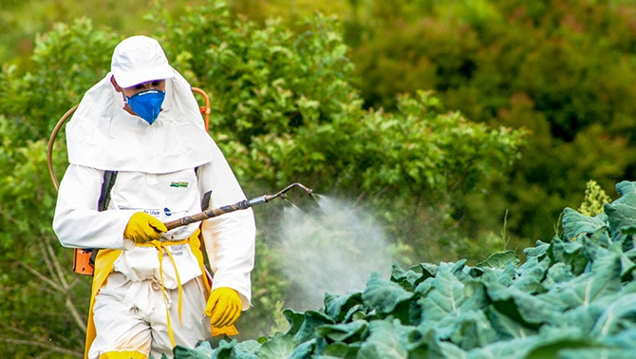
Notes:
Image: https://ensia.com/features/developing-world-pesticides/

Slide 13
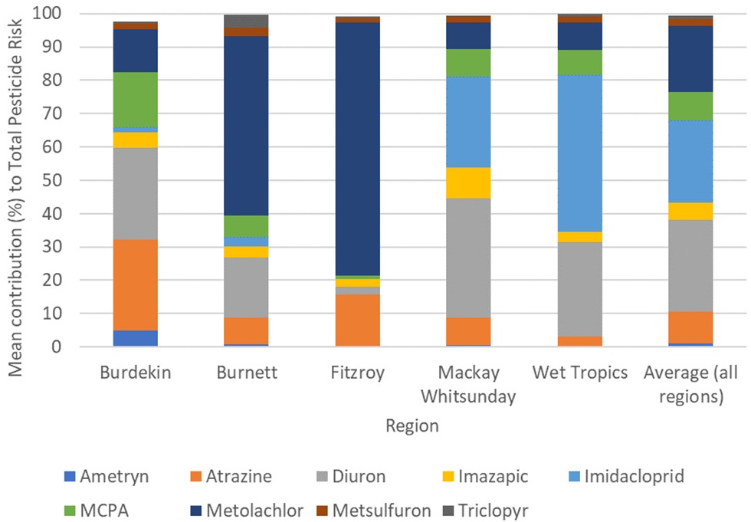
Active ingredients in Pesticides, found in waters of the GBR
In the Mackay/Whitsunday and Wet Tropics regions, Diuron and Imidaclopri posed the greatest risk. Whereas in the Burnett and Fitzroy regions, the main contributor was Metolachlor. This variation most likely reflects the different types and amounts of agriculture in regions and catchments and regional differences in pesticide spraying regimes even for the same crop (Warne et al., 2023).
Notes:
Source: Estimating the aquatic risk from exposure to up to twenty-two pesticide active ingredients in waterways discharging to the Great Barrier Reef
M.St.J. Warne ª ^{b} ^{c}, C. Neelamraju ª ^{b}, J. Strauss ^{b}, R.D.R. Turner ª ^{b} ^{d}, R.A. Smith ^{b} ¹, R.M. Mann ^{b}
Science of The Total Environment Volume 892, 20 September 2023, 164632

Slide 14
Coral reefs downstream of land disturbance are often degraded by….
disease; low rates of calcification and photosynthesis; mortality from hypoxia; tissue degradation; macroalgal competition: and low larval recruitment and survival
(Carlson et al., 2019).
Notes:
Image: https://www.diveplanit.com/marine-environment/great-barrier-reef-far-northern-reefs/

Slide 15
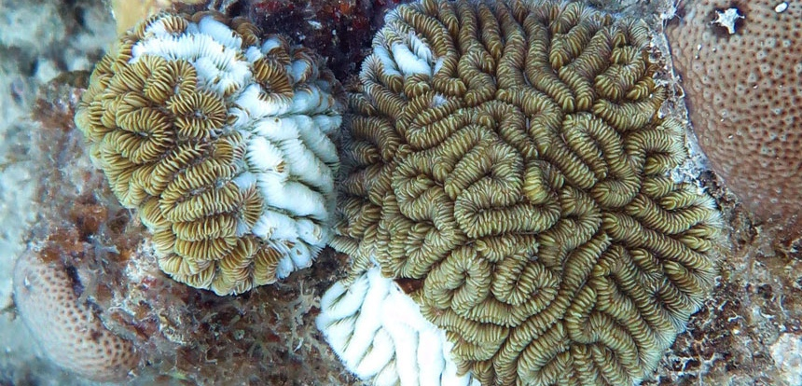
Disease
Notes:
Source: Land Use Impacts on Coral Reef Health: A Ridge-to-Reef Perspective. Rachel R. Carlson^{1,2*} Shawna A. Foo¹ Gregory P. Asner^{1.} REVIEW article
Front. Mar. Sci., 18 September 2019. Sec. Marine Conservation and Sustainability. Volume 6 - 2019 | https://doi.org/10.3389/fmars.2019.00562
Image: https://www.snexplores.org/article/mystery-disease-killing-caribbean-corals

Slide 16
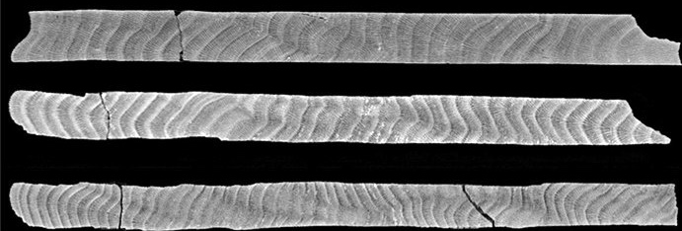
low rates of calcification and photosynthesis
Coral time capsules - coral core growth rings including high density stress bands. Photo: Thomas DeCarlo
Notes:
Source: Land Use Impacts on Coral Reef Health: A Ridge-to-Reef Perspective. Rachel R. Carlson^{1,2*} Shawna A. Foo¹ Gregory P. Asner^{1.} REVIEW article
Front. Mar. Sci., 18 September 2019. Sec. Marine Conservation and Sustainability. Volume 6 - 2019 | https://doi.org/10.3389/fmars.2019.00562
Image: https://lirrf.org/coral-time-capsules/
CT scans of coral skeletal cores showing the annual low- and high-density bands as dark and light shading, ageing from left to right. Photo credit: Thomas DeCarlo

Slide 17
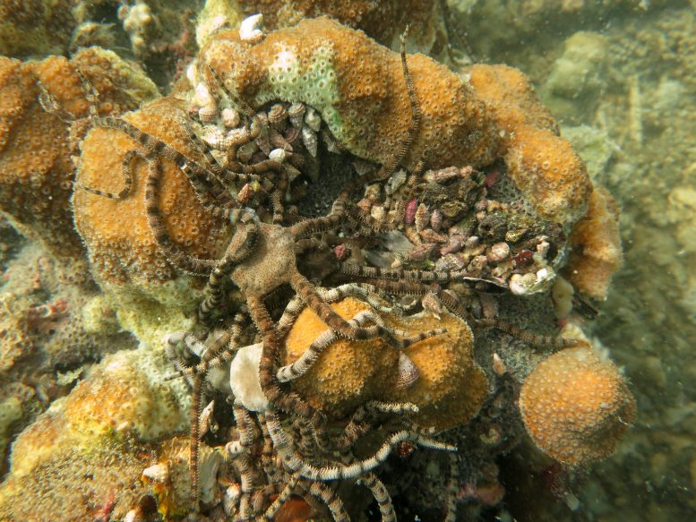
Brittle sea stars, which usually are in hiding, perch on top of coral to attempt to escape from hypoxic ocean waters, which have little to no oxygen in that area. Sadly, those that cannot escape essentially suffocate. Credit: Maggie Johnson © Woods Hole Oceanographic Institution
mortality from hypoxia - low oxygen
(e.g. from stagnant, warm waters and nutrient pollution)
Notes:
Source: Land Use Impacts on Coral Reef Health: A Ridge-to-Reef Perspective. Rachel R. Carlson^{1,2*} Shawna A. Foo¹ Gregory P. Asner^{1.} REVIEW article
Front. Mar. Sci., 18 September 2019. Sec. Marine Conservation and Sustainability. Volume 6 - 2019 | https://doi.org/10.3389/fmars.2019.00562

Slide 18
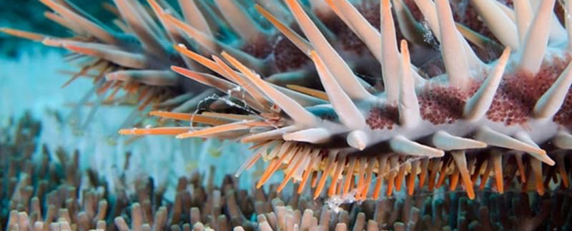
tissue degradation
e.g. from COTS outbreaks (due to excess nutrients)
XL Catlin Seaview Survey
Notes:
Source: Land Use Impacts on Coral Reef Health: A Ridge-to-Reef Perspective. Rachel R. Carlson^{1,2*} Shawna A. Foo¹ Gregory P. Asner^{1.} REVIEW article
Front. Mar. Sci., 18 September 2019. Sec. Marine Conservation and Sustainability. Volume 6 - 2019 | https://doi.org/10.3389/fmars.2019.00562
Image: https://encounteredu.com/cpd/subject-updates/learn-more-how-does-water-quality-affect-the-coral-reefs

Slide 19
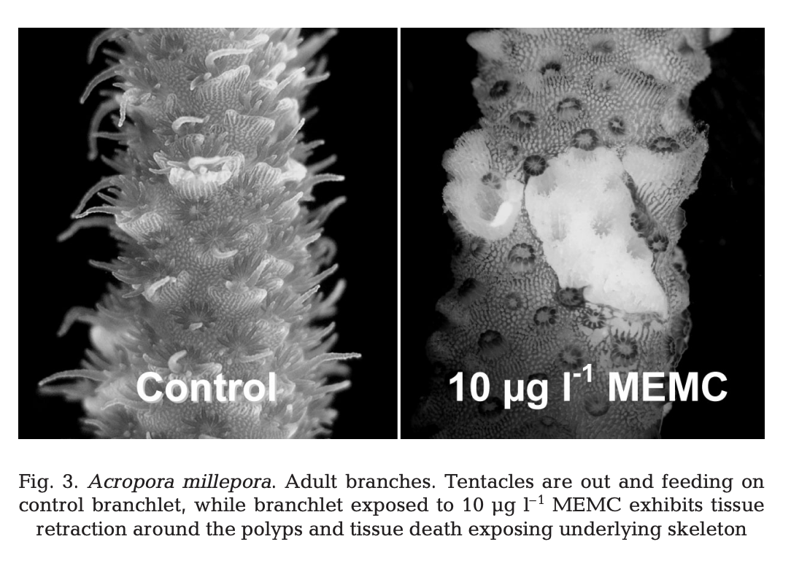
tissue degradation
e.g. from MEMC, a mercury-based sugarcane fungicide used to treat sugarcane diseases
(Markey et al., 2007)
Notes:
Image: MEPS 330:127-137 (2007) - doi:10.3354/meps330127
Insecticides and a fungicide affect multiple coral life stages
Kathryn L. Markey^{1,2}, Andrew H. Baird³, Craig Humphrey², Andrew P. Negri^{2,}*
¹School of Marine Biology and Aquaculture, and ³ARC Centre of Excellence for Reef Studies, James Cook University, Townsville, Queensland 4811, Australia ²Australian Institute of Marine Science, PMB 3, Townsville, Queensland 4810, Australia
*Corresponding author. Email: a.negri@aims.gov.au

Slide 20
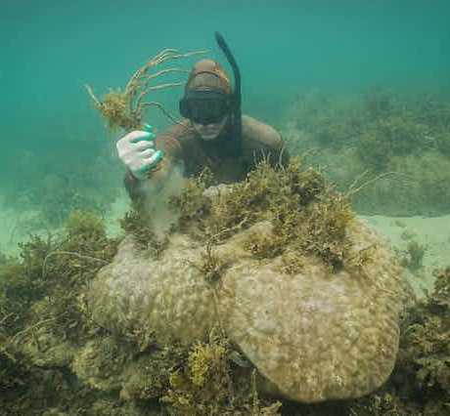
macroalgal competition
e.g. from excess nutrients feeding the algae, or from another major disturbance event/s weakening coral’s ability to outcompete the macroalgae.
Notes:
Source: Land Use Impacts on Coral Reef Health: A Ridge-to-Reef Perspective. Rachel R. Carlson^{1,2*} Shawna A. Foo¹ Gregory P. Asner^{1.} REVIEW article
Front. Mar. Sci., 18 September 2019. Sec. Marine Conservation and Sustainability. Volume 6 - 2019 | https://doi.org/10.3389/fmars.2019.00562
Image: https://theconversation.com/seaweed-is-taking-over-coral-reefs-but-theres-a-gardening-solution-sea-weeding-212460

Slide 21
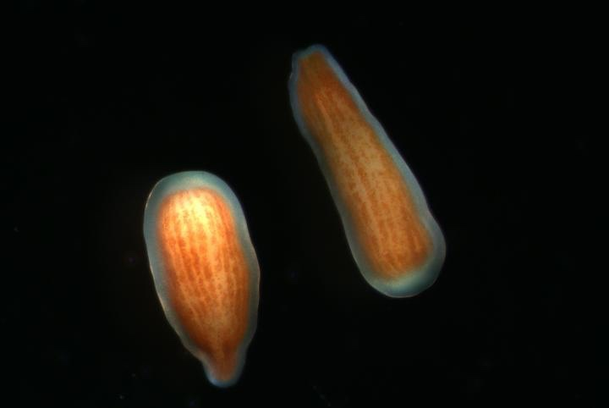
low larval recruitment and survival
e.g. also from MEMC and other chemicals
Two larvae of coral Pocillopora damicornis © E. Rivest/VIMS.
Notes:
Source: Land Use Impacts on Coral Reef Health: A Ridge-to-Reef Perspective. Rachel R. Carlson^{1,2*} Shawna A. Foo¹ Gregory P. Asner^{1.} REVIEW article
Front. Mar. Sci., 18 September 2019. Sec. Marine Conservation and Sustainability. Volume 6 - 2019 | https://doi.org/10.3389/fmars.2019.00562
Image: https://www.eurekalert.org/multimedia/904528
Caption: Adult corals release free-swimming larvae as one means of propagating the next generation. Here are two larvae of Pocillopora damicornis, the coral species that Rivest and colleagues used in their experiments. The brown 'ribbons' are the algal symbionts, which enter the larvae before they are released from the adult corals. CREDIT
© E. Rivest/VIMS.

Slide 22
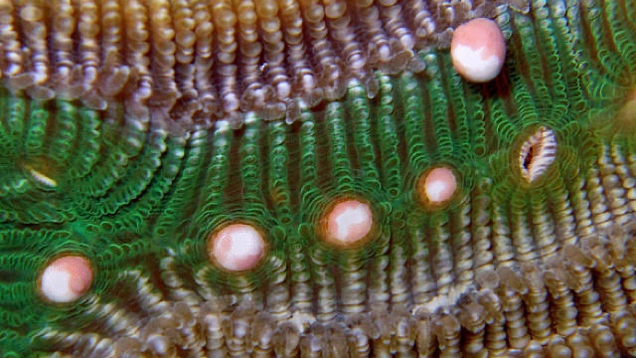
Notes:
Image: http://mrsdmarine.weebly.com/corals-the-animal.html

Slide 23
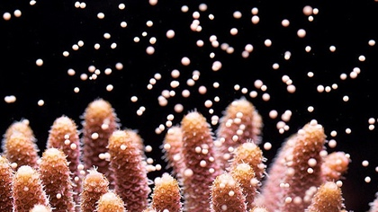
Broadcasting corals spawn egg/sperm bundles
Notes:
Image: Coral releasing egg / sperm bundles which will be fertilized in the water to form poppy-seed-sized larvae. (Credit: Penn State University / CC BY-NC-ND 2.0)
Source: https://www.fondriest.com/news/pacific-coral-larvae-transplants-likely-fail.htm

Slide 24
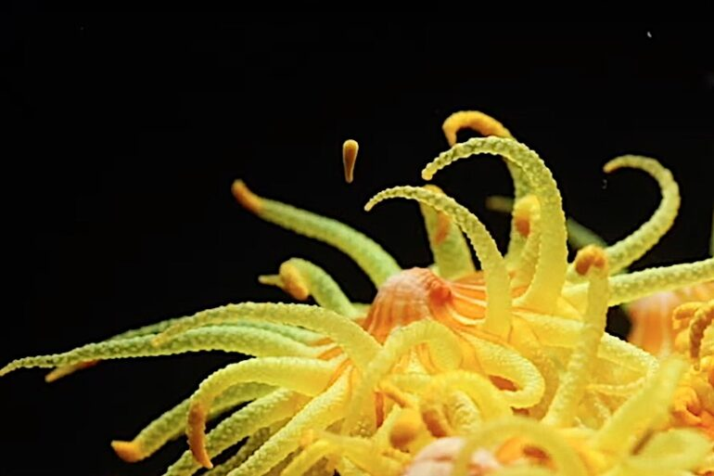
Brooder corals spawn well developed planula
Notes:
Image: https://reefbuilders.com/2020/06/26/watch-tubastrea-larvae-escape-its-parent-coral-by-the-tentacle/

Slide 25
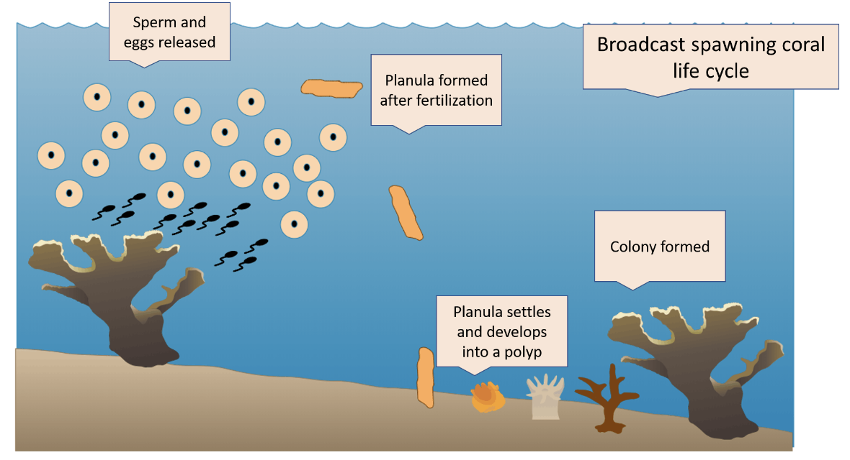
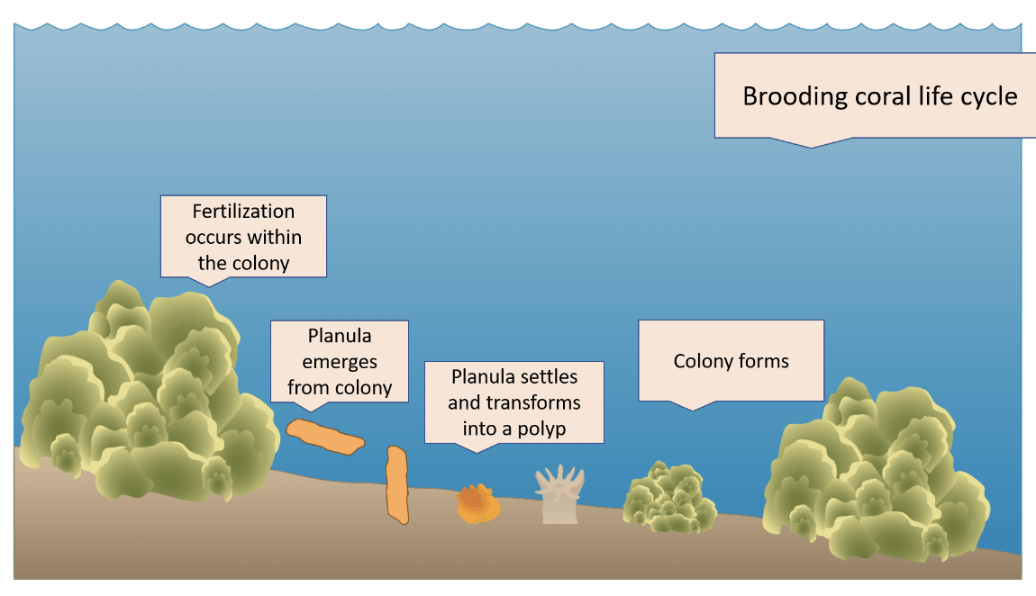
Broadcasters
Brooders
& most corals
Notes:
Images: https://coralworldvi.com/coral-reproduction/

Slide 26
Early life stages of coral
Notes:
Image: https://en.m.wikipedia.org/wiki/File:Settlement_and_early_life_stages_of_scleractinian_corals.png

Slide 27
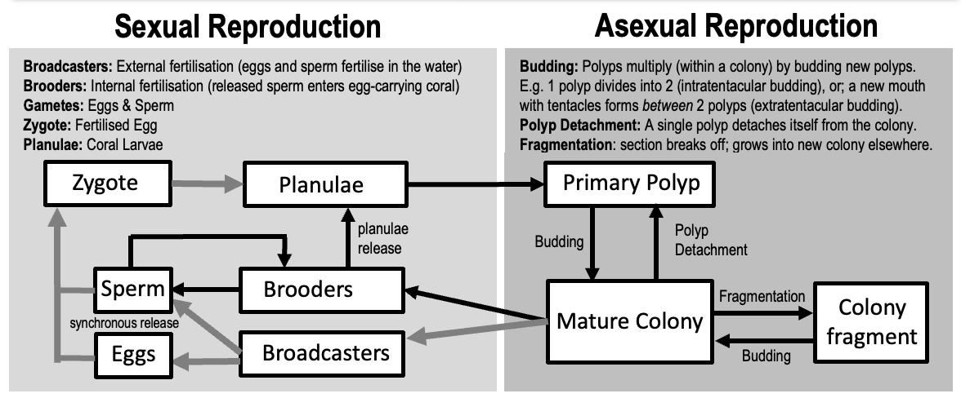
Coral Reproduction

Slide 28
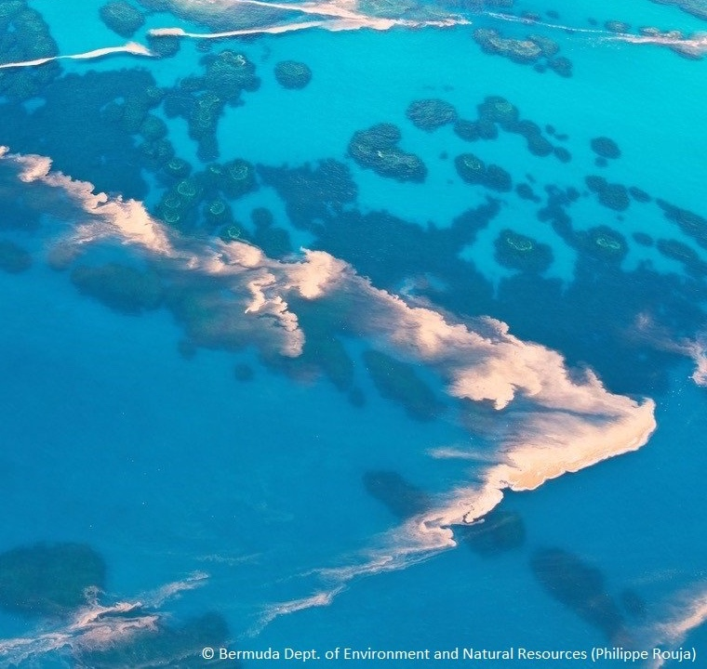
Site Selection
Larvae actively and repeatedly test, probe and explore the substrate (usually guided by chemical cues) searching for some characteristic properties to indicate a favourable settlement location. In the absence of chemical cues to stimulate settlement (or in the presence of inhibitors that deter settlement), planulae may either continue to seek a more suitable substrate, re-enter the plankton to seek a more suitable reef, or run out of energy reserves and die.
Notes:
Image: https://environment.bm/news-hot-topics//august-coral-spawning

Slide 29
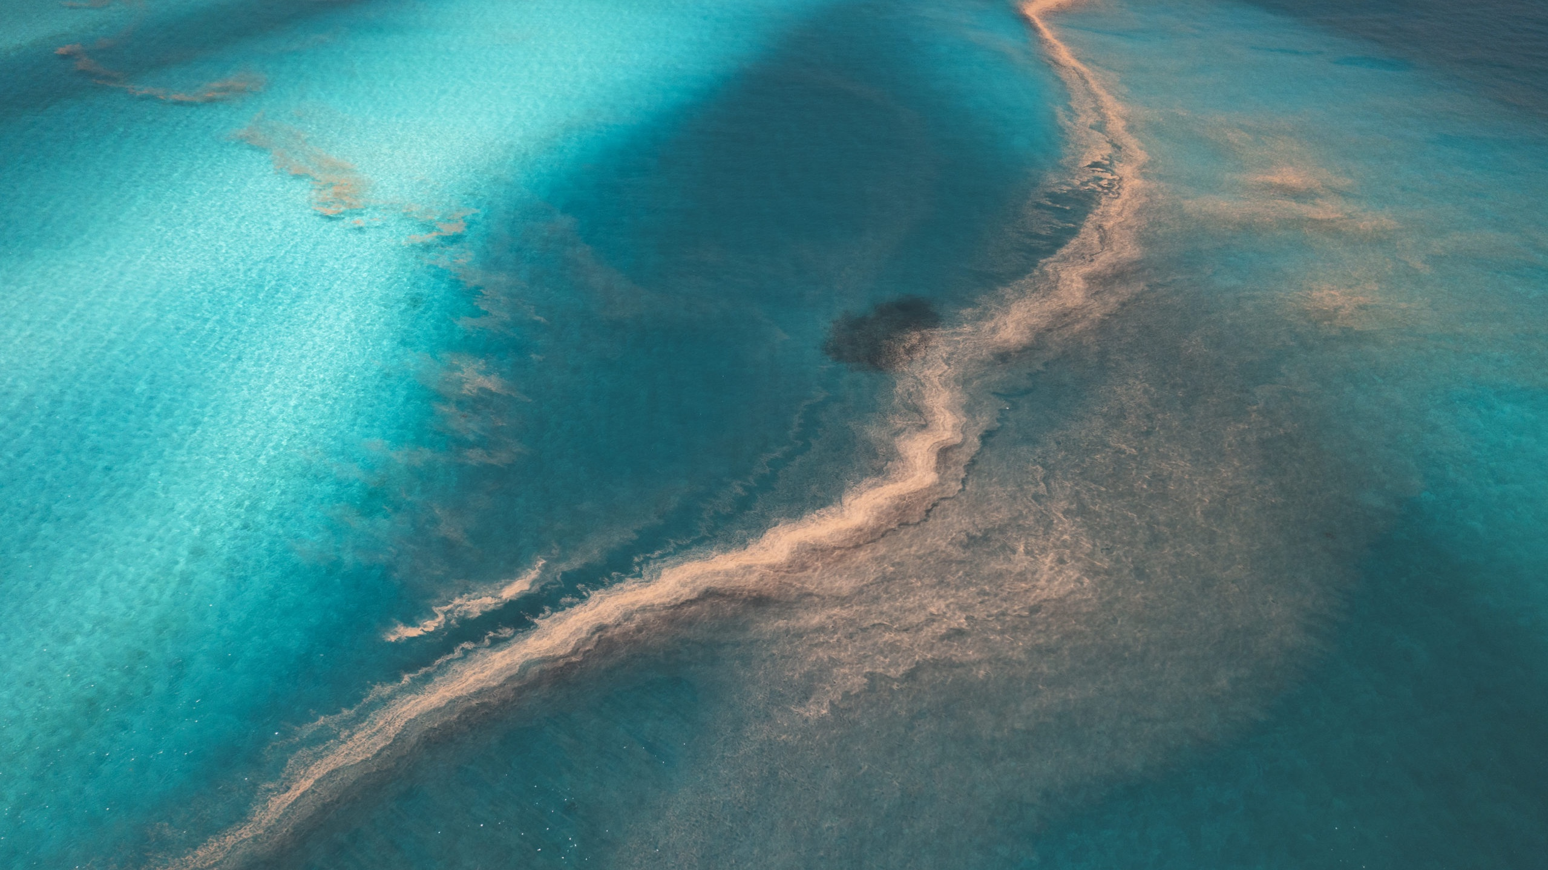
Notes:
Image: https://oceanographicmagazine.com/features/coral-spawn-in-western-australia/

Slide 30
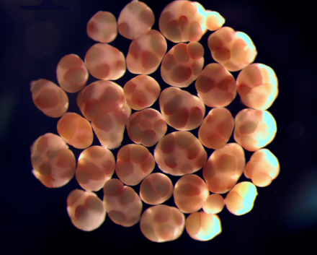
CORAL EGG AND SPERM BUNDLES UNDER A MICROSCOPE
Notes:
Image: https://www.aims.gov.au/information-centre/news-and-stories/global-effort-needed-produce-baby-corals-en-masse-help-struggling-reefs

Slide 31
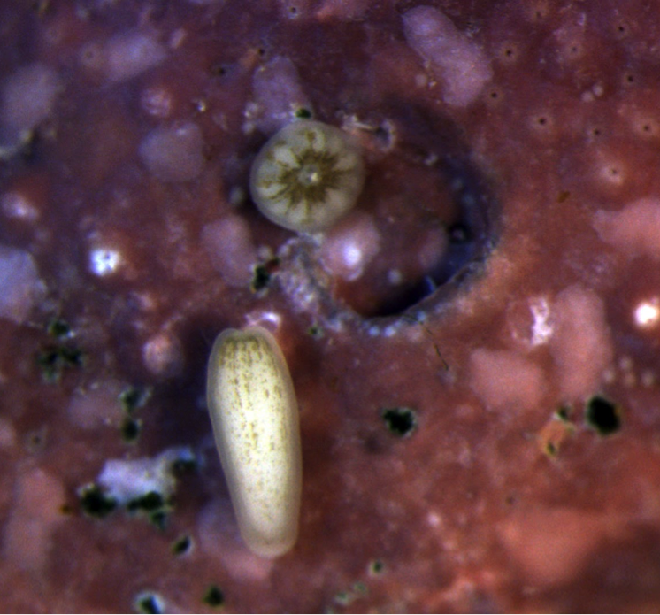
Settlement
A swimming larvae (bottom) and settled polyp (top). Credit: Raphael Ritson-Williams.
Planulae will not settle on live coral, loose sediment (i.e. sand), macro-algae or encrusting sponges. However, dead coral they’re ok with (so long as it is not covered in macro-algae of course). Acropora really like to settle on crustose coralline algae (CCA) and bacterial biofilms. Acropora corals think they smell goooood!! Upon settlement, planulae undergo metamorphosis to become a coral polyp.
Notes:
Image: https://www.soest.hawaii.edu/soestwp/announce/news/nutrient-pollution-and-ocean-warming-negatively-affect-early-life-of-corals/
Source: Stake, J.L. and Sammarco, P.W. (2002). Effects of pressure on swimming behaviour in planula larvae of the coral Porites astreoides (Cnidaria, Scleractinia). Journal of Experimental Biology and Ecology. 288 p.181-201. DOI:10.1016/S0022-0981(03)00018-2

Slide 32
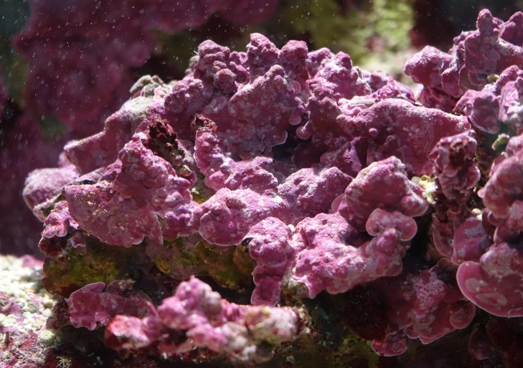
crustose coralline algae (CCA)

Slide 33
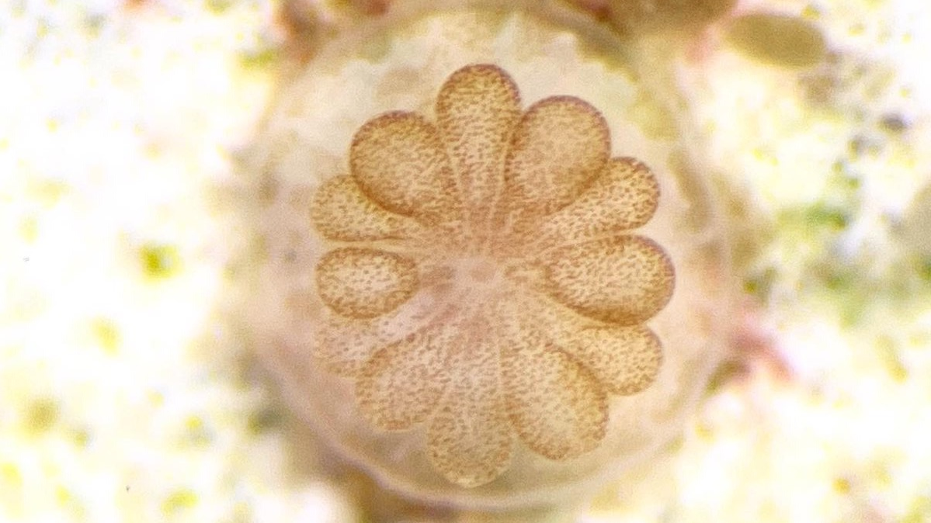
Notes:
Image: https://twitter.com/CoralReefFuture

Slide 34
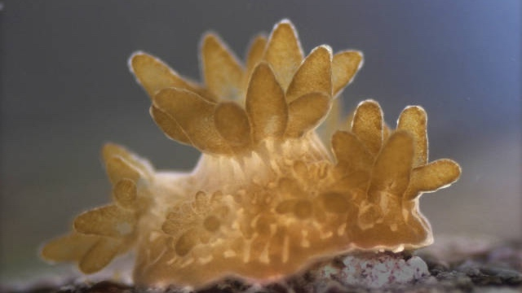
Budding (asexual reproduction)
Notes:
Image: https://www.secore.org/site/corals/detail/coral-reproduction.15.html

Slide 35
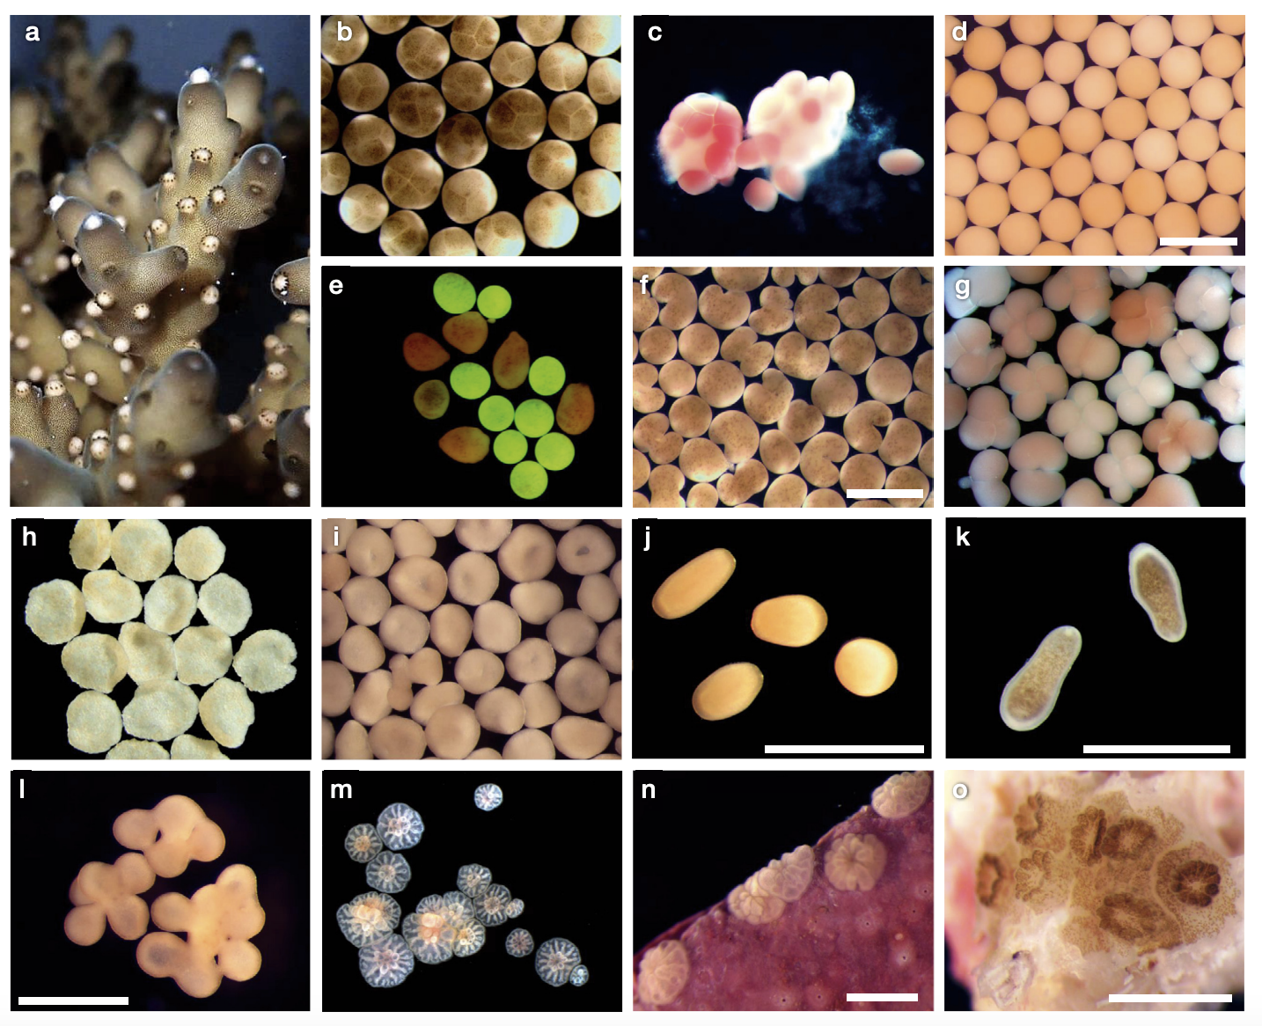
Coral development Stages
(all driven by chemicals, e.g. enzymes)
Release
Egg/sperm bundles
Eggs & sperm separating (broadcasters)
Unfertilised eggs
Unfertilised eggs
Fertilised eggs
3 hours after fertilised
15 hours after fertilised (zooxanthellae enter) ‘prawn chip’ stage
Gastrula stage
Beginning to elongate
Fully formed larvae
Coral chimeras
Fragmentated blastomeres
‘spat’ single polyps 2 days post-settlement
Several spat 2 days settled
Notes:
Image: https://www.int-res.com/articles/meps_oa/m635p203.pdf

Slide 36
Land-based pollutants that effect coral larval recruitment and survival

Slide 37
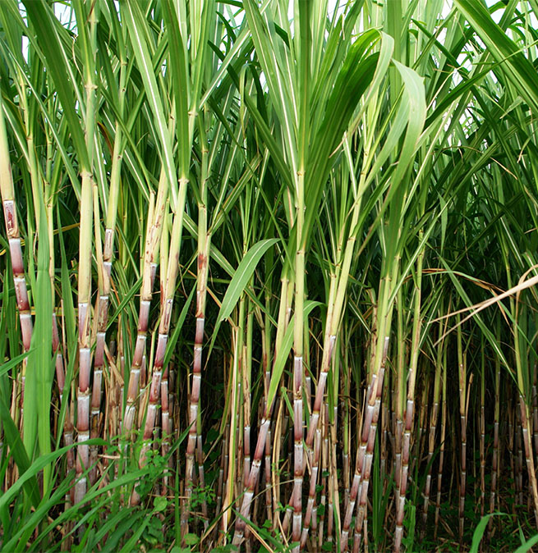
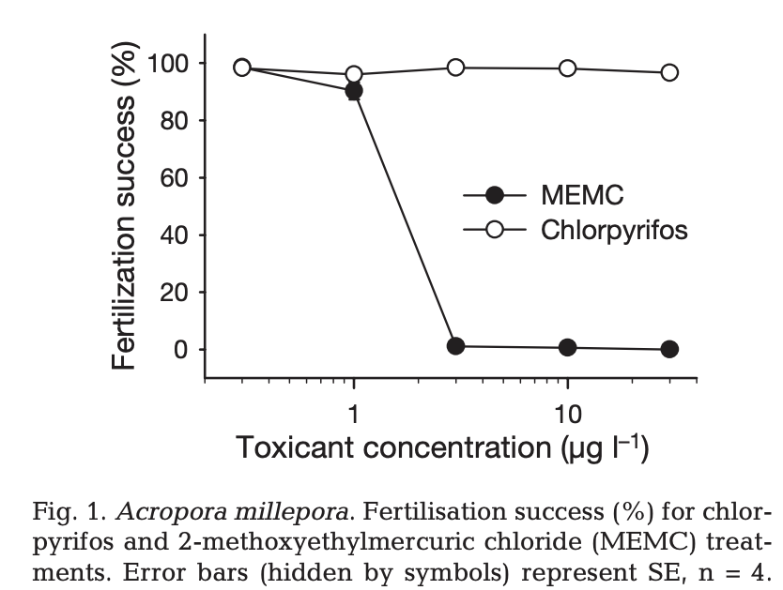
Corals do not fertilise when fungicide MEMC (applied to sugarcane) is >3 µg l^{–1}
Note: the Methoxy Ethyl Mercuric Chloride, MEMC, was purchased from Sigmaaldrich (Markey et al., 2007).
Notes:
MEPS 330:127-137 (2007) - doi:10.3354/meps330127
Insecticides and a fungicide affect multiple coral life stages
Kathryn L. Markey^{1,2}, Andrew H. Baird³, Craig Humphrey², Andrew P. Negri^{2,}*
¹School of Marine Biology and Aquaculture, and ³ARC Centre of Excellence for Reef Studies, James Cook University, Townsville, Queensland 4811, Australia ²Australian Institute of Marine Science, PMB 3, Townsville, Queensland 4810, Australia
*Corresponding author. Email: a.negri@aims.gov.au

Slide 38
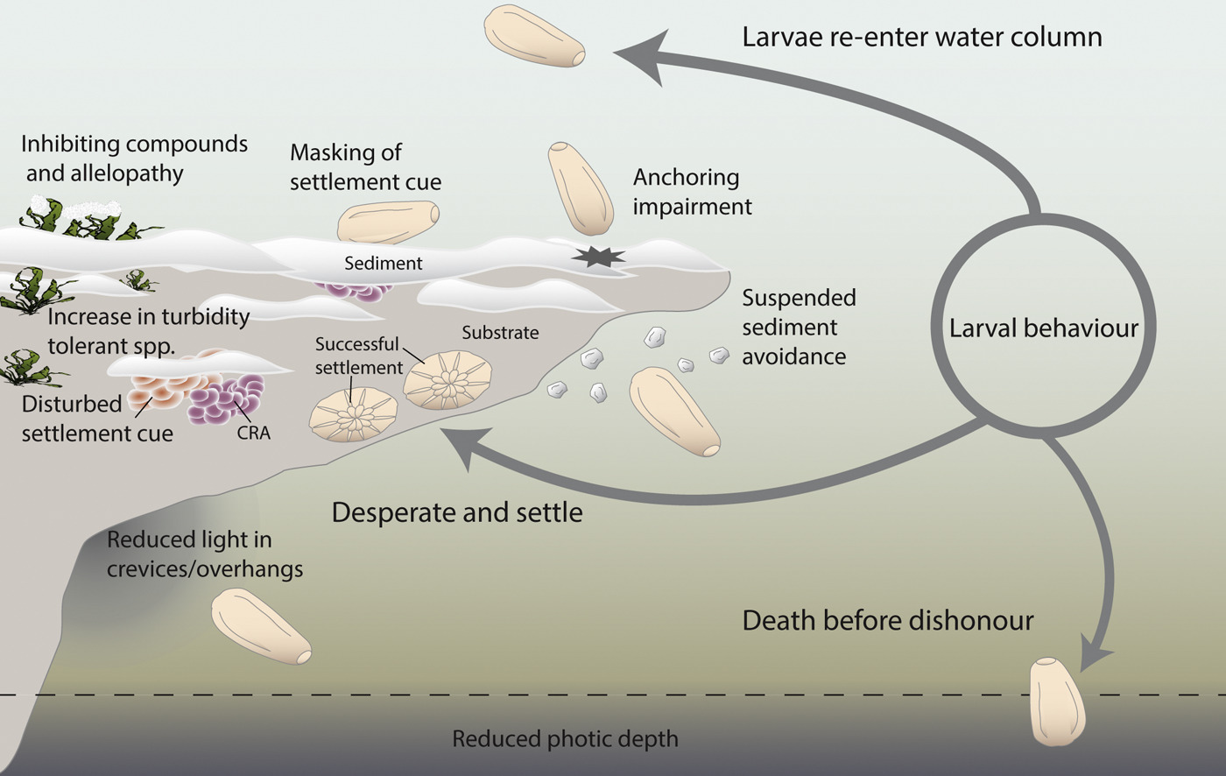
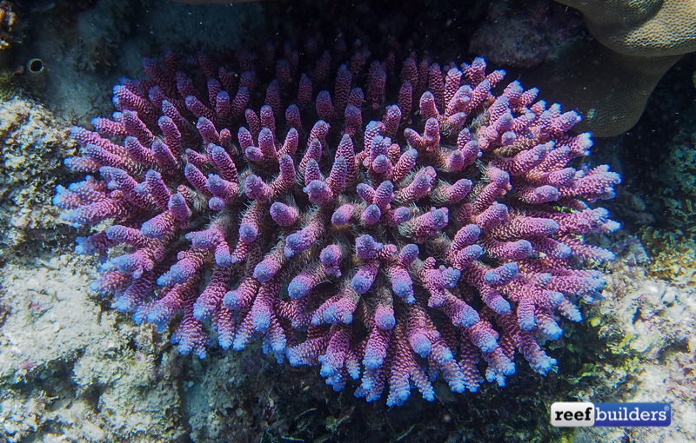
Acropora millepora
Acropora millipora larvae do not settle and grow on surfaces covered in sediment
Notes:
Image: Settlement patterns of the coral Acropora millepora on sediment-laden surfaces.
Source: https://www.sciencedirect.com/science/article/pii/S0048969717318569
Corrigendum to “Settlement patterns of the coral Acropora millepora on sediment-laden surfaces” [Sci. Total Environ. 609 (2017) 277–288]
Science of The Total Environment, Volumes 640–641, 1 November 2018, Pages 116
Gerard F. Ricardo, Ross J. Jones, Mikaela Nordborg, Andrew P. Negri

Slide 39
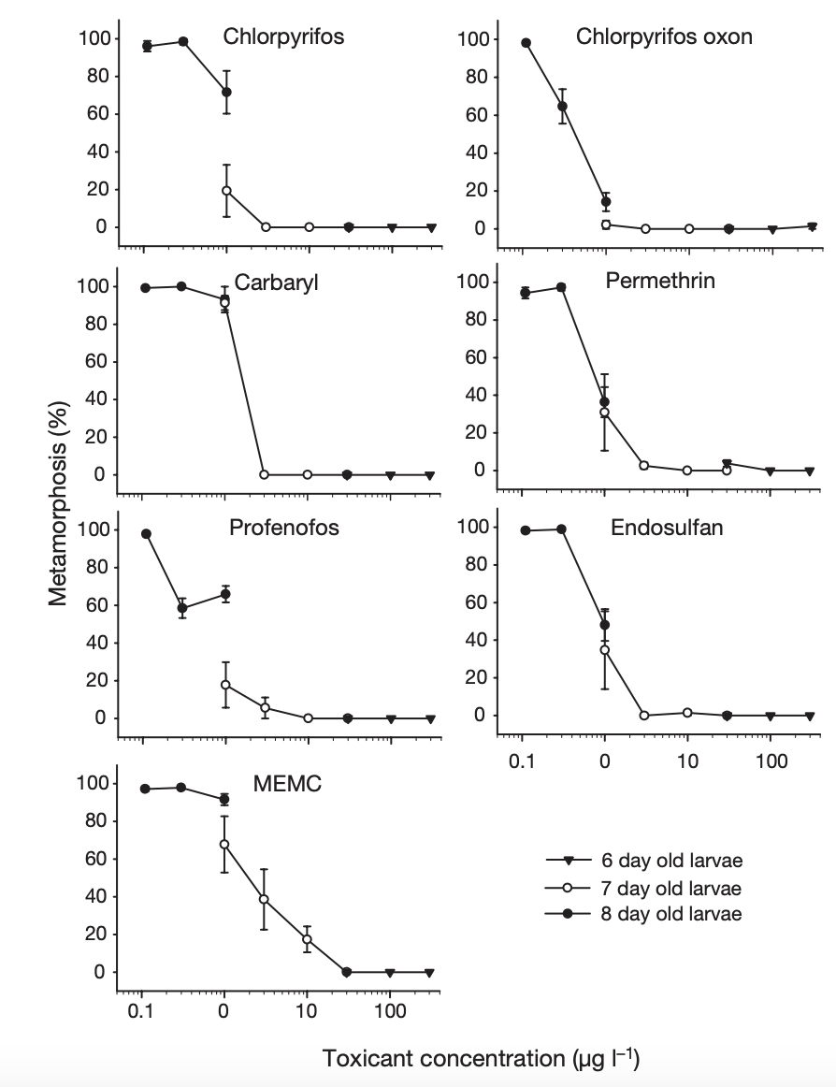
Even if they do settle,
corals do not metamorphosise into a coral polyp if insecticides and fungicides are present in toxic concentrations
(Markey et al., 2007)
Notes:
MEPS 330:127-137 (2007) - doi:10.3354/meps330127
Insecticides and a fungicide affect multiple coral life stages
Kathryn L. Markey^{1,2}, Andrew H. Baird³, Craig Humphrey², Andrew P. Negri^{2,}*
¹School of Marine Biology and Aquaculture, and ³ARC Centre of Excellence for Reef Studies, James Cook University, Townsville, Queensland 4811, Australia ²Australian Institute of Marine Science, PMB 3, Townsville, Queensland 4810, Australia
*Corresponding author. Email: a.negri@aims.gov.au

Slide 40
…and that’s only for corals. What about all the other species larvae?!

Slide 41
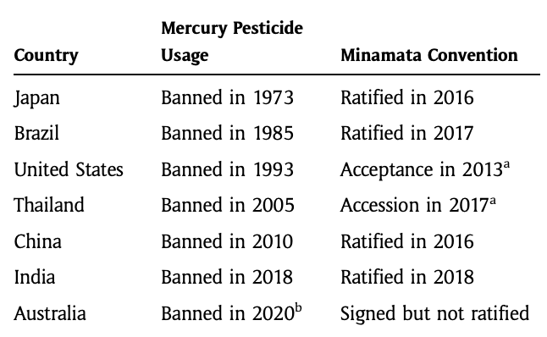
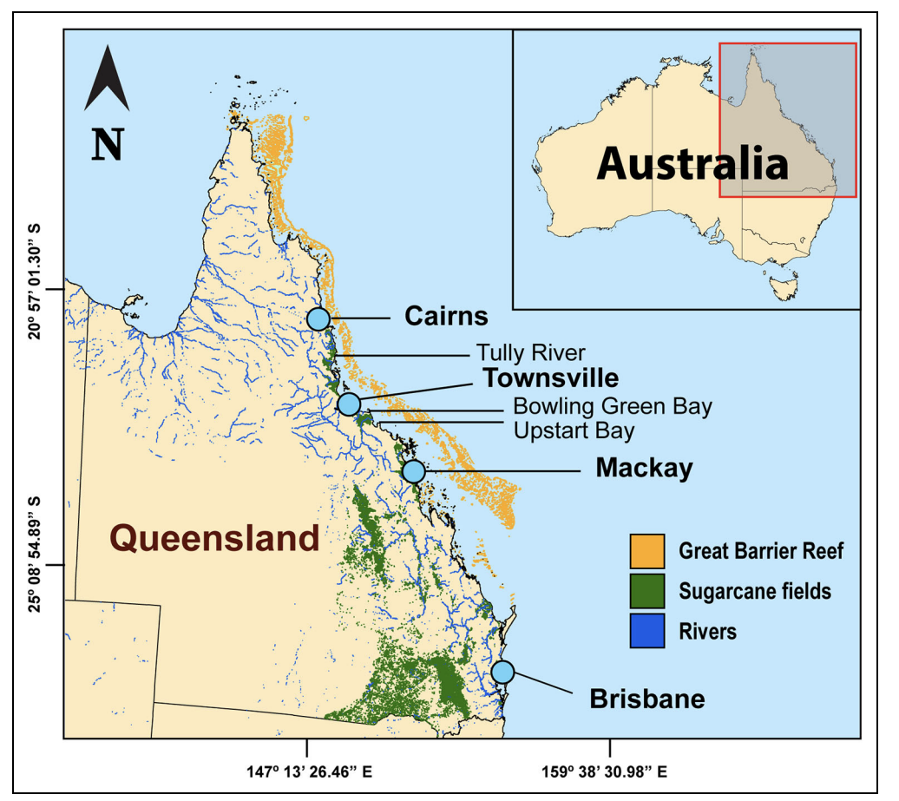
Chemicals like MEMC have been very popular in Australia
(MEMC was only recently banned in Australia)
Table 1: List of major agricultural and/or pesticide producer countries and actions taken to phase out the use of mercury pesticides. Accession, acceptance, or ratification has the same legal effect, where parties follow legal obligations under international law.
^{b}Australia cancelled the use of the last mercury pesticide product registered in the country in 2020. Existing supplies could be sold to, and used by, sugarcane farmers until May 2021 (Schneider, 2021).
Figure 1: Rivers (dark blue) that could potentially drain mercury from sugarcane farms (green) to the reef (orange). (Schneider, 2021).
Notes:
Source: Schneider, L. 2021. When toxic chemicals refuse to die—An examination of the prolonged mercury pesticide use in Australia. Elem Sci Anth, 9: 1. DOI: https://doi.org/10.1525/elementa.2021.053

Slide 42
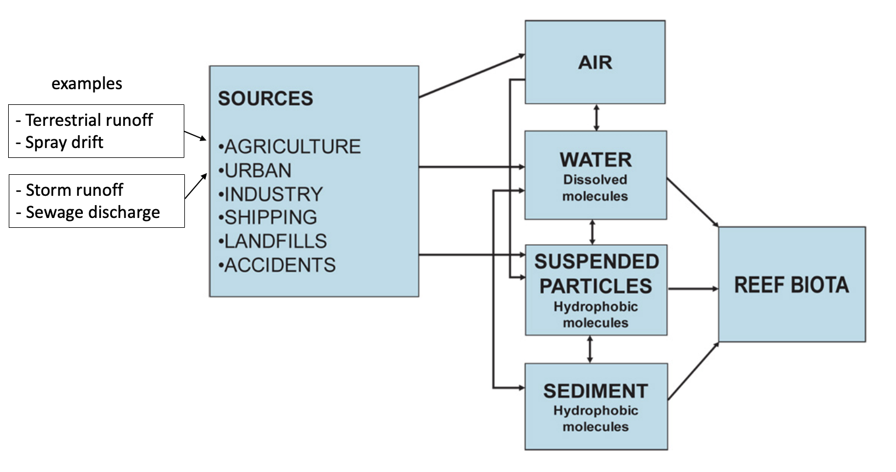
The pollutants are mainly coming from the land
Conceptual model for pollutant pathways in marine systems (van Dam et al., 2011)
Notes:
Image: https://edepot.wur.nl/192586
van Dam, Joost & Negri, Andrew & Uthicke, Sven & Mueller, Jochen. (2011). Chemical Pollution on Coral Reefs: Exposure and Ecological Effects. 10.2174/978160805121210187.

Slide 43
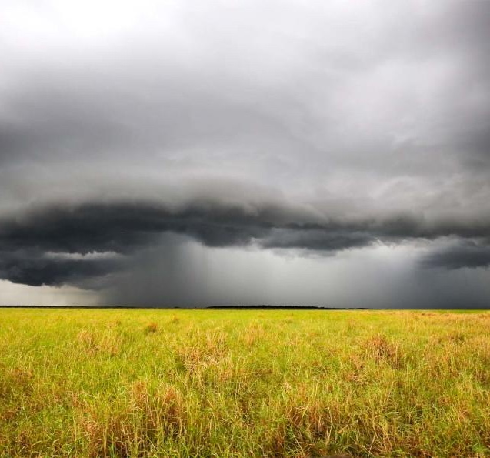
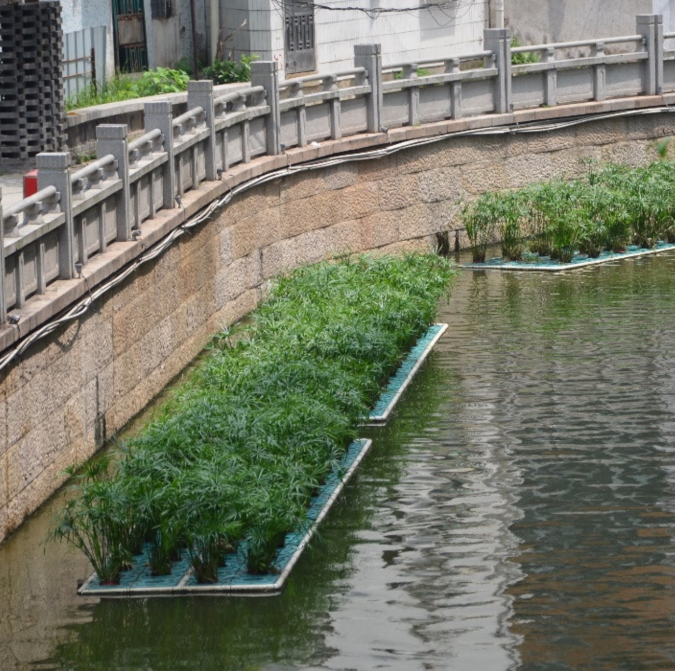
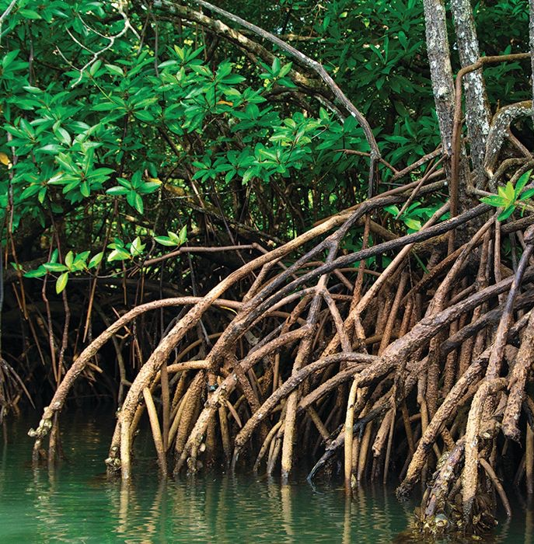
How the pollutants reach or do not reach the ocean:
Constructed wetlands
Mangrove filters
Rainfall runoff
Freshwater regulation
Contaminant retention
Land-sea biological exchange
Notes:
Land Use Impacts on Coral Reef Health: A Ridge-to-Reef Perspective
https://www.frontiersin.org/articles/10.3389/fmars.2019.00562/full

Slide 44
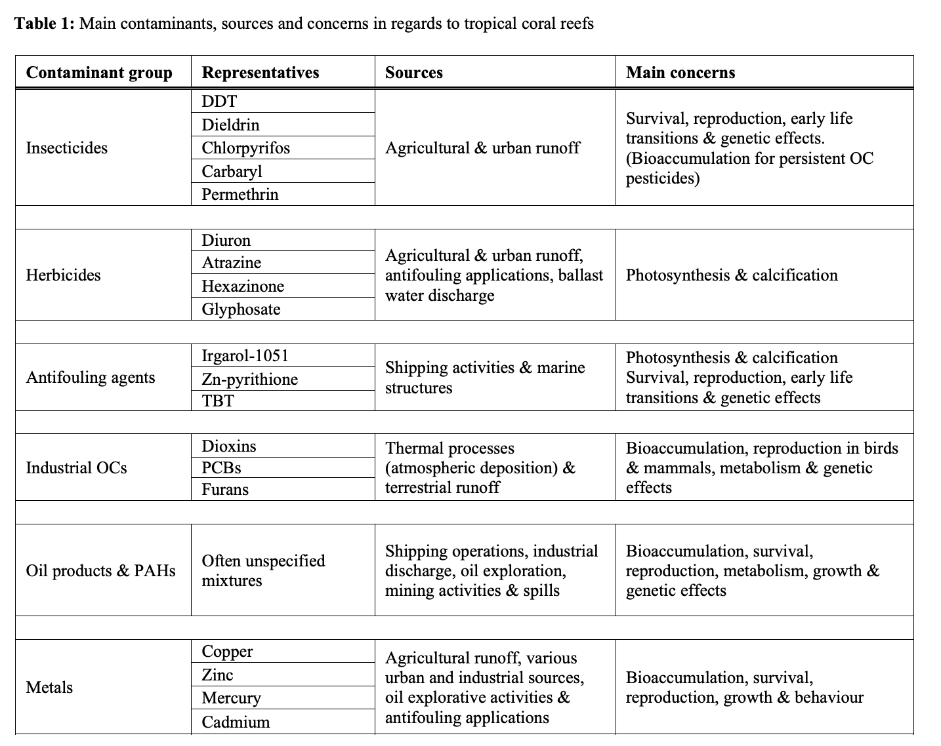
main contaminants of concern and why
Note: banned substances such as DDT still linger in the environment
Notes:
Image: https://edepot.wur.nl/192586
van Dam, Joost & Negri, Andrew & Uthicke, Sven & Mueller, Jochen. (2011). Chemical Pollution on Coral Reefs: Exposure and Ecological Effects. 10.2174/978160805121210187.

Slide 45
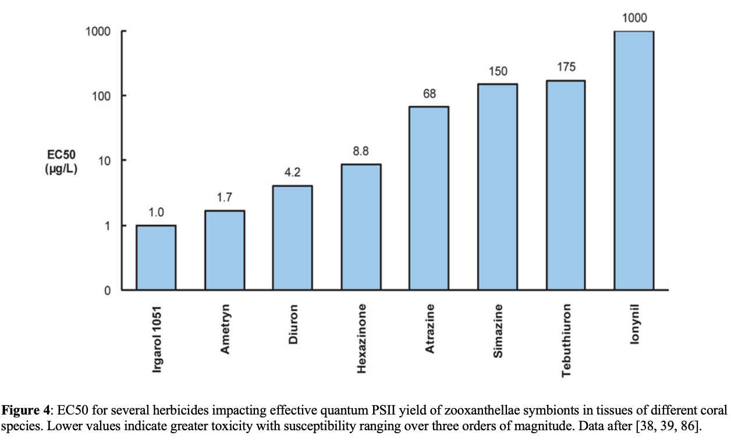
The greater the toxicity, the smaller amount needed to cause a negative effect
Increasing toxicity
Dose when 50% bleached
Note: EC50 is the concentration where 50% of a population responds to a pre-determined ‘end point’ e.g. coral bleaching

Slide 46
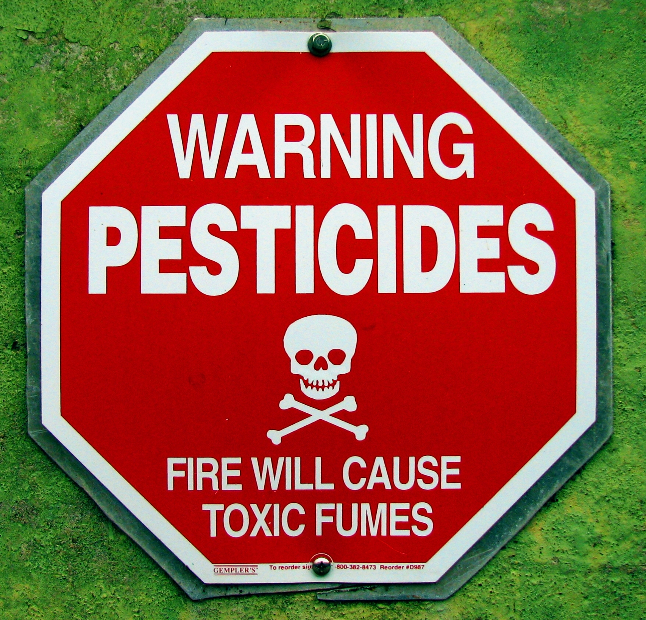
Their toxicity is why they were so popular in the first place
They worked!
A little too well….
(killing other stuff too)
Notes:
Source: Schneider, L. 2021. When toxic chemicals refuse to die—An examination of the prolonged mercury pesticide use in Australia. Elem Sci Anth, 9: 1. DOI: https://doi.org/10.1525/elementa.2021.053

Slide 47
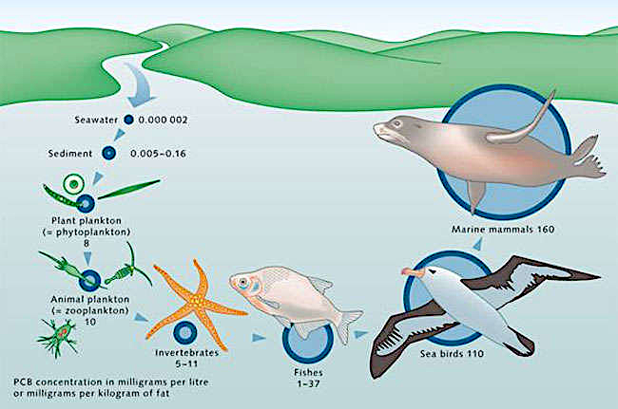
Plus, it hangs around….
E.g. Persistent Organic Pollutants (POPs)
resist degradation.
They are still toxic,
and now concentrated in wildlife via bioaccumulation.
Fig. 1: Bioaccumulation of Persistent Organic Pollutant, DDT
Notes:
Image: https://www.researchgate.net/figure/Showing-the-principle-of-Bioaccumulation-of-DDT-57-HOW-THE-POLLUTANT-CAN-BE-MEASURED-De_fig2_320078923
Sources, Fates and Control of Dichloro-DiphenylTrichloroethane (DDT); a case study on the Alpine Lakes (2016)

Slide 48
The "dirty dozen" POPs include:
Aldrin (insecticide)
Chlordane (insecticide)
Dieldrin (pesticide)
Endrin (insecticide)
Heptachlor (pesticide)
HCB (fungicide)
Mirex (insecticide)
Toxaphene (insecticide)
Polychlorinated biphenyls or PCBs (industry and consumer products)
DDT (insecticide)
Dioxins and
polychlorinated dibenzofurans (byproducts of high temp. processes)
A U.S. soldier is demonstrating DDT hand-spraying equipment. DDT was used to control the spread of typhus-carrying lice.
Notes:
Info: https://en.wikipedia.org/wiki/Persistent_organic_pollutant
Image: https://en.wikipedia.org/wiki/DDT#/media/File:DDT_WWII_soldier.jpg

Slide 49
How do we find out how much exposure to a chemical is considered ‘unsafe’?

Slide 50
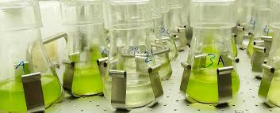
ecotoxicology tests expose biological life (cells, individuals, populations, communities) to harmful chemicals (on purpose, in a lab).
They measure how much chemical is needed to cause (or not cause) an effect.
Notes:
Image; https://www.holzforschung.at/en/testing/wood-protection-biology/ecotoxicology/

Slide 51
Fish, Early-life Stage Toxicity Test
Notes:
Image; https://www.situbiosciences.com/product/oecd-210-fish-early-life-stage-toxicity-test/

Slide 52
LD50 (Lethal Dose 50%) is the dose at which 50% of the animals will be expected to die.
No Observed Adverse Effect Level (NOAEL) is the highest exposure level at which there are no adverse effects on the exposed population; some effects may be produced at this level, but they are not considered adverse effects.
Lowest Observed Adverse Effect Level (LOAEL) is the lowest exposure level at which adverse effects are first observed on the exposed population.
Notes:
Image: https://www.chemsafetypro.com/Topics/CRA/Toxicology_Dose_Descriptors.html

Slide 53
It is important that NO year 11 or 12 student experiment is an ecotoxicology experiment.
QCAA does not endorse any activity or assessment item that harms other life forms.
You will be penalized.

Slide 54
ecotoxicology experiment results are used to inform the ANZECC-ARMCANZ 2000 water quality guidelines
Notes:
Image: https://www.waterquality.gov.au/sites/default/files/documents/anzecc-armcanz-2000-guidelines-vol1.pdf
More Info: https://www.sciencedirect.com/science/article/pii/S0048969721038481

Slide 55
Then we know how much of a chemical in the sediment, air or water is safe or not
Notes:
Image: https://www.waterquality.gov.au/anz-guidelines/resources/previous-guidelines/anzecc-armcanz-2000

Slide 56
…and evaluate the impacts of land-based management practices on marine conservation strategies
Notes:
Image: Photo : Steve Spring, Palm Beach County Reef Rescue
https://southeastfloridareefs.net/land-based-sources-of-pollution/

Slide 57
“Marine regulations that do not integrate land-based controls can be prone to failure”.
Carlson RR, Foo SA and Asner GP (2019) Land Use Impacts on Coral Reef Health: A Ridge-to-Reef Perspective. Front. Mar. Sci. 6:562. doi: 10.3389/fmars.2019.00562
Notes:
Source: Land Use Impacts on Coral Reef Health: A Ridge-to-Reef Perspective. Rachel R. Carlson^{1,2*} Shawna A. Foo¹ Gregory P. Asner^{1.} REVIEW article
Front. Mar. Sci., 18 September 2019. Sec. Marine Conservation and Sustainability. Volume 6 - 2019 | https://doi.org/10.3389/fmars.2019.00562
Image: https://www.futurelearn.com/info/courses/tackling-environmental-challenges/0/steps/150592

Slide 58
Would you like to be an ecotoxicologist?
Above: Ecotoxicologist Cecilia Berg feeds the frogs in her lab, one of few laboratories worldwide that performs life-cycle testing of chemicals on frogs.
Play video: https://www.youtube.com/watch?v=MX2PGhl64nc
Notes:
Image (left): https://www.uu.se/en/news/archive/2018-06-14-endocrine-disrupting-pesticides-impair-frog-reproduction
Image (right): https://www.antarctica.gov.au/science/meet-our-scientists/dr-catherine-king/

Slide 59
Learning Intention:
Recognise that the effectiveness of land-based management practices has a direct impact on the health of marine ecosystems. Scientific monitoring of these practices can be used to develop and evaluate projected impacts on marine conservation strategies
Success Criteria:
Complete Marine Education worksheet ’27. Roads to Reefs’
Notes:
Image: https://roundglasssustain.com/species/mudskipper

