Slide 1
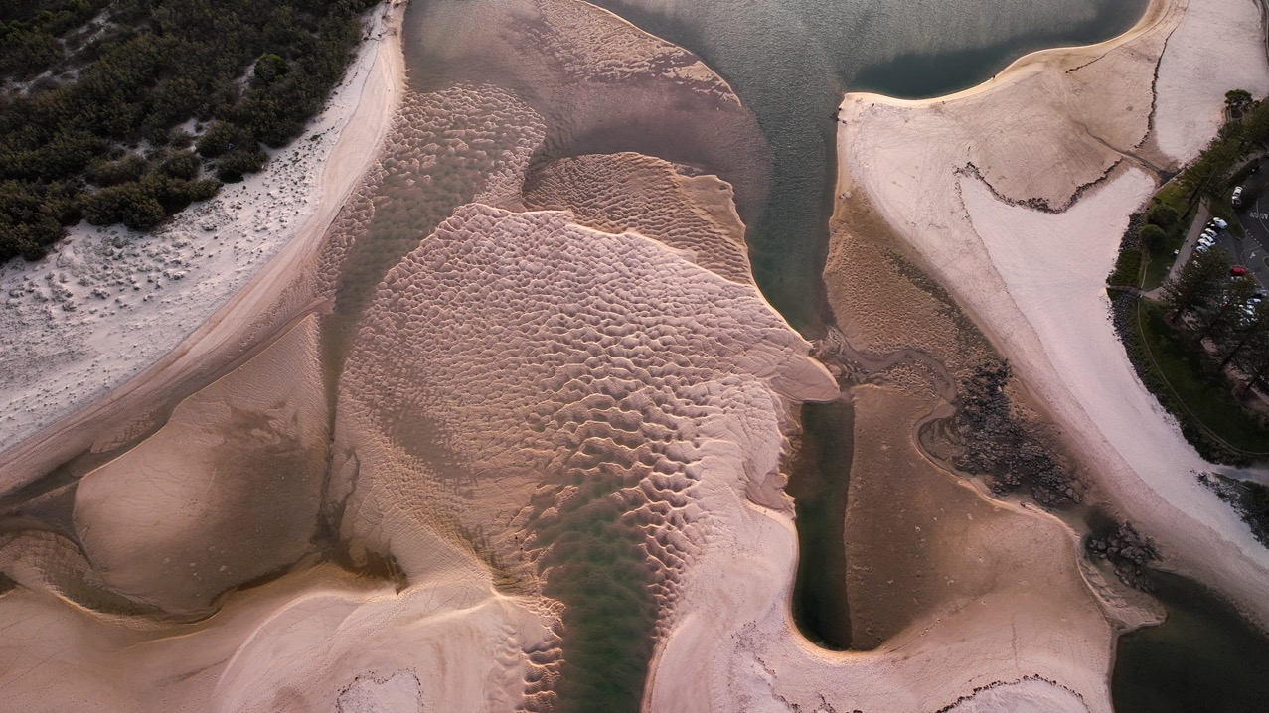
Learning Intention:
Consider that the use of data can inform the selection of coastal management strategies that may have beneficial, and/or harmful and/or unintended consequences
Success Criteria:
Complete Marine Education worksheet ’29. Power in data’
Photo © Bluey’s Photography

Slide 2
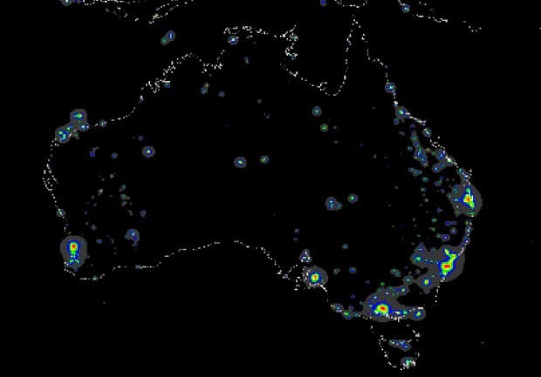
Most of the population lives near the coast
Image: Australian Geographic

Slide 3
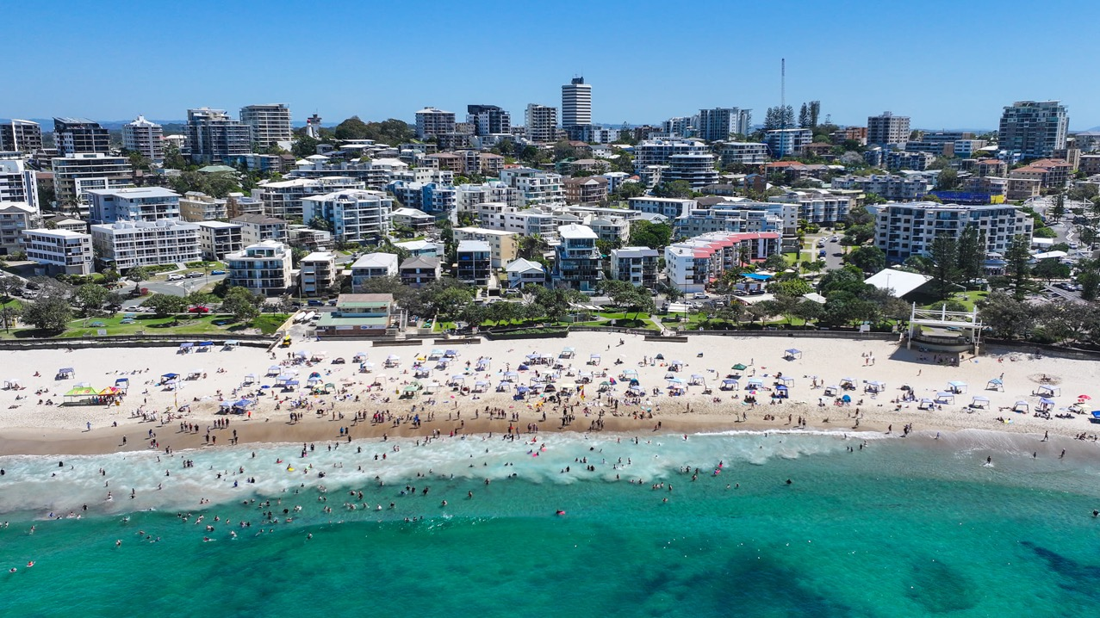
Kings Beach, Caloundra. Image: Blueys Photography

Slide 4
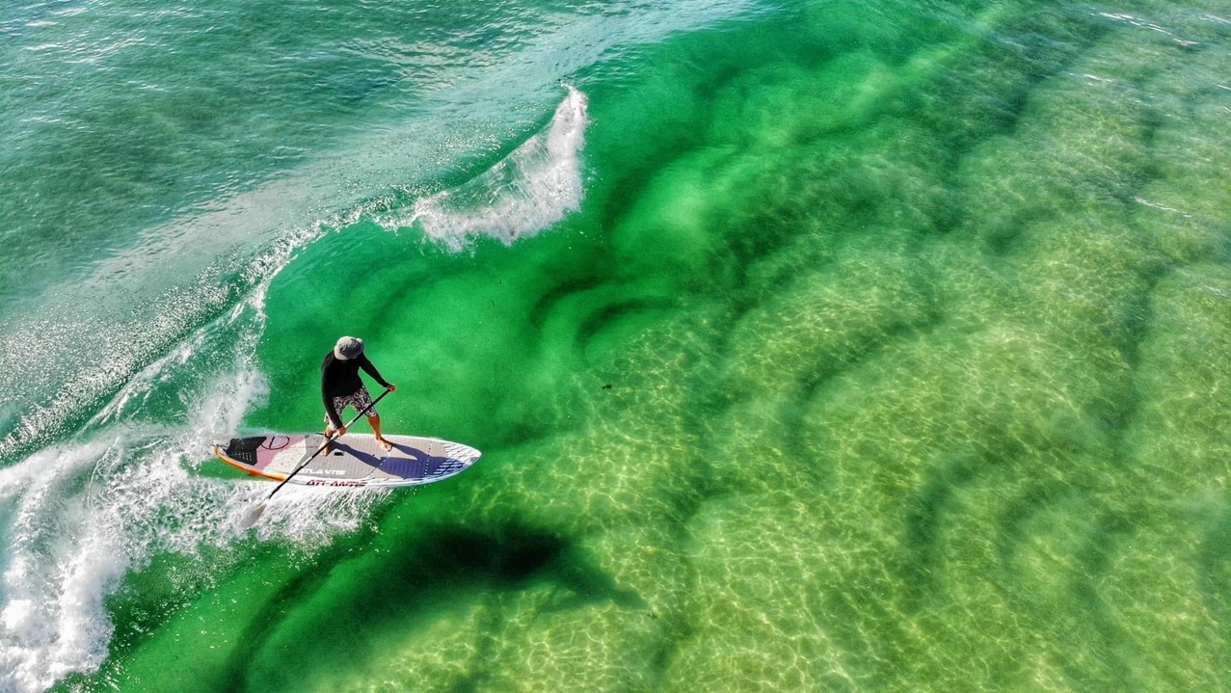
Caloundra. Image: Blueys Photography

Slide 5
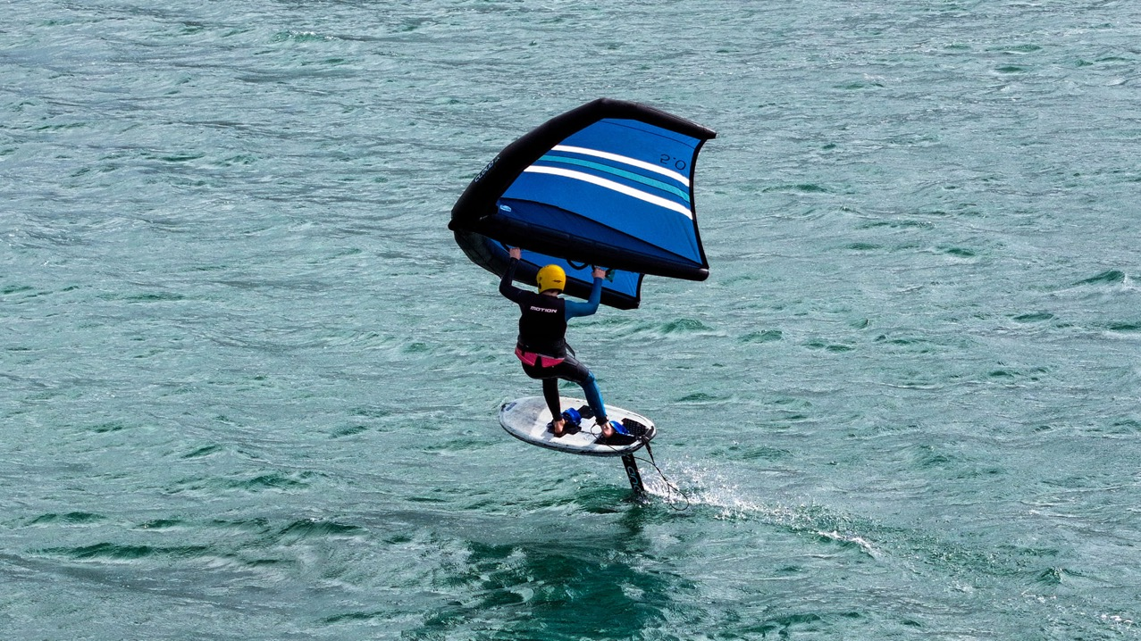
Image: Blueys Photography

Slide 6
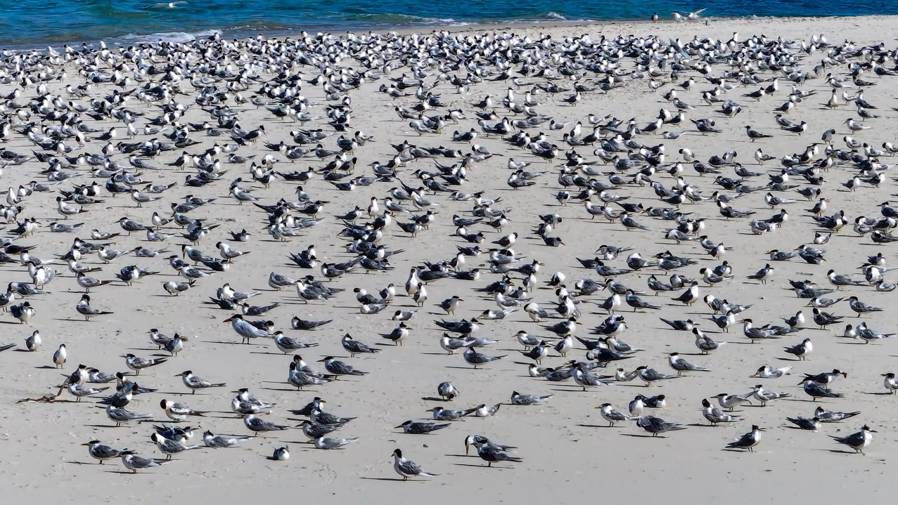
Sooty terns, Caloundra. Photo: Blueys Photography

Slide 7
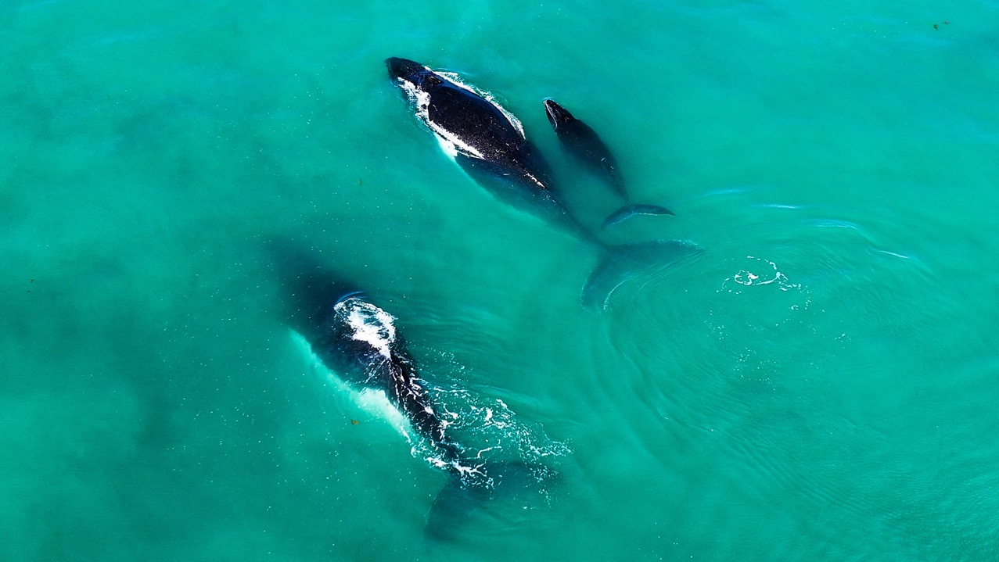
Sooty terns, Caloundra. Photo: Blueys Photography

Slide 8
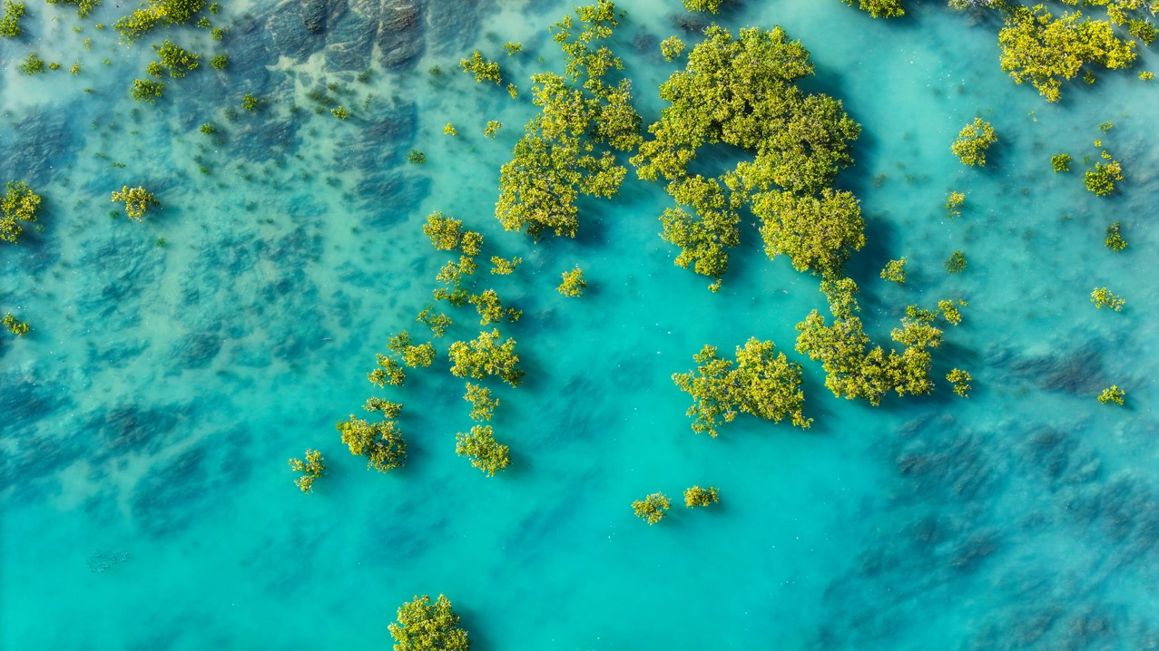
Stanage Bay. Photo: Blueys Photography

Slide 9
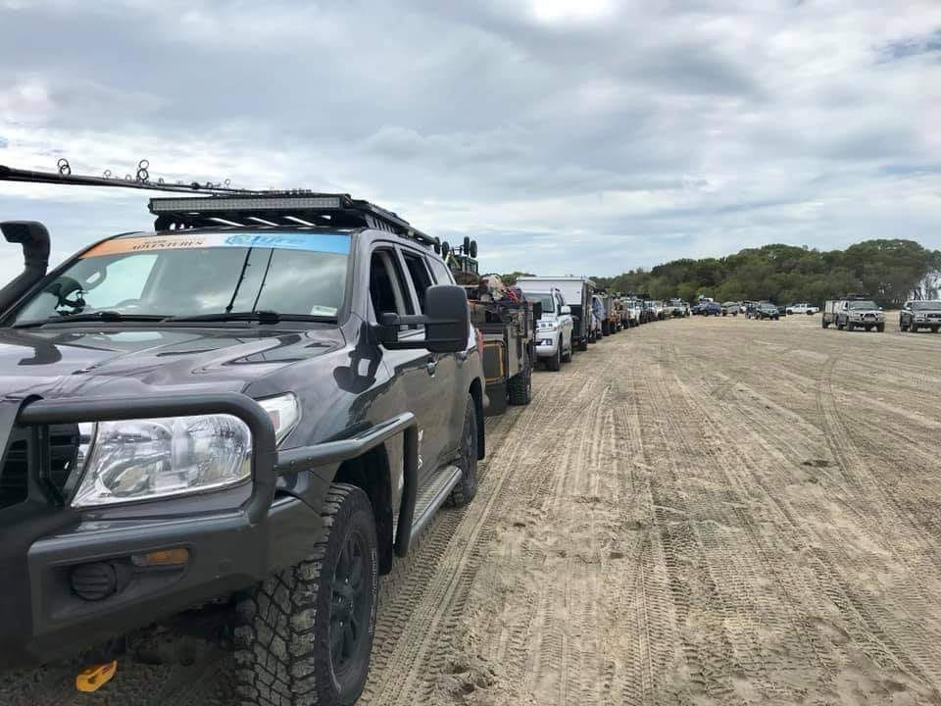
Thus, there are lots of decisions that need to be made about how these coastlines are managed. E.g. What do we do about the issue of erosion?
Should we bulldoze that wetland and build more housing or industry?
Should we build that dam to secure more water supplies? And so on.
Fraser Island barge waiting line
Notes:
Image: Aussie Offroad 4x4 Accessories facebook page post

Slide 10
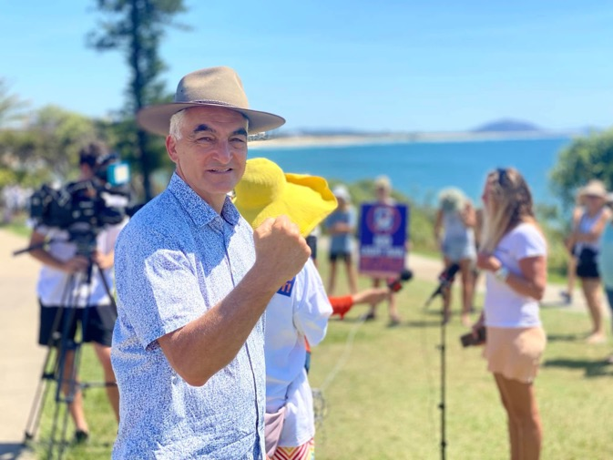
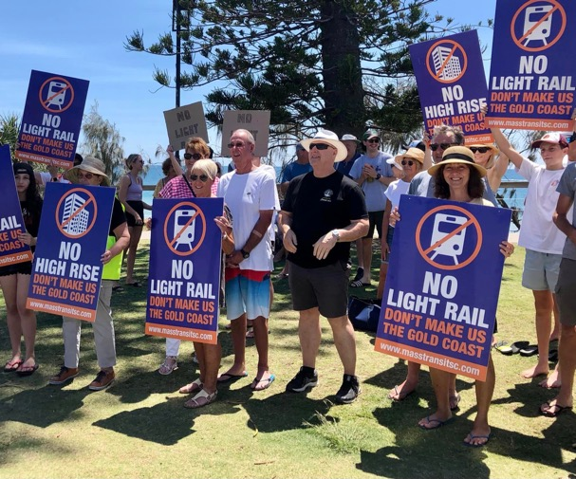
Coastal management decisions and strategies are often a compromise. Governments take into consideration the wants and needs of stakeholder groups (including investors) to decide who can build what and where, and what is allowed or not allowed.

Slide 11
Decisions like these can be politically motivated and heavily influenced by media, particularly when there is no scientific data available to give decision-makers any clear direction of the consequences of their decisions. For example, a decision-maker may be convinced something is a good idea, but it ends up being a bad idea.

Slide 12
The use of data can inform the decision-making process.

Slide 13
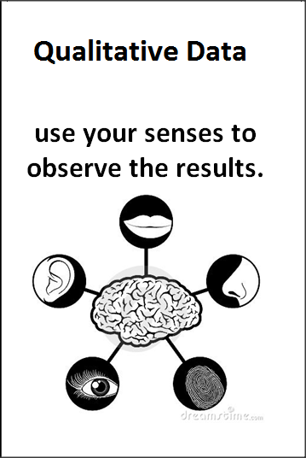
What is data exactly?

Slide 17
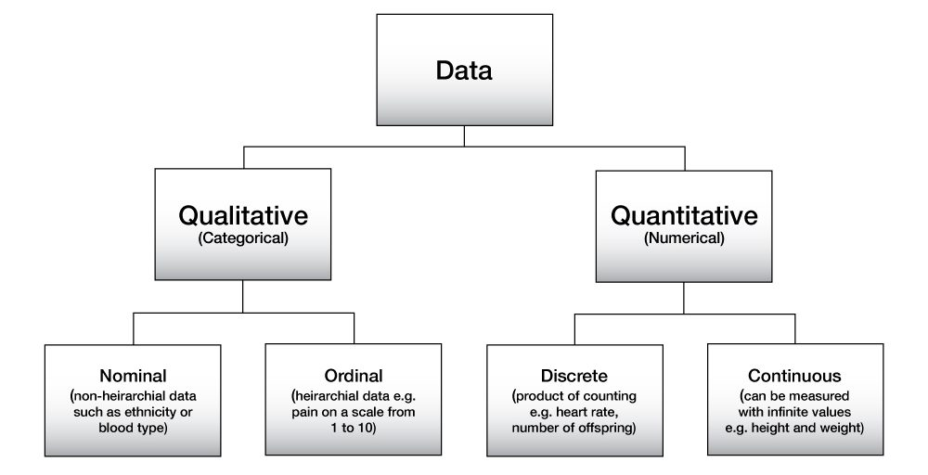

Slide 19
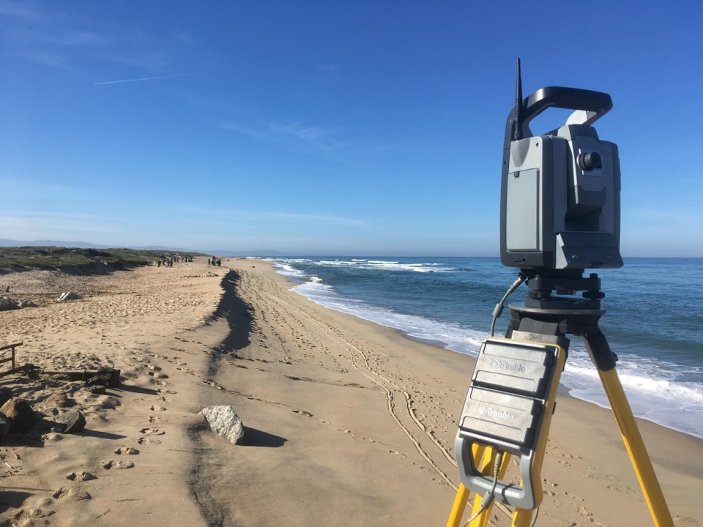
Data can be collected from
field studies
Notes:
Image: https://www.reddit.com/r/Surveying/comments/9g4jnx/surveyed_this_beach_23_times_over_15_yrs_to/

Slide 20
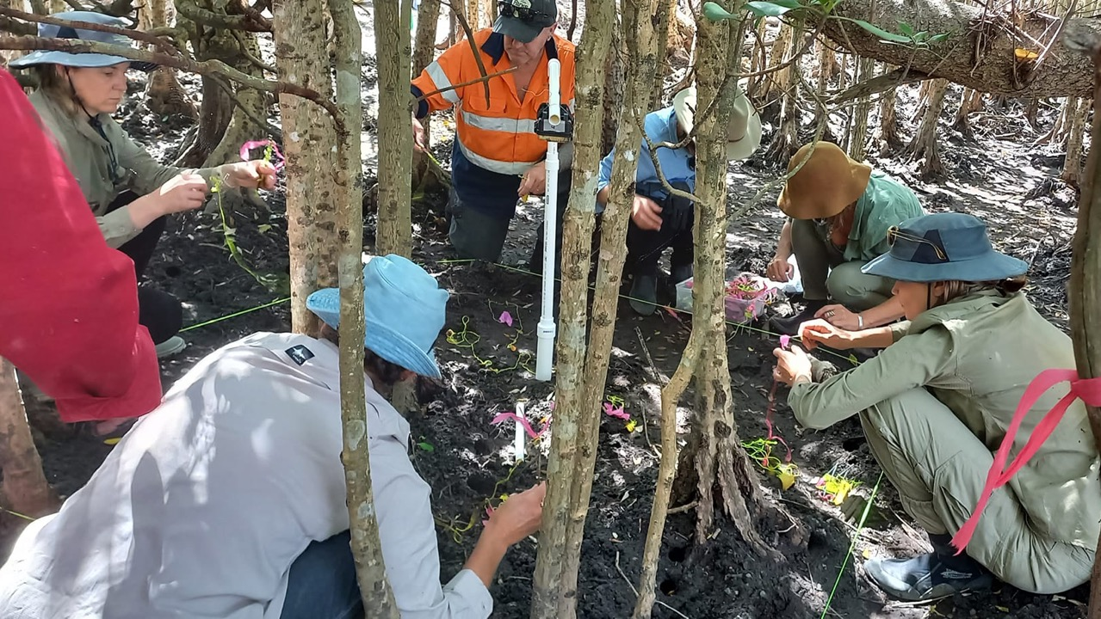
Notes:
Image: Gail Riches at EarthWatch/MangroveWatch PD

Slide 21
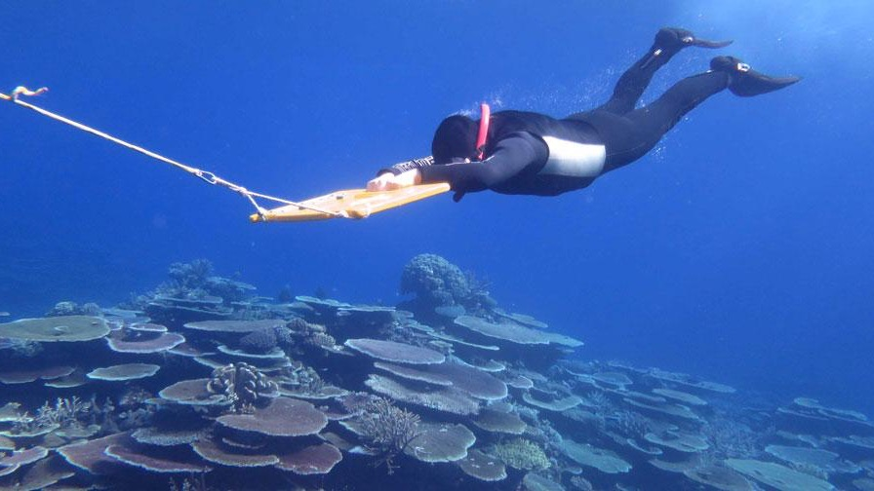
Notes:
Image: https://www.aims.gov.au/information-centre/news-and-stories/reef-recovery-window-after-decade-disturbances

Slide 22
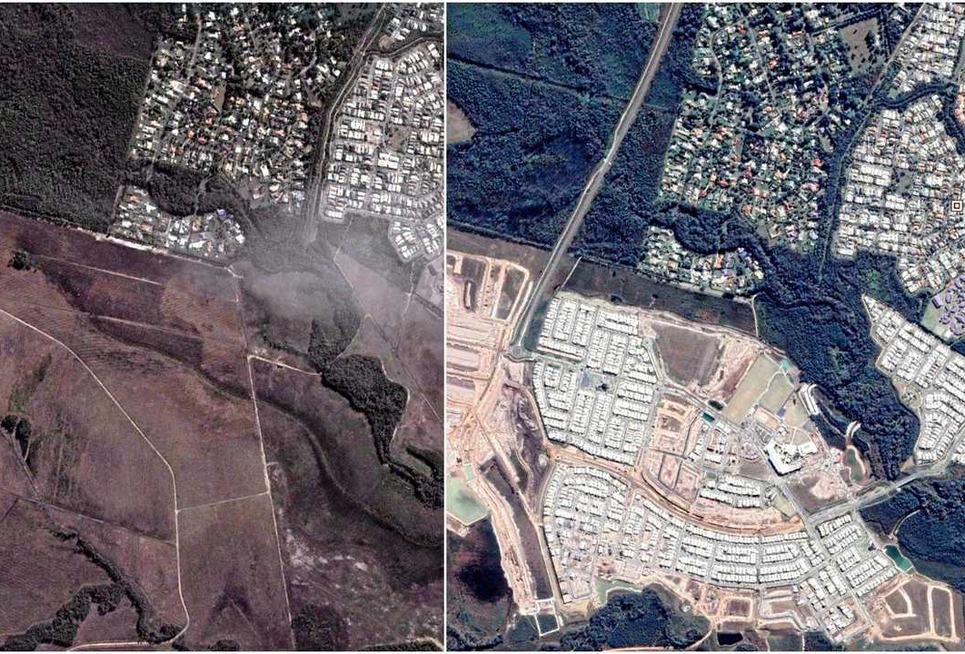
Satellite images
Notes:
Image: https://www.couriermail.com.au/subscribe/news/1/?sourceCode=CMWEB_WRE170_a_GGL&dest=https%3A%2F%2Fwww.couriermail.com.au%2Fnews%2Fqueensland%2Fsunshine-coast%2Fsatellite-images-how-the-coast-has-changed-over-time%2Fnews-story%2Fccea1c65a7be805206e981e8d050e726&memtype=anonymous&mode=premium&v21=HIGH-Segment-1-SCORE

Slide 23
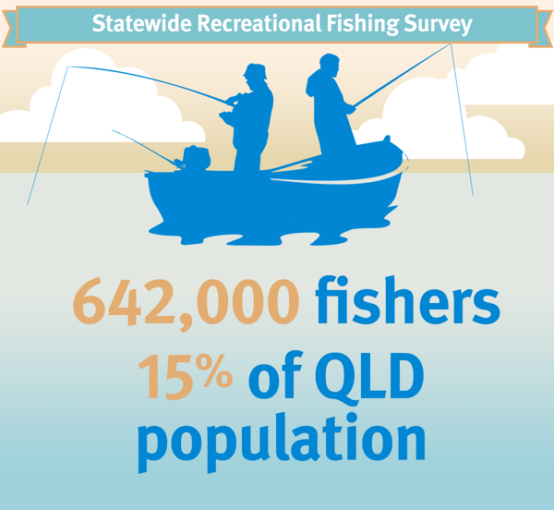
Surveys
According to the Queensland Recreational Fishing Survey, approximately 642,000 Queenslanders, or 15.1% of the population aged 5 or more, are recreational fishers (Fisheries Qld, 2015)

Slide 24
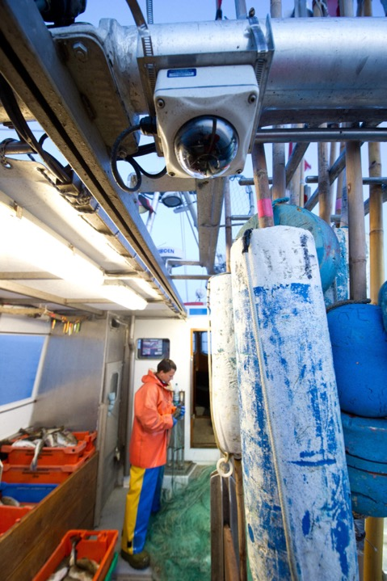
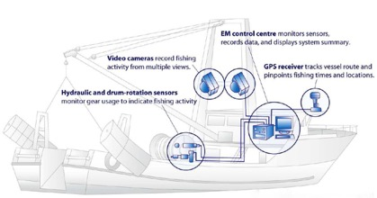
in situ
E.g. Electronic monitoring
(“e-monitoring”)
on fishing vessels
Notes:
Image: https://onlinelibrary.wiley.com/doi/full/10.1111/faf.12425
Electronic monitoring in fisheries: Lessons from global experiences and future opportunities

Slide 25
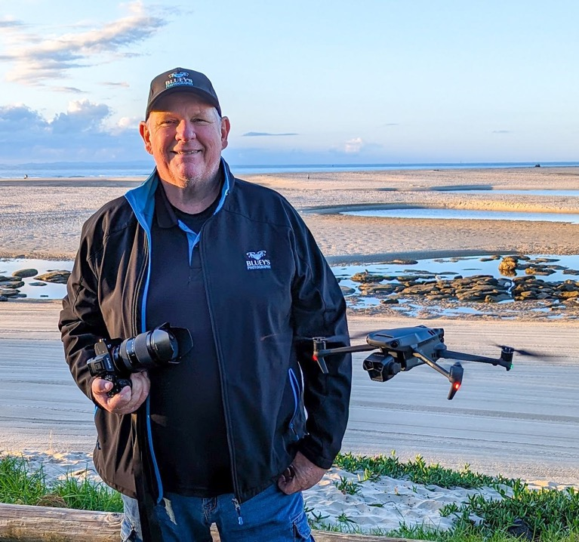
Doug Bazley of Bluey’s photography
(whose photos feature in this ppt)
Aerial photographs
and more…
Notes:
Image: https://www.sunshinecoastnews.com.au/2023/09/01/in-photos-passion-for-photography-soars-to-new-heights/

Slide 26
Data is used to inform coastal management strategies…

Slide 27
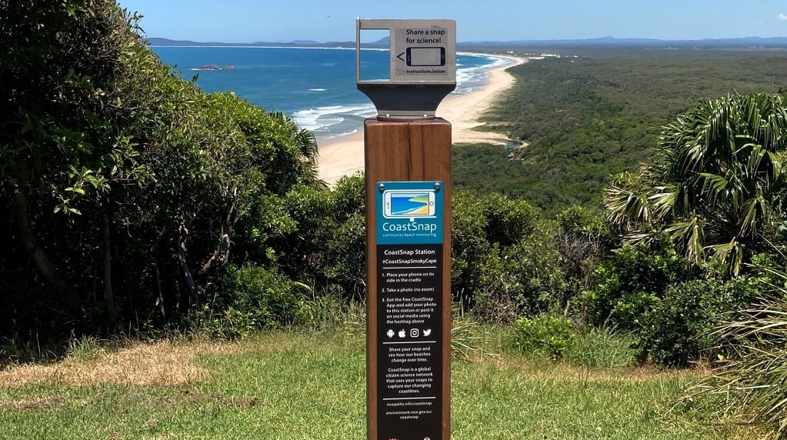
Notes:
Image: https://www.environment.nsw.gov.au/research-and-publications/your-research/citizen-science/get-involved/coastsnap

Slide 28
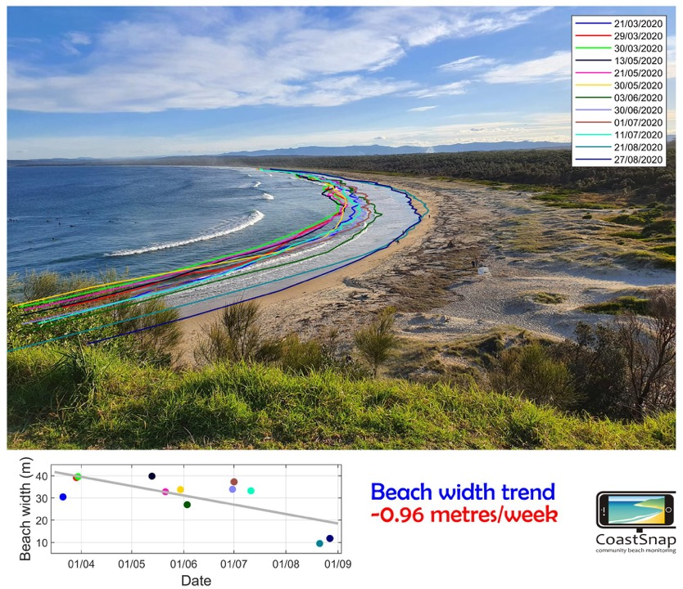
CoastSnap
“Use your smartphone to measure beach change and help us understand and manage our dynamic coast”
Notes:
Image: https://www.environment.nsw.gov.au/research-and-publications/your-research/citizen-science/get-involved/coastsnap

Slide 29
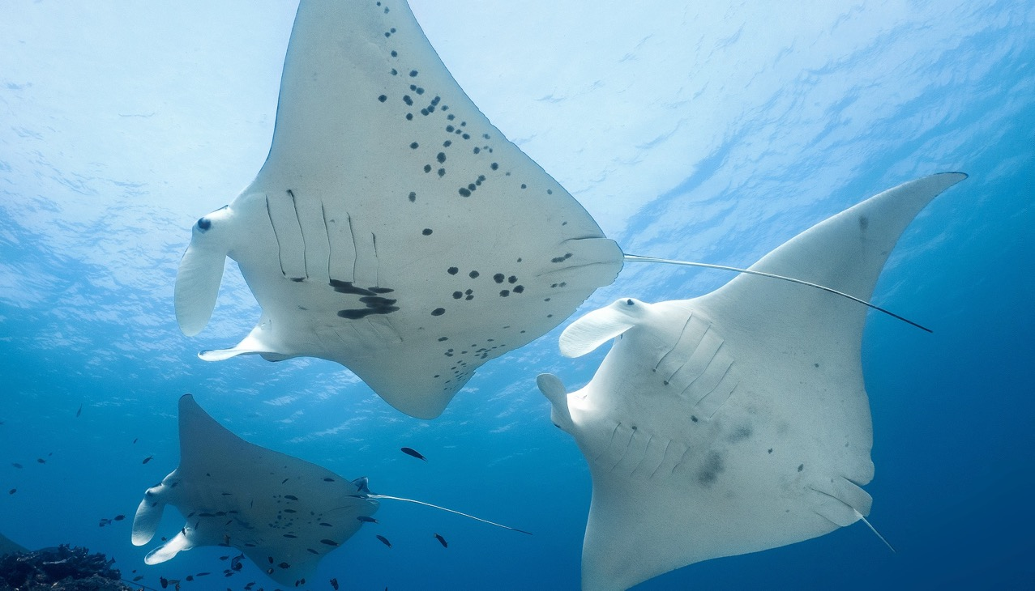
Manta Rays frequent habitats that are close to shore and accessible by boat.
“Project Manta is providing important baseline data to support the long-term conservation of manta rays and their relatives”
Without data, their
homes won’t be
protected.
Notes:
Image: https://www.usc.edu.au/about/structure/schools/school-of-science-technology-and-engineering/project-manta

Slide 30
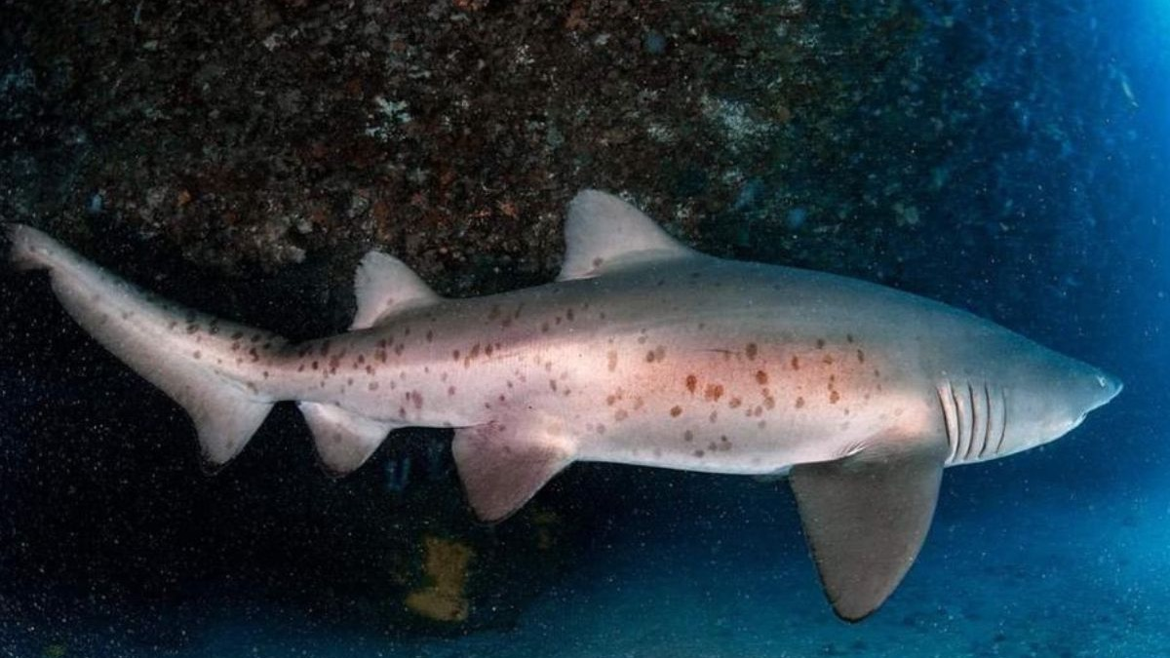
Grey Nurse Sharks are critically endangered and need their homes protected as well.
Unfortunately, we need more data to ensure their protection.
Divers can help by taking photographs of their spots so the sharks can be counted, identified and tracked.
Only then can the waters in which it frequents be confirmed as important critical habitats that need protecting.

Slide 31
“Turtle care volunteers provide essential data to support the protection of these majestic animals”

Slide 32
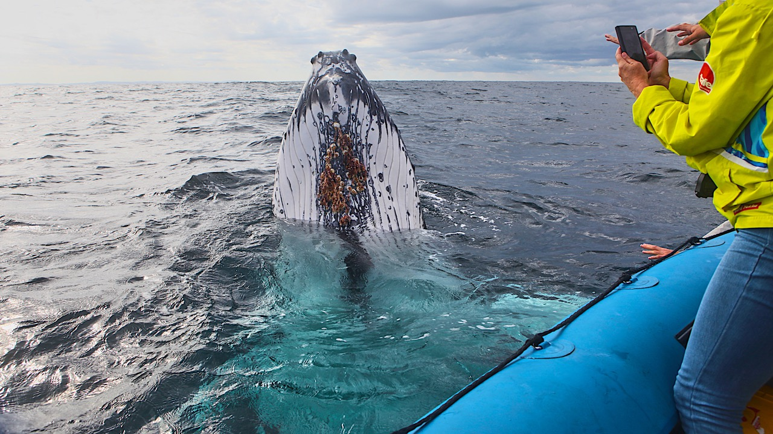
“Understanding marine mammals in their environment is key to their protection”

Slide 33
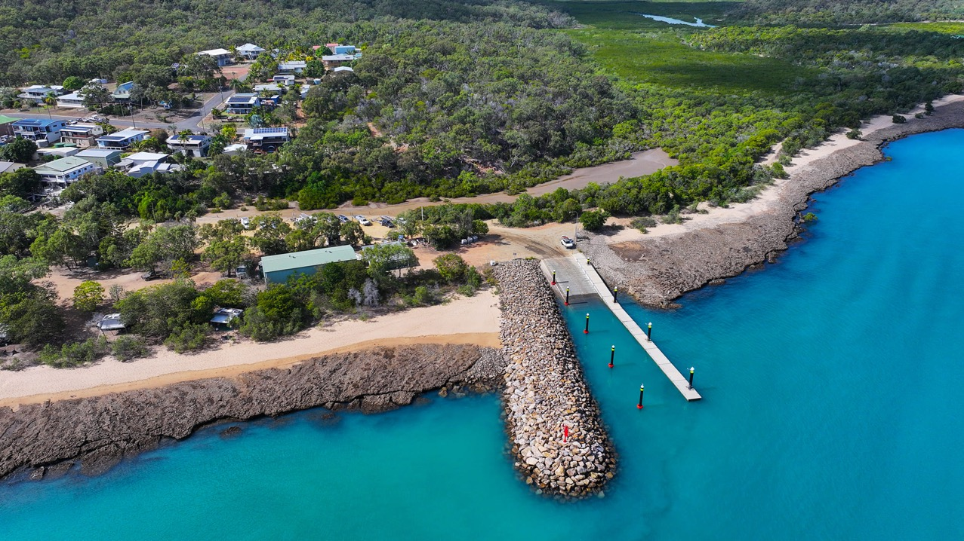
Album of coastal management strategies
Coast Guard boat ramp. Stanage Bay. Photo: Blueys Photography

Slide 34
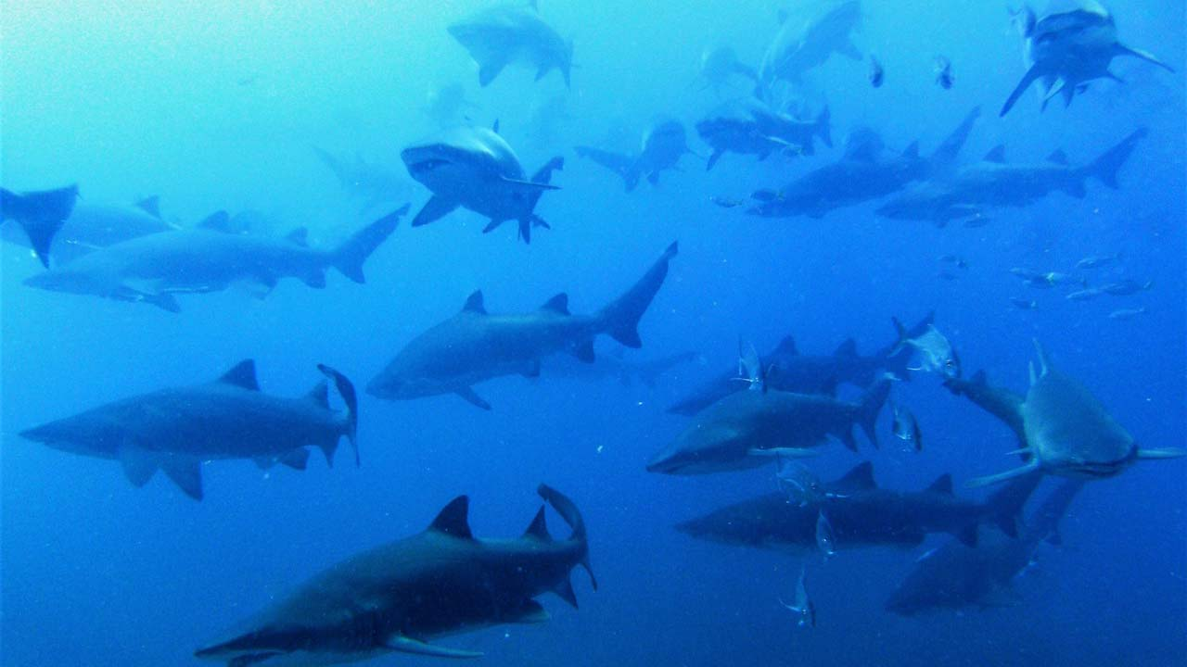
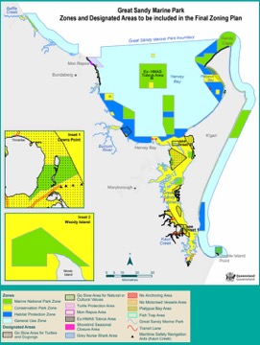
Critically endangered grey nurse shark breeding ground, Wolf Rock (green zone - protected).

Slide 35
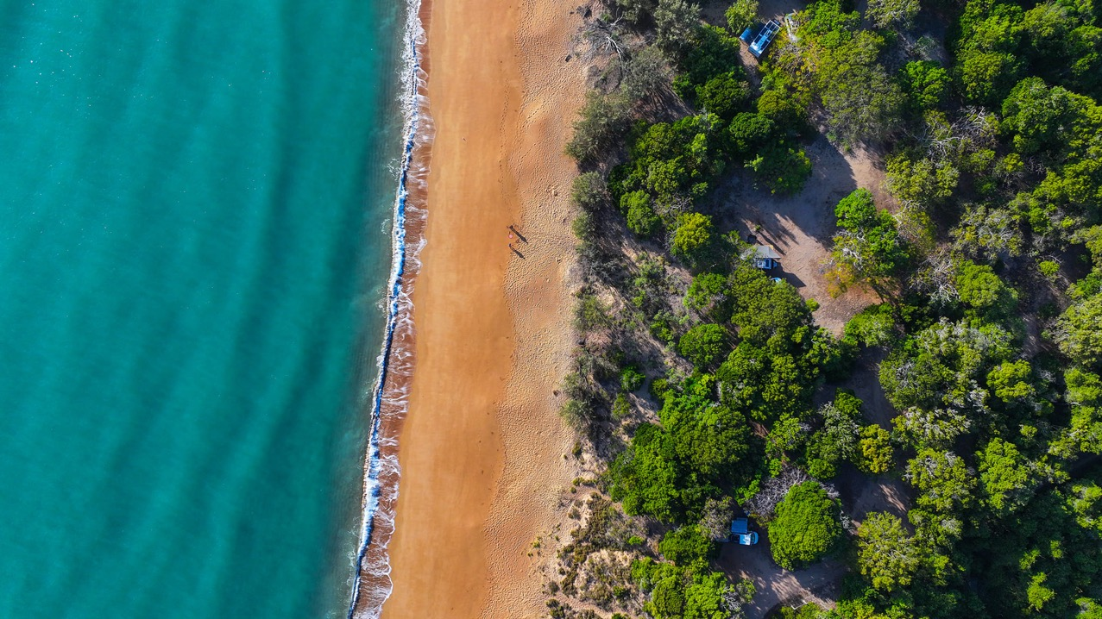
Middle camp. Stanage Bay. Photo: Blueys Photography

Slide 36
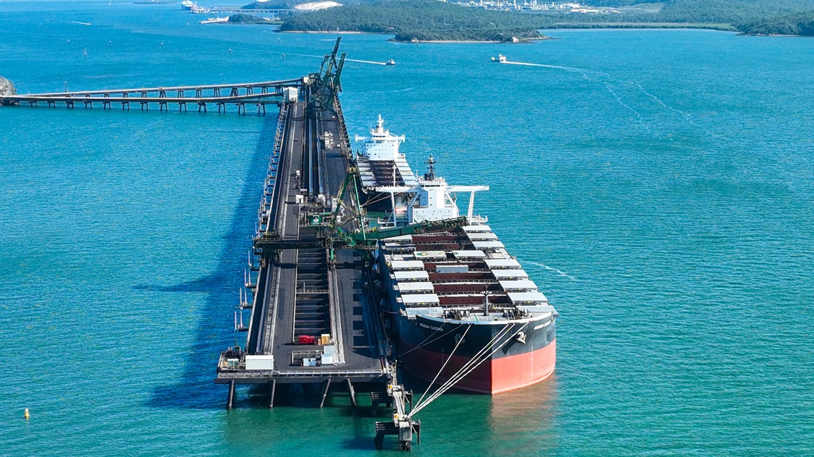
Gladstone Harbour. Image: Blueys Photography

Slide 37
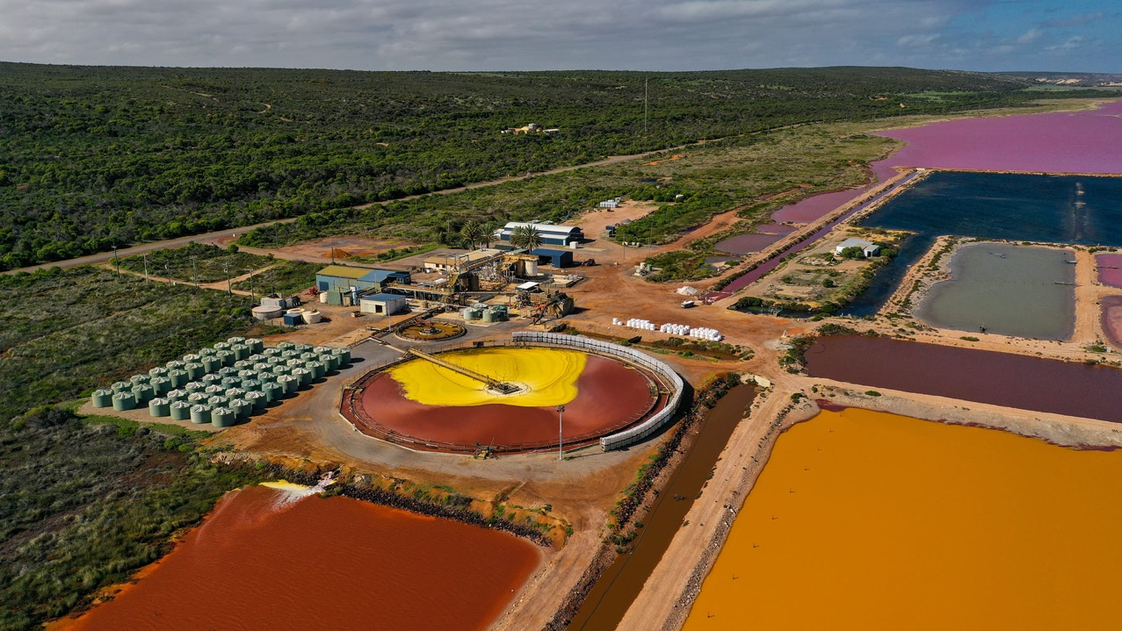
BASF Chemical Company is situated southeast of Hutt Lagoon, W.A. Image: Blueys Photography

Slide 38
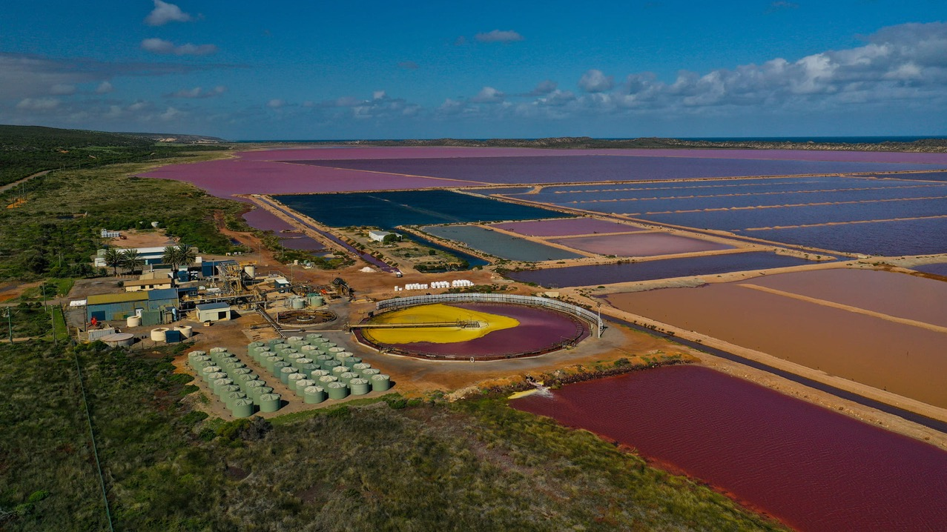
Image: Blueys Photography

Slide 39
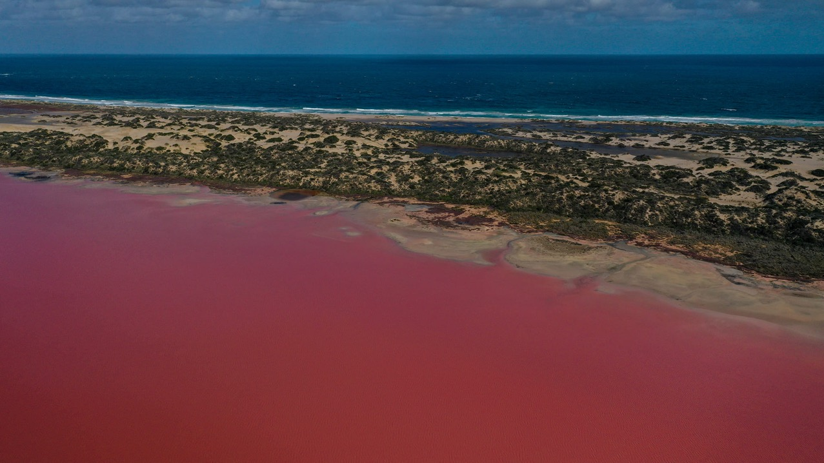
Pink Lake, W.A. Image: Blueys Photography

Slide 40
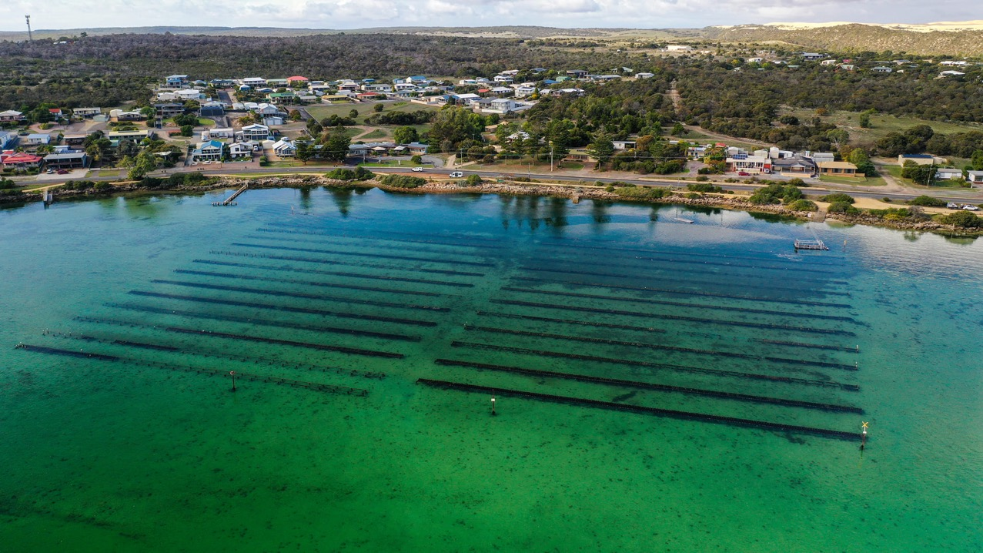
Oyster farm, Coffin Bay, S.A. Image: Blueys Photography

Slide 41
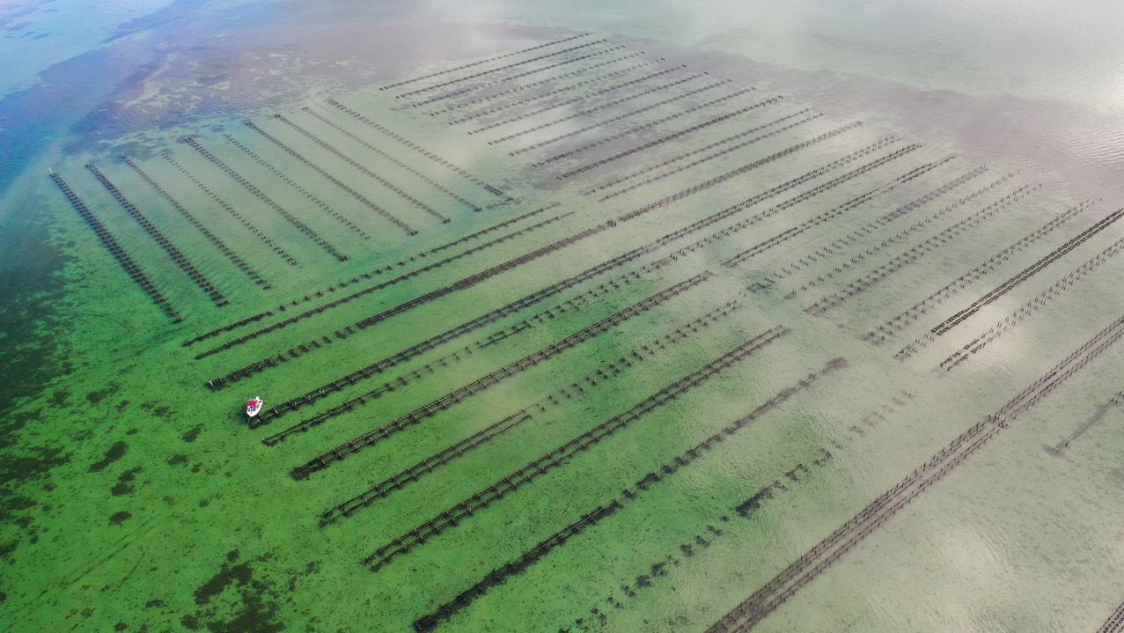
Oyster farm, Coffin Bay, S.A. Image: Blueys Photography

Slide 42
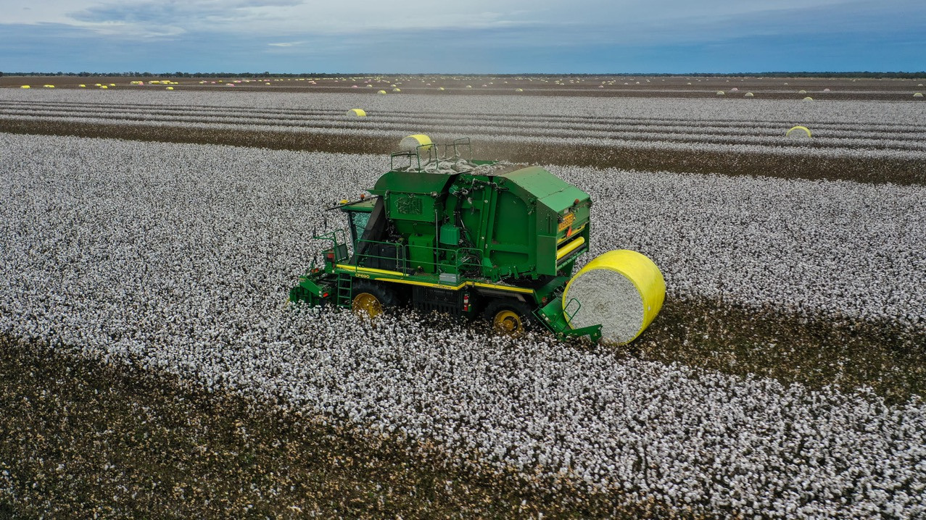
Cobar, N.S.W. Image: Blueys Photography

Slide 43
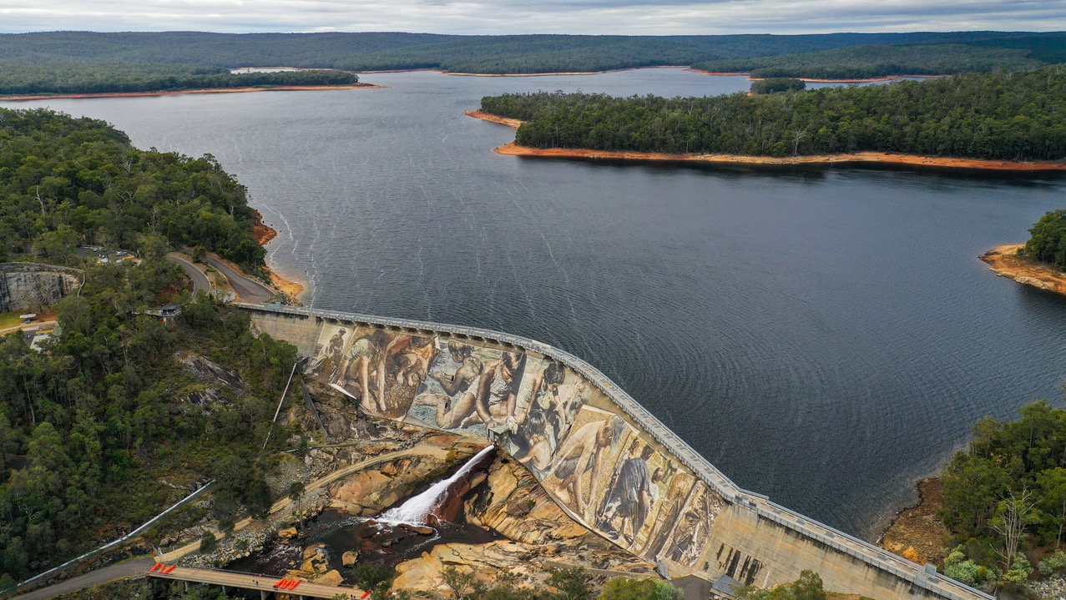
Wellington Dam, W.A. Photo: Blueys Photography

Slide 44
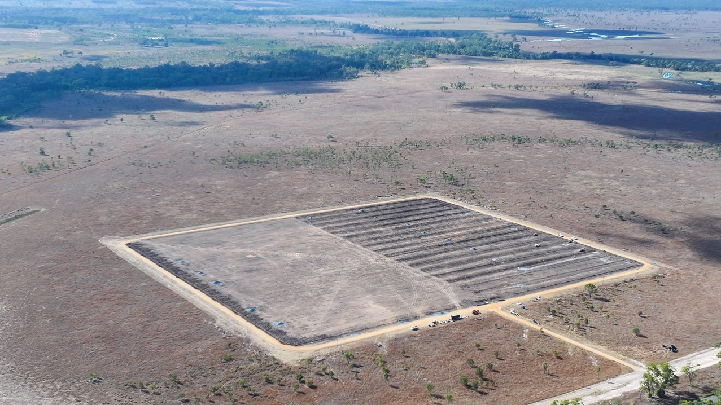
Shoalwater Bay Military Area. Photo: Blueys Photography

Slide 45
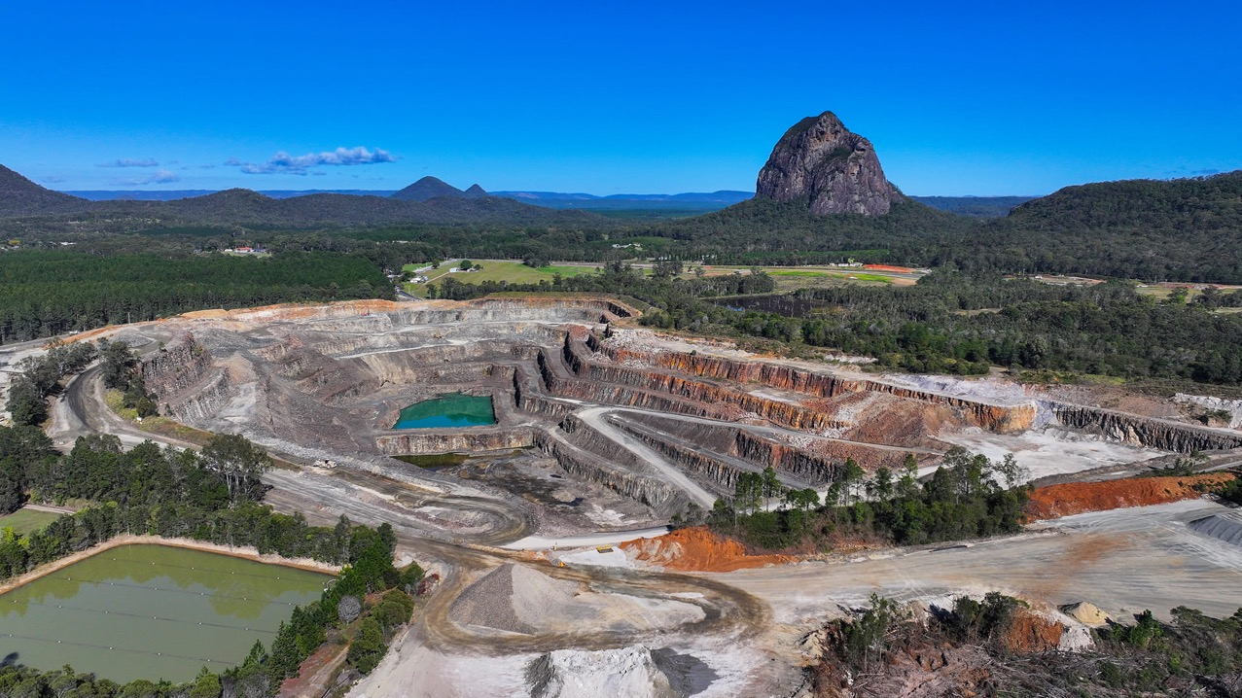
Sunrock (Beerburrum) Quarry. Photo: Blueys Photography

Slide 46
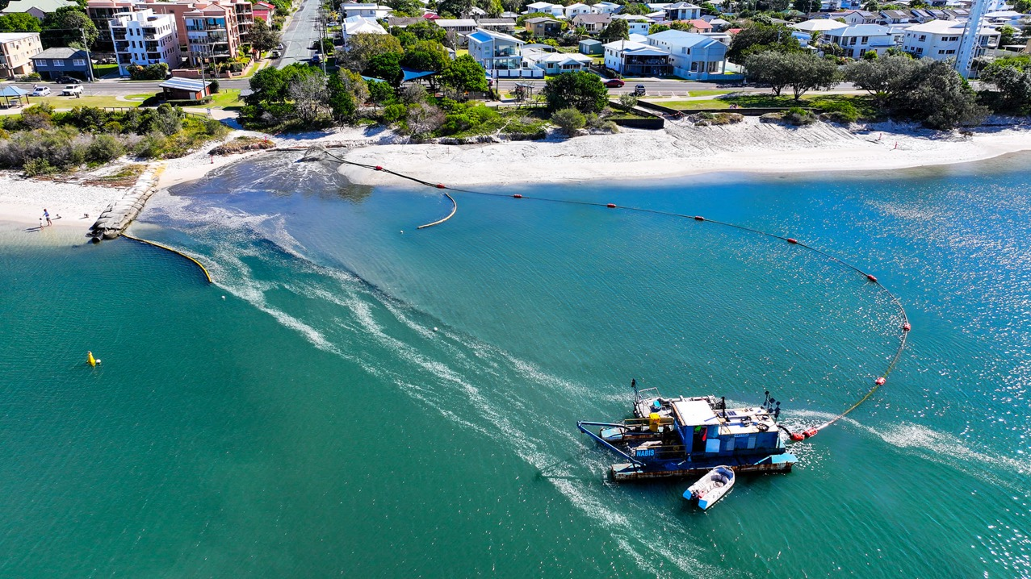
Annual sand replenishment, Golden Beach. Image: Blueys Photography

Slide 47
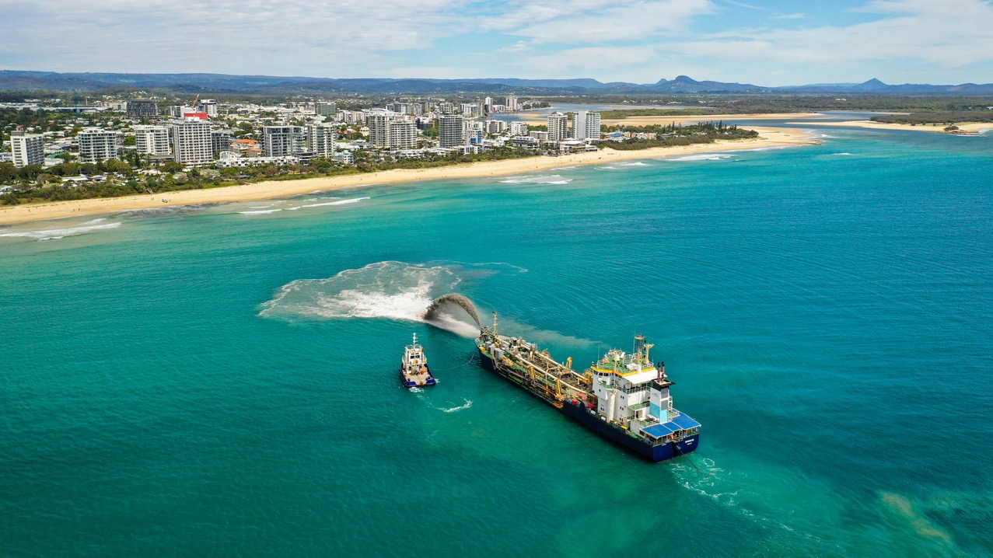
Maroochydore, SEQld. Image: Blueys Photography

Slide 48
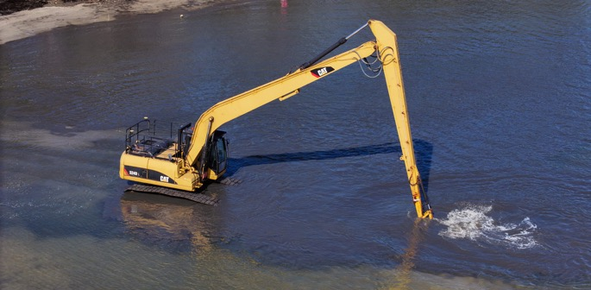
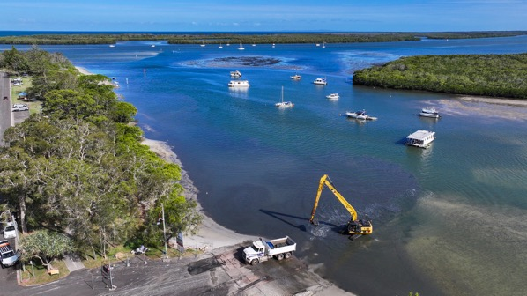
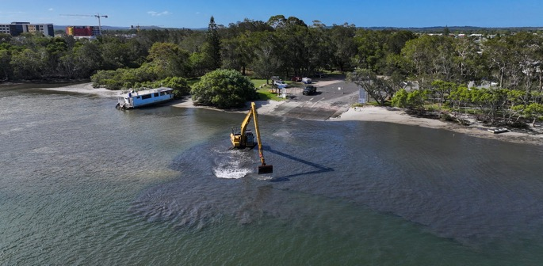
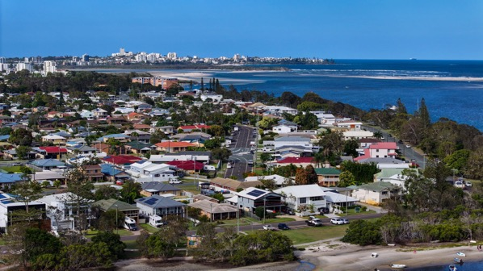
“Transport and Main Roads Queensland have started to remove sand from the Bells Creek boat ramp so it's good to use over the holidays” Blueys Photography 2023

Slide 49
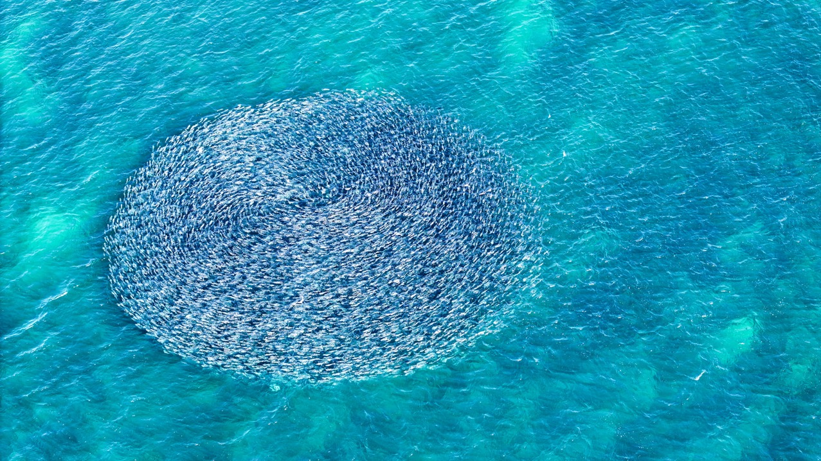
Mullet run, Kings Beach. Photo: Blueys Photography

Slide 50
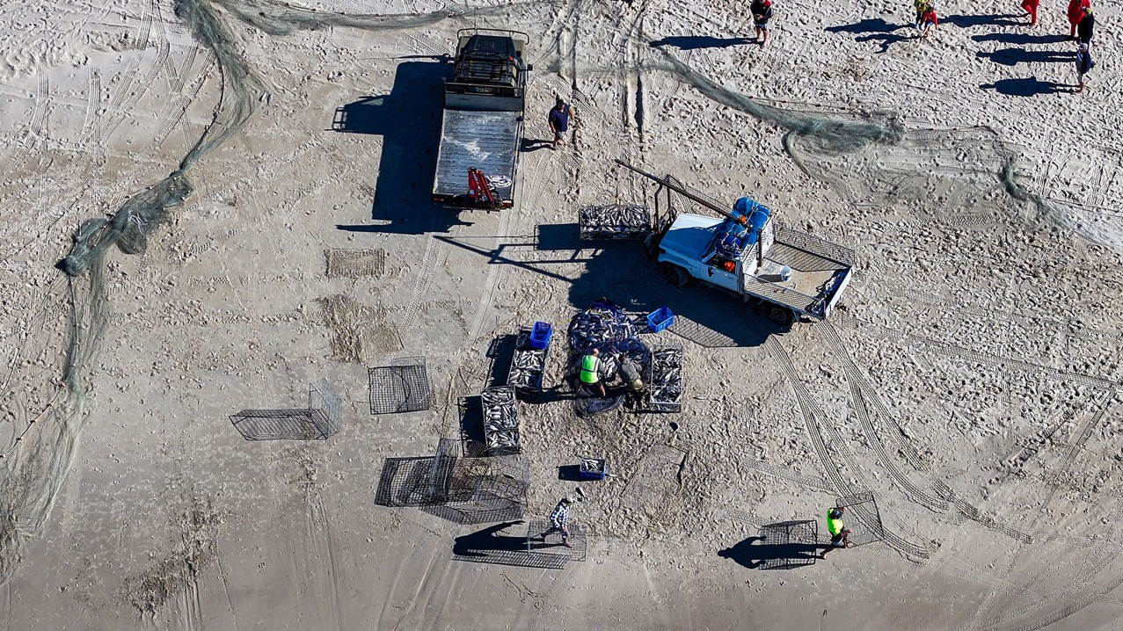
Mullet run, Kings Beach. Photo: Blueys Photography

Slide 51
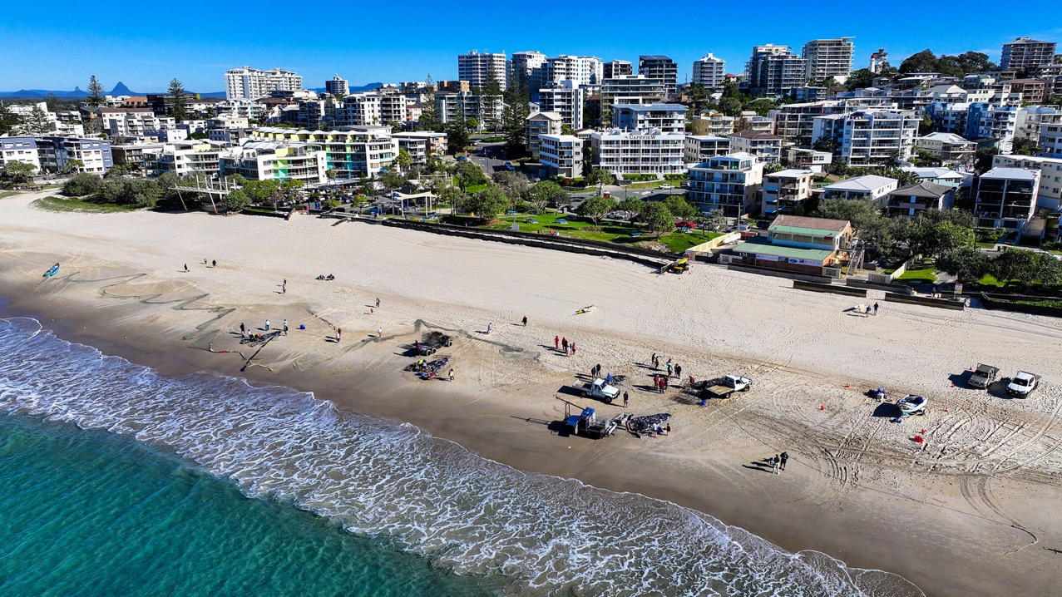
Mullet run, Kings Beach. Photo: Blueys Photography

Slide 52
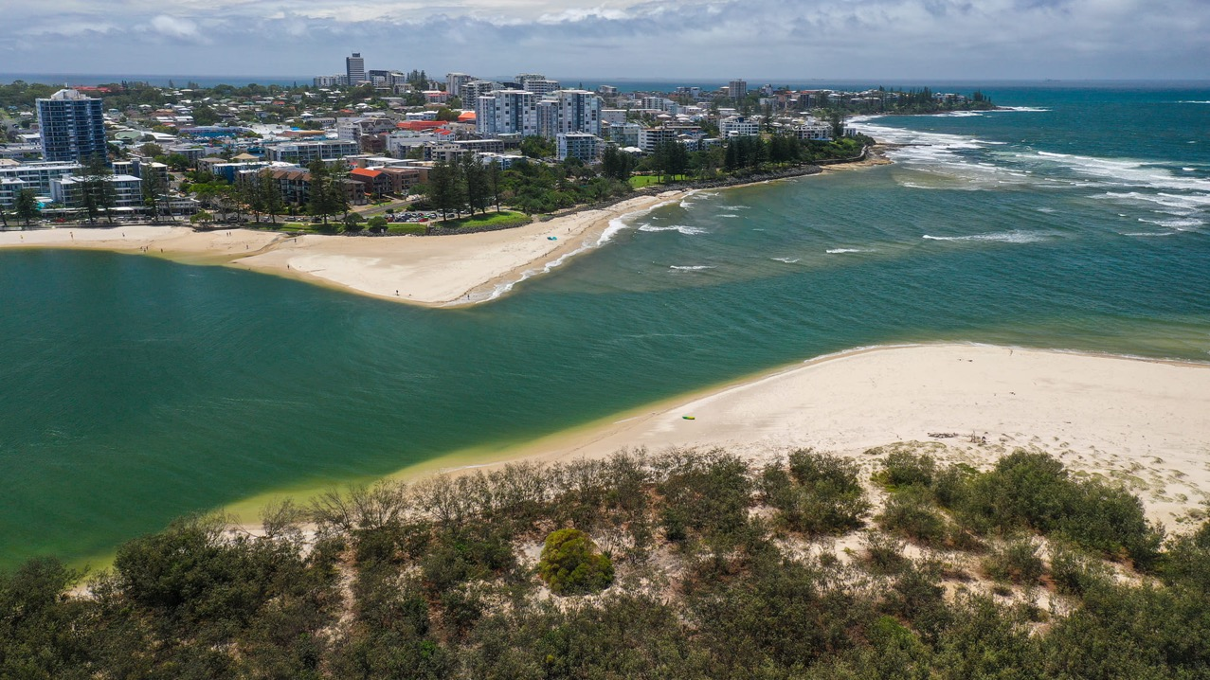
Caloundra bar (Bribie Island in front). Image: Blueys Photography

Slide 53
Caloundra bar – what it looks like now. Image: Blueys Photography

Slide 54
OLD BAR
NEW BAR

Slide 55
Just before Bribie Island broke in two (Jan, 2022). Image: Blueys Photography

Slide 56
A closing bar between Caloundra and Bribie Island (2022). Image: Blueys Photography

Slide 57
A closing bar between Caloundra and Bribie Island. Image: Blueys Photography

Slide 58
A closing bar between Caloundra and Bribie Island. Image: Blueys Photography

Slide 59
Bribie Island (left) Caloundra (right) closing bar (middle). Image: Blueys Photography

Slide 60
A closing bar between Caloundra and Bribie Island. Image: Blueys Photography

Slide 61
Once on the beach of Bribie Island, now in the ‘new’ bar (2023). Image: Blueys Photography
2018

Slide 62
Bribie Island, 2022. Image: Blueys Photography

Slide 63
As Bribie Island was braking in two. Image: Blueys Photography

Slide 65
Just before Bribie Island broke in two (Jan, 2022). Image: Blueys Photography

Slide 66
Just after Bribie Island broke in two (Jan, 2022). Image: Blueys Photography

Slide 67
Where it broke through
Bribie Island
Old bar
Caloundra

Slide 68
1971 vs 2020

Slide 69
Learning Intention:
Consider that the use of data can inform the selection of coastal management strategies that may have beneficial, and/or harmful and/or unintended consequences
Success Criteria:
Complete Marine Education worksheet ’29. Power in data’
Photo © Bluey’s Photography

