Slide 1
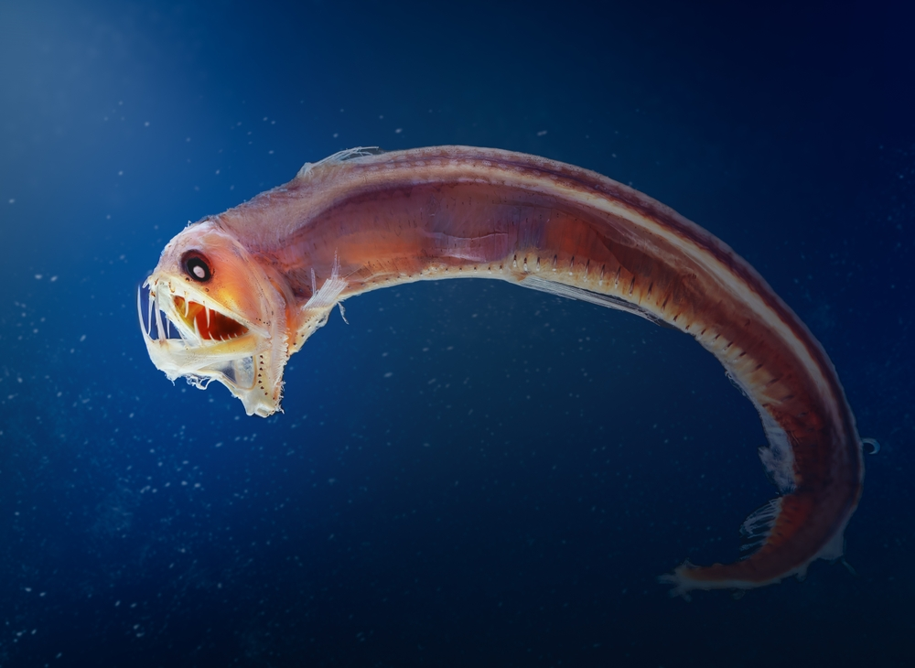
Learning Intention:
Identify the variety of ecosystems (e.g. estuaries, coastal lakes, saltmarshes, mangroves, seagrass, rocky shores, temperate reefs, coral reefs, lagoons, shelf and deep water) that constitute Australia’s marine biomes.
Success Criteria:
Complete Marine Education worksheet ‘3. A Diverse Australia’
Notes:
Image: https://hakaimagazine.com/news/this-mommy-shark-has-a-unique-way-of-making-babies/

Slide 2
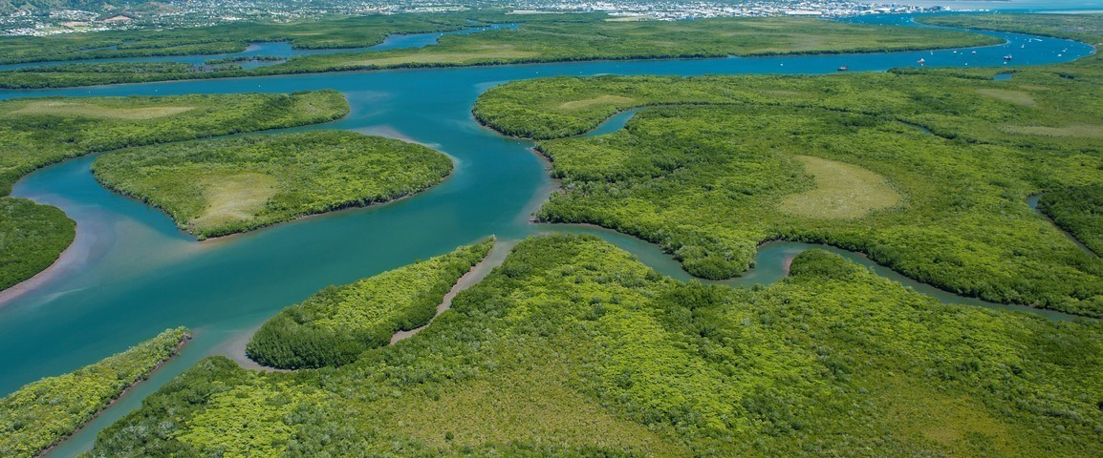
Estuary: where a river meets the sea
Notes:
ImAge; https://backpackerstours.com.au/tours/fishing/cairns-fishing-estuaries/

Slide 3
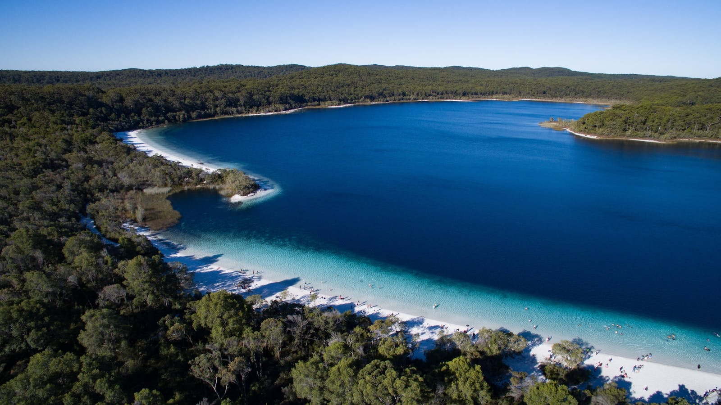
Coastal Lake: body of water separated from the sea by a narrow barrier of land
Notes:
ImAge; https://www.visitfrasercoast.com/product/lake-mckenzie/

Slide 4
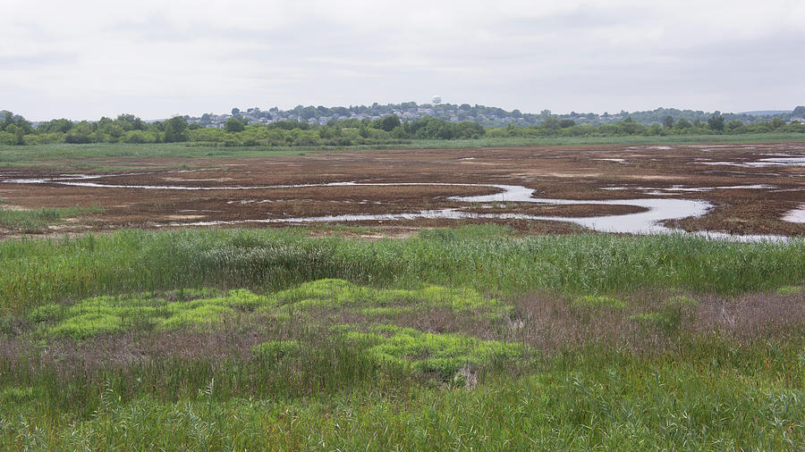
Salt Marsh: ‘behind the mangroves’ on the upper tidal zone, closer to land

Slide 5
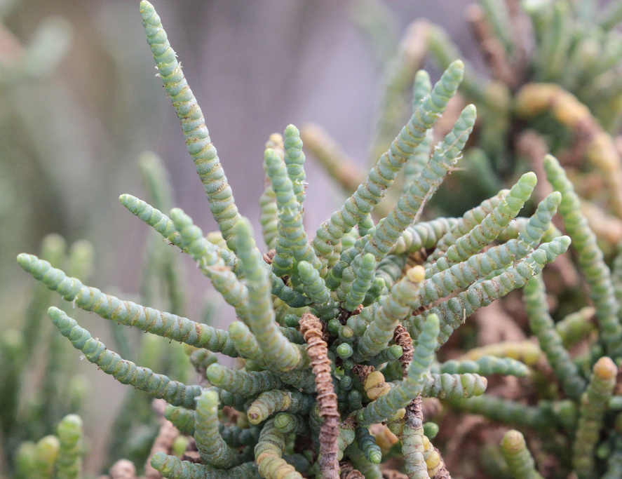
Salt Marsh Tecticornia pergranulata (commonly known as the blackseed glasswort)
has a unique resistance to salinity and adversity.
Notes:
Image; https://www.inaturalist.org/guide_taxa/1325489

Slide 6
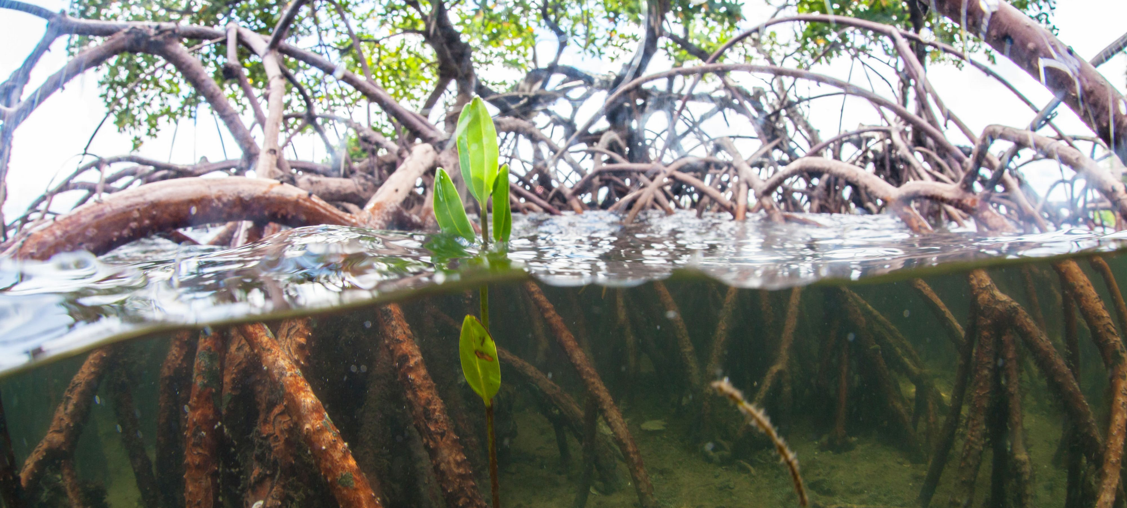
Mangroves: salt-tolerant, terrestrial plants between low and high tide zones
Notes:
Image: https://www.nature.org/en-us/about-us/where-we-work/united-states/florida/stories-in-florida/why-mangroves-important/

Slide 7
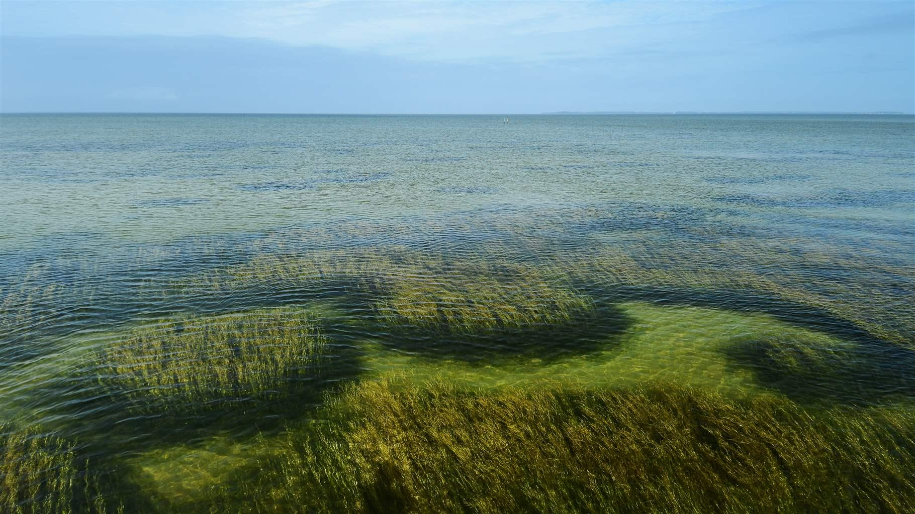
Seagrass meadows: an underwater ecosystem formed by seagrasses
Notes:
Image: https://www.pewtrusts.org/en/research-and-analysis/articles/2020/04/29/conservation-efforts-boost-seagrass-meadows-and-their-value-to-nature-and-people

Slide 8
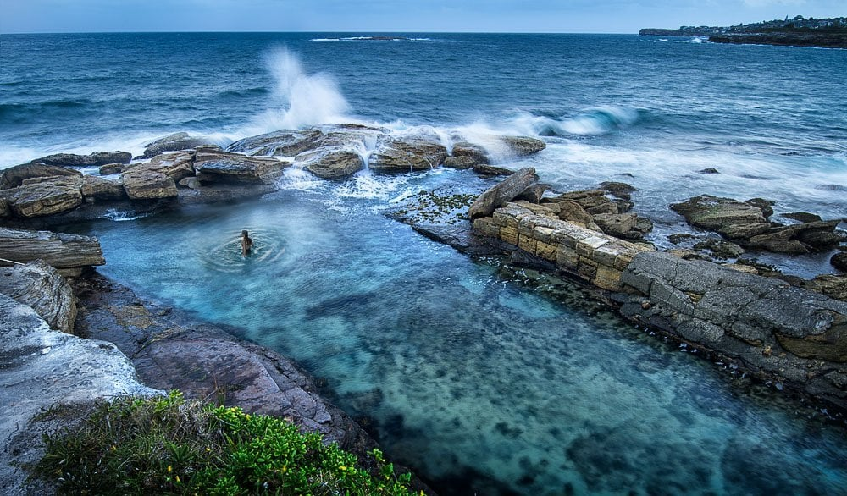
Rocky Shore: intertidal area of seacoasts where solid rock predominates
Notes:
Image: Rock pools of Syndey – National Geographic

Slide 9
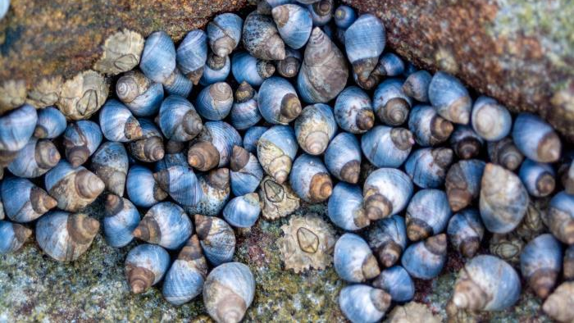
Notes:
Image: https://www.sunshinecoast.qld.gov.au/environment/education-resources-and-events/environment-resources-and-publications/coast-and-marine/rocky-shore-species-identification

Slide 10
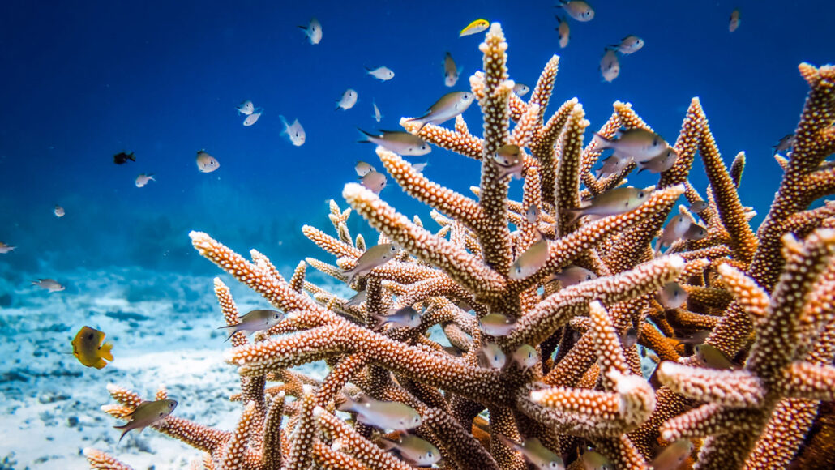
Coral Reefs: reefs made of coral

Slide 11
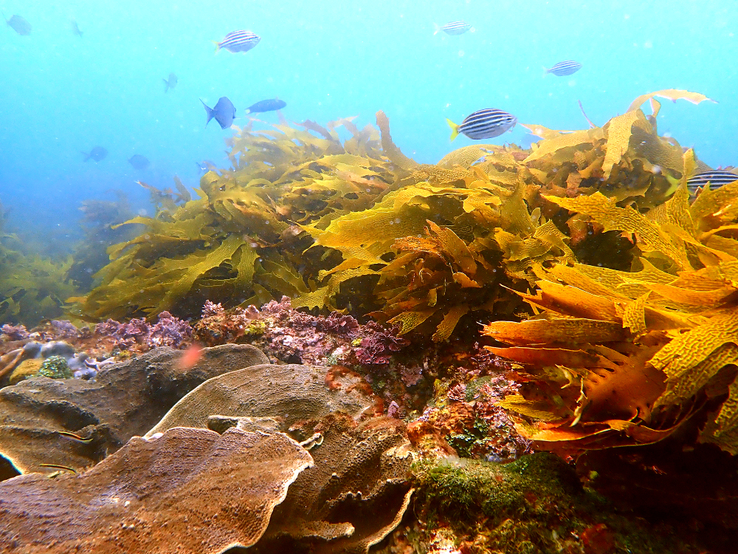
Temperate Reefs:
Reefs found in cool temperate waters between the tropics and the poles

Slide 12
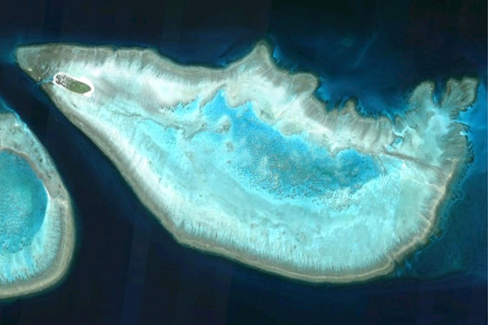
Lagoons:
(a.k.a. coral reef lagoons)
calm bodies of shallow water surrounded by barriers
Lagoon
Notes:
Image: https://phys.org/news/2011-06-scientists-space.html

Slide 13
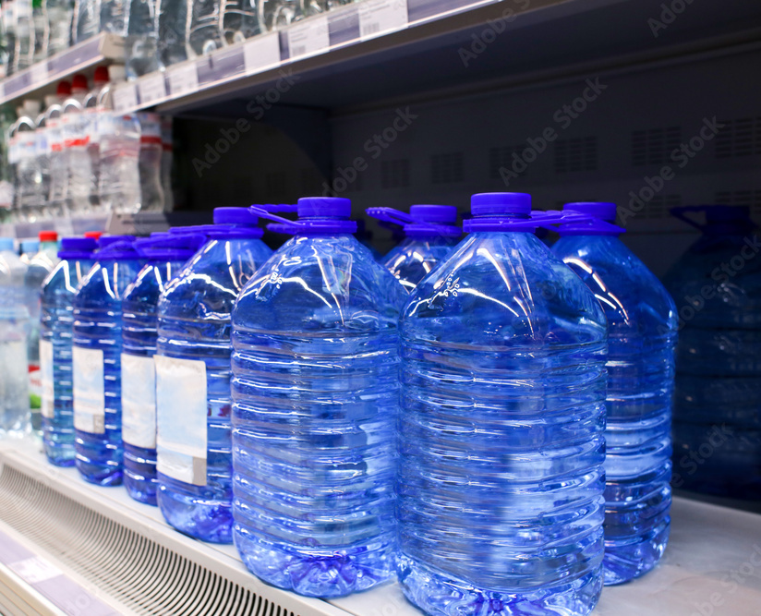
Shelf Water
(a.k.a. continental shelf water)

Slide 14
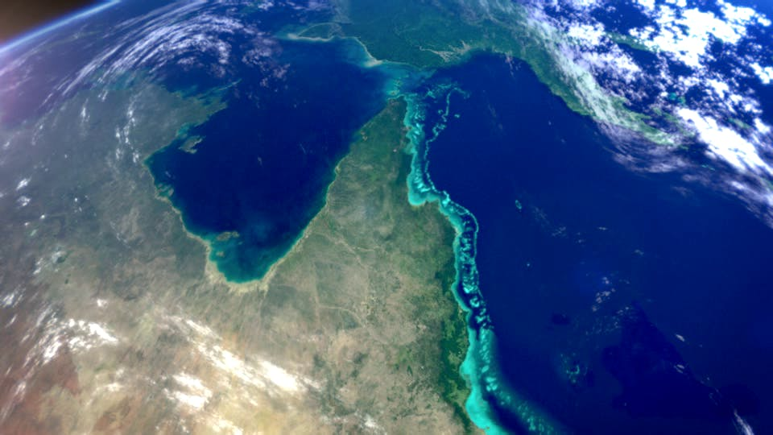
Notes:
Image: https://www.ozsail.com.au/blog/the-great-barrier-reef/

Slide 15
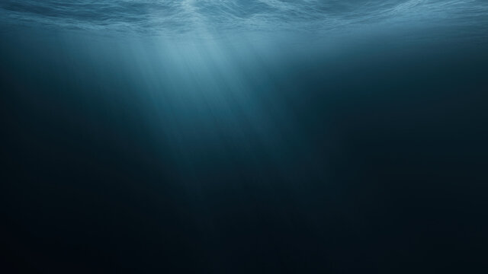
Deep Water: occurring or existing in water of great depth.

Slide 16
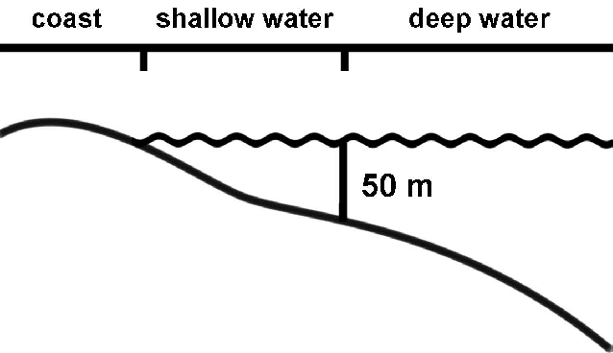

Slide 17
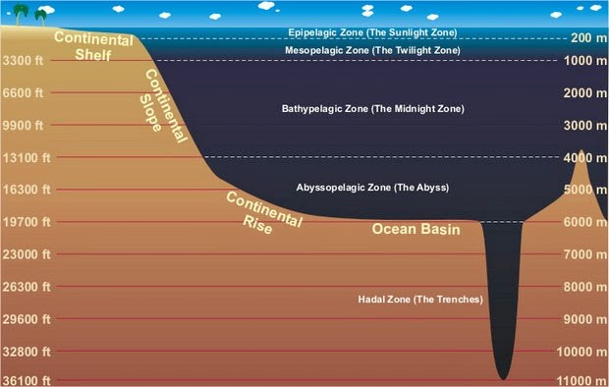
Notes:
Image: https://www.nps.gov/subjects/oceans/open-ocean.htm

Slide 18
Sloane’s viperfish (Chauliodus sloani)
is an easily recognizable deep sea fish with its long fang-like teeth.
Image credit: Diego Grandi/shutterstock
Notes:
Image: https://www.australiangeographic.com.au/topics/science-environment/2023/04/monsters-or-masters-of-the-deep-sea/

Slide 19
Worksheet Activity: Match the Genus species to the ecosystem
(may occupy more than one)
Are you ready?

Slide 20
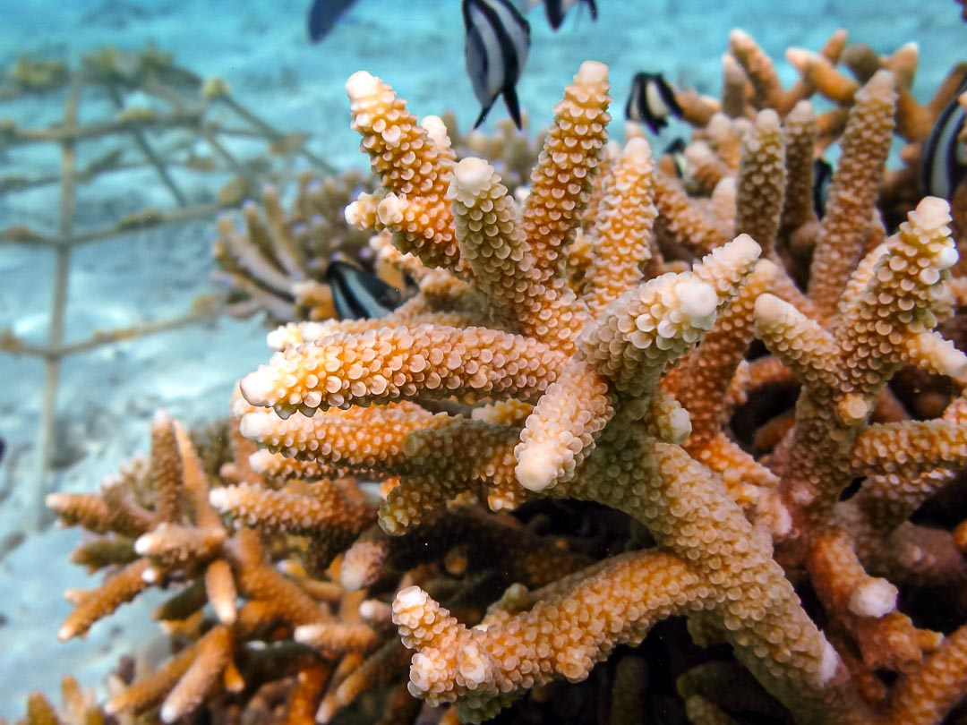
Acropora pulchra
Staghorn coral

Slide 21
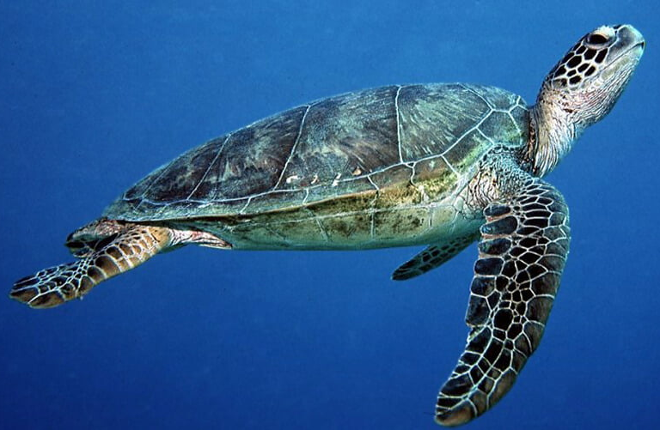
Chelonia mydas
Green sea turtle

Slide 22
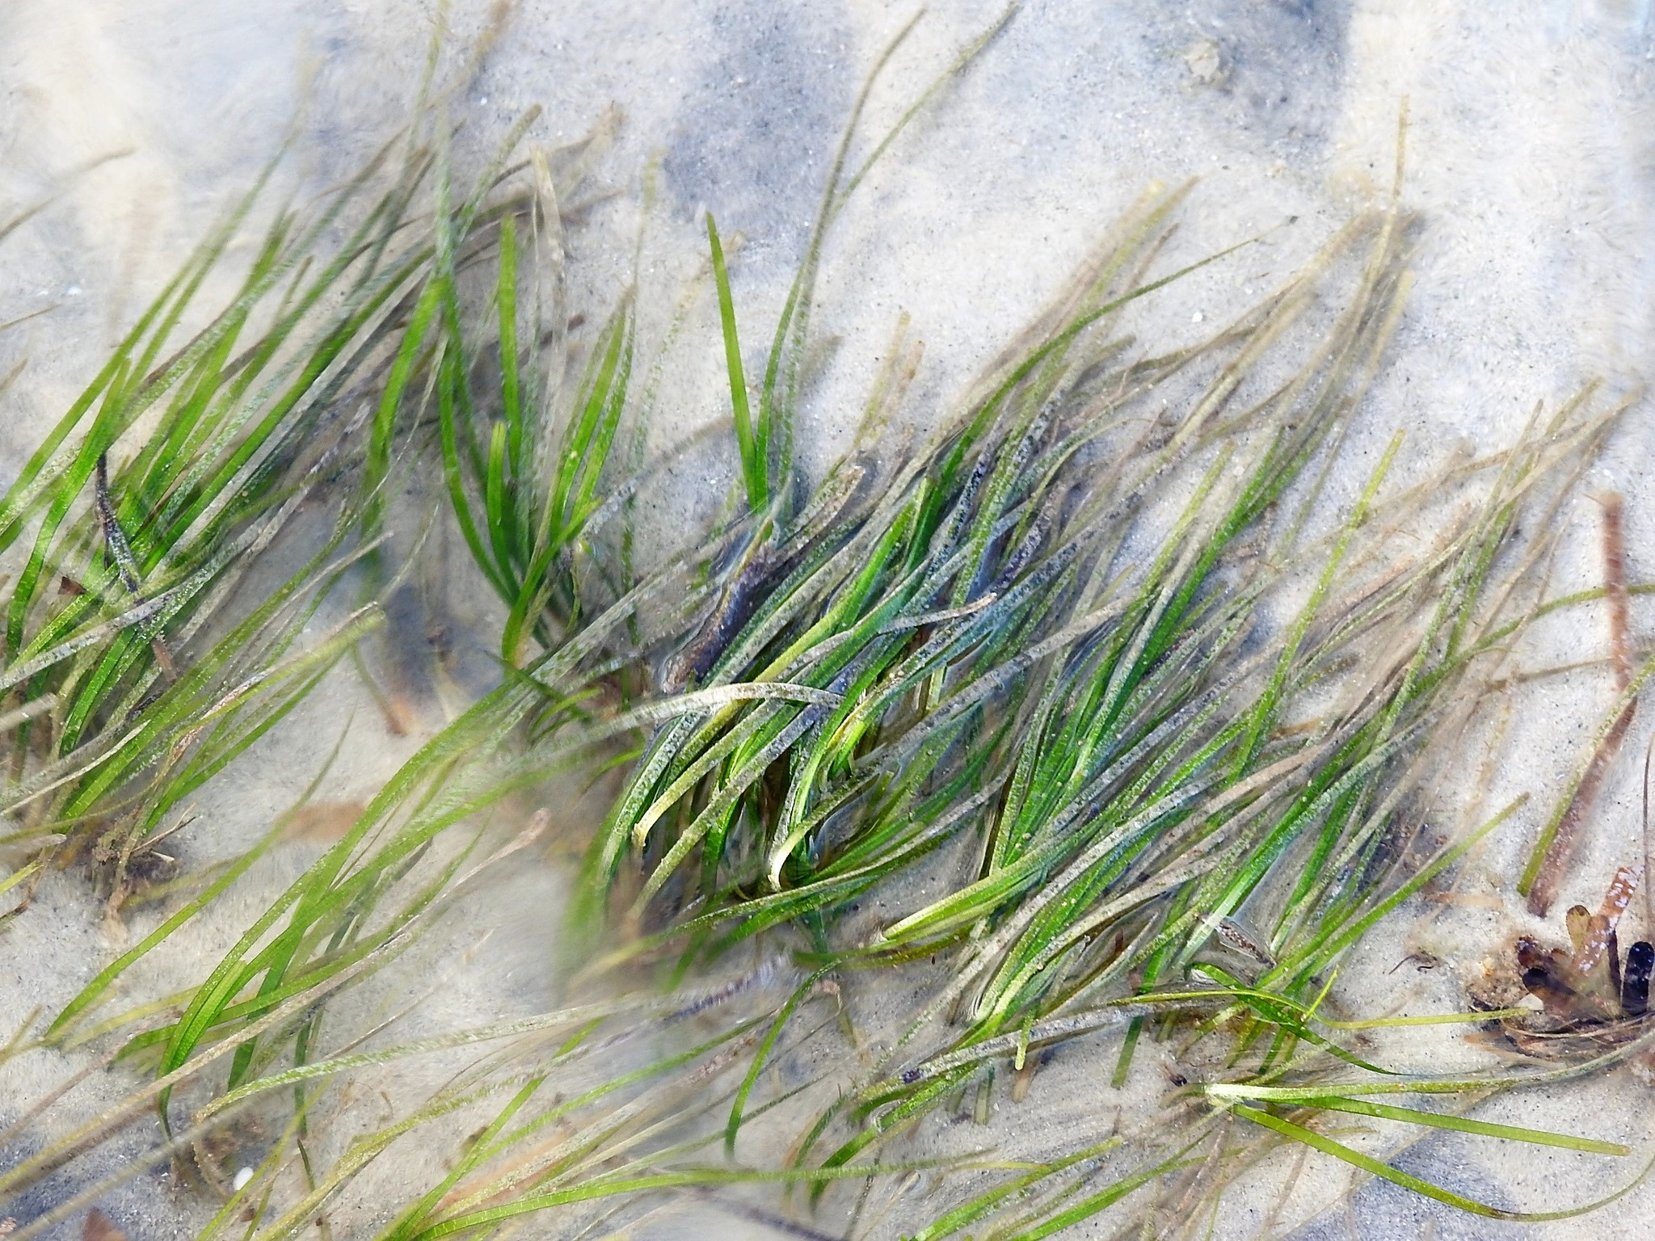
Zostera capricorni
Eelgrass

Slide 23
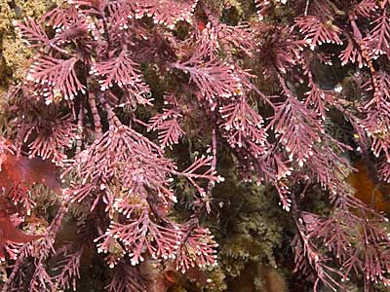
Corallina officinalis
Calcareous red seaweed

Slide 24
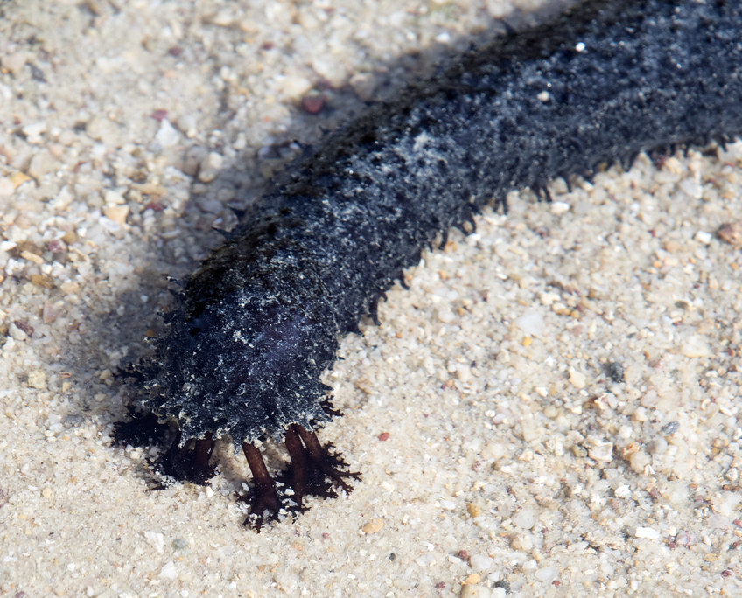
Holothuria leucospilota
Black sea cucumber

Slide 25
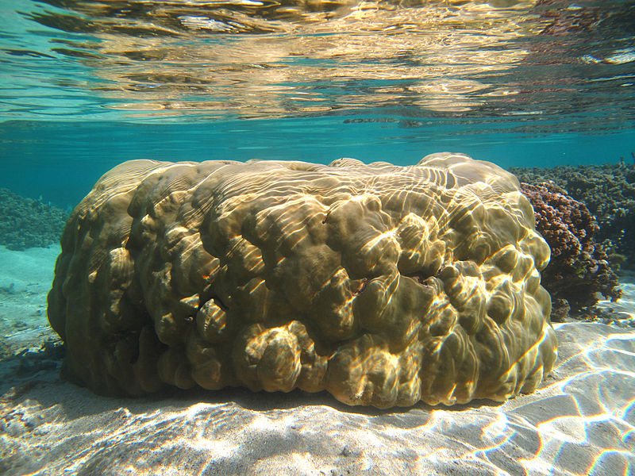
Porites lutea
Boulder coral

Slide 26
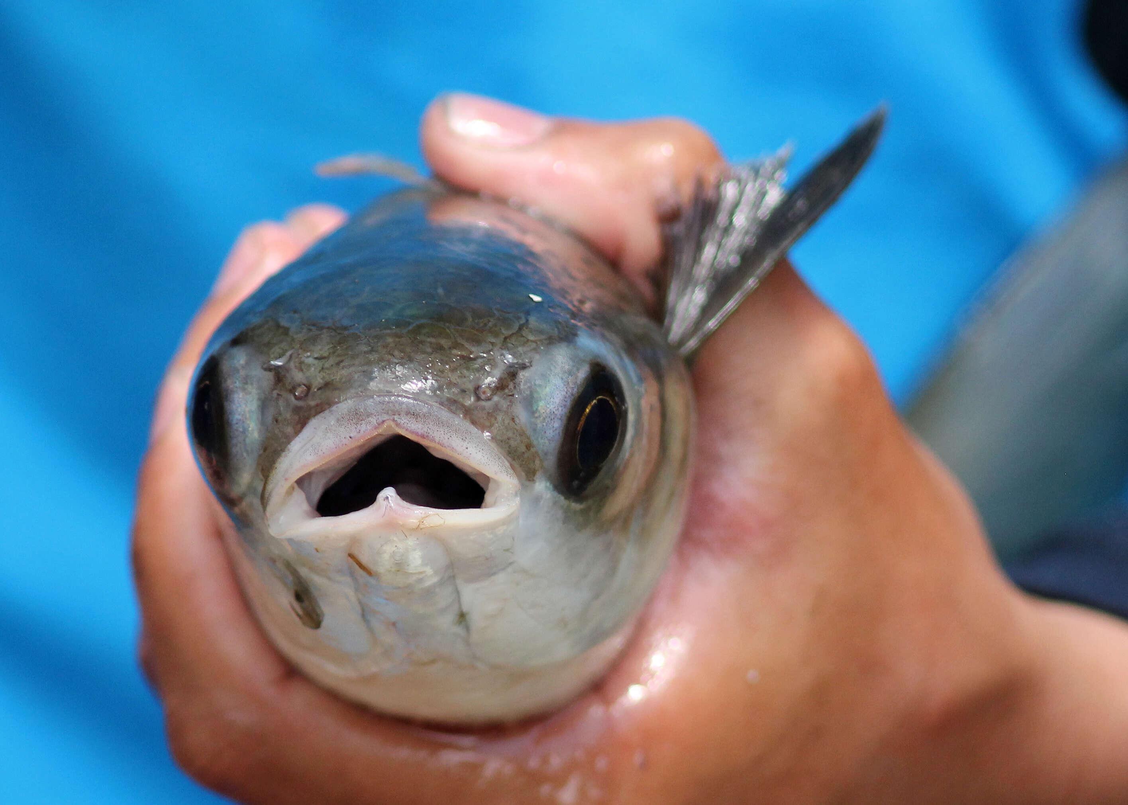
Mugil cephalus
Mullet

Slide 27
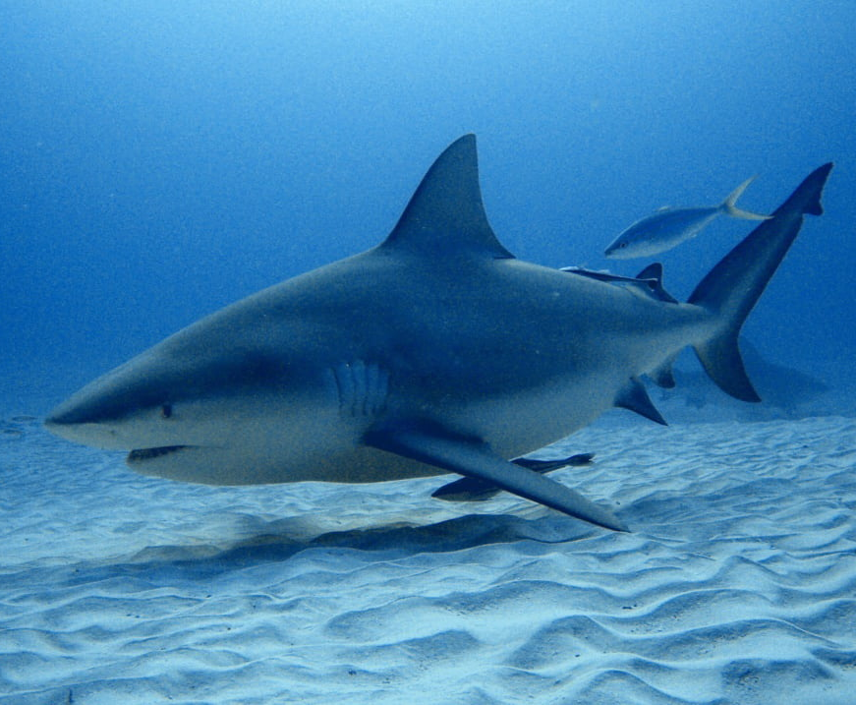
Carcharhinus leucas
Bull shark

Slide 28
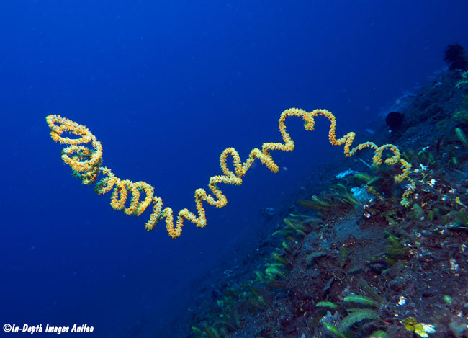
Cirrhipathes spiralis
Black coral

Slide 29
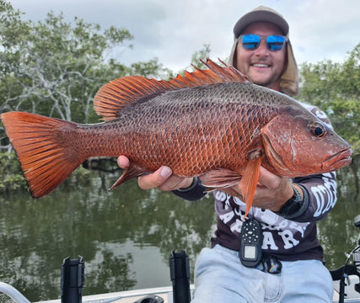
Lutjanus argentimaculatus
Mangrove Jack

Slide 30
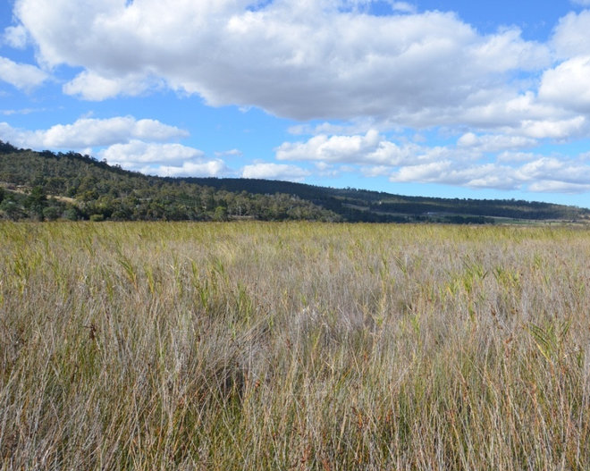
Juncus kraussii
Salt marsh rush

Slide 31
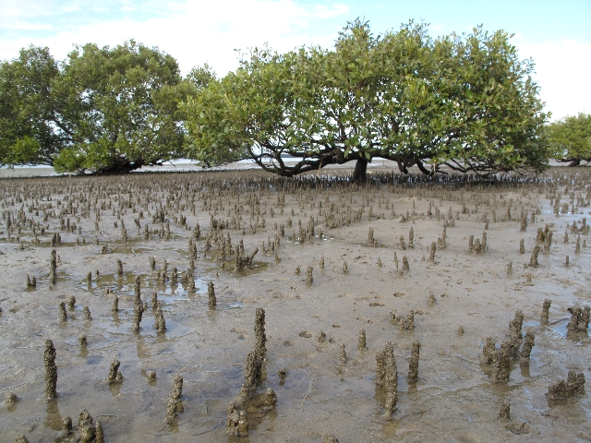
Avicennia marina
Grey mangrove

Slide 32
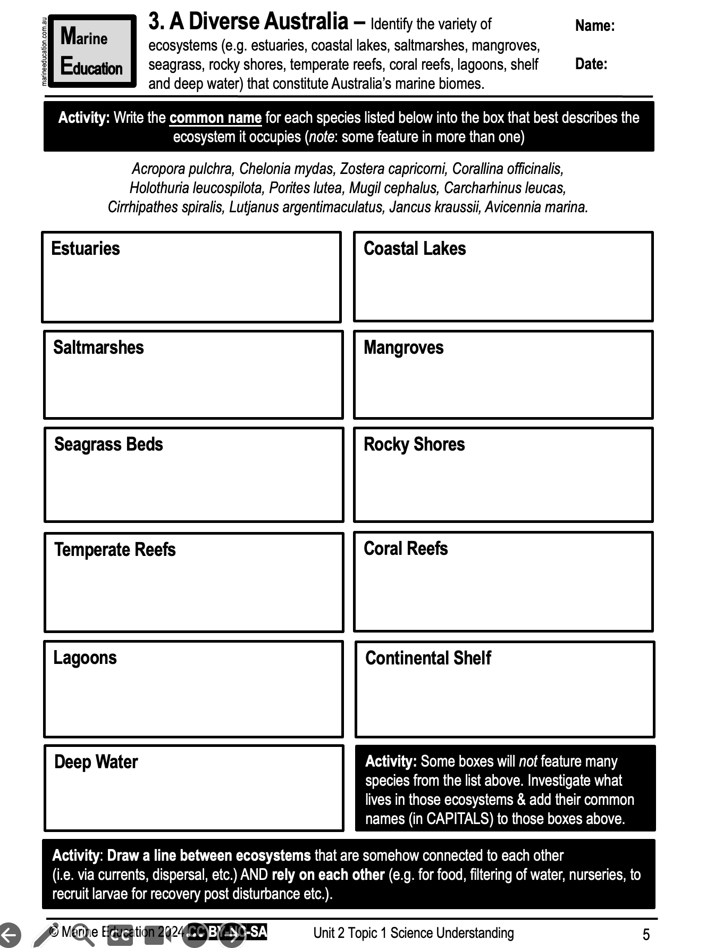
Learning Intention:
Identify the variety of ecosystems (e.g. estuaries, coastal lakes, saltmarshes, mangroves, seagrass, rocky shores, temperate reefs, coral reefs, lagoons, shelf and deep water) that constitute Australia’s marine biomes.
Success Criteria:
Complete Marine Education worksheet ‘3. A Diverse Australia’
Notes:
Image: https://hakaimagazine.com/news/this-mommy-shark-has-a-unique-way-of-making-babies/

