Slide 1
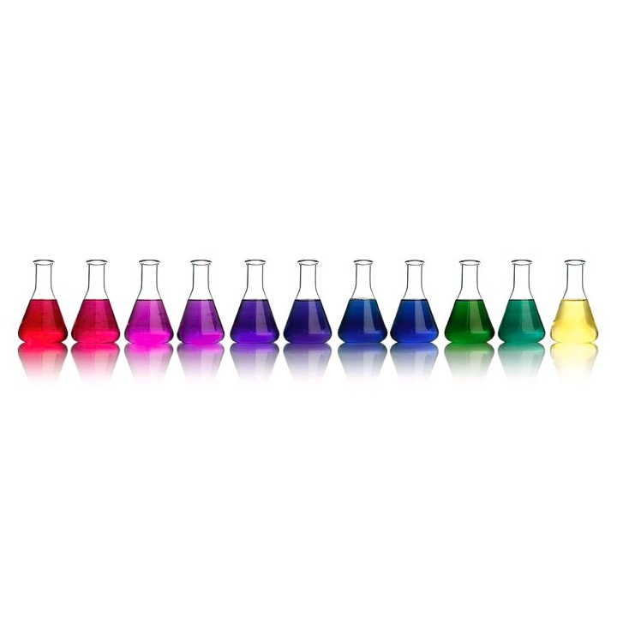
Learning Intention:
Investigate water quality by conducting biotic and abiotic tests on a water sample
Success Criteria:
Complete Marine Education worksheet ’30. What’s in the water?’

Slide 2
Biotic (living) tests
Important: check if any permits or approvals need to be obtained before biotic sampling

Slide 3
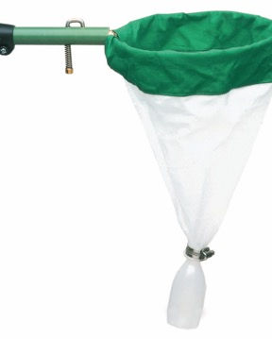
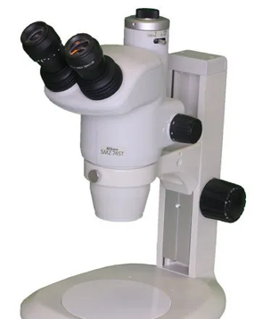
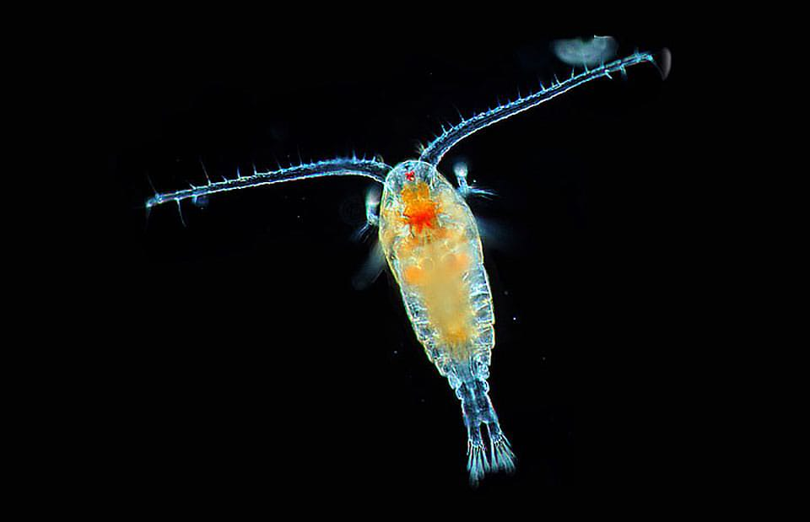
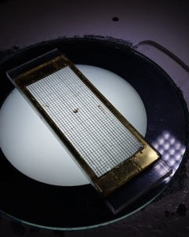
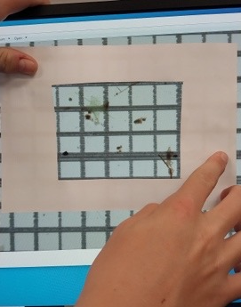
Plankton bioindicators
A copepod is a planktonic crustacean. Copepods are one of the most common and easily recognized types of zooplankton, found in almost every ocean, sea, and freshwater habitat, even in underground caverns. Image credit: NASA.
See student workbook for methodology on how to sample plankton as bioindicators of water quality.

Slide 4
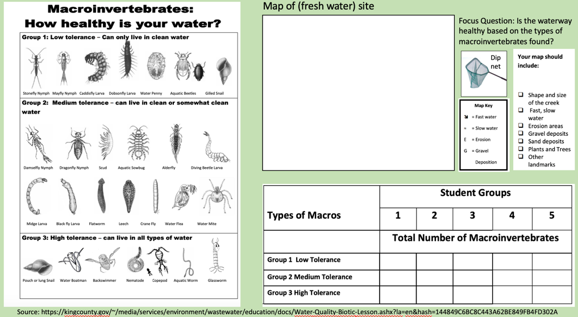
Counting macroinvertebrates as bioindicators of stream water quality
Notes:
Source: https://kingcounty.gov/~/media/services/environment/wastewater/education/docs/Water-Quality-Biotic-Lesson.ashx?la=en&hash=144849C6BC8C443A62BE849FB4FD302A
Methods used by DES: https://environment.des.qld.gov.au/__data/assets/pdf_file/0031/90778/biological-assessment-aquatic-macroinvertebrate-sampling-processing-and-index-calculation.pdf

Slide 5
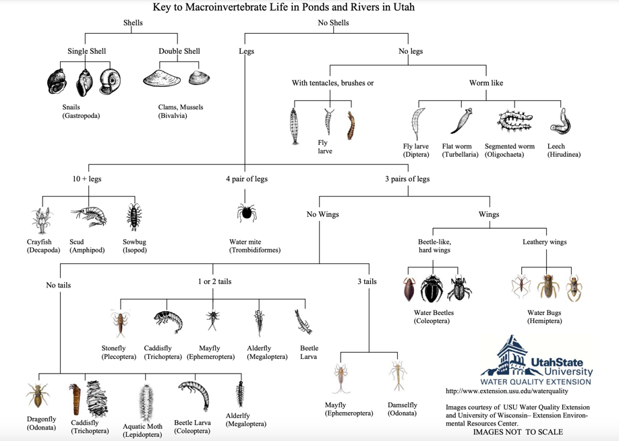
Need to Identify something?
Use a Dichotomous key!
Notes:
Image: https://www.tryoncreek.org/macroinvertebrates-in-tryon-creek/

Slide 6
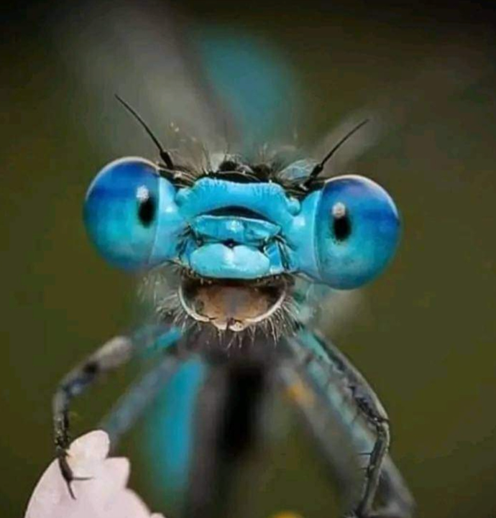
Dragon fly
Notes:
Image: MACRO (facebook)

Slide 7
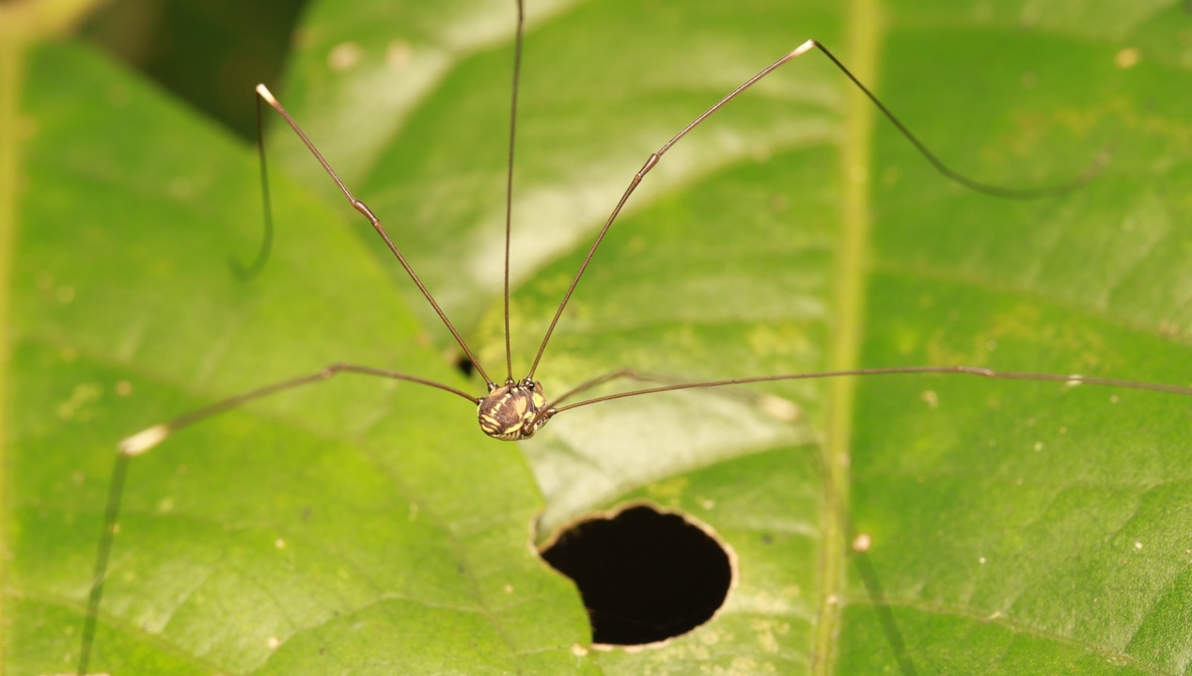
Notes:
Image: MACRO (facebook) photo uploaded by Apichit Orrasingha

Slide 8
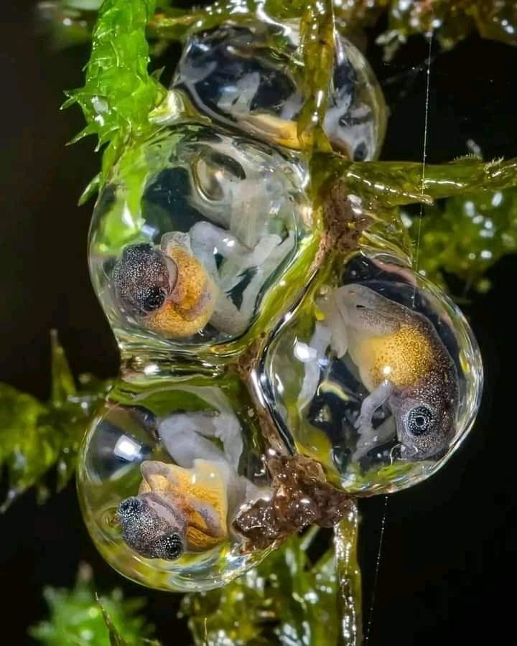
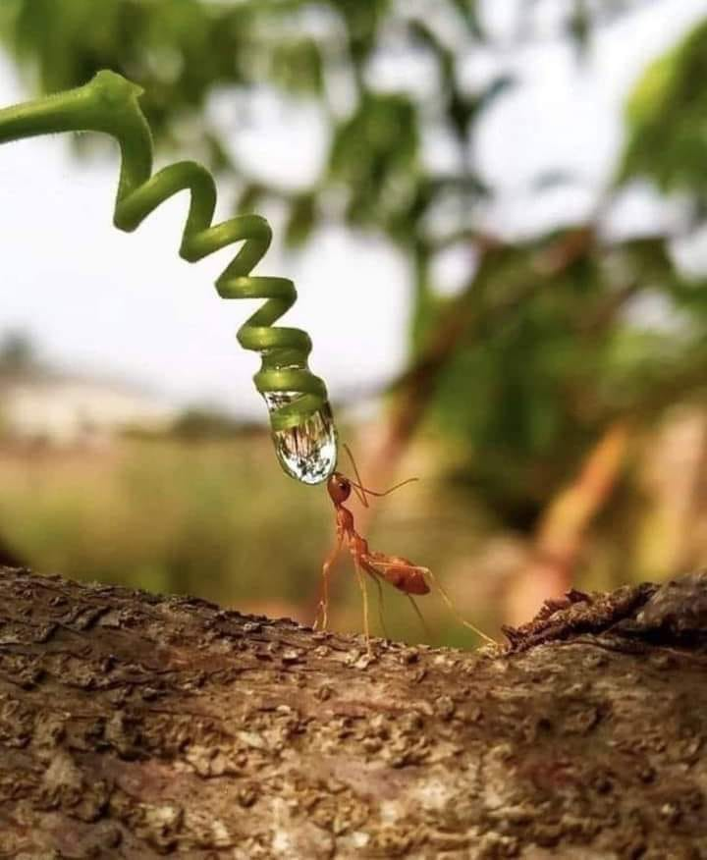
Images: MACRO some things facebook page
Notes:
Image left: Photo by @girishgowda.c shared on MACRO some things facebook page
Image right: shared on MACRO some things facebook page

Slide 9
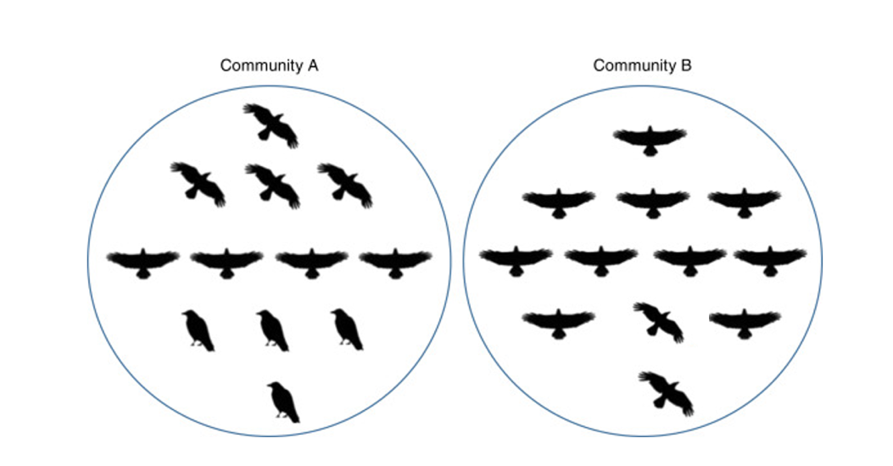
Species richness calculations
Which community has the greater number of different species (called species richness)?
Ans. A
Notes:
Image: https://www.sciencedirect.com/topics/earth-and-planetary-sciences/species-richness

Slide 10
Abiotic (non-living) tests

Slide 11
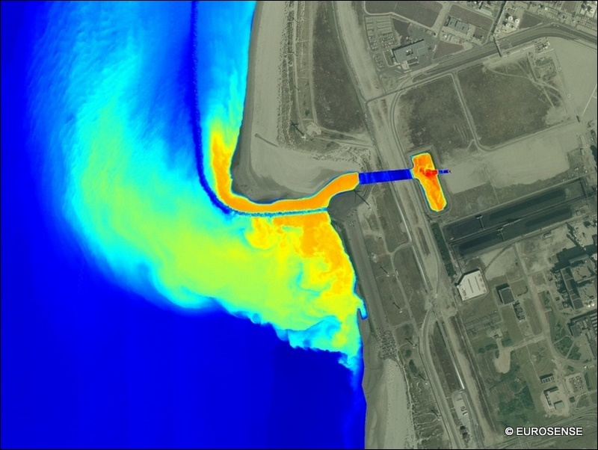
Temperature
E.g. thermal pollution
Notes:
Image: https://giveme-5.org/thermal-pollution-in-water/

Slide 12
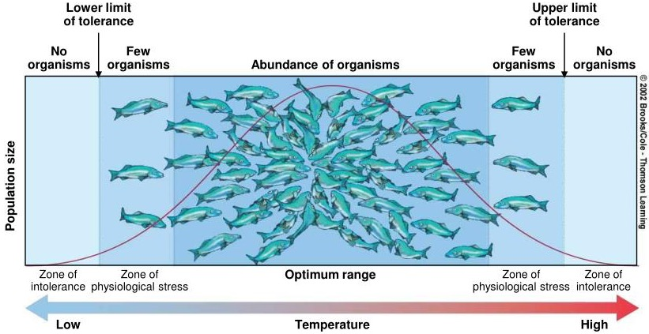
Temperature
influences many biological responses.
For example: hatching success, feeding rates and growth rates, as well as survival rates and migration patterns.
Each species requires a specific temperature range for optimal performance.
Above: Shelford’s Law of Tolerance for temperature (in ectotherms)
Notes:
Image: https://www.slideserve.com/jariah/chapter-5

Slide 13
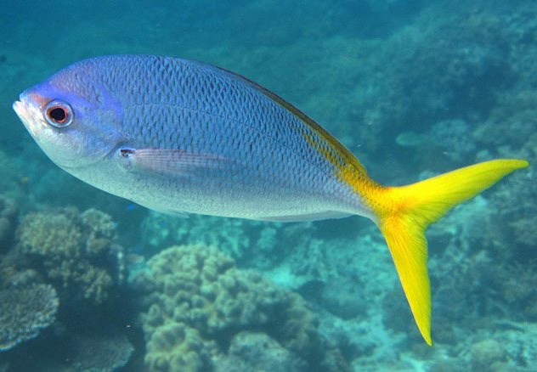
Organisms that can only live within a narrow temperature range are called stenothermal
Yellowtail fusilier Caesio cuning

Slide 14
Organisms that can live within a wide temperature range are called eurythermal
Carey (1982) described a ‘brain heater’ in swordfish (Xiphias gladius) from highly modified eye muscles that warm the brain and eye tissues that presumably contribute to foraging success in cold, deep (to 600m) oceanic depths.
Notes:
Source: aahttps://www.science.org/doi/abs/10.1126/science.7079766
Paper: A Brain Heater in the Swordfish by Francis G Carey. Science. 18 Jun 1982
Vol 216, Issue 4552
pp. 1327-1329
DOI: 10.1126/science.707976

Slide 15
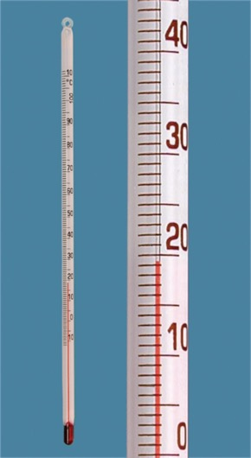
How to measure temperature
Carefully lower a temperature probe or thermometer into the water (about 10cm underwater). Wait a few minutes until the temperature stabilises.
Temperature changes with depth.
Therefore, when you record the temperature, also record the depth of the temperature probe.
Cold water holds more dissolved oxygen (DO) than warm water. For this reason, measure temperature and dissolved oxygen (DO) together.

Slide 16
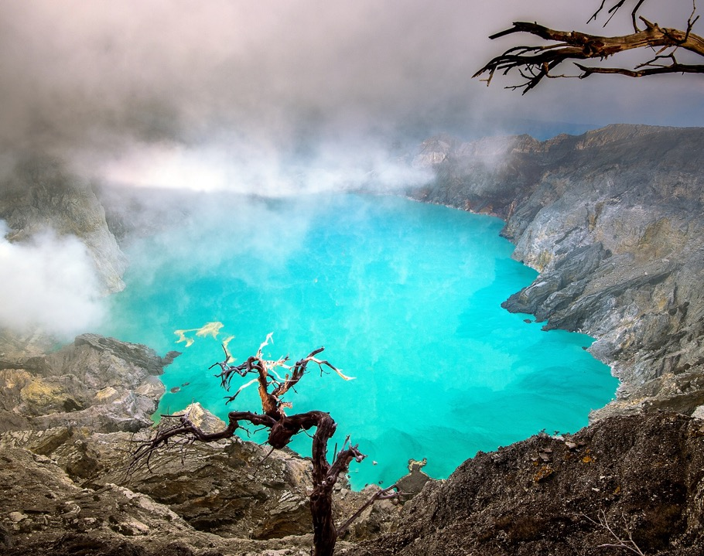
pH
The Ijen Crater, Indonesia (pH<1 – enough to melt human flesh)
Notes:
Image: https://authentic-indonesia.com/activities/the-ijen-volcano-and-its-acidic-lake/

Slide 17
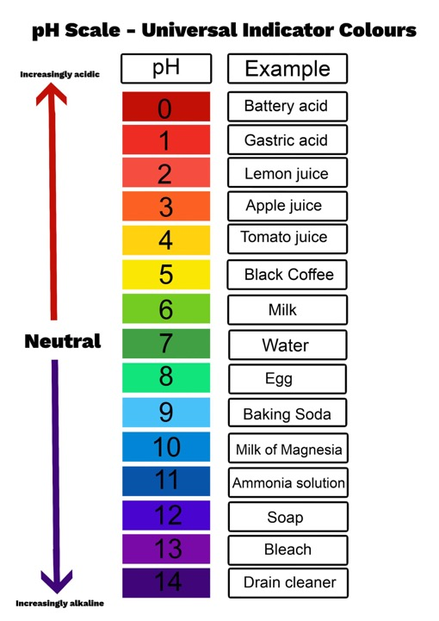
pH is a number from 1 to 14
Every liquid solution has a pH value
(with pure water at pH7)
Notes:
Image:

Slide 18
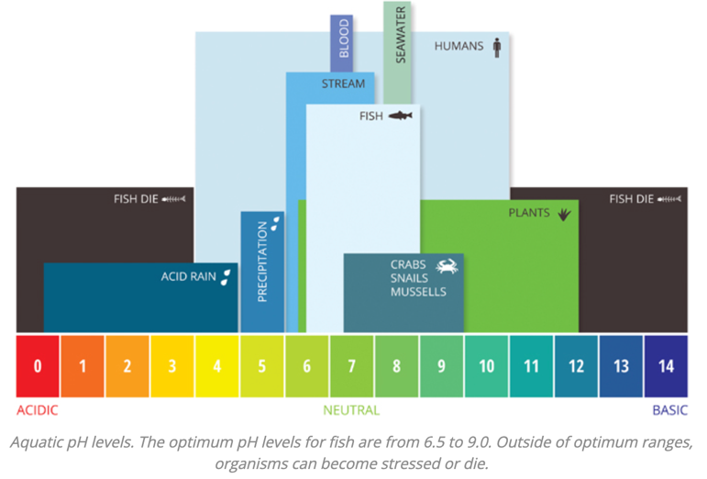
pH levels that are too low (acidic) or too high (basic) are both lethal.
Notes:
Image; https://www.fondriest.com/environmental-measurements/parameters/water-quality/ph/#:~:text=Pollution%20in%20the%20air%2C%20soil,known%20as%20acid%20rain%20%C2%B2%C2%B9.

Slide 19
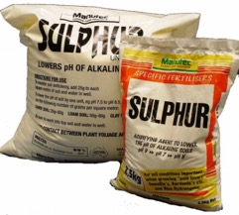
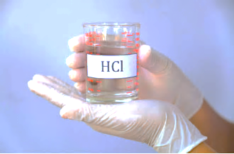
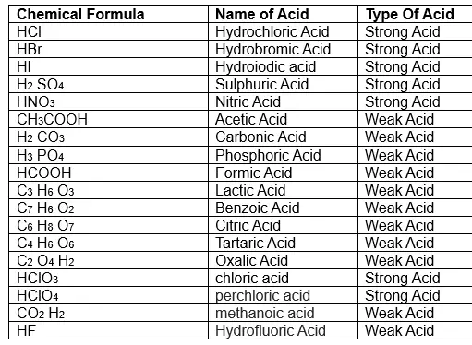
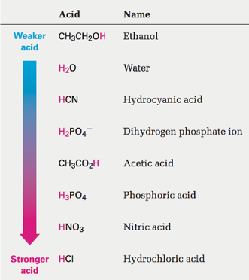
Acids decrease pH
Acids release hydrogen ions (H⁺)
pH is short for ‘the power of hydrogen’
(it is the H⁺ ions that give acids their acidic properties)
Notes:
Image: https://www.lbsw.org/wp-content/uploads/2017/12/Water-Quality-2017.pdf
Info: https://www.fondriest.com/environmental-measurements/parameters/water-quality/ph/#:~:text=Pollution%20in%20the%20air%2C%20soil,known%20as%20acid%20rain%20%C2%B2%C2%B9.

Slide 20
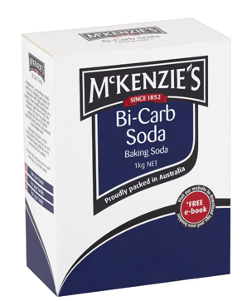
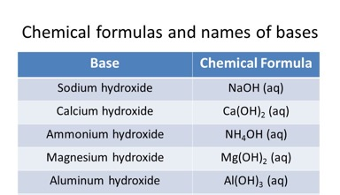
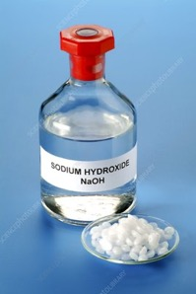
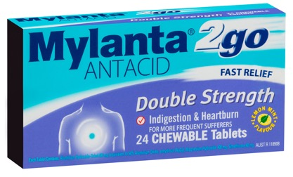
Bases increase pH
Bases release hydroxide ions (OH⁻)
which then bond with H⁺ ions to make H₂O (water) thus removing H⁺ ions from the solution.
For example:
Acid + Base → Salt + H₂O
HCl + NaOH → NaCl + H₂O
Notes:
Image: https://www.lbsw.org/wp-content/uploads/2017/12/Water-Quality-2017.pdf
Info: https://www.fondriest.com/environmental-measurements/parameters/water-quality/ph/#:~:text=Pollution%20in%20the%20air%2C%20soil,known%20as%20acid%20rain%20%C2%B2%C2%B9.

Slide 21
The pH of (the water between particles of) soil changes over time as it’s subjected to various factors such as farming, erosion and heavy rainfall.
Notes:
Image: https://www.nature.com/scitable/knowledge/library/soil-the-foundation-of-agriculture-84224268/

Slide 22
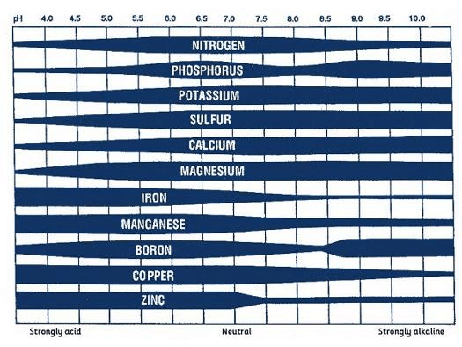
A change in pH changes the uptake of nutrients by plants
Here’s a table displaying the bioavailability of key nutrients by pH.
The thicker the bar
the more bioavailable the nutrient is at that pH.
Notes:
Image: https://www.researchgate.net/figure/Effect-of-pH-on-nutrient-uptake-in-soil-Silveira-2013_fig9_312083724
Info: https://www.mrfothergills.com.au/pages/post/npk-for-growing-plants

Slide 23
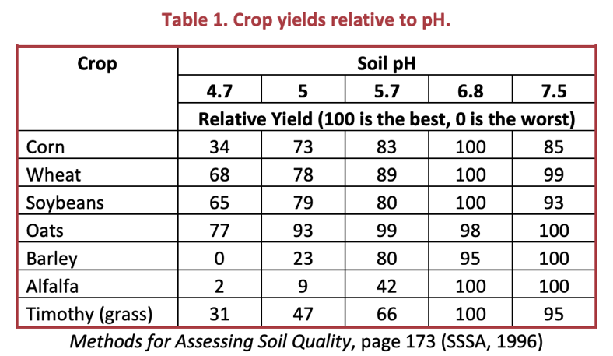
For most crops, a pH range of 6.0 to 7.5 is best
Notes:
Image: https://www.envirothonpa.org/documents/pH_guide.pdf

Slide 24
When soil pH is not within the desired range, farmers add chemicals (fertilizers) to make it right
lowers pH
Increases pH

Slide 25
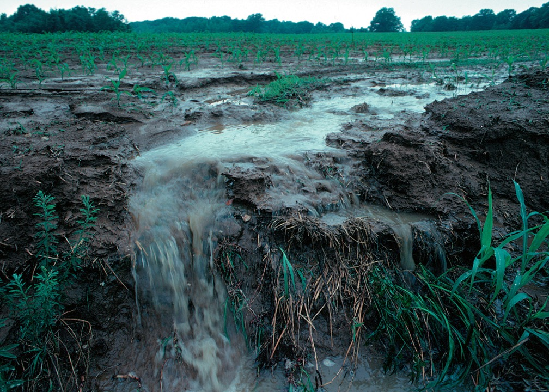
Which is all good - so long as the chemicals stay on the farm!
Notes:
Image: https://en.wikipedia.org/wiki/Nutrient_pollution

Slide 26
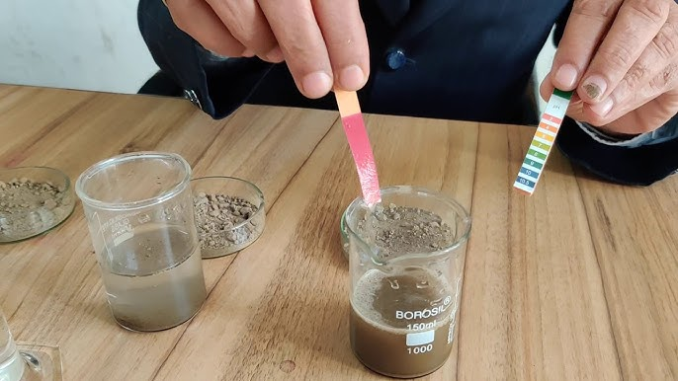
A change in pH indicates there is a problem that needs further investigation
Notes:
Image: https://www.youtube.com/watch?app=desktop&v=PPzsBKnxj3g

Slide 27
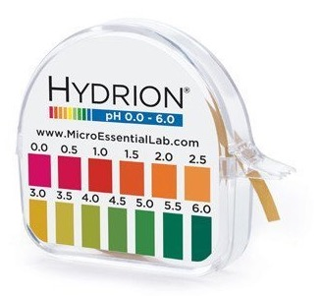
How to measure pH
using Litmus paper

Slide 28
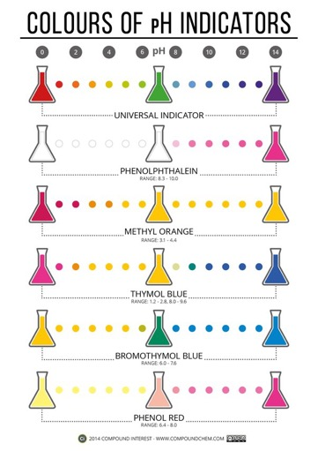
How to measure pH
using a pH indicator

Slide 29
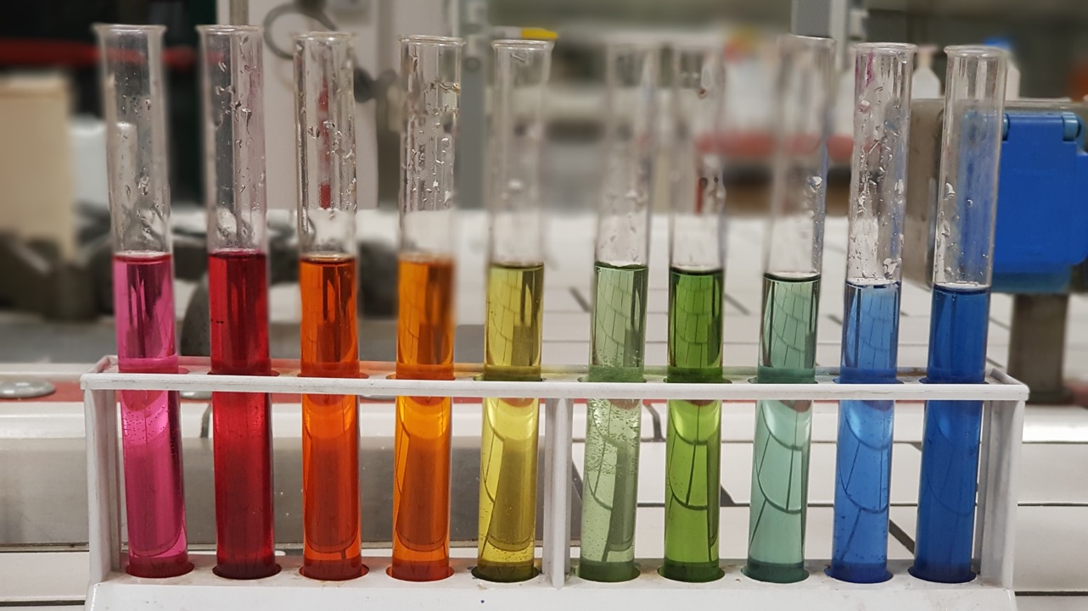
Notes:
Image: https://en.wikipedia.org/wiki/PH

Slide 30
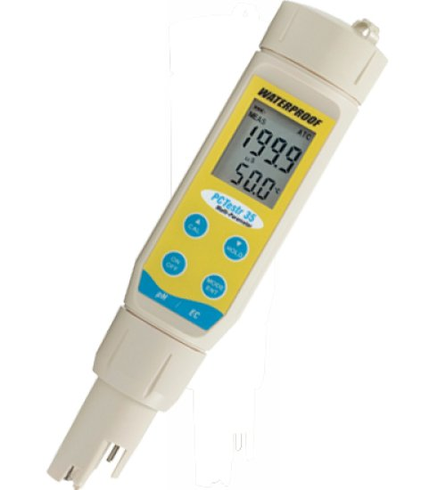
How to measure pH
using a pH probe/meter
Follow the instructions.
Remember to calibrate the pH meter before using it!
There will be a bottle of liquid sold with the probe that is used to dip the probe into and wait for the probe to calibrate before using.

Slide 31
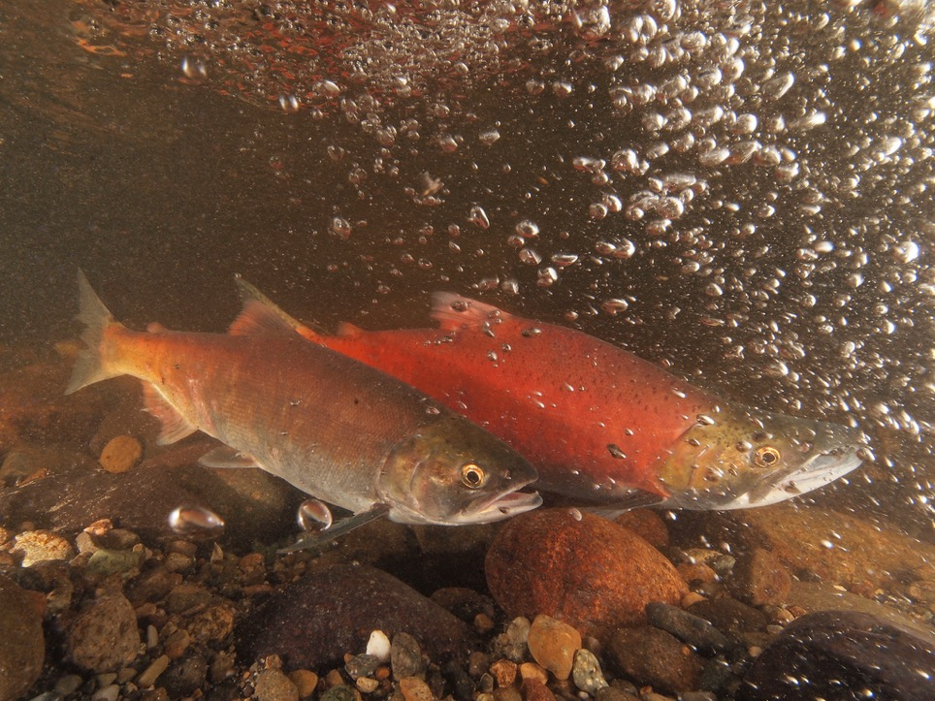
DO
Dissolved Oxygen
Notes:
Image: https://www.epa.gov/national-aquatic-resource-surveys/indicators-dissolved-oxygen

Slide 32
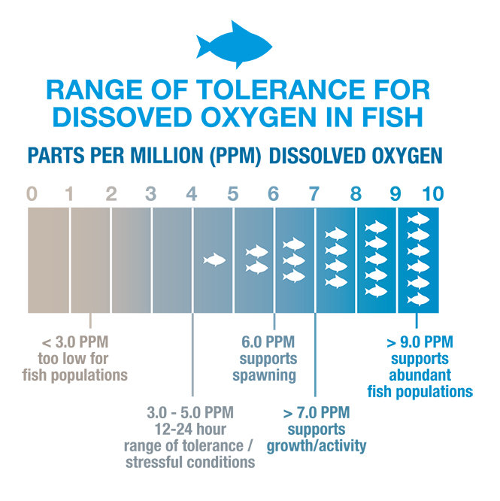
Aquatic animals rely on oxygen that is dissolved in the water to survive
Notes:
Image: https://www.knowyourh2o.com/outdoor-4/dissolved-oxygen-in-water

Slide 33
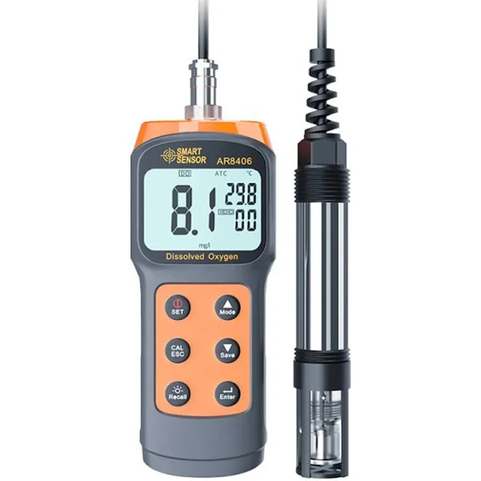
DO
is measured in ppm, mg/L and % saturation
Note: ppm and mg/L equal the same
Notes:
Image: https://www.google.com/search?q=DO+probe+cost+&sca_esv=595946801&biw=1264&bih=658&tbm=shop&ei=RPGXZdvTA47l2roPqeCC4AM&ved=0ahUKEwjbhbOpm8aDAxWOslYBHSmwADwQ4dUDCAg&uact=5&oq=DO+probe+cost+&gs_lp=Egtwcm9kdWN0cy1jYyIORE8gcHJvYmUgY29zdCBIqQRQ-AFY-AFwAHgAkAEAmAGwAaAB1QKqAQMwLjK4AQPIAQD4AQGIBgE&sclient=products-cc#spd=16522052190062395456

Slide 34
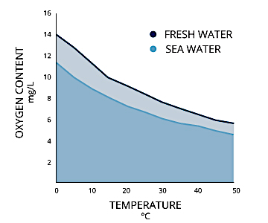
DO naturally varies.
Factors that affect DO include water temperature as well as time of day, season, depth, altitude and rate of flow
Notes:
Image: https://www.fondriest.com/environmental-measurements/parameters/water-quality/dissolved-oxygen/

Slide 35
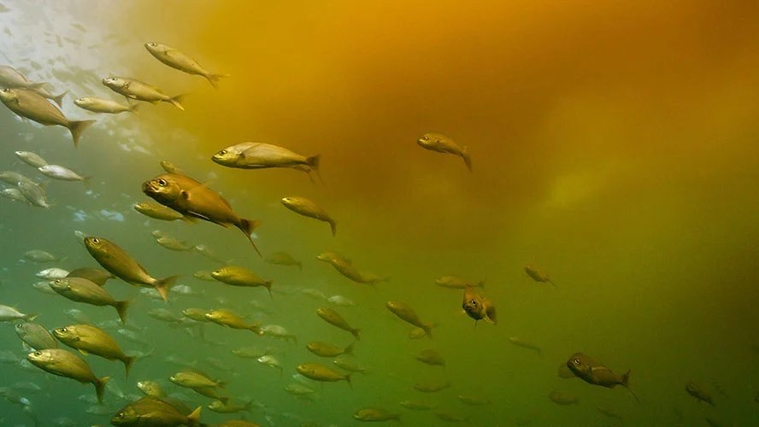
However, if DO is LOW
(when it shouldn’t be)
there is a problem

Slide 36
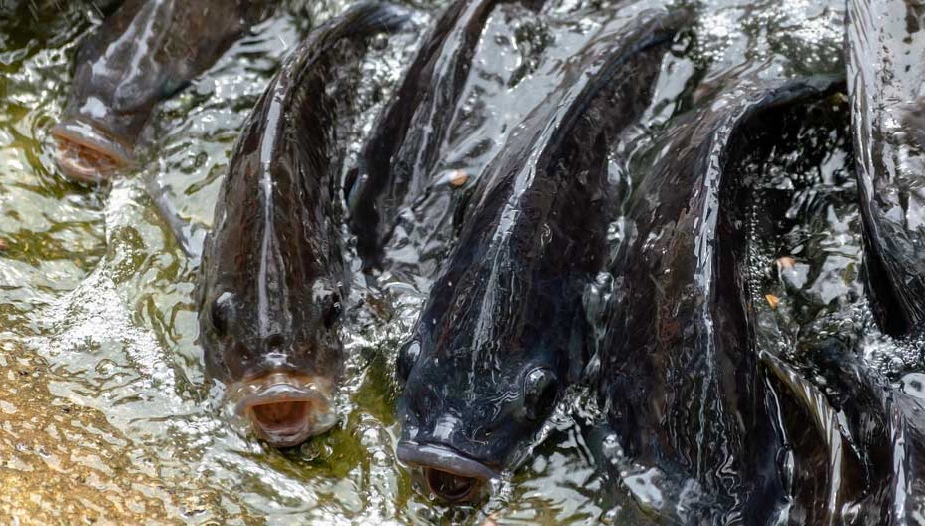
E.g. eutrophication
Notes:
Image: https://www.fishsens.com/how-do-fish-respond-to-low-dissolved-oxygen/

Slide 37
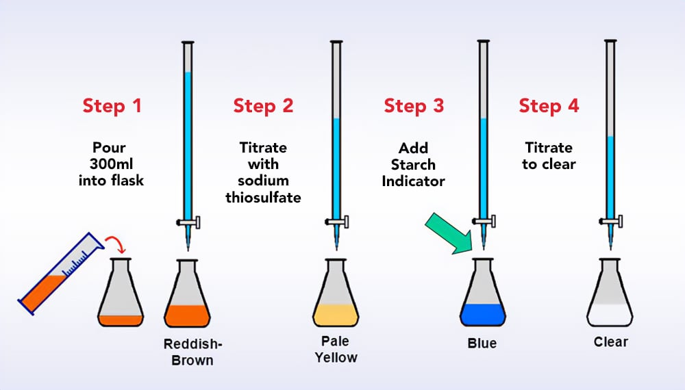
How to measure DO
using the Winkler titration method with a test kit in situ
The Winkler titration method involves adding chemicals to the water to react with the oxygen molecules, to form an acidic solution. The amount of neutralizing agent required to neutralize the solution until the sample becomes clear in colour, indicates how much oxygen was in the original water sample.
Test in situ (on site). Measure temperature at the same time (temperature changes DO).
Notes:
Image: https://atlas-scientific.com/blog/winkler-method-for-dissolved-oxygen/

Slide 38
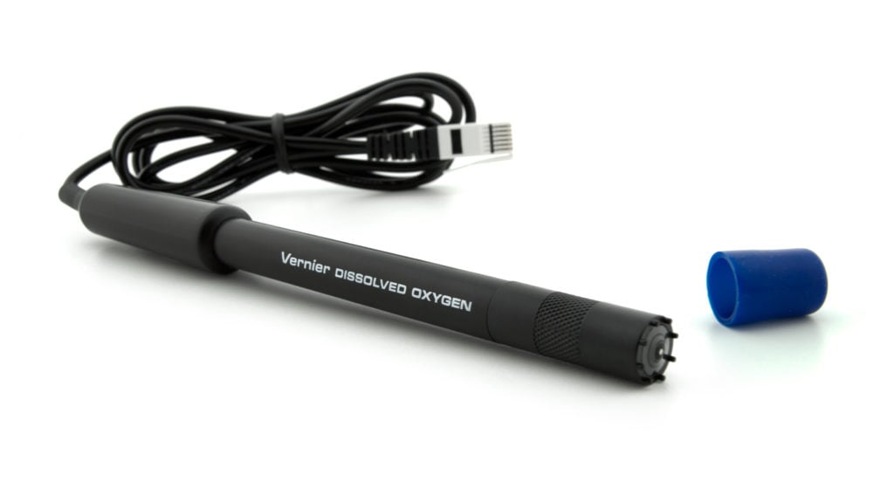
How to measure DO
using a DO meter/probe
Probes cost anywhere between $200 and $2000
Follow the instructions.
Remember to calibrate the DO meter before using it!
Notes:
Image: https://www.vernier.com/manuals/do-bta/

Slide 39
How to convert DO in mg/L to % saturation
Temp. °C | DO at saturation (mg/L)
11 | 11.1
12 | 10.8
13 | 10.6
14 | 10.4
15 | 10.2
16 | 10.0
17 | 9.7
18 | 9.5
19 | 9.4
20 | 9.2
21 | 9.0
22 | 8.8
23 | 8.7
24 | 8.5
25 | 8.4
26 | 8.2
27 | 8.1
28 | 7.9
29 | 7.8
30 | 7.6
DO% saturation = DO mg/L x 100
DO at saturation
E.g. If the DO was recorded
at 6.8 mg/L & the temperature
was 25°C (see yellow shaded row)….
6.8 x 100 / 8.4 = 80.95% sat.
Note: Temperature changes DO. E.g. water at 25°C is 100% saturated with DO at 8.4 mg/L.

Slide 40
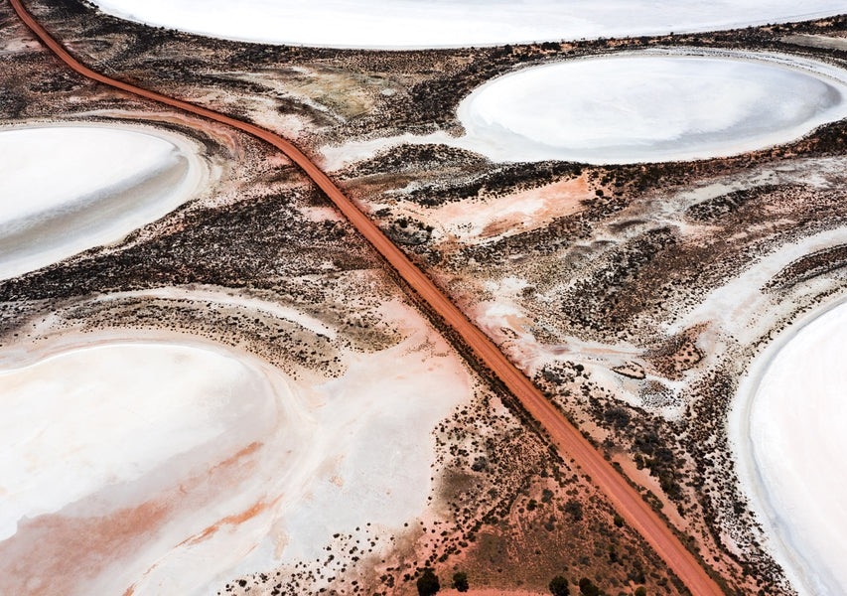
Salinity
Salt concentration
Pithara Salt Lakes WA
Notes:
Image: https://gingerimagery.com/products/gp0172

Slide 41
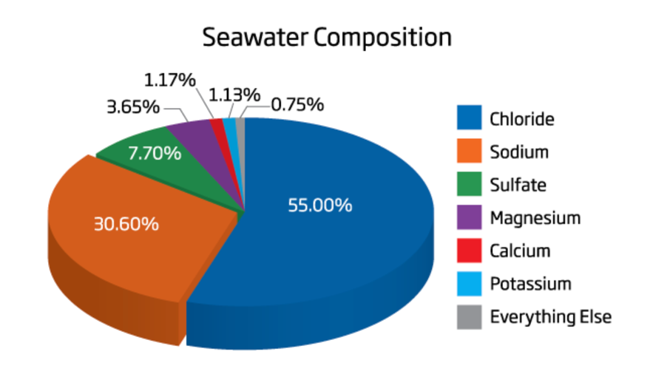
Salinity is the measure of dissolved salts in water
The percentages rarely change
Notes:
Image: https://www.bulkreefsupply.com/content/post/md-2014-05-how-to-measure-salinity-in-saltwater
Alternative Image: https://salinity.oceansciences.org/science-salinity.htm

Slide 42
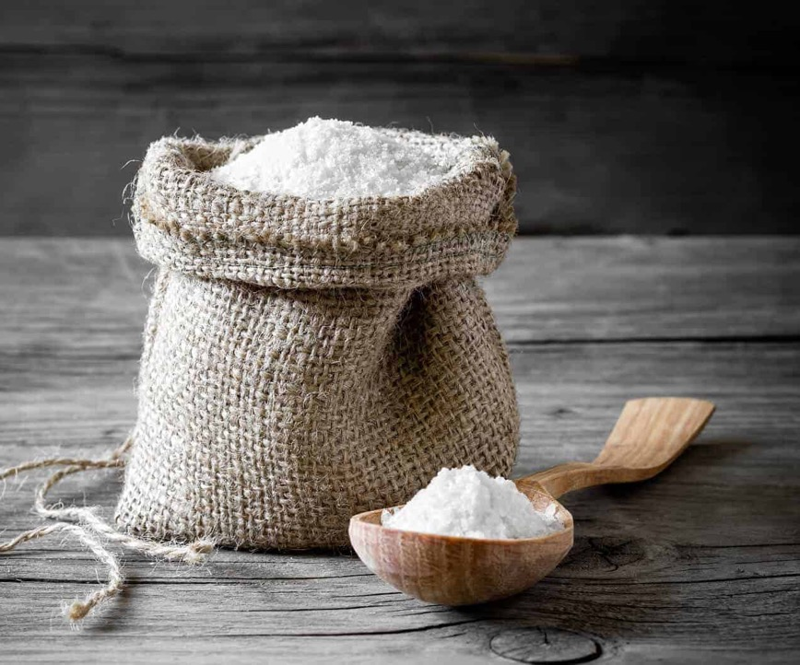
Salinity is most commonly expressed as
parts per thousand or ppt
35ppt equals
35grams per kilogram
(or 3.5%)
Notes:
Image: https://en.wikipedia.org/wiki/Salinity

Slide 43
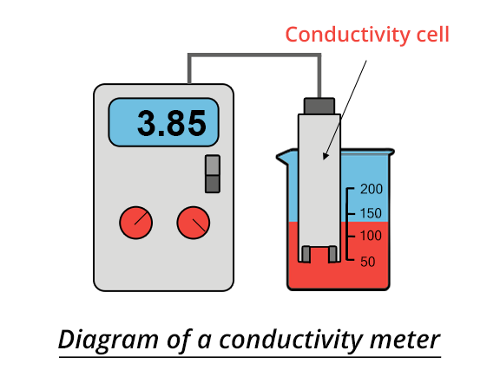
Salinity is determined by measuring the conductivity of water in
mS/cm or μS/cm.
The conductivity meter then
standardises the reading to 25°C and converts it to
practical salinity units (psu)
(whereby one gram of salt per 1000 grams of water is defined as one practical salinity unit or one psu)
or parts per thousand (ppt)

Slide 44
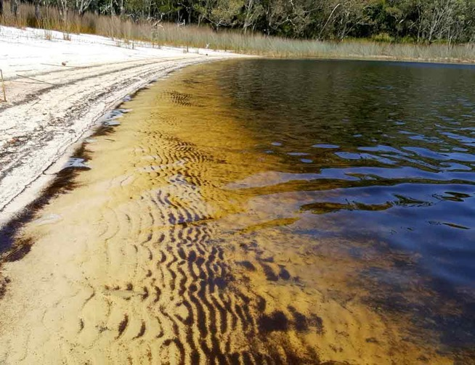
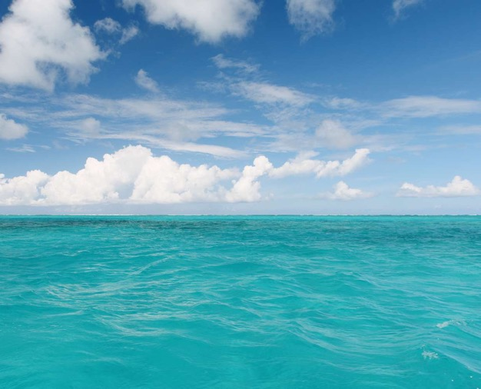
Fresh-water in rivers and creeks averages 0.5ppt or less
Seawater averages 35ppt

Slide 45
The mixture of seawater and freshwater in estuaries is called brackish water and its salinity can range from 0.5ppt to 35ppt.

Slide 46
Salinity
slowly increases as you move towards the ocean
Notes:
Image: https://recon.sccf.org/parameters/salinity/metrics

Slide 47
Species that can live within a wide salinity range are called euryhaline
(known to travel between both salt water and fresh water and/or live in estuaries where salinity fluctuates)
Barramundi
Notes:
Image:

Slide 48
Euryhaline species that live in saltwater but spawn in freshwater are called
anadromous
Chinook salmon spawning in a Canterbury stream (they die after spawning)
© Kevin Belcher
Notes:
Image: https://www.youtube.com/watch?app=desktop&v=vBME9YT3N2M

Slide 49
Euryhaline species that live in freshwater and migrate to saltwater to spawn are called catadromous
Mud Crab Scylla serrata
Notes:
Image: https://research-repository.griffith.edu.au/bitstream/handle/10072/138201/MeyneckePUB2.pdf?sequence=1

Slide 50
E.g. Mud crabs (Scylla serrata) are catadromous
“As mating can only occur when the shell of the female mud crab is soft, the successful male will carry the female around for the time it takes for her to moult and re-harden. Following ecdysis (i.e. the moult) a spermatophore is deposited into the female ready for fertilization. After which she migrates offshore as the deeper waters provide a more chemically and thermally stable
environment for development. Spawning involves the release of eggs in batches of two
to five million at a time”
(Meynecke, 2010).
Notes:
Image: https://research-repository.griffith.edu.au/bitstream/handle/10072/138201/MeyneckePUB2.pdf?sequence=1

Slide 51
Barramundi (Lates calcarifer) are also catadromous
Notes:
Image: https://riverhealth.org.au/wp-content/uploads/2023/10/FPRH-Barramundi-Fact-Sheet_High-Res.pdf

Slide 52
Species that can only live within a narrow salinity range are called stenohaline
Notes:
Image:

Slide 53
Marine fish can only live in salt water.
Freshwater fish can only live in fresh water.
You won’t find me in salt water!

Slide 54
Due to osmosis,
Marine fish deal with the constant challenge of dehydration whilst freshwater fish deal with salt depletion.
gains salt
I’m so thirsty!
saltwater fish
freshwater fish
loses salt
Osmosis is the process of when water and salt passively enters or exits a fish
(the fish can’t help this from happening). This is because the concentration of salt inside a fish is either lower or higher than the concentration of salt in the water surrounding it (depending on whether the fish is in salt water or fresh water).

Slide 55
Thus,
marine fish
drink more water
whereas
freshwater fish dilute their urine.
drinks more water
salty urine
Diluted urine
Osmoregulation is an internal balancing process that allows fish to actively make sure their levels of water and minerals (including salt) do not become too diluted or too concentrated regardless of environmental conditions.

Slide 56
Stenohaline fish only have a narrow salinity range.
So, when the salinity changes, stenohaline fish only have a few options:
move out
stay and risk death
(this may be the only option if they don’t have the energy to move out)
Murray River flood plume January 2023
Notes:
Image: https://www.dea.ga.gov.au/murrays-muddy-flood-plume-fills-southern-ocean
DEA Surface Reflectance True Colour Sentinel-2 imagery of Murray River flood plume showing sediment that flushed through the river and into the Southern Ocean in January 2023 following months of high rainfall.

Slide 57
Some marine life CAN’T move
Notes:
Image:

Slide 58
Reasons why salinity may change include….
Notes:
Image:

Slide 59
Flood events

Slide 60
Drought (high evaporation rates)
Notes:
Image: https://www.biosaline.org/news/2018-07-17-6571
With some 11m hectares of salt-affected lands, Ethiopia ranks first in Africa in terms of soil salinity caused by human activities and natural factors. This is a big problem for the second most populous country in the continent where agriculture accounts for 40 percent of the GDP, 80 percent of the total employment and 70 percent of the exports.

Slide 61
Rising (saline) groundwater due to excessive land clearing
Notes:
Image: https://www.axios.com/2023/01/26/amazon-rainforest-degraded

Slide 62
Return flows
A ‘return flow’ is the term used to describe when used water is returned to a river system
Notes:
Image: https://www.mdba.gov.au/water-use/allocations/return-flows

Slide 63
E.g. Desalination plant discharge
(desalination plants convert salt water into fresh drinking water)
Notes:
Image: https://geographical.co.uk/science-environment/the-future-of-desalination

Slide 64
There are several ways to measure salinity….
Notes:
Image:

Slide 65
How to measure salinity
using a box or swing arm hydrometer
When the box is filled with salt water, the swing arm rises to a certain point, based on the (specific gravity and thus) salinity.
Box hydrometers are cheap and easy to use, but often inaccurate. If the swing arm is corroded or has dried salt on it, the measurement may be off. Swing-arm hydrometers cannot be calibrated and must measure saltwater at a predetermined temperature (stated on the instructions) to maintain accuracy.
Approx. $30
Notes:
Info: https://www.bulkreefsupply.com/content/post/md-2014-05-how-to-measure-salinity-in-saltwater

Slide 66
How to measure salinity
using a floating glass hydrometer
The glass tube floats at a certain depth based on the salinity of the water. Water density increases with salinity causing the glass hydrometer to float higher in the water.
Water movement makes it impossible to use a floating glass hydrometer correctly. So, a beaker, graduated cylinder or tall container must be used to sample your water and take the measurement (at a certain temperature).
Notes:
Info: https://www.bulkreefsupply.com/content/post/md-2014-05-how-to-measure-salinity-in-saltwater

Slide 67
How to measure salinity
using a refractometer
Without getting technical, a refractometer works by measuring how much light “bends” as it passes through the water. As the salinity in the water changes, so does the angle of the refraction, or “bend.”
When using a refractometer, a drop of saltwater is placed onto the lens. Close the cover and point the refractometer towards a light source, like your tank or an outside window. Inside the viewfinder, a salinity scale is present and there will be a line of colour change that aligns with your water's salinity level. Accuracy is only as good as your ability to read that scale and colour change and you can focus the view by twisting the eyepiece. Remember to calibrate using a salinity reference solution before each use. Also, be sure you are buying a refractometer made for measuring the salinity of seawater; refractometers can be used to measure any number of things, and are calibrated depending on what they were manufactured for.
Notes:
Info and image (top): https://www.bulkreefsupply.com/content/post/md-2014-05-how-to-measure-salinity-in-saltwater
Images: https://5.imimg.com/data5/GY/OB/BT/SELLER-15205604/salinity-refractometer-0-100-aquarium-seawater-salinity-meter-seawater-refractometer.pdf

Slide 68
How to measure salinity
using a conductivity meter
Salinity can also be determined by measuring the conductivity of water.
This is called practical salinity (where practical salinity units or psu comes from).
Conductivity is the ability for water to pass an electrical current.
Conductivity increases as the concentration of ions increases, which is directly related to the amount of dissolved salts in the water.
Conductivity of salt water is usually measured in milliSiemens (mS/cm) whilst conductivity of fresh water is usually measured in microSiemens (μS/cm).
Whereby 1.0 mS/cm = 1000 µS/cm.
As the temperature of water will affect conductivity readings, conductivity meters will often correct and report conductivity at 25°C, to allow data to be easily compared (this standardized reporting method is called ‘specific conductance’).

Slide 69
E.g. influence of temperature on conductivity and salinity
Conductivity mS/cm |  |  |  | Salinity (dissolved salt)
15°C | 20°C | 25°C | 30°C | ‰ or ppt (parts per thousand)
25.9 | 29.0 | 32.2 | 35.5 | 20
27.1 | 30.3 | 33.6 | 37.0 | 21
28.3 | 31.6 | 35.0 | 38.6 | 22
29.4 | 32.9 | 36.5 | 40.1 | 23
30.6 | 34.2 | 37.9 | 41.7 | 24
31.7 | 35.4 | 39.3 | 43.2 | 25
32.8 | 36.7 | 40.7 | 44.8 | 26
33.9 | 37.9 | 42.1 | 46.3 | 27
35.1 | 39.2 | 43.5 | 47.8 | 28
36.2 | 40.4 | 44.8 | 49.4 | 29
37.2 | 41.7 | 46.2 | 50.9 | 30
38.5 | 43.0 | 47.6 | 52.4 | 31
39.6 | 44.2 | 49.0 | 53.9 | 32
40.7 | 45.4 | 50.3 | 55.4 | 33
41.8 | 46.7 | 51.7 | 56.8 | 34
42.9 | 47.9 | 53.0 | 58.3 | 35
44.0 | 49.1 | 54.4 | 59.8 | 36
Notes:
Image: https://www.phionics.com/2020/12/03/linear-conversion-conductivity-to-salinity/

Slide 70
Conductivity → salinity
(at 25°C)
Water Type | μS/cm | ms/cm | ppt & psu | %
Distilled water | <3.0
Melted snow | <42
Tap water | <800
Fresh water streams | <1000 | <1.0 | <0.5
Industrial wastewater | 10,000 | 10 | 5.6
Sea water | 53,000 | 53 | 35 | 3.5
Practical salinity (ppt & psu) at 25°C =
(0.7317x ms/cm) - 3.7635
Notes:
Info in table: https://www.fondriest.com/environmental-measurements/parameters/water-quality/conductivity-salinity-tds/

Slide 71
Turbidity
Water clarity
Notes:
Image: https://grist.org/article/their-water-became-undrinkable-then-they-were-ordered-to-pay-more-for-it/

Slide 72
Turbidity is the cloudiness or haziness of the water caused by suspended solids.
Turbidity is not a direct measurement of the total suspended solids in water; it just indicates that something is there.

Slide 73
Turbidity units have no inherent value.
E.g. clear water is not always healthy, and likewise turbid water does not necessarily indicate an issue.
Turbidity data must always be taken in context!

Slide 74
Thus, turbidity is rarely the only indicator of water quality
Notes:
Image: https://cdn.centralcoast.nsw.gov.au/sites/default/files/final-gosford-waters-2015-annual-water-quality-report.pdf

Slide 75
AND what is considered good water clarity in one location may be considered poor water clarity in another
Brisbane river
Lady Elliot Island
Notes:
Image: https://cdn.centralcoast.nsw.gov.au/sites/default/files/final-gosford-waters-2015-annual-water-quality-report.pdf

Slide 76
There are many different methods used to measure turbidity
Thus, if comparing datasets, make sure the method is the same
each time.
Notes:
Image: https://www.fondriest.com/environmental-measurements/measurements/measuring-water-quality/turbidity-sensors-meters-and-methods/

Slide 77
Turbidity is perhaps more commonly measured in Nephelometric Turbidity Units (NTU)
NTU represents the amount of incident light scattered at right angles from the sample. Particle size, shape, composition, and surface characteristics determine how a particle scatters light.

Slide 78
How to measure turbidity
using a turbidity meter (nephelometer) in NTU
A nephelometer has a light detector set up to the side of a light beam. The more light that is scattered off particles within the sample, the higher the reading, the cloudier and more turbid the water.
Notes:
Image: https://www.fondriest.com/environmental-measurements/measurements/measuring-water-quality/turbidity-sensors-meters-and-methods/
Fondriest Environmental, Inc. “Measuring Turbidity, TSS, and Water Clarity.” Fundamentals of Environmental Measurements. 5 Sep. 2014. Web. < https://www.fondriest.com/environmental-measurements/measurements/measuring-water-quality/turbidity-sensors-meters-and-methods/>.

Slide 79
How to measure turbidity
using a submersible turbidimeter
Set and Forget!
Notes:
Image: https://atlas-scientific.com/blog/what-is-a-turbidity-sensor/

Slide 80
How to measure turbidity
using a light attenuation designed transmittance turbidimeter or absorptometer
These attenuation instruments measure the loss of light that is transmitted between a light source and a detector directly across from it (180 degrees). They report as a percentage value of the original light amount.
Notes:
Image: https://www.fondriest.com/environmental-measurements/measurements/measuring-water-quality/turbidity-sensors-meters-and-methods/
Fondriest Environmental, Inc. “Measuring Turbidity, TSS, and Water Clarity.” Fundamentals of Environmental Measurements. 5 Sep. 2014. Web. < https://www.fondriest.com/environmental-measurements/measurements/measuring-water-quality/turbidity-sensors-meters-and-methods/>.

Slide 81
How to measure turbidity
using a secchi disk
The Secchi disk was invented by Pietro Angelo Secchi – an Italian Jesuit priest – in 1865 while serving as a scientific adviser to the Pope. He developed the disk that bears his name while quantifying water clarity in the Mediterranean Sea.
The original Secchi disk featured an all-white, weighted circular disk. George C. Whipple modified the disk in 1899 for freshwater by adding alternating quadrants of black and white, as he believed it was easier to see than the marine version.
Today, the black and white Secchi disk seems to be the most commonly used version, although some marine researchers still prefer a white disk.
To measure turbidity using a secchi disc, lower the secchi disc into the water, looking straight down at it. Record the depth that it disappears. Lift the disc back up again. Record the depth it reappears. Average the two depths (add them together and divide by 2). This is your turbidity.
Notes:
Info: https://www.ysi.com/parameters/turbidity

Slide 82
Seafarers use a secchi disk to measure turbidity as a proxy for plankton abundance

Slide 83
How to measure turbidity
using a turbidity or transparency tube
Another visual tool for the measurement of turbidity is a transparency tube. The tube is clear and features “hatch marks” to measure water depth. At the bottom, there is a stopper with a Secchi disk pattern and a release valve.
The transparency tube is filled with sample water. While looking down into the tube from the top, water is slowly released using the valve until the Secchi disk is barely visible. The remaining depth of water is then recorded. The procedure is typically performed at least twice, and an average value is recorded.
Note: If making your own DIY version, it can be difficult to source the release value. Therefore, instead fill the tube until the secchi disappears.
Transparency tube values are recorded in distance units, but tables are available for conversion to NTU. However, not all of these tables apply to every field condition – this is a significant drawback of transparency tubes.
Notes:
Info: https://www.ysi.com/parameters/turbidity

Slide 84
DIY Turbidity Tube material ideas
Clear tube: long, clear fluorescent light sleeve
Tube cap: Rubber stopper, PVC pipe cap, Gatorade lid with rubber washer, chair leg end cap, etc.
Viewing disc: yogurt lid cut into circle, poker chip
Measuring device: ruler, tape measure, etc.
glue
Notes:
Image: https://www.marineecologyfiji.com/wp-content/uploads/2014/07/Turbidity-Tube-making-Instructions.pdf

Slide 85
eReefs data (AIMS) March 2019
Notes:
Image: https://ereefs.aims.gov.au/ereefs-aims/gbr4/bgc/baseline/secchi_kd-490_epipar-sg
Links: https://ereefs.aims.gov.au/ereefs-aims
Reference: Skerratt, J, Mongin, M, Baird, M, Wild-Allen, K, Robson, B, Schaffelke, B, Davies, C, Richardson, A, Margvelashvili, N, Soja-Wozniak, M, and Steven, A, 2019a, Simulated nutrient and plankton dynamics in the Great Barrier Reef (2011-2016), Journal of Marine Systems, vol. 192, pp. 51-74, http://dx.doi.org/10.1016/j.jmarsys.2018.12.006

Slide 86
TSS
Total Suspended Solids
Notes:
Image: https://www.ysi.com/ysi-blog/water-blogged-blog/2022/05/understanding-turbidity-tds-and-tss

Slide 87
TSS is the total concentration of suspended solids (particles) bigger than 2µm.
It is expressed in mg/L or ppm.
(as opposed to turbidity which is an optical measurement)
Notes:
Image: https://www.fondriest.com/environmental-measurements/parameters/water-quality/turbidity-total-suspended-solids-water-clarity/

Slide 88
Clean water has low TSS
Murky water has high TSS
INCREASING TSS

Slide 89
Examples of suspended solids include sand, silt, clay and algae
Notes:
Image: https://www.fondriest.com/environmental-measurements/parameters/water-quality/turbidity-total-suspended-solids-water-clarity/

Slide 90
How to measure Total Suspended Solids (TSS)
Measuring TSS consists of passing a water sample
(of known volume, such as 1L) through a pre-weighed 2µm filter. Particles bigger than 2µm, are trapped by the filter, dried and re-weighed. Results are expressed in units of mg/L or ppm.
Notes:
Image: https://datastream.org/en-ca/guidebook/total-suspended-solids-tss-and-total-dissolved-solids-tds

Slide 91
Activity: test the correlation between TSS and turbidity in your local area to see if you can use turbidity as a proxy for TSS???

Slide 92
Qld water quality guidelines (des.qld.gov.au)
Notes:
Image: https://environment.des.qld.gov.au/__data/assets/pdf_file/0020/95150/water-quality-guidelines.pdf

Slide 93
Water Depth, Source and Flow
Barracuda Lake in the Philippines
Notes:
Image; https://weather.com/travel/video/lake-water-so-clear-at-philippines-barracuda-its-creepy
Travel to Barracuda Lake in the Philippines where there is crystal clear water and incredible rock formations.

Slide 94
As you know, water quality determines what can (or cannot) live somewhere.
Poor water quality - low biodiversity.
Notes:
Image: https://www.sheppnews.com.au/news/fish-deaths-blamed-on-poor-water-quality/

Slide 95
Water quality is closely related to water quantity
Atherton Tablelands
Notes:
Image: https://www.nomadasaurus.com/atherton-tablelands-waterfalls/

Slide 96
Water quantity describes how much water there is.
This is largely governed by water depth, source and flow
which differ
between
catchments
and
ecosystems
Notes:
Image: https://nano-magazine.com/news/2017/7/27/engineering-a-solution-to-dirty-water

Slide 97
The relationship between water quality and water quantity is therefore complex and specific to each individual waterbody
The Yamuna River, Delhi. Barcroft Media/Getty Images
Dam for hydropower generation on the Neretva River, Bosnia-Herzegovina showing no downstream flow
Notes:
Image (top): https://www.npr.org/sections/goatsandsoda/2017/06/07/527898124/if-you-see-dirty-water-dont-just-gripe-talk-to-the-cloud
The Yamuna River, which flows through Delhi, is polluted by industrial discharges and domestic sewage.
Barcroft Media/Getty Images
Image (bottom): https://www.researchgate.net/figure/Storage-diversion-dam-for-hydropower-generation-on-the-Neretva-River-Bosnia-Herzegovina_fig5_324727470
Storage diversion dam for hydropower generation on the Neretva River, Bosnia-Herzegovina showing no residual flow and a dry river channel below the dam.

Slide 98
Depth
The deeper a waterbody
the more water it holds.
As depth increases,
light and temperature decrease.
Remember, temperature influences DO, salinity, etc.
Abiotic factors change with depth.
E.g. Dissolved oxygen levels may be very low under a thermocline

Slide 99
Water source
Where does the water come from and what is the level of contamination?
E.g. rainfall runoff, groundwater, tidal waters, irrigation, return flows?
Is it a point source or non-point source?
Notes:
Image: https://www.hydronia.com/riverflow2d-st-model

Slide 100
Tooway Lake, Sunshine Coast, opened to ocean
Flow
Flow = volume (m³)
time (sec)
As flows increase or decrease, abiotic factors change.
Flow regimes include the magnitude (size), timing, frequency and duration of flows.
Notes:
Image: https://www.sunshinecoastnews.com.au/2023/07/07/see-the-video-rare-surfing-event-always-draws-a-crowd/
A rare event has occurred again this week at Tooway Lake at Caloundra's Moffat Beach. Picture: Brett Tollis

Slide 101
Bourke Public School students observe the flow of water below the surface, using an aquifer model they built from gravel and sand (October 2022). https://www.eftf.ga.gov.au/teaching-groundwater-science
Need ideas for a student experiment?
Any one of these (water depth, source or flow) could be used as an
independent variable
OR,
used as a
measured variable
to simply provide
context
Using the tape measure on a secchi disc to measure depth and turbidity at the same time.
Notes:
Image (top) : https://www.eftf.ga.gov.au/teaching-groundwater-science
Bourke Public School students observe the flow of water below the surface, using an aquifer model they built from gravel and sand (October 2022)

Slide 102
How to measure depth
Echo sounder (fish finder)
PVC pipe ‘ruler’
tape measure on a weight (e.g. secchi disk)

Slide 103
Examples of ways to identify the water sources
Maps
(e.g. Geoscience Australia, local council maps, land management maps, etc).
Tidal flows
Aerial photographs
Notes:
Image: https://www.ga.gov.au/news/navigating-australias-largest-groundwater-resource
Image: bom.gov.au
Image: https://www.jfp.com.au/project/gladstone-power-station/

Slide 104
How to measure flow
using the float method (steps 1-3)
The float method is used for measuring small to large water flow with medium accuracy. This method is best used in streams with calm water and during periods of good weather. If there is too much wind and the surface of the water is rough the float may not travel at the normal speed.
1. Prepare a float that sits just above the water
2. Measure the time (sec) it takes for the float to travel a straight-line distance of 10m.
Repeat and calculate the average time (sec).
Divide the distance (10m) by the average time (sec) to get the average speed in m/s.
E.g. 10m / 20sec = 0.5m/s
3. Take the average speed (m/s) from step 2 and multiply it by 0.85 (a correction factor). This is your average water velocity estimate.
E.g. 0.5m/s x 0.85 = 0.425m/s
x 0.85 = m/s
Alternatively, use a log.
Notes:
Info: https://www.fao.org/fishery/docs/CDrom/FAO_Training/FAO_Training/General/x6705e/x6705e03.htm#:~:text=To%20calculate%20the%20water%20flow%20(in%20m3%2Fs),by%20the%20average%20cross%2Dsection.&text=To%20express%20this%20water%20flow,3%2Fs)%20by%201000.&text=0.486%20m3%2Fs%20x%201%20000%20%3D%20486%20l%2Fs.

Slide 105
How to measure flow
using the float method (steps 4-6)
5. Estimate the average depth of the stream by halving the deepest point. E.g. deepest measurement is 1.2m so average depth is 0.6m.
5. Calculate flow in m³/sec by multiplying the average water velocity (step 3) by the average width (step 4) by the average depth (step 5). E.g. 0.425m/s x 1m x 0.6m = 0.255m³/s. Note: to convert to Liters per second, multiply by 1000. E.g. 0.255m³/s x 1000 = 255L/s.
4. Estimate the average width of the stream. E.g. 1m
Velocity x width x depth = m³/s
Notes:
Info: https://www.fao.org/fishery/docs/CDrom/FAO_Training/FAO_Training/General/x6705e/x6705e03.htm#:~:text=To%20calculate%20the%20water%20flow%20(in%20m3%2Fs),by%20the%20average%20cross%2Dsection.&text=To%20express%20this%20water%20flow,3%2Fs)%20by%201000.&text=0.486%20m3%2Fs%20x%201%20000%20%3D%20486%20l%2Fs.

Slide 106
Nutrients
Nitrogen and Phosphorus
Notes:
Image: https://greenplanetnutrients.com/blog/tips-advice/understanding-plant-nutrition/

Slide 107
Nitrogen and phosphorus naturally enter estuarine waters when freshwater runoff passes over geologic formations rich in phosphate or nitrate, or when decomposing organic matter and wildlife waste gets flushed into rivers and streams.

Slide 108
Man-made sources of nutrients entering estuaries include sewage treatment plants, leaky septic tanks, industrial wastewater, acid rain, and fertilizer runoff from agricultural, residential, and
urban areas.

Slide 109
Too much nitrogen and phosphorus acts as a water pollutant.
This leads to explosive algae blooms that cloud the water and deplete the oxygen (eutrophication).
Notes:
Image: wikapedia

Slide 110
There are many ways N and P exist in nature, so there are many ways to measure N and P.
What you measure depends on what you want to know
(of course).
Notes:
Image: https://acwi.gov/monitoring/network/nutrients.pdf

Slide 111
Dissolved Inorganic Nitrogen (DIN) and Dissolved Inorganic Phosphorus (DIP) often control the formation of algae blooms due to their bioavailability.
Thus, if wanting to monitor potential algae blooms, measure DIN and DIP!
DIN = nitrate + nitrite + ammonium (unlike Total N that measures all forms of N in the sample).
Note: “oxidised N” which is nitrate + nitrite (not ammonium) is also used to monitor algae blooms.
DIP only measures the inorganic P that is dissolved (unlike Total P that measures all forms of P in the sample).
Notes:
Image of N adapted from: https://www.researchgate.net/figure/Flow-diagram-of-nitrogen-analysis-TN-total-nitrogen-PN-particulate-nitrogen-TDN_fig3_242644258
Image of TP adapted from: https://www.researchgate.net/figure/Flow-diagram-of-phosphorus-analysis-TP-total-phosphorus-PP-particulate-phosphorus_fig4_242644258 Title, NUTRIENT ANALYTICAL SERVICES LABORATORY STANDARD OPERATING PROCEDURES

Slide 112
Both DIN and DIP
can be measured in
mg/L , g/m³ or ppm
but are more often expressed as
µg/L, mg/m³ or ppb
whereby 1ppm = 1000ppb
eReefs AIMS
Notes:
Image (left): https://ereefs.aims.gov.au/ereefs-aims/gbr4/bgc/baseline/din_no3_nh4
Reference: Skerratt, J, Mongin, M, Baird, M, Wild-Allen, K, Robson, B, Schaffelke, B, Davies, C, Richardson, A, Margvelashvili, N, Soja-Wozniak, M, and Steven, A, 2019a, Simulated nutrient and plankton dynamics in the Great Barrier Reef (2011-2016), Journal of Marine Systems, vol. 192, pp. 51-74, http://dx.doi.org/10.1016/j.jmarsys.2018.12.006

Slide 113
How to measure Nitrogen and Phosphorus
Test Strips
Test Kits
Spectrometer
Lab analysis

Slide 114
The expectations of water quality in a boat harbour differ to those elsewhere
Qld water quality guidelines (des.qld.gov.au)
Note: DIN is oxidized N (Oxid N) + ammonia (Amm N) combined.
Filterable reactive P (FiltR P) includes DIP, whereby the DIP filters through a 0.45µm filter and is reactive. It’s not called DIP here because it may also include some organic P that is <0.45µm and reactive too.
Notes:
Image/info: https://environment.des.qld.gov.au/__data/assets/pdf_file/0020/95150/water-quality-guidelines.pdf
Info on FiltR P: https://hess.copernicus.org/articles/6/113/2002/hess-6-113-2002.pdf. …. Separation of ‘dissolved’ and ‘particulate’ P phases is based mainly on filtration using 0.45 µm (mainly) or 0.7 µm membrane filters. Analytical determination of P in natural waters is based on the phosphomolybdic acid methodology, as modified by Murphy and Riley (1962). The following determinations are made routinely: (i) Soluble Reactive Phosphorus (SRP), a measure of monomeric inorganic phosphorus (orthophosphate) in solution. Other terms commonly used within the literature to describe this fraction include: ‘Dissolved Reactive Phosphorus (DRP)’, Dissolved Inorganic Phosphorus (DIP)’,
‘Filterable Reactive Phosphorus (FRP)’ and ‘Reactive Phosphorus for a filtered sample to a defined filter size ….
Info: https://www.nalms.org/secchidipin/monitoring-methods/phosphorus/ that read …At one time SRP was called “dissolved inorganic phosphorus.” This terminology was changed to “soluble reactive phosphorus” (Rigler 1964; Strickland and Parsons 1965) to reflect a more realistic interpretation of what forms of phosphorus were found in this fraction. The terms “soluble” and “reactive” were chosen instead because this form of filtered phosphorus was neither necessarily dissolved nor necessarily inorganic. The term “reactive” is used to indicate that the phosphorus in the SRP fraction is not solely inorganic phosphorus, but could include any form of phosphorus, including some organic forms, that react with the reagents. Some organic forms apparently do hydrolyze and react under the conditions of this test, while some forms of inorganic phosphorus (polyphosphates), in fact, do not react. There is a continuing debate as to what extent SRP represents solely the ortho form of phosphorus or is biologically available (Nürnberg and Peters 1984). The actual composition of SRP probably varies with the nature of the water body.
The “soluble” fraction does not necessarily contain only dissolved phosphorus forms: the phosphorus containing material in the soluble fraction is dependent on the porosity and characteristics of the filter used. Typically, a 0.45 micron cellulose (Millipore) filter is used as a standard. This filter excludes most particulates, but colloidal phosphorus may be present in the filtered fraction.

Slide 115
Chlorophyll a
Chl-a
Notes:
Image: https://www.downtoearth.org.in/news/wildlife-biodiversity/new-study-helps-monitor-trends-in-phytoplankton-biomass-in-bay-of-bengal-73377

Slide 116
All plants, algae and cyanobacteria contain about 1−2% (dry weight) of chlorophyll a.
Chl-a plays a role in converting light energy into chemical energy during photosynthesis
Notes:
Image: https://education.nationalgeographic.org/resource/chlorophyll/

Slide 117
Chlorophyll (a-f) give plants and algae their green colour
Notes:
Image: https://education.nationalgeographic.org/resource/chlorophyll/

Slide 118
Chl-a is used to measure the amount of algae growing in a body of water.
The higher the concentration of chl-a, the greater the algal content.

Slide 119
Mapping chl-a concentrations reveals the location of phytoplankton and how it changes over time
August 1997 © NASA
Notes:
Image: https://earthobservatory.nasa.gov/images/4097/global-chlorophyll
Animation: https://earthobservatory.nasa.gov/global-maps/MY1DMM_CHLORA

Slide 120
Phytoplankton and algae cells too small?
Measure their
chl-a instead!
Notes:
Image: https://www.what-are-algae.com/

Slide 121
Whilst high nutrient levels alert the potential for an algae bloom,
high chl-a levels confirm the algae have indeed bloomed!
High meaning double digits.
Notes:
Image: https://phys.org/news/2023-03-satellite-images-coastal-algae-blooms.html

Slide 122
E.g. a polluted Lake has high nutrient concentrations, high chl-a concentrations and low visibility (secchi disk depth)
Notes:
Image: https://www.rmbel.info/primer/water-quality-parameter-relationships/

Slide 123
OR
A productive ocean has high nutrient concentrations, high chl-a concentrations and low visibility (secchi disk depth)
Coastal upwelling delivers nutrient-rich water to the surface driving high primary productivity rates and thus highly productive fishing grounds
Notes:
Image: https://www.rmbel.info/primer/water-quality-parameter-relationships/

Slide 124
Drinking water treatment plants will measure chl-a to predict algae blooms to determine where to draw water from to avoid algae intake which can clog filtration systems, increase organic load, cause a public health nuisance, and necessitate extra treatment.
Notes:
Info: https://assets.thermofisher.com/TFS-Assets/LPD/Product-Information/Measuring-Chlorophyll-a-ST-CHLOROPHYLL-EN.pdf

Slide 125
Chl-a is usually measured in
µg/L
Qld water quality guidelines (des.qld.gov.au)
Notes:
Image: https://www.waterquality.gov.au/sites/default/files/documents/anzecc-armcanz-2000-guidelines-vol2.pdf

Slide 126
How to measure chlorophyll a
Fluorometer
Spectrometer
satellite

Slide 127
E. coli
Faecal bacteria
indicating the presence of feacal matter (poop) and used as an indicator species for the presence of more harmful pathogens
Notes:
Image: https://en.wikipedia.org/wiki/Escherichia_coli

Slide 128
Faecal coliform count
(bacteria in faeces)

Slide 129
Counting E. coli is common when testing drinking water quality
Notes:
Figure 1. Relationship between the use of selected microbial markers, potential monitoring sites, and diagnostic information by process operators and regulators. Use of these biological markers can facilitate actionable remedial measures by public health officials.
https://www.mdpi.com/2227-9717/9/11/2058
Biological Indicators for Fecal Pollution Detection and Source Tracking: A Review

Slide 130
Stormwater is also monitored for faecal coliforms
Obviously, you want none in drinking water!
Qld water quality guidelines (des.qld.gov.au)
Notes:
Image: https://environment.des.qld.gov.au/__data/assets/pdf_file/0020/95150/water-quality-guidelines.pdf

Slide 131
Faecal coliforms are measured in colony forming units
per mL or
cfu/mL
(for testing drinking water)
or
cfu/100mL
(for testing environmental water)
But, you must grow the colonies before you can count them.
Notes:
Image: https://techni-k.co.uk/inspection-testing/log-cfu/

Slide 132
How to measure bacteria in general
using petri dishes filled with agar (Steps 1-2)
Step 1: Prepare the AGAR and allow to set in petri dishes
Mix 1 teaspoon of agar powder with ¼ cup of water.
Heat until it boils (should be clear).
Allow to cool (3-5min).
Pour warm agar into petri dishes to cover bottom half
Allow to harden (roughly 1hr).
Step 2: Collect the bacteria
Collect some bacteria using cotton wool bud (e.g. swab your mouth, keyboard, mobile phone case, toilet seat...)
Lightly draw a squiggly line in the agar with the end of the cotton bud swab. Roll the swab in your fingers as you draw the line. Replace the lid and label the dish with the date and the name of the item you tested.
Notes:
Lab activity: https://www.ncbi.nlm.nih.gov/pmc/articles/PMC8006063/
Lab activity: https://www.stevespanglerscience.com/lab/experiments/growing-bacteria/
Video: https://www.youtube.com/watch?reload=9&v=A0b6_kg2oMc&t=46s

Slide 133
How to measure bacteria in general
using petri dishes filled with agar (Step 3)
Step 3: Culture (grow), count, record and dispose of the bacteria
Put in a zip-lock bag, turn the petri dish upside down and leave in a warm, dark place to grow (37 degrees C is best).
Do not open the dishes once things begin to grow. You could be culturing some serious bacteria and not even know it.
At the end of the growing period (24-48hrs), observe the petri dishes and write down, draw or photograph what you see.
Do not open the bags. Throw zip lock bags and petri dishes in the bin.
Notes:
Video: https://www.youtube.com/watch?reload=9&v=A0b6_kg2oMc&t=46s

Slide 134
How to measure faecal coliform bacteria (E. coli)
using liquid media in a drinking water test kit
Notes:
Image: https://www.amazon.com.au/AquaVial-Coli-Coliform-Water-4-Pack/dp/B07623JYGB?th=1

Slide 135
How to measure faecal coliform bacteria in water sample
using the membrane filtration technique
In the membrane filtration technique, a water sample is filtered through a membrane. The membrane is then placed on an agar plate as the culture (growing) medium. Because the bacteria are retained on the surface of the filter, they grow on the filter and develop into a visible colony. The number of colonies that are formed are counted and reported as the colony forming units (CFUs).
150 cfu/100mL
12 cfu/100mL
0 cfu/100mL
Notes:
Image: https://www.researchgate.net/figure/Membrane-filtration-method-for-the-analysis-of-E-coli-levels-in-water-Sugrim-2011_fig16_325465340

Slide 136
Learning Intention:
Investigate water quality by conducting biotic and abiotic tests on a water sample
Success Criteria:
Complete Marine Education worksheet ’30. What’s in the water?’

