Slide 1
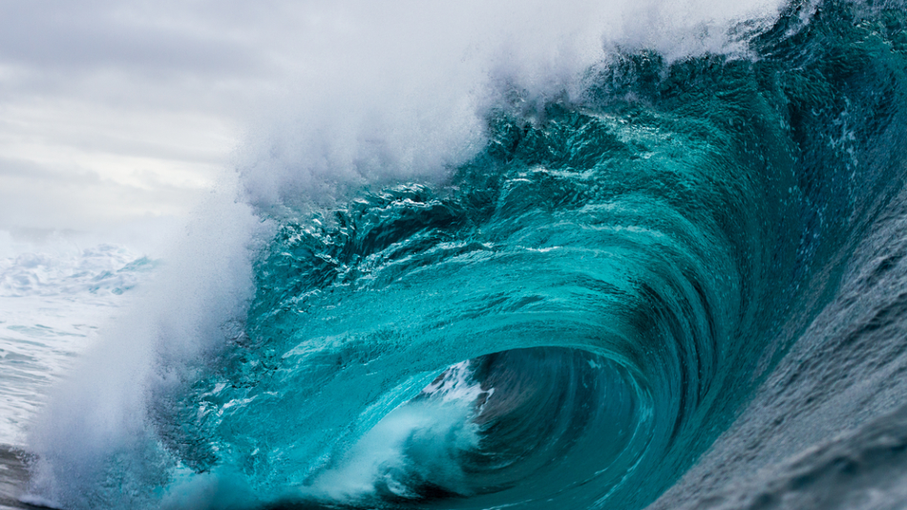
Learning Intention:
Investigate wave properties using a wave tank
Success Criteria:
Complete Marine Education worksheet ’31. Making Waves’
Notes:
Image: https://www.azocleantech.com/article.aspx?ArticleID=227

Slide 2
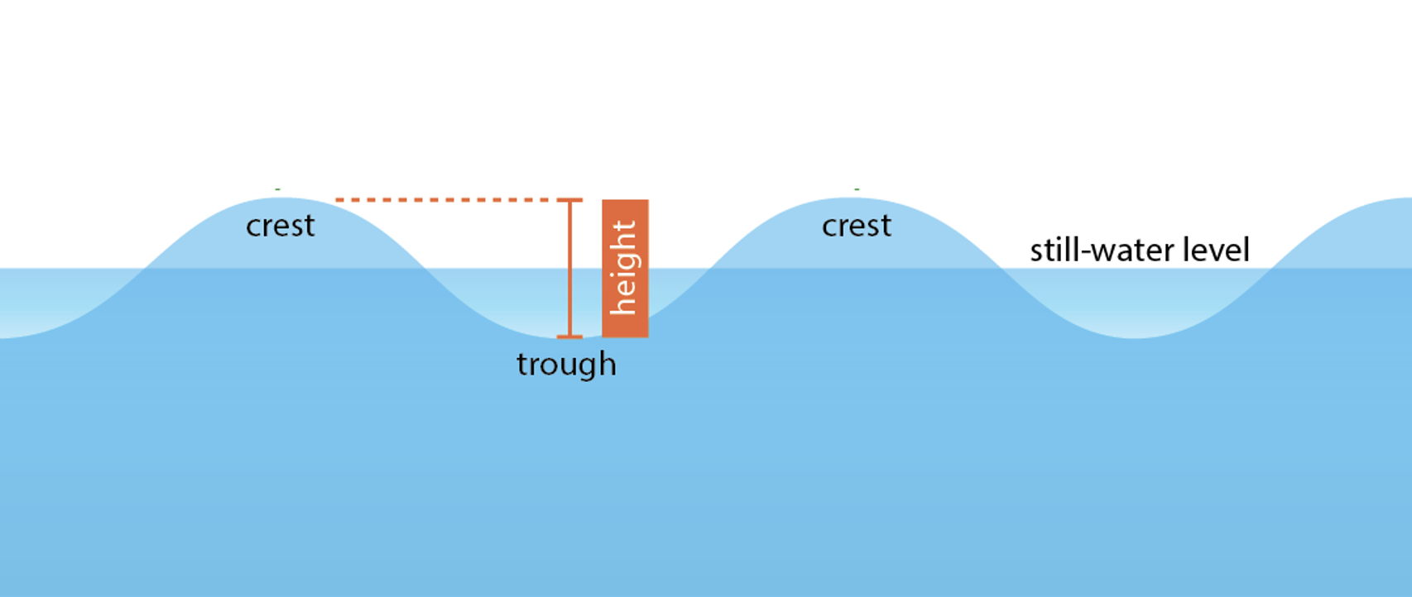
Wave Height: distance from crest to trough
Notes:
Image: https://manoa.hawaii.edu/exploringourfluidearth/physical/waves/wave-and-wave-properties

Slide 3
Wavelength: distance between two wave crests (peaks)
Notes:
Image: https://holyfins.com/what-is-the-wave-period/

Slide 4
Notes:
Image: https://foammagazine.com/wave-period/

Slide 5
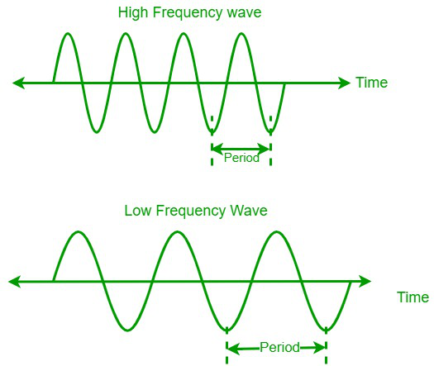
Wave Frequency
Number of waves passing a fixed point in one second
Notes:
Image: https://www.mdpi.com/2077-1312/10/8/1117

Slide 6
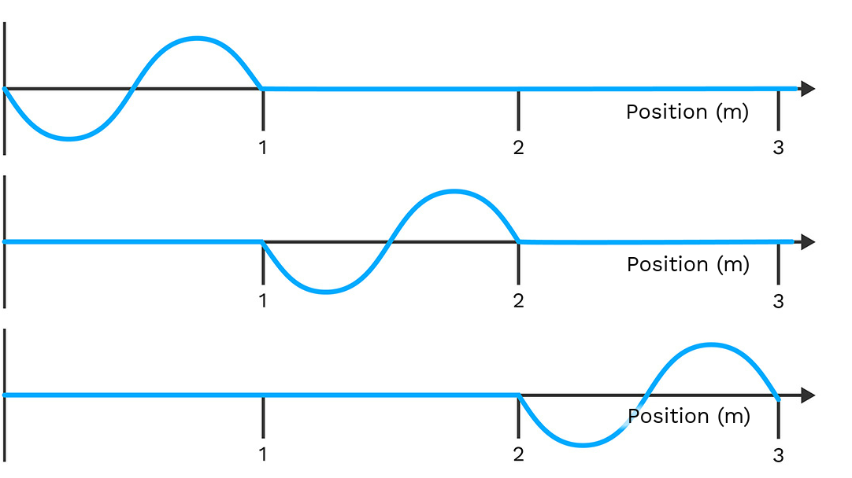
For example:
Frequency= 1Hz
Wavelength = 1m
Wave speed = 1m/s
1 second
2 seconds
3 seconds

Slide 7
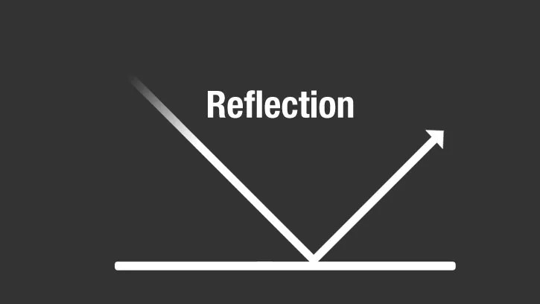
Notes:
Image: https://science.nasa.gov/ems/03_behaviors/

Slide 8
Notes:
Image: https://science.nasa.gov/ems/03_behaviors/

Slide 9
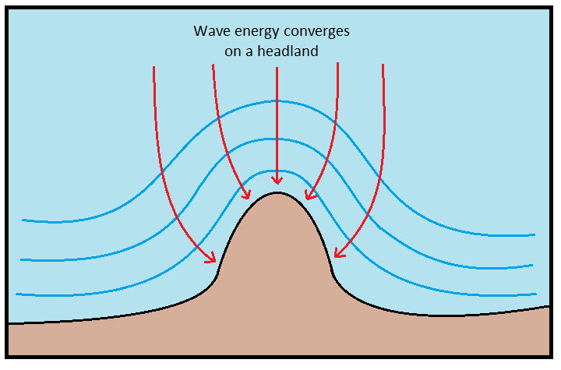
Wave refraction

Slide 10
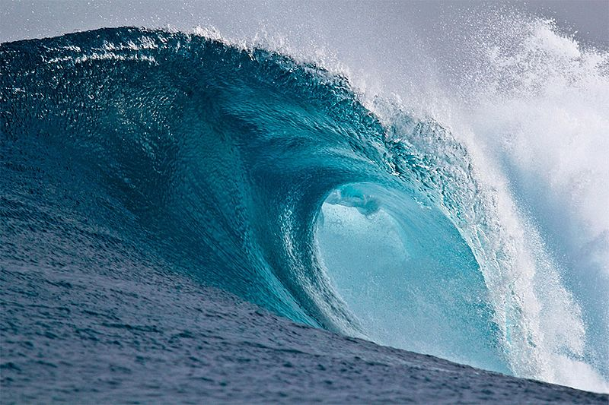
Waves break at a depth
1.3x
the wave height.
Notes:
Image: https://en.wikipedia.org/wiki/Breaking_wave

Slide 11
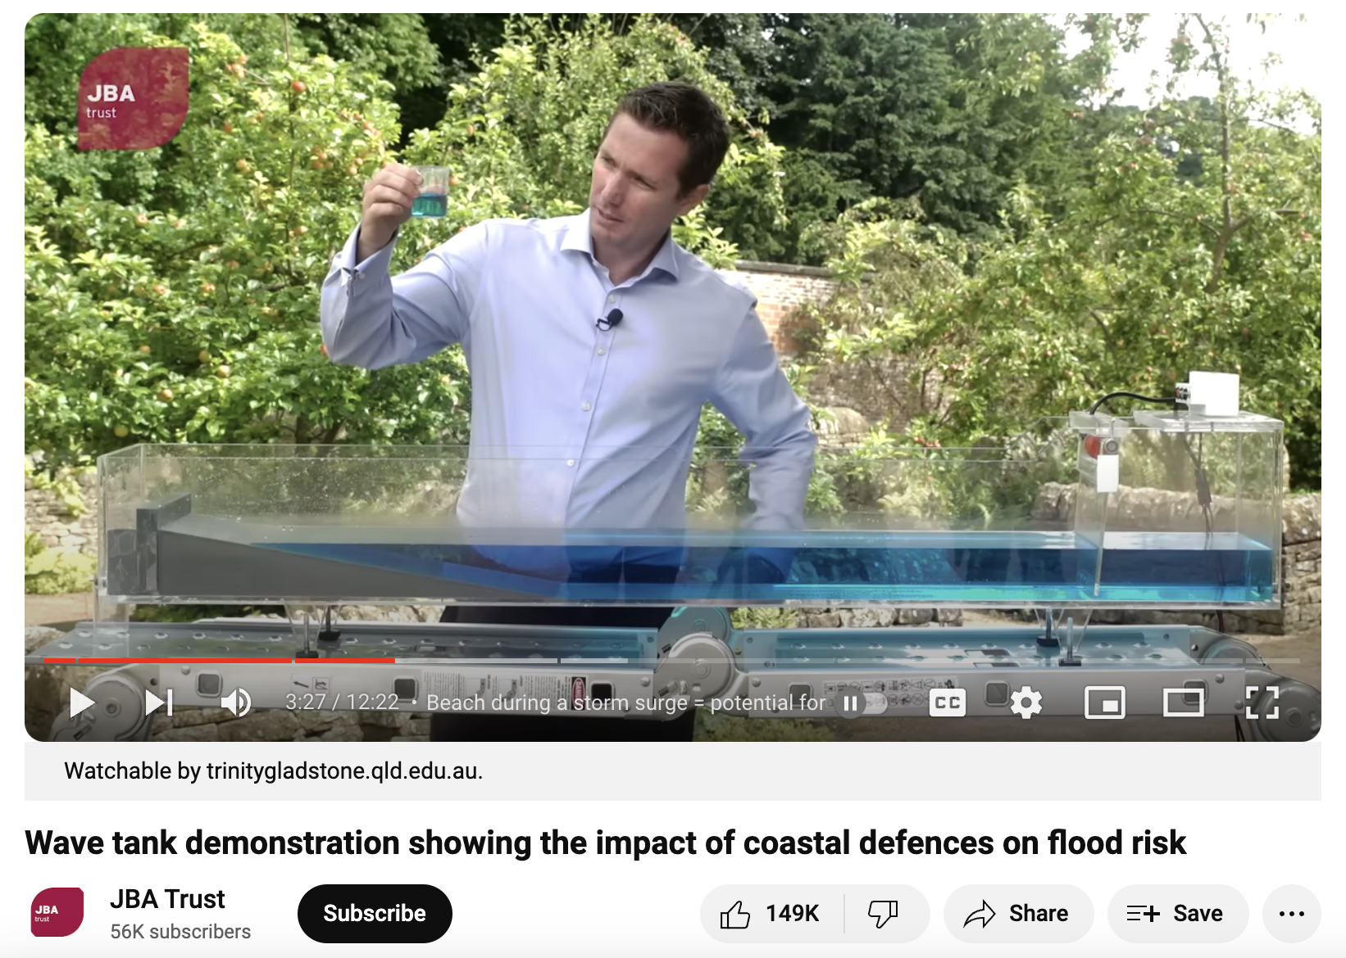
Must watch!
https://www.youtube.com/watch?v=3yNoy4H2Z-o

Slide 12
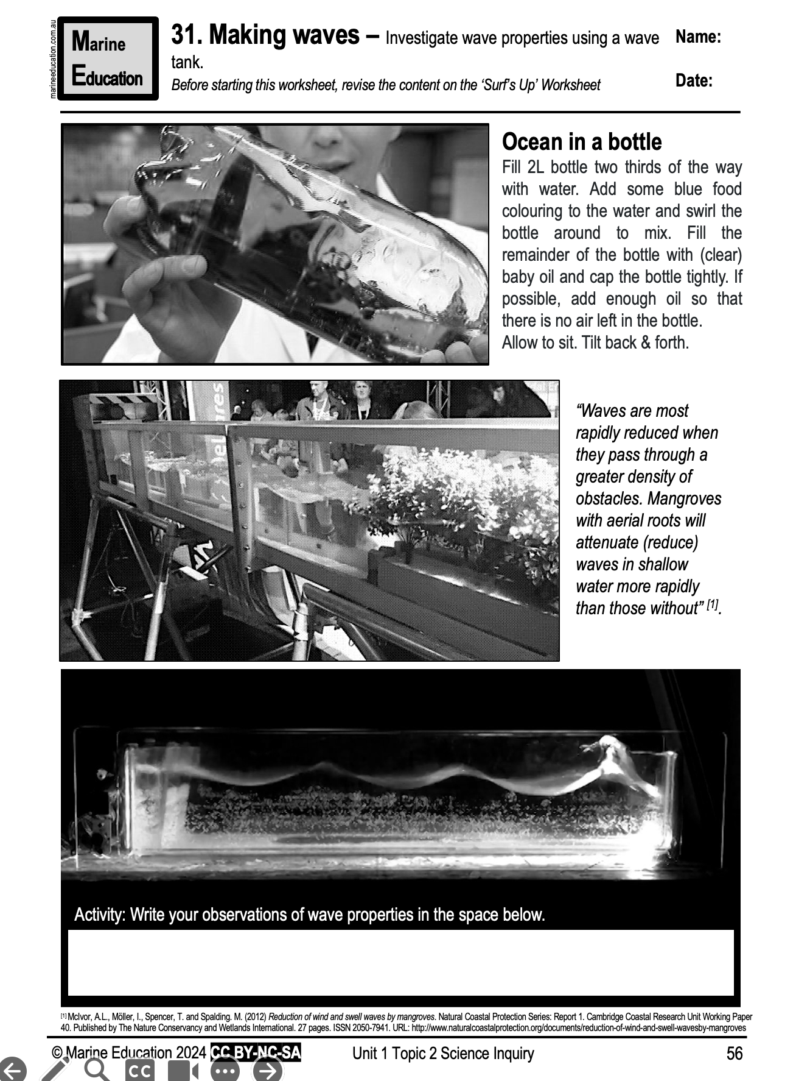
Learning Intention:
Investigate wave properties using a wave tank
Success Criteria:
Complete Marine Education worksheet ’31. Making Waves’
Notes:
Image: https://www.azocleantech.com/article.aspx?ArticleID=227

