Slide 1
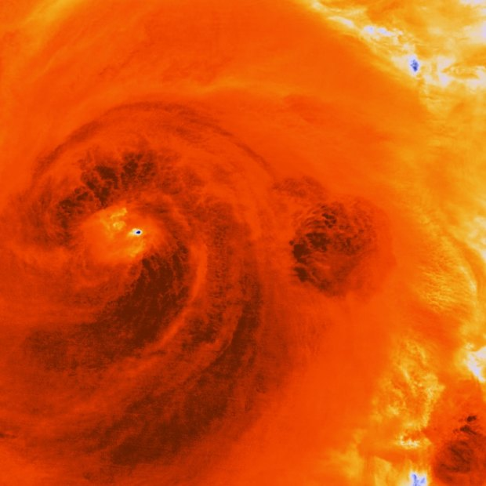
Learning Intention:
Interpret evidence used to inform the monitoring, assessment and evaluation of risk in relation to pulse events, i.e. cyclone, storm surge, tsunami and floods.
Success Criteria:
Complete Marine Education worksheet ‘34. Finger on the pulse’
Notes:
Image: https://www.smh.com.au/environment/weather/will-this-be-the-season-of-the-super-cyclone-20181027-p50cbi.html
In this infrared image, dark areas show the most intense energy swirling through Hurricane Sandy over Cuba in 2012.CREDIT:NOAA

Slide 2
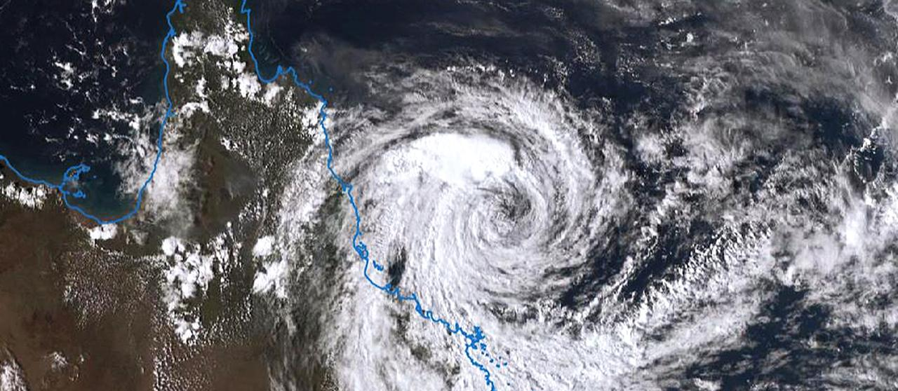
Cyclones
Notes:
Image: https://www.theaustralian.com.au/subscribe/news/1/?sourceCode=TAWEB_WRE170_a_GGL&dest=https%3A%2F%2Fwww.theaustralian.com.au%2Fnation%2Ftropical-cyclone-jasper-set-to-smash-far-north-qld%2Fnews-story%2F9b81fd7a7e8ac59fcc6a7c9a48c3aa54&memtype=anonymous&mode=premium&v21=LOW-Segment-1-SCORE&V21spcbehaviour=append

Slide 3
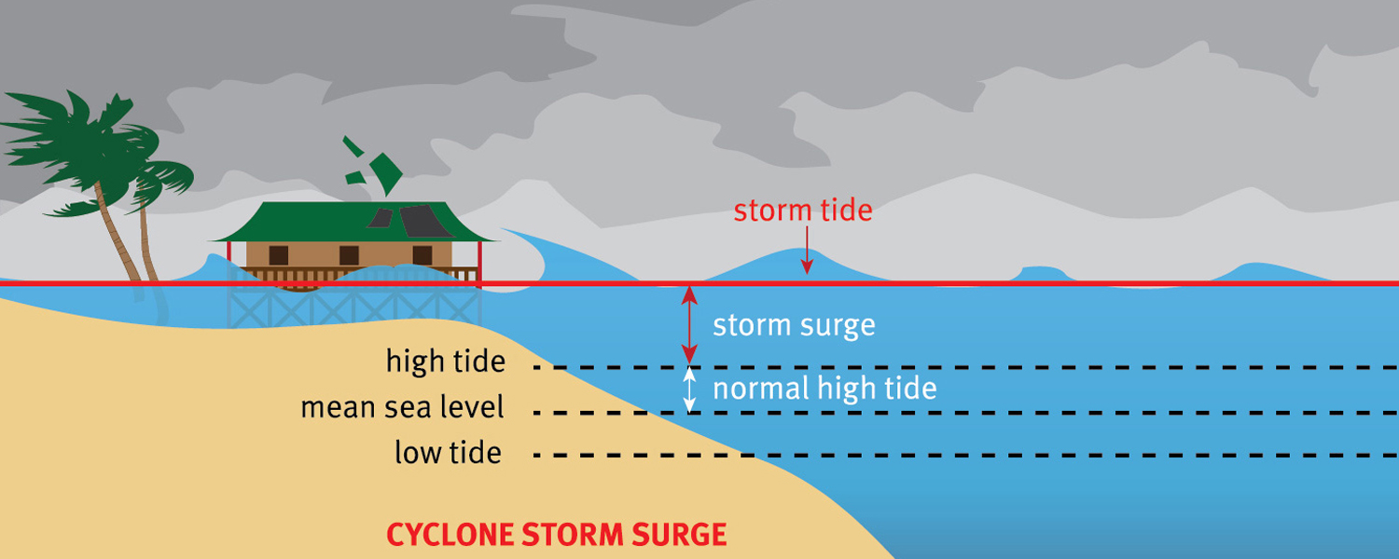
Storm surge
When strong cyclonic winds push large waves towards the coastline, causing water to swamp the landscape

Slide 4
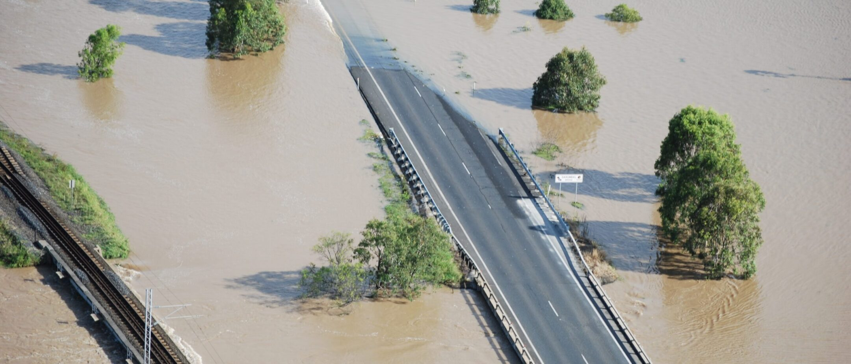
Flood
Notes:
Image: https://aecom.com/us/projects/bruce-highway-link-flood-study/

Slide 5
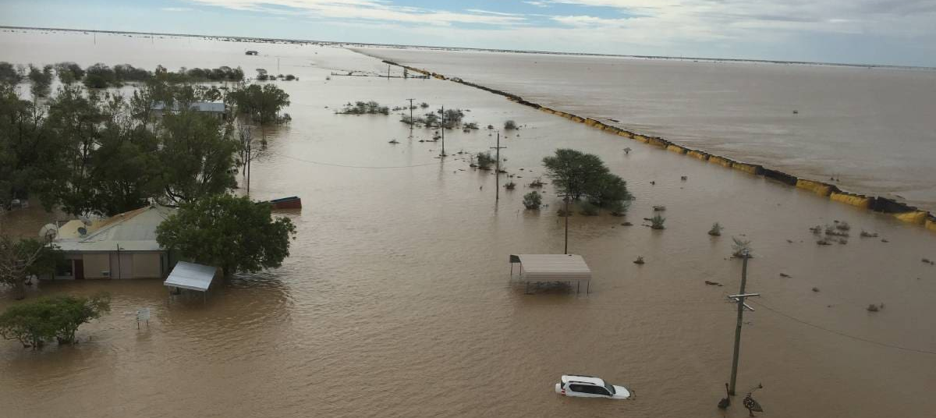
More cyclones and floods occur during La Niña years
(less during El Niño)
Notes:
Info: https://coastadapt.com.au/australias-climate-drivers-variability-and-extremes

Slide 6
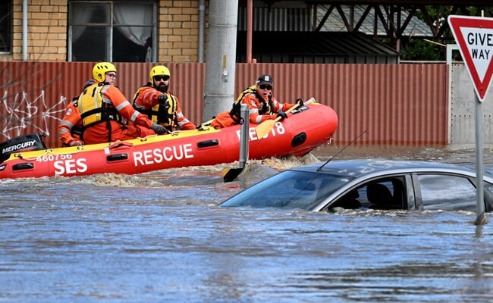
La Niña brings lots of rain to Australia.
Notes:
Info: https://www.ndtv.com/world-news/australia-floods-melbourne-floods-australia-floods-swallow-cars-houses-submerged-melbourne-faces-emergency-3430129

Slide 7
La Niña conditions generally result in above average rainfall over much of Australia.
Notes:
Info: https://edition.cnn.com/2021/11/23/weather/la-nina-australia-climate-wxc-intl/index.html

Slide 8
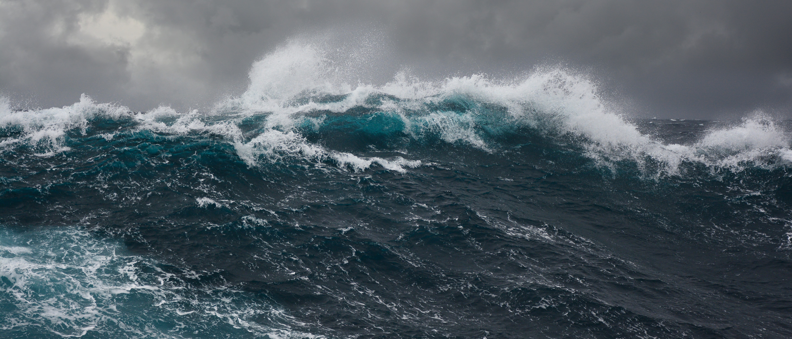
Warm water provides the energy needed for cyclones to form!
Notes:
Info: http://www.bom.gov.au/climate/about/australian-climate-influences.shtml?bookmark=lanina
Image: https://www.earth.com/news/destructive-weather-pattern-may-return-to-the-indian-ocean/

Slide 9
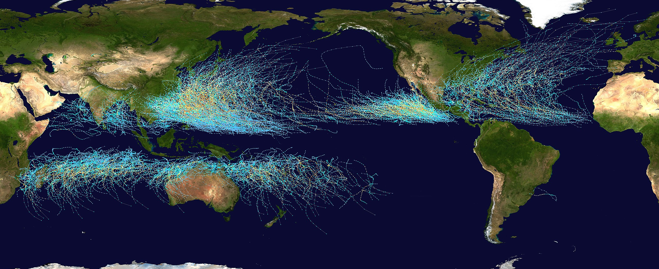
Cyclones only form when sea surface temperatures are above 26.5°C
(they also need the Coriolis effect to get a good ‘spin’ going. The Coriolis effect is too weak at the equator)
Notes:
Info: http://www.bom.gov.au/climate/about/australian-climate-influences.shtml?bookmark=lanina
Image: https://en.wikipedia.org/wiki/File:Global_tropical_cyclone_tracks-edit2.jpg

Slide 10
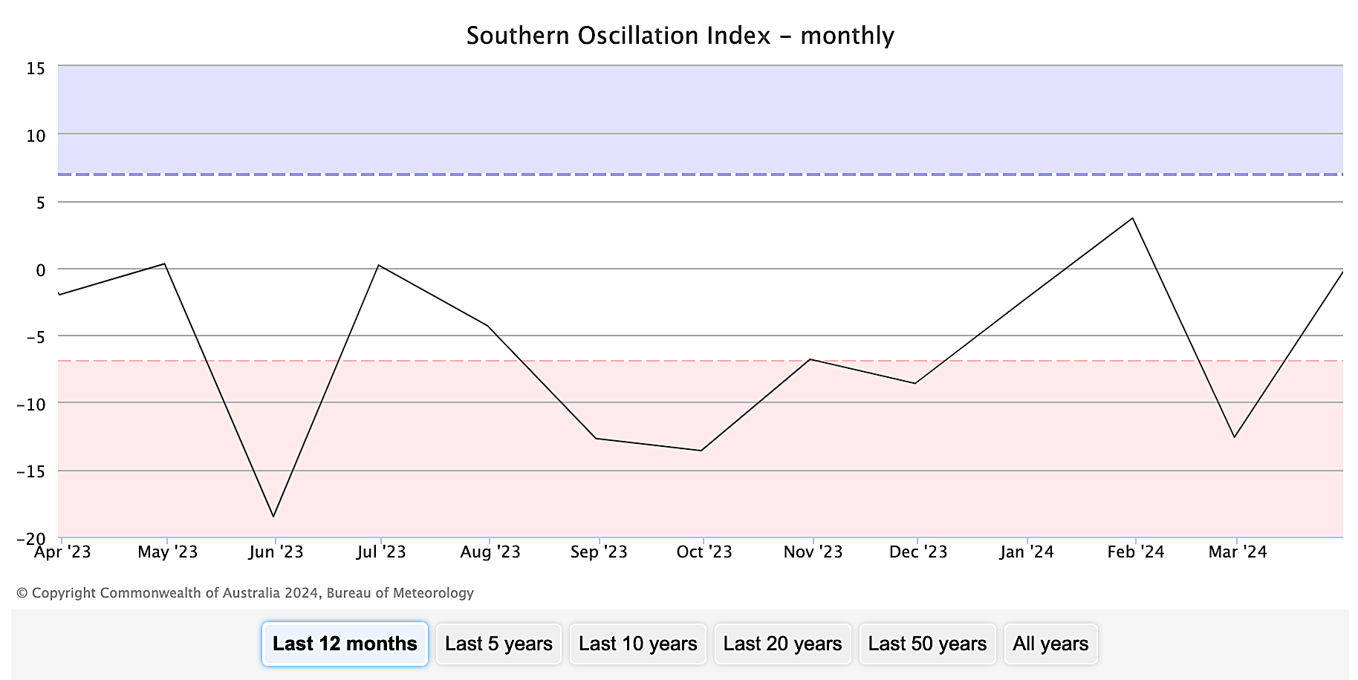
La Niña is the positive phase of the Southern Oscillation Index (SOI)
when the SOI is +7 or more
The SOI must be over +7 for a La Niña to be declared.
At no time on this graph was there a La Niña declared.
Notes:
Image: http://www.bom.gov.au/climate/enso/soi/

Slide 11
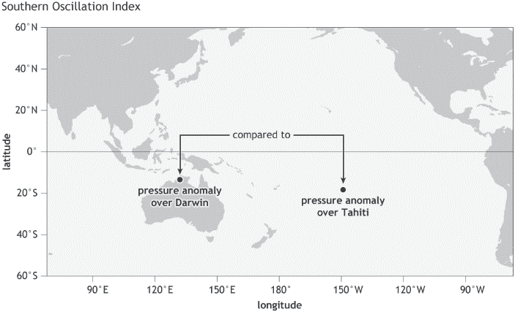
SOI is calculated by comparing barometer readings in Tahiti vs Darwin
E.g. when water is warm, it rises, lowering the atmospheric pressure at sea level, measured in hpa (hectopascals).
When warm water over Darwin, typical of LaNina, makes the atmospheric pressure over Darwin less than the atmospheric pressure over Tahiti, the SOI is a positive value.
Notes:
Image: https://www.researchgate.net/figure/llustration-of-Tahiti-and-Darwin-of-Australia_fig1_334388887
Paper: Climate Variability and Rainfed Sugarcane Production: Thailand a case study

Slide 12
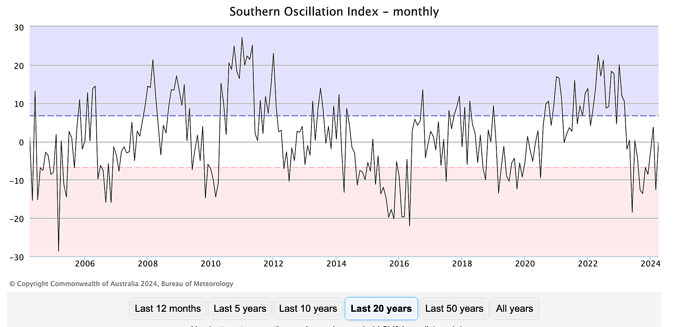
There was major flooding in 2011 when the SOI was above 20
Notes:
Image: http://www.bom.gov.au/climate/enso/soi/

Slide 13
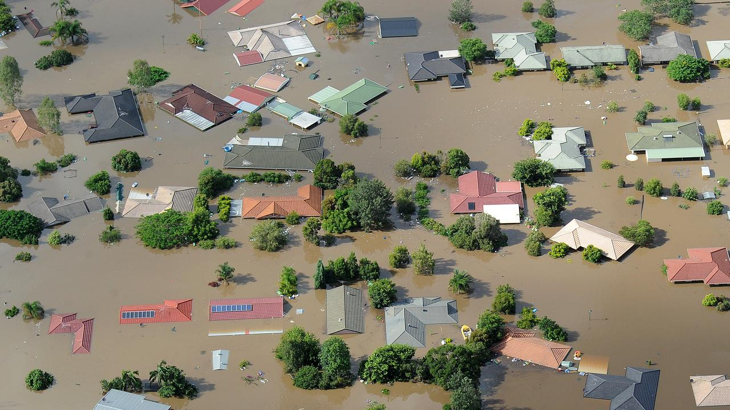
2011 floods
Notes:
Image: https://www.couriermail.com.au/subscribe/news/1/?sourceCode=CMWEB_WRE170_a_GGL&dest=https%3A%2F%2Fwww.couriermail.com.au%2Fnews%2Fqueensland%2Fin-pictures-queensland-2011-floods%2Fimage-gallery%2F2307de541de234d885982c275bb04964&memtype=anonymous&mode=premium&v21=LOW-Segment-1-SCORE

Slide 14
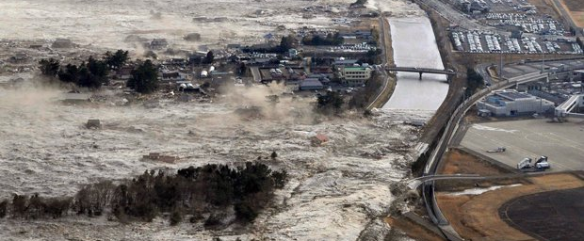
Tsunamis, on the other hand, are much harder to predict as they are formed by earthquakes on the seabed.
Notes:
Image: https://www.australiangeographic.com.au/topics/science-environment/2011/03/tsunamis-how-they-form/
A tsunami hits the north-east coast of Japan after a magnitude 9.0 earthquake on March 11, 2011. (AAP Photo/Kyodo News)

Slide 15
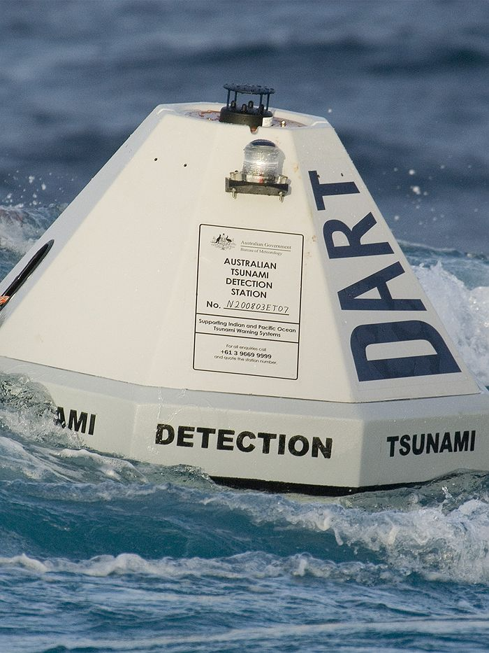
Tsunami buoys, which float in the deep ocean in different places around the world, detect and record the passing of tsunami waves
(Source: NOAA)
Notes:
Image: https://www.abc.net.au/science/articles/2014/12/17/4027721.htm

Slide 16
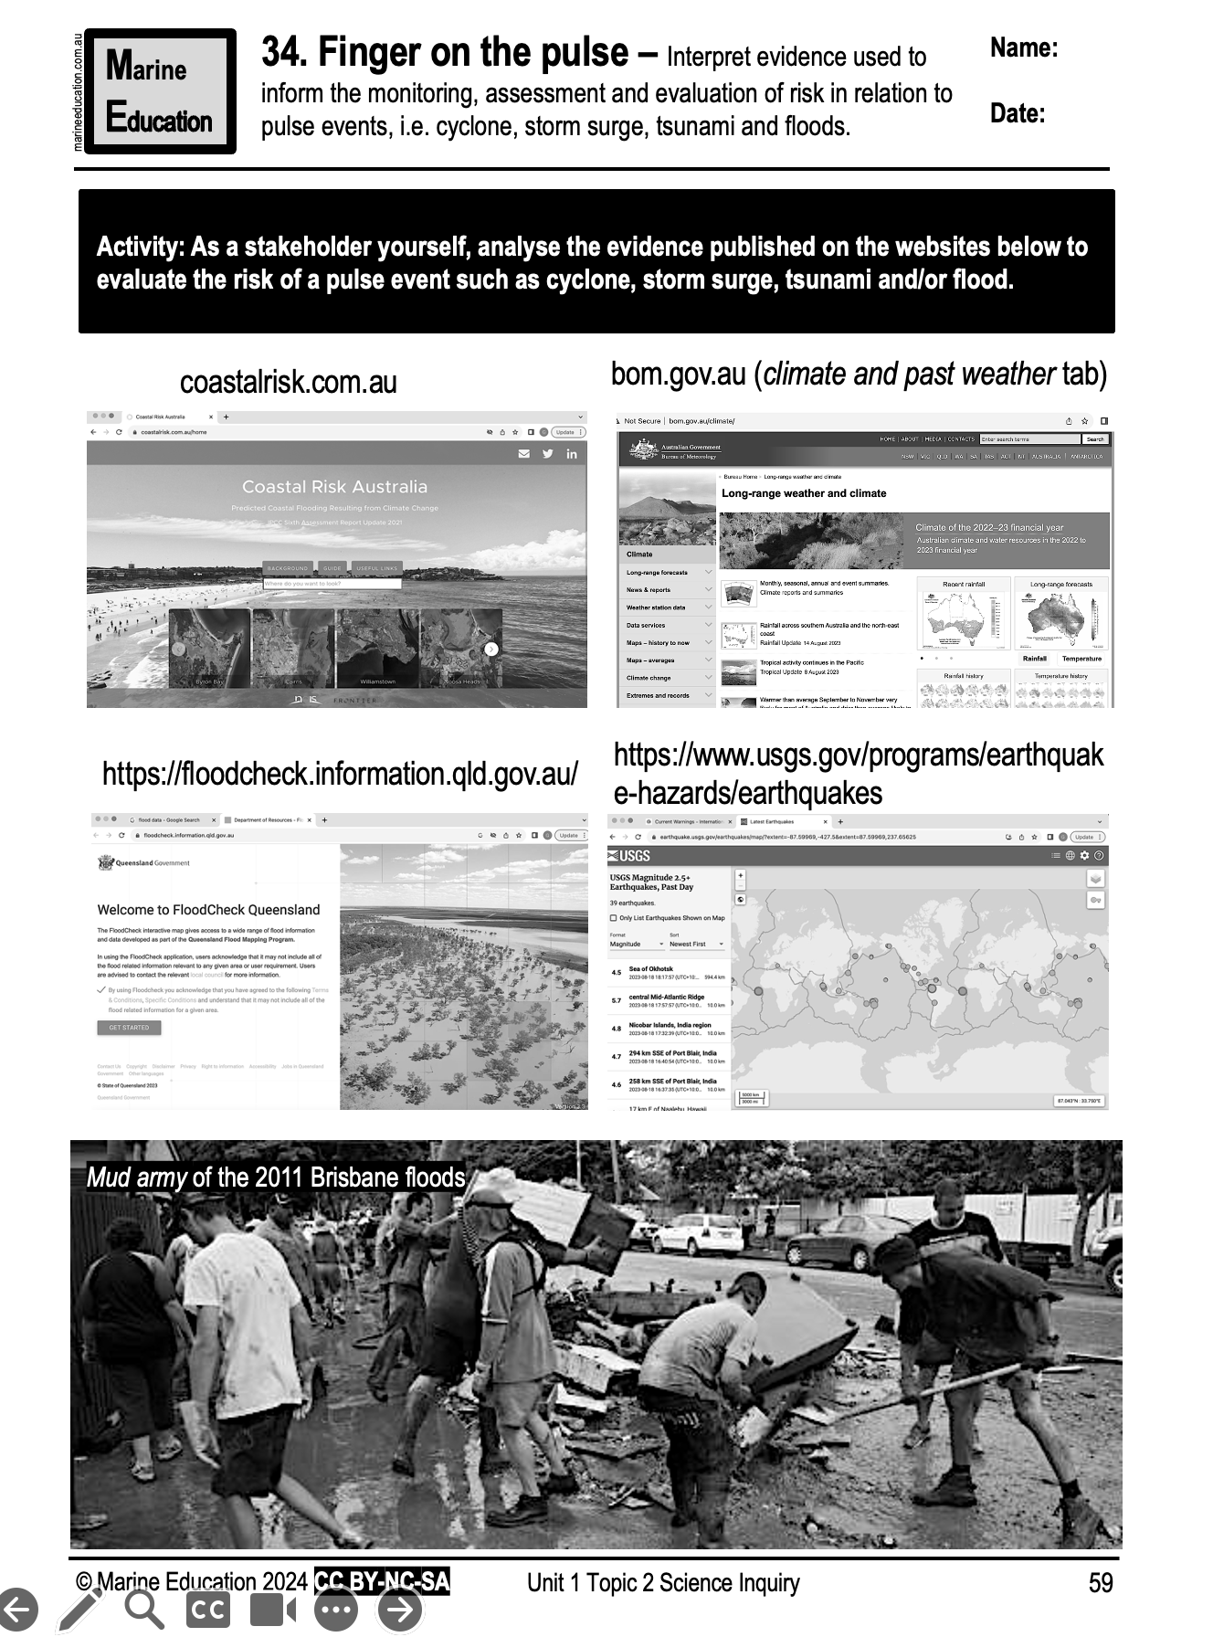
Learning Intention:
Interpret evidence used to inform the monitoring, assessment and evaluation of risk in relation to pulse events, i.e. cyclone, storm surge, tsunami and floods.
Success Criteria:
Complete Marine Education worksheet ‘34. Finger on the pulse’
Notes:
Image: https://www.smh.com.au/environment/weather/will-this-be-the-season-of-the-super-cyclone-20181027-p50cbi.html
In this infrared image, dark areas show the most intense energy swirling through Hurricane Sandy over Cuba in 2012.CREDIT:NOAA

