Slide 1
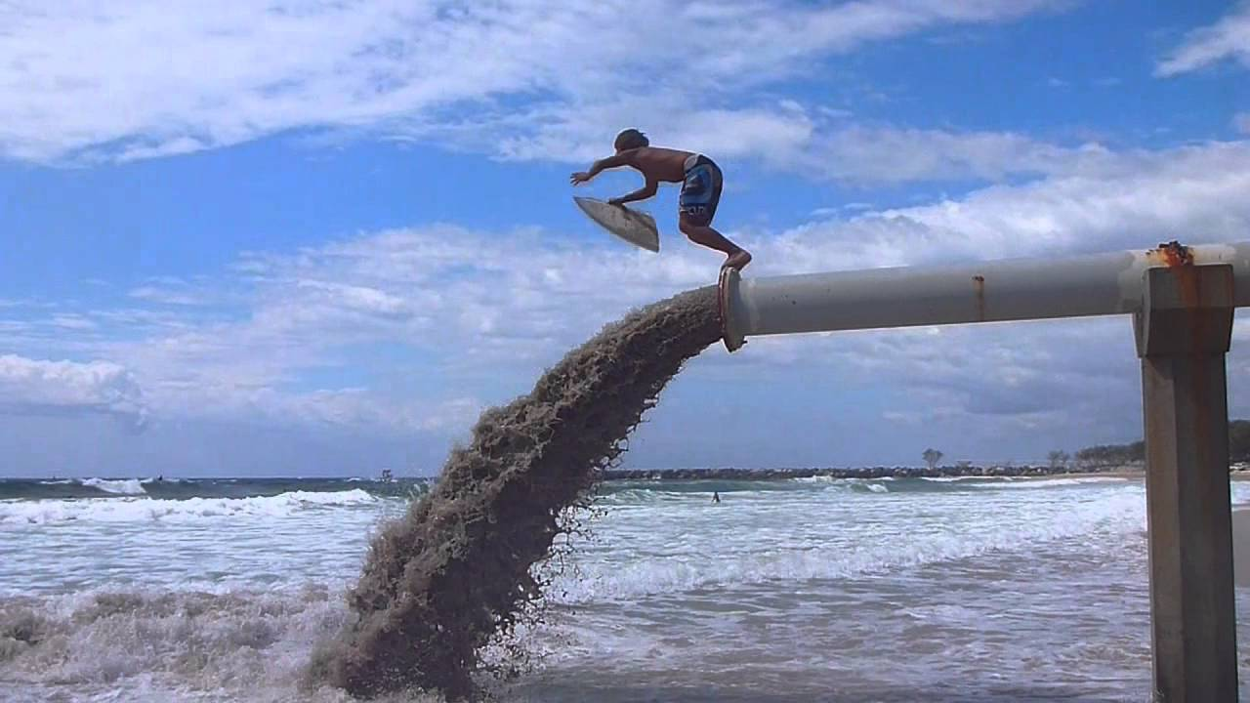
Learning Intention:
Analyse evidence from the use of groynes, river walls and sand bypass systems to determine the effects on longshore drift for a beach system resource, e.g. the Delft report; Griffith University Centre for Coastal Management.
Success Criteria:
Complete Marine Education worksheet ’34. Shifting Sands’

Slide 2
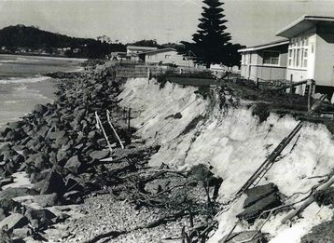
On January 29th 1967, tropical cyclone Dinah (category 4) hit SE Qld causing severe erosion and the loss of roads and buildings.

Slide 3
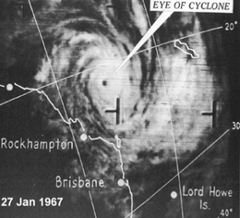
It was the strongest storm to approach SE Qld since reliable records began.
Notes:
Image: https://en.wikipedia.org/wiki/Cyclone_Dinah

Slide 4
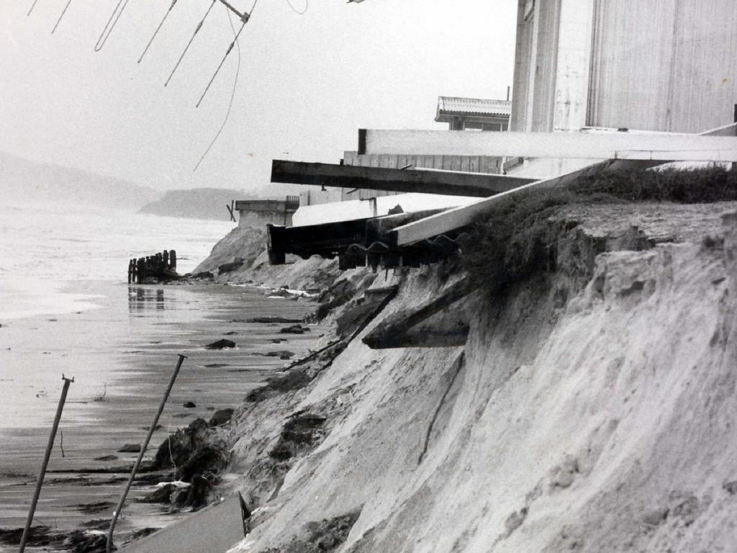
The Queensland Government commissioned a detailed study of Gold Coast beach erosion by the Delft Hydraulic Laboratory, known as the Delft Report
Notes:
Image: https://pantaimoribakila.weebly.com/gold-coast-case-study.html

Slide 5
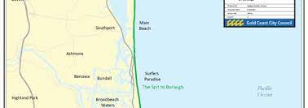
The Delft report recommended an extensive sand nourishment regime across all Gold Coast beaches in volumes large enough to withstand a similar event.
Notes:
Image: https://gcwa.qld.gov.au/portfolio-item/sand-bypass-system/

Slide 6
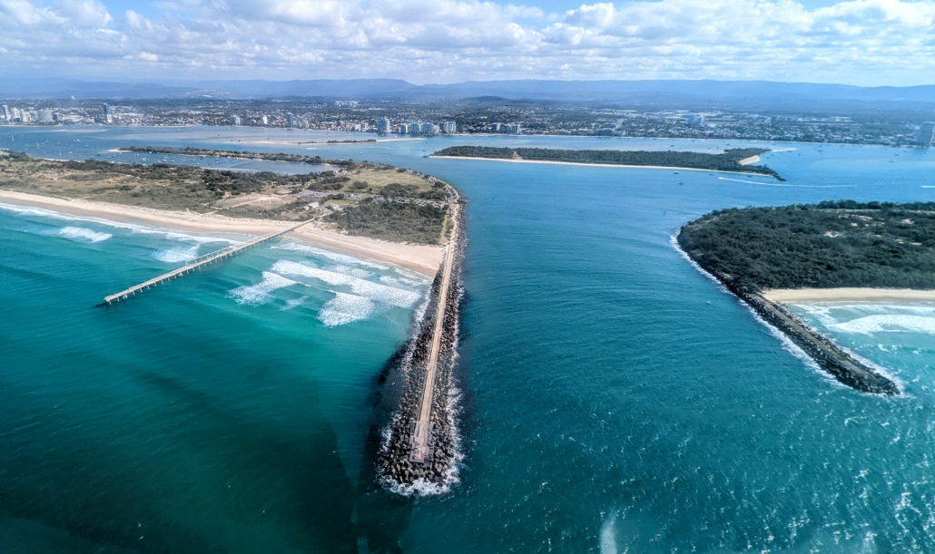
Since then, Gold Coast beaches have been adorned with groynes, river walls and sand bypass systems.
Notes:
Image:

Slide 7
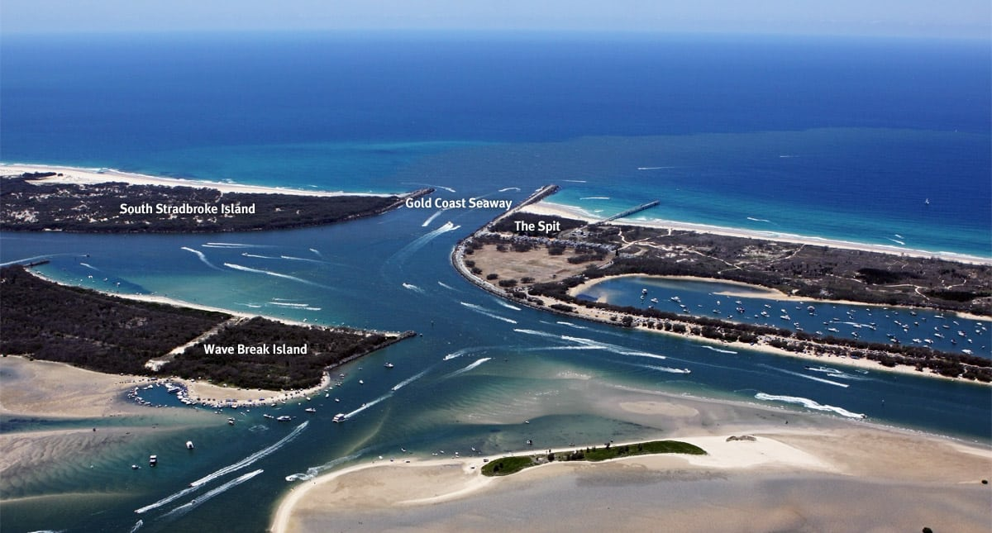
Notes:
Image: https://truebluefishing.com.au/gold-coast-seaway/

Slide 8
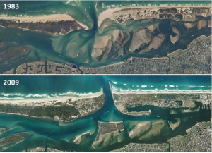
A seawall was built on the Nerang River mouth entrance between
the Gold Coast spit and South Stradbroke Island
Notes:
https://pantaimoribakila.weebly.com/gold-coast-case-study.html

Slide 9
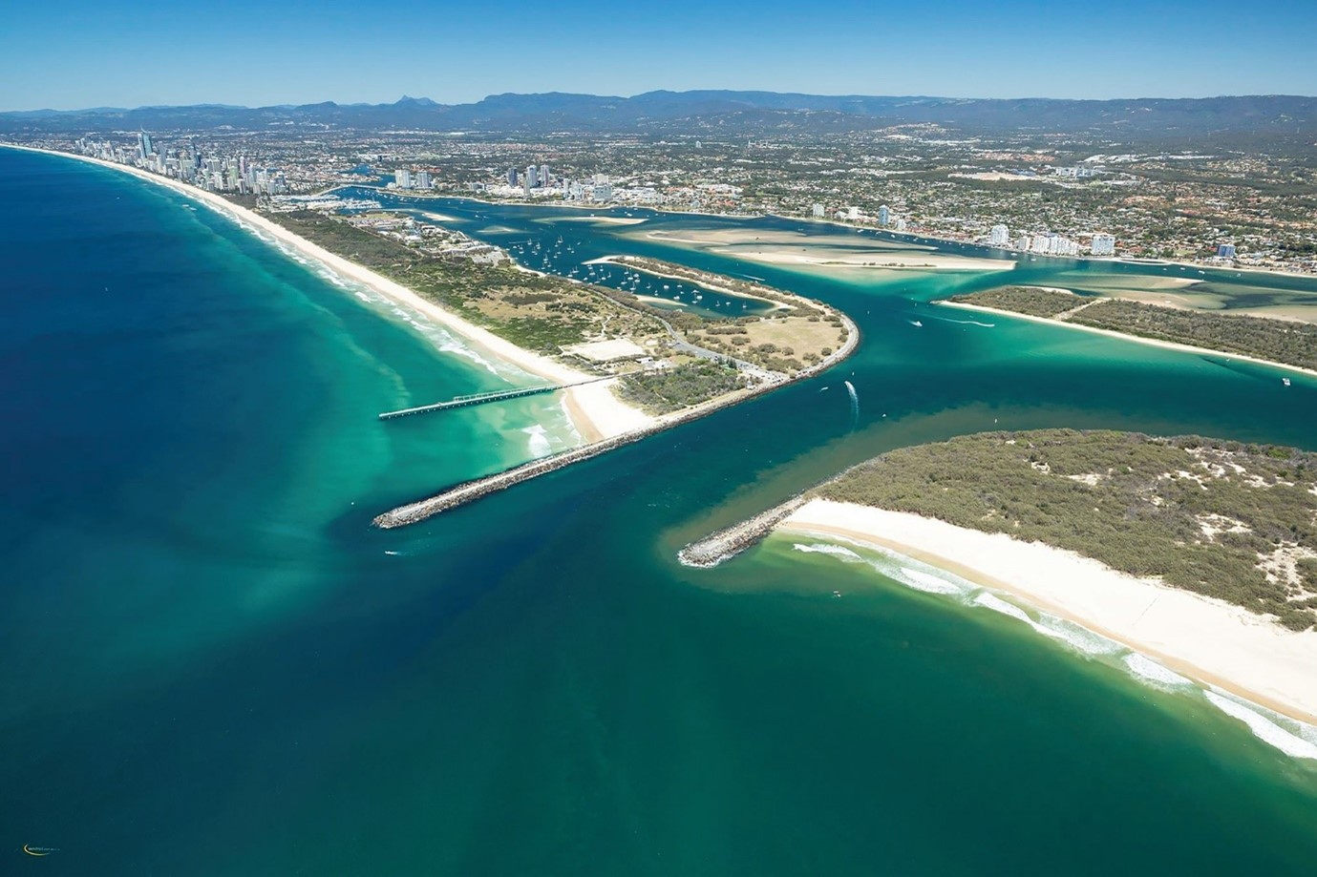
A
sand bypass system
was built there as well

Slide 10
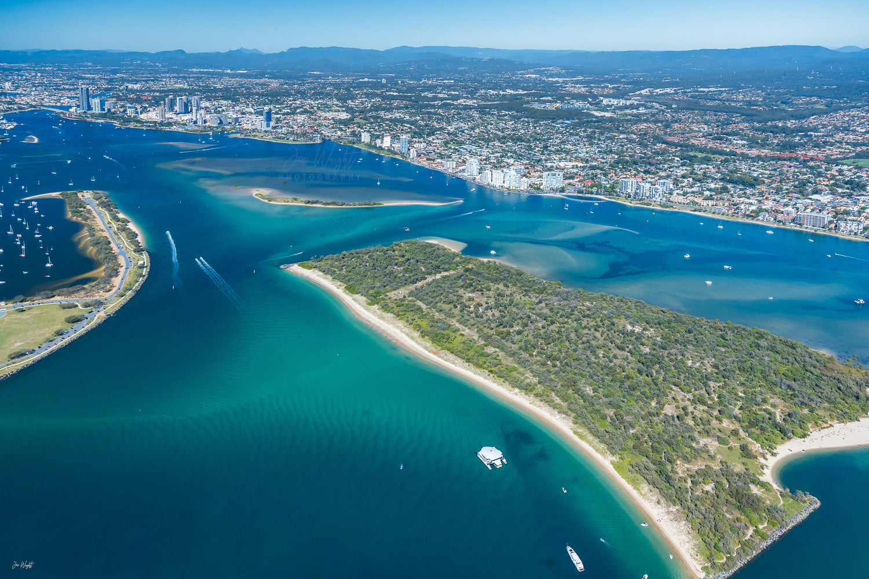
Wave Break Island was also made
Wave break island

Slide 11
Notes:
https://gcwa.qld.gov.au/wp-content/uploads/2022/06/Sand-Bypass-System-Brochure-V2.pdf

Slide 12
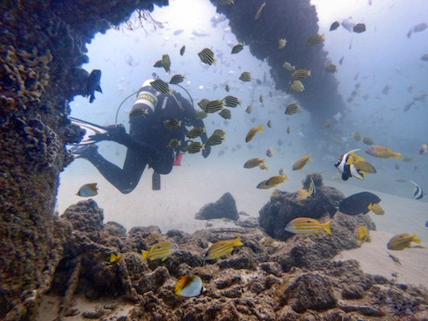
← pipeline
The pipeline that crosses the Nerang River is now a popular shore dive site.
(so too is the south wall of the seaway)

Slide 13
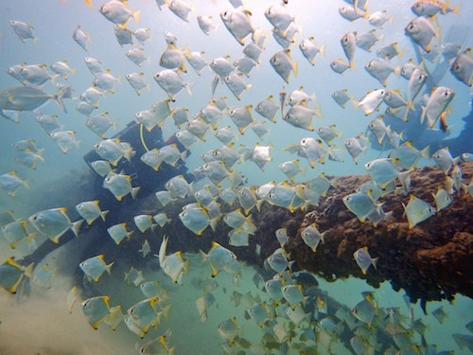
The Gold Coast Seaway sand pipe is an easy dive site for navigation as you go along the pipe, and back again
(but is subject to strong currents)
Notes:
Image: https://myfavouriteescapes.com/gold-coast-seaway-diving-snorkelling/

Slide 14
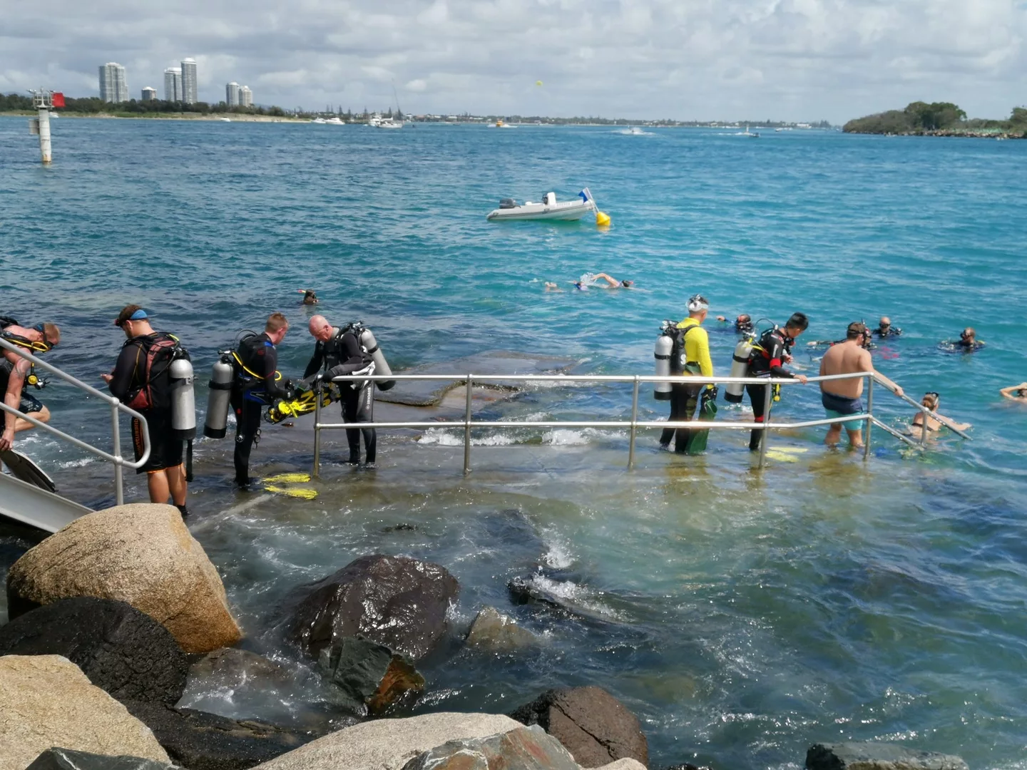
The sand pipe starts about 50m on the right of the stairs
(always use a dive float and if snorkeling, do not follow the pipe too far - stay close to the seawall to avoid collision with boat traffic. Also beware of fishing activities)

Slide 15
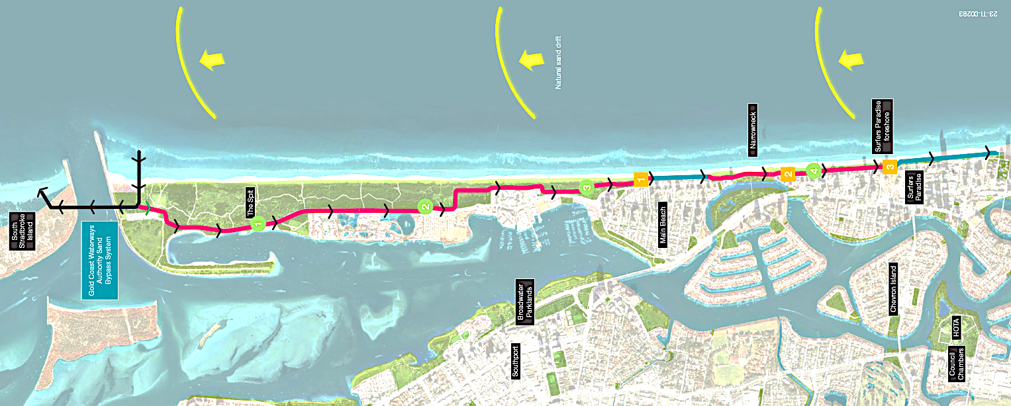
A new pipeline now runs from the spit all the way back to Surfers Paradise
called the sand backpass system
Notes:
Image: https://www.goldcoast.qld.gov.au/Services/Projects-works/Surfers-Paradise-Sand-Backpass-System

Slide 16
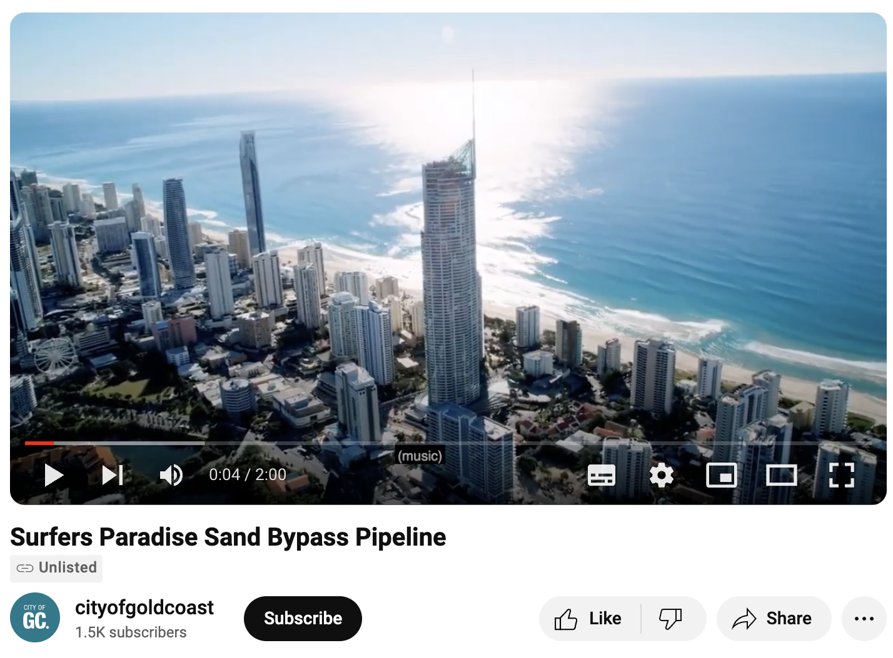
Play video: https://www.youtube.com/watch?v=akNIZY0MHUk&t=83s

Slide 17
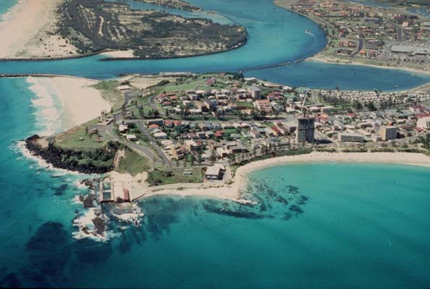
Meanwhile, the Tweed River was experiencing erosion as well
1980
Notes:
Image: Coolangatta from above in 1980. The shape of the bay was very different.(Supplied: Gold Coast City Council)
Source: https://www.abc.net.au/news/2023-06-16/gold-coast-sand-pumping-shapes-surf-superbank-snapper-rocks/102438546

Slide 18
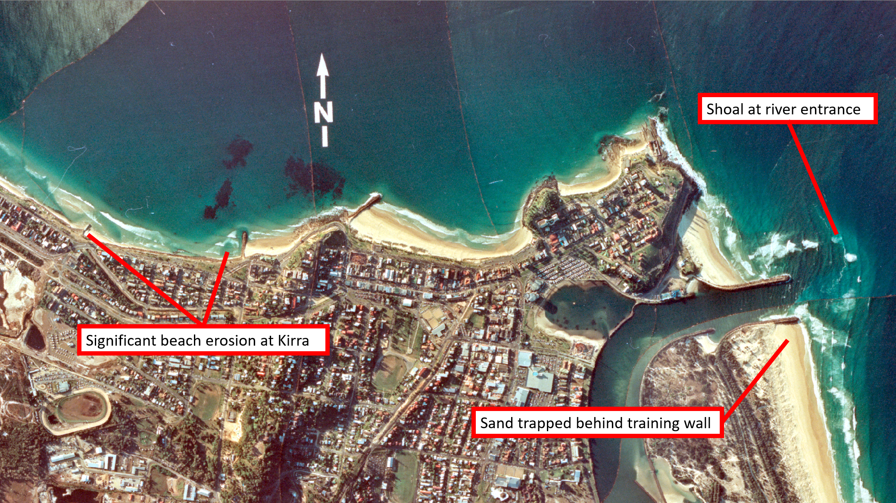
1982
Notes:
Image: https://www.tweedsandbypass.nsw.gov.au/why-tweed-sand-bypassing/project-background.html
Vertical Image from 1982 showing eroded beaches at north Kirra and significant shoaling at the Tweed River entrance

Slide 19
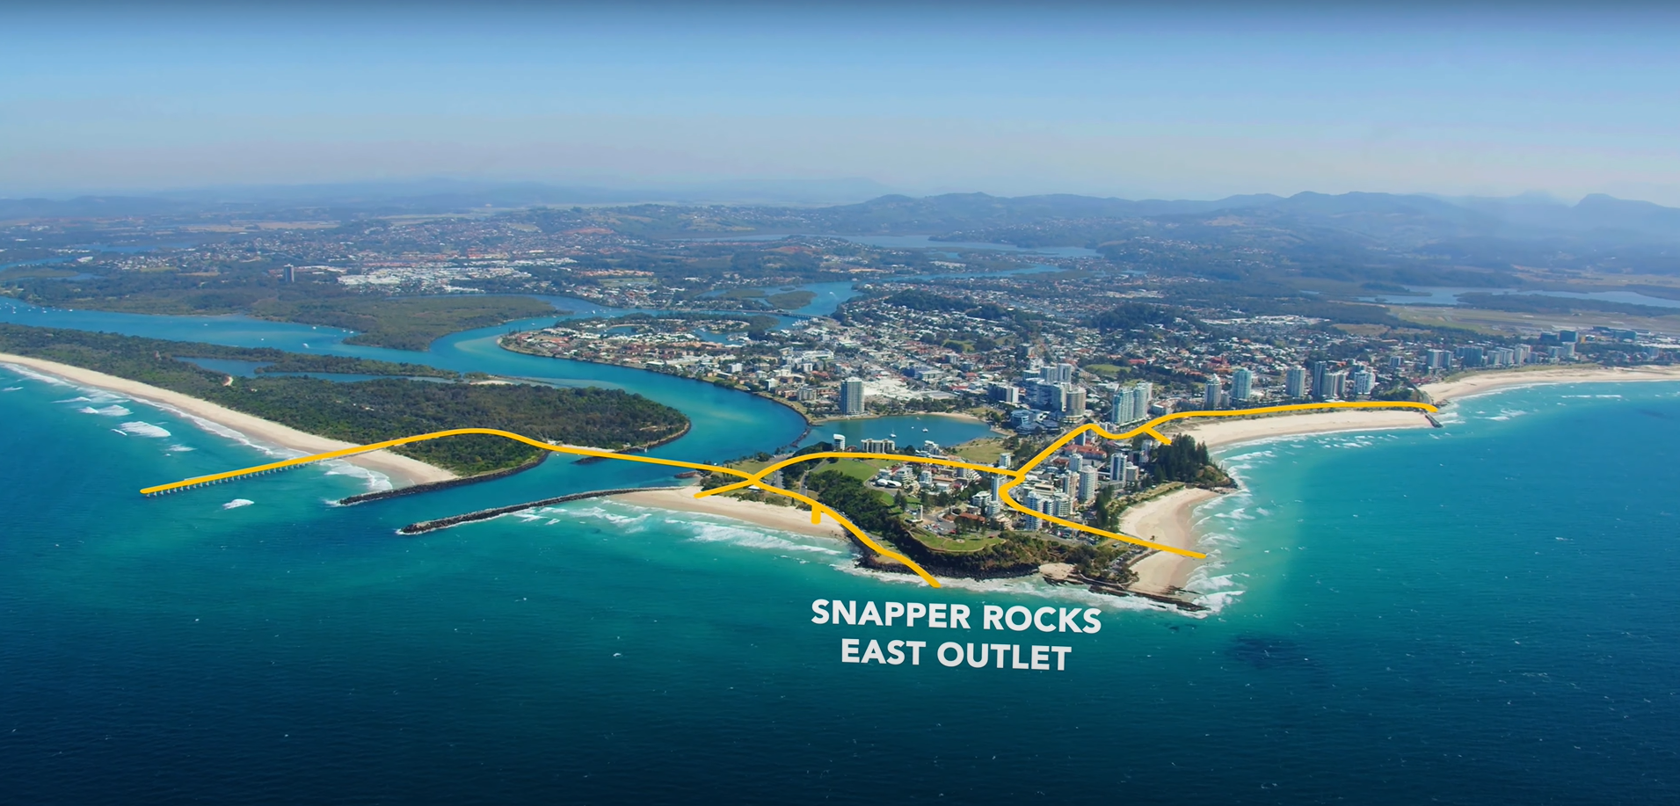
Thus, a sand bypass system was built for the Tweed River as well
The Tweed River Entrance Sand Bypassing Project (TRESBP)
Notes:
Image: https://www.abc.net.au/news/2023-06-16/gold-coast-sand-pumping-shapes-surf-superbank-snapper-rocks/102438546

Slide 20
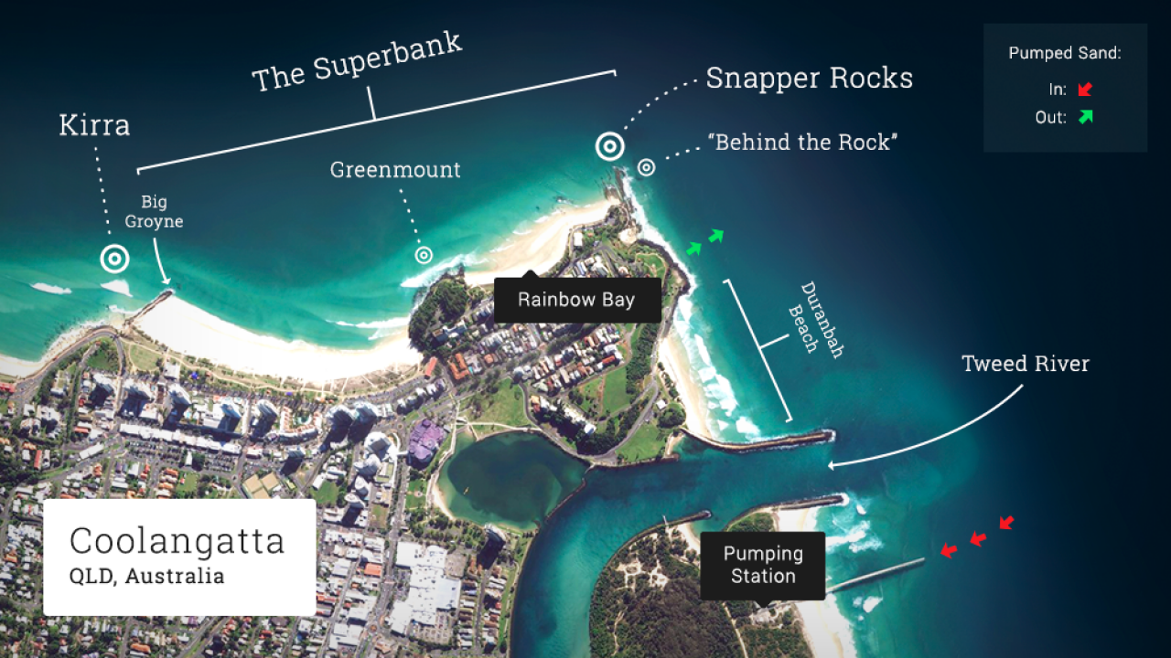
Photo: World Surf League
Notes:
Image: https://www.abc.net.au/news/2023-06-16/gold-coast-sand-pumping-shapes-surf-superbank-snapper-rocks/102438546

Slide 21
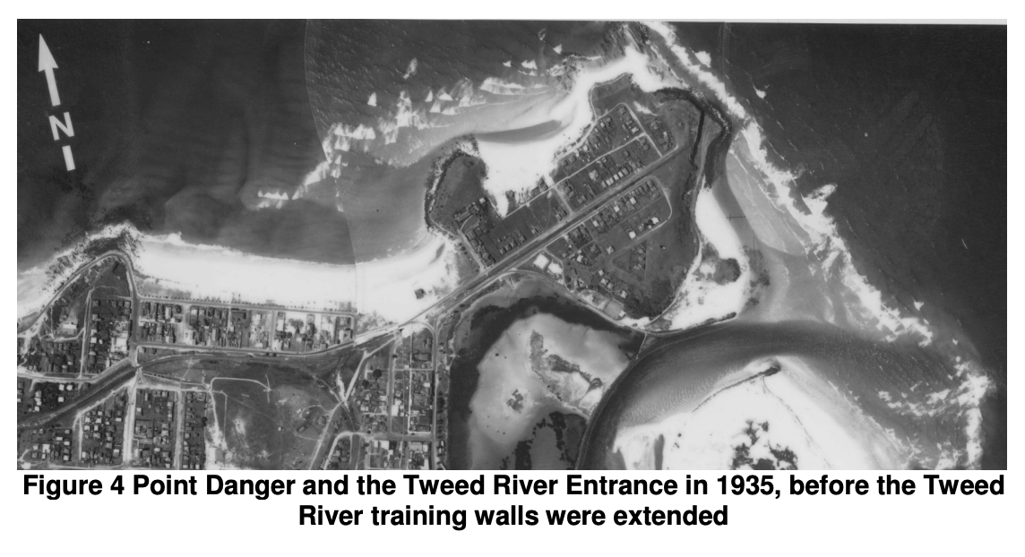
Notes:
Image: https://www.coastalconference.com/2011/papers2011/Cath%20Acworth%20Full%20Paper.pdf

Slide 22
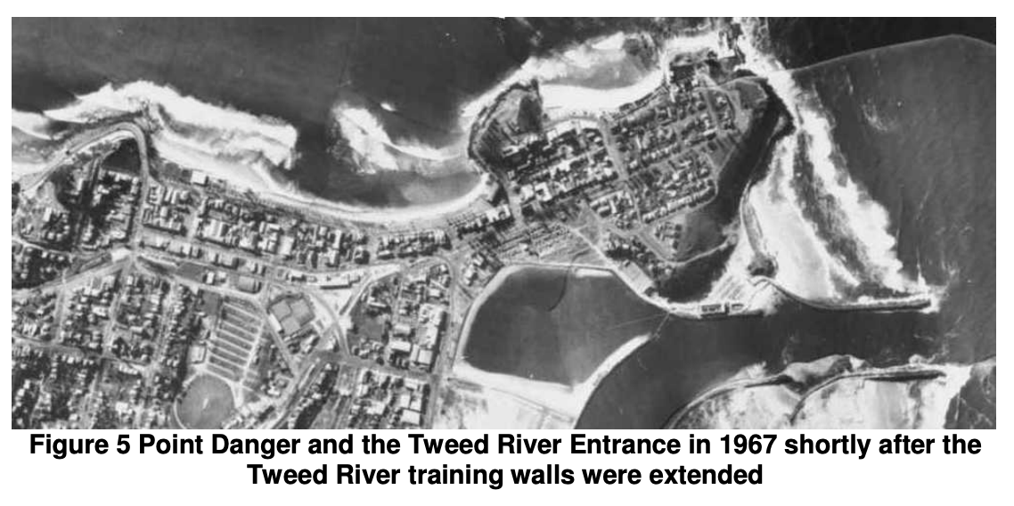
Notes:
Image: https://www.coastalconference.com/2011/papers2011/Cath%20Acworth%20Full%20Paper.pdf

Slide 23
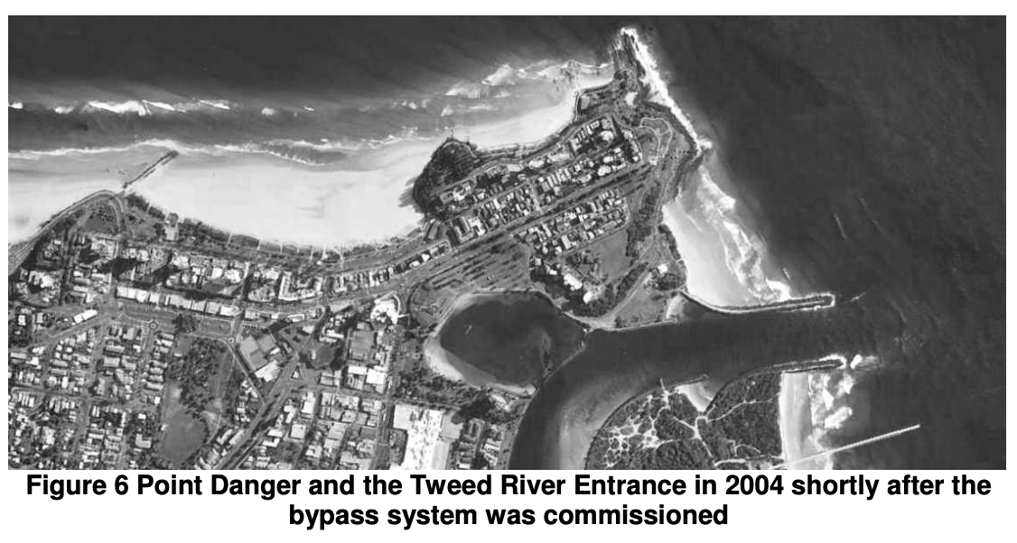
Notes:
Image: https://www.coastalconference.com/2011/papers2011/Cath%20Acworth%20Full%20Paper.pdf

Slide 24
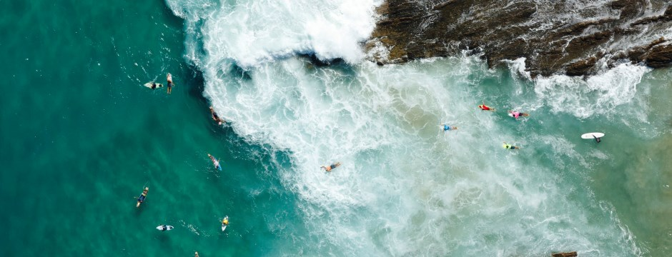
Notes:
Image: https://www.tweedsandbypass.nsw.gov.au/

Slide 25
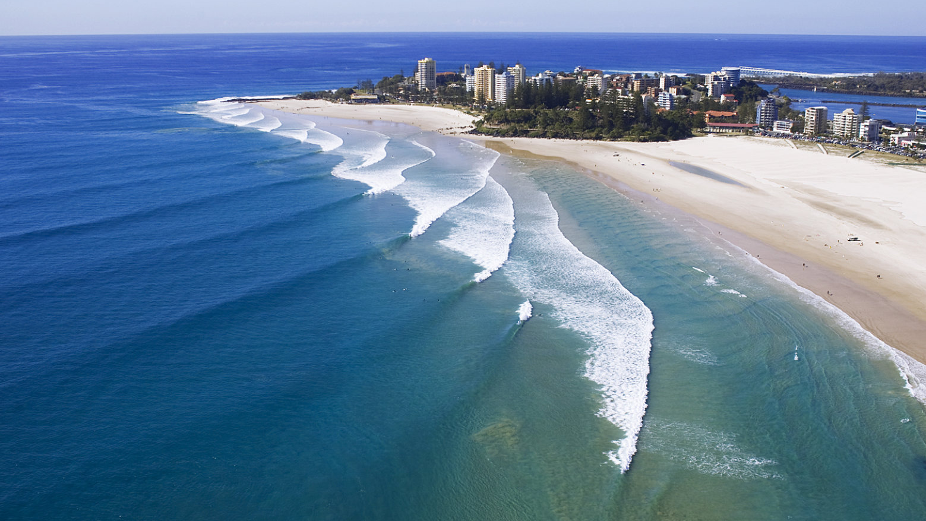
Snapper Rocks
Notes:
Image: https://www.surfline.com/surf-news/mechanics-snapper-rocks-gold-coast-superbank/20790

Slide 26
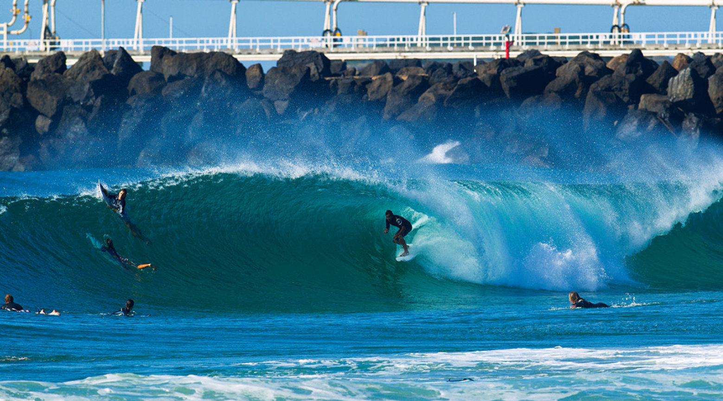
Duranbah

Slide 27
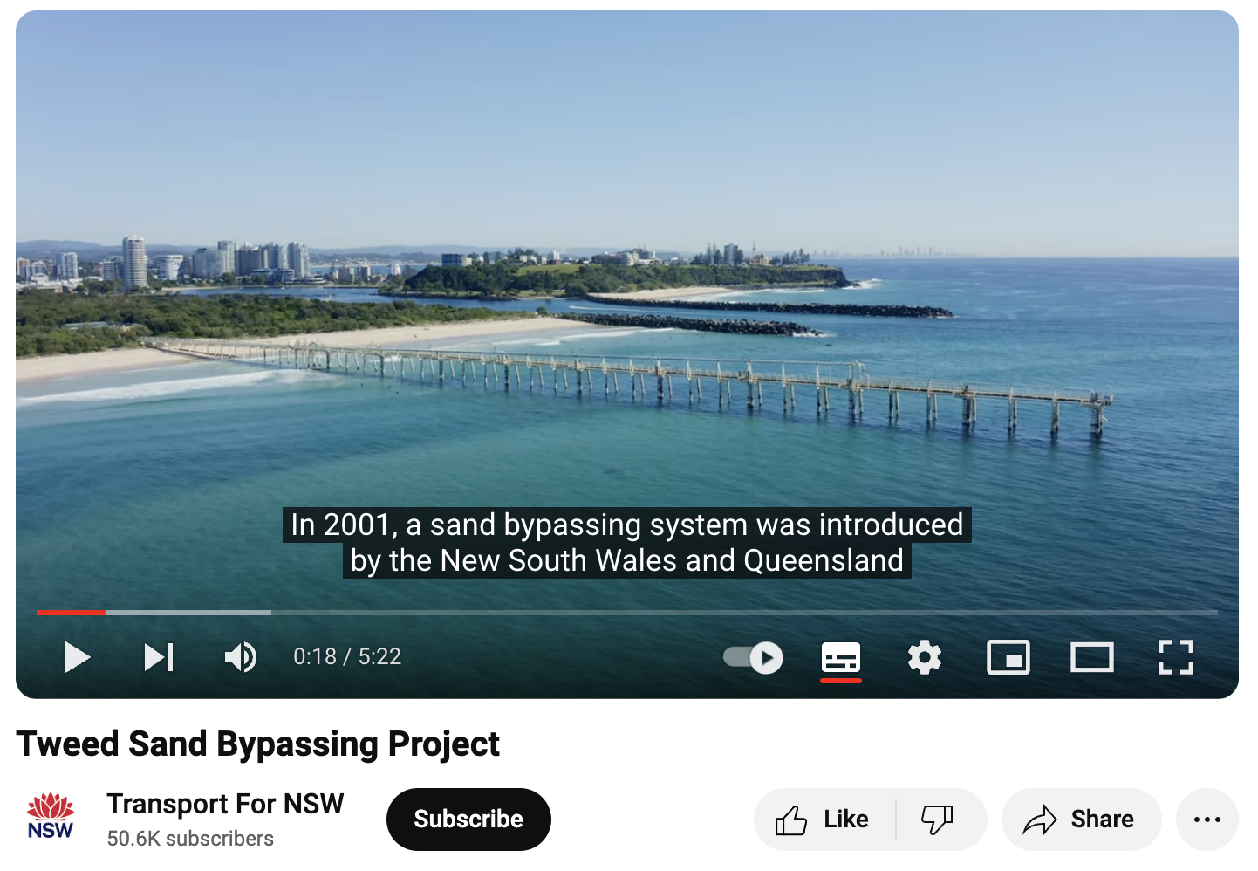
Play video https://www.youtube.com/watch?v=6M37XY6Kb68&t=1s

Slide 28
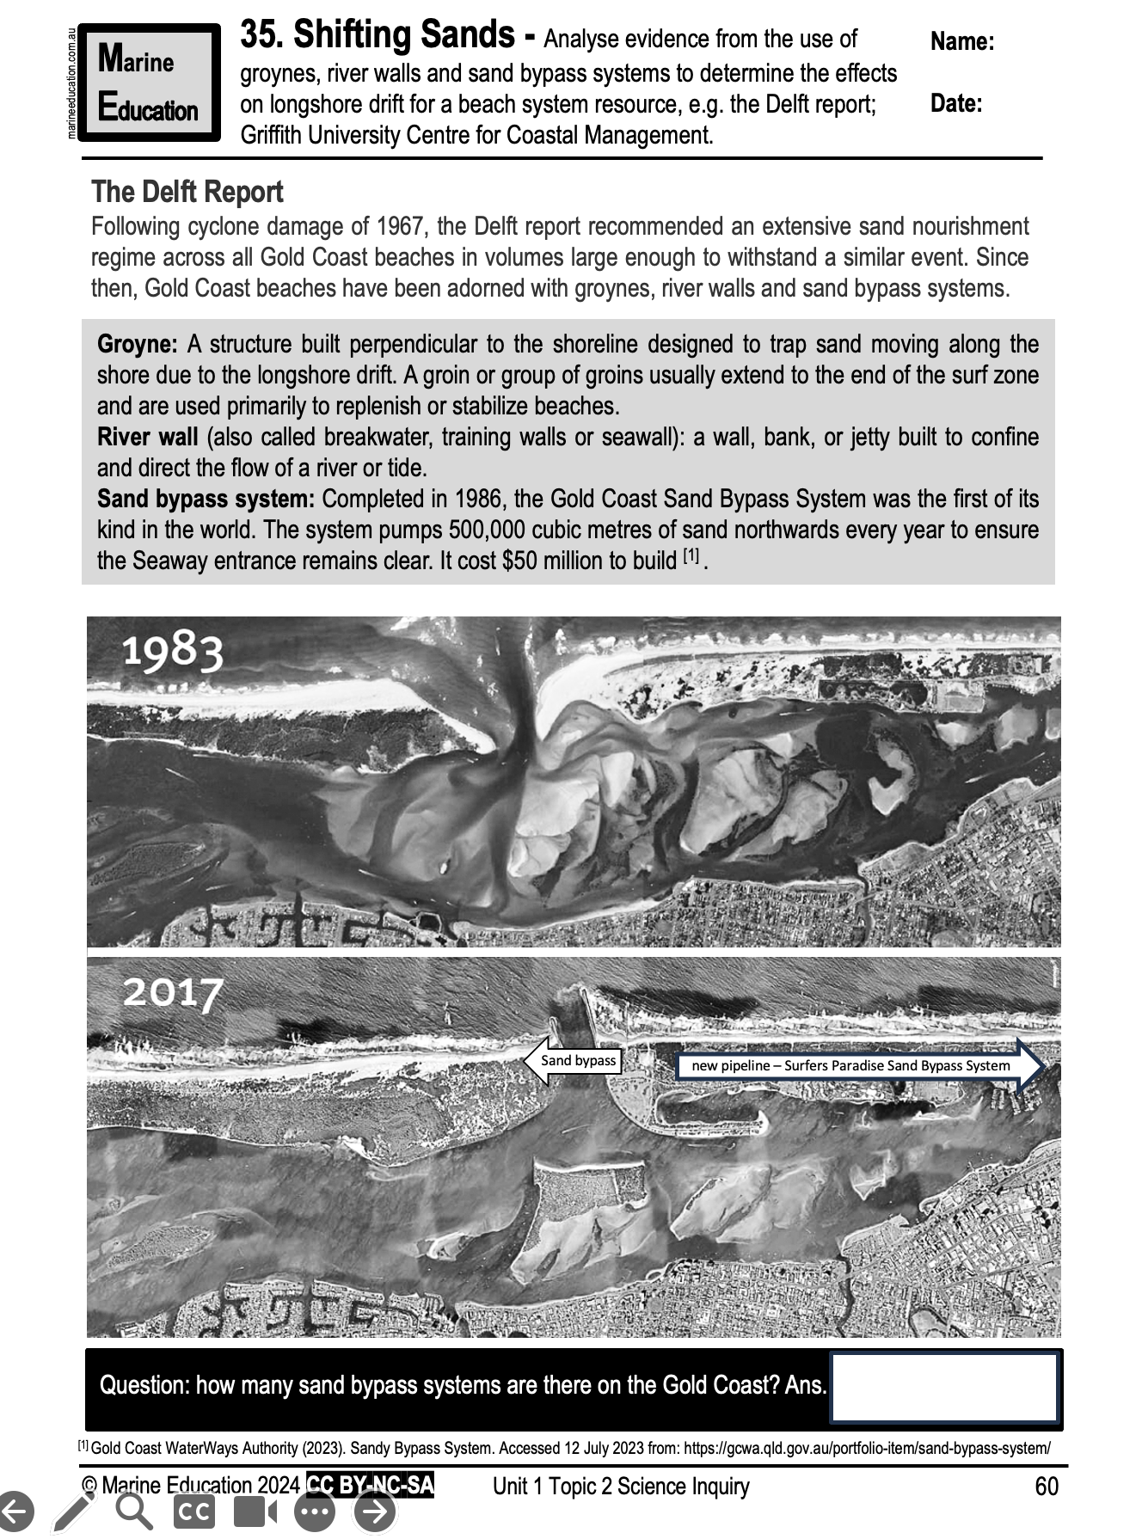
Learning Intention:
Analyse evidence from the use of groynes, river walls and sand bypass systems to determine the effects on longshore drift for a beach system resource, e.g. the Delft report; Griffith University Centre for Coastal Management.
Success Criteria:
Complete Marine Education worksheet ’34. Shifting Sands’

