Slide 1
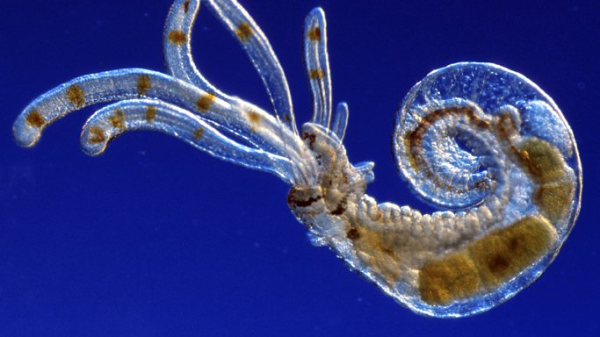
Terebellid worm larvae
Learning Intention:
Describe the implications of connectivity to marine ecosystems, e.g. estuaries, mangroves, seagrass beds.
Success Criteria:
Complete Marine Education worksheet ‘’4. Connect….ivity’
Notes:
Image: https://australian.museum/learn/animals/plankton/zooplankton/

Slide 2
Connectivity is the process by which local marine populations recruit larvae from distant sources via the currents that connect one part of the ocean with another.
It is essential for maintaining the genetic diversity and resilience of these populations.
Notes:
Source:: AIMS
More info: https://reefresilience.org/management-strategies/marine-protected-areas-2/resilient-mpa-design/connectivity/

Slide 3
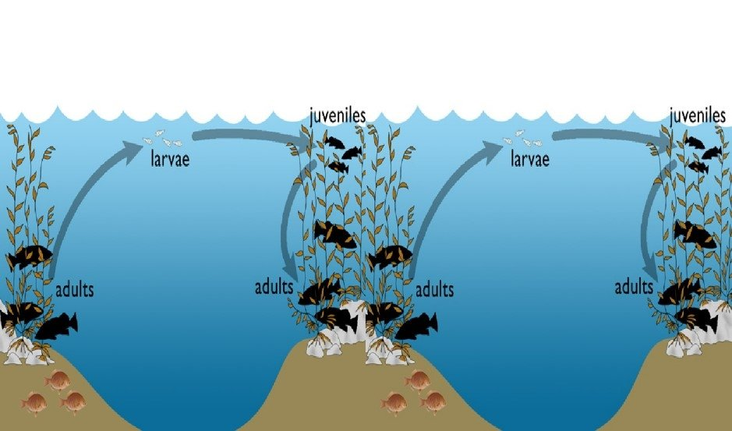

Slide 4
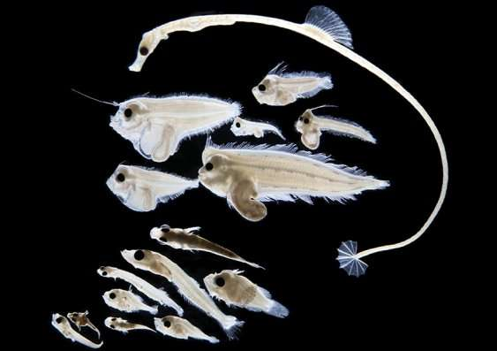
Notes:
Image: https://phys.org/news/2018-10-larval-fish-database-effects-climate.html

Slide 5
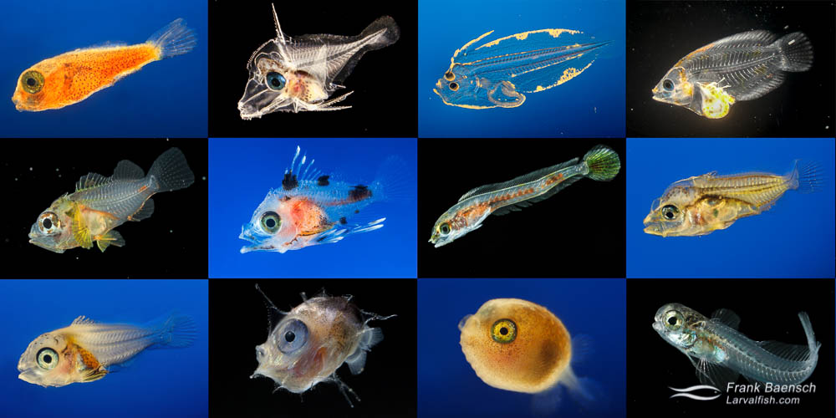
Notes:
Image: https://www.frankbaensch.com/marine-aquarium-fish-culture/my-research/larval-fish-project/

Slide 6
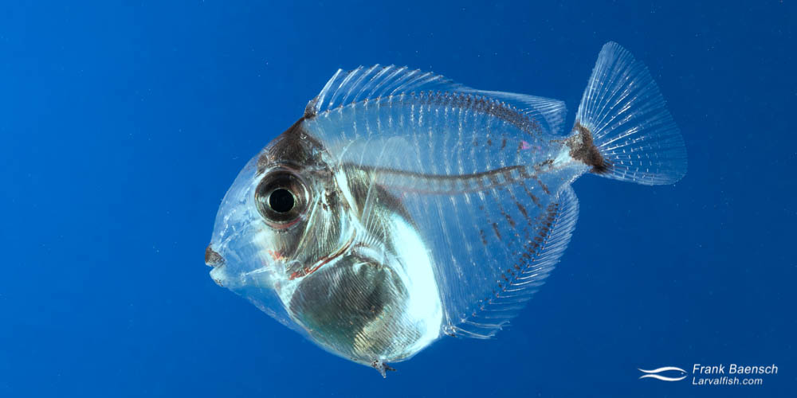
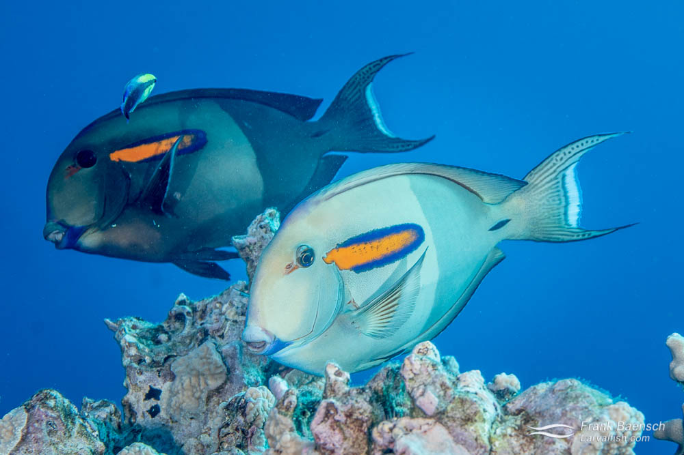
Orange band Surgeonfish larvae (Acanthurus olivaceus) drift for 130 days
Notes:
Image: https://www.frankbaensch.com/marine-aquarium-fish-culture/my-research/larval-fish-project/

Slide 7
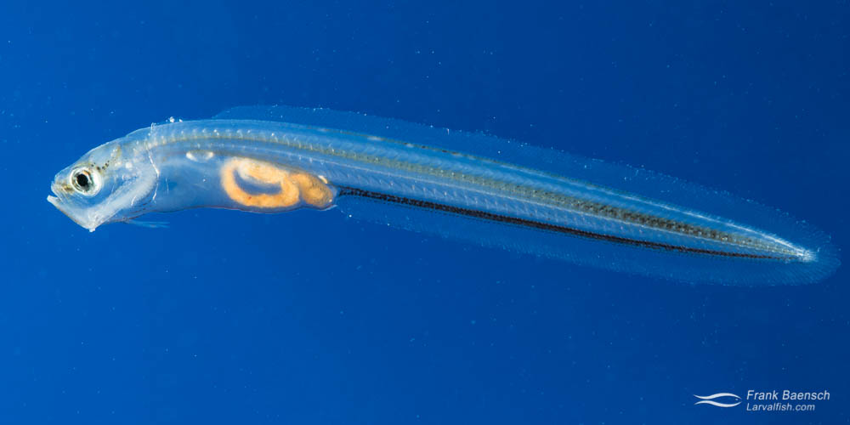
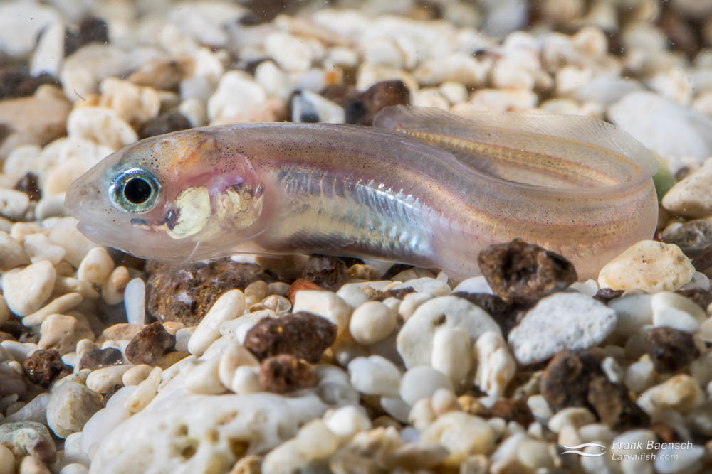
Blackedge cusk larvae (Ophidion muraenolepis) drift for 34 days
Notes:
Image: https://www.frankbaensch.com/marine-aquarium-fish-culture/my-research/blackedge-cusk-eel-culture/

Slide 8
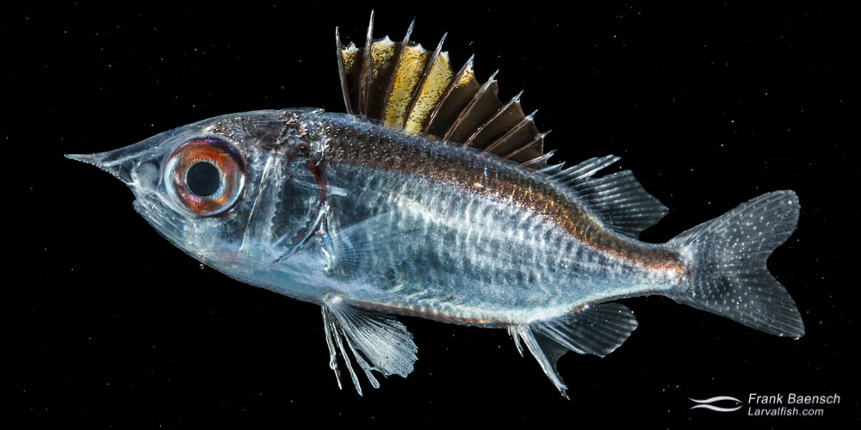
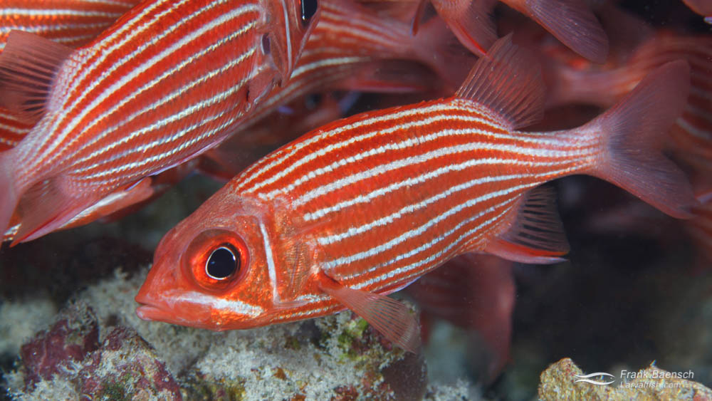
Squirrelfish larvae (Sargocentron xantherythrum) drift for 50 days

Slide 9
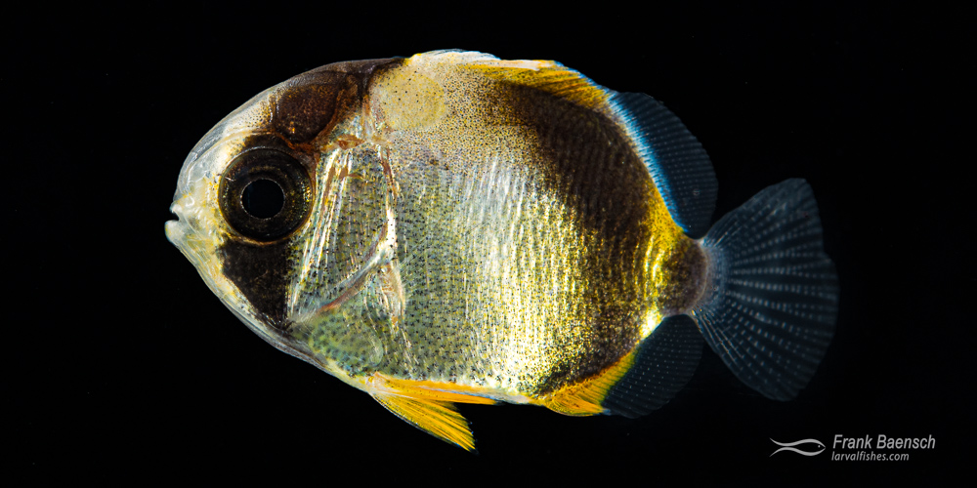
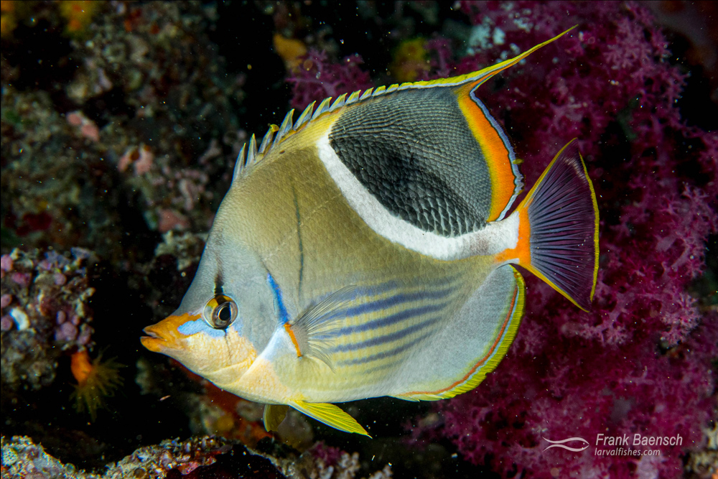
Saddleback butterflyfish (Chaetodon ephippium) drift for 68 days
Notes:
Image:https://www.frankbaensch.com/marine-aquarium-fish-culture/my-research/saddled-butterflyfish-culture/

Slide 10
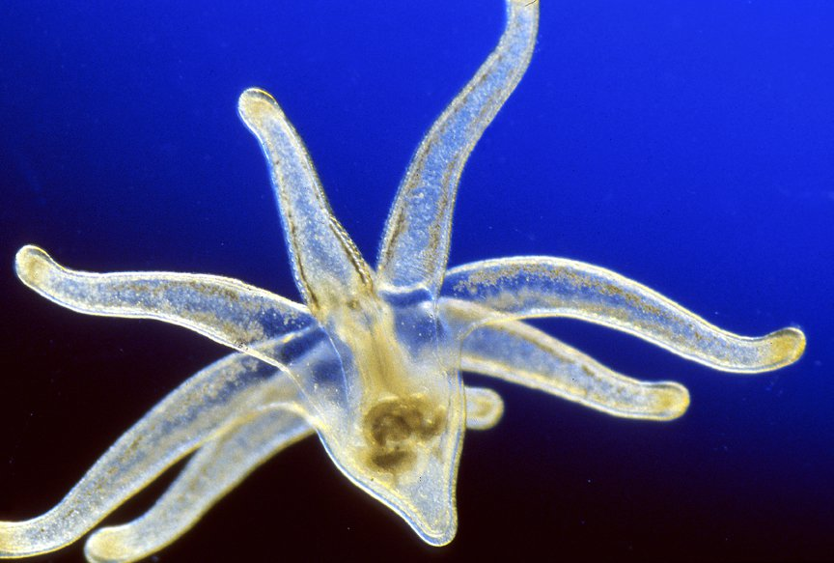
Tube anemone larvae
Notes:
Image: https://australian.museum/learn/animals/plankton/meroplankton/

Slide 11
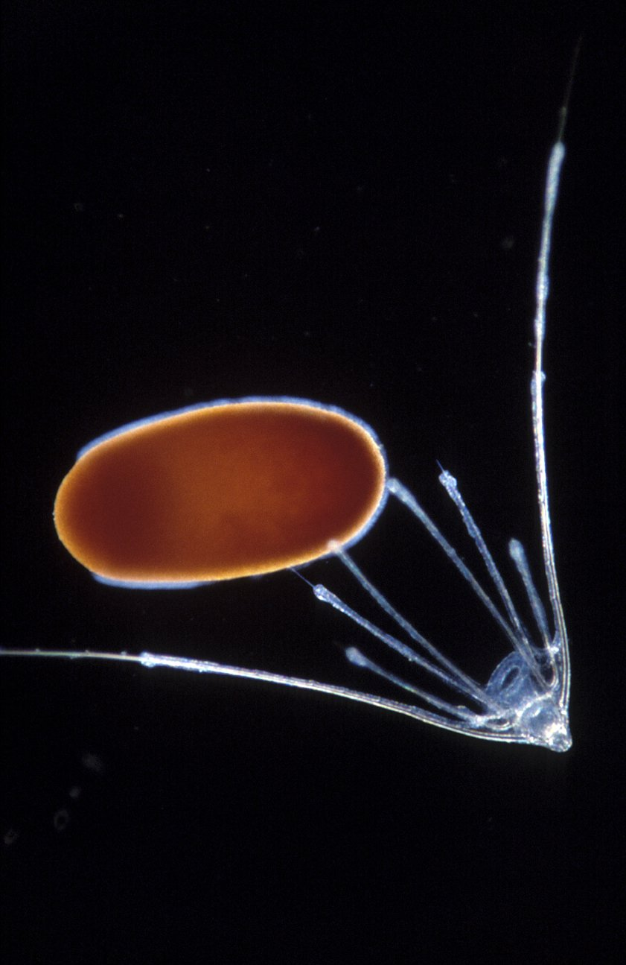
Brittle Star and Coral larvae

Slide 12
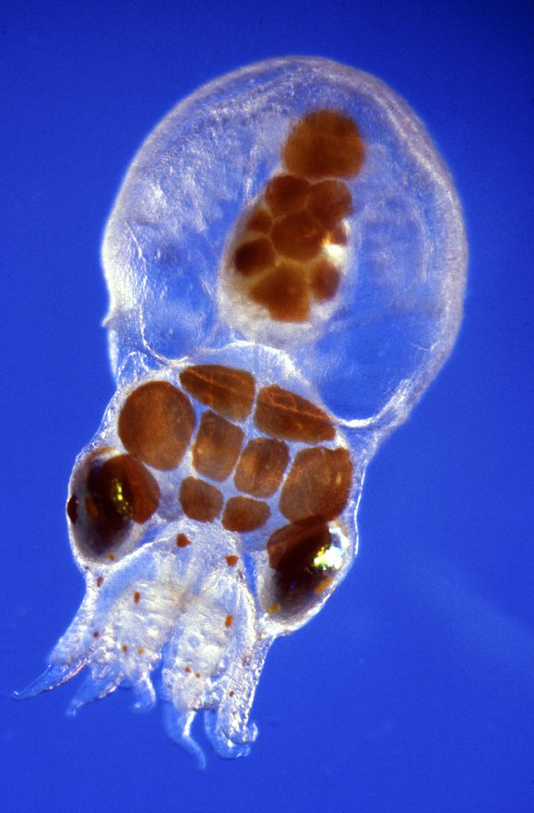
Octopus larvae
Notes:
Image: https://australian.museum/learn/animals/plankton/meroplankton/

Slide 13
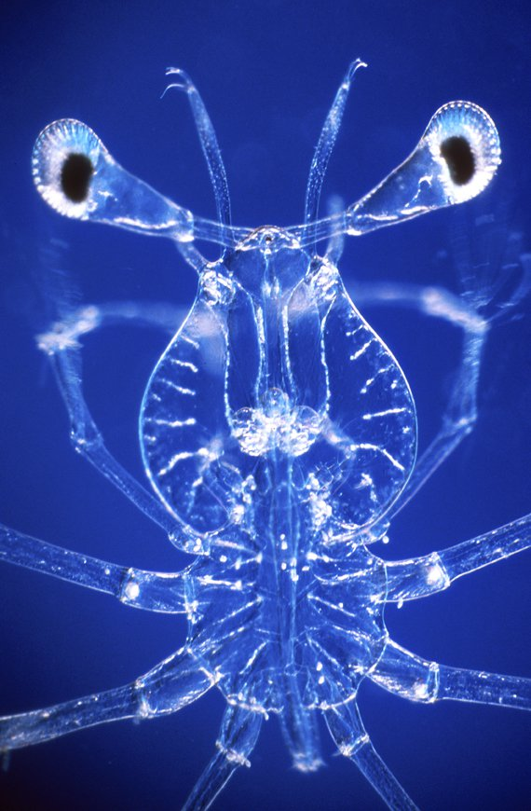
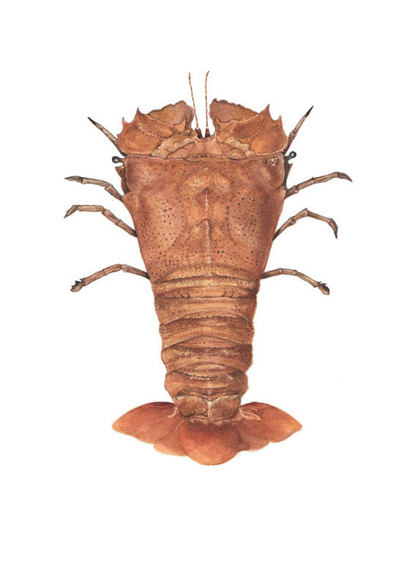
Slipper Lobster larvae
adult

Slide 14
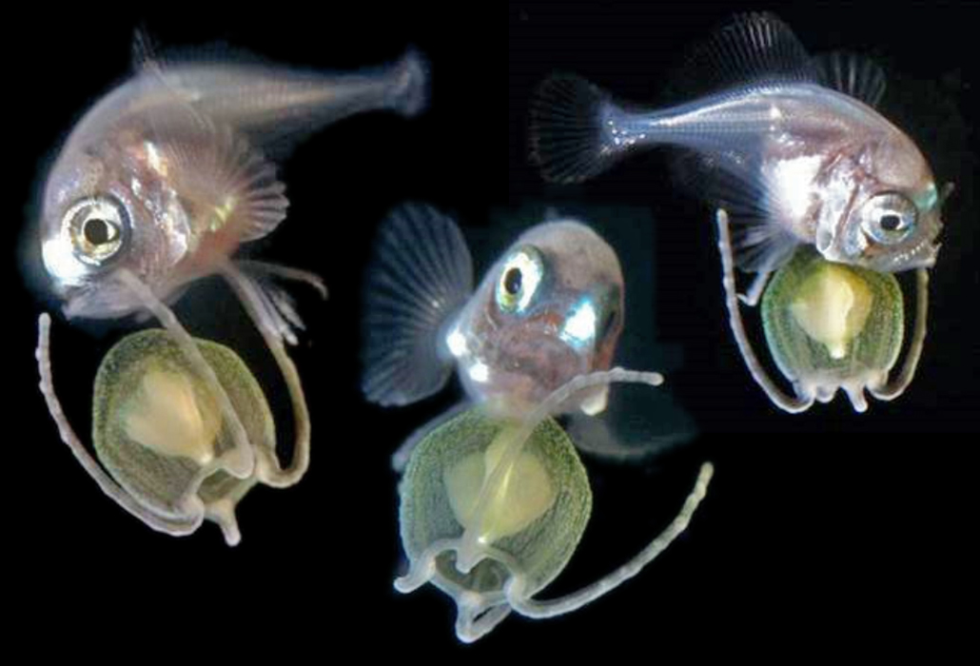
A Pacific pomfret (Brama orcini) larva (pictured from 3 angles) in the ocean, riding a jellyfish.
Notes:
Image: https://www.sciencenews.org/article/underwater-photos-deep-sea-fish-larvae-capture-new-views-detail

Slide 15
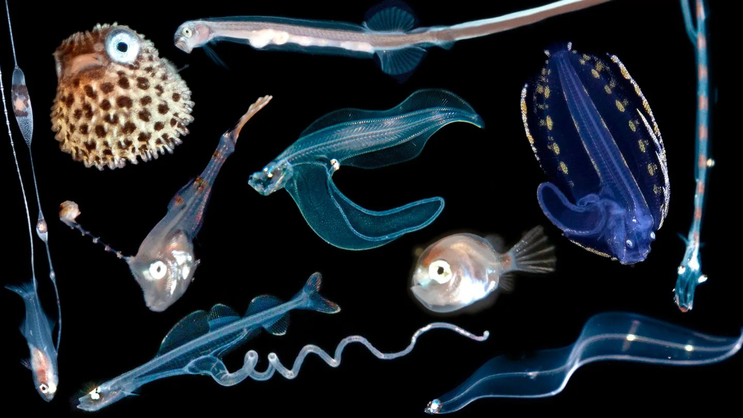
Notes:
Image: https://www.sciencenews.org/article/underwater-photos-deep-sea-fish-larvae-capture-new-views-detail

Slide 16
Larvae development of mud crab from Zoea to crablet stages
Notes:
Image: https://www.researchgate.net/figure/Larvae-development-of-mud-crab-from-Zoea-to-Crablet-stages_fig1_349156246

Slide 17
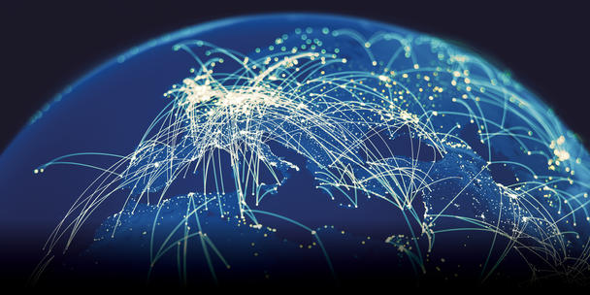
Connectivity

Slide 18
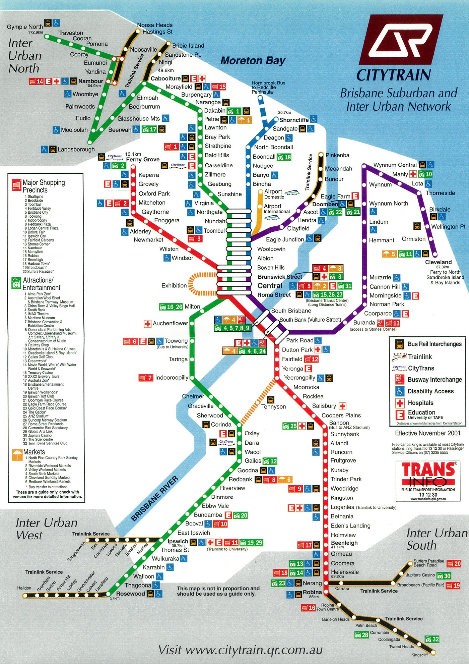
Think of connectivity as a
network of
train stations.

Slide 19
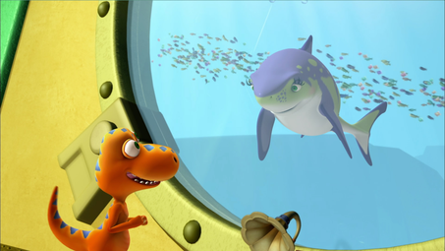
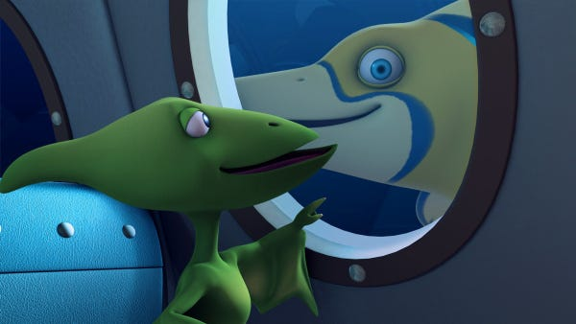
The water currents are the trains.
The larvae are the travelers.
The ecosystems are the stations.
The environmental managers are security.

Slide 20
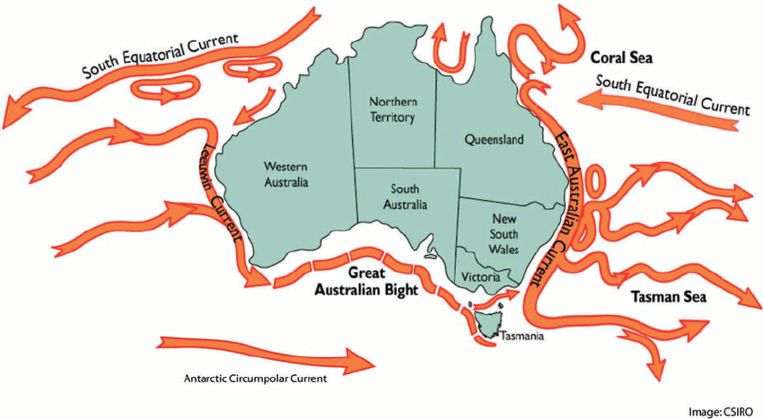
The ‘trains’
Notes:
Image: https://www.researchgate.net/figure/Oceanic-and-coastal-currents-of-Australia_fig1_230666486

Slide 21
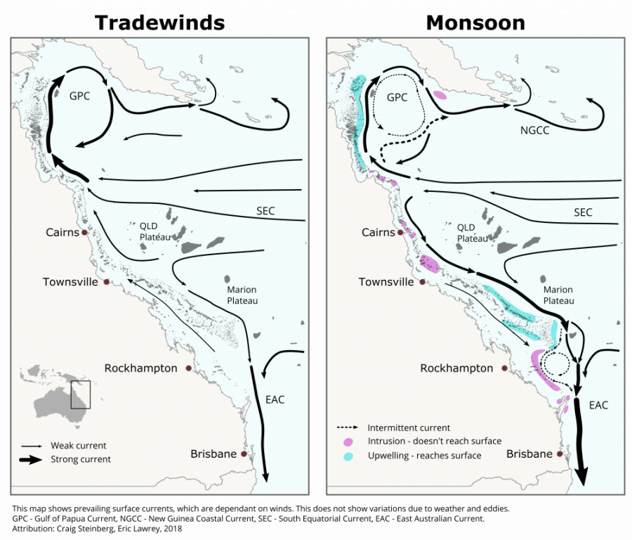
Trade winds
Monsoon season
Timetables change

Slide 22
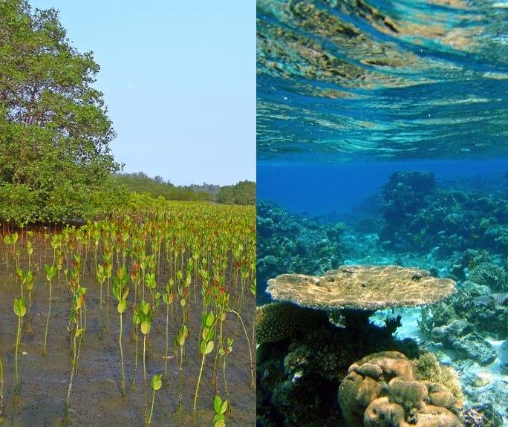
The ecosystems are the ‘stations’

Slide 23
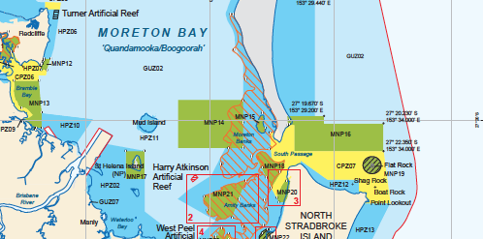
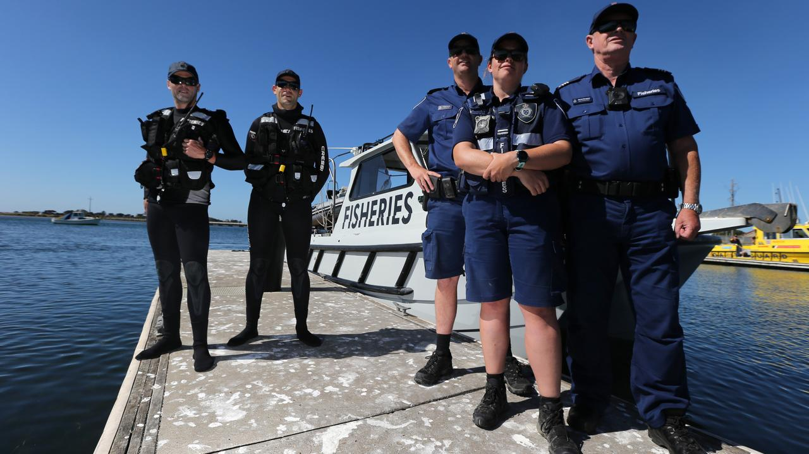
The environmental managers are security

Slide 24
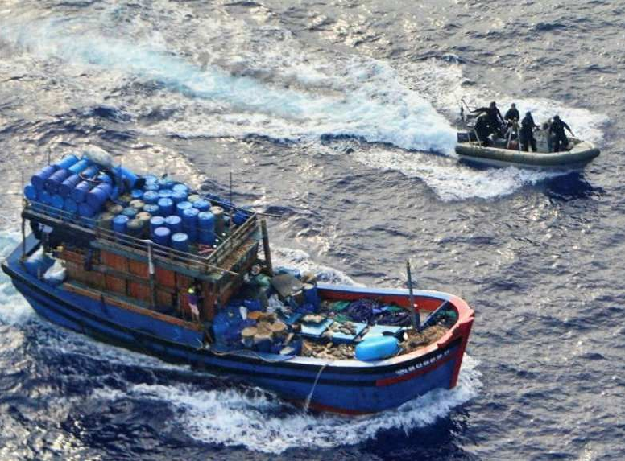
so passengers can reach their destinations safely

Slide 25
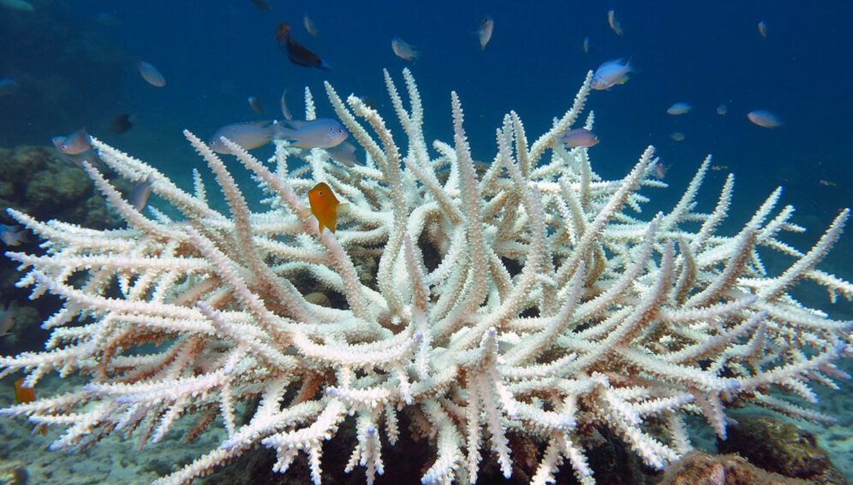
To help save (re-seed) a dying reef

Slide 26
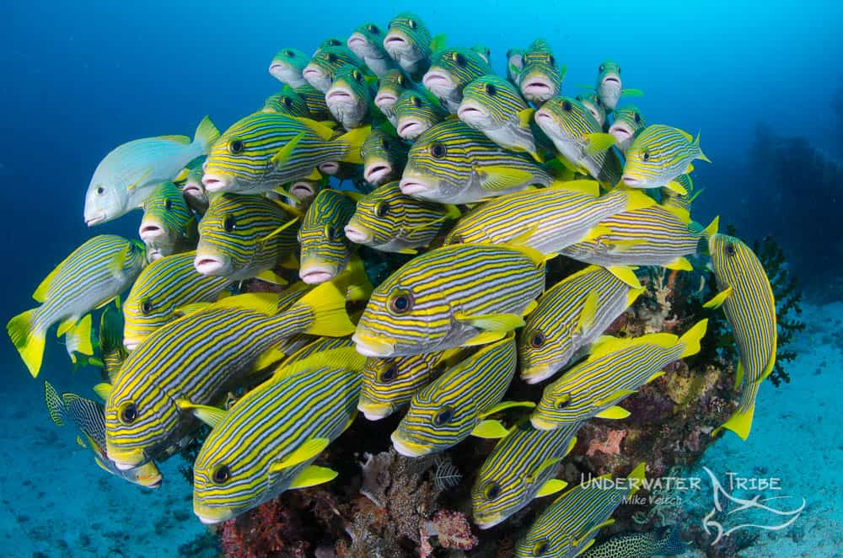
and maintain healthy ones
Notes:
Image: https://www.underwatertribe.com/tutorial/how-to-shoot-schooling-fish/

Slide 27
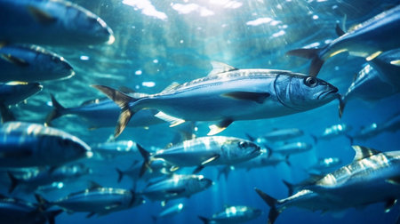
Notes:
Image: https://www.123rf.com/stock-photo/pelagic_fish.html

Slide 28
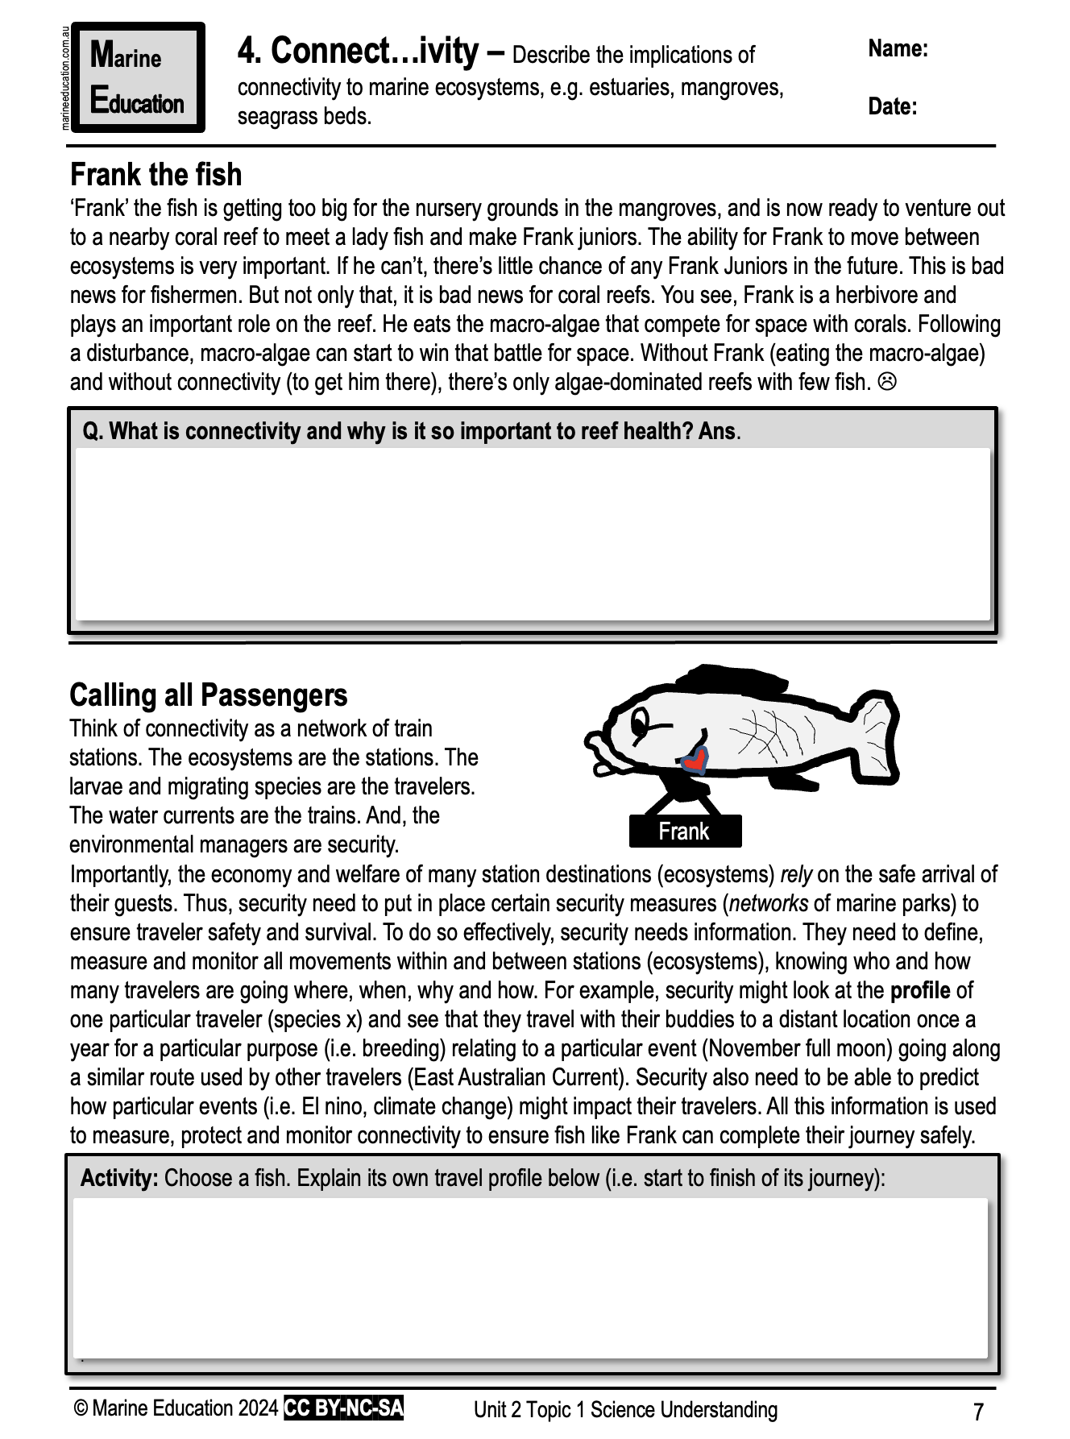
Terebellid worm larvae
Learning Intention:
Describe the implications of connectivity to marine ecosystems, e.g. estuaries, mangroves, seagrass beds.
Success Criteria:
Complete Marine Education worksheet ‘’4. Connect….ivity’
Notes:
Image: https://australian.museum/learn/animals/plankton/zooplankton/

