Slide 1
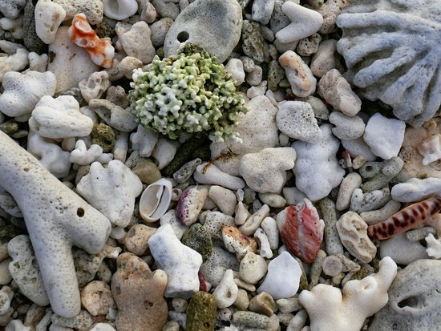
Learning Intention:
Describe how wave action, wind and longshore drift influence the movement of water, nutrients, sand, sediment and pollutants, e.g. oil spills, debris.
Success Criteria:
Complete Marine Education worksheet ‘5. All aboard’
Notes:
https://www.youtube.com/watch?app=desktop&v=loRr97fOWdg

Slide 2
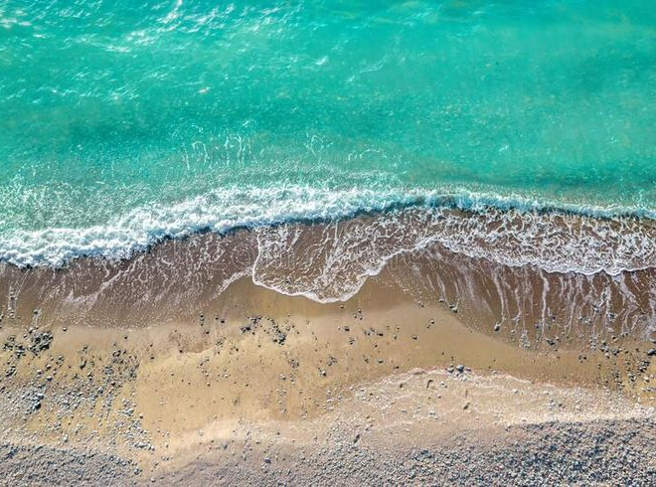
Particles in the ocean include sediment…

Slide 3
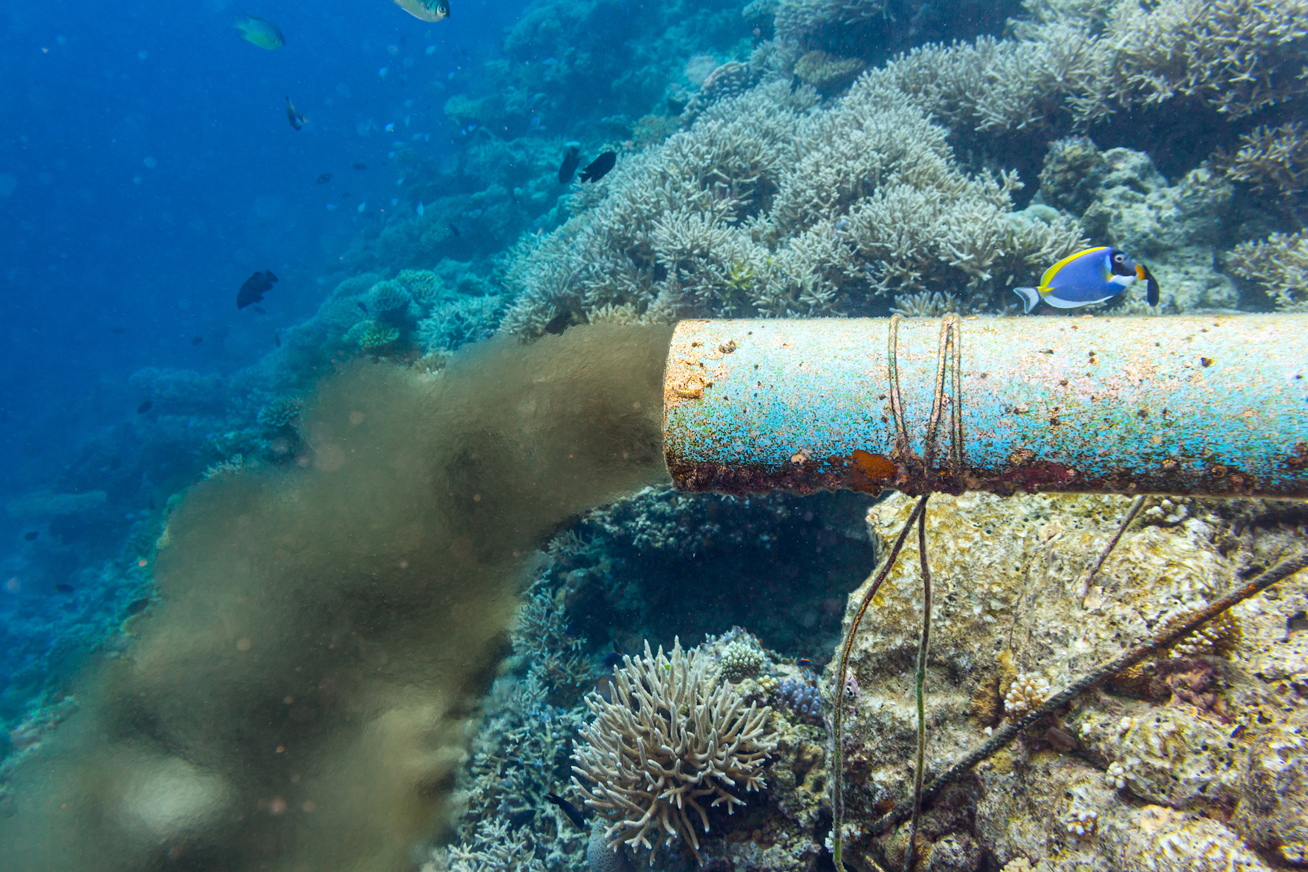
pollutants…

Slide 4
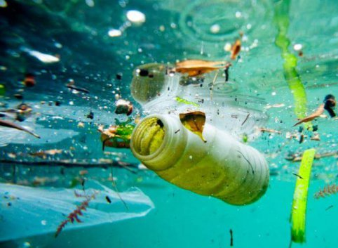
marine debris…

Slide 5
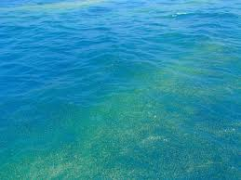
…and dissolved nutrients.

Slide 6
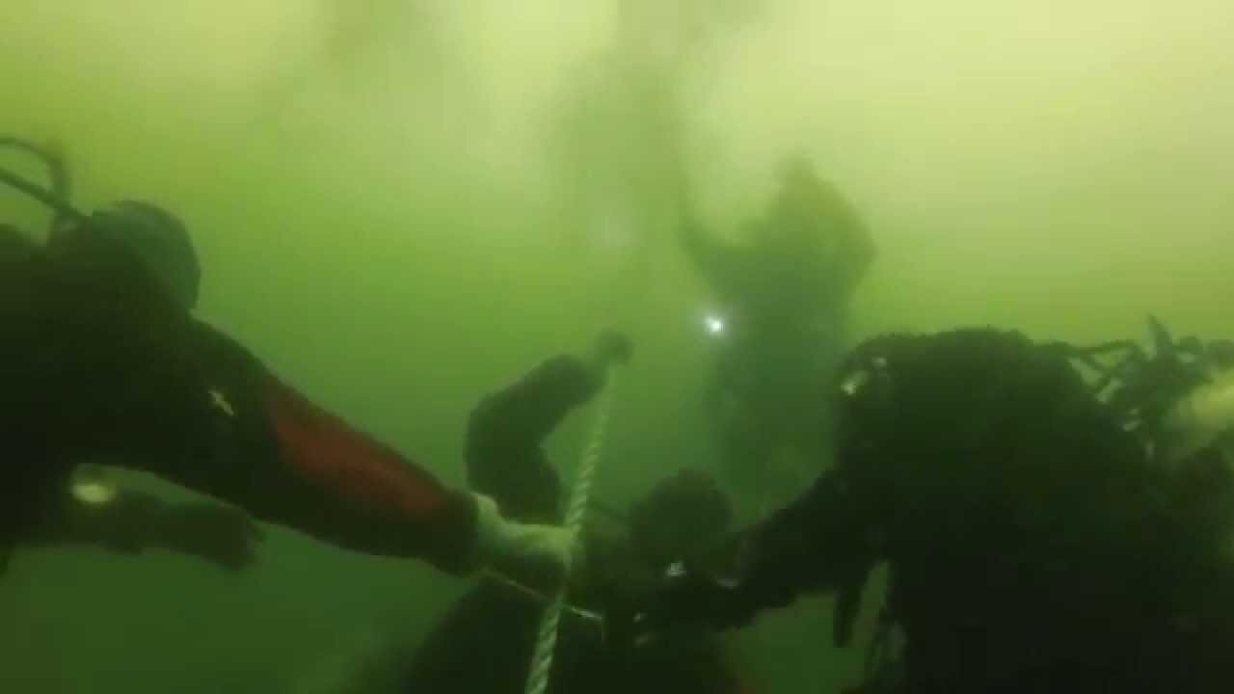

Slide 7
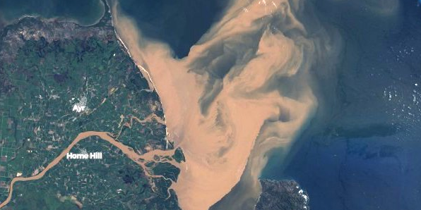
Particles travel down-stream

Slide 8
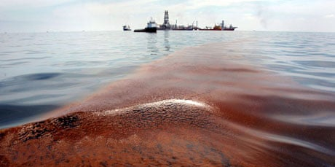
Particles travel down-wind and down-current
Oil spill

Slide 9
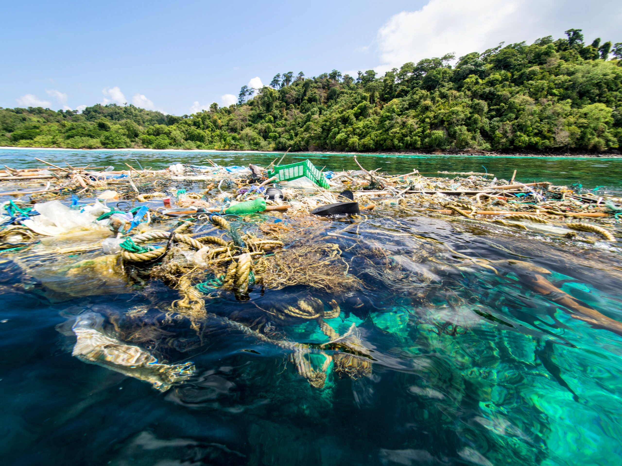
They either float…

Slide 10
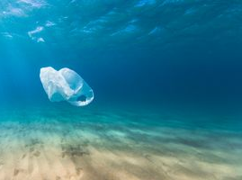
travel as suspended particles…

Slide 11
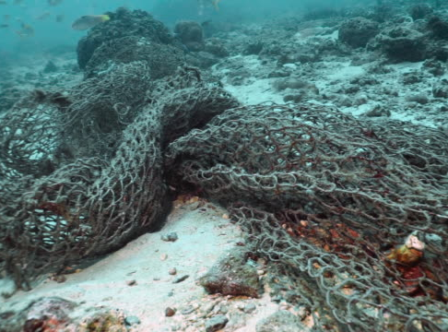
travel as bed load…

Slide 12
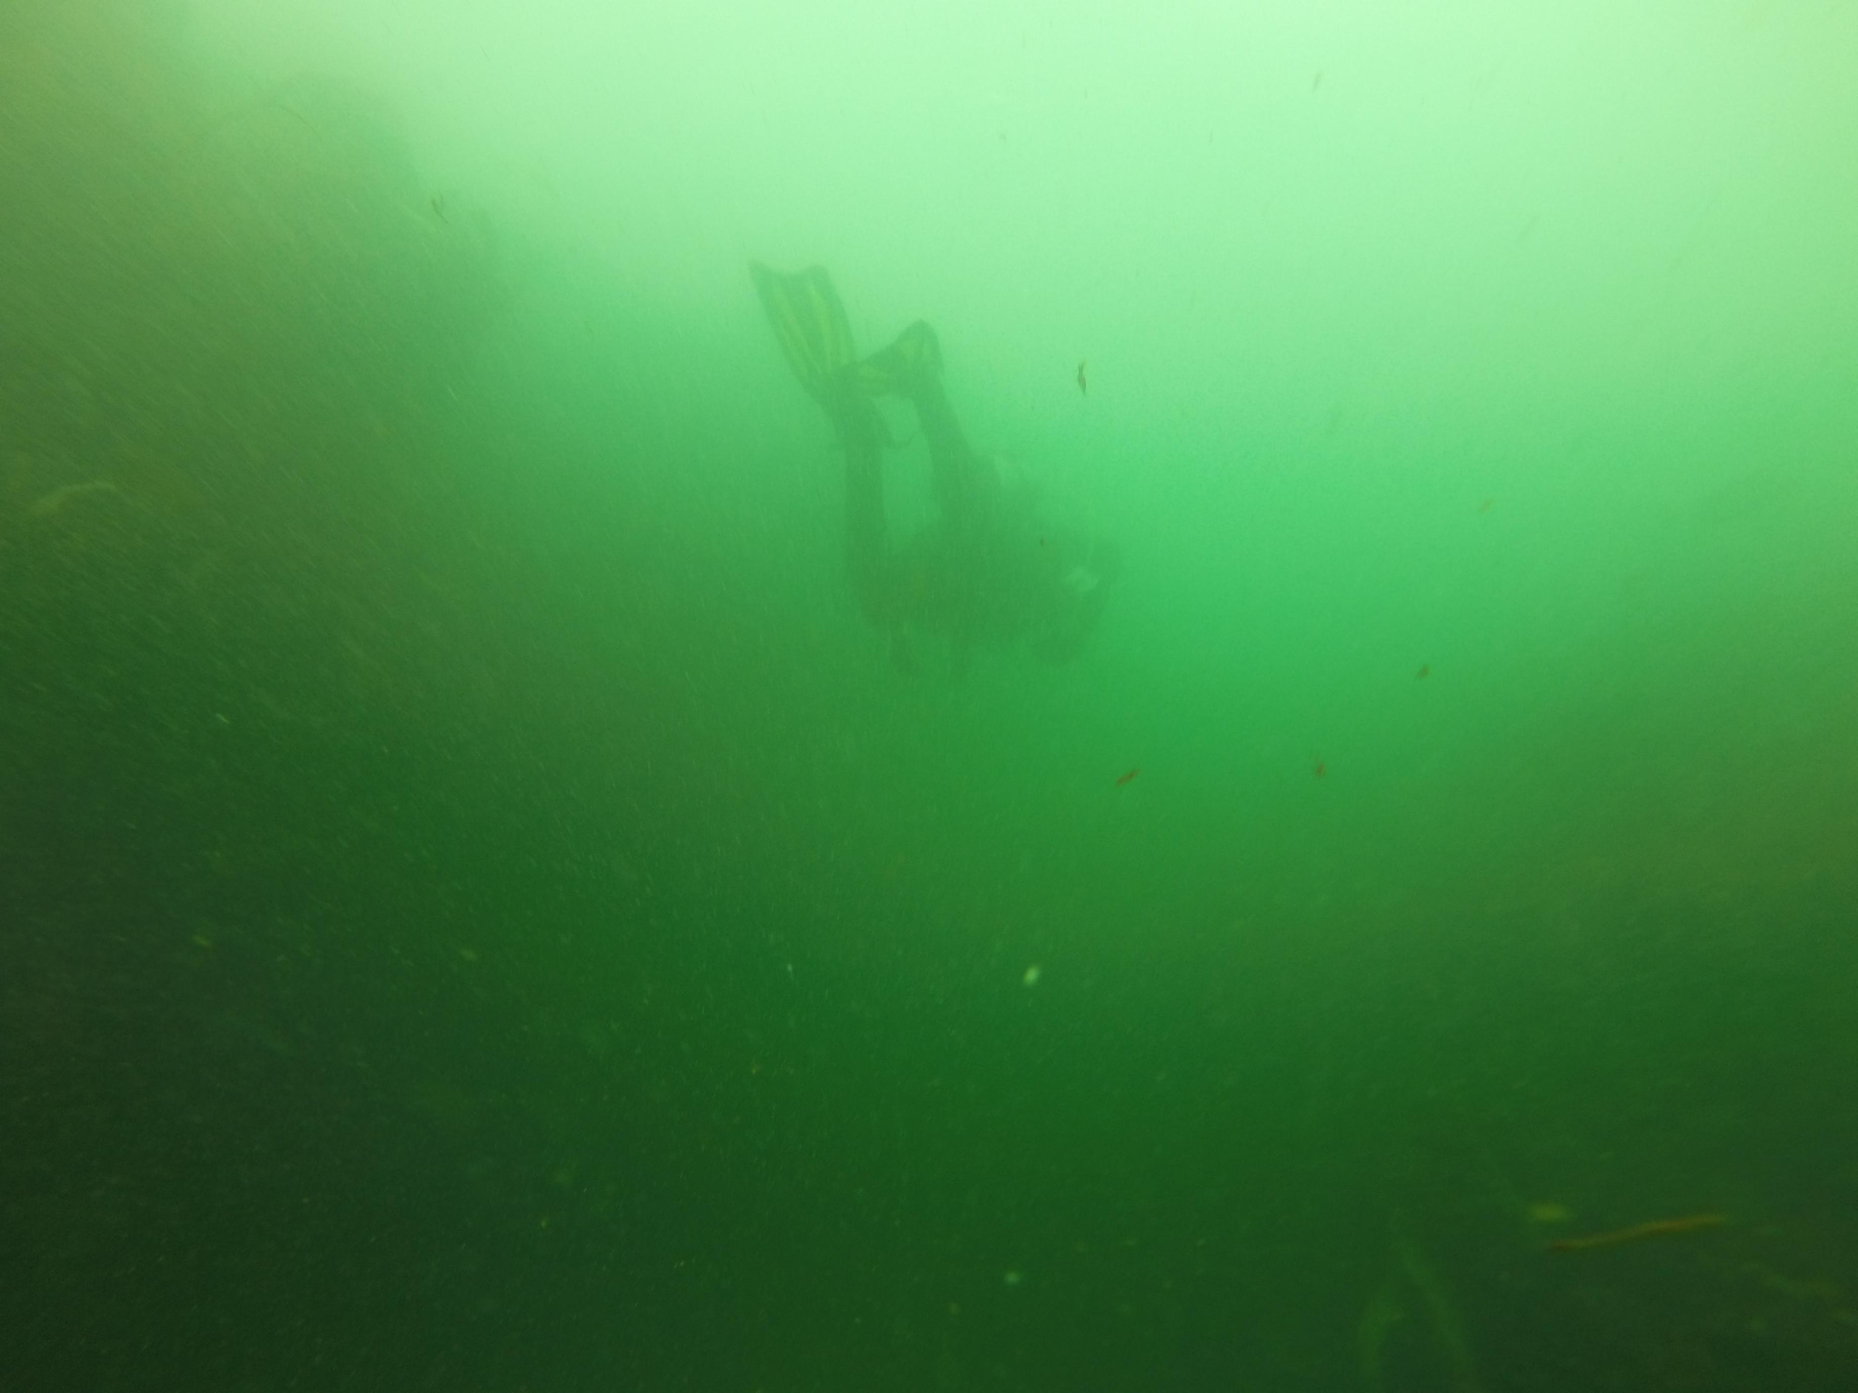
…or as dissolved load.

Slide 13
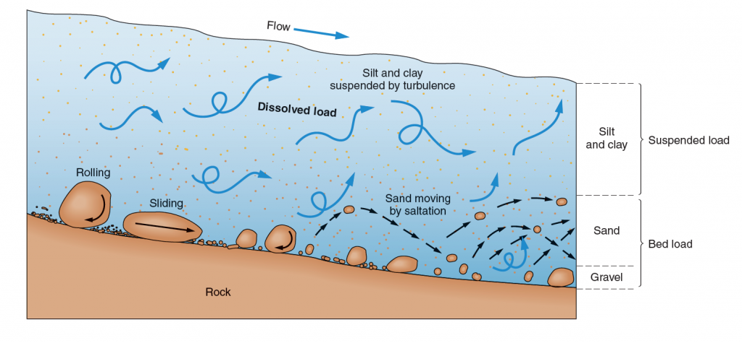
How they travel depends on their size, shape, density and solubility

Slide 14
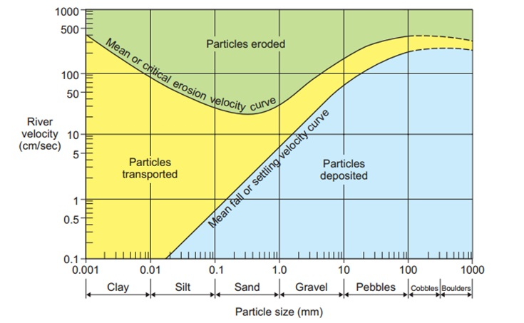
…as well as the energy of the water (wave, wind and current strength)
The Hjulstrom Curve which shows the link between sediment size and the velocity needed to erode, transport or deposit particles within a river system.

Slide 15
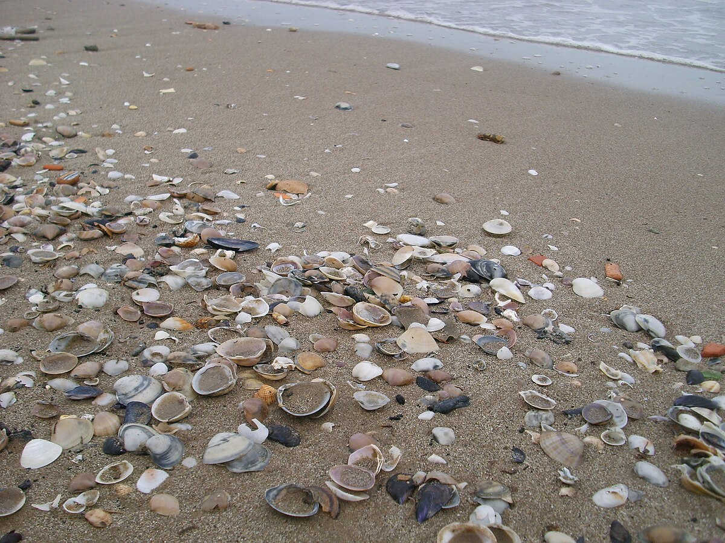
which also determines where they settle
(and can be found)

Slide 16
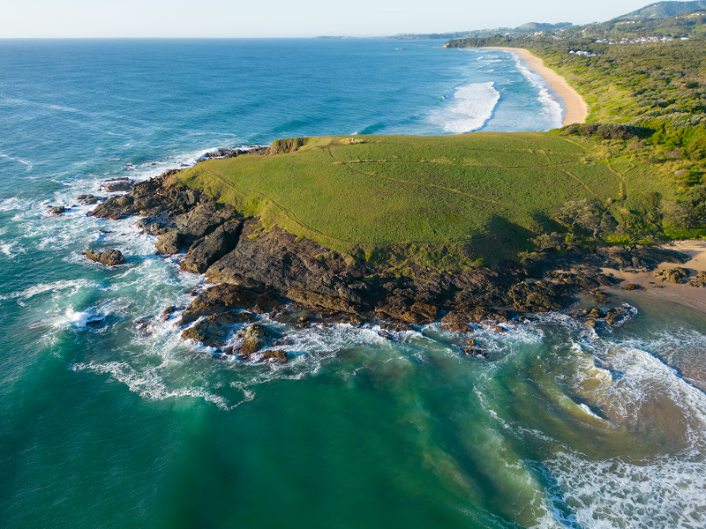
e.g. only heavy particles remain on the bottom in high energy environments

Slide 17
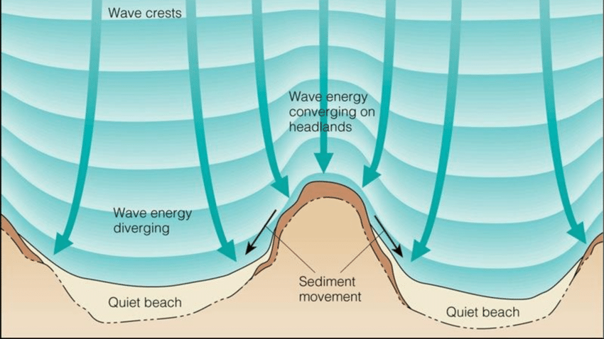

Slide 18
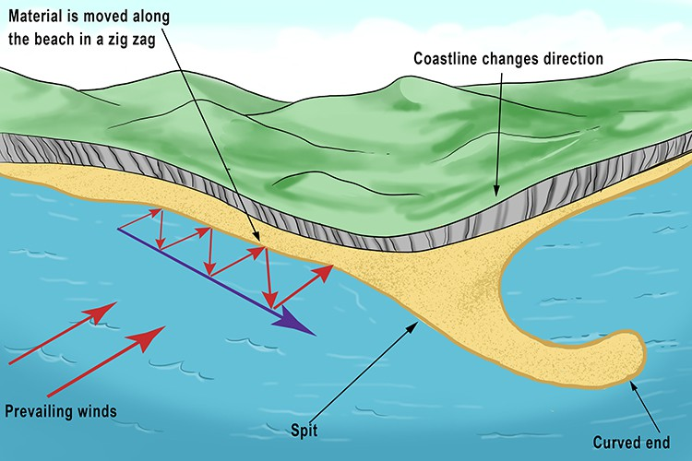
“longshore drift’

Slide 19
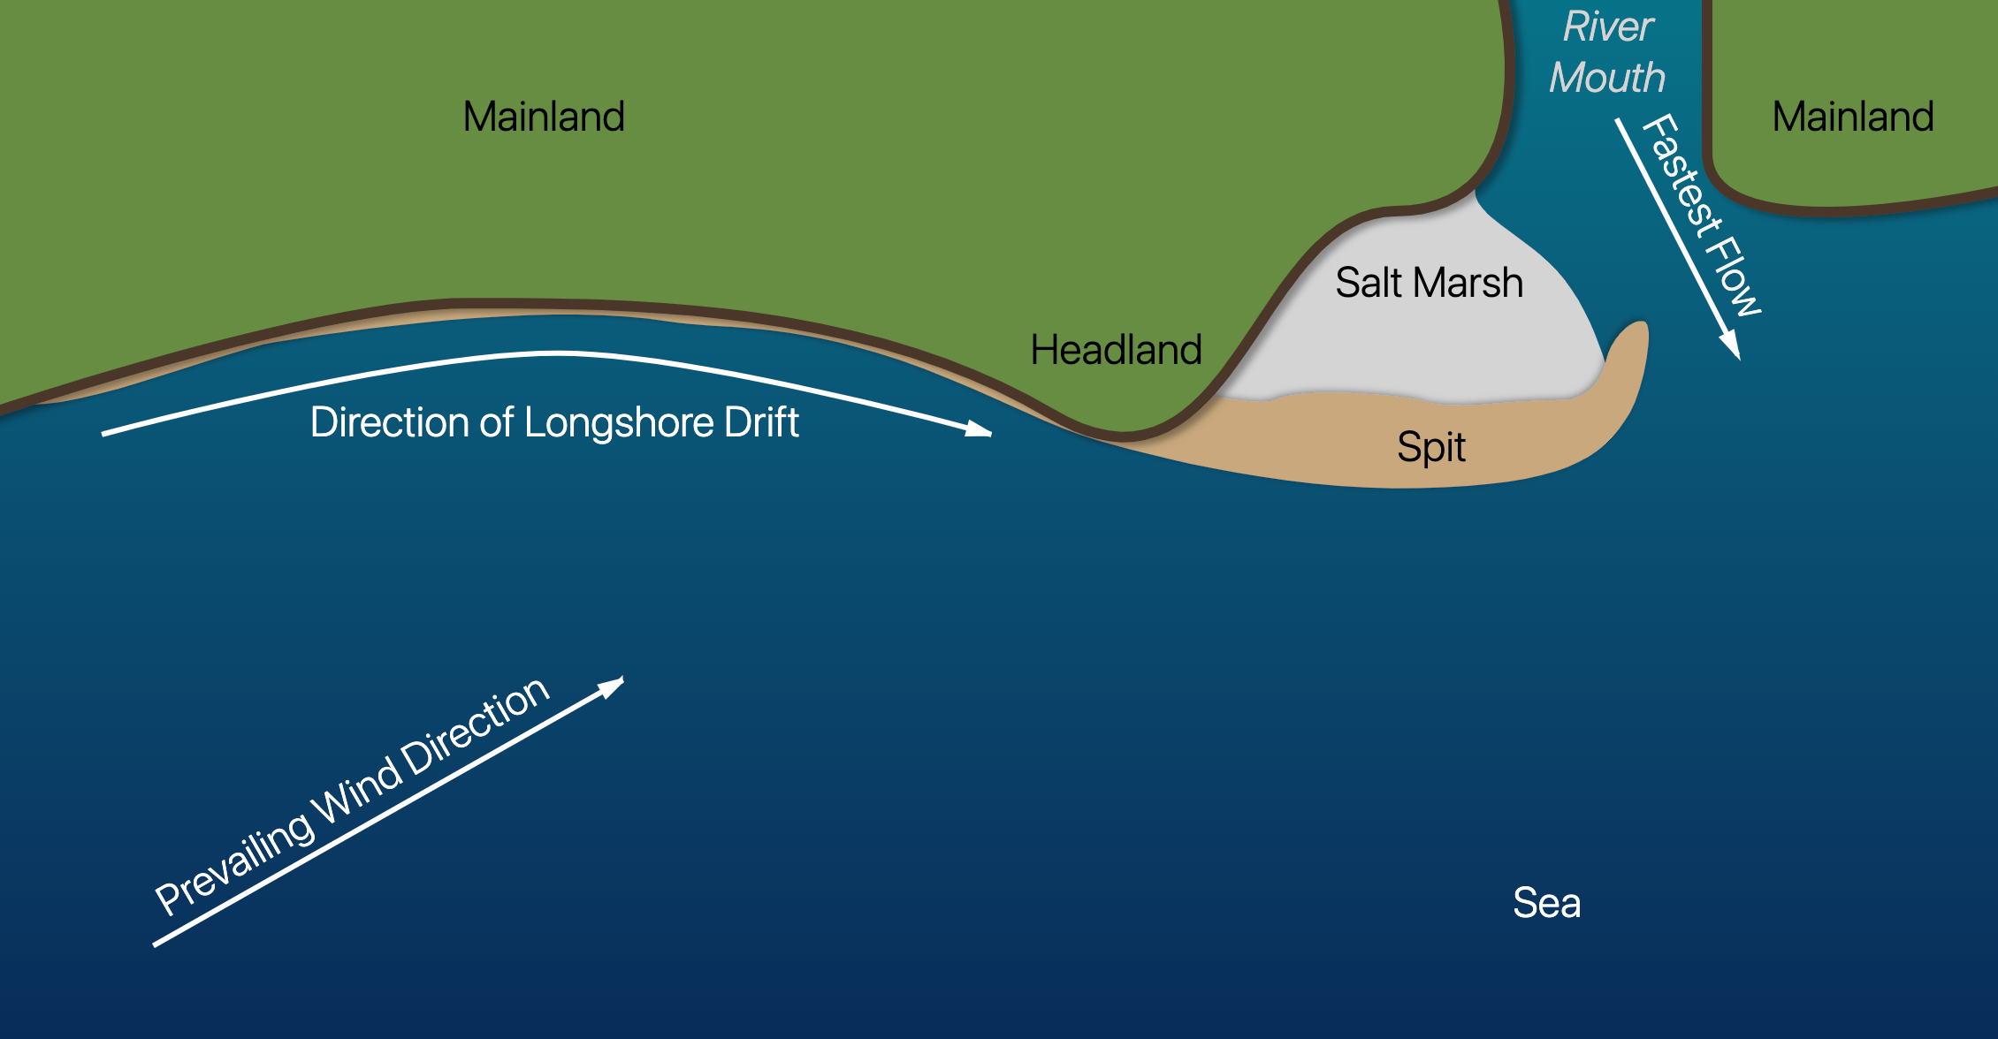
Notes:
https://geographyas.info/coasts/features-of-deposition/

Slide 20
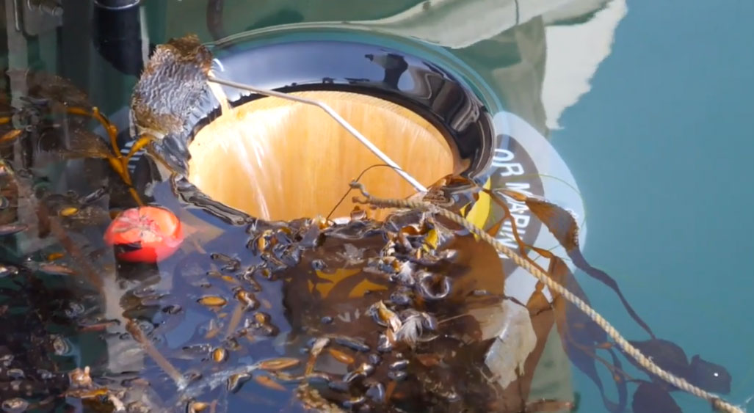
Seabin Project – trapping floating plastics in port
Notes:
https://www.nautilusint.org/en/news-insight/telegraph/seabin-project-trapping-floating-plastics-in-port/

Slide 21
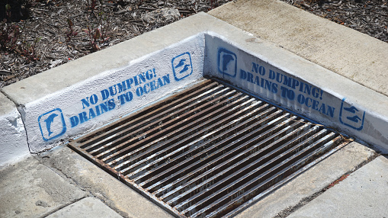

Slide 22
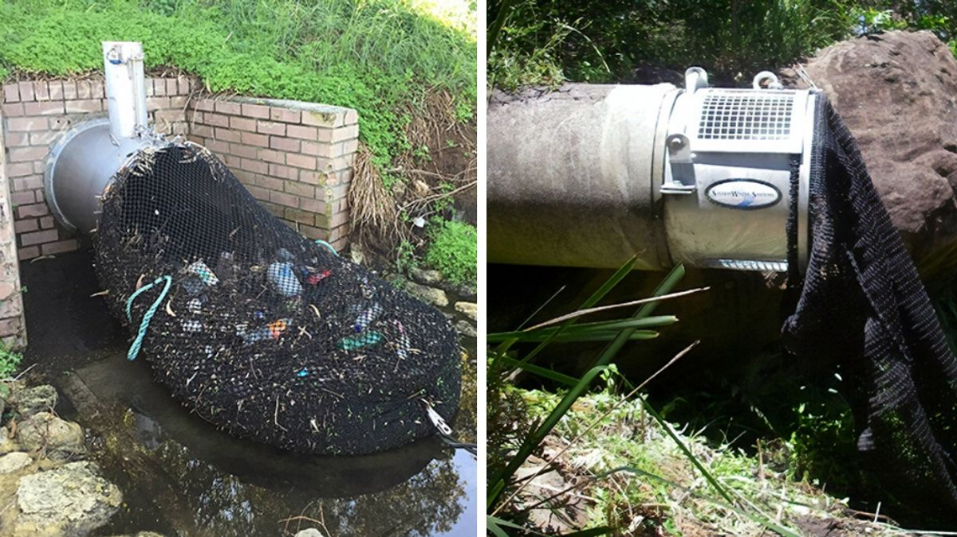
Kwinana has put nets on the outlet of drainage pipes.
Notes:
https://interestingengineering.com/innovation/australian-city-uses-drainage-nets-to-stop-waste-from-polluting-waterways Source: City of Kwinana

Slide 23
Learning Intention:
Describe how wave action, wind and longshore drift influence the movement of water, nutrients, sand, sediment and pollutants, e.g. oil spills, debris.
Success Criteria:
Complete Marine Education worksheet ‘5. All aboard’
Notes:
https://www.youtube.com/watch?app=desktop&v=loRr97fOWdg

Slide 24
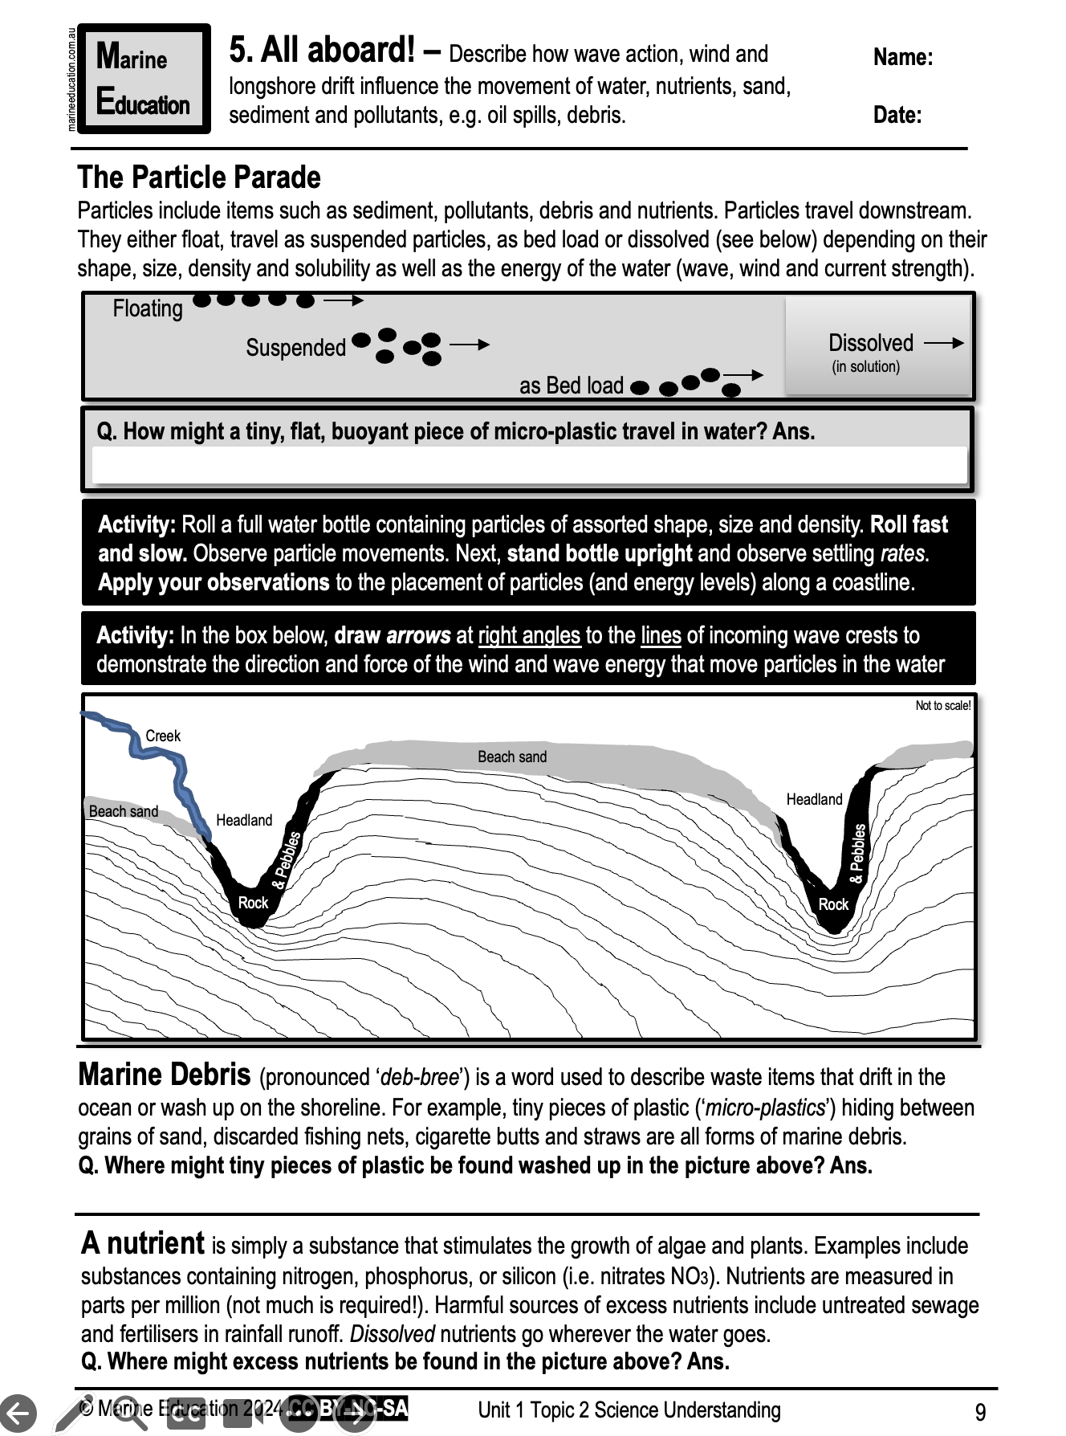
Learning Intention:
Describe how wave action, wind and longshore drift influence the movement of water, nutrients, sand, sediment and pollutants (e.g. oil spills and debris)
Success Criteria:
Complete Marine Education worksheet ‘5. All aboard’
Notes:
https://www.youtube.com/watch?app=desktop&v=loRr97fOWdg

