Slide 1
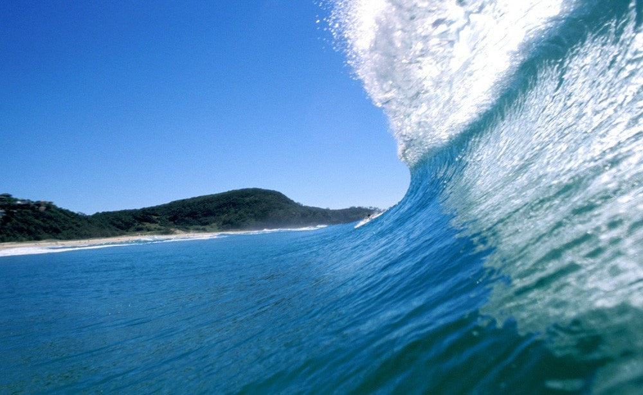
Learning Intention:
Compare accretion and erosion in the processes of coastal erosion
Success Criteria:
Complete Marine Education worksheet ‘6. The Sea-Saw of Sand”
Notes:
https://www.youtube.com/watch?app=desktop&v=loRr97fOWdg

Slide 2
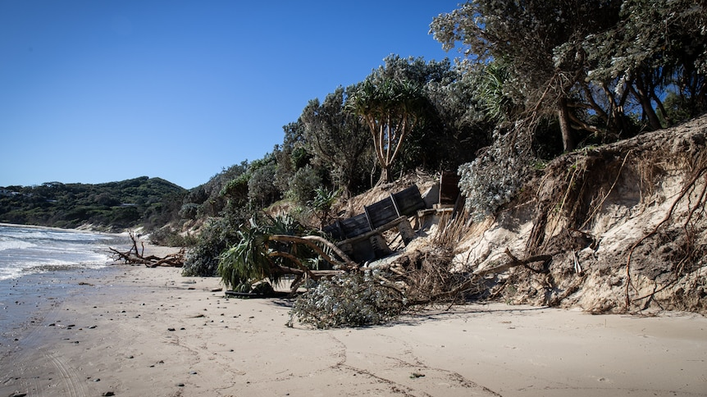
Coastal Erosion – more output of sand than input of sand

Slide 3
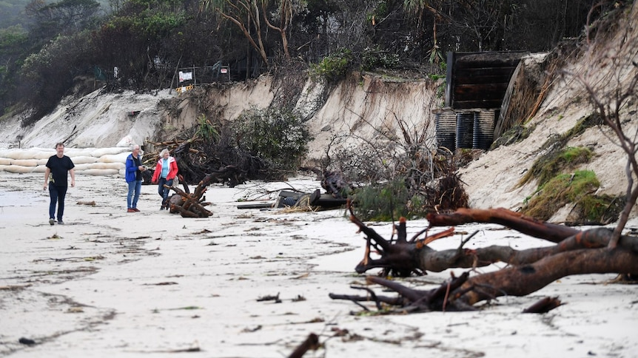

Slide 4
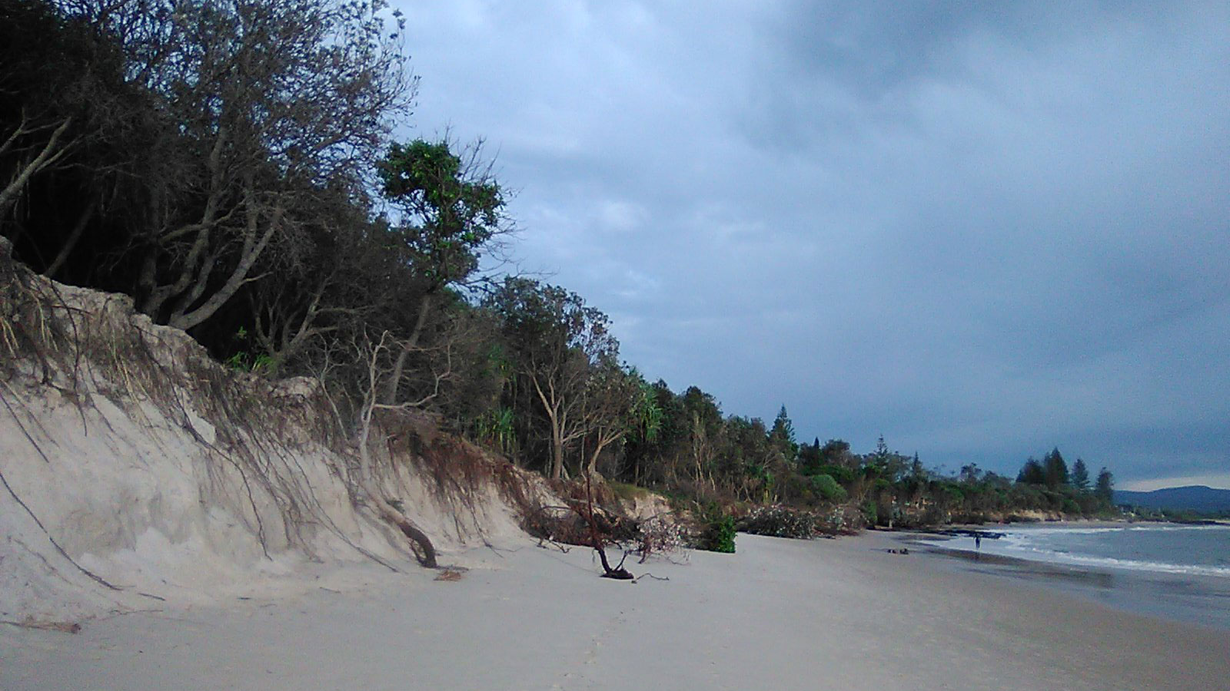

Slide 5
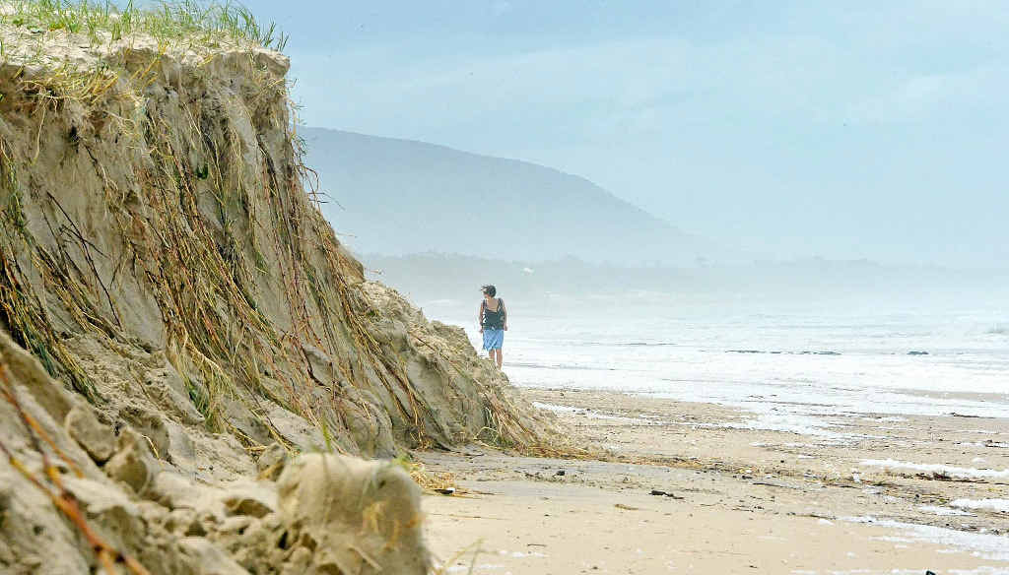

Slide 6
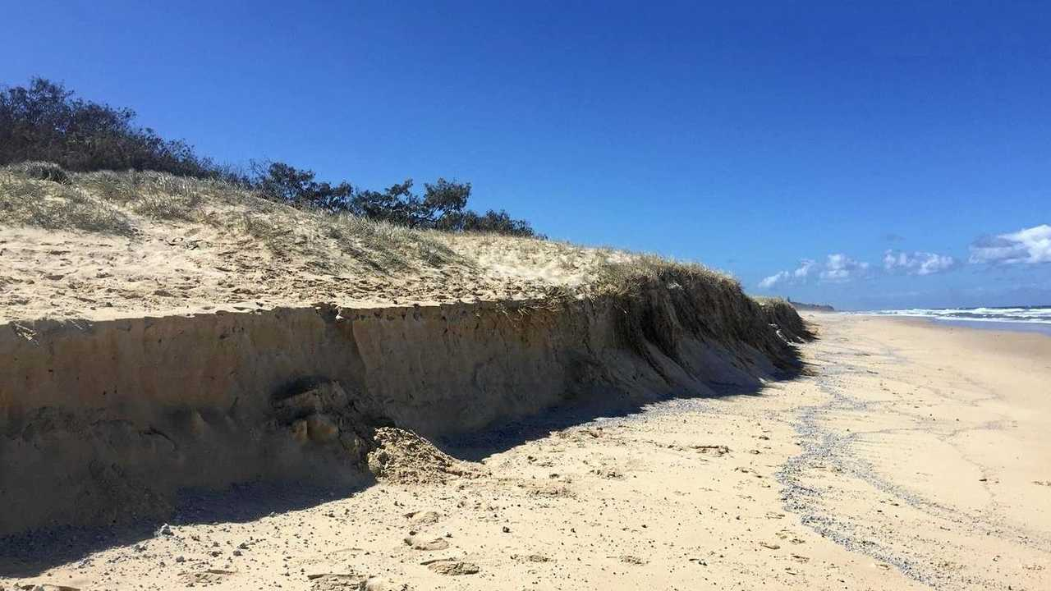

Slide 7
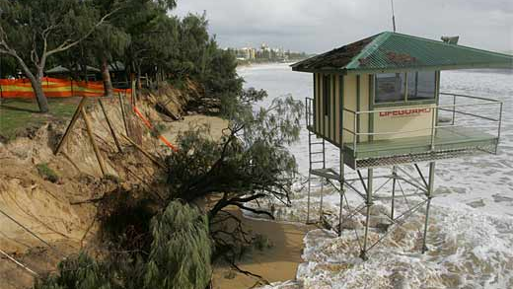

Slide 8
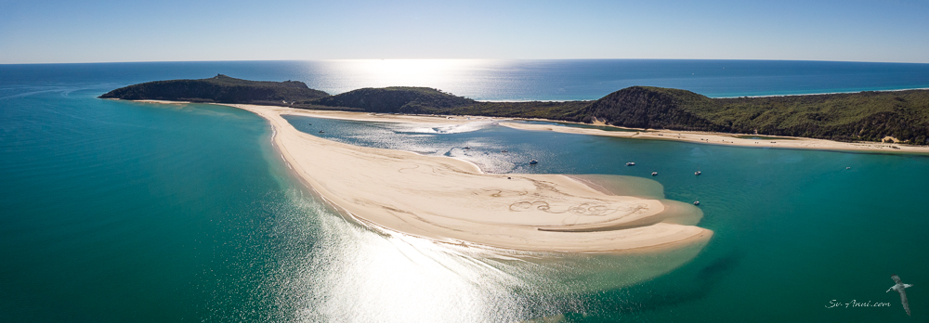
Coastal Accretion – more input of sand than output of sand
Double Island Point (near Rainbow Beach SE Qld)

Slide 9
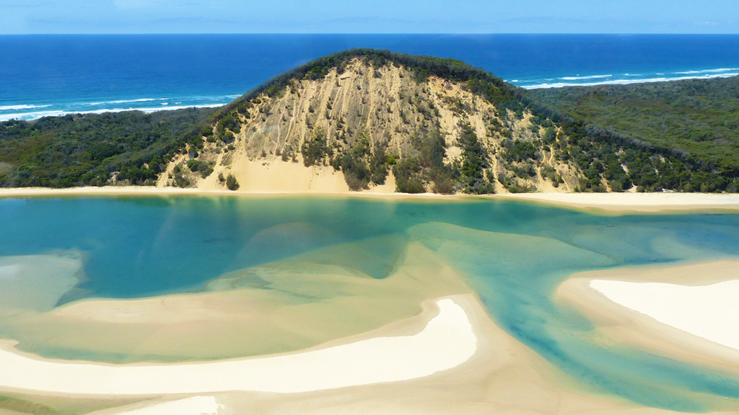

Slide 10
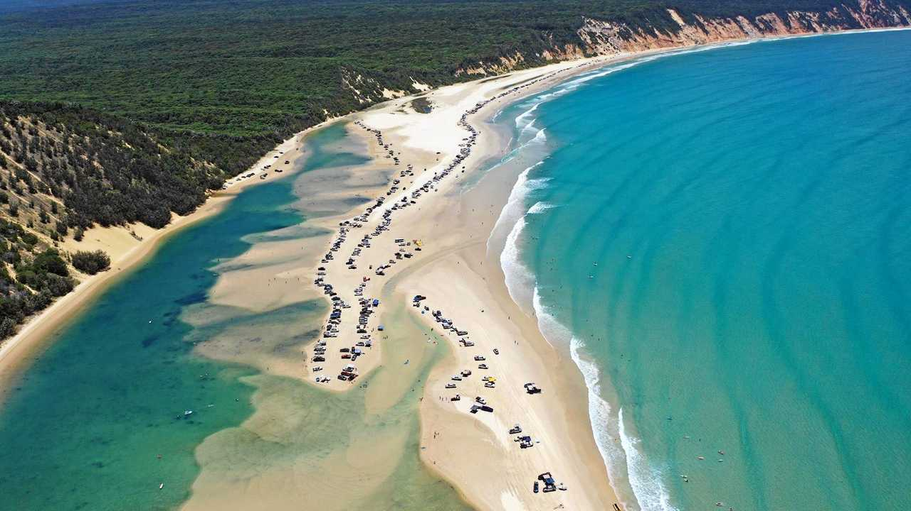

Slide 11
Accretion
“growth or increase by the gradual accumulation of additional layers or matter”

Slide 12
Coastal erosion occurs when rates of erosion exceed rates of accretion.
Processes that contribute to rates of accretion include inputs such as longshore drift delivering sand to the beach, rivers supplying the beach with sand, and constructive waves bringing sand onshore.
Processes that contribute to rates of erosion include outputs such as longshore drift taking sand away and destructive waves moving sand offshore.

Slide 13
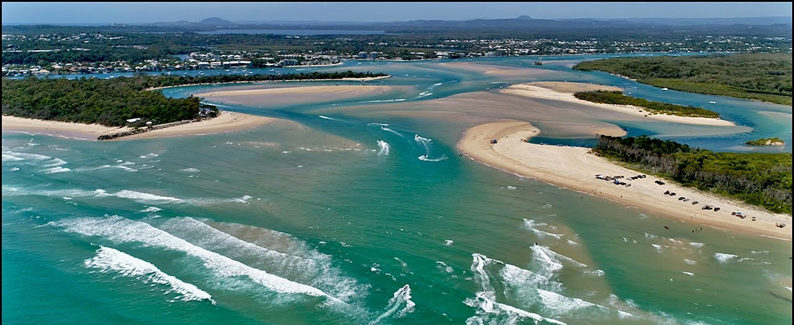
Problem – on its journey northbound via longshore drift, sand is eroding from beaches and accreting in bars and harbour entrances
Noosa Bar (SE Qld)

Slide 14
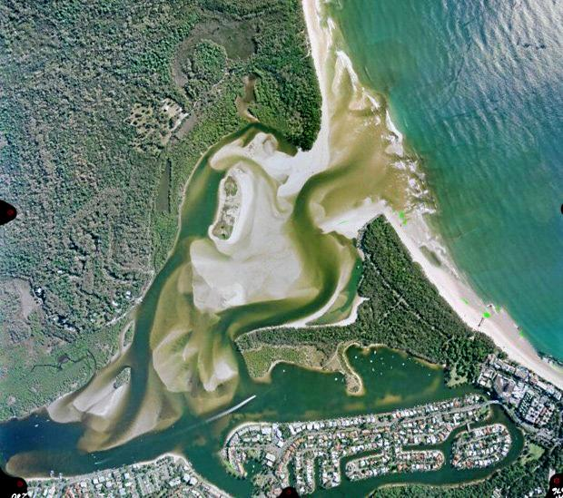
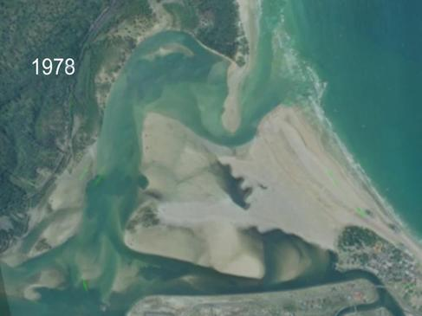
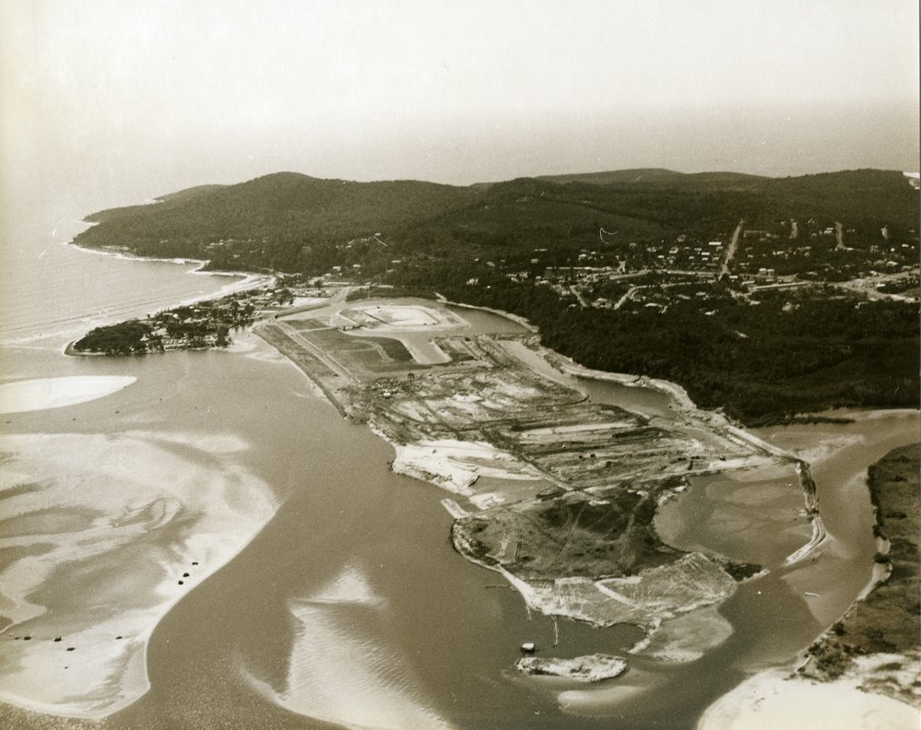
Noosa Bar (SE Qld)

Slide 15
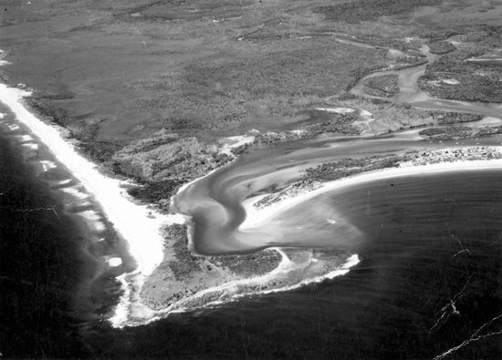
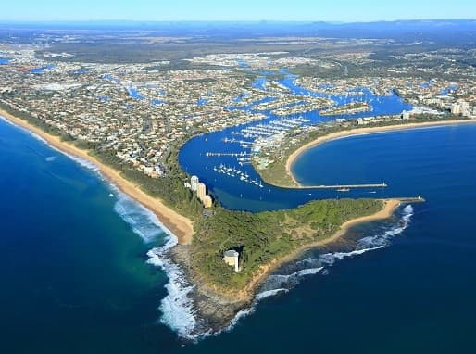
Mooloolaba SE Qld CASE STUDY
before
after
Notes:
https://www.swellnet.com/news/swellnet-dispatch/2022/06/10/mooloolah-river-entrance-wave-dredged

Slide 16
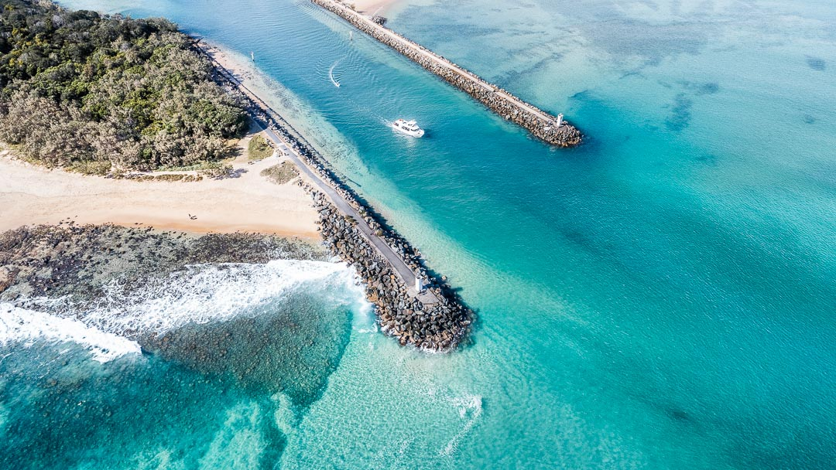
Accretion is blocking harbour entrance

Slide 17
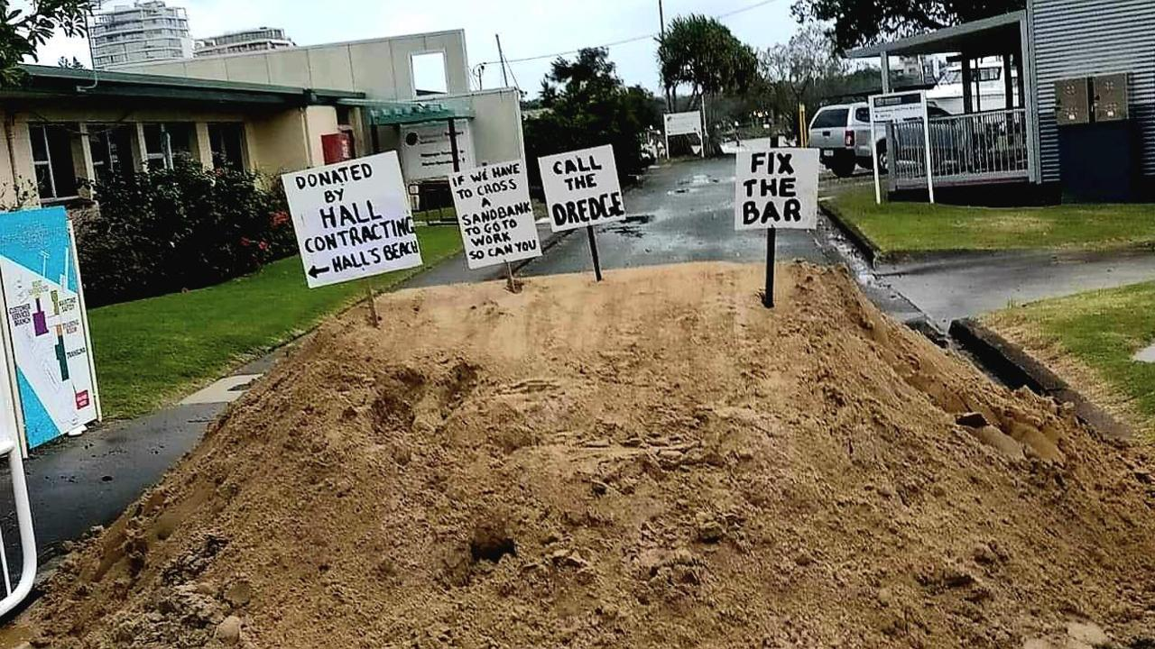
Marine commercial operators sent clear message to Maritime Safety Qld officers in 2022 –
‘if we can’t get to work (because of sand in the harbour) you can’t either’

Slide 18
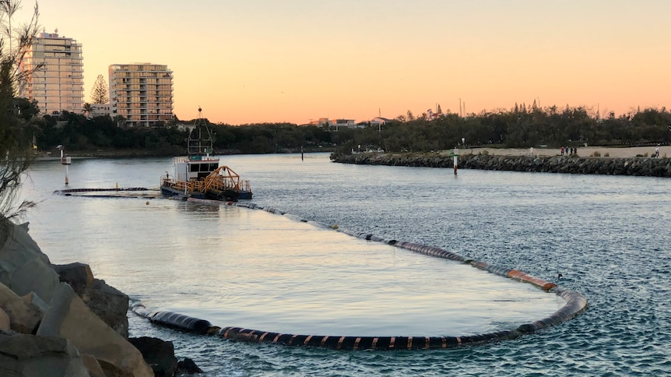
Dredge

Slide 19
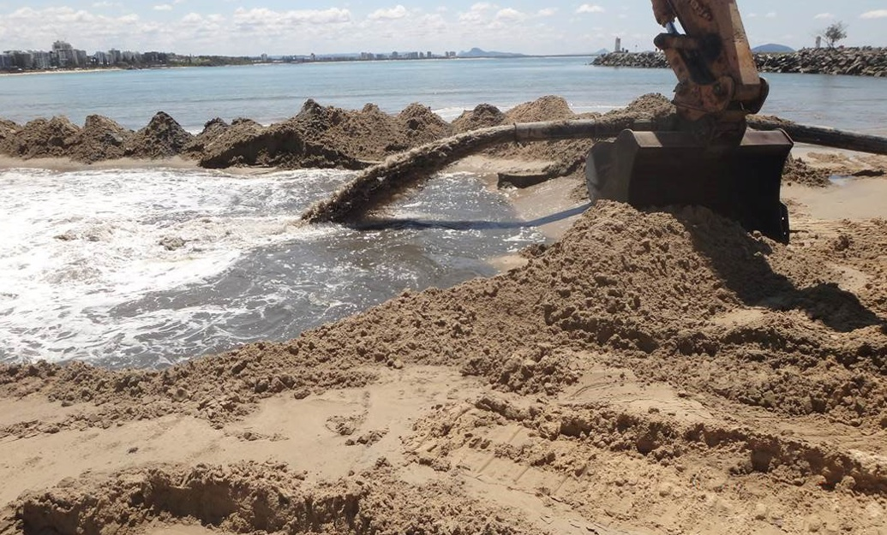

Slide 20
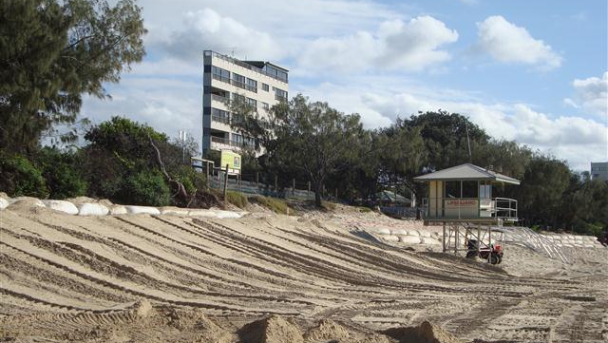

Slide 21
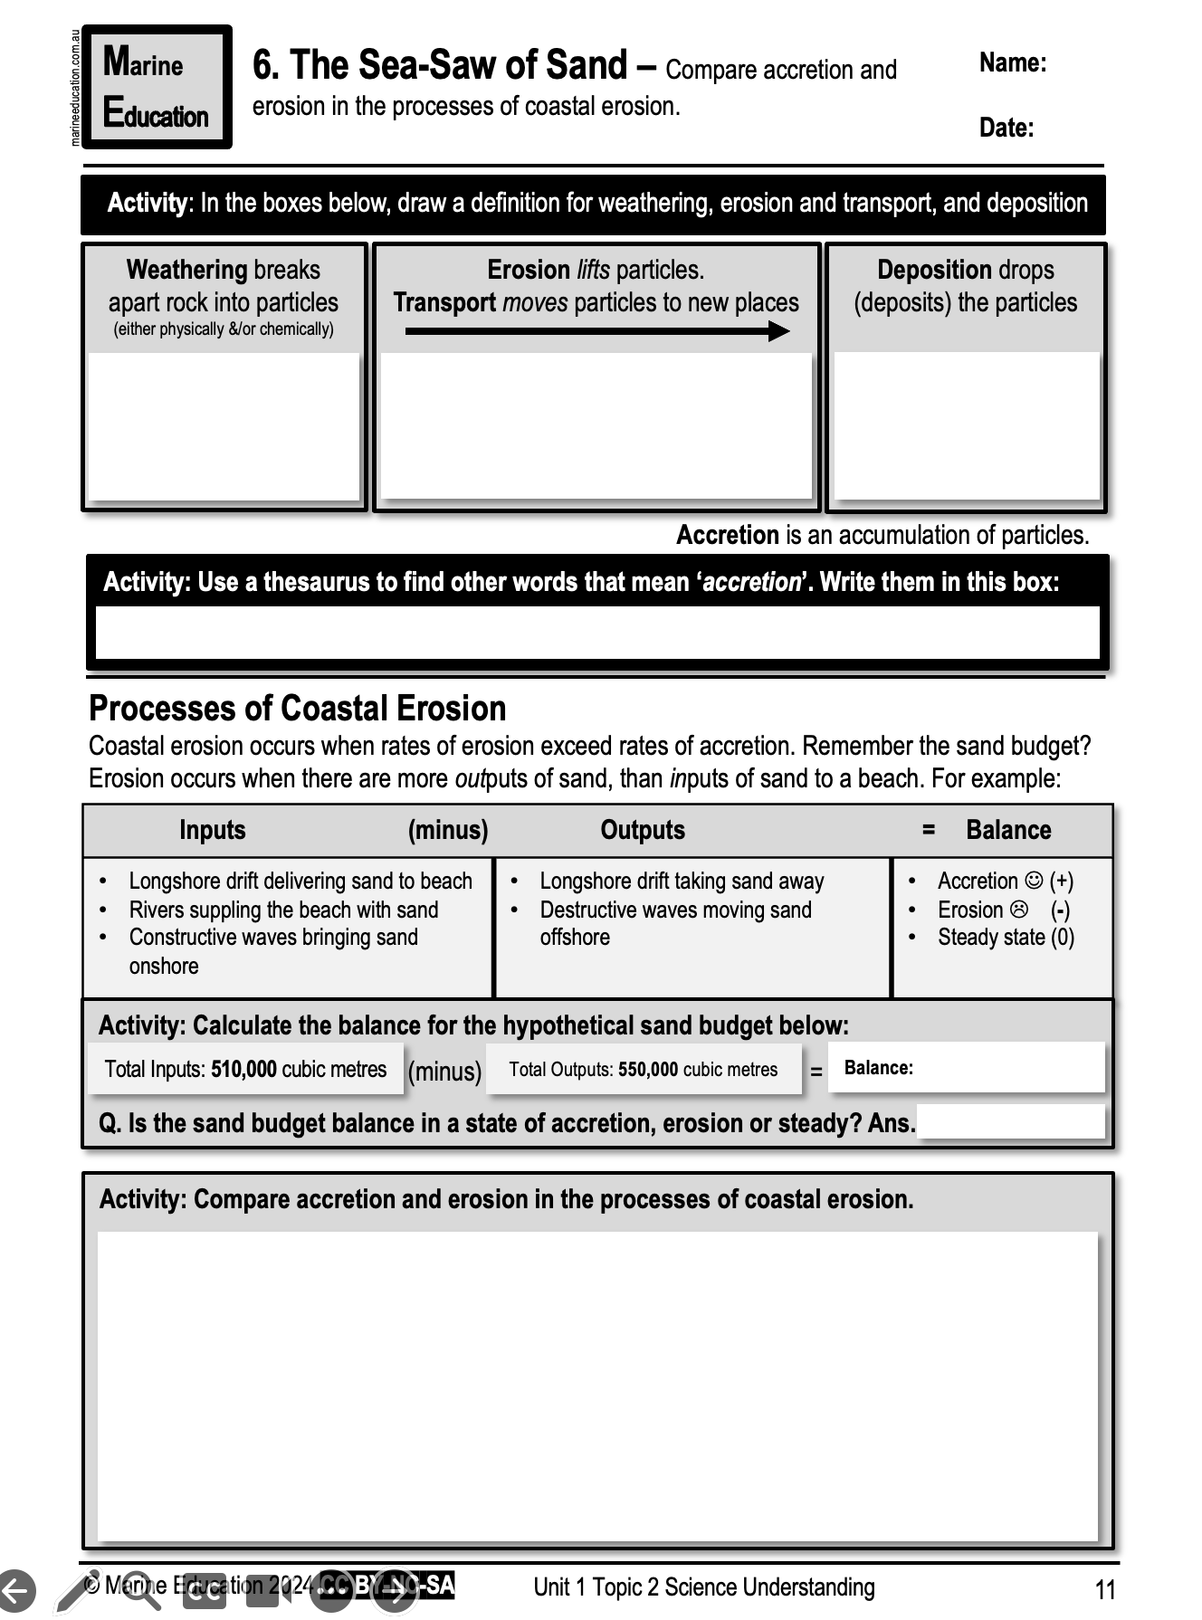
Learning Intention:
Compare accretion and erosion in the processes of coastal erosion
Success Criteria:
Complete Marine Education worksheet ‘6. The Sea-Saw of Sand”
Notes:
https://www.youtube.com/watch?app=desktop&v=loRr97fOWdg

