Slide 1
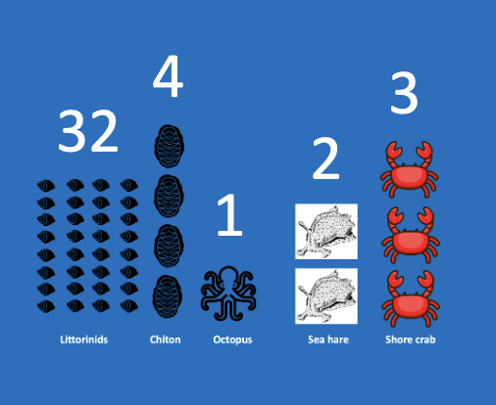
Learning Intention:
Interpret data to determine the biodiversity of a marine ecosystem using diversity indices.
Success Criteria:
Complete Marine Education worksheet ‘7. Formula Feast

Slide 2
Rocky Shore SDI?
Littorinids
Chiton
Octopus
Sea hare
Shore crab

Slide 3
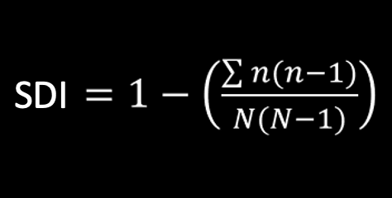
Name | COUNT (n) | n(n-1)
Littorinids | 32 | 992
Chitons | 4 | 12
Octopus | 1 | 0
Sea hare | 2 | 2
Shore crab | 3 | 6
TOTAL | N= 42 | ∑n(n-1) = 1012
 | N(N-1)= 1722 | SDI = 0.41

Slide 4
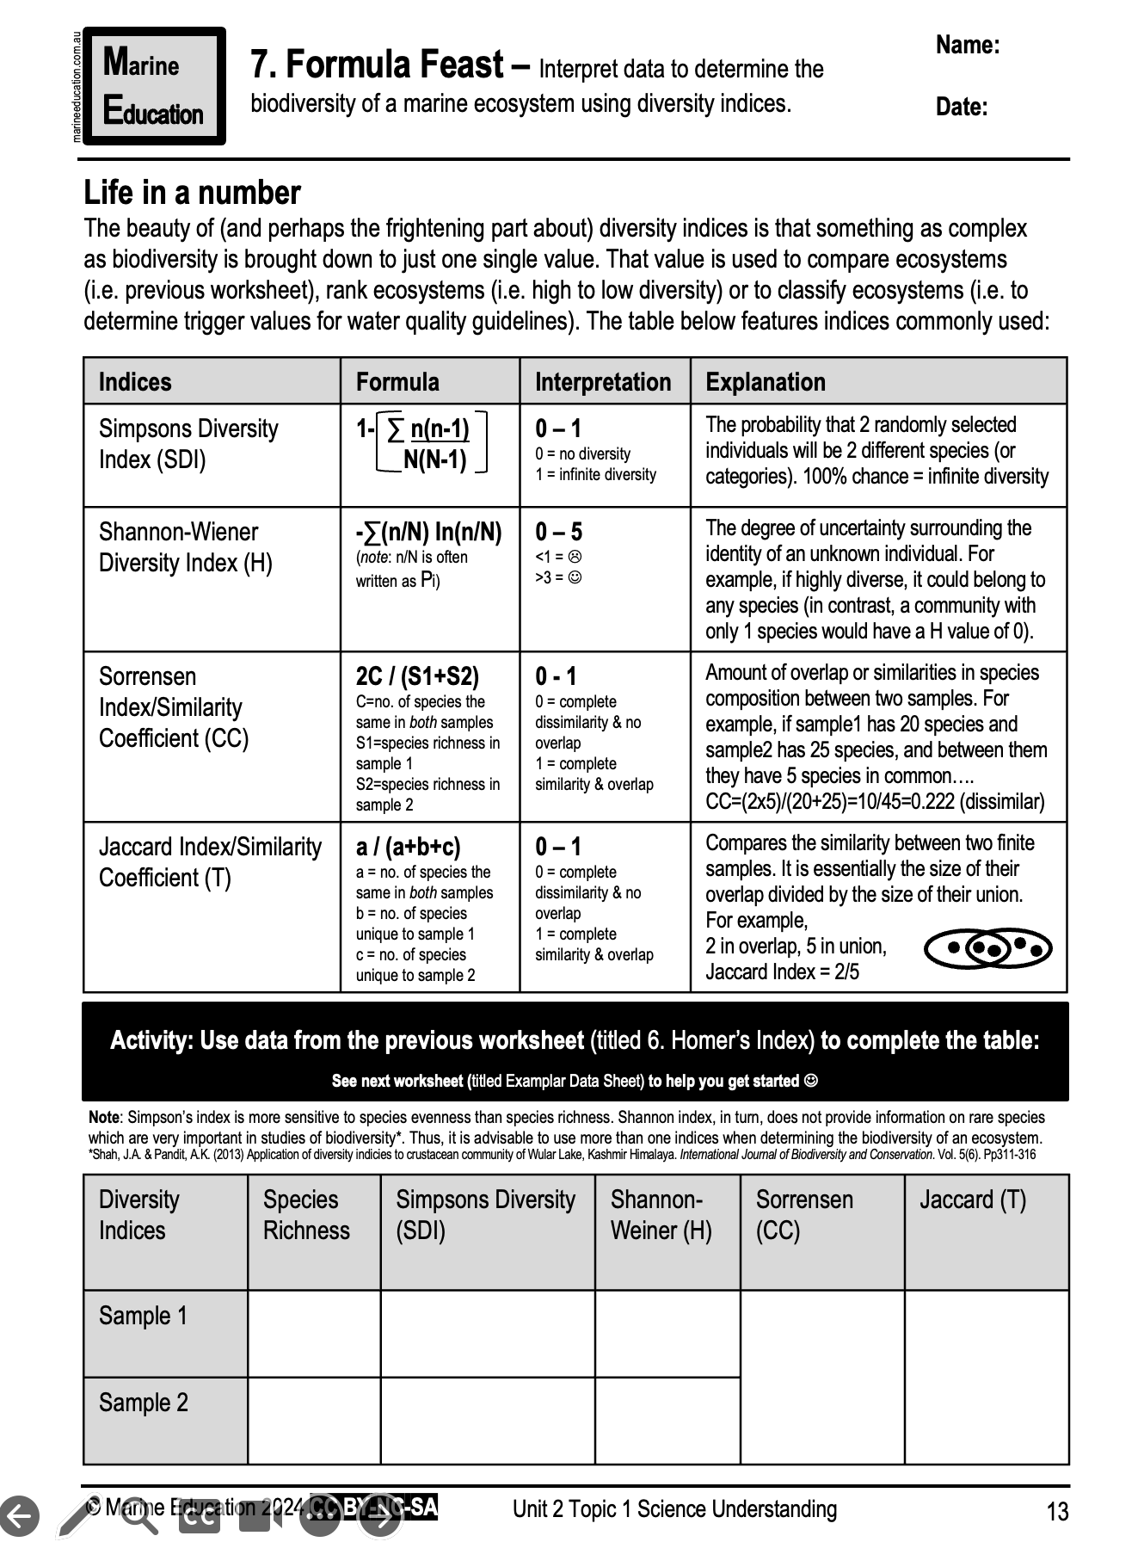
Learning Intention:
Interpret data to determine the biodiversity of a marine ecosystem using diversity indices.
Success Criteria:
Complete Marine Education worksheet ‘7. Formula Feast’

