Slide 1
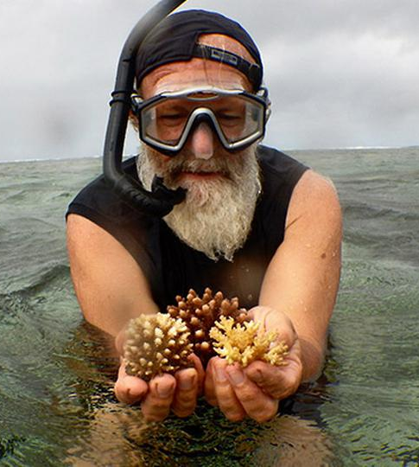
Learning Intention:
Describe the concepts of ecosystem resilience, disturbance and recovery.
Success Criteria:
Complete Marine Education worksheet ‘8. Environmental Medical’
Notes:
Image: https://corals4conservation.org/ Dr. Austin Bowden-Kerby

Slide 2
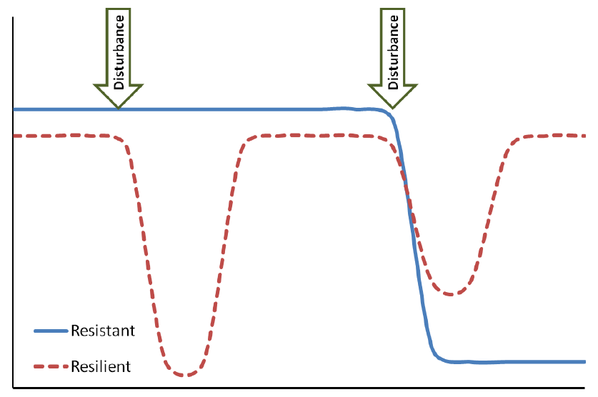
Disturbance is an event of intense environmental stress, forcing change upon an ecosystem (e.g. virus)
Strength
recovery
recovery
Time
Notes:
Image; https://www.researchgate.net/figure/Graphical-depiction-of-resistance-versus-resilience-in-response-to-functional-service_fig1_261797595

Slide 3
Resistance is the capacity to withstand a disturbance (e.g. to not get sick in the first place)
Strength
recovery
recovery
Time
Notes:
Image; https://www.researchgate.net/figure/Graphical-depiction-of-resistance-versus-resilience-in-response-to-functional-service_fig1_261797595

Slide 4
Resilience is the capacity to recover from a disturbance or withstand ongoing pressures (e.g. immunity)
Strength
recovery
recovery
Time
Notes:
Image; https://www.researchgate.net/figure/Graphical-depiction-of-resistance-versus-resilience-in-response-to-functional-service_fig1_261797595

Slide 5
Recovery refers to the return of a damaged ecological system and associated ecosystem services to a stable state (i.e. an identifiable abundance and composition of species) (e.g. getting better again).
Strength
recovery
recovery
Time
Notes:
Image; https://www.researchgate.net/figure/Graphical-depiction-of-resistance-versus-resilience-in-response-to-functional-service_fig1_261797595

Slide 6
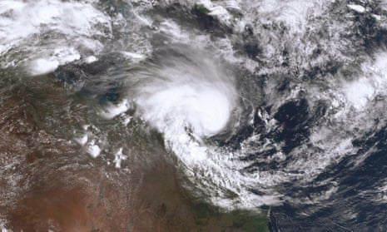
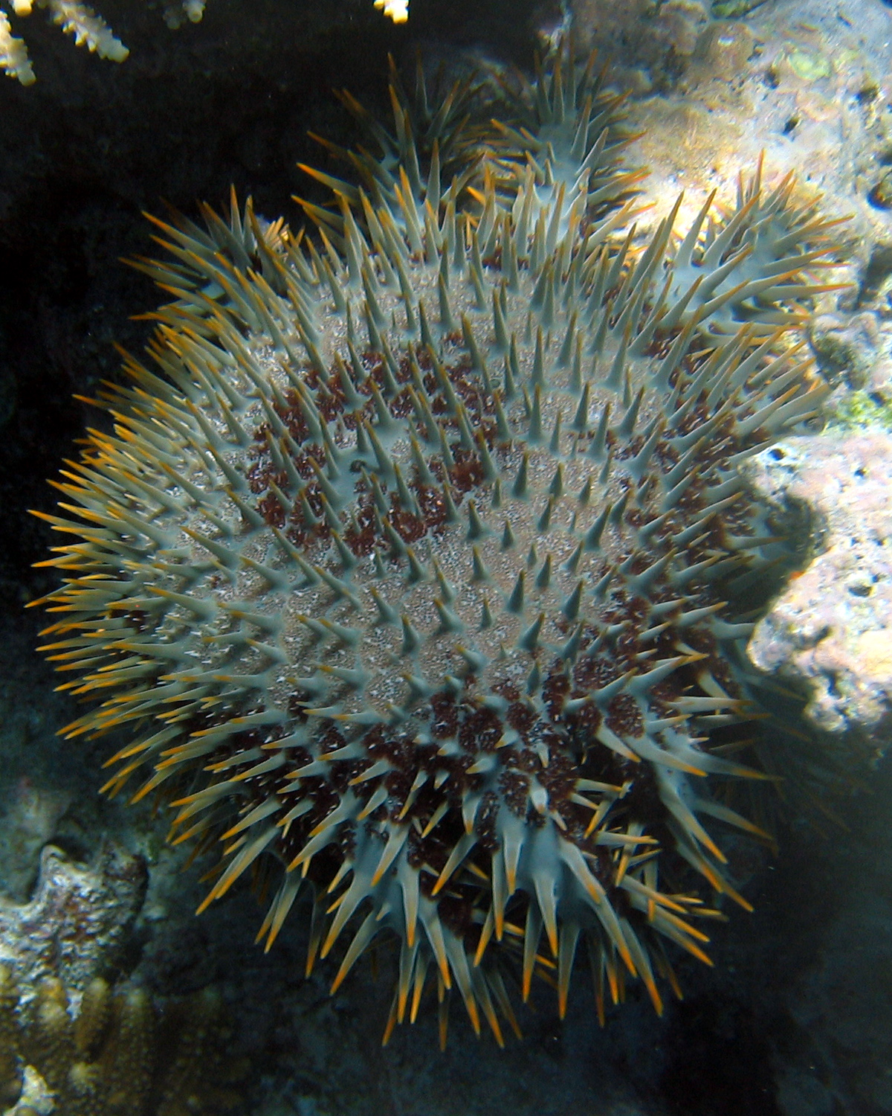
Disturbance is an event of intense environmental stress, forcing change upon an ecosystem (e.g. virus)
COTS (eat coral)

Slide 7
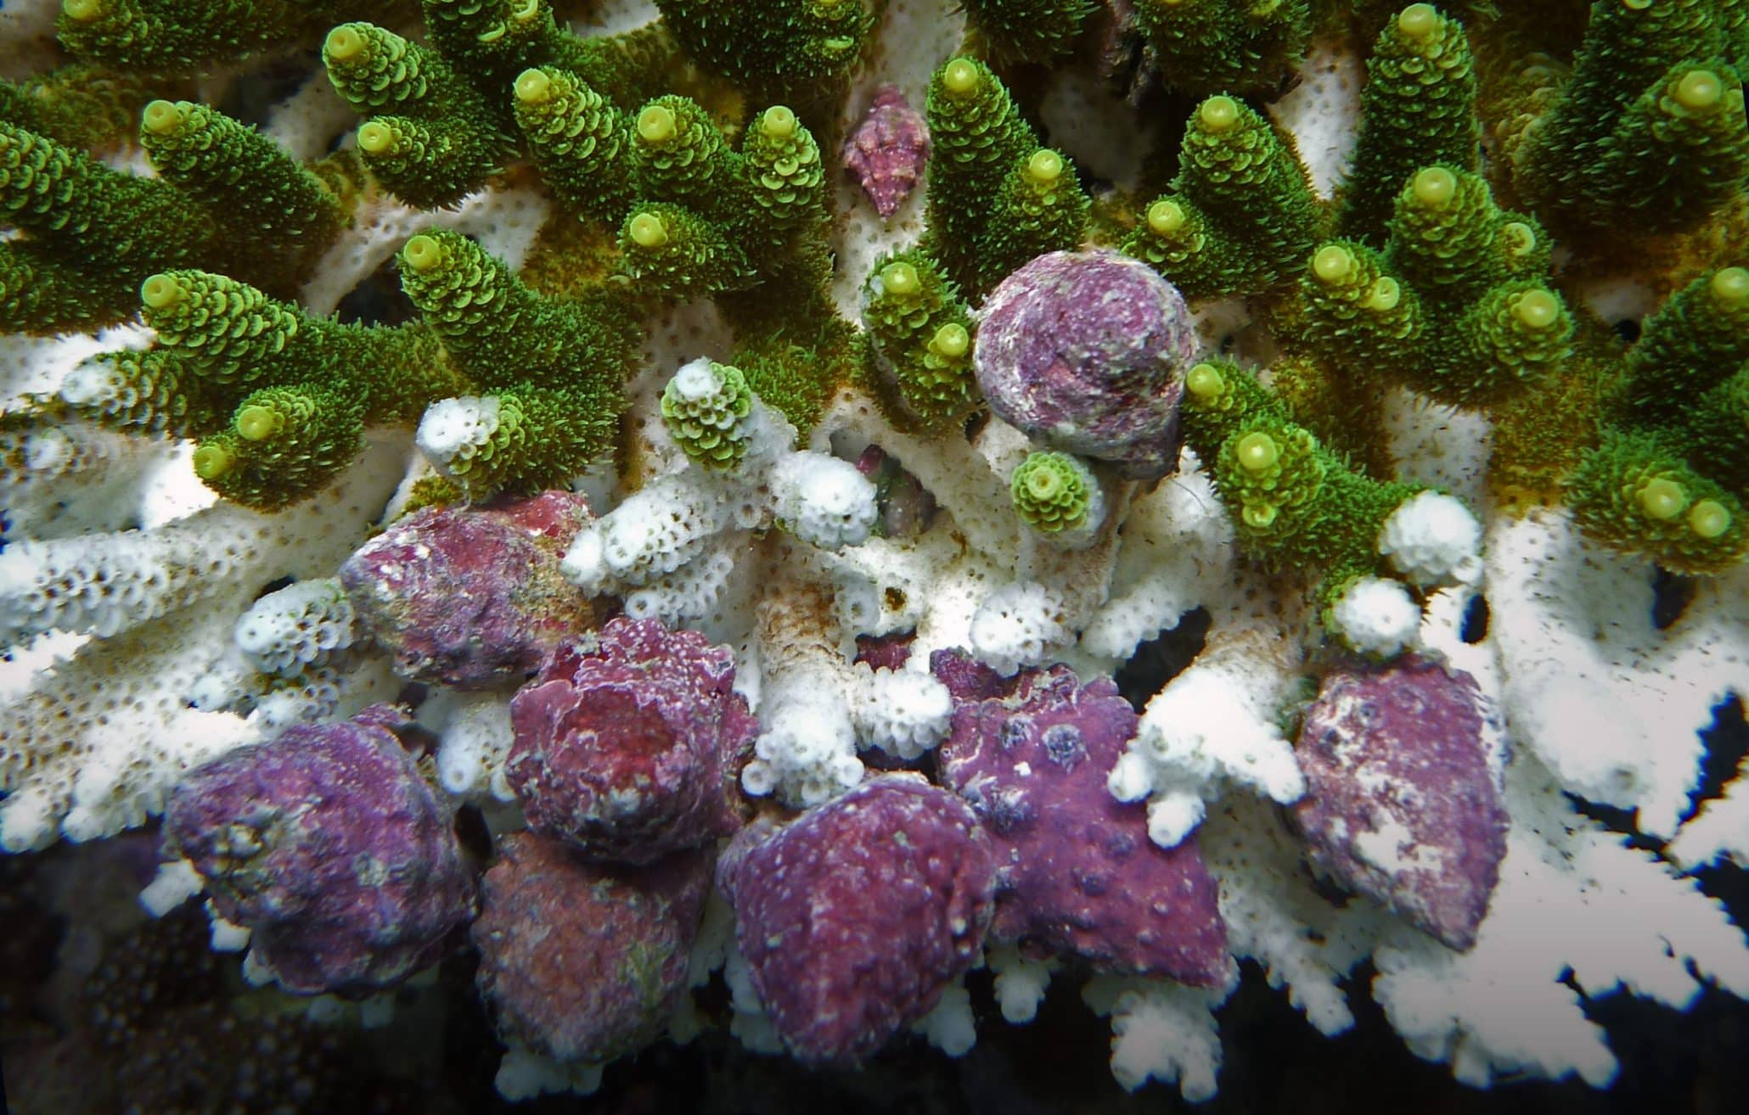
Drupella snails
(eat coral)

Slide 8
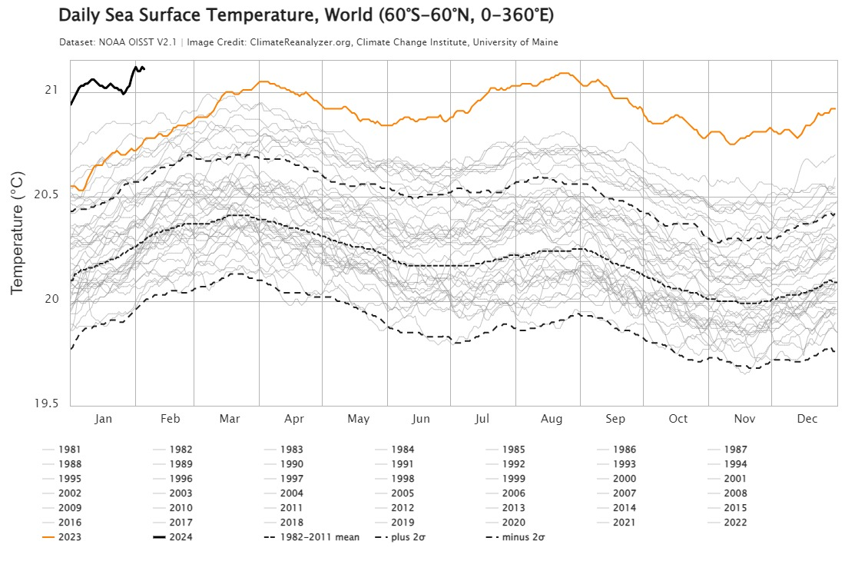

Slide 9
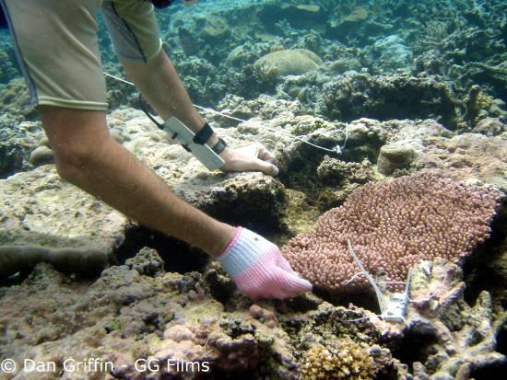
Resistance is the capacity to withstand a disturbance (e.g. to not get sick in the first place)
Heat resistant corals
and heat resistant zooxanthellae
Notes:
Image; https://www.edgeofexistence.org/blog/coral-resistance-to-bleaching-a-genetic-basis/

Slide 10
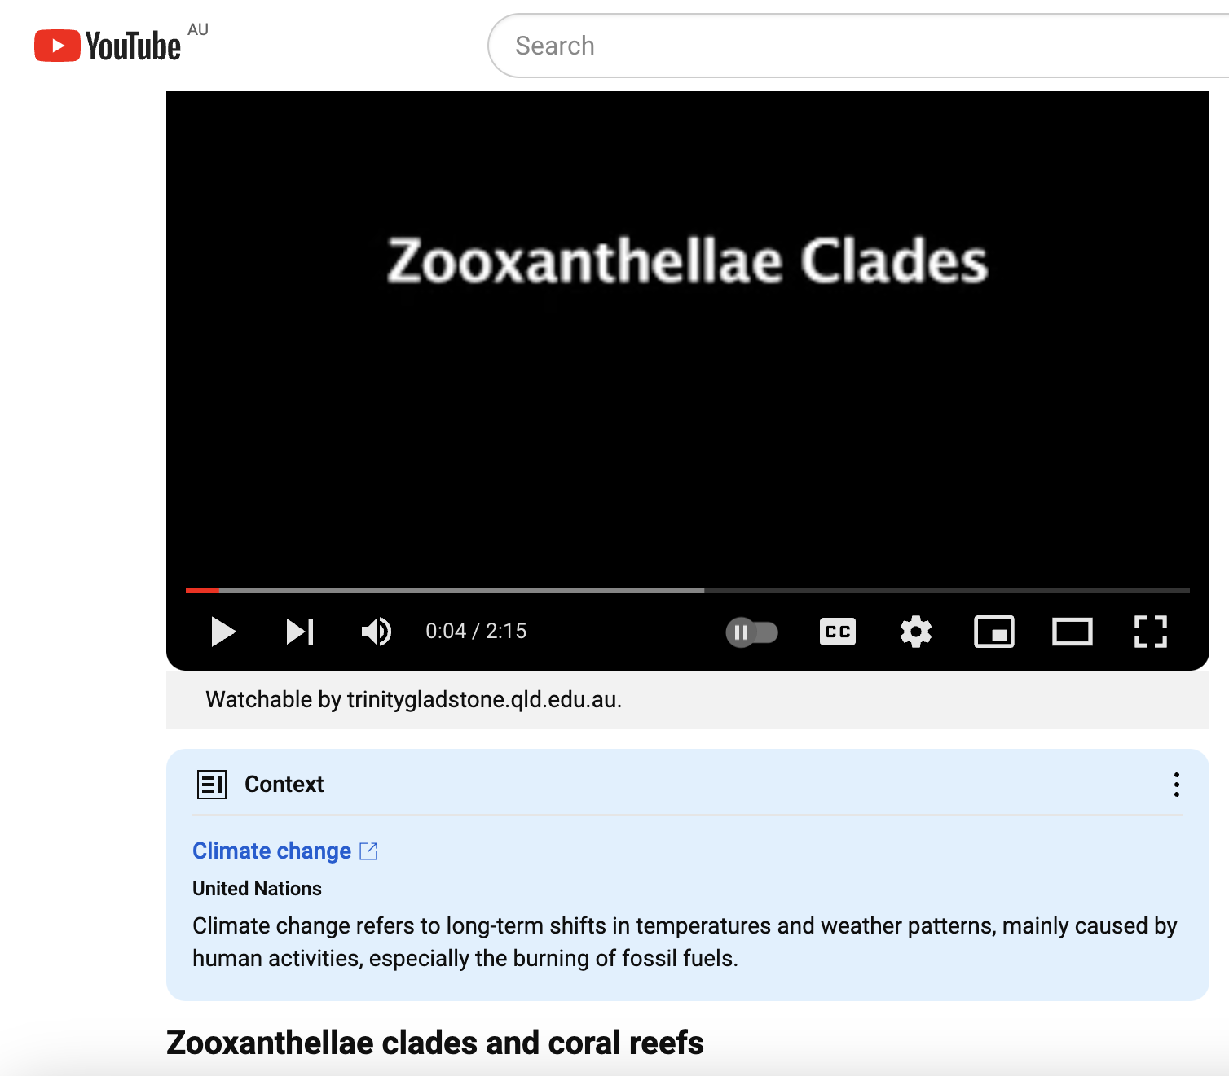
https://www.youtube.com/watch?v=IKaJ-uzy_UE

Slide 11
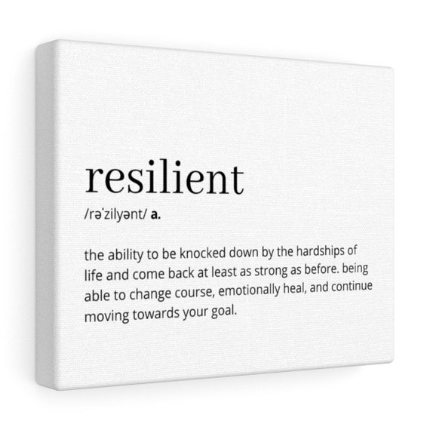
Resilience is the capacity to recover from a disturbance or withstand ongoing pressures (e.g. immunity)
Getting back up after being knocked down
https://reefresilience.org/news/

Slide 12
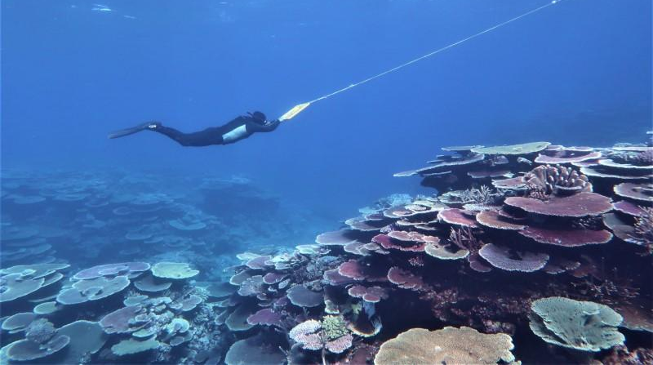
Recovery refers to the return of a damaged ecological system and associated ecosystem services to a stable state (i.e. an identifiable abundance and composition of species) (e.g. getting better again).

Slide 13
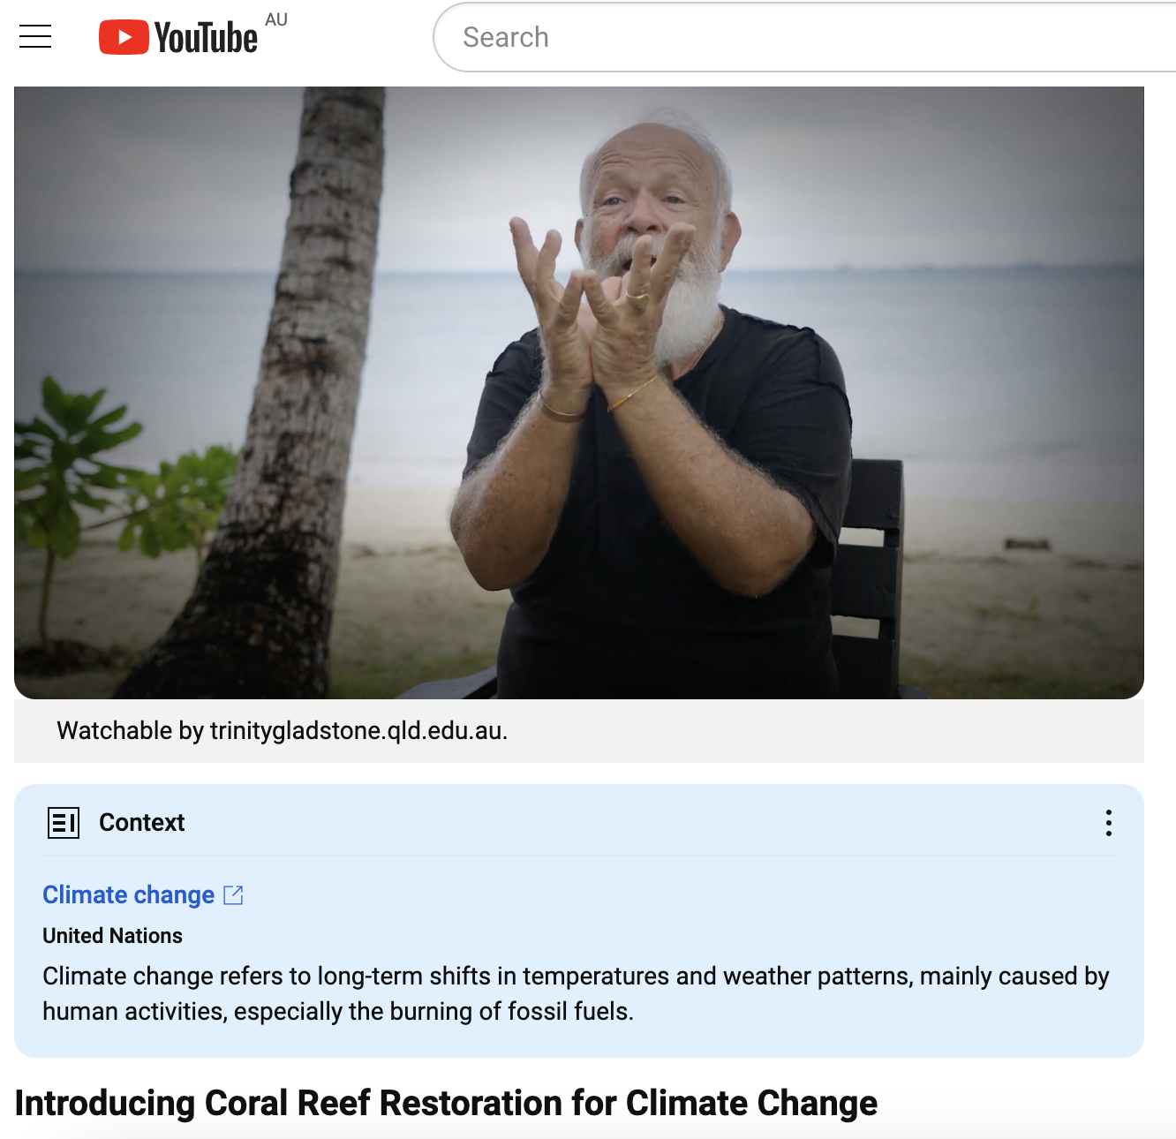
A must watch!
https://www.youtube.com/watch?v=9VbWV23JBxY
Notes:
Image: https://corals4conservation.org/ Dr. Austin Bowden-Kerby

Slide 14
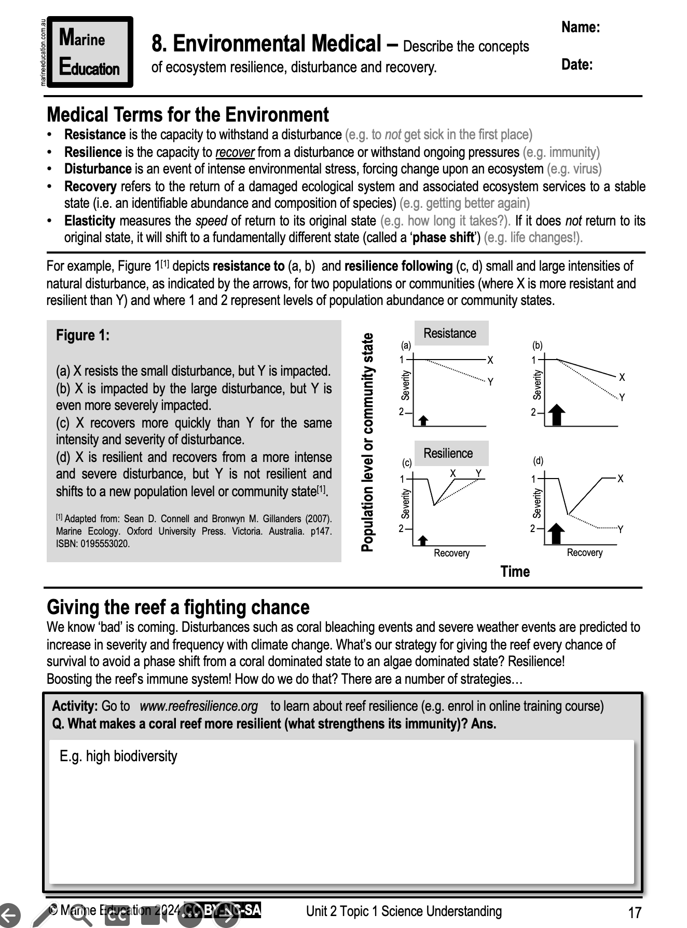
Learning Intention:
Describe the concepts of ecosystem resilience, disturbance and recovery.
Success Criteria:
Complete Marine Education worksheet ‘8. Environmental Medical’

