Slide 1
Marine
Education
Data SHEET
Name/s:
Date:
marineeducation.com.au
Date: | Start Time: End Time: | Location:
 |  | Forest Type:
Collectors: |  | Plot number:
GPS Start Coordinates: |  | Distance to shore:
GPS End Coordinates: |  | Plot length: | Plot Width
Compass bearing from START:
Dead Tree Tally: |  | Live Canopy Tree Tally:
Stem Number | Tree Number | Multi-stem (a,b ?) | Distance Along Tape (in m) | Distance From Tape (in m) | Side of transect: Left (L) or Right (R) | Species code | Tree girth (cm) |  | Tree height (m) to 0.1 decimal point |  |  |  | Lean: (º) | Position: Canopy (C) or Sub-canopy (SC) or Emergent (E) | Health score (0-5) | Tree Damage Code
 |  |  |  |  |  |  | Diameter (cm) to 0.1 decimal point | Circumference – calculate in class (3.14 x D) to 0.1 decimal point | Degrees to top of tree (protractor) | Height of person (cm) | Distance from person to tree (cm) | Tree height (m) – calculate in class
1
2
3
4
5
6
7
8
© Marine Education 2024 CC BY-NC-SA

Slide 2
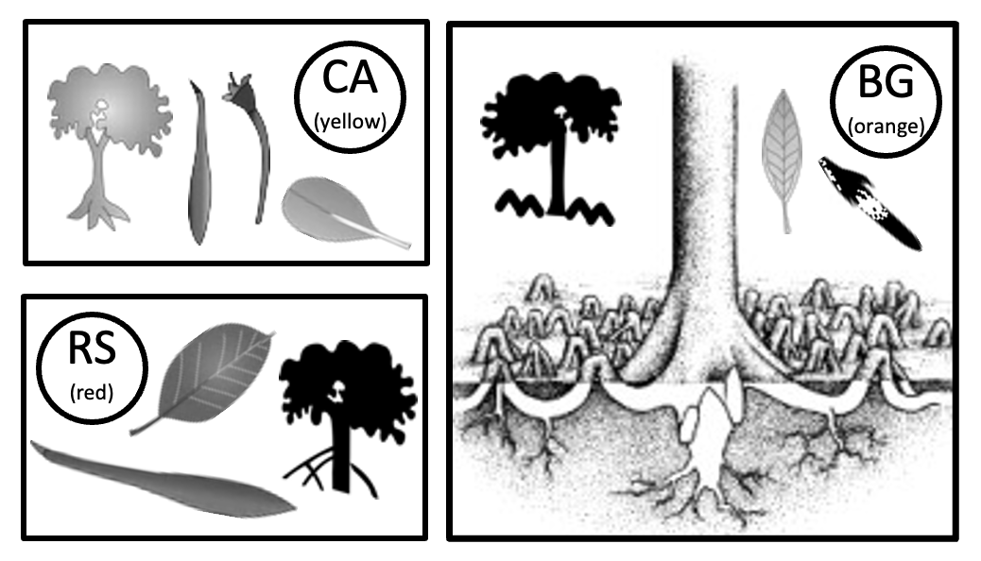
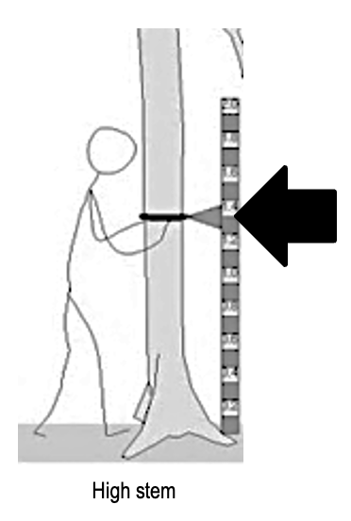
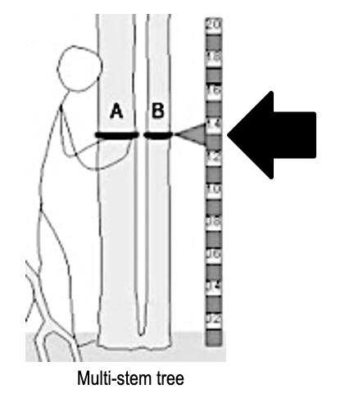
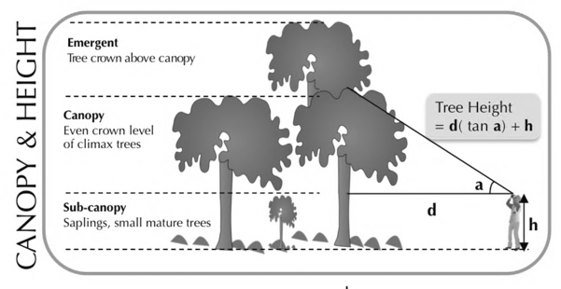
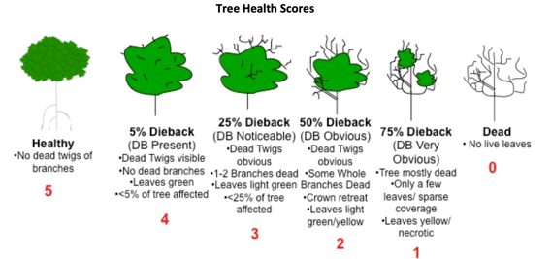
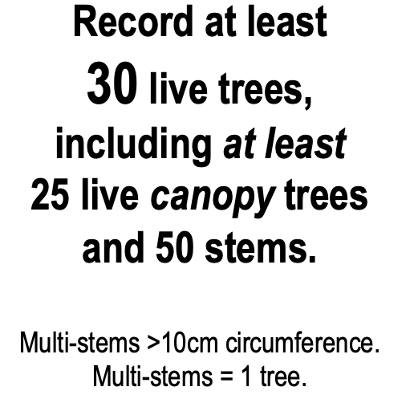
Marine
Education
Marvellous Mangroves
Name/s:
Date:
marineeducation.com.au
© Marine Education 2024 CC BY-NC-SA

