Slide 1
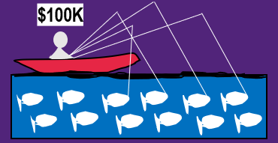
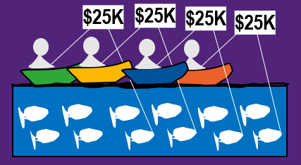
Marine
Education
Introduction to Fisheries Management
marineeducation.com.au
1. Data Collection
2. Stock Assessment
3. Management
How many fish are there?
How many fish can we catch?
How do we stop people overfishing?
Catch per unit effort (CPUE)
E.g. 10 fish/hr or 100 fish/hr
Lots of fish in the catch EQUALS
Lots of fish in the unit stock (pop.) right?!
“Fisheries Management is about managing people, not fish”
Fishing Vessel
K
Logistic Growth Curve
K: carrying capacity
K: maximum population size
K: births + immigration EQUALS deaths + emigration
Input controls
Licences, gear restrictions, taxes, closures…
Population size
Output controls
Selectivity criteria (e.g. size/age/sex), landing fees, TAC (total allowable catch), quotas…
Steep slope = population is growing very fast
MSY
Scientists
on board
For example, as ‘Observers’
time
or
?
To estimate population size of mobile organisms: Capture-Recapture Method (Lincoln Index)
More tagged recaptures EQUALS
smaller population, right?!
TAC (4 fish) as 1 quota
TAC (4 fish) as 4 quotas
Allocated
Auctioned
Idea: harvested stock is quickly replaced in the fastest time at MSY
“Quotas stop the RACE to catch fish”
MSY
Maximum Sustainable Yield
K/2
Fastest Birth rate
Fastest Population Growth rate
Who is making and enforcing the rules?
Research Vessel
Population growth rate
Governance:
Top-down vs. bottom-up governance, co-mgmt., RFMOs…
K
Types of management plans
First Catch (tag and release)
MSY
Single-Species Fisheries Management (SS)
Ecosystem-based Fisheries Management (EBFM)
Population size
MEY
Tagged
MSY
Plus MPA’s &
Climate Habitat Predator
MEY
Bycatch
NOT tagged
MSY
Q. Not enough scientific data? Ans. Precautionary Principle applies!
Population Boundary
MEY
Maximum Economic Yield
A Marine Protected Area (MPA) MUST be designed well
Second Catch
Revenue ☺ and Cost ☹
At MEY, the fishery (as a whole) makes MORE money, for LESS fishing effort (than MSY)
Lincoln Index:
1 : 3 = 6 : 18
m / n = M / N
N = M x n / m
18 = 6 x 3 / 1
Losing $$$
Criteria to design MPAs
site selection
networking and connectivity
replication
spacing
size and coverage
Dynamic Spatial Zoning
Fish Management
MPA
Fishing Effort
Q. How do we make sure the level of fishing effort stays at or below MEY?
Spill-over effect

