Slide 1
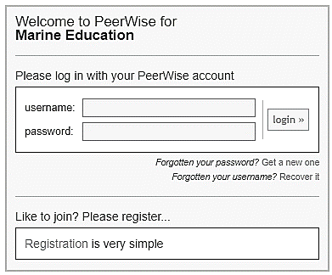
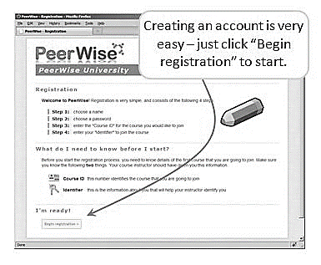
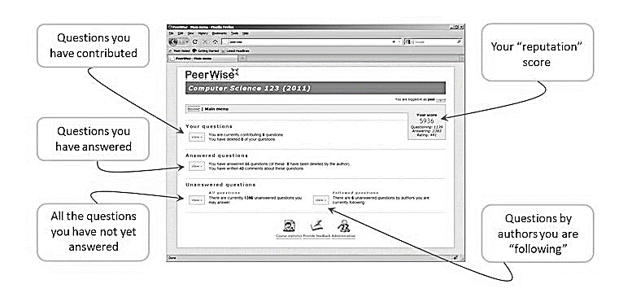
Marine Science Exam Preparation
using PeerWISE
Step 1: https://peerwise.cs.auckland.ac.nz/ (or Google PeerWise)
Step 2: Marine Education (Australia)
Step 3: Registration
Course ID:
19822
Identifier: Any number between 0 and 1000
If all Identifier numbers are taken, email: info@marineeducation.com.au
Step 4: Select ‘Marine Science’ in ‘Your Courses’ to begin!
Marine Science

