Slide 1
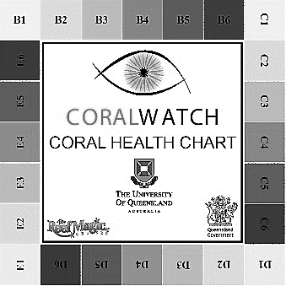
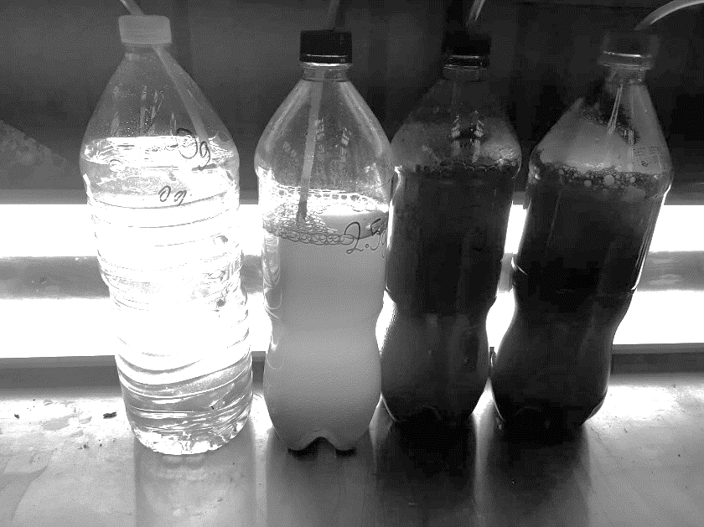
Marine
Education
Primary Productivity Prac
Name:
Date:
marineeducation.com.au
Modified from Lesson Plan by Kate Nunn
Rosedale State School (P-12)
Research Question: Is there a relationship between nutrient concentration and phytoplankton growth?
Unit 1 Topic 2: Define the process of eutrophication
Unit 2 Topic 1: Distinguish abiotic components of marine ecosystems: light availability, depth, stratification, temperature, currents (water and wind), tides, sediment type and nutrient availability
Unit 4 Topic 2: Explain how distribution of fish populations are determined by temperature, primary productivity and nutrient dispersal, and these are influenced by currents, upwelling and seasonal factors
EQUIPMENT:
Fluro Lights
Garden Fertiliser (and scales)
Water from a dam or lake system
Air tubing and pumps
1.25L bottles
Measuring Cylinders
Marker Pen
Microscope
Water Testing Equipment
CoralWatch Charts
RESULTS TABLE:
 | Fertiliser
Trial | 0g | 1g | 2g | 3g | 4g | 5g
1
2
3
Average
After one week, use a CoralWatch Chart to record the darkness of each trial as an indicator of phytoplankton growth.
ALLOCATE JOBS (listed below):
Safety officer
Prepare bottles - use a measuring cylinder to fill bottles with water containing phytoplankon
Setup air tubing - each bottle needs air tubing connected to a pump (above water level to prevent backflow)
Nutrient weighing – use fertiliser and scales
Label bottles
Light setup
Test Water
Check phytoplankton- use microscope to determine quality of phytoplankton
Image: CoralWatch.org
Double Fluro lights behind trials. Photograph: Kate Nunn – Rosedale SS
DISCUSSION QUESTIONS
What abiotic conditions do phytoplankton need to thrive (e.g. light, nutrient, heat, carbon dioxide and oxygen requirements)? Where do we see high levels of phytoplankton production? What abiotic factors affect phytoplankton growth?
Why do aquaculture farmers grow phytoplankton? How does the level of phytoplankton affect a wild-caught fishery?
How can human activities affect the natural production of phytoplankton (e.g. and cause eutrophication)?
© Marine Education 2020
Primary Productivity Prac

