Slide 1
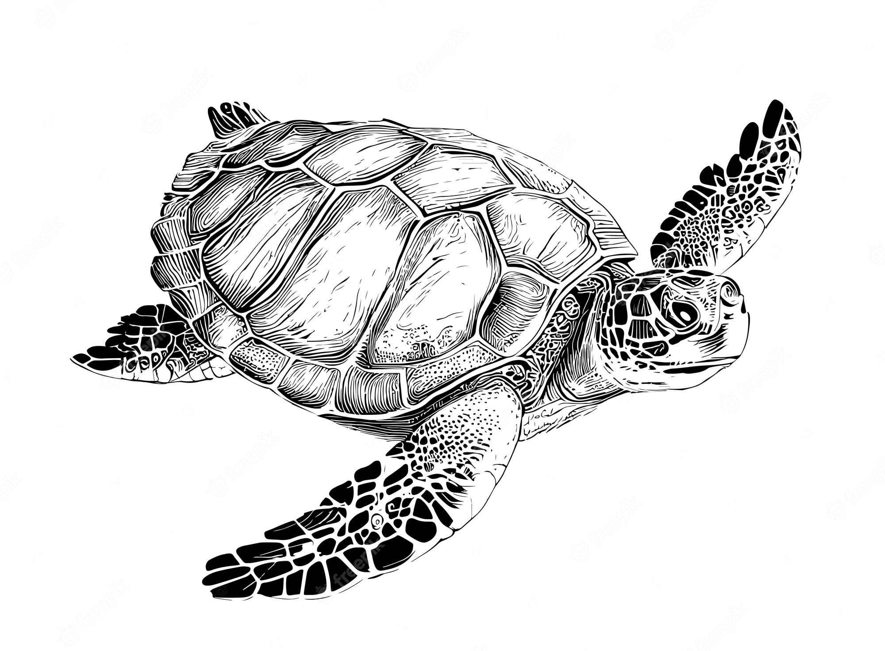
Marine
Education
Year 11 Marine Science
Student Workbook
Name:
Date:
marineeducation.com.au
Oceanography and Marine Biology
The Ocean Planet The Dynamic Shore Marine Ecology and Biodiversity
Marine Environmental Management
Content from DRAFT Syllabus
State of Queensland (QCAA) 2023
By Gail Riches
© Marine Education 2023 CC BY-NC-SA

Slide 3
Marine
Education
Course Overview
(Changes from 2019 syllabus highlighted in yellow)
Name:
Date:
marineeducation.com.au
Marine Science
Year 11 (this booklet)
Assessment
Data Test 10%
Student Experiment 20%
Research Investigation 20%
Exam 50%
Year 12 (next booklet)
Assessment
Data Test 10%
Student Experiment 20%
Research Investigation 20%
Exam 50%
Unit 1
Oceanography
Topic 1: An ocean planet
Topic 2: The dynamic shore
Unit 2
Marine Biology
Topic 1: Marine ecology and biodiversity
Topic 2: Marine environmental management
Unit 3
Marine systems – connections and change
Topic 1: The reef and beyond
Topic 2: Changes on the reef
Unit 4
Ocean issues and resource management
Topic 1: Oceans of the future
Topic 2 Managing fisheries
Syllabus Objectives
Describe ideas and findings
Apply understanding
Analyse data
Interpret evidence
Evaluate conclusions, claims and processes
Investigate phenomena
Science Strands
Science understanding (SU)
Science as a human endeavour (SHE)
Science inquiry skills (SIS)
© Marine Education 2023 CC BY-NC-SA
Course Overview

Slide 4
Marine
Education
Name:
Date:
marineeducation.com.au
Cognitive Verbs
Cognitive Verb | Description
Analyse
Apply | Use knowledge and understanding in response to a given situation or circumstance; carry out or use a procedure in a given or particular situation
Appreciate
Assess | Measure, determine, evaluate, estimate or make a judgement about the value, quality, outcomes, results, size, significance, nature or extent of something
Calculate | Determine or find (e.g. a number, answer) by using mathematical processes; obtain a numerical answer showing the relevant stages in the working; ascertain/determine from given facts, figures or information
Categorise | Place in or assign to a particular class or group; arrange or order by classes or categories; classify, sort out, sort, separate
Classify | Arrange, distribute or order in classes or categories according to shared qualities or characteristics
Consider
Compare | Display recognition of similarities and differences and recognise the significance of these similarities and differences
Contrast
Define | Give the meaning of a word, phrase, concept or physical quantity; state meaning and identify or describe qualities
Describe | Give an account (written or spoken) of a situation, event, pattern or process, or of the characteristics or features of something
Determine
Discriminate
Discuss | Examine by argument; sift the considerations for and against; debate; talk or write about a topic, including a range of arguments, factors or hypotheses; consider, taking into account different issues and ideas, points for and/or against, and supporting opinions or conclusions with evidence
Evaluate | Make an appraisal by weighing up or assessing strengths, implications and limitations; make judgements about ideas, works, solutions or methods in relation to selected criteria; examine and determine the merit, value or significance of something, based on criteria
Examine
Explain | Make an idea or situation plain or clear by describing it in more detail or revealing relevant facts; give an account; provide additional information
© Marine Education 2023 CC BY-NC-SA
Cognitive Verbs

Slide 5
Marine
Education
Name:
Date:
marineeducation.com.au
Cognitive Verbs
Cognitive Verb | Description
Explain | Make an idea or situation plain or clear by describing it in more detail or revealing relevant facts; give an account; provide additional information
Explore
Identify | Distinguish; locate, recognise and name; establish or indicate who or what someone or something is; provide an answer from a number of possibilities; recognise & state a distinguishing factor or feature
Infer
Interpret
Investigate
Predict
Recall | Remember; present remembered ideas, facts or experiences; bring something back into thought, attention or into one’s mind
Recognise | Identify or recall particular features of information from knowledge; identify that an item, characteristic or quality exists; perceive as existing or true; be aware of or acknowledge
State
Understand | Perceive what is meant by something; grasp; be familiar with (e.g. an idea); construct meaning from messages, including oral, written and graphic communication
© Marine Education 2023 CC BY-NC-SA
Cognitive Verbs

Slide 6
Marine
Education
Unit 1 Topic 1: An ocean planet
Science Understanding
Name:
Date:
marineeducation.com.au
© Marine Education 2023 CC BY-NC-SA
Unit 1 Topic 1 Science Understanding

Slide 7
Marine
Education
Explore the Floor– Describe the bathymetric features of the ocean floor including the continental margin, ocean-basin floor, deep-sea trenches, mid-ocean ridges, abyssal plain
(Note: bathymetric means the depths and shapes of underwater features ☺)
Name:
Date:
marineeducation.com.au
Sub-marine Exploring
Three thousand meters underwater, the lights of a submarine illuminate black smoke venting out of the sea floor. Interestingly, life is plentiful at this alien-like location. It is a hydrothermal vent situated along a mid-ocean ridge (the longest and largest mountain ranges on Earth) on the deep ocean-basin floor. Other ocean-basin floor features include seamounts (undersea volcanoes >1km high), abyssal plains (undersea deserts that are the flattest areas on Earth) and deep-sea trenches (the deepest regions on Earth). Later, the submarine will steer towards a continental margin, starting with a gradual rise in depth, called the continental rise, followed by a steep climb towards the sunlit zone, called the continental slope, and finishing on a bright, shallow extension of the land, called the continent shelf.
Activity: Search Google Maps to gain a visualisation of the depths and bathymetry of the ocean. Zoom in to find each of the bathymetric features listed in the table below. Research them in more detail using various resources. Complete the table below. Provide descriptions in your own words.
Bathymetric Feature |  | Description
Deep ocean-basin Floor | Mid-ocean ridge
 | Seamount
 | Deep-sea Trench
 | Abyssal Plain
Continental Margin | Continental Rise
 | Continental Slope
 | Continental Shelf
© Marine Education 2023 CC BY-NC-SA
Unit 1 Topic 1 Science Understanding

Slide 8
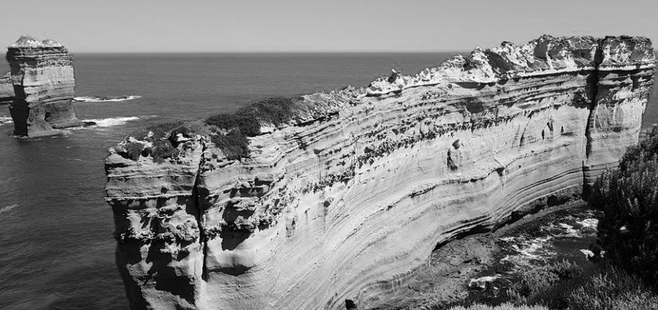
Marine
Education
Geology Rocks! – Apply models to understand the geological features of the Earth (e.g. sea floor modelling, tectonic plate movements, coastal landforms, stratigraphy)
Name:
Date:
marineeducation.com.au
Making Models
A model is a simple representation of reality that helps us to understand how something works.
The geological features of the Earth, particularly those underwater, such as trenches, mid-ocean ridges and seamounts, are difficult for you and me to access, see and therefore understand. Models help us to visualise what they look like and why. Models also help us to simulate Earth processes, to understand what happened in the past, and predict what will happen in the future.
Activity: Conduct a convection experiment to model Earth’s convection currents
Puzzle Pieces
Picture Earth’s crust as a giant puzzle, with puzzle pieces called tectonic plates…..that move!
Sometimes the plates collide to make a trench (when one plate dives under another plate).
Sometimes the plates move apart to make new sea floor at a mid-ocean ridge.
Sometimes the plates move over ‘hot spots’ in Earth’s mantle to make seamounts (undersea volcanoes).
Activity: Draw a trench in the box below
Activity: Draw a trench in the box below
Rock Detective Stratigraphers study different rock layers (called strata) to interpret the history that each layer represents in time.
The 12 Apostles, Great Ocean Road, Victoria. Photograph: Karen Anderson
Study the rock layers pictured right. Q. Where are the youngest rocks located?
Ans. [top] [middle] [bottom] Circle correct answer.
^{[1]} Hoban, G. (2014). Slowmation. Encyclopedia of Science Education. DOI: 10.1007/978-94-007-6165-0_250-3.
^{[2]} www.slowmation.com/
© Marine Education 2023 CC BY-NC-SA
Unit 1 Topic 1 Science Understanding

Slide 9
Marine
Education
To reCYCLE – Describe the processes of the following cycles: water, carbon and oxygen
Name:
Date:
marineeducation.com.au
The Water (H2O) Planet
Water is essential to life on Earth. It changes from solid to liquid to gas (not necessarily in that order) and cycles between the Atmosphere, Biosphere, Hydrosphere and Lithosphere. Activity: Complete table
Atmosphere
Water vapour
Clouds
Snow
Rain
Biosphere
Water in body systems
Process | Description
Evaporation | Liquid → Gas
Condensation
Precipitation
Infiltration (soil)
Hydrosphere
Oceans
Rivers, Lakes
Glaciers & Melt Water
Lithosphere
Ground water
The Carbon Backbone of Life
Carbon is the letter ‘C’ on the Periodic Table. Every carbon atom has (not 1, 2 or 3 but) 4 spots available for other atoms to bond to. Thus, carbon is part of a countless number of molecules that make up life on Earth. When life dies, carbon is recycled to make new molecules. Activity: Complete table
Atmosphere
CO2 Gas
Biosphere
Body Parts
Photosynthesis Respiration
Process | Description
Decomposition
Combustion
Dissolution
Excretion
Hydrosphere
Dissolved Carbon
e.g. carbon dioxide
carbonate & bicarbonate
Lithosphere
Detritus
Fossil Fuels
Limestone Rock
The Oxygen we breathe
Oxygen is the letter ‘O’ on the Periodic Table. We know it best as the air we breathe, or O2. Plants make oxygen via photosynthesis. Plants in the ocean include phytoplankton (plant plankton), seaweed (algae) and seagrass. Oxygen dissolves in water for marine life to respire. Activity: Complete table
Atmosphere
O2 Gas
Biosphere
Respiration
Photosynthesis
Process | Description
Photosynthesis (include formula)
Respiration (include formula)
Oxidation (chemical weathering)
Hydrosphere
Dissolved Oxygen
(D.O.)
Lithosphere
Rocks
Oxides
Silicates
© Marine Education 2023 CC BY-NC-SA
Unit 1 Topic 1 Science Understanding

Slide 10
Marine
Education
Water in motion – Describe how surface ocean currents are driven by temperature, wind and gravity
(as opposed to ‘deep’ ocean currents driven by temperature & salinity)
Name:
Date:
marineeducation.com.au
T004
Surface Currents Human beings live at the bottom of an ocean of air. This ocean of air – that is, of gas, the atmosphere, is in contact with water, the hydrosphere, over an area that covers more than 70% of Earth. As air molecules are dragged across the sea surface in a wind, they collide with water molecules at the ocean’s surface. This process, if prolonged, generates surface currents.
If wind makes currents…….what makes wind?
Pressure release
Wind is simply air moving from an area of high pressure (H) to an area of low pressure (L). For example, when you release air from a balloon, the air travels from an area of high pressure (inside the balloon) to an area of low pressure (outside the balloon) felt as wind (see picture top right).
Note: Air does NOT move in straight lines between Highs & Lows that are 1000’s of kilometers apart. Instead, the air deflects left (southern hemisphere) or right (northern hemisphere) due to Earth’s rotation & the Coriolis Effect. This deflection also applies to global currents called gyres.
H
wind
L
Balloon
H
L
Activity: Draw an arrow to indicate the direction of the wind between H & L on the map above
Temperature
Temperature differences in the atmosphere initially create the areas of high & low pressure. Areas of high pressure (H) are created by air that is cold and sinking (remember convection?). Because the air is cold & sinking, it weighs more, with more downward pressure on Earth.
cold air sinking
Whereas, areas of low pressure (L) are created by air that is warm and rising. Because the air is warm & rising, it weighs less, with less downward pressure on Earth. Pressure readings are measured at sea level in hectopascals (hPa). L=rain!
warm air rising
H
L
e.g. 1020 hPa
e.g. 990 hPa
Activity: Compare data from MSLP weather maps on www.bom.gov.au with data on www.windy.com
Gravity
Gravity drives surface ocean currents called tidal currents, or tides. The rise and fall of the tide is caused by gravity. Water on Earth is pulled in certain directions in relation to the positioning of the Moon and Sun, causing tidal currents to rise and fall (ebb & flood) on a daily basis.
Moon
E.g. Imagine standing on the moon looking down at Earth. There is a tidal bulge of water directly below (and a second tidal bulge on the opposite side of Earth that you can’t see from the moon). As a coastline rotates into a tidal bulge, the tide rises (e.g. X). As it rotates out, the tide falls.
Water on Earth is pulled towards the moon to make a
‘tidal bulge’
Gravitational pull
Earth
Low Tide
High Tide
X
High Tide
Low Tide
Activity: Find the location with >4m tides in Qld. on www.bom.gov.au Ans.
marine & ocean tab
© Marine Education 2023 CC BY-NC-SA
Unit 1 Topic 1 Science Understanding

Slide 11
Marine
Education
Free postage & handling – Describe how water, heat and nutrients are distributed across coastal regions and global ocean basins
(e.g. upwelling and downwelling, El Nino and La Nina events, Langmuir circulation, Ekman spiral)
Name:
Date:
marineeducation.com.au
Imagine the ocean without currents….There would be no recycling of food, no free-ride for migratory species, no dispersal of larvae from one ecosystem to the next. There would be no movement of heat around the earth, no oxygen in the deep oceans, or movement of sediment from one place to the next. Earth would be very different indeed. There are many different types of currents. Some have very interesting and quirky names. I wonder why? Let’s find out!
The Name Game: Name the current by matching their names to the descriptions below
Upwelling Downwelling Ocean gyres El Nino La Nina Langmuir circulation Ekman Spiral Rip Current Ocean Eddy Current
Note: Some feature more than once
Vertical currents that bring nutrient-rich, cold water UP from the bottom.
Australia
Sth. America
This current delivers nutrients UP from the deep. Primary producers (such as phytoplankton and algae) LOVE nutrients. They use them to carry out photosynthesis which helps them to grow and become food for consumers.
South
Pacific Ocean
e.g. Upwelling
A current that flows in a downward spiral pattern deflecting left in the southern hemisphere and right in the northern hemisphere due to the Coriolis Effect. Physicist Ekman first explained it in 1902.
A surface current that resembles a ‘corkscrew’ type of flow, named after its discoverer Irving Langmuir. It produces long streaks that go for several kilometers and sit 10-50m apart (0-6m deep). Sometimes the streaks carry floating material, bubbles or algae.
Deeper water
This name means ‘the little girl’ in Spanish.
Vertical currents that send water back DOWN to the bottom. Hint: the opposite to an upwelling
Wind
Wave break
Wave break
Spiralling currents
Surface current
Main Flow direction….
Beach
Net flow
~200m
obstruction
The name means ‘the little boy’ or ‘Christ child’ in Spanish. It was first named by fishermen in Peru to warn their people of the occasional (unwelcomed) return of a warm water current around Christmas time. The warm water would stop nutrient-rich upwellings near Peru from reaching the surface. The name is now used by people around the world to cast blame on the havoc wreaked by weather due to the transfer of heat and energy from one side of the Pacific to the other.
Streaks of bubbles, algae etc.
© Marine Education 2023 CC BY-NC-SA
Unit 1 Topic 1 Science Understanding

Slide 12
Marine
Education
Wacky Water – Describe the physical and chemical properties of water, including structure, hydrogen bonding, polarity, action as a solvent, heat capacity and density
Name:
Date:
marineeducation.com.au
H2O has Mickey Mouse Ears
Most people recognize that the chemical formula for water is H2O. But what does this mean? Well, the H stands for hydrogen, of which there are two atoms. And the O stands for oxygen, of which there is one atom (note: you don’t write the number 1 in chemical formulas). What does it look like? The two hydrogen atoms are much smaller than the oxygen atom. The two hydrogen atoms sit 105° apart on top of the oxygen atom, like mickey mouse ears. Because of the positioning and positive charge of hydrogen atoms, one end of the water molecule is positively charged and the other end is negatively charged. Thus, it has a dipole (two-pole) structure. Opposite charges attract each other (think of a magnet). Thus, H2O molecules attract each other - the negative end of one H2O molecule attracts the positive end of another H2O molecule. The bond that forms in between the two water molecules, holding them together, is called a hydrogen bond.
Positive (+)
H
O
H
Negative (-)
Hydrogen bond
Q. What is a hydrogen bond (in water)? Ans.
Dis…solvent
One of water’s special properties is its tremendous solvent power – it’s ability to dissolve stuff. The dipole structure of the H2O molecule accounts for its unsurpassed properties as a solvent, attracting (not only other H2O molecules but also) other positively or negatively charged atoms, called ions, such as SALT ions Sodium (+) and Chloride (-).
That’s why sea water tastes so salty!
Dissolved Salt
-
Cl
Activity: Draw the arrangement of H2O molecules around a Chloride ion & a Sodium ion (pictured right). Make it so the Proton ‘ears’ (+) touch the Chloride (-) ion and the Oxygen ‘ends’ (-) touch the Sodium (+) ion. This is (roughly) what salt looks like when dissolved in water!
+
Na
Cold as ICE
Frozen water – ice – is less dense than liquid water, due to the arrangement of H2O molecules when it freezes. Activity: Compare models of ice and water. Q. If ice didn’t float, would we still survive? Ans.
High Heat Capacity
Water changes temperature very slowly due to its high heat capacity. Even though a huge amount of the sun’s heat shines on the ocean every day, water absorbs this heat with little change in temperature. Thus, the ocean is very slow to change temperature, and in that time can travel very far! Water’s high heat capacity is also why atmospheric temperatures are more stable out at sea than on land.
Q. Why wear a wetsuit on a hot winter’s day? Ans. Because water has a [high][low] heat capacity.
© Marine Education 2023 CC BY-NC-SA
(circle correct answer)
Unit 1 Topic 1 Science Understanding

Slide 13
Marine
Education
All sorts of Clines – Define thermocline, halocline and pycnocline
Note: ‘cline’ means ‘layer’
Name:
Date:
marineeducation.com.au
Thermocline: ‘thermo’ means temperature
It may surprise many people to learn that most of the ocean is 4-5°C. It is only the sunlit layers that are warm. All of the water below 1000m is 4-5°C – even in the tropics! Another surprise is that the temperature does not cool gradually with depth. It cools rapidly. A layer of warm water sits on top a layer of cold water, as though completely separate. The barrier that separates these two layers is called a thermocline.
Q. What is a Thermocline? Ans.
warm
thermocline
cold
Halocline: ‘halo’ means salt or salinity
A halocline is similar to a thermocline, but instead of a rapid change in temperature, it is a rapid change in salinity (dissolved salt content). A halocline can occur when fresh water is added to the ocean (e.g. precipitation > evaporation, rivers flood, ice melts) or when water molecules are removed from the ocean (e.g. ice forms, evaporation > precipitation).
Q. What is a Halocline? Ans.
Fresh (or diluted) water
halocline
Salt water
Extra salty water
halocline
Salt water
Pycnocline: ‘pycno’ means density
A pycnocline is a rapid change in density (caused by a permanent thermocline and/or halocline). It is also the place where ‘mixed’ surface water transitions into deep water. Note: pycnoclines do NOT exist at the North or South pole due to upwellings and downwellings.
Q. What is a Pycnocline? Ans.
Mixed, surface water
Pycnocline layer
Deep water
Activity: Plot the following data^{[1]} (on graph paper) for an ocean in the low latitudes to
Identify the thermocline
Identify the halocline
Identify the pycnocline
Describe trends in the O2 profile
Depth (m) Temp (°C) Salinity (ppt) Oxygen (ml/L)
0
250
500
750
1000
2000
3000
4000
24.4
21.2
6.9
5.1
4.9
4.8
4.7
4.6
36.5
36.3
35.6
34.7
34.4
34.8
34.9
34.8
4.6
4.7
2.0
3.5
3.8
5.1
5.1
5.1
Hint: Plot depth on the y-axis, in quadrant four of a cartesian plain (x axis on top) so it looks like the ocean
^{[1]} Adapted from: Pinet, P. R. (1998). Introduction to Oceanography: Web Enhanced Edition. Jones and Barlett Publishers International (OceanLink). ISBN: 0763706140.
© Marine Education 2023 CC BY-NC-SA
Unit 1 Topic 1 Science Understanding

Slide 14
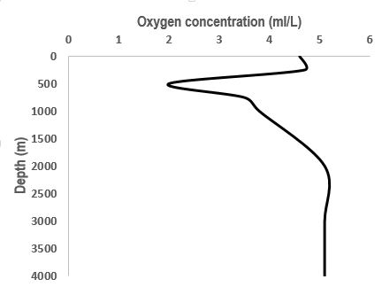
Marine
Education
The Shadow Zone – Describe how thermoclines and nutrients produce the oxygen minimum within the open ocean
Name:
Date:
marineeducation.com.au
The Oxygen Minimum is…
200-1000m
Where dissolved oxygen is at its ‘minimum’
Where permanent thermoclines slow down the falling motion of any dead organic matter (called ‘marine snow’)
Where a rich source of food (i.e. nutrients) accumulate
Where organisms deplete oxygen during respiration and decomposition (i.e. decomposing bacteria)
Where the two principal sources of oxygen for the oceans (gas diffusion and photosynthesis) do NOT exist
O2 min.
Why is there NO gas diffusion or photosynthesis in the oxygen minimum? (circle correct ans.)
Ans. Because it is too [deep] [shallow] for the diffusion of oxygen from the atmosphere, and because there is [too much] [not enough] light for photosynthesis.
Who was hiding in the shadow zone?
NAVY ships and sub-mariners use sonar (sound waves) to be able to ‘see’ underwater and to detect other submarines. Back in the 60’s, before modern sonar, the ocean offered some great secret hiding places. At the base of the mixed layer where the thermocline begins, sound refracting upwards and downwards would create a ‘shadow zone’ where submarines would hide with almost complete immunity. Under certain temperature conditions, it was possible for a submarine beneath the mixed layer to be undetected at ranges of as little as 50m^{[1]}.
Activity: Write 5 dot points of information about the O2 Minimum layer that you did not know before:
^{[1]} Roger Revelle, John Lyman, Charles L., Bretschneider, Bernard J. Le Mehaute, Rear Admiral W. H. Groverman, U.S. Navy; Captatin E.T. Harding, U.S. Navy; Captain T.K. Teadwell, U.S. Navy, Walter I. Wittmann, Sitney R. Galler, I. Eugene Wallen, Gilbert Jaffe, Maurice Ewing, Richard C. Vetter, Captain Stevel N. Anastasion, U.S. Navy, Donald L. McKernan, Athelstan Spilhaus, Robert B. Abel, Commander Robert J. Alexander, U.S. Navy. Edited by Captain E. John Long, U.S> Naval Reserve (Retired) (1964). Ocean Sciences. United States Naval Institute, Annapolis, Maryland. Library of Congress Catalogue Card Number 64-18472.
© Marine Education 2023 CC BY-NC-SA
Unit 1 Topic 1 Science Understanding

Slide 15
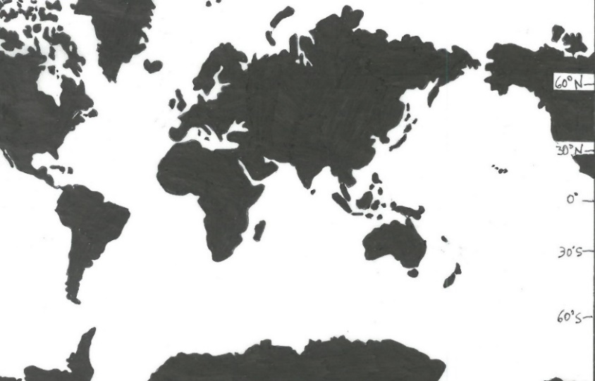
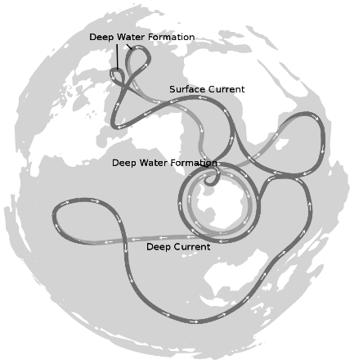
Marine
Education
The Global Ocean Conveyor Belt – Explain how thermohaline circulation in the deep ocean is affected by salinity and water density
Name:
Date:
marineeducation.com.au
The DEEEEP Ocean circulation
Thermohaline circulation (i.e. currents) in the deep ocean arise from density differences between water masses that differ in temperature (‘thermo’) and/or salinity (‘haline’). In other words, think of a water mass as a deep water current moving from one place to another (over very long distances, very slowly). Water masses generally do not mix. Instead, they are stacked, one on top of the other, in the order of their density - with the most dense (heaviest) to the bottom. The density of a water mass depends on its temperature and salinity. Cold water is more dense than warm water (because, in cold water, molecules move slower and closer together). Salt water is more dense than fresh water (because it has salt in it). Therefore, a water mass that is very cold and salty, is very dense, and found at the bottom of the stack.
Activity: Melt dye-stained ice in water. Observe current flow
Activity: Circle the correct answer and finish the sentence:
Cold water [sinks] [floats] because…
Q. Where is water very cold, salty and dense, and sinks all the way to the bottom of the ocean like an underwater waterfall?
Equator
Antarctica
Gulf Stream
ice
See-through container filled with tap water (i.e. beaker)
Global Ocean Conveyor Belt
A water mass will only descend to a depth that is appropriate to its density, sliding under less dense water and cruising over more dense water. The water mass then travels across entire oceans as an internal wave before it is redirected towards the surface as an ‘upwelling’ to mix with surface currents.
An oversimplified model of both deep and shallow water circulation depicts a global ocean conveyor belt of water movement. It is commonly referred to as the ‘global conveyor belt’ or ‘thermohaline circulation’.
Activity: Draw the Global Conveyor Belt on the map below
Figure 1 : The Global Conveyor Belt on a continuous-ocean map, with shallow water flows as the darkest flow lines^{[1]}
^{[1]} Avsa (2020). Oceans-image.svg, CC BY-SA 3.0. Wikapedia. Accessed 01/07/2020 from: https://commons.wikimedia.org/w/index.php?curid=8385268
© Marine Education 2023 CC BY-NC-SA
Unit 1 Topic 1 Science Understanding

Slide 16
Marine
Education
Are you up for the challenge? – Identify reasons why knowledge of the oceans is limited and requires further investigation
Name:
Date:
marineeducation.com.au
Activity: Identify reasons why knowledge of the oceans is limited and requires further investigation by completing the PEEL (Point, Evidence, Explain, Link) paragraph and referencing the reasons (stimulus) below.
Reason #1
Lack of sampling and expertise
Knowledge is limited because of a lack of sampling and taxonomic expertise. It is estimated that only 20-30% of all marine species have been discovered^{[1]}.
Reason #2
Challenging conditions
Knowledge is limited because of the challenges working underwater. Working underwater requires special equipment that is expensive and limited in scope^{[2]}.
Reason #3
Data-poor fisheries
Knowledge is limited because of the correlation between the value of a fishery and the amount of data collected on it. Fisheries considered of little value are allocated smaller amounts of time and money^{[3]}.
The first sentence of the PEEL paragraph states your main POINT or argument. The first sentence is already done for you….
Someone might read this and ask, ‘But what do you mean?’ or, ‘How do you know that is true and correct?’…’Prove it!’. You CAN’T just make a statement and NOT back it up with evidence and reason! Your chance to ‘prove it’ comes up next, in the sentences that follow…..
“Knowledge in the oceans is limited and requires further investigation.”
Find 3 pieces of EVIDENCE from the stimulus provided at the top of the page to complete the sentences below:
Evidence #1 (i.e. finish the first sentence in Evidence #1)
Evidence #2 (i.e. finish the first sentence of Evidence #2)
Evidence #3 (i.e. finish the first sentence of Evidence #3)
Explain your 3 pieces of evidence by providing more detail from the stimulus at the top of the page and complete the sentences below:
Explain Evidence #1 (i.e. the second sentence in Evidence #1) (in text citation).
Explain Evidence #2 (i.e. the second sentence of Evidence #2) (in text citation).
Explain Evidence #3 (i.e. the second sentence of Evidence #3) (in text citation).
Firstly, knowledge is limited because …
For example,…
Secondly, knowledge is limited because …
In addition,…
Lastly, knowledge is limited because …
Furthermore,…
How does this paragraph LINK to your next paragraph? Complete the last sentence:
As a result, knowledge in the oceans is limited. Further investigation may include (topic of paragraph to follow)…
^{[1]} Appeltans, W., Ahyong, S. T., Anderson, G., Angel, M.V., Artois, T., et al., (2012). The Magnitude of Global Marine Species Diversity. Current Biology. Volume 22, Issue 23, Pages R996-R997. DOI: 10.1016/j.cub.2012.09.036
^{[2]} Costello, M.J, Coll, M., Danovaro, R, Halpin, P., Ojaveer, H. and Miloslavich, P. (2010). A Census of Marine Biodiversity Knowledge, Resources, and Future Challenges. PLoS ONE 5(8): e12110. DOI: 10.1371/journal.pone.0012110
^{[3]} Bentley, N. (2014). Data and time poverty fisheries estimation: potential approaches and solutions. ICES Journal of Marine Science. 72:1:186-193. DOI:10.1093/icesjms/fsu023
© Marine Education 2023 CC BY-NC-SA
Unit 1 Topic 1 Science Understanding

Slide 17
Marine
Education
Money Talks – State that decisions relating to resource management are affected by the economic development of a nation and the value placed on marine environment
Name:
Date:
marineeducation.com.au
The Exclusive Economic Zone (EEZ)
The ocean is divided into zones and areas (sort of like how we divide up land into countries and states). For starters, every coastal nation has an Exclusive Economic Zone, or EEZ, the area of sea that extends out from a country’s shoreline to 200 nautical miles offshore. Each country has exclusive rights within its EEZ to exploit, conserve and manage the natural resources there, including marine life, minerals, fossil fuels, and renewable energy sources. Some countries sub-divide their EEZ’s into areas with special restrictions, such as a marine park. The area of ocean outside the EEZ is called the ‘high seas’. The resources in the high seas are ‘common’ heritage, which means they are shared, managed and governed by all countries. The ‘Tragedy of the Commons’ is thus a concern. The tragedy being overexploitation in the absence of regulation.
You are 200 nautical miles from land!
The High Seas
Australia’s EEZ
Q. What do the E’s in EEZ stand for? Ans.
Money Talks
Let’s face it. Money talks. If mining for oil and gas on a pristine patch of reef did not bring in billions of dollars, it simply would not happen. The learning objective for this lesson is one you already know too well….that money shapes many of our decisions….including those relating to resource management.
Where do you stand?
Activity: Divide the room into 3 sections: (1) The Economy (2) The Environment (3) The People
$$$$
Stand in the section that you think decision-makers consider the most when making resource management decisions (i.e. what do they value?). If you think it’s all three, stand in the middle. Discuss your reasoning. Tally where people are standing & record in the table, pictured right.
Now move to the section that you think decision-makers should consider the most (note: it has to be sustainable) Discuss your reasoning. Tally where people are standing & record in the table, pictured right.
 | The Economy | The Environment | The People | All 3
Tally
 | The Economy | The Environment | The People | All 3
Tally
ESD or Ecological Sustainable Development states that a ‘sustainable’ decision requires all three sections (in the activity above) to be given equal consideration. Those who stood in the middle for qu.2 will make very good resource managers one day! Activity: Google ‘Triple Bottom Line’ (images)
© Marine Education 2023 CC BY-NC-SA
Unit 1 Topic 1 Science Understanding

Slide 18
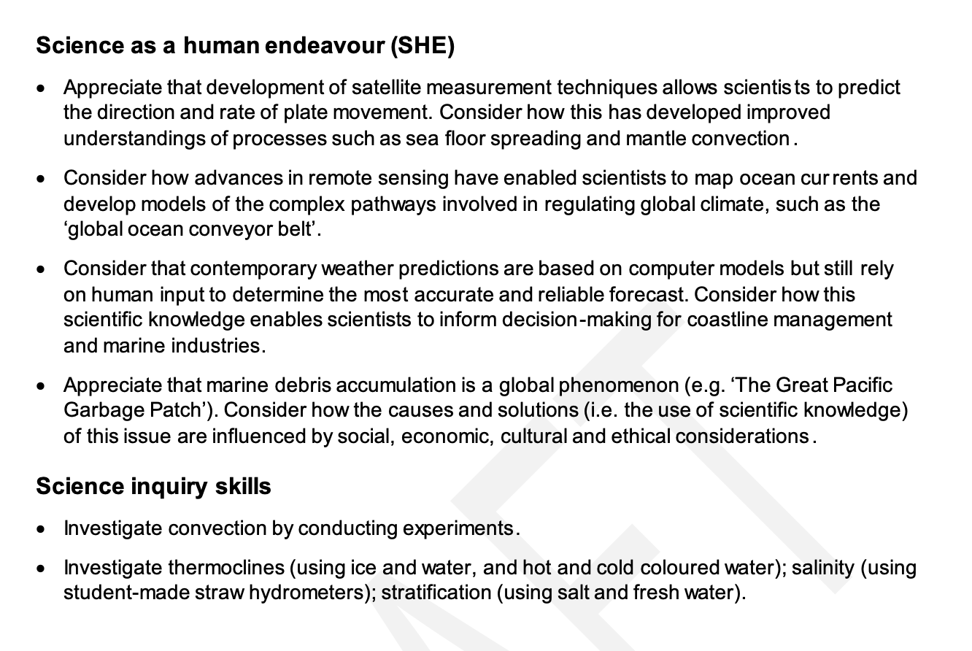
Marine
Education
Unit 1 Topic 1: An ocean planet
SHE and SIS
Name:
Date:
marineeducation.com.au
© Marine Education 2023 CC BY-NC-SA
Unit 1 Topic 1 Science as a Human Endeavour

Slide 19
Marine
Education
Sky high – Appreciate that development of satellite measurement techniques allows scientists to predict the direction and rate of plate movement. Consider how this has developed improved understandings of processes such as sea floor spreading and mantle convection
Name:
Date:
marineeducation.com.au
© Marine Education 2023 CC BY-NC-SA
Unit 1 Topic 1 Science as a Human Endeavour

Slide 20
Marine
Education
Tracking… Consider how advances in remote sensing have enabled scientists to map ocean currents and develop models of the complex pathways involved in regulating global climate, such as the ‘global ocean conveyor belt’.
Name:
Date:
marineeducation.com.au
© Marine Education 2023 CC BY-NC-SA
Unit 1 Topic 1 Science as a Human Endeavour

Slide 21
Marine
Education
Cloudy with a chance of meatballs – Consider that contemporary weather predictions are based on computer models but still rely on human input to determine the most accurate and reliable forecast. Consider how this scientific knowledge enables scientists to inform decision-making for coastline management and marine industries.
Name:
Date:
marineeducation.com.au
© Marine Education 2023 CC BY-NC-SA
Unit 1 Topic 1 Science as a Human Endeavour

Slide 22
Marine
Education
Dodgy Debris – Appreciate that marine debris accumulation is a global phenomenon (e.g. ‘The Great Pacific Garbage Patch’). Consider how the causes and solutions (i.e. the use of scientific knowledge) of this issue are influenced by social, economic, cultural and ethical considerations
Name:
Date:
marineeducation.com.au
© Marine Education 2023 CC BY-NC-SA
Unit 1 Topic 1 Science as a Human Endeavour

Slide 23
Marine
Education
Convection prac – Investigate convection by conducting experiments.
Name:
Date:
marineeducation.com.au
© Marine Education 2023 CC BY-NC-SA
Unit 1 Topic 1 Science Inquiry Skills

Slide 24
Marine
Education
Thermocline, hydrometer & stratification pracs
Investigate thermoclines (using ice and water, and hot and cold coloured water); salinity (using student-made straw hydrometers); stratification (using salt and fresh water).
Name:
Date:
marineeducation.com.au
© Marine Education 2023 CC BY-NC-SA
Unit 1 Topic 1 Science Inquiry Skills

Slide 25
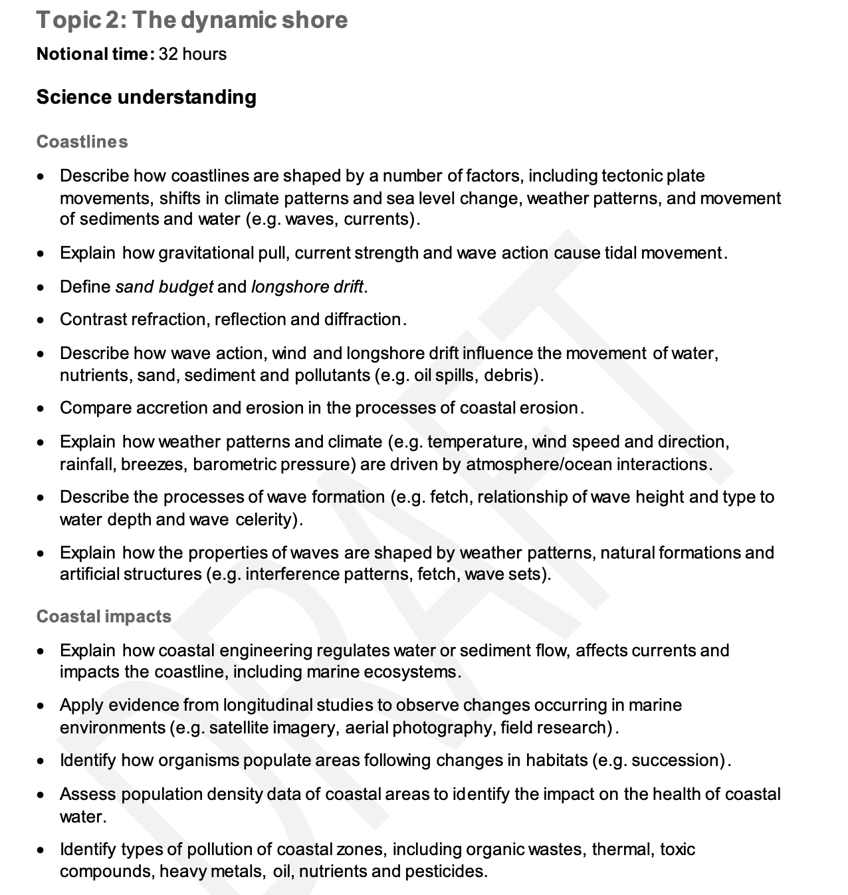
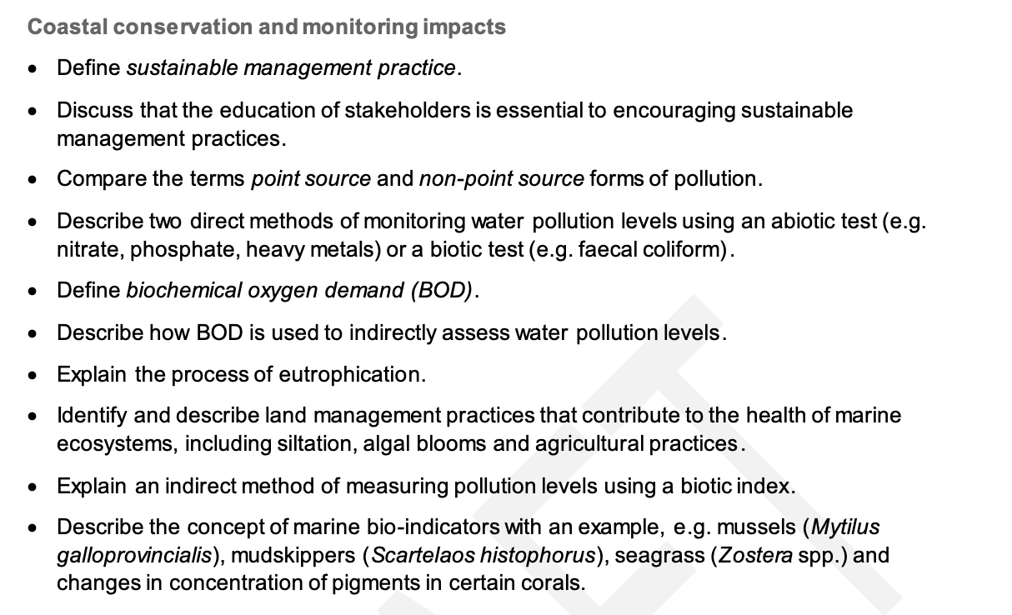
Marine
Education
Unit 1 Topic 2: The dynamic shore
Science Understanding
Name:
Date:
marineeducation.com.au
© Marine Education 2023 CC BY-NC-SA
Unit 1 Topic 2 Science Understanding

Slide 26
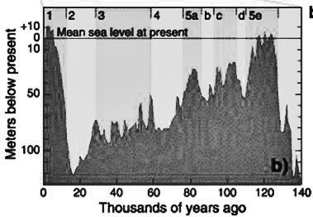
Marine
Education
The Dynamic Shore – Describe how coastlines are shaped by a number of factors, including tectonic plate movements, shifts in climate patterns and sea level change, weather patterns, and movements of sediments and water (e.g. waves, currents)
Name:
Date:
marineeducation.com.au
Geological Time Travel
The coastline that you see today looked very different 17,000 years ago when sea levels were much lower. In fact, it was so low, there was a land bridge between Tasmania and Victoria. Rewind even further back in time – millions of years ago – and the coastline was unrecognisable. Probably because it was still attached to Antarctica! So, what you see today is very different to what it looked like in the past, and perhaps very different to what it will look like in the future. Activity: Study the graph pictured right. Q. How far above sea level was the ground you are now standing on, 17,000 years ago? Ans.
Sea level rise and fall over time
17,000 years ago….
Land bridge between Tasmania & Victoria
b)
b)
Figure 1: Sea level change over time. Source: Wikapedia (2017). Past Sea Level.
Accessed 2018 from: https://en.wikipedia.org/wiki/Past_sea_level. CC BY-SA 3.0.
Activity: Complete the table below
Factors shaping our coastlines | How? | Provide One Example of a coastline feature (living or non-living) in your region that only exists because of this factor
Tectonic Plate Movements | Tectonic plate movements create mountain ranges, islands, headlands and underwater bathymetry | Q. Any large mountain ranges, islands or headlands
Shifts in Climate Patterns | Climate (average rainfall and temperature) determines what plants and animals live and thrive best there. | Q. Any rainforests? Coral bleaching? Flora/fauna?
Sea Level Change | Sea Level rise submerges the coastline. Whereas, sea level fall exposes the coastline to the elements. | Q. Any extensive shallow area? Any elevated, layered cliffs?
Weather Patterns | Weather patterns determine the amount of rain that falls, as well as the direction and the energy of the wind. | Q. Any big rivers (from lots of rain)? Is it wind-swept?
Movements of Sediment and Water | Waves and currents move, and drop, sediment (i.e. sand, mud, gravel, etc.). | Q. Where do you find lots of sand or mud or gravel?
Q. Will your house be under water in 2100? Go to www.coastalrisk.com.au to find out! Ans.
[Yes][No]
Circle your answer
Circle your answer
© Marine Education 2023 CC BY-NC-SA
Unit 1 Topic 2 Science Understanding

Slide 27
Marine
Education
Tide Trickery – Describe how gravitational pull, current strength and wave action cause tidal movement
To download tide charts, go to www.bom.gov.au (marine and ocean tab)
Name:
Date:
marineeducation.com.au
(designed for tourist snorkellers)
Activity: On the signs below, complete a ‘tide report’ for today and tomorrow
Tide Report Location:
Moon Phase:
Heights and Times for tides today….
Tide Report Location:
Moon Phase:
Heights and Times for tides tomorrow….
Q. If I want to snorkel the same tide height tomorrow, how much later in the day will it be? Ans.
Q. Which day and time has the largest tidal range (difference between high tide and low tide)? Ans.
Q. Which day and time will the current be strongest (and for snorkellers to avoid)? Ans*.
*Note: tidal currents are strongest half way between high tide and low tide (Rule of Twelfths). Calculate using the largest tidal range from your previous ans.
Sun
Lunar Logic
The ‘tidal bulge’ is a bulge of water that is pulled towards the moon’s position due to gravity. A second tidal bulge exists on the opposite side of Earth due to centrifugal forces. Notably, the sun does the same thing, however the force of the pull is comparatively smaller. The moon takes one lunar month to orbit earth. When the sun, earth and moon are all positioned in a straight line (full moon or new moon), the earth experiences its highest and lowest tides for the month, called spring tides. When the sun, earth and moon are positioned as a right angle (half moon), the earth experiences its smallest tides for the month, called neap tides.
Earth
Activity: In the picture above, draw the location of the moon and tidal bulges for today
Q. Are the tides today closer to a spring tide or a neap tide? Ans.
Passing tidal waves
The tide is actually classed as a ‘shallow water wave’ (do not get confused with a ‘tidal wave’ or ‘tsunami’ – that is completely different again). A shallow water wave (as opposed to a deep water wave) makes contact with the sea floor. In this case, the wave crest (highest point of the wave) is the tidal bulge (with one on each side of Earth) and the wavelength (distance between 2 crests) stretches 1000’s of kilometres & hugs every contour of the sea floor. Because the sea floor differs in shape, and the moon changes position (& declination) every day, the tides are different everywhere and every day.
Q. Can a strong wind change the direction or strength of the flow of the tide? Ans. [Yes] [No ]
© Marine Education 2023 CC BY-NC-SA
Unit 1 Topic 2 Science Understanding

Slide 28
Marine
Education
Shifty Sand – Define sand budget and longshore drift
Name:
Date:
marineeducation.com.au
Suggested Practical: Visit a sandy beach soon after a big storm and measure the slope of the beach. Take with you a level metre ruler and tape measure. Hold the ruler horizontal, point it towards the ocean, and with one end on the sand dune, measure the height of the other end above the sand. Repeat, working your way down to the water. Graph the results. Come back in six months and repeat. Q. Does the beach profile (slope) change over time? Ans.
[Yes] [No]
Circle your answer
A Sand ($) budget
Imagine the beach as your bank account. The more sand you have on your beach, the more money in your bank account! During periods of calm weather, sand accumulates on the beach because the waves are small and weak (constructive waves). Your bank account is looking great, and so is the amount of sand on your beach. Then, the weather turns rough and windy, and the waves are big and destructive (destructive waves). The backwash is strong and large chunks of sand are scooped off the beach and dumped out in the water, making sandbanks. So now all your money sits in the many sand banks in and behind the surf break. Now you have to be patient and wait for the weather to settle into a regular pattern of constructive waves before you will see the sand, and your money, back on the beach.
Q. What type of wave removes sand from the beach? Ans. [constructive] [destructive]
Circle correct answer
A river of sand
‘Longshore drift’ is the term given to a process that slowly transports sand along a coastline, in the general direction of the prevailing wind and waves. For example, approximately 500,000 cubic metres of sand crosses the border of NSW into Qld every year due to longshore drift and the south-east trade winds^{[1]}. The sand slowly creeps its way north by zig-zagging back and forth with the swash and backwash. Q. What is swash? Ans.
Q. What is backwash? Ans.
N
Longshore Drift (of sand)
W
E
beach
S
Prevailing wind and wave direction
swash
backwash
Activity: Complete the table below
Term | Definition
Sand Budget
Longshore Drift
^{[1]}Johnson, D. (2004). The Geology of Australia. Cambridge University Press, Cambridge, UK. Page 198.
© Marine Education 2023 CC BY-NC-SA
Unit 1 Topic 2 Science Understanding

Slide 29
Marine
Education
Wave Wrap – Contrast refraction, reflection and diffraction
Name:
Date:
marineeducation.com.au
Quick Quiz
When a wave encounters an obstruction in its path, what happens to the wave? Does it…
Appear to ‘bend’ towards the obstruction
Bounce off the obstruction in the total opposite direction
Appear to ‘wrap around’ the obstruction
Refraction
If you picked answer (a) appear to ‘bend’ towards the obstruction, you would be correct. But only if the obstruction changes the depth of the water, such as a headland. E.g. the first part of the wave to encounter shallow water, slows down first, whilst the rest of the wave continues to travel at normal speed. Thus, the wave (overall) appears to ‘bend’ towards the obstruction. This is called ‘refraction’.
Reflection
If you picked answer (b) bounce off the obstruction in the total opposite direction, you would also be correct. But only if the obstruction was wide enough to stop the wave, and steep enough to push it back the other way, such as a rock wall. This is called ‘reflection’.
Diffraction
If you picked answer (c) appear to ‘wrap around’ the obstruction, you would also be correct. But only if the wave can gain access to the area ‘behind’ the obstruction (in which it wraps around), such as around an island, a gap between two obstructions, or again, a headland. This is called ‘diffraction’.
Activity: Complete the table below
Term | Definition
Refraction
Reflection
Diffraction
headland
Rock wall
obstruction
© Marine Education 2023 CC BY-NC-SA
Unit 1 Topic 2 Science Understanding

Slide 30
Marine
Education
All aboard! – Describe how wave action, wind and longshore drift influence the movement of water, nutrients, sand, sediment and pollutants (e.g. oil spills and debris)
Name:
Date:
marineeducation.com.au
The Particle Parade
Particles include items such as sediment, pollutants, debris and nutrients. Particles travel downstream. They either float, travel as suspended particles, as bed load or dissolved (see below) depending on their shape, size, density and solubility as well as the energy of the water (wave, wind and current strength).
Floating
Suspended
Dissolved
(in solution)
as Bed load
Q. How might a tiny, flat, buoyant piece of micro-plastic travel in water? Ans.
Activity: Roll a full water bottle containing particles of assorted shape, size and density. Roll fast and slow. Observe particle movements. Next, stand bottle upright and observe settling rates. Apply your observations to the placement of particles (and energy levels) along a coastline.
Activity: In the box below, draw arrows at right angles to the lines of incoming wave crests to demonstrate the direction and force of the wind and wave energy that move particles in the water.
Creek
Not to scale!
Beach sand
Beach sand
Headland
Headland
& Pebbles
& Pebbles
Rock
Rock
Marine Debris (pronounced ‘deb-bree’) is a word used to describe waste items that drift in the ocean or wash up on the shoreline. For example, tiny pieces of plastic (‘micro-plastics’) hiding between grains of sand, discarded fishing nets, cigarette butts and straws are all forms of marine debris.
Q. Where might tiny pieces of plastic be found washed up in the picture above? Ans.
A nutrient is simply a substance that stimulates the growth of algae and plants. Examples include substances containing nitrogen, phosphorus, or silicon (i.e. nitrates NO3). Nutrients are measured in parts per million (not much is required!). Harmful sources of excess nutrients include untreated sewage and fertilisers in rainfall runoff. Dissolved nutrients go wherever the water goes.
Q. Where might excess nutrients be found in the picture above? Ans.
© Marine Education 2023 CC BY-NC-SA
Unit 1 Topic 2 Science Understanding

Slide 31
Marine
Education
The Sea-Saw of Sand – Compare accretion and erosion in the processes of coastal erosion
Name:
Date:
marineeducation.com.au
Activity: In the boxes below, draw a definition for weathering, erosion and transport, and deposition
Weathering breaks apart rock into particles (either physically &/or chemically)
Erosion lifts particles. Transport moves particles to new places
Deposition drops (deposits) the particles
Accretion is an accumulation of particles.
Activity: Use a thesaurus to find other words that mean ‘accretion’. Write them in this box:
Processes of Coastal Erosion
Coastal erosion occurs when rates of erosion exceed rates of accretion. Remember the sand budget? Erosion occurs when there are more outputs of sand, than inputs of sand to a beach. For example:
Inputs (minus) Outputs = Balance
Longshore drift delivering sand to beach Rivers suppling the beach with sand Constructive waves bringing sand onshore | Longshore drift taking sand away Destructive waves moving sand offshore | Accretion ☺ (+) Erosion ☹ (-) Steady state (0)
Activity: Calculate the balance for the hypothetical sand budget below:
Q. Is the sand budget balance in a state of accretion, erosion or steady? Ans.
Total Inputs: 510,000 cubic metres
(minus)
Total Outputs: 550,000 cubic metres
=
Balance:
Activity: Describe the processes of coastal erosion in terms of accretion and erosion:
© Marine Education 2023 CC BY-NC-SA
Unit 1 Topic 2 Science Understanding

Slide 32
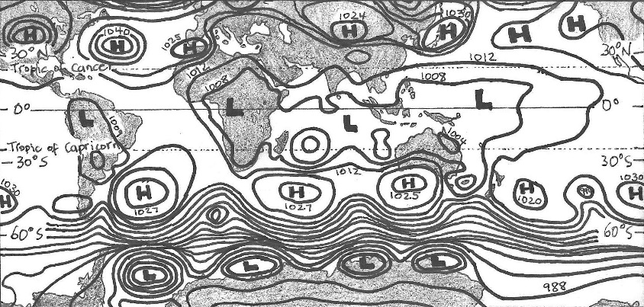
Marine
Education
Well, blow me down – Explain how weather patterns and climate (e.g. temperature, wind speed and direction, rainfall, breezes, barometric pressure) are driven by atmosphere/ocean interactions
Name:
Date:
marineeducation.com.au
Under Pressure
Atmospheric pressure is essentially the pressure exerted by the weight of the atmosphere. It is measured with a barometer in hectopascals. The lines (isobars) on a weather map (synoptic chart) connect areas of equal pressure. For example, a person standing at Point A (pictured right) has the same atmospheric pressure reading on their barometer as a person standing at Point B. The weight of the air at Point A & B is the same.
1004
A
L
1008
1016
B
H
996
Q. What do the isobars on a synoptic chart connect?
Ans. areas of [equal][different] pressure (circle correct ans.)
1012
Synoptic Signs
If the pressure is low (L) it is raining (or snowing). If the pressure is high (H) it is calm and sunny.
If the isobars (lines) are close together, it is very windy. Activity: On the synoptic chart below, shade in the windy areas, and draw umbrellas in the boxes next to the Lows (L). Note: 60-90°N lat. is not shown.
Q. What patterns do you identify?
Ans.
Figure 1: Interactive Weather and Wave Forecast Map for 14.01.2018 at 1200 hours (www.bom.gov.au).
Hadley, Ferrel and Polar pack a punch
Global wind patterns are created by 3 massive convection current cells in each hemisphere, as pictured below. These cells, of rising and falling air, create the predictable wind patterns that shape our climate and drive our ocean currents. Q. What is the heat source for the Hadley cell? Ans. the S u n .
Upper atmosphere
Jet
Streams
Why wet summers and dry winters?
Locations such as Darwin have wet summers and dry winters because of the changing position of the sun and convection cells. For example, in summer, the sun in Darwin is overhead. It is hot. Warm air is rising and it is the wet season. During winter, the sun is in the northern sky. It is not so hot. Cold air is sinking over Darwin and it is mostly dry and calm.
Q. What cell influences N^{th} Qld. weather?
Ans.
Cold air falling
POLAR CELL
Warm air rising
FERREL CELL
Cold air falling
HADLEY CELL
Warm air rising
HADLEY CELL
Cold air falling
FERREL CELL
Warm air rising
POLAR CELL
Cold air falling
Sea level
Trade
Winds
High
Low
High
Low
High
Low
High
90°N
60°N
30°N
0°
30°S
60°S
90°S
Nth Pole
Equator
Sth Pole
Hadley, Ferrel and Polar Cells positioning when sun is above equator
© Marine Education 2023 CC BY-NC-SA
Unit 1 Topic 2 Science Understanding

Slide 33
Marine
Education
Surf’s Up – Describe the processes of wave formation (e.g. fetch, relationship of wave height and type to water depth and wave celerity).
Name:
Date:
marineeducation.com.au
Wave Characteristics
Crest: Highest point of the wave
Wavelength (λ): Distance between crests
Trough: Lowest point of the wave
Wave Period (T): Time between crests (sec.)
Wave Speed (Celerity*): λ / T Activity: Label the crest, trough and wavelength
Wave height
*Physicists use the word ‘celerity’ instead of ‘speed’, to remind themselves that it’s the energy (not the mass) of the wave that is in motion.
The Orbitals
A wave represents ENERGY travelling through the water. The water itself does not flow along with the wave crest. Instead, the water particles circle up, down and back up again in a circular motion as the wave passes overhead (called an ‘orbital’). For example, fishing line bobbers move up and down as waves pass but are not carried along with the wave. These markers demonstrate that wave energy is moving through the water, but there is little lateral transport of the water itself*. Similarly, when surfers duck-dive a wave, their boards are propelled by the movement of the orbitals going in the same direction as the surfer – towards the back of the wave. Q. What is the circular motion of water particles in a wave called? Ans. An O _ _ _ _ _ _
Direction of wave ENERGY flow
Wave Break
The orbitals get progressively smaller with depth. At a depth of half the wavelength, the orbitals are so small, they are no longer detectable (called a ‘deep water wave’).
However, if the seafloor is at a depth of less than half the wavelength, the orbitals come into contact with the seafloor and erosion of the seafloor occurs (called a ‘shallow water wave’).
Upon making contact with the seafloor, the orbitals become ‘squashed’. Squashed orbitals slow down the wave’s advance towards shore, due to friction. As a result, the wavelength becomes shorter and shorter and the wave height becomes taller and taller, until it breaks at a depth 1.3 x the wave height.
Q. What depth will a wave break if the wave height is 2m.? Ans. = _____m
1.3 x wave height
λ ⁄ 2
Erosion of the seafloor occurs
The wave breaks when the depth is 1.3 x wave height
At a depth half the wavelength, orbitals do not contact the seafloor
(called a ‘deep water wave’)
At a depth less than half the wavelength,
orbitals do contact the seafloor
and become squashed
(called a ‘shallow water wave’)
Fetch Qu.: Why can’t waves get really big when cyclonic winds blow on a small dam or lake?
© Marine Education 2023 CC BY-NC-SA
Unit 1 Topic 2 Science Understanding

Slide 34
Marine
Education
That’s just Swell – Explain how the properties of waves are shaped by weather patterns, natural formation and artificial structures (e.g. interference patterns, fetch, wave sets)
Name:
Date:
marineeducation.com.au
Wave Size
Waves grow in size depending on 3 factors about the wind:
Strength. How strong is the wind? The stronger the wind, the bigger the wave.
Duration. How long has the wind been blowing for? The longer the time, the bigger the wave.
Fetch. How far does the wind blow? The longer the distance, the bigger the wave. Note: If the fetch is small (i.e. your pool) the waves will never, ever, grow big.
Activity: Go to windy.com and compare the ‘wind’ data to the ‘waves’ data. Go to bom.gov.au and compare the synoptic charts to the wave maps (marine & ocean)
Q. Why does the Southern Ocean have such big waves? (address all 3 factors above) Ans.
Activity: Find a surf cam online (live video feed of surf conditions). Go to bom.gov.au and find the current wind speed in knots for that location (Qld…Observations…). Record your findings below:
Location: Wind Speed in knots:
Find a marine Beaufort Scale. Q. What should waves look like for that wind speed? Ans.
Q. Are the waves on the surf cam the same as on the Beaufort Scale? Ans. …Why?
Revisit 3 factors
[Yes] [No]
Swell’s rolling in!
Ever noticed how big waves can turn up on days with no wind? How does that happen? Waves can travel long distances. E.g. a cyclone at Fiji can generate massive waves that travel all the way to Queensland, far away from the cyclone. These waves are known as swell or groundswell and have a wave period of >10sec., creating the slow up-and-down movement of the sea (causing sea-sickness!).
Q. True or False? Swell direction is the direction the wave is coming from (not going to). Ans.
Wave Interference Patterns
This diagram represents what happens to the water when two waves are travelling in the same direction, but at slightly different speeds. When the crests and troughs overlap each other, the water rises high (constructive interference). When the crests and troughs alternate, one cancels out the other, and the water does not rise (destructive interference). Constructive interference causes wave sets, and destructive interference causes gaps between wave sets.
2 waves travelling in the same direction, but at slightly different speeds
Destructive
Interference
Constructive
Interference
The end result….what we see….are the wave sets!
Q. What are two types of wave interference? Ans. C _ _ _ _ _ _ _ _ _ _ _ & D _ _ _ _ _ _ _ _ _ _
© Marine Education 2023 CC BY-NC-SA
Unit 1 Topic 2 Science Understanding

Slide 35
Marine
Education
Engineering Marvels or Mayhem? – Explain how coastal engineering regulates water or sediment flow, affects currents and impacts the coastline, including marine ecosystems
Name:
Date:
marineeducation.com.au
The Issue of Beach Erosion
Beach erosion would not be an issue if there were no people living along the coastline. River mouths would shift from left to right along the coastline. Sand would shift from offshore to onshore with the seasons and storms. Sand would cross river mouths and hug coastlines on its northbound longshore drift. Sandbars would appear and disappear. Bars would change location. Vegetation would be left to trap sand and build dunes. Over longer time scales, sea levels would rise and fall. However, given their beauty, productivity and roar energy, it’s no mystery why people have flocked to live at the beach – maybe a little too close. Coastal engineering is designed to protect property and infrastructure by regulating water and sediment flow. Pictured below are 3 broad categories of current strategies used to combat the issue of beach erosion.
Current strategies for combatting Beach Erosion
Engineer Structures
Move the sand from here to there.
Do Nothing.
Let it erode.
Groyne (wall perpendicular to shore)
Rock Wall (parallel, on the shore)
River Training Wall (river mouth)
Artificial Reef (acts as a barrier)
Breakwaters
Sand bypass system
(suck here, dump there)
Beach nourishment (tractor in sand to beach)
Plan a ‘Retreat’ Policy People are not allowed to protect their property – people must retreat along with the sand. Often ends up in court. E.g. Byron Bay
Activity: Apply your knowledge of longshore drift to explain the before & after scenes below
Ocean
Before
After
Groyne
Longshore Drift
Beach (sand)
© Marine Education 2023 CC BY-NC-SA
Unit 1 Topic 2 Science Understanding

Slide 36
Marine
Education
Information in Imagery – Apply evidence from longitudinal studies to observe changes occurring in marine environments (e.g. satellite imagery, aerial photography, field research)
Name:
Date:
marineeducation.com.au
Maxed out Maps
We all know that maps have been around for a very long time. People have been using maps for navigation and linking map objects together to derive information since the Middle Ages. However, recent developments, such as powerful computers, satellites, web-based development and internet map servers, have turned the humble old map into a powerful analytic tool. For example, satellite images capture and document changes to a landscape over time. Scientists use this information to model and predict what the future will bring, to inform management when making important decisions.
Image 1
image 2
Computer models and predictions
?
Decision-making
time
Image 3
Activity: Find a mapping project on the Great Barrier Reef. Describe their methods below:
The Beauty of Photographs
Photographs give maps so much more detail and information to work with. Photographs can be taken by satellites, drones and aircraft (aerial photography) or manually with a camera (during field research) to provide some great information. Particularly if taken repeatedly over time. For example, a longitudinal study is a research design method that observes the same subjects repeatedly over long periods of time, sometimes decades. Only then can you get a real sense of what’s going on.
Q. What is a longitudinal study? Ans.
What is the meaning of this?!
GIS or Geographic Information System is a computer software program that many researchers use to visualise, question, analyse and interpret mapping data to understand relationships, trends and patterns. GIS is also used to model future events, such as what would happen if the sea level rose by one metre.
Q. What computer software program is commonly used by researchers into mapping? Ans. _ _ _
Q. What event is documented in the images below? Ans.
26°C
34°C
26°C
Healthy
coral
Bleached
coral
Dead
coral
algae
August 2015
February 2016
August 2016
© Marine Education 2023 CC BY-NC-SA
Unit 1 Topic 2 Science Understanding

Slide 37
Marine
Education
Success-ion – Identify how organisms populate areas following changes in habitats (e.g. succession)
Name:
Date:
marineeducation.com.au
Disturbance Events (that change ecosystems and habitats)
A “disturbance” is regarded as an event of intense environmental stress, forcing change upon an ecosystem. Examples include floods, cyclones, crown of thorns outbreaks and coral bleaching. A disturbance event can smother, scour and dislodge marine organisms and damage their physical habitat, creating patches of free space on coral reefs and in mussel beds and gaps in the canopy of kelp and mangrove forests. Despite this impact, the corals, mussels, kelps and mangroves typically regenerate, demonstrating adaptations and a capacity to respond following natural disturbance. Occasionally, however, the original members of the community do not recover, and local populations go extinct or there is a shift of the community to a new state with a different composition of species and habitat features^{[1]}.
Q. What is a disturbance event? Ans.
Who’s to succeed?
Coastal marine life is constantly competing for space. The real estate game on the coast is brutal! When there is a disturbance, or when a new habitat forms (i.e. sand dune), free space becomes available! Woohoo! But who is going to get there first? The order in which species occupy a given space is called ‘succession’. The initial winners of the space do not stay there for long. They are replaced by other species which, in turn are replaced by different species again, in an ongoing battle for space, over time. The battle continues to change the habitat in, somewhat predictable, (‘serel’) stages of succession. For example, fast growing, r-selected species populate free spaces first (like weeds do on land), whilst slow-to-mature, K-selected species populate those areas last (like big trees do on land). The most competitively superior species, at the time, wins the space.
Q. What is succession? Ans.
Primary Succession of a Coral Cay
Types of succession include primary and secondary succession. Primary succession is when a community develops in a space that was never before occupied. Secondary succession is when a community develops in a space that was previously occupied (made available by a disturbance event). The development of a coral cay is a great example of primary succession. A coral cay is a small island made from coral fragments (as sand). Initially the island starts off as a sandbar. Birds visit the sand bar and poop. Seeds in the poop germinate and grow into trees. The trees trap more sand and the island grows in size. Activity: Indicate the correct order of the primary succession of a coral cay, below.
^{[1]}Connell S. D. and Gillanders G. M. (2007). Marine Ecology. Oxford University Press. Vic. Australia. pg.138. ISBN: 9780195553024
© Marine Education 2023 CC BY-NC-SA
Unit 1 Topic 2 Science Understanding

Slide 38
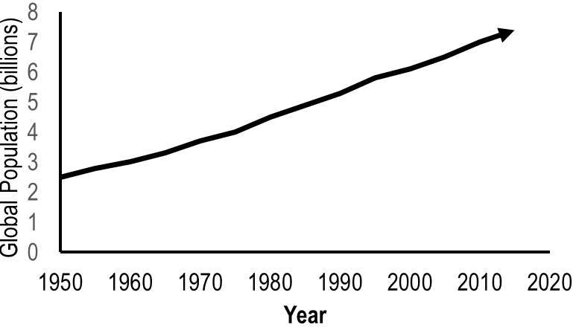
Marine
Education
Peeps – Assess population density data of coastal areas to identify the impact on the health of coastal water
Name:
Date:
marineeducation.com.au
T024
The Population Explosion
The global human population increases every year.
Activity: Go to www.worldometers.info
Q. What is the current global population? Ans.
Q. What was the global population in 1950? Ans.
Figure 1: Global Population (billions) over time^{[1]}.
Loving our coast to death
In Australia, 85% of people live within 50km of the coast with more people populating it every year^{[2]}. Why is this an issue? What do people do that’s so destructive to the health of coastal waters? First of all, we need to find a place to live (clearing vegetation that would normally function to keep oceans healthy). We need water to drink (building dams and stealing water from rivers). We need to eat (removing seafood stocks, clearing coastal habitat for aquaculture and polluting waterways with agricultural runoff). We need energy (supporting the mining of oil and gas and increasing CO2 emissions). We like to play (using noisy, oily boat engines and damaging anchors). And, we like to shop (more waste, more industrial pollution and more shipping requiring dredging and dumping of ballast water)!
Q. What percentage of people live within 50km of the Australian coast? Ans.
Activity: Indicate if the population is going up or down over time by drawing an arrow to identify a trend. Then, beneath the picture clues below, name the impacts of this trend on coastal waters.
Local Government Area (LGA) | Population^{[3]} |  |  | Trend? or
 | 2006 | 2010 | 2016
Gold Coast | 450,075 | 506,135 | 576,918
Brisbane | 987,831 | 1,073,144 | 1,184,215
Sunshine Coast | 236,654 | 263,053 | 303,389
Fraser Coast | 86,117 | 96,618 | 102,953
Bundaberg | 84,816 | 91,400 | 94,453
Gladstone | 52,051 | 57,697 | 63,288
Rockhampton | 74,204 | 78,193 | 81,589
Mackay | 103,567 | 113,669 | 117,703
Whitsunday | 30,255 | 32,140 | 34,626
Townsville | 159,482 | 176,528 | 192,058
Cairns | 131,843 | 148,943 | 162,451
Aerial View
Shipping
River
Dredge
Industrial Port
Plastic Bag
Turtle
^{[1]} Worldometers (2018). World Population. Accessed 2018 from: https://www.worldometers.info/
^{[2]} Clark GF & Johnston EL (2017). Australia state of the environment 2016: coasts, independent report to the Australian Government Minister for Environment and Energy. Australian Government Department of the Environment and Energy, Canberra.
^{[3]} Queensland Government Statistician’s Office (2016). Estimated resident population by local government area (LGA), Queensland, 2006 to 2016p. The State of Queensland (Queensland Treasury). Accessed 30.12.2017 from: http://www.qgso.qld.gov.au/products/tables/erp-lga-qld/index.php
© Marine Education 2023 CC BY-NC-SA
Unit 1 Topic 2 Science Understanding

Slide 39
Marine
Education
Pollution Playlist – Identify types of pollution of coastal zones, including organic wastes, thermal, toxic compounds, heavy metals, oil, nutrients and pesticides
Name:
Date:
marineeducation.com.au
Organic Wastes
When plants and animals die or defecate, the decay process uses up lots of oxygen. Large amounts of decay make oxygen levels dangerously low. Not good news for oxygen breathing animals! Activity: Draw an example of organic waste in the box
Thermal Pollution
Thermal means temperature. Thermal pollution changes the temperature of waterways. Sources include industrial factories releasing hot water (that was used to remove heat from machinery) & the release of water from a dam. Activity: Draw a thermometer in the box
Dam
Toxic Compounds
Toxic chemicals are those that cause harm when inhaled, ingested or absorbed. Their toxicity depends on the concentration and degree in which it harms the organism. Examples include chemical, biological, physical or nuclear. Activity: Draw a symbol used to identify a toxic waste
DANGER
Heavy Metals
A heavy metal is an element on the Periodic Table noted for its potential toxicity such as lead, mercury, copper, zinc & arsenic. Mining and industrial wastes are likely sources. They do not biodegrade and effects are horrendous. Activity: Draw the chemical symbol for a heavy metal
Oil Pollution
Oil (incl. fuel) does not dissolve in water. When spilled, oil forms a thick sludge that suffocates and smothers. Major oil spills are catastrophic, but rare. Other sources include industrial discharge, urban runoff & oil leaking from boats. Activity: Add oil to water and draw the layers
Oil Spill
Nutrients and Pesticides
Nutrients and pesticides are sprayed on food crops to enhance growth & control pests. They enter waterways via rainfall runoff (when it rains, the chemicals wash into the waterways) and groundwater contamination. Activity: Draw the symbol for poisonous pesticides
Plastics & Marine Debris
Plastics became popular over half a century ago for their durability & affordability. Marine life now get tangled in it & ingest plastic by mistake. Even our seafood contains traces of plastic. Activity: Conduct a marine debris survey, or, source marine debris data from Tangaroa Blue website.
Draw and label the most common marine debris item.
© Marine Education 2023 CC BY-NC-SA
Unit 1 Topic 2 Science Understanding

Slide 40
Marine
Education
The Ability to Sustain – Define sustainable management practice
“the application and monitoring of practices and/or policies that are informed by the concept of sustainability”^{[2]}
Name:
Date:
marineeducation.com.au
What is sustainability?
There is no universally agreed definition on what sustainability means (making it difficult to measure!)
Flip the word sustainability and what does it read?…the ABILITY to SUSTAIN. What does the word ‘sustain’ mean? According to Collins English Dictionary^{[1]}, if you sustain something, you continue it, or maintain it for a period of time.
The original, most frequently quoted, definition for sustainable development is in the Brundtland Report (Our Common Future)^{[2]} as, ‘development that meets the needs of the present without compromising the ability of future generations to meet their own needs’.
The Queensland Marine Science Curriculum^{[3]} defines sustainability as, ‘in science, the quality of not being harmful to the environment or depleting natural resources, and therefore supporting long-term ecological balance’.
UNESCO’s Teaching and Learning for a Sustainable Future^{[4]} defines sustainability as, ‘a future in which a healthy environment, economic prosperity and social justice are pursued simultaneously to ensure the well-being and quality of life of present and future generations. Education is crucial to attaining that future’.
The stool model: According to the stool model for Sustainable development, sustainability requires all 3 legs of the stool to be equal in size. If not, the stool falls over and it’s not sustainable.
society
economy
Sustainable Development
environment
Activity: List 3 important considerations YOU believe should be included in any good definition of sustainability. Write them in the space provided below:
Activity: Apply your 3 considerations to write your own definition of sustainability:
Activity: Define sustainable management practice in the space below: (hint: title)
^{[1]} Collin’s English Dictionary (2018). Definition of ‘sustain’. Collins. Accessed 2018 from: https://www.collinsdictionary.com/dictionary/english/sustain
^{[2]} IISD (2018). Sustainable Development. International Institute for Sustainable Development. Accessed 2018 from: https://www.iisd.org/topic/sustainable-development
^{[3]} Queensland Curriculum and Assessment Authority (2018). Marine Science 2019 v1.2: General Senior Syllabus. QCAA. Accessed 2018 from: https://www.qcaa.qld.edu.au/ ^{[4]} UNESCO (2018). Teaching and Learning for a Sustainable Future: a multimedia teacher education programme. UNESCO. Accessed 2018 from: http://www.unesco.org/education/tlsf/
© Marine Education 2023 CC BY-NC-SA
Unit 1 Topic 2 Science Understanding

Slide 41
Marine
Education
High stakes – Discuss that the education of stakeholders is essential to encouraging sustainable management practices
Name:
Date:
marineeducation.com.au
The holders of stakes
A stakeholder is a person or group of people who have an interest in (and will be affected by) the outcome of an environmental management decision. Examples of stakeholders include: locals, students, scientists, agencies, business owners and indigenous peoples. Stakeholder consultation and participation involves processes whereby all those with a stake in the outcome of a plan or project can actively contribute to decisions on planning and management.
Q. What is a stakeholder? Ans.
Q. Why is stakeholder education essential to sustainable management practices? Ans.
How do stakeholders become informed?
Where do stakeholders obtain their information from? What and who influences opinions and behaviours?
Activity: Below, write as many examples of sources of information as you can
Activity: Circle all the trustworthy and reputable information sources
Activity: Underline information sources that people pay most attention to, or understand best
Q. Did you circle and underline the same ones? Ans. [Yes][No][sort of]. Compare answers. Discuss.
Activity: Astericks* information sources that are related to educating people in sustainability
© Marine Education 2023 CC BY-NC-SA
Unit 1 Topic 2 Science Understanding

Slide 42
Marine
Education
Pin-pointing Pollution – Compare the terms point source and non-point source forms of pollution
Name:
Date:
marineeducation.com.au
Point vs Non-point
The term point source means the source of the pollution has one specific discharge point (pipe, ditch..). The term non-point source means the source of pollution comes from multiple points, spread out (runoff).
Activity: In the box above each picture, write the name of the pollutant (one of the dot points).
Point Sources
Raw sewage discharge
Industrial factory drain
A noise-polluting ship
A smoke stack
Live-a-board
Pew!
Seismic ship
Blast!
smoke
House
Non-Point Sources
Rainfall runoff from farms
Rainfall runoff from homes and streets
Marine debris
Air pollution from cars
House
House
Storm Water Drain
House
House
House
Rain cloud
smoke
farm
car
car
car
car
To the river
© Marine Education 2023 CC BY-NC-SA
Unit 1 Topic 2 Science Understanding

Slide 43
Marine
Education
Testing the waters – Describe two direct methods of monitoring water pollution levels using an abiotic test (e.g. nitrate, phosphate, heavy metals) or a biotic test (e.g. faecal coliform)
Name:
Date:
marineeducation.com.au
Test Kit Methods
The direct measurement of nitrates, phosphates, heavy metals and faecal coliforms etc. requires special equipment – test kits! Order your test kits through your school lab or online.
Activity: In the boxes below, copy down the test kit instructions for an abiotic and biotic test.
But first, reformat the test kit instructions to read like the ‘Methods’ section in a scientific report. E.g.
Write in past tense and in paragraph format - no dot points or numbered instructions
Write in a clear and concise manner using scientific language and conventions
Ensure the reader has enough information to be able to repeat the test, exactly, based on your description
Include labelled diagrams where required
Method for testing __________
Write pollutant here
Method for testing __________
Write pollutant here
© Marine Education 2023 CC BY-NC-SA
Unit 1 Topic 2 Science Understanding

Slide 44
Marine
Education
I demand Oxygen! – Define biochemical oxygen demand (BOD)
“a measure of the amount of dissolved oxygen required to decompose the organic material in a given volume of water through aerobic biological activity; used as an index of the degree of organic pollution in water”^{[1]}
Name:
Date:
marineeducation.com.au
Dissolved Oxygen (DO) is life
Animals need oxygen to breathe. Oxygen is dissolved in water (called DO or dissolved oxygen). Most marine animals have gills to breathe in dissolved oxygen. Animals die without oxygen. DO is measured using a probe or with micro-titration kits. If DO levels significantly drop in concentration over time (to anything below 5.0mg/L) there is serious cause for concern. DO levels below 1-2mg/L can result in large fish kills.
Q. What is DO? Ans.
Dissolved Oxygen increases with
Photosynthesis*
Diffusion**
Falling temperatures
Dissolved Oxygen decreases with
Respiration
Decomposition (aerobic bacteria)
Rising temperatures
DO
DO
* Photosynthesis occurs during daylight hours therefore, DO concentrations can change significantly between day and night.
** Diffusion (oxygen exchange between air and water) rate depends on (a) wave action (b) barometric pressure (c) oxygen saturation (d) salinity (e) humidity
Activity: Complete the boxes below
Dissolved Oxygen increases with…..
Dissolved Oxygen decreases with…..
DO
DO
Decomposition is when (aerobic) bacteria break down (decompose) organic material (i.e. dead plants and animals). DO is required for decomposition. Q. What is decomposition? Ans.
Biochemical oxygen demand (BOD) is a measure of the amount of DO required to decompose the organic material in a given volume of water through aerobic biological activity. In other words, it is the demand for oxygen from bacteria when decomposing organic material. Therefore, when the amount of organic material increases (via pollution), so does the amount of decomposition, the demand for DO, and BOD. Then, the fish might have trouble breathing! Q. What is BOD? Ans.
^{[1]} Queensland Curriculum and Assessment Authority (2018). Marine Science 2019 v1.2: General Senior Syllabus. QCAA. Accessed 2018 from: https://www.qcaa.qld.edu.au/
© Marine Education 2023 CC BY-NC-SA
Unit 1 Topic 2 Science Understanding

Slide 45
Marine
Education
Cracking the case – Describe how BOD is used to indirectly assess water pollution levels
Name:
Date:
marineeducation.com.au
Is that water polluted?
Let’s say you’ve been measuring the dissolved oxygen (DO) levels in a waterway every week for a year. You’ve been happy that all results indicate healthy, oxygenated water. Until now. Just recently, you noticed a significant drop in DO. You suspect organic waste as the cause. It is now time to conduct a BOD (biochemical oxygen demand) test. A BOD test measures the amount of DO required by bacteria to decompose organic waste over a period of time (e.g. 5 days). If organic waste is the cause, the BOD will be high. Below is a table that describes how BOD is used to indirectly assess water pollution levels.
BOD Level (ppm or mg/L) | Water Quality
1-2 (small amount of DO required by bacteria) | Very Good: clean water
3-5 | Fair: Moderately clean water
6-9 | Poor: Somewhat polluted water
10+ (large amount of DO required by bacteria) | Very Poor: Very polluted water
Q. What does a BOD reading of 8 indicate about water quality? Ans.
How to conduct a BOD test
BOD = Average DO on Day 1 minus (–) Average DO on Day 5
Step 1
Collect Samples
Step 2
Measure DO. Cover. Store at constant temperature
Step 3
5 days later, measure DO again.
Step 4
Average DO on Day 1 minus (–) Average DO on Day 5
# | DO Day 1 | DO Day 5
1
2
3
4
5
6
Av
Fill to the top and screw on the lid before removing from the water
Cover with alfoil
Control
Cover to eliminate photosynthesis (and any addition of oxygen)
minus
To improve accuracy, increase the number of repeats & controls
20°C
equals…
BOD!
(temperature changes DO therefore keep temperature the same throughout)
Activity: Below, describe how BOD is used to indirectly assess water pollution levels
© Marine Education 2023 CC BY-NC-SA
Unit 1 Topic 2 Science Understanding

Slide 46
Marine
Education
Nutrient overload – Explain the process of eutrophication
“the natural or artificial enrichment of a body of water, particularly with respect to nitrates and phosphates, that results in depletion of the oxygen content of the water” (QCAA Syllabus)
Name:
Date:
marineeducation.com.au
Eutrophication
Excessive BOD (biochemical oxygen demand) creates massive fish kills from dangerously low levels of DO (dissolved oxygen). How does this happen you ask? It all starts with nutrient pollution (e.g. the dumping of raw sewage, or farmland fertilisers washing into rivers and lakes). Lots of nutrients stimulate lots of plant growth, and/or algae to bloom. So what? Don’t plants and algae supply oxygen and that’s a good thing? Yes, they do. But after awhile, they grow so much, they block out the sun, or deplete all the nutrients. As a result, they die and sink to become organic material for bacteria to decompose. Decomposition, if you remember, requires oxygen. Eventually, the DO levels drop so low, that fish can not breathe and die. Eutrophication is the name given to this whole process, starting with nutrient enrichment and ending in low DO and fish kills.
Activity: Describe the process of eutrophication in the space below the picture clues.
6CO2+6H2O → C6H12O6+6O2
6CO2+6H2O → C6H12O6+6O2
DO
Farm
6CO2+6H2O → C6H12O6+6O2
6CO2+6H2O → C6H12O6+6O2
6CO2+6H2O → C6H12O6+6O2
6CO2+6H2O → C6H12O6+6O2
fertiliser
6CO2+6H2O → C6H12O6+6O2
6CO2+6H2O → C6H12O6+6O2
6CO2+6H2O → C6H12O6+6O2
6CO2+6H2O → C6H12O6+6O2
6CO2+6H2O → C6H12O6+6O2
6CO2+6H2O → C6H12O6+6O2
6CO2+6H2O → C6H12O6+6O2
Lake
6CO2+6H2O → C6H12O6+6O2
6CO2+6H2O → C6H12O6+6O2
6CO2+6H2O → C6H12O6+6O2
6CO2+6H2O → C6H12O6+6O2
6CO2+6H2O → C6H12O6+6O2
6CO2+6H2O → C6H12O6+6O2
6CO2+6H2O → C6H12O6+6O2
6CO2+6H2O → C6H12O6+6O2
6CO2+6H2O → C6H12O6+6O2
6CO2+6H2O → C6H12O6+6O2
6CO2+6H2O → C6H12O6+6O2
Nutrient enrichment Increased Biomass Dead Biomass Decomposition Fish Kills
Natural Eutrophication…. “lake aging”
Without the pollution, eutrophication occurs naturally in lakes and ponds over hundreds and thousands of years. An ‘aging’ lake or pond gradually builds up concentration of nutrients over time, classed initially as ‘oligotrophic’ (few nutrients) changing to ‘mesotrophic’ (some nutrients) and eventually becoming ‘eutrophic’ (lots of nutrients). Q. What is natural eutrophication? Ans.
Limiting nutrients Nitrogen and Phosphorus
Photosynthesising plants and algae require carbon, nitrogen and phosphorus in a ratio of 116:16:1 (‘redfield ratio’). Even though carbon is needed most (116), carbon is plentiful in water. Nitrogen and phosphorus, on the other hand, are not plentiful in water. Their bioavailability limits the amount of photosynthesis that can occur. Therefore, when water contains excess nitrogen and phosphorus (e.g. water is polluted, eutrophic, or an upwelling), with enough sunlight, plants and algae grow like crazy!
Q. What are 2 limiting nutrients for primary productivity? Ans. N _ _ _ _ _ _ _ & P _ _ _ _ _ _ _ _ _
© Marine Education 2023 CC BY-NC-SA
Unit 1 Topic 2 Science Understanding

Slide 47
Marine
Education
Saving our soils & seas – Identify and describe land management practices that contribute to the health of marine ecosystems, including siltation, algal blooms and agricultural practices
Name:
Date:
marineeducation.com.au
Supporting our farmers
We know that poor land management practices damage reefs. However, no farmer wants to see their hard earned money - soil, nutrients and pesticides - being washed away with the rain. Likewise, no marine management authority wants soil, nutrients or pesticides washed on to the reef. Government support and funding for best management practices (BMP) on land, not only saves farmers money, but saves the reef by keeping soil, nutrients and pesticides on farms instead of on reefs.
Q. How are farmers being supported to help the reefs? (e.g. Smartcane BMP) Ans.
Soil erosion and siltation
When water hits soil with enough force, it breaks the soil aggregates and washes the soil (and nutrients and pesticides) away, sometimes crossing several properties and roads before entering a major drainage line. Siltation is the addition of silt (soil particles) to a waterbody. Siltation reduces water quality. It makes the water cloudy, blocking sunlight and smothering benthos. Soil erosion and siltation intensify with tree clearing, overgrazing, poor drainage, un-stabilised soils and intense rainfall events. Maintaining surface cover (i.e. grass, trees) is an effective land management practice that reduces erosion and siltation. Table 1 illustrates the importance of cover in an experiment from a 54mm storm^{[1]}.
Activity: Analyse the data in Table 1 below. Apply your analysis and knowledge of BMP to write a conclusion about the importance of surface cover in the box below
Table 1: Results from a 54mm storm at Mt Mort^{[1]}
Conclusion
Treatment | A | B | C
Percent Surface Cover | 87 | 69 | 6
Total Runoff from storm (mm) | 1.5 | 14 | 38
Percent of Rainfall that ran off | 3 | 26 | 70
Soil loss (t/ha) | 0.03 | 0.3 | 22
Depth of soil loss (mm) | 0.002 | 0.02 | 1.7
Sediment concentration (g/L) | 1.5 | 1.9 | 63
Nitrogen removed (kg/ha) | 0.14 | 1.9 | 15.3
Phosphorus removed (kg/ha) | 0.02 | 0.26 | 4.3
^{[1]} Queensland Government (2018). Preventing and managing erosion. Accessed 2018 from: www.qld.gov.au/environment/land/soil/erosion/managment
© Marine Education 2023 CC BY-NC-SA
Unit 1 Topic 2 Science Understanding

Slide 48
Marine
Education
Bug life – Explain an indirect method of measuring pollution levels using a biotic index
Name:
Date:
marineeducation.com.au
Bug tolerance to pollution
Tolerance levels to pollution are not the same for all organisms. Some organisms survive in polluted waters, others don’t. If a waterbody is polluted, only tolerant species will be present. A biotic index is a rapid assessment technique for stream pollution and water quality based on the tolerance levels of species present. The tolerance levels (bug values) are predetermined^{[1]}. All you have to do is sample the water by catching as many species as you can in a given time period, identify what you find and count how many there are (abundance). Table 1 below includes the bug abundance data collected from a local stream.
Activity: Analyse the data in the table below (fill in the blanks)^{[1]}
Bug type | Scientific Name | Bug Value | Abundance (raw data collected from the stream!!) | Weight |  | Index (Bug Value x Weight)
 |  |  |  | Abundance | Weight
 |  |  |  | 1-2 | 1
 |  |  |  | 3-5 | 2
 |  |  |  | 6-10 | 3
 |  |  |  | 11-20 | 4
 |  |  |  | >20 | 5
Very sensitive
Stonefly nymph | Plecoptera | 10 | 2 | 1 |  | 10
Mayfly nymph | Ephemeroptera | 9 | 4
Caddis fly larva | Tricoptera | 8 | 1
Sensitive
Water mite | Acarina | 6 | 1
Beetles larvae | Coleoptera | 6 | 25
Beetles adult | Coleoptera | 5 | 30
Tolerant
Freshwater slater | Isopoda | 4 | 4
Mussel or clam | Bivalvia | 3 | 10
Flatworm | Turbellaria | 3 | 1
Very tolerant
Fly and mosquito larva | Diptera | 2 | 8
Leeches | Hirudinea | 2 | 2
Copepods & water fleas | Copepoda | 1 | 15
Snail | Gastropoda | 1 | 2
Totals
Total Index /Total Weight = Stream Water Quality Rating (<3 Poor; 3-4 Fair; 4-6 Good; >6 Excellent)
Q. What is the stream’s water quality rating? Ans.
^{[1]} Adapted from: Chessman, B. (2001). Signal 2 Manual: A scoring system for macro-invertebrates (‘Water Bugs’) in Australian Rivers: User Manual, Version 2. ACT Waterwatch. Accessed 2018 from: http://www.act.waterwatch.org.au/library.html
© Marine Education 2023 CC BY-NC-SA
Unit 1 Topic 2 Science Understanding

Slide 49
Marine
Education
Biology as indicators of change – Describe the concept of marine bio-indicators with an example, e.g. mussels (Mytilus galloprovincialis), mudskippers (Scartelaos histophorus), seagrass (Zostera spp.) and changes in concentration of pigments in certain corals.
Name:
Date:
marineeducation.com.au
What is a bio-indicator?
A bio-indicator is something that is biological and indicates that a change has occurred (i.e. pollution).
A bio-indicator can be something really obvious that we’re all familiar with observing (e.g. more mozzies in summer) or, it can be something really specific that scientists choose to measure to reveal the qualitative status of the environment.
AIMS (2018)^{[1]} explains, it is not possible to test and monitor water quality at all places at all times. Bio-indicators are organisms, chemical markers or biological processes whose change
points to altered environmental conditions….Bio-indicators can also provide information on the harmful effects of contaminants, acting as an early warning system for larger-scale effects.
Q. What is a bio-indicator? Ans.
Activity: Draw an arrow to connect what each bio-indicator, indicates (last one is done for you)
Mussels Mytilus galloprovincialis
Seagrass
Zostera spp. (eelgrass)
Mudskippers
Scartelaos histophorus
Coral bleaching (corals turn white)
Anyone want some toxins?!
Healthy
coral
Bleached
coral
Indicates pollution (e.g. heavy metals, radionuclides, hydrocarbons and sewage discharges) trapped by intertidal mudflats where they live.
Because it’s a filter feeder and relatively immobile, it’s a great bio-indicator for the toxic effects of chemical pollutants, particularly heavy metals.
The depth in which it grows indicates water clarity. The clearer the water, the deeper it can grow. Clarity is reduced by terrestrial inputs and sediment resuspension.
Indicates abnormally high sea surface temperatures (SST) affecting algal symbionts of corals (Symbiodinium spp. or zooxanthellae).
^{[1]} AIMS (2018). Bioindicators. Australian Institute of Marine Science. Accessed 2018 from www.aims.gov.au/docs/research/water-quality/runoff/bioindicators.html
© Marine Education 2023 CC BY-NC-SA
Unit 1 Topic 2 Science Understanding

Slide 50
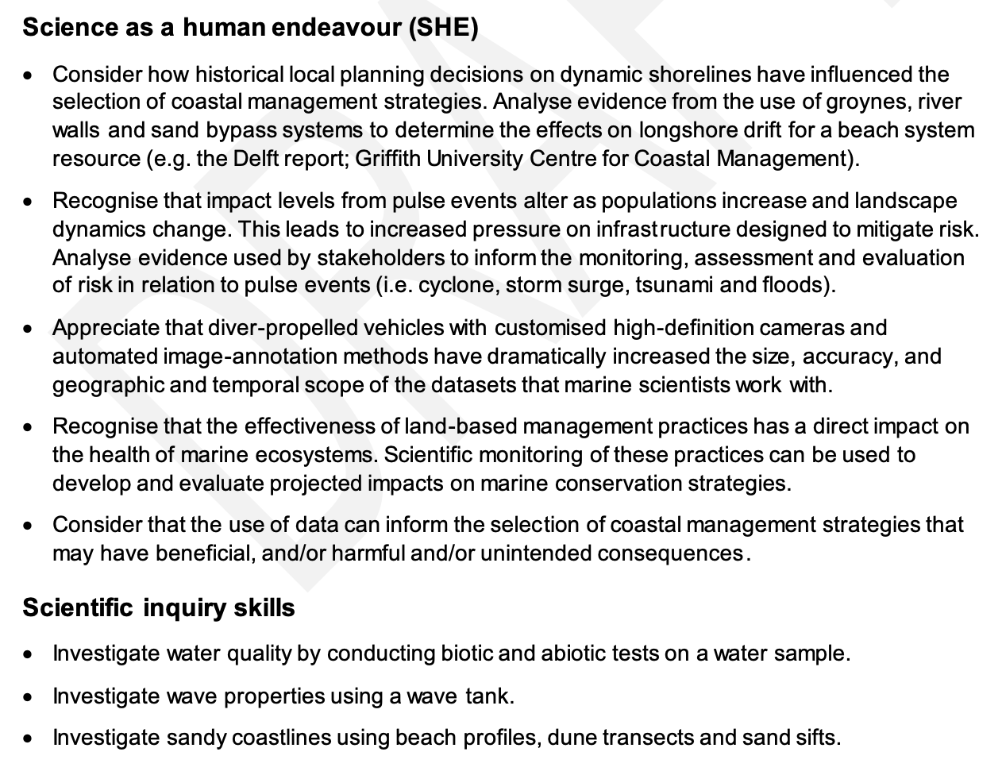
Marine
Education
Unit 1 Topic 2: The dynamic shore
SHE and SIS
Name:
Date:
marineeducation.com.au
© Marine Education 2023 CC BY-NC-SA
Unit 1 Topic 2 Science as a Human Endeavour

Slide 51
Marine
Education
Shifting Sands - Consider how historical local planning decisions on dynamic shorelines have influenced the selection of coastal management strategies. Analyse evidence from the use of groynes, river walls and sand bypass systems to determine the effects on longshore drift for a beach system resource (e.g. the Delft report; Griffith University Centre for Coastal Management).
Name:
Date:
marineeducation.com.au
© Marine Education 2023 CC BY-NC-SA
Unit 1 Topic 2 Science as a Human Endeavour

Slide 52
Marine
Education
Disturbance Dynamics - Recognise that impact levels from pulse events alter as populations increase and landscape dynamics change. This leads to increased pressure on infrastructure designed to mitigate risk. Analyse evidence used by stakeholders to inform the monitoring, assessment and evaluation of risk in relation to pulse events (i.e. cyclone, storm surge, tsunami and floods).
Name:
Date:
marineeducation.com.au
© Marine Education 2023 CC BY-NC-SA
Unit 1 Topic 2 Science as a Human Endeavour

Slide 53
Marine
Education
Zoom zoom - Appreciate that diver-propelled vehicles with customised high-definition cameras and automated image-annotation methods have dramatically increased the size, accuracy, and geographic and temporal scope of the datasets that marine scientists work with.
Name:
Date:
marineeducation.com.au
© Marine Education 2023 CC BY-NC-SA
Unit 1 Topic 2 Science as a Human Endeavour

Slide 54
Marine
Education
Land & Sea - Recognise that the effectiveness of land-based management practices has a direct impact on the health of marine ecosystems. Scientific monitoring of these practices can be used to develop and evaluate projected impacts on marine conservation strategies.
Name:
Date:
marineeducation.com.au
© Marine Education 2023 CC BY-NC-SA
Unit 1 Topic 2 Science as a Human Endeavour

Slide 55
Marine
Education
Power in data - Consider that the use of data can inform the selection of coastal management strategies that may have beneficial, and/or harmful and/or unintended consequences.
Name:
Date:
marineeducation.com.au
© Marine Education 2023 CC BY-NC-SA
Unit 1 Topic 2 Science as a Human Endeavour

Slide 56
Marine
Education
Water testing Prac – Investigate water quality by conducting biotic and abiotic tests on a water sample.
Name:
Date:
marineeducation.com.au
Activity: Complete the table below using the appropriate equipment and following kit instructions
Location |  |  | Date & Time |  |  | Group Members
Temp. °C | pH 0-14 | DO mg/L | DO % sat | Conductivity mS/cm | Salinity ‰ or ppt | Total N µg/L | Total P µg/L | Clarity m. or NTU
Probe or thermometer | Probe or litmus paper | Probe or mini-titration kit | Probe or formula (below) | Probe | Probe or Table 1 (PTO) | Test kits | Test kits | Secchi Disc or Turbidity meter
DO (mg/L → %sat)
To convert DO mg/L to DO% sat:
DO% sat. = DO mg/L x 100
DO at saturation
E.g. If the DO was recorded
at 6.8 mg/L & the temperature
was 25°C (see shaded row)….
6.8 x 100 / 8.4 = 80.95% sat.
Note: Temperature changes DO. E.g. water at 25°C is 100% saturated with DO at 8.4 mg/L.
Temp. °C | DO at saturation
21 | 9.0
22 | 8.8
23 | 8.7
24 | 8.5
25 | 8.4
26 | 8.2
27 | 8.1
28 | 7.9
29 | 7.8
See next page for full table
How to use a Secchi Disc
Lower the secchi disc into the water, looking straight down at it. Record the depth that it disappears. Lift the disc back up again.
Record the depth it reappears.
Average the two depths (add them together and divide by 2).
This is your water clarity.
Down | Up
m. | m.
Average: | m.
30 cm diameter
Hint: do a few practice runs first
Note: turbidity (NTU) is another measure of water clarity
Activity: Identify the living (biotic) components within your water sample. Write/draw them.
Activity: Evaluate the health of the ecosystem where your water sample came from.
© Marine Education 2023 CC BY-NC-SA
Unit 1 Topic 2 Science Inquiry Skills

Slide 57
Marine
Education
CONVERSION TABLES
FOR REFERENCE PURPOSES ONLY
Name:
Date:
marineeducation.com.au
Table 1: For converting Conductivity to Salinity
Table 2: for converting
DO mg/L to DO %sat
Conductivity mS/cm |  |  |  | Salinity (dissolved salt)
15°C | 20°C | 25°C | 30°C | ‰ or ppt (parts per thousand)
25.9 | 29.0 | 32.2 | 35.5 | 20
27.1 | 30.3 | 33.6 | 37.0 | 21
28.3 | 31.6 | 35.0 | 38.6 | 22
29.4 | 32.9 | 36.5 | 40.1 | 23
30.6 | 34.2 | 37.9 | 41.7 | 24
31.7 | 35.4 | 39.3 | 43.2 | 25
32.8 | 36.7 | 40.7 | 44.8 | 26
33.9 | 37.9 | 42.1 | 46.3 | 27
35.1 | 39.2 | 43.5 | 47.8 | 28
36.2 | 40.4 | 44.8 | 49.4 | 29
37.2 | 41.7 | 46.2 | 50.9 | 30
38.5 | 43.0 | 47.6 | 52.4 | 31
39.6 | 44.2 | 49.0 | 53.9 | 32
40.7 | 45.4 | 50.3 | 55.4 | 33
41.8 | 46.7 | 51.7 | 56.8 | 34
42.9 | 47.9 | 53.0 | 58.3 | 35
44.0 | 49.1 | 54.4 | 59.8 | 36
Temp. °C | DO at saturation (mg/L)
11 | 11.1
12 | 10.8
13 | 10.6
14 | 10.4
15 | 10.2
16 | 10.0
17 | 9.7
18 | 9.5
19 | 9.4
20 | 9.2
21 | 9.0
22 | 8.8
23 | 8.7
24 | 8.5
25 | 8.4
26 | 8.2
27 | 8.1
28 | 7.9
29 | 7.8
30 | 7.6
30 cm diameter
Note: Freshwater Is usually measured in µS/cm whereas Saltwater is usually measured in mS/cm
© Marine Education 2023 CC BY-NC-SA
Unit 1 Topic 2 Science Inquiry Skills

Slide 58
Marine
Education
Name:
Date:
marineeducation.com.au
Water Quality Parameters
Adapted from: Cairns Regional Council
https://www.cairns.qld.gov.au/water-waste-roads/water/smartcatchments/live-data-saltwater-creek2
Temperature
Temperature controls the rate of fundamental biochemical processes in organisms. Organisms that can only live within a narrow temperature range are called stenothermal. Whereas, organisms that can live within a wide temperature range are called eurythermal. Water temperature is affected by air temperature, stormwater runoff, groundwater inflow, turbidity and exposure to sunlight.
A rise in temperature reduces the concentration of dissolved oxygen (DO) in the water.
Likewise, a drop in temperature increases the concentration of dissolved oxygen (DO) in the water.
A thermocline is when there is an abrupt change in temperature with depth, forming a barrier between the warm water (usually above the thermocline) and the cold water (usually below the thermocline).
pH
pH is used to measure the acidity or alkalinity of a solution. Changing levels of pH in a creek or river can be an indicator of increasing pollution or some other environmental factor. A pH value is a number from 1-14, with 7 as the middle (neutral) point. The optimum pH levels for fish is between 6.5 and 8.4
Dissolved Oxygen (DO)
Aquatic animals rely on oxygen that is dissolved in the water to survive. Levels of Dissolved Oxygen (DO) vary depending on factors including water temperature, time of day, season, depth, altitude, rate of flow, and levels of pollution. If DO levels drop too low, there is not enough oxygen for the animals to ‘breathe’ and it can lead to ‘fish kill events’ where large numbers of fish die within a short period.
DO is measured in milligram per litre (mg/L) or parts per million (ppm). Exposure to less than 2 mg/L oxygen for one to four days may kill most of the biota in a system, leaving behind only the low-DO-tolerant fish, air-breathing insects and anaerobic (not requiring oxygen) bacteria and fungi (microflora).
Lethal DO concentrations for fish are generally between 1 and 3 mg/L. DO can also be measured as % saturation, whereby DO should be somewhere between 80-105%. DO <61% or >108% is poor quality.
Salinity
Salinity is a measure of salt content. Salinity is usually measured in parts per thousand (ppt). The salinity of fresh-water in rivers and creeks averages 0.5ppt or less. The salinity of sea-water averages 35ppt. The mixture of seawater and freshwater in estuaries is called brackish water and its salinity can range from 0.5ppt to 35ppt. Organisms that can only live within a narrow salinity range are called stenohaline. Whereas, organisms that can live within a wide salinity range are called euryhaline.
Turbidity (NTU)
Estuary Indicator Scores
Good/Very Good: ≤10
Moderate: 11-13
Poor: 14-16
Very Poor: >16
Turbidity is the cloudiness or haziness of the water caused by suspended solids. Turbidity does not identify individual substances; it just indicates that something is there.
© Marine Education 2023 CC BY-NC-SA
Unit 1 Topic 2 Science Inquiry Skills

Slide 59
Marine
Education
Name:
Date:
marineeducation.com.au
Water Quality Parameters
Adapted from: Cairns Regional Council
https://www.cairns.qld.gov.au/water-waste-roads/water/smartcatchments/live-data-saltwater-creek2
Depth and Flow
The overall size, depth and flow of a waterway can affect its water quality. For example, contaminants entering deep and fast-moving rivers will have less effect on the river than the same amount of contaminants entering a slow moving, shallow creek. The depth of the creek can also affect other ‘parameters’ of water quality, such as temperature and light which both decrease with depth. Measuring flow and concentration allows us to observe any change in the load of contaminants and sediment that may be in the water. Load = concentration x flow. Whereby, flow is a measurement of the amount of water (volume) x the speed of the water (velocity). Depth and flow are influenced by tides, weather, the landscape and obstructions such as rocks, fallen trees and bends in the waterway.
Nutrients – Nitrogen and Phosphorus
Nitrogen and phosphorus naturally enter estuarine waters when freshwater runoff passes over geologic formations rich in phosphate or nitrate, or when decomposing organic matter and wildlife waste get flushed into rivers and streams. Man-made sources of nutrients entering estuaries include sewage treatment plants, leaky septic tanks, industrial wastewater, acid rain, and fertilizer runoff from agricultural, residential, and urban areas. Too much nitrogen and phosphorus acts as a water pollutant. This leads to explosive algae blooms that cloud the water and deplete the oxygen.
Dissolved Inorganic Nitrogen (also known as Total Oxidised Nitrogen) is often measured in mg/L.
Dissolved Inorganic Phosphorus (also known as FRP or Ortho Phosphate) is often measured in mg/L.
Dissolved Inorganic Nitrogen (mg/L)
Estuary Indicator Score
Good/Very Good: ≤0.045
Moderate: 0.046-0.095
Poor: 0.096-0.146
Very Poor: >0.146
Dissolved Inorganic Phosphorus (mg/L)
Estuary Indicator Score
Good/Very good: ≤0.005
Moderate: 0.0051-0.0066
Poor: 0.0067-0.0082
Very Poor: >0.0082
Chlorophyll a (µg/L)
Estuary Indicator Score
Good/Very Good: ≤3
Moderate: 3.1-3.6
Poor: 3.7- 4.3
Very Poor: >4.3
Chlorophyll a concentrations are used as an indicator of algae abundance and productivity in aquatic environments. Higher concentrations typically indicate poor water quality, usually when high algal production is maintained due to high nutrient concentrations.
Bacterial Enterococci (CFU: colony forming units)
Enterococci bacteria are found in the faeces of human and warm-blooded animals. The presence of enterococci in water is an indicator of faecal pollution and possible enteric pathogens. The median bacterial content in samples of fresh or marine waters taken over the bathing season should not exceed 35 enterococci CFU/100 mL.
© Marine Education 2023 CC BY-NC-SA
Unit 1 Topic 2 Science Inquiry Skills

Slide 60
Marine
Education
Wave tank prac - Investigate wave properties using a wave tank.
Name:
Date:
marineeducation.com.au
© Marine Education 2023 CC BY-NC-SA
Unit 1 Topic 2 Science Inquiry Skills

Slide 61
Marine
Education
Beach prac - Investigate sandy coastlines using beach profiles, dune transects and sand sifts.
Name:
Date:
marineeducation.com.au
© Marine Education 2023 CC BY-NC-SA
Unit 1 Topic 2 Science Inquiry Skills

Slide 62
FA1 practice test

Slide 63
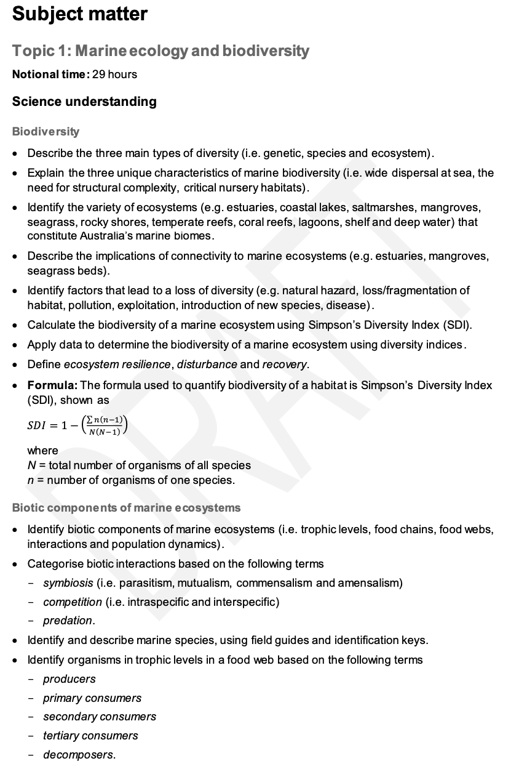
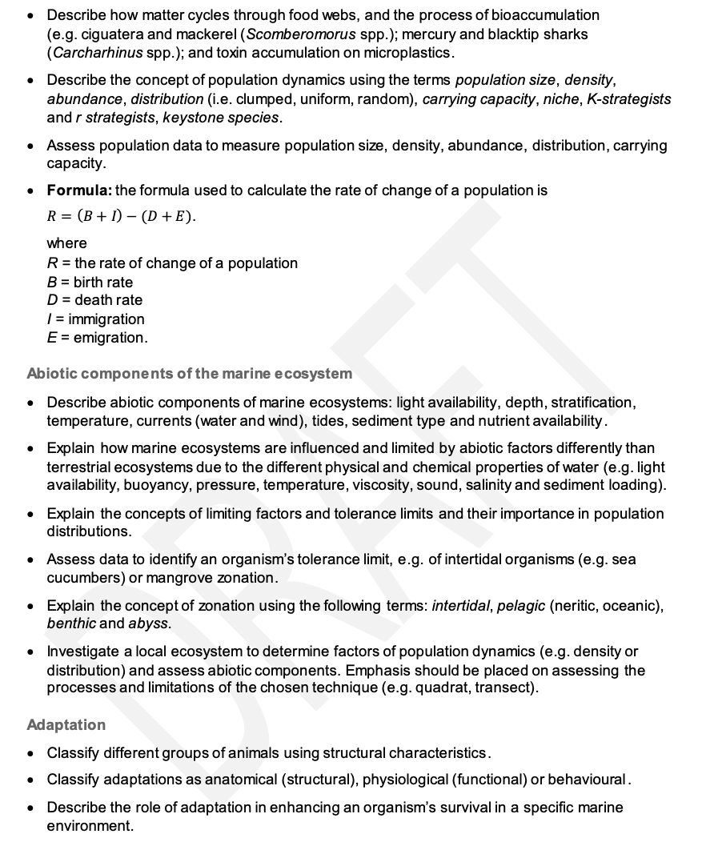
Marine
Education
Unit 2 Topic 1: Marine ecology & biodiversity
Science Understanding
Name:
Date:
marineeducation.com.au
© Marine Education 2023 CC BY-NC-SA
Unit 2 Topic 1 Science Understanding

Slide 64
Marine
Education
Life’s Diversity – Define the three main types of diversity (i.e. genetic, species and ecosystem)
Name:
Date:
marineeducation.com.au
T037
∑n(n-1)
N(N-1)
Simpson’s Diversity Index (SDI) =
1-
Genetic Diversity: the diversity of GENES
Genotype for Skin colour (in one species of fish) | Abundance (n) | n(n-1)
GGAATTCA | 3 | 6
GGAATTCC | 2 | 2
GAATTCCC | 1 | 0
ATTTTCCC | 1 | 0
Total | N = 7 | ∑n(n-1) = 8
Simpsons Index Calculations | N(N-1) = 42 | 1-[8/42]=0.81
Genetic diversity is the diversity of genes in one species. The greater the diversity, the greater chance of adapting to change and avoiding extinction. Note: SDI can range from 0 (no diversity) to 1 (infinite diversity). Thus, closer to 1 is better.
In this case, the SDI is 0.81, so it is considered relatively diverse ☺ with a likely chance of survival.
Species Diversity: the diversity of SPECIES
Species | (n) | n(n-1)
Sabella spallanzanii (introduced) | 20
Sabellastarte australiensis (native) | 1
Phoronsis australis (native) | 1
Total | N = | ∑n(n-1) =
Simpsons Index Calculations | N(N-1) = | 1-( / )=
Species diversity is the diversity of species in an ecosystem. The greater the diversity, the healthier and more resilient the ecosystem. Species richness is the number of rows. More rows, more diversity. In this case, the species richness is low. Hence the SDI will be close to zero. Activity: Calculate SDI
Ecosystem Diversity: the diversity of ECOSYSTEMS
Ecosystems | (n) | n(n-1)
Coral Reef | 20
Estuary | 25
Sandy Beach | 30
Total | N = | ∑n(n-1) =
Simpsons Index Calculations | N(N-1)= | 1-( / )=
Ecosystem diversity is the diversity of ecosystems. The greater the diversity, the more habitat diversity for more species to occupy. Note: Species evenness is the balance of ‘n’. The more evenly balanced, the more diversity.
Activity: Calculate SDI
Q. What is the species diversity (SDI) of your school grounds (or part of)? Ans.
© Marine Education 2023 CC BY-NC-SA
Unit 2 Topic 1 Science Understanding

Slide 65
Marine
Education
Marine must-haves – Explain the three unique characteristics of marine biodiversity (i.e. wide dispersal at sea, the need for structural complexity, critical nursery habitats)
Name:
Date:
marineeducation.com.au
Marine Biodiversity has three unique characteristics: (1) wide dispersal at sea (2) the need for structural complexity and (3) critical nursery habitats. Without these characteristics, species go extinct, which is a tragedy. What makes matters worse, is that when species go extinct, we lose their functional contribution towards ecosystem services (i.e. provisioning, regulating, supporting & cultural services)^{[1]}. These are services we need to live. And, biodiversity provides them for free! Biodiversity is like our own private workforce. Killing off biodiversity is like killing off the workforce. The workforce we need for our own survival. Marine biodiversity needs these three characteristics to remain strong. Remember them!
Activity: Imagine a deck of cards is biodiversity, and all the card games that you can play are all the ecosystem services that biodiversity provides. Q. What happens to those games (ecosystem services) when cards are removed from the deck (species go extinct)? Ans.
Wide _ _ _ _ _ _ _ _ _ at sea Fill in the blanks.
Dispersal is when species swim (i.e. fish), drift (i.e. plankton), or are carried by another (i.e. seagrass seeds in dugong and turtle faeces) to a new location. Water provides this opportunity, and species sure take advantage of it! They move all about the place. Even species that are stuck to the bottom (‘sessile’) travel as larvae, hitching a ride in currents to a new location before settling into their new home. As a result, dispersal maintains genetic diversity, rescues declining populations, and re-establishes extirpated (locally extinct) populations^{[2]}.
Disturbed in year 1196
Disturbed in year 1342
☹
No dispersal
No recovery
☹
A species that can NOT disperse from one patch to another, following a disturbance, will gradually go extinct^{[2]}.
Disturbed in year 1196, recolonised in year 1203
Disturbed in year 1342,
recolonised in year 1356
☺
☺
Dispersal
Q. What is dispersal? Ans.
Whereas, a species with a wide dispersal range can recolonise, maintain genetic diversity, rescue declining populations and re-establish extirpated populations^{[2]}.
The Need for Structural Complexity
Like an underwater city vs. an underwater desert, the more complex the structure, the more biodiversity.
E.g. picture a coral reef as an underwater city with lots of places to live, eat, work and visit, that wouldn’t exist without the complex city-like structures to accommodate everyone. Structural complexity increases the number of ecological niches (think of a niche as a ‘job description’ in the workforce of biodiversity).
Activity: Recall a habitat with structural complexity:
Critical Nursery Habitats
We all need a safe place to grow up. Put simply, no nursery, no life.
Activity: List 2 nursery habitats
^{[1]} Millennium Ecosystem Assessment (2005). Ecosystem and Human Well-Being: Biodversity Synthesis. World Resources Institute. Washington DC. Accessed 2018 from: www.millenniumassessment.org
^{[2]} Adapted from: A.J. Underwood and M.G. Chapman (2005). Coastal Marine Ecology of Temperate Australia. UNSW Press. p69. ISBN: 0868401587.
© Marine Education 2023 CC BY-NC-SA
Unit 2 Topic 1 Science Understanding

Slide 66
Marine
Education
A Diverse Australia – Identify the variety of ecosystems (e.g. estuaries, coastal lakes, saltmarshes, mangroves, seagrass, rocky shores, temperate reefs, coral reefs, lagoons, shelf and deep water) that constitute Australia’s marine biomes
Name:
Date:
marineeducation.com.au
Activity: Write the common name for each species listed below into the box that best describes the ecosystem it occupies (note: some feature in more than one)
Acropora pulchra, Chelonia mydas, Zostera capricorni, Corallina officinalis,
Holothuria leucospilota, Porites lutea, Mugil cephalus, Carcharhinus leucas,
Cirrhipathes spiralis, Lutjanus argentimaculatus, Jancus kraussii, Avicennia marina.
Estuaries
Coastal Lakes
Saltmarshes
Mangroves
Seagrass Beds
Rocky Shores
Temperate Reefs
Coral Reefs
Lagoons
Continental Shelf
Deep Water
Activity: Some boxes will not feature many species from the list above. Investigate what lives in those ecosystems & add their common names (in CAPITALS) to those boxes above.
Activity: Draw a line between ecosystems that are somehow connected to each other (i.e. via currents, dispersal, etc.) AND rely on each other (e.g. for food, filtering of water, nurseries, to recruit larvae for recovery post disturbance etc.).
© Marine Education 2023 CC BY-NC-SA
Unit 2 Topic 1 Science Understanding

Slide 67
Marine
Education
Connect…ivity – Describe the implications of connectivity to marine ecosystems (e.g. estuaries, mangroves, seagrass beds).
Name:
Date:
marineeducation.com.au
Frank the fish
‘Frank’ the fish is getting too big for the nursery grounds in the mangroves and sea grass beds, and is now ready to venture out to a nearby coral reef to meet a lady fish and make Frank juniors. The ability for Frank to move between ecosystems is very important. If he can’t, there’s little chance of any Frank Juniors in the future. This is bad news for fishermen. But not only that, it is bad news for coral reefs. You see, Frank is a herbivore and plays an important role on the reef. He eats the macro-algae that compete for space with corals. Following a disturbance, macro-algae can start to win that battle for space. Without Frank (eating
the macro-algae) and without connectivity (to get him there), the reef has fewer fish to eat the macro-algae.
Q. What is connectivity and why is it so important to reef health? Ans.
Calling all Passengers
Think of connectivity as a network of train stations. The ecosystems are the stations. The (biotic) animals and plants are the travellers. The (abiotic) water, bathymetry and materials exchange are the infrastructure (trains, etc.).
And, the environmental managers are security. Travellers range from migrating fish (i.e. Frank) to drifting larvae.
Frank
Importantly, the economy and welfare of many station destinations (ecosystems) rely on the safe arrival of their guests. Thus, security need to put in place certain security measures (networks of marine parks) to ensure traveller safety and survival. To do so effectively, security needs information. They need to define, measure and monitor all movements within and between stations (ecosystems), knowing who and how many travellers are going where, when, why and how. For example, security might look at the profile of one particular traveller (species x) and see that they travel with their buddies to a distant location once a year for a particular purpose (i.e. breeding) relating to a particular event (November full moon) going along a similar route used by other travellers (East Australian Current). Security also need to be able to predict how particular events (i.e. El nino, climate change) might impact their travellers. All this information is used to measure, protect and monitor connectivity to ensure fish like Frank can complete their journey safely.
Suggested Activity: Catch plankton using a plankton net. Identify one of the plankton (imas.utas.edu.au/zooplankton). Explain its own travel profile below (i.e. start to finish of its journey):
.
© Marine Education 2023 CC BY-NC-SA
Unit 2 Topic 1 Science Understanding

Slide 68
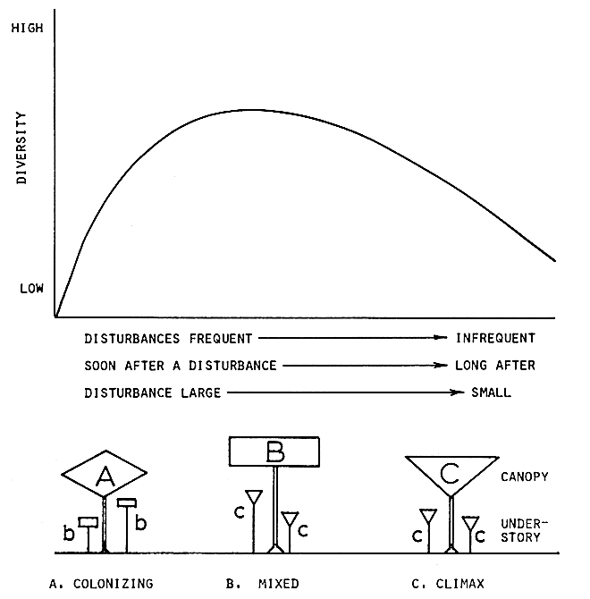
Marine
Education
Security Breach! – Identify factors that lead to a loss of diversity (e.g. natural hazard, loss/fragmentation of habitat, pollution, exploitation, introduction of new species, disease)
Name:
Date:
marineeducation.com.au
Border Security Breach
The introduction of a new species to an ecosystem can lead to a loss of diversity. The new species reduces species evenness by outcompeting native species. Which is why customs are so strict!
Activity: Name 1 introduced marine species that caused a loss of diversity and explain how it arrived
Frequent and Severe Natural Hazards
If a natural hazard is too frequent or severe (far left of the graph), only highly resilient, colonising (r-strategists) species survive, resulting in a loss of diversity. Likewise, if a natural hazard is too infrequent or weak (far right of the graph), climax species (K-strategists, that develop in the later stages of succession) will continue to dominate, monopolise the space and eliminate others, resulting in a loss of diversity. Ironically, diversity is highest when natural hazards are of intermediate frequency, duration and size (not too damaging, not too weak). This occurs as competitive exclusion is balanced by the destruction of competitive dominants, whereby more space is created for more species to occupy. The phenomenon has been called the ‘intermediate disturbance hypothesis’ (Fig. 1).
Q. What dominates after many cyclones? Ans.
A, B or C?
Figure 1: Intermediate Disturbance Hypothesis^{[1]}
Activity: LIST 4 more factors that lead to diversity loss (hint: title). Reference a case study for each
Factor | Case Study Reference: author, date (year), title, source (hint: use Google scholar to find journal articles)
^{[1]} From Connell, J. H. (1978). Diversity in Tropical Rain Forests and Coral Reefs. Science, New Series, Vol. 199. No. 4335. DOI: DOI: 10.1126/science.199.4335.1302. Reprinted with permission from AAAS.
© Marine Education 2023 CC BY-NC-SA
Unit 2 Topic 1 Science Understanding

Slide 69
Marine
Education
Homer’s Index – Calculate the biodiversity of a marine ecosystem using Simpson’s diversity index (SDI)
Name:
Date:
marineeducation.com.au
∑n(n-1)
N(N-1)
Simpson’s Diversity Index (SDI) =
1-
N=total number of organisms of all species; n=number of organisms of one species
Research Question
When carrying out an investigation or conducting research, you always have a research QUESTION. The question must be specific (so the answer is specific) and have a dependent and independent variable.
E.g. Is there a difference in species diversity between the inshore reef and offshore reef?
(A good start is to compare two groups)
(dependent variable)
(independent variable: e.g. two groups to compare)
To answer this question, the Simpsons Diversity Index (SDI) provides a value between 0 and 1 for each reef, indicating their level of species diversity, which you can then compare. If an ecosystem has an SDI of 1 this means it has infinite diversity. Whilst an SDI of 0 means it has zero diversity (i.e. only one species).
Note: SDI is actually calculating the probability that 2 randomly selected individuals will be of 2 different species (or categories). 100% = 1.0 and 0% = 0.
Activity: Complete the tables below using the following data
Inshore Reef
Offshore Reef
Species A
Species B
Species C
Species D
Species E
INSHORE REEF
IDENTIFY | COUNT | STATS
Name | n | n(n -1)
Total | N | ∑n(n-1)
Simpsons Diversity Index Calculations | N(N-1)= | SDI =
OFFSHORE REEF
IDENTIFY | COUNT | STATS
Name | n | n(n -1)
Total | N | ∑n(n-1)
Simpsons Diversity Index Calculations | N(N-1)= | SDI =
[Yes] [No]
Q Is there a difference in species diversity between the inshore reef and offshore reef? Ans.
© Marine Education 2023 CC BY-NC-SA
Unit 2 Topic 1 Science Understanding

Slide 70
Marine
Education
Formula Feast – Apply data to determine the biodiversity of a marine ecosystem using diversity indices
Name:
Date:
marineeducation.com.au
Life in a number
The beauty of (and perhaps the frightening part about) diversity indices is that something as complex as biodiversity is brought down to just one single value. That value is used to compare ecosystems (i.e. previous worksheet), rank ecosystems (i.e. high to low diversity) or to classify ecosystems (i.e. to determine trigger values for water quality guidelines). The table below features indices commonly used:
Indices | Formula | Interpretation | Explanation
Simpsons Diversity Index (SDI) | 1- ∑ n(n-1) N(N-1) | 0 – 1 0 = no diversity 1 = infinite diversity | The probability that 2 randomly selected individuals will be 2 different species (or categories). 100% chance = infinite diversity
Shannon-Wiener Diversity Index (H) | -∑(n/N) In(n/N) (note: n/N is often written as Pi) | 0 – 5 <1 = ☹ >3 = ☺ | The degree of uncertainty surrounding the identity of an unknown individual. For example, if highly diverse, it could belong to any species (in contrast, a community with only 1 species would have a H value of 0).
Sorrensen Index/Similarity Coefficient (CC) | 2C / (S1+S2) C=no. of species the same in both samples S1=species richness in sample 1 S2=species richness in sample 2 | 0 - 1 0 = complete dissimilarity & no overlap 1 = complete similarity & overlap | Amount of overlap or similarities in species composition between two samples. For example, if sample1 has 20 species and sample2 has 25 species, and between them they have 5 species in common…. CC=(2x5)/(20+25)=10/45=0.222 (dissimilar)
Jaccard Index/Similarity Coefficient (T) | a / (a+b+c) a = no. of species the same in both samples b = no. of species unique to sample 1 c = no. of species unique to sample 2 | 0 – 1 0 = complete dissimilarity & no overlap 1 = complete similarity & overlap | Compares the similarity between two finite samples. It is essentially the size of their overlap divided by the size of their union. For example, 2 in overlap, 5 in union, Jaccard Index = 2/5
Activity: Use data from the previous worksheet (titled Homer’s Index) to complete the table:
See next worksheet (titled Examplar Data Sheet) to help you get started ☺
Note: Simpson’s index is more sensitive to species evenness than species richness. Shannon index, in turn, does not provide information on rare species which are very important in studies of biodiversity*. Thus, it is advisable to use more than one indices when determining the biodiversity of an ecosystem.
*Shah, J.A. & Pandit, A.K. (2013) Application of diversity indicies to crustacean community of Wular Lake, Kashmir Himalaya. International Journal of Biodiversity and Conservation. Vol. 5(6). Pp311-316
Diversity Indices | Species Richness | Simpsons Diversity (SDI) | Shannon-Weiner (H) | Sorrensen (CC) | Jaccard (T)
Inshore Reef
Offshore Reef
Q. Is your answer still the same as the previous worksheet? Respond by answering the question:
[Yes] [No]
Q Is there a difference in species diversity between the inshore reef and offshore reef? Ans.
© Marine Education 2023 CC BY-NC-SA
Unit 2 Topic 1 Science Understanding

Slide 71
Marine
Education
EXAMPLAR DATA SHEET
* EXAMPLE PURPOSES ONLY*
Name:
Date:
marineeducation.com.au
Q. Is there a difference in diversity between & ?
FISH
REEF 1
REEF 2
Method: Data was collected using BRUV (baited remote underwater video). Analysis: Footage was paused every 5 seconds to I.D and count. Averages were calculated (excluding zero counts) and recorded as ‘n’.
SAMPLE 1:
IDENTIFY |  | COUNT | Simpson | Shannon-Wiener (“In” is the Inverse button on calculator)
Name |  | n | n(n -1) | n/N | In(n/N) | (n/N) In(n/N)
1 | Cromileptes altivelis (Barramundi cod) | 2 | 2 | 0.08695652174 | -2.442347035 | -0.212378003
2 | Epinephelus tukula (Potato cod) | 1 | 0 | 0.04347826087 | -3.135494216 | -0.136325835
3 | Lutjanus sebae (Red Emperor) | 1 | 0 | 0.04347826087 | -3.135494216 | -0.136325835
4 | Synodus dermatogenys (Two-spot Lizardfish) | 4 | 12 | 0.17391304348 | -1.749199855 | -0.304208670
5 | Forcipiger flavissimus (Long-nosed Butterflyfish) | 4 | 12 | 0.17391304348 | -1.749199855 | -0.304208670
6 | Pomacanthus imperator (Emperor Angelfish) | 2 | 2 | 0.08695652174 | -2.442347035 | -0.212378003
7 | Abudefduf sexfasciatus (Scissortail Sergeant) | 4 | 12 | 0.17391304348 | -1.749199855 | -0.304208670
8 | Labrichthys unilineatus (Cleanerfish) | 3 | 6 | 0.13043478261 | -2.036881927 | -0.265680251
9 | Chlorurus frontalis (Reefcrest Parrotfish) | 2 | 2 | 0.08695652174 | -2.442347035 | -0.212378003
 | Total | N 23 | ∑n(n-1) 48 |  |  | -∑(n/N) In(n/N) 2.088
Reef 1: Structurally complex coral reef
SAMPLE 2:
IDENTIFY |  | COUNT | Simpson | Shannon-Wiener
Name |  | n | n(n -1) | n/N | In(n/N) | (n/N) In(n/N)
1 | Scorpaenodes varipinnis (Ornate Scorpionfish) | 2 | 2 | 0.07142857143 | -2.63905733 | -0.188504095
2 | Hemiramphus far (Barred Garfish) | 25 | 600 | 0.89285714286 | -0.11332868 | -0.10118632
3 | Synodus dermatogenys (Two-spot Lizardfish) | 1 | 0 | 0.03571428571 | -3.33220451 | -0.119007304
 | Total | N 28 | ∑n(n-1) 602 |  |  | -∑(n/N) In(n/N) 0.409
Reef 2: Flattened, algae-dominated reef
Diversity Indices | Species Richness | Simpsons Diversity (SDI) | Shannon-Weiner (H) | Sorrensen (CC) | Jaccard (T)
Sample 1 | 9 | 1-[48/(23*22)] 0.905 | 2.088 | 2C / (S1+S2) C=1 S1=9 S2=3 2(1) / (9+3) 0.1666’ | a / (a+b+c) a=1 b=8 c=2 1 / (1+8+2) 0.09091
Sample 2 | 3 | 1-[602/(28*27)] 0.2037 | 0.409
Q. Is there a difference in diversity between & ? Ans.
FISH
REEF 1
REEF 2
Yes
© Marine Education 2023 CC BY-NC-SA
Unit 2 Topic 1 Science Understanding

Slide 72
Marine
Education
Environmental Medical – Define ecosystem resilience, disturbance and recovery
Name:
Date:
marineeducation.com.au
Medical Terms for the Environment
Resistance is the capacity to withstand a disturbance (e.g. to not get sick in the first place)
Resilience is the capacity to recover from a disturbance or withstand ongoing pressures (e.g. immunity)
Disturbance is an event of intense environmental stress, forcing change upon an ecosystem (e.g. virus)
Recovery refers to the return of a damaged ecological system and associated ecosystem services to a stable state (i.e. an identifiable abundance and composition of species) (e.g. getting better again)
Elasticity measures the speed of return to its original state (e.g. how long it takes?). If it does not return to its original state, it will shift to a fundamentally different state (called a ‘phase shift’) (e.g. life changes!).
For example, Figure 1^{[1]} depicts resistance to (a, b) and resilience following (c, d) small and large intensities of natural disturbance, as indicated by the arrows, for two populations or communities (where X is more resistant and resilient than Y) and where 1 and 2 represent levels of population abundance or community states.
Figure 1:
(a) X resists the small disturbance, but Y is impacted.
(b) X is impacted by the large disturbance, but Y is even more severely impacted.
(c) X recovers more quickly than Y for the same intensity and severity of disturbance.
(d) X is resilient and recovers from a more intense and severe disturbance, but Y is not resilient and shifts to a new population level or community state^{[1]}.
^{[1]} Adapted from: Sean D. Connell and Bronwyn M. Gillanders (2007). Marine Ecology. Oxford University Press. Victoria. Australia. p147. ISBN: 0195553020.
Population level or community state
(a)
Resistance
(b)
1
X
1
Severity
Y
Severity
X
2
2
Y
(c)
Resilience
(d)
1
X
Y
1
X
Severity
Severity
2
2
Y
Recovery
Time
Recovery
Giving the reef a fighting chance
We know ‘bad’ is coming. Disturbances such as coral bleaching events and severe weather events are predicted to increase in severity and frequency with climate change. What’s our strategy for giving the reef every chance of survival to avoid a phase shift from a coral dominated state to an algae dominated state? Resilience!
Boosting the reef’s immune system! How do we do that? There are a number of strategies…
Activity: Go to www.reefresilience.org to learn about reef resilience (e.g. enrol in online training course)
Q. What makes a coral reef more resilient (what strengthens its immunity)? Ans.
E.g. high biodiversity
© Marine Education 2023 CC BY-NC-SA
Unit 2 Topic 1 Science Understanding

Slide 73
Marine
Education
SDI Formula - The formula used to quantify biodiversity of a habitat is Simpson’s Diversity Index (SDI), shown as 𝑆𝐷𝐼 = 1 − (∑ 𝑛(𝑛−1)) 𝑁(𝑁−1) where:
N = total number of organisms of all species
n = number of organisms of one species.
Name:
Date:
marineeducation.com.au
© Marine Education 2023 CC BY-NC-SA
Unit 2 Topic 1 Science Understanding

Slide 74
Marine
Education
Bio…ta – Identify biotic components of marine ecosystems (i.e. trophic levels, food chains, food webs, interactions and population dynamics)
Name:
Date:
marineeducation.com.au
Definition of Ecology
“Ecology” is the scientific study of the interactions between organisms and their abiotic and biotic environment that determines their distribution and abundance^{[1]}. The next 5 worksheets focus on the biotic environment part of this definition, which includes all the living components of an ecosystem.
Q. What is meant by the ‘biotic environment’ in the definition above? Ans.
Q. Identify 5 biotic components of marine ecosystems? (hint: title) Ans.
Distribution means “where they are found”. All species have a limited geographical range (i.e. certain species are only found in certain places). What limits a species geographical range?
Species absent because of…
YES
Dispersal
NO
Area inaccessible or insufficient time
(can’t get there)
YES
Behaviour
NO
Activity: Think about what limits our own geographical range!?
Habitat selection (chooses not to be there)
YES
Other Species
NO
Krebs (1972)^{[1]} designed a flow chart (Figure 1) that is used to discover what causes the geographical limits of species by proceeding down the chain, eliminating things one by one.
Predation, competition, parasitism, disease
Physical & Chemical Factors
Figure 1: To explain any particular problem of distribution, one proceeds down the chain, eliminating things one by one^{[1]}.
Temperature, light, sediment structure, currents, etc.
Water, oxygen, salinity, pH, nutrients etc.
Q. In Kreb’s flow chart, what is meant by ‘other species’? Ans.
Abundance means “how many”. To measure abundance, ecologists use sampling methods such as quadrats and the capture-recapture method to estimate, for example, the size of a population (defined as a group of organisms of the same species in the same space at the same time^{[1]}). Once the size of the population has been established, then ecologists can measure any changes to the size of a population over time (population dynamics). This is achieved by comparing the number of species entering a population (birth rate and immigration) with the number of species leaving a population (death rate and emigration) over time. Population dynamics empowers us to practice sustainable resource management.
Q. Why do ecologists want to estimate how populations change over time? Ans.
^{[1]} Adapted from: Krebs, C. J. (1972). Ecology: The experimental analysis of distribution and abundance. Harper & Row, Publishers, Inc., New York. Library of Congress Catalog Card Number: 70-184931.
© Marine Education 2023 CC BY-NC-SA
Unit 2 Topic 1 Science Understanding

Slide 75
Marine
Education
Social Shenanigans – Categorise biotic interactions based on the following terms: symbiosis (i.e. parasitism, mutualism, commensalism and amensalism), competition (i.e. intraspecific and interspecific) and predation
Name:
Date:
marineeducation.com.au
To help or hinder?
Interactions are classified on the basis of the mechanism of the interaction (i.e. symbiosis, competition and predation) and the effects of the interaction, albeit positive (+), negative (-) or no effect/neutral (0).
Mechanism of Interaction |  | Effect on X | Effect on Y
Symbiosis | Parasitism | + | -
 | Mutualism | + | +
 | Commensalism | + | 0
 | Amensalism | 0 | -
Competition |  | - | -
Predation |  | + | -
guest
host
Symbiosis is a host-guest relationship whereby two different species live together, in direct contact, for an extended period of time. The ‘guest’ exploits a unique niche that the ‘host’ provides. Except for amensalism, the guest always benefits from the relationship. As for the host, the relationship can be beneficial (mutualism), have no effect (commensalism), or harmful (parasitism).
Unlike symbiosis, competition and predation are oppositional interactions. Intraspecific competition involves two of the same species (i.e. competing for a mate). Interspecific competition involves two different species (i.e. competing for space). Competitions intensify when resources are in short supply.
Activity: Complete the table below by categorising biotic interactions based on mechanism & effect
Biotic Interaction (between X & Y) | Mechanism of Interaction | Effect on X | Effect on Y
Zooxanthellae and corals | Mutualism | + | +
Barnacles attached to whales
Decorator crab carrying a sponge
Remora ‘sucking’ to a manta ray
Clownfish and anemones
Isopods and fish
Cleaner fish and organisms it cleans
Killer whales/orcas and sharks
Seaweed allelopathy and corals
Two male fiddler crabs fighting
Activity: Choose three more interactions that you find interesting to complete the table…
© Marine Education 2023 CC BY-NC-SA
Unit 2 Topic 1 Science Understanding

Slide 76
Marine
Education
Marine Mug Shots - Identify and describe marine species, using field guides and identification keys
Name:
Date:
marineeducation.com.au
© Marine Education 2023 CC BY-NC-SA
Unit 2 Topic 1 Science Understanding

Slide 77
Marine
Education
Bring on the Buffet – Identify organisms in trophic levels in a food web based on the following terms: producers, primary consumers, secondary consumers tertiary consumers and decomposers
Name:
Date:
marineeducation.com.au
Hungry? How hungry?
Feeling hungry? The production and consumption of food is always going to have a strong influence on the way organisms interact with each other, which in turn influences their abundance and distribution. Classifying organisms into trophic levels based on how they obtain their nutritional requirements (i.e. producer, primary consumer, secondary consumer etc.) is the first step towards understanding the circumstances that influence population dynamics and community structures. The next step is to create a food web to identify exactly what eats what. This requires a lot of reading (literature reviews), dissections (suggested practical?!) and sometimes the tracing of stable isotopes as biomarkers. The next step after that is to identify the strength of the interactions between species in a food web (e.g. how much do they eat and how much influence do certain consumers have on prey abundance?). This is achieved by removing a species from a food web (in a ‘manipulative experiment’ using cages or removing them altogether) and measuring what happens. For example, results show strong interaction strengths between herbivorous fish and algae biomass on reefs and herbivorous gastropods and algae biomass on intertidal rock pools^{[1]}.
Activity: Categorise species from an ecosystem of your choice into the table of trophic levels below, left. Then, transfer the information from the table to create a food web in the large box below, right.
Ecosystem Name:
Food Web
Tertiary Consumers (large carnivores): | Decomposers:
Secondary Consumers (small carnivores):
Primary Consumers (herbivores & omnivores):
Primary Producers (plants):
Q. Which species in your food web is most likely to have a strong influence on the abundance of its prey and therefore on population dynamics and community structure, making it a great candidate for a manipulative experiment (i.e. keystone species)? Ans.
^{[1]} Sean D. Connell and Bronwyn M. Gillanders (2007). Marine Ecology. Oxford University Press. Victoria. Australia. P. 84-85.ISBN: 0195553020.
© Marine Education 2023 CC BY-NC-SA
Unit 2 Topic 1 Science Understanding

Slide 78
Marine
Education
Big Fish eats Little Fish – Describe how matter cycles through food webs, and the process of bioaccumulation (e.g. ciguatera and mackerel (Scomberomorus spp.); mercury and blacktip sharks (Carcharhinus spp.); and toxin accumulation on microplastics.
Name:
Date:
marineeducation.com.au
Ciguatera Poisoning
Soon after Johnny ate spanish mackerel, he started to feel sick. Apart from the usual gastrointestinal symptoms that indicate food poisoning (vomiting, diarrhea, muscle pain) his nervous system started doing strange things, such as his mouth, lips and extremities felt numb, he felt dizzy (which made driving for help out of the question) and anything that was cold felt hot and vice versa. Johnny made it to the hospital and eventually recovered (it took a few months) but for many years to follow, the symptoms returned whenever he ate seafood again. Johnny had ciguatera poisoning. It comes from eating large reef fish, as in, larger than average for its species (and usually from the tropics). Take home message: throw the big ones back! Ciguatera poisoning is caused by the (bio)accumulation of CTX (ciguatoxin), a toxin produced by dinoflagellates (Genus Gambierdiscus) that live attached to certain corals, seaweeds and seagrasses. Primary consumers are the first to eat food containing CTX, followed by secondary and tertiary consumers. CTX remains stored in a fish’s body – it does not break down! Thus, the toxin accumulates over time as fish continue to eat lower order consumers and producers that contain CTX. Since large fish live longer and eat more, they bioaccumulate higher concentrations of CTX than smaller fish of the same species. Hence, don’t eat the big ones!
Increasing Toxicity
Tertiary Consumer
Decomposer
CTX
Secondary Consumer
CTX
CTX
Primary Consumer
CTX
CTX
CTX
CTX
Primary Producer
CTX
CTX
CTX
CTX
CTX
CTX
CTX
CTX
Figure 1: CTX bioaccumulation: the accumulation of CTX in fish over time following the repeated consumption of contaminated lower order consumers and producers.
Fish to avoid (if they are XL) include: Barracuda, Grouper, Cod, Coral trout, Red emperor, Chinaman, Paddletail, Red bass, Yellowtail kingfish, Trevally, Moray eel, Spanish mackerel and >400 other species!
Note: the term bioaccumulation also applies to other harmful chemicals that bioaccumulate in living organisms over time, such as heavy metals, persistent organic pollutants (POP’s) and micro-plastics.
Activity: Describe the process of bioaccumulation:
Activity: Research……ciguatera & mackerel; mercury & blacktips; microplastics in seafood.
© Marine Education 2023 CC BY-NC-SA
Unit 2 Topic 1 Science Understanding

Slide 79
Marine
Education
Population Dynamics – Describe the concept of population dynamics using the terms population size, density, abundance, distribution (i.e. clumped, uniform, random), carrying capacity, niche, K-strategists and r-strategists, keystone species
Name:
Date:
marineeducation.com.au
Population Size and Density
Measuring the exact size of a population is not easy to do! Quite often, we estimate population size instead. We count the number of individuals in smaller samples of the population, and then use a math formula to convert it to total population size (see next page). The population size can then be converted to population density with the following formula: Population Density = Population Size / Area
Q. What is the population density when the population size is 20 in an area of 10ha? Ans.
Dispersion Patterns (distribution)
The accuracy and precision of a population size estimate will largely depend on sampling design. It is very easy to over or underestimate a population’s size. Especially if the dispersion patterns of the distribution (e.g. pictured right) are (a) clumped (i.e. schooling fish), as opposed to (b) random or (c) uniform.
(a) clumped
(b) random
(c) uniform
Q. Which is easiest to estimate? Ans.
Circle correct answer
(a) (b) (c)
Carrying Capacity (K)
Logistic Growth Curve
Pierre Verhulst in 1838 created a graph (right) that launched a thousand exam questions. The graph illustrates the growth of a population over time. Whereby, in stable predictable environments, a population will continue to grow in size until the environment reaches full capacity (i.e. overcrowded). Thus, the maximum size a population can grow (due to density-dependent effects such as overcrowding) is called its carrying capacity or K.
Population Size
Carrying Capacity (K)
Q. What is K? Ans.
Time
r-strategists and K-strategists
Species are sometimes referred to as r-strategists or K-strategists depending on the selective processes that have shaped their life history strategies. Activity: Complete the table pictured below
 | r–strategists The maximum population size is determined by how fast they can grow and reproduce between catastrophes, thus population dynamics is controlled by r (rate of increase), hence the name. | K-strategists Occur in stable predictable environments, thus mortality is controlled by K (the carrying capacity), hence the name.
Environment | Fluctuating, unpredictable | Stable, predictable
Mortality | Density-independent, high | Density-dependent, low
Growth | Fast, short life-span
Reproduction | Early maturity, high fecundity
A Niche is...complete the sentence….
A Keystone Species is…complete the sentence….
© Marine Education 2023 CC BY-NC-SA
Unit 2 Topic 1 Science Understanding

Slide 80
Marine
Education
Measuring Populations – Assess population data to measure population size, density, abundance, distribution, carrying capacity
Name:
Date:
marineeducation.com.au
Research Question After an outbreak of COTS was observed on Swains Reef in 2017…..
Population SIZE (or density) of Crown of Thorns starfish
2012
on Swains Reef
2017
on Swains Reef
Q. Is there a difference in between & ?
Method: Belt Transect
An 80m transect line (graduated tape measure) was randomly laid down (at a constant depth) at four potential COTS habitats around Swains Reef (identified using a Manta Tow). Divers spent 30-40 minutes surveying each 80m transect using an s-shaped search pattern extending 2.5m either side of the line, to look for and count COTS inside cracks and crevices on the reef (methods modified from Reef Check^{[1]}). The total survey area is 4(80m x 5m)=1600m . The total area of Swains Reef is 580,000m .
5m
2
2
80m transect line (tape measure)
x4
Diver’s s-shaped search pattern looking for, and counting, COTS inside cracks and crevices of the reef
Results
Note: the COTS outbreak was real, but the data for this worksheet has been made up.
Activity: Complete the table below. Formulas for Population Size and Density are provided below.
Group (Population) | Transect (quadrat) |  |  |  | Mean (average) | Total Area of Population m | Area of one transect (quadrat) m | Population Size “N” | Population Density per m
 | 1 | 2 | 3 | 4
2012 | 1 | 0 | 2 | 3 | 1.5 | 580,000 | 400 | 2175 | 0.00375
2017 | 50 | 60 | 55 | 70 |  | 580,000 | 400
2
2
2
Estimating Population Size (Quadrat Method)
Note: the ‘belt’ is the same as one long rectangular quadrat (length x width)
Population Size = x Total Area of Population
“N” Area of one quadrat
Population Size
=
Population Density
Total Area
Data Analysis
To statistically answer the research question, we must first calculate s, SE & Cl to obtain error bars and a
P value. If the error bars do not overlap, and the P value is equal to or <0.05, the difference is significant.
Activity: Complete the table below. Read the following two pages for instructions!!!
df
Group (ifor example, population) | Transect (quadrat) |  |  |  | Mean | N | Density per m | n | s | SE | Cl |  | P
 | 1 | 2 | 3 | 4
2012 | 1 | 0 | 2 | 3 | 1.5 | 2175 | 0.00375 | 4 | 1.29 | 0.6 | 2.1 | 6 | 0.0001
2017 | 50 | 60 | 55 | 70
2
n=sample size s=standard deviation SE=Standard Error CI=Confidence Interval df =degrees of freedom (n1 –1) + (n2 –1) Note: subscripts indicate group number. P value: results from t-test
[Yes] [No]
Q. Is there a significant difference between Group 1 (2012) & Group 2 (2017)? Ans.
Circle correct answer
^{[1]}Hodgson, G., Hill, J., Kiene, W., Maun, L., Mihaly, J., Liebeler, J., Shuman, C. and Torres, R. (2006). Reef Check Instruction Manual: A Guide to Reef Check Coral Reef Monitoring. 2006 Edition. Reef Check Foundation, Pacific Palisades, California, USA. Accessed 2018 from: https://www.biosphere-expeditions.org/images/stories/pdfs/2006%20Reef%20Check%20Instruction%20Manual%20with%20covers.pdf
© Marine Education 2023 CC BY-NC-SA
Unit 2 Topic 1 Science Understanding

Slide 81
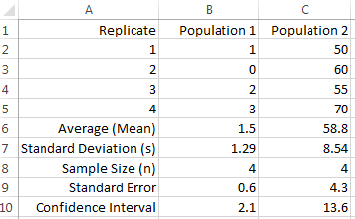
Marine
Education
Name:
Date:
marineeducation.com.au
ANALYSING POPULATION DATA
It’s all about answering the Research Question!
When comparing two datasets, at what point is the difference between them considered to be significant?
To find out, we need to do some more calculations (begin by entering 2012 data into cells B2-B5 in Excel).
Measures of Central Tendency (i.e. medium, mean, mode).
A common measure of central tendency used in population dynamics is the mean, or average.
The mean of a population goes by the symbol µ
The mean of a sample (usually representative of the population) goes by the symbol
Always quote the mean to one decimal place more than the raw data. To calculate the mean:
In Excel, type in an empty space/cell at end of data (i.e. B6): =AVERAGE(B2:B5) (then press Enter)
Or, manually, add them all up (Σ x) and divide that total, by the number of observations ( = Σ x / n)
Measures of Dispersion (i.e. range, deviation & standard deviation).
The range is the distance between the lowest data point and the highest data point. Range is a very crude measure of dispersion because we still don’t know how close or far away each data point is from the mean (known as deviation). Hence, Standard deviation is a much better measure of dispersion.
The standard deviation of a population goes by the symbol σ (sigma)
The standard deviation of a sample (usually representative of the population) goes by the symbol s
Always quote the standard deviation one decimal place more than the mean. To calculate s:
In Excel, type in the next empty space/cell at end of data (i.e. B7): =STDEV(B2:B5)
Or, manually, square root the sum of the deviation squared, divided by the number of observations -1
Standard Error (SE) of the mean measures how well represents µ. Were we close?
The smaller the value, the more accurate the sample mean represents the population mean.
The standard error equals the standard deviation divided by the square root of the sample size (SE=s/√n).
In Excel, first type in the next empty space/cell at end of data (i.e.B8) =COUNT(B2:B5) to calculate ‘n’. Then, type in the next empty space/cell at end of data (i.e. B9) =(B7)/SQRT(B8)
A Confidence Interval is a range of values that we are 95% confident contains the pop. mean.
It’s a bit like saying, I am 95% confident the population mean will be somewhere within the range of this value and that value. Whereby, the sample mean is at the centre of this range. To calculate the confidence interval (CI), you need the following values: α =0.05, the standard deviation (s), and the sample size (n).
In Excel, type in an empty space/cell at end of data (i.e. B10): =CONFIDENCE.T(0.05,B7,B8)
Error Bars represent the uncertainty in estimates. It is a line that passes through a point (or bar) on a graph, representing s or SE or Cl. If error bars do not overlap, the difference could be significantly different (answering your research question!). However, to be sure, a t-test is required (see next page).
Activity: Copy the data pictured left (down to row 5) onto an Excel spreadsheet. Add the formulas (provided above) to calculate the same answers pictured left (rows 6-10). Highlight both Means and Insert Chart (column graph). Add error bars.
Q. Do the error bars overlap? Ans.
[Yes] [No]
Circle correct answer
© Marine Education 2023 CC BY-NC-SA
Unit 2 Topic 1 Science Understanding

Slide 82
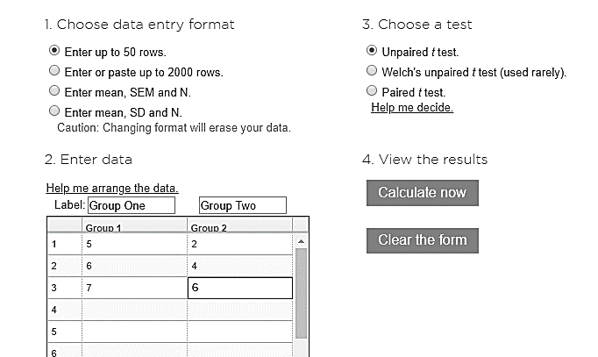
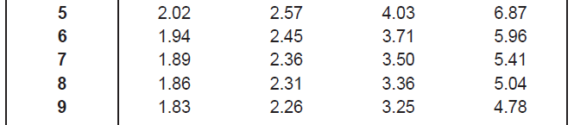
Marine
Education
HOW TO IDENTIFY A SIGNIFICANT DIFFERENCE BETWEEN 2 GROUP MEANS using a t-test
Name:
Date:
marineeducation.com.au
Online
Google ‘t-test calculator’. Open GRAPHPAD at: https://www.graphpad.com/quickcalcs/ttest1.cfm
Enter data for Group 1 and Group 2. If P = <0.05, they are significantly different!
Maintain default values/assumptions: two sample t-test, two-tailed test, unpaired t-test, independent groups, groups have equal variance, 0.05 significant level.
P = < 0.05
There is a significant difference between 2 groups
Don’t change
P = > 0.05
There is NO significant difference between 2 groups
Enter Data
Calculate now
Note: The word SIGNIFICANT is ONLY used when a STATISTICS test, such as a t-test with a P value, has been used to answer the research question. Importantly, the word significant has NOTHING to do with the SIZE difference between 2 groups. Significant is a Science term. Its only purpose is to notify the audience that the research question was answered using a STATISTICS test.
Hand calculation
The formula is:
numerator
Difference between
the means
=
Group 1 mean – Group 2 mean
Standard error of
the difference
[(s₁² x df₁)+ (s₂² x df₂)] / [df₁ + df₂ ] + ← that again
denominator
Square root √ of:
n1
n2
Note: s=standard deviation; SE=Standard Error; = sample mean; df (degrees of freedom) = (n1 –1) + (n2 –1).
Whereby n=sample size, and subscripts indicate group number.
The t test formula is simply a ratio (also a fraction). The numerator is the difference between two means.
The denominator is a measure of variability or dispersion of the scores (standard error of the difference).
Note: a t test by hand calculates tcalc sometimes called t Stat or t (instead of a P value).
Step 1: Calculate tcalc using the formula above
Step 2: Calculate tcrit using the Student’s t-distribution table (left) whereby = 0.05
Step 3: Compare tcalc to tcrit
Table 1: Student’s t-distribution
numerator
Medium variation
P is close to 0.05
High variation
P is > 0.05
tcrit is large.
If tcalc ≥ tcrit
there is a significant difference between the
2 groups
Figure 1 (right): Even though the difference between the means (the gap between the peaks, or distance between the vertical lines) are the SAME for all three graphs, the denominator determines the amount of overlap (variation) between both data sets. Only when the overlap is minimal can a significant difference be identified.
Low variation
P is < 0.05 and closer to zero.
tcrit is small.
denominator
© Marine Education 2023 CC BY-NC-SA
Unit 2 Topic 1 Science Understanding

Slide 83
Marine
Education
Population Dynamics Formula - the formula used to calculate the rate of change of a population is 𝑅 = (𝐵 + 𝐼) − (𝐷 + 𝐸) where:
R = the rate of change of a population; B = birth rate; D = death rate; I = immigration; E = emigration.
Name:
Date:
marineeducation.com.au
© Marine Education 2023 CC BY-NC-SA
Unit 2 Topic 1 Science Understanding

Slide 84
Marine
Education
Abiotic Antics – Describe abiotic components of marine ecosystems: light availability, depth, stratification, temperature, currents (water and wind), tides, sediment type and nutrient availability.
Name:
Date:
marineeducation.com.au
Light availability
Light availability decreases with depth. In addition, suspended particles further reduce the depth that light can reach by scattering the light (measured as turbidity) and obstructing the transmittance of light.
Q. How is light availability measured? Ans.
Depth
Depth has a significant effect on species abundance, distribution and community composition.
Q. How is depth measured? Ans.
Stratification
Stratification is the layering of water. Thermoclines, haloclines and pycnoclines form barriers to mixing.
Q. How is stratification measured? Ans.
Temperature
Temperature controls the rate of fundamental biochemical processes, thus influencing species abundance and distribution. Species operate within a specific temperature range (Shelford’s Law).
Q. How is temperature measured? Ans.
Currents (water and wind)
Currents are Earth’s transport system. They deliver heat, food, nutrients, oxygen, larvae and plankton.
Q. How are currents measured? Ans.
Tides
Tides are the daily ebb and flow of water. Tides are highly predictable in height and duration.
Q. What is the height of a tide measured from? Ans.
Sediment Type
Sediment size (gravel, sand or mud) changes the conditions in which benthic organisms must live.
Q. How is sediment size measured? Ans.
Nutrient Availability
Upwellings create productive fishing grounds by delivering limiting nutrients to the photic (sunlit) zone.
Q. How is nutrient availability measured? Ans.
© Marine Education 2023 CC BY-NC-SA
Unit 2 Topic 1 Science Understanding

Slide 85
Marine
Education
Wrapped in Water – Explain how marine ecosystems are influenced and limited by abiotic factors differently than terrestrial ecosystems due to the different physical and chemical properties of water compared to air (e.g. light availability, buoyancy, pressure, temperature, viscosity, sound, salinity and sediment loading).
Name:
Date:
marineeducation.com.au
Define ‘abiotic’
Do you remember the definition of ecology from page 47? Ecology is the scientific study of the interactions between organisms and their abiotic and biotic environment that determines their distribution and abundance^{[1]}. The next 5 worksheets focus on the abiotic environment part of this definition, which includes all the non-living components of an ecosystem (e.g. physico-chemical, not biological).
Q. What is meant by the ‘abiotic environment’ in the definition above? Provide 1 example. Ans.
Life in WATER vs Life on LAND
Life in water differs to life on land. Life in water is influenced and limited by abiotic factors such as: light availability, depth, buoyancy, pressure, pH, sound, temperature, viscosity, salinity, sediment loading, sediment type, tides, nutrient availability, DO, BOD, trace elements, solubility, high heat capacity etc. Living, working and playing in water is very different to living, working and playing on land. For example….
Activity: Circle or write the correct answers below:
Viscosity is much [greater][smaller] in water than in air.
Pressure increases by one atmosphere every [1 metre][2 metres][10 metres][100 metres].
Buoyancy must be controlled. How do fish control buoyancy? Ans.
Sound travels [2][3][4] times faster in water than in air (making it difficult to pin-point the direction it’s coming from)
[True] or [False] Red blood appears as a shade of dark green in depths greater than 10m.
[True] or [False] A diver must add more weight when changing from fresh water to salt water
Salt water fish drink lots of water, whereas, fresh water fish do not drink water. Q. Why? Ans.
Activity: Draw a salt water fish & a fresh water fish & the direction of H2O molecules due to osmosis:
Note: Osmosis is the diffusion (high concentration → low concentration) of water molecules across a semipermeable membrane
Salt Water Fish
Fresh Water Fish
^{[1]} Adapted from: Krebs, C. J. (1972). Ecology: The experimental analysis of distribution and abundance. Harper & Row, Publishers, Inc., New York. Library of Congress Catalog Card Number: 70-184931.
© Marine Education 2023 CC BY-NC-SA
Unit 2 Topic 1 Science Understanding

Slide 86
Marine
Education
Shelford & Leibig – Explain the concepts of limiting factors and tolerance limits and their importance in population distributions
Name:
Date:
marineeducation.com.au
Shelford’s Law of Tolerance
To live in a given environment, a species must be able to survive, grow and reproduce. That requires a certain set of conditions to be just right for that species. When an environmental factor (such as temperature) is raised or lowered beyond the optimal range for that species, it struggles to live there. The job of physiological ecologists is to determine the tolerances of species to a variety of environmental factors to understand their abundance and distribution. Notably, different species have different tolerances to different environmental factors and therefore live in different places (and have different niches). That’s why you never see a Greenland Shark in the tropics, or a Bull Shark in the Arctic.
Range of Tolerance
Optimum Range
Few individuals
Lots of
individuals
Few individuals
No individuals
No individuals
Population Size
For example:
Environmental Factor
temperature
Too cold Too warm
Q. How does Shelford’s Law (above graph) help us to understand population distributions? Ans.
Leibig’s Law of the Minimum
If an environmental factor is below the critical minimum (far left of the graph above) or above the maximum tolerable level (far right of the graph above) and it’s the only environmental factor restricting a population’s survival, growth or reproduction, it’s called the limiting factor. For example, in polar waters in winter (when it’s always dark), sunlight is the limiting factor for phytoplankton. Only when there’s sunlight, can phytoplankton bloom. In the tropics (where there’s plenty of sunlight), nutrients are the limiting factor for phytoplankton. Only where there’s nutrients (i.e. upwellings) can phytoplankton bloom.
Q. How does Leibig’s Law help us to understand what limits a population’s size? Ans.
© Marine Education 2023 CC BY-NC-SA
Unit 2 Topic 1 Science Understanding

Slide 87
Marine
Education
Testing Tolerance – Assess data to identify an organism’s tolerance limit, e.g. of intertidal organisms (e.g. sea cucumbers) or mangrove zonation.
Name:
Date:
marineeducation.com.au
© Marine Education 2023 CC BY-NC-SA
Unit 2 Topic 1 Science Understanding

Slide 88
Marine
Education
Living in the Zone – Apply the concept of zonation using the following terms: intertidal, pelagic (neritic, oceanic), benthic and abyss
Name:
Date:
marineeducation.com.au
Marine Life Zones
Abiotic factors such as water depth, light availability and distance from shore are used to divide the ocean into distinct marine life zones. The table below^{[1]} illustrates the characteristics that define each zone:
Basis | Marine Life Zone | Subdivision | Characteristics
Depth | Pelagic |  | All water above the seabed; organisms swim or float
 | Benthic |  | On the seabed; organisms attach to, burrow into, or crawl
 |  | Abyssal | Deep-sea bottom; dark, cold, high pressure; sparse life
Light Availability | Photic |  | Sunlit surface waters
 |  | Euphotic | Enough sunlight for photosynthesis
 | Aphotic |  | No sunlight; many organisms have bioluminescent capabilities
Distance from Shore | Intertidal |  | Narrow strip of land between high and low tide; dynamic area
 | Neritic |  | Above continental shelf; high biomass and diversity of species
 | Oceanic |  | Open ocean beyond the shelf break; low nutrient concentration
Q. What is the benthic zone (where ‘benthos’ live)? Ans.
Q. What is the pelagic zone? Ans.
Shelf break
High Tide
Low Tide
Continental Shelf
Enough light for photosynthesis
Continental Slope
Not enough light for photosynthesis
Complete Darkness
Continental Rise
Deep ocean-basin floor
Abyssal Plain
Activity: Shade the area in complete darkness above. Label the photic, euphotic & aphotic zone
Activity: Label the zones according to distance from shore (intertidal, neritic & oceanic)
^{[1]} Adapted from: Tarbuck E. J. & Lutgens, F. K. (2006). Earth Science: eleventh edition. Pearson Prentice Hall. New Jersey. USA. Pg.392
© Marine Education 2023 CC BY-NC-SA
Unit 2 Topic 1 Science Understanding

Slide 89
Marine
Education
Population dynamics prac – Investigate a local ecosystem to determine factors of population dynamics (e.g. density or distribution) and assess abiotic components. Emphasis should be placed on assessing the processes and limitations of the chosen technique (e.g. quadrat, transect).
Name:
Date:
marineeducation.com.au
© Marine Education 2023 CC BY-NC-SA
Unit 2 Topic 1 Science Understanding

Slide 90
Marine
Education
Marine Match-up – Classify different groups of animals using structural characteristics
Name:
Date:
marineeducation.com.au
Activity: Write the scientific name for each group of animal using the words from the word box below
Echinoderms Porifera Crustaceans Molluscs Cnidarians Vertebrates
Annelids & Nematodes
SCIENTIFIC NAME: ________________________
Radial Symmetry (like the spokes of a wheel)
Water vascular system (water instead of blood)
No heart, no brain, tube feet
Powers of regeneration
Complex central nervous system
Calcareous skeleton (i.e. spicules)
Sea Urchin
Sea Star
Sea Cucumber
SCIENTIFIC NAME: ________________________
Hard exoskeleton (which they ‘shed’ to grow)
Manoeuvrable Limbs
Head, thorax, abdomen and tail region
Prawn
Crab
SCIENTIFIC NAME: ________________________
Foot (used for moving &/or capturing prey)
Visceral mass (internal organs), Mantle
Clam
Octopus
Chiton
SCIENTIFIC NAME: ________________________
Spinal chord or notochord (backbone/vertebrae)
Fish
Sea snake
Turtle
Dolphin
SCIENTIFIC NAMES: ______________________
Worm-like
leeches
roundworms
SCIENTIFIC NAME: ________________________
Medusa (free-swimming) or Polyp (sessile)
Nematocysts (stinging cells)
One opening (for mouth and anus)
Jellyfish (medusa)
anemone (polyp)
Coral
SCIENTIFIC NAME: ________________________
Porous - small pores (ostia) & large openings (oscules)
Filter feeders (with beating flagellum that work like a pump)
Lots of different shapes and colours
Sponges
Q. Which of the following is NOT a mollusc?
Octopus, Chiton, Nudibranch, Clam, Barnacle?
Circle correct answer
Q. What is an invertebrate? Ans.
© Marine Education 2023 CC BY-NC-SA
Unit 2 Topic 1 Science Understanding

Slide 91
Marine
Education
Life Hacks – Classify adaptations as anatomical (structural), physiological (functional) or behavioural
Name:
Date:
marineeducation.com.au
To Survive and Reproduce
Adaptations that aid our chance of survival and reproduction can be classified into 3 general categories:
1. Structural adaptations are structural features (i.e. fins, tentacles) that you can draw with pen and paper.
2. Functional adaptations are functional features (i.e. circulatory system, venom) that you usually can’t see.
3. Behavioural adaptations are behaviours (i.e. migrations), instinctual or learned, that you can observe.
Activity: Identify the adaptations below as structural, functional or behavioural (can be > 1)
The teeth of a shark:
The water vascular system of an Echinoderm:
The barb of a sting ray:
The camouflage of an octopus:
The shape of the caudal fin in a thresher shark:
Activity: Complete the table. Use a ruler to measure the structural adaptations of the fish (in mm).
Total Length
Structural Adaptation | Length (mm)
Total Length
Fork Length
Standard Length
Dorsal Fin base
Caudal Peduncle Length
Eye Diameter
Total Height
Jaw Length
Head Length
Pectoral Fin Length
Anal Fin base Length
Fork Length
Standard Length
Dorsal Fin base Length
Eye Diameter
Caudal Peduncle Length
Total Height
Jaw Length
Pectoral Fin Length
Anal Fin base Length
Head Length
(to edge of operculum)
Activity: Complete the table. Write the function of the functional adaptations labelled on the fish.
Swim Bladder
Functional Adaptation | Function
Swim Bladder
Kidney
Stomach & Intestines
Liver
Gills
Heart
Gonads
Liver
Stomach
Kidney
SB
L
S
H
G
Gills
(underneath operculum)
Heart
Gonads
Intestine
Anus
Urogenital tract
© Marine Education 2023 CC BY-NC-SA
Unit 2 Topic 1 Science Understanding

Slide 92
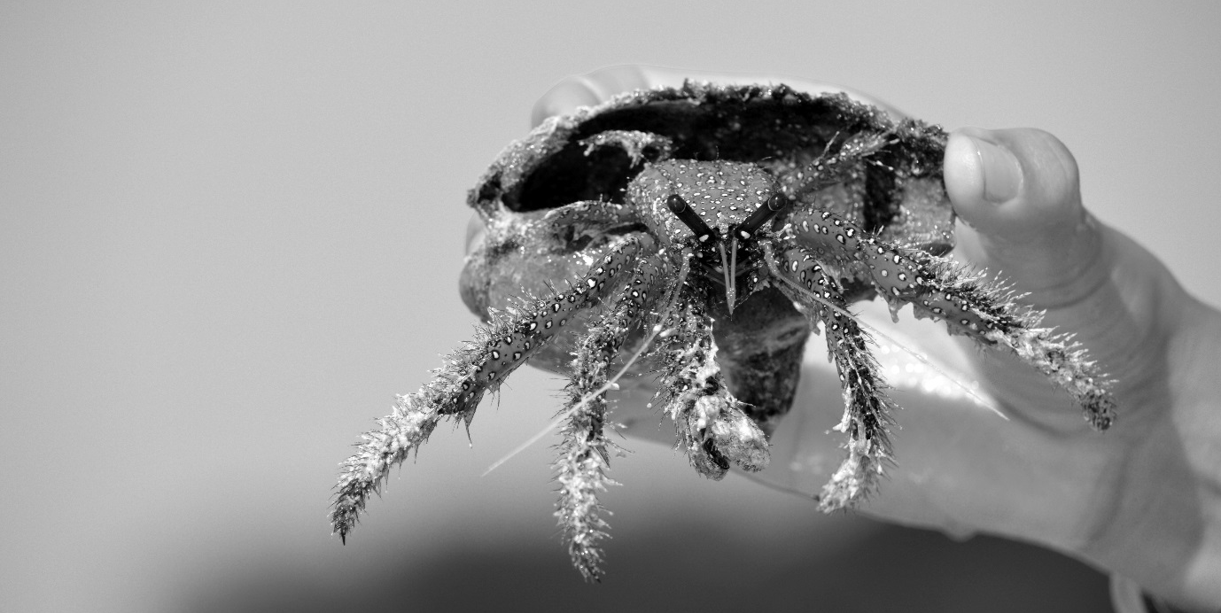
Marine
Education
Life or Death – Describe the role of adaptation in enhancing an organism’s survival in a specific marine environment
Name:
Date:
marineeducation.com.au
Rocking it on a Rocky Shore
The rocky shore is a fascinating but formidable place. At high tide, waves batter the rocks and predators are common. At low tide, organisms are baked by the sun or drenched by fresh water from rain. However, we give thanks to these environmental challenges. Because it’s challenges like these, that have shaped the fascinating repertoire of adaptations that exist on Earth today. Not only do adaptations enhance each organism’s survival and reproductive success, but they’re also very entertaining to watch! And, on a rocky shore, you have a front row seat. For example, the frilly bits (cirri) that stick out from the shell of a barnacle are feet. Filter-feeding feet! Limpets (that look like a china-man’s hat) only start to move when the tide comes in (or at night) to seek out their favourite food, seaweed. At low tide, limpets and chitons use a powerful muscular foot as a suction cup to fix themselves to rocks to make a water-tight seal and prevent from drying out. The periwinkle has special ridges on its shell that act like cooling ribs on a car radiator to stop it from overheating. It’s the best show on Earth. And it’s all free!
North West Island, Capricorn Bunker Group November 2016. Photograph: Gail Riches
Activity: Describe the role of adaptation in enhancing an organism’s survival in a specific marine environment.
© Marine Education 2023 CC BY-NC-SA
Unit 2 Topic 1 Science Understanding

Slide 93
Marine
Education
Unit 2 Topic 1: Marine ecology & biodiversity
SHE and SIS
Name:
Date:
marineeducation.com.au
© Marine Education 2023 CC BY-NC-SA
Unit 2 Topic 1 Science as a Human Endeavour

Slide 94
Marine
Education
Title – Discuss how scientific evidence from the impact of cyclones and/or floods, allows scientists to offer reliable predictions about the loss of biodiversity of a chosen marine ecosystem.
Name:
Date:
marineeducation.com.au
© Marine Education 2023 CC BY-NC-SA
Unit 2 Topic 1 Science as a Human Endeavour

Slide 95
Marine
Education
Title – Discuss how scientists use the evidence from the monitoring and assessment of an ecosystem to inform scientific knowledge about ecosystem resilience and population recovery.
Name:
Date:
marineeducation.com.au
© Marine Education 2023 CC BY-NC-SA
Unit 2 Topic 1 Science as a Human Endeavour

Slide 96
Marine
Education
Title – Evaluate the role of biosecurity measures in preventing or responding to incursions of invasive marine species in Australian ports. Examples of invasive species could include one of the following: European fan worm (Sabella spallanzanii), northern Pacific sea star (Asterias amurensis), killer algae (Caulerpa taxifolia), green mussel (Perna viridis), black-striped zebra mussel (Dreissena polymorpha) or tilapia (Oreochromis spp).
Name:
Date:
marineeducation.com.au
© Marine Education 2023 CC BY-NC-SA
Unit 2 Topic 1 Science as a Human Endeavour

Slide 97
Marine
Education
Title – Investigate by:
…estimating populations, e.g. survey count, quadrats, species density, percentage coverage, indirect or direct observation, catch and release.
Name:
Date:
marineeducation.com.au
© Marine Education 2023 CC BY-NC-SA
Unit 2 Topic 1 Science Inquiry Skills

Slide 98
Marine
Education
Title – Investigate by:
…using field guides to identify to a genus level
Name:
Date:
marineeducation.com.au
© Marine Education 2023 CC BY-NC-SA
Unit 2 Topic 1 Science Inquiry Skills

Slide 99
Marine
Education
Title – Investigate by:
…using a range of field equipment to measure biotic factors related to marine environments.
Name:
Date:
marineeducation.com.au
© Marine Education 2023 CC BY-NC-SA
Unit 2 Topic 1 Science Inquiry Skills

Slide 100
Marine
Education
Title – Investigate by:
…conducting in-field mapping of food webs via gut analysis to determine food sources.
Name:
Date:
marineeducation.com.au
© Marine Education 2023 CC BY-NC-SA
Unit 2 Topic 1 Science Inquiry Skills

Slide 101
Marine
Education
Title – Investigate by:
…identifying physical structures of a specific marine organism (this could be virtual, practical or as a demonstration)
Name:
Date:
marineeducation.com.au
© Marine Education 2023 CC BY-NC-SA
Unit 2 Topic 1 Science Inquiry Skills

Slide 102
FA2 title page/picture

Slide 103
Marine
Education
Formative Assessment #2 (FA2)
Scientific Experiment Preparation
Scientific Method steps
Name:
Date:
marineeducation.com.au
1. Observation
The scientific method always starts with an observation. Something is observed about something. Whether that something was the result of a previous study, a political issue, or just your own sense of curiosity, an observation was made. For this investigation, the observation will be something you observe about a population. For example, you might observe that some species are present in some places and absent from others (i.e. distribution). Or, you might observe a population has a very large abundance compared to others (i.e. relative density).
The scientific method
Observation
2. Model
It may or may not be obvious why a population is the way that it is. Regardless, it is important to first research as much background information as you can to find out. There will be more than one explanation. Model all explanations (i.e. mind-map or list). Select one to test. Keep the model – don’t throw it away - because you’ll need to either control or measure the remaining items on the list.
3. Aim and Research Question
Once you have your aim, create one or more research questions. Each question must be very specific. It must include the dependent and independent variable. You can also make a hypothesis (null).
4. Experimental Design So, what sampling method is most appropriate? The easy answer to that question is a sampling method that has been used, tried and tested before! The benefit of standardising the methodology is that your data can be compared to other data! Do your homework, thoroughly, for this part of the planning process is very important!!
5. Data Collection
The fun part!
6. Data Analysis
The Results. What is the answer to your research question/s? Do you accept or reject the null hypothesis? Could your answer be incorrect?
7. Interpretation and Evaluation
Why did you get those results? What do the results mean? How bullet-proof was your experimental design? How can it be improved? Can you update your model? Any other variables to test (new questions)? Did you come across any new observations to investigate?
Activity: Complete the boxes above
© Marine Education 2023 CC BY-NC-SA
FA2 Student Experiment

Slide 104
Marine
Education
Activity: Modify an existing experiment
Criteria: Research and Planning
Scientific Method step: Observation
Name:
Date:
marineeducation.com.au
Modifications ….
The observation may be the results of a previous experiment!
What does it mean by ‘modifications’?
e.g. The provided method is an alteration from the original one. It has been redirected (the aim has been changed to ensure the data answers the (new) research question) and it has been refined (the method changed to make the collected data more accurate and reliable).
How do you redirect an experiment? E.g. The preliminary experiment has been redirected by changing the aim and by changing either or both the independent and dependent variable. Explain what those changes are exactly. Then, justify how these changes ‘redirect’ the preliminary experiment.
How do you refine an experiment? E.g. number of repeats/trials, different equipment used? How should these changes make the data more accurate and reliable?
Question: WHY do we modify experiments? Ans. to improve on them. Plus, you might’ve made an observation (when you were doing the original experiment) that you wanted to explore further, and/or it gave you an idea of another research question??!!
Relate it to the ‘observation’ phase of the scientific method. And how science is all about asking questions!!
REWORD!
© Marine Education 2023 CC BY-NC-SA
FA2 Student Experiment

Slide 105
Marine
Education
Activity: Choose your dependent variable
Criteria: Research and Planning
Scientific Method step: Observation
Name:
Date:
marineeducation.com.au
What do you want to know? Research can be categorised into four general types of study^{[1]}:
Baseline Study
Data is collected to define the present state of a biological assemblage (i.e. surveyed for the first time).
Impact Study
Data is collected to determine if an impact changes a population or assemblage.
Note: some impacts have negative effects (i.e. sewage outfalls, dumping of dredging, introduction of exotic species, climate change) whilst others have positive effects (i.e. marine parks, catch limits etc.).
Monitoring Study
Data is collected repeatedly to detect any changes from the present state (often follows an impact study).
Patterns and Processes
Data is collected to describe the distribution and abundance patterns of organisms, with the intention of identifying the processes responsible for them.
Activity: Tick one box above to indicate the type of research (& purpose) of your investigation
The Study Site/s…To make an observation, it really helps to visit the study site (this can be virtual).
Activity: Describe the study site/s.
Make the Observation…Look at the life that is around you (at the study site/s). What do you see? Make an observation about a population – a group of individuals of the same species living in the same place and time. Choose wisely. This is what you will be measuring. This is your dependent variable!
Q1. What is the name (Genus species) of the population? Ans.
Q2. What was the observation you made about this population? E.g. Does the population change between two different times, or two different locations, or over a gradient of time or space? Ans.
Q3. What is the best way to measure this population? E.g. population density? distribution? Ans.
^{[1]} Adapted from: Kingsford, M. and Battershill, C. (1998). Studying temperate marine environments: A handbook for ecologists. Canterbury University Press. NZ. p.19
© Marine Education 2023 CC BY-NC-SA
FA2 Student Experiment

Slide 106
Marine
Education
Activity: Choose your independent variable
Criteria: Research and Planning
Scientific Method step: Model
Name:
Date:
marineeducation.com.au
Making a Model
Why was the population like that? To find out, you need to make a model. Your model will comprise of a collection of explanations for your observation. Examples of models include a mind-map, a list, a bunch of graphs, an animation, etc. When making your model, include ALL plausible explanations for the observation (not just the most obvious explanation, or the one you are most familiar with). This will require lots of reading (hint: start your bibliography now – it will save you lots of time later!!!).
Activity: Research the following (and take lots of notes). Tick the checklist box when complete.
Biology: adaptations for survival (e.g. structural, functional, behavioural), reproductive strategies
Ecology: the biotic and abiotic components of its environment (and the interactions within and between them)
Activity: In the space below, create a model to include all explanations for your observation.
Pick ONE to investigate!
Your model will be far too complex, with too many explanations to investigate all at once on your own. Therefore, pick just one explanation from the model (above) to investigate further. Pick the one that makes the most sense (and other scholars think so too) and, if possible, is easy to measure (e.g. abiotic). This is your independent variable!
Importantly, all other variables must be controlled (CV). If they can’t be controlled, they must be measured (MV), so their influence can be considered in the outcome of the study.
Q1. Which explanation did you pick? E.g. What changed that (you think) made the population change? Was it time, location, other species, protection level, a pollutant? Pick only ONE! Ans.
Q2. How are you going to measure this change to the independent variable, to measure its effect on the population? E.g. group 1 (effect) vs group 2 (no effect). Ans.
© Marine Education 2023 CC BY-NC-SA
FA2 Student Experiment

Slide 107
Marine
Education
Activity: Create your research question
Criteria: Research and Planning
Scientific Method step: Research Question
Name:
Date:
marineeducation.com.au
The aim of this investigation is to measure the effect of …….on……..
The aim of your investigation will be to measure the effect of the independent variable (Q1 on page 63) on the observation that you made about a population (Q1 & 3 on page 62).
Activity: Complete this sentence: The aim of this investigation is to …..
The Research Question
It is very important to create a research question that can be answered using the data that you collect!!!!!
One way to ensure you can do this, is to word the research question in one of two ways….
Is there a difference in ….. between ……. & .……?
Is there a (linear) relationship between ……. & ……..?
If you don’t word it like this, you won’t be able to (statistically) answer your research question! For example,
Q. Is there a difference in between & ?
The dependent variable (Q1&3 page 62)
Two groups to compare (Q2 page 63)
For example,
Is there a difference in the density of Morula sp. between the high tide zone and low tide zone?
Is there a difference in percentage cover of Rhizophora stylosa between Location A and Location B?
Is there a difference in the density of a bio-indicator species between a protected and unprotected zone?
Is there a difference in the population size of an endangered species between last year and this year?
P=0.12
Bio-indicator Density
Or, you can word it like this….
Green Zone
Yellow Zone
Q. Is there a (linear) relationship between & ?
Must be CONTINUOUS data (& measured as a pair)
For example,
Is there a (linear) relationship between abundance of Grapsidae crabs and abundance of pnematophores?
Is there a (linear) relationship between abundance of species x and body size?
Is there a (linear) relationship between coral mortality and temperature?
y=mx+c
For this type of question, once you have measured both pairs of continuous data, draw up a scatter graph (with one dataset on the x-axis and the other dataset on the y-axis). Plot the data and draw a (straight) line of best fit (y=mx+c). If plots are close to the line, a ‘linear’ relationship exists, which is quantified by Pearson’s Correlation Coefficient or ‘r’. The closer r is to 1, the closer the plots are to the line and the stronger the relationship.
Coral mortality
r=0.80
Temperature °C
Activity: Create one or more research questions using the formatting described above
Note: the ‘null’ hypothesis is a statistical term that always states there is NO difference (or NO relationship) between this and that. Your results will either accept or reject the null hypothesis.
© Marine Education 2023 CC BY-NC-SA
FA2 Student Experiment

Slide 108
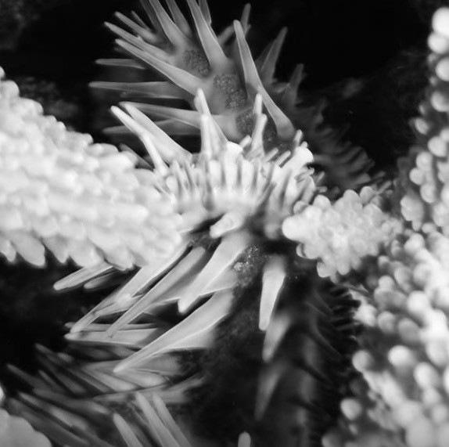
Marine
Education
Activity: Select a sampling technique & equipment
Criteria: Research and Planning
Scientific Method step: Experimental Design
Name:
Date:
marineeducation.com.au
Sampling Techniques and Equipment
Your choice of sampling technique and equipment depends on a number of factors: the environment that you are sampling, the scale of the sample question, the size and mobility of the organisms, and time and budget constraints. Note: if you standardise the methodology by replicating what others have done in the past, you can compare data! Below is a comprehensive list of sampling techniques and equipment.
Subtidal Hard Substrata (e.g. reefs)
Satellite Images and Aerial Photography Echo sounding Side-scan sonar (swath mapping) Remote sensing and GIS Manta Tow Free-swimming Observer Underwater Video (remotely or diver controlled) | Spot-checks Quadrats and Transects Photography Sample Removal (plastic and mesh bags) Marking and Tagging Core Sampling Benthic Grabs Airlifts (i.e. suction airlift)
Intertidal Hard Substrata (e.g. rocky shores)
Quadrats & Transects Remote sensing and GIS Photography Sample removal Marking and Tagging Exclusion Cages
Soft Sediments (e.g. beach)
Box corer and sieve with various mesh sizes for: Megafauna >200mm Macrofauna 0.5mm-200mm Meiofauna 0.063mm-0.5mm Microfauna <0.063mm | Sediment Analyses Echo sounding Remote sensing
Intertidal Estuarine Vegetation (i.e. mangroves)
Aerial photography, remote sensing and GIS Quadrats and Transects
Fish Communities
Hand lines and set lines Traps Belt transects Stationary visual technique Video methods (i.e. BRUV) Tagging Gill nets Fish traps | Seine (drag) nets Trawls Electrofishing Fish poisoning Visual consensus Pot-net traps Drop net traps and throw traps Cast nets
Plankton
Plankton nets and Plankton Tows Continuous plankton recorder (i.e. towed over transects 400nmiles at speeds up to 20knots) Remote sensing Depth stratification in planktonic communities Water pumps Water bottles (open and close at depth) Cod-ends and collecting buckets Purse-seine nets Plankton traps (demersal and light) Optical plankton counters
Addressing limitations
Every sampling technique, every piece of equipment and every methodology has certain limitations. If you fail to identify these limitations, the validity of your experiment will be compromised. E.g. the answer to your research question will be incorrect.
For example, pictured left is a crown of thorns starfish (note the spikes). It is tucked in behind the branches of a staghorn coral. Its hidden position may obscure it from view. As a result, the 2D (as opposed to 3D) nature of the quadrat is a limitation of the quadrat. Another limitation is when mobile animals ‘flee from the scene’. Or, if the quadrat is too large or too small (or out of focus) for the size and scale of what is being measured.
Activity: Download and peruse the following publication:
Hill J. & Wilkinson, C. (2004). Methods for Ecological Monitoring of Coral Reefs: A resource for Managers: Version 1. AIMS. Townsville. QLD. ISBN: 0 642 322 376
© Marine Education 2023 CC BY-NC-SA
FA2 Student Experiment

Slide 109
Marine
Education
Activity: Choose your Experimental Design
Criteria: Research and Planning
Scientific Method step: Experimental Design
Name:
Date:
marineeducation.com.au
Quadrats and Transects
Quadrats and transects are common tools of the trade in marine science research. Below is a brief overview of the Quadrat-transect method, the Point Intercept Method and the Line Intercept Method^{[1]}.
Quadrat-transect method
Quadrats (i.e. squares) are randomly placed along a transect or evenly spaced along a transect (line).
For example, a 1mx1m square quadrat is placed every 2m along a transect (tape measure)……
Q1 |  | Q2 |  | Q3 |  | Q4 |  | Q5 |  | Q6
0m
1m
2m
3m
4m
5m
6m
7m
8m
Transect (tape measure)
x3
Identify & record anything under a point (randomly or evenly spaced) in a quadrat
The dot method is commonly used when quadrats are photographs, called ‘photoquadrats’ (i.e. using Coral Point Count (CPCe) software with Excel extension).
…to EITHER
Identify and record everything within the quadrat
OR
Point Intercept Method
Identify & record anything under a point along a transect (points are randomly or equally spaced)
Line Intercept Method
Identify and record anything under a length of transect (the transect is a tape measure)
Branching
Plate
Boulder
Branching
10.0 cm
14.6 cm
8.4 cm
6.2 cm
4 cm
Branching Coral
Boulder Coral
Sand
Transect
Transect (tape measure)
Plate Coral
Branching
Replicates and Precision
Marine environments can be highly variable (i.e. different) in both space and time. To collect enough information that is representative of the entire area of interest, you need to take more than one sample at a survey site. Additional samples are called replicates^{[1]}. The number of replicates that you choose to include in your experimental design depends on the level of precision (and reliability) that you desire. Precision is the degree to which several measurements (replicates) provide answers very close to each other.
Because marine environments, such as coral reefs, are highly variable, replicates are rarely exactly the same. But if you have enough of them, they can come close. If you don’t have enough replicates, the level of precision, and the reliability of the experiment, will be low (you will know this because your standard deviation will be high). As a result, you will not be able to detect any significant difference between two populations (if there is one) and accurately answer your research question. If you think this has happened to you, recommend more replicates and consider a stratified, or nested sampling design for next time.
^{[1]} Adapted from: Hill J. & Wilkinson, C. (2004). Methods for Ecological Monitoring of Coral Reefs: A resource for Managers: Version 1. AIMS. Townsville. QLD. ISBN: 0 642 322 376
© Marine Education 2023 CC BY-NC-SA
FA2 Student Experiment

Slide 110
Marine
Education
Activity: Prepare to collect your data
Criteria: Research and Planning
Scientific Method step: Experimental Design
Name:
Date:
marineeducation.com.au
Quadrat and Transect Data
Either identify species as you go along, writing their scientific names on the data sheet in the field (see below left) OR set up categories of what to measure, prior to sampling in the field (see below right).
Quadrat-transect Method - identifying and recording everything in the quadrat
Quadrat-transect Method - identifying and recording everything in the quadrat
SCIENTIFIC NAME | Tally of individuals OR percentage cover of modular organisms (Q stands for Quadrat)
 | Q1 | Q2 | Q3 | Q4
CATEGORY | Tally of individuals OR percentage cover of modular organisms (Q stands for Quadrat)
 | Q1 | Q2 | Q3 | Q4
HARD CORAL
SOFT CORAL
TURF ALGAE
OR
etc.
etc.
Quadrat-transect Method - identifying and recording anything under a randomly placed point in the quadrat
Quadrat-transect Method - identifying and recording anything under a randomly placed point in the quadrat
SCIENTIFIC NAME | TALLY of POINTS (i.e. 50/Quadrat)
 | Q1 | Q2 | Q3 | Q4
CATEGORY | TALLY of POINTS (i.e. 50/Quadrat)
 | Q1 | Q2 | Q3 | Q4
HARD CORAL
SOFT CORAL
TURF ALGAE
DEAD CORAL
OR
etc.
etc.
etc.
Point-Intercept Method
Point-Intercept Method
Substrate Code
HC Hard Coral
RB Rubble
POINT | SCIENTIFIC NAME
1
2
3
4
5
6
POINT | CATEGORY
1
2
3
4
5
6
Adapted from Reef Watch methods
OT Other
SC Soft Coral
SD Sand
OR
RC Rock
SI Silt/Clay
NIA Nutrient Indicator Algae
RKC Recently Killed Coral
etc.
etc.
Line-Intercept Method
Line-Intercept Method
Substrate Code
HC
RB
LINE INTERCEPT (cm) |  | SCIENTIFIC NAME
START | FINISH
LINE INTERCEPT (cm) |  | CATEGORY
START | FINISH
OT
SC
SD
OR
RC
SI
NIA
RKC
etc.
etc.
© Marine Education 2023 CC BY-NC-SA
FA2 Student Experiment

Slide 111
Marine
Education
Activity: Consider Risks/Ethics/Environmental Issues
Criteria: Research and Planning
Scientific Method step: Experimental Design
Name:
Date:
marineeducation.com.au
Activity: Complete the tables below
Hazard | Likelihood it occurs 1 (unlikely) – 5 (highly likely) |  |  |  |  |  | Severity of injury (worst case scenario) 1 (minor) – 5 (major) |  |  |  |  |  | Action/s to reduce the risk
 | 1 | 2 | 3 | 4 | 5 |  |  | 1 | 2 | 3 | 4 | 5
On a BOAT
Seasickness | x | x | x | x |  |  |  | x | x |  |  |  | Seasickness tablets
Dehydration |  |  |  |  |  |  |  |  |  |  |  |  | Bring extra water, drink often
Sunburn |  |  |  |  |  |  |  |  |  |  |  |  | Sunscreen, wear protective clothing
Equipment malfunction |  |  |  |  |  |  |  |  |  |  |  |  | Maintain, check and safely stow equipment, bring spares
Collision |  |  |  |  |  |  |  |  |  |  |  |  | Follow COLREGS and IALA, maintain lookout
Loss of a passenger |  |  |  |  |  |  |  |  |  |  |  |  | Buddy system, log book, roll call, head count
IN the WATER
Ruptured eardrum |  |  |  |  |  |  |  |  |  |  |  |  | Equalisation of ears every metre going down
Swept away by current |  |  |  |  |  |  |  |  |  |  |  |  | Listen to safety brief and follow instructions
Separation from others |  |  |  |  |  |  |  |  |  |  |  |  | Look up and around you at least every minute
Lookout can’t see you |  |  |  |  |  |  |  |  |  |  |  |  | Take a whistle and safety sausage with you in the water
Hyperthermia |  |  |  |  |  |  |  |  |  |  |  |  | Wear the correct wetsuit, bring warm change of clothes
Mask strap breaks |  |  |  |  |  |  |  |  |  |  |  |  | Don’t stray far from boat. Bring spares
Lack of floatation |  |  |  |  |  |  |  |  |  |  |  |  | Take floatation device (i.e. noodle)
Ethical Standard Breach |  |  |  |  |  |  |  |  |  |  |  |  | Find out the rules when working with animals
Irukandji Sting |  |  |  |  |  |  |  |  |  |  |  |  | Avoid (Oct-April). Wear stinger suit.
Dangerous Marine Creature | Signs/Symptoms | First Aid
Irukandji – related to box jellyfish (note: average size is 2cm). | Initial sting is painless. 20min later, severe lower back pain followed by nervous system shut down | Evacuate asap to nearest medical facility. Reassure patient and be ready to conduct CPR. Administer O2.
Box Jellyfish | Very painful whip marks → Heart attack
Blue bottle | Painful whip marks → Lymph node pain
Stinging Hydroid (e.g. fire coral) | Painful, itchy weals
Sea urchin or Crown of Thorns (spine) | Pain, redness and swelling around wound
Stone fish (spine) | Extreme pain at the site of the wound
Sting ray (barb) | Extreme pain at the site of the wound
Animal Bite (moray eel, shark etc.) | Excessive bleeding
Textile Cone Shell | Puncture → numbness → breathing failure
Blue-ringed Octopus (bite) | Bite is often not felt → paralysis
© Marine Education 2023 CC BY-NC-SA
FA2 Student Experiment

Slide 112
Marine
Education
Activity: Collect your data
Criteria: Collection and Processing of Data
Scientific Method step: Data Collection
Name:
Date:
Pictures…
© Marine Education 2023 CC BY-NC-SA
FA2 Student Experiment

Slide 113
Marine
Education
Activity: Collect and Process your Data
Criteria: Collection and Processing of Data
Scientific Method step: Data Analysis
Name:
Date:
marineeducation.com.au
Activity: Follow the flow chart to analyse your data and answer your research question!
Q. Is there a difference in between & ?
Dependent Variable
Population (Group) 1
Population (Group) 2
Start here
Q1. Is this the wording of your research question?
No
Yes
Calculate the
mean,
standard deviation,
standard error &
confidence interval
of each population (group).
Conduct a t-test
or use error bars
to statistically answer your research question.
See pages 52-54 for instructions
Go to Next Page
Q2. Is the dependent variable abundance?
Yes
No
Q3. Is the dependent variable population size (N)?
No
No
Yes
Population Size= x total area of population
area of one quadrat
(Quadrat Method)
where:
N = Total Population Size
= sample mean = TOTAL count of individuals / number of quadrats
Q4. Is the dependent variable population density?
No
No
Yes
Density = Population size (see above) / Area
Q5. Is the dependent variable percentage cover?
No
Yes
See your teacher
Q6. Did you use sample points in your methods?
No
Percentage Cover
Yes
x100
Total number of sample points occupied by a species
=
Total points sampled
Q7. Did you use the Line Intercept Method?
No
Yes
No
Percentage Cover
x100
Total length of transect occupied by a species
=
Total transect length
Q8. Did you use a quadrat in your methods?
No
Yes
Percentage Cover
x100
=
Total % cover for all quadrats
Total number of quadrats
See your teacher
© Marine Education 2023 CC BY-NC-SA
FA2 Student Experiment

Slide 114
Marine
Education
Activity: Collect and Process your Data
Criteria: Collection and Processing of Data
Scientific Method step: Data Analysis
Name:
Date:
marineeducation.com.au
Q. Is there a (linear) relationship between & ?
Dependent Variable
Y
X
Condense your data into two columns, x and y.
For example….
5
4
3
2
1
(50,5)
X | Y
10 | 1
20 | 2
30 | 2
40 | 3
50 | 5
Line of best fit (y=mx+c)
(10,1)
Y
(40,3)
(20,2)
(20,2)
(30,2)
(30,2)
r = 0.938
(see below for instructions)
(10,1)
(40,3)
10 | 20 | 30 | 40 | 50
(50,5)
X
Pearson’s Correlation (r)
…is a measure of the strength of the linear relationship between two variables, x and y.
The value r =1 indicates the strongest possible positive relationship between x and y (i.e. as one increases the other increases).
The value r = - 1 indicates the strongest possible negative relationship between x and y (as one increases, the other decreases).
The value r = 0 ± 0.5 indicates no linear relationship between x and y.
Note: this does not rule out any strong relationship between x and y.
How to calculate r manually
There could still be a strong relationship, but one that is not linear.
How to calculate r in EXCEL:
r =
n (∑xy) - (∑x)(∑y)
See your teacher
√
Simply click on an empty cell and type =CORREL( X , Y )
where: X is the column containing all the data for the x-axis &
Y is the column containing all the data for the y-axis.
[n∑x - (∑x) ] [n∑y – (∑y) ]
2
2
2
2
where: n= sample size (i.e. 5) and; ∑ is the SUM of….(i.e. total).
2
2
 | X | Y | XY | X | Y
 | 10 | 1 | 10 | 100 | 1
 | 20 | 2 | 40 | 400 | 4
 | 30 | 2 | 60 | 900 | 4
 | 40 | 3 | 120 | 1600 | 9
 | 50 | 5 | 250 | 2500 | 25
Total | 150 | 13 | 480 | 5500 | 43
 | A | B | C
1 | X | Y | = CORREL(A2:A6,B2:B6)
2 | 10 | 1
3 | 20 | 2
4 | 30 | 2
5 | 40 | 3
6 | 50 | 5
∑x
∑y
∑xy
2
2
∑x
∑y
© Marine Education 2023 CC BY-NC-SA
FA2 Student Experiment

Slide 115
Marine
Education
Activity: Analyse your Data
Criteria: Analysis
Scientific Method step: Data Analysis
Name:
Date:
marineeducation.com.au
Taking control
In the lab, when conducting an experiment, conditions are strictly controlled. In the field, we aim to control as many variables possible (i.e. date, time, tide, etc.). However, given that it is outside, there are many variables that can not be controlled. These are called ‘measured variables’. They’re called measured variables because they need to be measured. Why? Because they can influence the result.
Activity: Below, list the measured variables from your original model on page 63 (those you couldn’t control….and hopefully measured!). Rank them from most likely to least likely to influence the result.
Detective work
A researcher must always consider the probability that the result is incorrect – either the experiment failed to pick up a difference when there was one, or the experiment found a difference that didn’t exist. Your experiment must therefore be critically analysed – the data analysis part and the experimental design.
 | Question
Data Analysis | Did you use the correct statistics test for the wording of the research question? How close to 0.05 (the cut-off point) was the P value? If the difference was significant, how close to zero was the P value? If applicable, how close was r (Pearson’s correlation coefficient) to 1.0 or -1.0? How close to zero were the values for s (standard deviation), SE & Cl? (if they were not close to zero, you need to examine why your replicates were not the same) Did you construct a graph to make a visual comparison before reaching a conclusion? Were any measured variables likely to have influenced the result? Were there any variables that could not be controlled, measured?
Experimental Design | Could you have picked a better dependent variable (population) to measure? Could you have changed the independent variable in a different (and more effective) way? Should you have used qualitative data instead of quantitative data and vice versa? Did the experimental design take into account the dispersion patterns of the population (i.e. clumped)? Were there enough replicates? Were the replicates independent of each other, to avoid double counts? Was there randomisation in sampling to avoid bias? Was the size of the sample unit appropriate for the size of the organism? Was the choice of sample unit appropriate for the mobility of the organism? Were the limitations of the sampling technique addressed? Was the scale of the experimental design suitable for the scale of the research question?
Q. How valid (how close to the truth) are your results and WHY? Ans.
Q. How reliable (how precise) are your results and WHY? Ans.
© Marine Education 2023 CC BY-NC-SA
FA2 Student Experiment

Slide 116
Marine
Education
Activity: Mark this example to become familiar with the ISMG criteria for
‘research and planning’
Name:
Date:
marineeducation.com.au
Rationale
* Copy/paste from QCAA exemplar
The aim of this experiment is to measure the effect of ….. on …… * Copy/paste from QCAA exemplar
'the aim of this experiment is to…'
Activity: Using the ISMG Criteria below, give a mark out of 5 for the rationale provided above.
Marks | ISMG Criteria | FINAL MARK
4-5 | a considered rationale for the experiment
2-3 | a reasonable rationale for the experiment
1 | a vague or irrelevant rationale for the experiment
Modifications to original experiment
* Copy/paste from QCAA exemplar
Activity: Using the ISMG Criteria below, give a mark out of 5 for the modifications above.
Marks | ISMG Criteria | FINAL MARK
4-5 | justified modifications to the methodology
2-3 | feasible modifications to the methodology
1 | inappropriate modifications to the methodology
© Marine Education 2023 CC BY-NC-SA
FA2 Student Experiment

Slide 117
Marine
Education
Activity: Mark this example to become familiar with the ISMG criteria for
‘research and planning’
Name:
Date:
marineeducation.com.au
Research Question: Is there a significant difference in the abundance of ghost crabs (Genus species) between the high tide zone and the low tide zone at Tannum Sands on spring low tide?
Activity: Using the ISMG Criteria below, give a mark out of 5 for the research question above.
Mark | ISMG Criteria | FINAL MARK
4-5 | a specific and relevant research question
2-3 | a relevant research question
1 | an inappropriate research question
Methods
* Copy/paste from QCAA exemplar
Activity: Using the ISMG Criteria below, give a mark out of 5 for the rationale provided above.
Activity: Using the ISMG Criteria below, give a mark out of 5 for the methods provided above.
Marks | ISMG Criteria | FINAL MARK
4-5 | a methodology that enables the collection of sufficient, relevant data
2-3 | a methodology that enables the collection of relevant data
1 | a methodology that causes the collection of insufficient and irrelevant data
Management of risks/ethical issues/environmental issues
* Copy/paste from QCAA exemplar
Activity: Using the ISMG Criteria below, give a mark out of 5 for the rationale provided above.
Activity: Using the ISMG Criteria below, give a mark out of 5 for the manag’mt. of issues above.
Marks | ISMG Criteria | FINAL MARK
4-5 | considered management of risks/ethical issues/environmental issues
2-3 | management of risks/ethical issues/environmental issues
1 | inadequate management of risks/ethical issues/environmental issues
© Marine Education 2023 CC BY-NC-SA
FA2 Student Experiment

Slide 118
Marine
Education
Activity: Mark this example to become familiar with the ISMG criteria for ‘collection and processing of data’
Name:
Date:
Raw Data:
* Copy/paste from QCAA exemplar
Activity: Using the ISMG Criteria below, give a mark out of 5 for the raw data above.
Mark | ISMG Criteria | FINAL MARK
4-5 | collection of sufficient and relevant raw data
2-3 | collection of relevant raw data
1 | collection of insufficient and irrelevant raw data
© Marine Education 2023 CC BY-NC-SA
FA2 Student Experiment

Slide 119
Marine
Education
Activity: Mark this example to become familiar with the ISMG criteria for ‘collection and processing of data’
Name:
Date:
Results (Processed Data):
* Copy/paste from QCAA exemplar
Activity: Using the ISMG Criteria below, give a mark out of 5 for the processed data above.
Mark | ISMG Criteria | FINAL MARK
4-5 | correct and relevant processing of data
2-3 | basic processing of data
1 | incorrect or irrelevant processing of data
© Marine Education 2023 CC BY-NC-SA
FA2 Student Experiment

Slide 120
Marine
Education
Activity: Mark this example to become familiar with the ISMG criteria for ‘collection and processing of data’
Name:
Date:
Results (Graphs/Tables)
* Copy/paste from QCAA exemplar
Activity: Using the ISMG Criteria below, give a mark out of 5 for the processed data above.
Mark | ISMG Criteria | FINAL MARK
4-5 | fluent and concise use of scientific language and representations
2-3 | competent use of scientific language and representations
1 | simplistic use of language and representations.
© Marine Education 2023 CC BY-NC-SA
FA2 Student Experiment

Slide 121
Marine
Education
Activity: Mark this example to become familiar with the ISMG criteria for ‘analysis’
Name:
Date:
Results (Text)
* Copy/paste from QCAA exemplar
Activity: Using the ISMG Criteria below, give a mark out of 5 for the results described above.
Mark | ISMG Criteria | FINAL MARK
4-5 | thorough identification of relevant trends/patterns/relationships
2-3 | identification of obvious trends/patterns/relationships
1 | identification of incorrect or irrelevant trends/patterns/relationships
© Marine Education 2023 CC BY-NC-SA
FA2 Student Experiment

Slide 122
Marine
Education
Activity: Mark this example to become familiar with the ISMG criteria for ‘analysis’
Name:
Date:
Uncertainty (i.e. margins of error) in the evidence (results)
* Copy/paste from QCAA exemplar
Limitations of evidence
* Copy/paste from QCAA exemplar
Activity: Using the ISMG Criteria below, give a mark out of 5 for uncertainty and limitations.
Mark | ISMG Criteria | MARK
4-5 | thorough and appropriate identification of the uncertainty and limitations of evidence
2-3 | basic identification of uncertainty/limitations of evidence
1 | incorrect or insufficient identification of uncertainty/limitations of evidence
Activity: Using the ISMG Criteria below, give a mark out of 5 for genre and referencing.
Mark | ISMG Criteria | MARK
4-5 | appropriate use of genre and referencing conventions
2-3 | use of basic genre and referencing conventions
1 | inadequate use of genre and referencing conventions.
© Marine Education 2023 CC BY-NC-SA
FA2 Student Experiment

Slide 123
Marine
Education
Activity: Mark this example to become familiar with the ISMG criteria for ‘interpretation and evaluation’
Name:
Date:
Conclusion/s linked to the research question
* Copy/paste from QCAA exemplar
Activity: Using the ISMG Criteria below, give a mark out of 5 for the rationale provided above.
Activity: Using the ISMG Criteria below, give a mark out of 5 for the conclusion provided above.
Marks | ISMG Criteria | FINAL MARK
4-5 | justified conclusion/s linked to the research question
2-3 | reasonable conclusion/s relevant to the research question
1 | inappropriate or irrelevant conclusion/s
Discussion - Reliability
* Copy/paste from QCAA exemplar
Discussion - Validity
* Copy/paste from QCAA exemplar
Activity: Using the ISMG Criteria below, give a mark out of 5 for the discussion above
Mark | ISMG Criteria | MARK
4-5 | justified discussion of the reliability AND validity of the experimental process
2-3 | reasonable description of the reliability AND validity of the experimental process
1 | cursory or simplistic statements about the reliability AND validity of the experimental process
© Marine Education 2023 CC BY-NC-SA
FA2 Student Experiment

Slide 124
Marine
Education
Activity: Mark this example to become familiar with the ISMG criteria for ‘interpretation and evaluation’
Name:
Date:
Suggested Improvements
* Copy/paste from QCAA exemplar
Activity: Using the ISMG Criteria below, give a mark out of 5 for the rationale provided above.
Suggested extensions
* Copy/paste from QCAA exemplar
Activity: Using the ISMG Criteria below, give a mark out of 5 for the suggested improvements and extensions
Mark | ISMG Criteria | MARK
4-5 | suggested improvements and extensions to the experiment that are logically derived from the analysis of evidence
2-3 | suggested improvements and extensions to the experiment that are related to the analysis of evidence
1 | ineffective or irrelevant suggestions
© Marine Education 2023 CC BY-NC-SA
FA2 Student Experiment

Slide 125
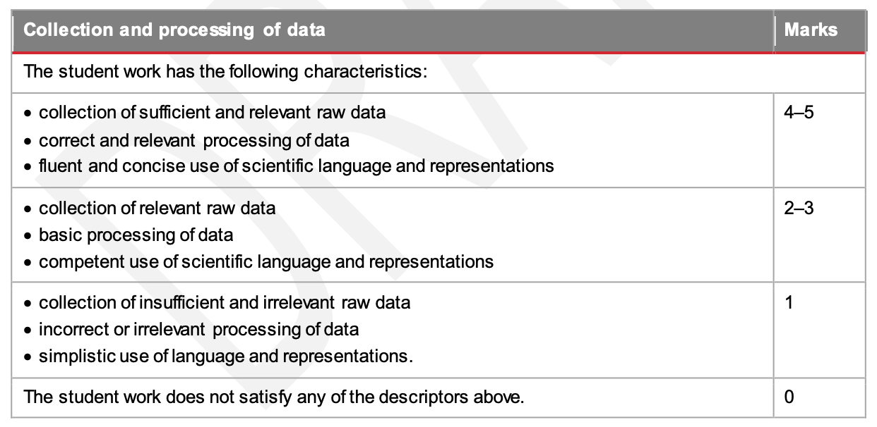
Marine
Education
Activity: Provide a final mark for this exemplar paper by completing the
ISMG below
Name:
Date:
Activity: Using the ISMG Criteria below, give a mark out of 5 for the rationale provided above.
© Marine Education 2023 CC BY-NC-SA
FA2 Student Experiment

Slide 126
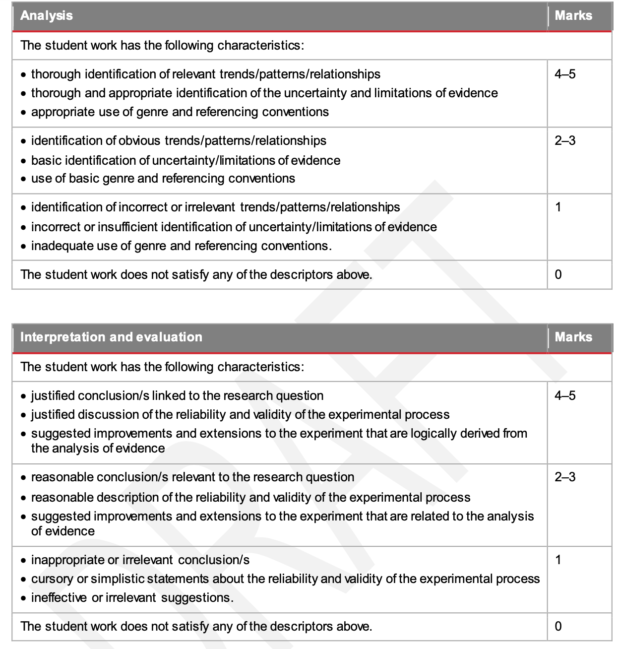
Marine
Education
Activity: Provide a final mark for this exemplar paper by completing the
ISMG below
Name:
Date:
Activity: Using the ISMG Criteria below, give a mark out of 5 for the rationale provided above.
Criterion | Marks
Research and Planning | / 5
Collection and processing of data | / 5
Analysis | / 5
Interpretation and evaluation | / 5
TOTAL MARKS | / 20
© Marine Education 2023 CC BY-NC-SA
FA2 Student Experiment

Slide 127
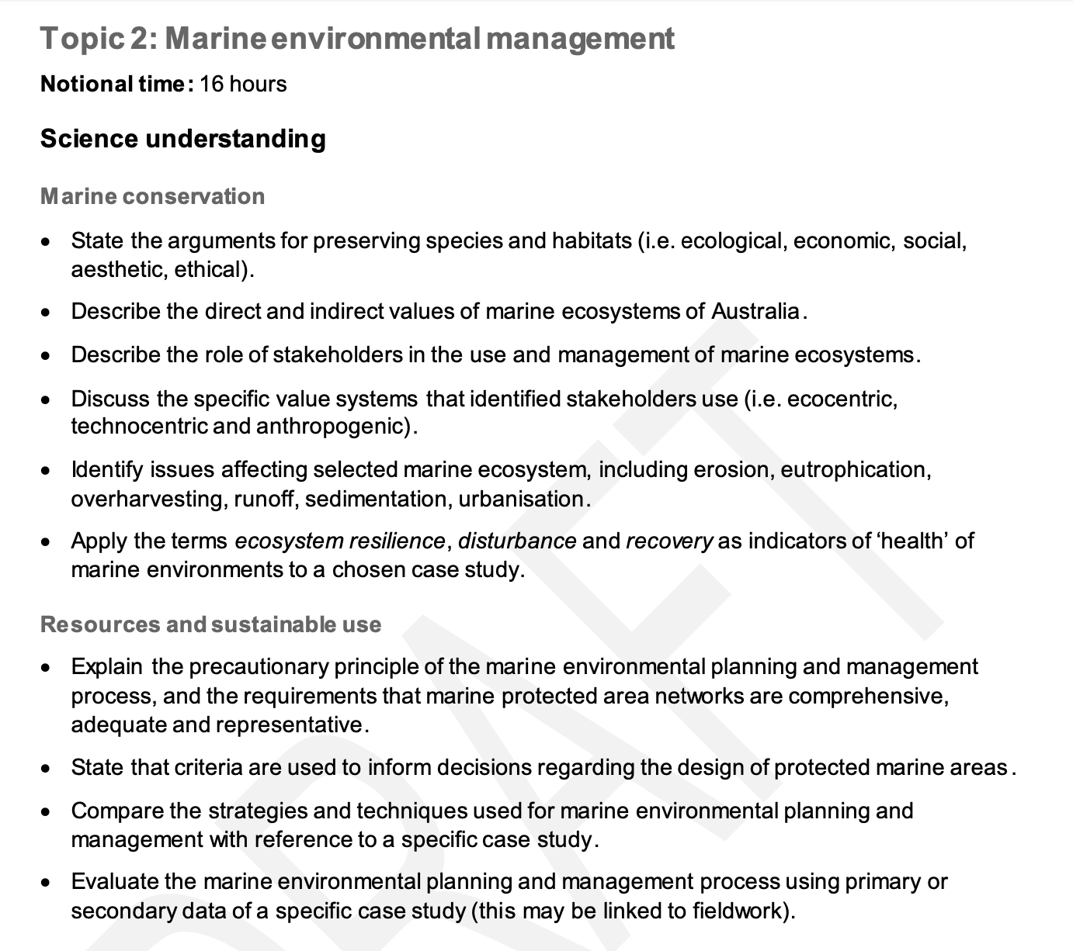
Marine
Education
Unit 2 Topic 2: Marine environmental management
Science Understanding
Name:
Date:
marineeducation.com.au
© Marine Education 2023 CC BY-NC-SA
Unit 2 Topic 2 Science Understanding

Slide 128
Marine
Education
Nature’s Capital – State the arguments for preserving species and habitats (i.e. ecological, economic, social, aesthetic, ethical)
Name:
Date:
marineeducation.com.au
The most valuable thing we extract from the ocean is our existence
Sylvia Earle^{[1]}
Benefiting by default!
Biodiversity is Earth’s workforce (without a HR or finance department, lol). As organisms go about their day-to-day lives, trying to survive, grow and reproduce, their attempts to do so (indirectly) become the ecosystem services that we benefit from. For example, when phytoplankton carry out photosynthesis, they are providing us with oxygen to breathe. Our ability to breathe is not why they do it. Phytoplankton carry out photosynthesis to live. And lucky for us, they do! Likewise, fish do not grow for us to have the pleasure of eating them. They grow to survive and reproduce. But, in doing so, we get a nice meal.
Q. Can you think of any more examples? Discuss your answers and complete the table below
Organism/s | Functional Trait* | Benefit (ecosystem service)
Phytoplankton | Photosynthesis | Provides oxygen for us to breathe
 | Roots | Trap sediment and prevent erosion
Humpback Whales | Annual migration
*Functional traits are morphological, biochemical, physiological, structural, phenological, or behavioural characteristics that influence performance or fitness^{[2]}.
Millennium Ecosystem Assessment (MEA)
Humankind benefits from many functional contributions made by natural ecosystems. Collectively, these benefits are called ecosystem services. Whilst we have known about ecosystem services for a very long time, the term was popularised and its definitions formalised in 2004 by the Millennium Ecosystem Assessment^{[3]}.
Q. How many experts (worldwide) took part in the MEA? Ans.
Ecosystem Services are grouped into four general categories (see below).
Activity: Provide examples for each category of ecosystem service below (hint: see table above)
Provisioning Services
(Products derived from ecosystems)
Regulating Services
(natural processes regulated by ecosystems)
Cultural Services
(non-material benefits)
Supporting Services (functions that maintain all other services)
^{[1]} TEDx (2009). Sylvia Earle: How to protect the oceans (TED Prize winner!). Youtube. Accessed 2018 from: https://www.youtube.com/watch?v=43DuLcBFxoY
^{[2]} Diaz, S., Purvis, A., Cornelissen, J.H.C., Mace, G.M., Donoghue, M. J., Ewers, R., Jordano, P. and Pearse, W.D. (2013). Functional traits, the phylogeny of function and ecosystem service vulnerability. Ecology and Evolution. 3(9); 2958-2975.
^{[3]} Millennium Ecosystem Assessment (2004). Ecosystems and Human Well-being: A framework for Assessment: Summary. Island Press. Washington. Accessed 2018 from: www.millenniumassessment.org/en/index.html
© Marine Education 2023 CC BY-NC-SA
Unit 2 Topic 2 Science Understanding

Slide 129
Marine
Education
Valuing nature – Describe the direct and indirect values of marine ecosystems of Australia
Name:
Date:
marineeducation.com.au
The dollar value of nature
We live in a world where money and economics influences so many of our decisions and behaviours. Thus, ecosystem services are often assigned economic values ($) to assist decision-making.
Q. What do you think of the idea of putting a price (a dollar value) on the environment? Ans.
Making nature’s values visible
The terms direct and indirect values are economics terms. They are part of a formula (see below) used by economists to calculate the total economic value (TEV) of an ecosystem (i.e. its total value in dollars)^{[1]}. A direct use value is the product value of nature, when you remove or exploit something from it for money. An indirect use value is the social and functional value of nature, when you still use it (indirectly) & benefit from it, but you don’t take anything from it, nor profit from it. The dollar values are calculated using various methods, including market prices, as well as surveys asking how much money people are willing to pay.
How much is it worth if we ‘use’ it? E.g. remove fish from it (direct) OR
use it for recreation (indirect), our mental health (indirect), or even flood protection (indirect)?
Total Economic Value ($$$)
How much is it worth for just being there (and not being used)? E.g. how much is preserving the gene pool worth (bequest), the fact it will still exist for future generations to enjoy (existence), or the potential it will be worth more in the future (option)?
Use Value
Non-use Value
Direct
Value
Indirect
Value
Bequest
Value
Existence
Value
Option
Value
Activity: Write examples of Direct Values
Activity: Write examples of Indirect Values
BP
O2
O2
Fish Market Open
Krill Oil Tablets
****Resort
O2
Shell
O2
O2
^{[1]} TEEB (2010). The Economics of Ecosystems and Biodiversity: Mainstreaming the Economics of Nature: A synthesis of the Approach, Conclusions and Recommendations of TEEB. Accessed 2018 from: www.teebweb.org
© Marine Education 2023 CC BY-NC-SA
Unit 2 Topic 2 Science Understanding

Slide 130
Marine
Education
The human dimension of marine management – Describe the role of stakeholders in the use and management of marine ecosystems
Name:
Date:
marineeducation.com.au
“Resource management is not about managing the resource, it is about managing the people!”
“The management of marine resources is a politically and culturally driven process, shaped by human livelihoods and perceptions” ^{[1]}
Q. What is your interpretation of the two statements provided above? Ans.
^{[1]} Levine A. S., Richmond, L. and Lopez-Carr, D. (2015). Marine resource management: culture, livelihoods, and governance. Applied Geography. Vol 59. P. 56-59. DOI: 10.1016/j.apgeog.2015.01.016
Planning for success
First, let’s grasp an understanding of the planning component of marine management.
Define the objective (what needs to be achieved?). Find out what stakeholders want/need.
Make a plan using an integrated planning approach. Again, include stakeholder input.
Consult with stakeholders (hold meetings and workshops etc.) to gain feedback on the plan.
Collect information (research and monitoring, surveys, data analysis, etc.)
Disseminate the information (publicize, spread the word, educate)
Public consultation (invite the community to have their say)
Draw up papers outlining any issues and options
Develop draft plans
Review
Activity: Tick the components that (should) involve stakeholder consultation &/or participation
Q. What might happen if stakeholders are not included in this process? Ans.
A combined effort
Solving complex environmental problems requires flexible and transparent decision-making that embraces a diversity of knowledges and values. Therefore, in many countries (including ours) stakeholder participation is embedded in policy^{[2]}. The role of the governing party is to provide lots of opportunities for stakeholders to participate in the decision-making process to ensure outcomes are sustainable.
Q. What is the role of the governing party towards stakeholders? Ans.
Q. What is the role of the stakeholders? Ans.
^{[2]} Reed, M. S. (2008). Stakeholder participation for environmental management: A literature review. Biological Conservation. Vol 141. Issue 10. P. 2417-2431. DOI: 10.1016/j.biocon.2008.07.014
© Marine Education 2023 CC BY-NC-SA
Unit 2 Topic 2 Science Understanding

Slide 131
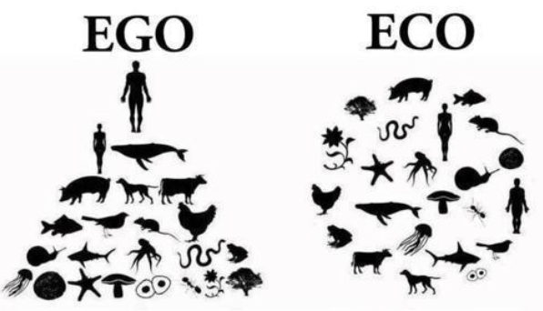
Marine
Education
Psychology Insights – Discuss the specific value systems that identified stakeholders use (i.e. ecocentric, technocentric and anthropogenic)
Name:
Date:
marineeducation.com.au
Are you Ego-centric…..
Are you self-centred? Do you like to win an argument, seldom acknowledging your mistakes? Do you think people should give you top priority? Do you constantly re-live and talk about moments of glory from the past? Do you get offended by criticism easily because you believe you are superior to others and it’s not cool to criticise superiors? Do you feel possessive of your possessions, not wanting to share? Do you feel lonely because no-one else meets your standards?
…or Eco-centric?
Do you value nature as much as yourself? Do you concern yourself with moral issues that are not only concerned with humanity but also for other forms of life? Do you picture yourself as a part of nature (as opposed to a controller of nature)? Would you help someone you will never meet, without any personal gain or bragging rights? Do you live with less so that others can have more (incl. nature)? Do you put others before yourself?
New Ecological Paradigm’ Scale^{[1]}
Q. Do you share the view that shortages in natural resources will always be overcome by advances in technology? If Yes, you are also ‘technocentric’
Worldviews “We don’t see things as they are. We see them as we are”^{[2]}.
A worldview is a set of assumptions about physical and social reality that effect cognition and behaviour. It is a way of describing the universe and life within it, both in terms of what is and what ought to be done^{[2]}. For example, worldviews are one’s philosophy of life, world hypothesis, world outlook, visions of reality or self-and-world construct. There are many models (paradigms and theories) that are used to measure people’s worldviews (in order to explain and predict their behaviours). Here are two to consider:
What do you believe?
Worldview Statements are made from three types of beliefs: what you believe is fact, what you believe is ok/not ok (your attitude) and how you believe we should act or not act (your values).
Note: Existential beliefs (truths) only account for 30% of a person’s worldview, therefore throwing facts at a person will not change their attitude or value^{[2]}.
Cultural Theory
You can map people’s worldviews (which is collectively the culture) on two dimensions. The y-axis is a scale of how much we think we should stick to the rules, with rule-book followers at the top, and those who couldn’t care for rules at the bottom. The x-axis is a scale of how much we think we can achieve on our own, as opposed to wanting to be part of a group and to do what the group says.
Rules please!
Existential Beliefs
Evaluative Beliefs
Fatalism
Hierarchism
Power in one
person
Power in Numbers
What is fact?
True or False?
Worldview Statements
Your attitude towards things
Individualism
Egalitarianism
Prescriptive & Proscriptive Beliefs
No Rules please!
How you believe we should act/not act? (Values)
Activity: Mark your position along the x and y axis. Use the marks as co-ordinates to plot your position. Repeat for class mates. The position of all the plots reveals the class culture.
Stakeholder values? As you can see, there are many flavours of society and many different viewpoints. Therefore, if you are trying to ‘convince’ people of something (i.e. to remove shark nets) be aware that your justifications may not be well received. Some just won’t care. Others will openly question your authority. Don’t get frustrated. Know and understand your audience, by understanding the psychology behind the behaviour.
Activity: Make up a worldview statement that the following stakeholders might say:
The subsistence farmer said,….
The oil company worker said,…
The fisheries officer said,………
The aboriginal elder said,………
The trawler fisherman said,……
The research scientist said,……
^{[1]} Dunlap R.E.V.L., Van Liere, K.D., Mertig, A.G., and Jones, R.E. (2000). Measuring Endorsement of the New Ecological Paradigm: A Revised NEP Scale. Journal of Social Issues. 56(3):425-442. DOI: 10.1111/0022-4537.00176
^{[2]}Koltko-Rivera, M. E. (2004). The Psychology of Worldviews. Review of General Psychology. 8(1):3-58. DOI: 10.1037/1089-2680.8.1.3
© Marine Education 2023 CC BY-NC-SA
Unit 2 Topic 2 Science Understanding

Slide 132
Marine
Education
Not aPEELing – Identify issues affecting a selected marine ecosystem, including erosion, eutrophication, overharvesting, runoff, sedimentation, urbanisation.
Name:
Date:
marineeducation.com.au
Marine Ecosystem | Issues (add more if you can think of more!)
Estuaries | Catchment run-off, changing river flows, acid soil run-off
Coastal Lakes | Urbanisation, eutrophication, sedimentation, saltwater encroachment
Saltmarshes | Urbanisation, sea level rise, introduced species
Mangroves | Urbanisation, contaminants
Rocky Shores | Overharvesting
Sand beaches | Coastal erosion
Seagrass | Sediment and nutrient run-off
Coral Reef | Anchor damage, climate change, ocean acidification, overfishing
Deep Sea | Overfishing, damaging fishing methods
Activity: Construct a PEEL paragraph to highlight an issue affecting a selected ecosystem from above
Point
It can be argued that….
This source suggests that….
Evidence suggests that….
It can be inferred that…..
It is evident that…..
Evidence
Comparable Evidence
Firstly…..
Furthermore…..
Additionally….
Similarly…..
Moreover….
Contrasting Evidence
However…..
Conversely….
Alternatively…..
In contrast…..
On the other hand…..
Explanation
This means that…
What this shows is…..
Therefore…..
As a result…..
Because of this…..
Consequently…..
Link
It is clear that….
This is important because….
In conclusion…..
To summarise…..
The significance of this is…..
Bibliography
Author/s (surname, initial/s)
Year of Publication (in brackets)
Title
Publisher
Volume No. Issue No. Page No.
DOI or URL and access date
© Marine Education 2023 CC BY-NC-SA
Unit 2 Topic 2 Science Understanding

Slide 133
Marine
Education
Marine Diagnosis – Apply the terms ecosystem resilience, disturbance and recovery as indicators of ‘health’ of marine environments to a chosen case study
Name:
Date:
marineeducation.com.au
Ecosystem Resilience: the capacity of an ecosystem to recover from a disturbance or withstand ongoing pressures.
Ecosystem Disturbance: a temporary change in environmental conditions that alters physical structures or arrangements of biotic and abiotic elements within an ecosystem; can occur over larger temporal scales and affect diversity; can be natural or anthropogenic.
Ecosystem Recovery: the return of a damaged ecological system and associated ecosystem services to a stable state.
Functional diversity
An ecosystem’s resilience and recovery rate following a disturbance is largely dependent on the functional diversity of the ecosystem. What is that you ask? It is quite simply another way to measure biodiversity. But instead of measuring, for example, how many different species there are, it is measuring how many different functional groups there are. What is a functional group? A functional group is a group of organisms that share a similar function^{[1]}. For example, grazers that intensely graze on epilithic algal turf such as rabbitfish, angelfish and surgeonfish comprise one functional group. Browsers that constantly feed on macro-algae is another. It takes many different functional groups to keep the ecosystem healthy. Why? Let me explain using an analogy (stay with me). Think of biodiversity as a workforce. Workers have job descriptions that help the business (ecosystem) to remain productive and resilient to withstand disturbances such as price hikes or flu epidemics (pollutants, storms, outbreaks of disease etc.). If you start removing job descriptions (functional groups) from the business model, the business (ecosystem) will be unhealthy and its products (ecosystem services) will diminish in quality and quantity. If too many job descriptions go, the resilience of the business (ecosystem) will decline resulting in a slow recovery post disturbance. Worse, the business (ecosystem) may never recover (undergo a phase shift). Those once dependent on the business will suffer too.
Q. In the graph below, what percentage of jobs are done by only one species? Ans.
250
200
150
100
50
0
Indo-Pacific Fish Functional Diversity
This graph shows the functional diversity of fish communities in the Indo-Pacific region, which includes the Great Barrier Reef. While there are some jobs (functional groups) that are performed by lots of fish, the steep downward slope of the curve indicates that most jobs are done by only a few species^{[2][3]}.
Number of species per job
(functional redundancy)
Vulnerable jobs
What happens if a disturbance takes them
out?
Popular jobs
Number of jobs done by only one species
38.5%
Average number of species per job = 7.9
 | 100 | 200 | 300 | 400 | 500
Number of Jobs (Functional Groups)
Q. What happens to ecosystem health when functional diversity declines (jobs go)? Ans.
(Use the terms ecosystem resilience, disturbance and recovery in your response)
^{[1]} Bellwood D. R. and Green A. L. (2009). Monitoring functional groups of herbivorous reef fishes as indicators of coral reef resilience – A practical guide for coral reef managers in the Asia Pacific region. IUCN working group on Climate Change and Coral Reefs. IUCN. Gland. Switzerland. Page 9.
^{[2]} Adapted from: Bellwood, D. and Mallela, J. (2016). Biodiversity and the Great Barrier Reef. Australian Academy of Science. Accessed 2018 from: www.science.org.au/curious/great-barrier-reef
^{[3]} Adapted from: Mouillot, D., Villeger, S., Parravicini, V., Kulbicki, M., Arias-Gonzalez, J.E., Bender, M., Chabanet, P., Floeter, S.R., Friedlander, A., Vigliola, L. and Bellwood, D.R. (2014). Functional over-redundancy and high functional vulnerability in global fish faunas on tropical reefs. PNAS. 111(38) 13757-13763. 10.1073/pnas.1317625111.
© Marine Education 2023 CC BY-NC-SA
Unit 2 Topic 2 Science Understanding

Slide 134
Marine
Education
Proceed with caution! – Explain the precautionary principle of the marine environmental planning and management process, and the requirements that marine protected area networks are comprehensive, adequate and representative
Name:
Date:
marineeducation.com.au
The preCAUTIONary principle
When management are busy making decisions about environmental planning and management (i.e. deciding whether or not to approve an application for a new development), if they believe a decision has the potential to put the environment or human health at risk, but there’s not enough scientific data to know with confidence the outcome of their decision (and it will take too long to find out), but they still need to make a decision regardless, then the precautionary principle applies.
I want to build a great big reef pontoon!!!
Yes?
No?
Say No
(Your reason? When scientific data does not permit a complete evaluation of the risk, recourse to the principle may, for example, be used to decline the application)
Say Yes, but modify or safeguard the activity
Suggest alternative/s
Precautionary Principle applies
Is there enough scientific data to know with confidence the outcome of my decision?
No
Conduct a standard risk assessment and make a decision
Yes
Q. When does the precautionary principle apply? Ans.
I know I get seasick but I really want to go out fishing today!!!
WHY IS IT SO IMPORTANT TO HAVE IT IN LEGISLATION?
I know I’m not qualified but I really want to go scuba diving!!!
Activity: Write something that you want to do, that may be harmful
?
Precautionary Principle applied
NO Precautionary Principle applied
?
Precautionary Principle applied
NO Precautionary Principle applied
Ans.
Q. What did you decide to do?
Precautionary Principle applied
NO Precautionary Principle applied
NO precautionary action taken. Just went and did it.
Takes a seasick pill
Ignores the risk
Q. Predicted outcome? - worst case scenario!
Gets qualified
Ignores the risk
Ans.
Ans.
Feels a little sleepy
Vomits the entire time
Has a great time!
Dies
(air embolism)
Activity: Think/pair/share…Why is it important that marine protected area networks are comprehensive, adequate and representative?
© Marine Education 2023 CC BY-NC-SA
Unit 2 Topic 2 Science Understanding

Slide 135
Marine
Education
How to draw lines & make pretty shapes – State that criteria are used to inform decisions regarding the design of protected marine areas
Name:
Date:
marineeducation.com.au
What is governance?
Governance refers to who makes all the decisions and how those decisions are made. Governance also describes who has all the influence, authority and accountability. Governance is often the job of the government (i.e. GBRMPA). Particularly in Australia. However, private individuals, organisations (i.e. not-for-profit), Indigenous peoples and local communities can also be the governing party^{[1]}. Sometimes, it is a collaborative effort between community and government (i.e. co-managed fisheries).
Q. What is governance? Ans.
What is a Marine Protected Area (MPA)?
Marine protected areas go by many names, and come in lots of different shapes and sizes. There are marine parks (MP), extensive marine management areas (MMA), small no-take fishery reserves (NTR) and locally managed marine areas (LMMA) to name a few. All MPA’s offer some sort of protection to the plants and animals that live and breed within their borders, with the hope these protections create benefits that spill over the borders of the MPA and into the surrounding water (called spillover). There are many more benefits to an MPA, which makes it an attractive marine management strategy (when they are designed well).
Q. What does MPA stand for?
The DESIGN phase of an MPA….
It is no use just drawing a line on a map to indicate where the border of an MPA might go. It is not a game of pin the tale on the donkey. There’s a lot more to it than that! The following list of criteria can be used to decide whether an area should be included in an MPA or to determine the boundaries of an MPA^{[2]}.
Naturalness | The extent to which the area has been protected from, or has not been subject to human change.
Biogeographic importance | Either contains rare biogeographic qualities or is representative of a biogeographic ‘type’ or types. Contains unique or unusual geological features.
Ecological importance | Contributes to maintenance of essential ecological processes or life-support systems. E.g. source for larvae for downstream areas. The degree to which the area (either by itself or in association with other protected areas) encompasses a complete ecosystem (connectivity). Contains a variety of habitats (representativeness). Contains habitat for rare or endangered species. Contains nursery or juvenile areas. Contains feeding, breeding or rest areas. Contains rare or unique habitat for any species. Preserves genetic diversity (i.e. abundant or diverse).
Economic importance | Existing or potential contribution to economic value by virtue of its protection e.g. protection of an area for recreation, subsistence, use by traditional inhabitants, appreciation by tourists and others or as a refuge nursery area or source of supply for economically important species.
Social importance | Existing or potential value to the local, national or international communities because of its heritage, historical, cultural, traditional, aesthetic, educational or recreational qualities.
Scientific importance | Value for research and monitoring.
International or National significance | is or has the potential to be listed on the World or a national Heritage List or declared as a Biosphere Reserve or included on a list of areas of international or national importance or is subject to an international or national conservation agreement.
Practicality/feasibility | Degree of insulation from external destructive influences. Social and political acceptability, degree of community support. Accessibility for education, tourism, recreation compatibility with existing uses. Ease of management. Compatibility with existing management regimes.
Q. Name a location/ecosystem that is not protected. Ans.
Q. Should it be protected, based on the above criteria? Ans.
Q. Why/why not? Ans.
[Yes] [No] Circle your answer
^{[1]} Lewis, N., Day, J.C., Wilhelm, A., Wagner, D., Gaymer, C., Parks, J., Friedlander, A., White, S., Sheppard, C., Spalding, M., San Martin, G., Skeat, A., Taei, S., Teroroko, T. and Evans, J. (2017). Large-Scale Marine Protected Areas: Guidelines for design and management. International Union for Conservation of Nature and Natural Resources (IUCN). Gland, Switzerland: IUCN. Xxviii + 120 pp. P.27. ISBN: 9782831718644
^{[2]} Adapted from: Kenchington, R. & Kelleher, G. (1992). Guidelines for Establishing Marine Protected Areas. A Marine Conservation and Development Report. IUCN. Gland, Switzerland. Vii + 79 pp. P15-16. ISBN: 2831701058.
© Marine Education 2023 CC BY-NC-SA
Unit 2 Topic 2 Science Understanding

Slide 136
Marine
Education
Marine Park or Paper Park? – Compare the strategies and techniques used for marine environmental planning and management with reference to a specific case study
Name:
Date:
marineeducation.com.au
Top-down or Bottom-up?
Government makes the rules
Top-down governance is when the government makes the rules and the community must comply. If the community does not comply and the regulating body is unable to enforce the rules, the marine park quickly becomes a ‘paper park’ (as good as the paper it is written on) ^{[1]}. Unfortunately there are many paper parks^{[2]}.
Bottom-up governance is when the community makes the rules. Arguably, customary and traditional management practices and taboos have been doing this for years. Advantages include ownership and (therefore) compliance. Disadvantages include lack of funding, technical/scientific support, and lacking legal status.
Community makes the rules
E.g. management strategies for GBR marine park….
E.g. management strategies of Nguna-Pele MPA….
Management strategy/technique | Who it applies to
GBRMPA Act and regulations (rules) | All marine park users
Zoning plans (what is allowed, permits) | All marine park users
Economic Instruments | Most commercial operations
Surveillance & enforcement | All marine park users & visitors
Research and monitoring | (informs) management
Education and interpretation | Targeted MP users and visitors
It began as a small area closure in the 1990’s when Fisheries began speaking to communities on Efate Island (Vanuatu) about the benefits of area closures for trochus stock recovery. Later, a turtle monitoring programme gained momentum. The message of conservation began to spread with each village-based marine closure, taboo or conservation area. By 2003 four chiefs from Piliuru, Worearu, Unakap and Taloa established the Nguna-Pele MPA network. Today 16 villages have officially joined the network. Each village has set aside one or two reefs to protect. Working together rather than as individual villages, they have improved food and livelihood security and maintained critical ecosystem processes and services. Community lectures, village clean-up campaigns and school outings are all part of the ongoing environmental awareness programme. Regular monitoring and review ensures goals and aspirations of member communities and residents are being met.
Adapted from: Day,J.C.(2002). Zoning: lessons from the GBRMPA. Ocean and Coastal Mgmt. (45) p.151
UNDP (2012 ). Nguan-Pele Marien and Land Protected Area Network, Vanuatu. Equator Initiative. NY.
Strategies and Techniques
Strategies and techniques for marine environmental planning and management include policies (mission statements), plans (game plans), regulations (rules) and legislation (laws). For example, as manager of a fishery, your policy is to ensure fish for the future. Your plan includes input controls and output controls. To enforce these controls, you have rules and regulations that people must follow. If passed by government, these become law under another piece of legislation called an Act (e.g. Fisheries Act 1994).
Input Controls
Fishing effort restrictions that apply before the fish are caught. For example, limiting the number of boats (i.e. through licencing), seasonal closures, gear restrictions and MPA’s.
Output Controls
Imposing limits on how many fish are taken out of the water, after the fish are caught. For example, assigning quotas, total allowable catch (TAC) limits, bag limits, size limits and throwing the pregnant females back.
Activity: Compare the strategies and techniques used for marine environmental planning and management with reference to a specific case study.
^{[1]} Bennet, N. J. and Dearden, P. (2014). From measuring outcomes to providing inputs: Governance, management, and local development for more effective marine protected areas. Marine Policy. (50) A p.96-110. DOI: 10.1016/j.marpol.2014.05.005
^{[2]} Ban, N.C., Adams, V.M., Almany, G.R., Ban, S., Cinner, J.E., McCook, L.J., Mills, M., Pressey, R.L. and White, A. (2011). Designing, implementing and managing marine protected areas: Emerging trends & opportunities for coral reef nations. Journal of Experimental Marine Biology & Ecology. (408) p.21-31. DOI: 10.1016/j.jembe.2011.07.023
© Marine Education 2023 CC BY-NC-SA
Unit 2 Topic 2 Science Understanding

Slide 137
Marine
Education
Title – Evaluate the marine environmental planning and management process using primary or secondary data of a specific case study (this may be linked to fieldwork)
Name:
Date:
marineeducation.com.au
© Marine Education 2023 CC BY-NC-SA
Unit 2 Topic 2 Science Understanding

Slide 138
FA3 title page/picture

Slide 139
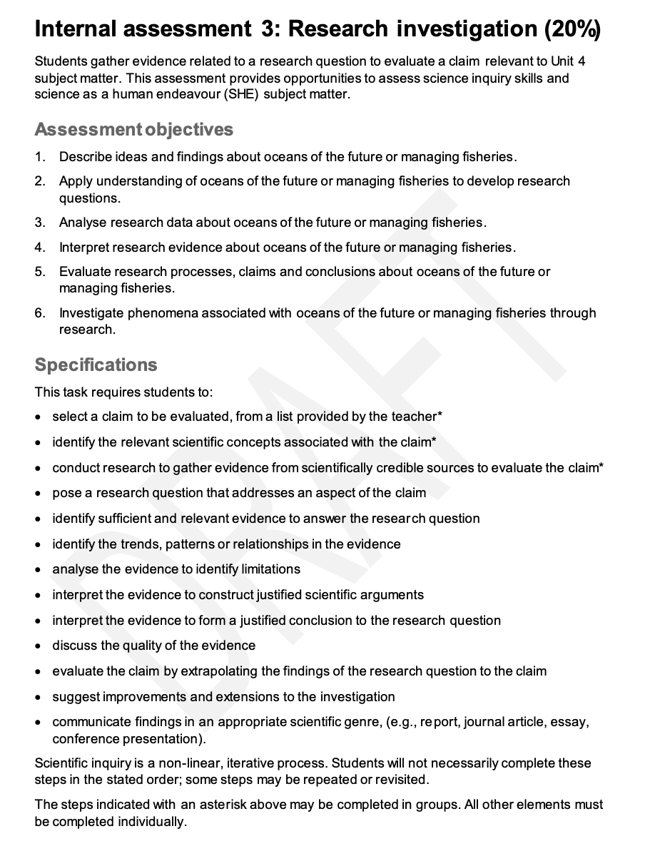
Marine
Education
Title – words
Name:
Date:
marineeducation.com.au
© Marine Education 2023 CC BY-NC-SA
FA3 Research Investigation

Slide 140
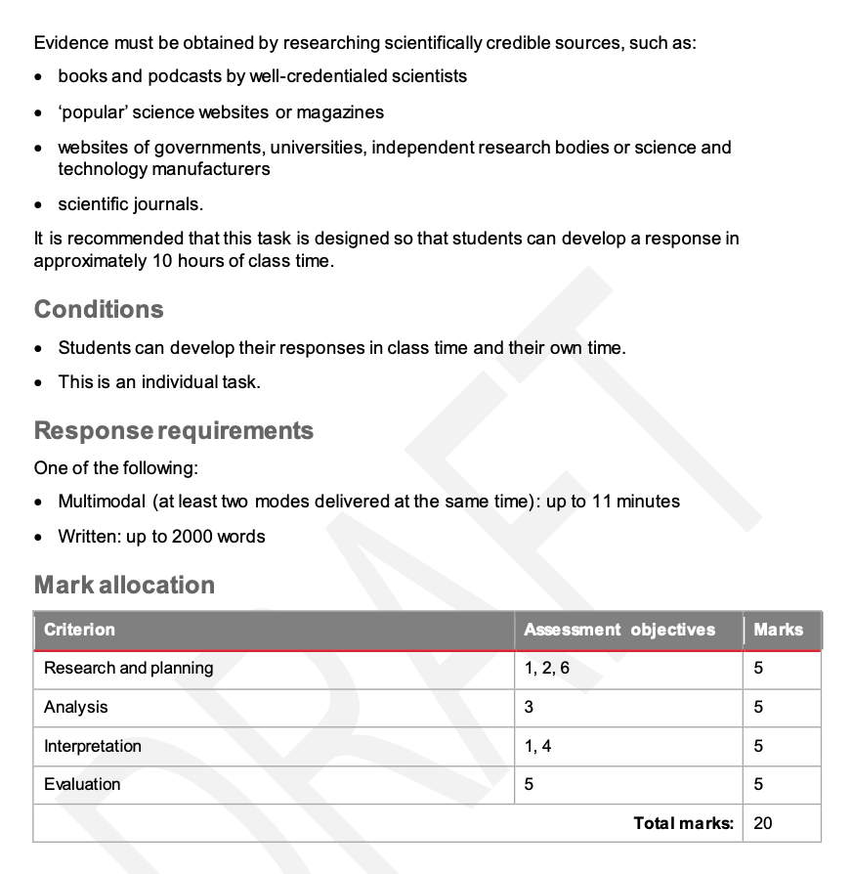
Marine
Education
Title – words
Name:
Date:
marineeducation.com.au
© Marine Education 2023 CC BY-NC-SA
FA3 Research Investigation

Slide 141
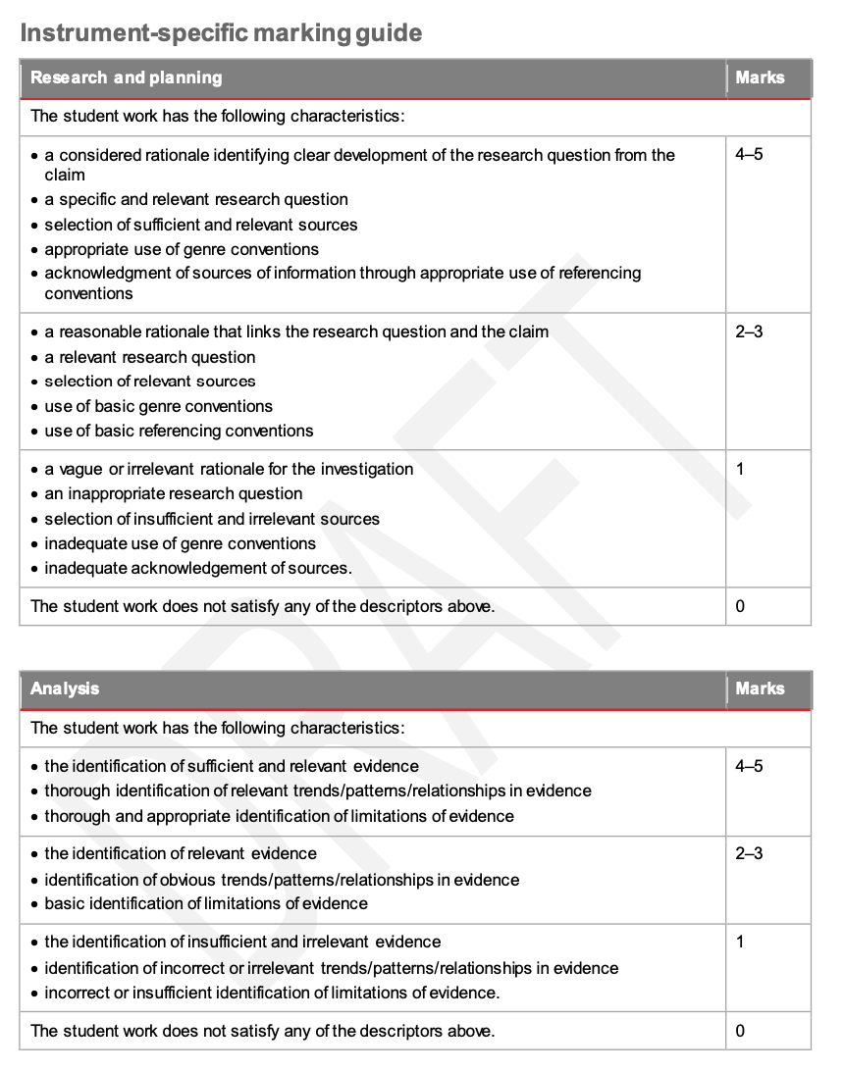
Marine
Education
Title – words
Name:
Date:
marineeducation.com.au
© Marine Education 2023 CC BY-NC-SA
FA3 Research Investigation

Slide 142
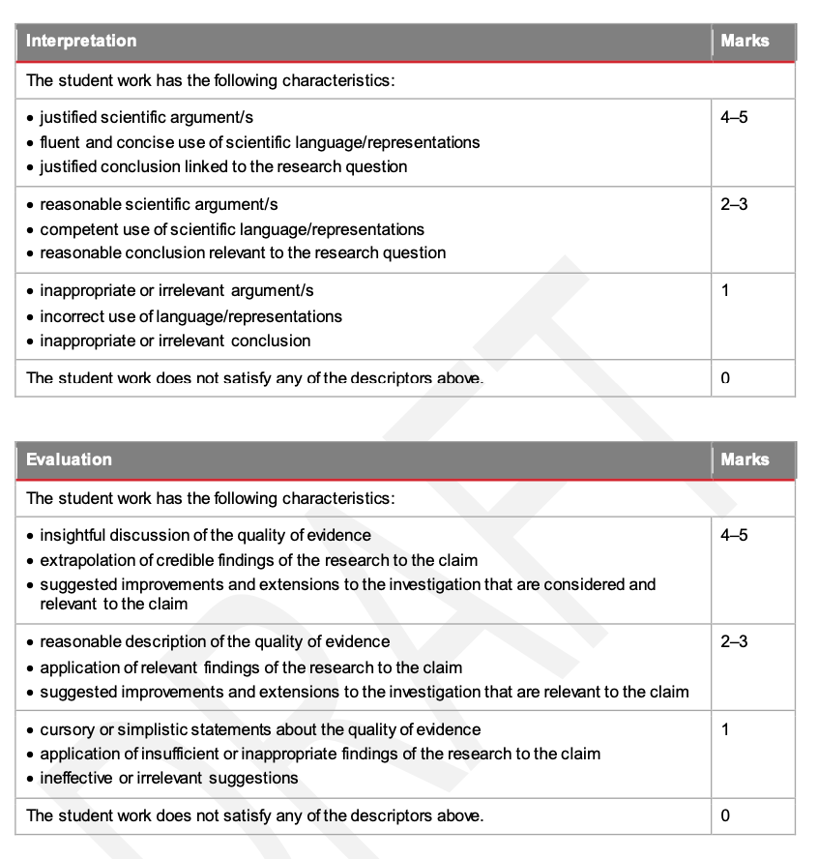
Marine
Education
Title – words
Name:
Date:
marineeducation.com.au
Criterion | Marks
Research and Planning | / 5
Analysis | / 5
Interpretation | / 5
Evaluation | / 5
TOTAL MARKS | / 20
© Marine Education 2023 CC BY-NC-SA
FA3 Research Investigation

Slide 143
Marine
Education
Name:
Date:
marineeducation.com.au
Rationale (IA3)
Rationale: a set of reasons, or logical basis for a course of action or decision
Claim (broad)
RATIONALE marking criteria
Considered (4-5) | Reasonable (2-3)
A rationale that shows evidence of careful and deliberate thought and the progression of information from a very BROAD claim to a very SPECIFIC Research Question. The sequence of ideas involved in the development of the RQ from the claim is easily seen. Background information about the claim and about the dependent and independent variables in the RQ are there to support the development of the RQ from the claim (otherwise it should not be there). | The information shows the merit in investigating the claim. Information shows a LINK from the claim to the RQ. The science supports this, so it is appropriate. The RQ is connected to the syllabus subject matter.
Rationale
RQ (specific)
Student Example (4-5)
Climate change is the greatest threat to our environment in modern times. Driven by the increased CO2 over the past century, climate change is the gradual warming of the atmosphere due to the abundance of greenhouse gases such as CO2, H2O, N2O and CH4; molecules which prevent the heat radiating from earth from escaping the atmosphere (NASA, 2021). Much of this excess heat (>90%) is absorbed into the ocean’s surface due to its high specific heat capacity (SHC) (Cooper, 2019), with over 326±2×1021J of energy introduced into the ocean since the collection of data began in 1956 (NASA, 2021). Subsequently, this increase in SST (sea surface temperature) has disrupted ocean thermodynamics globally, inhibiting the potential for vertical mixing and driving the increase in stratification globally, see Figure 1 (Snider, 2020). This mixing is crucial for the distribution of nutrients through oceanic layers, particularly the mixed layer which resides from the surface downwards to the top of the pycnocline (N.A., 2009). It fosters the growth of a diverse group of essential microscopic producers known as phytoplankton (NASA, 2021). These micro-organisms, responsible for producing between 50-85% of the global oxygen supply annually, photosynthesise to provide much of the energy required to fuel the complex aquatic food web and thus, maintain fish populations globally (Earth Sky, 2015). Subsequently, to address the broad claim “Climate change is altering ocean thermal regimes which will have a profound effect on fish populations”, phytoplankton populations will form the focus of this investigation as a direct indicator for overall fish populations. With global warming only projected to increase SST and thus, drive stratification levels further, this investigation will focus on the significance of an increasing SST on stratification in surface layers and its respective effect on global primary production (phytoplankton abundance). Therefore, the research question is as follows:
RQ: How does the increase in ocean stratification, resulting from an increase in SST affect primary production in the mixed layer, as a result of the reduction in the exchange of cold, nutrient rich water vital for the growth of phytoplankton?
Question: What is a Rationale? Answer by filling in the BLANKS (hint: see underlined)
The progression of information from to….
© Marine Education 2023 CC BY-NC-SA
FA3 Research Investigation

Slide 144
Marine
Education
Name:
Date:
marineeducation.com.au
Research Question (IA3)
The Research Question (in an IA3) addresses a claim (or an aspect of a claim)
Claim: an assertion made without any accompanying evidence to support it
RQ: To what extent is overfishing causing declines in world Bluefin Tuna fisheries?
RQ: What effect does Global Longline Fishing have on the population of Southern Bluefin Tuna (Thunnus maccoyii) before and after the introduction of the Commission for the Conservation of Southern Bluefin Tuna?
SCIENTIFIC ARGUMENTS marking criteria
Specific AND Relevant (4-5) | Relevant (2-3)
Specific (clearly defined, identified, narrowed down) AND relevant BOTH the Dependent variable and Independent variables are specific The RQ includes specific measures of each variable. | It is NOT copied or reworded from existing paper. Directly relates to the claim (or an aspect of the claim) and syllabus subject matter. BUT....it is NOT specific enough. The Independent and/or Dependent variable are too general or not clearly defined.
Inappropriate (1): not appropriate or relevant to the claim or subject matter
Activity: Below are 2 research questions from past student papers responding to the following claim: “More effective fishing techniques are impacting on marine life and habitats”.
In the box beside each RQ, indicate if the RQ is a 2-3 (relevant) or a 4-5 (specific and relevant).
Activity: Write a RELEVANT (general) research question (3-4) that addresses a claim (or an aspect of a claim) assigned by your teacher.
Activity: Add more detail to the Dependent and Independent Variables to make them more SPECIFIC (4-5) Hint: make sure your evidence can still (collectively) answer the RQ and address the claim.
RQ (2-3):
RQ (4-5):
© Marine Education 2023 CC BY-NC-SA
FA3 Research Investigation

Slide 145
Marine
Education
Name:
Date:
marineeducation.com.au
Sources of Information
Sources of Information: In-text citations and Bibliography/Reference List
SOURCES OF INFORMATION marking criteria
Sufficient and Relevant Sources (4-5) | A selection of Relevant Sources (2-3)
Sufficient: just enough (NOT too many nor too few) A sufficient amount that is adequate for the purpose (answering the RQ and linking the RQ to the claim) Only cited sources are listed in the Bibliography. Must be BOTH sufficient AND relevant to get a 4-5! | Relevant: scientifically credible sources, such as scientific journals, books by well-credentialled scientists, and websites of governments, universities, independent research bodies, or science and technology manufacturers. Directly relates to the claim and RQ. Related to topics covered in the Unit. If you get a 2-3 this means your sources are relevant – but there’s not enough.
To get a 4-5, you need a sufficient amount of relevant sources that are adequate for the purpose.
Q. What does it mean by ‘adequate for the purpose’? Ans.
Q. True or False? Only the in-text citations in the Rationale count. Ans.
What is a Journal Article?
Journal articles are articles published in journals about very specific topics, written by (and for) experts such as faculty, researchers and scholars. The really good ones have been peer-reviewed as well. Journals are like magazines for scientists. Because journals are published regularly, they are categorized by year, volume and issue or number (like the year and month on a magazine). Some journals are more prestigious than others. For example, an article published in journal Nature is a big deal. Sometimes you can recognize the journal by its formatting. Journals have strict formatting rules.
Find a Journal Article for FREE
Can’t download the journal article you were looking for free-of-charge? Try your luck by typing the title into google scholar. Alternatively, become a member of the Qld State Library and use their OneSearch. Or search the title in your school library database. They might’ve paid for access already.
If that doesn’t work, email the author directly. Often, they are more than happy to share their papers. As a side note, writing a paper is part of a scholar’s job description. They don’t get paid when you buy it online. Often, it’s the author who pays the journal to publish their paper as open-access (free) in order to showcase their work. Particularly before the arrival of open-access mega-journals like PLoS ONE.
© Marine Education 2023 CC BY-NC-SA
FA3 Research Investigation

Slide 146
ID of Trends, Patterns and Relationships (IA3)
Name:
Date:
Marine
Education
marineeducation.com.au
Trend: general direction in which something is changing (e.g.) temperature warming over time
Pattern: a series of data that repeats in a recognizable way (e.g.) boom and bust life cycles
Relationship: a correlation between two variables (e.g.) proximity of dots to a line of best fit
IDENTIFICATION OF TRENDS, PATTERNS AND RELATIONSHIPS marking criteria
Thorough and Relevant (4-5) | Obvious (2-3)
Thorough: Complete with attention to detail; including all that is required. Explicitly refers to specific data in the evidence to support response. To be thorough, further processing of the data is expected (in addition to identifying key trend/pattern/relationships) such as calculating % change, rate, identifying outliers/exceptions and comparing/contrasting datasets. Any statistical information must be commented on. Relevant: directly relates to the RQ in arguing plausible points. | Clearly evident Easily recognised Identifies the most evident points Re-stating what is on the Fig./Table
Activity: In the boxes below, indicate if the identification of the trend, pattern or relationship is obvious (2-3) or thorough and relevant (4-5).
"It can be seen in figure 3, that there was a significant increase in estimated dugong populations of Moreton Bay from 2005-2011”.
"Figure 1 demonstrates the significant rise in Global Plastic manufacturing from 1950-2015. Throughout these 65 years, there has been a clear rise in plastic manufacturing. Especially in the years following 1960. In 2014, 311 million metric tonnes of plastic were produced globally, with between 4.8 and 12.7 million tonnes of that is estimated to have ended up in the ocean (Orayeva, 2020).”
“By 1990, the annual commercial catch dropped by 79.59% since its peak in 1967." Note: this percentage was calculated by the student and did not feature on the graph.
“Figure 2 supports Figure 1, establishing the positive relationship between temperature and food consumption in coral trout”.
“Calcification rates of Acropora millepora had a 51% decrease from 382uatm to 741uatm and a steady decline. Acropora was statistically significant in both Figure 1 (p=0.01) and Figure 2 (p=0.001).”
Q. Is identifying what is already on a table or graph (incl. amounts) enough for a 4-5? Ans.
Q. Is describing an obvious trend, pattern or relationship enough analysis for a 4-5? Ans.
© Marine Education 2023 CC BY-NC-SA
FA3 Research Investigation

Slide 147
Marine
Education
Name:
Date:
marineeducation.com.au
Genre Conventions (IA3)
Genre conventions are elements commonly found in specific genres.
E.g. writing in Science is different to writing in English.
It is important in science writing to avoid overly complex sentences that include too many ideas or too much information for the reader to process. Short sentences convey information in a manageable way;
scientific writing has its own implicit and explicit conventions.
The format, structure, content, and style of a scientific paper is readily recognized by college students, academicians, and scientists.
Certain tentative verbs (e.g., show, indicate, suggest) are commonly used in scientific discourse. Adverbs and adverbial phrases (e.g., possibly, very likely, as far as the evidence suggests) and modal auxiliary verbs (e.g., might, may, could, can) are also important for researchers to limit or qualify a claim. By studying scientific communication, you will gain a deeper respect for the content, style, linguistic devises, and the overall empirical process.
Science writing often relates to experimentation and contributes to building a body of knowledge, so its primary focus is on facts and conclusions drawn from careful observation, not opinion. Conclusions should be directly supported by the data presented and/or by others’ research.
Writing is free of contractions, colloquialisms, and informal language, and often uses the passive voice (third person). The active voice (e.g. first person – I, we ) is often avoided.
The passive voice emphasizes the object receiving the action rather than the actor performing it. E.g. The samples were diluted with 100 ml of H2O…. Here the subject (samples) receives the action of the verb (to dilute).
To support an objective stance, it is important to acknowledge limitations by explaining results in a way that allows for a degree of uncertainty. Thus, results suggest, indicate, or are significant rather than prove. If you use somewhat definitive statements, be sure to back them up with evidence.
Organize material effectively If you indicate an order for your sections early in your paper or report, it is important to maintain this order throughout so your reader can progress easily through your document.
Avoid wordiness
For conciseness, replace frequently used terminology with abbreviations. After the first use of a term, identify the abbreviation in parentheses and use it thereafter.
Use accurate word choices
Avoid using modifiers such as much, very, and really because they are subjective and imprecise
Note: use the modifier significant carefully and accurately – in science writing, a result is significant if it is statistically significant.
© Marine Education 2023 CC BY-NC-SA
FA3 Research Investigation

Slide 148
Referencing
Conventions (IA3)
Name:
Date:
Marine
Education
marineeducation.com.au
Referencing Conventions are elements commonly found in reference lists, bibliography’s and in-text citations.
APA…
Harvard….
© Marine Education 2023 CC BY-NC-SA
FA3 Research Investigation

Slide 149
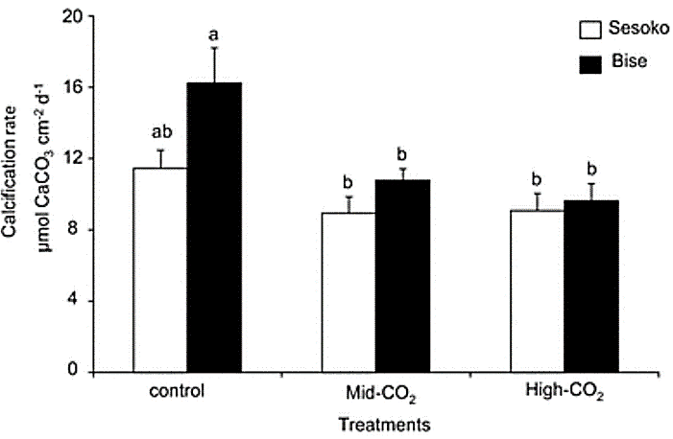
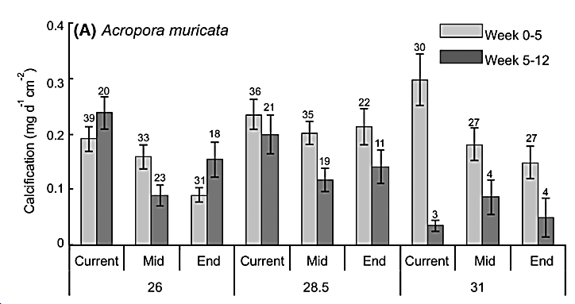
Marine
Education
Name:
Date:
marineeducation.com.au
Evidence (IA2)
Evidence: Graphs, Tables, Figures, in-text citations
EVIDENCE marking criteria
Sufficient and Relevant Evidence (4-5) | Relevant Evidence (2-3)
Sufficient: No less than 2 Figures But, NOT too many either (e.g. more than 6 Figures is too many to analyse AND keep within the word limit). Must be enough to be able to answer the RQ Includes in-text citations as well as data from analysis Must be BOTH sufficient AND relevant to get a 4-5! | Links directly to the RQ. Relevant to the Unit subject matter. Draws on qualitative and/or quantitative data from scientifically credible sources, such as peer-reviewed journal articles.
Q. Can all graphs/tables/figures come from ONE peer-reviewed journal article and still get a 4-5?
Ans. Yes, BUT it is very uncommon and not recommended. There would also need to be supporting evidence from other papers (as in-text citations). Analysing evidence from just one paper lends itself to summarizing that existing paper, instead of analysing a range of evidence to (not only answer the RQ but also) evaluate the claim. It also makes it difficult to get full marks for the remaining criteria.
Activity: Evaluate the Evidence below (claim and RQ from the student’s paper are also below)
CLAIM: Global climate changes impact marine ecosystems
RQ: Will there be a significant difference in the calcification rate of Acropora corals between current, mid-century and end-of-century pCO2 predictions?
Figure 1: Calcification rate (mean ± SE) of Acropora digitifera populations Sesoko and Bise (5 colonies each) after 5 weeks of three different pCO2 treatments (control: 420 ±40µtm, mid-CO2: 1030 ±48µtm, high-CO2: 2381±156µtm). A represents statistically significant difference between populations (p<0.05), b represents statistically significant difference from the control (p<0.05) (Source: Kurihara et al., 2018).
Figure 2: Net calcification of Acropora muricata (mean ± SE) from 0-12 weeks in current (410 ±4µtm), mid-century (653 ±6µtm), and end of century (934 ±11µtm) pCO2 levels, at 26°C (average sea temperature), 28.5°C (summer maximum) and 31°C (future temperature). Sample size is provided above each bar (Source: Anderson et al., 2019).
Q. Is the Evidence above RELEVANT and SUFFICIENT (4-5) or just RELEVANT (2-3)? Ans.
Reference List
Kurihara et al (2018). Intraspecific variation in the response of the scleractinian coral Acropora digitifera to ocean acidification. Marine Biology. Vol 165 Issue 2.
Anderson et al (2019). Independent effects of ocean warming versus acidification on the growth, survivorship and physiology of two Acropora corals. Coral Reefs. 38.
© Marine Education 2023 CC BY-NC-SA
FA3 Research Investigation

Slide 150
ID of Trends, Patterns and Relationships (IA3)
Name:
Date:
Marine
Education
marineeducation.com.au
Trend: general direction in which something is changing (e.g.) temperature warming over time
Pattern: a series of data that repeats in a recognizable way (e.g.) boom and bust life cycles
Relationship: a correlation between two variables (e.g.) proximity of dots to a line of best fit
IDENTIFICATION OF TRENDS, PATTERNS AND RELATIONSHIPS marking criteria
Thorough and Relevant (4-5) | Obvious (2-3)
Thorough: Complete with attention to detail; including all that is required. Explicitly refers to specific data in the evidence to support response. To be thorough, further processing of the data is expected (in addition to identifying key trend/pattern/relationships) such as calculating % change, rate, identifying outliers/exceptions and comparing/contrasting datasets. Any statistical information must be commented on. Relevant: directly relates to the RQ in arguing plausible points. | Clearly evident Easily recognised Identifies the most evident points Re-stating what is on the Fig./Table
Activity: In the boxes below, indicate if the identification of the trend, pattern or relationship is obvious (2-3) or thorough and relevant (4-5).
"It can be seen in figure 3, that there was a significant increase in estimated dugong populations of Moreton Bay from 2005-2011”.
"Figure 1 demonstrates the significant rise in Global Plastic manufacturing from 1950-2015. Throughout these 65 years, there has been a clear rise in plastic manufacturing. Especially in the years following 1960. In 2014, 311 million metric tonnes of plastic were produced globally, with between 4.8 and 12.7 million tonnes of that is estimated to have ended up in the ocean (Orayeva, 2020).”
“By 1990, the annual commercial catch dropped by 79.59% since its peak in 1967." Note: this percentage was calculated by the student and did not feature on the graph.
“Figure 2 supports Figure 1, establishing the positive relationship between temperature and food consumption in coral trout”.
“Calcification rates of Acropora millepora had a 51% decrease from 382uatm to 741uatm and a steady decline. Acropora was statistically significant in both Figure 1 (p=0.01) and Figure 2 (p=0.001).”
Q. Is identifying what is already on a table or graph (incl. amounts) enough for a 4-5? Ans.
Q. Is describing an obvious trend, pattern or relationship enough analysis for a 4-5? Ans.
© Marine Education 2023 CC BY-NC-SA
FA3 Research Investigation

Slide 151
Identification of
Limitations of Evidence
Name:
Date:
Marine
Education
marineeducation.com.au
Analyse THE evidence (not the lack OF evidence)
Limitations: parts to investigations that make the results likely to be LESS accurate
IDENTIFICATION OF LIMITATIONS OF EVIDENCE marking criteria
Thorough and Appropriate (4-5) | Basic (2-3)
Thorough: COMPLETE with attention to detail; including all that is required. NOT superficial nor partial. Appropriate: suitable; acceptable. The limitations are suitable for determining the reliability of the evidence in responding to the RQ. The response identifies limitations of evidence that affect how well the evidence can be used to develop a response to the RQ. Consideration is given to the completeness or the coverage of the data in relation to the RQ and not just sample size. Identifies the main weak points or disadvantages that makes the data less effective in answering the RQ. | Fundamental The response gives fundamental limitations of the evidence. However, this is not thorough, as the response only shows partial identification of limitations of the evidence. Limitations too generic - applicable to all studies (e.g. small sample size).
Incorrect or insufficient (1): not correct OR not enough
Student example 1 of incorrect or insufficient response (1): “Some of the data collected is out of date and may not be the same as what is currently happening. Figure 1 shows the average coral loss in each region of the reef, the data used in that figure was collected in 2016 and may be different to the reef now in 2021”.
Student example 2 of a basic response (2-3): “In the first dataset, the study only lasted 4 months, despite the fact that abalone require 2 years to grow from spat to a full adult.”
Student example 3 of a thorough and appropriate response (4-5): “Data does not include size variations/length/age of the swordfish…reports do not specify where they got their fish from….only one report says whether the samples were fresh, frozen or on ice before the methyl mercury content was sampled for….. what part of the swordfish the methyl mercury concentration was sampled from was unclear…the reports and data don’t have the same measures of central tendency…”
Q. Why did student example 2 only get a score of (2-3)? Ans.
© Marine Education 2023 CC BY-NC-SA
FA3 Research Investigation

Slide 152
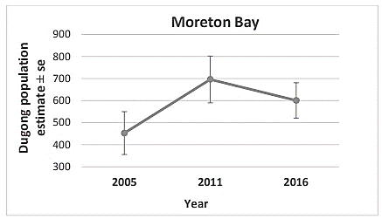
Marine
Education
Name:
Date:
marineeducation.com.au
Scientific Arguments (IA3)
Scientific Arguments: using science to argue what you’re saying is true and correct
SCIENTIFIC ARGUMENTS marking criteria
Justified (4-5) | Reasonable (2-3)
Justified: sound reasons or evidence is provided. Arguments are supported with references; reasoning is evidence based. Appropriate use of data and evidence to support a scientific argument. Because you understand the topic very well (which you should for a 5-6), firstly, you have arguments to begin with and, secondly, you demonstrate the ability to select the appropriate scientific evidence to support them. Links to theory/statistics/citations used effectively to support a conclusion. Interpretations of evidence are supported with scientific reason or evidence | Based on good sense; having sound judgement. Interpretations are logical with some scientific basis.
Inappropriate or irrelevant (1): using citations that are not appropriate or relevant to the argument
Do NOT use the words PROVE or FACT in science !!!
Below is an extract from the analysis section of a past student paper.
Q. What is their scientific argument what evidence does the student provide to support it?
CLAIM: Marine Protected Areas (MPA's) are effective at preserving marine ecosystems
RQ: How does the go-slow areas of The Moreton Bay Marine Park influence the population of Dugong dugon in Moreton Bay?
“There was a significant increase in the estimated dugong population in Moreton Bay from 2005-2011 (Figure 3). This may be the result of many different influences. However, after the introduction of the go-slow zones in 2008, it can be assumed that the go-slow zones were the leading cause of dugong's population increasing."
Figure 3: Total Dugong population estimate in Moreton Bay for 2005, 2011 and 2016 (Sobtzick et al., 2017).
Reference: Sobtzick, Susan & Cleguer, Christophe & Hagihara, Rie & Marsh, Helene. (2017). Distribution and abundance of dugong and large marine turtles in Moreton Bay, Hervey Bay and the southern Great Barrier Reef.
© Marine Education 2022
Scientific Arguments

Slide 153
Scientific Language/ Representations (IA3)
Name:
Date:
Marine
Education
marineeducation.com.au
Scientific language is terminology that has specific meaning in a scientific context
Scientific representations are the ways you choose to present the science to your audience
e.g. 3D models, tables, graphs, diagrams, science journals, multi-modal reports, and appropriate vocabulary and measurement for specific topics
© Marine Education 2023 CC BY-NC-SA
FA3 Research Investigation

Slide 154
Conclusions linked to
the Research Question
Name:
Date:
Marine
Education
marineeducation.com.au
Conclusion: the most important outcome/s of your work
CONCLUSION marking criteria
Justified (4-5) | Reasonable (2-3)
Conclusions refer to the data and in-text citations. | Conclusions refer to SOME evidence.
Your interpretation of the evidence (in order to answer the RQ) – the data you’ve presented in graphs, table, figures, etc., as well as scientific research cited throughout your paper - are what you use as evidence to develop (and then justify) your conclusions with. Your conclusions will be based on your answer to the RQ and your evaluation of the claim - e.g. was the claim supported or not (was it true/false) and why? When first stating your conclusions in the body of your paper, use PEEL paragraphs. The ‘P’ Point sentence will be a conclusion and the ‘E’s will be your evidence for that conclusion (the L is a sentence that ‘Links’ to the next paragraph). At the end of your paper, in the Conclusion section, repeat the point sentences, so the most important outcomes of your work are easy to find.
RQ
Conclusions linked to the RQ
(i.e. stated in PEEL paragraphs)
Claim (evaluate)
In conclusion,…..
In conclusion, the claim
was supported / not supported.
write your claim here…
Pick one
It was found that….
write answer to RQ here…
Restate key parts to your interpretation of the EVIDENCE that justify your conclusion here…
Link Sentence
© Marine Education 2023 CC BY-NC-SA
FA3 Research Investigation

Slide 155
Marine
Education
Findings of the research to the claim (IA3)
Name:
Date:
marineeducation.com.au
A finding of research to the claim is…
© Marine Education 2023 CC BY-NC-SA
FA3 Research Investigation

Slide 156
Marine
Education
Suggested improvements and extensions (IA3)
Name:
Date:
marineeducation.com.au
A suggested improvement is…
A suggested extension is…
© Marine Education 2023 CC BY-NC-SA
FA3 Research Investigation

Slide 157
FA4 Practice Exam

Slide 158
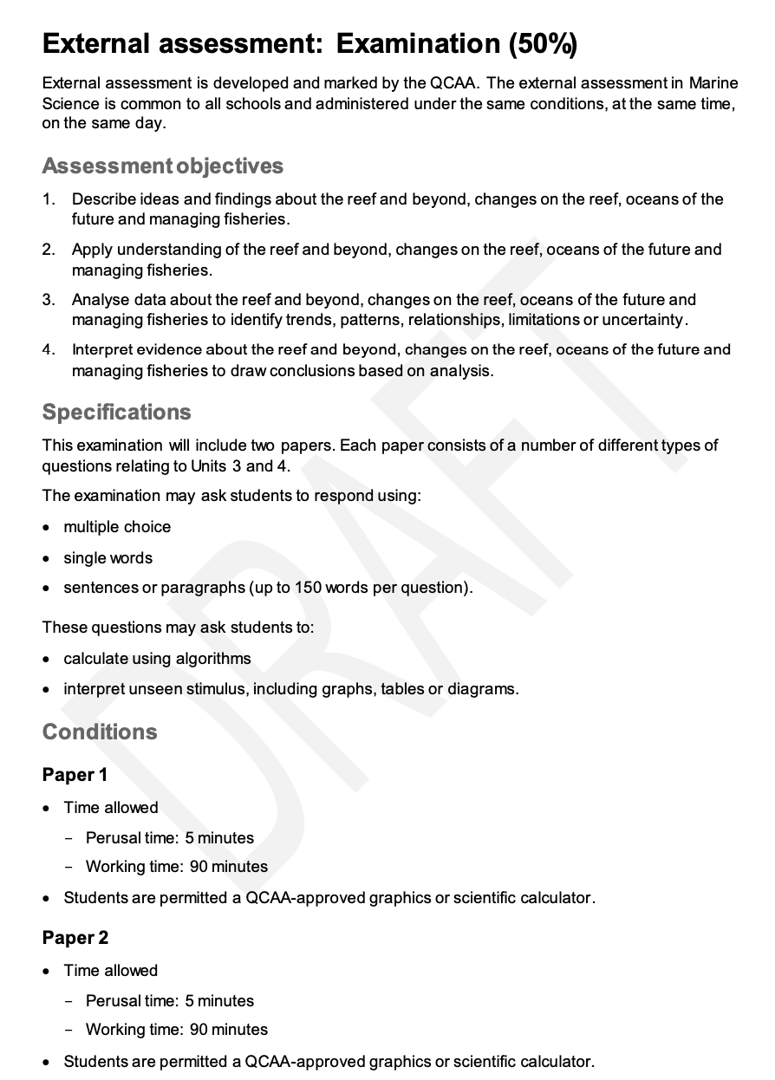
Marine
Education
Title – words
Name:
Date:
marineeducation.com.au
© Marine Education 2023 CC BY-NC-SA
FA4 Exam

Slide 159
FINAL GRADE A-E

Slide 160
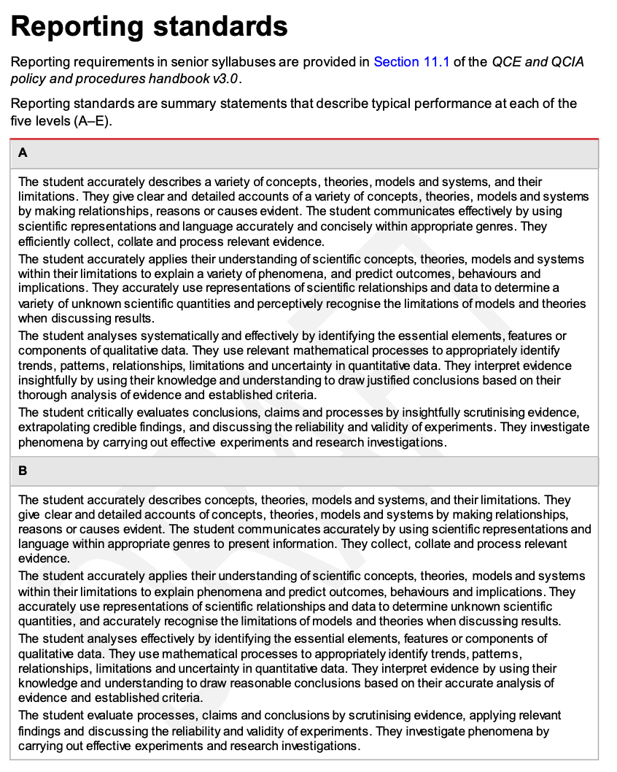
Marine
Education
Title – words
Name:
Date:
marineeducation.com.au
© Marine Education 2023 CC BY-NC-SA
FINAL GRADE

Slide 161
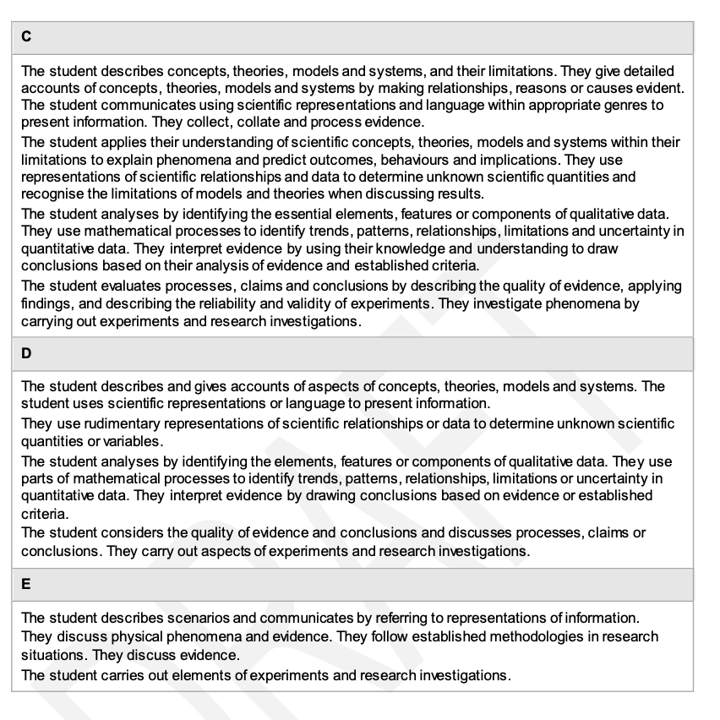
Marine
Education
Title – words
Name:
Date:
marineeducation.com.au
© Marine Education 2023 CC BY-NC-SA
FINAL GRADE

