Slide 1
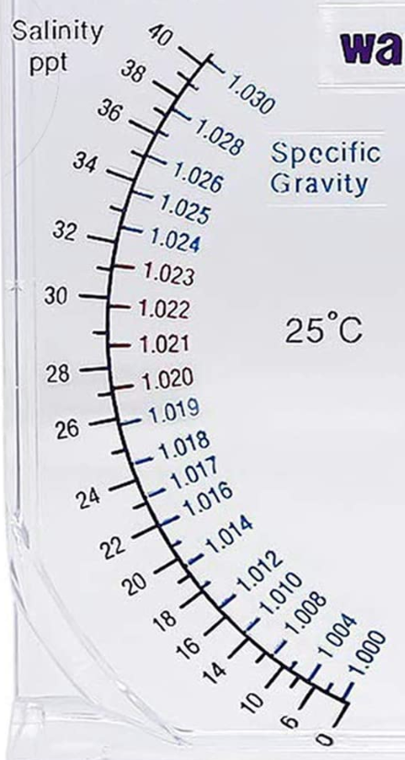
Coral Reefs
Definition:
Biotic Components
Abiotic Components
Description:

Slide 2
Mangroves
Definition:
Biotic Components
Abiotic Components
Description:

Slide 3
Seagrass meadows
Definition:
Biotic Components
Abiotic Components
Description:

