Slide 1
Your Name Journey Line

Slide 2
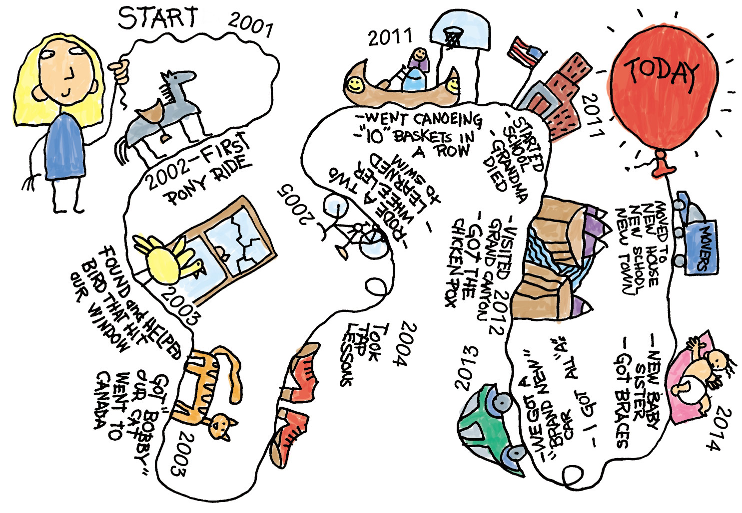
Notes:
I am the poster child for this statement. Have you ever heard of a journey line. Its like a map of your life. In the corporate world you do them as a team building exercise to learn more about the people that you are working with. Here is journey line from one year of my life in relation to this statement!

Slide 3
5
19
11
18
4
10
17
6
13
3
9
15
16
8
2
7
12
14
1
Notes:
- I am the poster child for this statement. In I was in 9 car wrecks. I did a speech about one of them a year a go for a contest. I march my car caught on fire. I was hit by a semi truck that did not check it’s blind spot shortly after rebuilding the car that was caught on fire. Only to buy a new car that would be totaled by a lady who would run a red light in red dodge truck with a grill guard. I would be hit by another semi truck and I had a few smaller wrecks, none of which were my fault. By the time I was done with that year this was the only bitmoji I would use. I felt like I finally qualified. Yet when I look back I never really think of all those events as something going wrong. In fact they bring some of the best smile when I think back about everything that happened. I see it more as life kept giving me opportunities to grow strong. It keep giving me hope that something was about to go right.

