Slide 1
Schools’ Air quality Monitoring for Health and Education
Dr. Sarah West
SEI York / University of York

Slide 2
Citizen science
Benefits for science and for participants
Pupils (and teachers) gain knowledge and understanding of air quality
Skills
Knowledge of what action to take
New data about air quality in schools (PM, TVOCs, temp, humidity, CO₂)

Slide 3
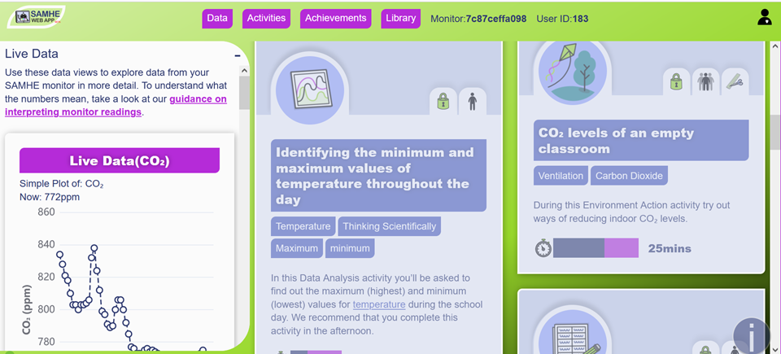

Slide 4
123
800
2,000
Schools in our Co-Design and Pioneer phases
Schools signed up so far
Target schools across the UK

Slide 5
The SAMHE monitor and app have provided our Y4/5 science group with a wealth of data to interrogate and analyse. The children’s enthusiasm has been infectious and there is tangible excitement at being able to access the data in real time…We are now determined to continue, working towards earning all the achievement badges
Teacher, SAMHE Co-Design school

Slide 6
Challenges for improving IAQ
Air quality is largely invisible
Children are particularly vulnerable
Ventilation is very important - but challenges with rising energy costs
Raising awareness is critical
Tailored advice about actions is needed

Slide 7
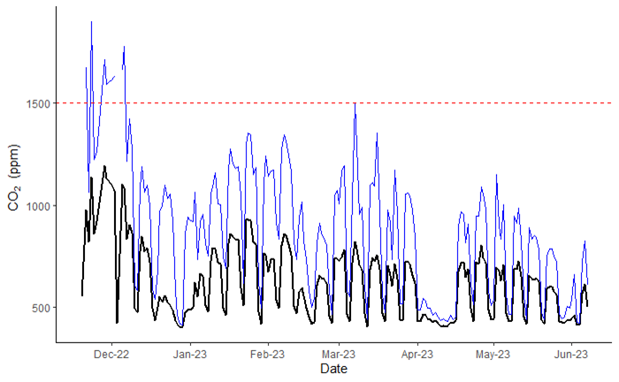
CO₂ data from 43 monitors
CO₂. daily means are largely below BB101 threshold of 1500 ppm for naturally ventilated classrooms.
Daily mean CO₂ exceeds 1500 ppm on ~2.5% of sensor-days

Slide 8
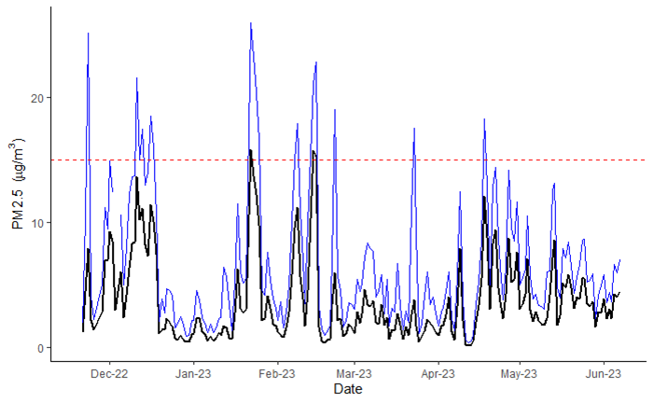
PM_{2.5} data from 43 monitors
PM_{2.5} daily means generally below 15 μg/m³ guideline recommended by WHO
Daily mean PM_{2.5} exceeds 15 μg/m³ on ~4% of sensor-days.

Slide 9
Get in touch!
www.samhe.org.uk
hello@samhe.org.uk, sarah.west@york.ac.uk

