Slide 1
An Introduction to Children’s Rights and what the UNCRC Bill means for Public Bodies
Rebecca Spillane
UNCRC Implementation Project Manager

Slide 2
Format for the Workshop
Introductions and Purpose of the Session
Understanding Children’s Human Rights
Introduction to the United Nations Convention on the Rights of the Child
The UNCRC in Scotland – what is happening and what does it mean for me?

Slide 3
What are Human Rights?
Human rights are a set of principles concerned with equality and fairness. They recognise our freedom to make choices about our lives and to develop our potential as human beings. They are about living a life free from fear, harassment or discrimination.
You have them no matter where you are from, how old you are, what you believe, or how you choose to live your life.
Governments cannot pick or choose which rights to honour. Your rights can’t be taken away from you.

Slide 4
The United Nations Convention of the Rights of the Child
Most widely ratified international human rights treaty in history.
Applies to everyone under the age of 18
Sets out children’s rights in a way which recognises that children are more vulnerable and need special protection.
Starts with the premise that children should grow up in an environment of happiness, love and understanding
Gives children status as having a distinct set of rights, not just passive objects of care and charity

Slide 5
What does the UNCRC cover?
Provision (survival needs, food and nutrition, health and shelter, an education)
Protection (from all forms of harm and exploitation)
Participation (as an active agent in their own lives and in society)

Slide 6
A rights based approach
UNCRC General Principles
Non-discrimination (Article 2).
Survival and development (Article 6).
Children’s participation (Article 12).
Best interests (Article 3).
Dignity

Slide 7
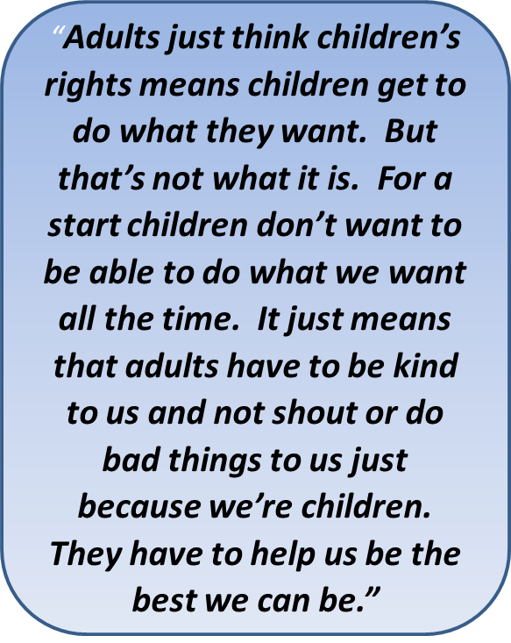
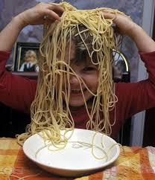
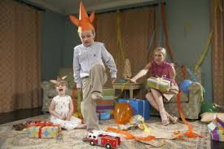
What a rights based approach isn’t?

Slide 8
Exploring Some Articles
UNCRC Article 12
I have the right to be listened to and taken seriously
UNCRC Article 20
I have the right to special protection and help if I can’t live with my own family
UNCRC Article 17
I have the right to information in ways I can understand
UNCRC Article 27
I have the right to have a proper house, food and clothing
UNCRC Article 19
I have the right to be protected from being hurt or badly treated
UNCRC Article 32
I have the right not to work until I reach a particular age and should not be allowed to do dangerous work

Slide 9
Aligning Agendas
Child Poverty
The Promise
Getting It Right for Every Child
Whole Family Wellbeing
Trauma Informed Practice
Violence Against Women and Girls
Community Learning and Development

Slide 10
‘Recognizing that the child, for the full and harmonious development of his/her personality, should grow up in a family environment, in an atmosphere of happiness, love and understanding’
UNCRC preamble
‘You will grow up loved, safe and respected’ The Promise
‘GIRFEC, as a strengths-based approach, seeks to realise children’s rights on a day to day basis’ Scottish Government
Whole Family Wellbeing Fund: Underpinned by Children's Rights: Children's rights should be the funnel through which every decision and support service is viewed.

Slide 11
Group Exercise 1
Thinking about children and young people in your community/ service area, what rights come to mind?
Where are children and young people experiencing these rights e.g. in their home, community, health setting, partner organisation?
Thinking again about children and young people in your community/service area, can you think of areas where rights are at risk or where rights are not being experienced?

Slide 12
Children’s Rights Framework in Scotland
The Children (Scotland) Act 1995 provides a major part of the legal framework for child welfare and protection in Scotland and is based on the UNCRC.
Children and Young People (Scotland) Act 2014 places a duty on specified public authorities and Scottish Ministers to report every 3 years on the steps they have taken in that period to secure better or further effect of the requirements of the UNCRC.
Getting It Right for Every Child (GIRFEC) is Scotland’s national approach to improving the wellbeing of children, and is based on the UNCRC.
Its main principles are:
putting the best interests of the child at the heart of decision-making
taking a holistic approach to the wellbeing of a child

Slide 13
UNCRC (Incorporation) Scotland Bill 2021
The Bill aims to incorporate the UNCRC fully and directly into Scots law to ensure that:
children’s rights are respected and protected in the law in Scotland
public authorities are legally required to respect and protect children’s rights in all the work that they do
The intent behind the UNCRC Bill is to deliver a proactive culture of everyday accountability for children’s rights across public services in Scotland.

Slide 14
The Bill: A proactive approach
Duty not to act incompatibly with the UNCRC (s6) – placed on all those delivering ‘functions of a public nature’ include functions carried out ‘under a contract or other arrangement with a public authority’.
Children’s Rights Scheme (s11-13) – Scottish Ministers to publish an annual plan and report on steps taken to further the UNCRC, including children’s participation, raising awareness, child rights budgeting, complaints mechanisms, child rights impact assessment and more.
The Scottish Ministers must prepare and publish a Child Rights and Wellbeing Impact Assessment in relation to decisions of a strategic nature relating to the rights and wellbeing of children.
Public body reporting (s15-16) – Listed public bodies to report on steps taken and steps planned to further UNCRC – cross cutting across all services.

Slide 15
Challenging Breaches of Rights
Children and young people can complain if they think their rights aren’t being protected (s.7).
No time limits on proceedings until children reach the age of 18 years old (s.7).
Courts can decide if laws follow the UNCRC (s. 18-21)*
The Children and Young People’s Commissioner will be able to help if someone wants to complain their rights are not being protected (s.10).
A court could tell an organisation to change what they are doing, if the court agrees that they are not protecting children’s rights properly (s. 18-21).

Slide 16
UNCRC Incorporation – Timeline and Current Stage
October 2021
The Supreme Court issued their decision that certain aspects of the UNCRC Bill were out-with the powers of the Scottish Parliament.
Next steps:
The Bill gets reintroduced to the Scottish Parliament
If passed by the Scottish Parliament and not challenged by the UK Government, it receives Royal Assent
12-week public consultation begins on the statutory guidance
March 2021
The Scottish Parliament unanimously passed the UNCRC Bill
March 2021
The UK Government referred the Bill to the Supreme Court
RECONSIDERATION STAGE
May 2022
The Scottish Government announced their intention to amend the Bill to address the judgement of the Supreme Court.
September 2020
UNCRC Bill was introduced to the Scottish Parliament

Slide 17
Key factors to consider at the local level
A proactive approach to children’s rights and compliance with the UNCRC
Children’s Rights and Wellbeing Impact Assessment
Leadership Commitment
Participation of children and young people in decision-making that affect them
Knowledge and awareness of children’s rights
Child-friendly communication including child-friendly complaints process and reports
Reporting on progress and planning future work

Slide 18
Workshop 2
Thinking about the rights you identified earlier, what are the impacts of the new legislation for the way you work?
Can you identify/share ways in which you are already taking a children’s rights approach?

Slide 19
Getting Ready for the UNCRC
Help and support is available from the Improvement Service

Slide 20
Things to think about….
What was new information to you?
Which rights are most relevant to your service?
How do children’s rights relate to the work you do or are supporting others to do?
What do you see being the main challenges in encouraging and supporting a human rights approach in your work?
Can you share information about what you have already done?
What do you need to support you? Can you already identify sources of support?

Slide 21
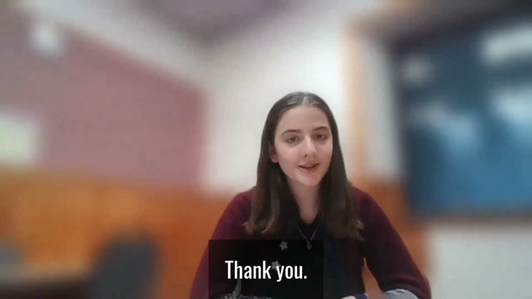
‘No Time to Waste’ … to Empower and Protect Children and Young People’s Rights to Climate Justice
https://www.youtube.com/watch?v=zmhI6dlBydA

Slide 22
Keep in Touch
•Connect:
Rebecca.spillane@improvementservice.org.uk
Felicia.szloboda@improvementservice.org.uk
@beckyporty
@FeliciaSzloboda
•Join our Knowledge Hub:
https://khub.net/web/childrens-human-rights-in-scotland-uncrc

