Slide 1
Making Equality a Reality
Ying Zhang & Rania Qussasi

Slide 2
Who we are
The Whole Family Equality Project is funded by the Robertson Trust Partners in Change Fund, the National Lottery Young Start Fund, Scottish Government and City of Edinburgh Council.
What we do
Family Well-being support to 120 families
Youth Engagement and Employment support to 70 young people
Income Maximisation Advice support
Employability support
Participatory Budgeting Projects
Citizen’s Panel

Slide 3
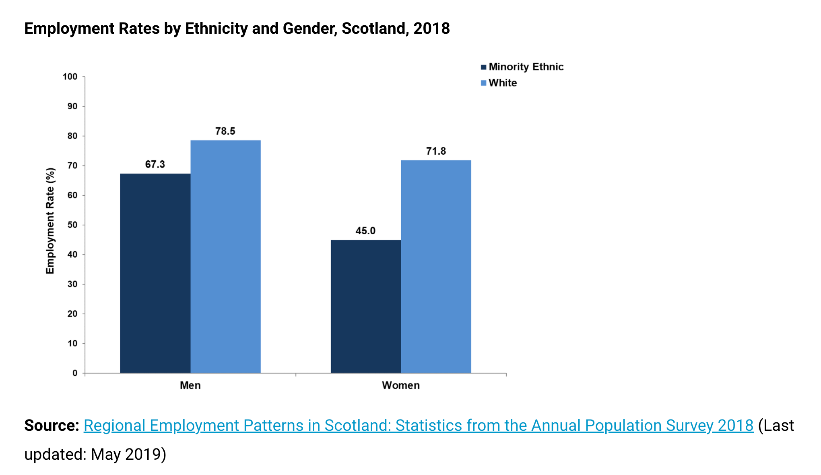
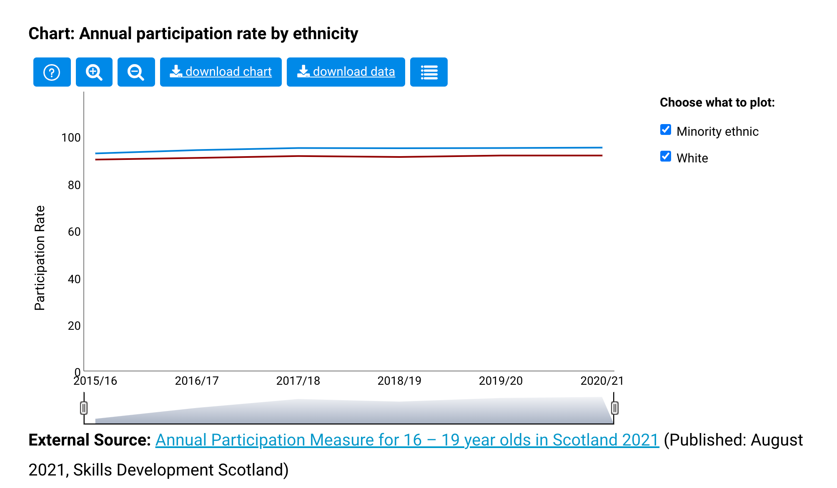
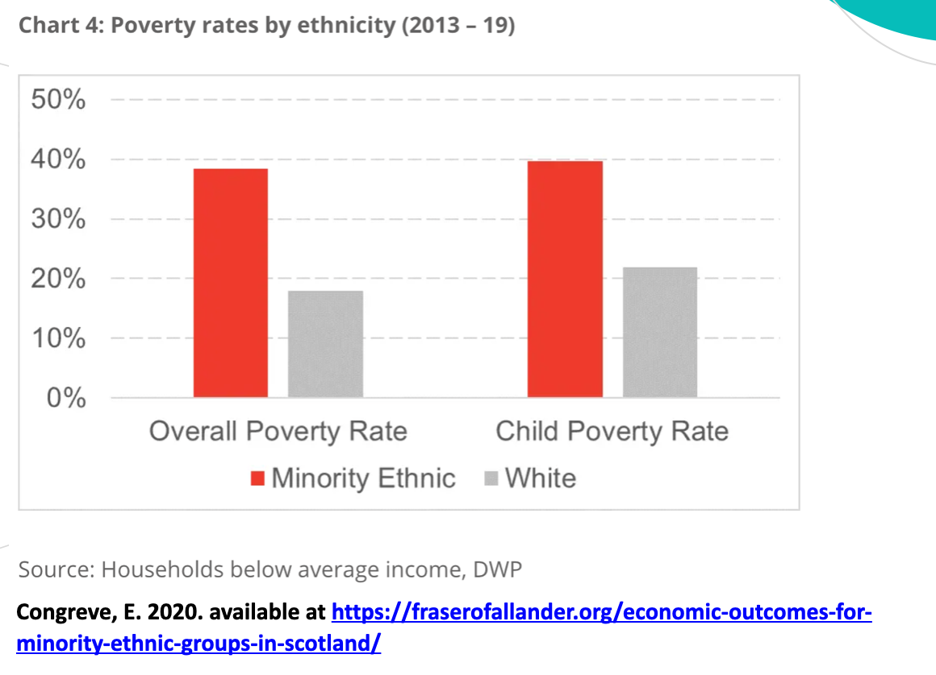
Social and Economic Disparities between Minority Ethnic and White Population

Slide 4
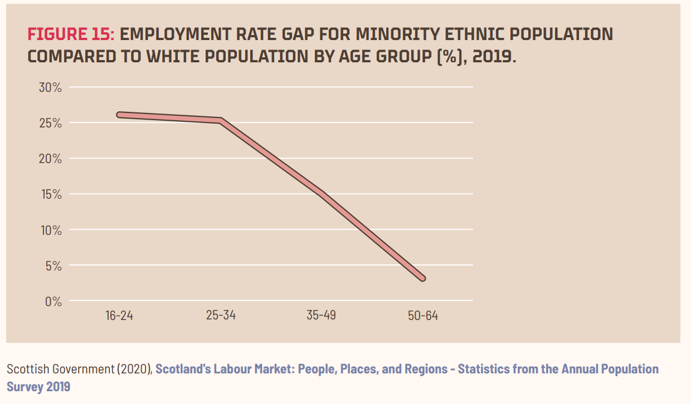
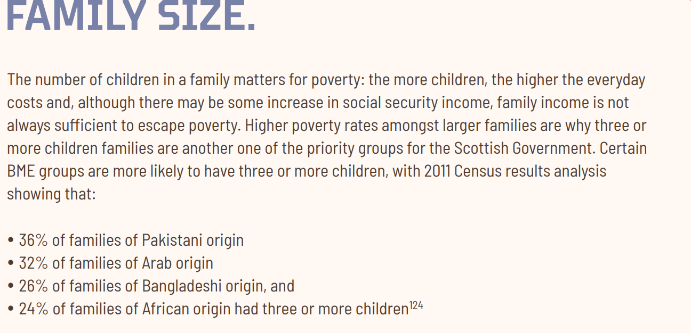
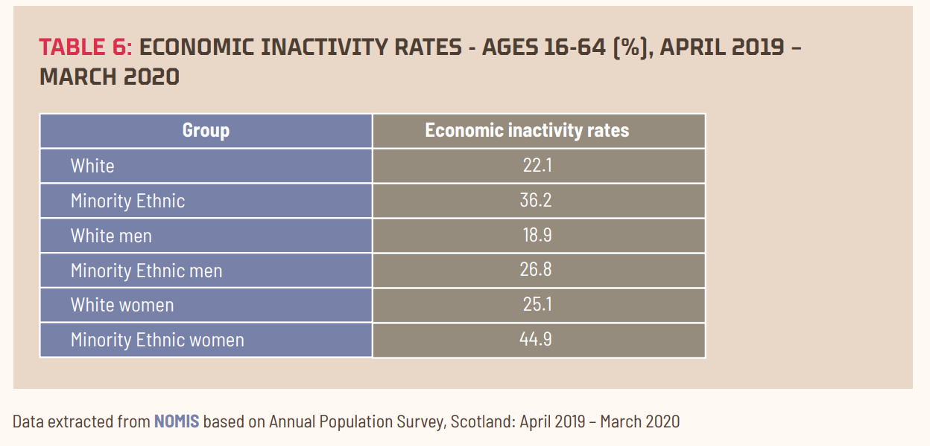
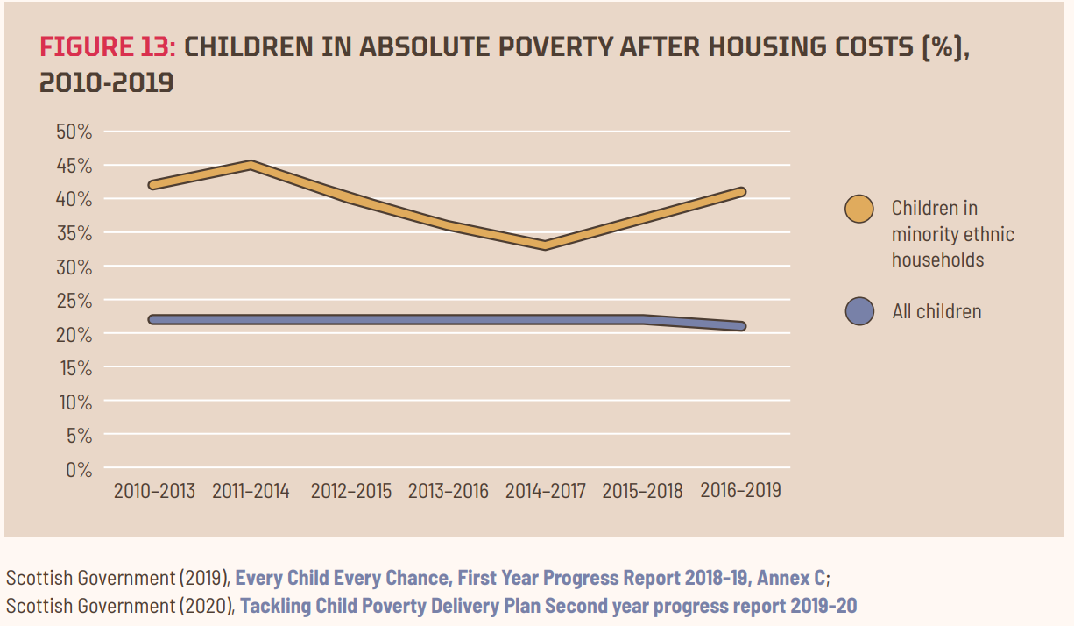
Available at CRER Ethnicity and Poverty in Scotland 2020 (squarespace.com)

Slide 5
Strategic Objectives
To maximise equitable support and impact for minority ethnic families and communities through a joined-up whole family support model of delivery.
To reduce racial disparities through improvement of minority ethnic family well-being, skills and employment, social and economic outcomes.
To improve participation and representation through elevating the voices of minority ethnic families and communities.
To make racial equality an everyday accountability through securing change at system and structural level.

Slide 6
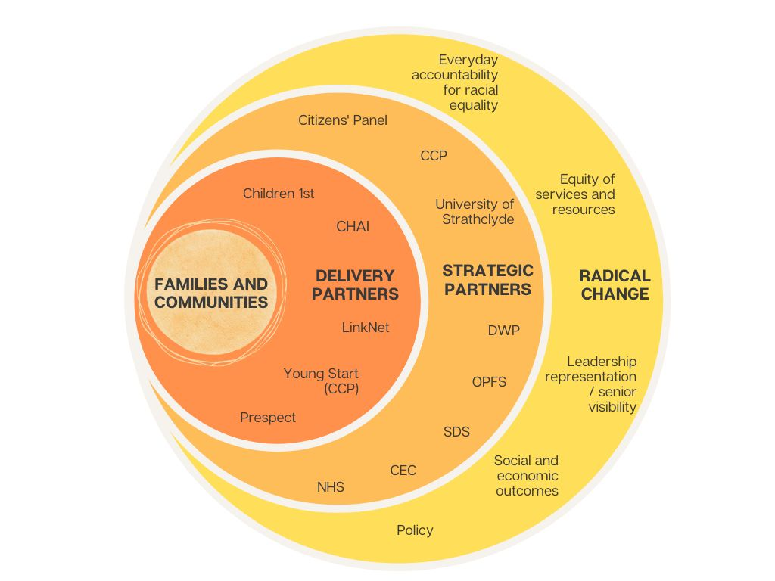
Delivery model
Fundamentals of the delivery model:
Voices of family and communities
A joined-up whole family approach
Equity of support
Relationship based
Rights focused
Trauma informed

Slide 7
WFEP Family Well-Being Service |  | Target Reached
Family Support | No. of families with intensive support | 17
 | No. individuals (adults/Children) | 20 adults/ 38 children, YP
 | Intensive outreach support | 26
 | Safe | 6
 | Health | 6
 | Achieving | 8
 | Nurtured | 8
 | Active | 9
 | Respected | 5
 | Responsible | 5
 | Included | 8
Youth Engagement | No. young people referred | 8
 | No. young people accessed service | 8
Income Maximisation Advice | No. families/ individuals referred | 10
 | No. families /individuals accessed service | 5
Employability | No. families/ individuals referred | 4
 | No families/ individuals accessed service | 3
Progress Update
Family Well Being (reached out to 44 families)
Intensive Family Support (17)
Drop-in Service Support (12)
Community outreach (14)
Service identified (3)

Slide 8
Youth Engagement |  | Target Reached
Young people supported (61) | No. of young people with intensive individual support | 16
 | No. YP supported in group settings | 30
 | No. YP supported on an outreach basis | 15
 | Safe | 13/16
 | Health | 5/16
 | Achieving | 12/16
 | Nurtured | 8/16
 | Active | 9/16 4/16
 | Respected
 | Responsible | 15/16
 | Included | 11/16
Youth Engagement (Hard Outcomes ) | Progressed into further education/ apprenticeship | 4/16
 | Progressed into voluntary role | 1/16
Participation and Community Engagement | No. of YP reached out | 45/61
 | No. Of YP supported in community engagement | 45/61
Progress Update
Family Well Being (reached out to 44 families)
Intensive Family Support (17)
Drop-in Service Support (12)
Community outreach (14)
Service identified (3)

Slide 9
Intersectionality and Multiple Barriers
Ethnically Diverse Families | 17/17 | Emotional/ Mental Health issues | 15/17 (88%)
Lone Parent Families | 15/17 (14 female, 1 male) | Economically inactive | 13/17 (76%)
Large Families (3+Children) | 9/17 | Victim of Violence (gender based, honour based, racially aggravated | 10/17 (59%)
Families with a disable adult or child | 9/17 | Temporary accommodation | 7/17 (41%)
Families with a younger mother under 25 | 4/17 | No recourse to public funds | 7/17 (41%)
Families with a child under 1 | 0/17 | Substance misuse | 1/17 (6%)
All families (100% -17 /17) fall into two categories of priority family groups
Over 50% families (53% -9 /17) fall into three categories of priority family groups
Over a third families (35% -6/17) fall into four categories of priority family groups

Slide 10
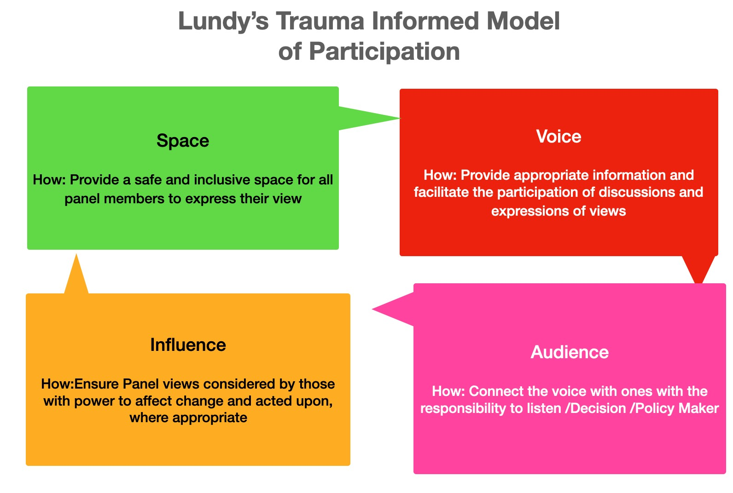
Citizens’ Panel

Slide 12
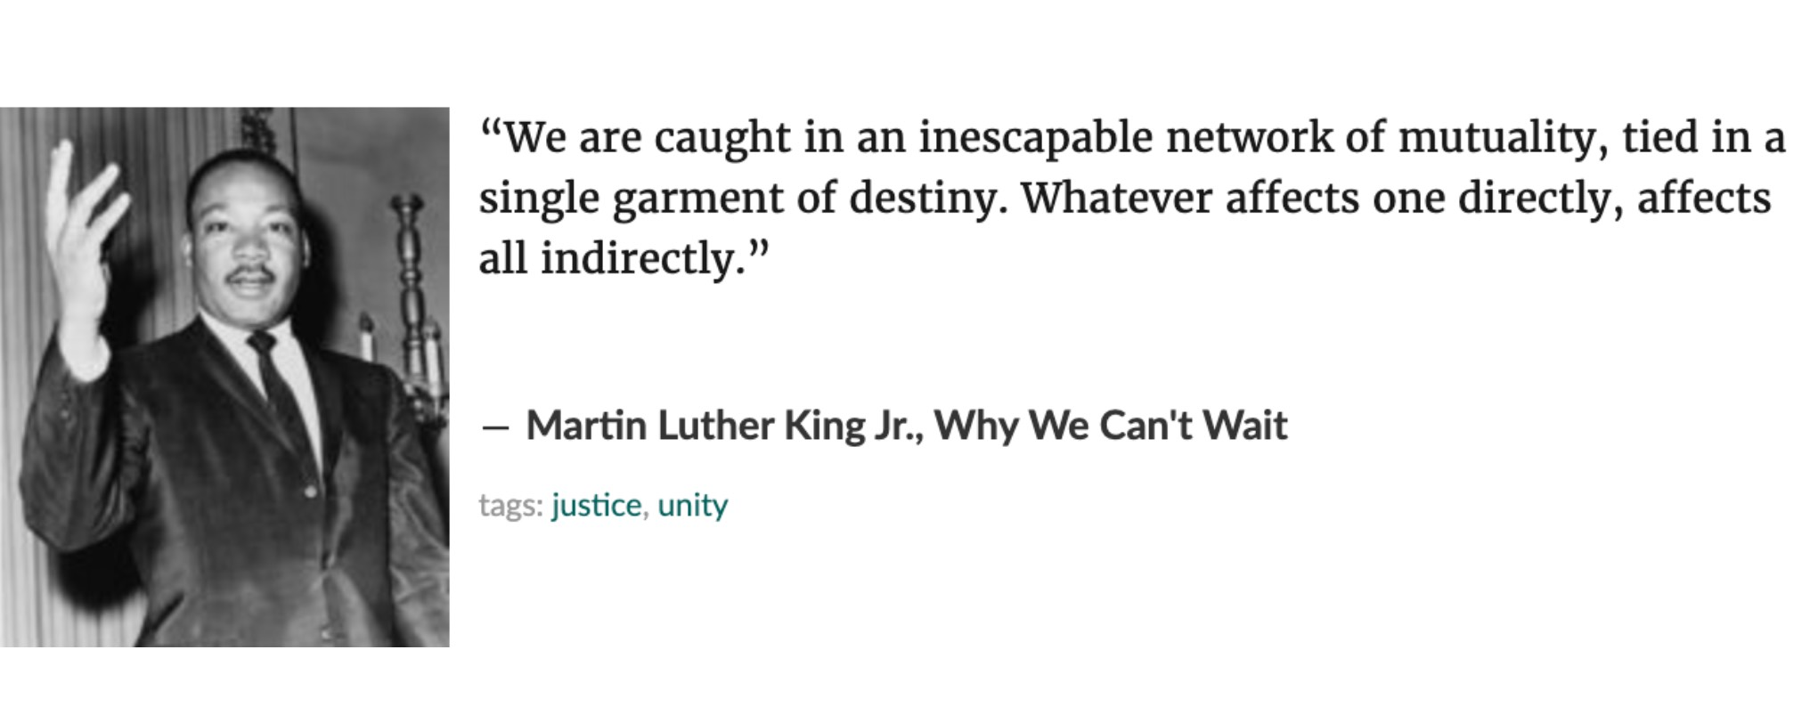
Make Racial Equality a Reality
Approach (Joined up, culturally sensitive, trauma informed, rights focused and equitable support)
Cultural Shift (anti-racist organisational culture, participation and representation, conscious and unconscious bias)
Partnership and Allyship building
Systemic Change (sustainable social and economic outcomes)

Slide 13
Thank you
www.joinedupforfamilies.org
ying.zhang@capitalcitypartnership.co.uk

